Slide 1


Emerging needs for tactical scale ice information in the north
David Jackson
Canadian Ice Service
7th ice-diminished Arctic Symposium, Washington DC
July, 2017

Slide 2
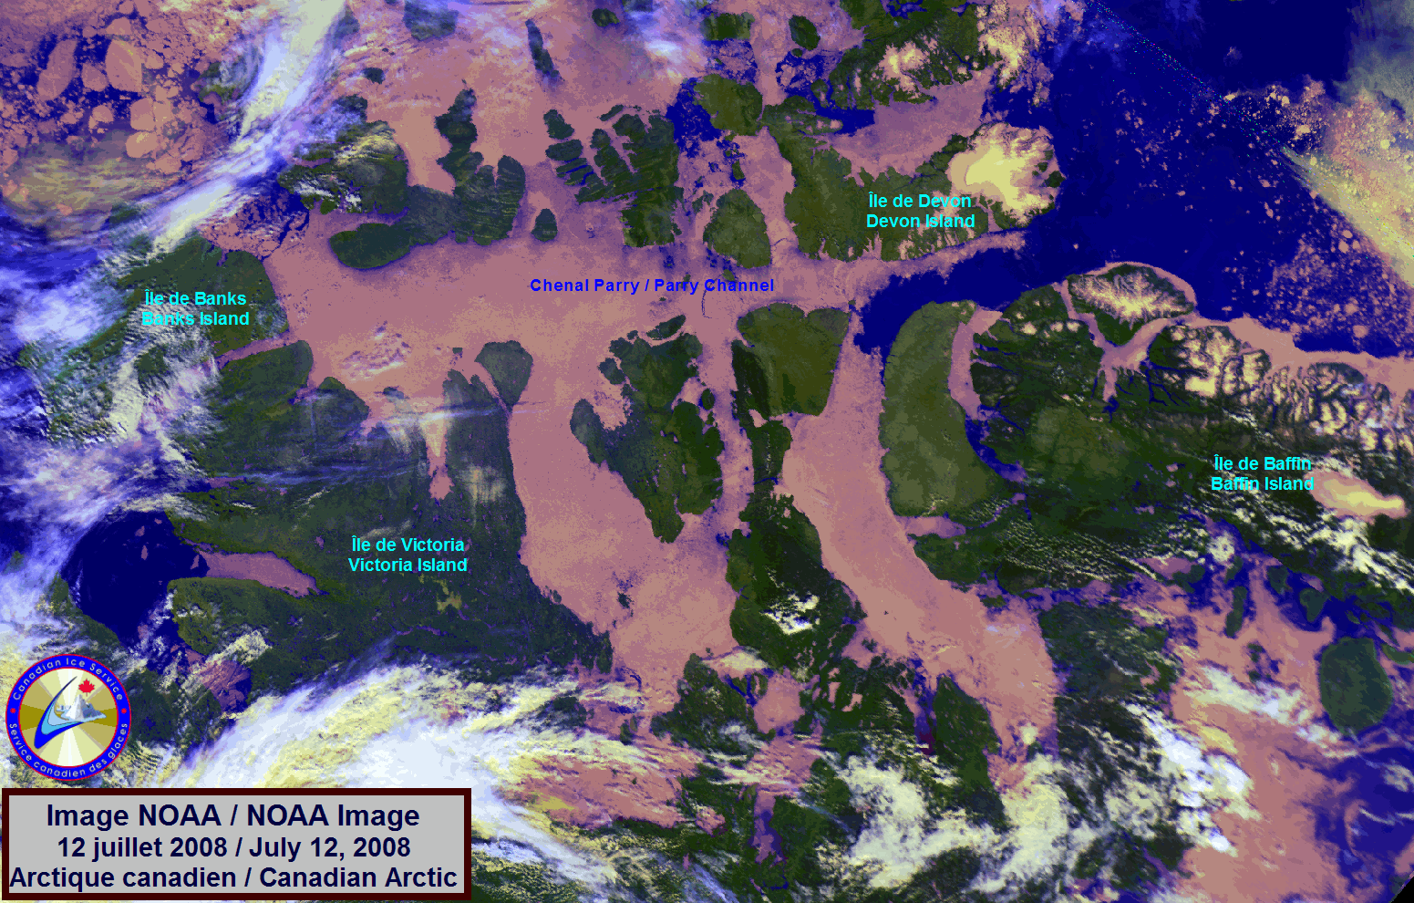
Contents
Setting the stage: who is CIS? what’s it like in the Arctic?
Marine environmental information
  Weather (winds, waves, visibility, precipitation)
  Ice (sea ice, icebergs)
Variety of needs
  Avoiding ice
  Going though ice
Operational needs:
  National Defence
  Search & Rescue
Community needs
New products to address emerging needs

Slide 3
What we do:
Part of the Meteorological Service of Canada (MSC)
The leading authority for information about ice in Canadian navigable waters.
  Provide real-time and forecast ice and iceberg information to mariners
  Provide archive information to scientists and policy makers
Monitor waters for oil spills
  Integrated Satellite Tracking of Pollution (ISTOP)
  uses satellite imagery to direct aircraft
  support spill confirmation, tracking and evidence procurement
Notes:
The Canadian Ice Service (CIS) of the Meteorological Service of Canada (MSC) is the leading authority for information about ice in Canada's navigable waters.
The unique mission of CIS is to provide timely and accurate information about sea ice and icebergs in Canada's navigable waters.
The CIS provides ice information for the purposes of ship routing through and around ice-covered waters, Icebreaking operations, climate monitoring and weather forecasting. While increasing the safety of shipping in ice-infested or covered waters is a paramount contribution of the CIS, it should be noted that knowledge of where ice is (especially dangerous ice and significant ice under pressure) and where it isn’t also contributes to the efficient movement of maritime traffic especially where that maintains maritime commerce into and out of ice-bound ports on the east coast, Great Lakes and in the Arctic.
The ISTOP program uses satellite imagery to direct surveillance aircraft to the sites of suspected oil releases from marine transportation and offshore oil production – enabling spills to be confirmed and tracked while obtaining evidence required for prosecution. This has been particularly useful on the east coast, for instance, where since its inception, the incidence of oiled seabirds has reportedly decreased as a result of the decrease in oily-water/bilge discharge by shipping.
It should be noted that the ISTOP capabilities were in use during the 2010 BP Gulf spill to support the response operation.

Slide 4
Sea ice: A very Canadian issue
Canada claims the world’s:
  longest coastline
  greatest area of ice
Annual variation in
extent of ice
is approx. ½ the area of
Canada (4M km²)
Seasonal effects on:
  weather and climate
  marine ecosystems
  safety and efficiency
  of marine transportation
Notes:
Remember, there may be increasingly less ice in the polar regions, but, if the dangerous ice is where you are then it doesn’t matter how much ice there is!

Slide 5
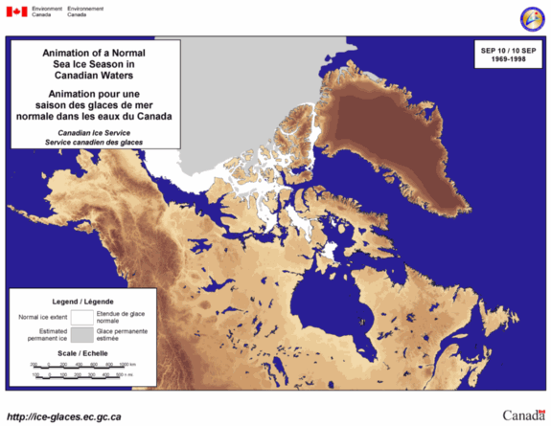
Sea Ice development
Notes:
This is an animation that shows general ice development in Canada. At any point in the year, ice in the sea affects some part of the country.

Slide 6
Arctic Challenges
Cold: There is still winter:
  effect on people and equipment
Dark: periods of 24 hrs darkness; seasons of low light
Isolated: Low population density; very few built up areas
  Lack of infrastructure: ports, repair, salvage, fuel/provisions
  Vast distances
Topography: Eastern Arctic vs Western Arctic
Navigation issues: radar, satellite, manoeuvering room
  Charts: 10% of Arctic is charted to modern standards
  Limited communications
  Weather – winds, blizzards, freezing spray, fog
  Water depth, rocks, shoals
  Tides, currents
  Icebergs
  Ice conditions: old ice, ice pressure, ridges, snow cover
Notes:
Start with an overall look at the major challenges affecting any operation in the north.
Marine transportation is the most effective means of transportation and is therefore predominant.

Slide 7
Sea ice and Ice of land origin (icebergs)
Safety of navigation
Danger to maritime interests
Impedance of maritime trade and commerce
Riparian interests
Notes:
Ice in any form not only affects the safety of your ship, but also the efficiency and effectiveness of your operation.
In addition, the presence of ice on your route forces you to alter your course to avoid it. This is important to understand from a general navigation point of view but more importantly in poorly charted areas where it may leave you with fewer and poorer choices for safe alternate routes.

Slide 8
Encountering sea ice
Sea Ice has different stages of development:
  New ice, grey, grey-white, thin/medium/thick first year, second year, multi-year
  They are all found in an ice field and are frequently snow covered, therefore difficult to detect type
Ice thickness varies
  There is usually ridging and rafting
In the Eastern Arctic, icebergs are commonly found within the sea ice
  Always accompanied by “bergy bits” (size of a truck) and growlers” (size of a car)
Notes:
Ice fields can be difficult to navigate thru

Slide 9
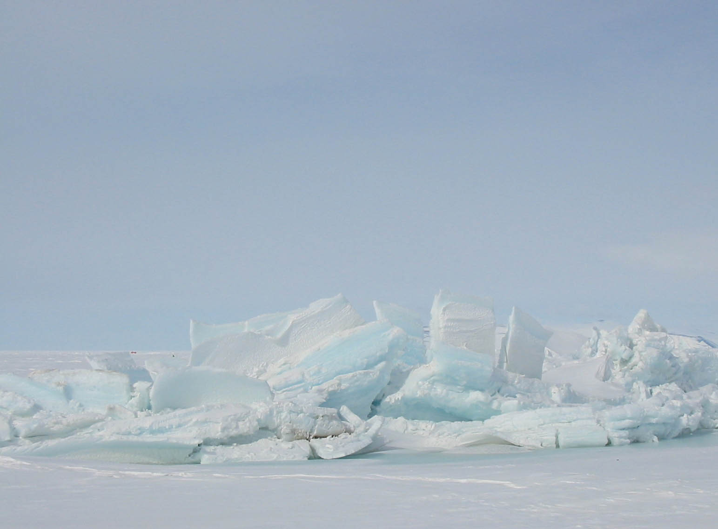
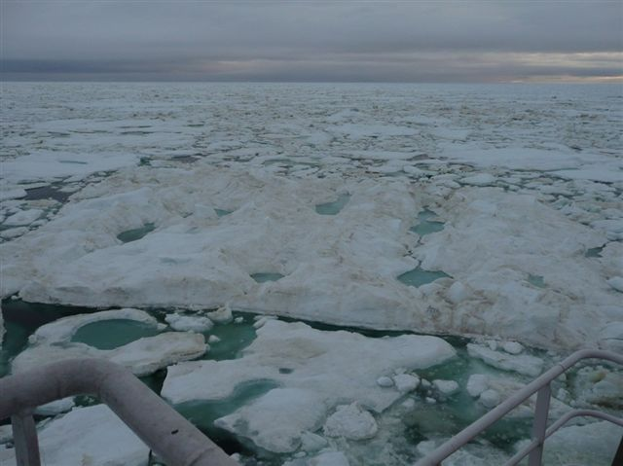
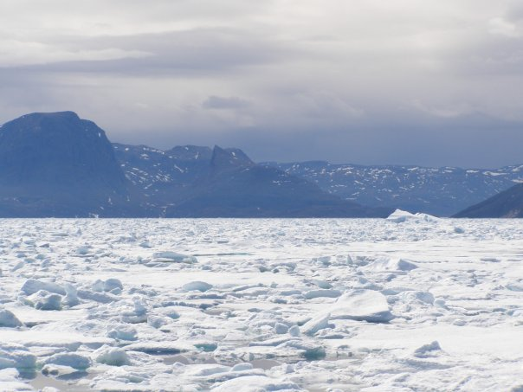
Challenges
Varying ice strength
Ridges
Varying ice thickness
Snow covered
Notes:
Ice fields can be difficult to navigate thru

Slide 10
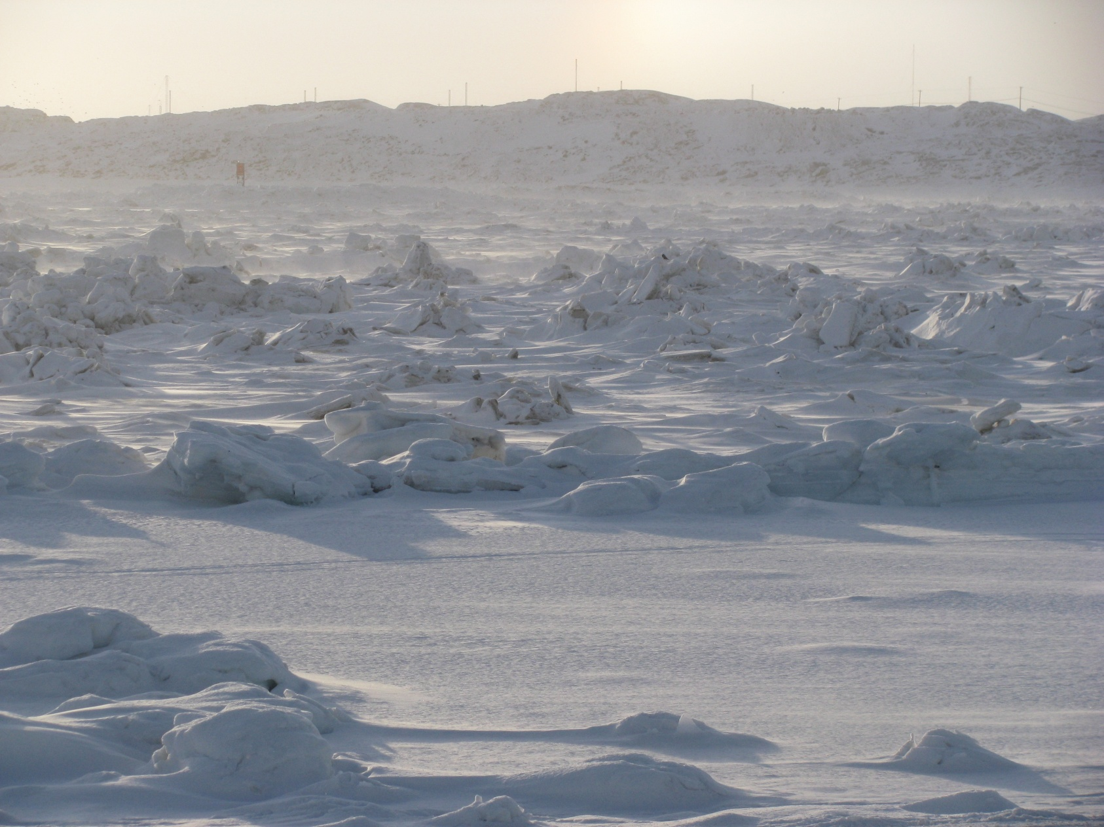
Challenges
Notes:
Frobisher Bay Feb 2012

Slide 11
What do you need?
Weather information needed for all marine activities
  Current wx plus forecasts
  Includes precipitation
  Winds, speeds, direction
  Air temperature
  Risk of structural icing
Ice information needed when approaching ice-infested waters
  Limit/edge of known ice
  Concentration
  Stage of development: ice is never uniform and generally snow covered
  Arctic: presence of ice of land origin

Slide 12
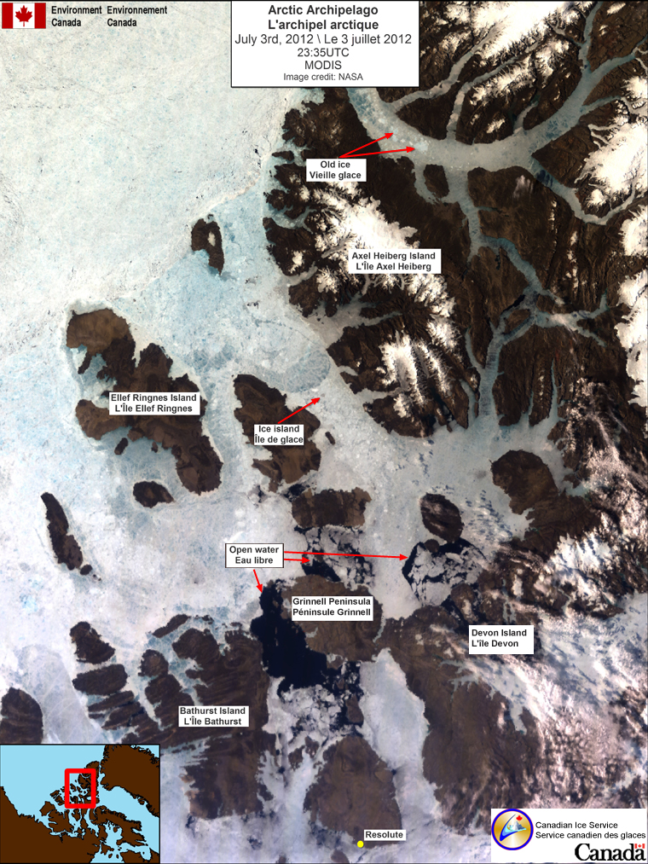
When do you need it?
Current conditions
Short term forecasts (days, weeks)
Medium range forecasts (months)
Long term forecasts based on climatology

Slide 13
How do you use it?
Ice charts produced from a variety of sources
  Visual observations ships/aircraft/shore
  Satellites: SAR, optical
Satellite imagery can:
  Provide information over large areas
  Be difficult to interpret
  Have bandwidth restrictions for its reception on ships
Trained ice analysts interpret satellite data and incorporate all available data sources to provide a consistent depiction of the current ice conditions.
  International code
  Variety of scale of information

Slide 14
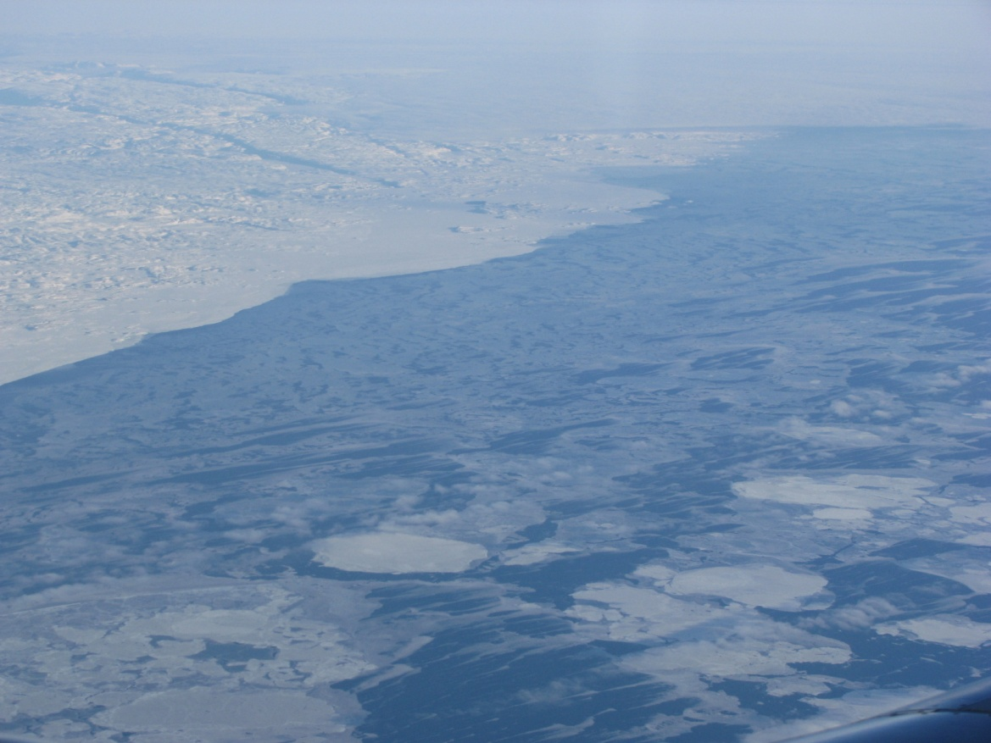
Variety of Ice Information available
Overview of conditions
  Average ice concentration for areas
  Percent of each stage of development
  Areas of ice pressure
  Areas of ridging, leads

Slide 15
Forecasts and Uncertainty
Probability of ice being at a certain location at a given time.
  Useful for planning
Possible trajectories of icebergs or significant ice floes
  Chance that hazardous ice will impact marine activities
Probability of ice pressure
  Likelihood of ice pressure easing in 12 hours
    Wait or act
Notes:
20% chance of ice moving into area in 6 hours; 80% chance ice will move into area in 12 hours.

Slide 16
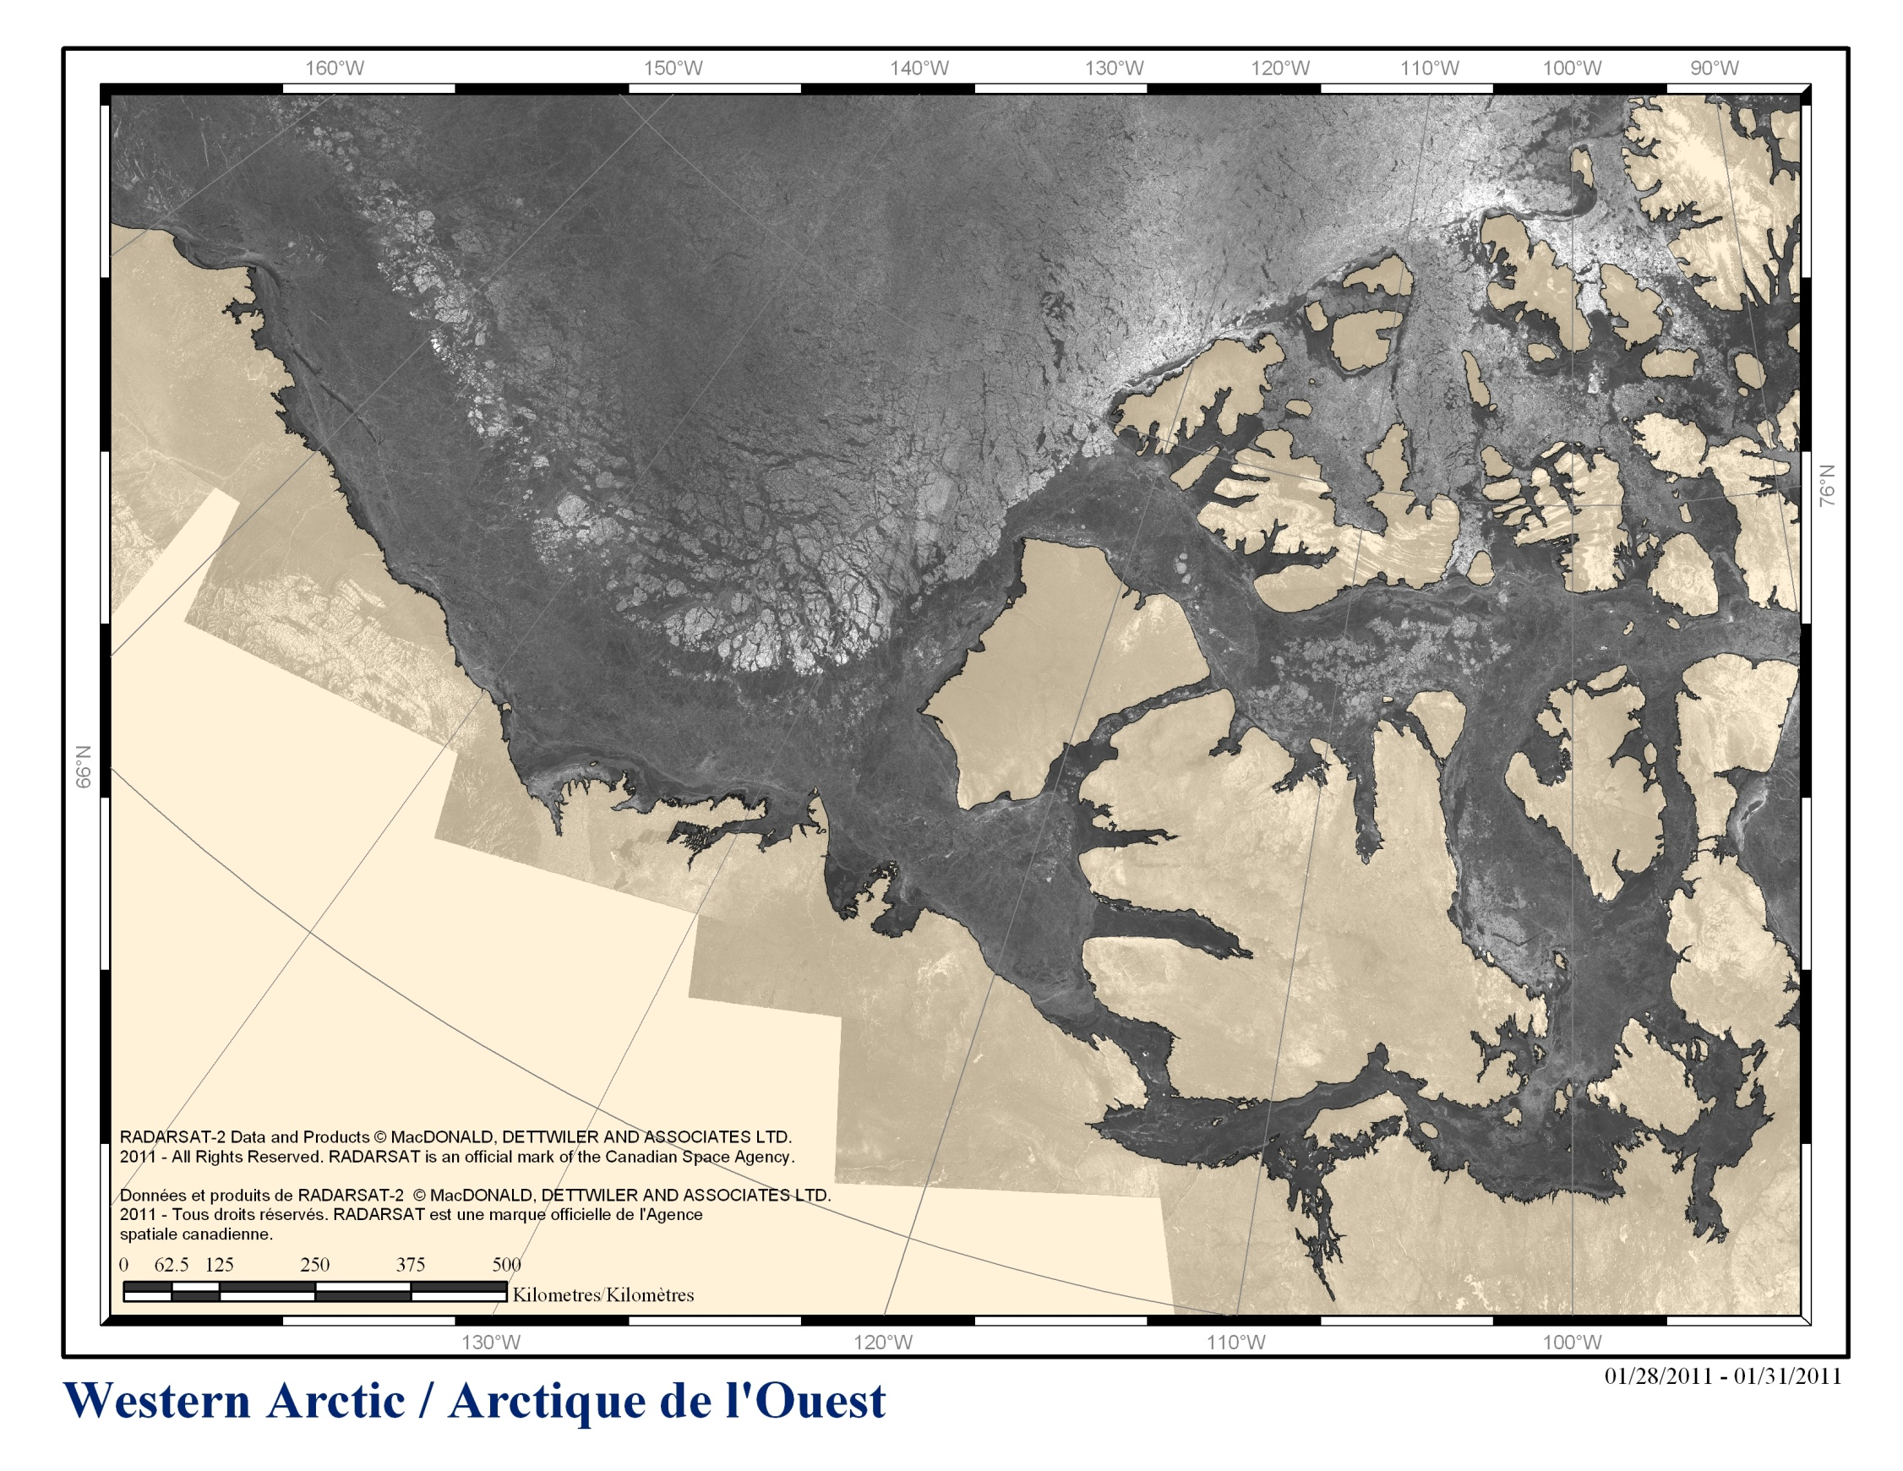
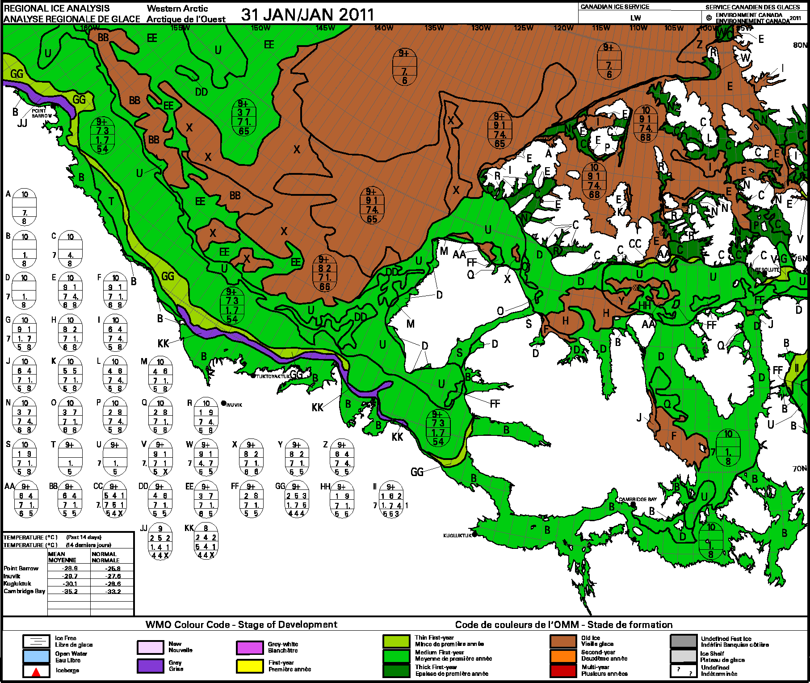

Slide 17
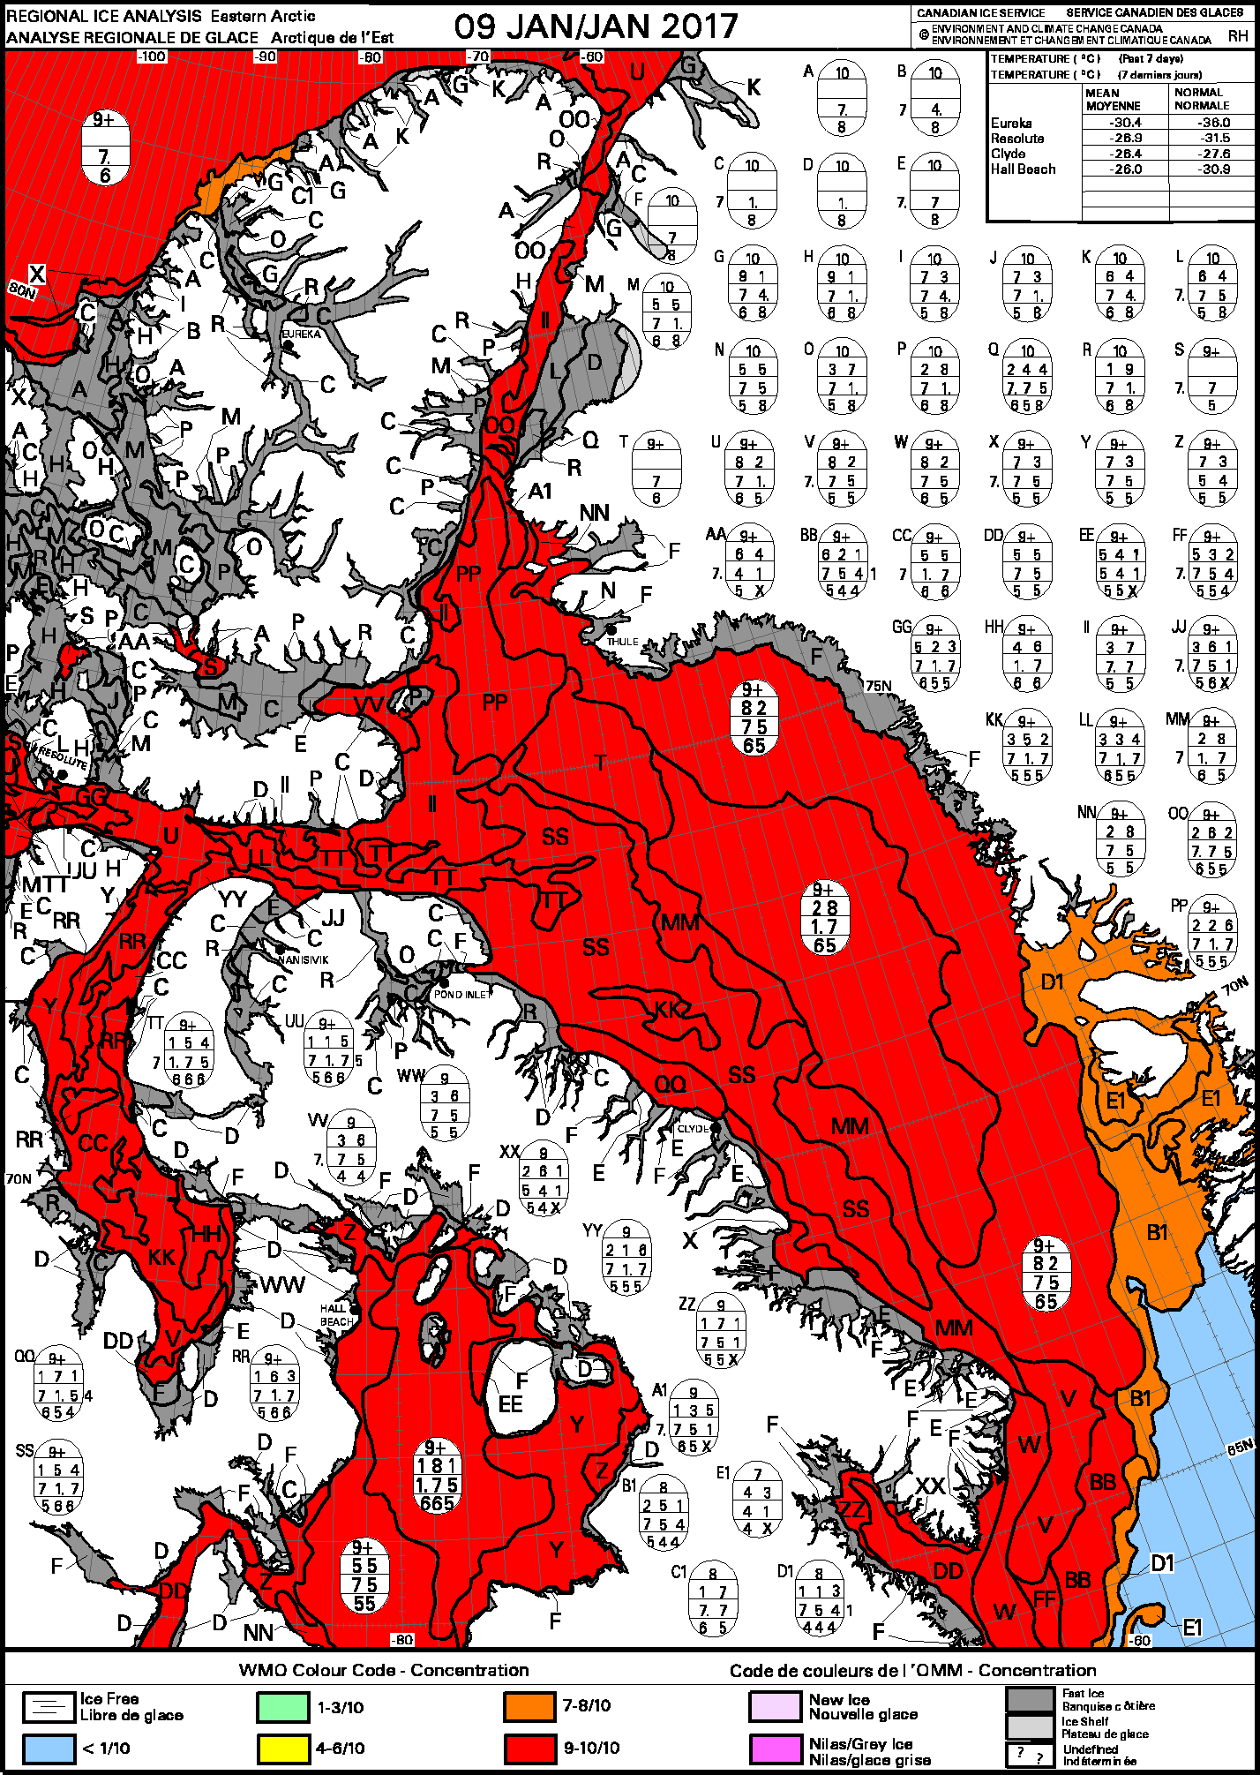
Weekly Regional Ice Charts
Currently service marine clients during the summer shipping season.
During the winter, weekly large scale climatological products are created using the World Meteorological Organization standardized Egg coding.
Not at a scale for community use
Notes:
What is currently available during the winter season

Slide 18
Additional Needs
Acquisition of imagery; ability to analyze and integrate it all
Training on the interpretation of marine information, including ice and iceberg data
Frequent updates
Accurate modelling between acquisitions
High resolution information in critical areas
Low bandwidth products for shipboard use
Additional products for onshore planning

Slide 19
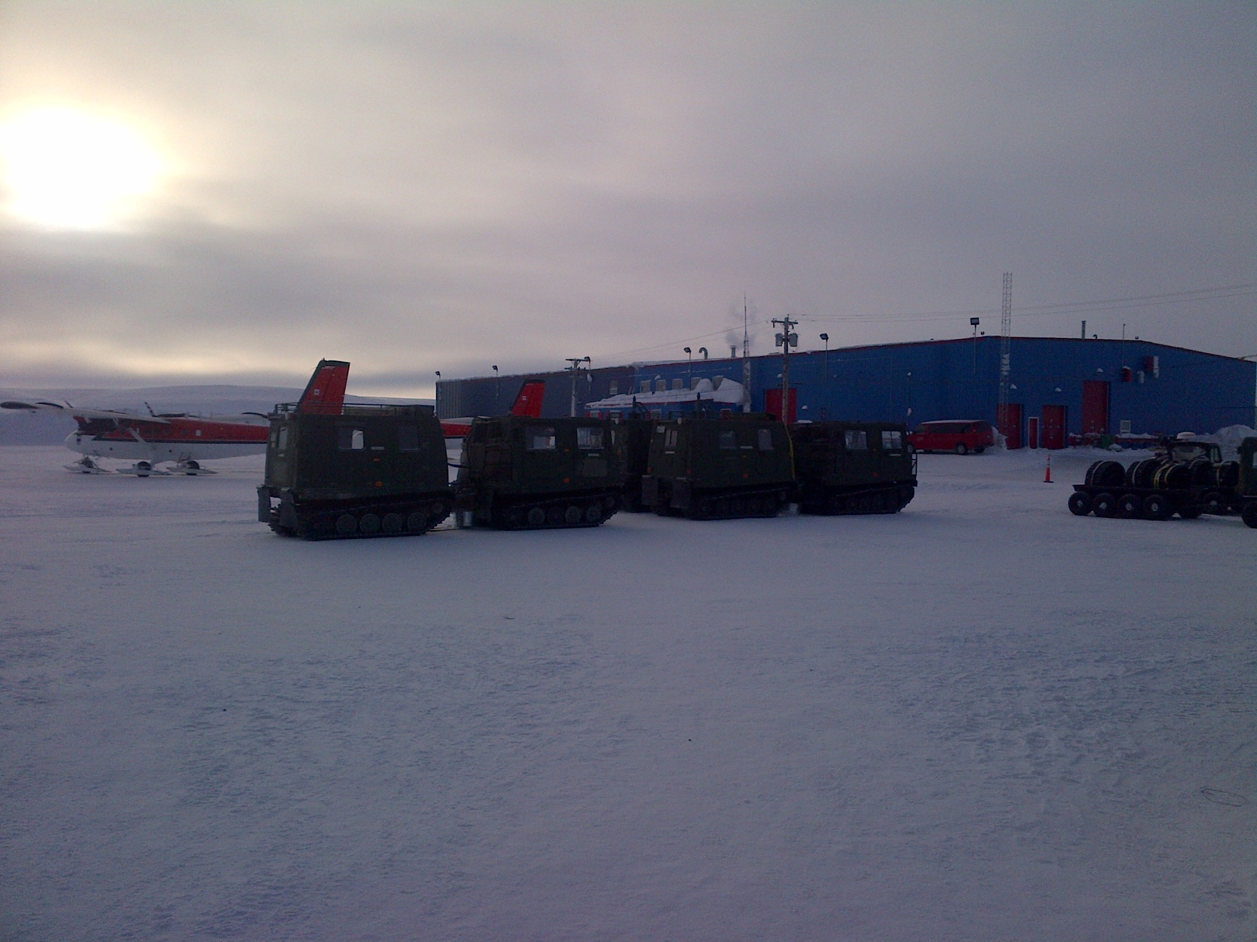
Notes:
Northern exercises utilize numerous vehicles and aircraft types requiring ice information for travel and locating safe landing sites (Resolute Arctic Training Centre in background).

Slide 20
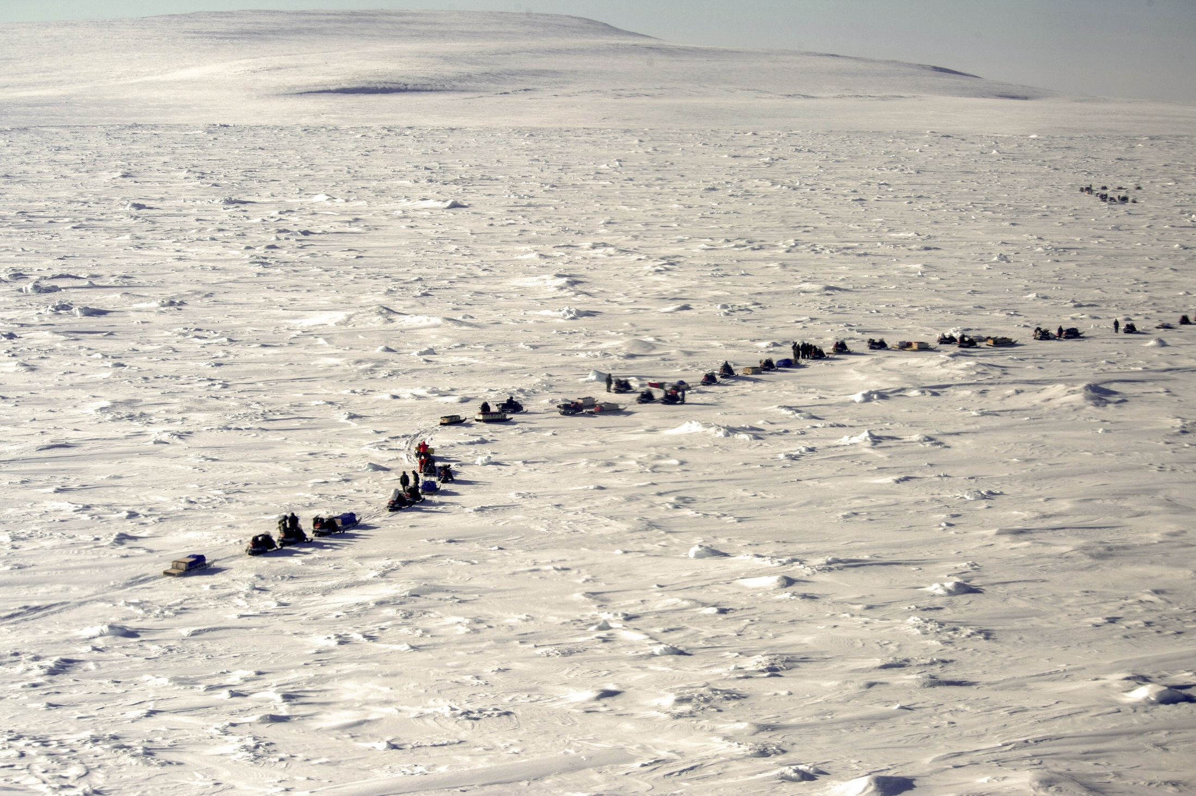
Notes:
Army patrol over sea ice in vicinity of Resolute. Ice information provided by CIS.

Slide 21
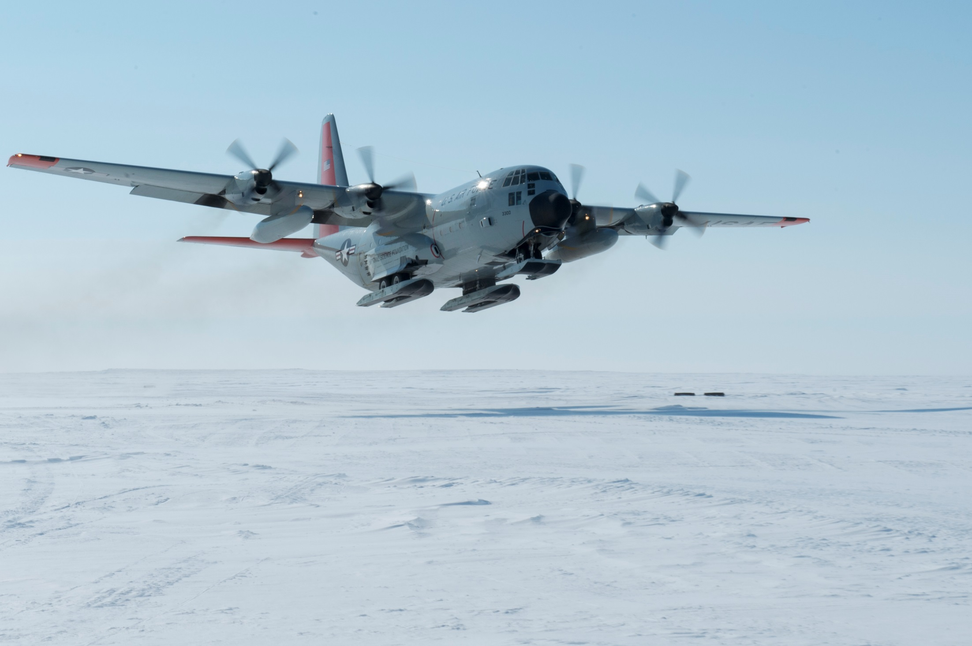
Notes:
Landing sites on sea ice are chosen based on detailed ice analysis (US Air National Guard as part of Operation Nunalivut in Queen Maud Gulf).

Slide 22
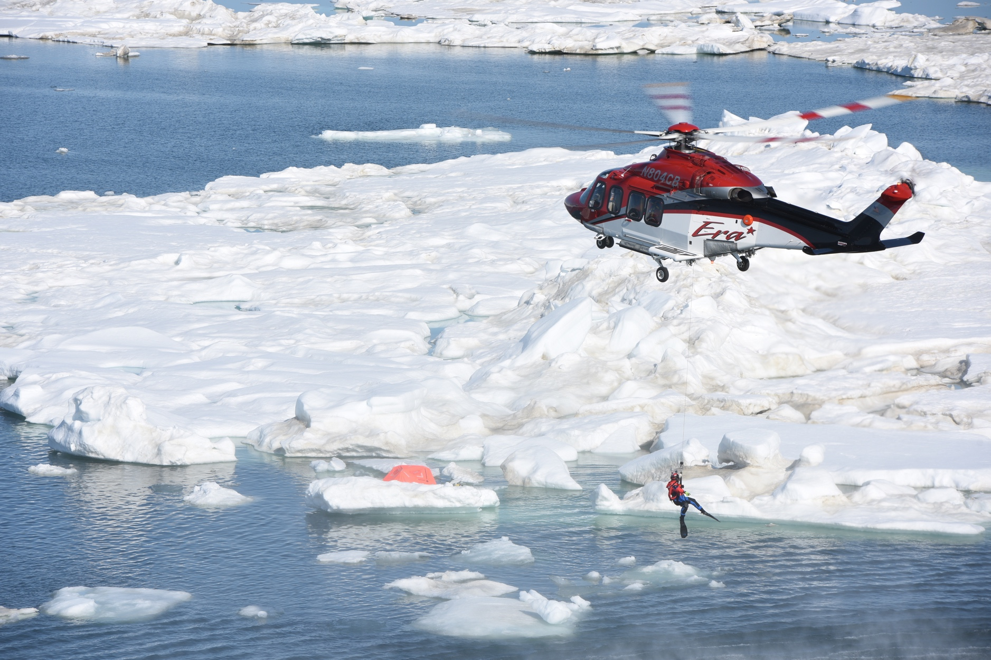
Canadian Arctic Search and Rescue
Image Courtesy of the United States Coast Guard
Notes:
Extra slide

Slide 23
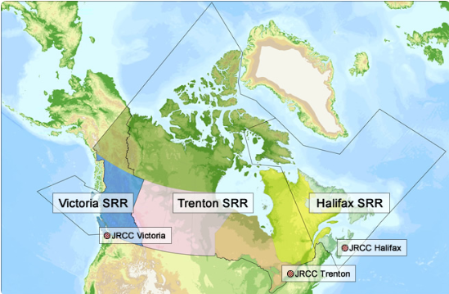
Arctic SAR Coordination Challenges
Image Courtesy of the Canadian Forces
Notes:
Due to its vast size and range of environments, the country relies on a diverse group of government, military, volunteer, academic and industry partners to provide overall Search and Rescue services to the Canadian public.
The Armed Forces Joint Rescue Coordination Centers and Coast Guard assets are based in the south, so response times to the Arctic are significant

Slide 24
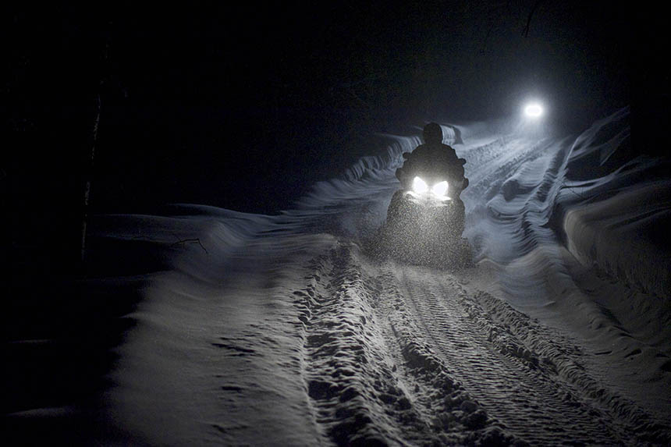
darkness
Notes:
As a result of the vast distances, first responders are at the Territorial and community level.
These searches by local community volunteers often take place during extreme cold and during the dark winter period that occurs from November to April.
These first responders need better sea-ice information to assist in their sea-ice travel during such conditions.

Slide 25
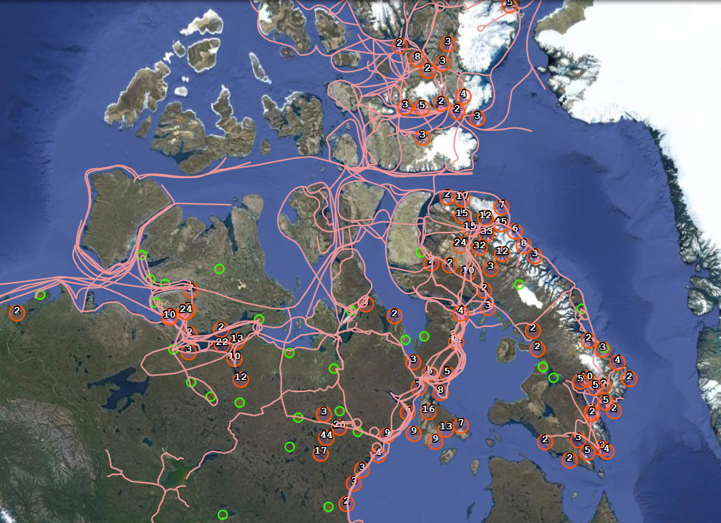
Arctic Sea-Ice is a Highway
Image Courtesy of Claudio Aporta
Notes:
The sea-ice is their highway and travel great distance during extreme conditions
They travel as soon as the ice freezes up in November until break up in late June.
As a result of climate change, warmer temperatures and thinning ice are altering typical travel routes and seasons.
Nunavut averages 250-300 search and rescue events per year, most of the searches are in wintertime.
Problem seasons are around fall sea-ice freeze-up and spring break-up

Slide 26
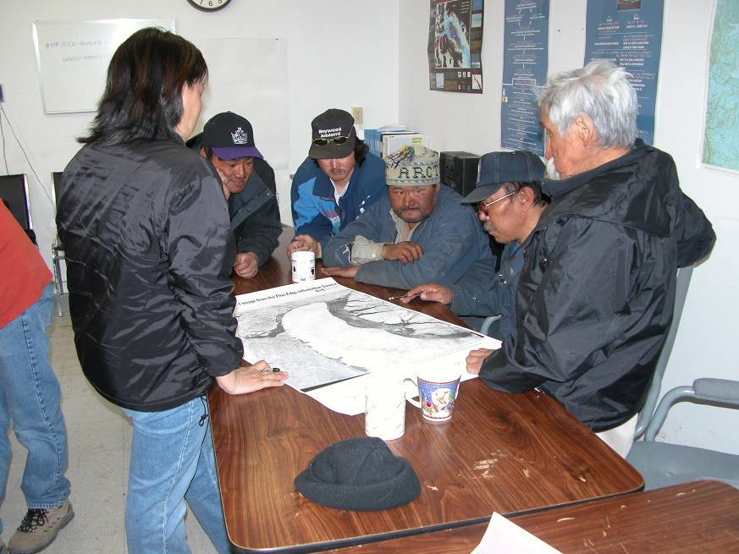
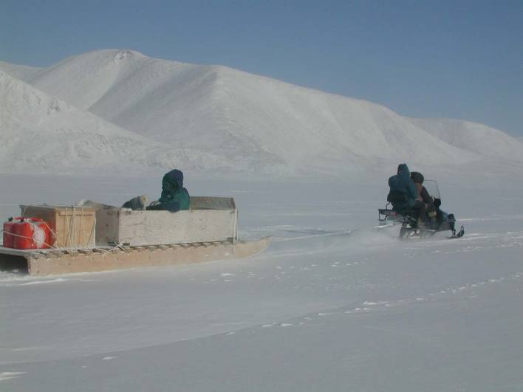
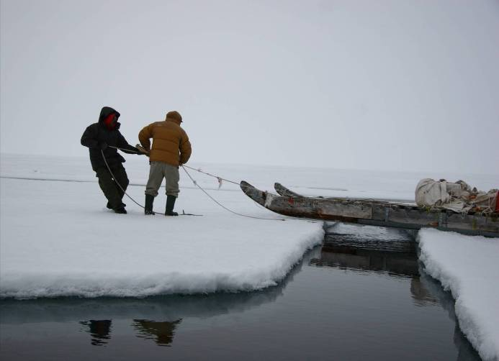
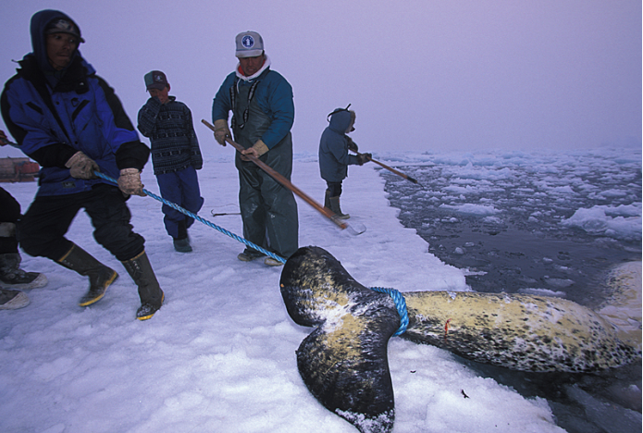
Sea ice information is used on a daily basis by those who live by and travel on sea ice

Slide 27
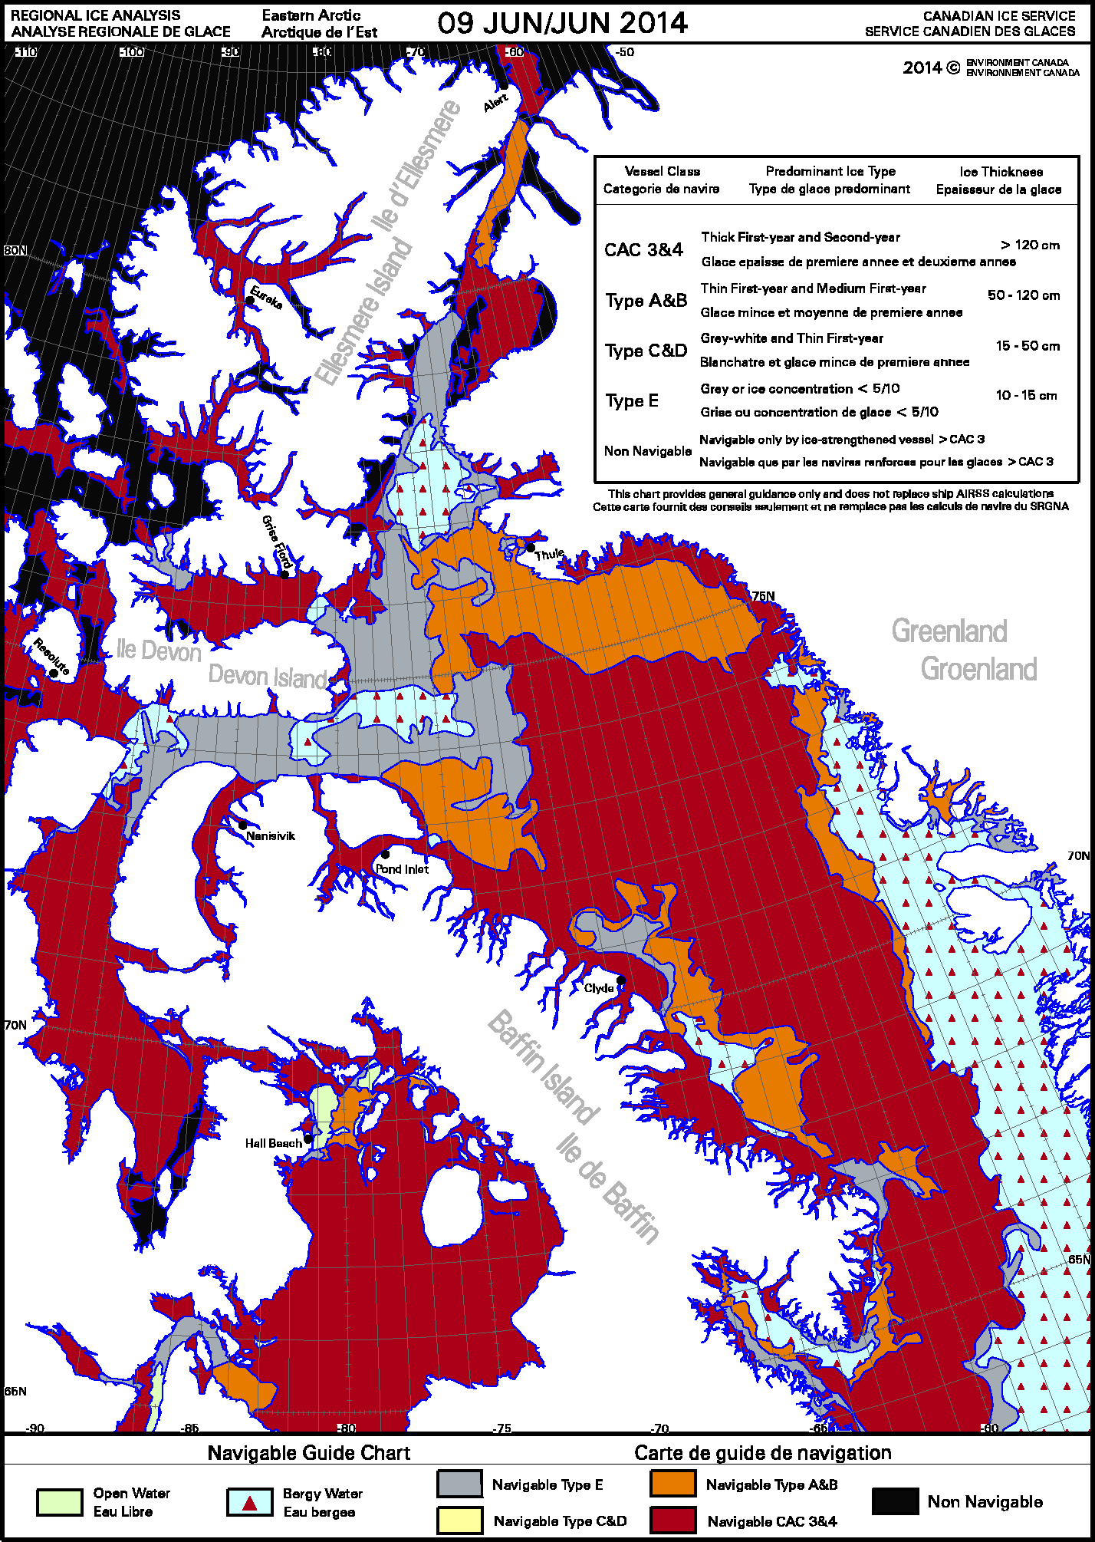
Ice-class navigability

Slide 28
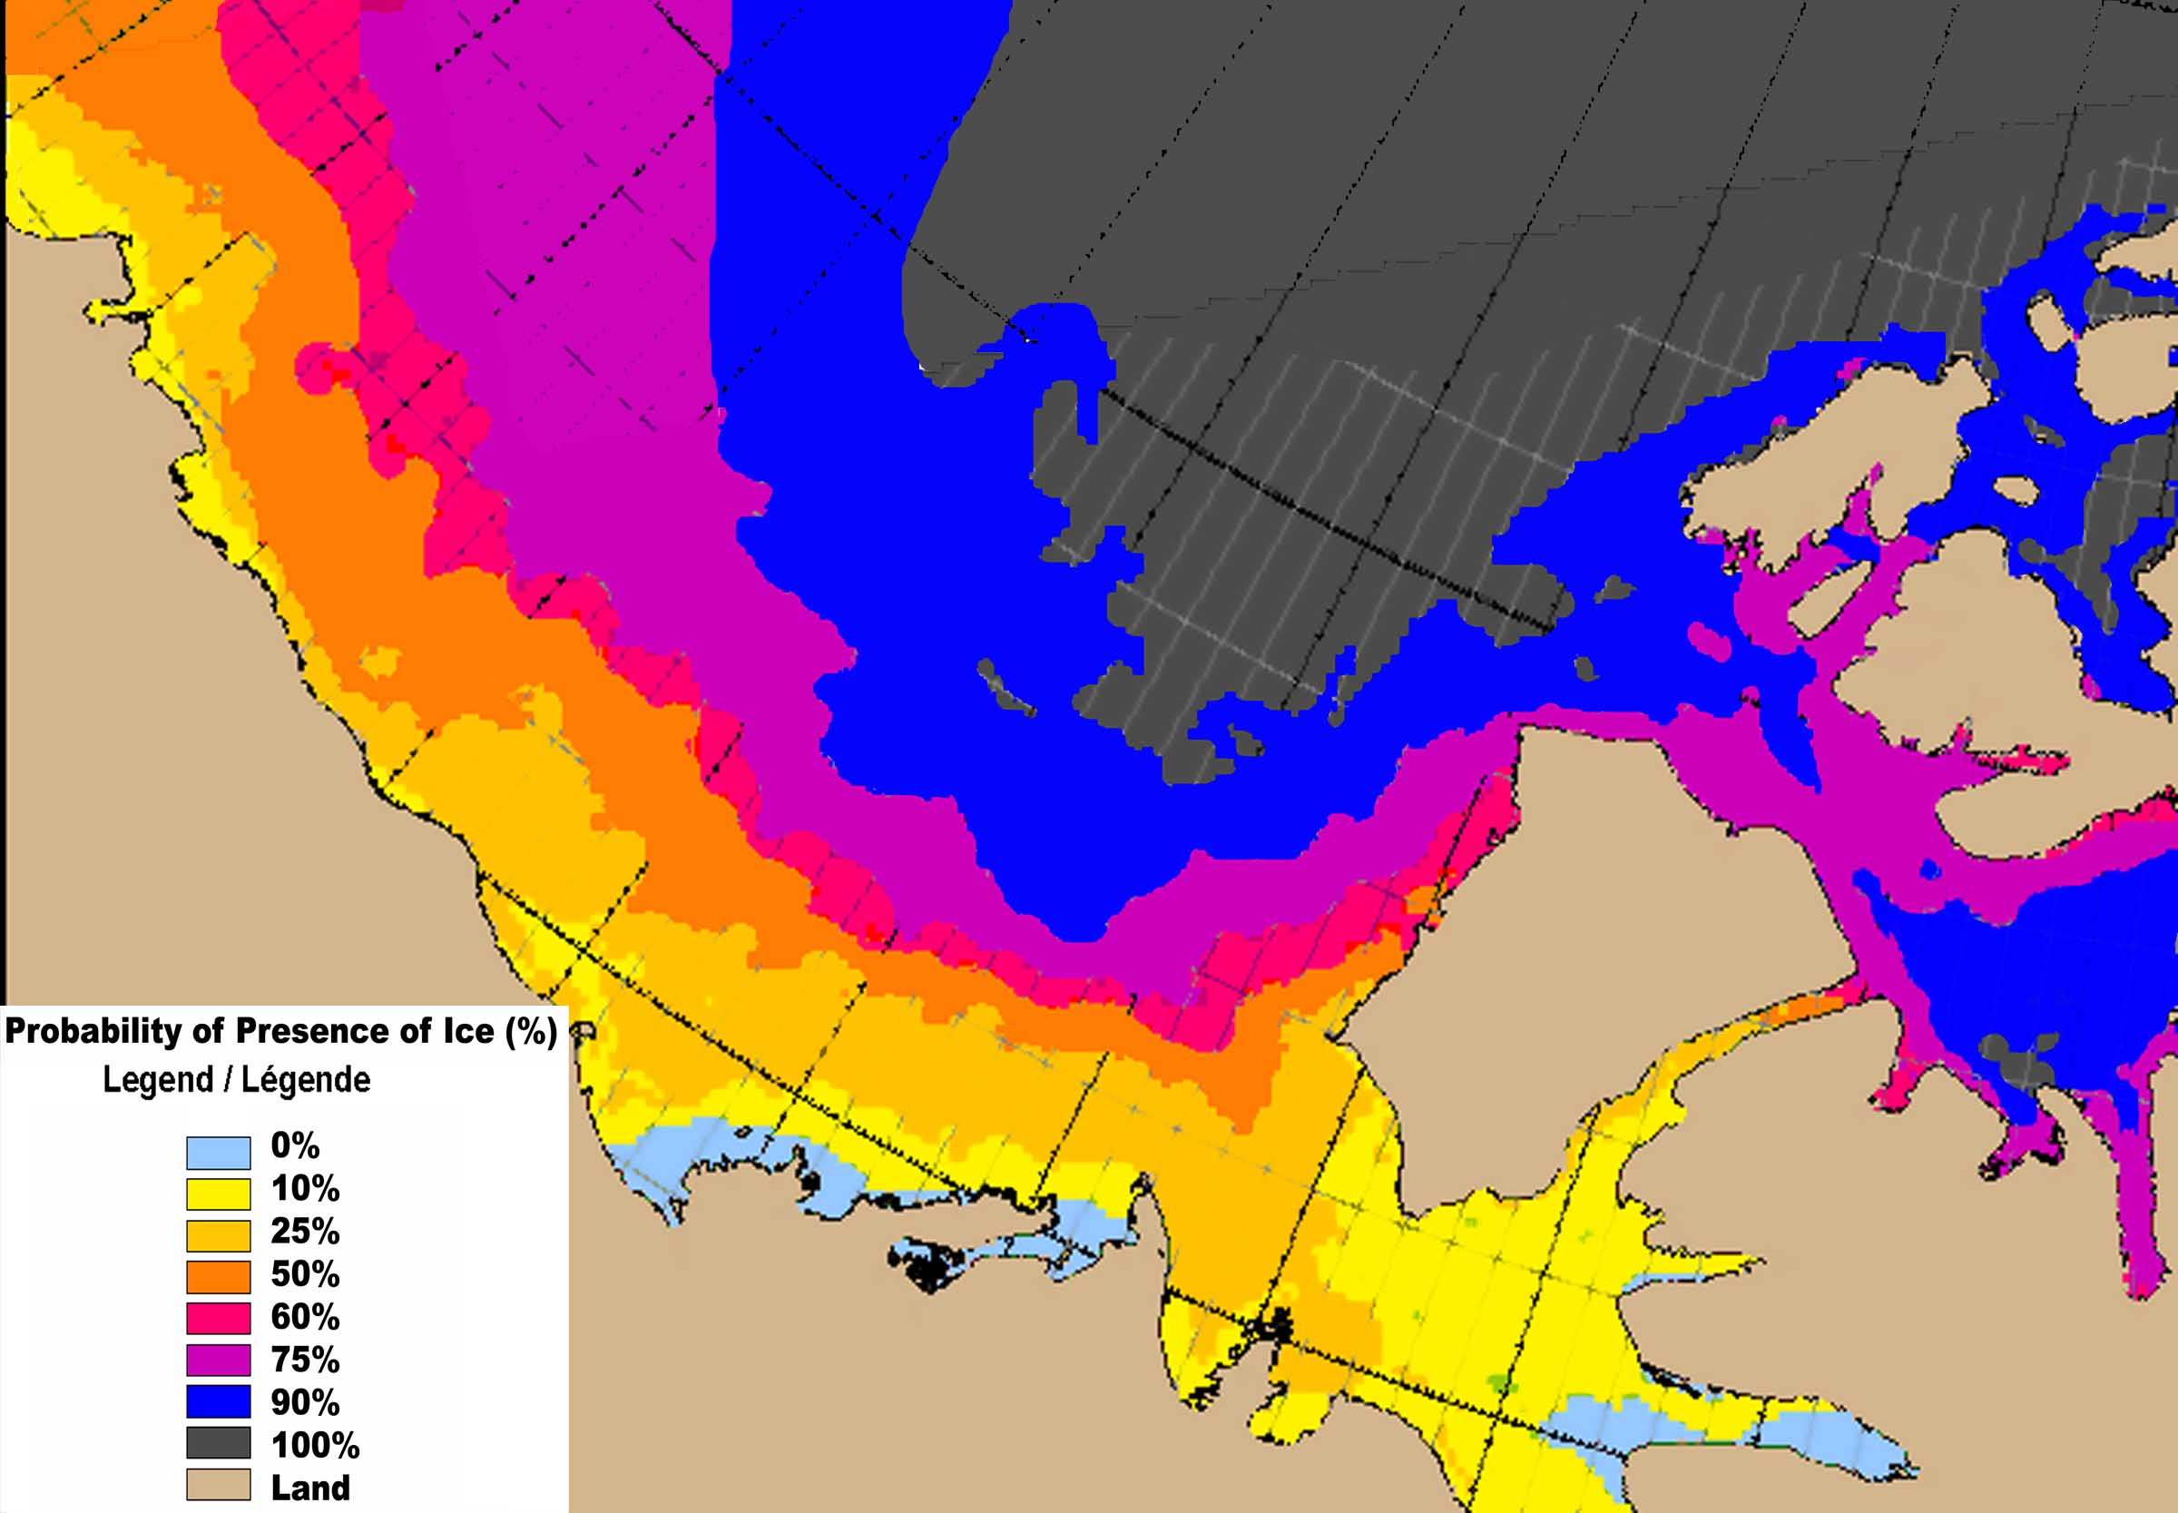
Long-Term forecasting – Planning
For the week of September 10.
Based on CIS regional chart digital database for the period 1981 through 2010.
Notes:
Analysis since 1968 at the CIS provide base for statistical analysis .

Slide 29
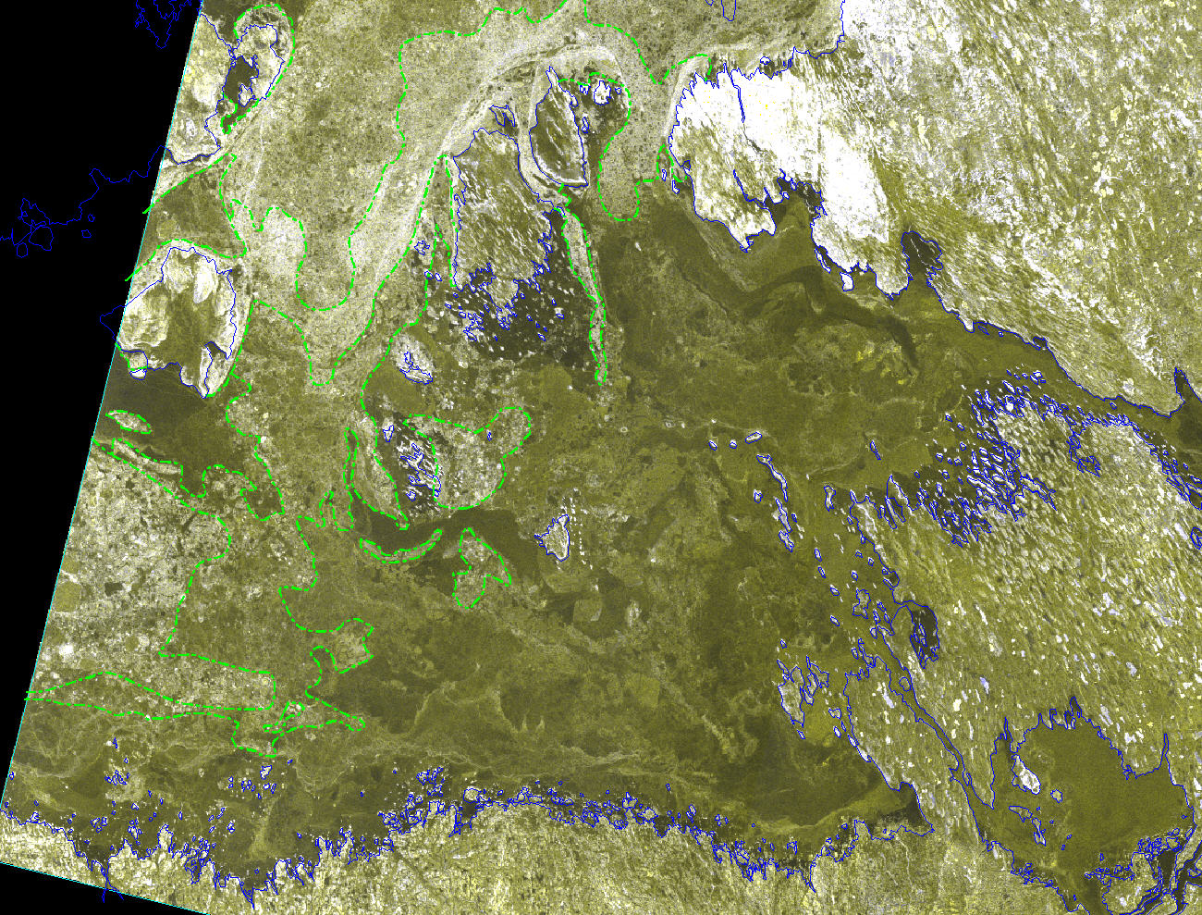

Operation Nunalivut-15 RADARSAT-2 Image April 02, 2015
R Ice
R Ice
R Ice
King William Island
R Ice
R Ice
Royal Geographical Society I
S Ice
Jenny Lind I
S Ice
S Ice
R Ice
S Ice
R Ice
Hat I
R Ice
R Ice
S Ice
Adelaide Peninsula
S Ice
Legend
OW = Open water
Surface roughness
R Ice = Heavy
R Ice = Medium
S Ice = Light
Ridges
Notes:
Surface roughness boundaries indicated on a RADARSAT-2 image in the vicinity of the Franklin wrecks.

Slide 30
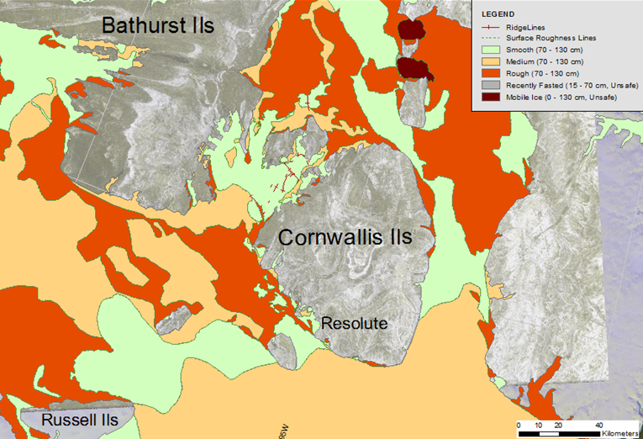
Polaris
Devon
Ils
Notes:
Existing client and new client needs for tactical scale information for local safe sea ice travel. Department of National Defence requires ice information on stability of consolidated ice, location of mobile ice area and information on surface roughness.

Slide 31
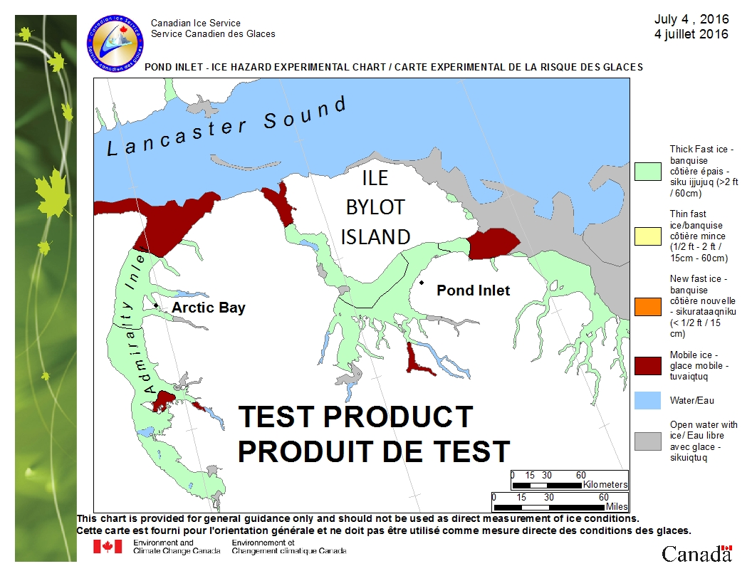
Notes:
Example of a new weekly prevention product that will be tested this Winter/Spring with select communities in Nunavut
In English, French and Inuktitut
Small file size, low bandwidth
Scale for between community travel
In Metric and Imperial (Inuit work in Imperial)
Colour coded (red: dangerous mobile/thin ice. orange/yellow: caution. green: safe ice thickness
Also providing training for community members and EMOs at the CIS in ice, weather and remote sensing
Looking at historical case studies to learn how to better support SAR events in real-time.

Slide 32
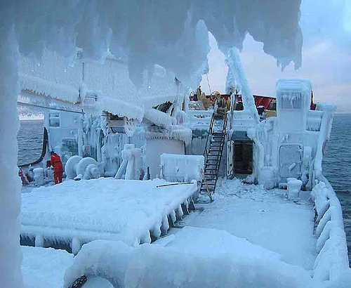
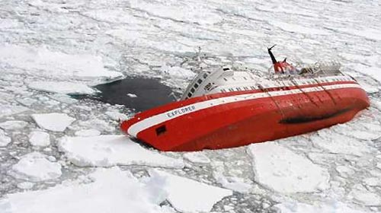
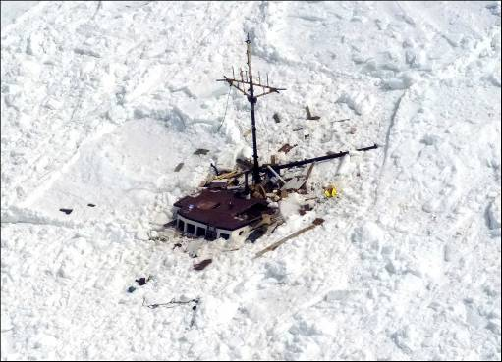
And finally….
Plans are useless, Planning is essential
  Dwight David Eisenhower

