Slide 1
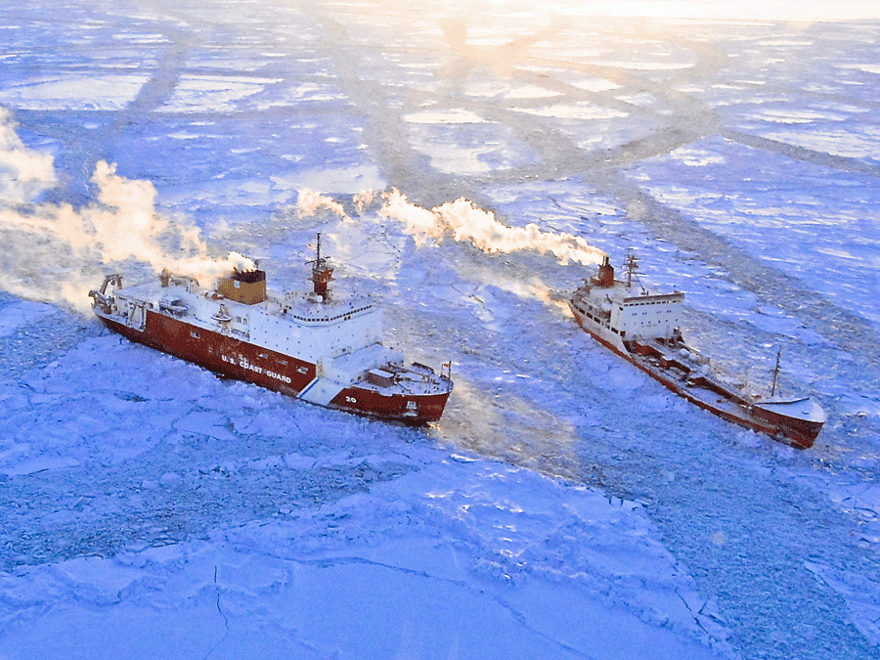
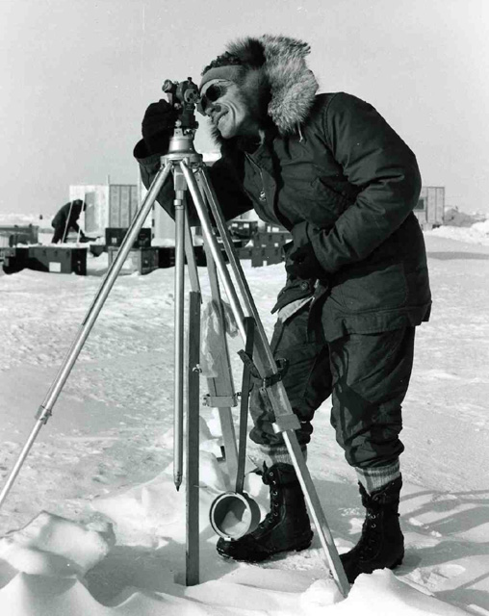
Sea ice indicators: The northern Alaska navigation corridor and pan-Arctic linkages John Walsh¹, Florence Fetterer², J. Scott Stewart²
¹International Arctic Research Center, University of Alaska, Fairbanks ²National Snow and Ice Data Center, University of Colorado, Boulder
Notes:
1
Alan Gill AIDJEX 1972 pilot study. Image Credit: National Snow & Ice Data Center AIDJEX Web site

Slide 2
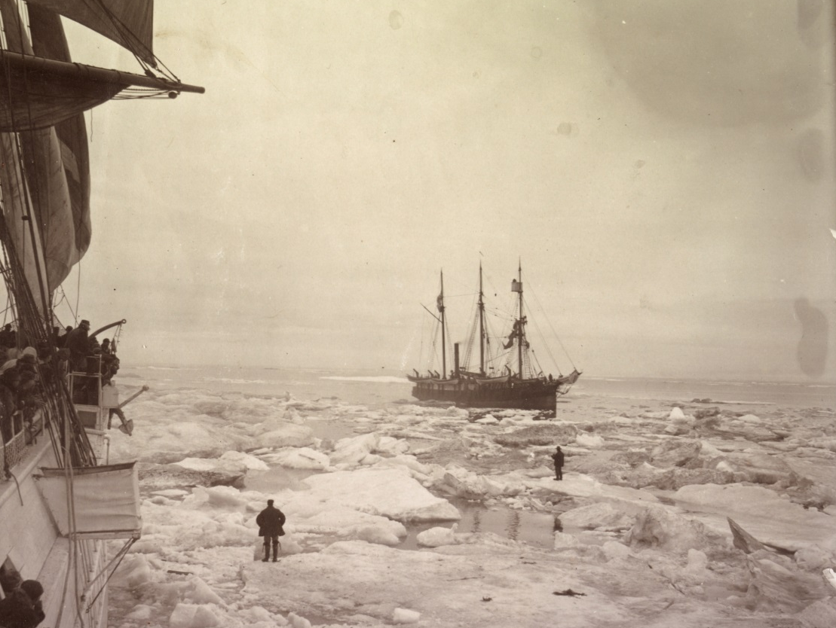
Outline
A Beaufort sea ice severity index
-- variations and trends over the past 60 years
-- representativeness and seasonal predictability
-- reconstruction spanning 1850-present
2. Extension to pan-Arctic indicator development
Photo from the New Bedford Whaling Museum

Slide 3
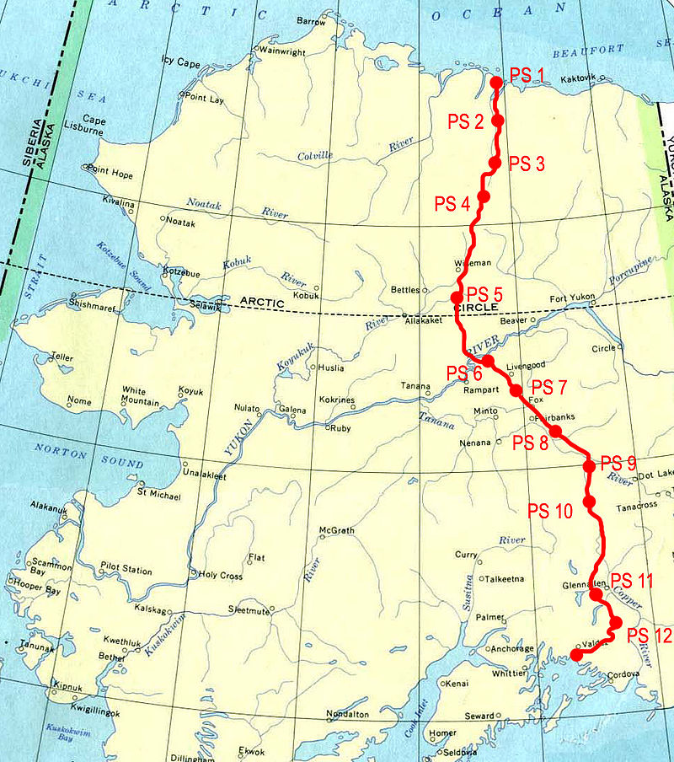
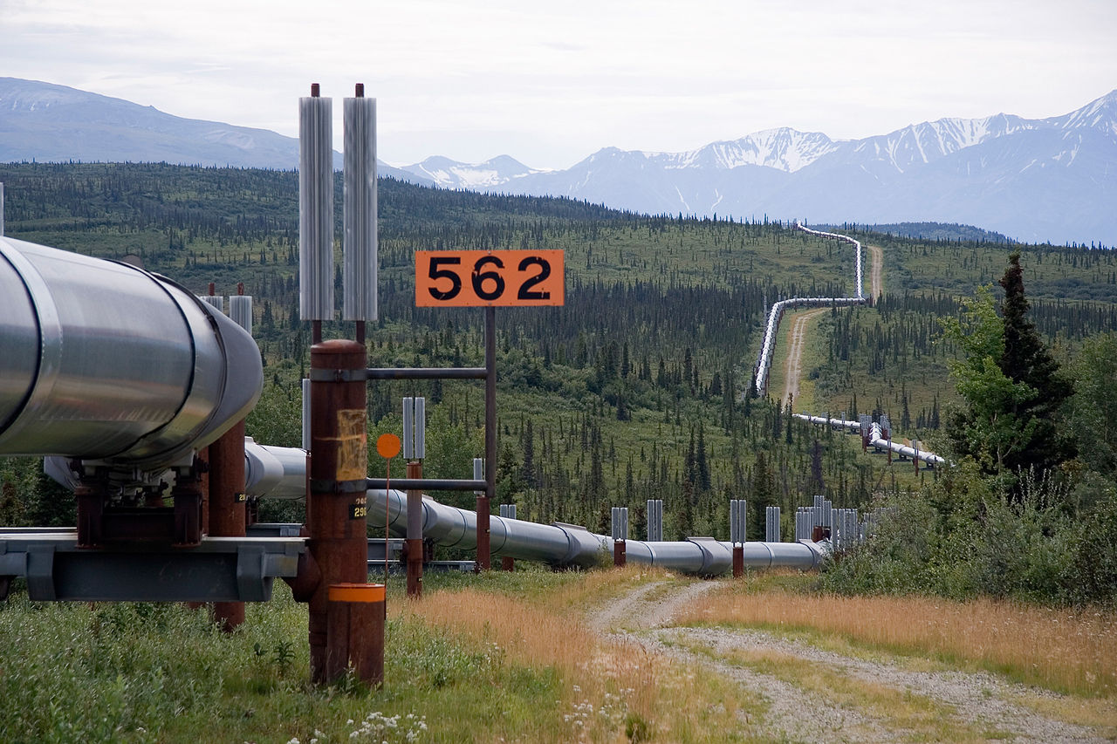
Historical background: Barnett Severity Index, origins in 1970s sealifts for the Alaska oil pipeline

Slide 4
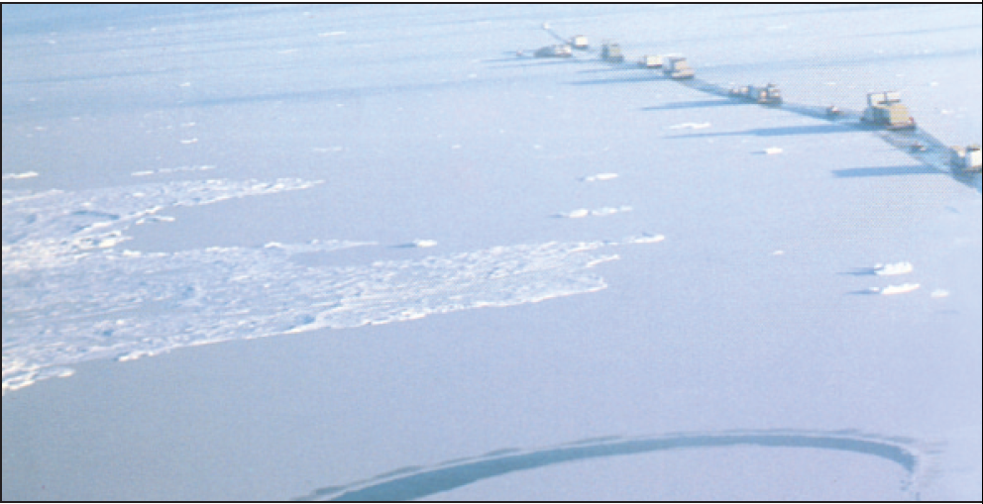
“With pipeline construction well underway in 1975, the Crowley summer sealift flotilla to the North slope faced the worst Arctic ice conditions of the century…Vessels stood by for nearly two months waiting for the ice to retreat. Finally in late September the ice floes moved back and Crowley's tugs and barges lined up for the slow and arduous haul to Prudhoe Bay. When the ice closed again, it took as many as four tugs to push the barges, one at a time, through the ice. -- From Crowley Maritime, 50 Years of Service in Alaska

Slide 5
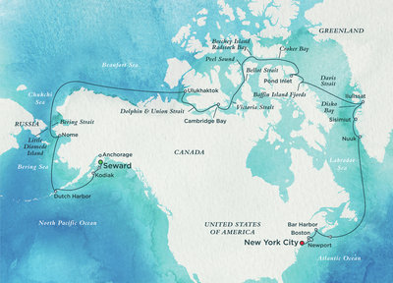
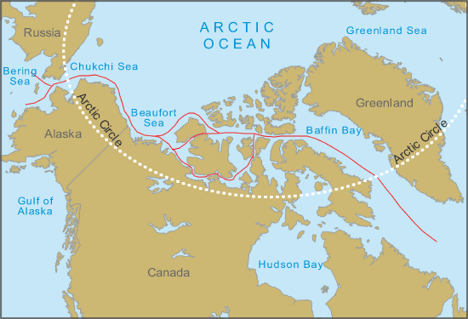
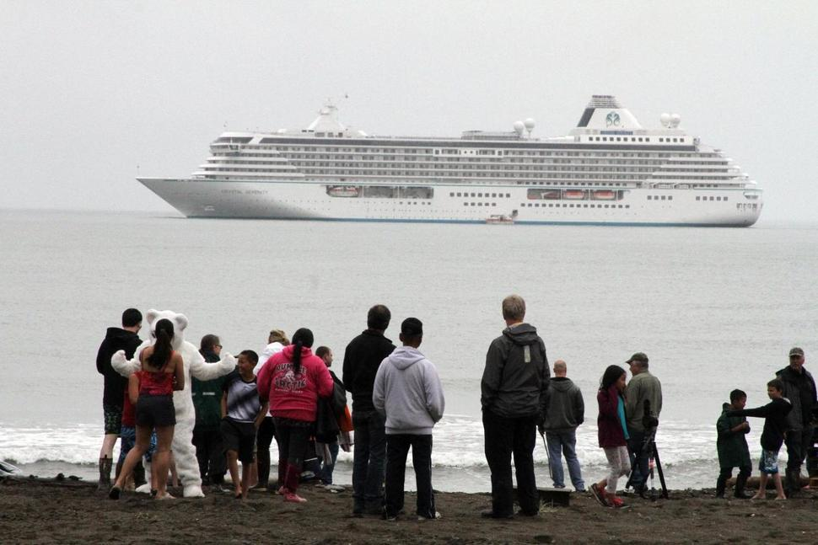
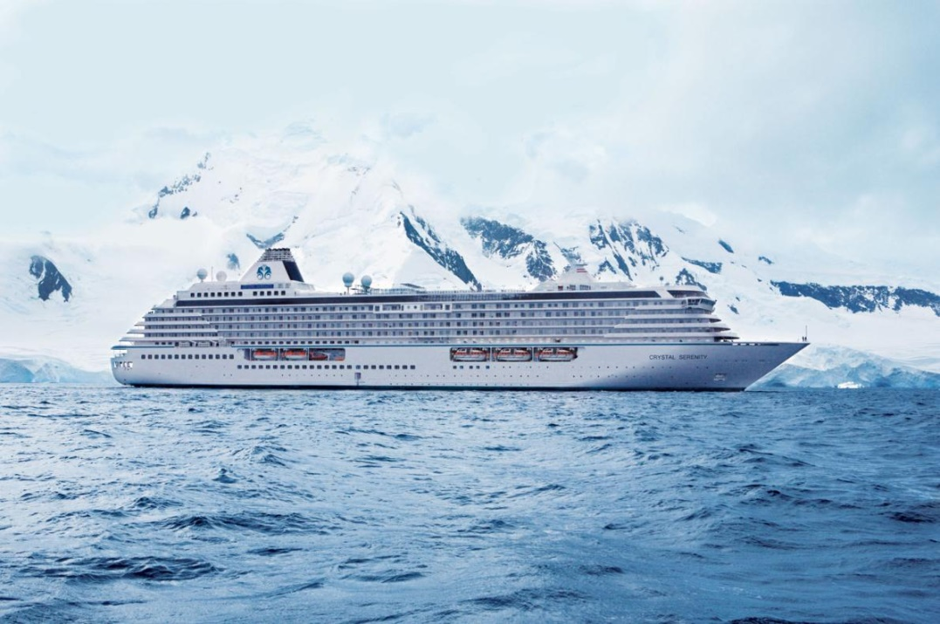
August-September 2016: Cruise ship transits the Northwest Passage

Slide 6
The Barnett Severity Index is a sum of: 1) the distance in nautical miles from Point Barrow northward to the ice edge on 15 September, 2) the distance from Point Barrow northward to the 4/8th ice concentration line on 15 September, 3) the number of days the entire sea route from the Bering Strait to Prudhoe Bay is ice-free in a calendar year, 4) the number of days the sea route from Barrow to Prudhoe Bay is less than or equal to 4/8th ice concentration in a calendar year, and 5) the temporal length of the navigable season, defined as the time period from the initial data the sea route is less than 4/8th ice concentration to 1 October.

Slide 7
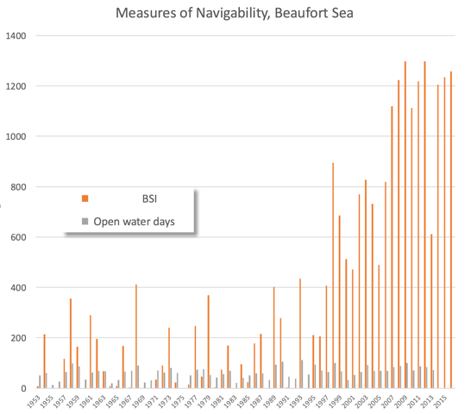
Barnett index, 1953-2016 (red bars)

Slide 8
Average sea ice coverage in September: 1980 vs 2015 1980 2015
(Ice concentration from satellite passive microwave data)

Slide 9
Observed change in yearly # of days with ice cover (days per decade), 1979-2013 [from Parkinson, 2014, GRL]

Slide 10
The Barnett Severity Index is a sum of: 1) the distance in nautical miles from Point Barrow northward to the ice edge on 15 September, 2) the distance from Point Barrow north-ward to the 4/8th ice concentration line on 15 September, 3) the number of days the entire sea route from the Bering Strait to Prudhoe Bay is ice free in a calendar year, 4) the number of days the sea route from Barrow to Prudhoe Bay is less than or equal to 4/8th ice concentration in a calendar year, and 5) the temporal length of the navigable season, defined as the time period from the initial data the sea route is less than 4/8th ice concentration to 1 October. Proxy used here: Beaufort Severity Index ⇒ Number of days the Barrow-Prudhoe corridor is navigable: < 50% ice concentration -- Goldstein et al. (2016, The Cryosphere)

Slide 11
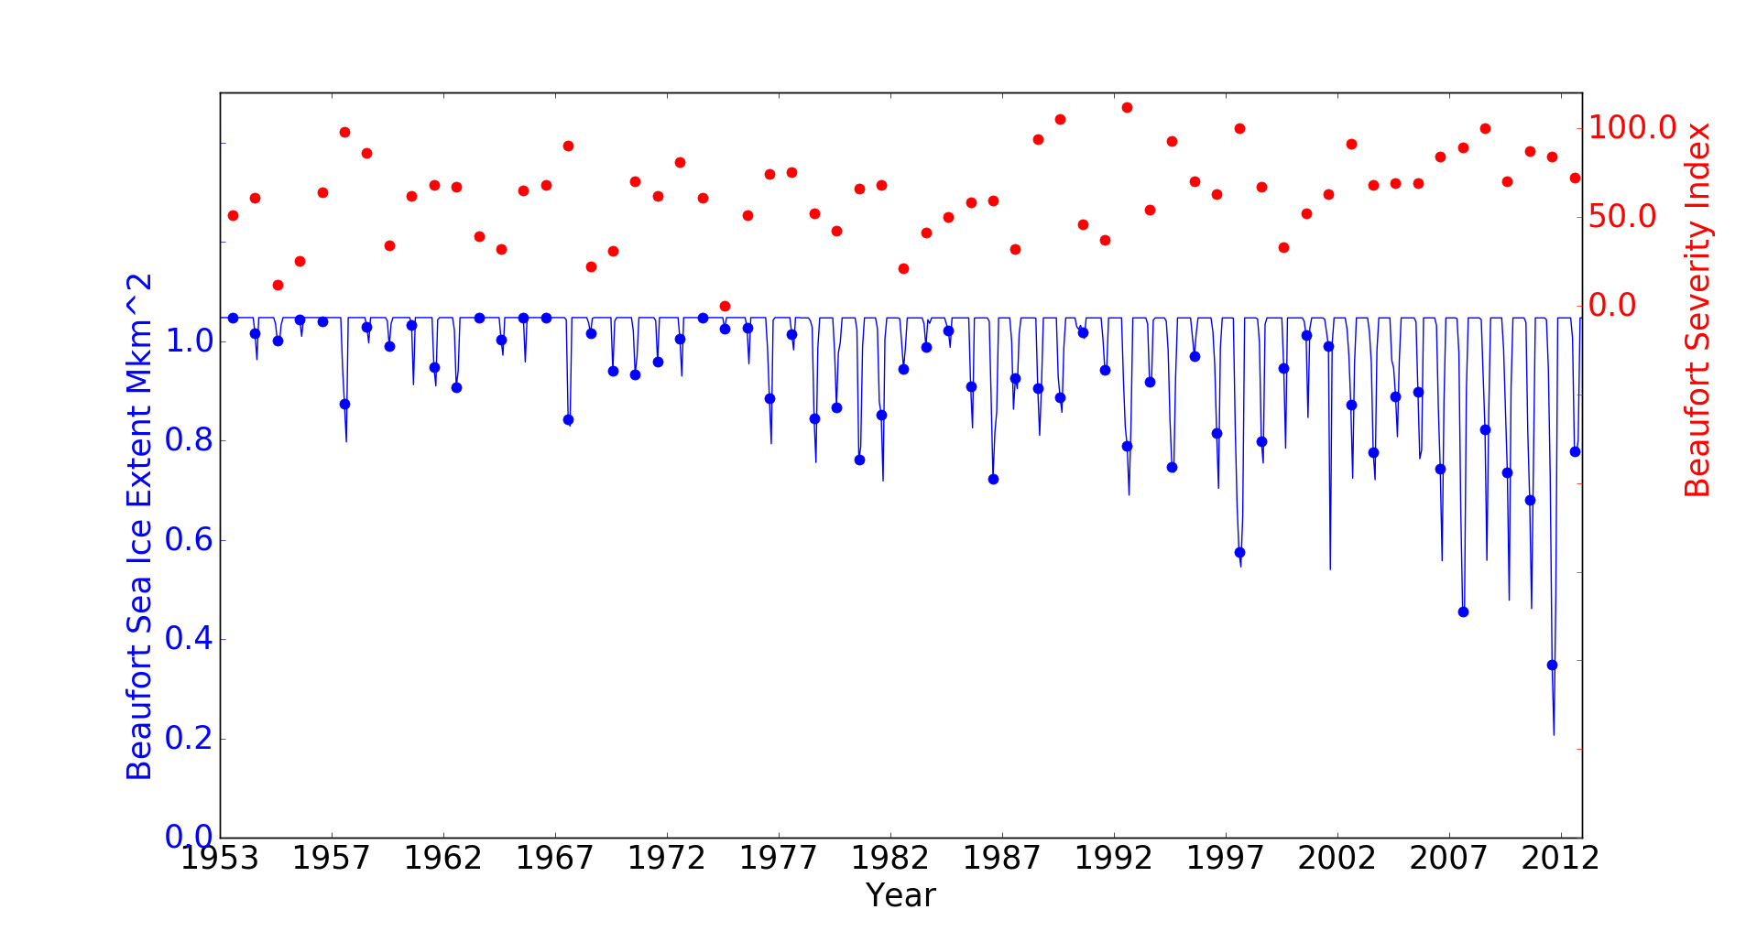
Beaufort sea ice extent vs. Beaufort Severity Index (red)
• August ice extent

Slide 12
Beaufort Severity Index (gray bars) vs. Barnett Index, 1953-2016 (red bars)
↓

Slide 13
Outline
A Beaufort sea ice severity index for northern Alaska
-- variations and trends over the past 60 years
-- representativeness and seasonal predictability
-- reconstruction spanning 1850-present
2. Extension to pan-Arctic indicator development

Slide 14
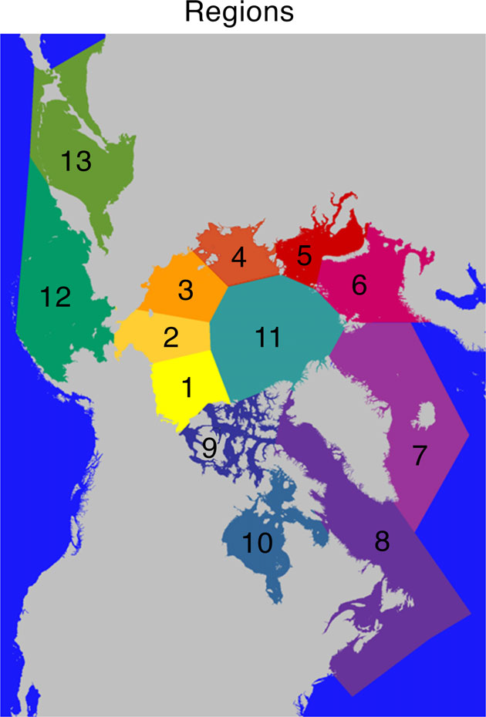
Regions used in sea ice indicator evaluations [from NSIDC and NIC]
Notes:
Region boundaries drawn by NIC for the Multisensor Analyzed Sea Ice Extent product.

Slide 15
Beaufort Severity Index vs. regional ice extent: variance explained, 1953-2013
Notes:
Plot of Scott’s file: regional_extent_predicts_BSI.txt Barnett Severity Index regressed on regional ice extent using SIBT1850 (G10010) years from 1953-2013

Slide 16
Outline
A Beaufort sea ice severity index for northern Alaska
-- variations and trends over the past 60 years
-- representativeness and seasonal predictability
-- reconstruction spanning 1850-present
2. Extension to pan-Arctic indicator development

Slide 17
A gridded database of Arctic sea ice extending back to 1850 (Walsh, Fetterer, Stewart and Chapman, 2016, Geographical Review)
(Image courtesy of UAF/SNAP)

Slide 18
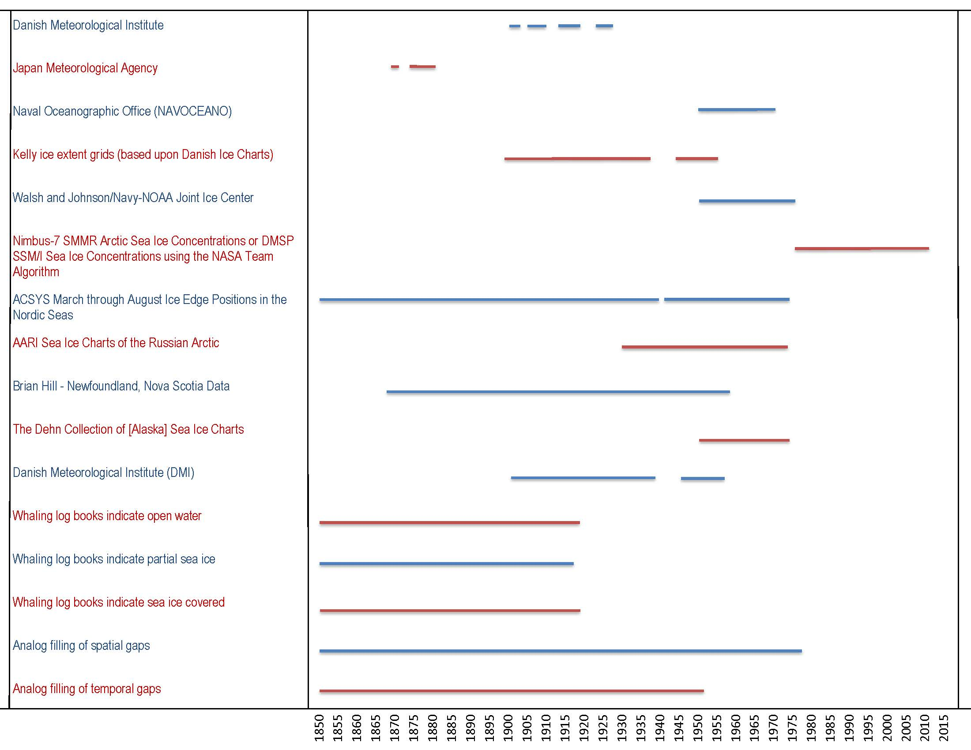
Primary data sources

Slide 19
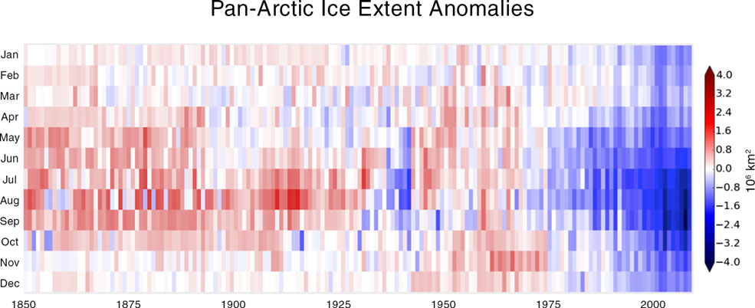
Pan-Arctic ice extent anomalies vs. year and calendar month, 1850-

Slide 20
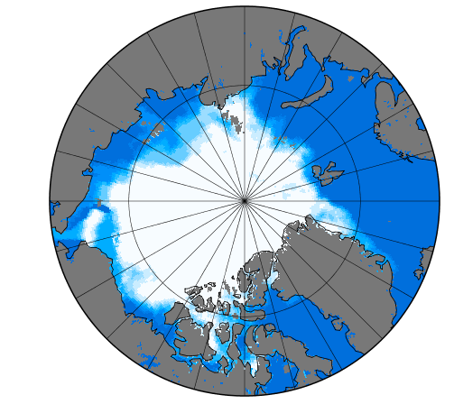
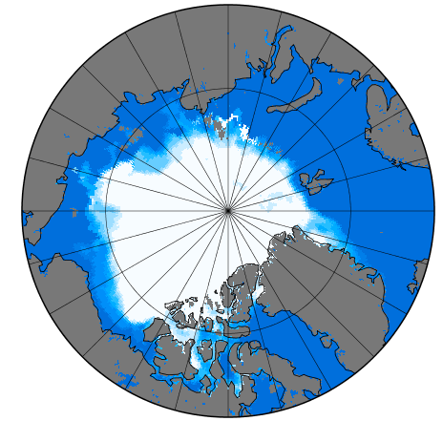
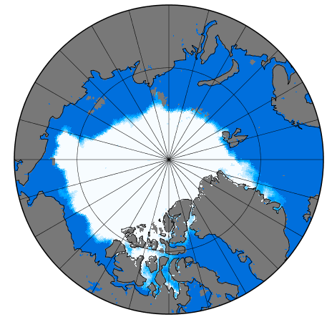
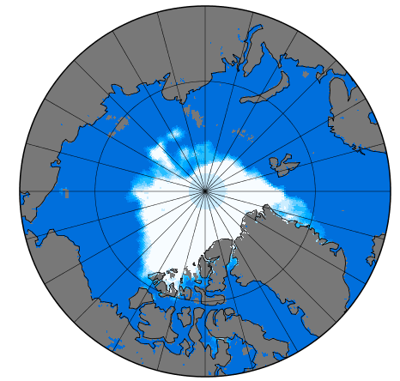
Extreme September minimum ice extents
1879
1943
1850-1900
1901-1950
1951-2000
1995
2000-2013
2012

Slide 21
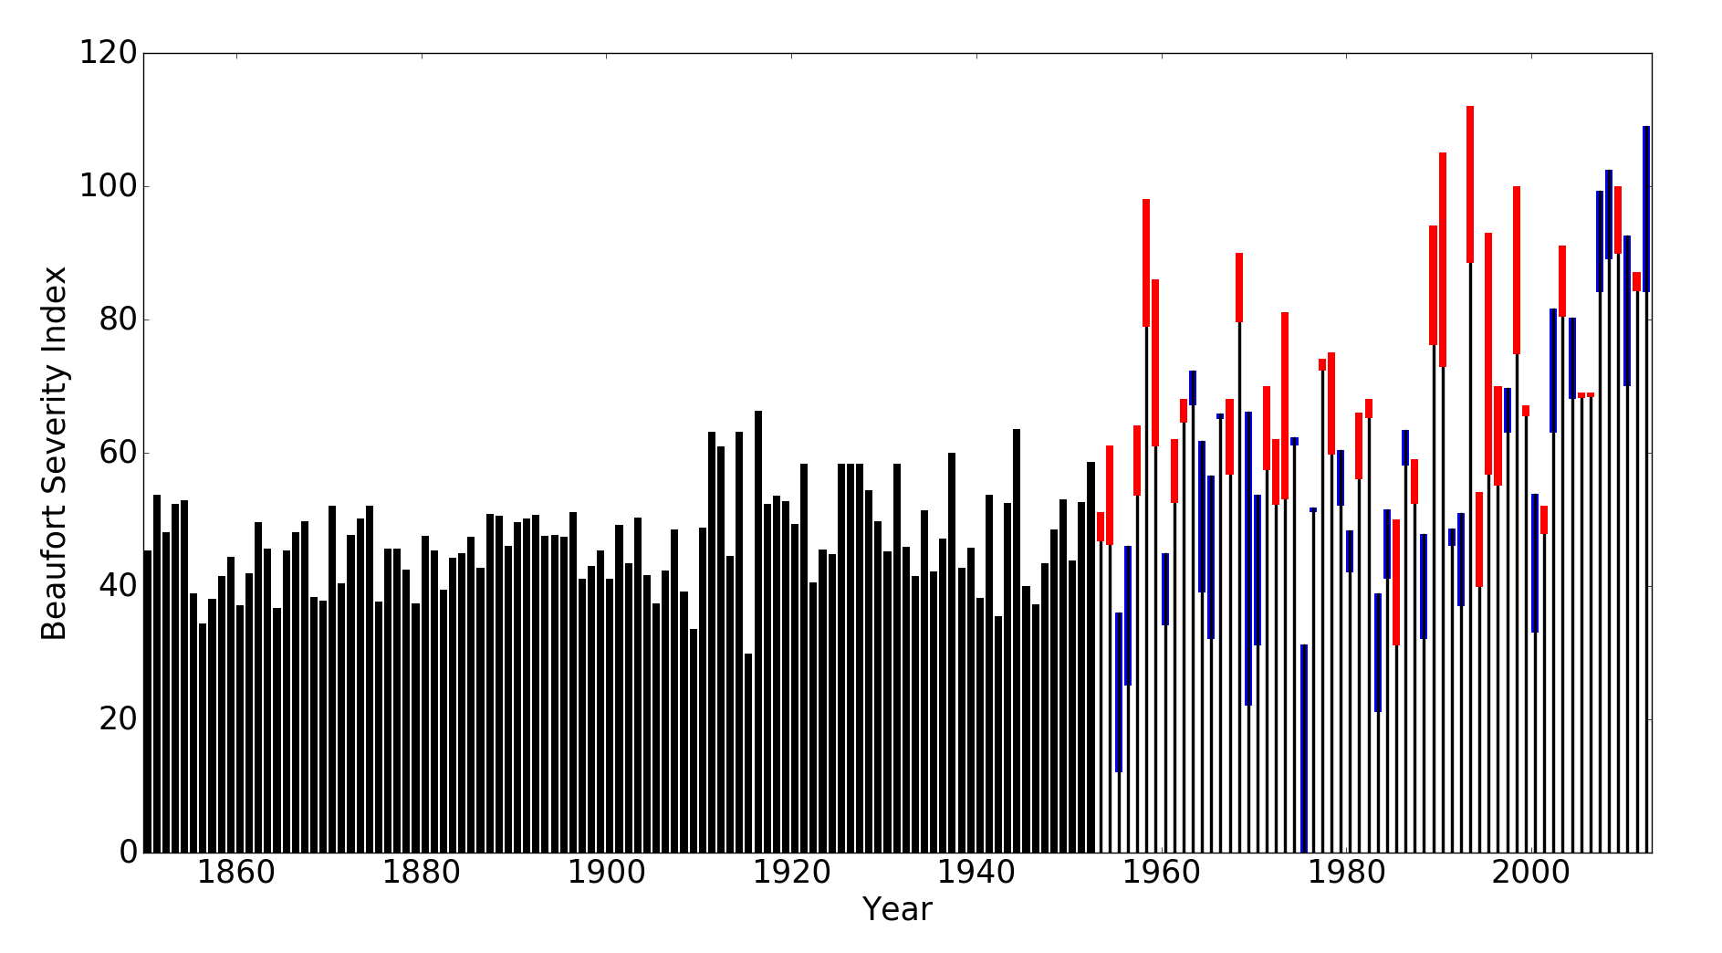
Beaufort Severity Index reconstructed back to 1850 [multilinear regression onto Beaufort/Chukchi/East Siberian/panArctic extents] red = underspecified, blue = overspecified

Slide 22
Outline
A Beaufort sea ice severity index for northern Alaska
-- variations and trends over the past 60 years
-- reconstruction spanning 1850-present
-- representativeness and seasonal predictability
2. Extension to pan-Arctic indicator development

Slide 23
September pan-arctic sea ice extent regressed on regional ice extent, 1953-2013
Notes:
Plot of Scott’s file: regional_extent_predicts_SepPanArc.txt September pan-arctic sea ice extent regressed on regional ice extent using SIBT1850 (G10010) years from 1953-2013

Slide 24
Summary
The Beaufort Severity Index is an indicator of summer ice severity in the Beaufort, Chukchi and eastern Russian subarctic seas
Simple correlative predictability of the Beaufort Severity Index is limited to 1-3 months and to information from Alaskan-Siberian seas
The present period of ice-diminished seas in the Alaskan region is unique in the historical record back to 1850
Regional ice extents in several subarctic seas are leading (by several seasons) indicators of September pan-Arctic ice extent
-- will extend to other seasons after determining trend effect
Notes:
Walsh, J. E., W. L. Chapman, and F. Fetterer. 2015. Gridded Monthly Sea Ice Extent and Concentration, 1850 Onward, Version 1. Boulder, Colorado USA. NSIDC: National Snow and Ice Data Center. doi: http://dx.doi.org/10.7265/N5833PZ5.
Walsh, J. E., F. Fetterer, J. Scott Stewart, and W. L. Chapman. 2016. A database for depicting Arctic sea ice variations back to 1850. Geographical Review doi:10.1111/j.1931-0846.2016.12195.x

Slide 25
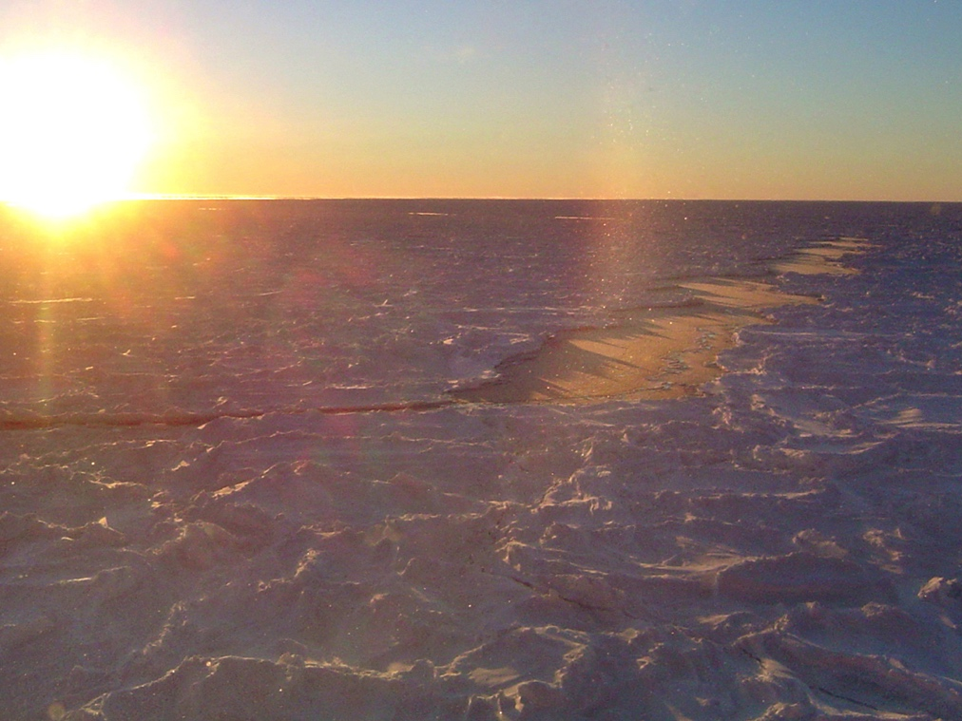
Thank you for your attention!
Notes:
25

