Slide 1


Arctic Environmental Response and Management
Alexey Knizhnikov
WWF Russia,
aknizhnikov@wwf.ru
7th Symposium on the “Impacts of an Ice-Diminishing Arctic on Naval
and Maritime Operations, 18-20, July 2017, Washington, DC

Slide 2

Extractive industry and shipping– key drivers for economic development and environmental risks in Russian Arctic for upcoming decades.

Slide 3
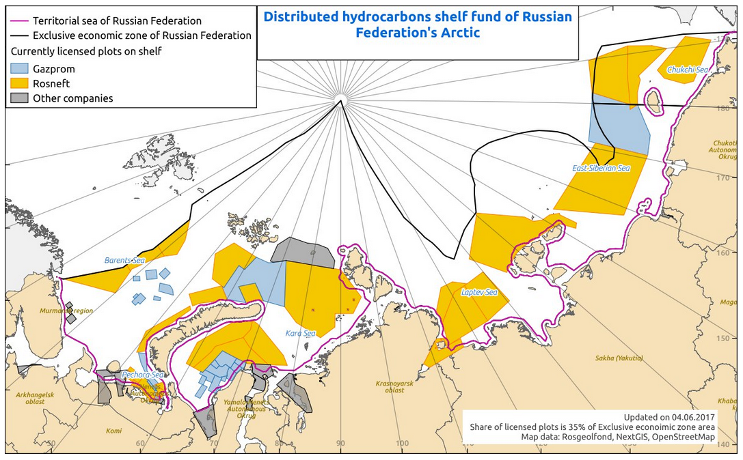
The scale of threats for Arctic ecosystems.
Oil&gas lease areas in Russian Arctic
Challenges
Notes:
By June 2017 about 35% of EEZ has already leased, mostly by Rosneft (yelow) and Gazprom (blue)

Slide 4
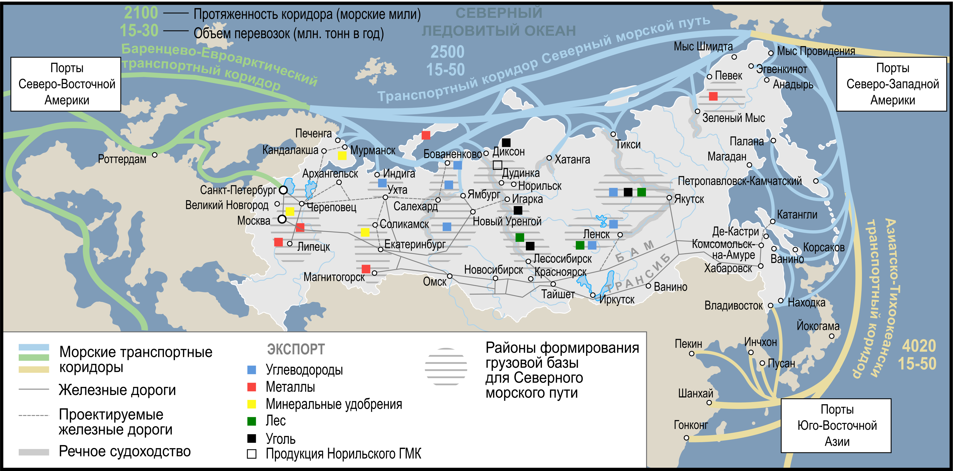
Future of Northern Sea Route – not transit but destination routes
Notes:
White area – supply recourses, mostly extractive industry to drive increase the shipping traffic in Russian arctic. For instance, only one shipping company – Sovkoflot predict total cargo at 12 mln t in 2018, 2 times bigger that was before

Slide 5
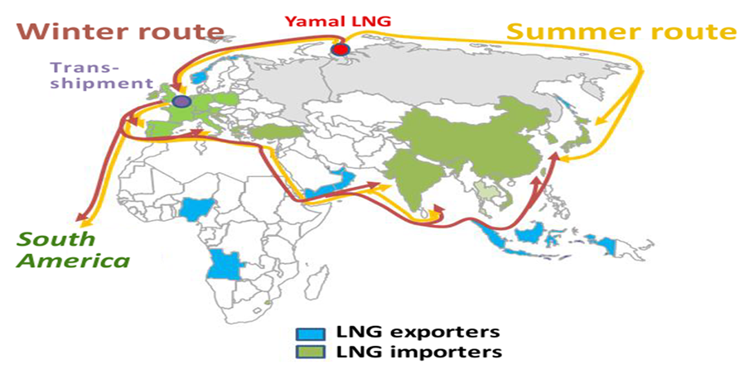
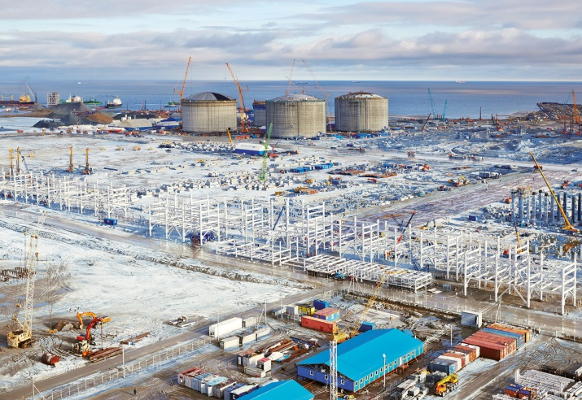

Slide 6
Lesson learnt from tanker “Nadezhda” oil spill, Sakhalin, 2015-16
Up to 400 t of oil fuel spilled, up to 25 km of coast polluted, massive death of birds.
The gaps are still existed in
Oil spill clean up technology and Governance
Notes:
7 июня 2014 года в рамках 21-го Мирового нефтяного конгресса - открытое обсуждение проекта методологии Рейтинга.
Перечень (кол-во) компаний, участвующих в обсуждении методологии
Участники обсуждения, представители компаний «Газпром», «Газпром нефть», «Новатэк», «Сахалин Энерджи», «Сургутнефтегаз»,

Slide 7
WWF is working to support RU-US dialogue on reducing risks of shipping
and oil spills. Focus on Bering strait
Work with the USCG on establishing ATBAs and recommended shipping routes for the US side of the Bering Strait (PARS) , on supporting the US PARS proposal at the IMO,
Advocated for re-engagement under the oil spill prevention MoU,
Work with the Russian government on establishing marine buffer zones for the Beringia national park,
Cooperation on using ERMA as a joint response tool in the Bering Strait.

Slide 8
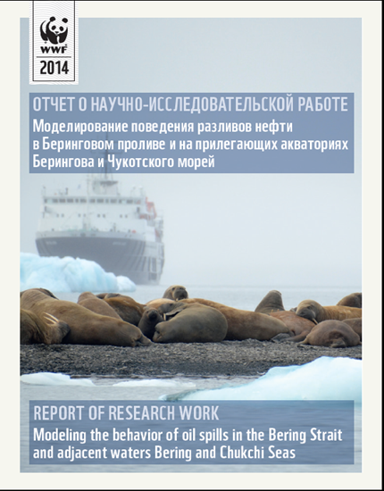
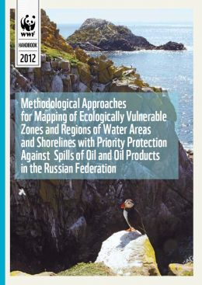
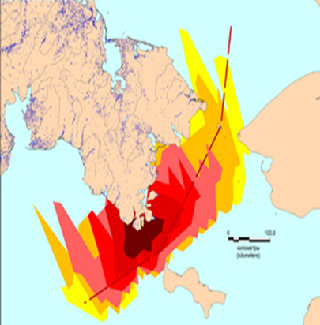
Modeled oil spill scenarios for potential tanker accidents on the Russian side of the Bering Strait and sensitivity mapping – some WWF contribution in ERMA

Slide 9
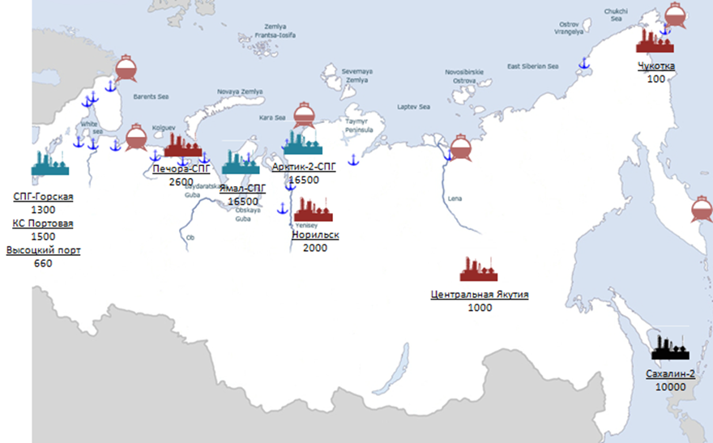
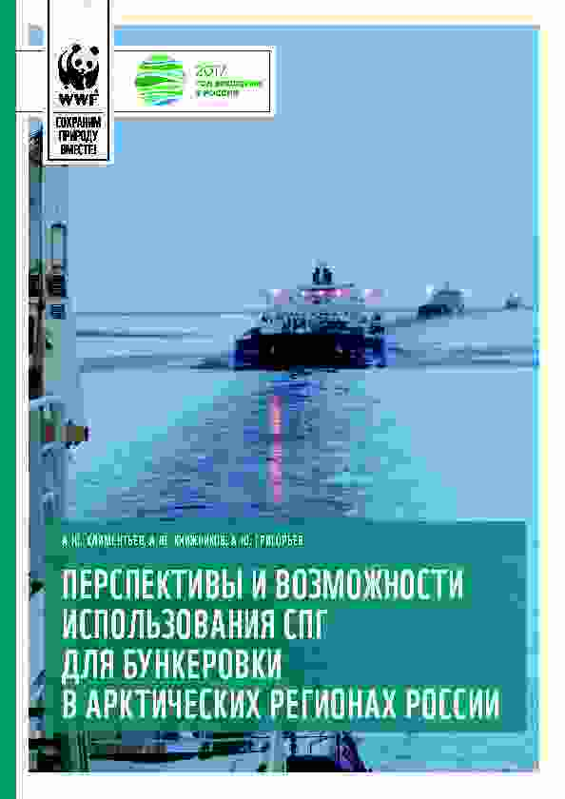
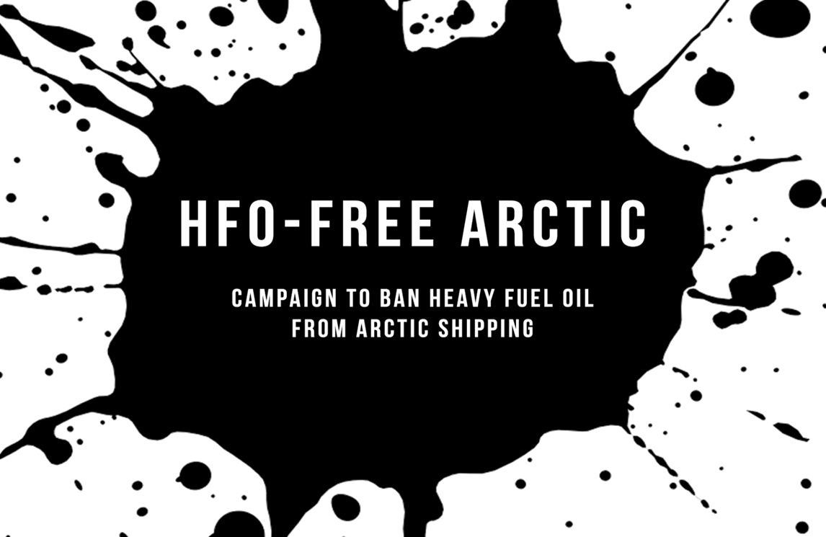
Radical elimination of oil spill threats –
switch Arctic shipping to LNG. Russian initiative.
Map of possible LNG production
plants along the NSR

