Slide 1
CASRAS: Canadian Arctic Shipping Risk Assessment System
Anne Barker
National Research Council of Canada
Ocean, Coastal and River Engineering

Slide 2
Outline
Whirlwind overview of NRC
Who cares about risk?
What is CASRAS?
CASRAS examples in action:
Risk assessment module
Data exploration for planning or operations module
Tell me more about CASRAS!

Slide 3
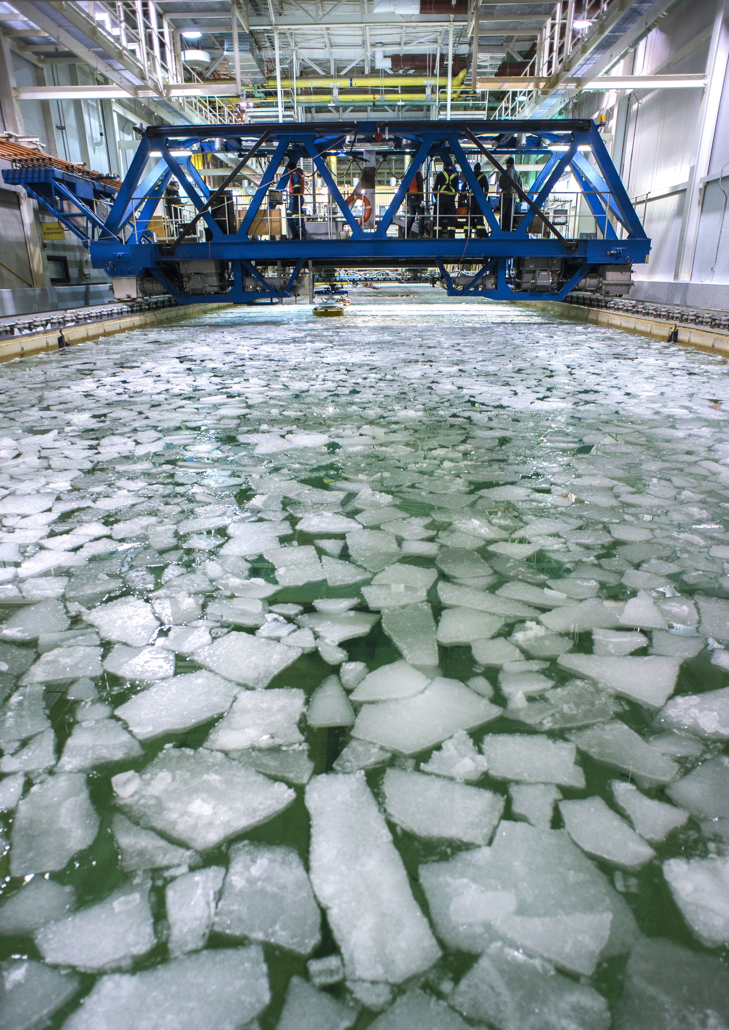
NRC’s Mission
Develop and deploy solutions to meet Canada’s current and future industrial and societal needs
Innovation support, strategic research, scientific & technical services
Notes:
Work with clients and partners to provide innovation support, strategic research and scientific and technical services.
Specializing in state of the art technology.
Expertise and know-how from across NRC
Multidisciplinary solutions-tailored to the needs of our clients.

Slide 4
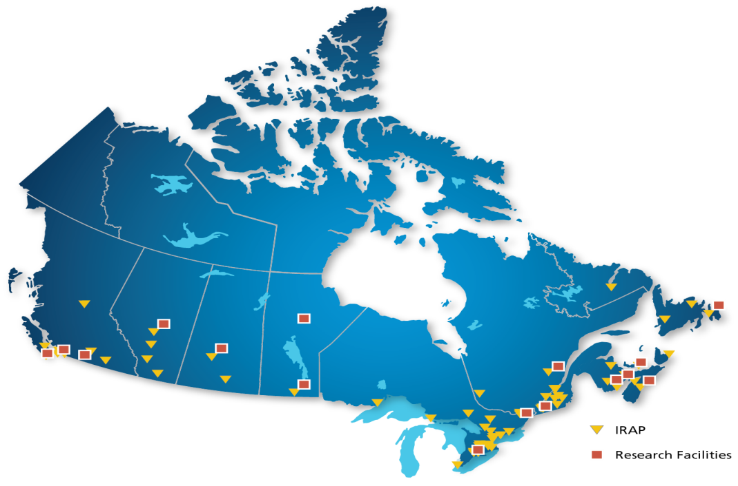

NRC at a glance A national organization with regional presence and global reach
NRC delivers research for Canada through a set of focused large-scale, collaborative, multi-disciplinary R&D programs.
100-year history
of science and innovation
for Canada
$1B Total expenditures in 2016/17
*Includes $300M in Industrial Research Assistance Program support for SMEs, etc.
3,700 Full-time equivalents
NRC R&D facilities
IRAP locations

Slide 5
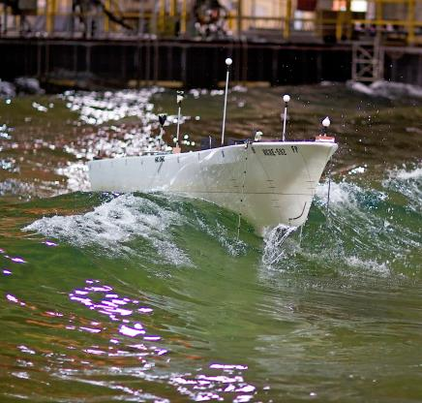
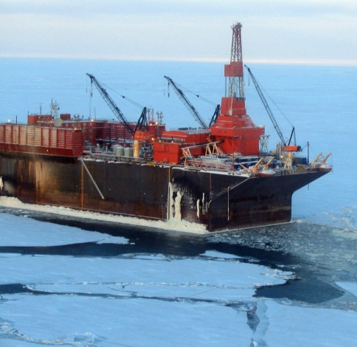
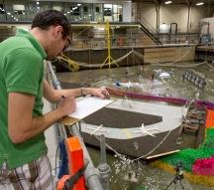
Ocean, Coastal and River Engineering PROGRAMS
Marine Vehicles
Arctic
Marine Infrastructure, Energy and Water Resources

Slide 6
Risk Assessment – Why?
Environmental Change (Climate, Sea Ice, Migrations)
Regulatory Change (Polar Code)
Operational Change (New Fleet, New Crew, New Infrastructure, New Operators, New Ports)
Technology Change (Navigation Aids, Charting, Vessel Design)
Incident/Casualty Response

Slide 7

Risk Assessment & the Polar Code
Steps for an Operational Assessment from IMO Polar Code Annex 10, p 30
Identify Relevant Hazards
Develop a Model
Assess Risks & Determine Acceptability
Identify & Develop Risk Control Options
See also: IMO Guidelines for Formal Safety Assessment (FSA) for Use in the IMO Rule-making Process (2002)

Slide 8
CASRAS – Canadian Arctic Shipping Risk Assessment System
CASRAS is a tool that supports operation-specific risk assessments by providing relevant and defensible data analytics generated for defined shipping scenarios.
A dynamic and integrated database, CASRAS will store, query and visualize all key relevant environmental data with specific application to shipping, icebreaking and navigation in Northern waters and marine corridors.

Slide 9
Why develop the system?
Assess the risk associated with shipping in various northern regions
Apply the Polar Code
Document mariners knowledge and information on local communities
Easily access different types of data such as static and time-varying rasters, points, polygons, time-series, and documents
Minimize the effects due to limited access to Internet
Notes:
Assess the risk associated with shipping in various northern regions
Easily access different types of data such as static and time-varying rasters, points, polygons, time-series, and documents
Apply the Polar Code
Document mariners knowledge and information on local communities
Minimize the effects due to limited access to Internet
For use in the office and onboard the vessel: stand alone system, all data stored locally on a PC - not dependent on access to Internet when in the High Arctic

Slide 10
CASRAS use
For making decisions with the best available data
For regulatory process transparency, e.g. applying the Polar Code
Means for assisting successful navigation, training for ice navigators, shipping operators and Captains
For route planning and route optimization, as a data source for where and when icebreaking is needed, and for succession planning
For evaluating historical information on wind, waves, tides, ice movement, ice deformation, bathymetry and nautical charting
Provide information on local communities
Identifying gaps in important data and assist in identifying the most beneficial and cost effective methods required to close those gaps
Notes:
For making decisions with the best available data
For regulatory process transparency, e.g. applying the Polar Code
Means for assisting successful navigation, training for ice navigators, shipping operators and Captains
For route planning and route optimization, as a data source for where and when icebreaking is needed, and for succession planning
For evaluating historical information on wind, waves, tides, ice movement, ice deformation, bathymetry and nautical charting
Provide information on local communities
Identifying gaps in important data and assist in identifying the most beneficial and cost effective methods required to close those gaps

Slide 11
Who would use the system?
Shipping industry
Ice Navigators and mariners
Regulators
Canadian Government Departments
Fisheries and Oceans - Canadian Coast Guard, Transport Canada, Department of National Defence, Environment and Climate Change Canada, Indigenous and Northern Affairs Canada
Northern communities
Insurance companies
Academia
Notes:
Ice assistance emergency program - $5M due to ice conditions for fishing

Slide 12
CASRAS Risk Assessment Framework
What can go wrong?
How likely is it?
What are the impacts?
Analytical Methods
Historical Experience
Knowledge & Judgement
Database Analysis
Mariner & Local Knowledge Analysis
Canadian Arctic Shipping Risk Assessment System (CASRAS)
Adapted from Guidance Notes on Risk Assessment Applications for the Marine and Offshore Oil and Gas Industries - American Bureau of Shipping
Notes:
Adapted from American Bureau of Shipping

Slide 13
Canadian Arctic Shipping Risk Assessment System
Distributed Datasets
CASRAS Database
Processing Modules
Risk Report
Aggregate
Query
Compute
Assess

Slide 14
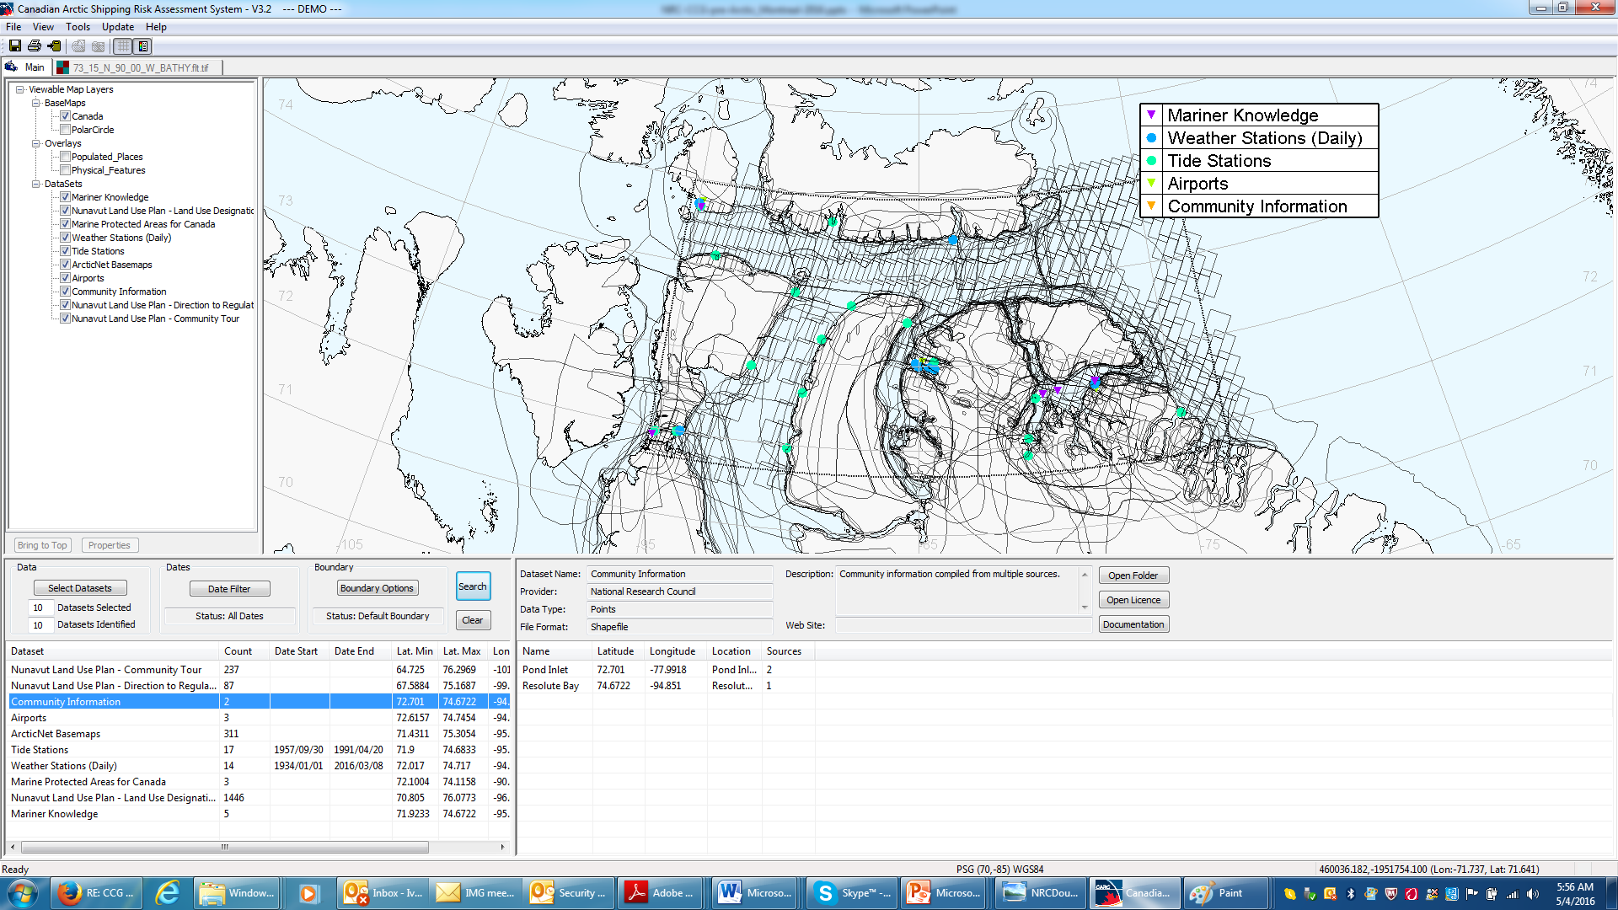
Multiple datasets

Slide 15
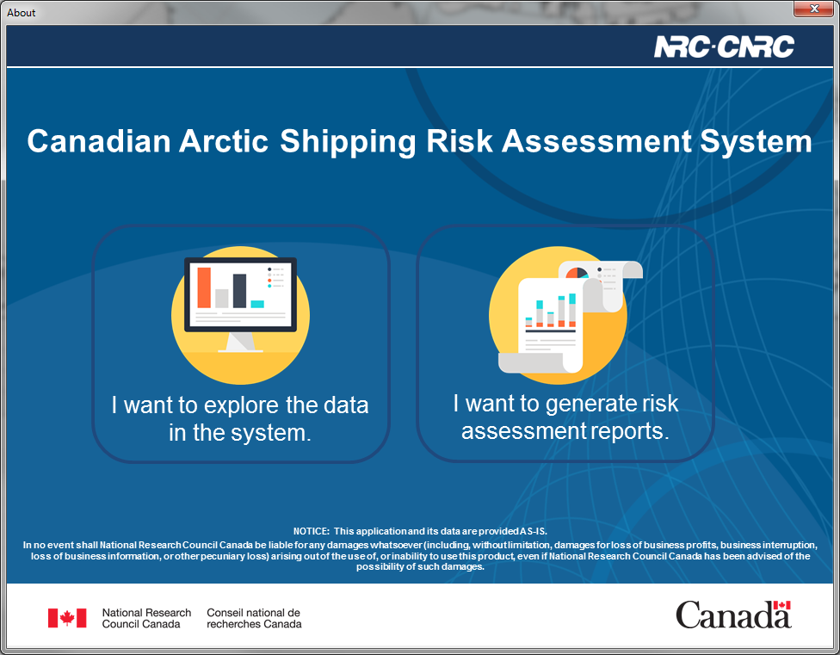
CASRAS Data and Reporting

Slide 16
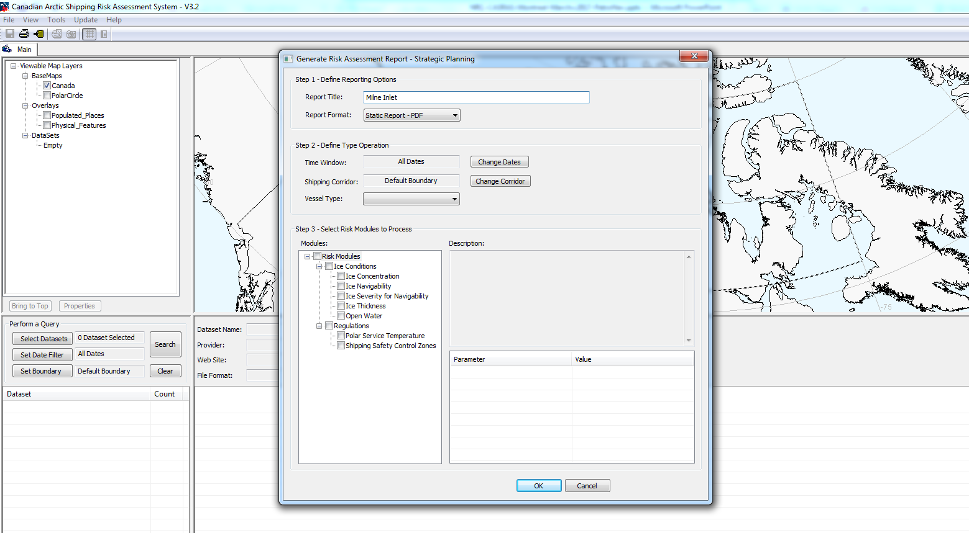
The system produces customizable reports on hazardous conditions along user- defined shipping routes

Slide 17
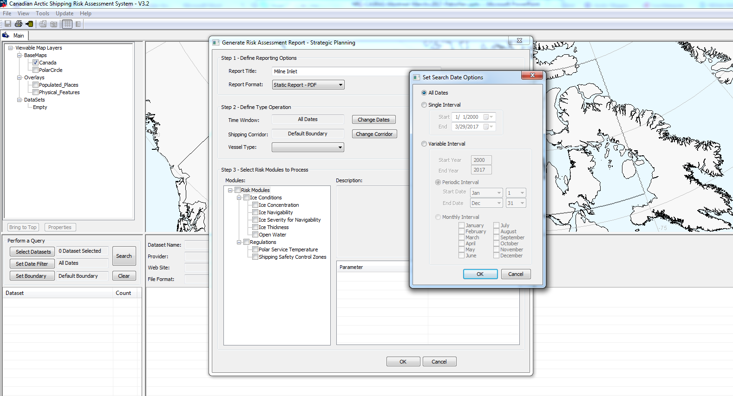
Selecting Dates : 2000 - 2015

Slide 18
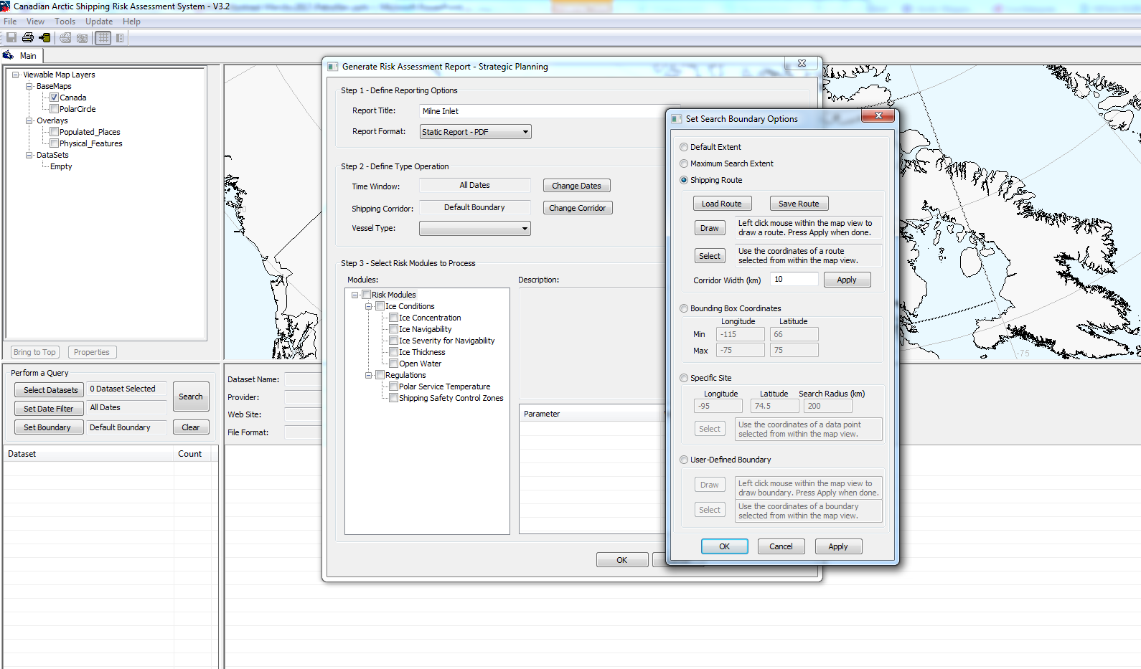
Selecting Route: Baffin Bay to Milne Inlet

Slide 19
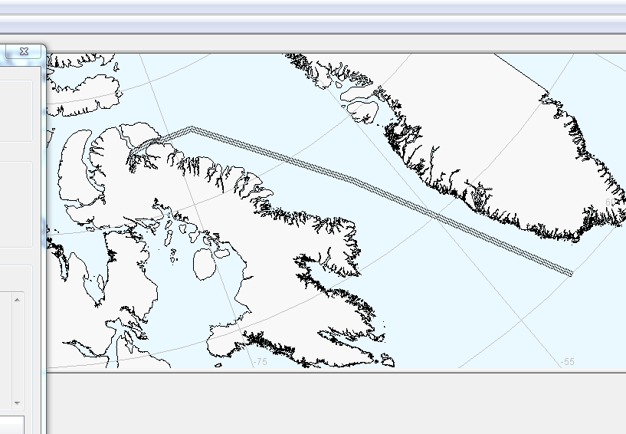
Selected Route

Slide 20
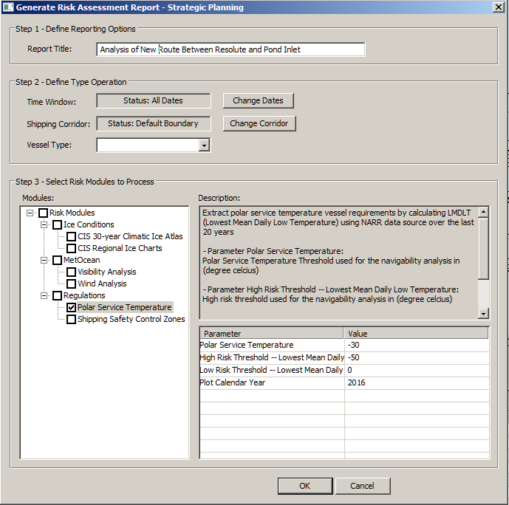
Select Risk Modules (report information)
Modules
Threshold values can be
changed by end users
Notes:
n = 429 measured values over 10 years (2003-2013, only 5 months each year considered from each year.

Slide 21
Generate the report
pdf printable version
html version (interacting – online or offline)
Notes:
Detailed On-the-fly Climate Analysis

Slide 22
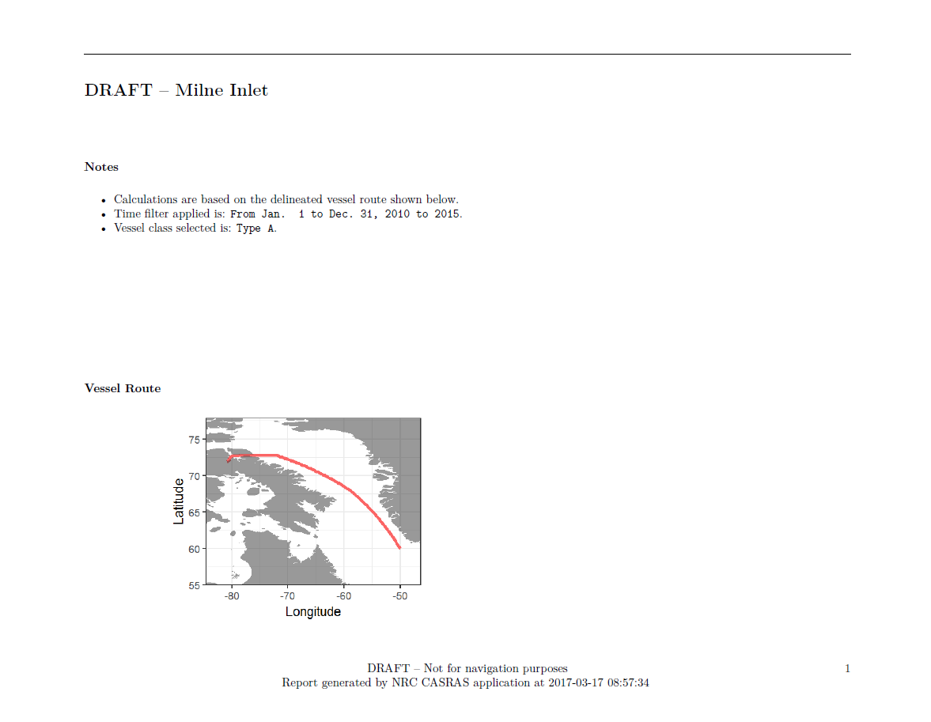

Slide 23
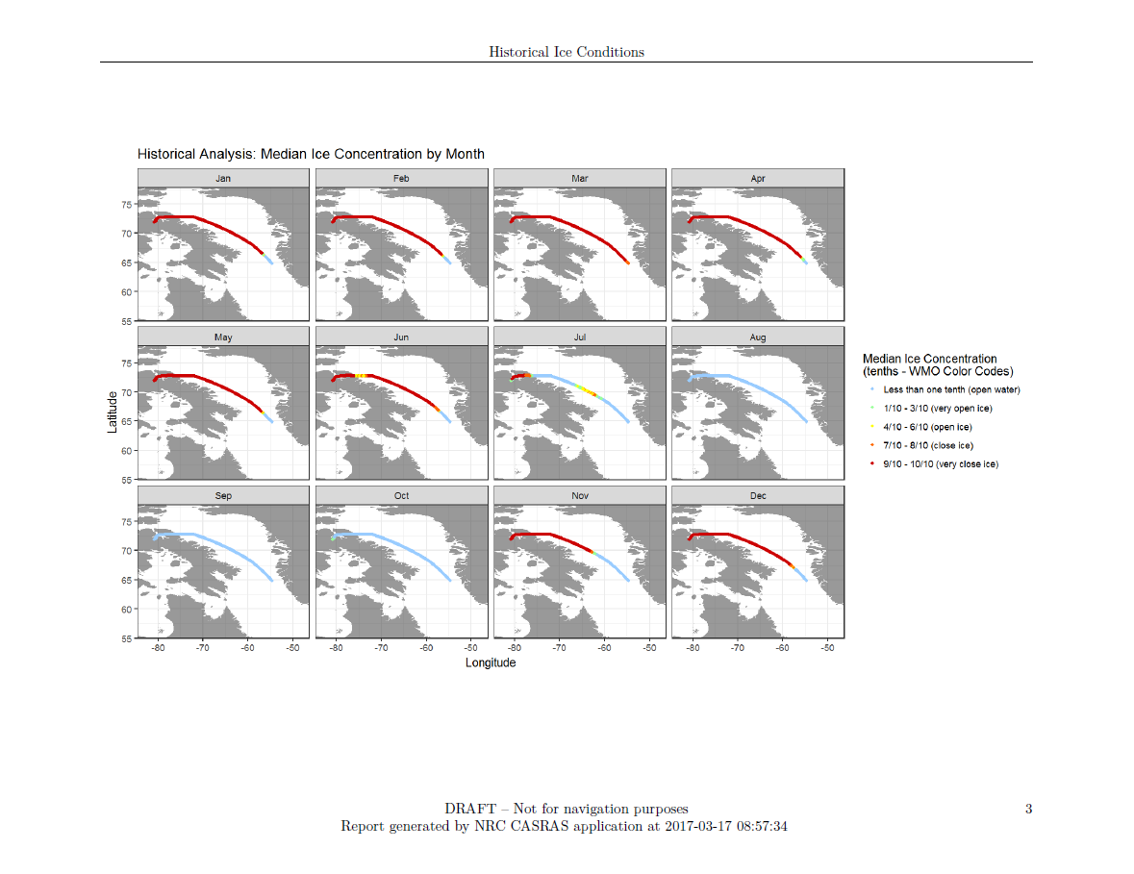

Slide 24
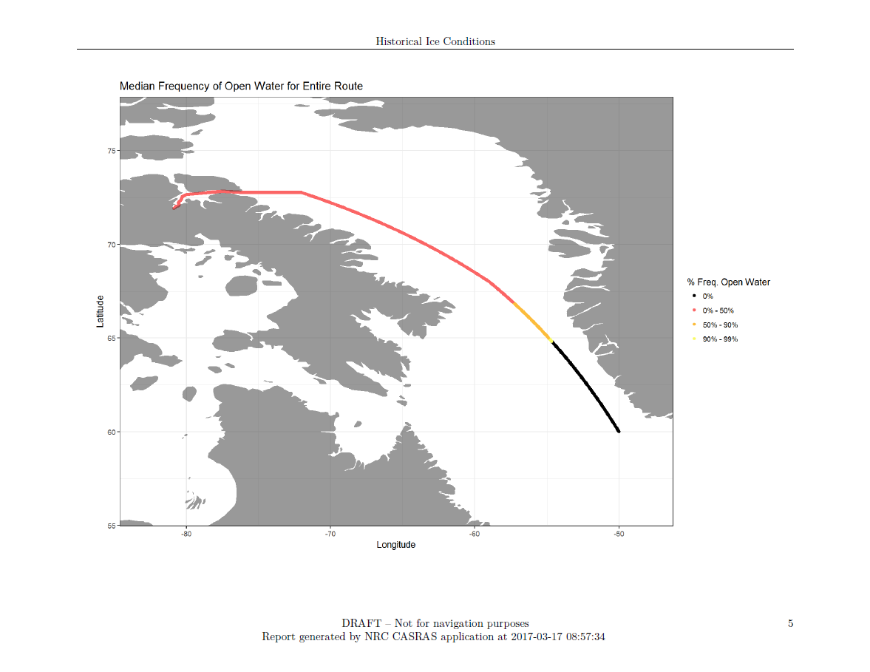

Slide 25
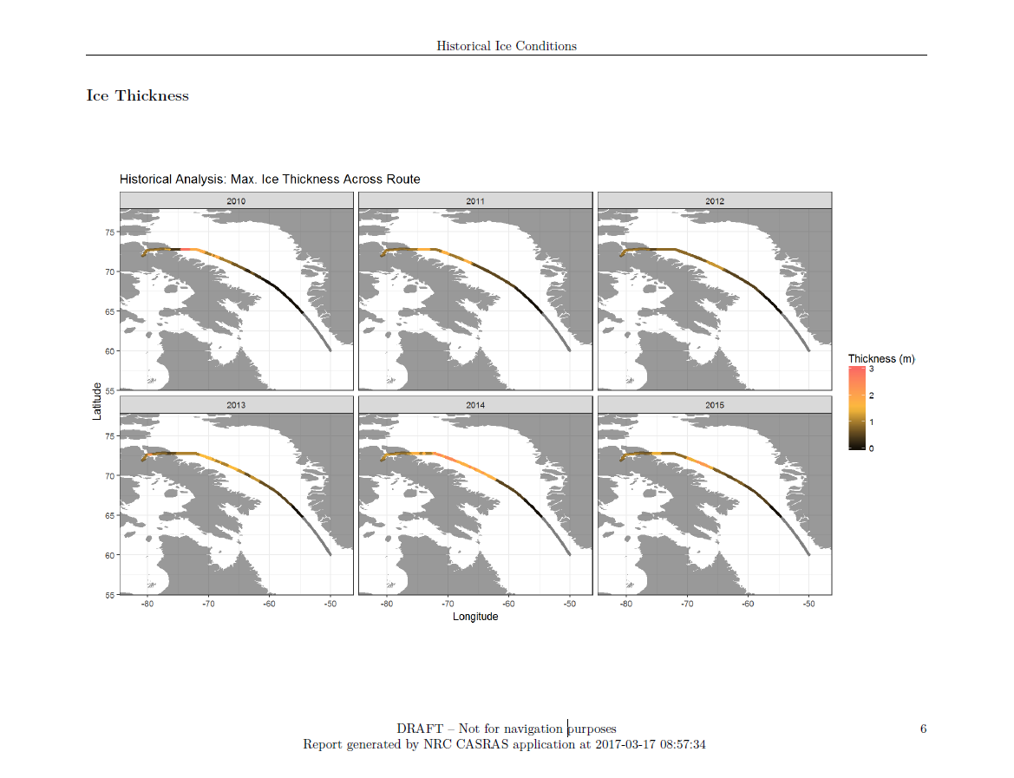

Slide 26
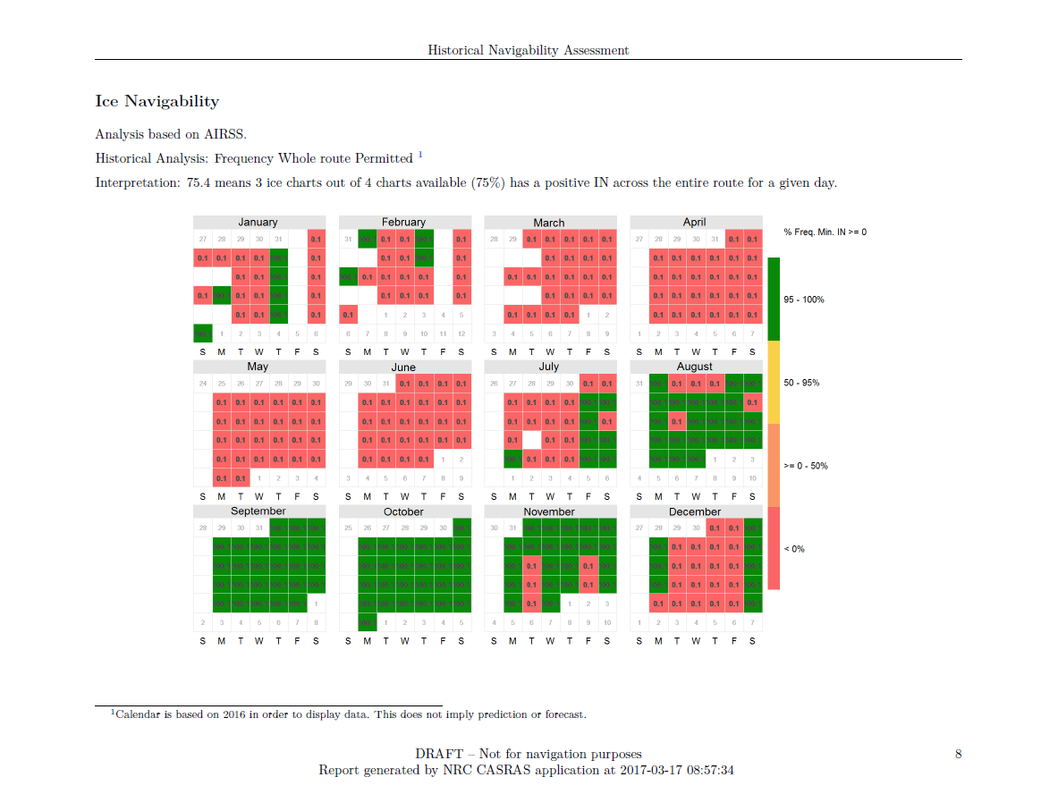

Slide 27
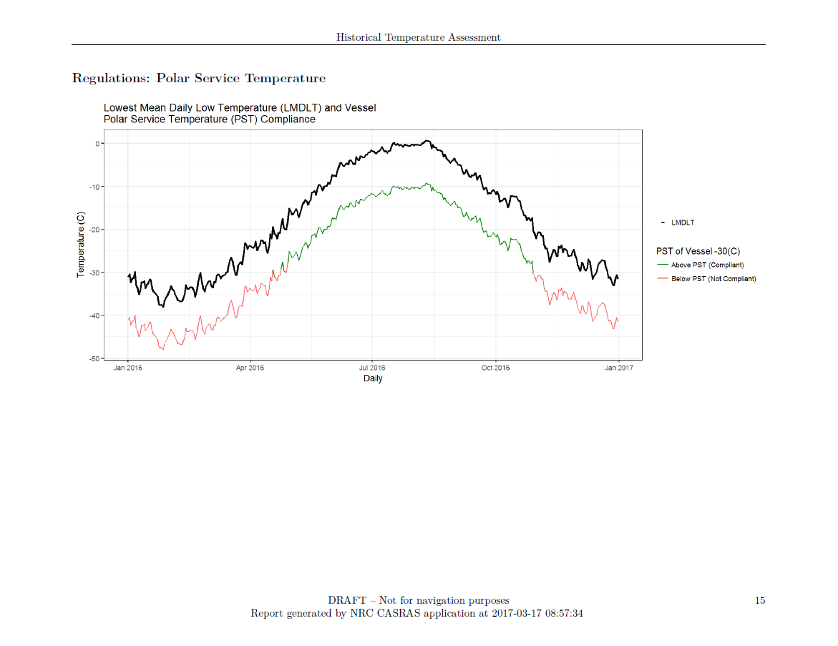

Slide 28
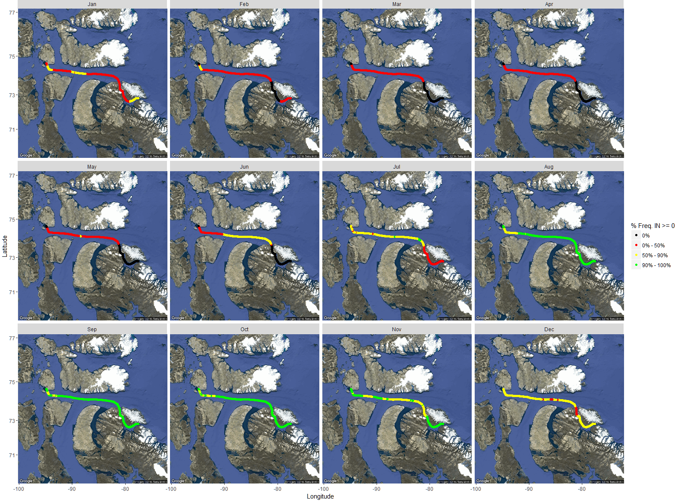
Risk-based Voyage Planning – Online report Go / No-Go Spatial and Temporal Frequency Analyses

Slide 29
CASRAS Data and Reporting
Notes:
CASRAS interface

Slide 30
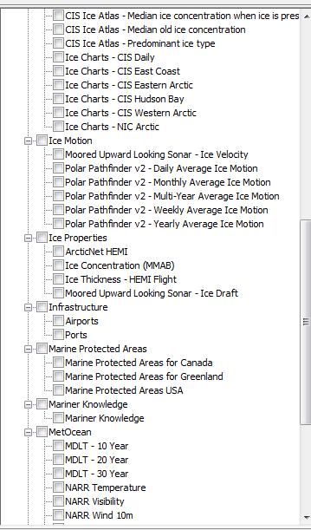
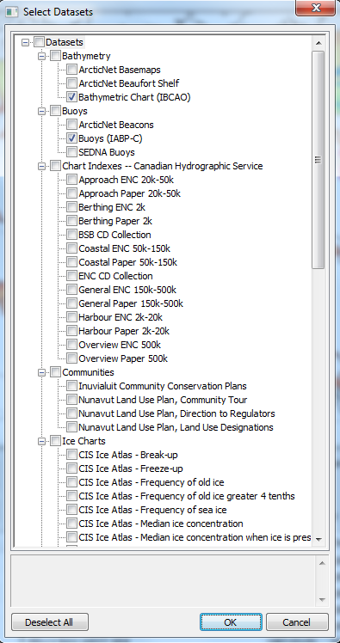
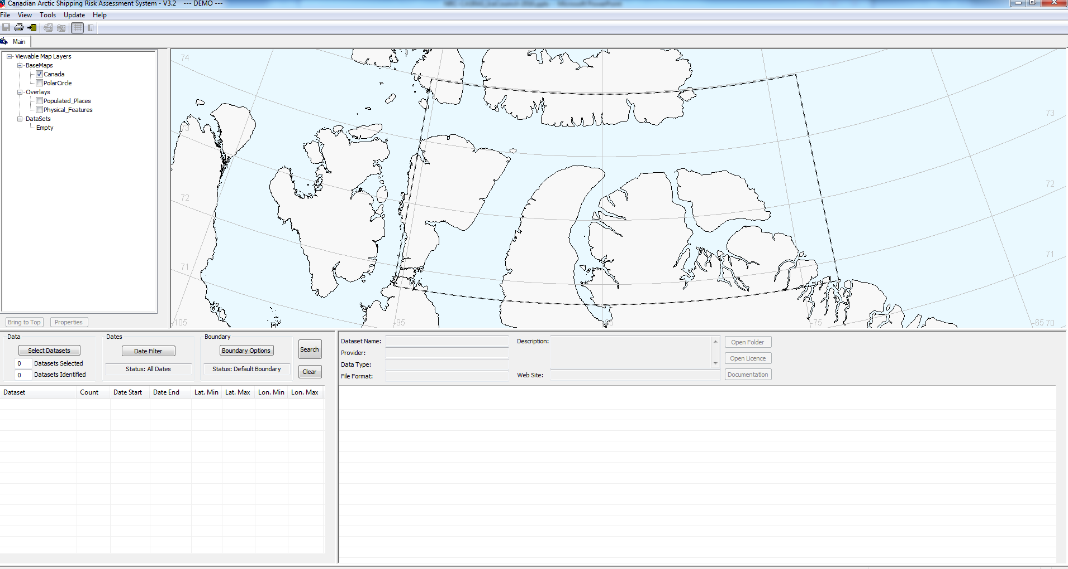
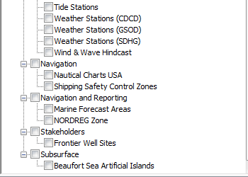
Select datasets
The user can search all databases, a subset of databases or within a specific one.

Slide 31
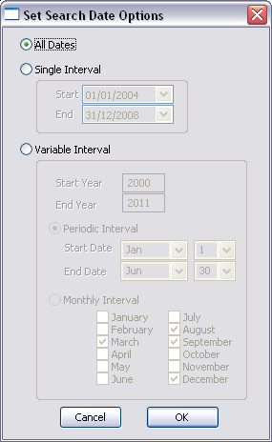
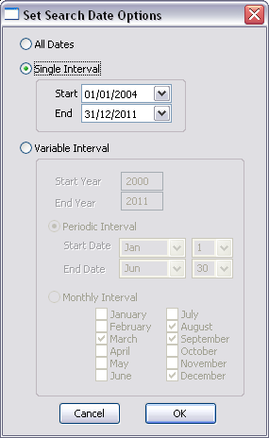
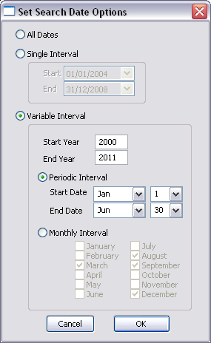
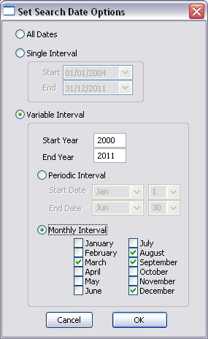
Select date - 4 Date Filters Available

Slide 32
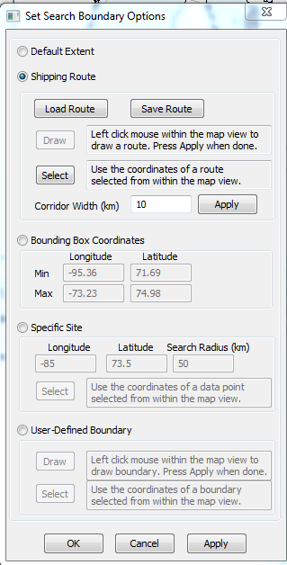
Select area or a route (spatial filter)

Slide 33
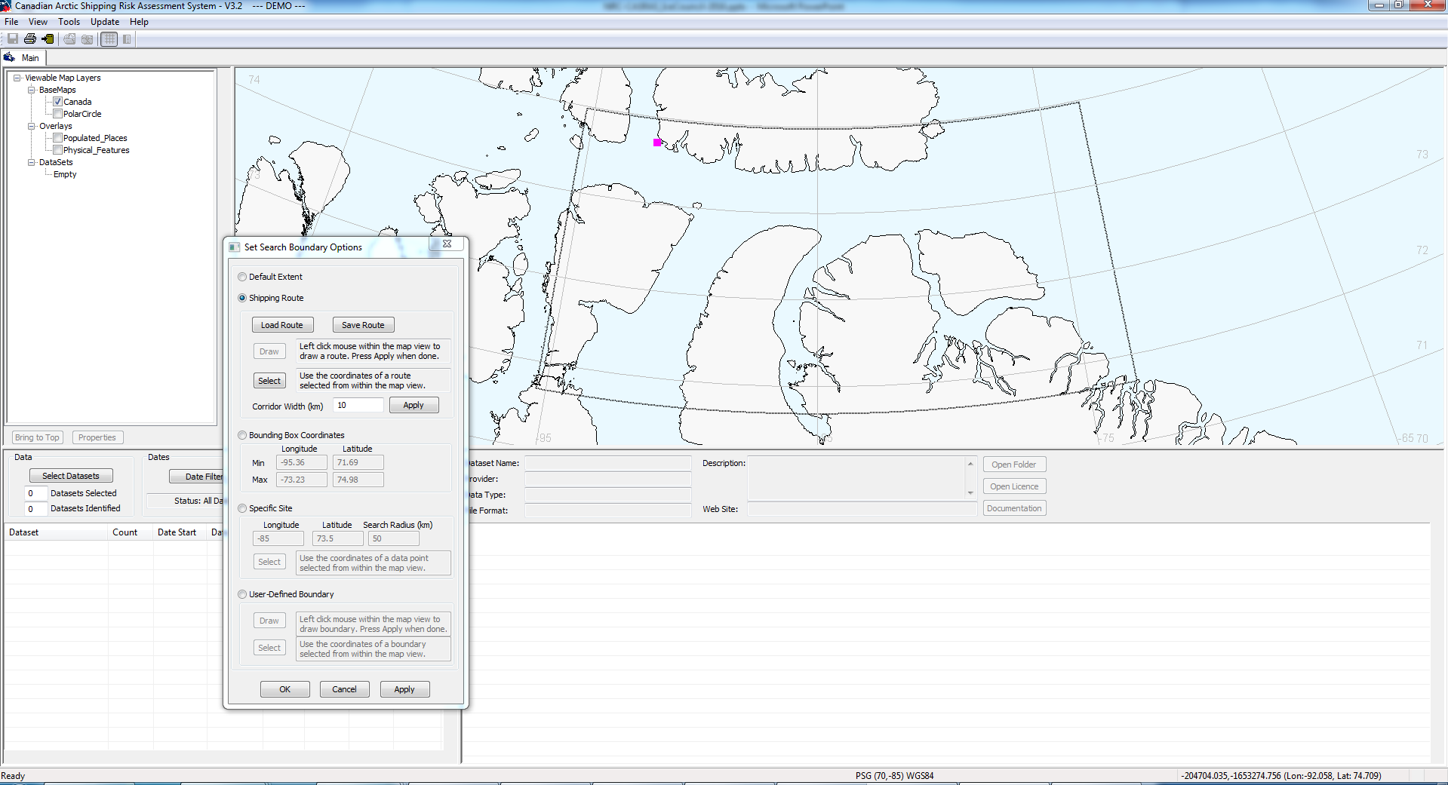
Select a route

Slide 34
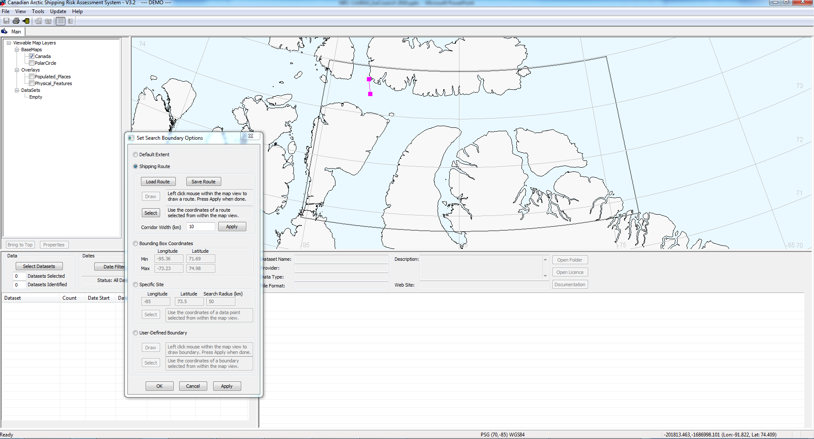
Select a route

Slide 35
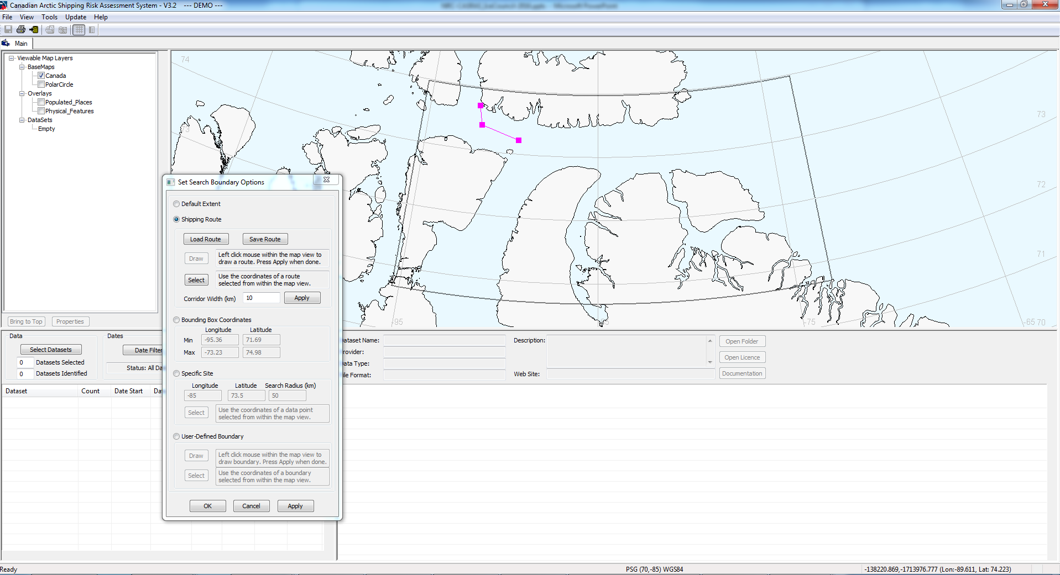
Select a route

Slide 36
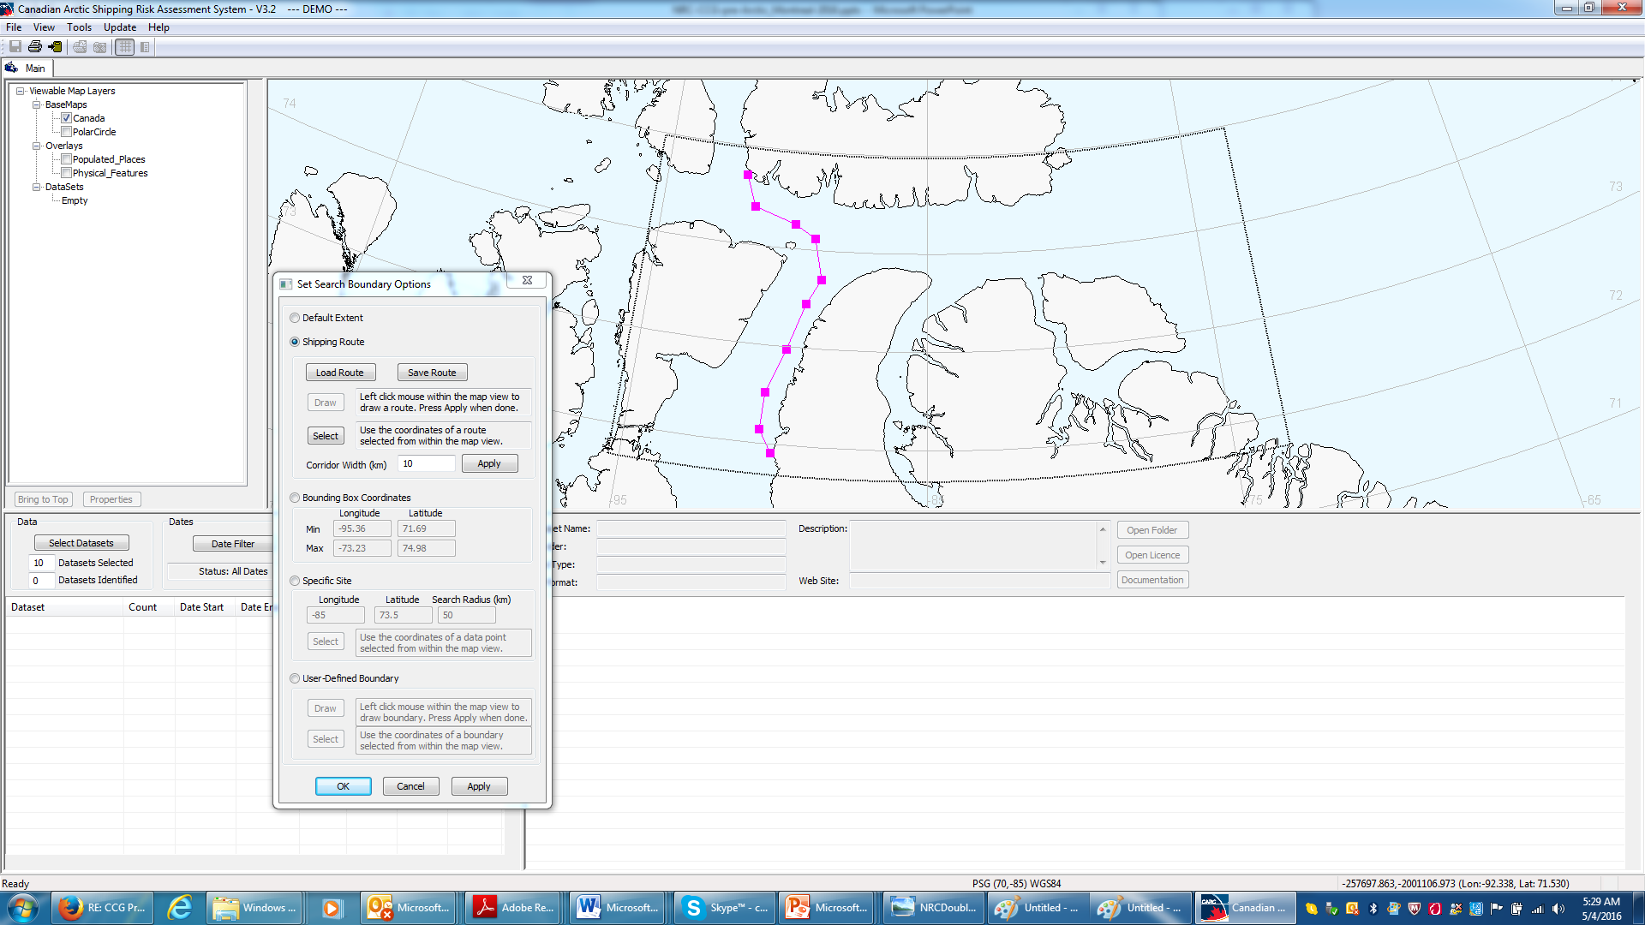
Select a route

Slide 37
Select corridor width

Slide 38
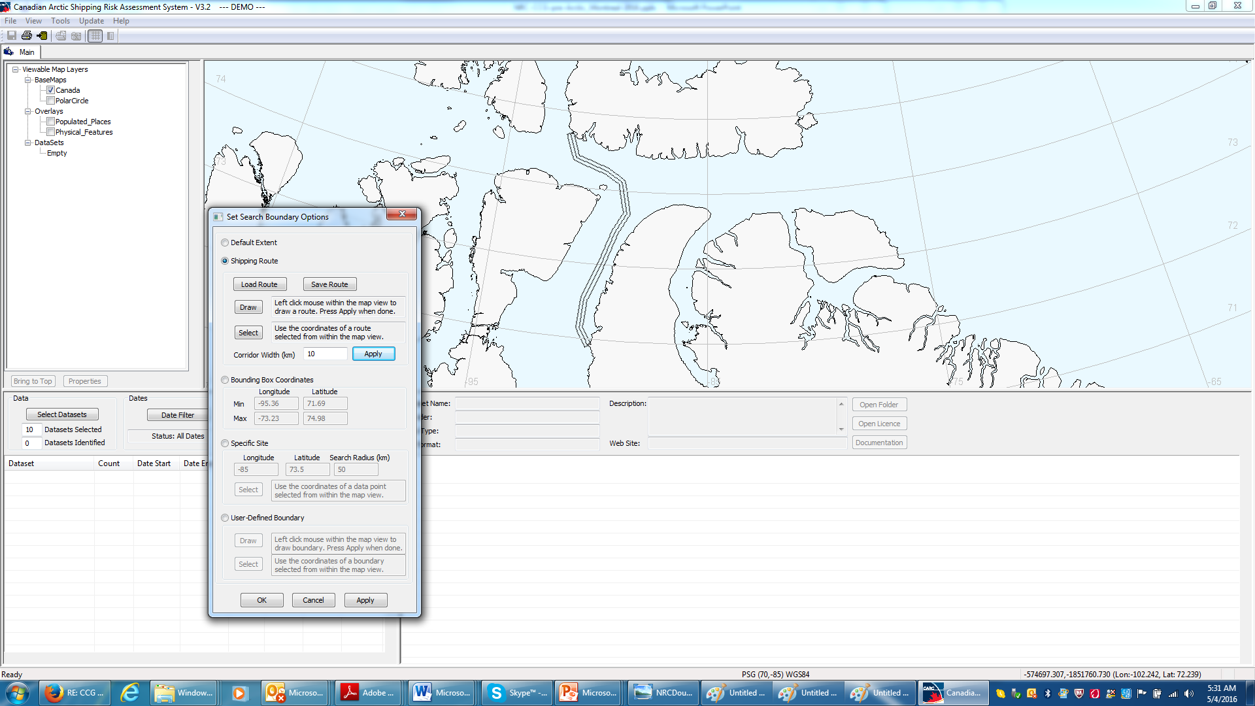
Add 5.5 N mi buffer

Slide 39
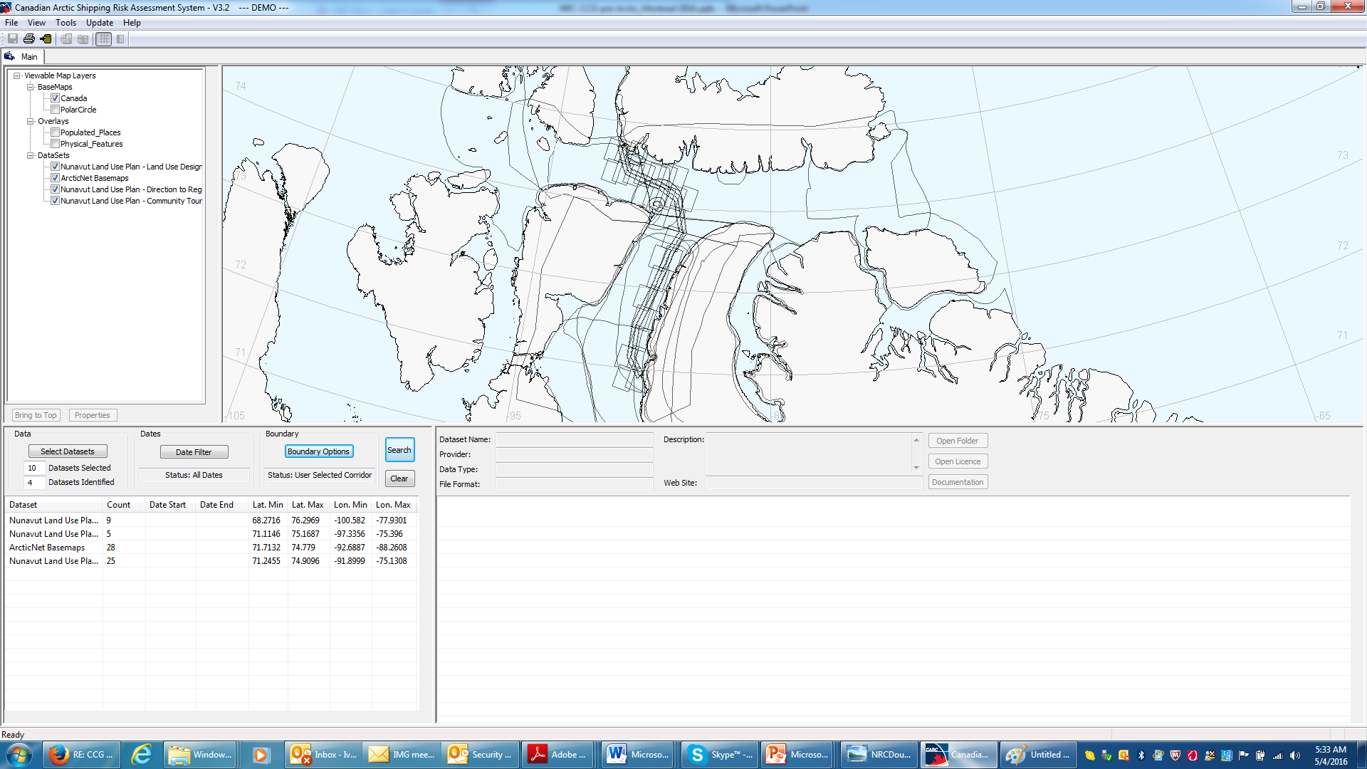
Execute search

Slide 40
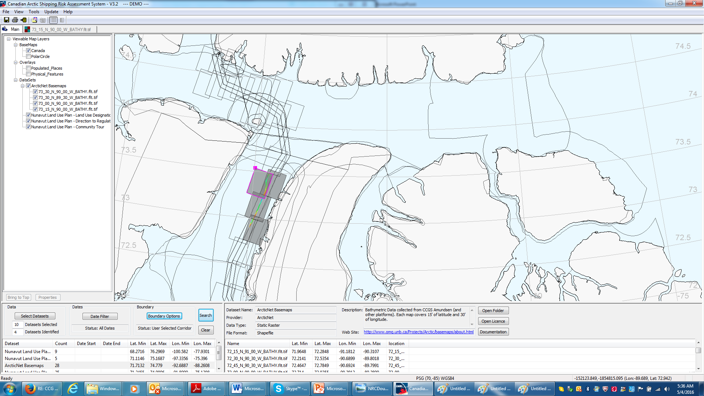
Bathymetry
ArcticNet Basemaps (bathymetry)

Slide 41
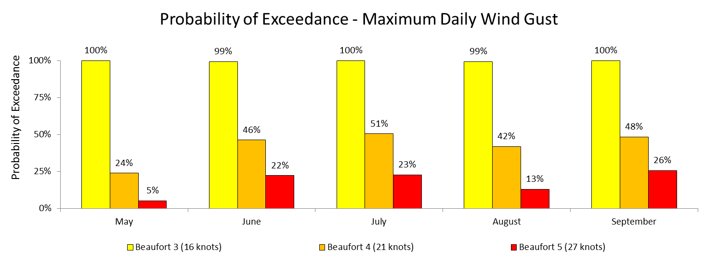
Maximum Daily Wind Gust
Period 2003-2013; Arctic Bay weather station
Notes:
n = 429 measured values over 10 years (2003-2013, only 5 months each year considered from each year.

Slide 42
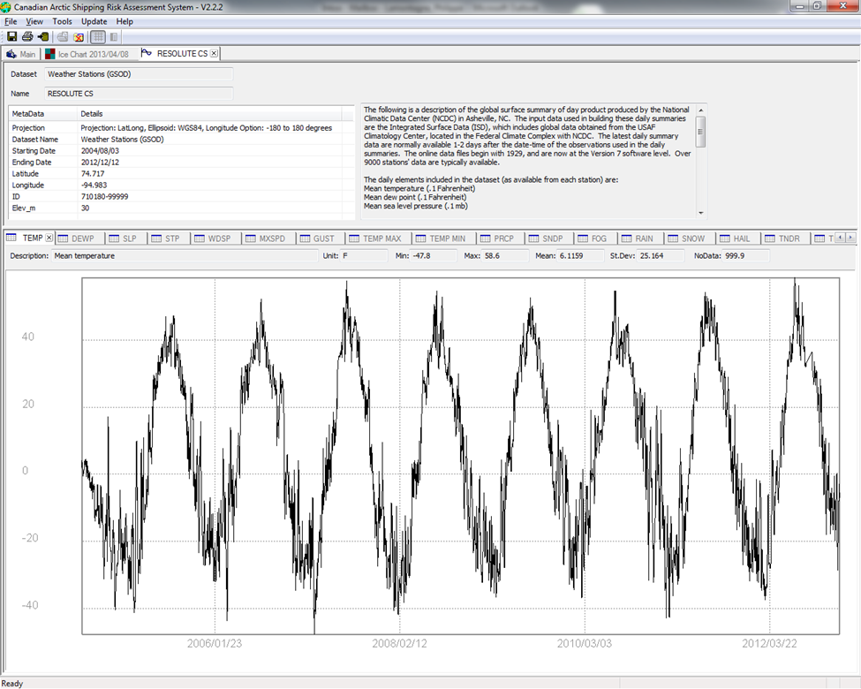
Time-Varying Data Sets (wind, tides, fog, snow…)

Slide 43
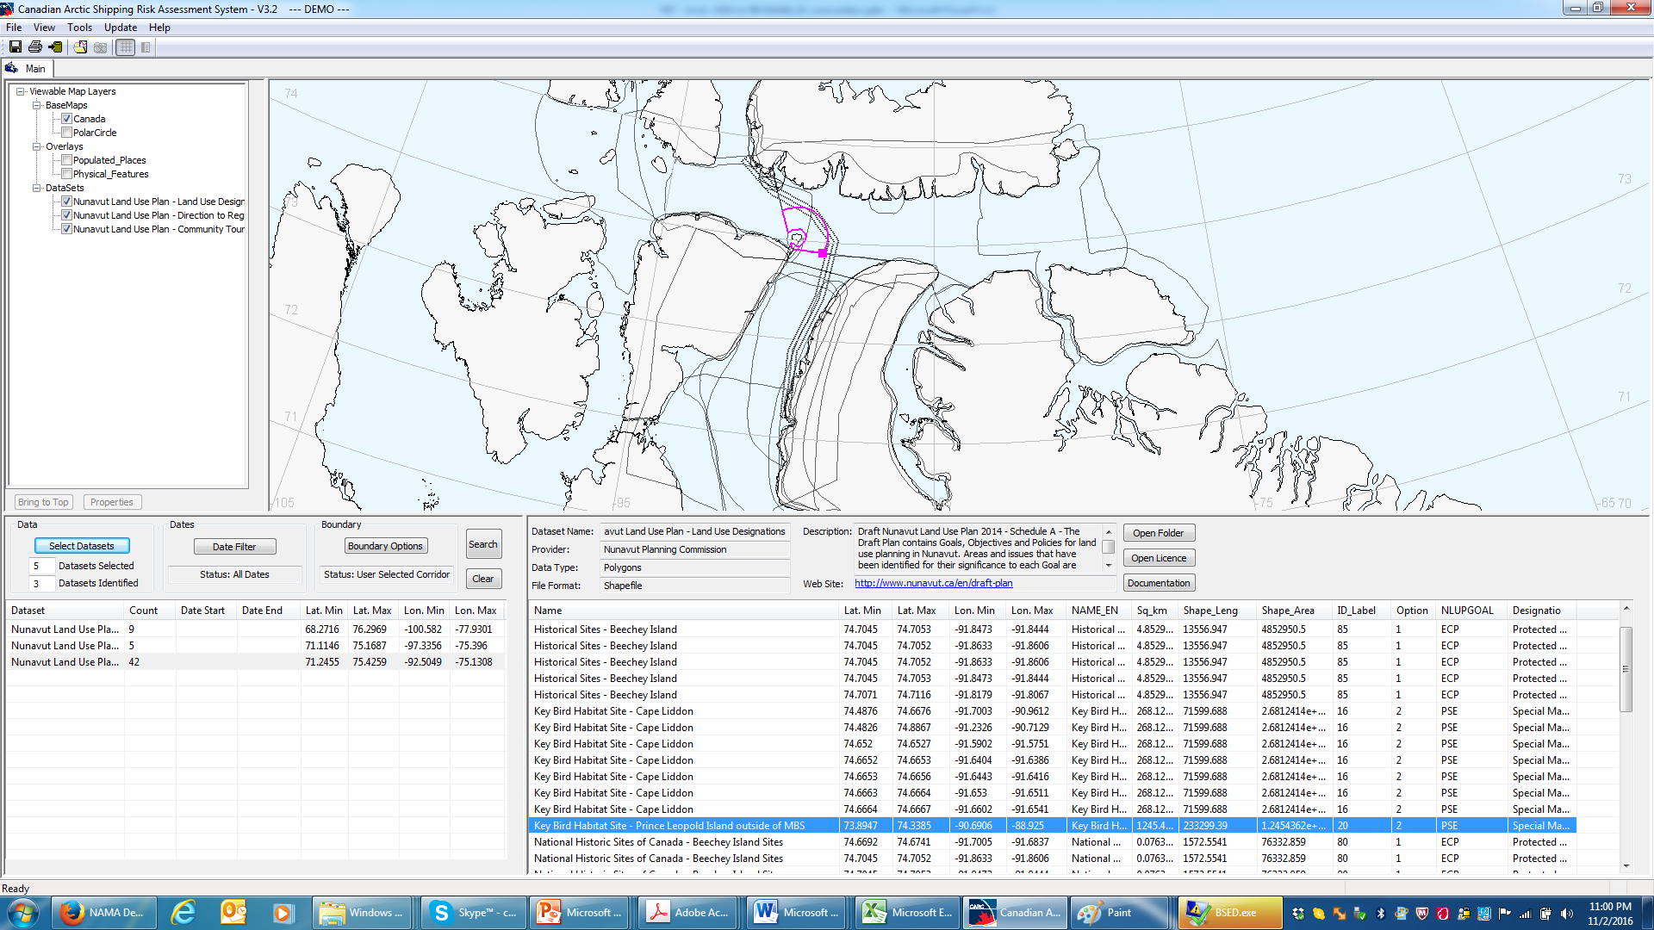
Nunavut Land Use Plan
Key Bird Habitat Site – Prince Leopold Island outside of MBS
(Migratory Bird Sanctuaries)

Slide 44
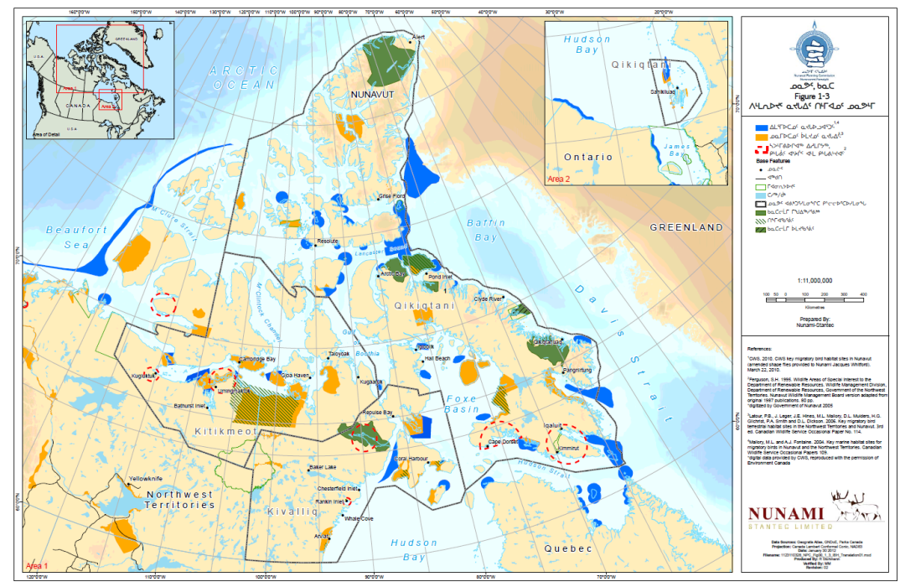
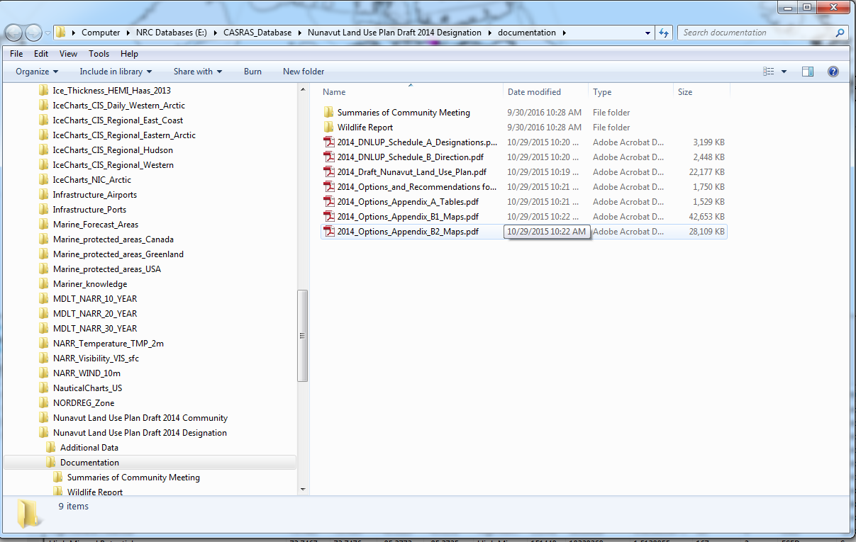
Land Use Plan – Documentation

Slide 45
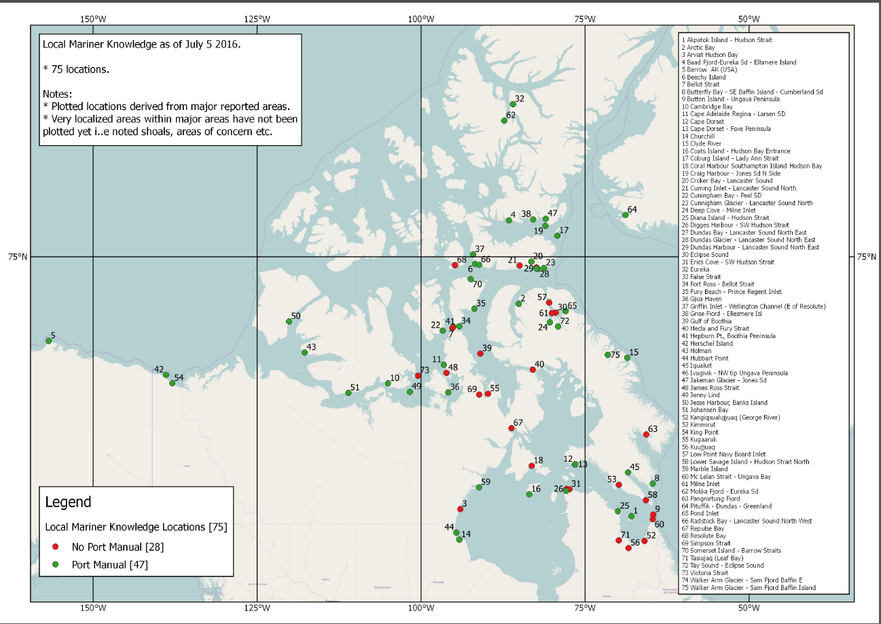
Mariners Knowledge (knowledge transfer)

Slide 46
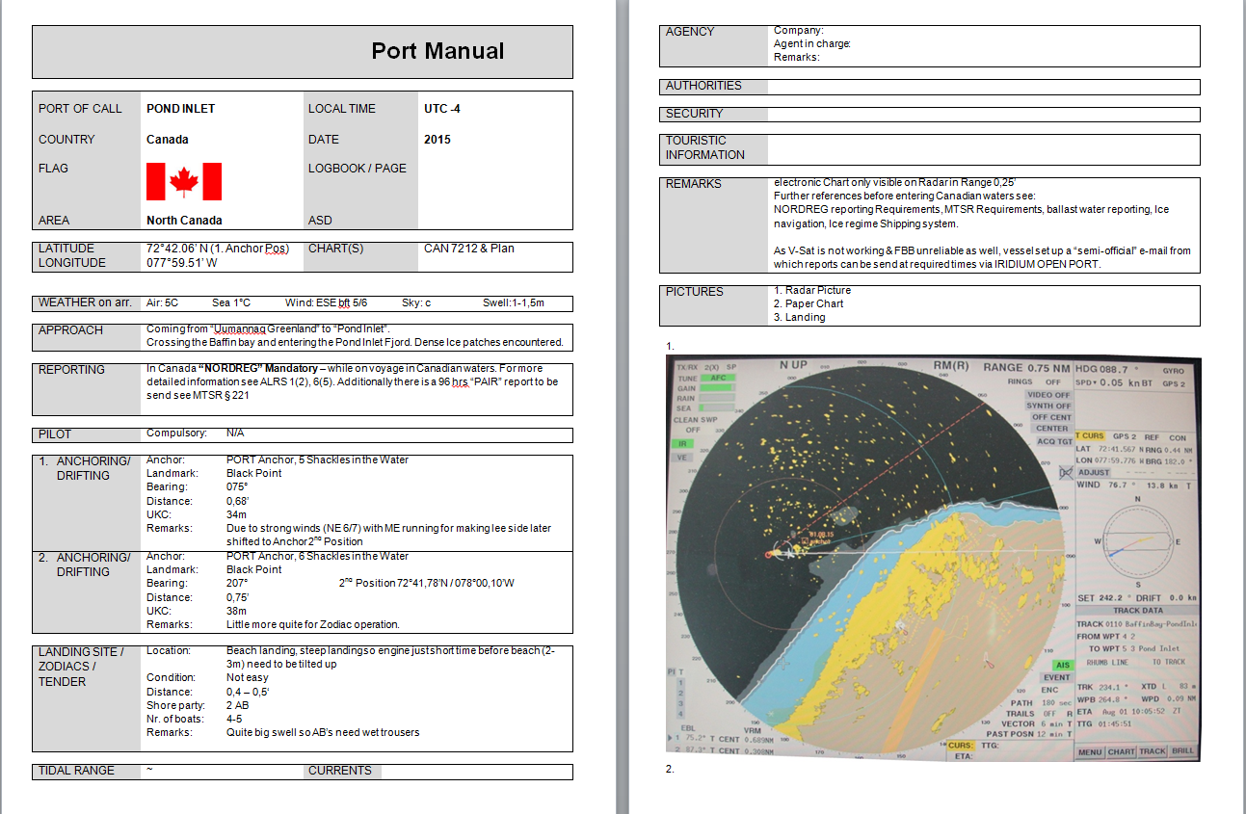
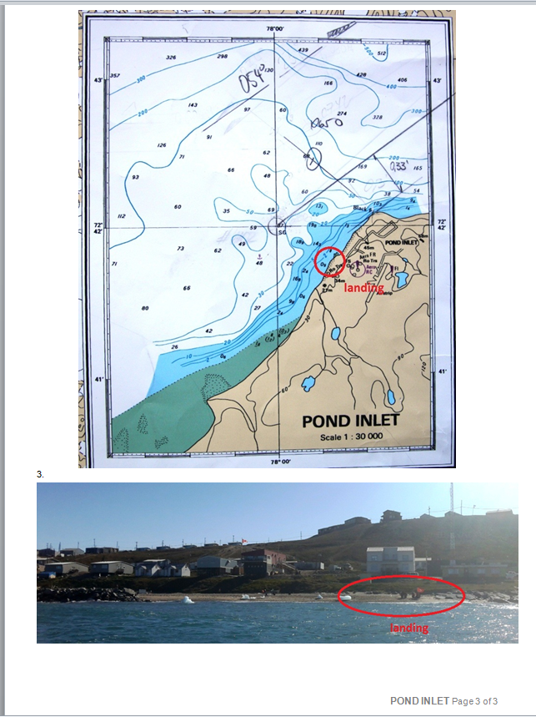
Mariner and Local Knowledge - Port Manuals and Approach Details

Slide 47
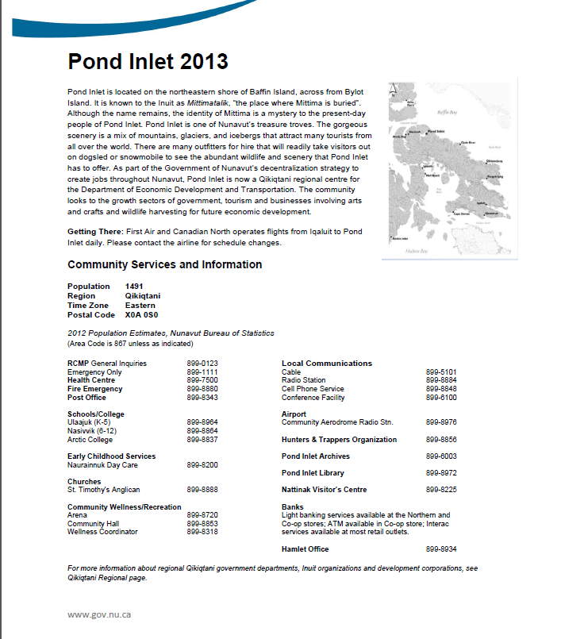
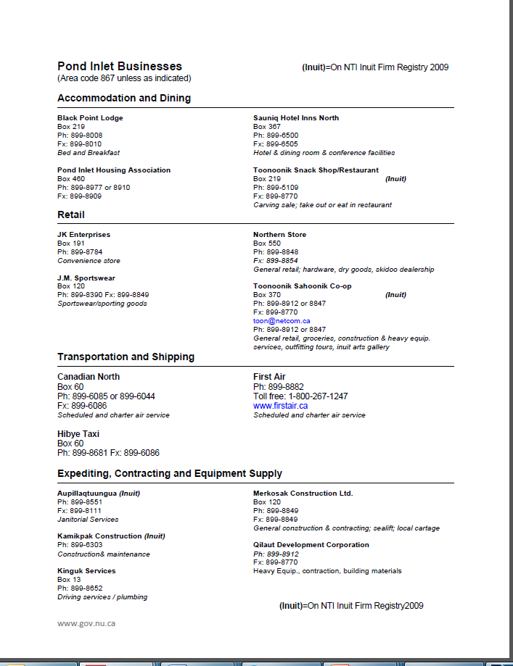
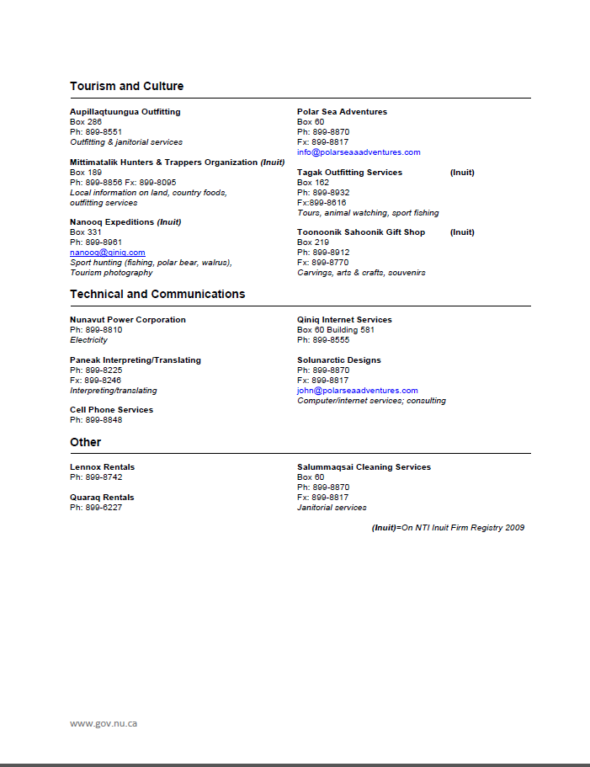
Mariner and Local Knowledge - Community Information and Available Services

Slide 48
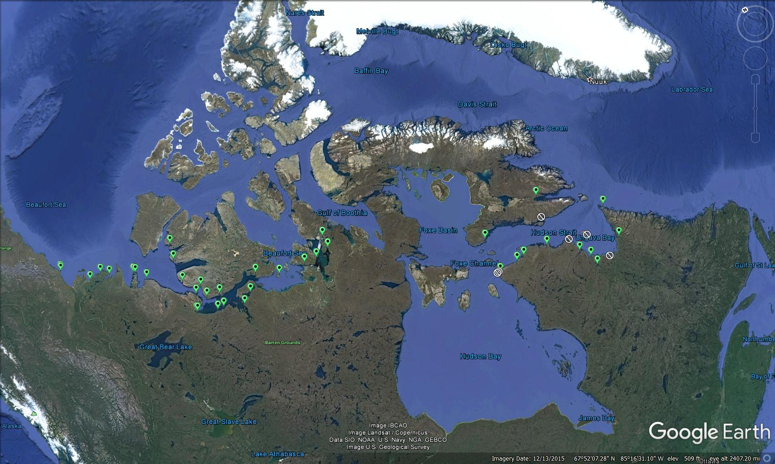
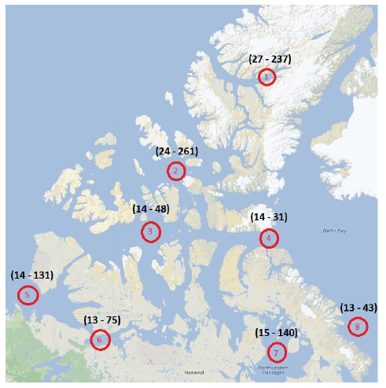
Mariner and Local Knowledge - Places of Refuge
Safe harbours and ports suitable for shelter in the event of an emergency (e.g. storms, spills or SAR)
Detailed site description in accordance with Transport Canada guidelines
Vetted by experienced Arctic Captains

Slide 49
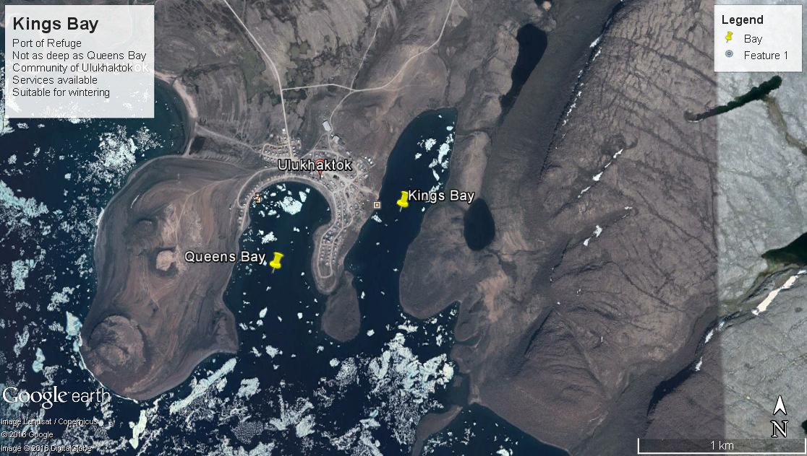
Places of Refuge
Accessible information on ice conditions, weather, tides, hydrographic charts, and more
Allows mariners to assess risks to communities, environment, and the vessel

Slide 50
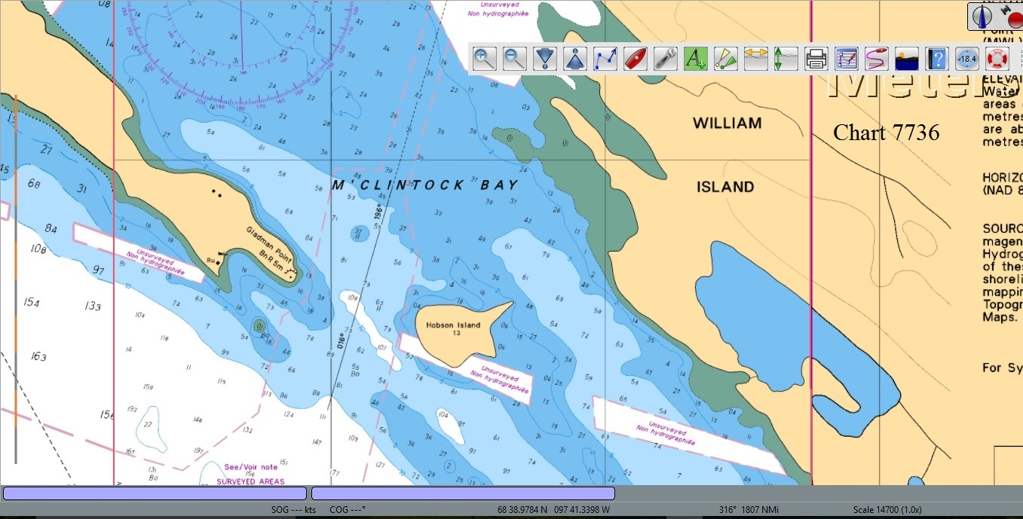
Places of Refuge: detailed info (e.g. photographs, charts)
Chart 7736 – M’Clintock Bay

Slide 51
Marine Safety - Evaluating Exposure Time until Recovery by Location
Notes:
NRC data collection
Longer distances / times until rescue (hours)
Extreme environments

Slide 52

Canada C3 Expedition Example

Slide 53

Canada C3 Expedition - Leg 9

Slide 54

Canada C3 Expedition - Leg 9

Slide 55

Canada C3 Expedition - Leg 9

Slide 56

Canada C3 Expedition - Leg 9

Slide 57


Canada C3 Expedition - Leg 9: “Today’s Ice Chart”
Western Arctic
Ice Concentration – August 25th 2014
Eastern Arctic

Slide 58
Canada C3 Expedition - Leg 9: “Today’s Ice Chart”
Western Arctic
Ice Concentration – August 25th 2014
Eastern Arctic

Slide 59

Canada C3 Expedition - Leg 9: Today’s Ice Chart analysis
route
Ice Concentration – August 25th 2014

Slide 60

Canada C3 Expedition - Leg 9
Stage of Development – August 25th 2014

Slide 61

Canada C3 Expedition - Leg 9
Old Ice concentration – August 25th 2014

Slide 62

Canada C3 Expedition - Leg 9: AIRSS
Ice Numeral Type B – August 25th 2014

Slide 63

Canada C3 Expedition- Leg 9: AIRSS
Ice Numeral Type A – August 25th 2014

Slide 64

Canada C3 Expedition - Leg 9: AIRSS
Ice Numeral PC 5 – August 25th 2014

Slide 65

Canada C3 Expedition - Leg 9: Polaris
Polaris PC 5 – August 25th 2014

Slide 66

Canada C3 Expedition - Leg 9
Ice Numeral Type B – Navigability Analysis from 2000 to 2016

Slide 67

Canada C3 Expedition - Leg 9
Polar Service Temperature Required

Slide 68

CASRAS
An integrated database and risk assessment system for marine transportation in the Canadian North:
enabling sound decision-making
leading to safer, more efficient shipping in this harsh environment
decreasing the risk of polluting the environment
ensuring minimal impact on the life of Northerners
Scientific data + community input + engineering applications = sound design, planning and operations

Slide 69
CASRAS Development Team
NRC: Lawrence Charlebois, Richard Burcher, Ivana Kubat, Philippe Lamontagne, Dave Watson and other subject matter experts
Contractor: James Reid
CCG and industry Captains: John Broderick, Terry Camsell, Dave Fowler, Ray Pierce, Mark Taylor
Input from shipping industry: Fednav/Enfotec, Groupe Desgagnes/ PetroNav, NEAS, industry captains
Input from government: INAC, CCG, CHS, EC and CIS, TC, Government of Nunavut

Slide 70
CASRAS Contacts
Thank you
Project Manager: Ivana Kubat
1-613-993-7695
ivana.kubat@nrc-cnrc.gc.ca
Program Leader: Anne Barker
1-613-990-2511
Anne.barker@nrc-cnrc.gc.ca

