Slide 1
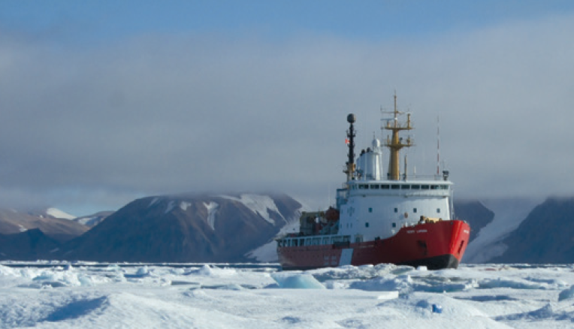
Arctic Marine Infrastructure: R&D to Support Design and Operations by Mitigating Hazards and Lowering Risks
Anne Barker
National Research Council of Canada

Slide 2
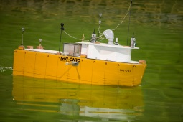
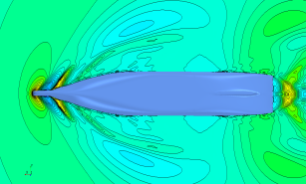
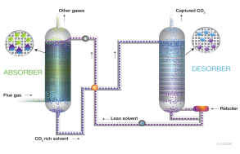
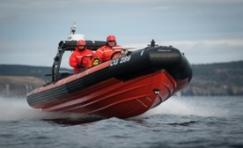
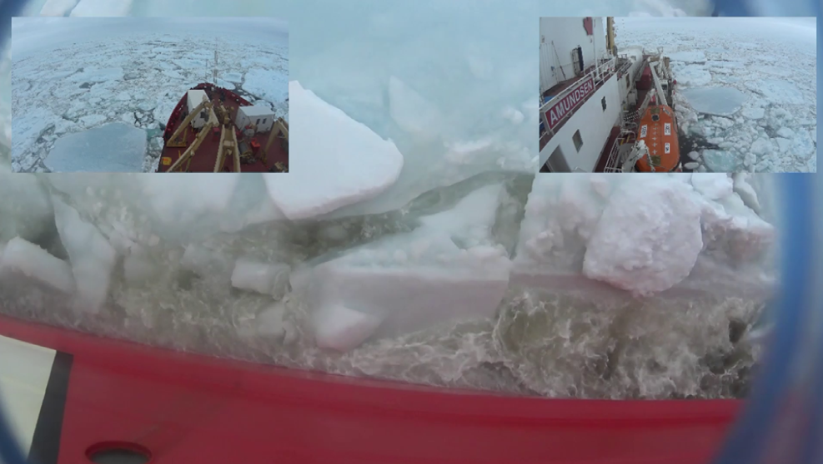
Marine Vessels

Slide 3
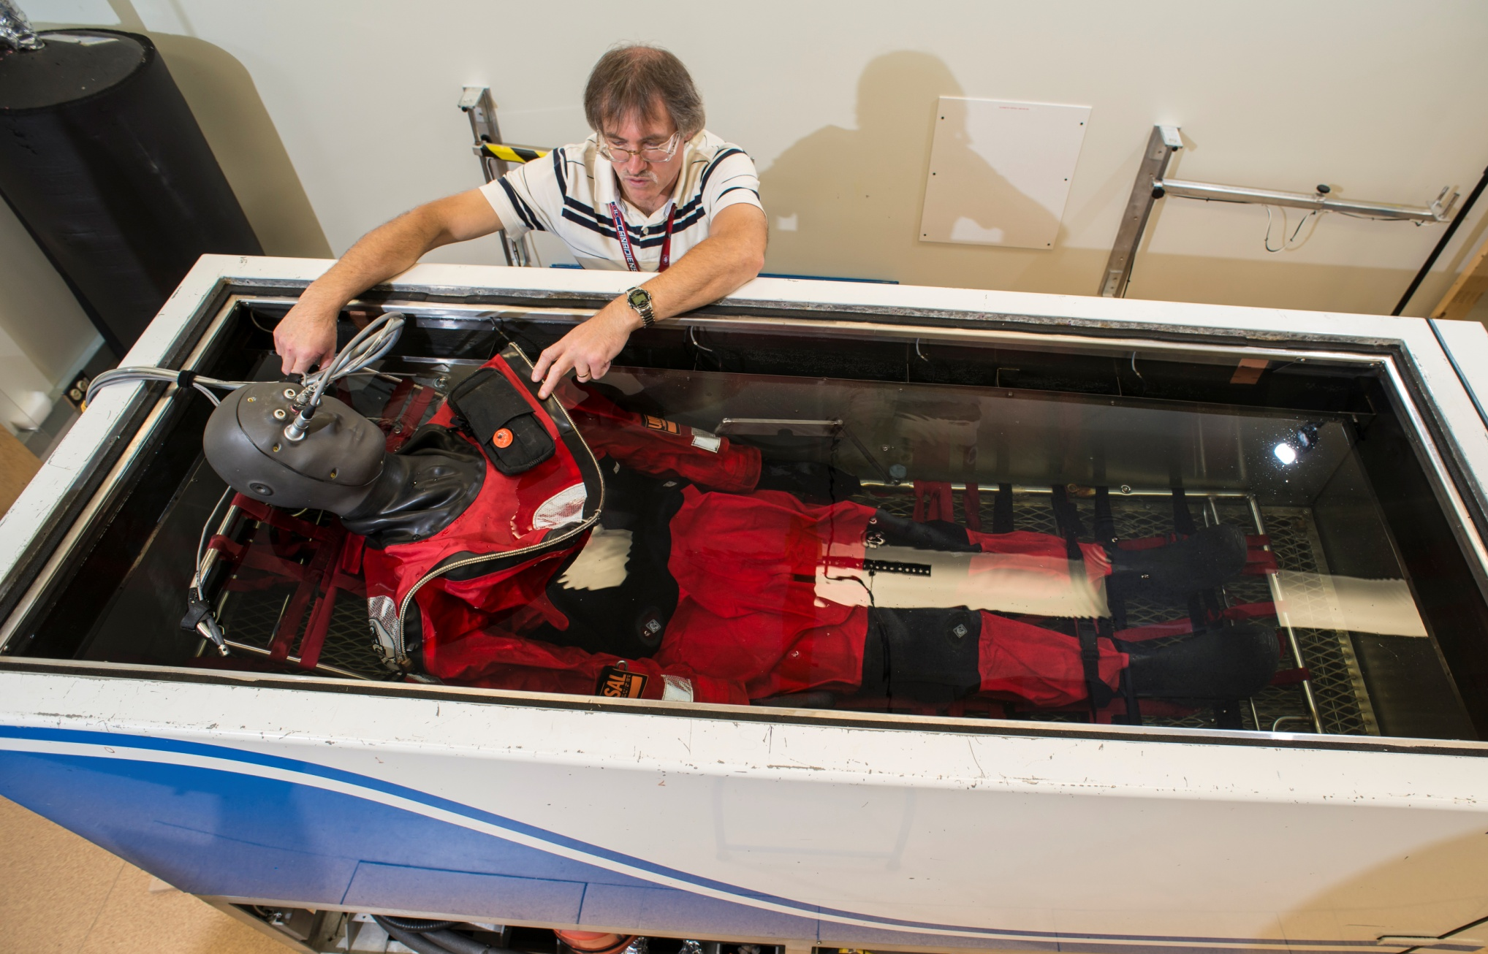
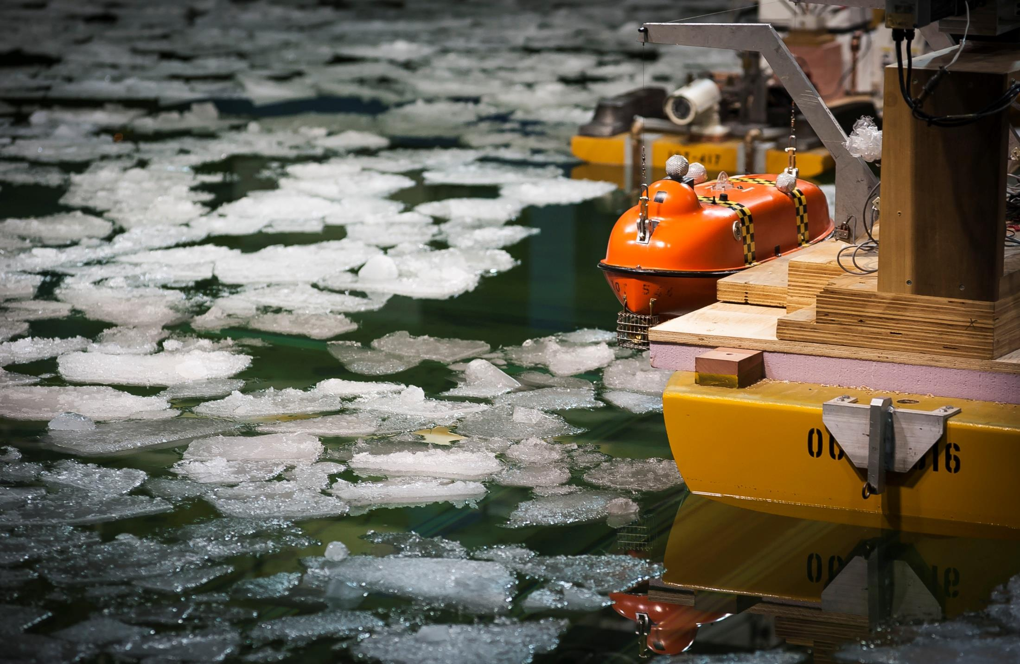
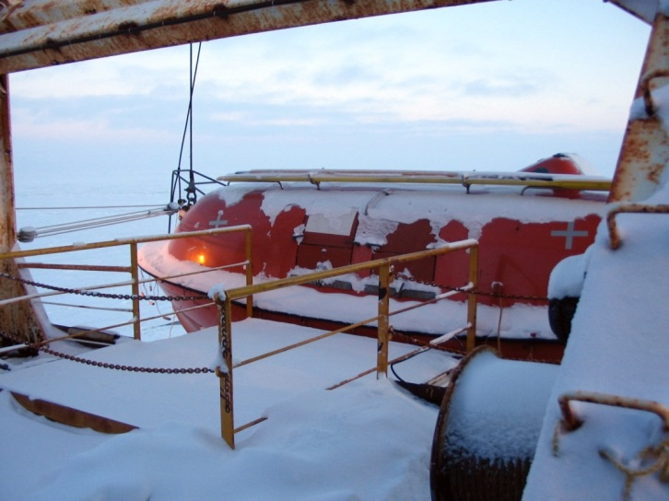
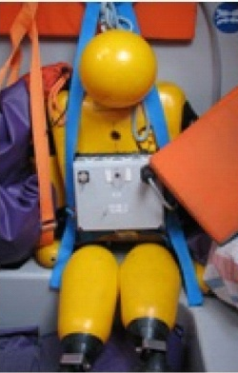
Infrastructure Supporting SAR: Life Saving Appliances and PPE

Slide 4
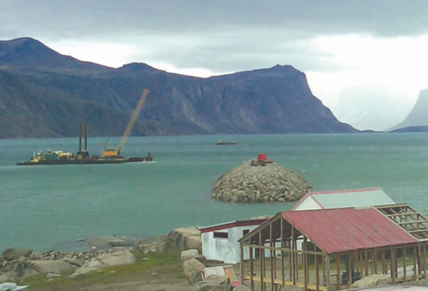
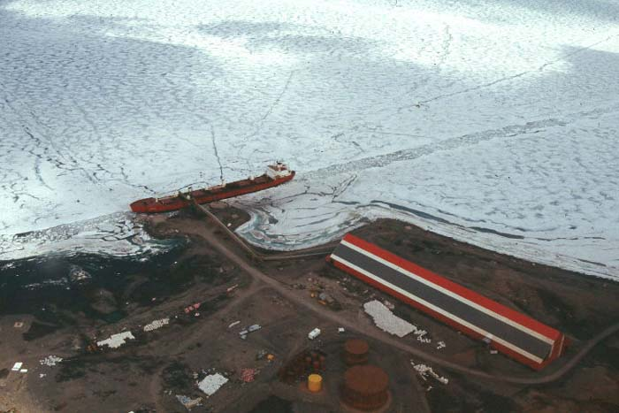
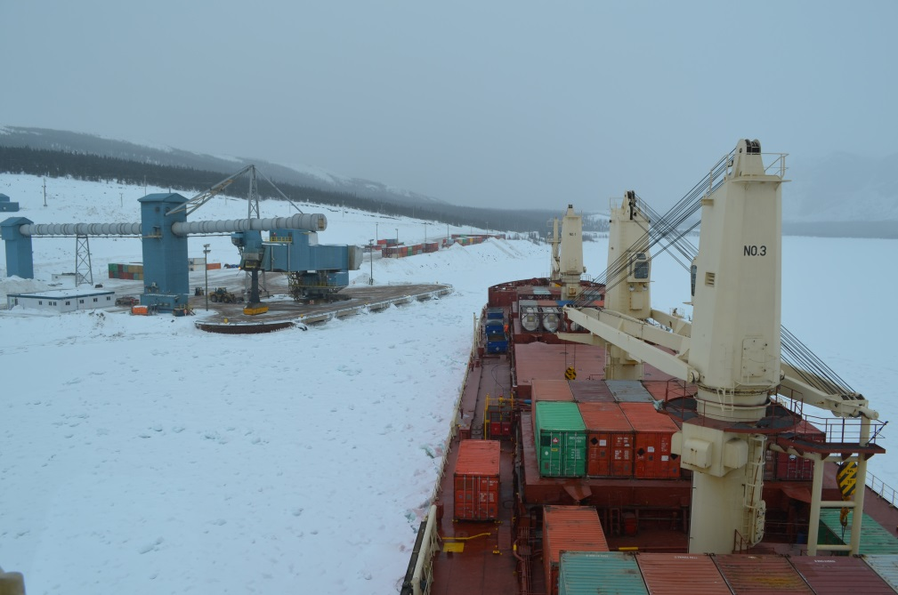
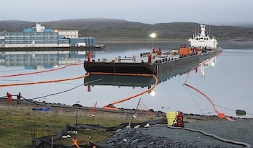
Port and Harbour Infrastructure
Photo: DFO
Photo: Victor M Santos-Pedro (Transport Canada)
Photo: NRC
Photo:Newmont
Notes:
Assessment and mitigation of coastal hazards, including climate change impacts
Developing improved numerical modelling tools and capabilities to predict coastal processes and the impacts of waves and tides on ports, ships, coastal and ocean structures. Improving methods for simulating realistic coastal and ocean environments in lab test facilities and collecting and analyzing information from lab experiments and the ocean.
Working closely with technology developers to test, prove and improve the performance of wave and hydroki- netic energy converters and supporting systems (moorings, deployment and retrieval operations)
Applied research to assess the hazards threatening shorelines, coastal communities and coastal infrastructure due to tsunami, sea level rise and increasing storminess, and develop and prove practical methods to mitigate impacts and improve resiliency.
Application of sophisticated numerical and physical modelling technologies to assess the performance of planned infrastructure developments in harsh storm conditions prior to construction, and also develop and validate optimizations to improve performance, durability, sustainability and reduce lifecycle costs.
Performance of wave, tidal and marine hydrokinetic energy systems
Assessment, modelling and optimization supporting infrastructure development
Improving underlying numerical and physical modelling technologies
Research to model, quantify and map renewable energy resources due to ocean waves, tides and river currents, and support the development of marine renewable energy technology demonstrations and projects.
Marine energy resource modelling, assessment and mapping

Slide 5
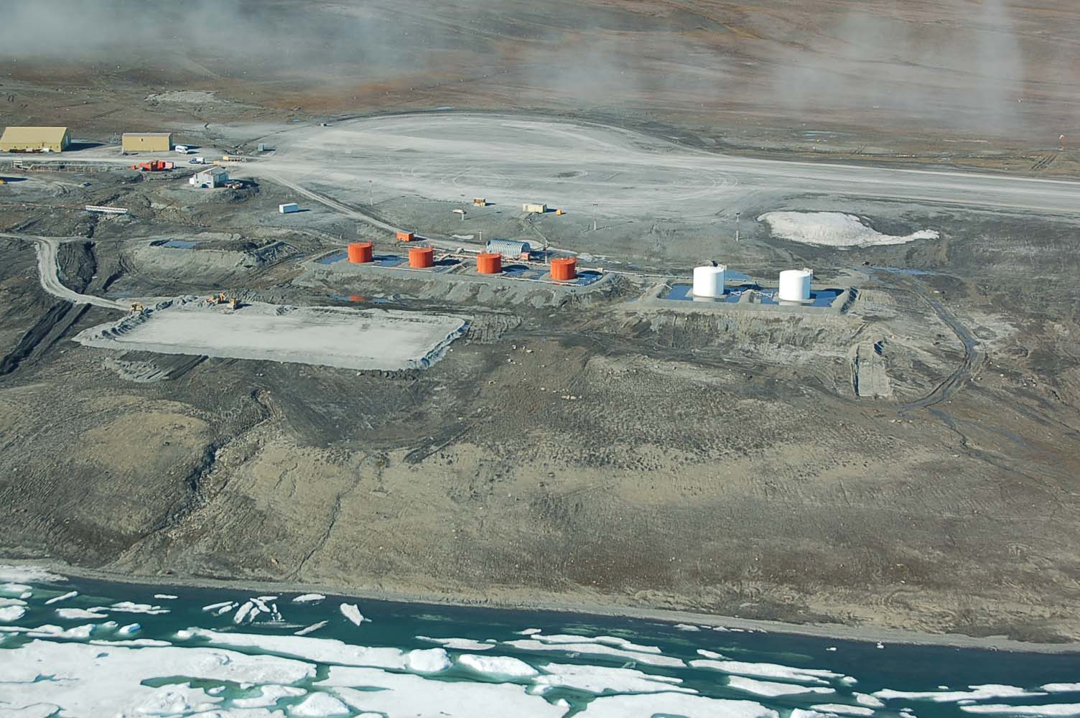
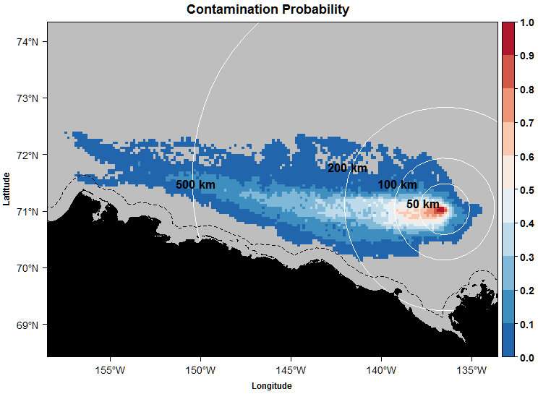
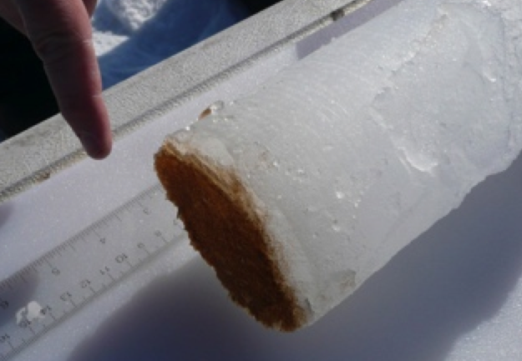
Oil Spill Response Infrastructure

Slide 6
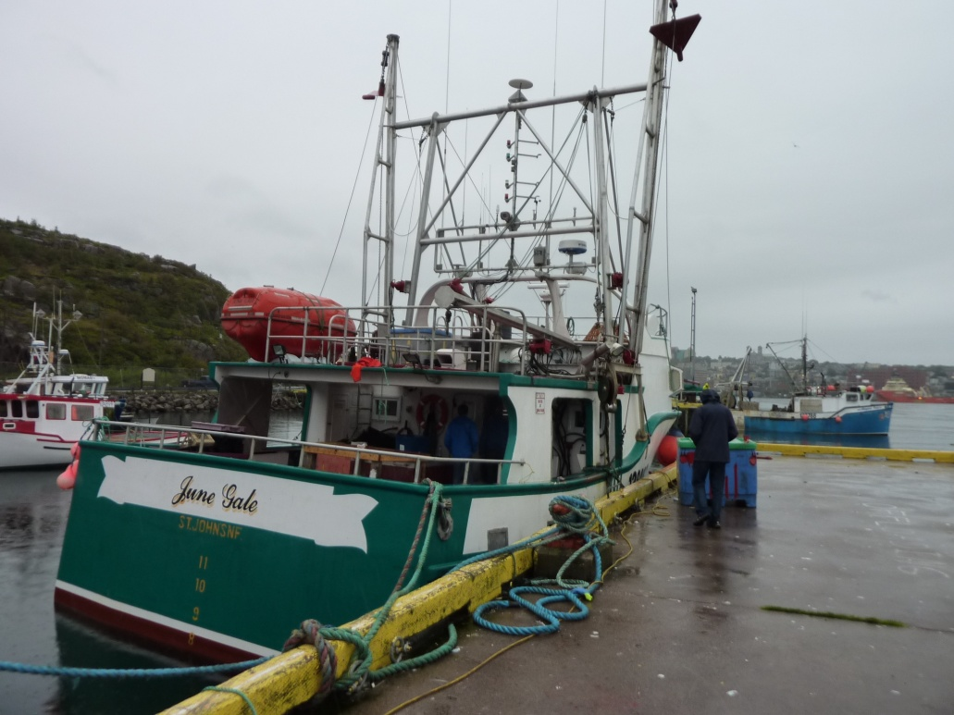
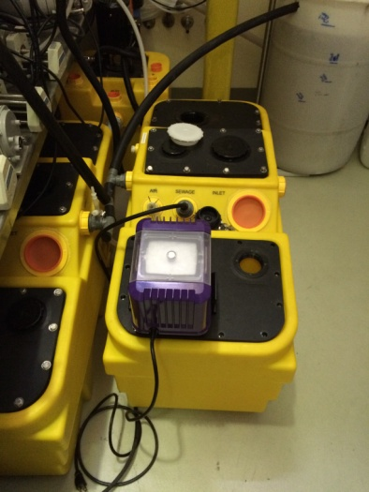
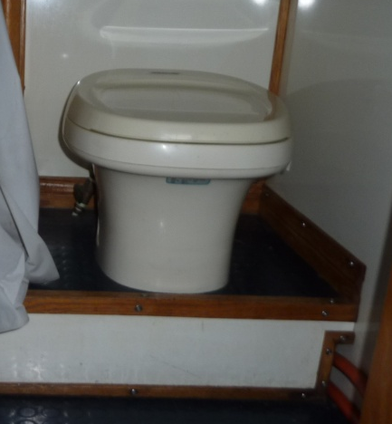
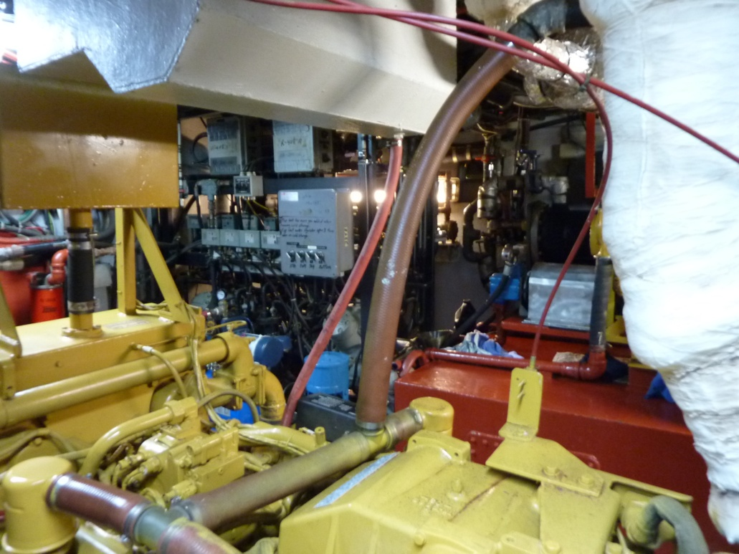
Sewage and Waste Treatment Infrastructure

Slide 7
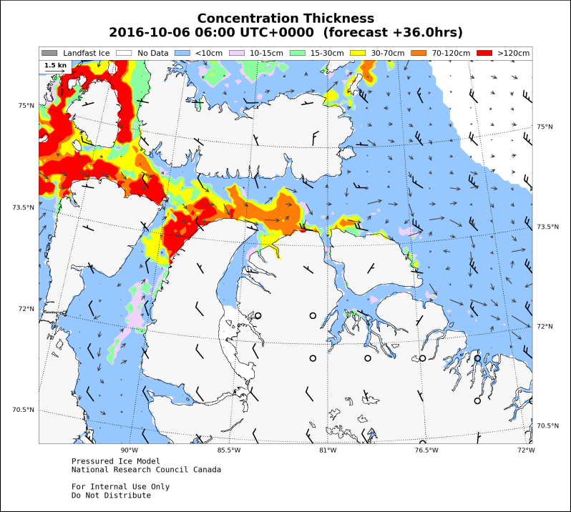
Forecasting and Community-Based Monitoring Infrastructure

Slide 8
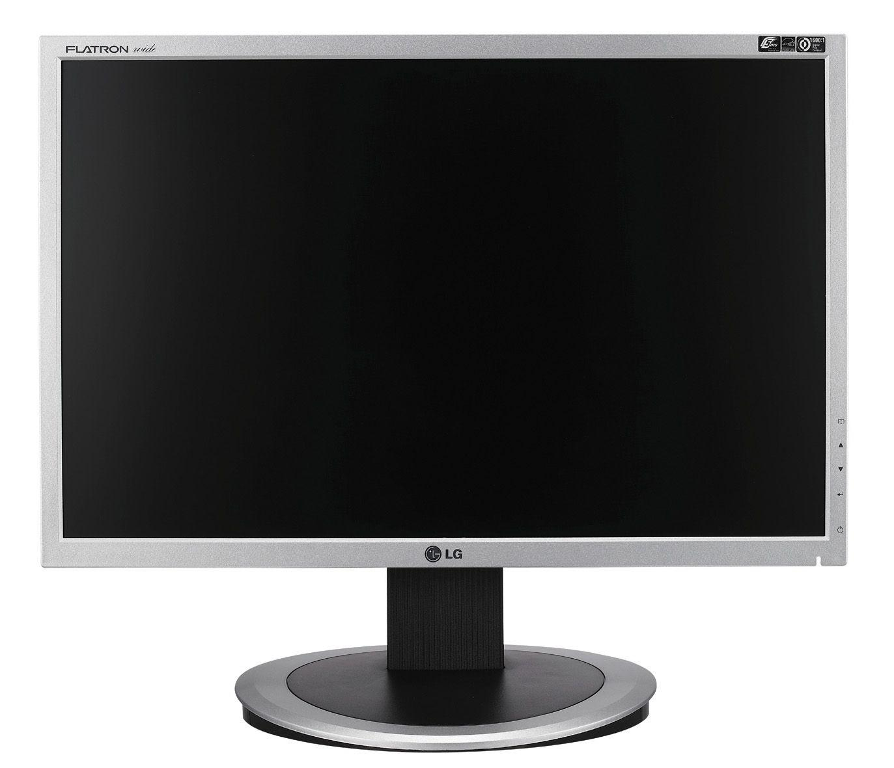
Other Types of Infrastructure: IT, Remote Sensing, Energy, Fuel Re-Supply, Roads, Gravel Runways, Buildings…
Sorry – no service

Slide 9

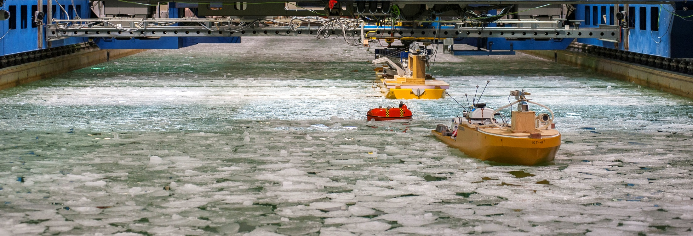
Thank you
www.nrc.gc.ca
Andrew Cornett, Marine Infrastructure Program Leader
Telephone: 1-613-993-6690 email: andrew.cornett@nrc-cnrc.gc.ca
Fraser Winsor, Marine Vehicles Program Leader Telephone: 1-709-772-2582 email: fraser.winsor@nrc-cnrc.gc.ca
Anne Barker, Arctic Program Leader Telephone: 1-613-990-2511 email: anne.barker@nrc-cnrc.gc.ca
9

