Slide 1

The Interagency Arctic Research Policy Committee
& The Arctic Executive Steering Committee:
Marine & Maritime Issues
Martin O. Jeffries, Ph.D.
Assistant Director for Polar Sciences,
Office of Science and Technology Policy
& Executive Director, Interagency Arctic Research Policy Committee
Symposium on the Impacts of an Ice-diminishing Arctic on Naval and Maritime Operations
Washington, DC, 18-20 July 2017

Slide 2

NATIONAL SECURITY PRESIDENTIAL DIRECTIVE/NSPD-66
HOMELAND SECURITY PRESIDENTIAL DIRECTIVE/HSPD-25
DATE: 9 January 2009
SUBJECT: Arctic Region Policy
II. BACKGROUND
A. The United States is an Arctic nation, with varied and compelling interests in that region.
III. POLICY
A. It is the policy of the United States to:
This space deliberately left blank.
Notes:
The Office of Science and Technology Policy, or OSTP, was established by Congress in 1976 with a broad mandate to:
Advise the President and others within the Executive Office of the President on the effects of science and technology on domestic and international affairs
Lead interagency efforts to develop and implement sound science and technology policies and budgets
Work with the private sector, state and local governments, the science and higher education communities, and other nations toward this end
For the past six years, OSTP has had the privilege of supporting a President who truly loves and understands the value of science and technology – both as a key component of good governance and in its own right.

Slide 3
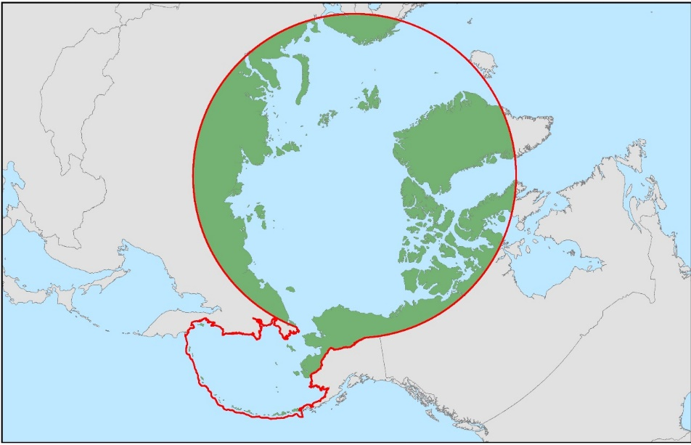
The United States is an Arctic Nation
Defining the Arctic
The Legislated Arctic
  Arctic Research and Policy Act (1984)
The Arctic Circle
Temperature
July Mean T<10°C
Arctic Treeline
Arctic Watershed
Iceland
Russian Federation
Greenland
Arctic
Ocean
Prudhoe Bay
Canada
Alaska
(U.S.A.)
“The Lower 48”
3

Slide 4
NATIONAL SECURITY PRESIDENTIAL DIRECTIVE/NSPD-66
HOMELAND SECURITY PRESIDENTIAL DIRECTIVE/HSPD-25
DATE: 9 January 2009
SUBJECT: Arctic Region Policy
II. BACKGROUND
A. The United States is an Arctic nation, with varied and compelling interests in that region.
III. POLICY
A. It is the policy of the United States to:
Meet national security and homeland security needs relevant to the Arctic region;
Protect the Arctic environment and conserve its biological resources;
Ensure that natural resource management and economic development in the region are environmentally sustainable;
Strengthen institutions for cooperation among the eight Arctic nations (the Arctic Council);
Involve the Arctic's indigenous communities in decisions that affect them; and
Enhance scientific monitoring and research into local, regional, and global environmental issues.
The full text (10 pages) is available at:
https://www.nsf.gov/geo/opp/opp_advisory/briefings/may2009/nspd66_hspd25.pdf
Notes:
The Office of Science and Technology Policy, or OSTP, was established by Congress in 1976 with a broad mandate to:
Advise the President and others within the Executive Office of the President on the effects of science and technology on domestic and international affairs
Lead interagency efforts to develop and implement sound science and technology policies and budgets
Work with the private sector, state and local governments, the science and higher education communities, and other nations toward this end
For the past six years, OSTP has had the privilege of supporting a President who truly loves and understands the value of science and technology – both as a key component of good governance and in its own right.

Slide 5
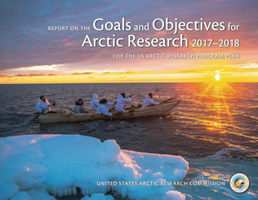
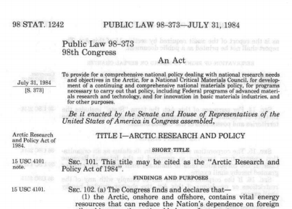
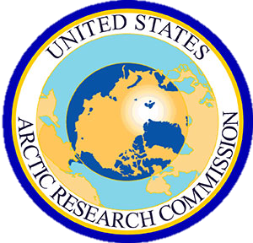

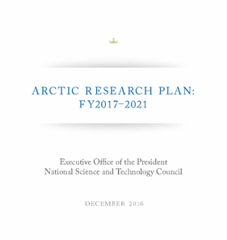
Arctic Research
& Policy Act, 1984
USARC
develops and recommends an integrated Arctic research policy
IARPC
IARPC
develops a 5-year plan to implement Arctic research policy
USARC: U.S. Arctic Research Commission
Chair: Fran Ulmer
IARPC: Interagency Arctic Research
Policy Committee
Chair: Dr. France Còrdova, NSF
Consult with the State of Alaska, Arctic residents, the private sector, and public interest groups.
5

Slide 6
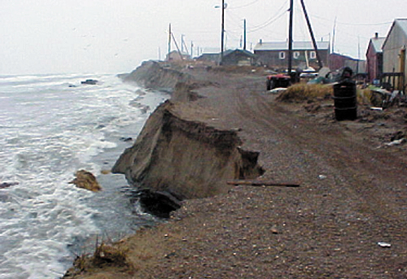
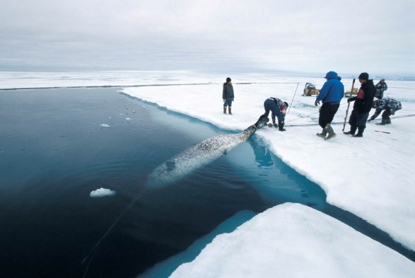
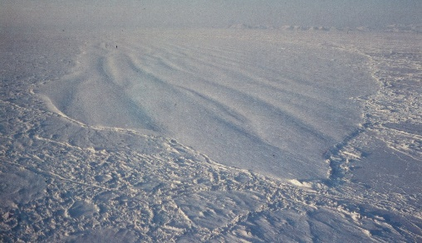
Arctic Research Plan 2017-2021
Goals (by topic)
Human Health and Well-being
Atmosphere
Sea Ice
Marine Ecosystems
Glaciers, Ice Caps and the Greenland Ice Sheet
Permafrost
Terrestrial and Freshwater Ecosystems
Coastal Community Resilience
Environmental Intelligence
(Observations, Data Management, Modeling)
Shishmaref, AK
Arctic Domain Awareness
Weather, Water & Sea Ice Forecasting
Decision Support
Hobson’s Choice Ice Island
Arctic Research Plan 2017-2021 is available at:
https://www.nsf.gov/geo/opp/opp_advisory/briefings/may2009/nspd66_hspd25.pdf

Slide 7
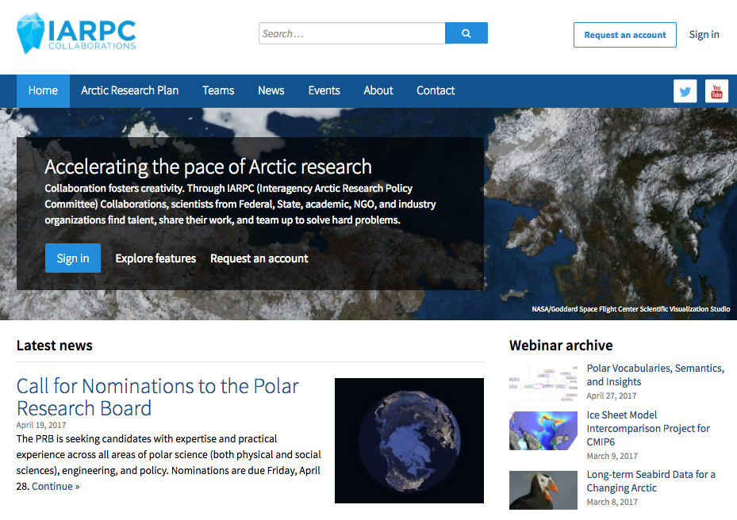
IARPC Collaborations
Join here
www.iarpccollaborations.org
7

Slide 8
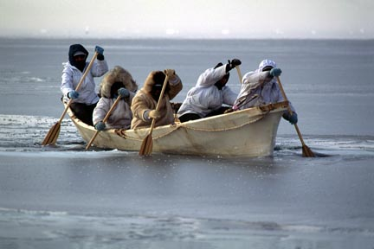
Arctic Executive Steering Committee
Created in January 2015, the Arctic Executive Steering Committee (AESC) provides guidance to executive departments and agencies, and enhances coordination of Federal Arctic policies across agencies and offices, and, where applicable, with State, local, and Alaska Native tribal governments and similar Alaska Native organizations, academic and research institutions, and the private and non-profit sectors.
The AESC provides guidance and coordinates efforts to implement the priorities, objectives, activities, and responsibilities identified in:
National Security Presidential Directive 66/Homeland Security Presidential Directive 25, Arctic Region Policy;
the National Strategy for the Arctic Region (NSAR) and its Implementation Plan; and
related agency plans.
1. Chair: Director of OSTP
2. Vice Chair: Assistant to the President
for National Security Affairs
3. Executive Officer
Working Groups:
Alaska Natives
Community Resilience
Energy
Arctic Digital Elevation Model
Arctic Science Ministerial
8

Slide 9
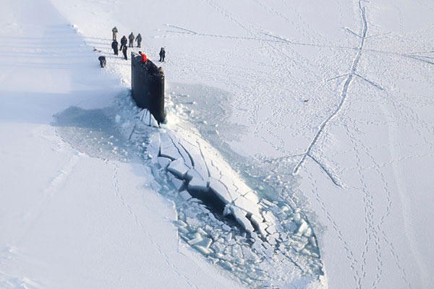
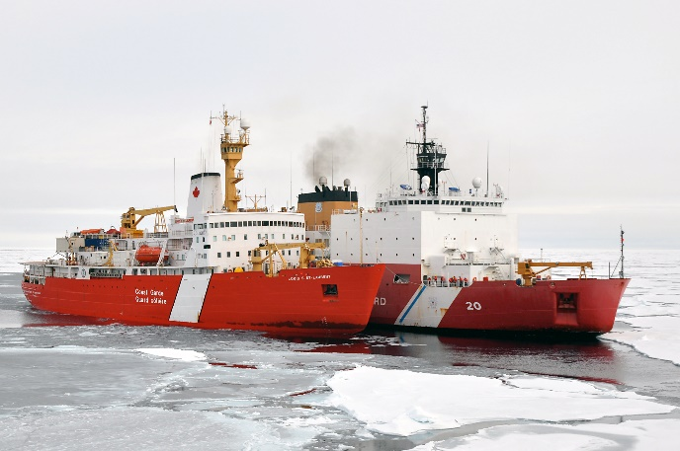
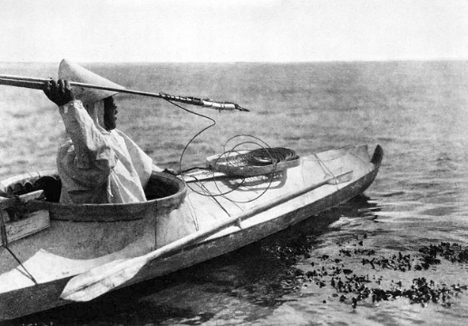
National Strategy for the Arctic Region
Released in May 2013, the National Strategy for the Arctic Region (NSAR) has three lines of effort:
Advance United States Security Interests;
Pursue Responsible Arctic Region Stewardship; and
Strengthen International Cooperation.
USS Hampton (SSN-767)
CCGC Louis S. St. Laurent & USCGC Healy
The NSAR has four guiding principles:
Safeguard Peace and Stability;
Make Decisions Using the Best Available Information;
Pursue Innovative Arrangements; and
Coordinate and Consult with Alaska Natives.

Slide 10
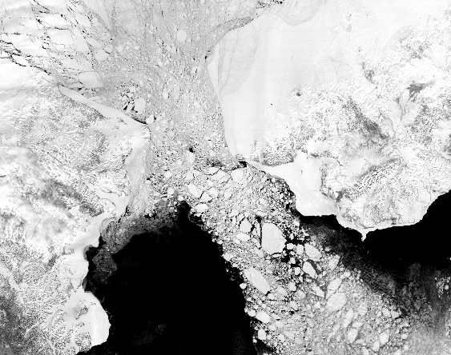
NSAR Lines of Effort & Objectives
Advance United States Security Interests
Evolve Arctic Infrastructure and Strategic Capabilities;
Enhance Arctic Domain Awareness;
Preserve Arctic Region Freedom of the Seas; and
Provide for Future United States Energy Security.
Pursue Responsible Arctic Region Stewardship
Protect the Arctic Environment and Conserve Arctic Natural Resources;
Use Integrated Arctic Management to Balance Economic Development, Environmental Protection, and Cultural Values;
Increase Understanding of the Arctic through Scientific Research and Traditional Knowledge; and
Chart the Arctic Region.
Strengthen International Cooperation
Pursue Arrangements that Promote Shared Arctic State Prosperity, Protect the Arctic Environment, and Enhance Security;
Work through the Arctic Council to Advance U.S. Interests in the Arctic Region; and
Accede to the Law of the Sea Convention.
The Bering Strait Region
7 May 2000
10

Slide 11
NSAR Lines of Effort
CMTS Arctic IAT Reports
A 10-Year Projection of Maritime Activity in the U.S. Arctic Region (2015);
A Ten-Year Prioritization of Infrastructure Needs in the U.S. Arctic (2016); and
Recommendations and Criteria for Using Federal Public-Private Partnerships to Support Critical U.S. Arctic Maritime Infrastructure (2017).
Advance United States Security Interests
Evolve Arctic Infrastructure and Strategic Capabilities;
Enhance Arctic Domain Awareness;
Preserve Arctic Region Freedom of the Seas; and
Provide for Future United States Energy Security.
Pursue Responsible Arctic Region Stewardship
Protect the Arctic Environment and Conserve Arctic Natural Resources;
Use Integrated Arctic Management to Balance Economic Development, Environmental Protection, and Cultural Values;
Increase Understanding of the Arctic through Scientific Research and Traditional Knowledge; and
Chart the Arctic Region.
Strengthen International Cooperation
Pursue Arrangements that Promote Shared Arctic State Prosperity, Protect the Arctic Environment, and Enhance Security;
Work through the Arctic Council to Advance U.S. Interests in the Arctic Region; and
Accede to the Law of the Sea Convention.
U.S.A. & The Arctic Council
Agreement on Cooperation on Aeronautical and Maritime Search and Rescue;
Agreement on Cooperation on Marine Oil Pollution Preparedness and Response in the Arctic; and
Agreement on Enhancing International Arctic Scientific Collaboration.
Dept. of Homeland Security
Arctic Domain Awareness Center (ADAC), University of Alaska Anchorage and others. Main Customer: U.S. Coast Guard.
NOAA Arctic Navigation
Airborne geodetic surveys;
Hydrographic surveys and improving nautical charts;
Tides and currents for navigation; and
Arctic Regional Hydrographic Commission.
U.S. Coast Guard
Arctic Coast Guard Forum.
11

Slide 12
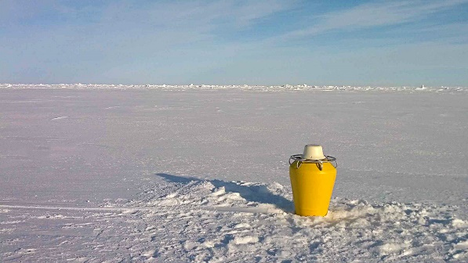
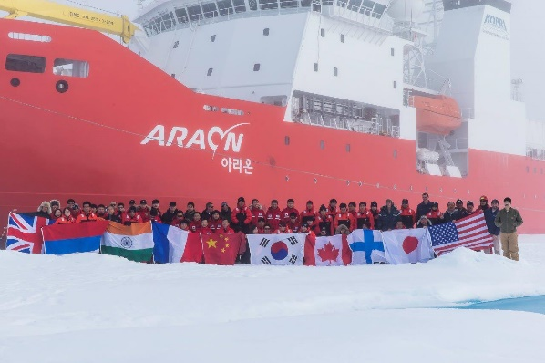
Linking the AESC & IARPC
National Strategy for the Arctic Region
Three lines of effort:
Advance United States Security Interests
Pursue Responsible Arctic Region Stewardship
Strengthen International Cooperation
Scientific research for understanding the Arctic operational environment & enhancing Arctic domain awareness
Arctic Research Plan 2017-2021
Goals:
Human Health and Well-being
Atmosphere
Sea Ice
Marine Ecosystems
Glaciers, Ice Caps and the Greenland Ice Sheet
Permafrost
Terrestrial and Freshwater Ecosystems
Coastal Community Resilience
Environmental Intelligence
(Observations, Data Management, Modeling)
Increase Understanding of the Arctic
through Scientific Research and
Traditional Knowledge
ONR Marginal Ice Zone Team
R/V Araon (Korea Polar Research Institute)
Arctic Ocean, Summer 2014
12

Slide 13
That concludes my remarks.
Thank you.
4

