Slide 1
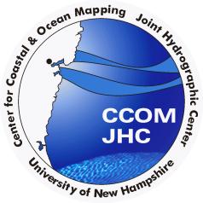


Status of ECS Activities in the Arctic
Larry Mayer
Center for Coastal and Ocean Mapping /Joint Hydrographic Center University of New Hampshire, USA
2012
1979
7th Symposium on the Impacts of an
Ice-Diminishing Arctic on Naval and Maritime Operations
Diminished Ice Arctic 18 July 2013
July 19 2017

Slide 2
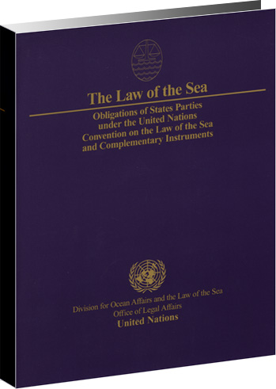
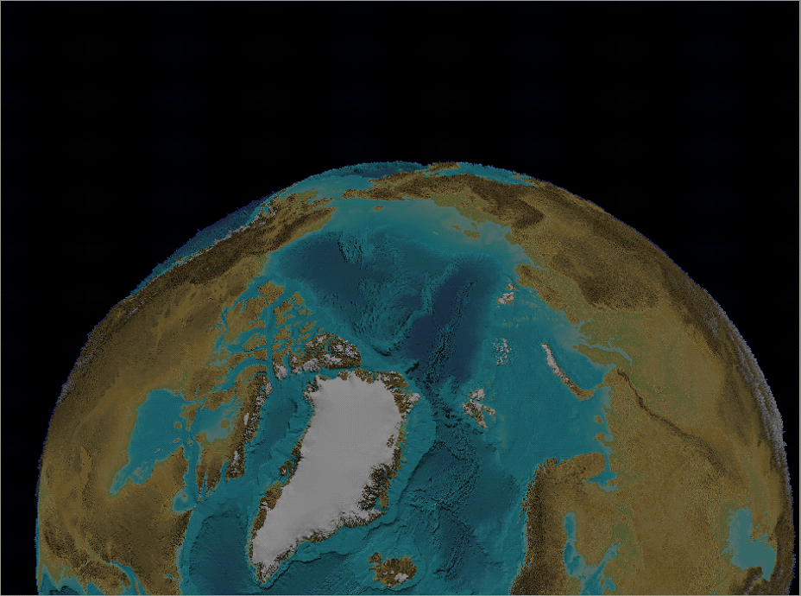
THE CONVENTION ON THE LAW OF THE SEA

Slide 3
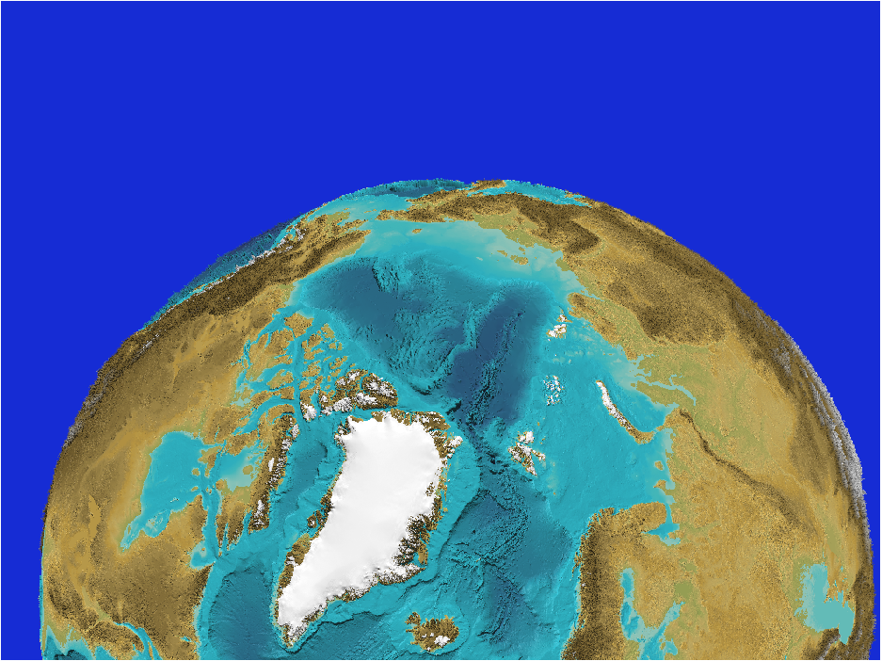
ARTICLE 76 of UNCLOS
Six hundred and seventeen words that redefine the “continental shelf” of a coastal state and provide a mechanism for the state to extend its sovereign rights over the resources of the “seabed and subsoil” of the continental shelf

Slide 4
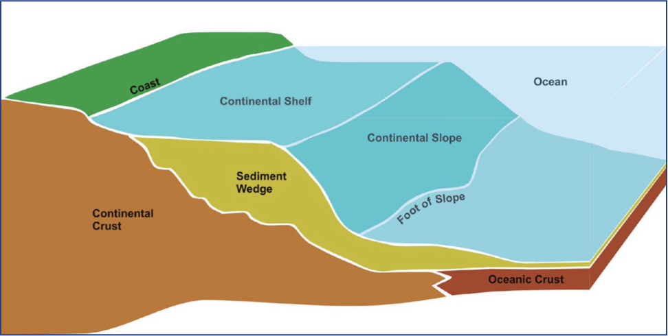

Formulae Lines:
Foot of Slope + 60 nmi - bathy
Gardiner line - sediment thickness at least 1% of distance back to FOS - seismic and bathy
200 nm EEZ
60 nm
sediment

Slide 5
Limit Lines
2500 m contour+100 nmi - bathy
350 nmi from baseline - distance
350 nm
200 nm EEZ
2500m
100 nm

Slide 6
‘EXTENDED’ CONTINENTAL SHELF
200 nm EEZ

Slide 7
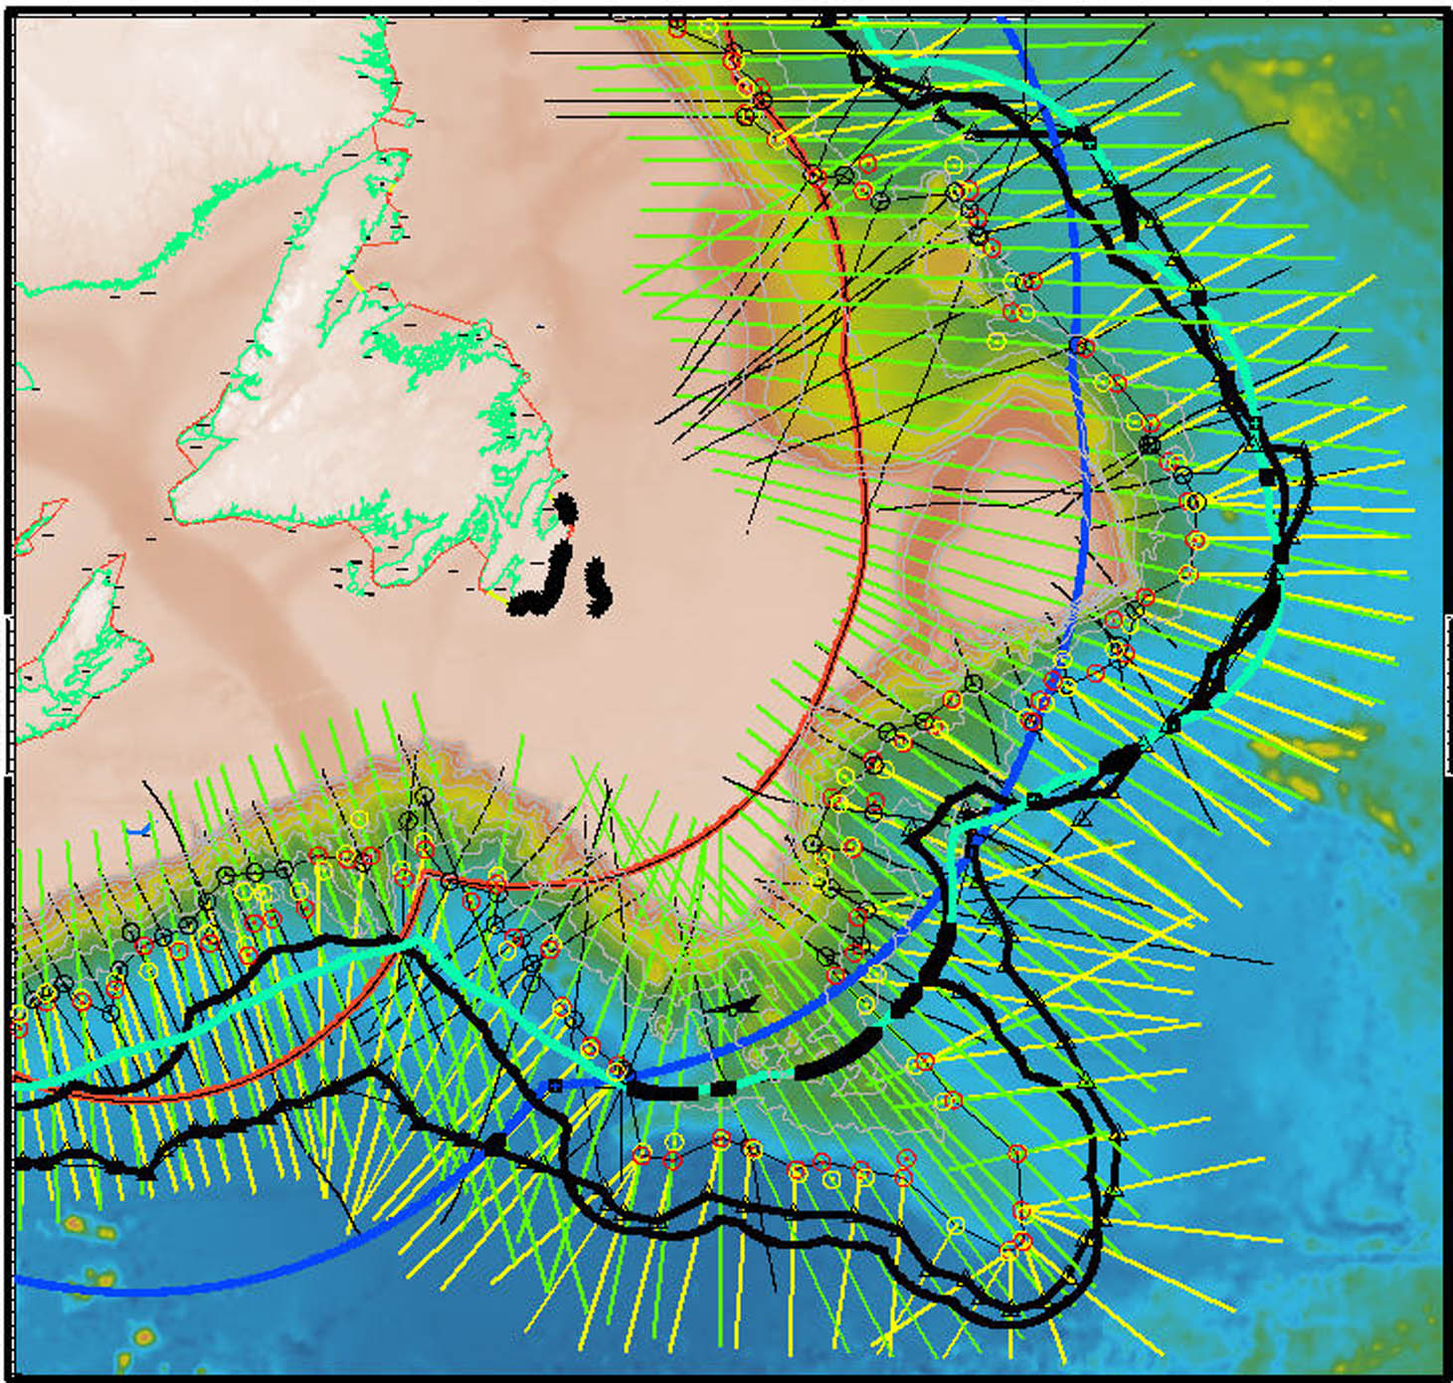
WE NEED TO MAP THE SEAFLOOR!

Slide 8
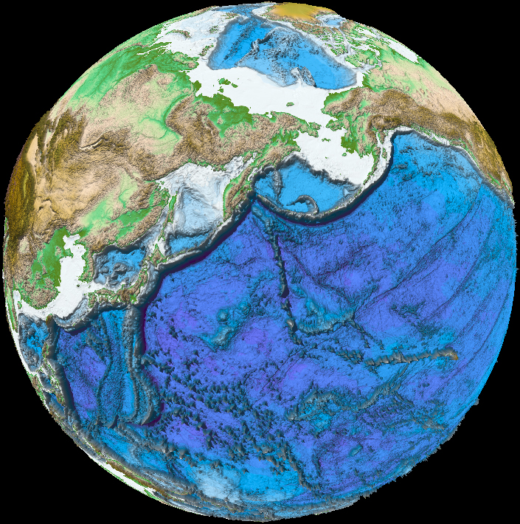
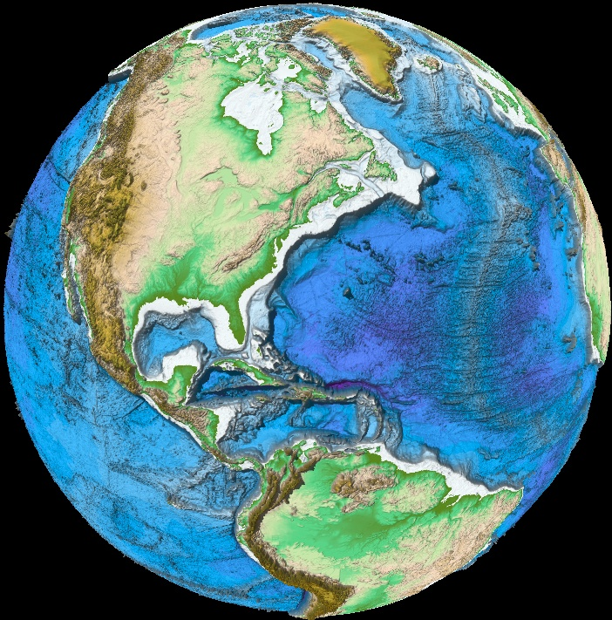
UNH CCOM-JHC U.S. Law-of-the-Sea Bathymetric Mapping to Date
…..Arctic
2003
2004 2007
…Atlantic
2004
2008
2009, 2010 2011, 2012, 2016
2005
Bering Sea
2003
2008 2012 2015
Gulf of Alaska
2005
Mendocino
2009
2014
Necker Ridge 2011
Gulf of Mexico
2007
Marianas
2006
Kingman Reef-
Palmyra Atoll
2010, 2014, 2015
2016
2007,2010,2016
> 2,650,000 km²

Slide 9
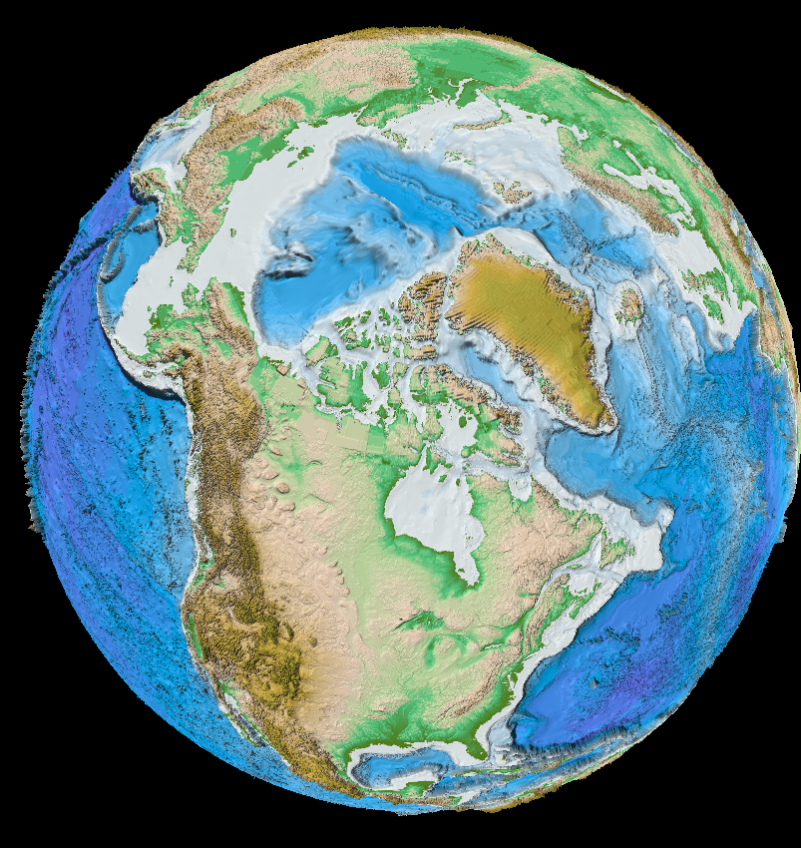
Arctic is unique as an ocean basin in that >52% is made up of shelf (geologic)

Slide 10
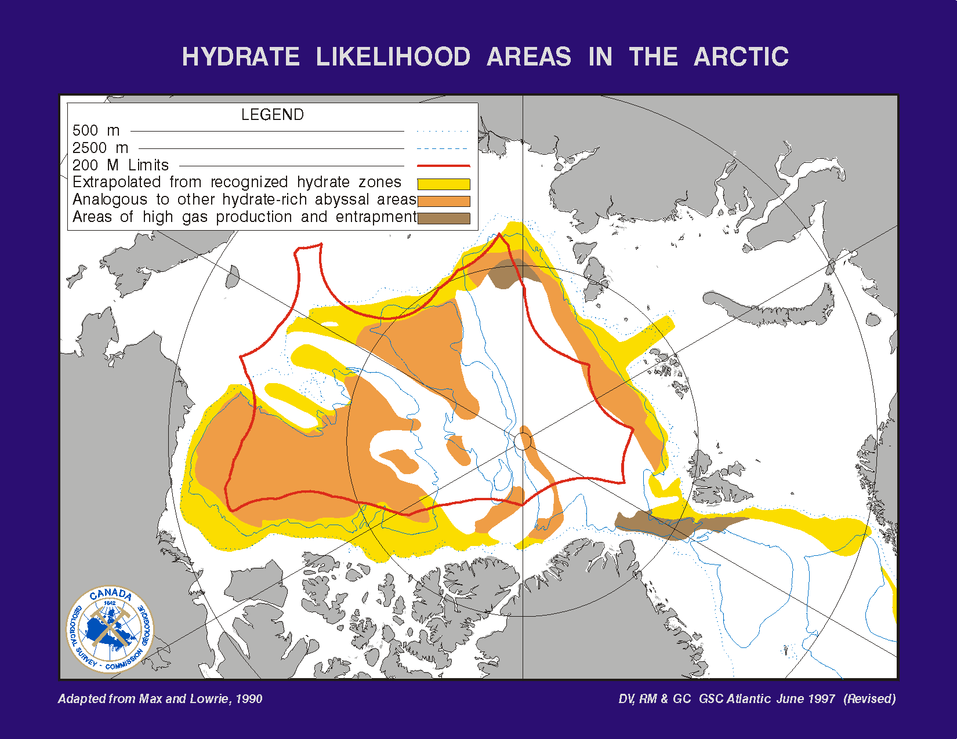
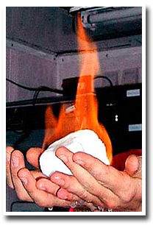
Potential for Oil and Gas in the Arctic
USGS (2009) 13% of world’s undiscovered oil, 30% undiscovered gas, 20% undiscovered natural gas liquids
Slide courtesy Ron Macnab

Slide 11
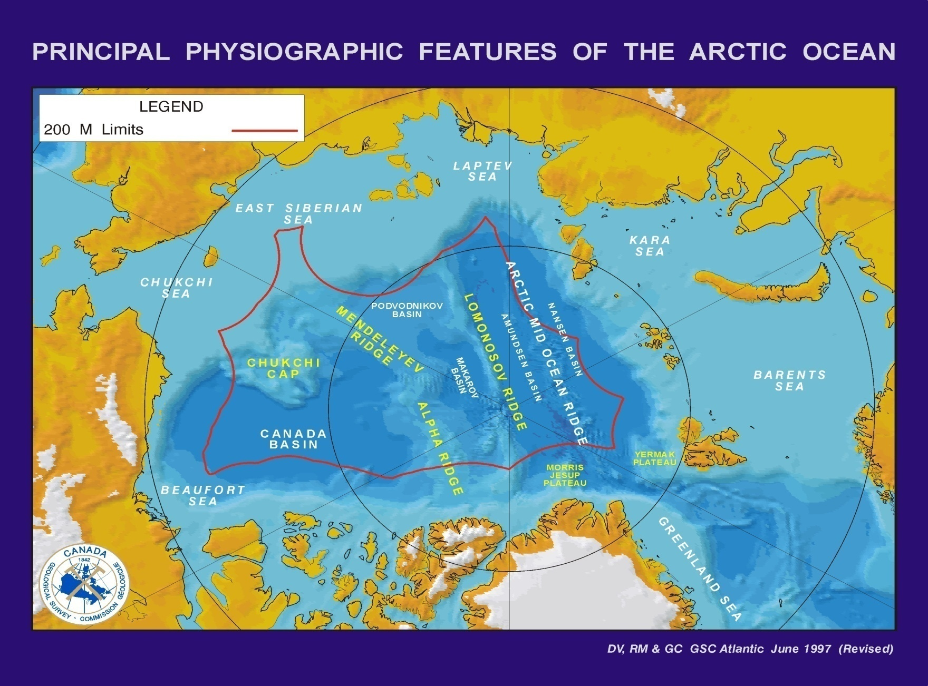





Five nations having potential extended shelves
From Ron MacNab

Slide 12
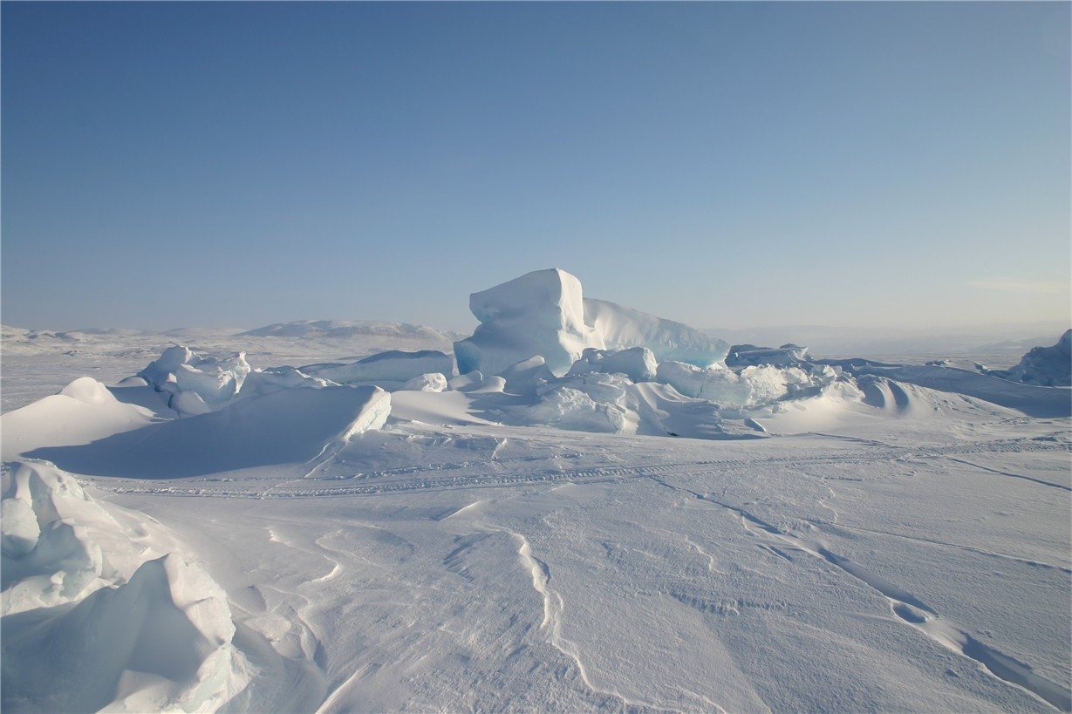
How do we map in this?

Slide 13
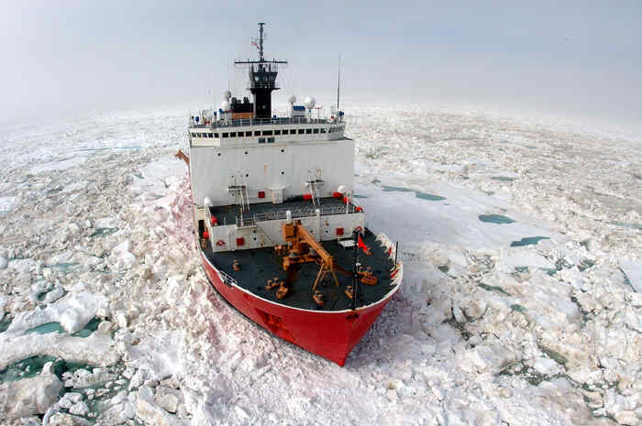
USCG HEALY
MBES 2003 - 2009 – Seabeam 2112 2x2 deg 12 kHz
Now – Kongsberg EM122 – 1x1 deg 12 kHz MBES
Hi-Res Subbottom - Knudsen 350B Chirp Sonar
Dredging

Slide 14
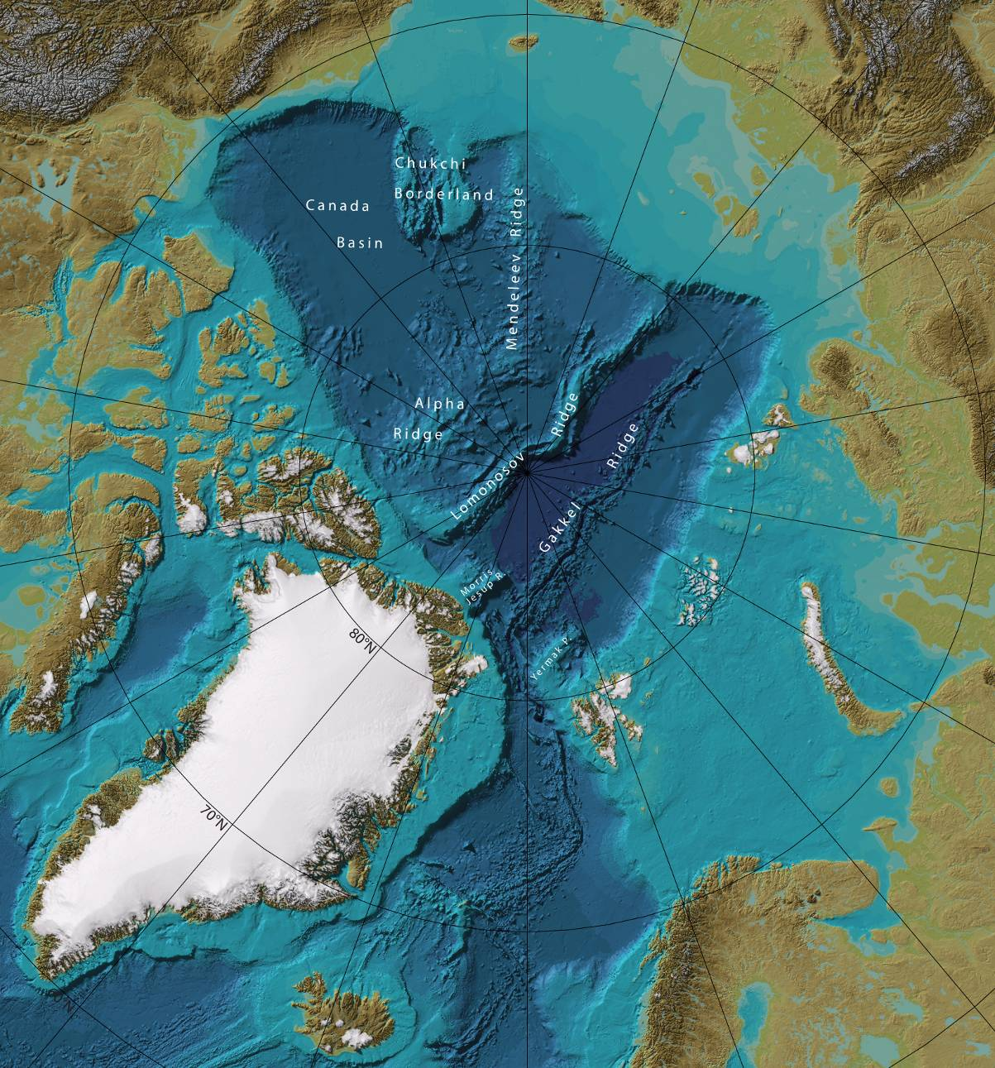
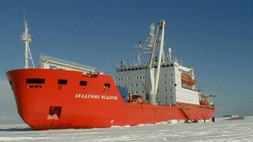
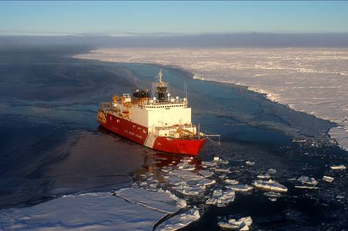
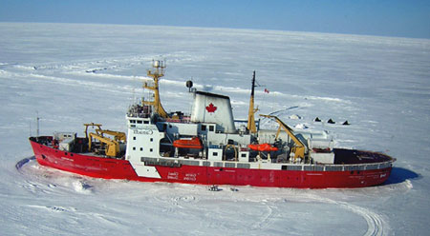
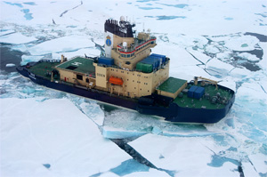
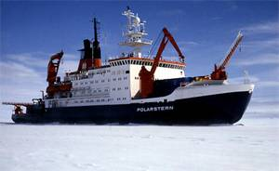
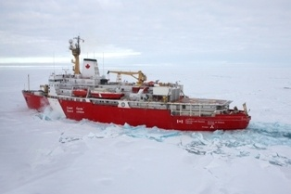
Multibeam mapping
Chukchi
Borderland
RV Akademik Fedorov
Mackenzie
USCGC Healy
Alpha-Mendeleev
BUT NONE WOULD HAVE BEEN ABLE TO EASILY COLLECT USEFUL DATA 15-20 YEARS AGO
Canadian Archipelago
Lomonosov Ridge
Gakkel Ridge
E u r a s i a n S h e l f S e a s
CCGS Amundsen
Morris Jesup Rise
Yermak Plateau
I/B Oden
R/V Polarstern
CCGS Louis St. Laurent

Slide 15
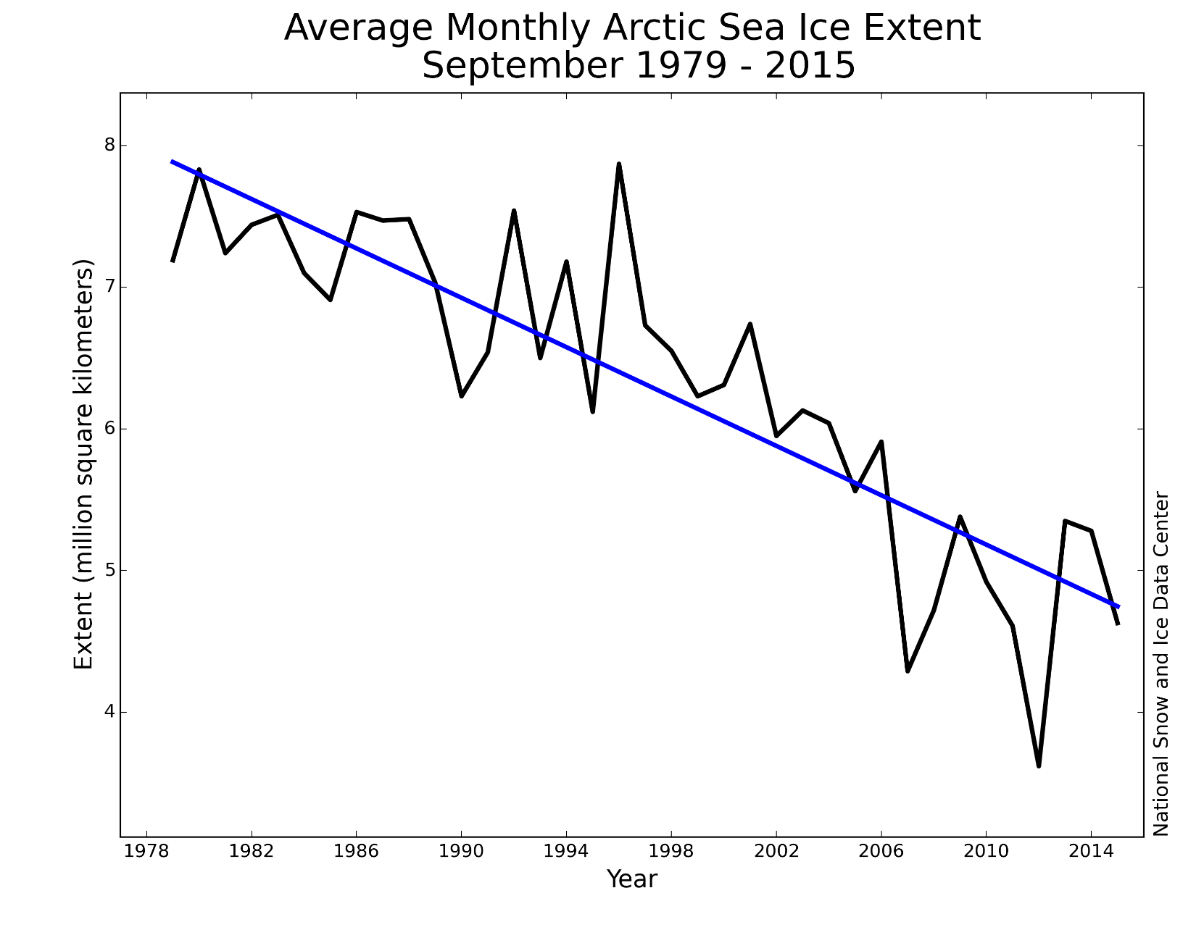
Minimum Ice Extent – 1979-2016
6
Decline of ~13% per decade.

Slide 16
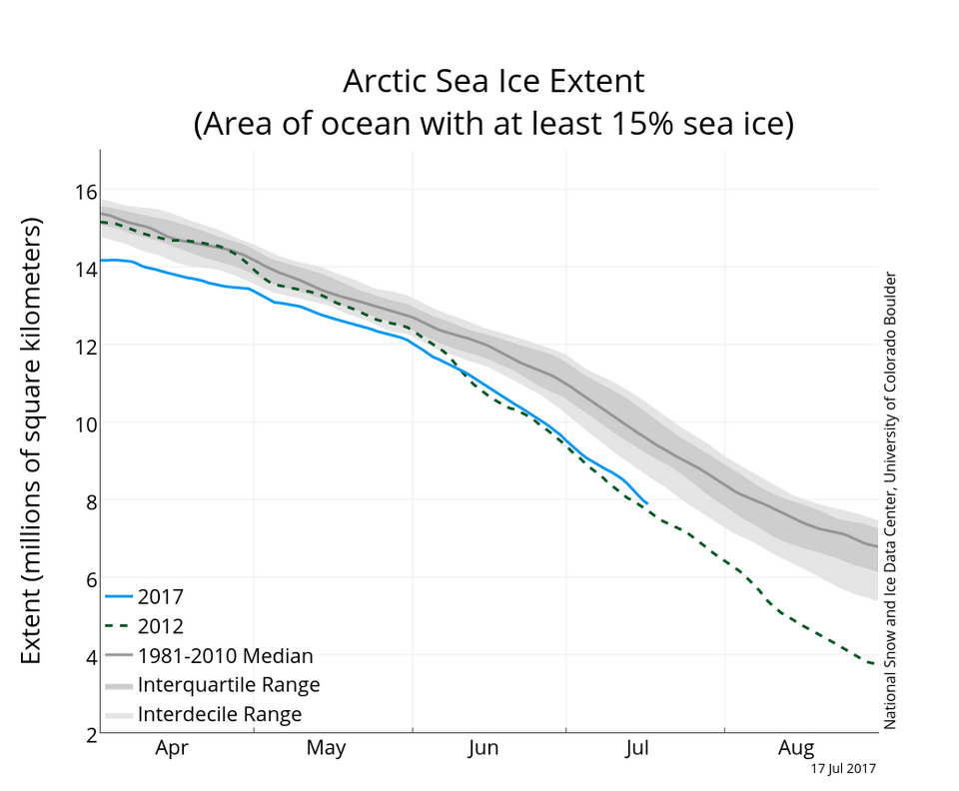
ICE EXTENT – 17 July 2017

Slide 17
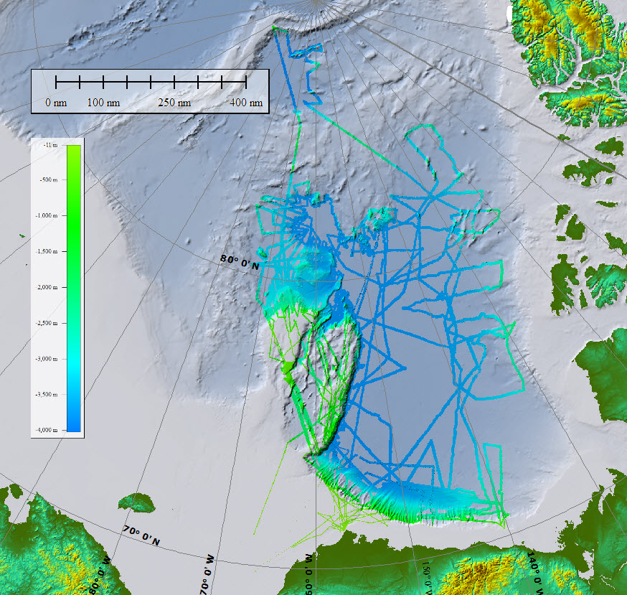
Area mapped…….…. ~442,000 km²
US ECS Arctic Mapping 2003,2004,2007,2008,2009, 2010, 2011. 2012,2016

Slide 18
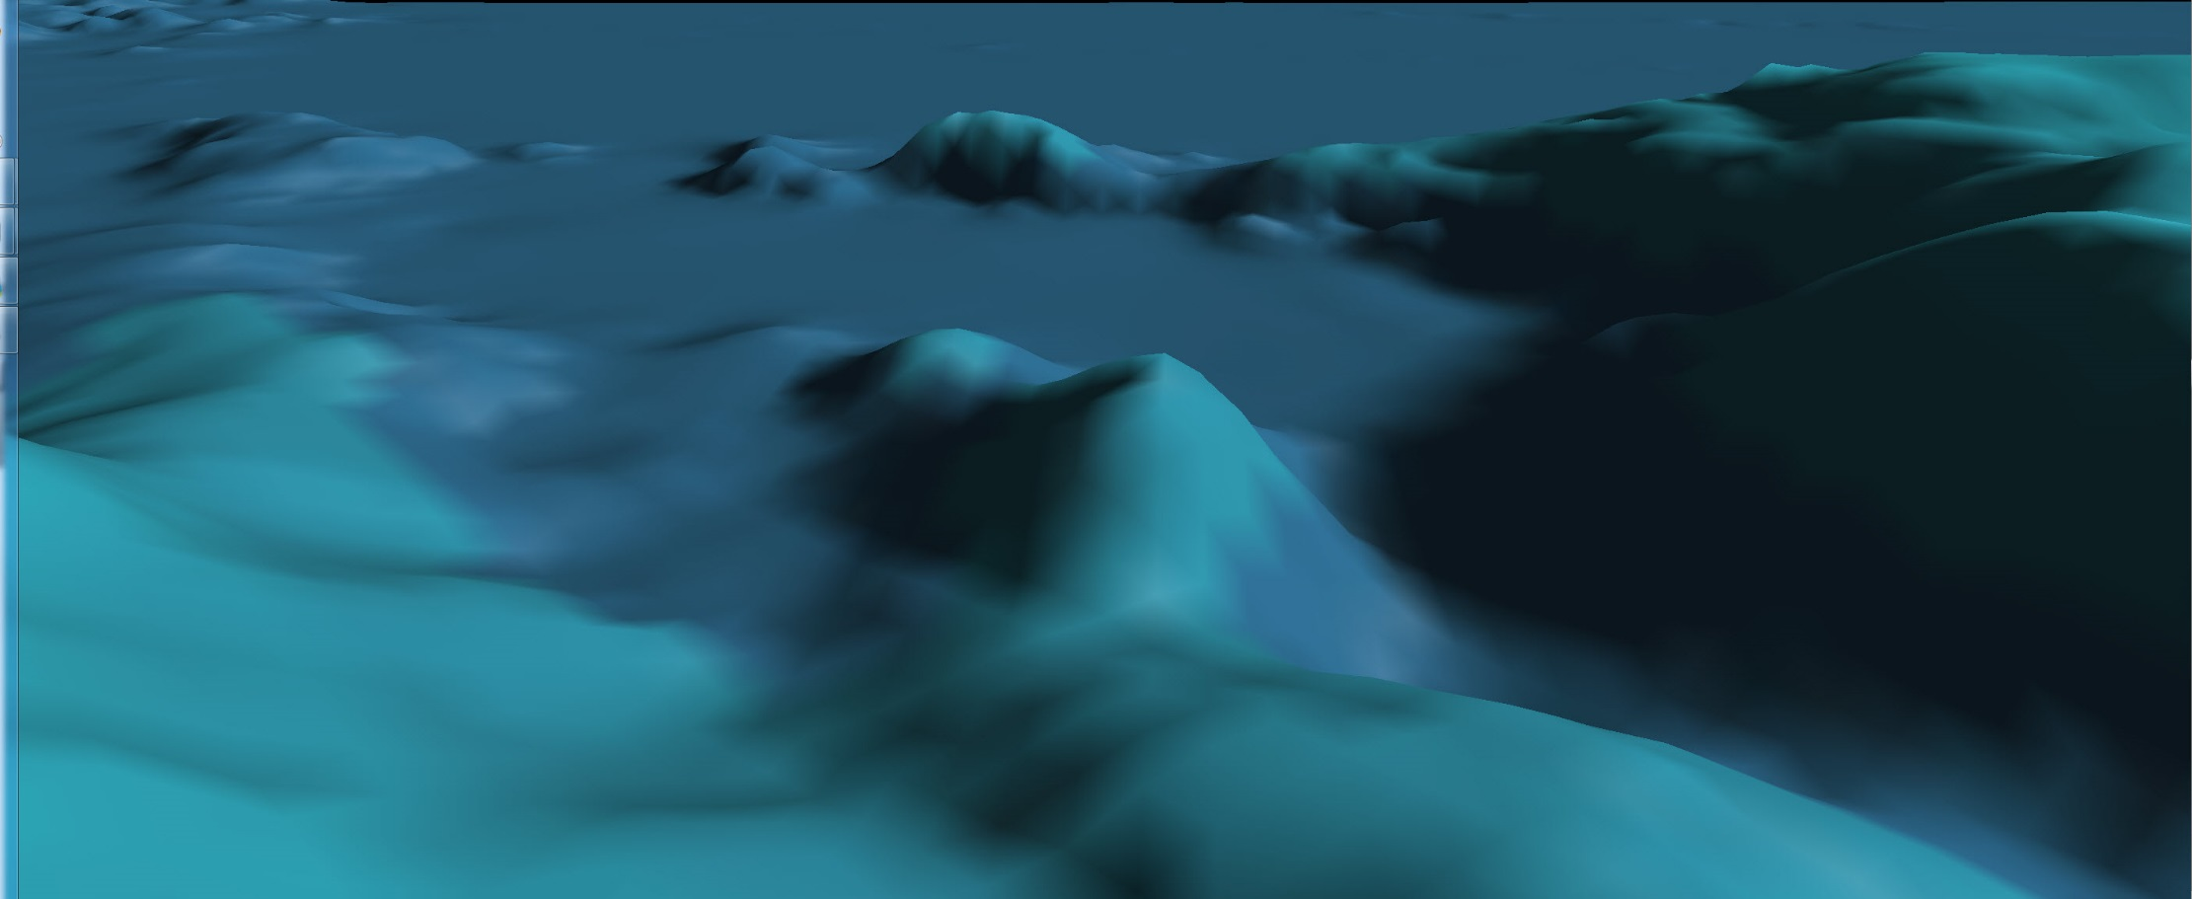

Slide 19
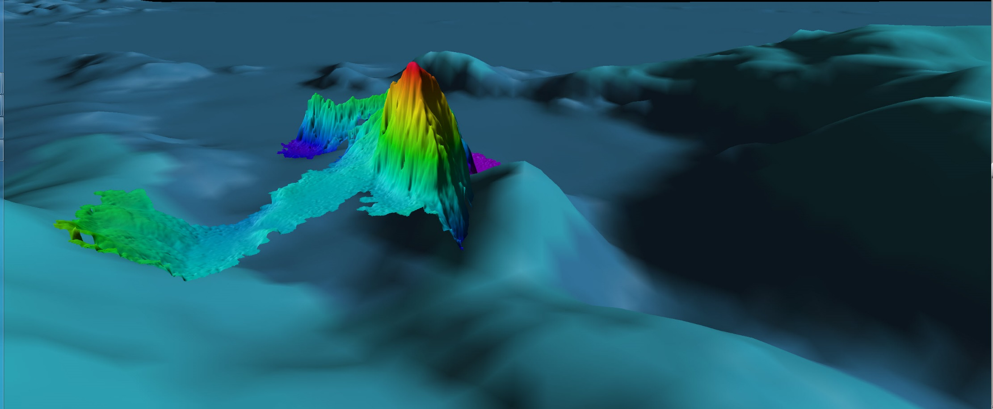
HEALY SEAMOUNT – 11,000 feet high

Slide 20
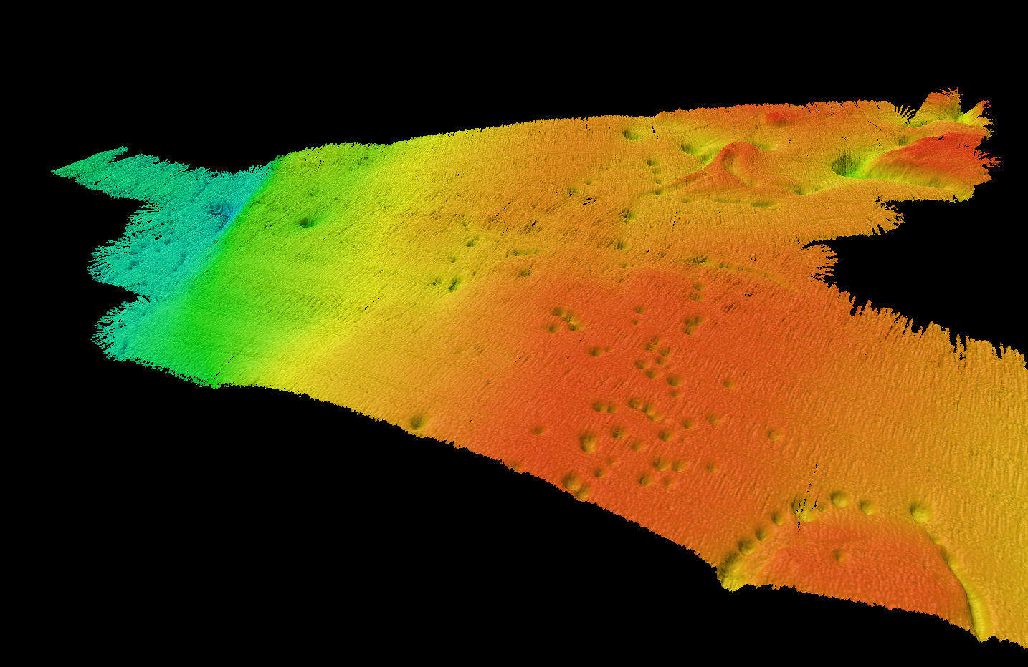
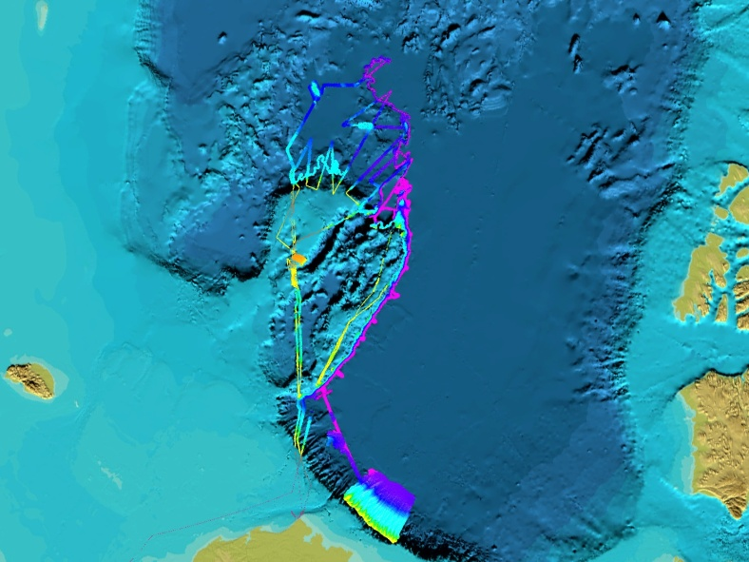
Central Chukchi Plateau pockmarks
200-m diameter
20-m deep
VE = 10x
looking SW

Slide 21
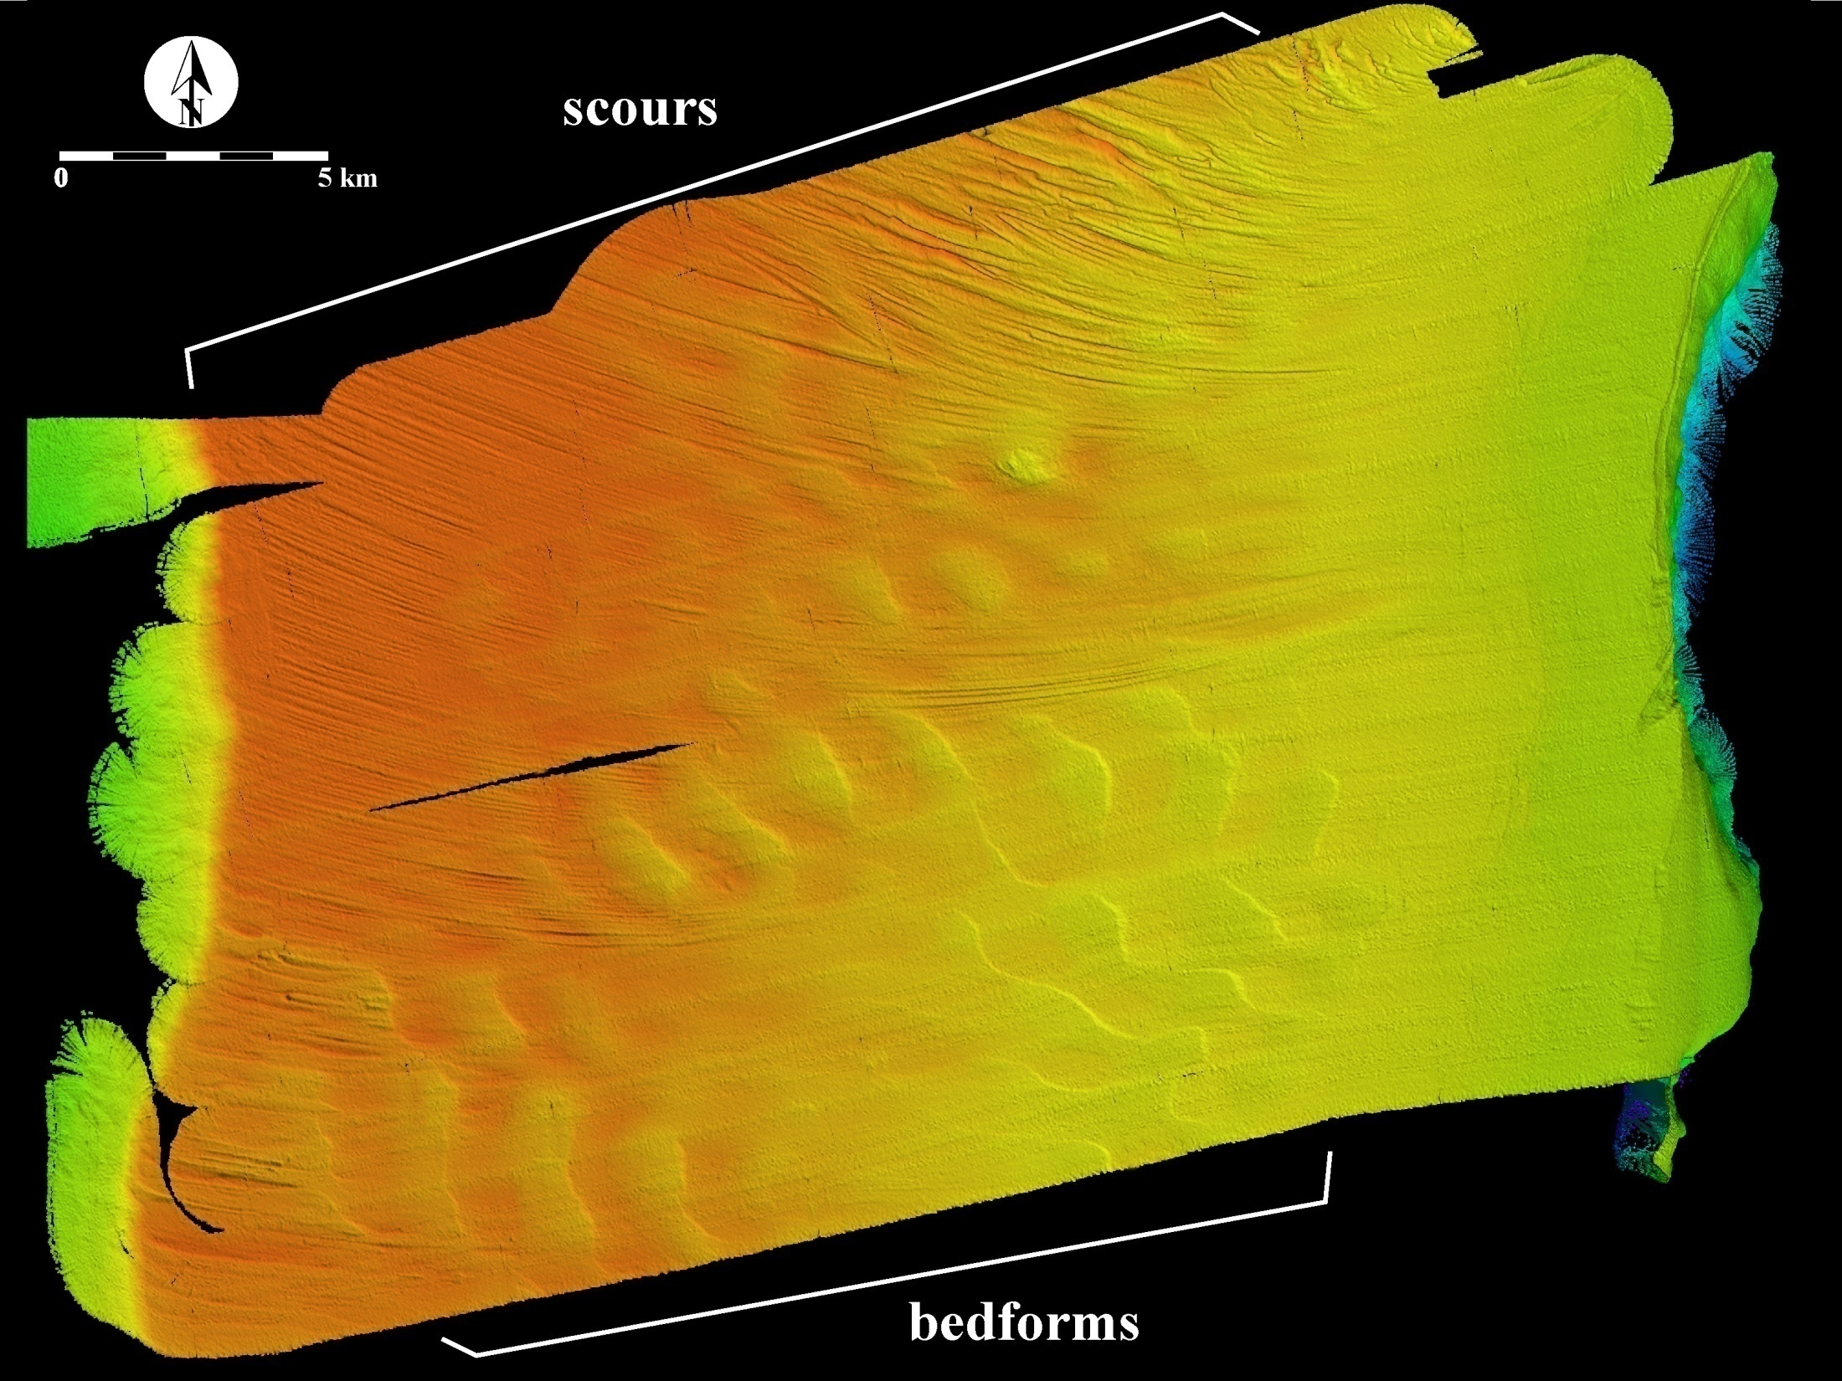
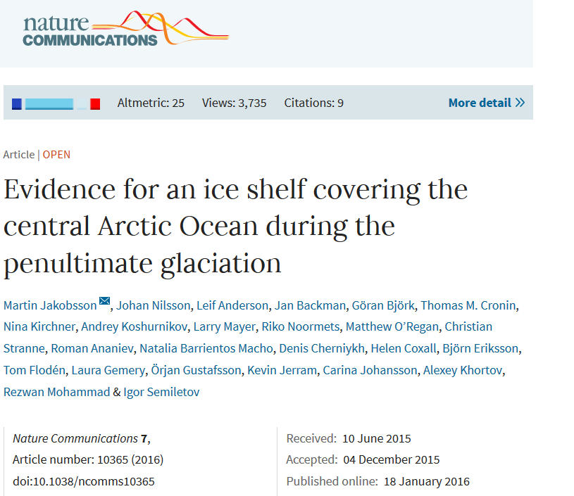
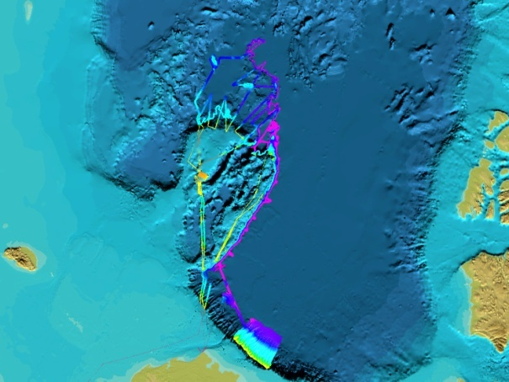
3 to 5 m deep
-470 m
Central Chukchi
Plateau
-380 m
Mega-scale glacial lineations
λ = ~2 km
H = ~10 m

Slide 22
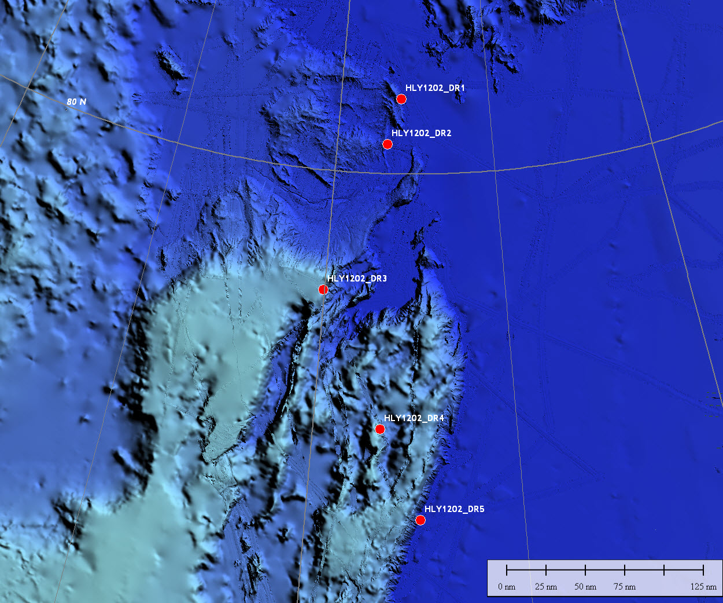
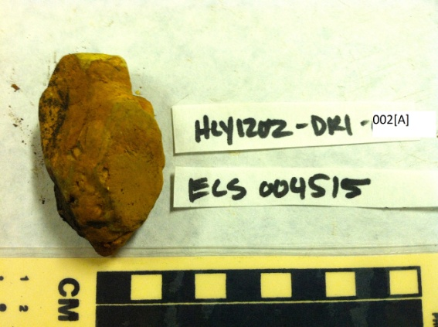
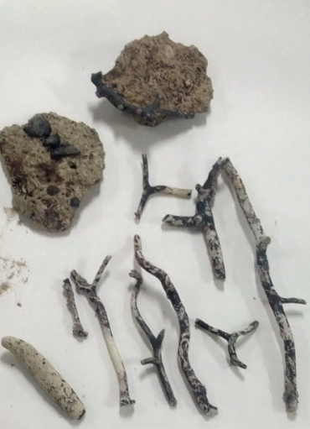
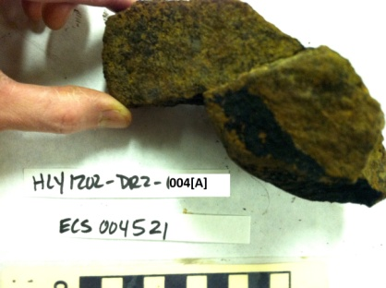
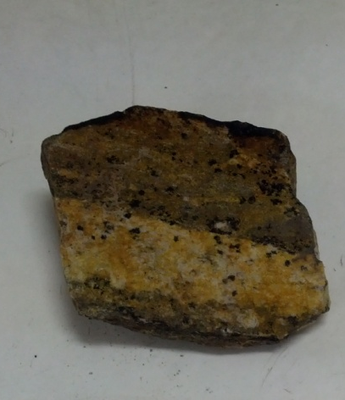
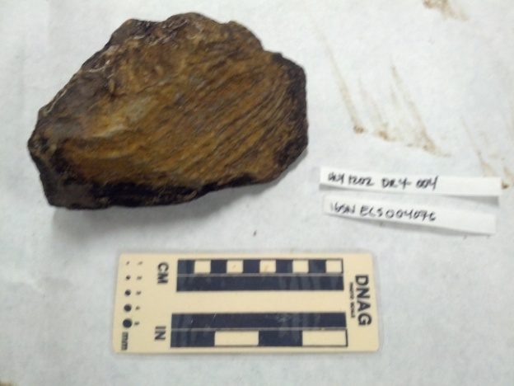
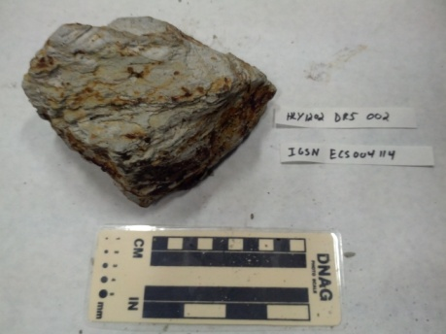
HEALY 1202 DREDGE SITES
coral
volcanoclastic?
altered basalt
metasediment
schisht
schisht

Slide 23
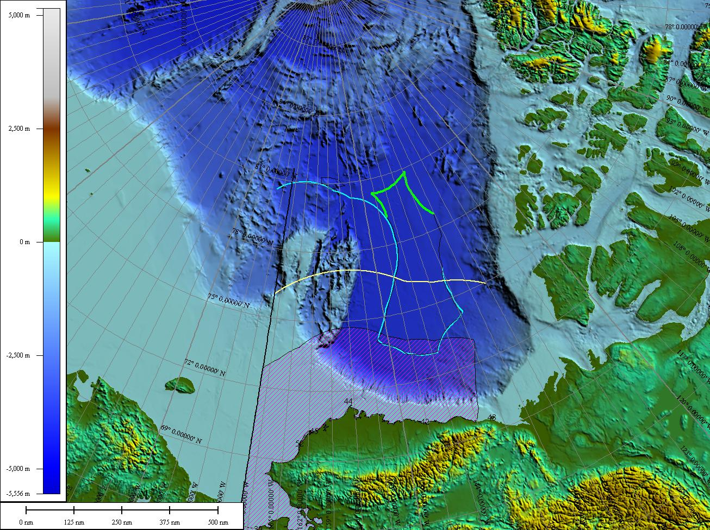

Slide 24
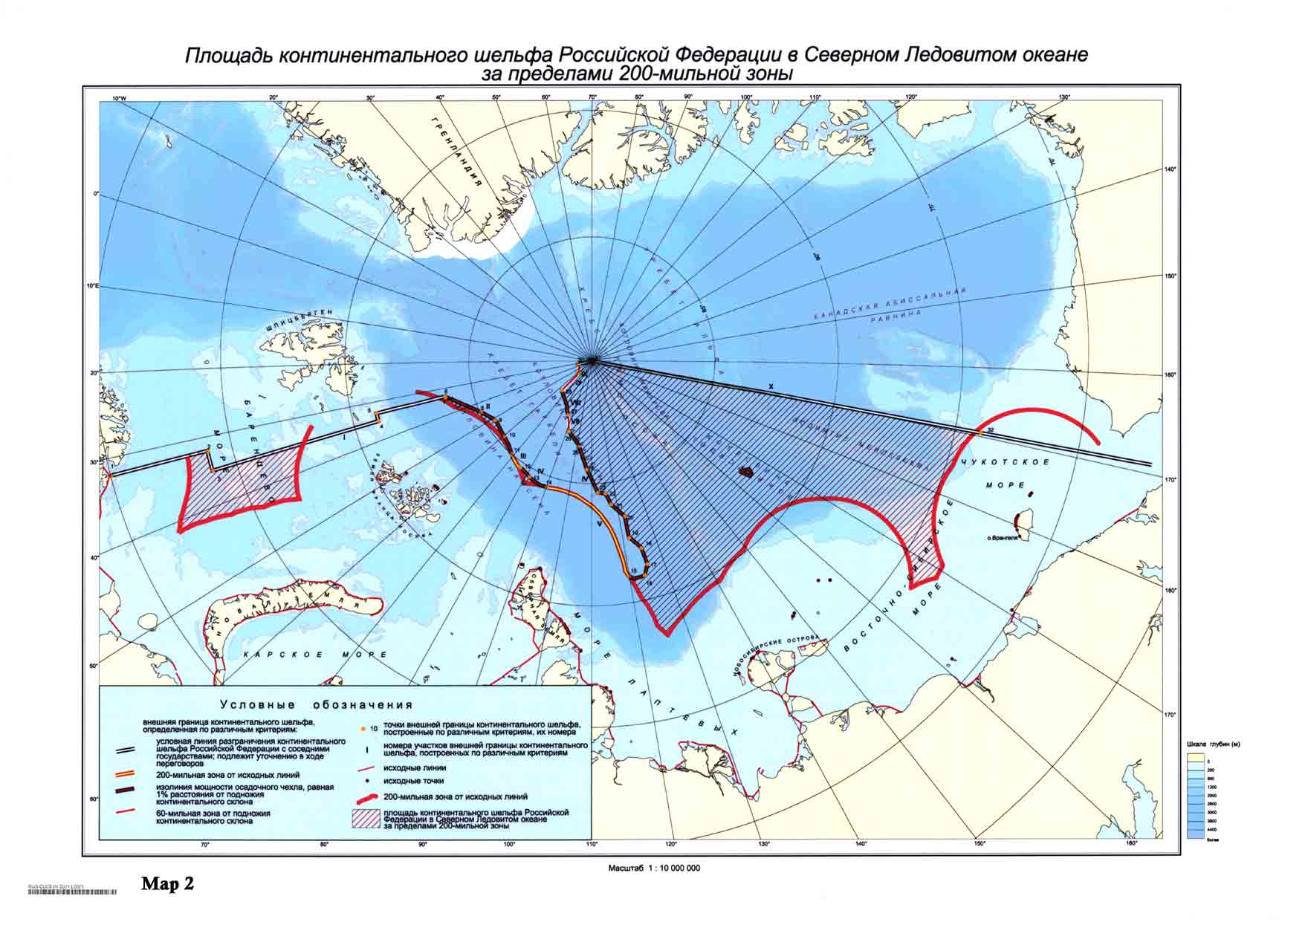
Russian Submission - 2001

Slide 25
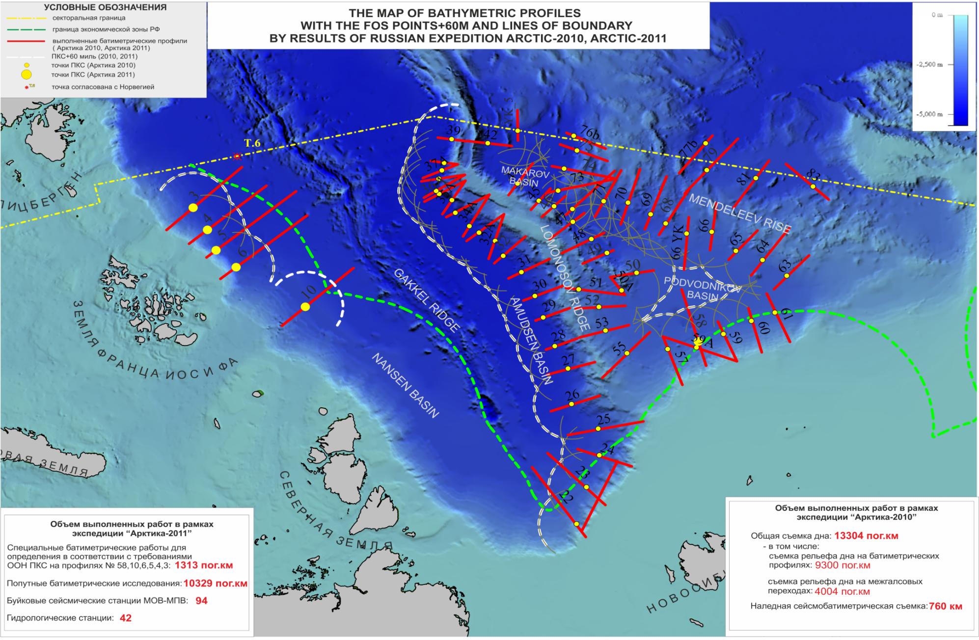
RECENT RUSSIAN DATA COLLECTION
From: S. Alekseyev, I. Glumov, S. Kursin, A. Kostenich, K. Stavrov, A. Zen'kov, ROSNEDRA and GNINGI, St. Petersberg, May 2013

Slide 26
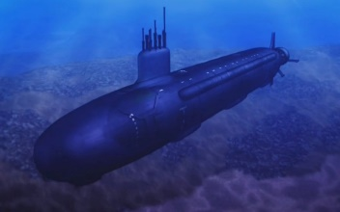
ARCTICA-2012 Research methods.

Slide 27
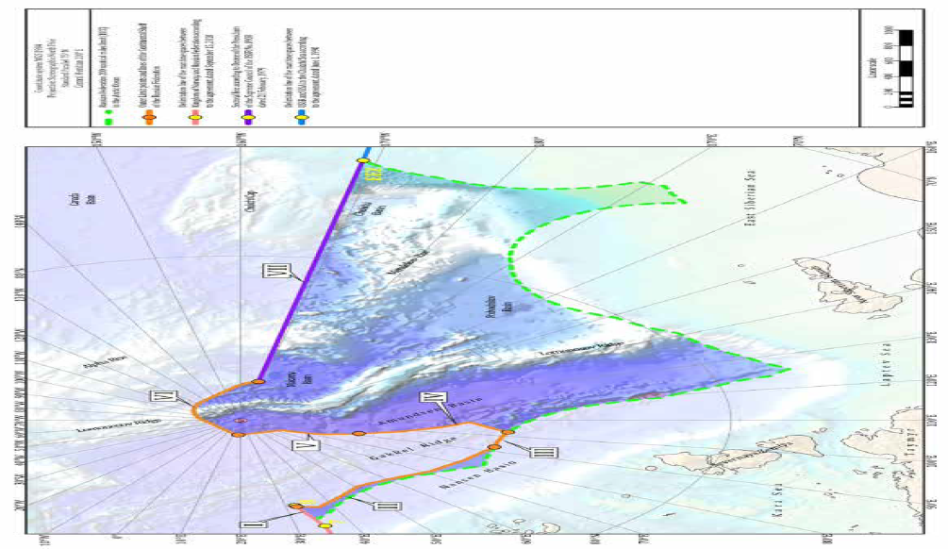
RUSSIAN SUBMISSION AUGUST 2015

Slide 28
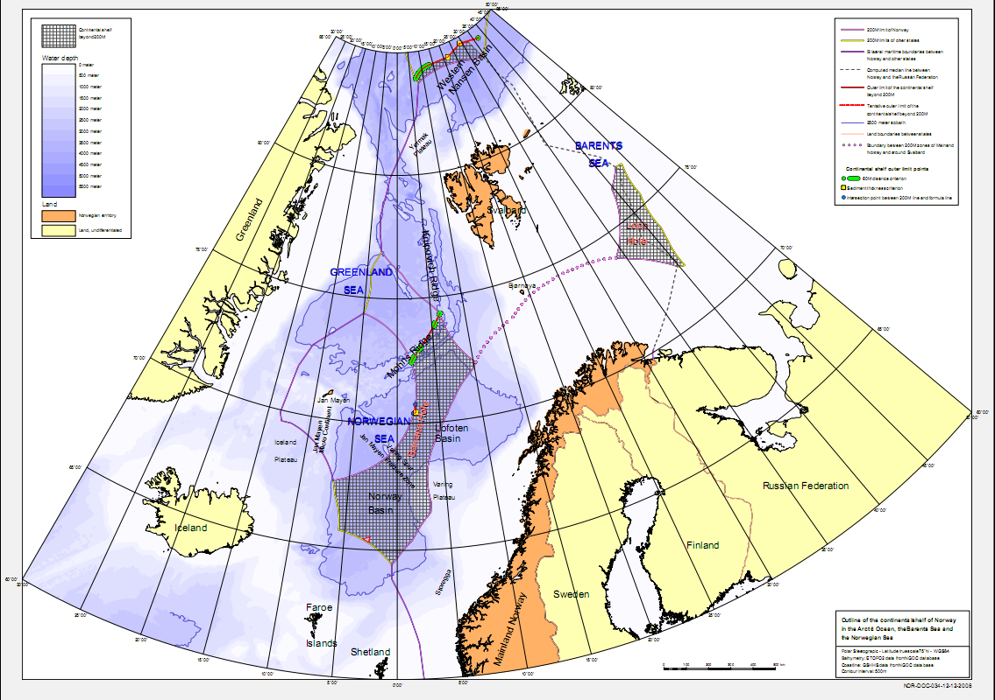
NORWAY 27 Dec 2006

Slide 29

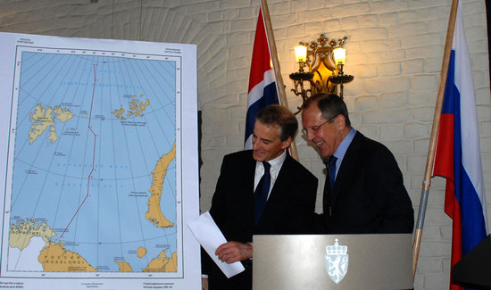
Exchange of ratification protocols 8 June 2011
Barents Sea and Arctic Ocean
http://www.barentsobserver.com/the-new-norwegian-russian-border.4930280-116320.html
http://www.aftenposten.no/nyheter/iriks/article3626313.ece

Slide 31
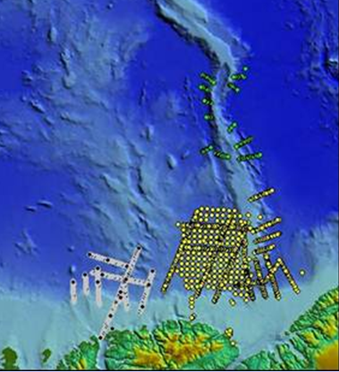
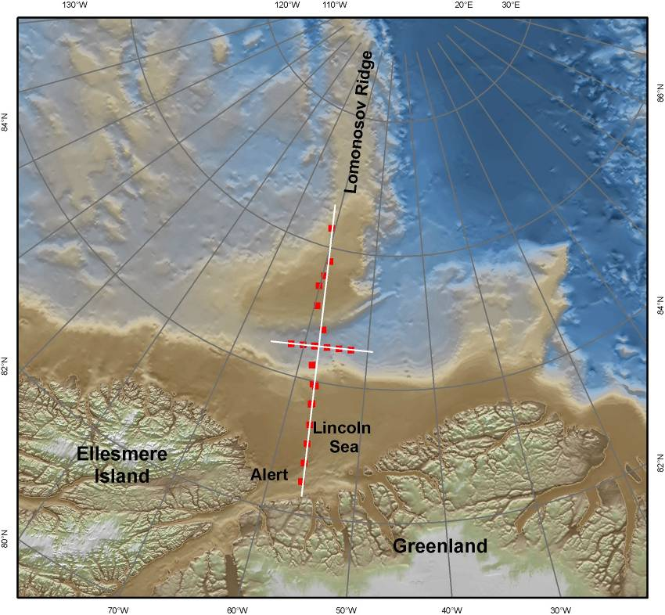
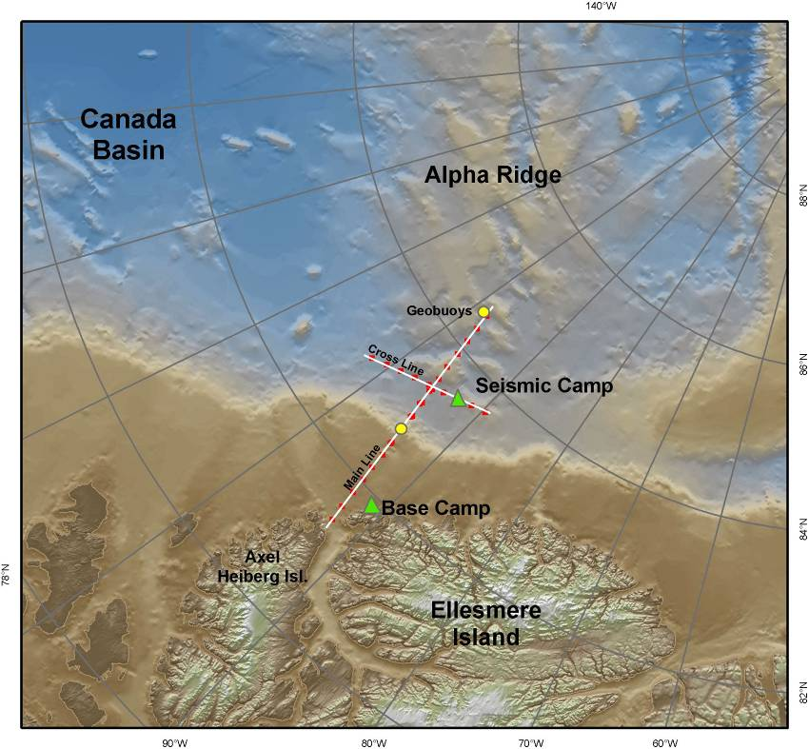
CANADA
Eastern Arctic
Refraction surveys:
2006: LORITA (with Denmark)
2008: ARTA
Bathymetry spot soundings
2006-2010
From Jacob Verhoef

Slide 32
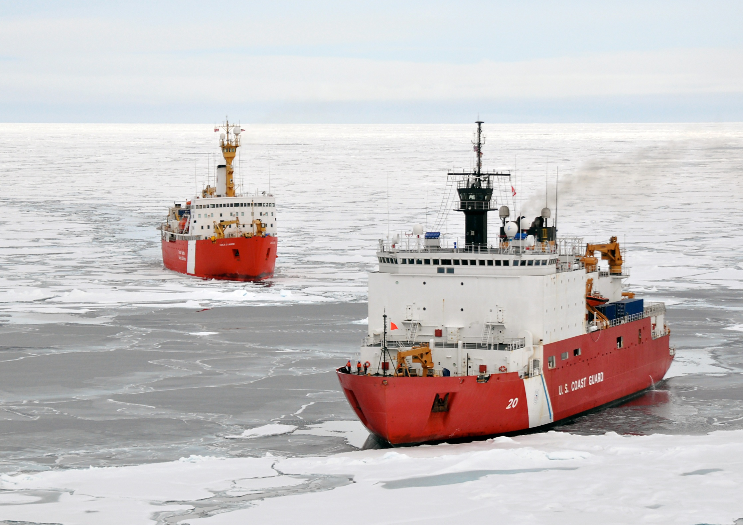
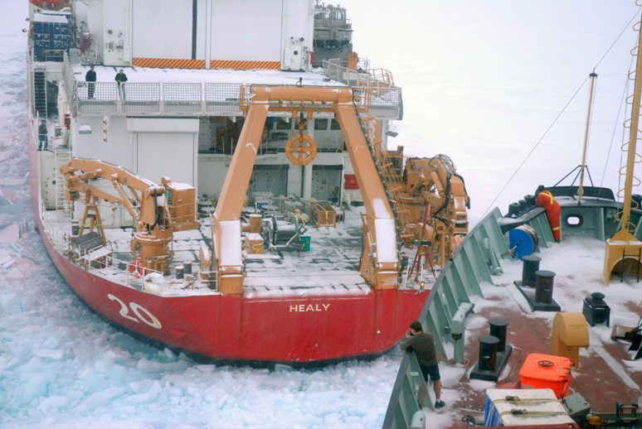
WESTERN ARCTIC
JOINT PROGRAMS CANADIAN AND US ICEBREAKERS
LOUIS S. St. LAURENT and HEALY
2008 2009
2010 2011

Slide 33

DEC 2013

Slide 34

kkelprojektet
Data collection north of Greenland from 2006 to 2012. Yellow line: LORITA seismic refraction profiles 2006; green line - LOMROG I ship track 2007; red line - LOMROG II ship track 2009, orange line - LOMROG III ship track 2012, blue stippled lines - bathymetric profiles acquired by helicopter during spring of 2009 and during LOMROG II and LOMROG III; yellow lines - seismic data acquired during LOMROG I, II and III (2007, 2009 and 2012); white stippled lines - unofficial median lines.
http://a76.dk/greenland_uk/north_uk/index.html

Slide 35

The Kingdom of Denmark

Slide 36

15 Dec. 2014

Slide 37

Russian/Danish Overlap

Slide 38

From Institute for Strategic Studies

Slide 39


Slide 40





IBCAO VER 3.0
Nansen 1907
1906
~11 % OF THE ARCTIC OCEAN HAS BEEN MAPPED WITH MULTIBEAM
THERE IS STILL MUCH MUCH MORE TO MAP & DISCOVER!!!

Slide 41

SINCE IBCAO 2008

Slide 42

Submissions as of today (77)
28 Recommendations

Slide 43
Canada contends that the maritime boundary should follow the land boundary along the 141st meridian out 200 miles
U.S. contends that the maritime boundary of the EEZ is the equidistant line
Disputed area ~ 6110 sq n.m.

