Slide 1
Quintillion Subsea Cable System
^{Presented by:}
^{Elizabeth Pierce, CEO}

Slide 2
Arctic Communications can be… Challenging
Satellite or limited microwave backhaul
Limited capacity
High latency
Service outages caused by environmental disruptions
High cost: wholesale $1,500 to $11,000 per Mbps per month
2

Slide 3
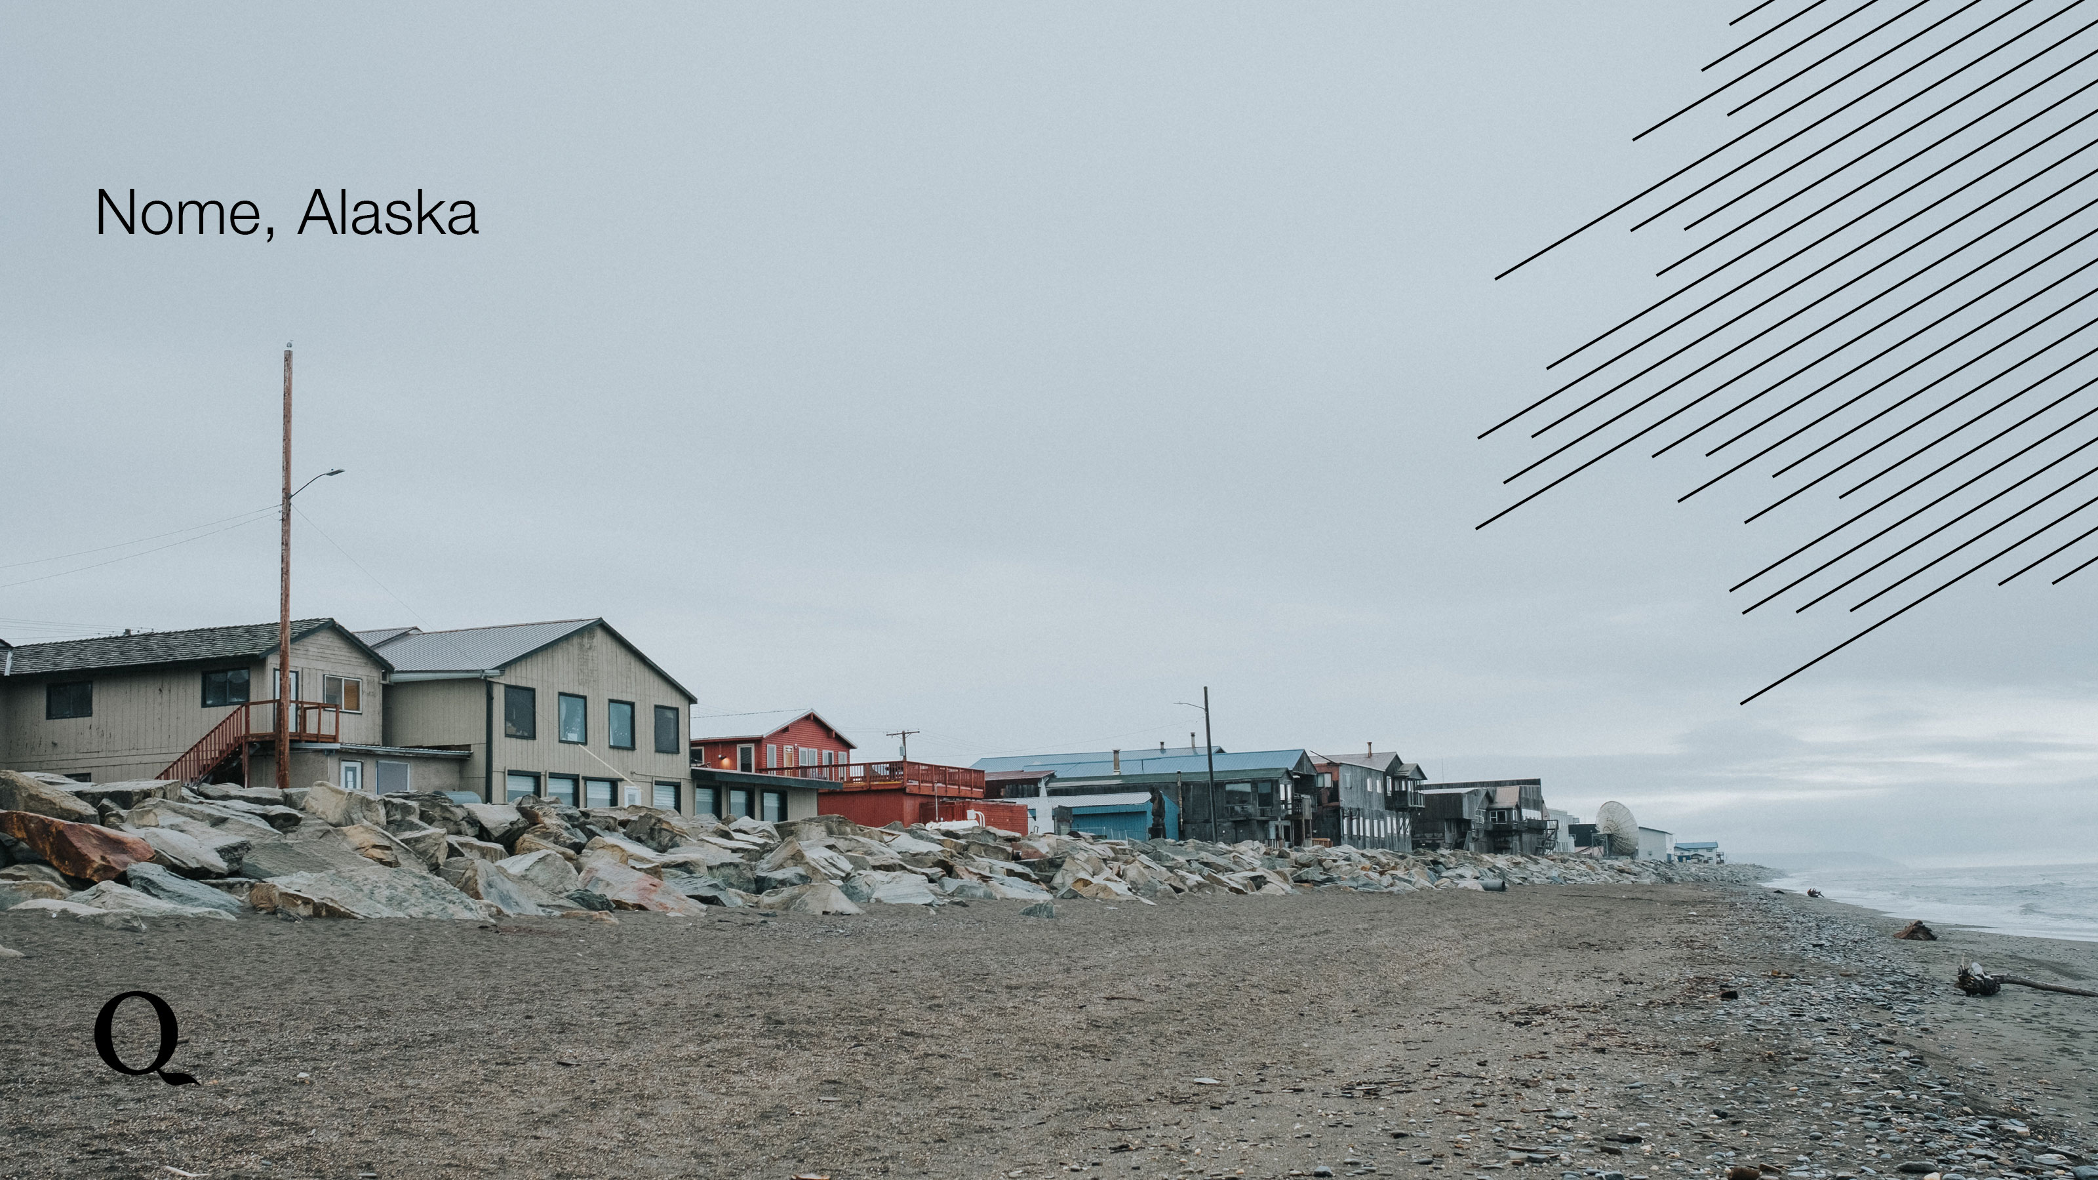
3
Notes:
This is a picture of Nome, Alaska.

Slide 4
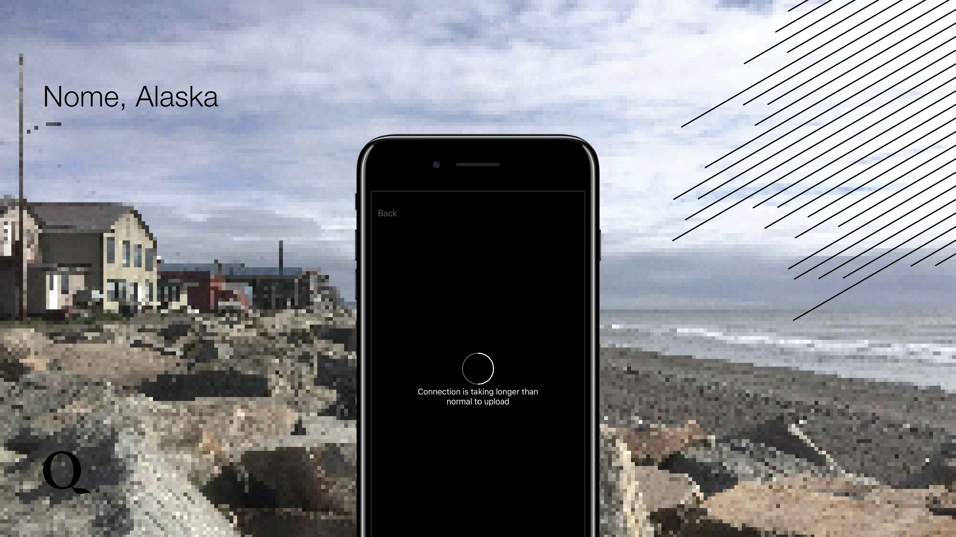
4
Notes:
Like many places in the Arctic, comms are a necessity, but at the same time a challenge. This is an actual screenshot taken in Nome when one of our team members tried to load a work document. In Wainwright, a gentleman we talked to said it took him 36 hours to download windows anniversary addition.

Slide 5
National Security is a Priority
Homeland Security
Customs & Border Protection
International Proximity
Safety and Emergency Response
5
Notes:
In addition to the education, social media, economic and health argument, Alaska is the gateway to the Arctic for the US. International interests do not always align. Therefore, national security is a priority and requires comms.

Slide 6
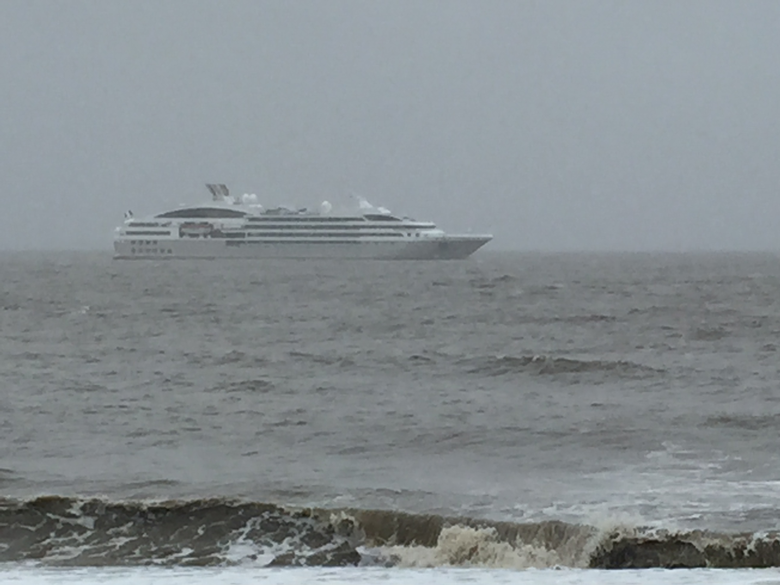
Utqiagvik (Barrow) September 11, 2015: One of many foreign cruise ships

Slide 7
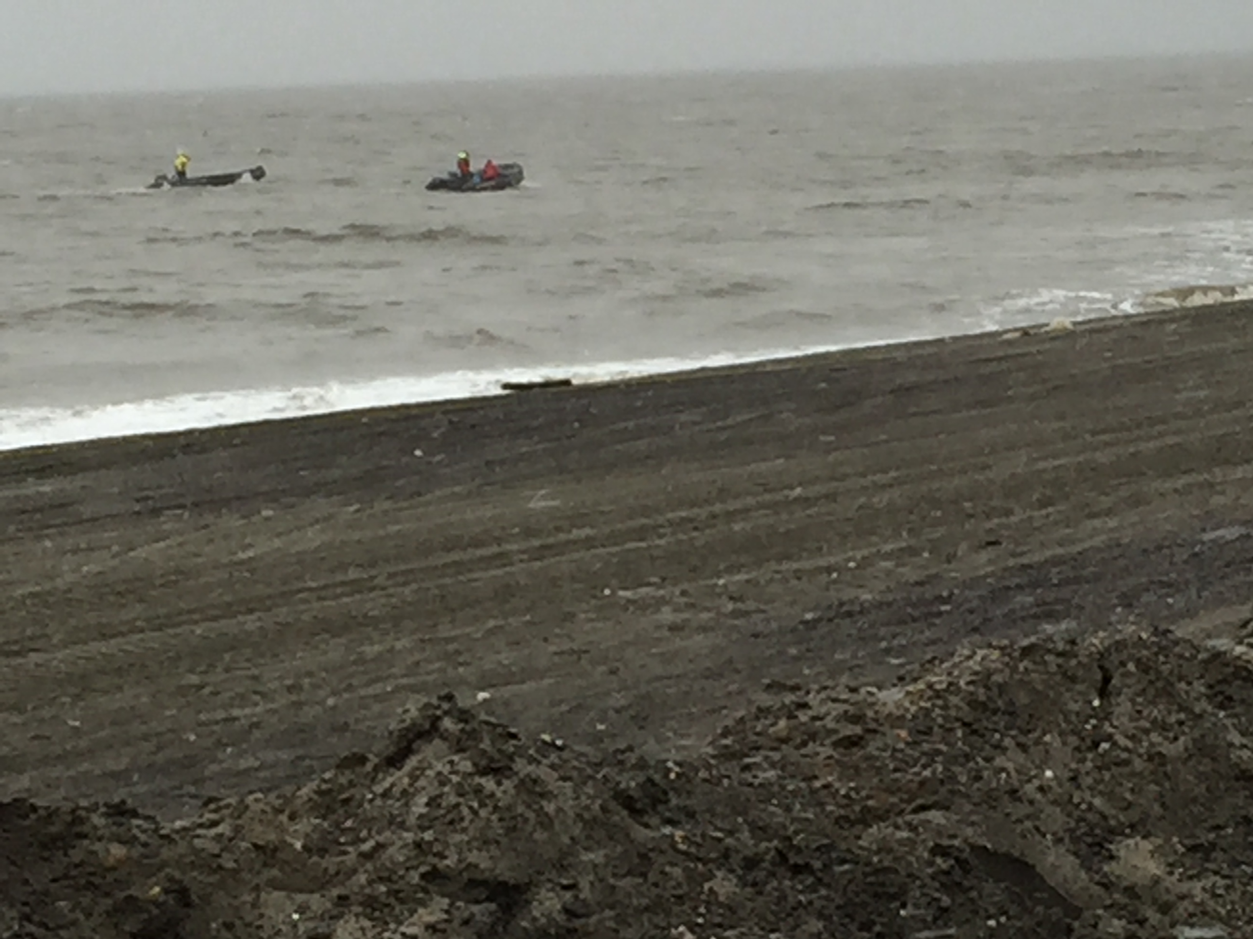
Passengers from cruise ship landing on shore

Slide 8
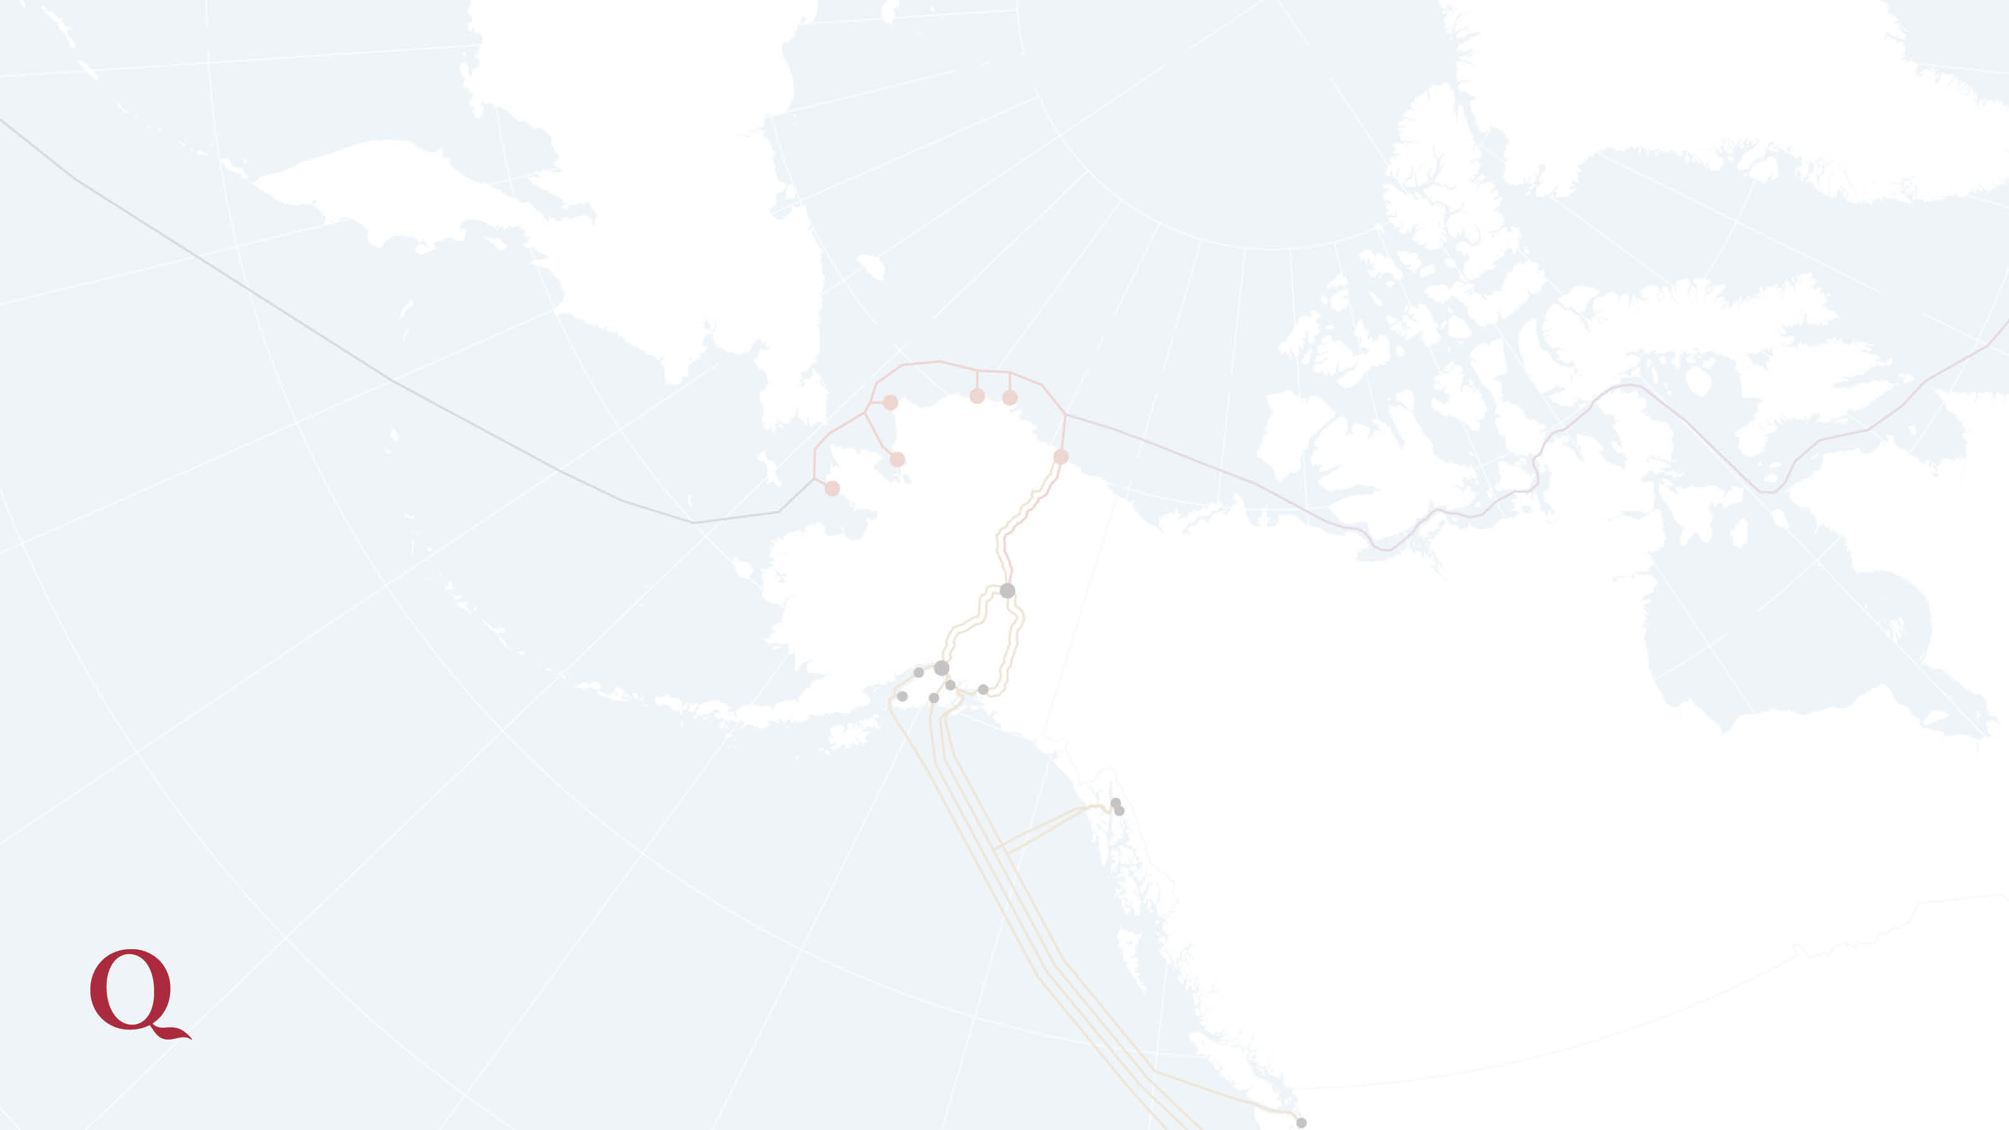
Quintillion is Advancing Arctic Communications
8

Slide 9
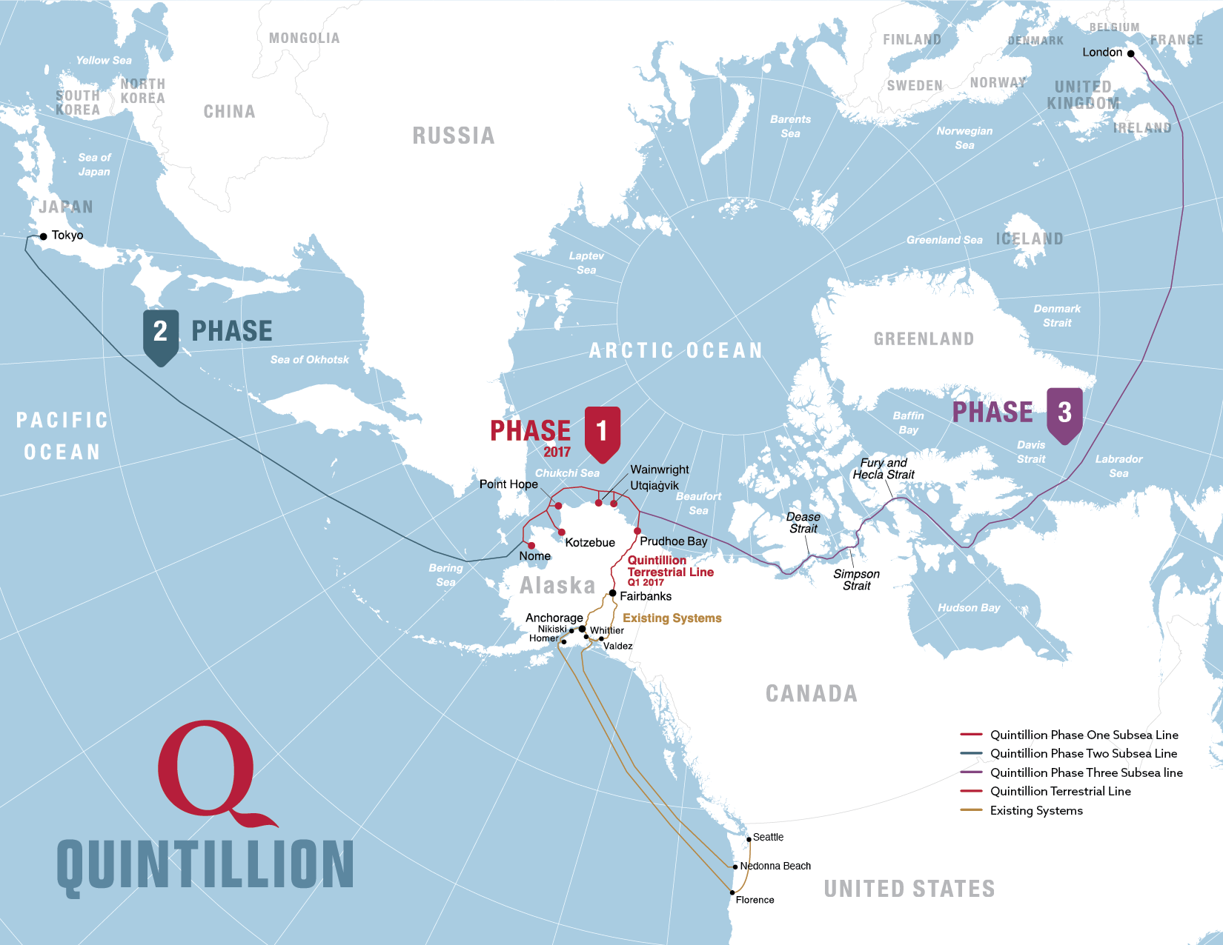

Slide 10
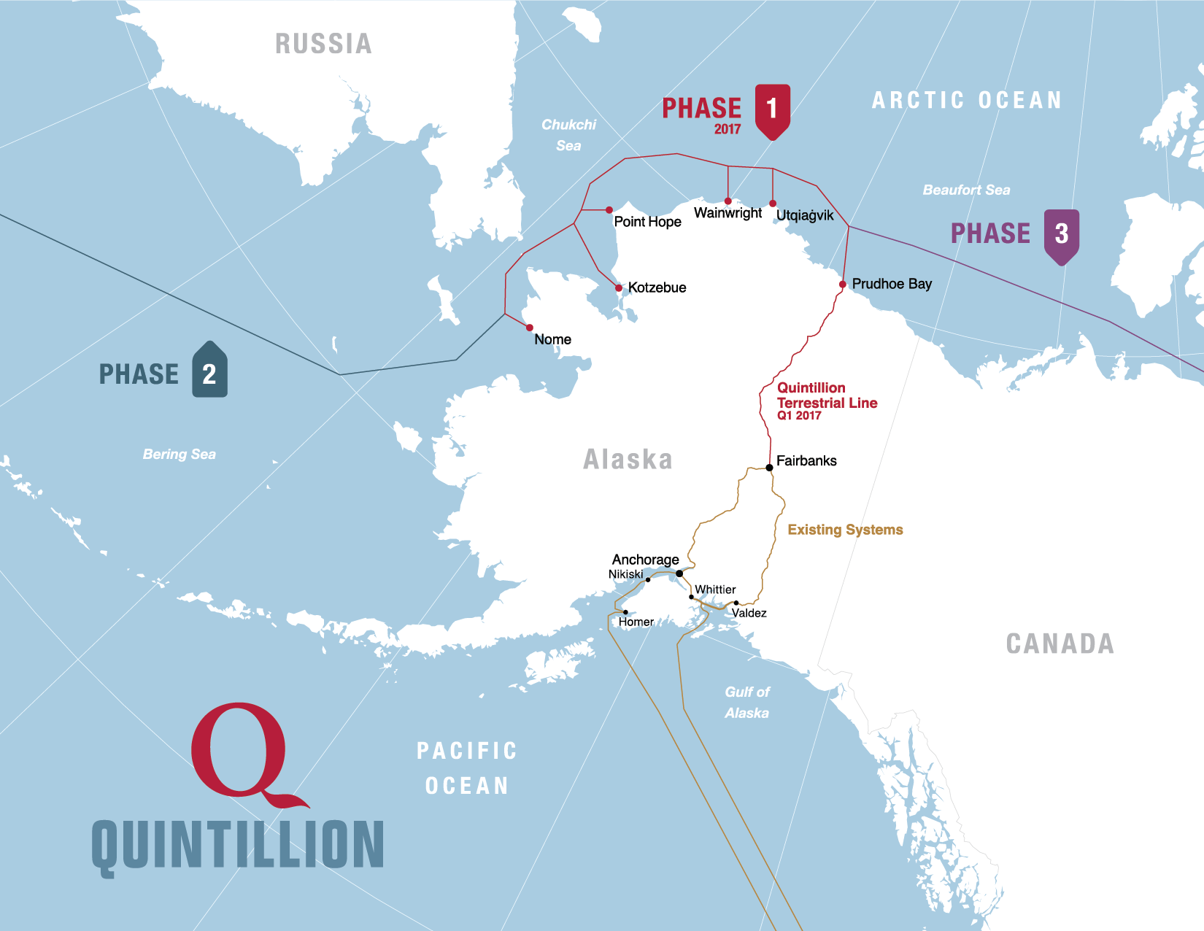

Slide 11
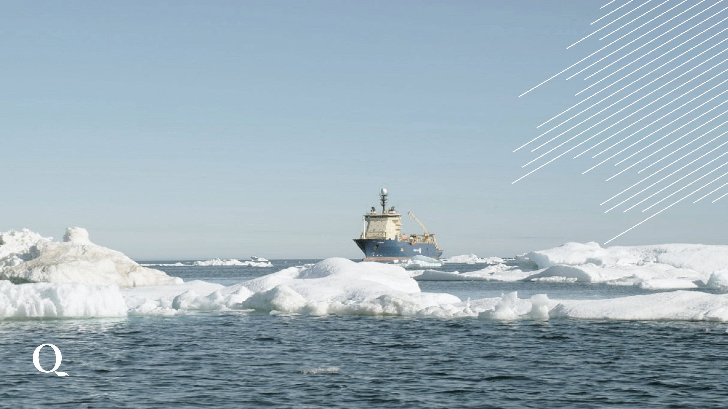
Northwest and northeast routes present challenges
Construction is more challenging
Short open water season
Requires resilient design and installation
11

Slide 12
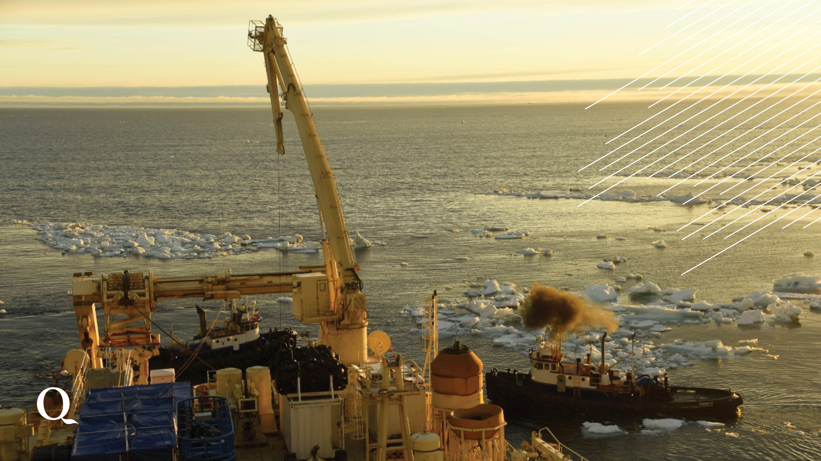
12
Notes:
Working in the Arctic is difficult. While we do not use ice class vessels to install cable, there is the potential for some ice to be present. So we use ice managing techniques with support vessels to gently nudge the ice from the cable installation path. The short window for construction is a consideration when

Slide 13
13
Notes:
To mitigate against latency, repeaters are used to protect the integrity of the signal. One every 30km along Phase 1. We selected Alcatel Lucent Submarine Networks to build and install Quintillion’s Phase 1 as a result of their best in class repeaters.

Slide 14
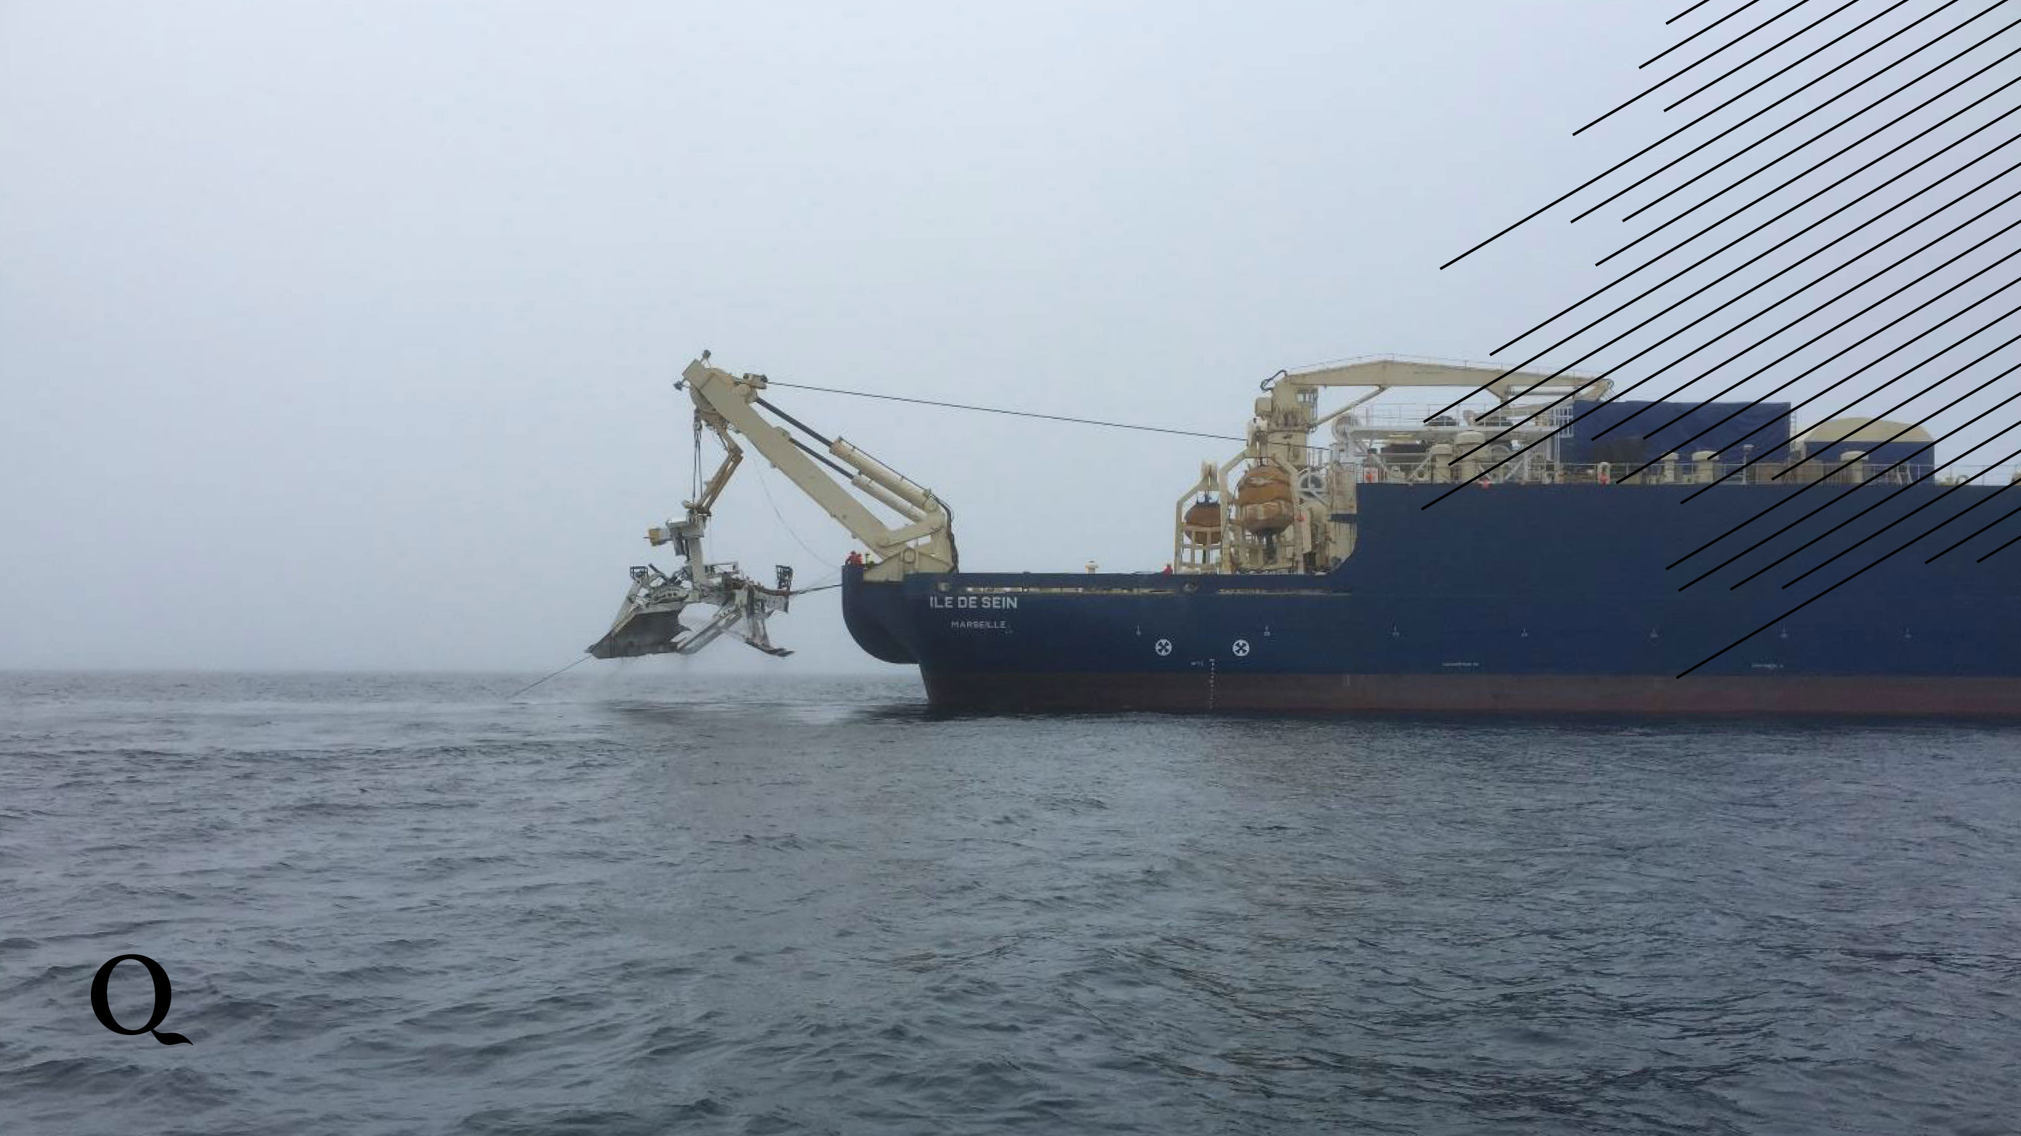
14
Notes:
Three purpose built cable laying vessels, the Ile de…., have worked alongside specialty cable installation vessels and equipment to achieve Quintillion’s desired burial depth. This photo features a 2 meter plow share off the stern of the Ile de Sein during installation near Wainwright last summer.
Quintillion buries along the majority of the cable route to protect against potential ice scouring, anchorages, fishing, gold mining and dredging and other external aggression potential.

Slide 15
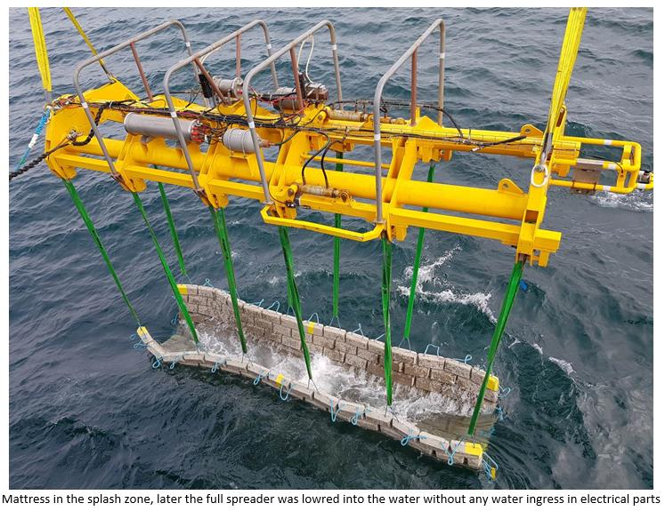
Intentionally left blank
Template for additional photo slides
15
Notes:
Additional protection for branching units and other areas of the cable that require additional protection are covered with concrete “mattresses”. This mattress was deployed off Nome, protecting the Nome Branching Unit

Slide 16
Northwest and northeast routes present opportunities
Provide resilience: diverse path from other cable systems
Facilitate international cooperation for shared Arctic interests
Facilitate responsible development of the Arctic
Enable safety emergency response and safety capabilities
16

Slide 17
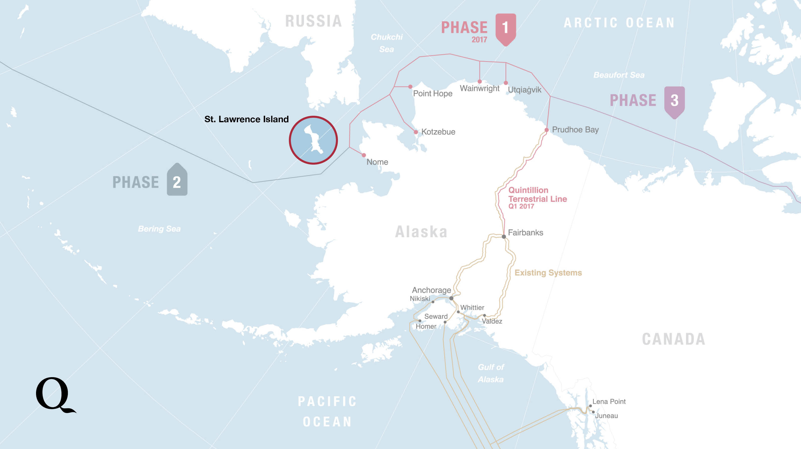
Notes:
St Lawrence Island could facilitate connection of international cables acting as an international meet-me-point in the Arctic.

Slide 18
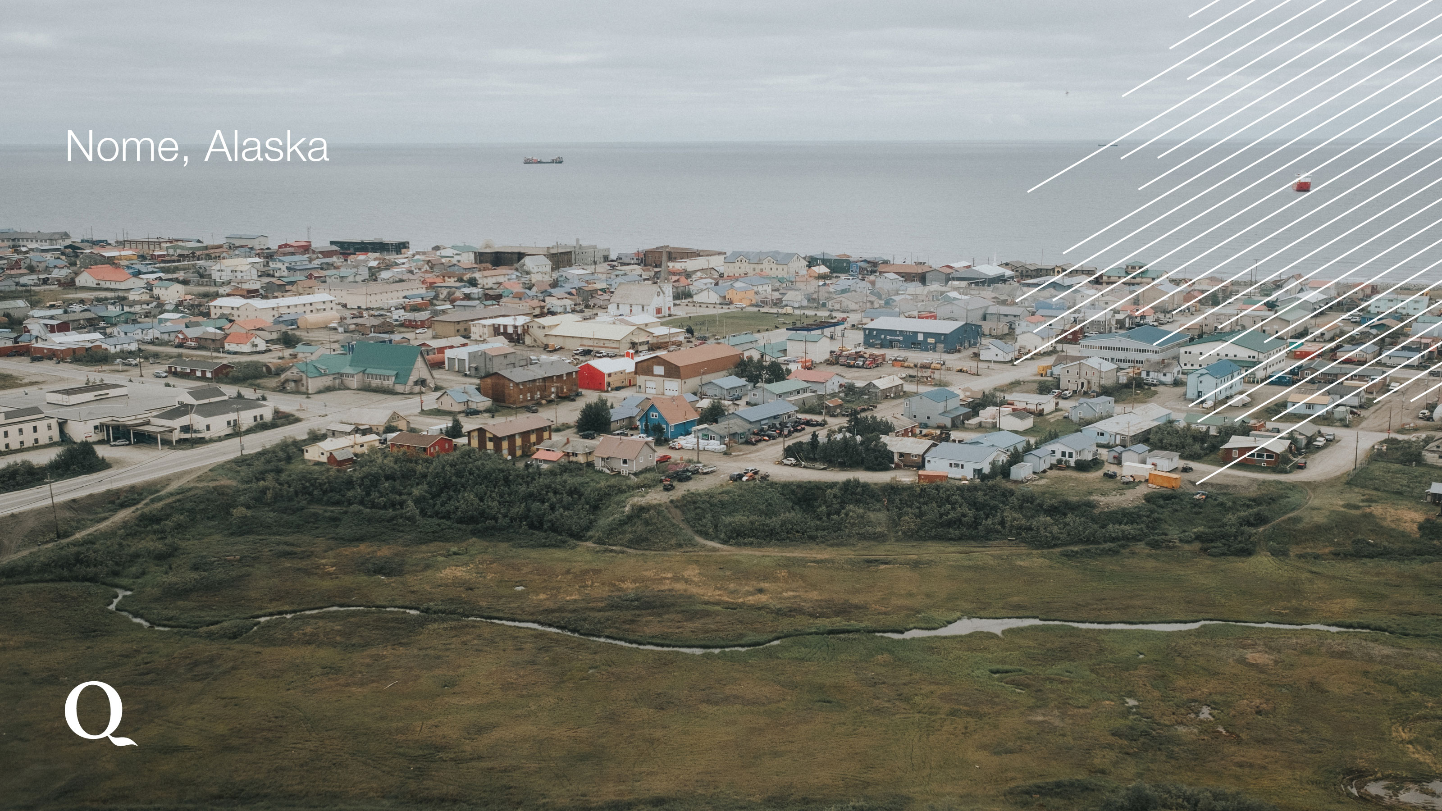
18
Notes:
Remember Nome, Alaska? Well there’s a happy ending to this story. This year, the Quintillion Subsea Cable System is set to turn up service. Years past, the Nome City School District paid over $120,000 a MONTH for 40 Mbps Internet service over MICROWAVE. This year, a telecom provider on Quintillion’s system will be begin serving the Nome City School District providing 100 Mbps at $95,000 a month over FIBER.

