Slide 1
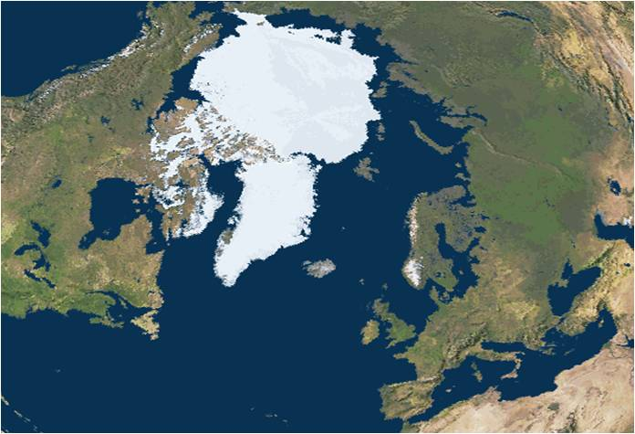
The Impacts of an Ice-Diminishing Arctic on Naval and Maritime Operations –
A Danish Perspective
Rear Admiral Niels Olsen

Slide 2
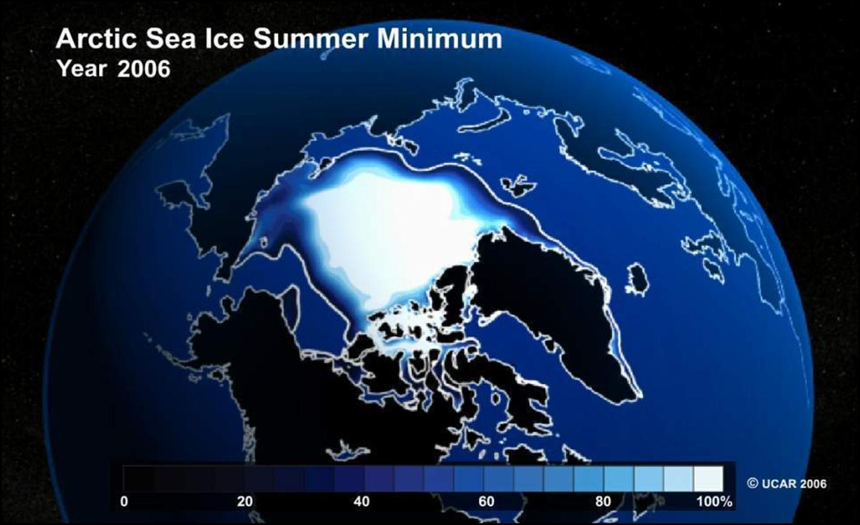
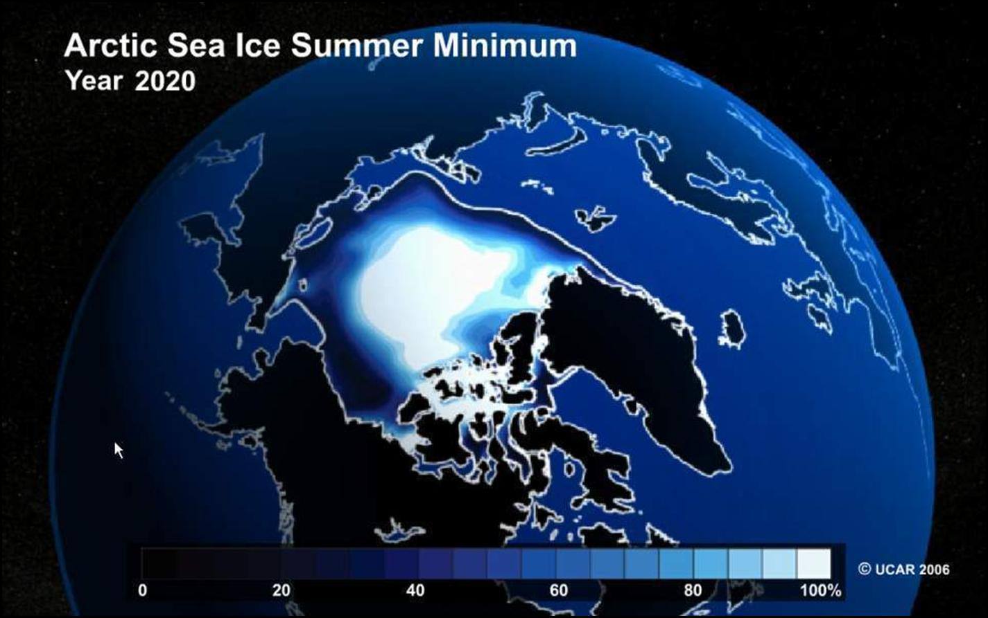
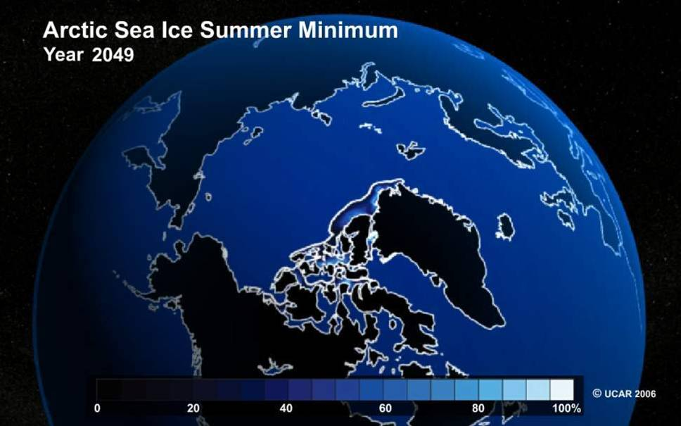
GAME CHANGER

Slide 3
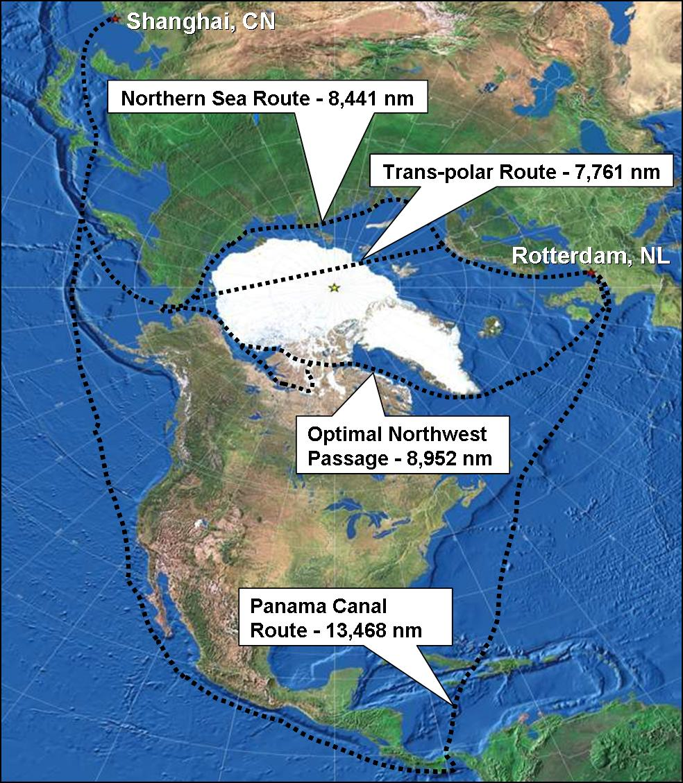
– 37%
– 42%
– 34%

Slide 4
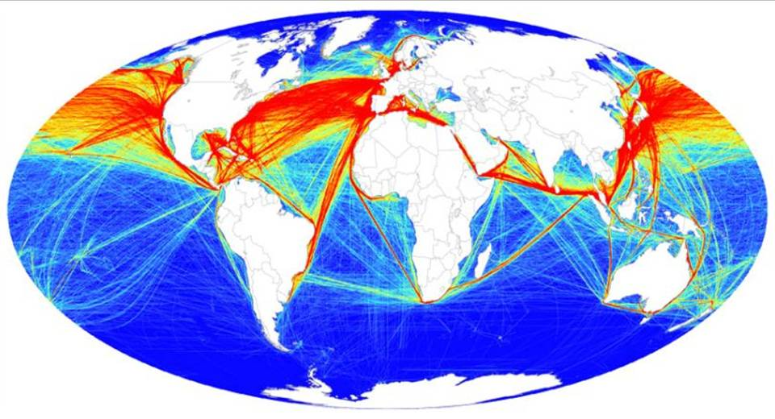
If just some of this head North?
It could lead to massive increase in traffic volume in the Arctic, and a complete transformation of sea transportation

Slide 5
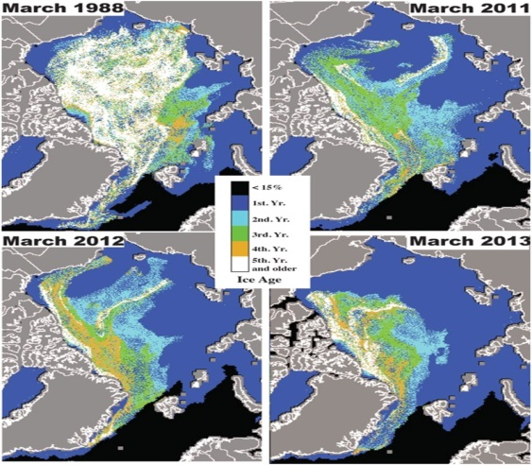
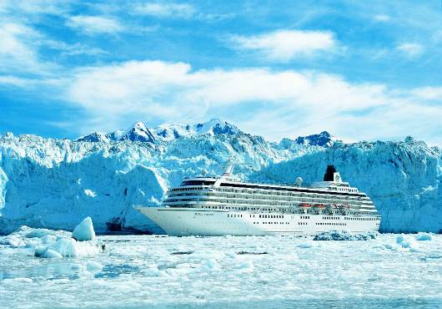
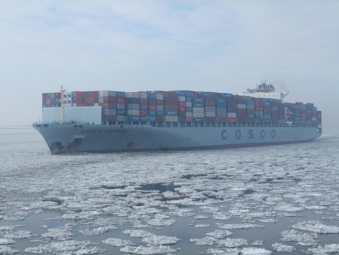
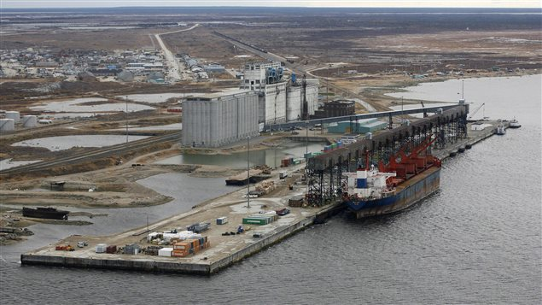
A very simple extrapolation
Arctic Icecap
Human activity
Cruise ships
Merchant traffic
Extraction of resources
Development

Slide 6
A very simple extrapolation
Arctic Icecap
Human activity
Cruise ships
Merchant traffic
Extraction of resources
Development
One thing is certain: It will happen – and it is happening

Slide 7
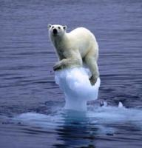
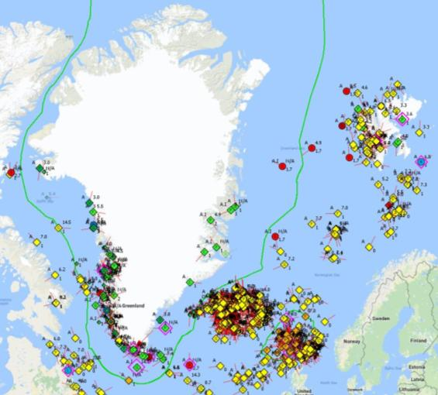
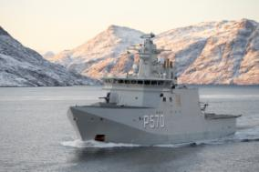
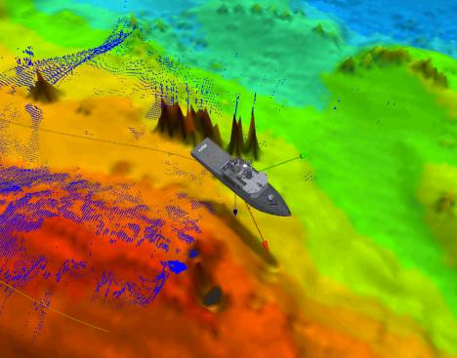
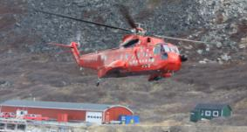
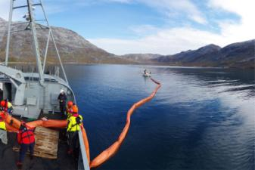
Might not be linear
Might be happening very quickly
Might outpace our capabilities to cope
We better scale up!
More surveillance
More presence
More survey capacity
More search and rescue resources
More emergency response resources

Slide 8
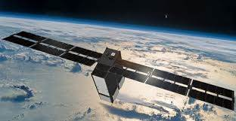
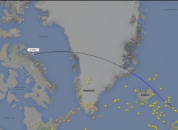
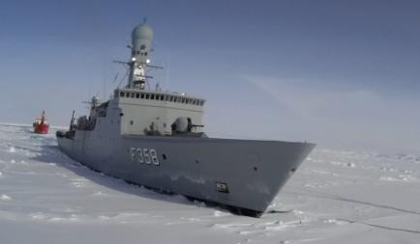
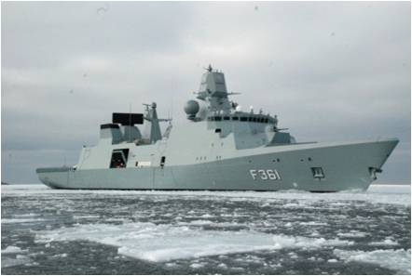
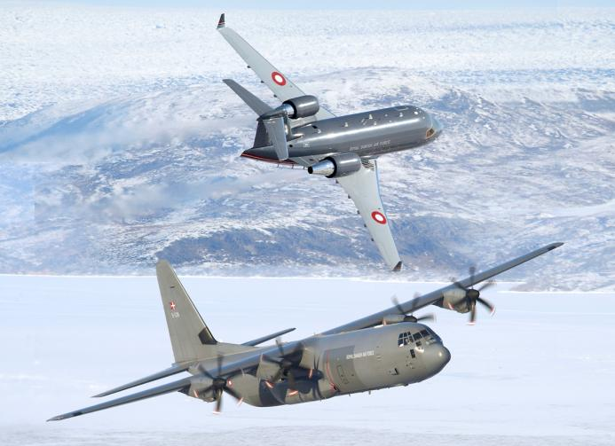
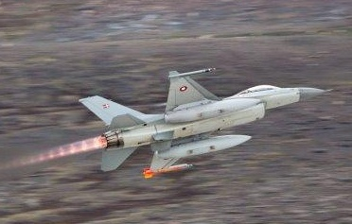
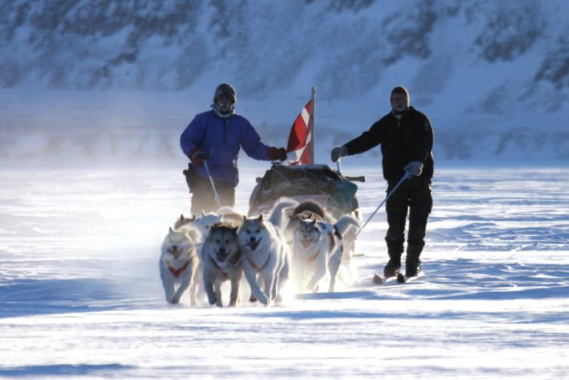
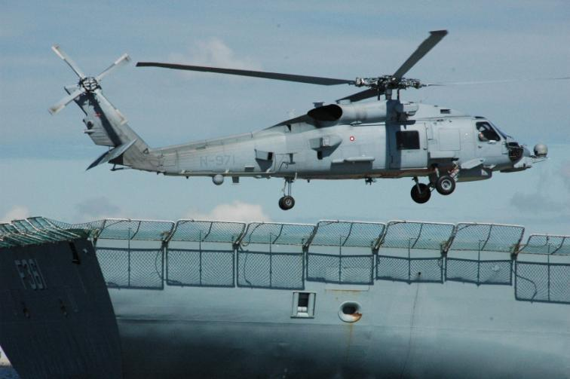
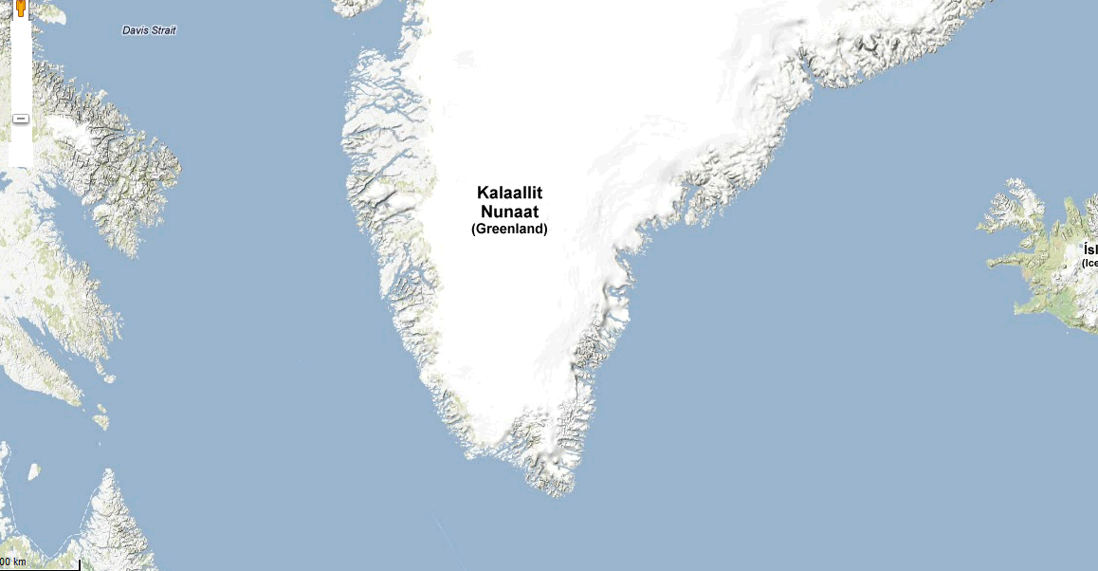
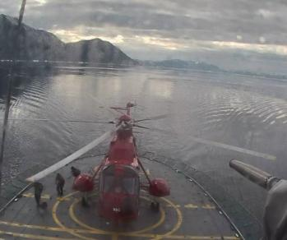
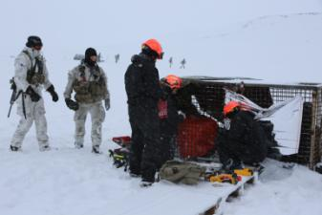
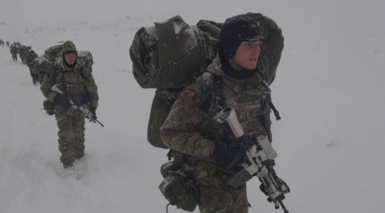
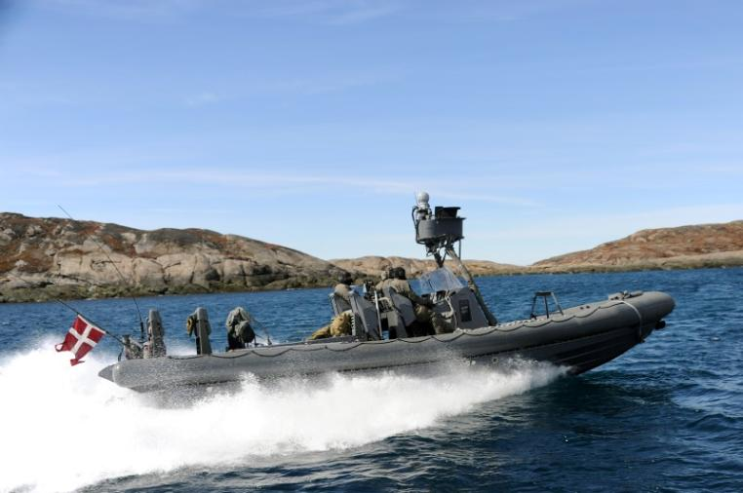
National responsibility will increase, as will our common responsibility.
So what are we doing?
Surveillance
Naval presence
Air & Ground
SAR
MH-60R SEAHAWK
LYNX
Arctic Response Force

Slide 9

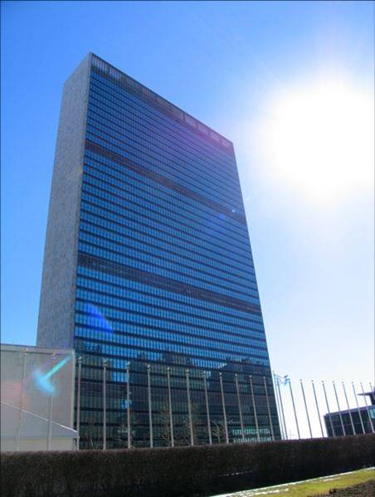

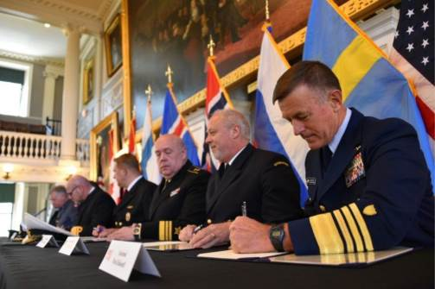
And not least:
More cooperation
Cooperation is critical
and a prerequisite in addressing the challenges
Arctic Council
(Russia)
USA
Canada
Norway
Iceland
NORAD
Kingdom of
Denmark
Sweden
Finland
Germany
Arctic security
forces Roundtable
France
Netherlands
UK
Arctic Council
Permanent
Observers
India
China
Japan
Italy
Singapore
Spain
Poland
Republic of Korea
NATO
Baltic States
Northern Group
EU
Real problems need Real solutions
Real solutions need Real cooperation

Slide 10
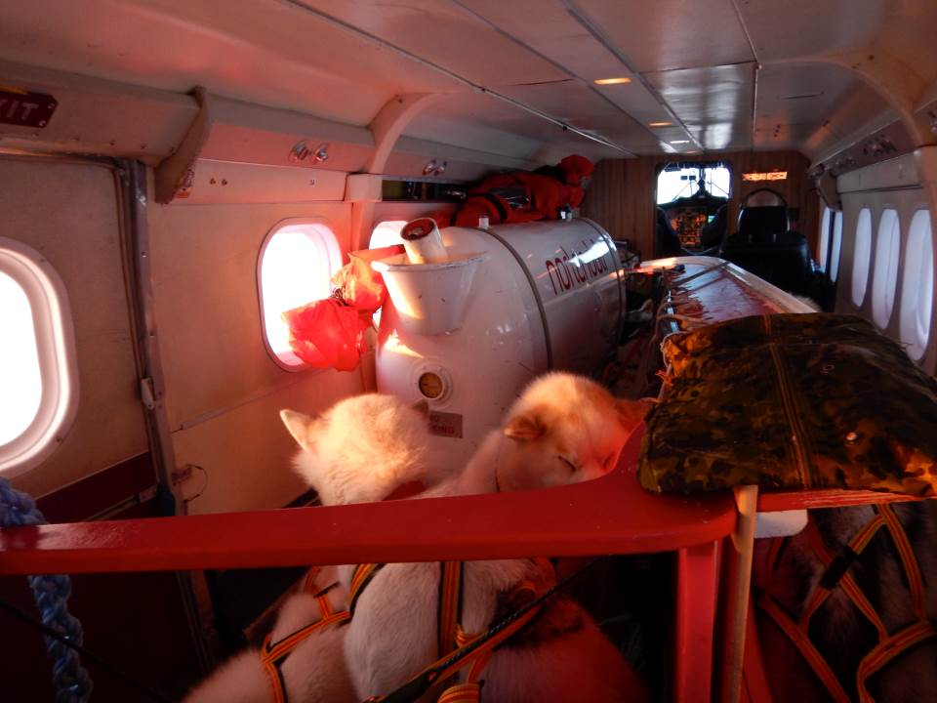
Thank you for your attention
I stand ready to answer any questions

