Slide 1
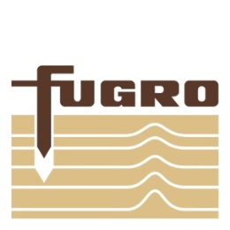
Arctic Information Infrastructure
What’s New, What’s Next
David Millar - Fugro
Notes:
This was actually taken in Canada, I believe, but still the Arctic. ☺

Slide 2
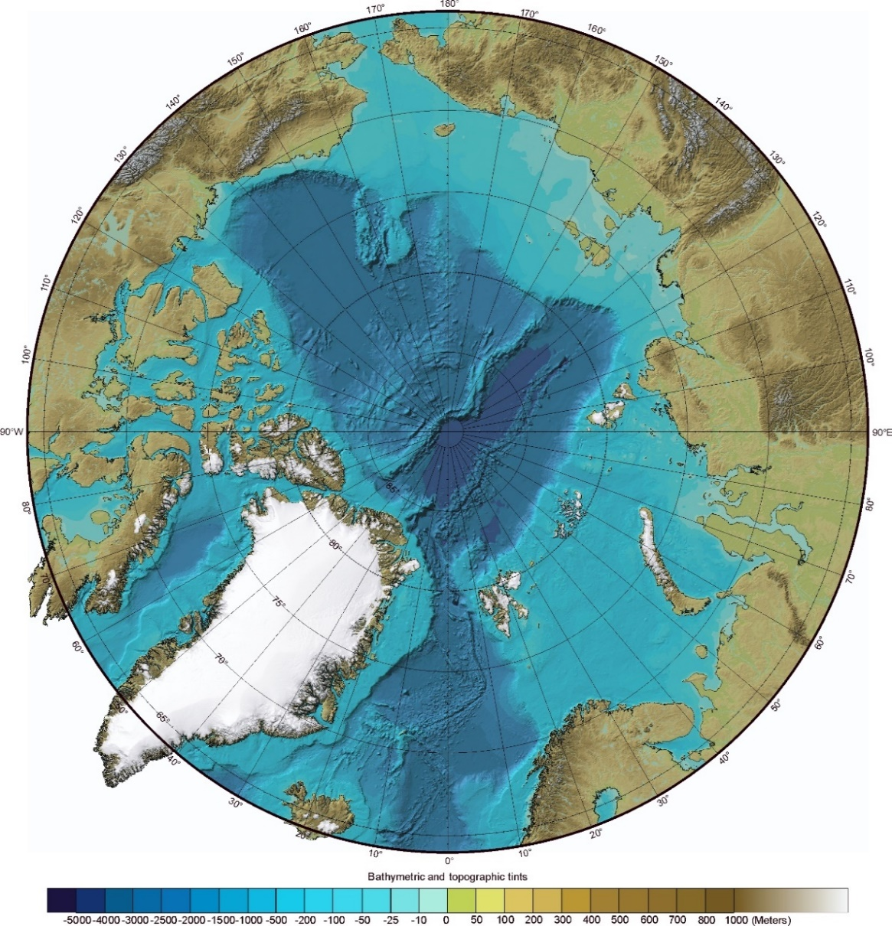
The Need for Ocean Mapping in the Arctic
The Arctic Ocean comprises 15,558,000 square kilometers.
Only 6-7% of these waters are mapped to modern survey standards.
As of 2016, only 2.5% of the U.S. Arctic has been mapped using modern survey techniques.
These data are used to:
support maritime safety
inform ocean policy
guide sustainable use
improve ocean/weather models
identify future research, exploration, and development
Source: International Bathymetric Chart of the Arctic Ocean 3.0 (2012)
7th Symposium on the Impacts of an Ice-Diminishing Arctic on Naval and Maritime Operations
Notes:
Goal here is just to lay out what we mean by Arctic information infrastructure – data about the seabed and the coastline.
The map shown here looks pretty nice for a layperson like me. The next image shows how the map was created, though – so I think it helps to show the massive data gaps. I figure you’ll be able to articulate this well.

Slide 3
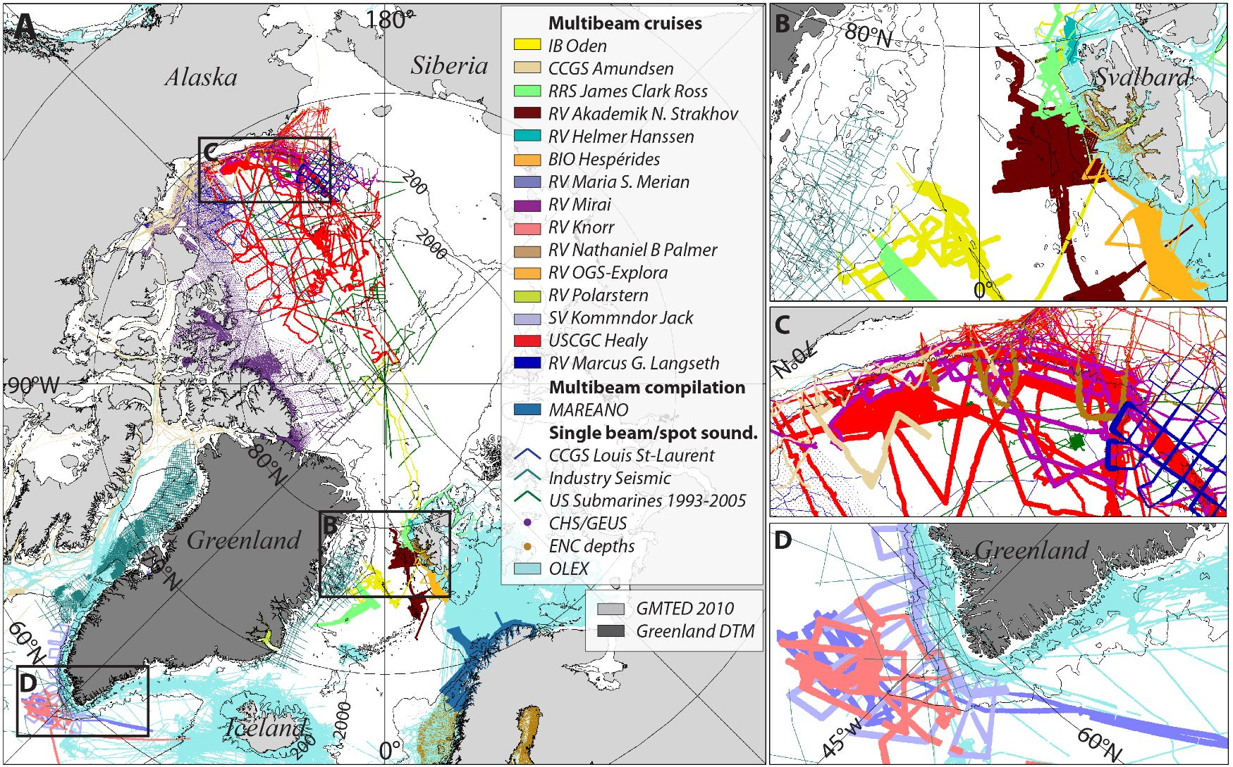
The Need for Ocean Mapping in the Arctic
Source: International Bathymetric Chart of the Arctic Ocean 3.0 (2012)
7th Symposium on the Impacts of an Ice-Diminishing Arctic on Naval and Maritime Operations
Notes:
Source data for the map that came before. This is apparently the most recent map of the series.

Slide 4
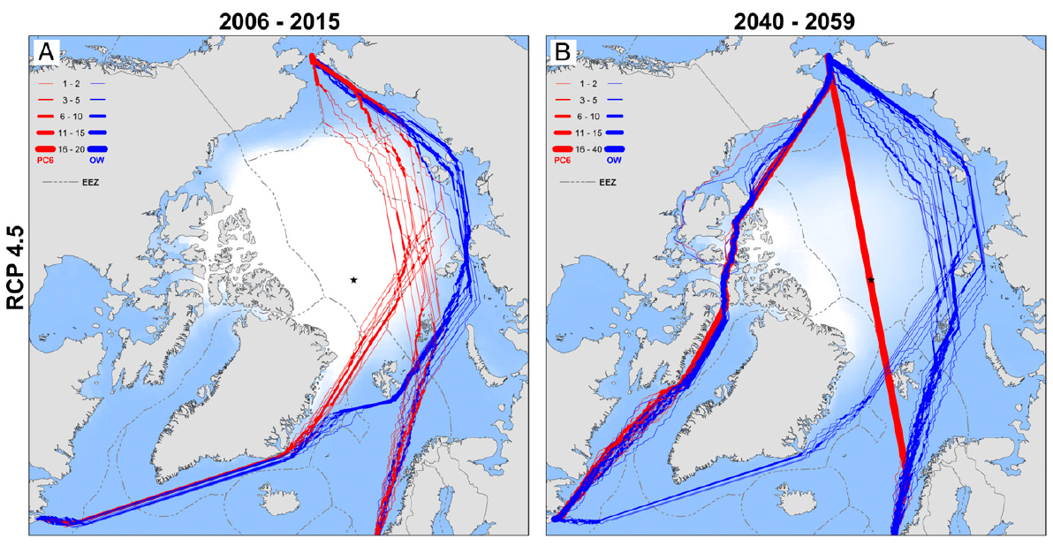
The Opening of Arctic Shipping Routes
Source: The Washington Post
7th Symposium on the Impacts of an Ice-Diminishing Arctic on Naval and Maritime Operations
Notes:
Describe the shrinking polar ice cap and the opening of Arctic shipping routes that will dramatically increase vessel traffic in the Arctic over the next 25+ years

Slide 5
We Have Better Maps of Mars than of our Own Oceans
The World’s Oceans
Satellite altimeter data
5,000 m horizontal resolution
+/- 1,000 m vertical accuracy
Mars
Stereo camera
20 m horizontal resolution
+/- 13 m vertical accuracy
It is impossible to map the ocean floor using radio or other electromagnetic waves
2,300 miles
2,300 miles
1,700 miles
1,700 miles
7th Symposium on the Impacts of an Ice-Diminishing Arctic on Naval and Maritime Operations
Notes:
You may opt not to include this, but I like the slide because:
It gives you a place to say the Arctic is not alone in its data gaps – the entire planet is in need of better mapping
It provides an avenue to talk about multibeam datasets, which is important to later slides.

Slide 6
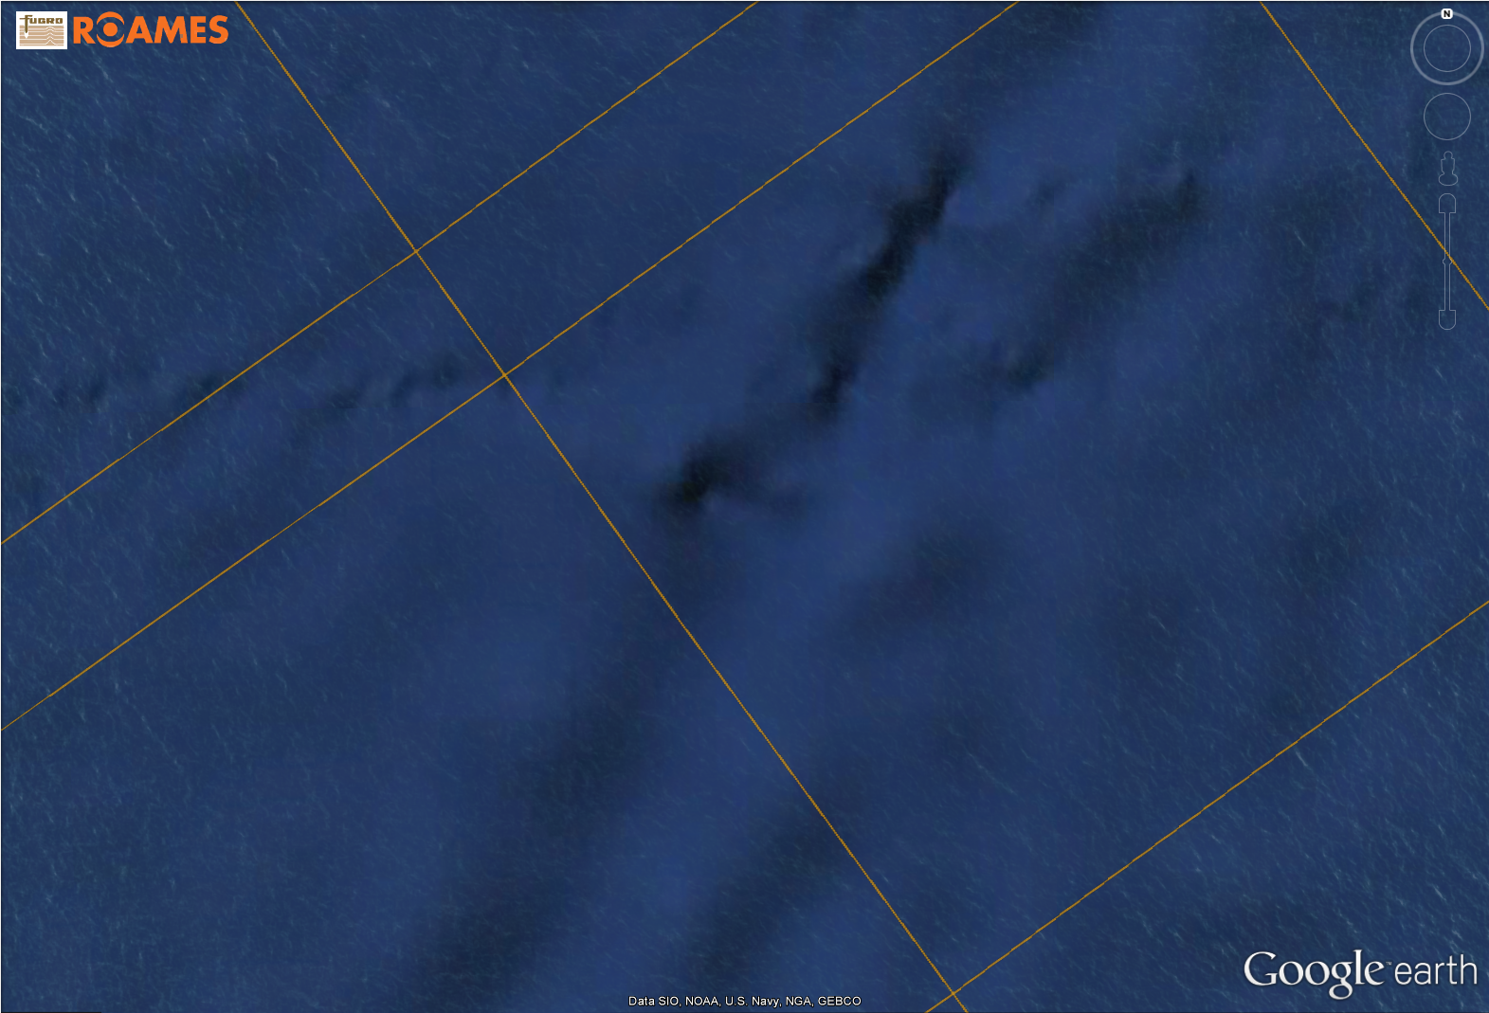
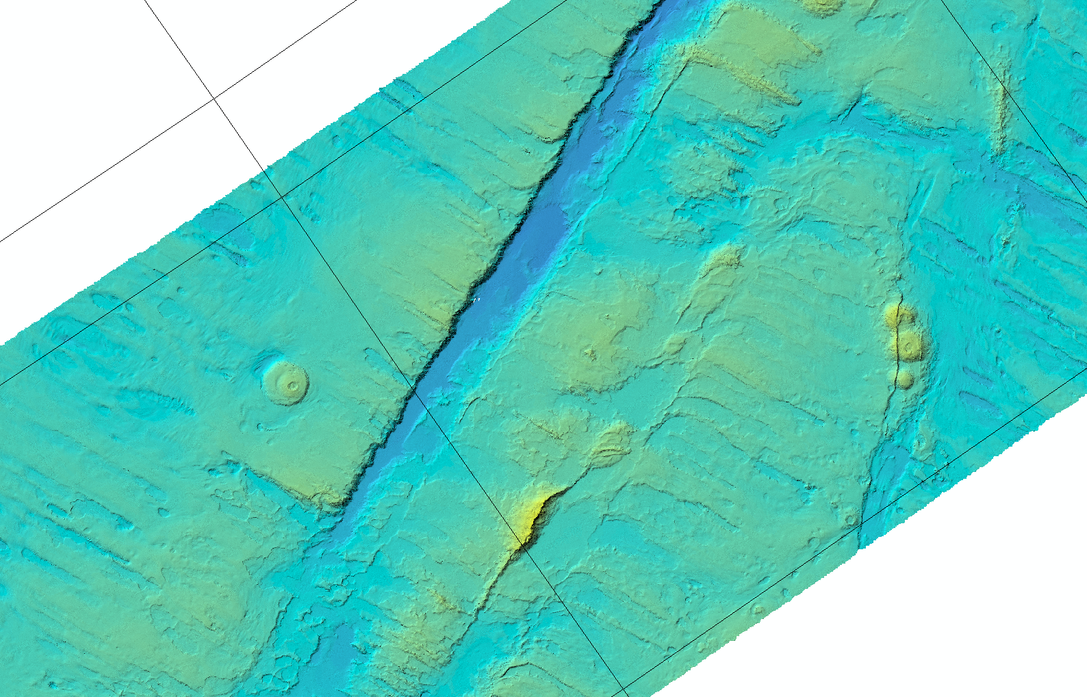
MH370 - Bathymetry from Satellite Altimeter vs. Multibeam
Geelvink Fracture Zone
100 km
Geelvink Fracture Zone
100 km
Notes:
Combined to one slide as a time saver. Rada and I really like this slide because it shows the power of multibeam and the MH370 reference underscores to Fugro’s leadership role in the industry.

Slide 7
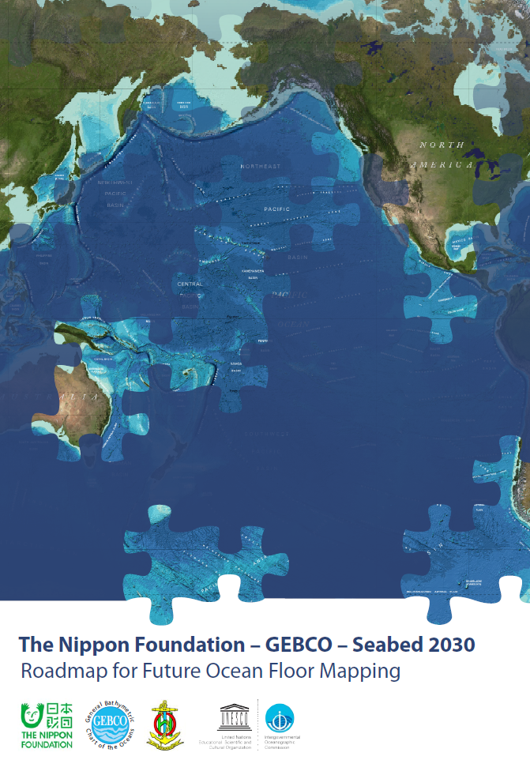
A Global Push to Map the World’s Oceans
Seabed 2030
Shell Ocean Discovery XPrize
7th Symposium on the Impacts of an Ice-Diminishing Arctic on Naval and Maritime Operations
Notes:
Assume here you’ll speak briefly on the different initiatives with a quick mention on Fugro’s role in each.

Slide 8
Regional Strategies for Closing the Data Gap
Map once, use many times. Bathymetric data has numerous purposes beyond providing accurate depth measurements. Examples include marine habitat characterization, inundation modelling, environmental baselining and resource evaluation and cataloguing.
Interagency collaboration. By sharing existing datasets, new acquisition priorities, and available funding, government agencies can better serve the public by meeting tomorrow’s data needs with today’s dollars.
Private-sector partnerships. The private-sector has a proven track record of teaming with academic and government partners to deliver technology innovations in acquisition, processing, and deliverables.
7th Symposium on the Impacts of an Ice-Diminishing Arctic on Naval and Maritime Operations
Notes:
This last bullet is a segue to the next slide, which is where Fugro shines (not that we are trying to sound like a commercial).

Slide 9
Partnership Examples
Seabed Seep Hunting: utilizing the backscatter data from regional (>1,000,000 km²/year) multibeam datasets to assist in natural seeps hunting.
NOAA, Penobscot Bay: integrating satellite derived bathymetry, airborne lidar bathymetry, and vessel-based multibeam techniques for faster/safer nautical charting.
Arctic Domain Awareness Center (ADAC), Arctic Satellite Derived Bathymetry: a project planned for 2017 to test the ability of SDB to address the shortfall in Arctic nearshore bathymetry.
7th Symposium on the Impacts of an Ice-Diminishing Arctic on Naval and Maritime Operations
Notes:
Depending on the time, you may choose to talk about each or highlight one in particular. The goal here is to hit a little of the ‘what’s now’ and ‘what’s new’ that was teased in the intro and tie it back to Arctic mapping.

Slide 10
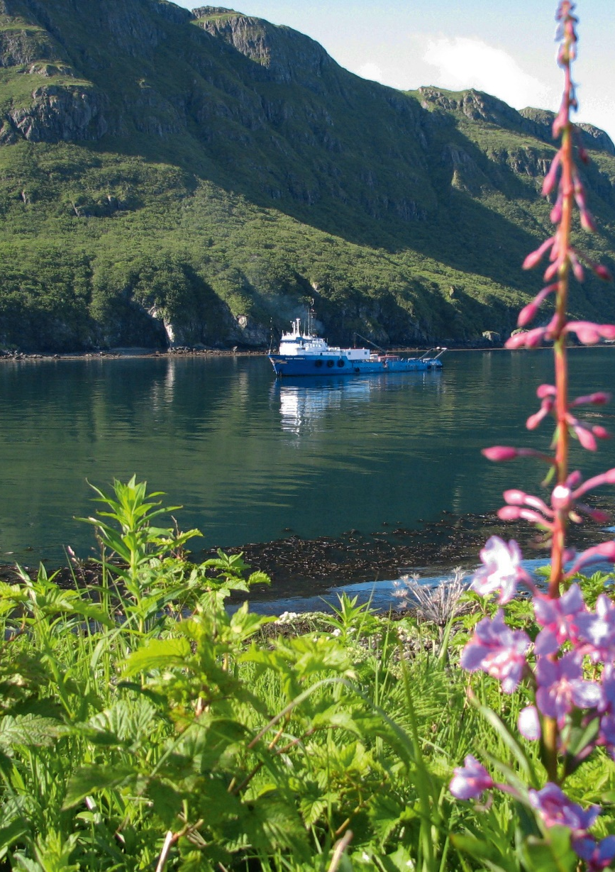
Coastal Mapping is Another Critical Need
Coastal communities in Alaska are facing changing ocean and weather conditions, making the need for accurate coastal mapping data increasingly urgent.
Additionally, a significant portion of Alaska’s economy is driven by maritime transportation and marine resources, which also needs accurate and updated coastal mapping data.
Though the rest of the nation is served by the National Coastal Mapping Program, Alaska is not.
The Digital Coast Act introduced in January 2017, co-sponsored by Alaska Senators Murkowski and Sullivan, seeks to fill these data gaps.
7th Symposium on the Impacts of an Ice-Diminishing Arctic on Naval and Maritime Operations
Notes:
Coastal mapping merges shallow water, shoreline, and coastal elevation datasets for seamless depictions of the land-sea interface.
Much of the state’s 33,904 miles of coastline is unmapped our outdated.
A significant portion of Alaska’s economy is driven by maritime transportation and marine resources. Coastal communities face increasing challenges due to changing ocean and weather conditions, and the need for accurate coastal mapping data is becoming increasingly urgent.
The Digital Coast notes the following: “(2) focus on filling data needs and gaps for coastal management issues, including with respect to areas that, as of the date of the enactment of this Act, were underserved by coastal data and the areas of the Arctic that are under the jurisdiction of the United States;” The bill unanimously passed the Senate without amendment by unanimous consent
In late May.

Slide 11
Benefits to a Well Mapped Arctic
Safe Navigation
Domain awareness
First responders
Arctic shipping lanes
Insurance rates
Resource Development
Mineral leasing, exploration, development
Fishing (commercial, sport, subsistence)
Efficient Infrastructure Siting
Fiber optic cables (Tokyo-Alaska-London)
Pipelines
Power cables
Ports and harbors
Rate of Change Monitoring
Coastal erosion
Marine science and research
Nautical charts for save navigation
Cable routing for telecommunications
7th Symposium on the Impacts of an Ice-Diminishing Arctic on Naval and Maritime Operations
Notes:
Final slide to remind people why it all matters.

Slide 12
Questions?
David Millar
Fugro USA, Inc.
DMillar@fugro.com
+1 858 427 2005
www.fugro.com

