Slide 1
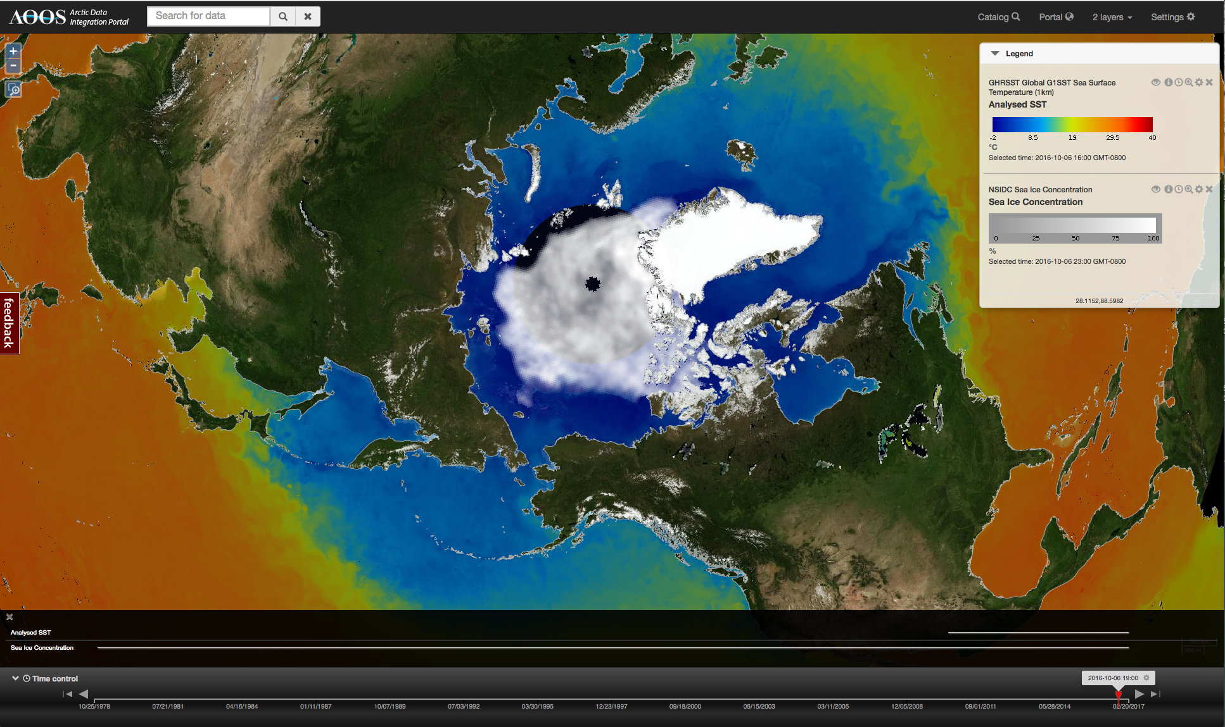
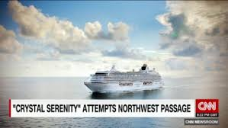
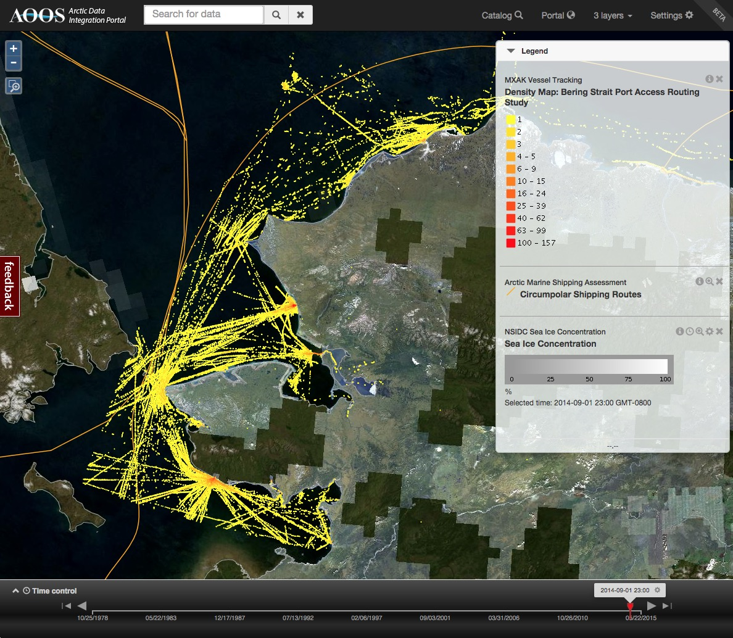
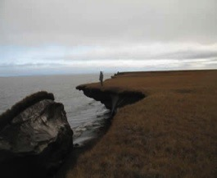
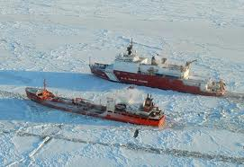
Planning for the Emerging Arctic Marine Highway
Molly McCammon
Alaska Ocean Observing System
July 19, 2017
Notes:
Very small investment compared to icebreakers & ports; millions not hundreds of millions
Stakeholder driven, science based, policy neutral
Ocean information for decision-making

Slide 2
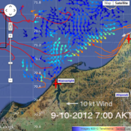
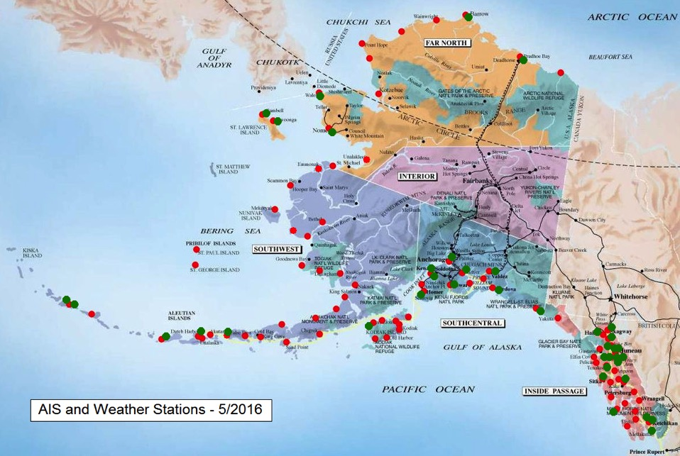
Navigation Safety Observations
Freeze-up detection buoy
High frequency radars: surface current mapping
Wave buoys
Notes:
Multiple observing platform needs:
1. High frequency radars – surface current maps for search and rescue, oil spill response
2. Wave buoys
Add weather packages to AIS stations, more localized weather
Freeze-up detection buoy

Slide 3
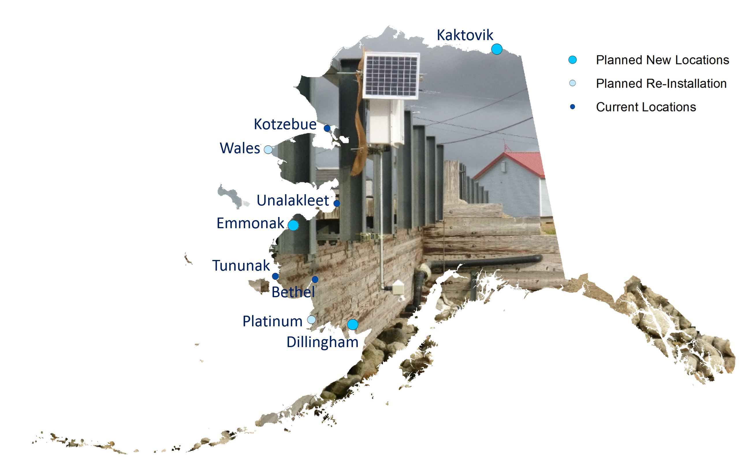
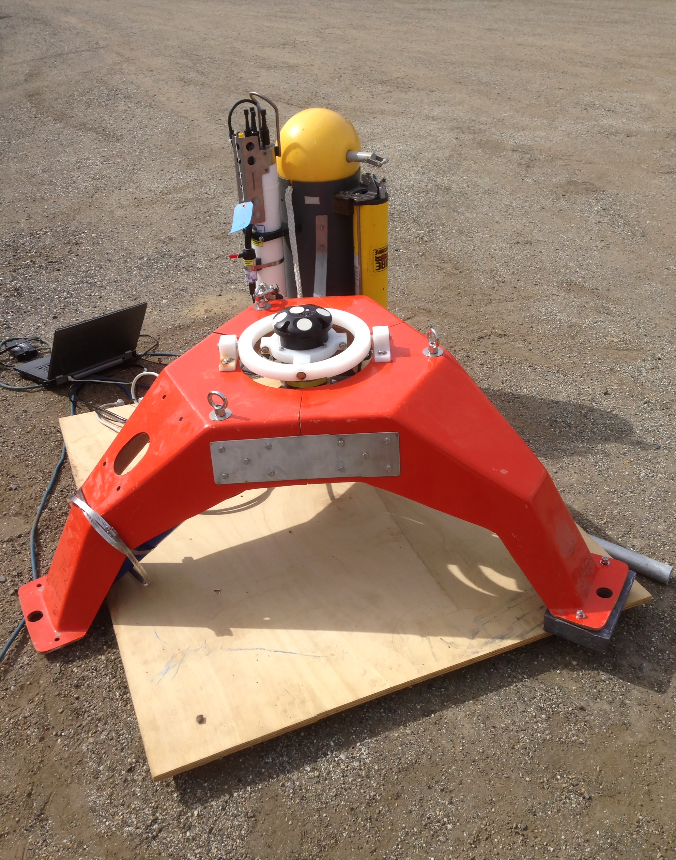
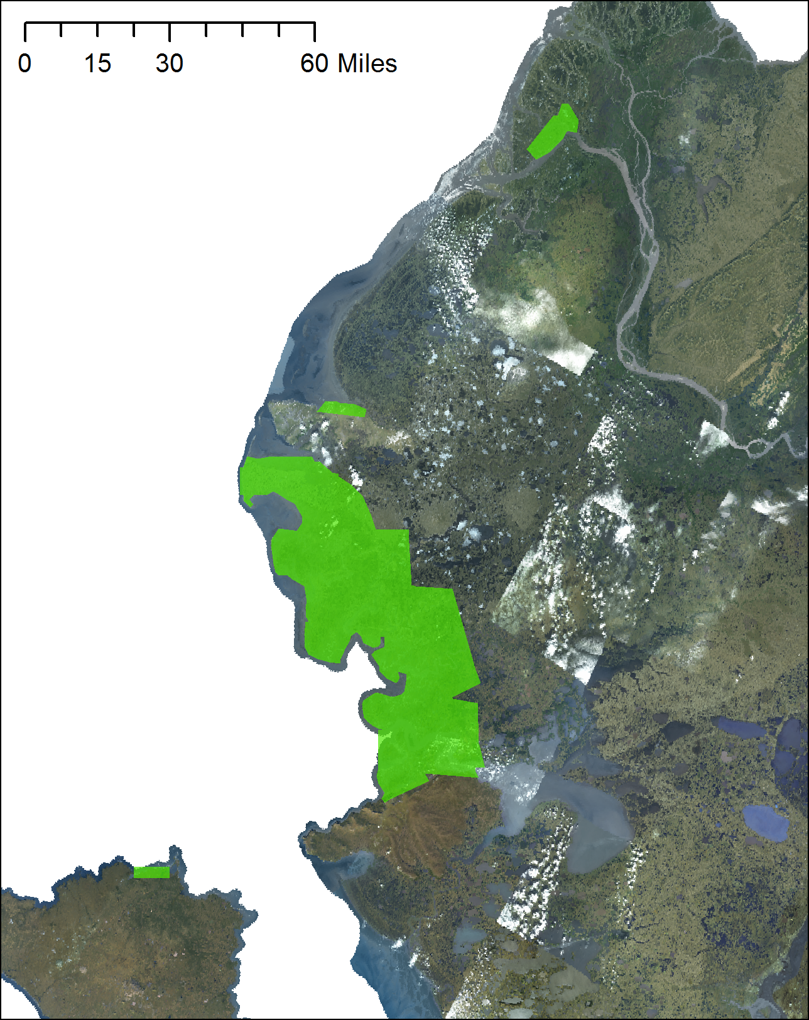
iGage ultrasonic acoustic water level gauges in 9 remote communities
Alaska Water Level Observation Network
Land-based GPS Reflectometry with private Sector Partners:
UNAVCO - NSF funded Plate Boundary Observatory
ASTRA, LLC
Accurate Sea Level Observations in the Beaufort Sea
Rapid Installation water level devices in remote villages
USGS 3D Elevation Program (3DEP) LIDAR over the Yukon and Kuskokwim River Deltas:
7 federal and state partners
Notes:
Water level obs: critical for storm & storm surge forecasting, planning for coastal erosion, emergency response
3 water level gauges along 3000 km of west coast of Alaska; compared to 3 gauges along 50 km of Delaware coast
Testing new technologies: GPS reflectometry; community flood maps; low-tech gps gauges

Slide 4
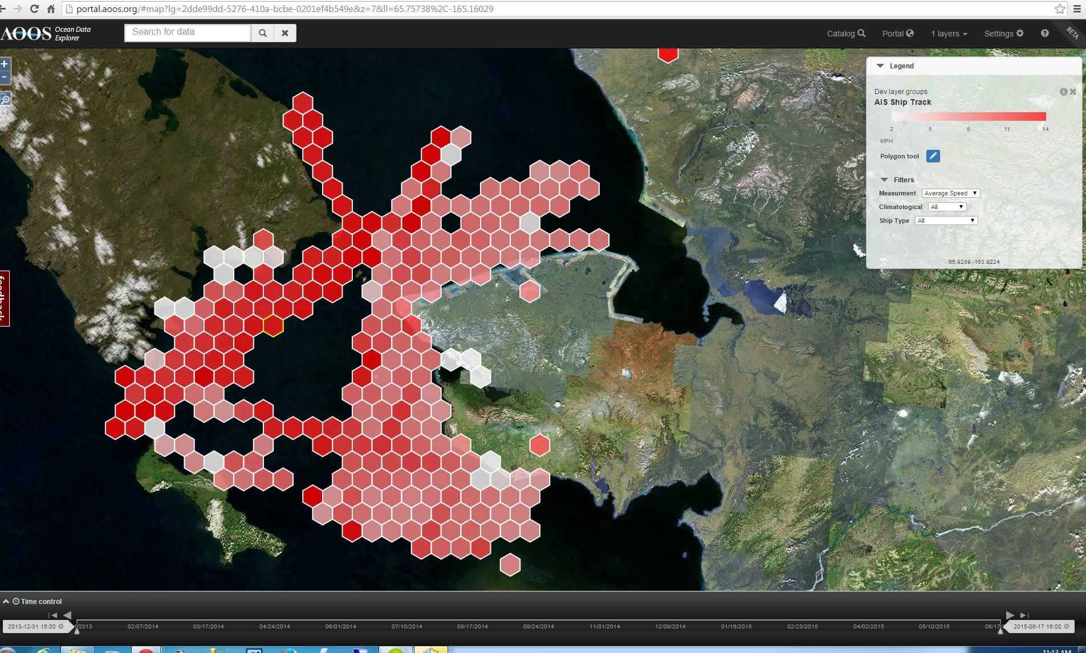
AIS Vessel Tracking Database
Prioritize bathymetry surveys
Oil spill scenarios
Subsistence harvest conflict avoidance
Vessel-marine mammal avoidance

Slide 5
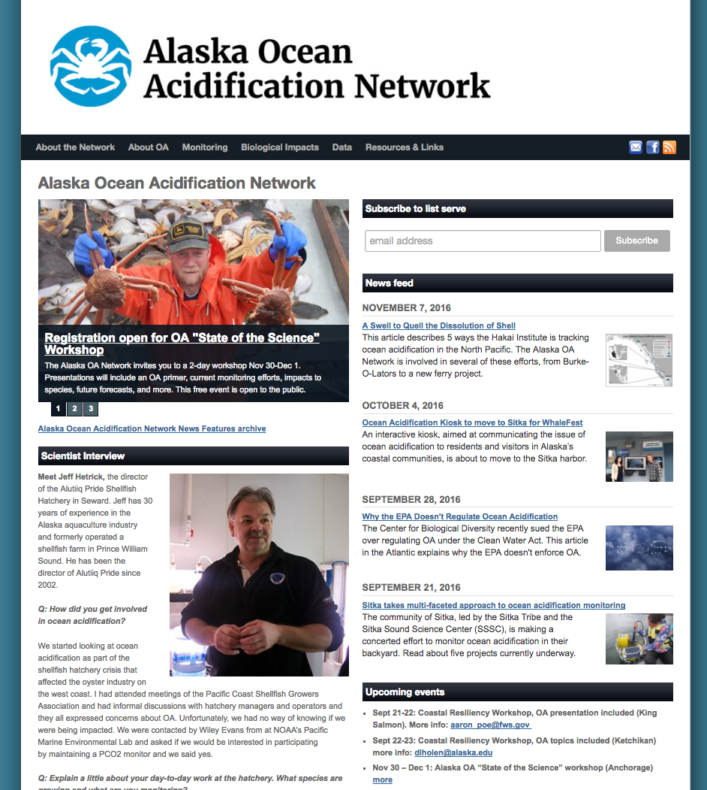
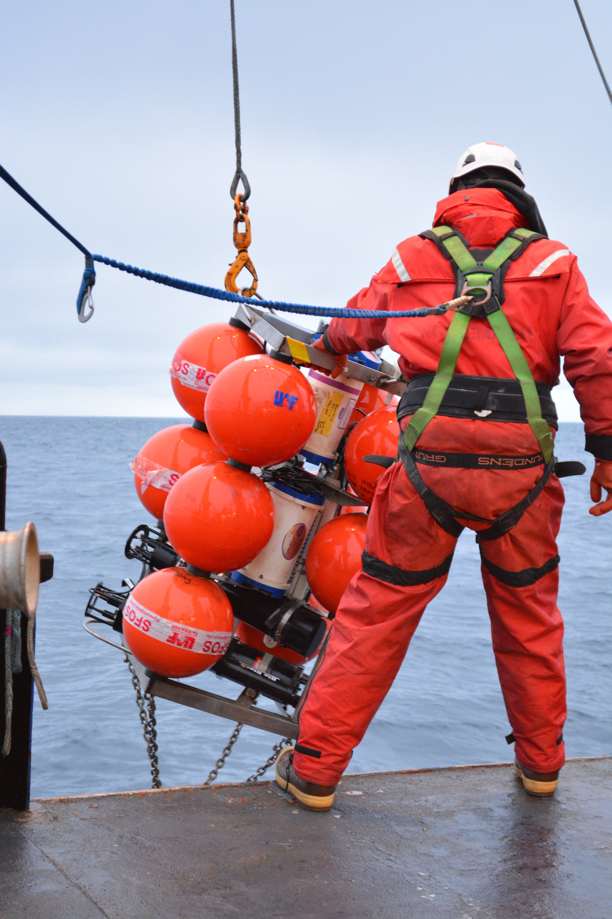
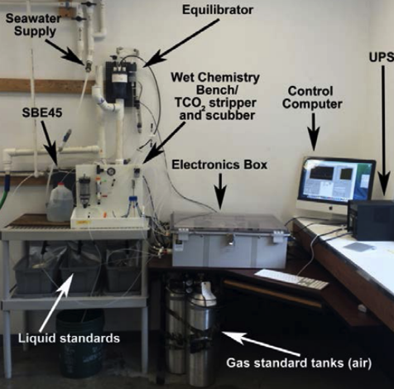
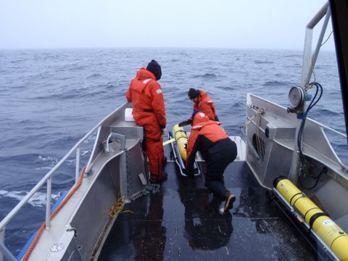
Environmental Intelligence
Notes:
Part of marine domain awareness:
Coordinate the AK Ocean Acidification Network; starting a new Harmful Algal Bloom Network
Support buildout of ecosystem moorings in Chukchi & Bering Seas
Whale glider – use acoustic recorders on gliders to track marine mammals in near real time

Slide 6
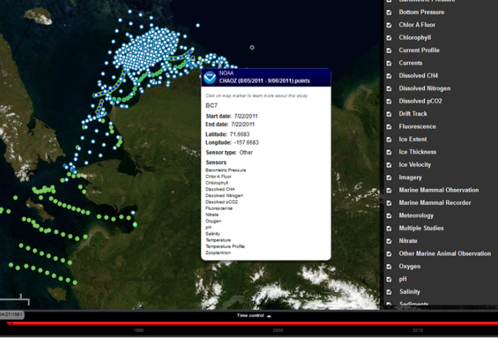
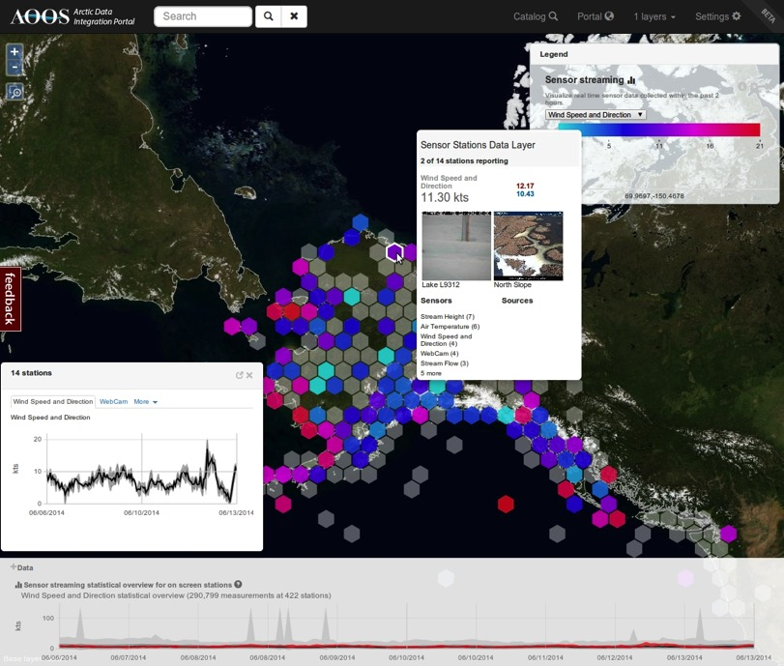
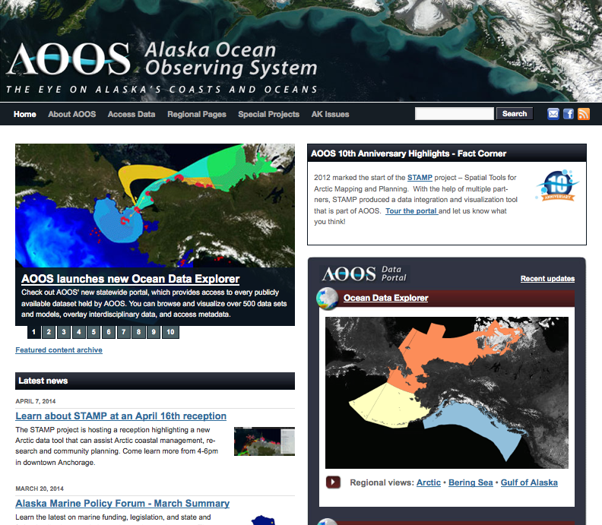
NOAA-certified Regional Data Assembly Center: Arctic Data Portal
Sustained capacity
Largest collection of data
in Alaska, all Real-Time data,
Arctic Marine Synthesis Atlas
Polar projection
Stacks & visualizes multiple
data layers
High Performance Compute
capacity
Industry Arctic data
Specialized decision support
tools, portals & products:
Research Assets Map, Historic
Sea Ice Atlas, Seabird Portal,
Aleutian/Bering Sea Climate
Vulnerability Assessment, ERMA
testbed

