Slide 1
Cal/Val Tasks Status
13 January 12
Kris Robinson
Kris.Robinson@sdl.usu.edu
(781) 275-8273

Slide 2
SDL ATMS Cal/Val Tasks
Task #16 Geolocation Verification
Task #23 Raob Validation

Slide 3
Task 16: Geolocation Verification
OBJECTIVE:
Evaluate pointing tolerance of the ATMS FOVs
DESCRIPTION:
Tools
SDL tool to plot geolocated data (GeoBrowser)
SDL tool to determine coastline points and compare to coast truth (GeoLocate)
Cal/Val Phase(s): Sensor Checkout, ICV, LTM
Sensor mode: normal mode SDRs
Expected Results:
5.2° (channels 1,2) pointing tolerance validated to .3°
2.2° (channels 3-16) pointing tolerance validated to .2°
1.1° (channels 17-22) pointing tolerance validated to .1°

Slide 4
Geolocation Verification Method
Pick multiple regions with high coastline contrast and orbits with coastal crossings close to nadir (BP 24-74)
Calculate the inflection point between every four consecutive
points in across-track rows and along-track columns
Compare points to actual coast (GSHHS fine resolution dataset)
For each approximate coastline point the intersection of the perpendicular is found on the actual coast. This distance is separated into a North-South and East-West error
Accumulate error statistics for Channels 1,3,16 & 17

Slide 5
Regional Overview

Slide 6
4 Regions
Baja Peninsula
10 Data Sets
10500 Crossing Pts.
US East Coast
12 Data Sets
7500 Crossing Pts.

Slide 7
4 Regions
South America West Coast
12 Data sets
4500 Crossing Pts.
Red Sea
9 Data sets
5800 Crossing Pts.

Slide 8
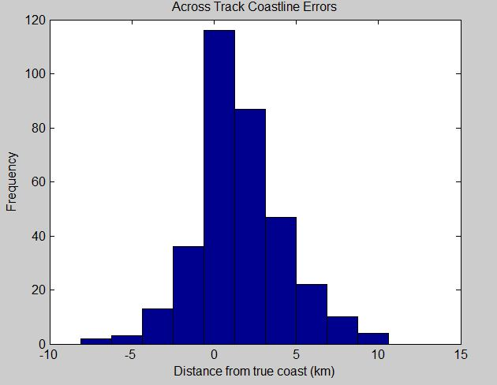
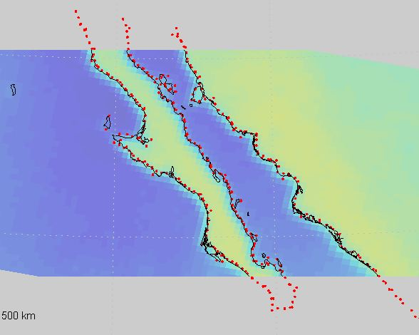
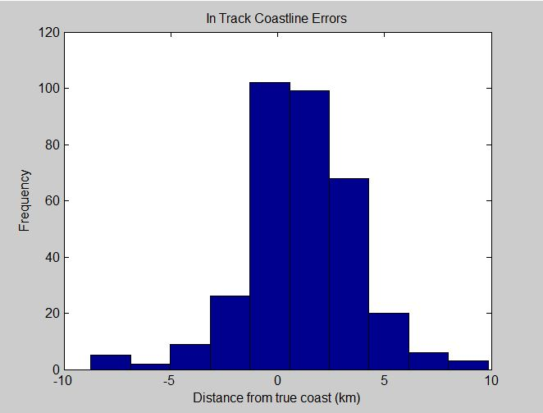
Baja Individual Data Set
Orbit 610
11 Dec11
4 Granules
285 Crossing Pts. (Channel 1)

Slide 9
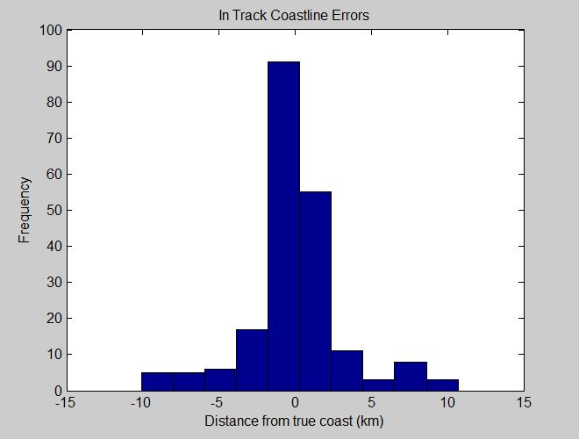
US East Coast Individual Data Set
Orbit 779
22 Dec 11
4 Granules
221 Crossing Pts. (Channel 1)

Slide 10
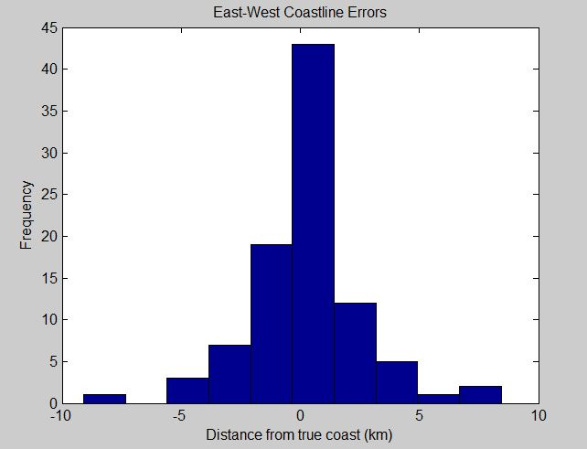
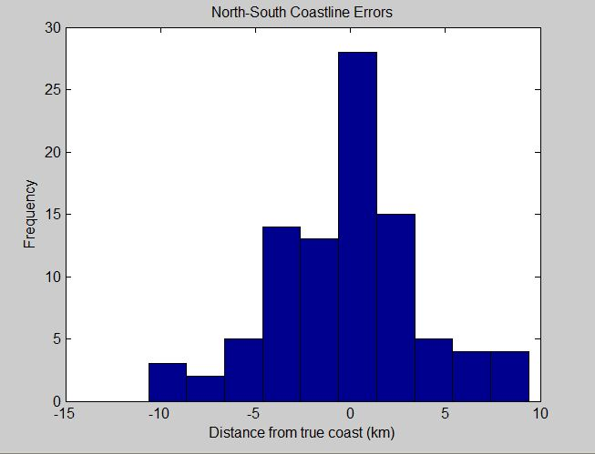
South America West Coast Individual Data Set
Orbit 622
11 Dec 11
5 Granules
130 Crossing Pts. (Channel 1)

Slide 11
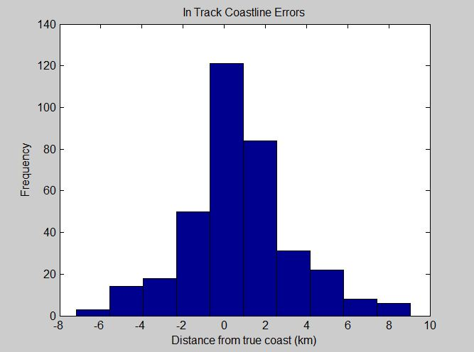
Red Sea Individual Data Set
Orbit 668
14 Dec 11
7 Granules
271 Crossing Pts. (Channel 1)

Slide 12
Preliminary Data Analysis

Slide 13
Channel 1 Individual Data Sets – 4 Regions
Mean – slight positive bias
Mean – slight positive bias

Slide 14
Channel 3 Individual Data Sets – 4 Regions
Mean – Positive bias
Mean – Positive Bias

Slide 15
Channel 16 Individual Data Sets – 4 Regions
Mean- very slight negative bias
Mean ~ 0

Slide 16
Channel 17 Individual Data Sets – 4 Regions
Mean ~ 0
Mean ~ 0

Slide 17
Summary
12 days of data
4 geographic regions
40+ data sets per channel
100 – 300 crossing pts. each data set
28K total crossing points
Slight mean bias on some channels
More data sets necessary
Positive initial results

Slide 18
Questions

Slide 19
Task 23: Raob Validation
OBJECTIVE:
Validate ATMS calibration through independent observations
DESCRIPTION:
Tools
Dedicated radiosonde soundings
NPROVs – EDGE
Radiative Transfer Model – OSS, Rosenkranz, MODTRAN,
Cal/Val Phase(s): Sensor Checkout, ICV, LTM
Sensor mode: normal mode SDR/EDR
Expected Results:
Mean & Standard Deviation of differences over time

Slide 20
Method
Two observations of two dedicated radiosondes daily
“Bracket” the NPP overpass
Co-location with overpass in space and time is critical
3 locations (high-latitude, mid-latitude, tropical)
ARM/CART sites and/or SDL
Several months of observations
Calculate ATMS minus Raob for Rh and Temp and trend
Use Raob as input to an RTM and trend differences for model validation
Continue difference trending during long term monitoring

Slide 21
Questions

