Slide 1
NGES Cal/Val
Kent Anderson
13 January 2012

Slide 2
NGES Evaluation Tasks
1. Activation Sequence (SEV-1)
3. Functional Evaluation (SEV-3)
4. Dynamic Range (SEV-6)
8. Scan Angle (SEV-7)
9. Radiometric Sensitivity (VER-1)
10. Temperature Stabilization (SEV-8)

Slide 3
1. Activation Sequence (SEV-3)
ATMS Activation Sequence Flow
Incorporates required spacecraft operations
All commands issued from ground (no stored commands)
Activation includes monitoring various telemetry points to ensure ATMS is ready to proceed

Slide 4
Activation Sequence (cont.)

Slide 5
3. Functional Evaluation (SEV-3)
Parameters:
  Passive Telemetry Assessment
  Health and Status Telemetry
  Engineering (Hot-Cal) Telemetry
  Timing and Synchronization
  Video Test Channels
Scope: Trending over Orbits 163 – 603
Characterization:
  Compliance with specified limits
  Stability
Results to be reported in ATMS PFM On-Orbit Verification Report (RE17650)
  Scheduled submission by end of January
  Further evaluations to be performed only as needed in response to NASA/NOAA requests

Slide 6
Example Telemetry Trending Results
All ATMS internal voltages are well within specified limits
All ATMS internal temperatures are well within specified limits
Receiver Shelf Temperatures remain stable

Slide 7
Scan Synchronization Assessment
Scan Synchronization was analyzed over 1500 scans of data
Delta time between BP1 & 8 Second Pulse is at max 0.06 msec, within specification of 25 msec.

Slide 8
7. Dynamic Range (SEV-6)
Parameters:
  Predicted maximum radiometric counts
Scope: Based on data collected from orbit 163
Characterization:
  Dynamic range is assessed by comparison to requirement that maximum allowable radiometric counts, for any channel, shall be < 45,150
  The dynamic range assessment is done by extrapolating the warm target counts to a 330 K temperature, using gains computed from on-orbit data.
  As shown in following chart, for orbit 163, all channels consistently met the criterion that counts (330K) < 45,150. Dynamic range requirements are satisfied.
Results shown in following chart, demonstrating the requirements are satisfied
Re-assessments to be performed only as needed
  Upon request from NASA/NOAA
  In the event of a significant counts increase and/or gain increase

Slide 9
Dynamic Range Charts, Orbit 163
Over 13,100 counts margin relative to 45,150 limit

Slide 10
8. Scan Angle (SEV-7)
Parameters:
  Reported scan angles during the Earth-view sector
Scope: Based on data collected from orbits 163-603
Characterization:
  For first scan of each orbit, determine the maximum positive and maximum negative angle error occurring during the Earth-view sector
  Plot versus orbit number, to assess any trends
Results shown in following chart
  Requirements are satisfied
  No notable trends
Re-assessments
  As needed, upon request from NASA/NOAA
  Will consider monitoring end-of-slew ripple characteristics, as a possible indicator of bearing friction increases

Slide 11
Scan Angle Data
ATMS Scan Angle Errors in the Earth View are well within specification with no negative trend

Slide 12
9. Radiometric Sensitivity (VER-1)
Parameters: NEΔT
Scope:
  Precise values based on data collected from orbit 164, to assess compliance and for comparison to ground test values
  Approximate values plotted for orbits 163-603, to assess stability
Characterization, for spec-compliance assessment:
  Computed as standard deviation of inferred warm cal brightness temperature errors
  Calibration uses uniform weighting of 9 scans of calibration data
  Standard deviation computed from sliding window of 201 scans (804 warm-cal samples)
  Reported NEΔTs are the average over the entire orbit
Results shown in following charts
  Requirements are satisfied
  No notable differences from ground calibration test results
  No notable trends over orbits 163-603
Re-assessments: Only as needed, upon request from NASA/NOAA

Slide 13
Equations for NEΔT Computation

Slide 14
NEΔT Equations (cont.)

Slide 15
ATMS NEΔT Summary
No Change in Sensitivity Since 2005 Calibration

Slide 16
ATMS PFM NEΔT Trending, Channels 1-9

Slide 17
ATMS PFM NEΔT Trending, Channels 10-18

Slide 18
ATMS PFM NEΔT Trending, Channels 19-22

Slide 19
10. Temperature Stabilization (SEV-8)
Parameters to be characterized are stability of:
  Calibration target temperatures
  Receiver shelf temperatures
  Radiometric gain
Scope:
  Data from orbit 164 was used to determine that spec-compliant stabilization was achieved
  Data from orbit 182 was used to characterized full stabilization (thermal steady-state)
Criteria for spec-compliance assessment:
  Drift in calibration target temperatures < 0.001°C / sec
  Drift in receiver shelf temperatures < 0.001°C / sec
  Gain drift:
    < 0.00008 dB / sec for channels 1-11, 16-2
    < 0.0001 dB / sec for channels 12-15
Example results shown in following charts
  Requirements are satisfied by orbit 164
  Steady state achieved by orbit 182
Re-assessments: Only as needed, upon request from NASA/NOAA

Slide 20
Calibration Targets Stability
Orbit 164
Orbit 182

Slide 21
Assessment of Target Temperature Variations
At onset of solar eclipse:
Maximum temperature slope:
0.00075 °C/sec
Average of 7 PRTs
9-scan average temperatures
Maximum target temperature slope is 0.00075 °C/sec, which is within spec limits of 0.001°C/sec
Less than 0.01°C deviation between the 9-scan average and each sample
  Expected electrical noise of measurements
  No additional error induced by 2nd derivative of the temperature fluctuations
No Radiometric Performance Impact

Slide 22
Cause of Temperature Variations – Incident Solar and Thermal Flux
At onset of solar eclipse:
WG load temperature correlated with W-shelf
  Faster and larger leading edge indicates target has stronger coupling to the thermal source than the shelf
Similar variation in KAV target is much smaller magnitude, indicating less coupling to thermal source
Consistent with radiated coupling from WG Reflector/Shroud assembly and/or direct solar flux
  WG reflector/shroud radiatively coupled to WG load, not to KAV load or V shelf
  WG reflector/shroud is conductively & radiatively coupled to W shelf
  Both loads conductively isolated
General orbital variation (decreasing temp during eclipse) is consistent with thermal model predicts of solar heating of reflector, with subsequent radiative coupling to loads

Slide 23
Correlation with Eclipse
onset of solar eclipse
WG temperature has brief positive excursion just prior to eclipse, followed by expected decrease after onset of eclipse
Behavior unchanged from orbit 172 to orbit 554
KAV temperature shows similar but much smaller fluctuation
WG PRT #2 is most affected, #1 is 2nd, and #4,6,7 are least affected

Slide 24
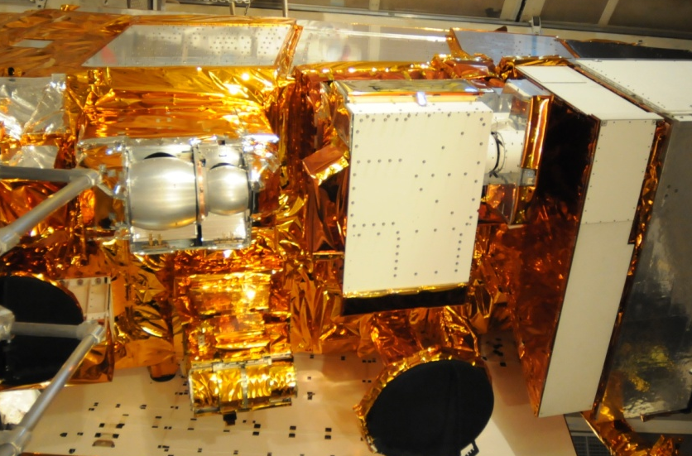
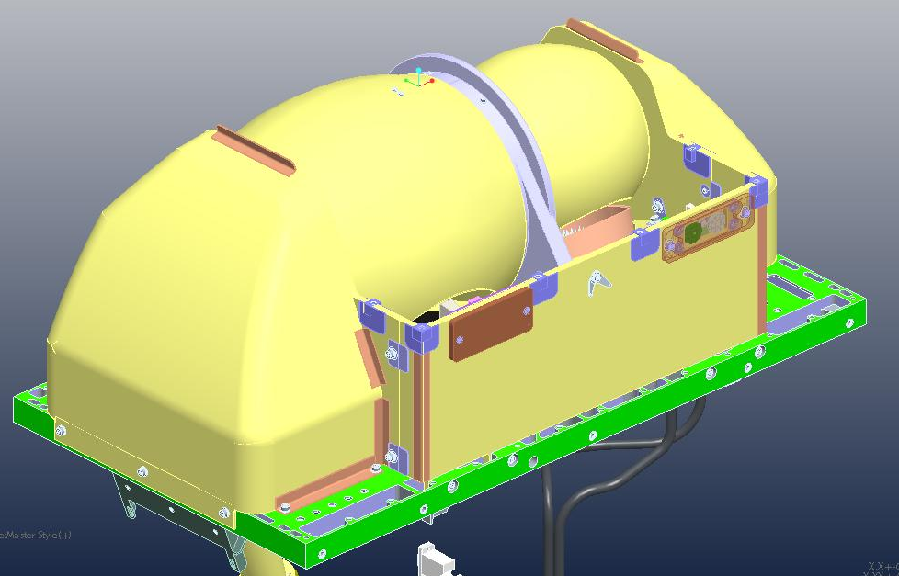
Probable Cause:
Solar path to WG load near eclipse
Y
Solar heating of shroud assembly accounts for large-scale orbital variations, but:
  Not account for pre-eclipse WG increase
  Not explain why WG variations >> KAV
Direct solar path onto WG load allowed by Sun shield for sun angles up to 75° off nadir (13° beyond eclipse)
  Visibility duration is about 220 seconds : same as observed temperature ramp-up interval
  Incidence from –y side is consistent with location of PRT1 and 2
No direct solar path to KAV load (blocked by sun shade)
X
PRTs #1, #2
WG Load
Y
View from sun, at eclipse
X

Slide 25
Receiver Shelf Stability – K, Ka and V Bands
Orbit 164
Orbit 182

Slide 26
Receiver Shelf Stability – W and G Bands
Orbit 164
Orbit 182

Slide 27
Gain Stability – Chan 1, 2
Orbit 164
Orbit 182

Slide 28
Gain Stability – Chan 3, 4
Orbit 164
Orbit 182

Slide 29
Gain Stability – Chan 5, 6
Orbit 164
Orbit 182

Slide 30
Gain Stability – Chan 7, 8
Orbit 164
Orbit 182

Slide 31
Gain Stability – Chan 9, 10
Orbit 164
Orbit 182

Slide 32
Gain Stability – Chan 11, 12
Orbit 164
Orbit 182

Slide 33
Gain Stability – Chan 13, 14
Orbit 164
Orbit 182

Slide 34
Gain Stability – Chan 15, 16
Orbit 164
Orbit 182

Slide 35
Gain Stability – Chan 17, 18
Orbit 164
Orbit 182

Slide 36
Gain Stability – Chan 19, 20
Orbit 164
Orbit 182

Slide 37
Gain Stability – Chan 21, 22
Orbit 164
Orbit 182

