Slide 1




ATMS Instrument Performance Monitoring Report
Li Bi, Ninghai Sun, Fuzhong Weng, Tsan Mo
NOAA/NESDIS/STAR
13 January 2012

Slide 2
Outline
STAR ATMS Cal/Val Flow
ATMS Long-term Instrument Trending System Overview
  Introduction and available products
ATMS TDR Bias Monitoring System Overview
  Evaluation methods and available products
ATMS TDR comparison with NOAA-18 AMSU-A
Initial look of remapped ATMS SDR vs. ATMS TDR
Future work

Slide 3
STAR ATMS Cal/Val Flow
ATMS
RDR (GRAVITE)
ATMS
SDR (GRAVITE)
CrIS
SDR (GRAVITE)
ECMWF
(EC)
GDAS/GFS (NCEP)
TLE/SNOs
SDRs+NWP
ATMS/CrIS SDRs
RDRs
STAR Storage
Backus-Gibbert remapping
Long-term Instrument Performance Trending System
Input Radiometric Counts, PRT Counts, Coefficients
TLE/SNOs+DD
Instrument cross-calibration
Remapped SDRs
EDR algorithm
Long-term Bias Monitoring System
Compute Hot Target PRT temp
Compute Average Temp for Hot Target over Np scans
Fundamental Climate Data Records (FCDR)
NWP application
STAR Instrument Performance Monitoring Suite (IPMS) Storage
Compute Apparent code Space TB
Statistic data
+ real time plots
Level-II CDRs
Compute Target TBs (bias correction)
Compute Average Hot/Cold Counts over Nc Scans
Climate application
Nonlinear estimation
Compute Scene TBs
Quadratic correction
TDRs
Antenna pattern correction
SDRs
Cross-track bias correction

Slide 4
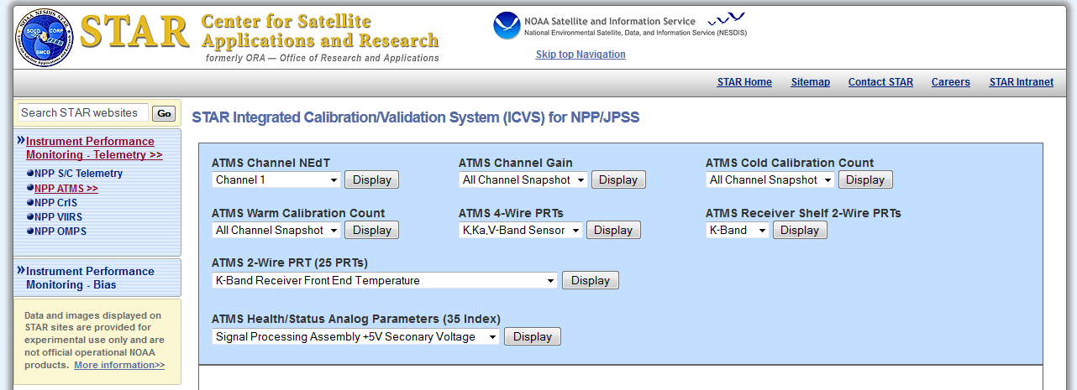
Long-term Instrument Performance Trending System
Capability of monitoring different calibration parameters in real-time

Slide 5
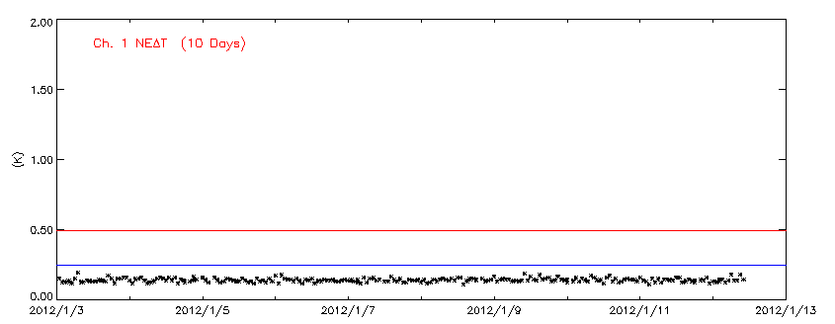
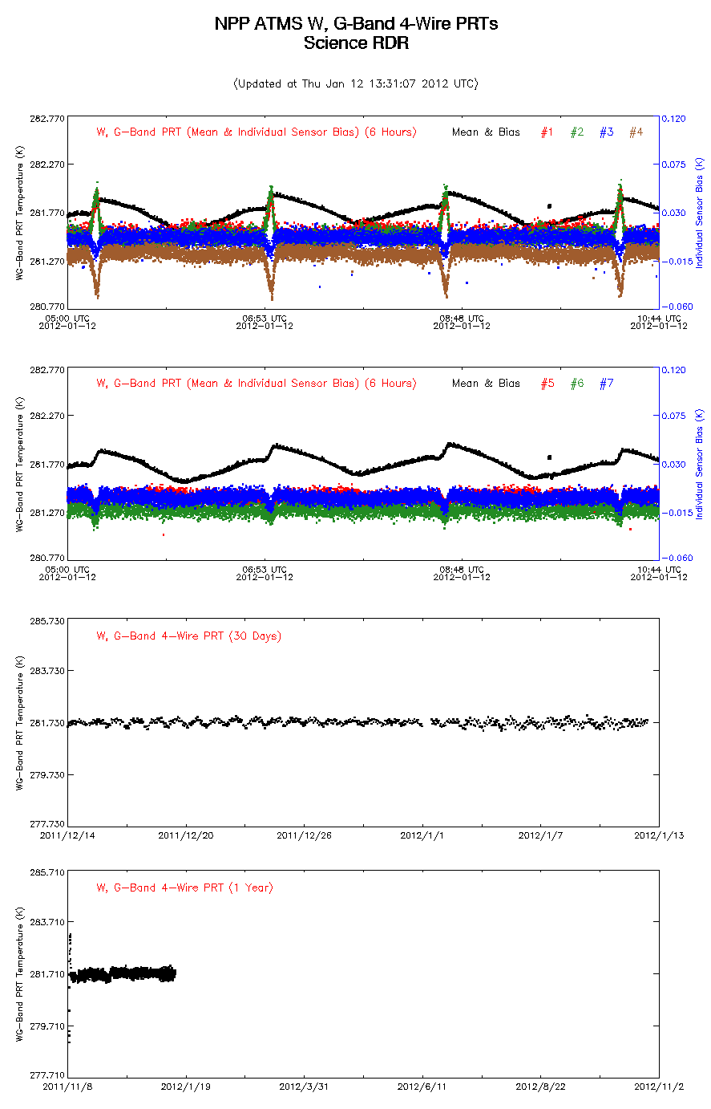
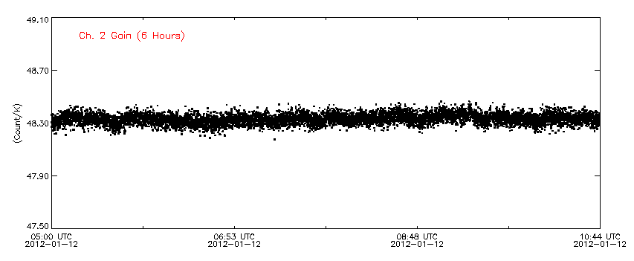
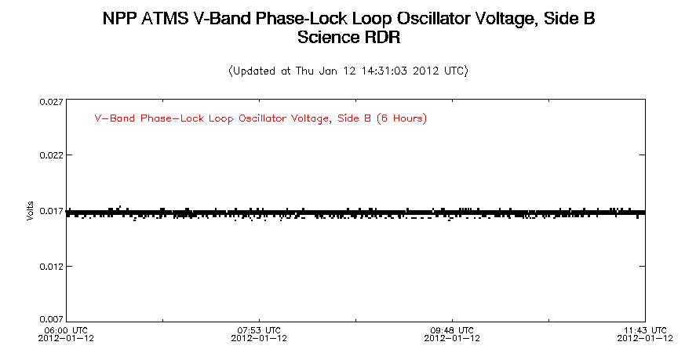
Available Products from ICVS System
ATMS Channel NEdT
ATMS Channel Gain
ATMS Health/Status Analog Parameters (35 Index)

Slide 6
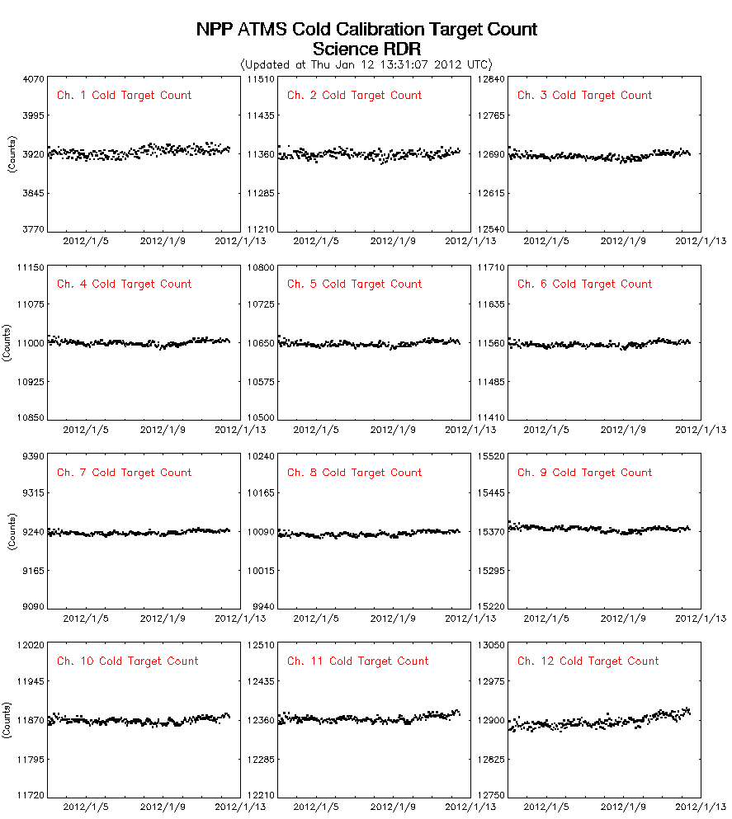
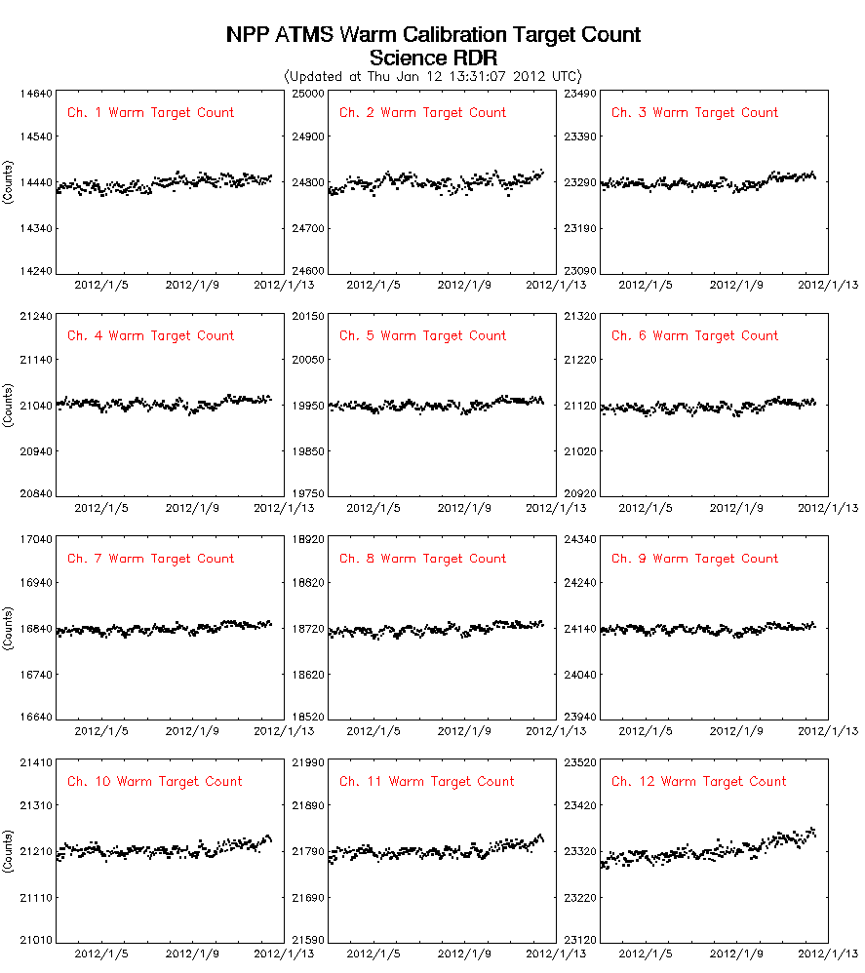
Available Products from ICVS System (Cont’d)
ATMS Cold Calibration Target Count
ATMS Warm Calibration Target Count

Slide 7
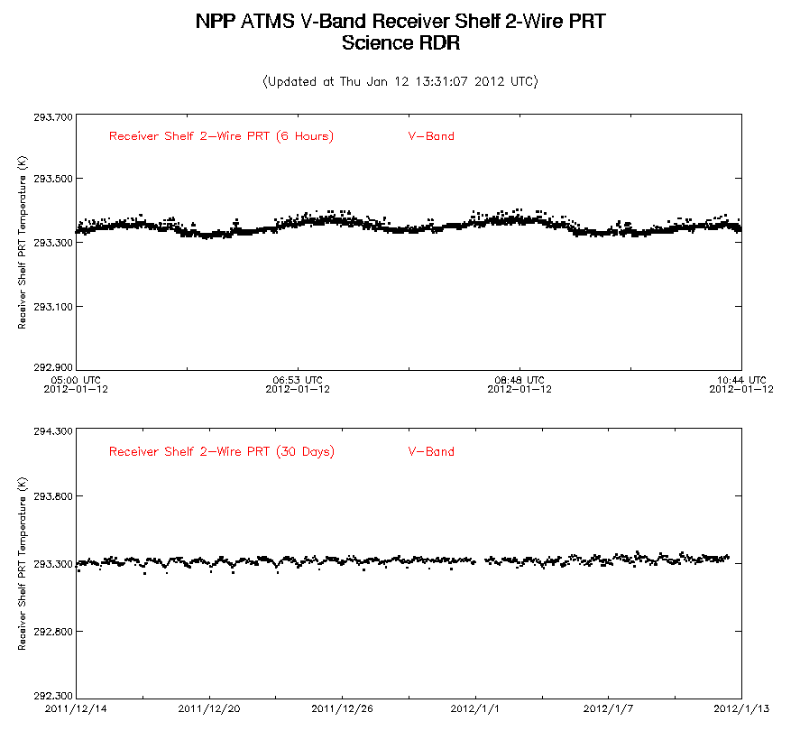
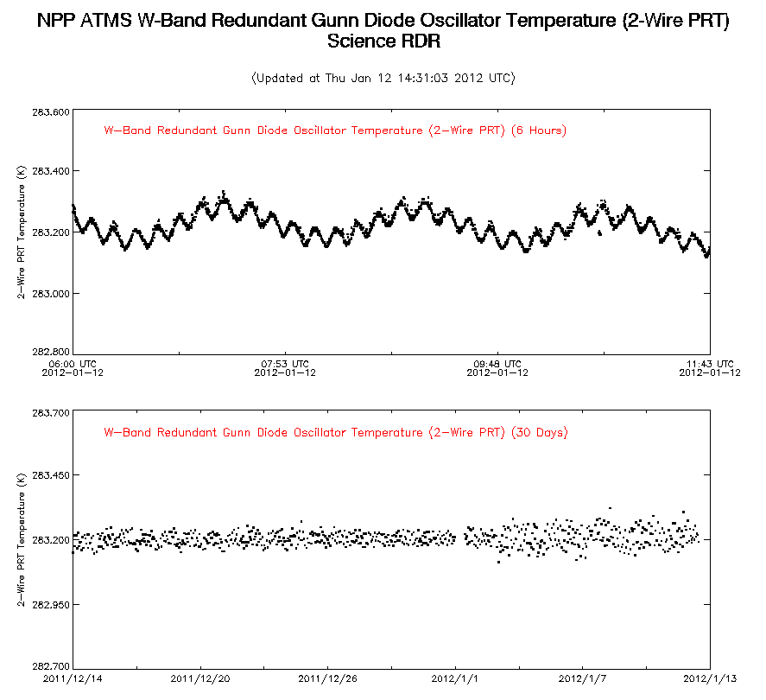
Available Products from ICVS System (Cont’d)
STAR ICVS System has the capability of monitoring NPP CrIS/VIIRS/OMPS

Slide 8
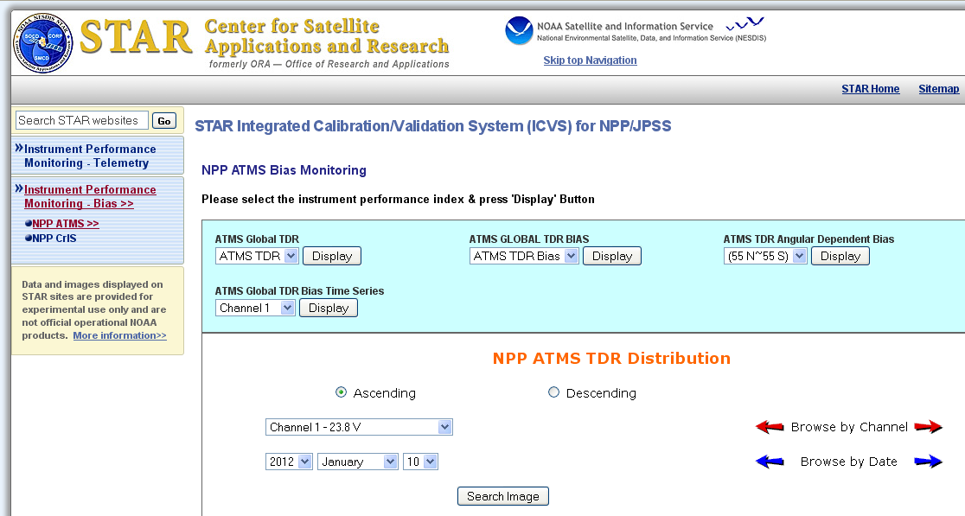
Long-term Bias Monitoring System
GOAL: To provide real-time/long-term bias monitoring for instrument performance evaluation

Slide 9
Bias Monitoring Package Introduction
Goal: To provide real-time/long-term instrument bias monitoring for instrument performance evaluation
Instrument bias monitoring test using real-time ATMS TDR data has been performed.
The JCSDA Community Radiative Transfer Model (CRTM) is used.
  Temperature/moisture profiles are obtained from the NCEP Global Data Assimilation System (GDAS)
Clear Sky identification
  Physical Cloud Liquid Water Path retrieval algorithm applied to identify clear sky (Weng et al., 2003)
  CLW < 0.05 is considered as clear sky

Slide 10
Evaluation Methods
ATMS TDR Bias O-B at Each Channel
  Over ocean (55 ^{O}N ~ 55 ^{O}S)
  Clear sky
  Ascend/Descend separated
ATMS TDR Angular Dependent Bias O-B at Each FOV
  Over ocean (55 ^{O}N ~ 55 ^{O}S)
  Clear sky
  Ascend/Descend separated

Slide 11
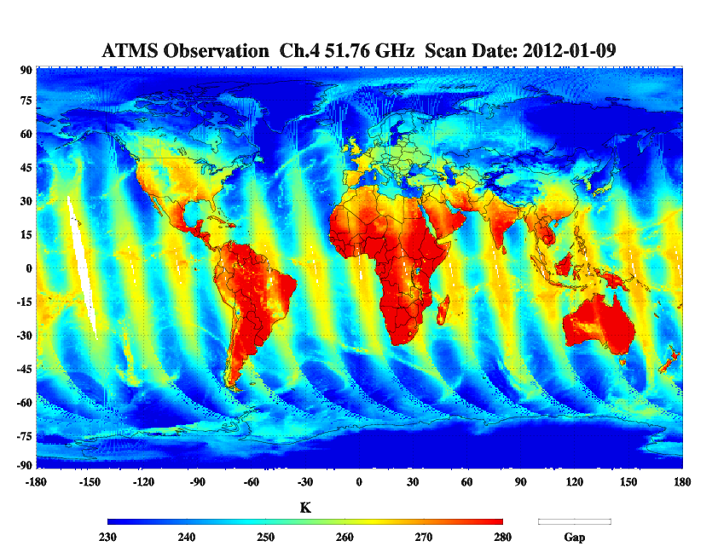
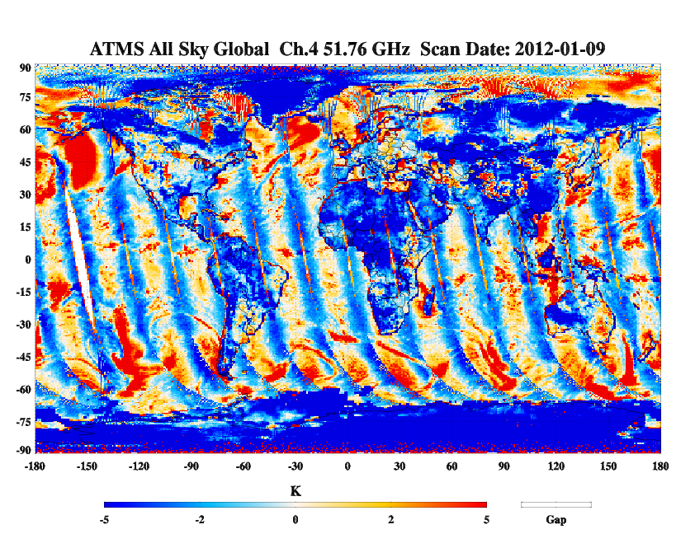
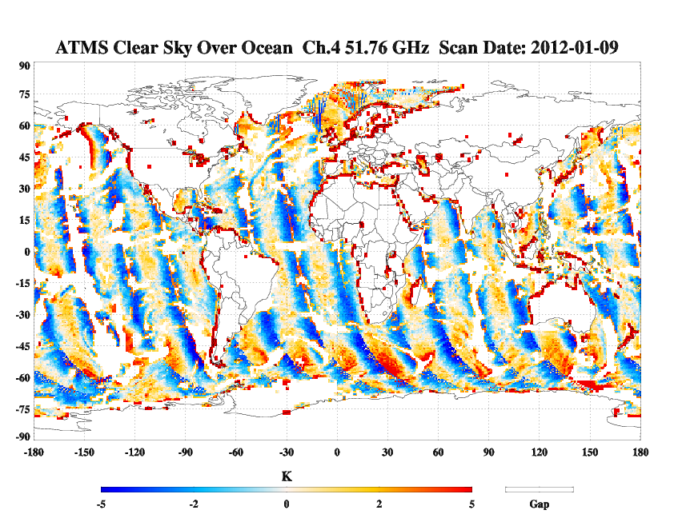
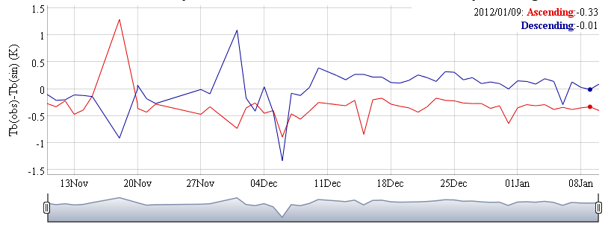
Available Products from Bias Monitoring Package
ATMS Ch4 Bias Time Series Over Ocean Clear Sky

Slide 12
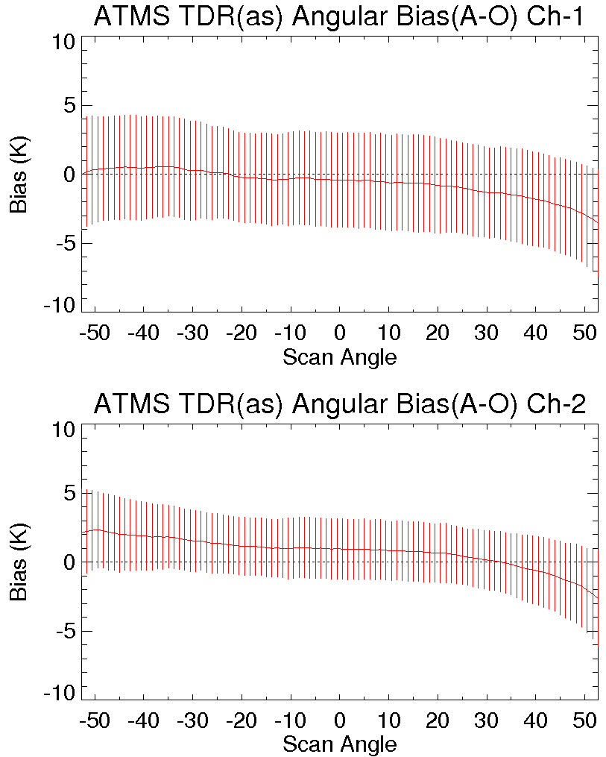
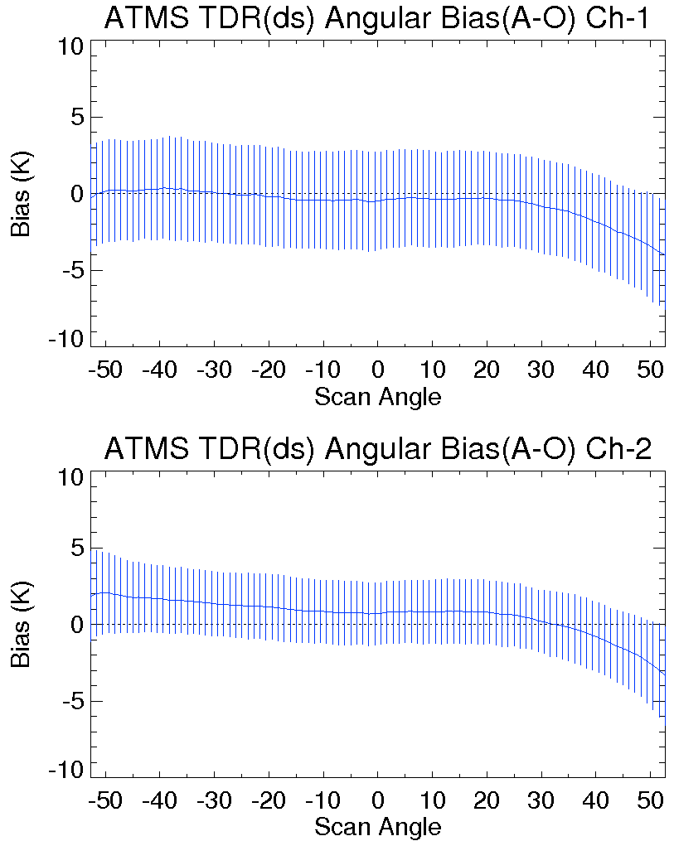
ATMS TDR Cross-Track Asymmetry
Angular dependent bias (A-O) Dec, 16-22, 2011
Offline study, courtesy of Tong Zhu

Slide 13
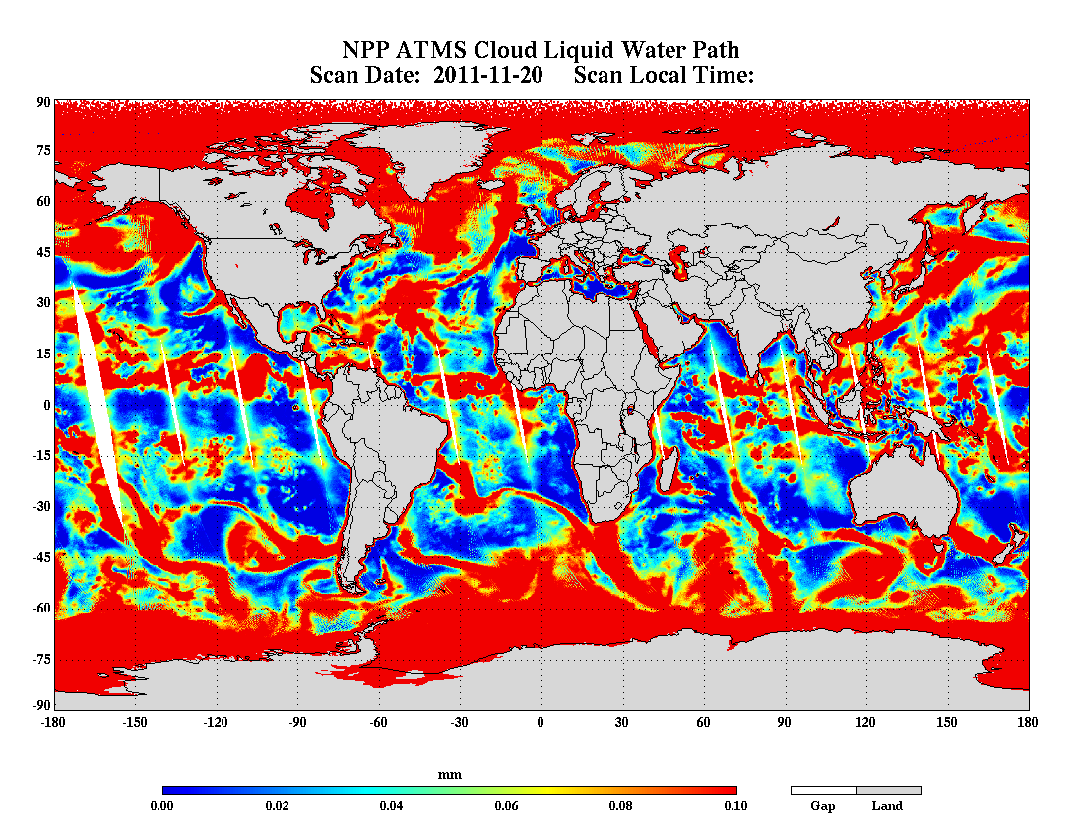
Clear Sky Identification
Physical Cloud Liquid Water Path retrieval algorithm applied to identify clear sky (Weng, et al., 2003)
CLW < 0.05 is considered as clear sky

Slide 14
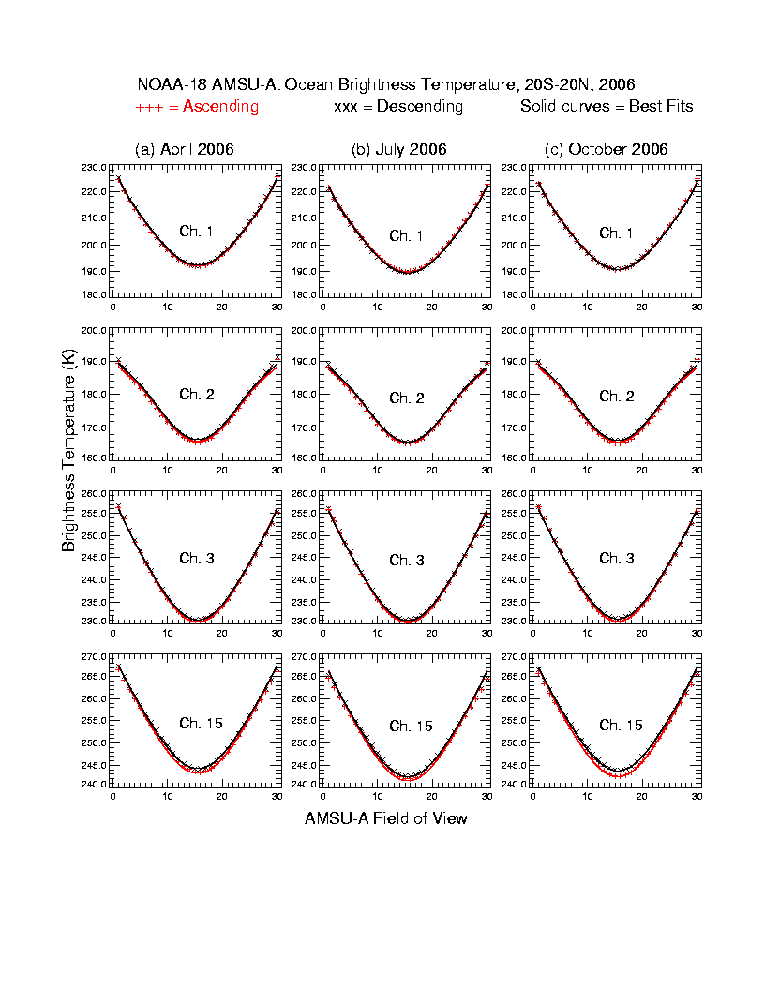
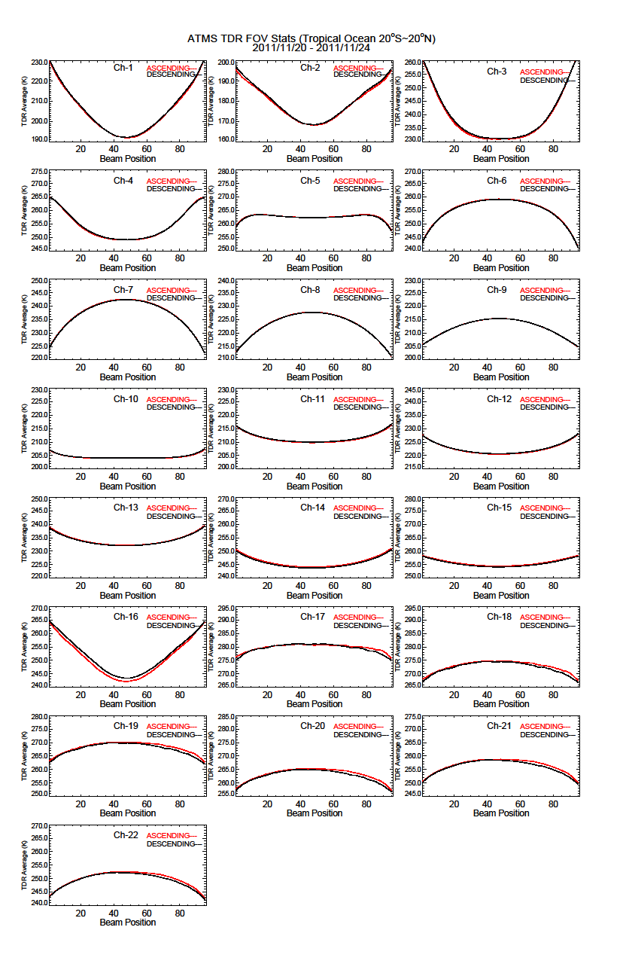
Comparison with NOAA-18 AMSU-A
ATMS
Tropic Ocean: -20S to 20N
NOAA-18 AMSU-A
AMSU-A FOV
ATMS mean TDR temperature at each FOV is consistent with NOAA-18 AMSU-A

Slide 15
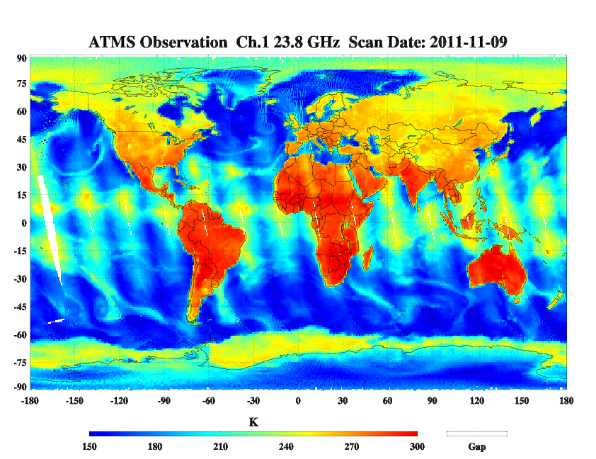
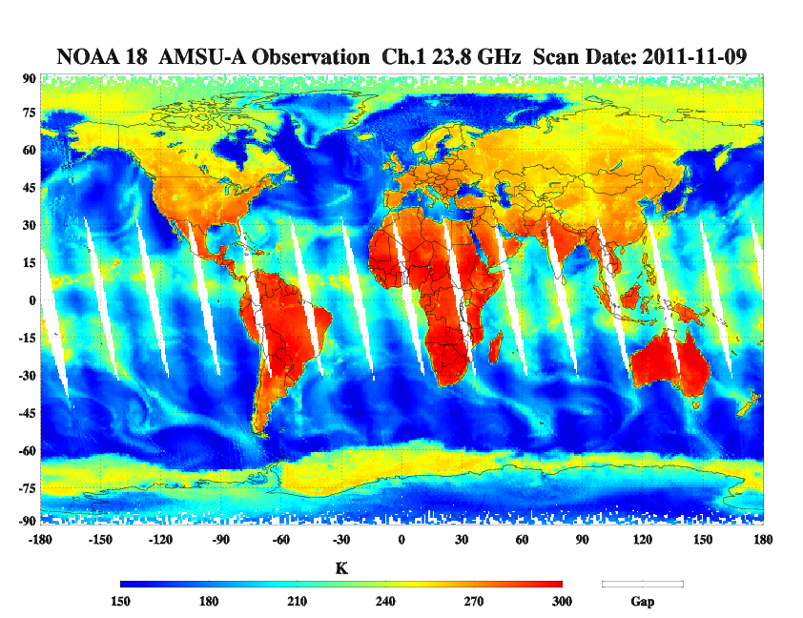
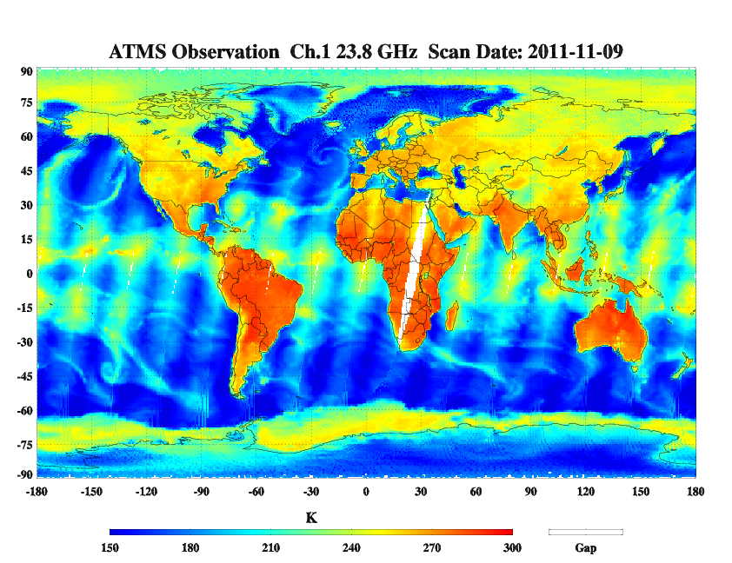
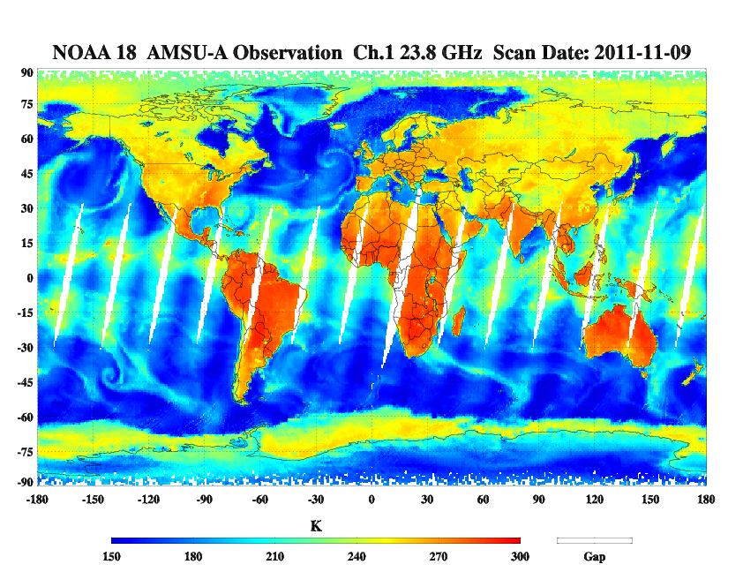
ATMS Observation Ch.1 Ascending
NOAA 18 AMSU-A Observation Ch.1 Ascending
ATMS Observation Ch.1 Descending
NOAA 18 AMSU-A Observation Ch.1 Descending
ATMS TDR show nice global coverage with less data gap

Slide 16
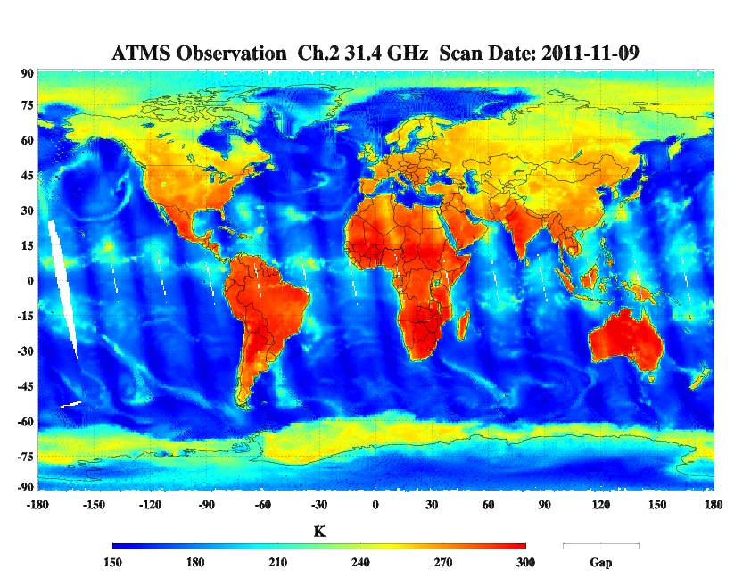
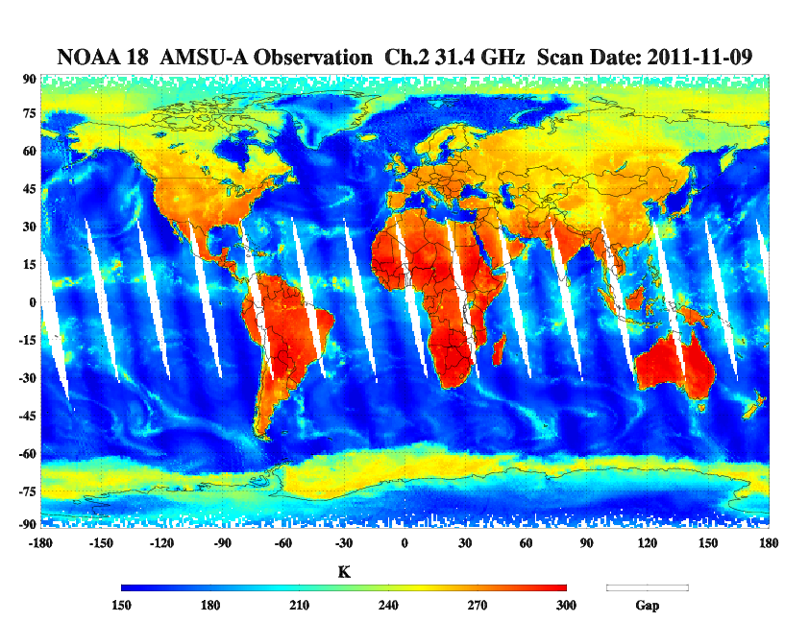
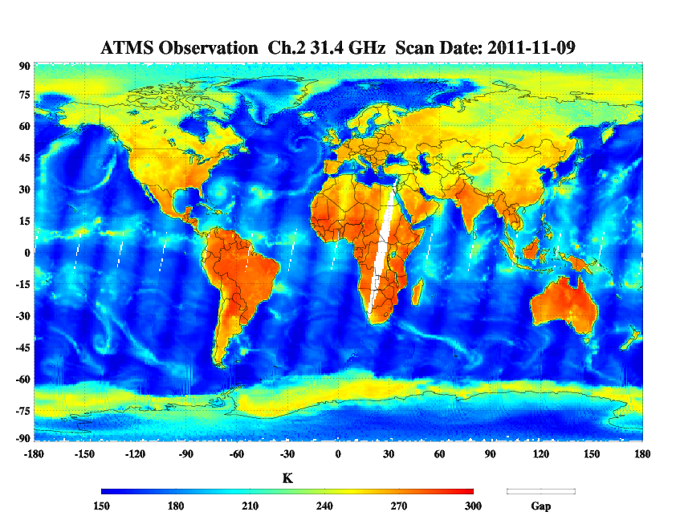

ATMS Observation Ch.2 Ascending
NOAA 18 AMSU-A Observation Ch.2 Ascending
ATMS Observation Ch.2 Descending
NOAA 18 AMSU-A Observation Ch.2 Descending

Slide 17
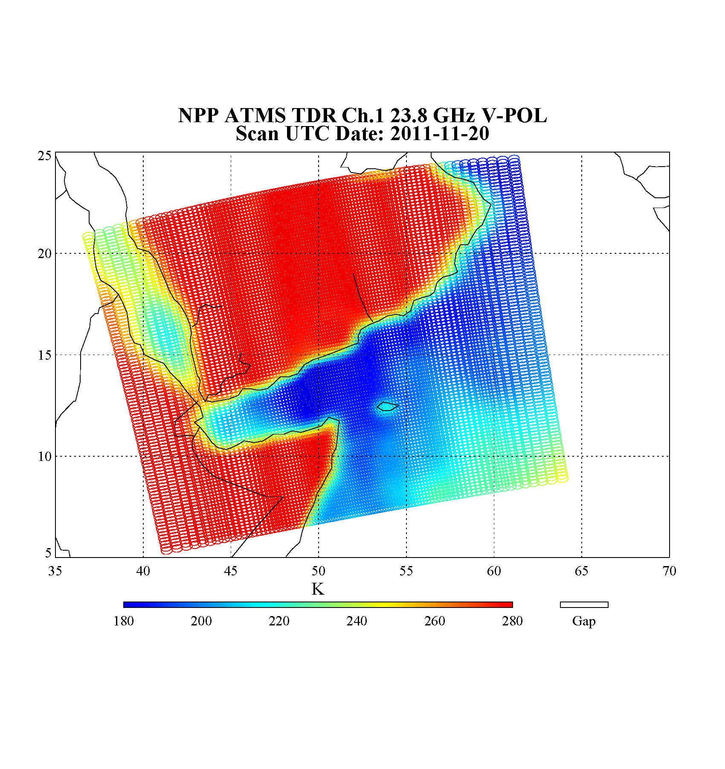
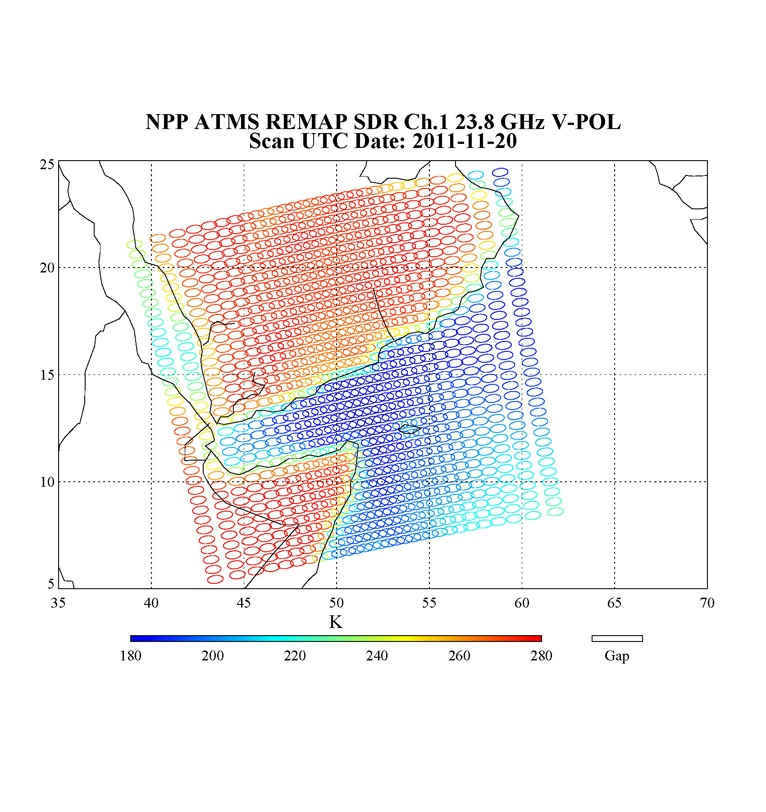
Initial look of ATMS TDR vs. REMAPPED SDR
ATMS TDRs are warmer than ATMS remapped SDRs

Slide 18
Future Work
Improve cloud identification algorithm
Quantify scan asymmetry bias
Verify operational TDR to SDR conversion coefficients
Assessment of intercalibration between ATMS and NOAA-19 AMSU-A
Evaluate ATMS remapped SDR vs. ATMS TDR
Continue update current bias monitor package
  Test high resolution background input for RT simulation
  Provide more bias monitoring parameters to the package

