Slide 1
CrIMSS EDR Empirical Bias Correction for ATMS
C. Barnet
Gambacorta
Jan. 13, 2012

Slide 2
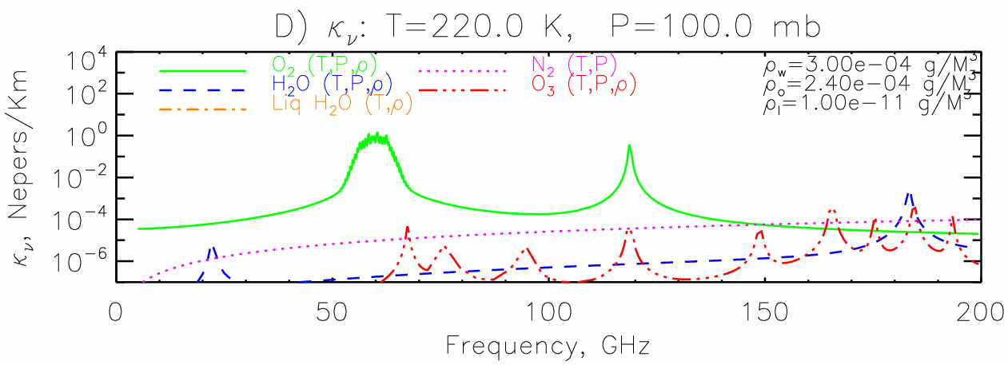
Description of the Forward Model
NUCAPS system uses “MIT” forward model
AIRS science team heritage (Rosenkranz 2003 TGARS)
LBL model maintained by Phil Rosenkranz
Includes spectroscopy
H2O: (Golubiatnikov 2005 J. Mole. Spec); Podobedov 2004 JQSRT,;Koshelev 2007 J. Mole. Spec., Clough’s continuum)
O2: (Tretyakov 2004, 2005 J. Mole. Spec.; Drouin 2007 JQSRT)
N2: (Maetzler 2006 IET; Boissoles 2004 JQSRT)
O3: added new HITRAN lines in 150-166, 425 GHz)
new surface emissivity over ocean (Ellison 2003 JGR)
Derived empirical bias corrections of ATMS w.r.t. MIT model (Rosenkranz and Barnet 2006 JGR)

Slide 3
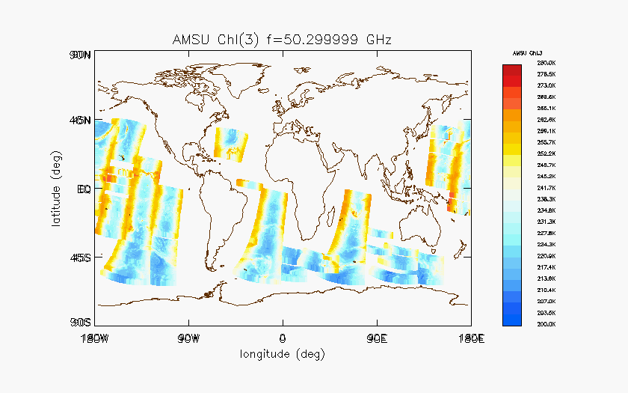
ATMS tuning Methodology: I. Radiance data set preparation
Goal: MW radiance tuning file globally applicable
Radiance data set includes selected regions where RTA is more accurate:
Ocean only (to avoid land surface emissivity uncertainties)
Night only (to avoid solar heating of the skin temperature)
Non precipitating only (the MW RTA does not handle precipitating cases)
65N to 65S only (to avoid snow/ice surface emissivity uncertainties)
281 Granules collected on ATMS focus day from December 7th, 2011
RTA model used: MIT MW RTA [Rosenkranz et al.]

Slide 4
ATMS tuning Methodology: II. Co-located atmospheric “truth” data set
Step 1
Temperature and water vapor profiles from ECMWF
CO, O3, CO2, CH4, N2O, SO2 and HNO3 profiles from climatology
Surface temperature correction of -0.25K
Ellison model for ocean dielectric constant in the computation of surface emissivity
Step 2
Iterative removal of 1 sigma OBS-CALC outliers for each view angle and each frequency. Two iterations performed. (Example shown below for ATMS chn. 16, f=88.2 GHz, Scan angle position =7)
Step 1 ensemble pdf
Step 2 ensemble pdf
OBS-CALC (K)
OBS-CALC (K)
Black: ensemble distribution
Red: bin smoothed distribution
Green: theoretical normal distribution

Slide 5
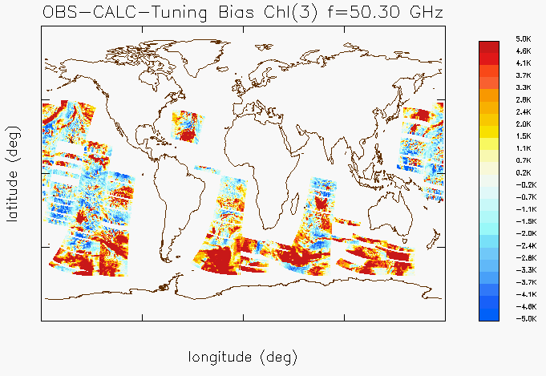
Left: OBS-CALC (ATMS chn.3) Right: OBS-CALC – tuning (ATMS chn.3)

Slide 6
NPP ATMS, MetOp AMSU, Aqua AMSU comparison

Slide 7
NPP ATMS, MetOp AMSU, Aqua AMSu comparison

Slide 8
Next Steps
Tuning of brightness temperatures needs to be done carefully
Will apply the NUCAPS approach w.r.t. the OSS forward model (used in CrIMSS EDR code)
Will compare bias terms to the OSS and MiRS (w.r.t. CRTM) empirical bias corrections
Multiple groups will compute and compare their results to ensure that we are not introducing artifacts into the observations.
Even after the SDR and remap-SDR have instrument effects removed (side-lobes, etc.) we will still need a residual empirical tuning (hopefully small).
For NUCAPS we plan on using the TDRs and adopt the ATMS SDR team approach as applied to the TDRs and compute/apply a residual bias correct w.r.t. the MIT forward model.
For the operational (NGAS) code we will utilize the remap-SDR and compute/apply a residual bias correction w.r.t. OSS

