Slide 1
Evaluation of ATMS and CrIS data at ECMWF
Niels Bormann, Tony McNally,
Anne Fouilloux, William Bell,
Mohamed Dahoui
With help from Nigel Atkinson (Met Office), Steve Swadley (NRL) and others

Slide 2
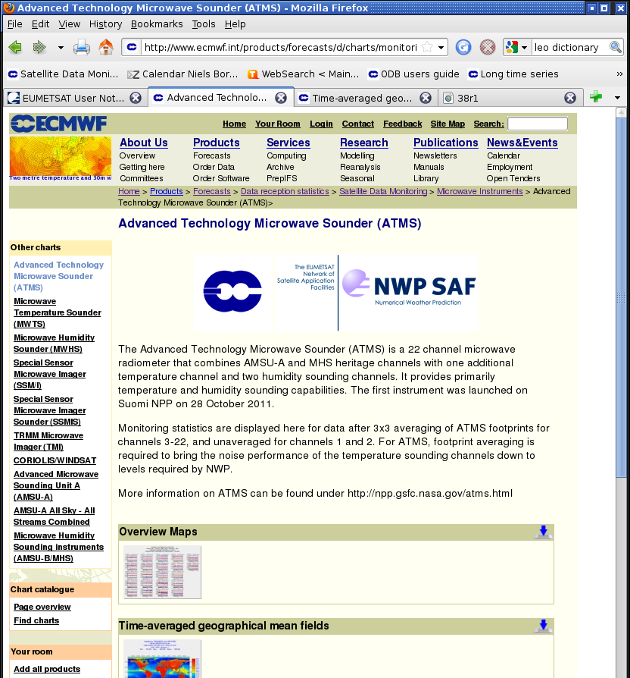
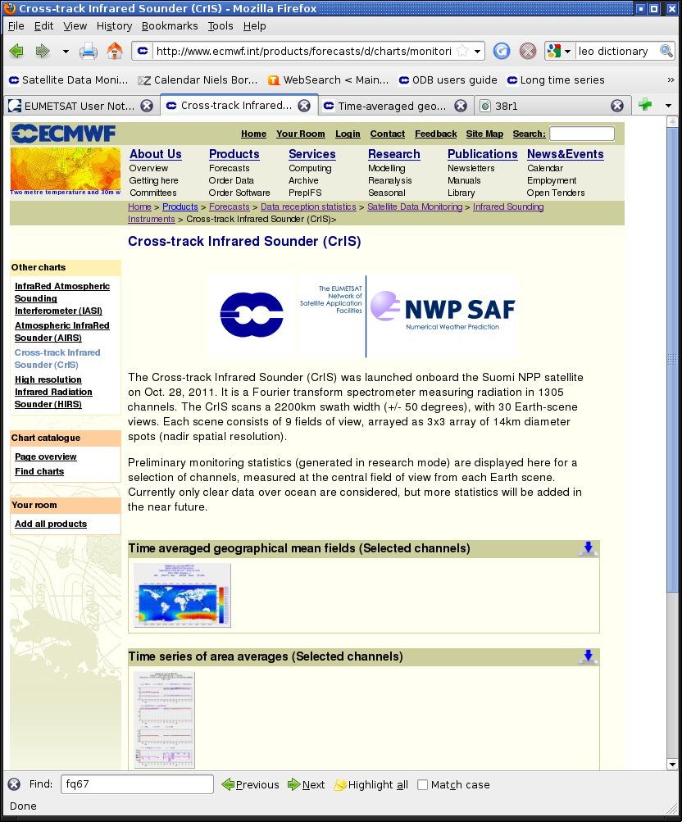
Up-to-date monitoring statistics
Up-to-date monitoring statistics on the web:
http://www.ecmwf.int/products/forecasts/d/charts/monitoring/satellite/
since 26 June 2012

Slide 3
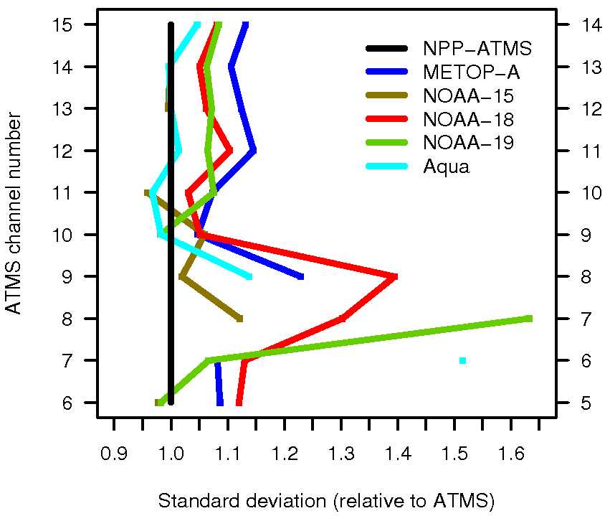
ATMS: Comparison to AMSU-As (for ATMS 3x3)
→ After averaging, ATMS noise performance at least as good as AMSU-A.
AMSU-A channel number
Standard deviation of observation – background
(normalised by ATMS)

Slide 4
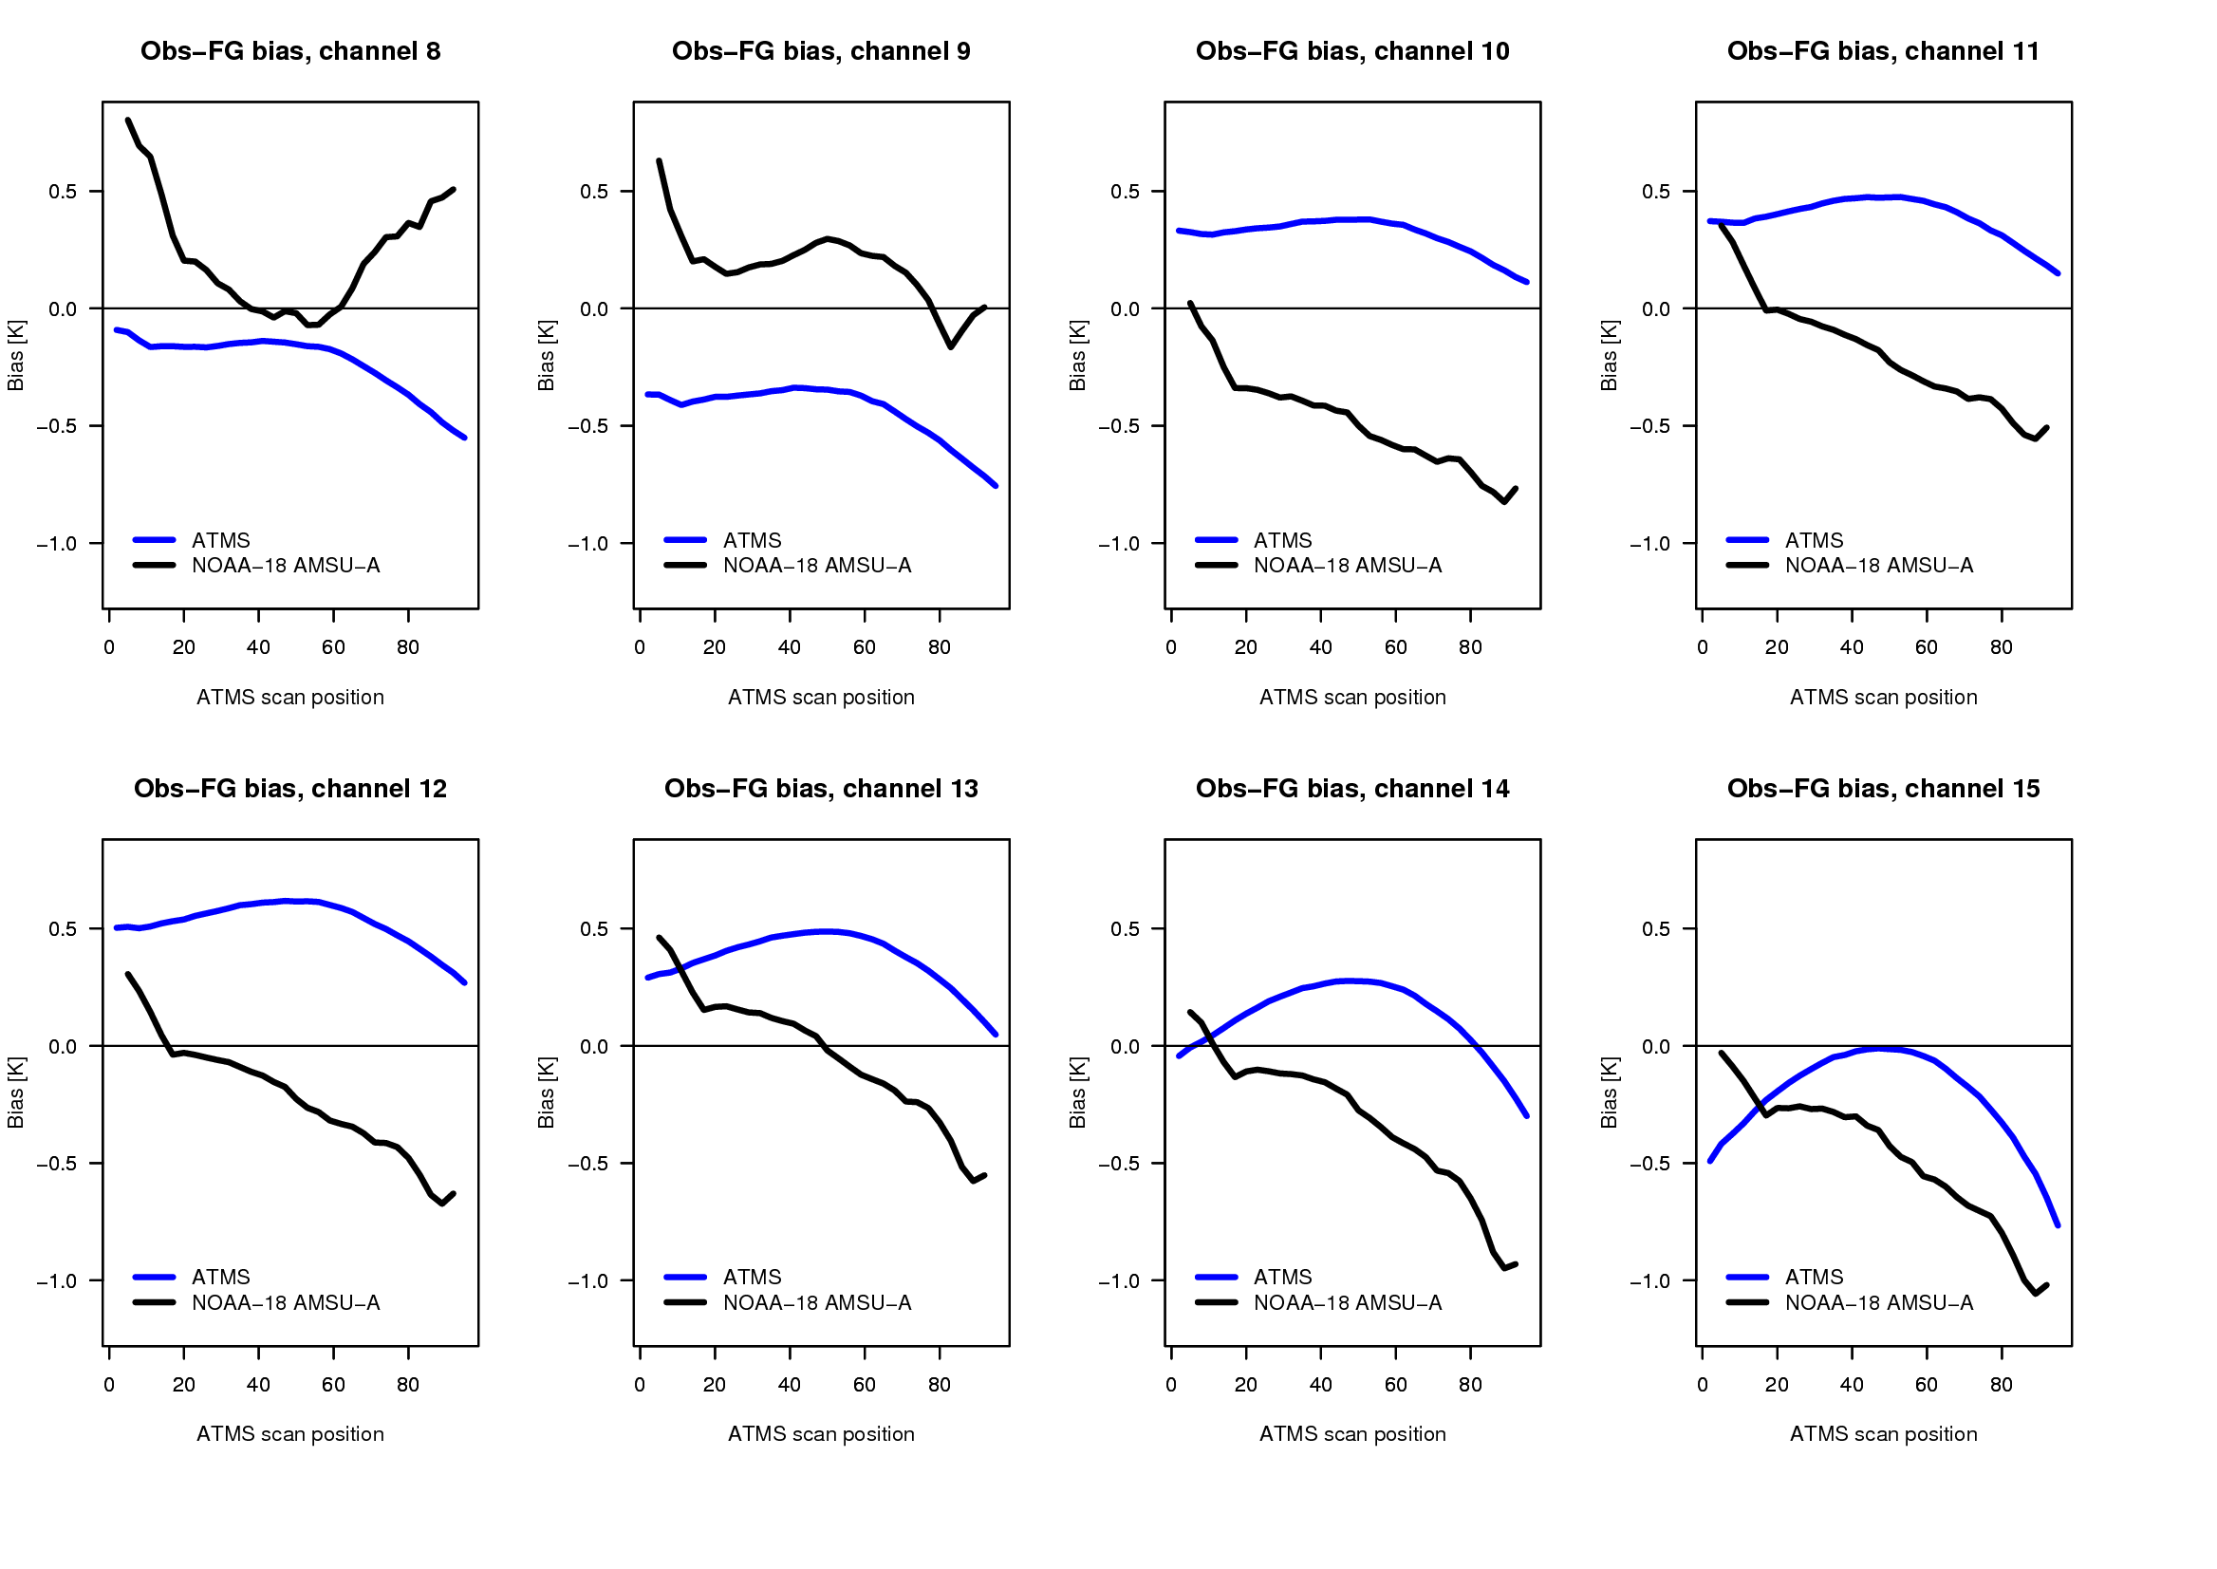
ATMS: Smooth scan-biases (obs – background)

Slide 5
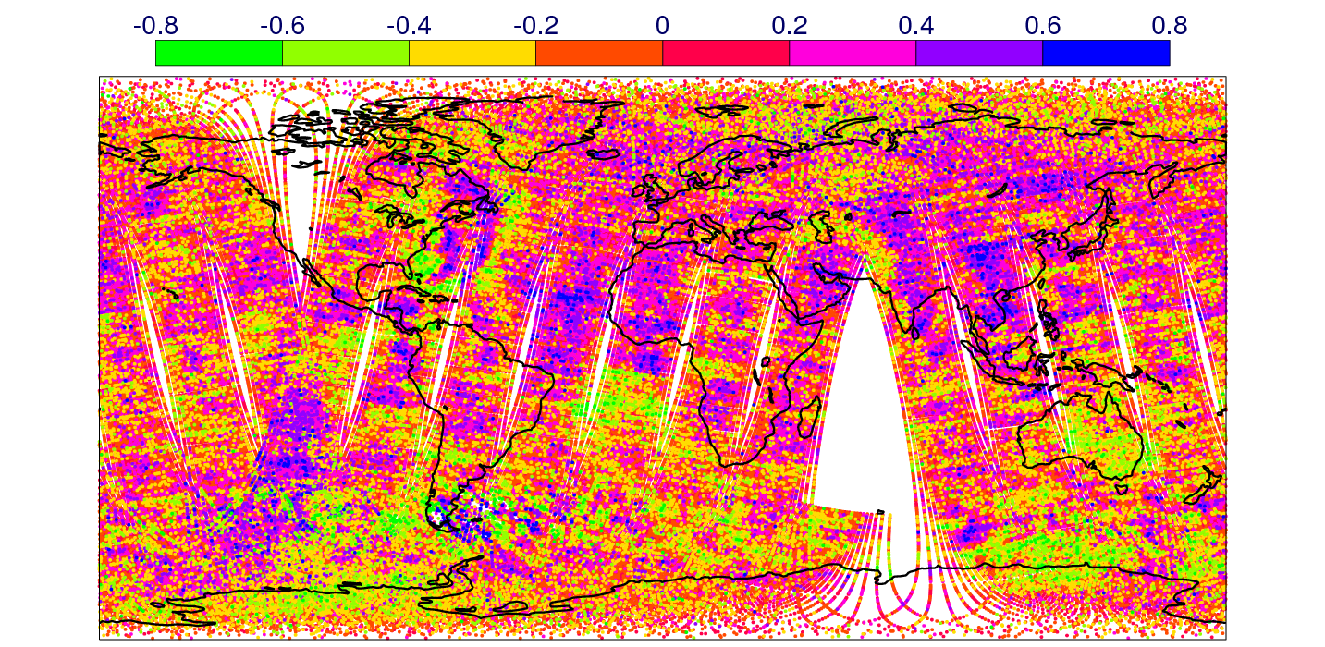
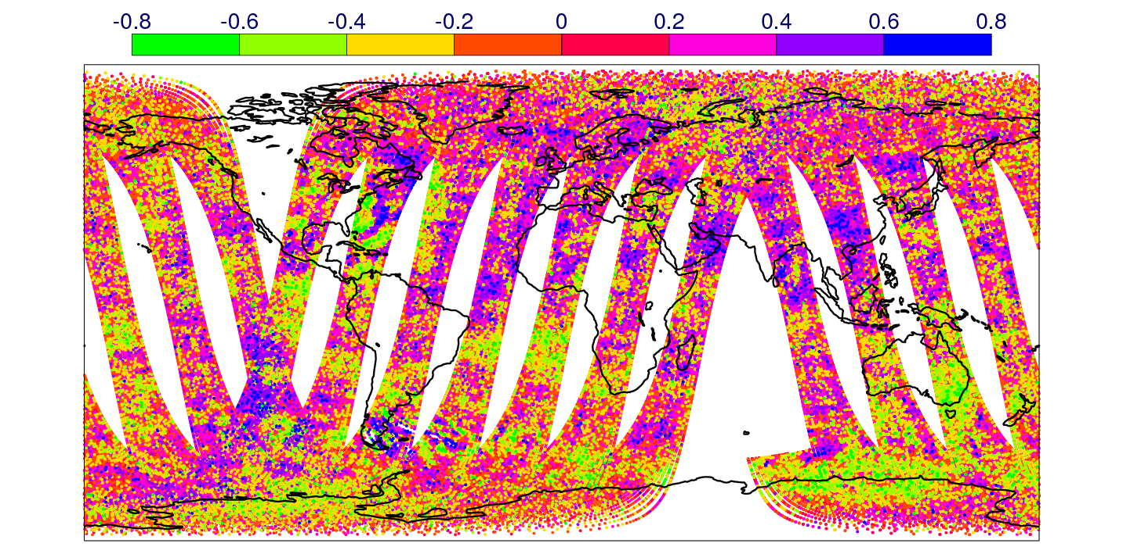
ATMS: Striping
ATMS, ch 12, Obs-background [K]
Weak cross-track striping effect, especially for stratospheric temperature-sounding channels.
N19 AMSU-A, ch 11, Obs-background [K]

Slide 6
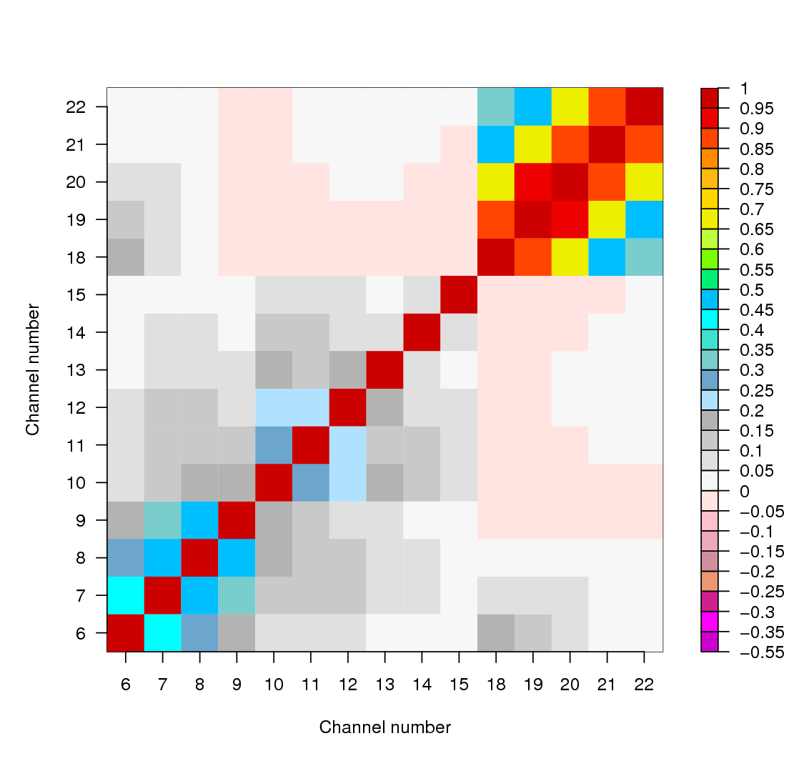
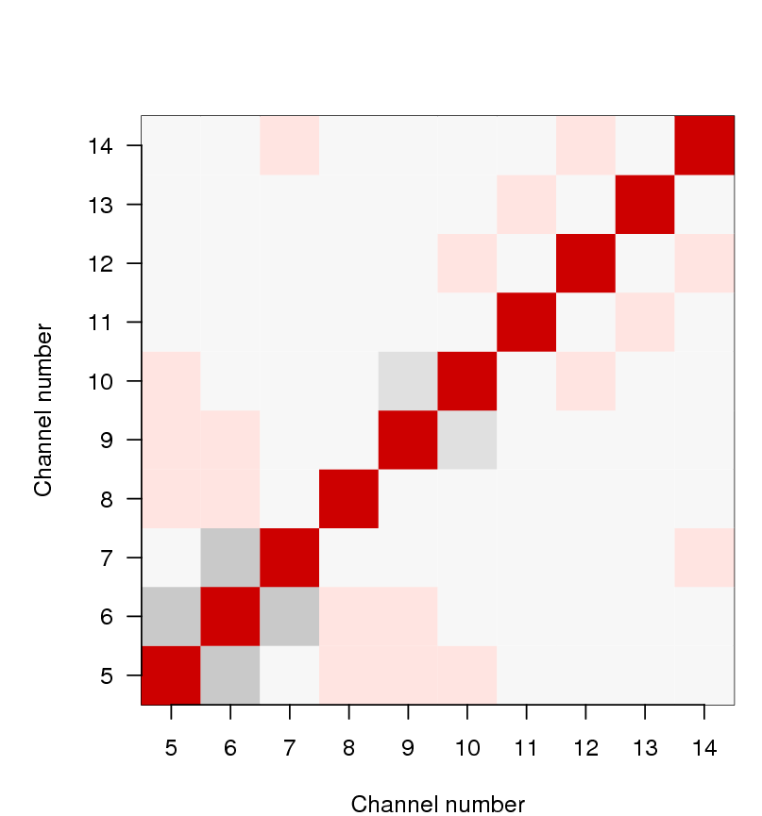
ATMS: Inter-channel error correlation diagnostics
(based on Desroziers et al. 2005; Bormann et al. 2010)
ATMS (3x3):
NOAA-18 AMSU-A:

Slide 7
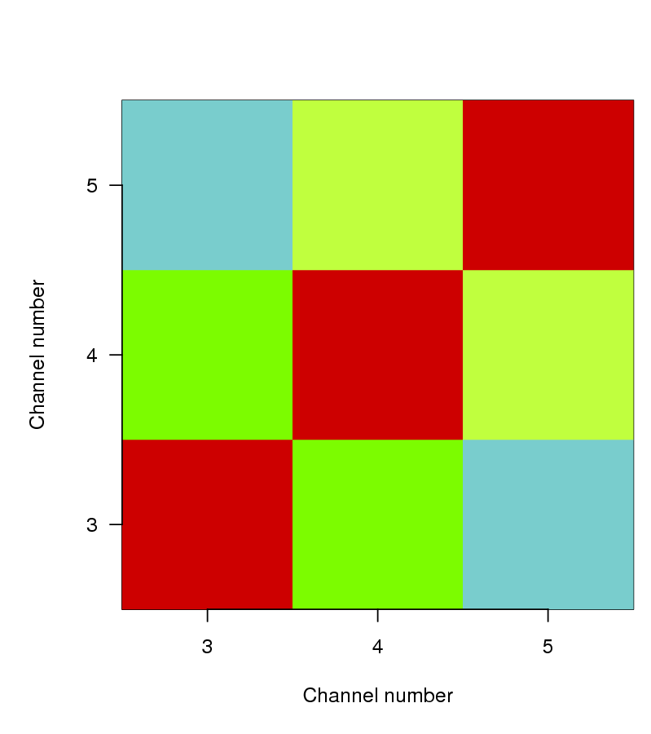
ATMS: Inter-channel error correlation diagnostics
(based on Desroziers et al. 2005; Bormann et al. 2010)
ATMS (3x3):
NOAA-18 MHS
(unaveraged):

Slide 8
ATMS: Forecast impact
Assimilation experiments over two seasons:
15 Dec 2011 – 6 Feb 2012
28 June 2012 – 31 August 2012
Use temperature and humidity channels (6-15; 18-22); surface-sensitive channels over sea only.
Combined scores over two seasons (102 cases):
N.Hem, Z 500 hPa
S.Hem, Z 500 hPa
ATMS bad
Normalised RMSE difference
ATMS good

Slide 9
ATMS: Forecast impact
Improved short-term humidity forecasts, as measured by MHS, HIRS, AIRS, IASI humidity channels.
For instance for MHS:

Slide 10
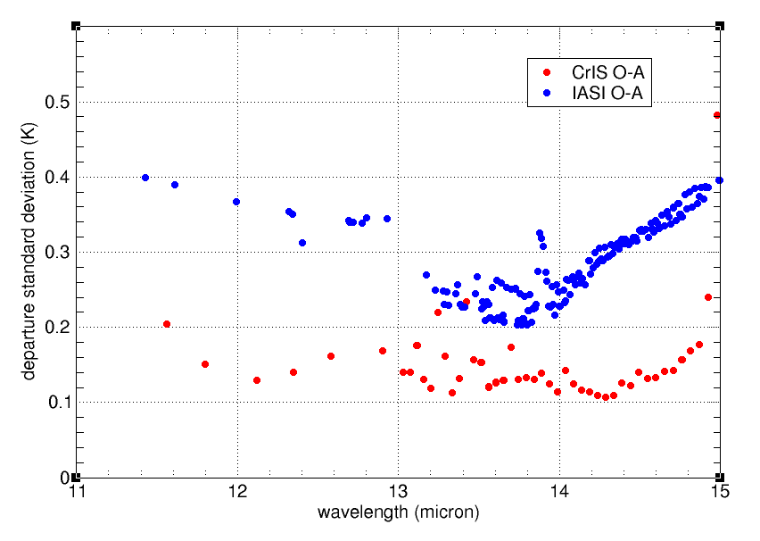
CrIS: Comparison to IASI
Radiance observations from CrIS have significantly lower noise than IASI.
STDV (OBS-AN) in K
Important temperature sounding channels

Slide 11
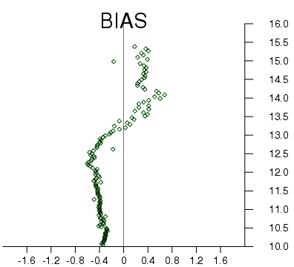
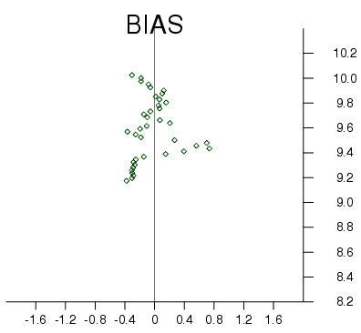
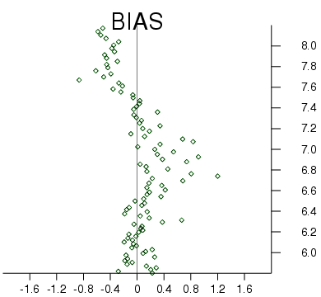
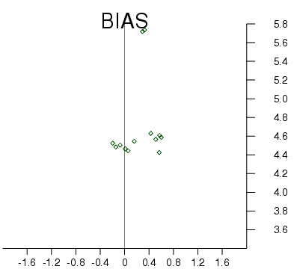
CrIS: Biases
Radiance bias corrections for CrIS are slightly larger than for IASI. However, this is probably more attributable to different RTTOV radiative transfer model training (LBLRTM v KCARTA).
LW
O3
WV
SW
Radiance bias corrections (K) evaluated over 1 July 2012

Slide 12
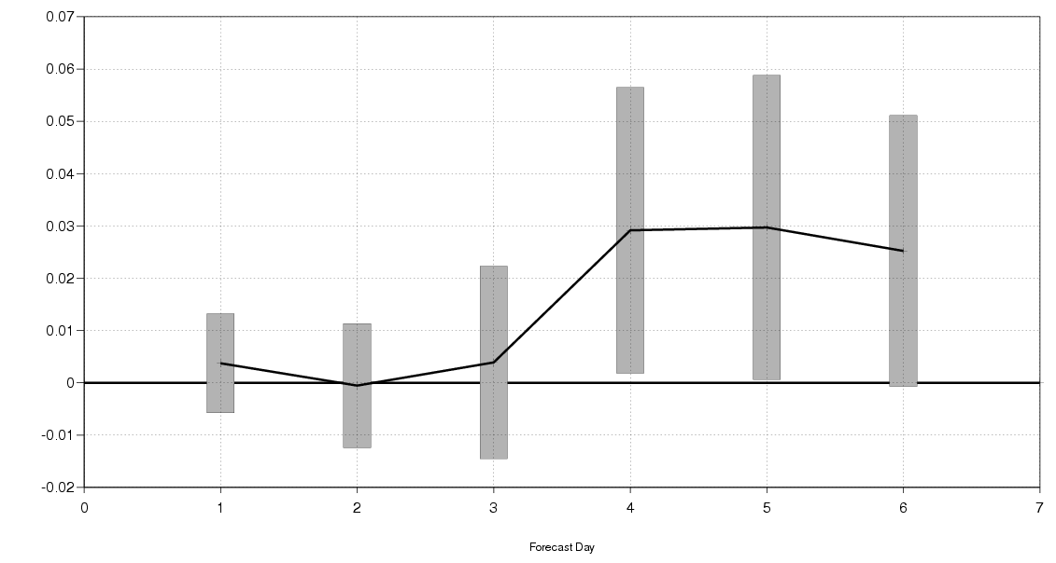
CrIS: Forecast impact
Radiance observations from CrIS have only been available since 26 June 2012 and thus forecast impact experiments are not yet mature.
However, preliminary results suggest that assimilating just 57 key temperature sounding channels from CrIS in addition to AIRS and IASI can improve forecasts compared to the control.
Note that the orbit of NPP is on top of that of AQUA (13:30) so CrIS and AIRS data are used in close proximity – work continues to optimise analysis weights.
0.06
Northern Hemisphere , Z 500 hPa;
2-month trial
0.04
Normalised ACC difference
0.02
CrIS good
0.00
CrIS
bad
-0.02
0 1 2 3 4 5 6
Forecast day

Slide 13
Summary
Data quality:
ATMS:
Noise comparable to AMSU-A or better (after averaging)
Smooth scan-biases
Cross-track striping issue
CrIS:
Very low noise for CrIS LW, much better than AIRS or IASI
Forecast impact:
ATMS:
Neutral to positive (on top of NOAA-18, NOAA-19, Aqua AMSU-A/MHS, etc)
Operational assimilation since 26 Sept 2012
CrIS:
Promising (on top of AIRS), but not yet mature

Slide 14
Recommendations
Recommend further investigations into ATMS striping – are there ways to avoid it for future instruments?
Recommend user notification about data/satellite changes as for NOAA satellites (ESPCOperations emails)
Data dissemination:
Production of simulated data before launch worked very well and was very helpful for preparations.
Nevertheless, dissemination of real data to NWP users could be improved for JPSS:
Real-time data dissemination stream should be fully tested before launch.
Real-time data dissemination should start as soon as possible after launch.

