Slide 1
Assessment of the Suomi NPP VIIRS Aerosol
Products for Provisional/Beta Maturity Level
H. Liu, J. Huang, H. Huang, J. Jackson, M. Oo,
P. Ciren, H. Zhang
Presented by I. Laszlo, S. Kondragunta and L. Remer
April 26, 2013
Updated on June 10, 2013

Slide 2
VIIRS Aerosol Cal/Val Team
Name | Organization | Major Task
Kurt F. Brueske | IIS/Raytheon | Code testing support within IDPS
Ashley N. Griffin | PRAXIS, INC/NASA | JAM
Brent Holben | NASA/GSFC | AERONET observations for validation work
Robert Holz | UW/CIMSS | Product validation and science team support
Nai-Yung C. Hsu | NASA/GSFC | Deep-blue algorithm development
Ho-Chun Huang | UMD/CICS | SM algorithm development and validation
Jingfeng Huang | UMD/CICS | AOT Algorithm development and product validation
Edward J. Hyer | NRL | Product validation, assimilation activities
John M. Jackson | NGAS | VIIRS cal/val activities, liaison to SDR team
Shobha Kondragunta | NOAA/NESDIS | Co-lead
Istvan Laszlo | NOAA/NESDIS | Co-lead
Hongqing Liu | IMSG/NOAA | Visualization, algorithm development, validation
Min M. Oo | UW/CIMSS | Cal/Val with collocated MODIS data
Lorraine A. Remer | UMBC | Algorithm development, ATBD, liason to VCM team
Andrew M. Sayer | NASA/GESTAR | Deep-blue algorithm development
Hai Zhang | IMSG/NOAA | Algorithm coding, validation within IDEA

Slide 3
Criteria for Provisional Maturity Status
Product quality may not be optimal
  Product accuracy is determined for a broader (but still limited) set of conditions.
  No requirement to demonstrate compliance with specifications.
Incremental product improvements still occurring
  DR history and future planned efforts will be shown
General research community is encouraged to participate in the QA and validation of the product, but need to be aware that product validation and QA are ongoing
Users are urged to consult the EDR product status document prior to use of the data in publications
Ready for operational evaluation
3

Slide 4
Overview of Data Products
Parameter Name | Units | Horizontal Cell Size (HCS) at Nadir | Comments
Aerosol Optical Thickness (AOT) | Dimensionless | 6 km (EDR) 0.75 km (IP) | Retrieved globally during daylight except areas of clouds and bright surfaces. Reported at eleven wavelengths ranging from 0.412-2.25 μm.
Aerosol Particle Size Parameter (APSP) [Ångström Exponent, AE ] | Dimensionless | 6 km (EDR) 0.75 km (IP) | Reported as Ångström Exponent calculated from optical depths at pairs of wavelengths. Only proxy, not a true measure of size.
Suspended Matter (SM) | Dimensionless (except, smoke concentration in µg/m³) | 0.75 km | Type of aerosol (ash, dust, smoke, sea salt, unknown, none) for moderate to heavy aerosol loading, for AOT larger than threshold.
4

Slide 5
Work planned before Provisional
Task | Completed
Continue investigations beyond one month of analysis | Yes
Collocations against AERONET/MAN data over ocean | Yes
Determine reasons for high AOT bias over land | Yes
Determine whether there is possibility for any skill in APSP over land | Yes
Tune threshold to improve detection of dust over water | Yes
Lower AOT threshold from 1.0 to 0.5 to type SM | Yes
Determine reasons for high APSP bias over ocean | Ongoing
Implement subpixel snow/ice mask similar to MODIS to avoid issues with spring thaw | Ongoing
Evaluate and improve internal tests to flag bright pixels, ephemeral water, fires, etc. | Ongoing

Slide 6
Aerosol Optical Thickness (AOT)
Outline:
Objectives and methods for Provisional
Data and Time period used
Reduction of high bias over land
Evaluation with AERONET
  PGE Matchup
  MAPSS-like matchup
  MAN matchup
Evaluation with MODIS
Planned improvements
  Improving surface reflectance band ratios in over-land retrieval

Slide 7
Data Quality Assessment Objectives and Methods for Provisional
Objectives:
  Establish how well VIIRS AOTs match AErosol RObotic NETwork (AERONET) observations and retrievals.
  Establish how well VIIRS AOTs match Moderate Resolution Imaging Spectroradiometer (MODIS) retrievals.
Methods:
  Comparison with ground measurements
    AOT at stationary sites
    AOT from ships
  Comparison with other satellite-derived AOT:
    collocated (paired) data
    non-collocated (unpaired) data

Slide 8
Data used in evaluation
Data used in AOT evaluation
Ground measurements
  AERONET aerosol data (land and coast) http://aeronet.gsfc.nasa.gov/
  MAN data (deep ocean cruise data) http://aeronet.gsfc.nasa.gov/new_web/maritime_aerosol_network.html
Satellite-derived aerosol data
  VIIRS EDR and IP products http://peate.ssec.wisc.edu/
  MODIS Aqua aerosol products http://ladsweb.nascom.nasa.gov/
  MISR aerosol product http://eosweb.larc.nasa.gov/
  Note: MODIS and MISR are not truth and do not exactly match AERONET; nevertheless they represent the current state of the art.

Slide 9
Time periods used in maturity status evaluation
Year | 2012 |  |  |  |  |  |  |  |  | 2013
Month | May | Jun | Jul | Aug | Sep | Oct |  | Nov | Dec | Jan | Feb | Mar
Beta
Provisional
Changes in algorithm dictated 2-3 time intervals to be used in the analysis for Provisional
  Processing error (more on slide “Critical DRs”, DR4962)
    introduced on Oct 15, 2012, 15:19 GMT
    corrected on Nov 27, 2012, 14:58 GMT
  Processing coefficient update (see next slides)
    intended to reduce high AOT bias over land
    introduced on Jan 22, 2013, 17:28 GMT
Land: May-Sep 2012, Dec 2012-Jan 2013, Feb-Mar 2013
Ocean: May-Sep 2012, Dec 2012-Mar 2013

Slide 10
Aerosol Optical Thickness (AOT) Reduction of high bias over land

Slide 11
Reduction of high AOT bias over land
The (current) VIIRS algorithm over land assumes a constant ratio between the surface reflectance in specific bands.
The significant positive AOT bias over land, reported during the Beta maturity review, was attributed to the surface reflectance band ratios used (pre-launch values)
  The pre-launch surface reflectance band ratios used in the land inversion were computed using MODIS / AERONET match-up data
  Originally computed for use in the MOD09 MODIS Surface Reflectance product and adopted by the VIIRS Aerosol algorithm
The surface reflectance band ratios (BR) were recomputed using VIIRS / AERONET match-up data
  Jun-Sep 2012; ~60,000 match-ups over 99 globally distributed sites
  DR4989, operational as of January 22, 2013, 17:28 GMT
Wavelength (µm) | Ratio | Pre-launch | Updated
0.412 (M1) | M1/M5 | 0.3905 | 0.513
0.445 (M2) | M2/M5 | 0.475 | 0.531
0.488 (M3) | M3/M5 | 0.578 | 0.645
0.672 (M5) | M5/M5 | 1.000 | 1.000
2.250 (M11) | M11/M5 | 2.000 | 1.788
Mx/M5 surface reflectance band ratios, x=1, 2, 3, 5, 11

Slide 12
Evaluation of updated BR using
VIIRS / AERONET (PGE) match-up data (1)
Time period:
  May, 2012 through September, 2012.
  Reprocessing of VIIRS aerosol retrievals was done on the ADL using the updated band ratios (BR).
Match-up and Quality control criteria applied:
  Truth data source
  AERONET level 1.5 inversion product
  Match-up time window is +/- one hour
  If two observations within the time window are available they are averaged
  VIIRS Aerosol EDR & IP
  High quality retrievals used
  EDR area is 5x5 HCS around AERONET site
  IP area is 51x51 HCS around AERONET site
  Area Match-up
  Require 25% of retrievals in area to be high quality
  Use average value of all high quality pixel

Slide 13
Evaluation of updated BR using
VIIRS / AERONET (PGE) match-up data (2)
AOT at 550 nm | May, 2012 - September, 2012 (Original Ratios) |  |  |  | May, 2012 - September, 2012 (Updated Ratios)
 | Number of Match-ups | Bias | Std | R2 | Number of Match-ups | Bias | Std | R2
Land AOT EDR | 1010 | 0.042 | 0.110 | 0.559 | 862 | -0.011 | 0.095 | 0.564
Land AOT IP | 833 | 0.077 | 0.125 | 0.508 | 645 | 0.018 | 0.099 | 0.574
VIIRS AOT data reprocessed using updated surface reflectance band ratios (BR) for May, 2012 – September, 2012 were used.
Test results show the updated surface reflectance ratios over land lead to
  a significant reduction in VIIRS-AERONET AOT bias,
  a moderate improvement in AOT Std,
  a reduction in the number of match-up passing QC.
Bias (VIIRS-AERONET) and Std of AOT IP are somewhat larger than bias and Std of AOT EDR.

Slide 14
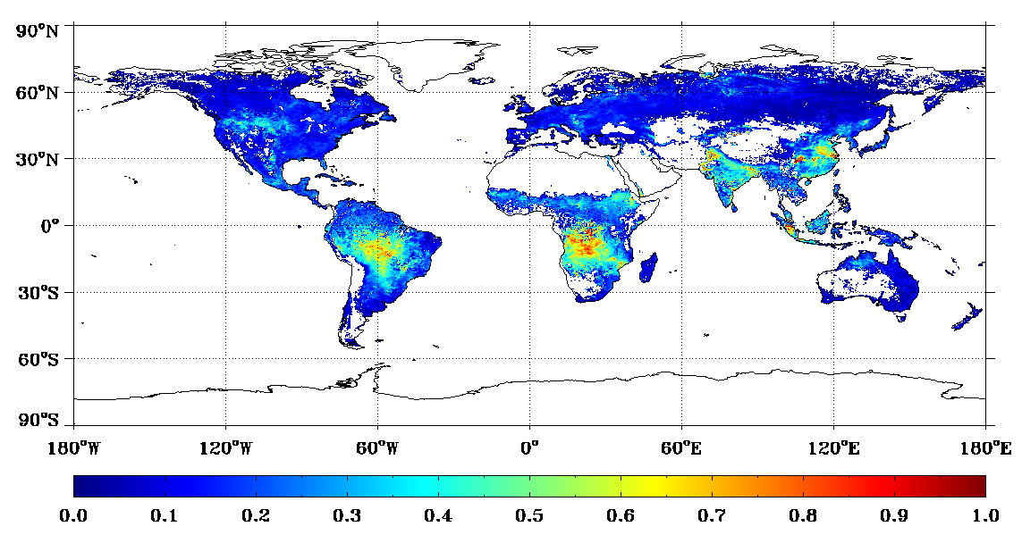
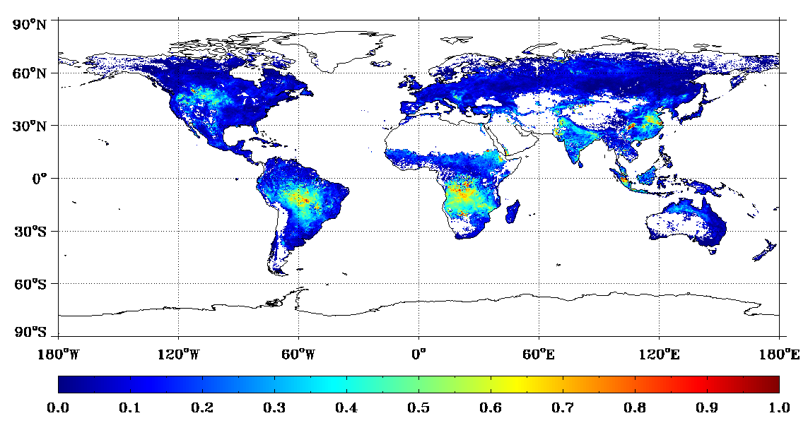
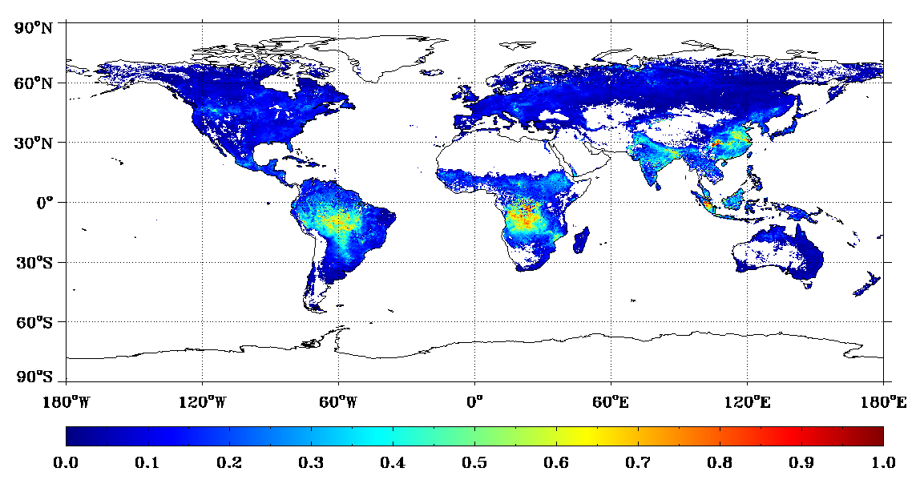
Evaluation of updated BR using non-collocated Global Data over Land (1)
Demonstration of the effect of surface band ratio (BR, PCT) update on a global scale.
  VIIRS AOT retrievals for Sep 2012 were re-processed with updated BR.
Best quality EDRs are gridded to 0.25º regular grid.
Only common grids are used
Monthly averages (arithmetic average of daily data) are plotted.
VIIRS
(IDPS)
Global Mean: 0.204
VIIRS
(PCT)
MODIS
Global Mean: 0.155
Global Mean: 0.153

Slide 15
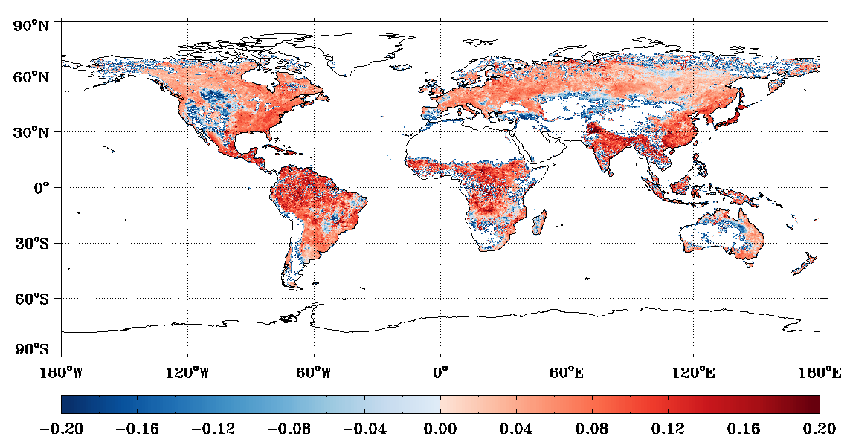
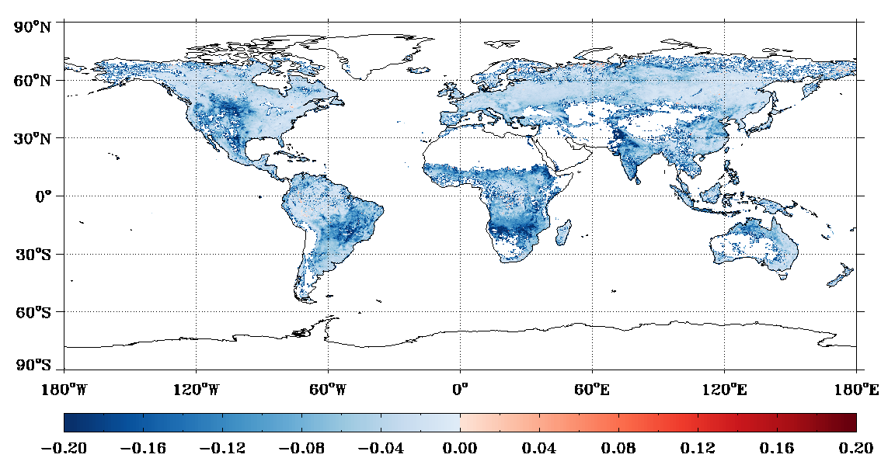
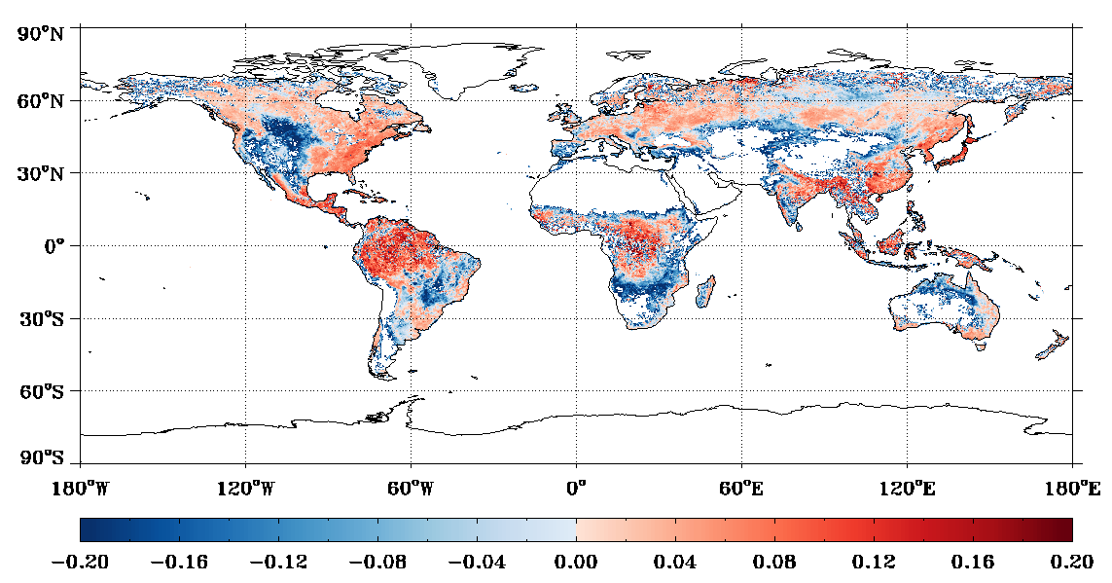
Evaluation of updated BR using non-collocated Global Data over Land (2)
VIIRS-MODIS difference
VIIRS(PCT)-VIIRS(IDPS) difference
VIIRS(IDPS)-MODIS
VIIRS(PCT)-VIIRS(IDPS)
Monthly mean AOT for Sep 2012
 | IDPS-MODIS | PCT-MODIS
Bias | 0.050 | -0.002
StdDev | 0.084 | 0.098
MinErr | -2.291 | -2.570
MaxErr | 1.146 | 1.112
VIIRS(PCT)-MODIS
Large positive bias in IDPS has been reduced in PCT, but magnitude of negative bias has increased.

Slide 16
Aerosol Optical Thickness (AOT) Comparison with AERONET

Slide 17
Evaluation using PGE Match-up Data
AOT (550 nm) | May 2012 - Sep 2012 |  |  |  | Jan 2013 - Mar 2013
AOT EDR | # | Bias | Std | R2 | # | Bias | Std | R2
Land | 862 | -0.011 | 0.095 | 0.564 | 1561 | -0.024 | 0.117 | 0.783
Ocean | 208 | 0.016 | 0.051 | 0.901 | 554 | 0.015 | 0.076 | 0.746
AOT IP | # | Bias | Std | R2 | # | Bias | Std | R2
Land | 645 | 0.018 | 0.099 | 0.574 | 821 | -0.003 | 0.124 | 0.802
Ocean | 181 | 0.019 | 0.050 | 0.890 | 262 | 0.016 | 0.054 | 0.808
PGE match-up data are used; inversion data from globally distributed AERONET sites (described on slide 13)
Over-land aerosol retrievals used updated land BR; updated BRs do not affect ocean retrievals
Bias (EDR) over land is about -0.01 and -0.02 for these time periods.
Performance over ocean continues to be good for the period extended from one month in Beta (May 2012); EDR and IP AOT are less than ~0.02 higher than AERONET with about half the Std than that over land.

Slide 18
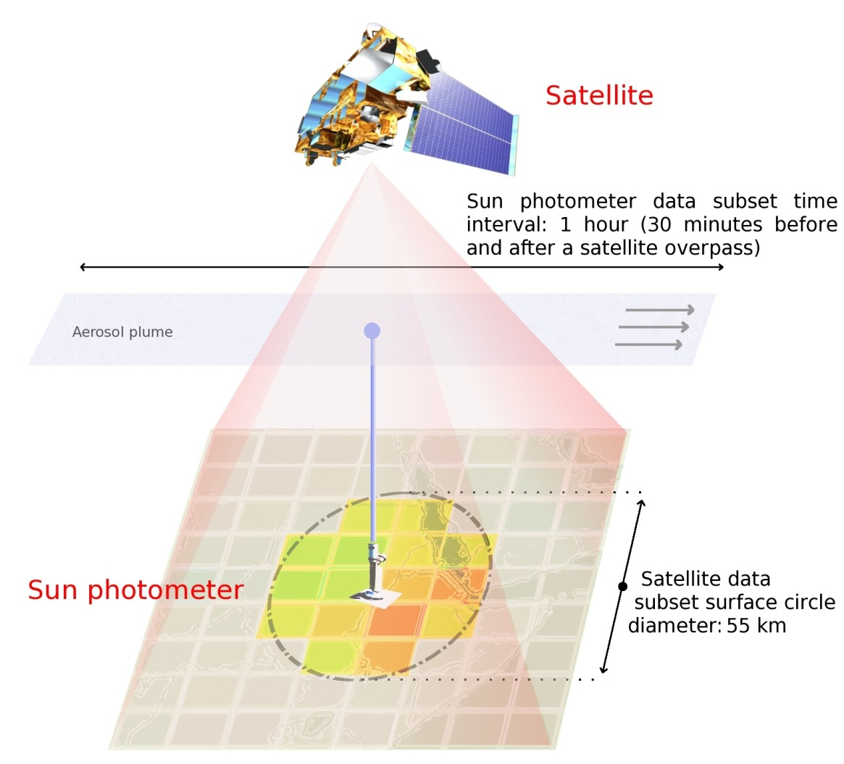
Evaluation using MAPSS-like matchups
In addition to the PGE Match-up Data, another set of match-ups are also used in the evaluation.
This set has been prepared following the Multi-sensor Aerosol Products Sampling System (MAPSS) protocol.
  http://disc.sci.gsfc.nasa.gov/aerosols/services/mapss/mapssdoc.html#description
Matchup and Quality control criteria for MAPSS-like data:
  AERONET L1.5 Direct Sun retrievals from max 444 sites (includes DISCOVER_AQ sites) are averaged within ±30 minutes of VIIRS overpass time.
  Best quality VIIRS AOTs (QF=0 for IP; QF=3 for EDR) within a radius of 27.5 km from the AERONET site are averaged.
  A minimum of five best quality VIIRS AOT retrievals (EDR, IP) and two AERONET observations must be available within the spatial and temporal constraints.
  AERONET AOT data, if observed at wavelengths other than 550 nm, are interpolated to 550 nm using AOT at 440 nm and 670nm.

Slide 19
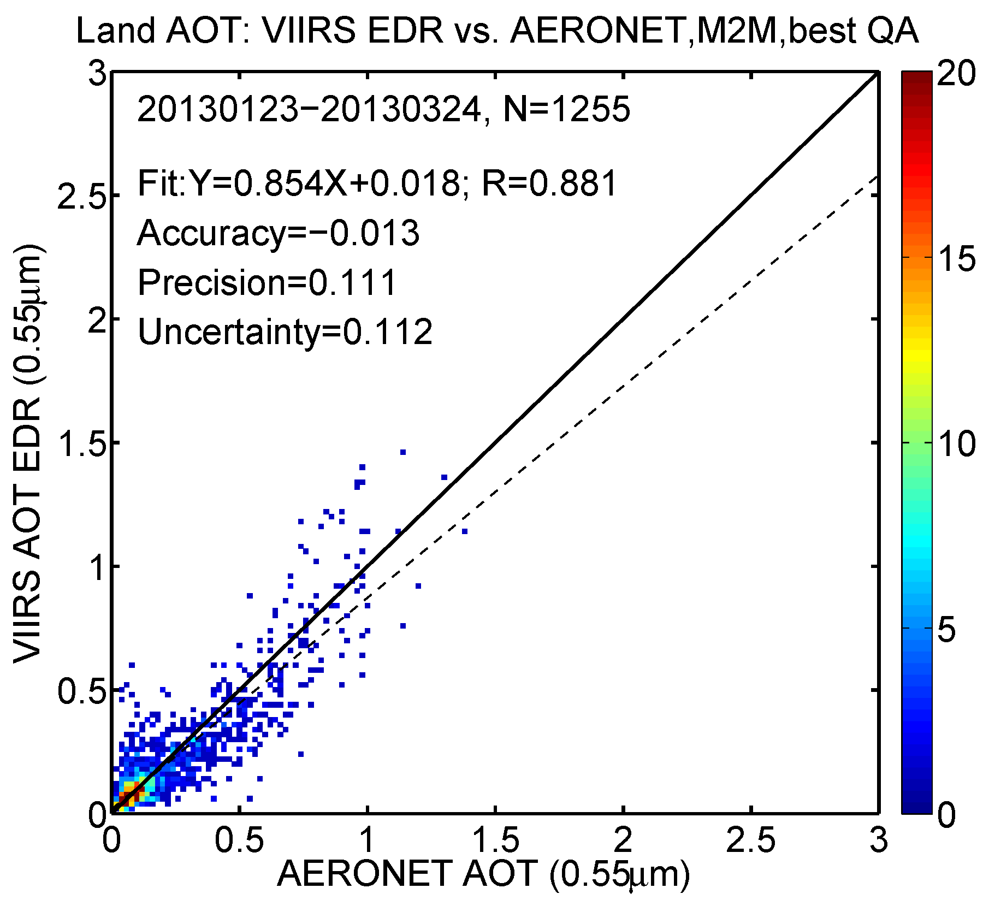
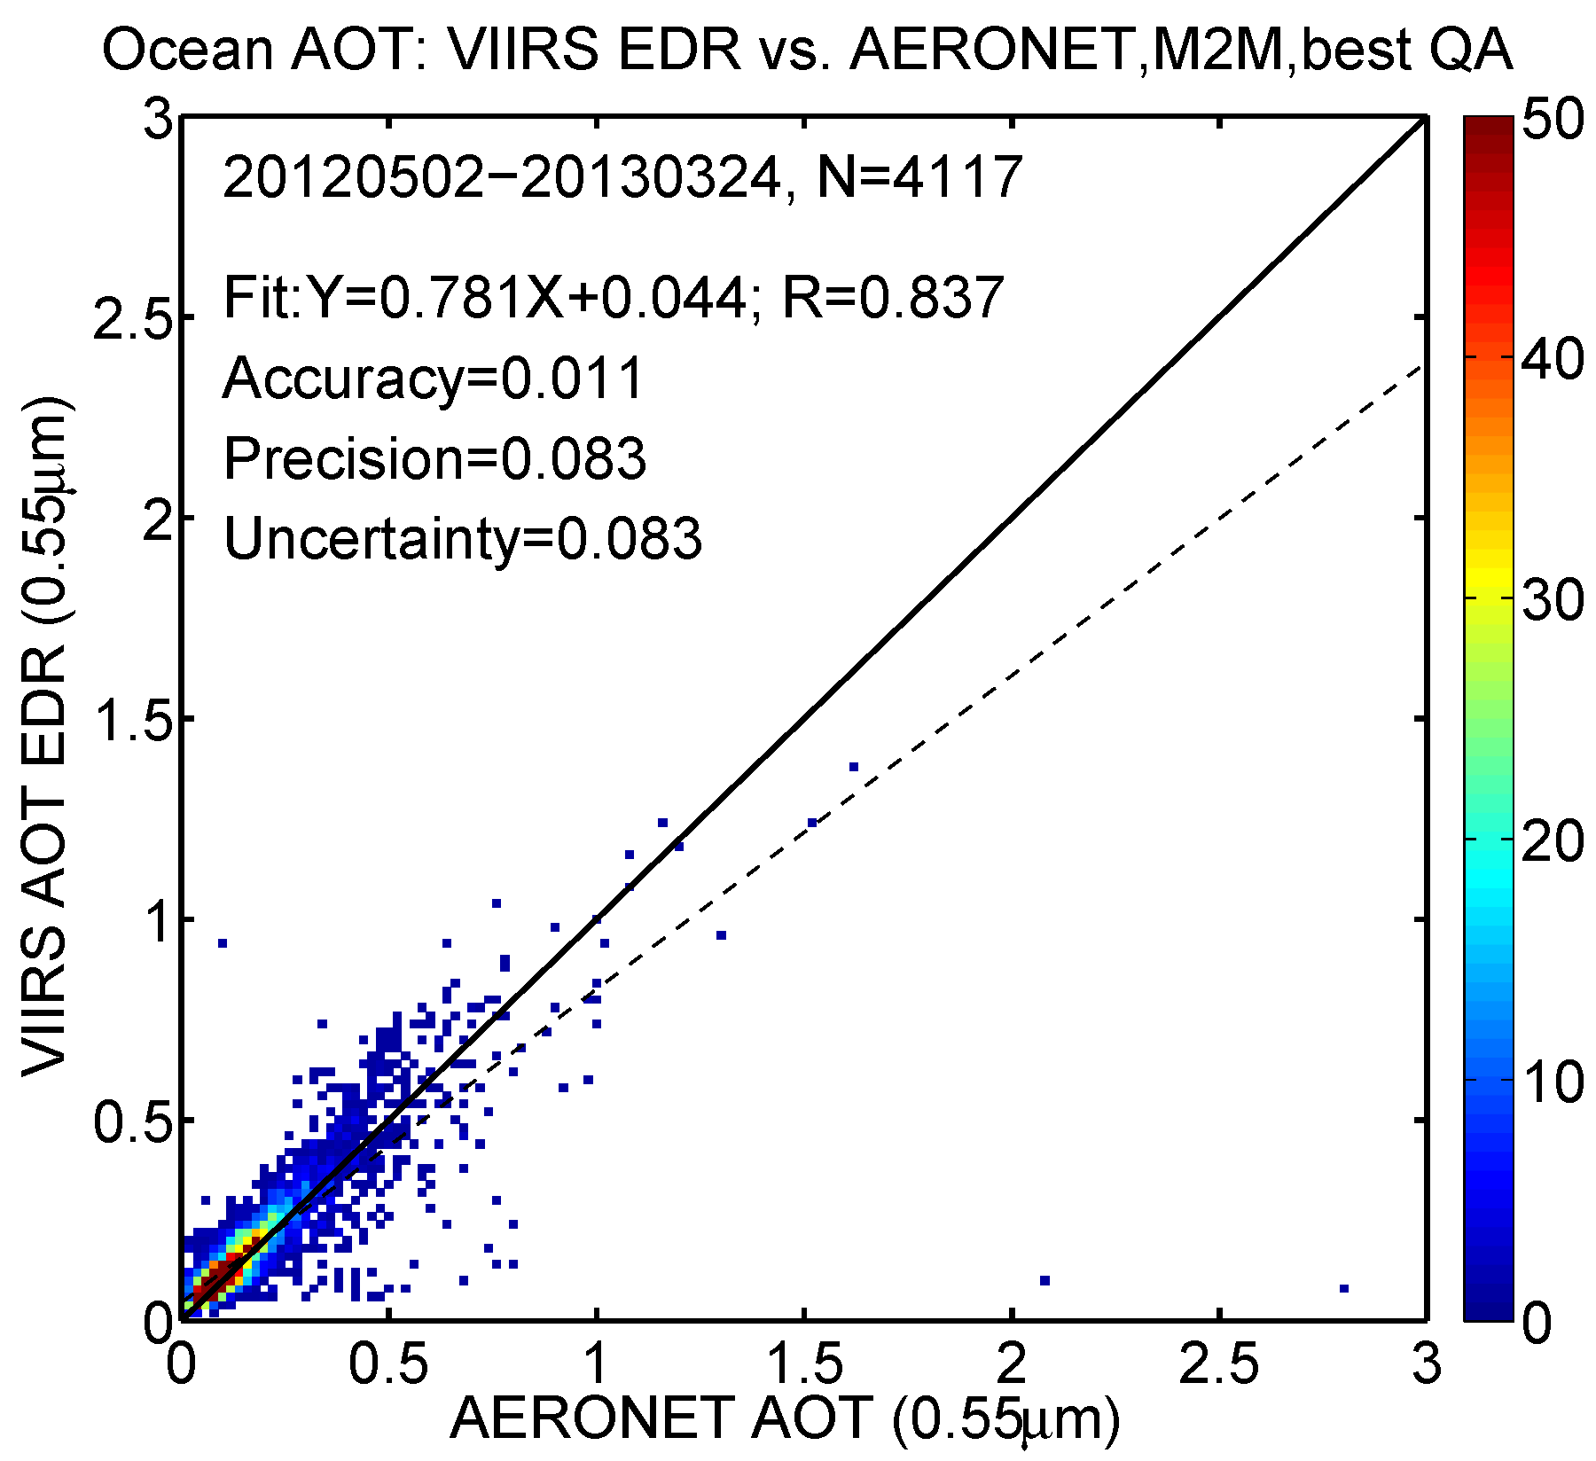
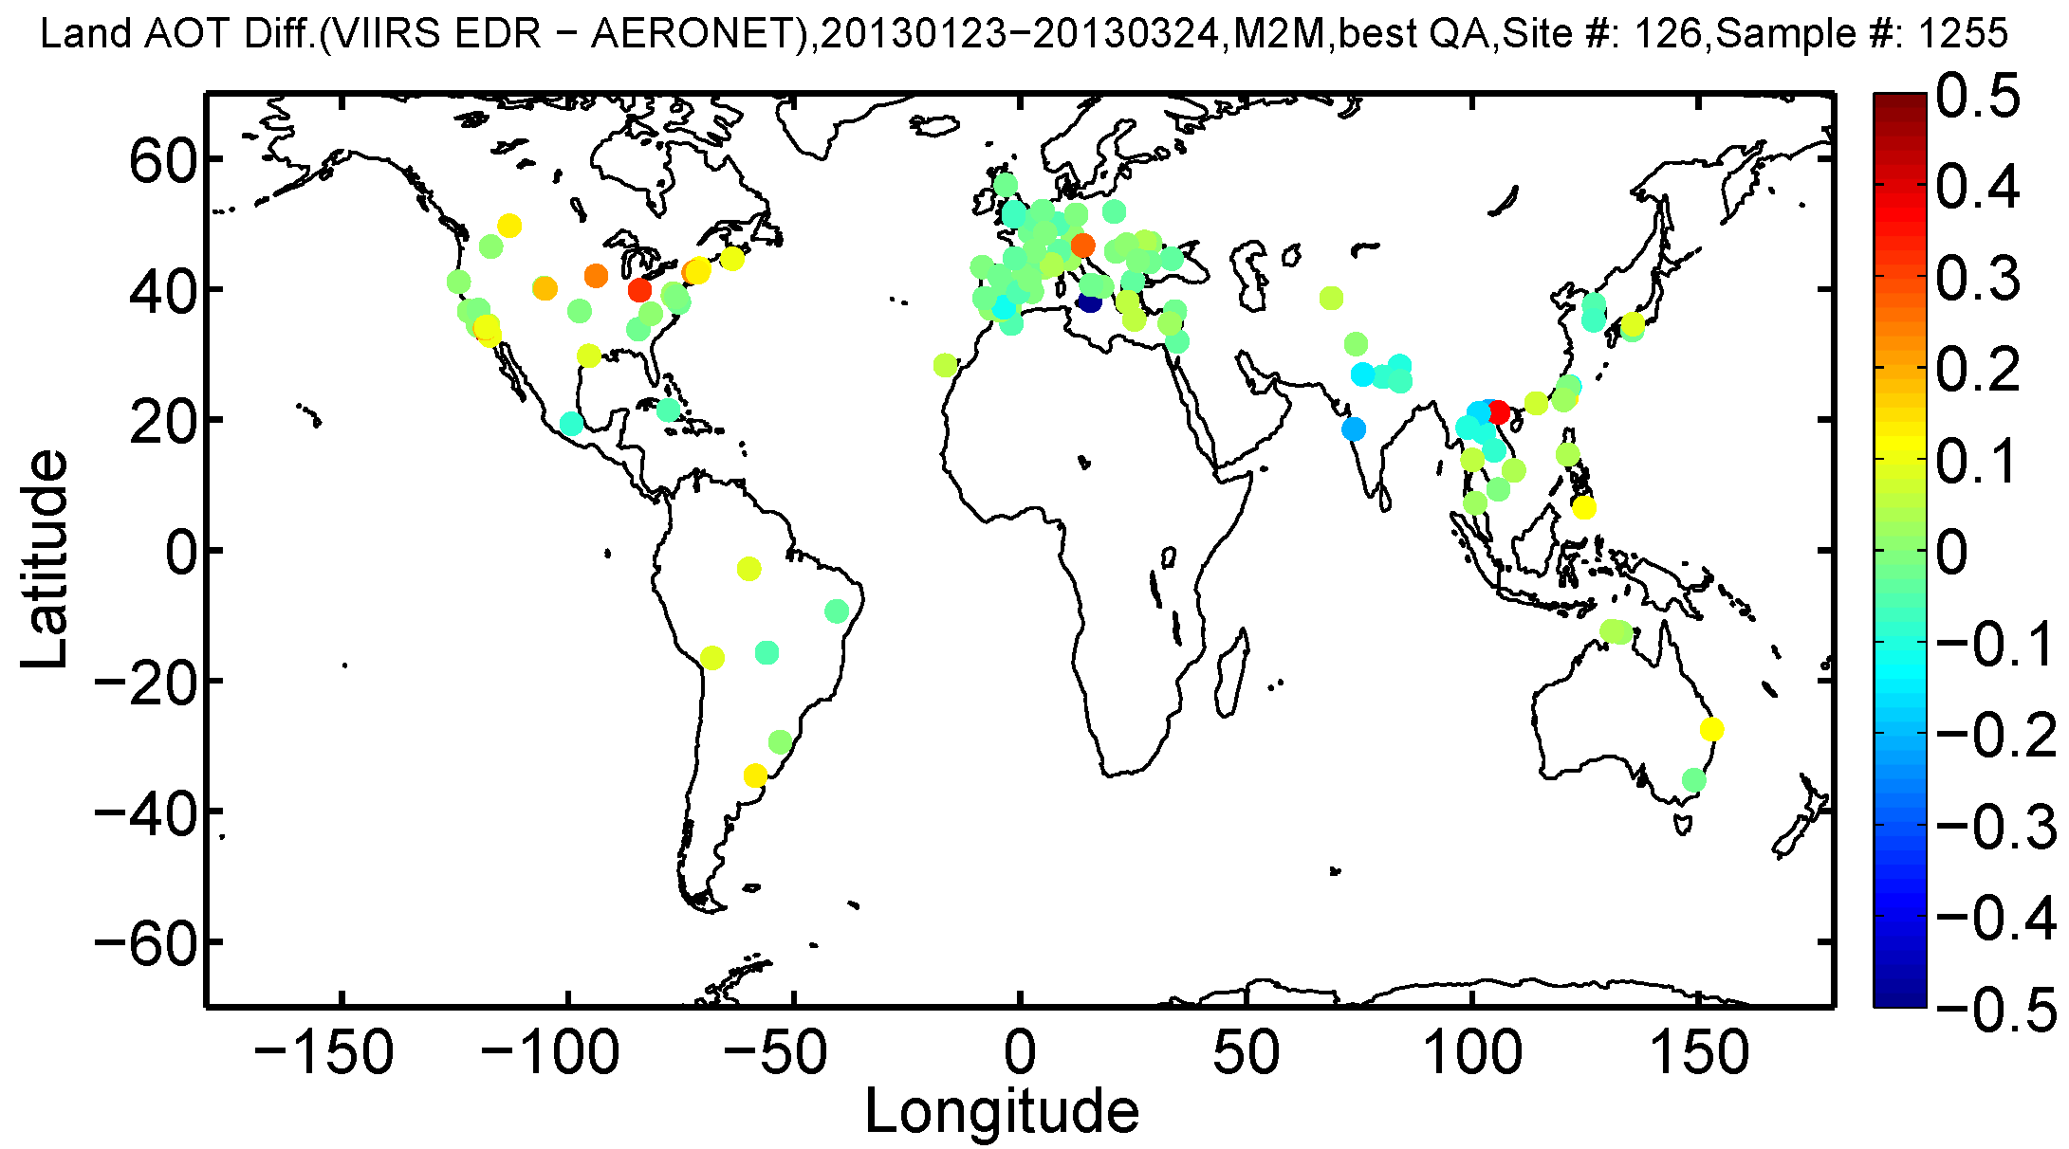
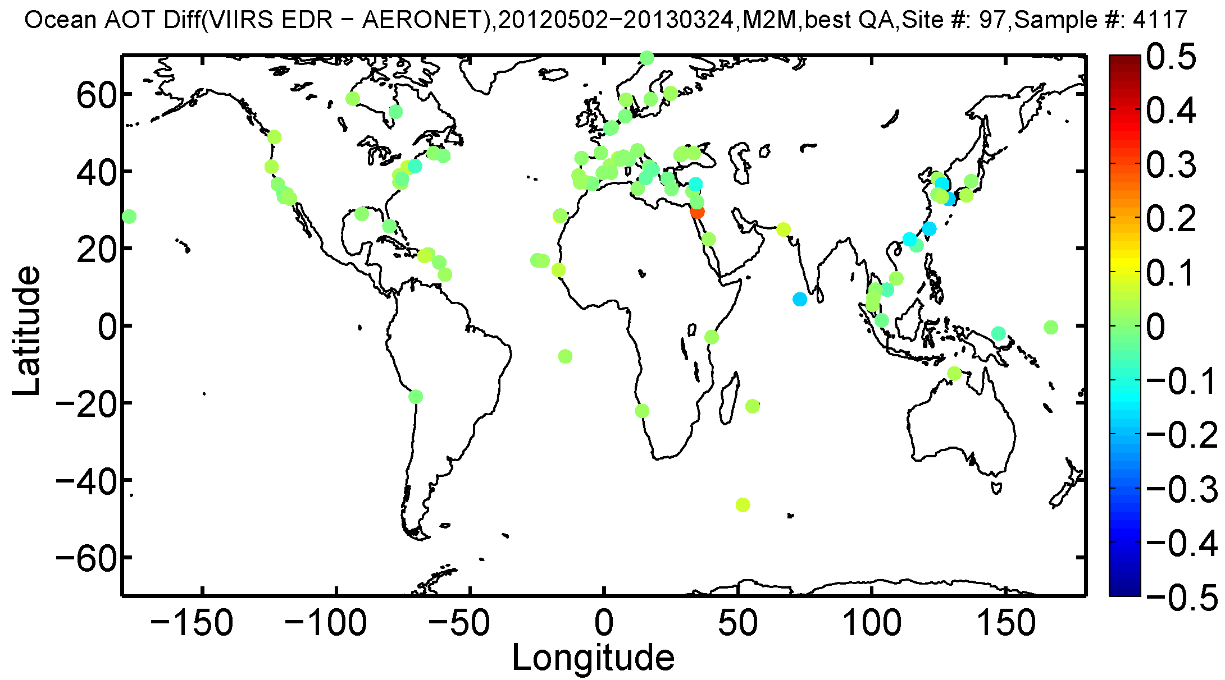
VIIRS AOT EDR vs. AERONET AOT
Land (Feb-Mar, 2013)
Ocean (May 2012-Mar 2013)

Slide 20
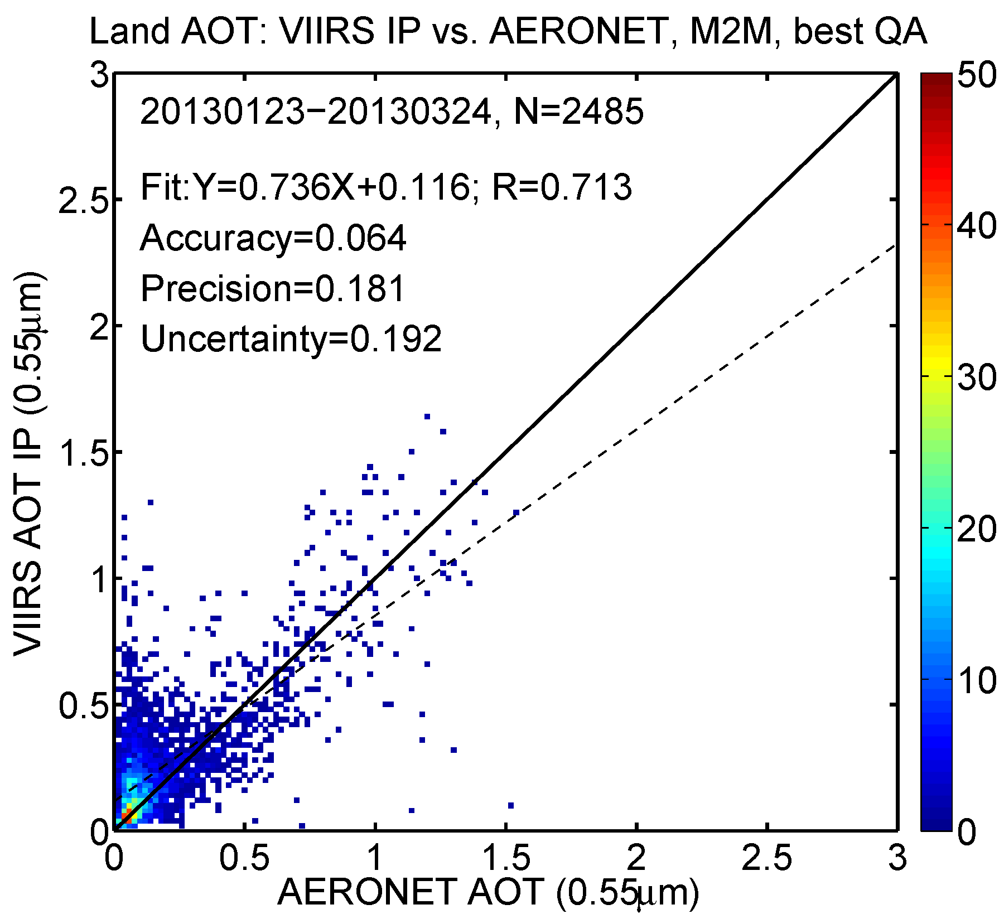
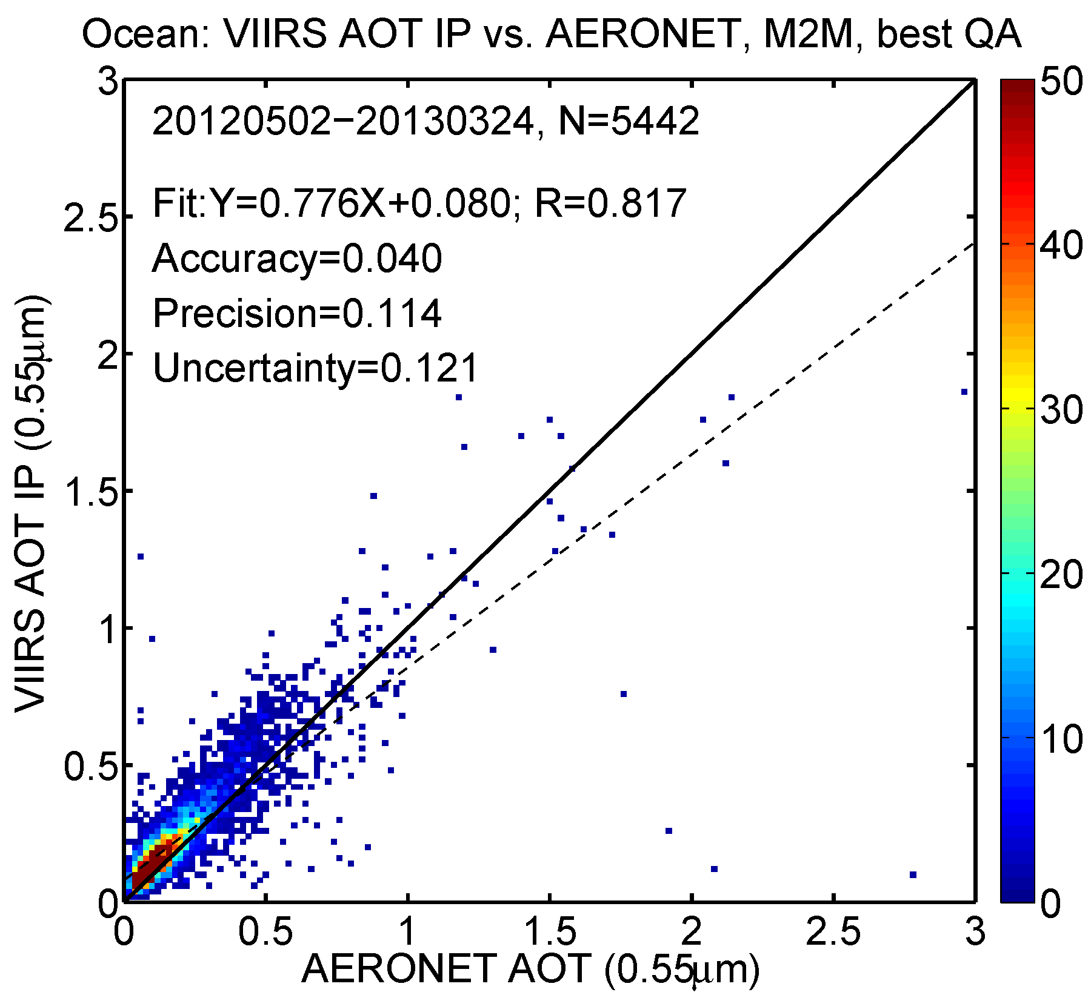
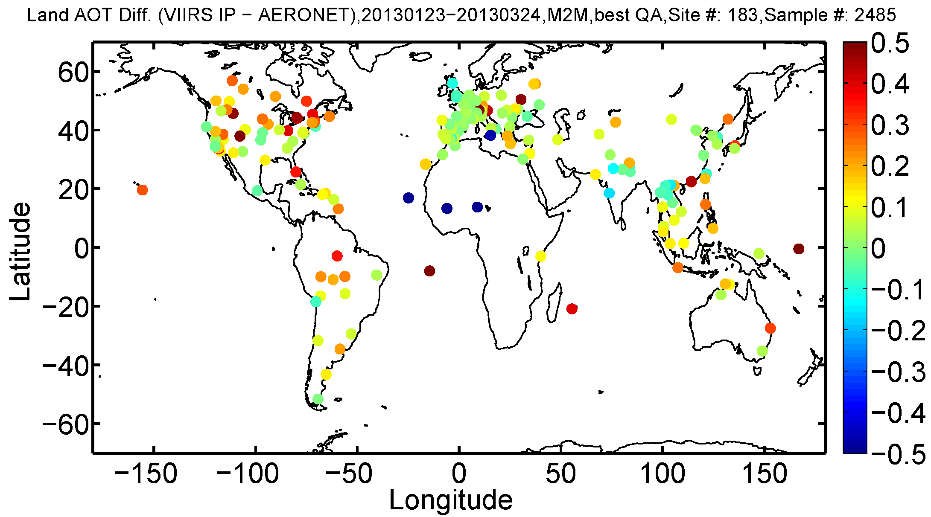
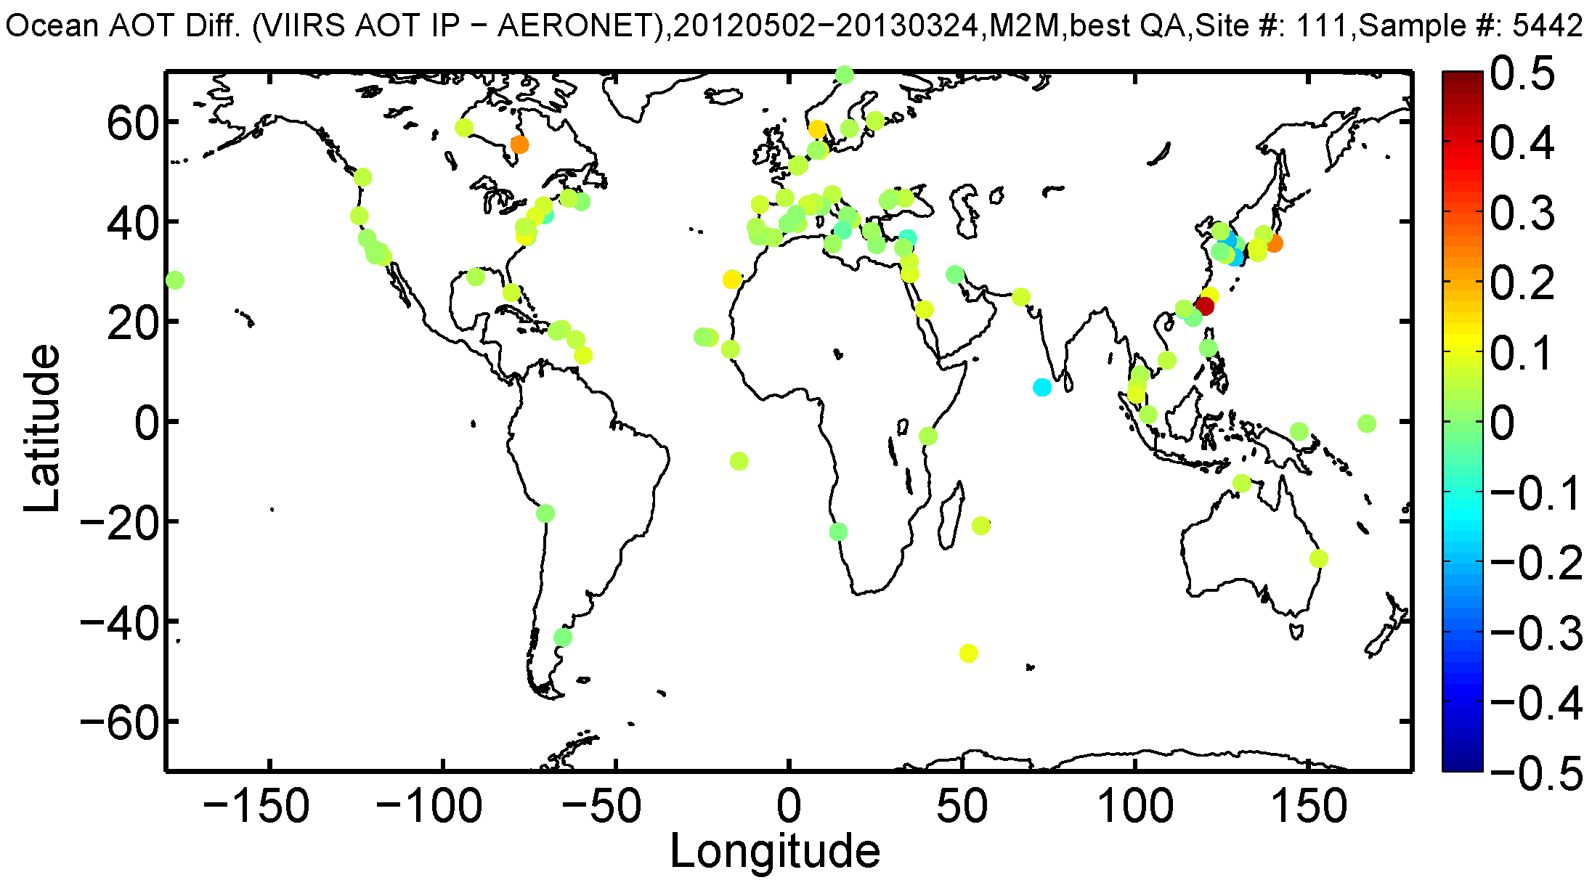
VIIRS AOT IP vs. AERONET AOT
Land (Feb-Mar, 2013)
Ocean (May 2012-Mar 2013)

Slide 21
Satellite-derived AOT vs. AERONET AOT
VIIRS, MODIS (Aqua&Terra), MISR AOT EDR
EDR | VIIRS | MYD04 | MOD04 | MISR | VIIRS | MYD04 | MOD04 | MISR
AOT (550 nm) | LAND |  |  |  | OCEAN
Sample Size | 1255 | 1026 | 1269 | 718 | 4117 | 4742 | 4495 | 91
Accuracy | -0.013 | -0.014 | -0.043 | -0.009 | 0.011 | 0.006 | 0.010 | 0.038
Precision | 0.111 | 0.143 | 0.140 | 0.133 | 0.083 | 0.117 | 0.087 | 0.059
Uncertainty | 0.112 | 0.144 | 0.146 | 0.134 | 0.083 | 0.117 | 0.087 | 0.071
Cor Coef | 0.881 | 0.858 | 0.887 | 0.845 | 0.837 | 0.795 | 0.871 | 0.957
VIIRS, MODIS (Aqua and Terra), and MISR AOTs are compared to AERONET AOT.
Time periods:
  Land: 01/23/2013-03/24/2013 [~2 months]
  Ocean: 05/02/2012-03/24/2013 (10/15/2012-11/27/2012 excluded) [~9 months]
  MISR data period is 05/20/2012-11/30/2012
In terms of “global” average AOT, the VIIRS aerosol algorithm performance is comparable to those of other algorithms/sensors.
  Regionally, significant differences may exist

Slide 22
Comparison of AOT with MAN (1)
Maritime Aerosol Network (MAN) – cruise based aerosol measurements
  MAN level 2 (L2) series average data are used.
Period for EDR: 2 May – Oct 15, 2012 (~5 months)
  10/16-11/27, 2012 excluded (bad VIIRS data)
  Dec 2012 excluded (most ships at same location or only occasional measurements)
  MAN L2 data are not yet available for 2013
Period for IP: May 2012 and Sep 2012 (2 months)
Match-up procedure:
  Best quality VIIRS EDR (QF=3) and IP (QF=0) AOTs.
  MAN’s observation time and location are used as reference
  Box Mean Comparison - Selected VIIRS IPs/EDRs are
    within ± 30 minutes of MAN observation time,
    within 0.5°x 0.5° box centered on MAN location.

Slide 23
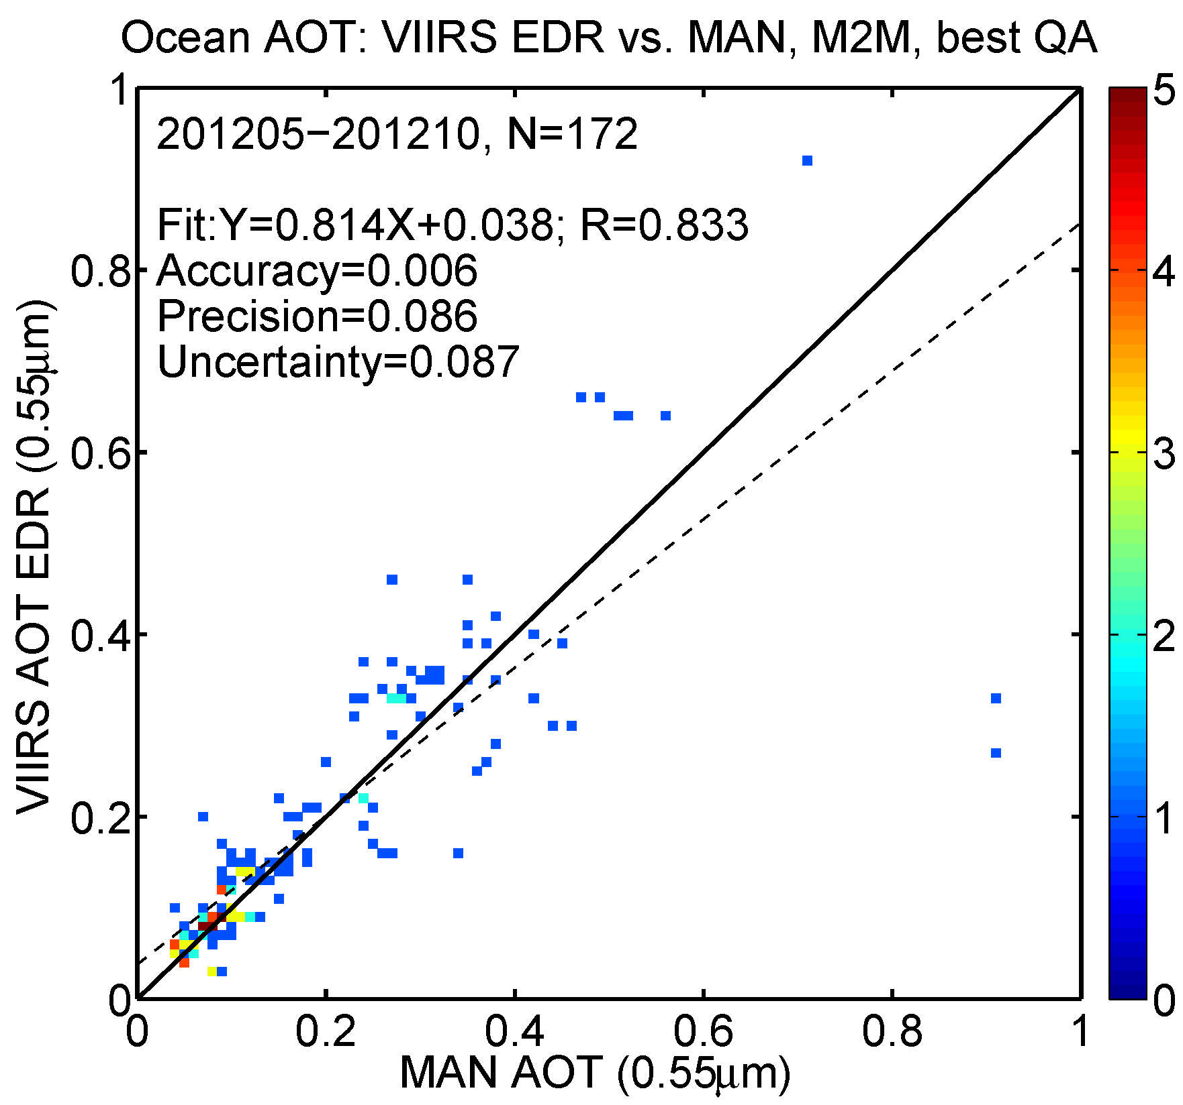
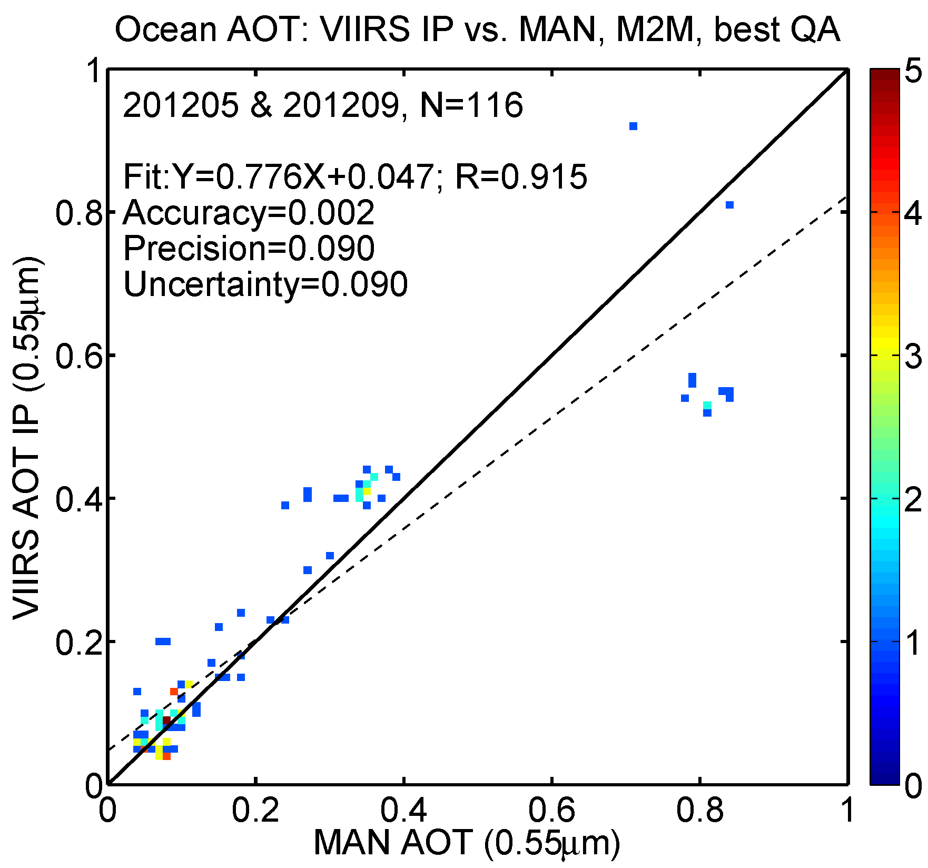
Comparison of AOT with MAN (2)
EDR
IP
Some outliers, but excellent agreement overall for both EDR and IP.

Slide 24
Aerosol Optical Thickness (AOT)
Comparison with MODIS

Slide 25
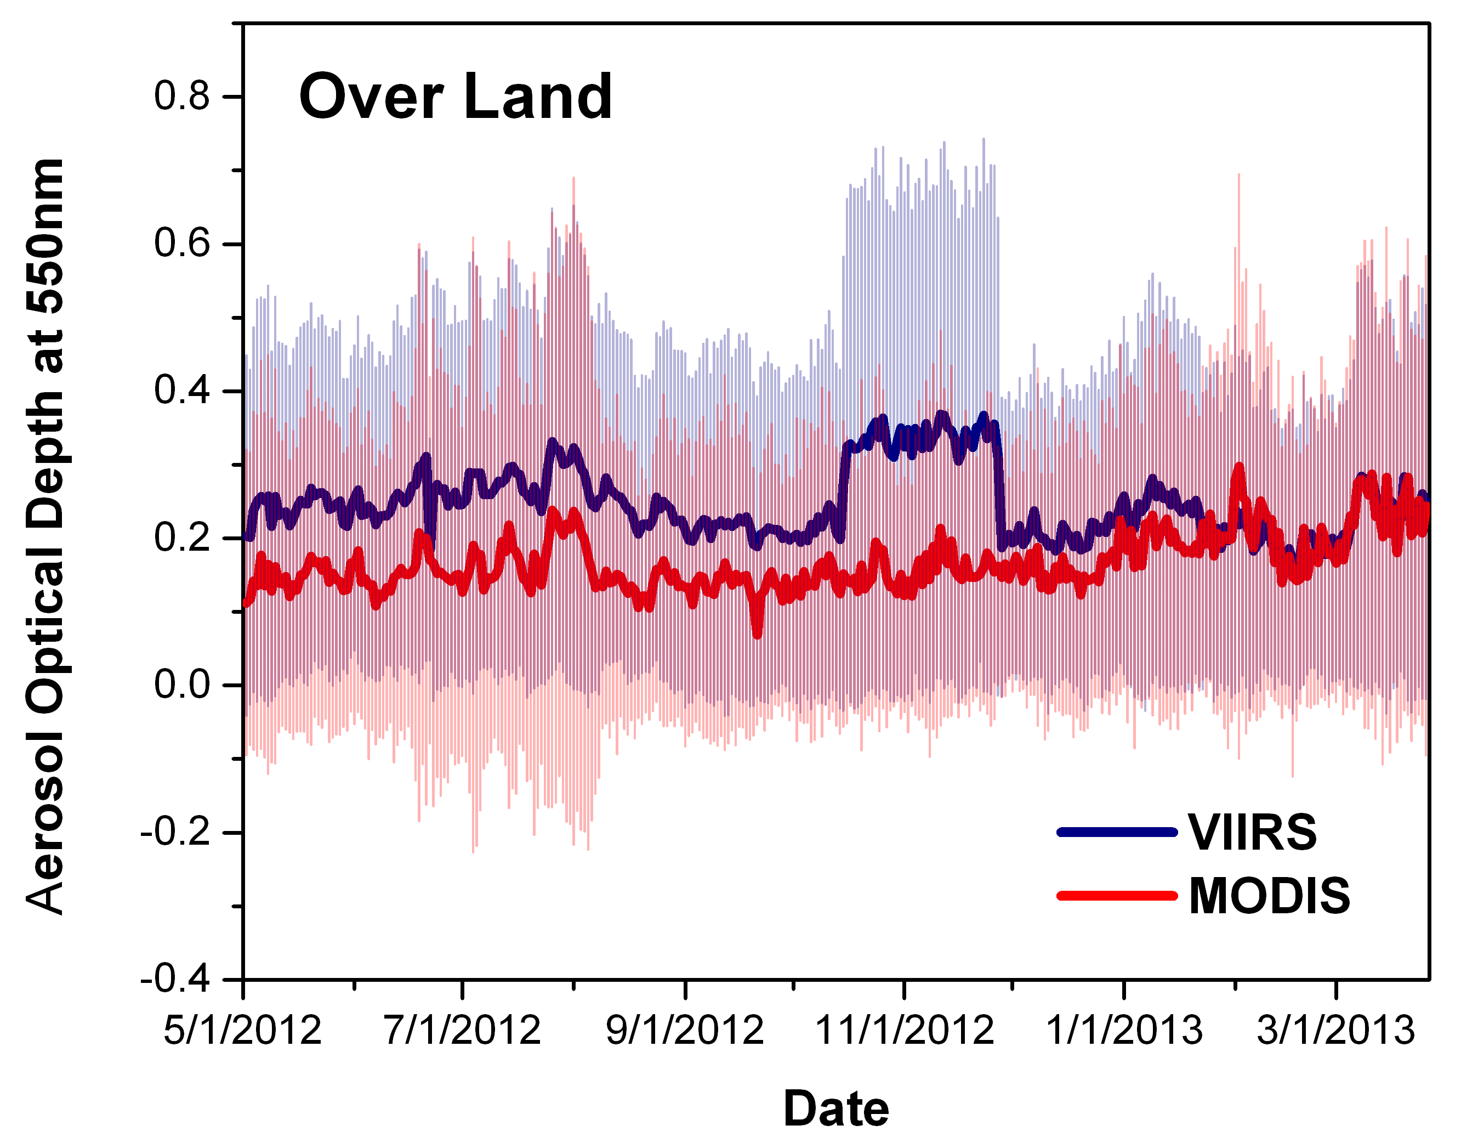
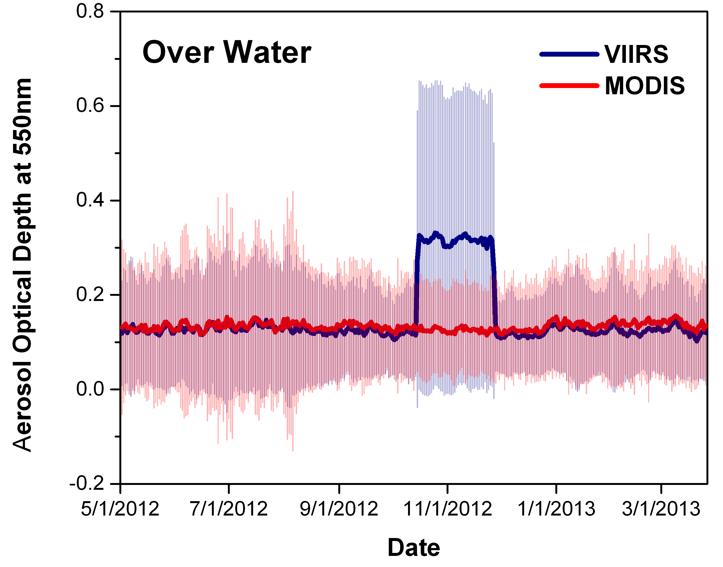
VIIRS vs. MODIS global mean AOT
Processing error
Processing error
surface refl. ratio update
Time series of global mean AOTs
  Time period: 05/02/2012 – 03/26/2013
  VIIRS high quality EDR
  MODIS (Aqua) “very good” quality retrievals over land and “top-3 quality” over water.
  Non-collocated data.
VIIRS follows changes in global mean MODIS AOT even before the surface reflectance ratio update.

Slide 26
Collocated VIIRS and MODIS AOT
Collocation method:
Time: MODIS (L2) and VIIRS (IP/EDR) AOT are matched up in time within 5 minutes
Space: VIIRS AOT from nearest pixel falling within MODIS 10 km.
Both MODIS over Land and over Ocean AOTs are filtered with MODIS Could Fraction = 0 (from aerosol cloud mask)
MODIS AOT is filtered with Best Quality Assurance Land and Ocean Flag
VIIRS AOT is filtered with High Quality flag (QF=3 for EDR and QF=0 for IP)
Time periods used:
Dec 2012 – Mar 2013: Ocean only
Feb-Mar 2013: Land and Ocean

Slide 27
VIIRS AOT vs. MODIS/Aqua Over Ocean
( Dec 2012 to Mar 2013)
EDR
IP
Collocated MODIS and VIIRS data are used.
Over ocean, accuracy (bias) and precision (STD) of VIIRS AOT EDR with respect to MODIS AOT are small, about -0.007 and 0.04, respectively.
Bias and STD of bias of AOT IP are comparable to corresponding EDR values.

Slide 28
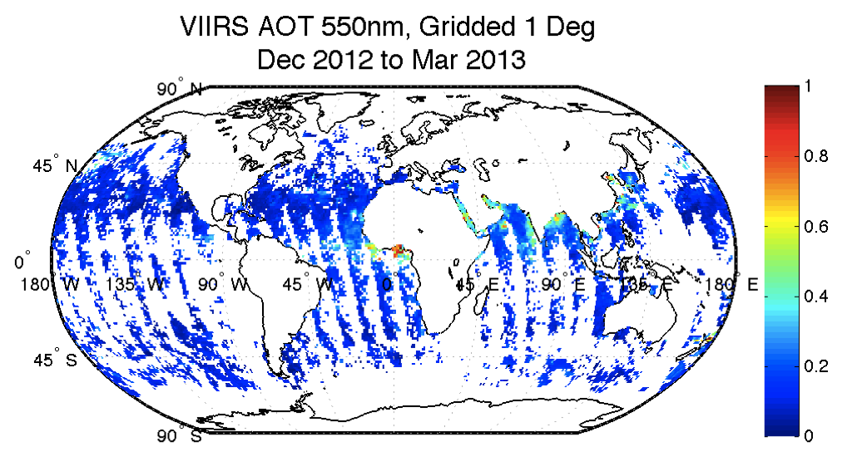
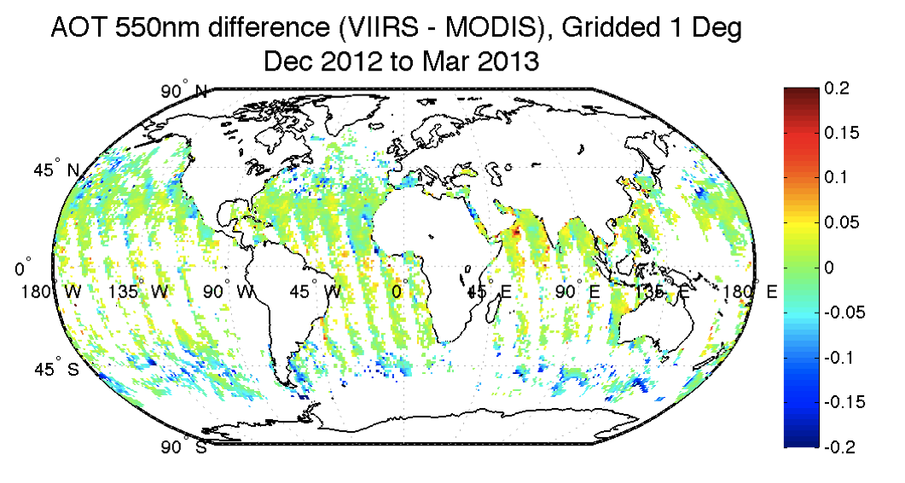

Maps of collocated gridded VIIRS and MODIS/Aqua AOT over ocean
( Dec 2012-Mar 2013)
AOT EDR mapped to 1-degree grids.
Over ocean, spatial distribution of VIIRS and MODIS/Aqua AOT are similar
    with somewhat smaller VIIRS AOT at high latitude oceans, and
    somewhat higher VIIRS AOT at tropical latitudes.

Slide 29
VIIRS AOT vs. MODIS/Aqua over Land
( Feb-Mar 2013)
EDR
IP
Collocated MODIS and VIIRS data are used.
Over land, bias (accuracy) and STD (precision ) of VIIRS AOT EDR with respect to MODIS AOT are larger than those over ocean, about -0.05 and 0.15, respectively.
Bias of VIIRS AOT EDR and IP are comparable.
STD of bias of AOT IP is larger than that of AOT EDR, 0.19 vs. 0.15 (this is expected).

Slide 30
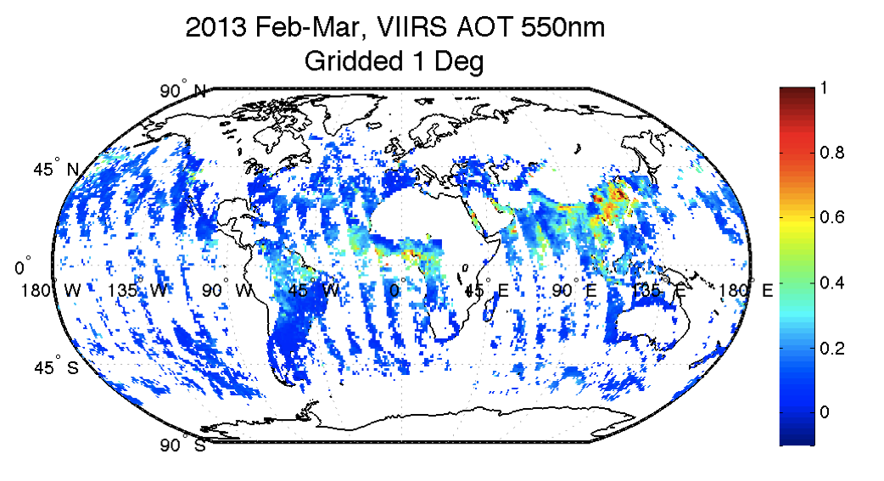
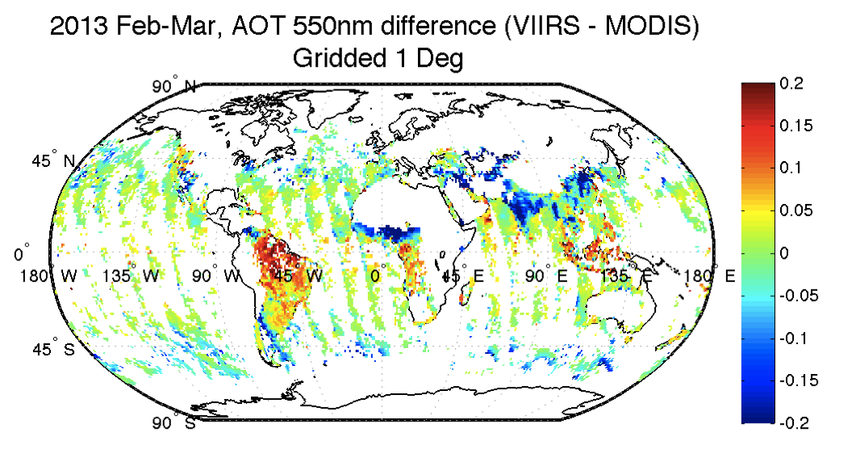
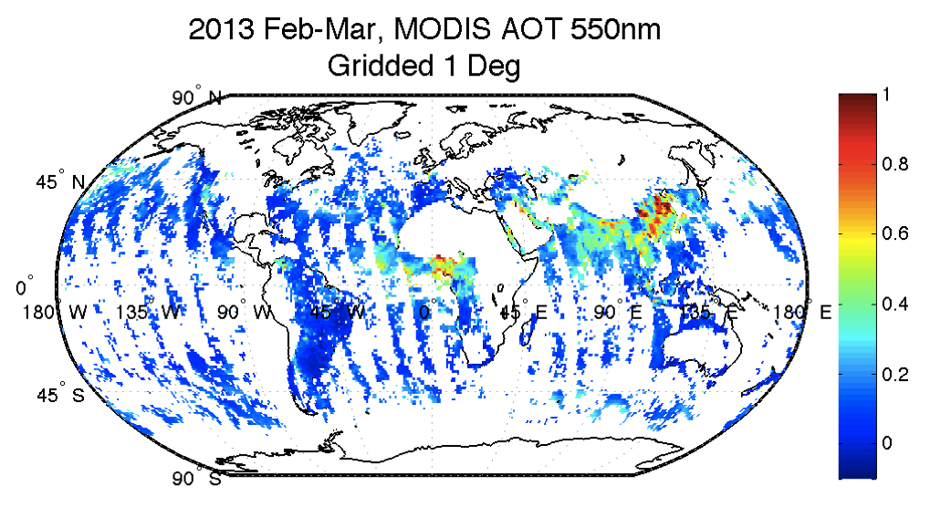
Maps of collocated gridded VIIRS and MODIS/Aqua AOT over land and ocean
( Feb-Mar 2013)
AOT EDR mapped to 1-degree grids.
  Over land, relative to MODIS, VIIRS AOT is still biased high in some places (e.g., Brazil) , while it is biased low at other places (e.g., India).
    constant BR is not sufficient!
Over ocean, conclusion is the same as for the Dec 2012 – Mar 2013 period (slide 30).

Slide 31
Aerosol optical thickness (AOT) planned improvements

Slide 32
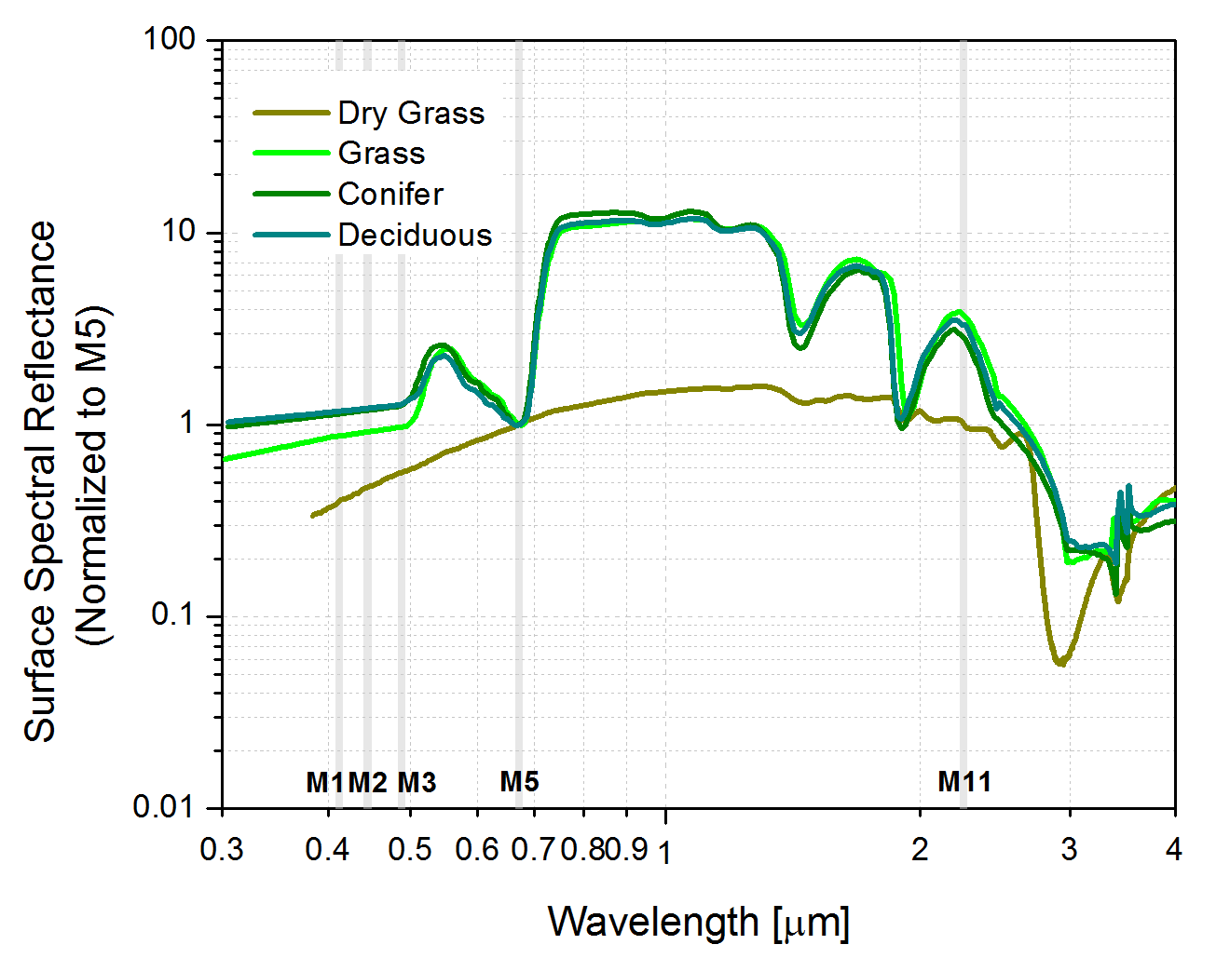
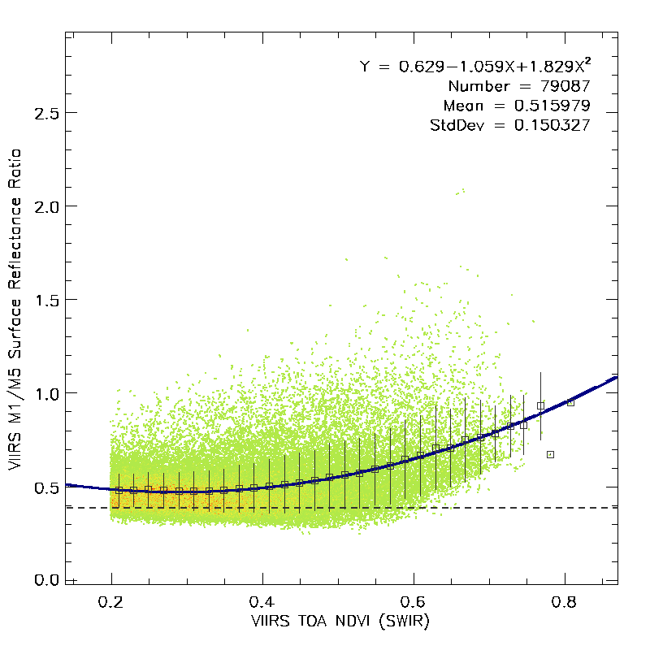
NDVI-dependent surface reflectance ratio (1)
Surface reflectance band ratios (BR) are expected to depend on geographical location and state of vegetation (season).
Proposed surface reflectance band ratios are function of top-of-atmosphere SWIR NDVI (proxy of surface type)
  NDVI_SWIR = (M8-M11)/(M8+M11)
Method:
  Retrieved land surface reflectance in VIIRS bands M1, M2, M3, M5 and M11 for five aerosol models (dust, high/low absorbing smoke, clean/polluted urban) using operational VIIRS lookup tables and atmospheric correction routines in VIIRS over-land aerosol retrieval and AERONET AOT. (MAY-OCT 2012)
  Mean of the surface reflectances obtained for the five aerosol models with low AOT (<= 0.1) is used in determining BR.
Increase in ratio results in decrease in AOT; more negative AOT retrievals; decrease in number of high quality EDR
 | PCT* | NDVI-dependent BR
M1/M5 | 0.513 | 0.629-1.059*NDVI+1.829*NDVI²
M2/M5 | 0.531 | 0.662-0.711*NDVI+1.146*NDVI²
M3/M5 | 0.645 | 0.741-0.653*NDVI+1.076*NDVI²
M11/M5 | 1.788 | 1.117+0.286*NDVI+1.1698*NDVI²
BR prior to update in Jan 22, 2013
*PCT: constant BR current as of Jan 23, 2013

Slide 33

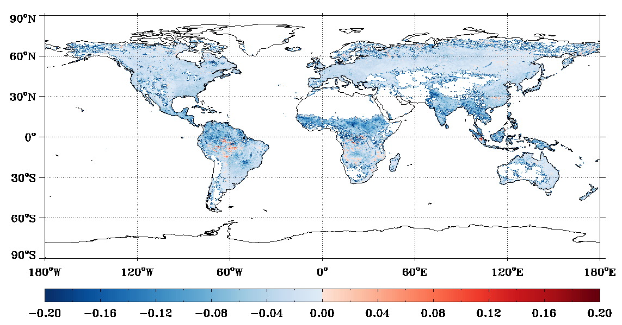
NDVI-dependent surface reflectance ratio (2)
 | IDPS-MODIS | PCT-MODIS | NDVI-MODIS
Bias | 0.050 | -0.002 | -0.029
StdDev | 0.084 | 0.098 | 0.098
MinErr | -2.291 | -2.570 | -2.598
MaxErr | 1.146 | 1.112 | 1.143
VIIRS AOT EDR (PCT)
VIIRS(NDVI)-VIIRS(PCT) difference
VIIRS AOT EDR (NDVI)
VIIRS AOT EDR (NDVI-PCT)
Monthly mean AOT retrieved over land for September 2012.
IDPS: original constant BR; PCT: updated constant BR; NDVI: NDVI-dependent BR

Slide 34
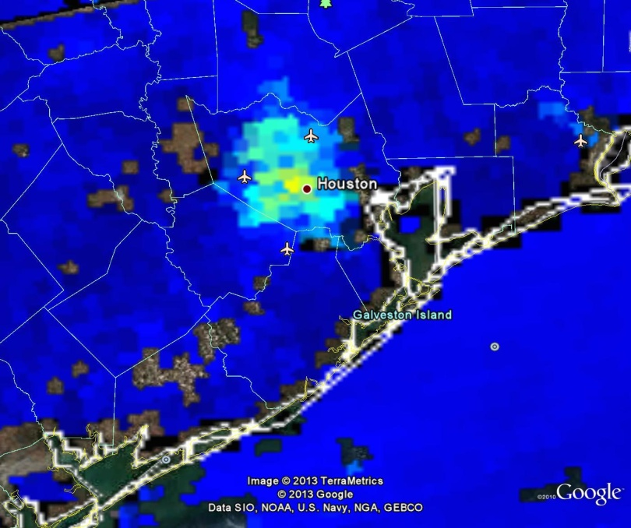
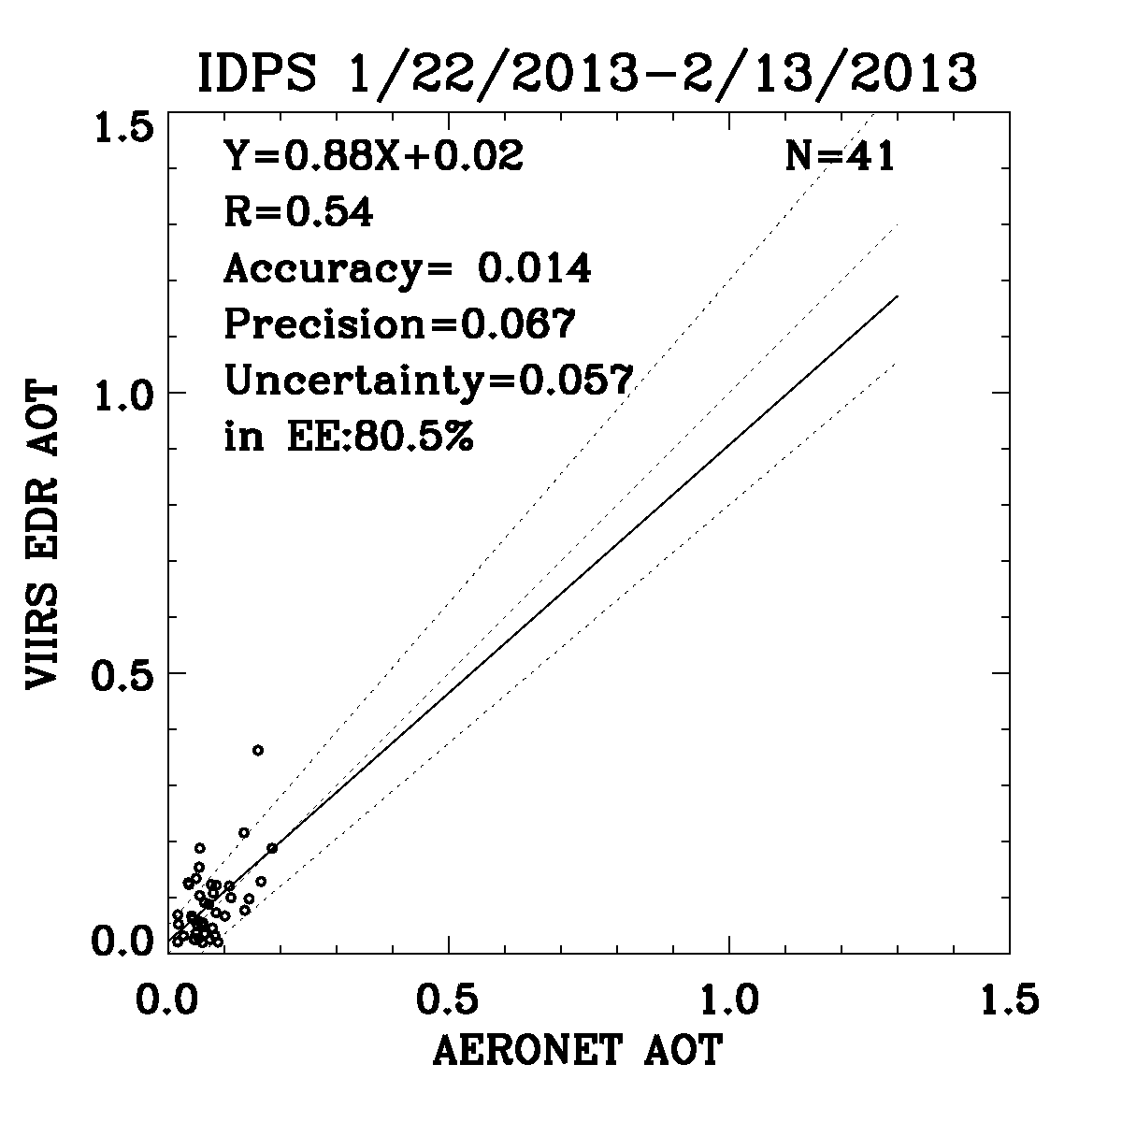
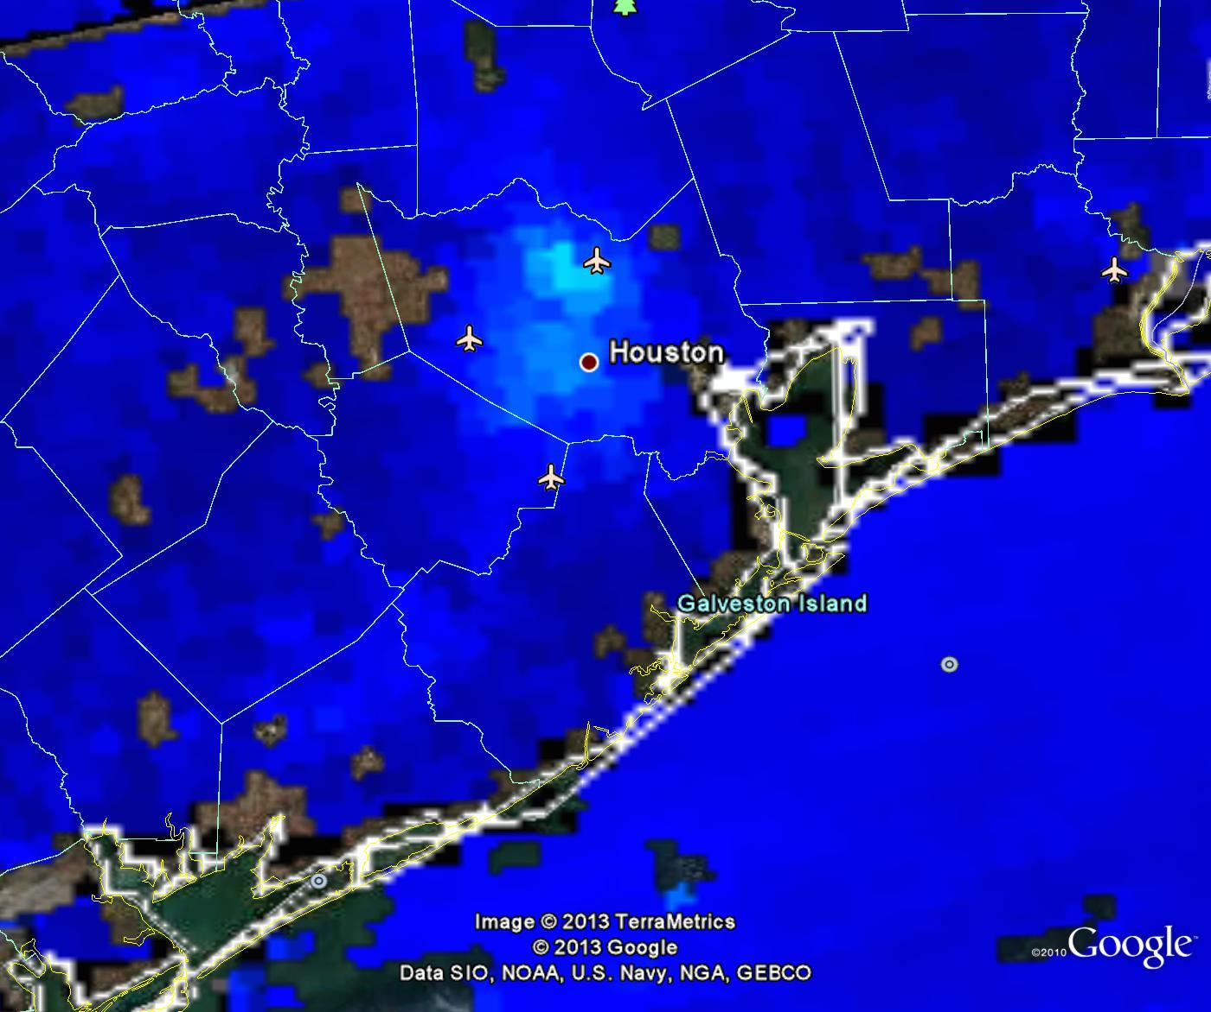
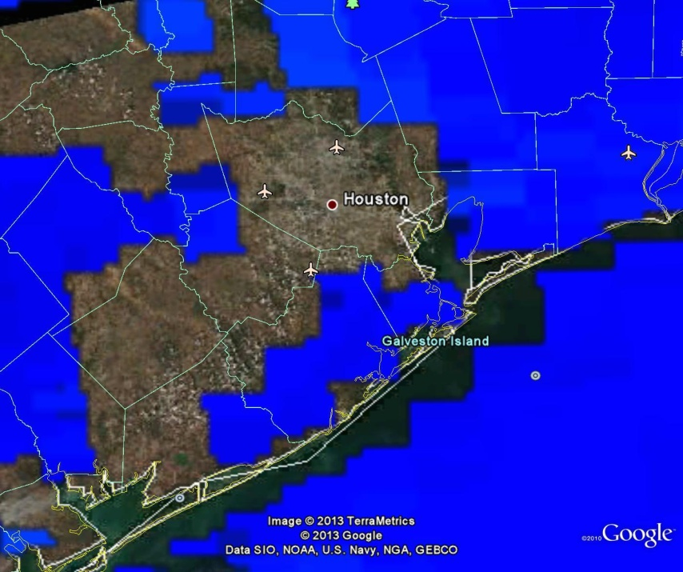
NDVI-dependent surface reflectance ratio (3)
IDPS
NDVI-dependent BRs have been implemented in VIIRS aerosol algorithm driven by direct broadcast VIIRS data in the Infusing satellite Data into Environmental Applications (IDEA) over CONUS.
NDVI (IDEA)
MODIS (Aqua)
NDVI-dependent BRs reduce AOT in Houston area 1/22/2013, and
  eliminate VIIRS outlier in scatterplot for 1/22-2/13, 2013.
  MODIS makes no retrieval in this area

Slide 35
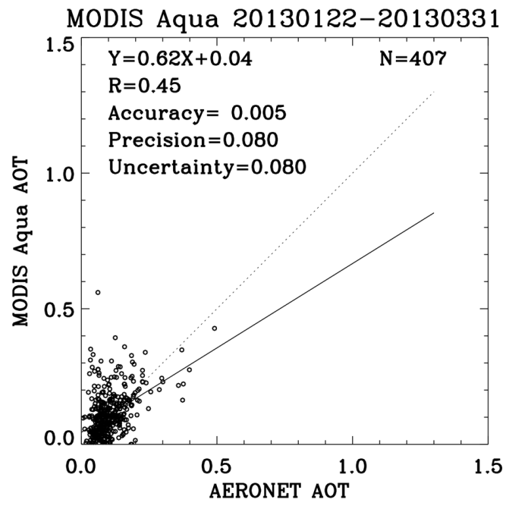
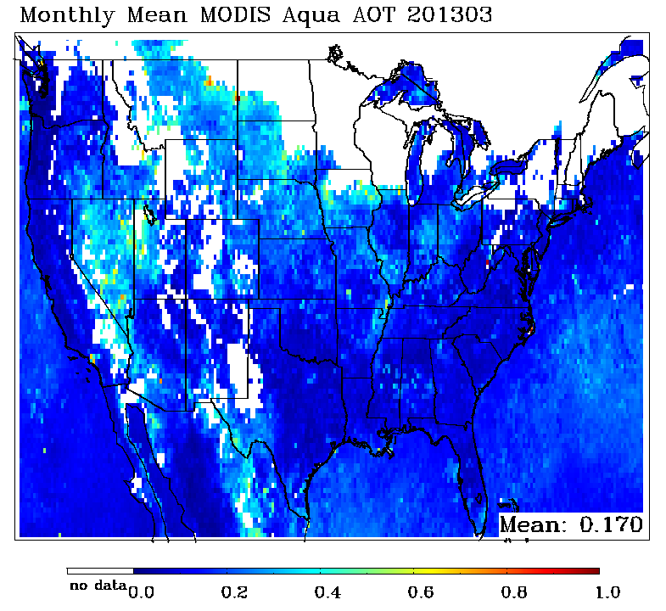
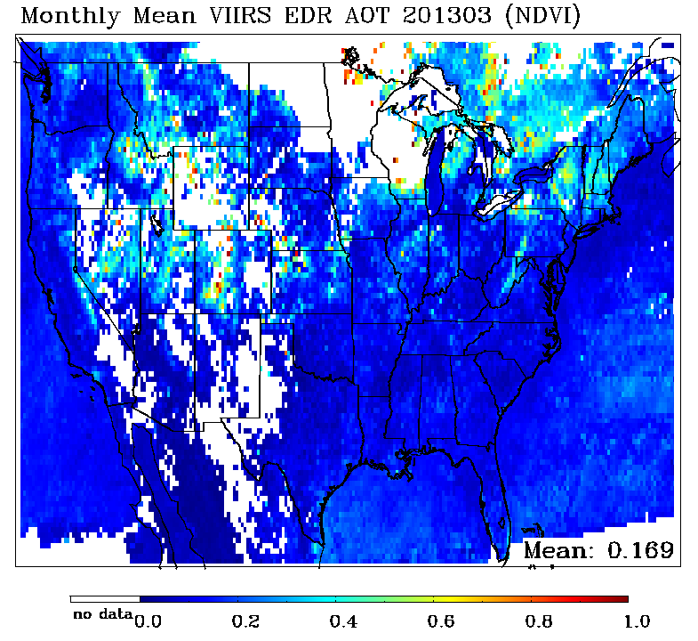
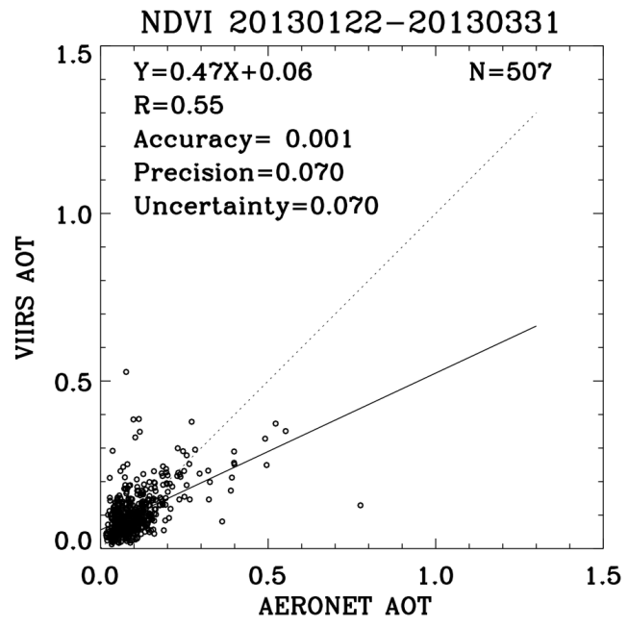
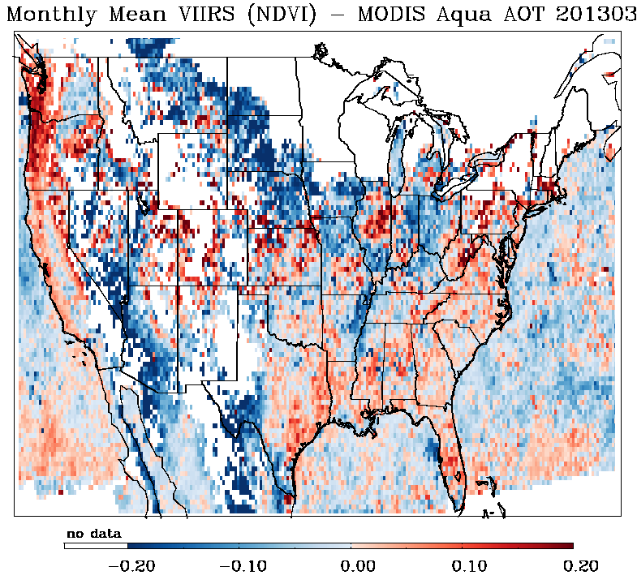
NDVI-dependent surface reflectance ratio (4)
Monthly mean AOT data on 0.25x0.25 degree grids for March 2013.
VIIRS/IDEA retrievals where no MODIS retrievals!
Similar MODIS and VIIRS/IDEA area (CONUS) averages, but
substantial regional differences.
VIIRS outperforms MODIS

Slide 36
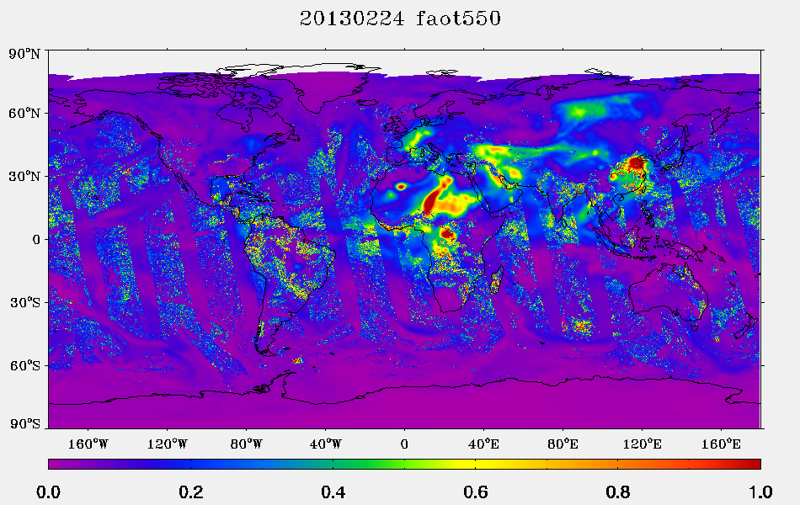
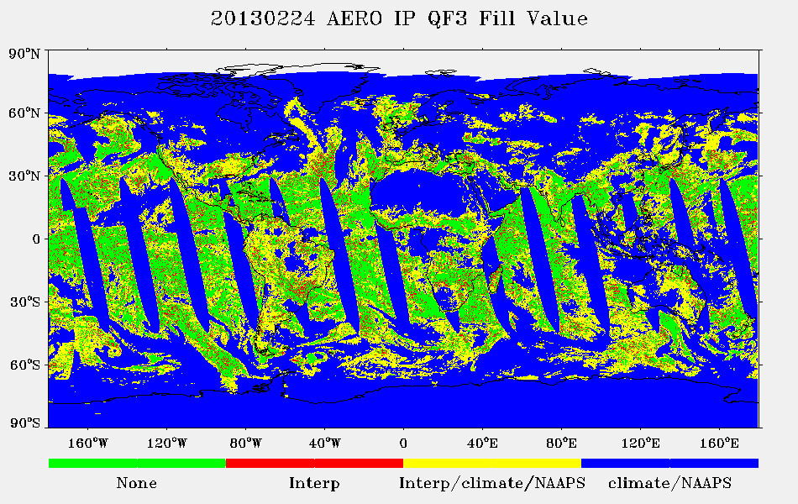
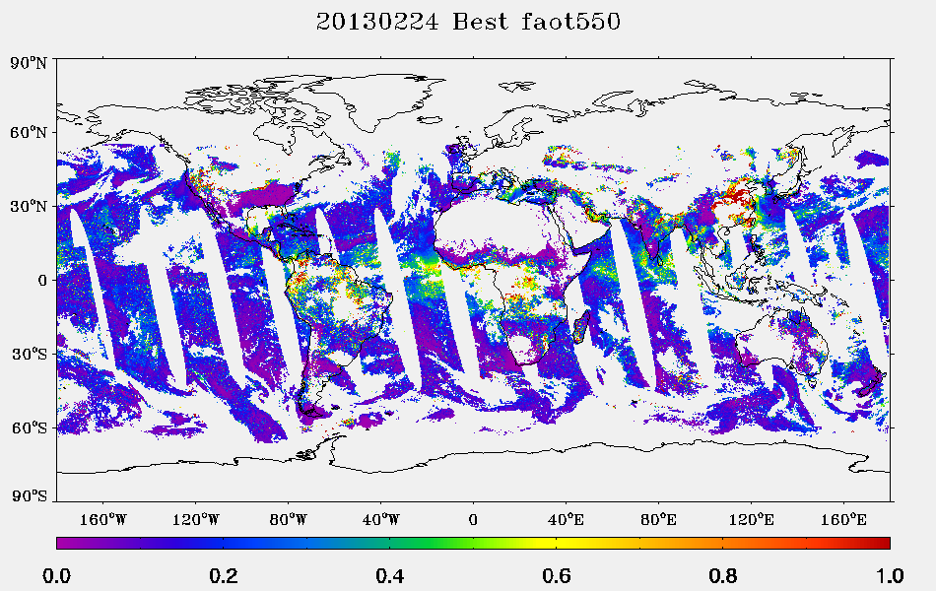
Note on AOT IP
IP AOT product includes AOT from interpolation and NAAPS or climatology.
The AOT field has sharp gradients (top) at the boundaries of VIIRS retrievals and filled data as indicated by Fill Value QF (middle).
Filtering the IP AOT with “High quality” flag recovers the retrieved VIIRS AOT IP (bottom).
Users should be made aware of this.
Filled data are not included in the evaluation.
Plots are for Feb 24, 2013.

Slide 37
Additional Comments on VIIRS AOT
VIIRS (unlike MODIS) does not report negative AOT retrievals;
VIIRS retrieves in places where MODIS does not (internal tests need to be revised/added);
The internal sea ice test can trigger false detection of sea ice in the tropical Atlantic under heavy dust plumes, thus preventing aerosol retrieval.
Some VCM data artifacts are present
  prescribed “no heavy aerosol” flag and higher than expected fraction of heavy aerosol mostly over ocean
  VCM test for heavy aerosol now includes ‘Probably Cloudy’ pixels. There is evidence of cloud contamination at cloud edges affecting AOT retrievals.

Slide 38
Aerosol particle size parameter (APSP)
Comparison with aeronet

Slide 39
Evaluation of updated BR using
VIIRS / AERONET (PGE) match-up data
Angstrom Exponent | May, 2012 - September, 2012 (Original Ratios) |  |  |  | May, 2012 - September, 2012 (Updated Ratios)
 | Number of Match-ups | Bias | Std | R2 | Number of Match-ups | Bias | Std | R2
Land AE EDR | 358 | -0.014 | 0.550 | 0.162 | 218 | 0.199 | 0.487 | 0.092
Land AE IP | 350 | -0.106 | 0.545 | 0.081 | 208 | 0.163 | 0.455 | 0.104
VIIRS aerosol data reprocessing on ADL using the updated band ratios (BR) over land for May, 2012 through September, 2012 were used.
Test results show the updated surface reflectance ratios over land lead to
    no improvement in bias and correlation (R2),
    some (marginal) improvement in standard deviation, but not enough to make the product useful,
    reduction in the number of match-up passing QC.

Slide 40
Evaluation of AE using PGE Match-up Data
Angstrom Exponent | May 2012 - Sep 2012 |  |  |  | Jan 2013 - Mar 2013
APSP EDR | # | Bias | Std | R2 | # | Bias | Std | R2
Land | 218 | 0.199 | 0.487 | 0.092 | 761 | 0.238 | 0.553 | 0.067
Ocean | 99 | 0.026 | 0.315 | 0.697 | 216 | 0.082 | 0.350 | 0.452
APSP IP | # | Bias | Std | R2 | # | Bias | Std | R2
Land | 208 | 0.163 | 0.455 | 0.104 | 352 | 0.242 | 0.451 | 0.155
Ocean | 72 | 0.025 | 0.290 | 0.732 | 73 | 0.064 | 0.381 | 0.366
PGE match-up data are used; inversion data from globally distributed AERONET sites (described on slide 13).
Over-land aerosol retrievals used updated land BR; updated BRs do not affect ocean retrievals.
Bias (EDR) over land with updated BR is about 0.2; Std is about 0.5, but correlation is very low (practically, no correlation)
Over ocean, bias is about 0.03 to 0.08; Std is about 0.3-0.4, and correlation is higher than that over land.
EDR and IP bias and Std are not much different.

Slide 41
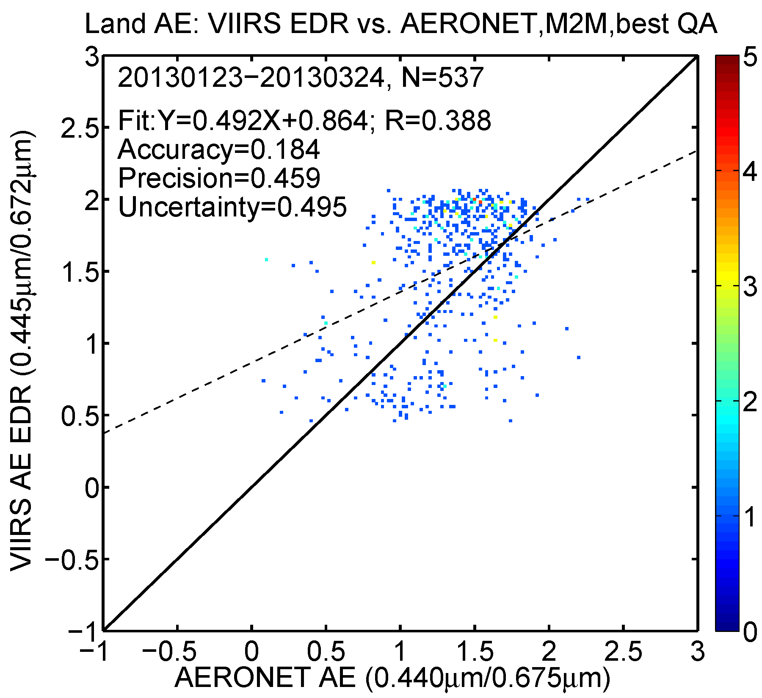
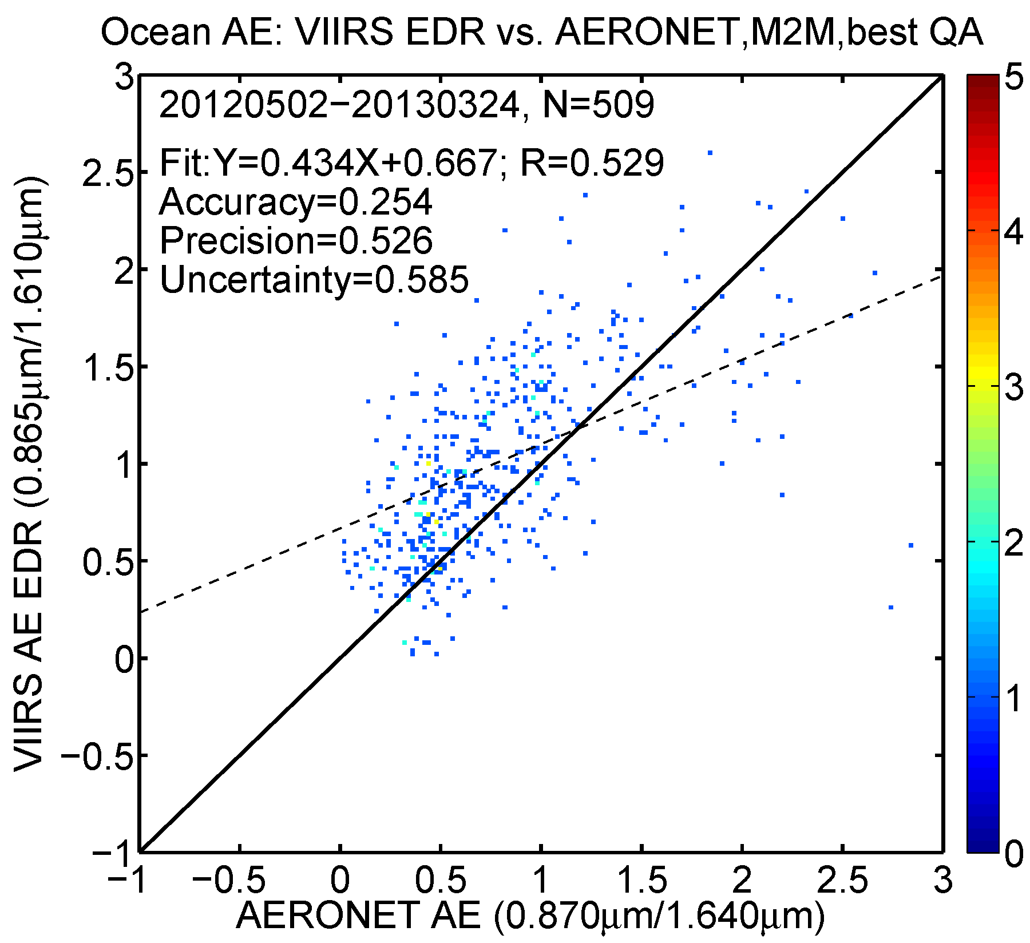
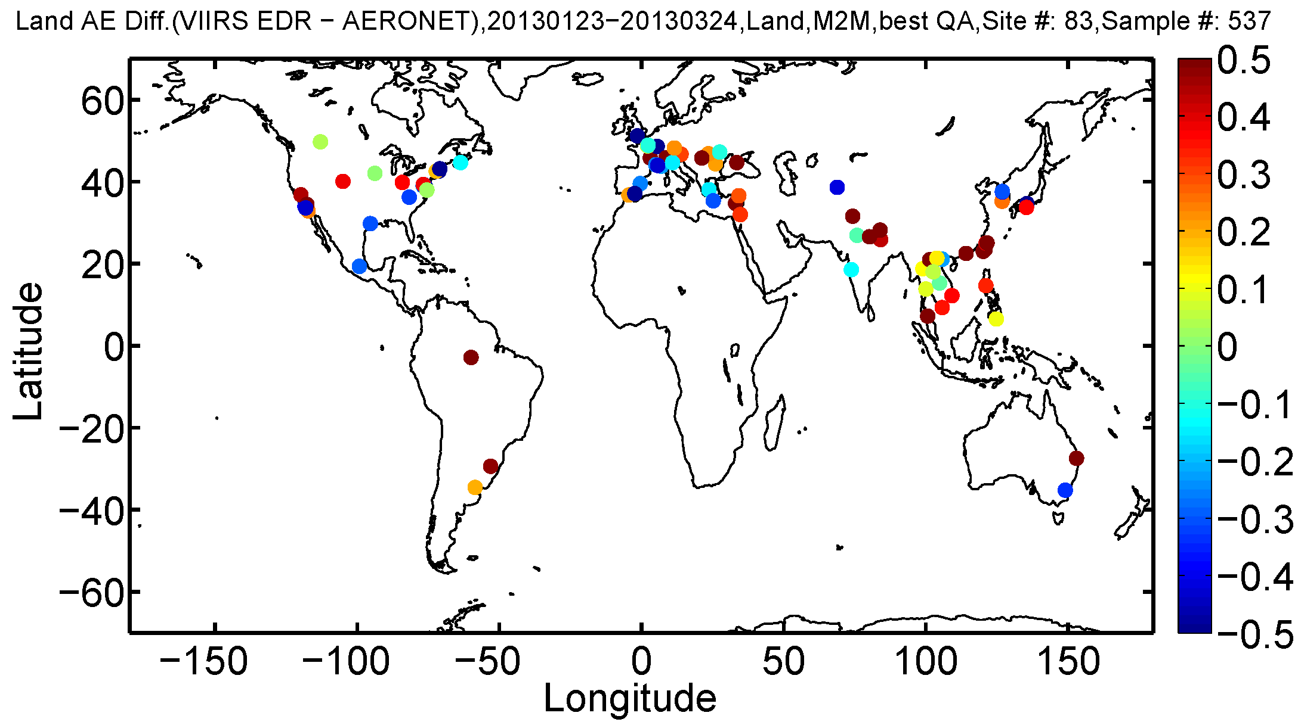
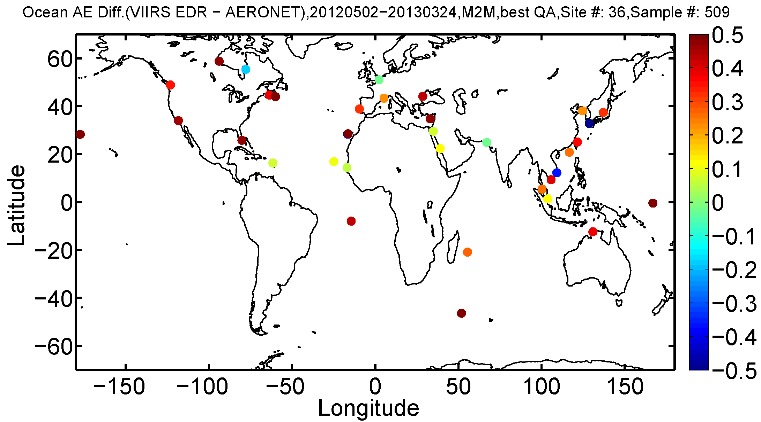
VIIRS APSP (AE) EDR vs. AERONET
Land (Feb-Mar, 2013)
Ocean (May 2012-Mar, 2013)

Slide 42
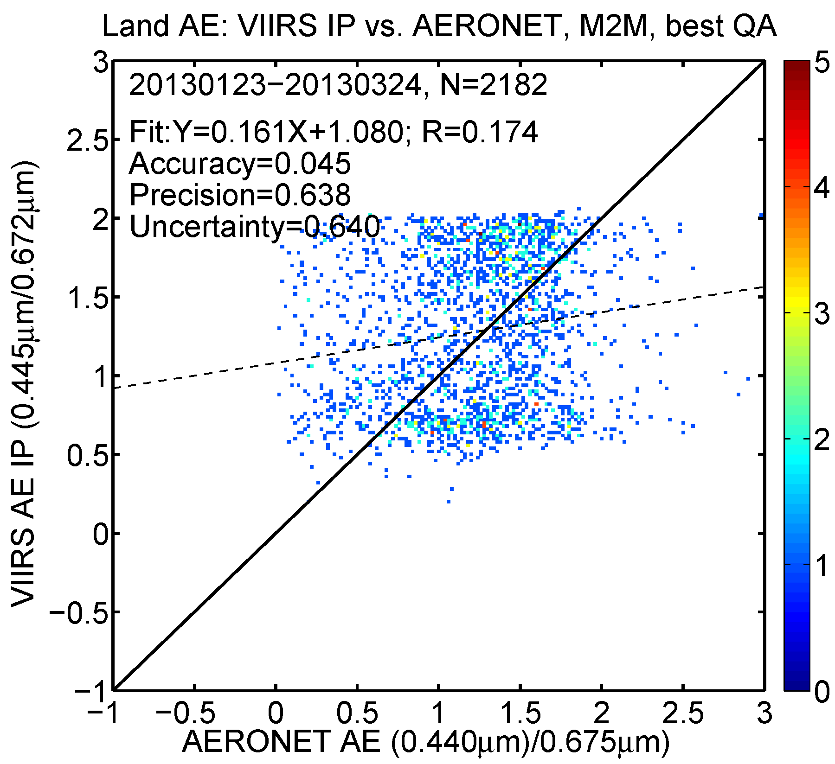
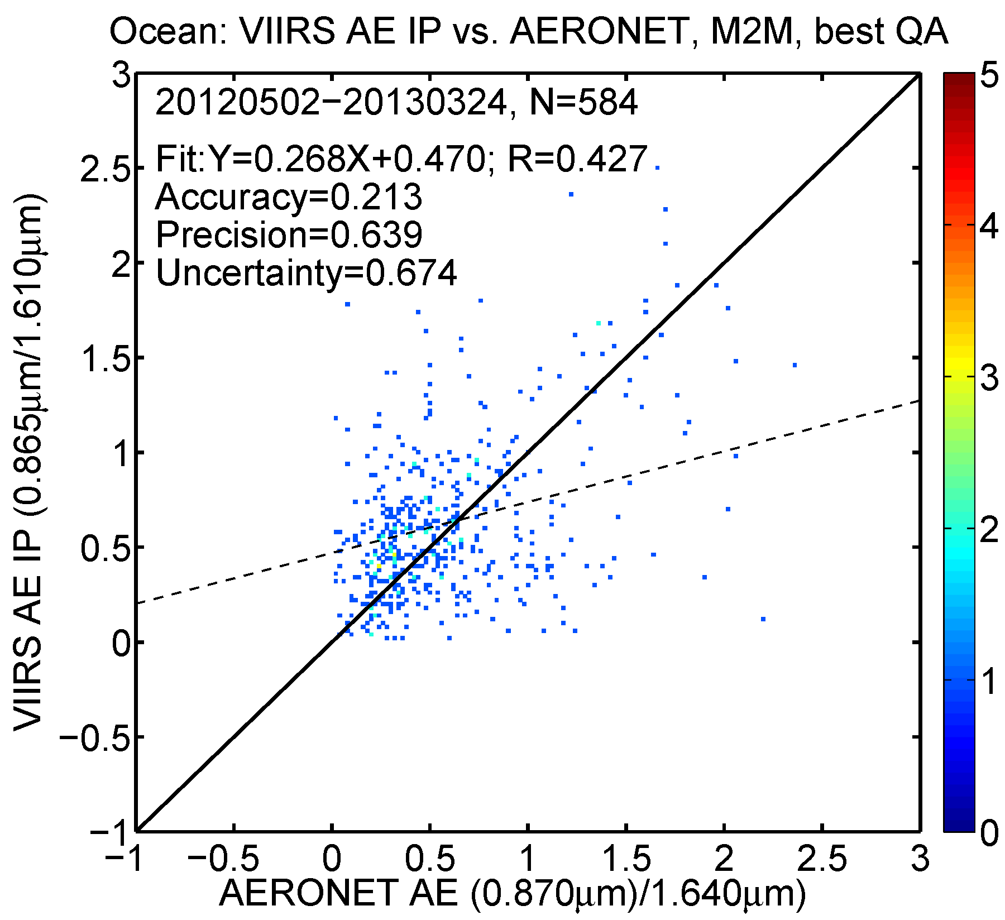
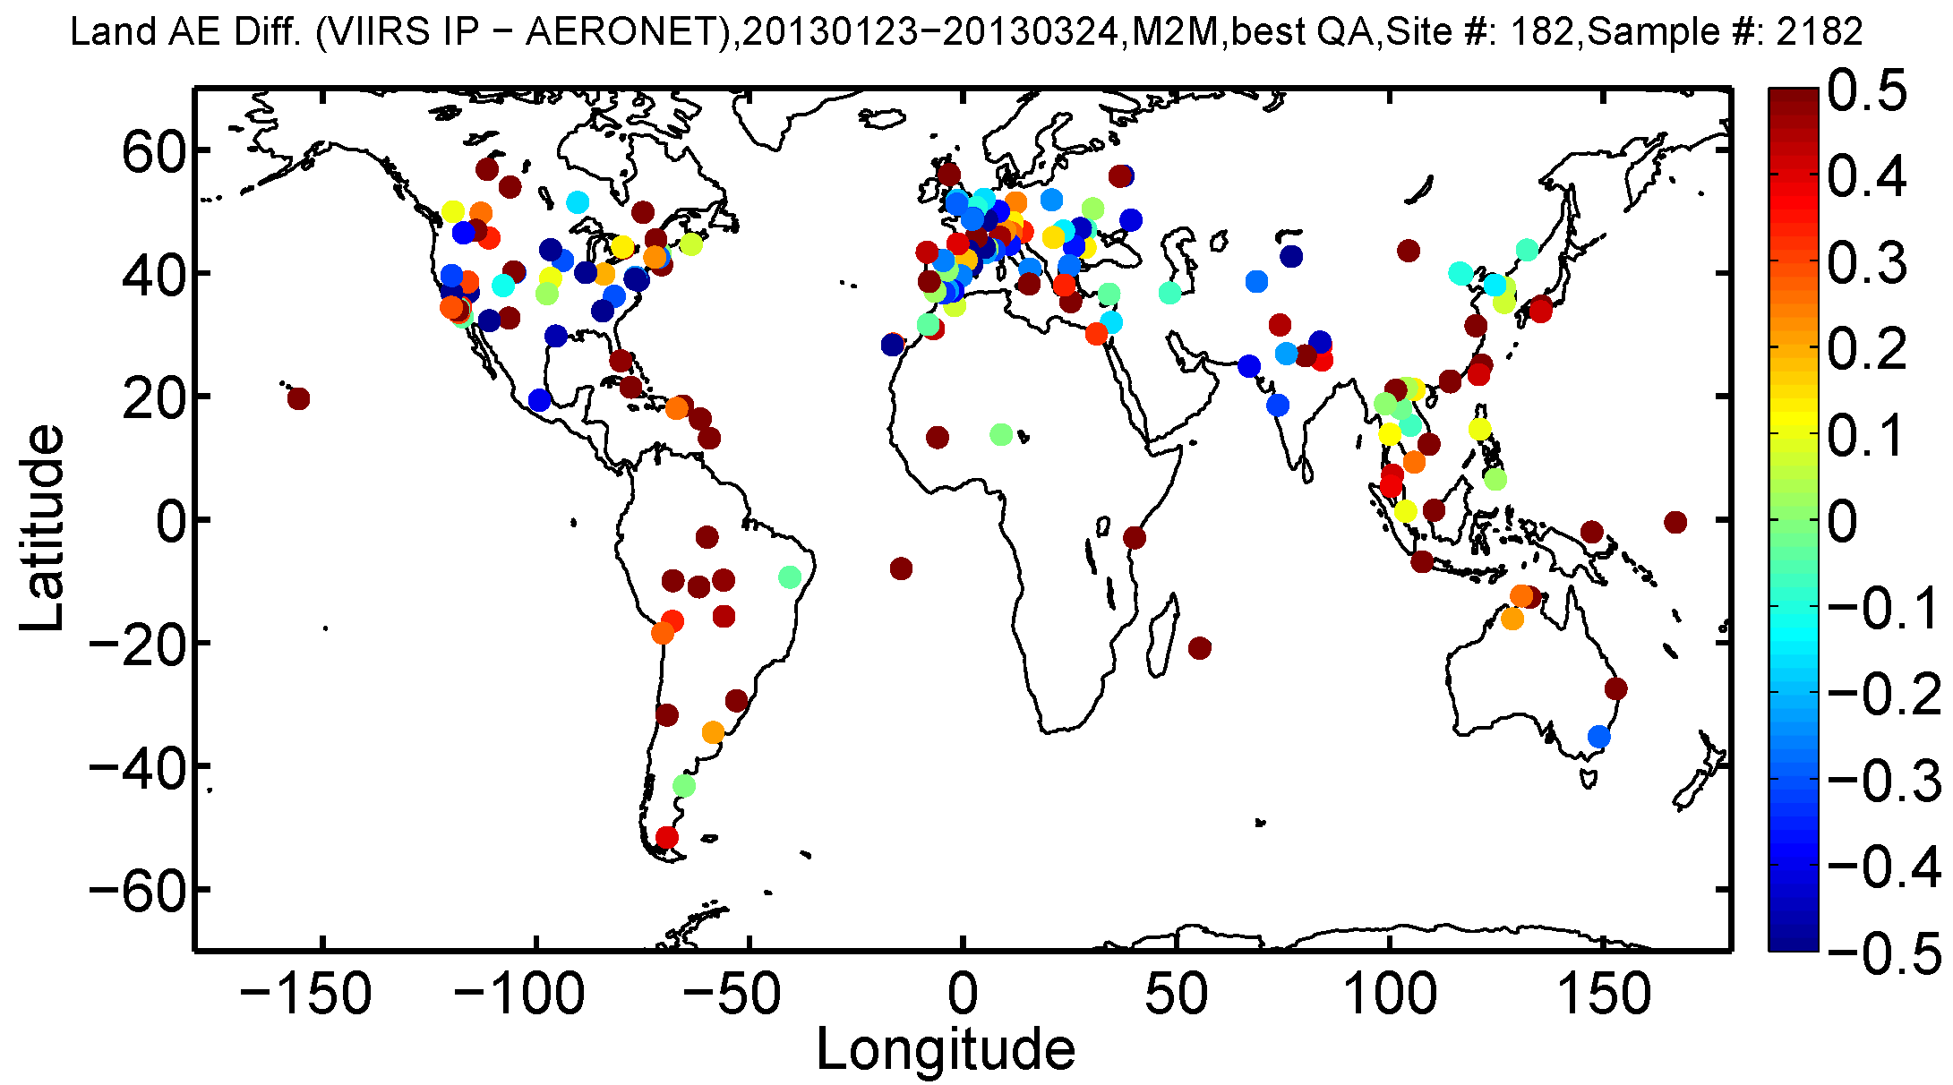
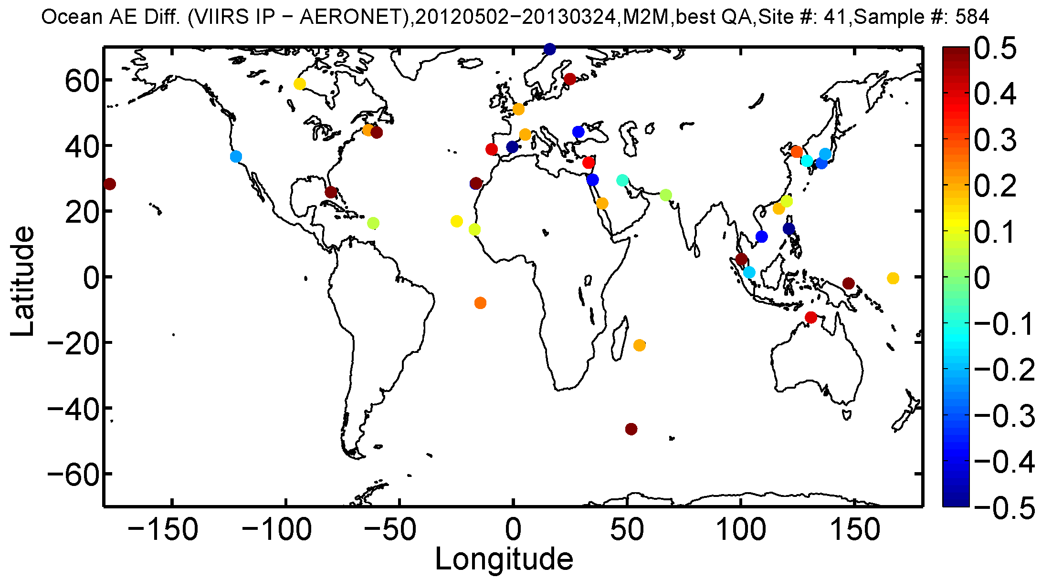
VIIRS APSP (AE) IP vs. AERONET
Land (Feb-Mar, 2013)
Ocean (May 2012-Mar, 2013)

Slide 43
Satellite-derived AE vs. AERONET AE
VIIRS APSP EDR , MODIS (Aqua&Terra), MISR AE compared to AERONET AE
EDR | VIIRS | MYD04 | MOD04 | MISR | VIIRS | MYD04 | MOD04 | MISR
Angstrom Exp | LAND |  |  |  | OCEAN
Sample Size | 537 | 601 | 701 | 718 | 509 | 787 | 737 | 91
Accuracy | 0.184 | -0.272 | -0.248 | -0.071 | 0.254 | -0.128 | -0.230 | 0.153
Precision | 0.459 | 0.686 | 0.675 | 0.404 | 0.526 | 0.639 | 0.726 | 0.393
Uncertainty | 0.495 | 0.738 | 0.719 | 0.411 | 0.585 | 0.652 | 0.761 | 0.422
Cor Coef | 0.388 | 0.175 | 0.216 | 0.611 | 0.529 | 0.579 | 0.563 | 0.714
Time periods: see slide 22
Over land, VIIRS and MODIS AE performance is inferior to MISR, but MODIS group does not recommend using their AE.
Over ocean, VIIRS and MODIS AE performance is comparable; better correlation with AERONET; MISR is still the best.
Wavelength pairs (nm)
 | VIIRS | AERONET
Land | 445/672 | 440/675
Ocean | 865/1610 | 870/1640
 | MODIS | AERONET
Land | 440/670 | 440/675
Ocean | 550/860 | 550/870
 | MISR | AERONET
Land | (1) | 440/675
Ocean | (1) | 550/870
⁽¹⁾ From fit of AOTs at 446, 558, 672, and 867 nm

Slide 44
Aerosol particle size parameter (APSP)
Comparison with MODIS

Slide 45
Collocated VIIRS and MODIS APSP
Collocation method:
Time: MODIS (L2) and VIIRS (IP/EDR) AOT are matched up in time within 5 minutes
Space: VIIRS AOT from nearest pixel falling within MODIS 10 km.
MODIS AEs are derived from MODIS AOTs at wavelengths 0.86 and 1.63 µm filtered with MODIS Could Fraction = 0 (from aerosol cloud mask) and best MODIS AOT Quality Assurance over Ocean
VIIRS AEs are derived from VIIRS AOTs at wavelengths 0.86 and 1.61 µm filtered with High Quality flag (QF=3 for EDR and QF=0 for IP)
Time periods used:
Dec 2012 – Mar 2013: Ocean only; no MODIS AE over land.

Slide 46
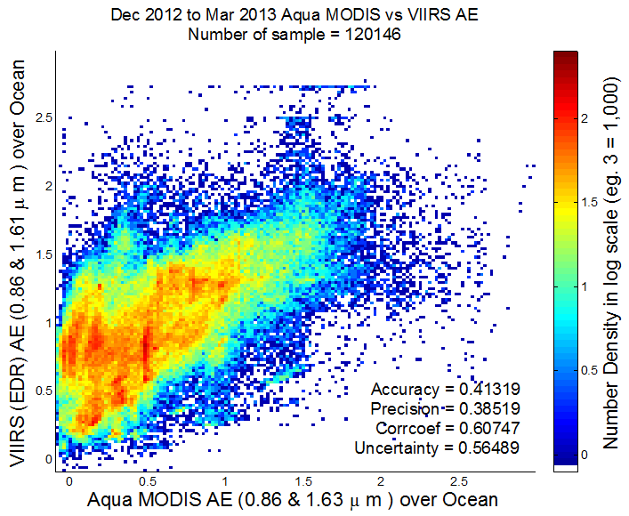
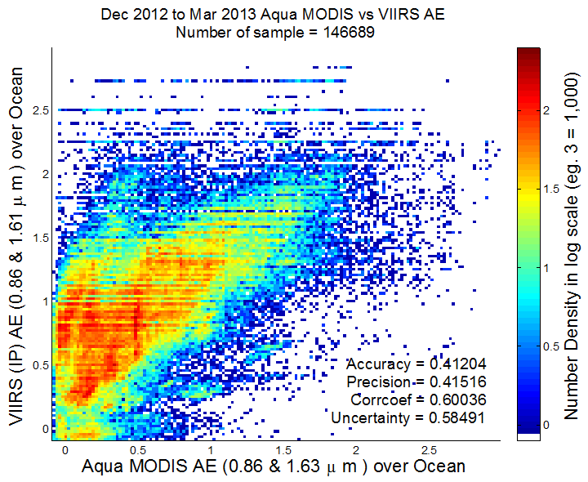
VIIRS vs. MODIS/Aqua AE Over Ocean
( Dec 2012 to Mar 2013)
EDR
IP
Collocated VIIRS and MODIS data are used.
VIIRS AE is biased high (suggesting smaller particles) relative to MODIS AE.
Standard deviation is somewhat larger for IP than for EDR.

Slide 47
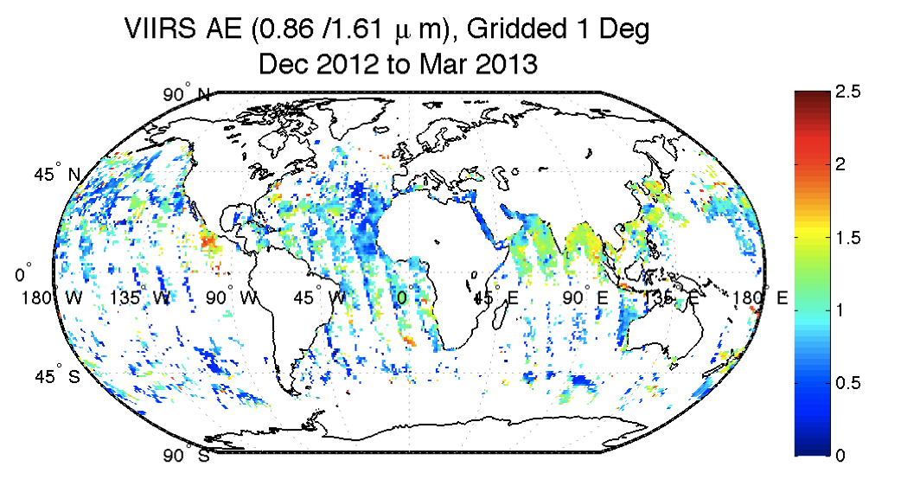

Maps of collocated gridded VIIRS and MODIS/Aqua AE over ocean
( Dec 2012-Mar 2013)
AE EDR mapped to 1-degree grids.
Similar spatial pattern:
  larger values over the Bay of Bengal, South China Sea, west of the southern tip of Africa, south-west of Mexico City.
But overall, VIIRS AE tends to be higher than MODIS AE

Slide 48
AOT and APSP recommendation
The statements below reflect the status as of April 2013 when the assessment was completed.
VIIRS AOT is at Provisional maturity level.
APSP remains at Beta maturity level.
Recommended starting (effectivity) date for AOT qualifying for Provisional level is Jan 23, 2013.

Slide 49
Suspended matter (SM)

Slide 50
SM User Requirement and Current Operational Capabilities at NOAA
Product | Sensor | Accuracy | User | Application
Dust flag | Aqua MODIS | 80% correct classification | NWS/NCEP | Tag MODIS dark target AOT and deep blue AOD as “dust AOT” to verify NWS operational dust forecasts
 |  |  | NWS field offices (e.g., NWS Alaska) | Dust event monitoring and forecasting
 |  |  | EPA | Provide waivers to states for exceptional events rule
Smoke flag* | GOES Imager | 80% correct classification | NWS/NCEP | Tag GOES AOT as “smoke AOT” to verify NWS operational smoke forecasts
 |  |  | NWS field offices (e.g., NWS Alaska) | Smoke event monitoring and forecasting
 |  |  | EPA | Provide waivers to states for exceptional events rule
* STAR also generates smoke detection from Aqua and Terra MODIS but the product is a research version. NWS preferred a GOES product because forecasts can be verified on an hourly basis.

Slide 51
L1RD Supplement Requirements
Product | Threshold | Objective | Notes
SM | Dust, smoke, volcanic ash | Dust, smoke, volcanic ash, sea salt
Smoke plume | 0 to 150 µg/m³ | 0 to 200 µg/m³
Accuracy
SM | 80%
Smoke | 70%
Dust | 80%
Ash | 60% |  | Dust can be mis-identified as ash
Mixed Aerosol |  | 80% | Report not only dominant aerosol but other aerosol components as well

Slide 52
SM Algorithm Overview
Ocean
Land
Dependence on Fine Mode Weight (FMW)
Fine Mode Weight (FMW)
AOT Model Selection
0.2 < FMW ≤0.5
FMW ≤ 0.2
FMW > 0.5
Dust Model
Any other Model
Dust
AOT
Smoke
Dust
Smoke
AOT ≤ 0.3
AOT > 0.3
VCM
Ash
Sea Salt
Undetermined
Tuned out due to too many false positives as of 11/2/2012
From SM ATBD prepared by NGAS, dated 3/17/2010

Slide 53
Heavy Aerosol Flag vs. SM
VCM attempts to identify the presence of heavy aerosol flag for scenes that are classified as “confidently/probably cloudy” and passes that information to aerosol algorithm.
  Aerosol algorithm uses it to reset “confidently/probably cloudy” pixels as clear sky to attempt AOT/Angstrom Exponent/SM retrieval.
  If heavy aerosols (dust and smoke) are indeed present, AOT up to 2.0 is retrieved. AOTs higher than 2.0 are flagged as “out of range”.
  If the pixels are indeed cloudy, AOTs will be high and likely out of range as well.
With the recent inclusion of “probably cloudy” into heavy aerosol logic (implementation date June 27, 2013), cloud edges are being falsely identified as heavy aerosols.
  This will have an implication for global mean values, especially over Ocean.
SM algorithm does not rely on heavy aerosol information from VCM except for “volcanic ash”.
  But, VCM tuned out all volcanic ash testing as of November 2, 2012

Slide 54
SM Product Validation
Qualitative comparison of monthly global maps of VIIRS SM (dominant aerosol type), dust fraction, and smoke fraction to CALIPSO product (http://cain.larc.nasa.gov/)
    CALIPSO: 5º x 5º
      Coarser grid for CALIPSO is used to obtain a good sample size.
  VIIRS: 0.25º x 0.25º
Direct matchups of CALIPSO and VIIRS SM to compute accuracy, probability of detection, and false alarm ratio.
  31 individual cases (granules) covering both land and water. Most of the matchups are for dust; for smoke no good matchups were obtained in the time period (August 2012 and January - February 2013) we looked at.

Slide 55

CALIPSO – VIIRS Matchups
CALIPSO
Time difference: ±2 minutes
Spatially , VIIRS pixels within ± 375m of
the middle CALIPSO profile was selected.
Middle three profiles are used to determine aerosol type in the column
  All three profiles need to be cloud-free;
  Dominant aerosol type is determined through the calculation of dust (or smoke) fraction ( i.e., no of dust (or smoke) layers divided by the no. of aerosol layers from surface to 12km.
VIIRS SM data are filtered for high quality.
330m
VIIRS pixels
375m
5km
True Positive (TP): VIIRS and CALIPSO say dust
True Negative(TN): VIIRS and CALIPSO say no dust
False Negative(FN): VIIRS says no dust but CALIPSO says dust
False Positive(FP): VIIRS says dust when CALIPSO says no dust
POD = TP/(TP+FN)
Accuracy = (TP+TN)/(TP+TN+FP+FN)
FAR = FP/(FP+TP)

Slide 56

From Beta Maturity Report: Global Map of Dominant
Suspended Matter Type
Too much smoke over land.
Too much volcanic ash, especially in regions where volcanic ash is not expected to be present.
Missing dust over near dust sources and dust outflow regions (e.g., off of African coast).

Slide 57

March 2013 (After PCT Update) : Global Map of Dominant
Suspended Matter Type
No volcanic ash because VCM tuned out the tests. Impact: if there is a volcanic eruption, VIIRS will not be able to provide volcanic ash information although the eruption will show up in the AOT product.
Too much smoke over land.
Missing dust over near dust sources and dust outflow regions (e.g., off of African coast).

Slide 58


February 2013
CALIPSO “Dust Fraction” at 5º x 5º
VIIRS “Dust Fraction” at 0.25º x 0.25º
VIIRS global dust distribution not consistent with CALIPSO

Slide 59


February 2013
CALIPSO “Smoke Fraction” at 5º x 5º
VIIRS “Smoke Fraction” at 0.25º x 0.25º
VIIRS global smoke distribution not consistent with CALIPSO but very consistent with seasonal global biomass burning shown in Zhang et al., 2012

Slide 60

VIIRS – CALIPSO SM Matchups
VIIRS RGB January 31, 2013 showing a dust plume over the Atlantic. Next slide shows VIIRS SM matchup with CALIPSO for this granule.

Slide 61

VIIRS SM product

Slide 62
VIIRS vs. CALIPSO SM Matchups
Granule |  | Accuracy | POD | FAR
d20120801_t1332529
 | VSUMO | 24.3 | 0.0 | N/A
d20130108_t1010226
 | VSUMO | 0.0 | 0.0 | N/A
d20130115_t1122460
 | VSUMO | 16.7 | 0.0 | N/A
d20130222_t1110420
 | VSUMO | 16.7 | 0.0 | N/A
Land
Water
Granule |  | Accuracy | POD | FAR
d20120801_t1324204
 | VSUMO | 80.4 | 0.0 | N/A
d20130108_t1511560
 | VSUMO | 6.9 | 0.0 | N/A
d20130131_t1443344
 | VSUMO | 2.3 | 0.0 | N/A
d20130131_t1444598
 | VSUMO | 13.1 | 0.0 | N/A
d20130222_t1110420
 | VSUMO | 45.0 | 0.7 | 14.3

Slide 63
SM Algorithm Approach Issues
Attempts to determine SM based on Fine Mode Weight (FMW) over Ocean:
  Single thresholds (e.g., 20% for dust), although based on AERONET volume size distribution analysis, for different aerosol types are not valid because changes in plume characteristics change FMW;
  Analysis of FMW from MODIS data (Yu et al., JGR, 2009) shows that values have seasonal and regional dependencies;
  The operational (IDPS) version of Look-up-Table (LUT) for over Ocean aerosol retrieval used aerosol optical properties (models) different from MODIS Collection 5.
Attempts to determine SM based on land aerosol model over Land:
  Uncertain and depends on the way residuals are calculated.
High quality SM detection for AOTs > 0.5 and typing only for AOTs > 1.0

Slide 64


Analysis of VIIRS FMW
MODIS shows lower FMW near the dust source regions. This feature is missing in VIIRS due to which SM algorithm misses dust detection.

Slide 65

Analysis of January 13, 2013 Dust Case

Slide 66


Analysis of VIIRS FMW (cont.)
FMW has to be less than 20% for dust to be detected.

Slide 67
Analysis of VIIRS FMW (cont.)
No single VIIRS dust pixel has FMW less than 20%
Mean FMW in the dust plume ~50%
VIIRS FMW correlates well with MODIS but both MODIS and VIIRS show high FMW

Slide 68
Test Changes to SM Algorithm
Test runs were conducted using the following approaches:
  IDPS: no change operational output
  LUT: using new lookup table calculated with MODIS Collection 5 ocean aerosol models
  RES: using new lookup table; residual computation following MODIS method
Testing done on the following datasets:
  2012.09.09: t1441290, t1442544
  2012.09.13: t1506465, t1508119
  2013.01.13: t0834207, t0835461
  September 2012 DOY 259

Slide 69

2012.09.09

Slide 70


FMW
LUT - IDPS
IDPS
RES - LUT
LUT
-0.20 -0.16 -0.12 -0.08 -0.04 0.00 0.04 0.08 0.12 0.16 0.20
RES
0.0 0.1 0.2 0.3 0.4 0.5 0.6 0.7 0.8 0.9 1.0

Slide 71



2012.09.09
Image 1: IDPS
Image 2: LUT update
Image 3: LUT update + Update to residual calculation

Slide 72

IDPS Product

Slide 73

Reprocessed with STAR Stand Alone Algorithm
With updated LUT (using MODIS C5 ocean aerosol models) and NDVI-dependent land surface reflectance ratios

Slide 74
Some Key Remarks on SM
SM is not a legacy NASA MODIS product
SM product is very difficult to evaluate and validate
  Reliance on other satellite (CALIPSO) data. Poor matchups with CALIPSO. Will look into MISR for future work.
  In situ (IMPROVE network) data are available but with a 1 to 2 yr latency.
  AERONET Angstrom Exponent based classification can be used but not really “truth” like the AERONET AOT product is.
VIIRS SM algorithm relies on AOT and other internal parameters (not validated) to identify and type SM
  Aerosol FMW over ocean
  Aerosol model over land
In this review, we showed that VIIRS SM product cannot meet user requirement and alternate algorithms (slide 28) are needed to improve the product performance. The VIIRS SM product is not recommended for use in any applications.

Slide 75
VIIRS IDPS SM product

Slide 76

VIIRS SM based on Deep Blue Dust Detection Algorithm

Slide 77
VIIRS vs. CALIPSO SM Matchups
Land
Granule |  | Accuracy | POD | FAR
d20120801_t1332529
 | VSUMO | 24.3 | 0.0 | N/A
d20130108_t1010226
 | VSUMO | 0.0 | 0.0 | N/A
d20130115_t1122460
 | VSUMO | 16.7 | 0.0 | N/A
d20130222_t1110420
 | VSUMO | 16.7 | 0.0 | N/A
Water
Granule |  | Accuracy | POD | FAR
d20120801_t1324204
 | VSUMO | 80.4 | 0.0 | N/A
d20130108_t1511560
 | VSUMO | 6.9 | 0.0 | N/A
d20130131_t1443344
 | VSUMO | 2.3 | 0.0 | N/A
d20130131_t1444598
 | VSUMO | 13.1 | 0.0 | N/A
d20130222_t1110420
 | VSUMO | 45.0 | 0.7 | 14.3

Slide 78
VIIRS vs. CALIPSO SM Matchups
Granule |  | Accuracy | POD | FAR
d20120801_t1332529 | DBDI | 78.4 | 100.0 | 22.2
 | VSUMO | 24.3 | 0.0 | N/A
d20130108_t1010226 | DBDI | 96.7 | 96.7 | 0.0
 | VSUMO | 0.0 | 0.0 | N/A
d20130115_t1122460 | DBDI | 78.3 | 84 | 10.6
 | VSUMO | 16.7 | 0.0 | N/A
d20130222_t1110420 | DBDI | 93.3 | 96.0 | 4
 | VSUMO | 16.7 | 0.0 | N/A
Land
Water
Granule |  | Accuracy | POD | FAR
d20120801_t1324204 | DBDI | 89.1 | 44.4 | 0.0
 | VSUMO | 80.4 | 0.0 | N/A
d20130108_t1511560 | DBDI | 93.0 | 100.0 | 6.98
 | VSUMO | 6.9 | 0.0 | N/A
d20130131_t1443344 | DBDI | 82.7 | 84.7 | 2.7
 | VSUMO | 2.3 | 0.0 | N/A
d20130131_t1444598 | DBDI | 79.8 | 82.2 | 6.3
 | VSUMO | 13.1 | 0.0 | N/A
d20130222_t1110420 | DBDI | 90.9 | 80.0 | 0
 | VSUMO | 45.0 | 0.7 | 14.3

Slide 79
Conclusions on VIIRS SM
The VIIRS SM product is advanced to Beta maturity level, but is not recommended for use at this time.
  Effectivity date: May 2, 2012
Both qualitative and quantitative comparisons of VIIRS SM with CALIPSO Vertical Feature Mask show that SM product should not be used in scientific work or in any applications related to policy and decision support systems.
Alternate algorithms exist for SM which show a better accuracy, probability of detection, and false alarm ratio compared to operational (IDPS) VIIRS SM product but they have some limitations as well:
  More testing and upgrades needed over bright surface

Slide 80
Challenges and Remaining Issues
ATBD Update
Critical DRs
Caveats at the time of beta maturity level review
Updates/new caveats
Path Forward

Slide 81
ATBD Updates
AOT & APSP
Update is an almost complete re-write of the VIIRS Aerosol Optical Thickness (AOT) and Particle Size Parameter Algorithm Theoretical Basis Document (ATBD).
Revised theoretical and mathematical description of over-land aerosol retrieval to match algorithm implemented.
Revision reflects updated surface reflectance band ratios.
Expanded description of aerosol models used in look-up tables.
Aggregation of AOT IP into AOT EDR and quality flags are now fully described.
Updated/expanded the validation section using evaluation of actual VIIRS aerosol retrievals with AERONET and MODIS aerosol data.
Methodology for NDVI-dependent surface reflectance band ratios, as a potential update for over-land retrieval, is discussed.
Draft of updated ATBD is available now.
Updated ATBD will be submitted in upcoming DR for requesting Provisional Maturity.
SM
No update to SM ATBD.

Slide 82
Critical DRs
ADR Title | Aerosol retrieval anomaly following Mx6.3/6.4 transition
ADR4962 | Submit Date: 2012-10-19 | PCR32735 | Status: Closed
ADR Description | Following the recent Mx6.3/6.4 transition, VIIRS Aerosol EDR and IP values are showing up even for confidently cloudy areas (as determined by the VCM) where there should not be aerosol retrievals. The VCM input appears to be correct. However, the AOT IP Cloud Confidence Flag reports ‘Confidently Clear’ where the VCM says "Confidently Cloudy". As a result, aerosol retrievals are performed for much of the cloudy areas leading to increased AOT values.
Note | Fix was implemented in Mx6.5 on 2012-11-27.
ADR Title | Update spectral reflectance ratios for land inversion
ADR4989 | Submit Date: 2012-11-27 | 474-CCR-12-0788 | Status: Closed
ADR Description | The pre-launch spectral reflectance ratios used in the land inversion were generated using MODIS /AERONET match-up data. These spectral reflectance ratios have been regenerated using VIIRS / AERONET match-up data. Reprocessing VIIRS data using the updated coefficients shows improvement versus AERONET in-situ measurements of AOT. The operational processing coefficients should be updated to use these new values.
Note | New PCT of spectral reflectance ratios went into operation on 2013-01-22.

Slide 83
Other DRs (1)
ADR Title | Aerosol inversion failure for a single pixel should not cause a granule failure
ADR4889 | Submit Date: 2012-09-04 | PCR32259 | Status: Closed
ADR Description | There are numerous reasons for an individual pixel inversion to fail in the main pixel loop of the VIIRS Aerosol algorithm. Error trapping has been implemented to avoid segmentation faults; however, the logic in the main pixel loop is incorrect and returns PRO_FAIL from the main program under certain error conditions. If an individual pixel inversion fails, that pixels should have all output values set to fill, the overall quality set to not produced and then processing should continue with the next pixel.
Note | The fix is in Mx7.1 build with TTO 2013-06-27.
ADR Title | Inconsistent Low Sun Quality Flags between aerosol IP and EDR products
ADR4975 | Submit Date: 2012-10-31 | PCR33470 | Status: Closed
ADR Description | When the two aerosol EDR low sun quality flags are compared against the aerosol IP day/night quality flag, there are data patches where the quality flags are not set correctly or consistently to the aerosol IP day/night flag. Investigation indicated that such inconsistency is due to the aerosol EDR low sun quality flags are set within the land/ocean aerosol retrieval determination loop. Therefore, for any EDR pixels that are not going to have aerosol retrievals because they are not land or ocean dominated, the corresponding aerosol EDR low sun quality flags will stay as the initial default values that may not be consistent to the aerosol IP day/night quality flag.
Note | The fix is in Mx7.1 build with TTO 2013-06-27.

Slide 84
Other DRs (2)
ADR Title | AOT IP does not contain proper fill at night in maneuver
ADR5016 | Submit Date: 2012-12-13 | PCR32613 | Status: Open
ADR Description | AOT IP has incorrect fill in maneuver at night, but ok in day.RTN PCR Wording: In VIIRS Maneuver PROXY Dataset 4, Granule NPP001212109974, the Aerosol Optical Thickness IP (AOT IP) does not properly contain ELINT fill. This is a night granule and the product seems to contain proper ELINT fill in day granules. This was found in build 7.F.
Note | The fix is planned for IDPS_NPP_Maint_1.5.8.
ADR Title | VIIRS Suspended Matter EDR not compliant with EDRPR
ADR7049 | Submit Date: 2013-02-14 | PCR33804 | Status: Open
ADR Description | Suspended Matter EDR is currently implemented to be fill when the VCM is not Confidently clear or Probably Clear. The EDRPR says: NPP.EDR.9.2 SM product shall be produced only for pixels under Confidently Clear as determined by the VCM. Fill values shall be used otherwise. The (under development) new Level 2 spec also says the same thing. The decision needs to be made now whether the EDRPR is changed (and upcoming Block 2 Level 2 spec as well as Level 3 SRS) or the implementation is changed. The current functionality is non-compliant with the EDRPR and fails current and Block 1.5 IDPS/PRO requirements.
Note | Aerosol Cal/Val Team recommended to retrieve SM from both Confidently Clear and Probably Clear pixels; that is, the documentation should be changed not the code. The fix is planned for IDPS_NPP_Maint_1.5.8.

Slide 85
Recent DRs
ADR4991 | Update spectral reflectance ratios for land inversion to be a function of SWIR NDVI
ADR4988 | Extend reporting range of AOT EDR
ADR4836 | Inconsistency in VIIRS IP AOT and EDR AOT Quality Flag (QF) Definitions
ADR4724 | Angstrom Exponent Quality Flag (IP) error
ADR4706 | Update Aerosol LUT for RSR changes
ADR7113 | Aerosol inversion over ocean should not use band M6 when saturation rollover is possible
ADR7115 | Calculation of residual for band M7 is not skipped in over-ocean aerosol retrieval

Slide 86
Caveats
AOT:
  Recommend using only high quality EDR and IP
  Accuracy and precision values over land are derived from “only” two months of VIIRS retrievals (Feb-Mar, 2013), which have the updated surface reflectance band ratios implemented
  Testing and tuning of various internal tests are still ongoing (expected to minimize artifacts associated with snow melt, etc.)
APSP (AE):
  Only “best quality” AE with AOT greater than 0.4 over ocean correlates moderately well with ground-based measurements.
  AE over land is not recommended.
SM:
  SM is not recommended for use at this time.

Slide 87
Work planned before Validated 1
(Path forward)
AOT and APSP:
  Monitor the effect of latest changes to the VCM, and adapt aerosol PCT and code to these changes, if necessary;
  Investigate options for reducing std in fit of surface reflectance band ratios (may lead to decrease in number of negative AOT retrievals over land);
  Test NDVI-dependent surface reflectance ratio using a longer time period;
  Implement NDVI-dependent surface reflectance ratio;
  Evaluate VIIRS APSP (and MODIS AE) with MAN APSP over open ocean;
  Test and expand valid range of land and ocean AOT retrievals from 2 to 5 at the high end and from zero to small negatives at the low end;
  Test the elimination of the internal snow/ice flag over oceans;
  Evaluate choice of aerosol models, land and ocean, in terms of covering adequate solution space and consequences for retrieving AE;
SM
  Additional testing with new LUT over ocean retrievals to see if there is any skill. Even so, over land product will continue to be an issue
  Complete testing of alternate algorithm based on deep blue and mid-IR channels for different scenarios; make it a stand alone SM algorithm for operational implementation, and update SM ATBD

Slide 88
Assessment of
Data Quality Threshold Tables
The current aerosol Data Quality monitoring reports summaries of
  AOT, APSP, SM and SM typing product quality,
  AOT, APSP, SM detection and SM typing exclusion.
The current DQTTs are adequate, no update is necessary for Provisional Maturity.
DQTTs will be re-evaluated using several months of Provisional aerosol data
  Updates to DQTT will be implemented if needed at the time of Validated 1 Maturity.

Slide 89
Product Timeline
Initial instrument check out; Tuning cloud mask parameters | Beta status AOT, APSP, SM | Error | Beta status | Provisional status AOT
 |  |  |  | Beta status APSP, SM
28 Oct 2011
2 May 2012
15 Oct 2012
28 Nov 2012
23 Jan 2013
Red periods: | Product is not available to public, or product should not be used.
Blue periods: | Product is available to public, but it should be used with caution, known problems, frequent changes.
Green period: | Product is available to public; users are encouraged to evaluate.
89

Slide 90
In perspective -
VIIRS vs. MODIS algorithm evolution

Slide 91


In perspective
VIIRS vs. MODIS algorithm evolution
3 years after Terra launch
1 year after Suomi-NPP launch
Global validation heavily weighted to Eastern U.S. and western Europe, with Amazon also well-represented.
ALL VEGETATED SURFACES
In time AERONET spread out to less desirable surfaces and MODIS retrieval “got worse”
VIIRS is facing a harder “audience”

Slide 92
In perspective
VIIRS vs. MODIS algorithm evolution
MODIS aerosol validation 2000-2002
(3 years after Terra launch)
AERONET sites
ocean
land
both
land
0.06 high bias over land,
against “favorable” AERONET stations.
2 years later this bias was closer to 0.10

Slide 93

In perspective
VIIRS vs. MODIS algorithm evolution
4 years after launch and still plagued by Spring thaw snow melt and artificial AOT of 0.2 to 0.3 over low NDVI areas and places with complex topography, which was finally eliminated in 2006 (6 years after launch)
Li et al. (2005)

Slide 94
In perspective
VIIRS vs. MODIS algorithm evolution
It’s only been 18 months since launch of VIIRS
Already VIIRS is producing AOT and AE with accuracy equal to MODIS that took MODIS 4 to 6 years to accomplish!
From the MODIS perspective, VIIRS is advancing at light speed, and people need to be patient with the expectations.

