Slide 1
Validated Stage 1 Science Maturity Review for VIIRS Cloud Top Height and Daytime Optical and Microphysical Products
Andrew Heidinger
September 3, 2014

Slide 2
Outline
Algorithm Cal/Val Team Members
Cloud Top Properties
  Product Requirements
  Evaluation of algorithm performance to specification requirements
    Evaluation of the effect of required algorithm inputs
    Quality flag analysis/validation
    Error Budget
Cloud Optical Properties
  Product Requirements
  Evaluation of algorithm performance to specification requirements
    Evaluation of the effect of required algorithm inputs
    Quality flag analysis/validation
    Error Budget
Documentation
Identification of Processing Environment
Users & User Feedback
Conclusion
Path Forward

Slide 3
VIIRS Cloud Cal/Val Team
Name | Organization | Major Task
Kurt F. Brueske* | IIS/Raytheon | Code testing support within IDPS
Janna Feeley* | Aerospace Inc | JAM
Andrew Heidinger | NOAA/STAR | Lead
Eric Wong* | NGAS | Algorithm Updates and Documentation Lead
Robert Holz | UW/SSEC | CALIPSO Validation and PEATE Liaison
Andi Walther | UW/CIMSS | Daytime COP Algorithm Support
Yue Li | UW/CIMSS | CTP Algorithm + ADL Support
Denis Botembakov | UW/CIMSS | Validation Data and Analysis Generation
Steve Miller | CSU/CIRA | Cloudsat Validation
Jay Mace | University Utah | ARM (surface) Validation Tools
Kwo-Sen Kuo | NASA/Goddard | Scattering Models for Daytime COP
Bryan Baum | UW/SSEC | Scattering Models for Daytime COP
Eva Borbas | UW/SSEC | Using CrIS for VIIRS cloud height validation
Curtis Seaman | CSU/CIRA | Cloud Base Height
Yoo-Jeong Noh | CSU/CIRA | Cloud Base Height
Min Oo | UW/SSEC | General Validation Support
Members in grey are no longer funded. * Members funded outside of cloud team budget

Slide 4
SNPP Validation Stages Maturity Definition
Validated Stage 1:
  Using a limited set of samples, the algorithm output is shown to meet the threshold performance attributes identified in the JPSS Level 1 Requirements Supplement with the exception of the S-NPP Performance Exclusions
Validated Stage 2:
  Using a moderate set of samples, the algorithm output is shown to meet the threshold performance attributes identified in the JPSS Level 1 Requirements Supplement with the exception of the S-NPP Performance Exclusions
Validated Stage 3:
  Using a large set of samples representing global conditions over four seasons, the algorithm output is shown to meet the threshold performance attributes identified in the JPSS Level 1 Requirements Supplement with the exception of the S-NPP Performance Exclusions

Slide 5
Cloud Provisional Recommendations
Guidance from the Review Board:
All cloud products except Night COP for Water Clouds are provisional.
The Cloud Team feels that remaining issues with Day COP are significant enough to prevent Validation Stage 1.
The Review Board recommends assessment of CLAVR-x algorithms as the replacement algorithms. Freeze further NPOESS cloud property algorithm improvements.
  Action to Andrew Heidinger to present to review panel within 30 days results based on CLAVR-x with similar rigor shown in this review.
  CLAVR-x = clouds from AVHRR and beyond.
    Beyond = VIIRS, ABI = Enterprise Algorithm
CLAVR-x is in CSPP with user engagement .
Cloud Team followed all of these directives.

Slide 6
Evaluation of algorithm performance to specification requirements
Improvements since Provisional
Cloud Team did stop work on open DR’s for IDPS cloud algorithms (IR RTM and Surface Reflectance)
Algorithm Improvements of the NDE are ongoing
  CTP – cirrus heights near edges have been improved using a spatial filter to limit edges deviating from cloud centers
  Cloud base height retrained with CloudSat
  Day COP modified to work better over snow
  Use of DNB in Cloud Mask and “Lunar” COP is maturing.

Slide 7
Evaluation of algorithm performance to specification requirements
Cal/Val Activities for evaluating algorithm performance:
  Cal/Val Activities are unchanged with move to NDE
  Mask: CALIPSO, METAR and MODIS C6 comparisons
  Type: CALIPSO
  CTP: CALIPSO
  Day COP: MODIS C6, ATMS
  Night COP: ATMS
  Cloud Base Height: CloudSat
  Cloud Cover Layers: (CALIPSO)

Slide 8
Evaluation of the effect of required algorithm inputs
Required Algorithm Inputs
  Primary Sensor Data
    Mask: M1,M5,M7,M9-M16,I1,I5, (DNB)
    Type: M5,M9,M10,M12,M14-M16
    CTP/ACHA: M14-M16
    Day COP: M5,M8,M10,M11,M12
    Night: M12,M13,M15,M16
  Ancillary Data
    NWP: Profiles of Pressure, Temp, Height, wvmr, o3mr, tropopause height, surface temperature, surface pressure and surface elevation.
    Surface: MODIS White-sky albedo (M5,M8,M9,M10). IR Emiss (M12-M16). UMD Surface Type, MODIS Land Mask, Hires Surface Elevation.
  Upstream Algorithms: Mask/Phase
  LUTs / PCTs
    Mask: Naïve Bayesian Classifier Data
    Type: No
    CTP: No:
    Day COP: Reflectance LUTS
    Night COTP: Emissivity LUTS
Evaluation of the effect of required algorithm inputs
  Not Done.

Slide 9
Evaluation of the effect of required algorithm inputs
Evaluation of the effect of required algorithm inputs
  We have not explored robustness due to ancillary data drop outs or degradation.
  Our algorithms have been designed to operate on many channel combinations. This have given us robustness in terms of missing channels.
    Mask will perform as long as 11 μm is available.
    Type will perform as long as 11 μm is available.
    Height will perform as long as 11 μm is available but will also perform with only the 11 and 12 μm channels (8.5 μm is missing).
    Day COP will perform if 0.65 μm is available and any of the following: 1.6, 2.2 or 3.75 μm.

Slide 10
Description of Analysis
NDE cloud algorithms have delivered to AIT and are being implemented in the SAPF.
These algorithms run with the Clouds from AVHRR Extended (CLAVR-x) processing system with is run in OSPO (and will be replaced by the SAPF).
CLAVR-x can not run
  The Nighttime Cloud Optical Properties.
  The NDE Cloud Type
For this analysis, CLAVR-x read in the VCM and Cloud Type/Phase from the IDPS output.
  NDE is funding a separate VIIRS Cloud Mask but that is not analyzed here.
  NDE algorithms retrieve for probably-cloudy
Pixels where the VCM (Mask/Phase) disagrees with our validation data are ignored.

Slide 11
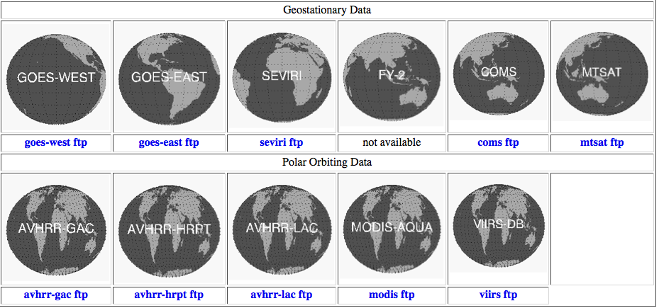
What is CLAVR-x?
CLAVR-x is the NESDIS Operational AVHRR and GOES Cloud Processing System.
CLAVR-x runs the GOES-R AWG cloud algorithms implemented in NDE. Product list almost equivalent to IDPS cloud products.
CLAVR-x is now part of the CSPP Direct Broadcast Package.
CLAVR-x and the NDE algorithms also run on many other sensors (see below)
http://cimss.ssec.wisc.edu/clavr

Slide 12
Cloud Height
Yue Li and Andrew Heidinger

Slide 13
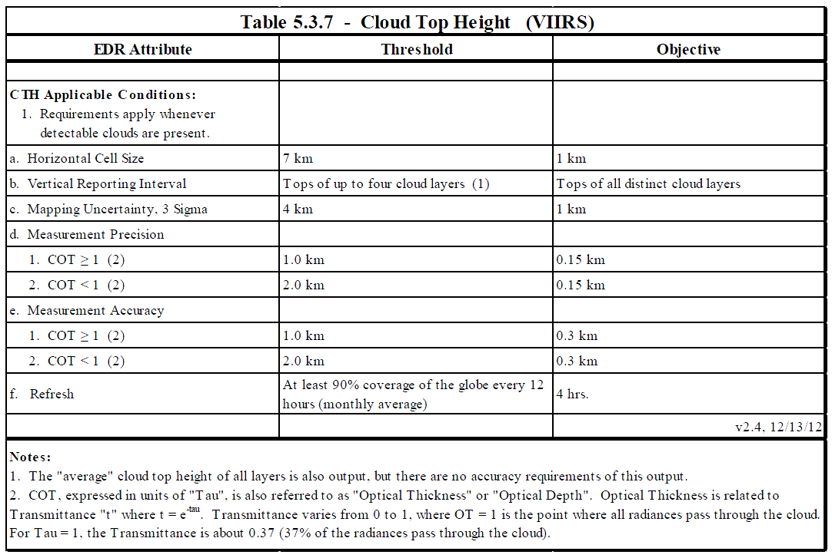
Cloud Top Height Requirements

Slide 14
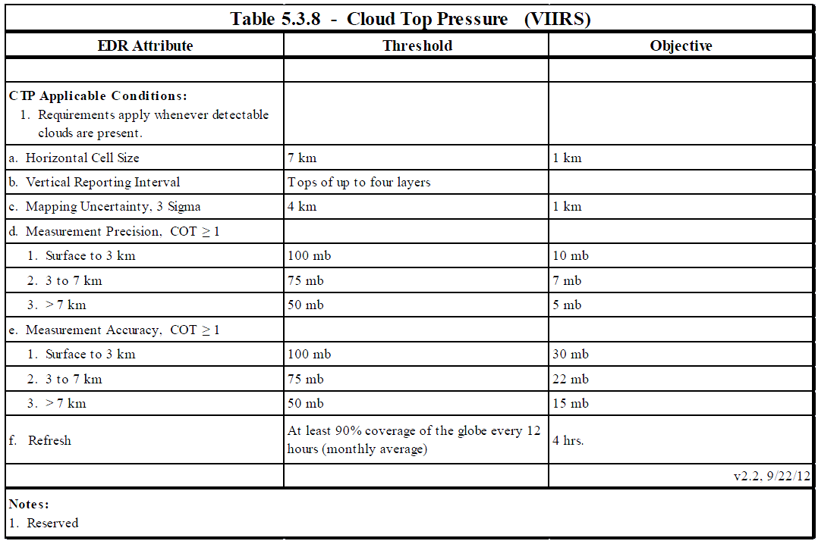
Cloud Top Pressure Requirements

Slide 15
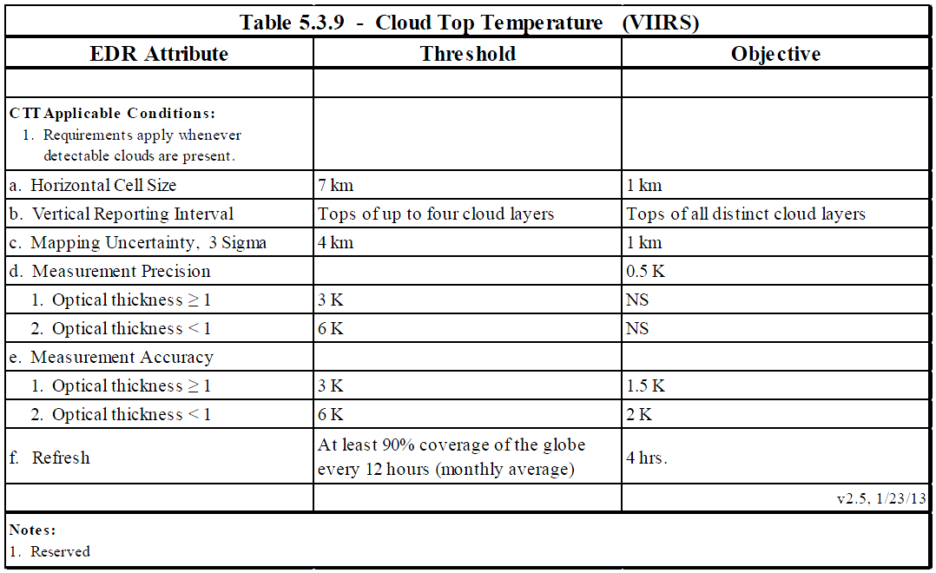
Cloud Top Temperature Requirements

Slide 16
Cloud Top Property Error Budget
Based on CALIPSO/CALIOP co-locations with VIIRS.
COT filter > 1 accomplished using CALIOP COT
Data where VIIRS and CALIOP phase disagreed where thrown out (a loss of 17% of data)
CTP based on MODIS Comparisons. No CTP in CALIOP product.
Attribute Analyzed | L1RD Threshold | Analysis/Validation Result (within specs) | Error Summary
CTT | 3K when τ ≥ 1, 6K when τ < 1 | 47.6% (accuracy) 37.8% (precision) | 1.9K (bias) 8.3K (standard dev)
CTH | 1km when τ ≥ 1, 2km when τ < 1 | 73.2% (accuracy) 77.2% (precision) | -0.51km (bias) 1.24km (standard dev)
CTP | τ ≥ 1: 100mb for [0,3km], 75mb for [3,7km], 50mb for > 7km | 82.9% (accuracy) 82.9% (accuracy) | -0.02hPa (bias) 68.8hPa (standard dev)
Limitations:
a. Analysis is based on single-layer data between 60°N and 60°S
b. Phase match excludes a large percentage of data
c. CTP is based on comparison with MODIS C6

Slide 17
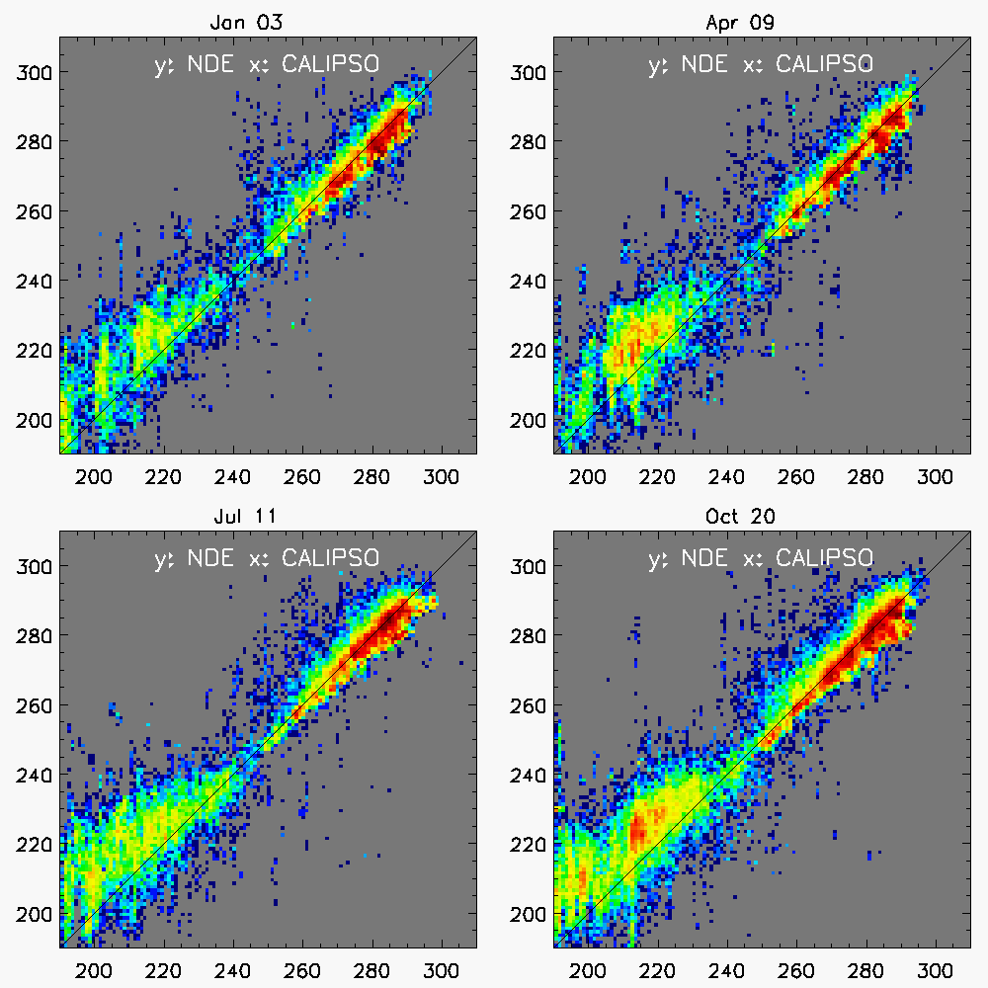
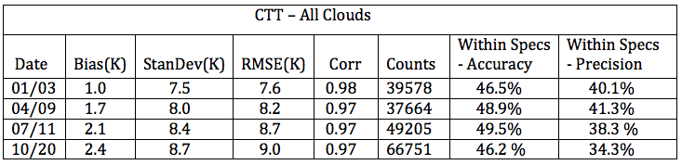
Cloud Temperature Error Budget Supporting Material and Analysis

Slide 18
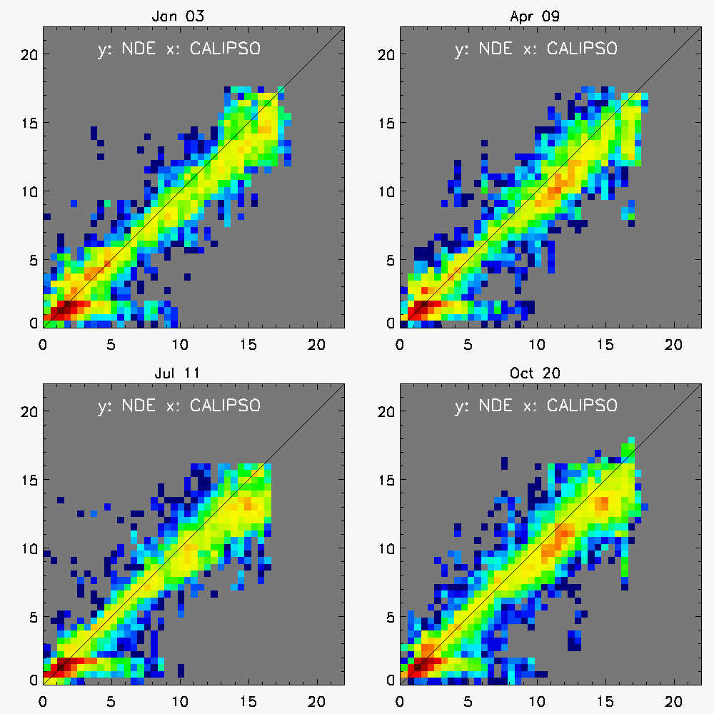
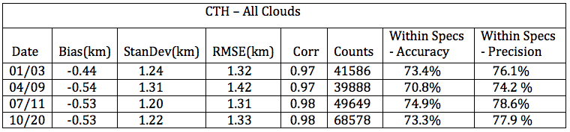
Cloud Height Error Budget Supporting Material and Analysis

Slide 19
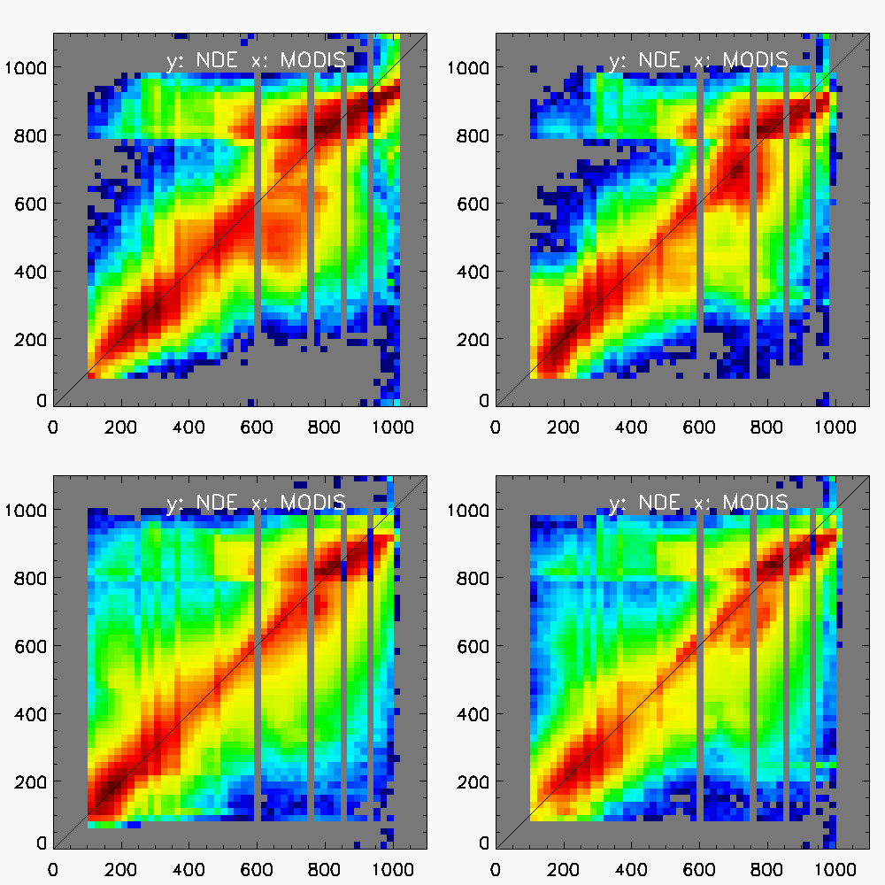
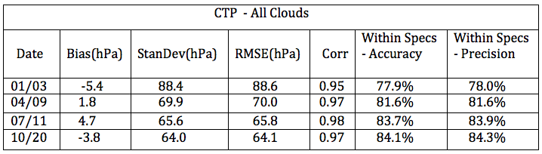
Cloud Pressure Error Budget Supporting Material and Analysis

Slide 20
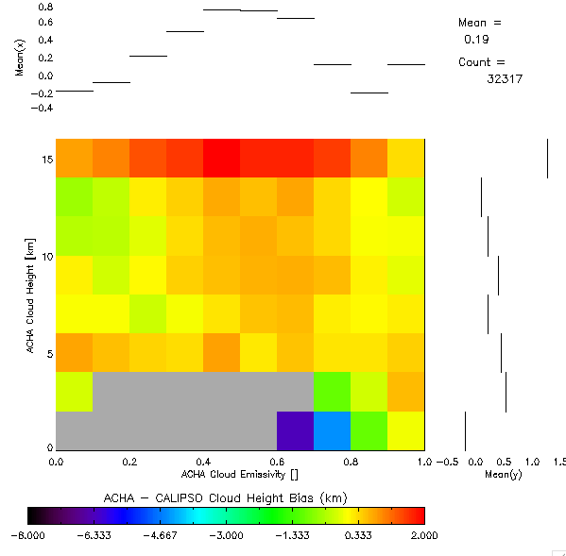
Cloud Height Error Budget Supporting Material and Analysis
Plotting CTH bias as a function of retrieved height (y-axis) and retrieved emissivity (x-axis).
This illustrates a known problem – over estimation of height for thin and very high cirrus clouds.
The solution is the microphysical model which is the most difficult thing to nail down and is an active area of research.
Similar to k-ratio DR’s on IDPS algorithms.
VIIRS is sensitive to this because of no h2o or co2.

Slide 21
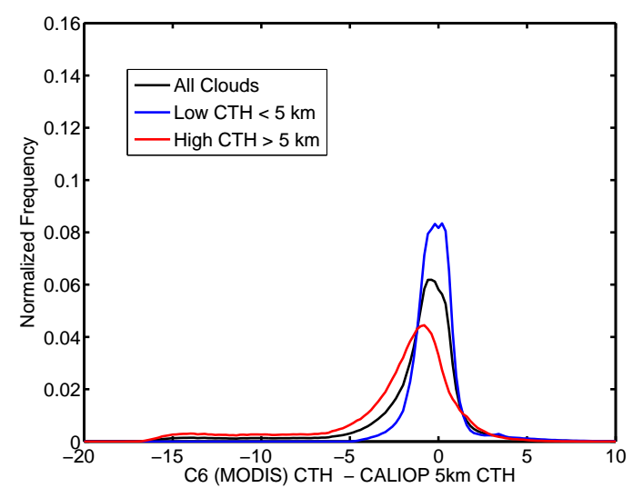
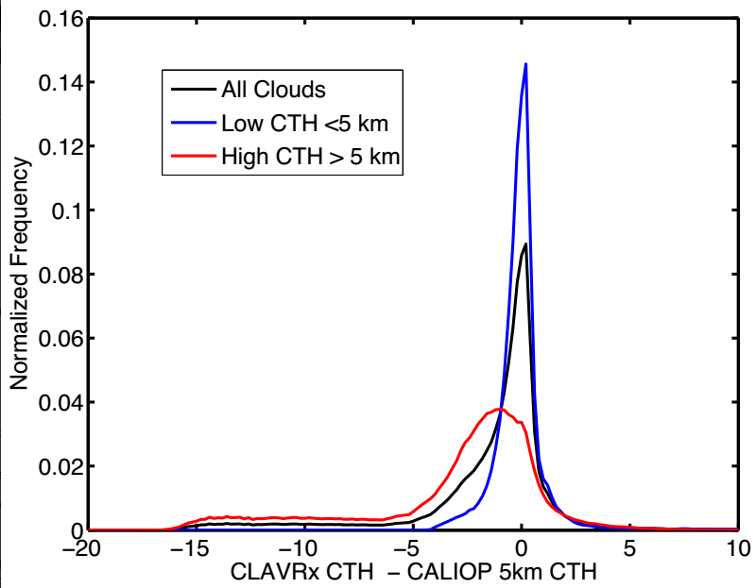
CTPH: NDE-VIIRS vs C6-MODIS
Images below show the same analysis plotted differently for C6 MODIS and CLAVR- vs CALIPSO cloud height . NDE is run in CLAVR-x run and CLAVR-x appears on axis.
MODAWG = MODIS + NOAA AWG = Processing system proposed for NPP Proposal lead by Steve Platnick. MODAWG heights are CLAVR-x.
CLAVR-x on VIIRS is similar to but not identical with C6 MODIS.
January 2014 Day + Night

Slide 22
CTP/ACHA Quality flag analysis/validation
Meta Data Definition (per pixel)
  Cloud Height Attempted (0 = no / 1 = yes)
  Bias Correction Employed (0 = no / 1 = yes)
  Ice Cloud Retrieval (0 = no / 1 = yes)
  Local Radiatve Center Processing Used (0 = no / 1 = yes)
  Multi-layer Retrieval (0 = no / 1 = yes)
  Lower Cloud Interpolation Used (0 = no / 1 = yes)
  Boundary Layer Inversion Assumed (0 = no / 1 = yes)
  NWP Profile Inversion Assumed (0 = no / 1 = yes)
Quality Flag Definition (per pixel)
  Processed (0 = no / 1 = yes)
  Valid Tc Retrieval (0 = yes, 1 = no)
  Valid ec Retrieval (0 = yes, 1 = no)
  Valid beta Retrieval (0 = yes, 1 = no)
  degraded Tc Retrieval (0 = no, 1 = yes)
  degraded ec Retrieval (0 = no, 1 = yes)
  degraded beta Retrieval (0 = no, 1 = yes)
Analysis/validation
  Verified manually

Slide 23
Cloud Top Property Summary
Within specs percentages are higher for CTH and CTP than CTT, due to conversion relationship from height to temperature
NDE shows a negative cloud height bias for ice clouds, common to passive sensor
Water clouds CTH bias is possibly related to temperature inversion, and less reliable CALIPSO data at lower levels?
Large bias and variations of nighttime CTP is likely due to poor MODIS performance at night, and MODIS C6 CTP is pending validation too
ACHA COD performs well for values less than 1.5
ACHA COD validation is only applicable to ice clouds

Slide 24
Daytime Cloud Optical Properties
Andi Walther, CIMSS

Slide 25
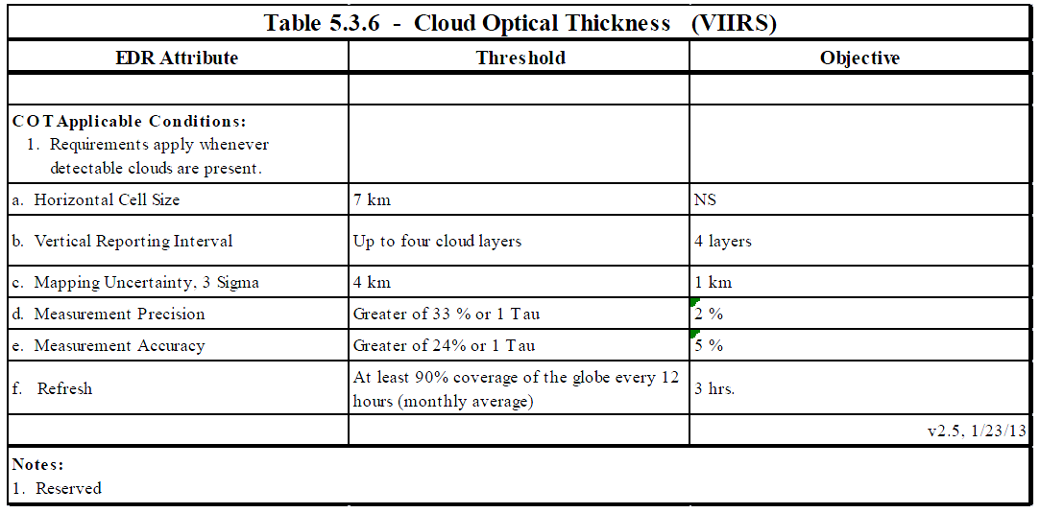
Cloud Optical Depth Requirements

Slide 26
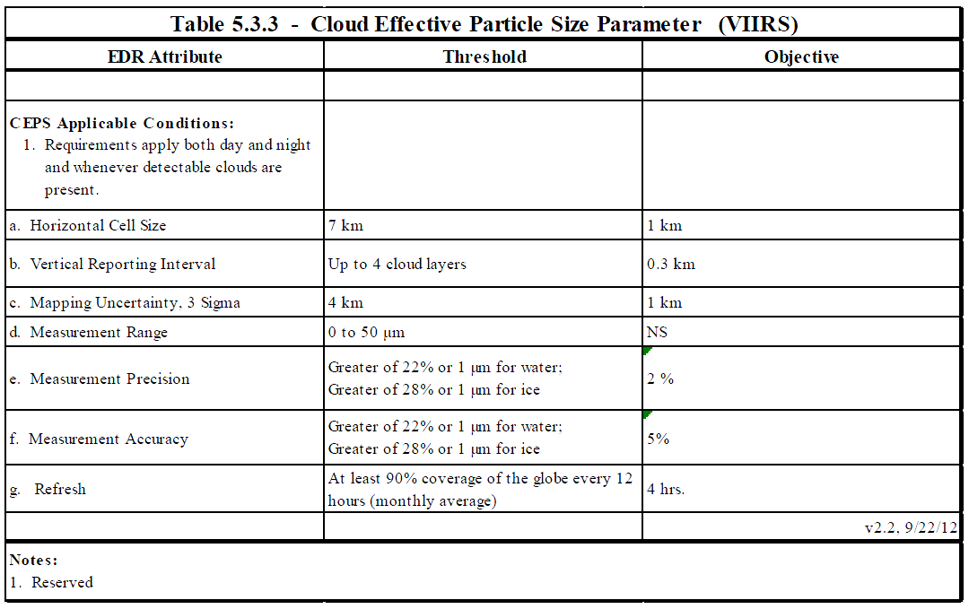
Cloud Effective Particle Size Requirements

Slide 27
Day Cloud Optical Properties Error Budget Supporting Material and Analysis
Challenge: Cloud optical parameters, in particular optical depth, are difficult to validate. Validation sources are rare. Most evaluation sources use similar retrieval approaches, and are therefore not independent.
Strategies:
Sanity checks by inter-comparisons with existing retrievals
Direct comparison with MODIS products.
Use of passive microwave retrievals to validate liquid water path.
A-TRAIN measurements can help to identify aerosol layers and multi-layer clouds.

Slide 28
Day Cloud Optical Properties Error Budget
Errors computed relative to MODIS C6 COD and CEPS.
VIIRS results are colocated AQUA/MODIS over 10 days.
Attribute Analyzed | L1RD Threshold | Analysis/Validation Result | Error Summary
COD Accuracy | Greater of 24% or 1 | A: 2.9% P: 26% ; 92.1% inside accuracy specs | ✔
CEPS Water Accuracy | Greater of 22% or 1um | A: 21.5% P: 5.6%; 77.4% inside accuracy specs | ✔
CEPS Ice Accuracy | Greater of 28% or 1um | A: 22.9% P: 3.6%; 69.3 % in accuracy specs | ✔

Slide 29
Day Cloud Optical Properties Error Budget Supporting Material and Analysis
Comparison of DCOMP to MODIS-AQUA products for 10 full days. White lines depict requirement limits.

Slide 30
Day Cloud Optical Properties Error Budget Supporting Material and Analysis
Microwave sensors offer a further validation source
Validation is limited due to coarse spatial resolution and to only liquid phase sensitivity
We apply several filter criteria:
  90% of DCOMP pixels must be covered by liquid clouds
  MW is insensitive to thin clouds. We exclude clouds thinner than COD = 5.
  We exclude all MW pixels with rain flag.
Image shows that 90 percent of pixels are within the 50 g/m2 spec.

Slide 31
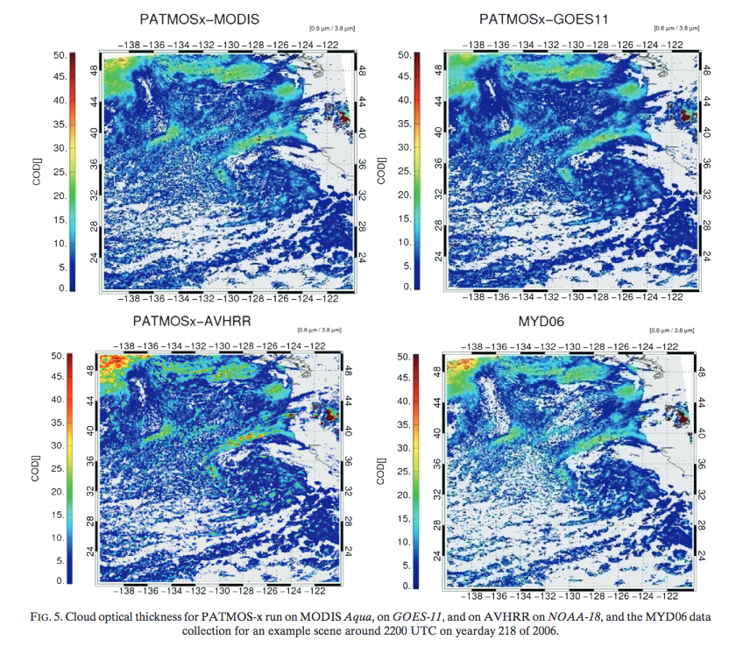
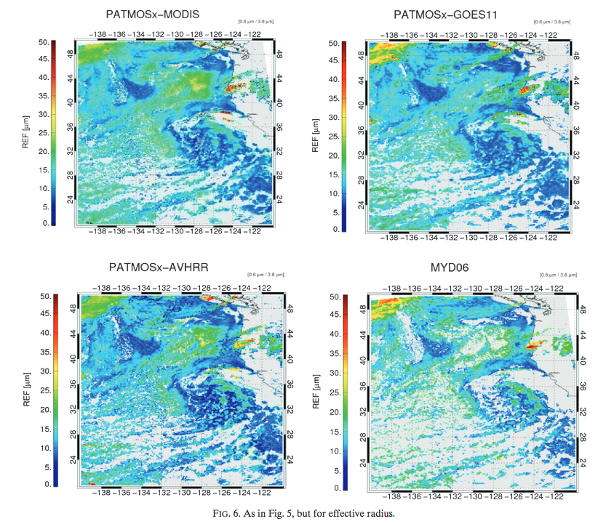
Day Cloud Optical Properties Error Budget Supporting Material and Analysis
We demonstrated that DCOMP is consistent over the sensors:
→ Validation efforts of DCOMP can be made for any sensor.

Slide 32
Day Cloud Optical Properties Error Budget Supporting Material and Analysis
COD-Inter comparison during CREW workshop
DCOMP was continuously tested in the Cloud Retrieval Evaluation Workshop (CREW) series. All leading cloud retrieval developer are part of CREW.
Image shows comparison of DCOMP (on x-axis’) to KNMI, EUMETSAT, DLR, Belgium Met office, UK Met Office and Goddard/NASA retrievals.

Slide 33
Day Cloud Optical Properties Error Budget Supporting Material and Analysis
EPS- Intercomparison during CREW workshop
DCOMP was continuously tested over the last 6 years in the Cloud Retrieval Evaluation Workshop (CREW) series. All leading cloud retrieval developers are part of CREW.
Image shows comparison of DCOMP/EPS (on x-axis’) to KNMI, EUMETSAT, DLR, UK Met Office. Langley/NASA and Goddard/NASA retrievals.

Slide 34
DCOMP Comparison with IDps

Slide 35
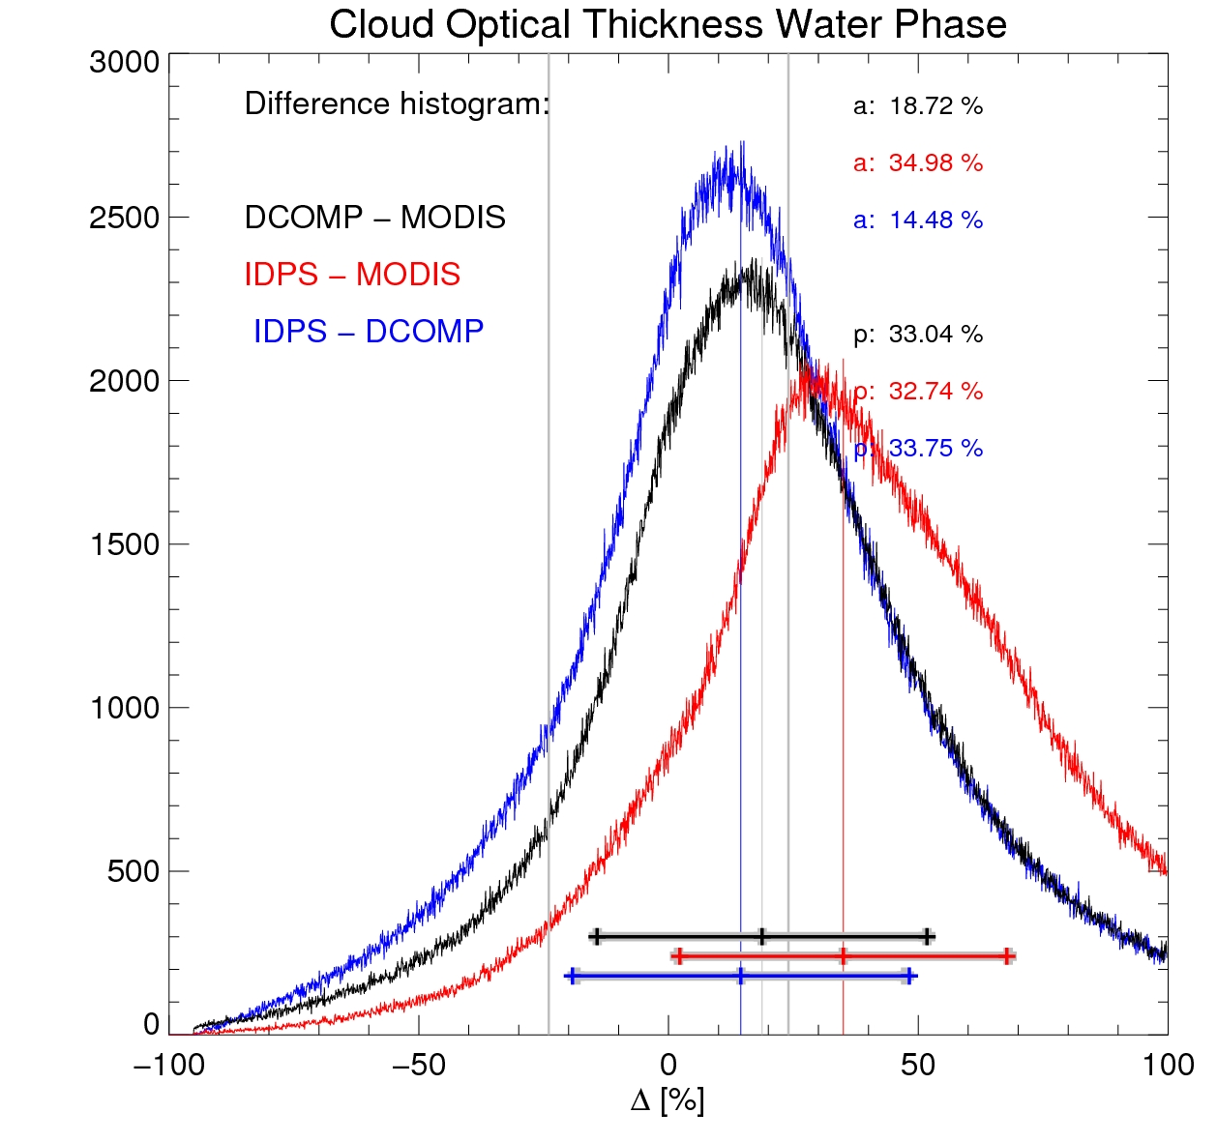
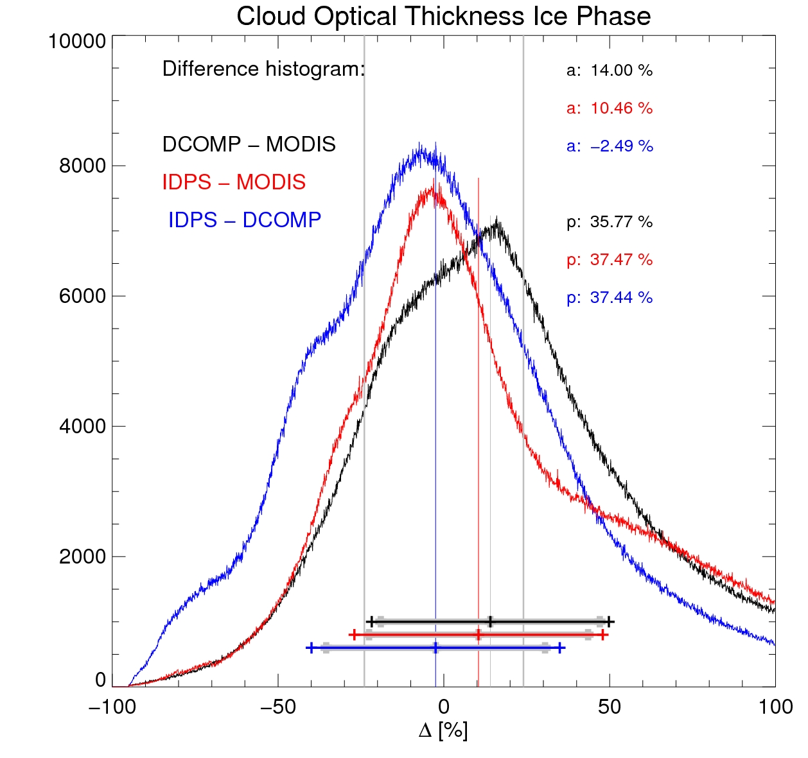
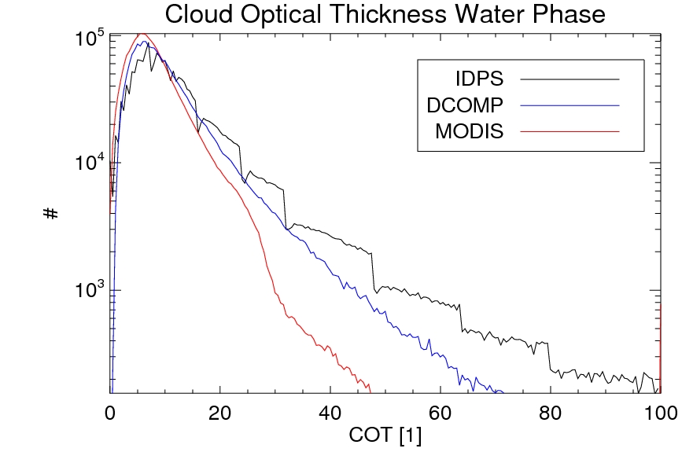
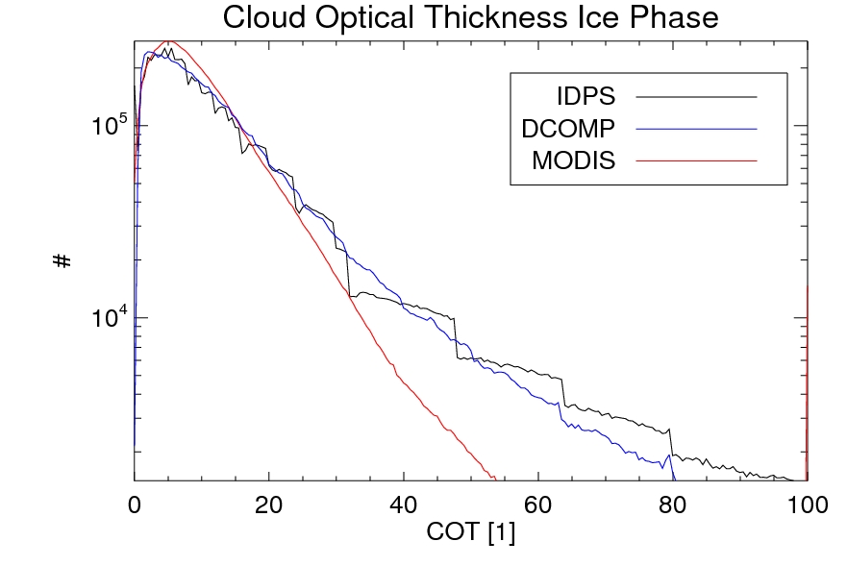
Day Cloud Optical Properties Error Budget Supporting Material and Analysis
Images show difference histograms of pixel by pixel comparison between DCOMP on VIIRS, MODIS and IDPS on VIIRS retrievals for COD for water and ice.
Matching criteria are 5km and 10 minutes.
Imperfect matching complicates evaluation. Histograms of results over same region and time can support analysis.
Images show Frequency of occurrence for COD water and ice phase for DCOMP, MODIS and IDPS.

Slide 36
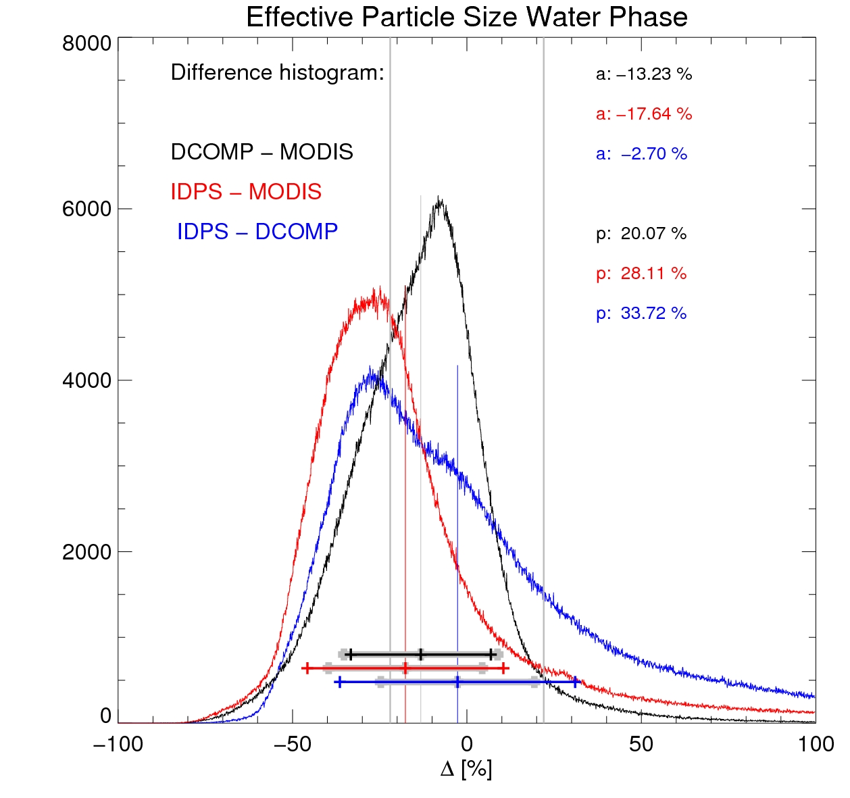
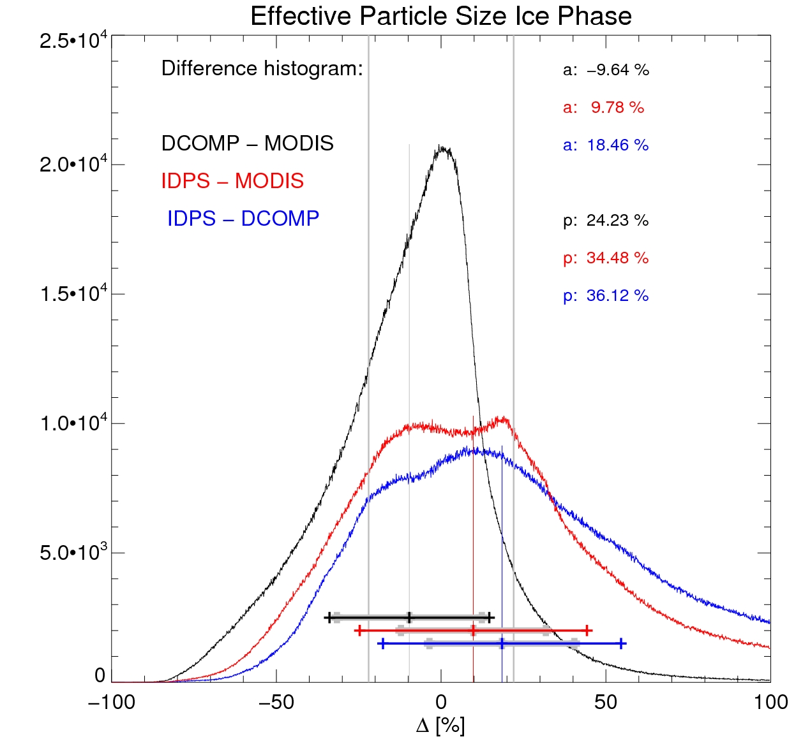
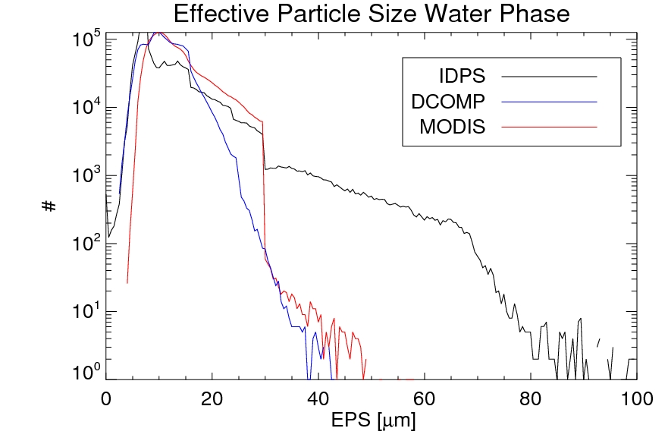
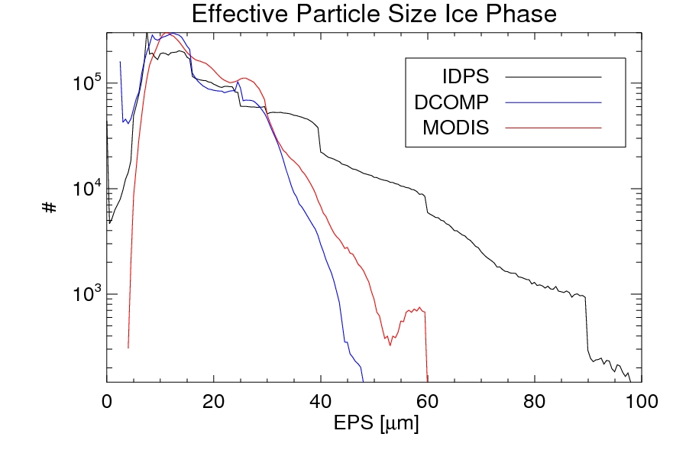
Day Cloud Optical Properties Error Budget Supporting Material and Analysis
Images show difference histograms of pixel by pixel comparison between DCOMP, MODIS and IDPS retrievals for EPS for water and ice.
Matching criteria are 5km and 10 minutes.
Imperfect matching complicates evaluation. Histograms of results over same region and time may support analysis.
Images show Frequency of occurrence for EPS water and ice phase for DCOMP, MODIS and IDPS.

Slide 37
Day COP/DCOMP Quality flag analysis/validation
DCOMP Quality Flag per pixel:
QF1 | Bit | F_{i} | Description | When to apply
DCOMP_PRCS_FLAG | 0 | 1 | 0 - not processed 1- processed
DCOMP_QF_COD_VALID | 1 | 2 | 0 –Valid retrieval 1- not valid | If Q1/B0 EQ ‘1’
DCOMP_QF_REF_VALID | 2 | 4 | 0 –Valid retrieval 1- not valid | If Q1/B0 EQ ‘1’
DCOMP_QF_COD_DEGRADED¹ | 3 | 8 | 0 –no 1- degraded | If Q1/B0 EQ ‘1’
DCOMP_QF_REF_DEGRADED² | 4 | 16 | 0 –no 1- degraded | If Q1/B0 EQ ‘1’
DCOMP_QF_CONVERGENCY | 5 | 32 | 0 – convergent 1 - not | If Q1/B0 EQ ‘1’
DCOMP_QF_GLINT | 6 | 64 | 0 – no glint 1- glint | If Q1/B0 EQ ‘1’
¹Reasons for COD degradation are set in DCOMP_INFO flag. Possible reasons for COD are snow, sea-ice, twilight and thick cloud saturation.
²Reasons for REF degradation are set in DCOMP_INFO flag. Possible reasons for REF degradation are snow, sea-ice, twilight.

Slide 38
Day COP/DCOMP Quality flag analysis/validation
DCOMP Meta information per pixel:
QF1 | Bit | F_{i} | Description | When to apply
DCOMP_INFO_LAND_SEA | 0 | 1 | 0 –Land 1- Ocean
DCOMP_INFO_DAY_NIGHT | 1 | 2 | 0 –Day 1-Night
DCOMP_INFO_TWILIGHT | 2 | 4 | 0- no 1- solar angle between 65 and 82
DCOMP_INFO_SNOW | 3 | 8 | 0 – no snow 1 -snow
DCOMP_INFO_SEA_ICE | 4 | 16 | 0 – no sea ice 1- sea ice
DCOMP_INFO_PHASE | 5 | 32 | 0- water 1- ice | If Q1/B0 EQ ‘1’
DCOMP_INFO_THICK_CLOUD¹ | 6 | 64 | 0 – not 1 – yes | If Q1/B0 EQ ‘1’
DCOMP_INFO_THIN_CLOUD² | 7 | 128 | 0-not 1-yes | If Q1/B0 EQ ‘1’
¹ Thick cloud retrieval set COD to upper bound (160). The COD Quality is degraded. REF quality is good.
²Thin cloud retrieval set REF to a-priori value. The REF retrieval output is not valid. COD quality is good.

Slide 39
Documentation
The following documents will be updated and provided to the EDR Review Board before AERB approval:
  Current or updated ATBD
  README file for CLASS
  Product User’s Guide
  Other documentation as required by SPSRB for NDE
  * Note, there is no OAD equivalent for an NDE project. The delivery of the OAD is therefore unknown.

Slide 40
Identification of Processing Environment
All algorithms shown here have been delivered to and implemented in the STAR Algorithm Processing Framework (SAPF).
Algorithm Version = First Delivery to SAPF (number unknown).
Version of LUTs : First Delivery to SAPF
Version of PCTs: Not Applicable
Description of environment used to achieve validated stage 1
  All results shown here were generated with CLAVR-x version 5.4
  CLAVR-x runs within CSPP (VIIRS, MODIS and AVHRR)
  CLAVR-x runs in OSPO though only on AVHRR and GOES
  CLAVR-x does not run the Night Cloud Optical Properties
  CLAVR-x does not run the NDE Cloud Phase/Type Algorithm.
  The official IDPS VCM including Cloud Phase were used in this analysis. CLAVR-x has the ability to read those in before generated downstream cloud products.

Slide 41
Users & User Feedback
User Feedback
  NDE Algorithms Released in CSPP.
  Most feedback and interaction has been with training users on the product definitions and use of quality flags.
  Taiwan Weather Service has given most feedback.
  EUMETSAT has been served IDPS CTH since January – no feedback yet.
  Bill Ward expressed interest Cloud Cover Layers over Hawaii.
Downstream product list
  Polar Winds (CTH used in height assignment)
  In NDE, Fog and Icing use DCOMP and ACHA output.
  Precipitation is considering use of DCOMP products. (Risk Reduction)
Reports from downstream product teams on the dependencies and impacts
  None received for IDPS or NDE algorithms yet.

Slide 42
Conclusion
Cal/Val results summary:
  Team recommends algorithm validated stage 1 maturity for
    Cloud Top Parameters (ACHA)
      Cloud Top Height
      Cloud Top Temperature
      Cloud Top Pressure
    Daytime Cloud Optical Properties (DCOMP)
      Cloud Optical Depth
      Cloud Particle Size

Slide 43
Path Forward
Planned further improvements
  daytime cloud optical properties
    Performance over snow surfaces
    Optimal use of 1.6, 2.2 and 3.75 mm for improved cloud effective radius.
    Explore integration of lunar algorithm to extend day time performance (JPSS-RR)
    Explore elevating lwp and iwp as products as they are in GOES-R.
  cloud height
    optimize cloud height for AWV support
    Improve use of cloud type and other information for multilayer performance.
    Explore elevating IR optical depth and particle size as products as they are for GOES-R.
Planned Cal/Val activities / milestones
  Validate Nighttime COP when available from NDE SAPF
  Launch our CALIPSO and MODIS near-real time monitoring site.
  Draft reports on impacts of cloud type and cloud mask errors on cloud product performance.

Slide 44
Extra material

Slide 45
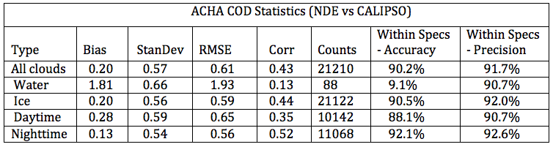
ACHA Cloud Optical Properties Error Budget
Compare analysis/validation results against requirements, present as a table. Error budget limitations should be explained. Describe prospects for overcoming error budget limitations with future improvement of the algorithm, test data, and error analysis methodology.
Attribute Analyzed | L1RD Threshold (Precision/Accuracy) | Analysis/Validation Result | Error Summary
ACHA COD | Greater of 33% or 1 Greater of 24% or 1 | 90.2% (accuracy) 91.7% (precision) | 0.20 (bias) 0.57 (standard dev)
Limitations:
a. Analysis is based on data between 60°N and 60°S
b. Only COD values between 0 and 3 are included

Slide 46
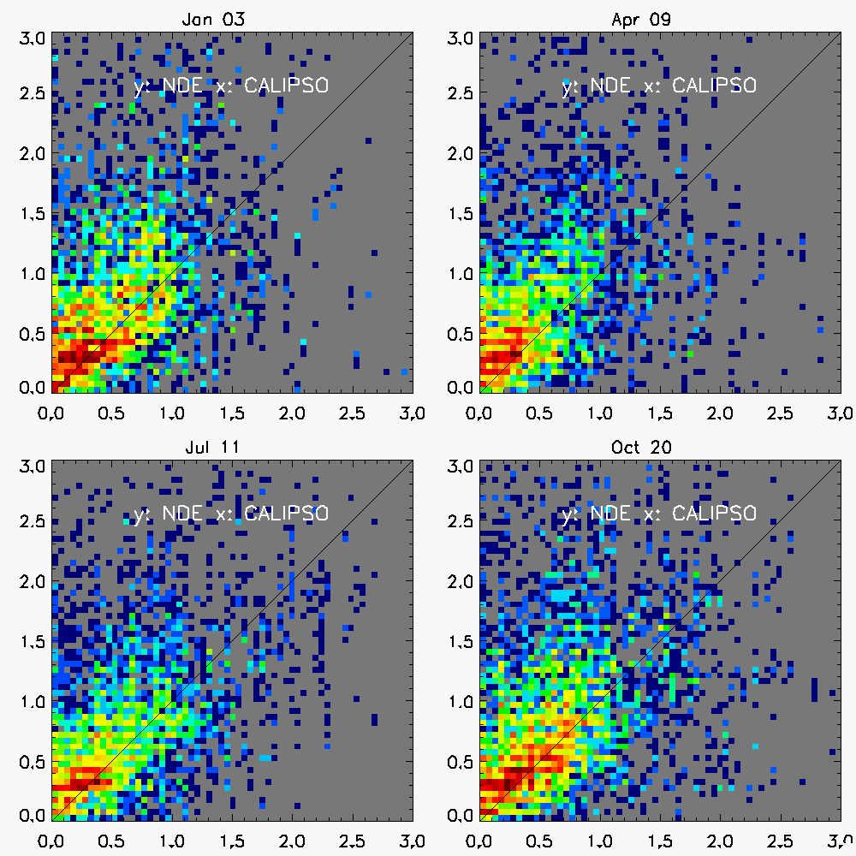
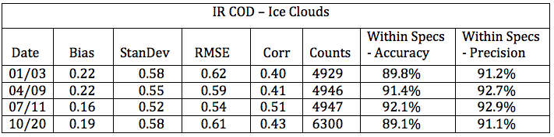
ACHA Cloud Optical Properties Error Budget Supporting Material and Analysis

