Slide 1
Validated Stage 1 Science Maturity Review for VIIRS Cloud Base, Nighttime Optical Properties and Cloud Cover Layers Products
Andrew Heidinger
September 3, 2014

Slide 2
Outline
Cloud Base Height
  Product Requirements
  Evaluation of algorithm performance to specification requirements
    Evaluation of the effect of required algorithm inputs
    Quality flag analysis/validation
    Error Budget
Nighttime Optical and Microphysical Properties
  Product Requirements
  Issues preventing Val Stage 1 Maturity
Cloud Cover Layers
  Product Requirements
  Issues with definition in NDE
Conclusion
Path Forward

Slide 3
Cloud BASE
Curtis Seamen, CIRA

Slide 4
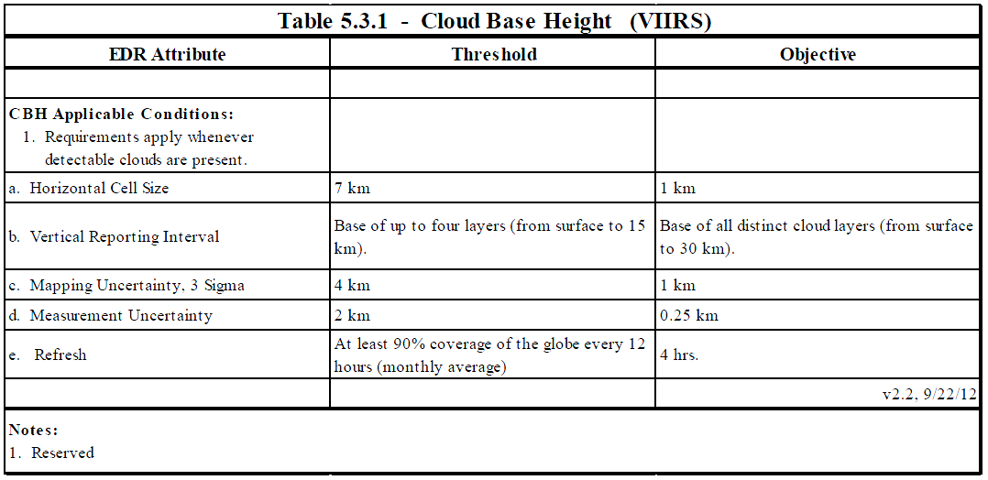
Cloud Base Height Requirements

Slide 5
Cloud Base Height Error Budget
Based on VIIRS co-locations with CloudSat CPR data.
Data for separated for all clouds and those that meet the CTH specification.
Attribute Analyzed | L1RD Threshold | Analysis/Validation Result | Error Summary
CBH | 2 km uncertainty | 0.3 km and 40% of time | All clouds
CBH | 2 km uncertainty | -0.1 km and 70 % of time | Clouds with CTH within spec

Slide 6
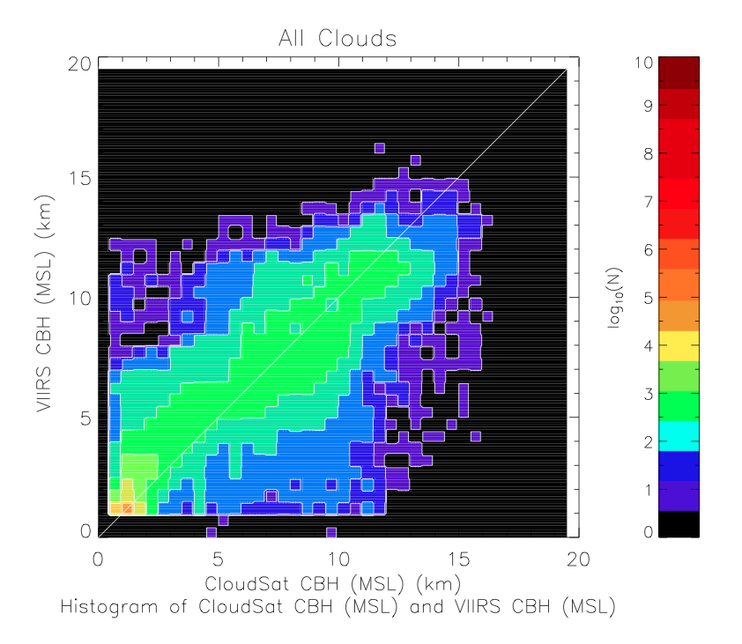
Cloud Base Height Error Budget Supporting Material and Analysis
The Cloud Profiling Radar (CPR) on the NASA CloudSat Mission provides the most complete cloud vertical structure information.
We define Cloud Base Height as the height of the lowest cloud layer.
Distribution shows results where CTH was in spec. CBH is based on CTH.

Slide 7
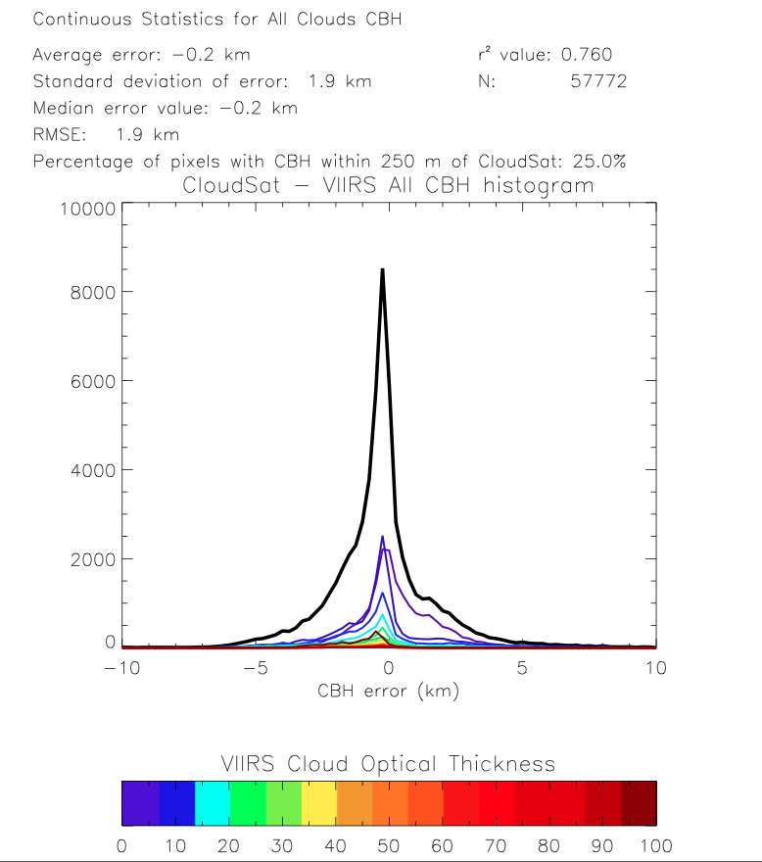
Cloud Base Height Error Budget Supporting Material and Analysis
Same analysis as previous slide but show as a bias histogram.
Colors denote optical thickness.
The specification calls for an uncertainty of 2 km.
NDE is approach is similar to IDPS but new improvements are coming based on CloudSat “tuning”.

Slide 8
Nighttime Cloud optical properties

Slide 9
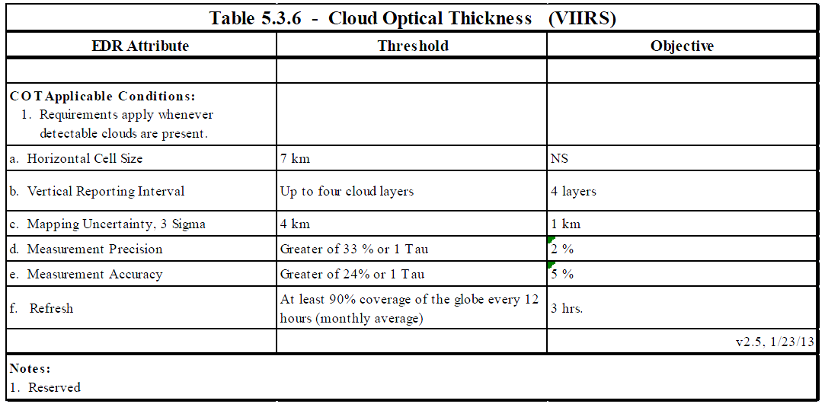
Cloud Optical Depth Requirements
No difference from Day Requirements shown earlier

Slide 10
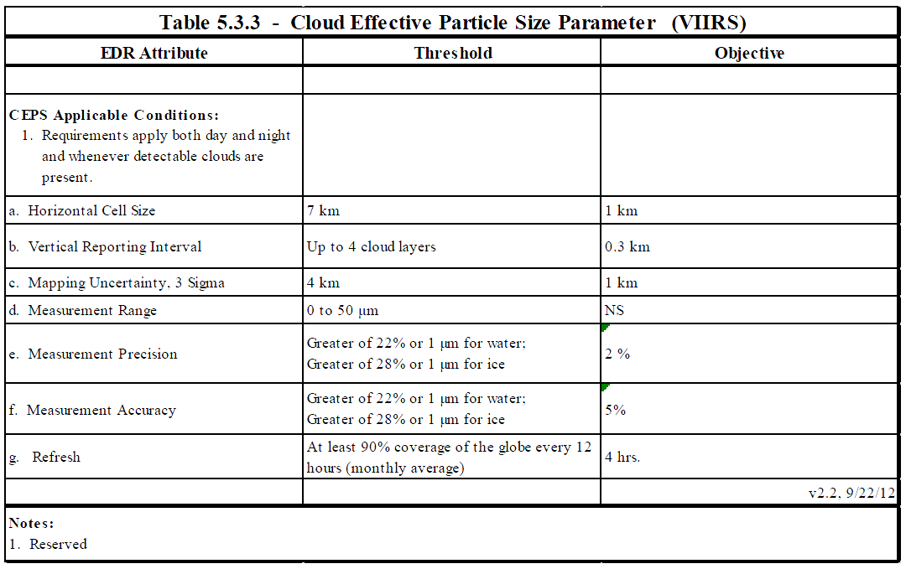
Cloud Effective Particle Size Requirements
No difference from Day Requirements shown earlier

Slide 11
Nighttime Cloud Optical and Microphysical Product Issues
NDE is implementing the GOES-R version (NCOMP) which comes from Dr. Patrick Minnis of NASA LaRC.
This algorithm does not run in CLAVR-x and we can’t yet run it in the NDE SAPF. Therefore we can’t assess its maturity on VIIRS.
NCOMP will undergo an NDE review later this year and this material should be relevant for the JPSS maturity assessment.
IDPS products never made it to Provisional.

Slide 12
Cloud Cover layers

Slide 13
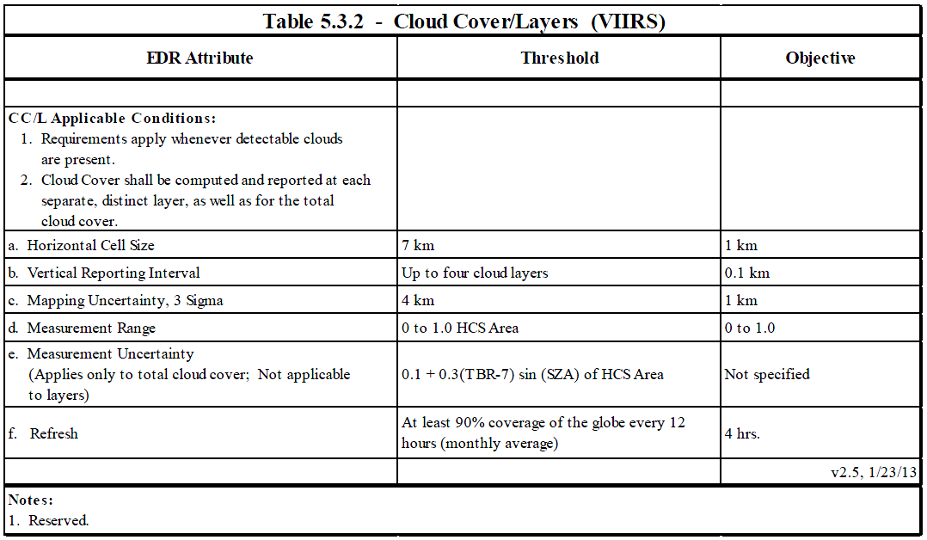
Cloud Cover/Layers Requirements

Slide 14
Cloud Cover Layers Issues
NDE is implementing the GOES-R version which is simply the cloud fraction for the high, middle and low cloud layers.
The JPSS Cloud Cover Layers dynamically finds the layers based on binning.
The performance of both of these is totally dependent on the CTP algorithm.
Either way is not a technical problem.
Bill Ward has communicated interest for CCL over Hawaii and we work with him to gauge NWS interest.

Slide 15
Identification of Processing Environment
All algorithms shown here have been delivered to and implemented in the STAR Algorithm Processing Framework (SAPF).
Algorithm Version = First Delivery to SAPF (number unknown).
Version of LUTs : First Delivery to SAPF
Version of PCTs: Not Applicable
Description of environment used to achieve validated stage 1
  All results shown here were generated with CLAVR-x version 5.4
  CLAVR-x runs within CSPP (VIIRS, MODIS and AVHRR)
  CLAVR-x runs in OSPO though only on AVHRR and GOES
  CLAVR-x does not run the Night Cloud Optical Properties
  CLAVR-x does not run the NDE Cloud Phase/Type Algorithm.
  The official IDPS VCM including Cloud Phase were used in this analysis. CLAVR-x has the ability to read those in before generated downstream cloud products.

Slide 16
Users & User Feedback
User Feedback
  NDE Algorithms Released in CSPP.
  Most feedback and interaction has been with training users on the product definitions and use of quality flags.
  Taiwan Weather Service has given most feedback.
  EUMETSAT has been served CTH since January – no feedback yet.
  Bill Ward expressed interest Cloud Cover Layers over Hawaii.
Downstream product list
  Polar Winds (CTH used in height assignment)
Reports from downstream product teams on the dependencies and impacts
  None received for IDPS or NDE algorithms yet.

Slide 17
Conclusion
  Team does not recommend algorithm validated stage 1 maturity yet for
    Cloud Base
      While the cloud base performs better than IDPS version, we still think we need development to make a useful product. This development is on-going and should yield a mature product in 6 months.
      Should we adopt GOES-R L1 Requirements?
  Team can not make a decision on the maturity of the following
    Nighttime Cloud Optical Properties
      This algorithm is recently implemented into NDE SAPF. We do not have the ability to run it yet. GOES-R version would meet specs.
    Cloud Cover Layers
      NDE Cloud Cover Layers has a different (simpler) definition than JPSS. The algorithm is simple and driven by Cloud Top Parameters. We recommend implemented IDPS-like Cloud Cover Layers into NDE. Alternatively, we adopt simpler GOES-R definition

Slide 18
Path Forward
Planned further improvements
  cloud base
    Finalize CloudSat derived parameterizations of geometrical thickness.
    Finalize use of NWP profiles for thick clouds.
  Implement IDPS-like cloud cover layers (if directed).
Planned Cal/Val activities / milestones
  Validate Nighttime COP when available from NDE SAPF
  Launch our CALIPSO and MODIS near-real time monitoring site.
  Draft reports on impacts of cloud type and cloud mask errors on cloud product performance.

