Slide 1




UW status/report:
1. Impact of new FIR filter
2. IDPS/ADL comparisons
CrIS SDR Cal/Val Telecon
25-Apr-2012

Slide 2
FIR Filter: Topics/Summary
Example 14 March slides (initial briefing of problem to the team)
  Sweep direction bias with old FIR filter
Before/After “striping images”
  New filter shows large reduction in sweep direction bias
ICT magnitude spectra
  Sweep direction bias greatly reduced/negligible with new filter
900 cm⁻¹ Imaginary Part images
  Still shows sweep direction bias, but not due to filter
FOR15/16 Analysis
  Spectral dependence of remaining sweep direction bias
PCA
  Ringing largely unchanged (preliminary)
Other (Backup slides)
  Spectral calibration unaffected
  Radiometric nonlinearity unaffected (but see backup slides)
  Shortwave FOV-2-FOV biases – analysis underway, not complete yet

Slide 3
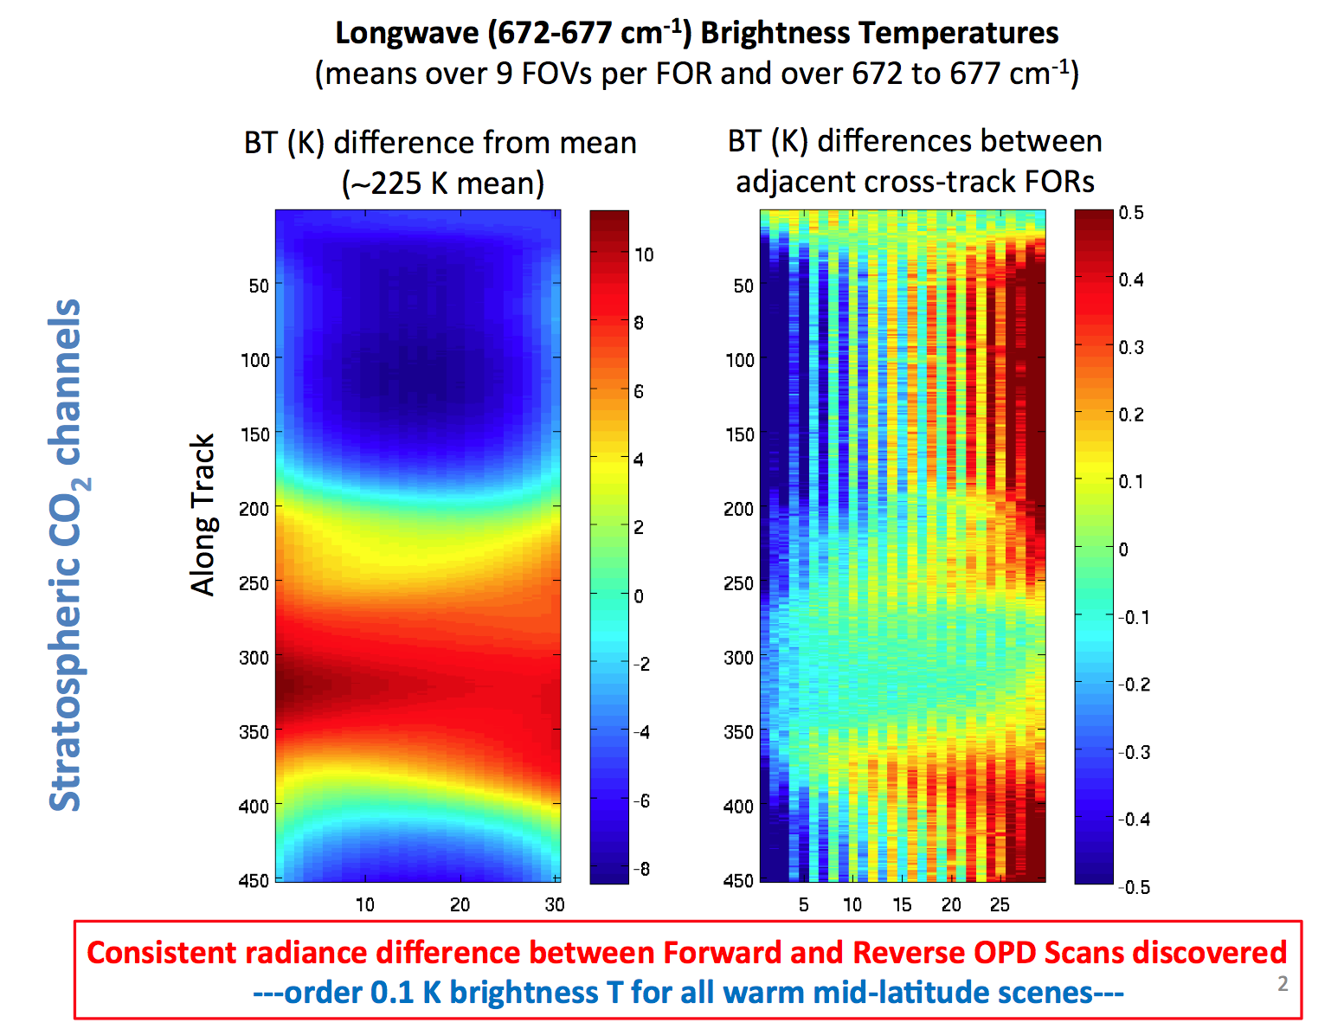
Example 14 March slides

Slide 4
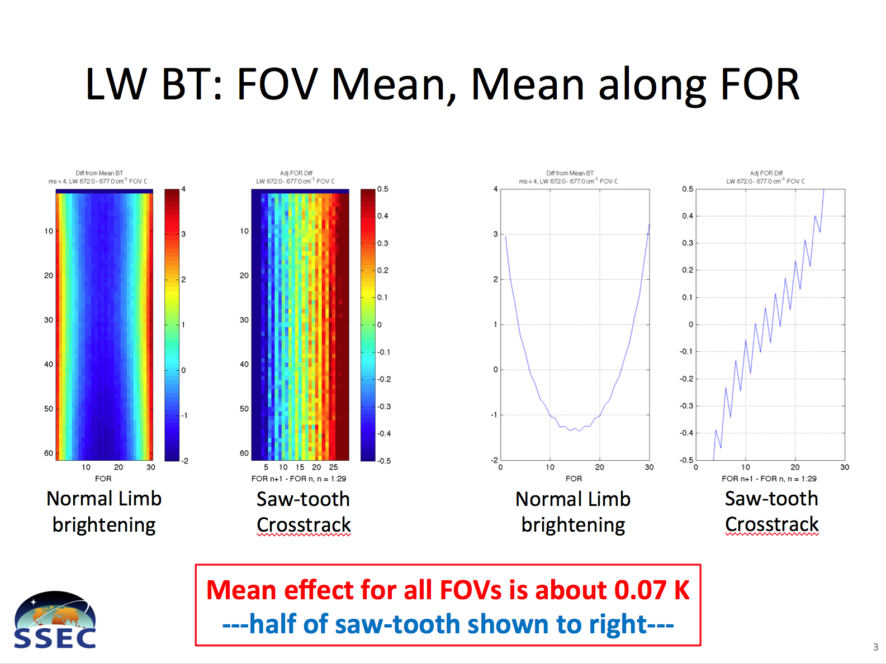
Example 14 March slides

Slide 5
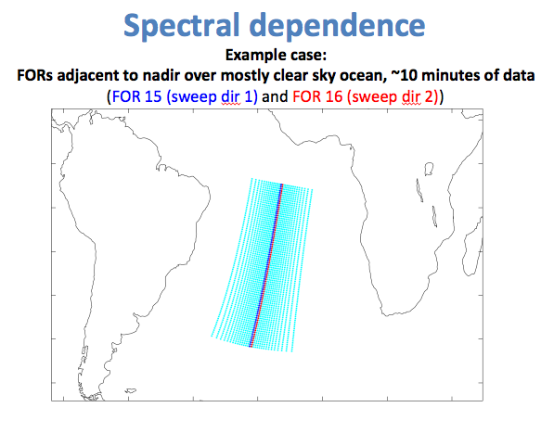
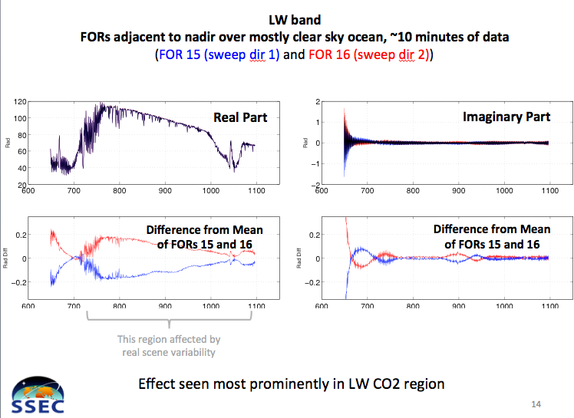
Example 14 March slides

Slide 6
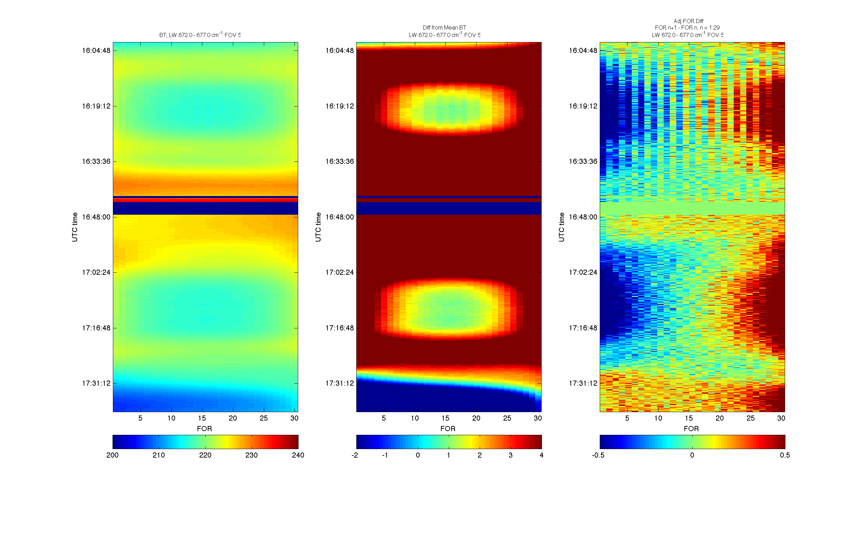
Julian Day 109, 16:02:36 - 17:38:28, LW: 672 – 677 cm⁻¹
Before/After striping images
BT
Diff from Mean BT
Adj FOR Diff
Original
Filter
New
Filter

Slide 7
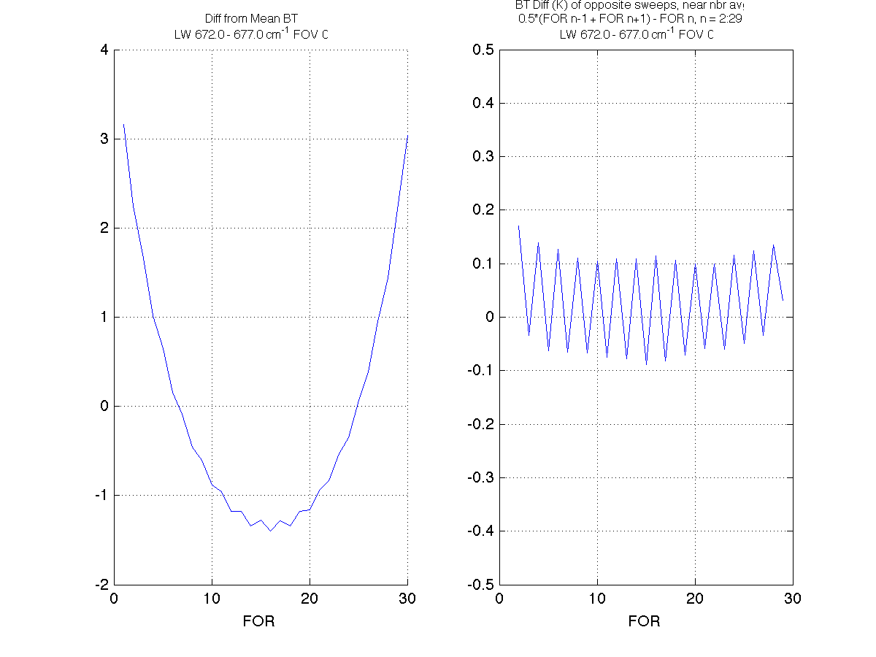
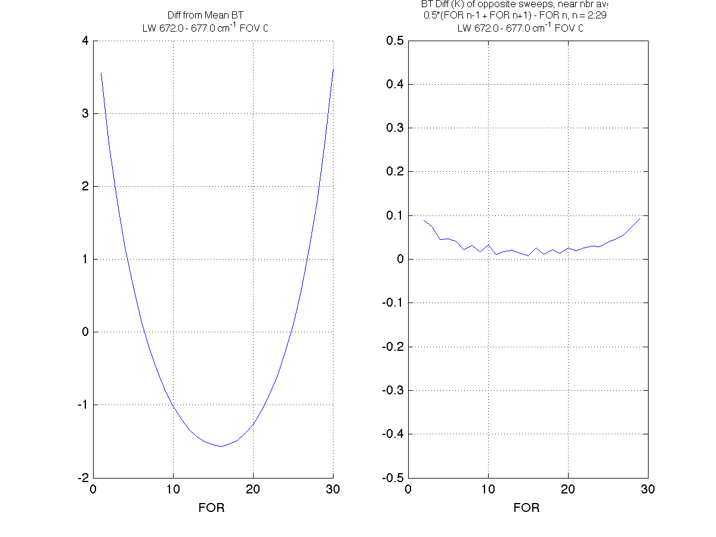
LW BT (672 – 677 cm⁻¹): Can minimize impact of limb darkening/brightening in difference by using nearest neighbor FOR averages
Before/After striping images
Original Filter
SCRIS_npp_d20120418_t1530029
New Filter
SCRIS_npp_d20120418_t1706029
Difference from mean of nearest neighbor FORs
Difference from mean of nearest neighbor FORs

Slide 8
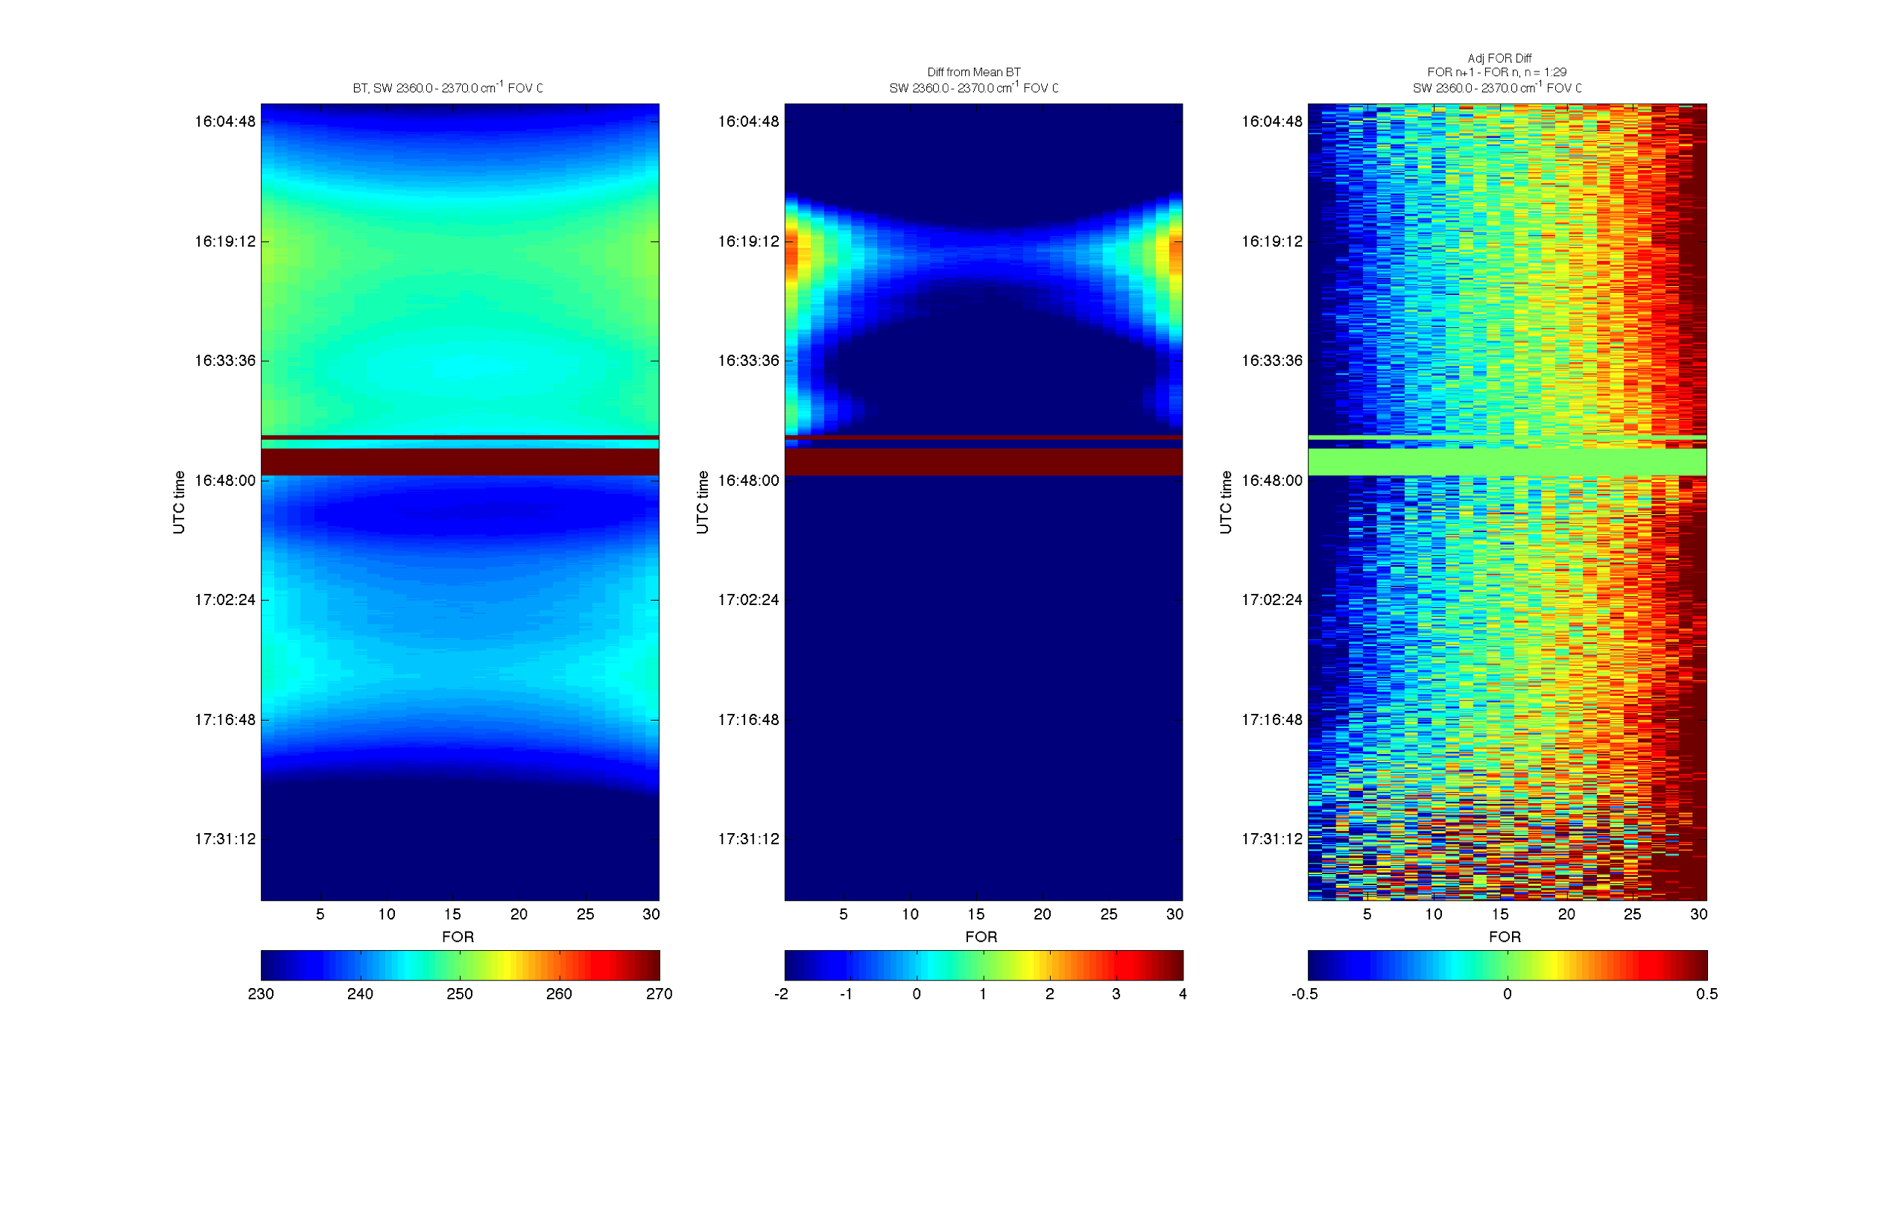
Julian Day 109, 16:02:36 - 17:38:28, SW: 2360 – 2370 cm⁻¹
Before/After striping images
BT
Diff from Mean BT
Adj FOR Diff
Original
Filter
New
Filter

Slide 9
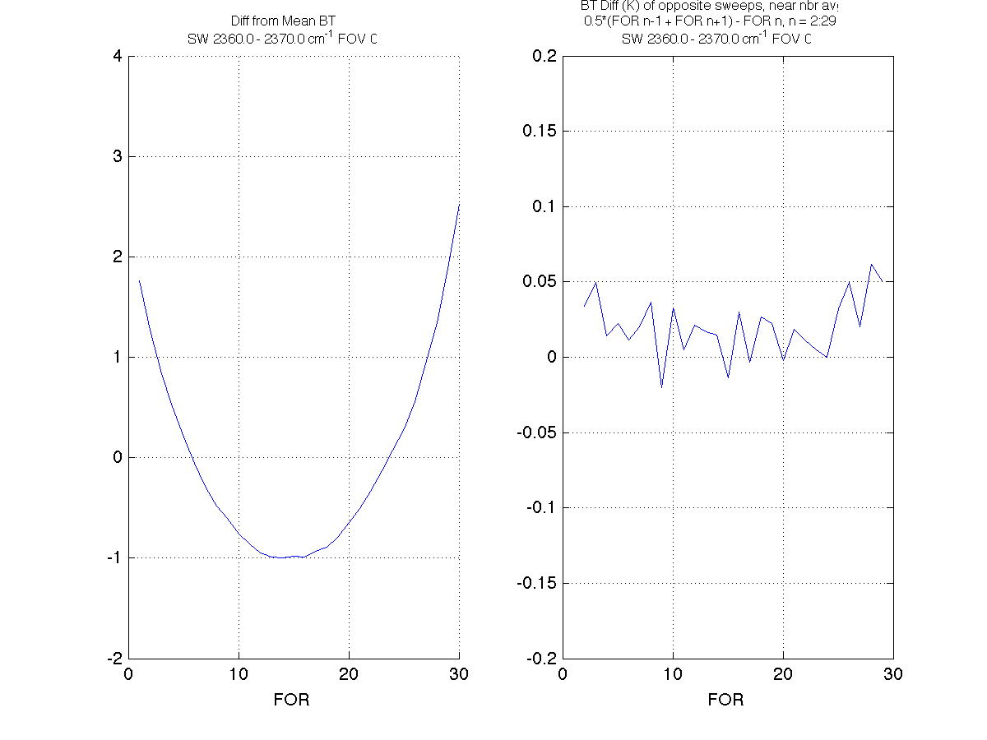
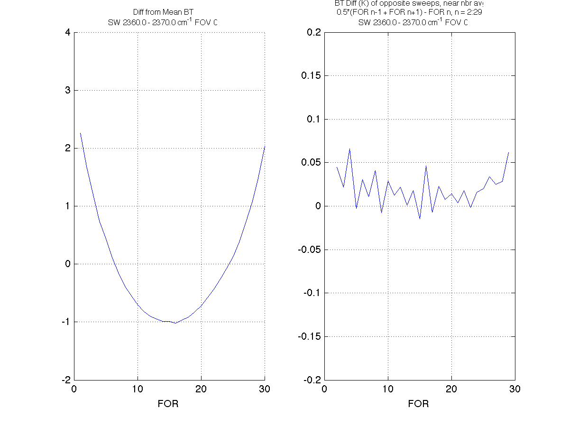
SW BT (2360 – 2370 cm⁻¹): Can minimize impact of limb darkening/brightening in difference by using nearest neighbor FOR averages
Before/After striping images
Original Filter
SCRIS_npp_d20120418_t1530029
New Filter
SCRIS_npp_d20120418_t1706029
Difference from mean of nearest neighbor FORs
Difference from mean of nearest neighbor FORs

Slide 10
ICT Magnitude Spectra: Original Filter
Difference between ICT mag spectra of sweep dir 0 and sweep dir 1
Simulated NF'd DM data (decimation index offset = 0) with NM and DM shown
“DM …” = DM data with current NF applied in software
“NM” = NM data from the satellite
“DM” = DM data
NB: NF DM mag spectra scaled by Npts_DM/2

Slide 11
ICT Magnitude Spectra: New 253 tap Filter
Difference between ICT mag spectra of sweep dir 0 and sweep dir 1
Simulated NF'd DM data (decimation index offset = 0) with NM and DM shown
“DM …” = DM data with current NF applied in software
“NM” = NM data from the satellite
“DM” = DM data
NB: NF DM mag spectra scaled by Npts_DM/2

Slide 12
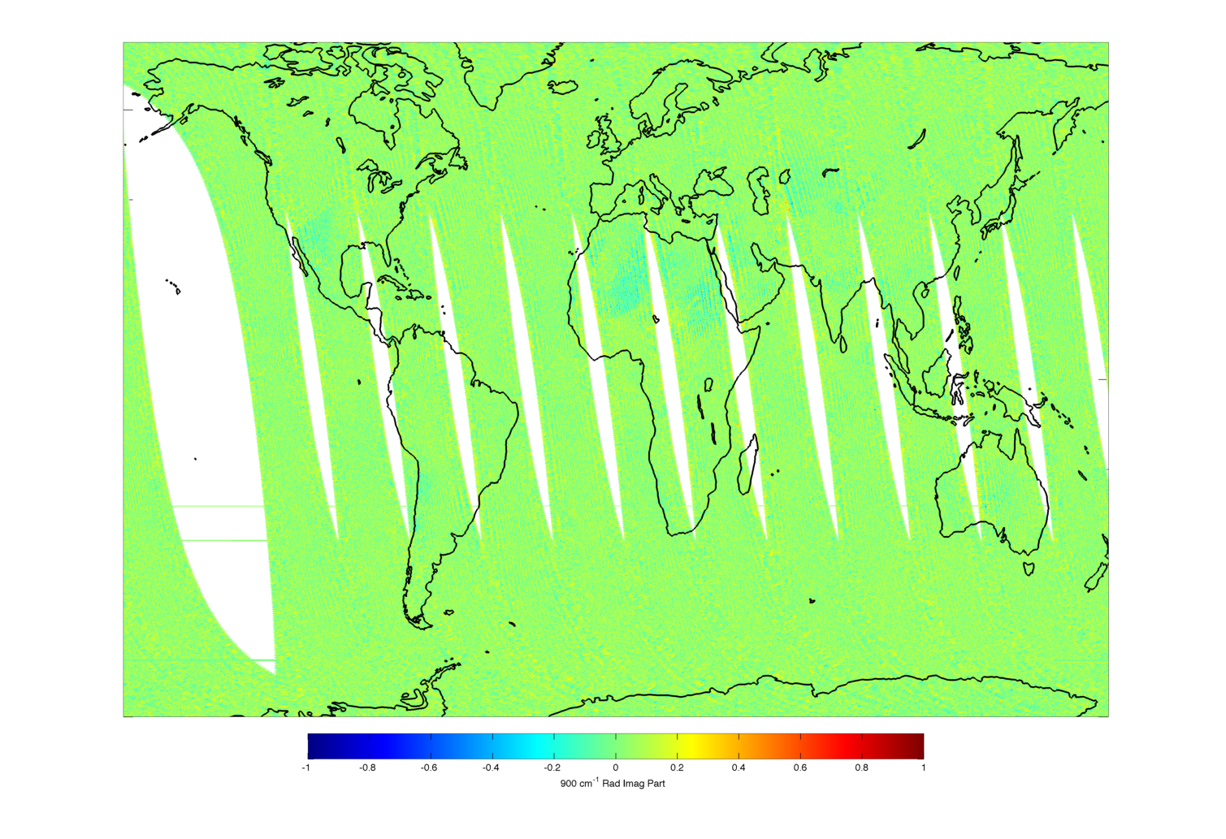
900 cm⁻¹ Imaginary Part, 18 April, IDPS
Old Filter
New Filter

Slide 13
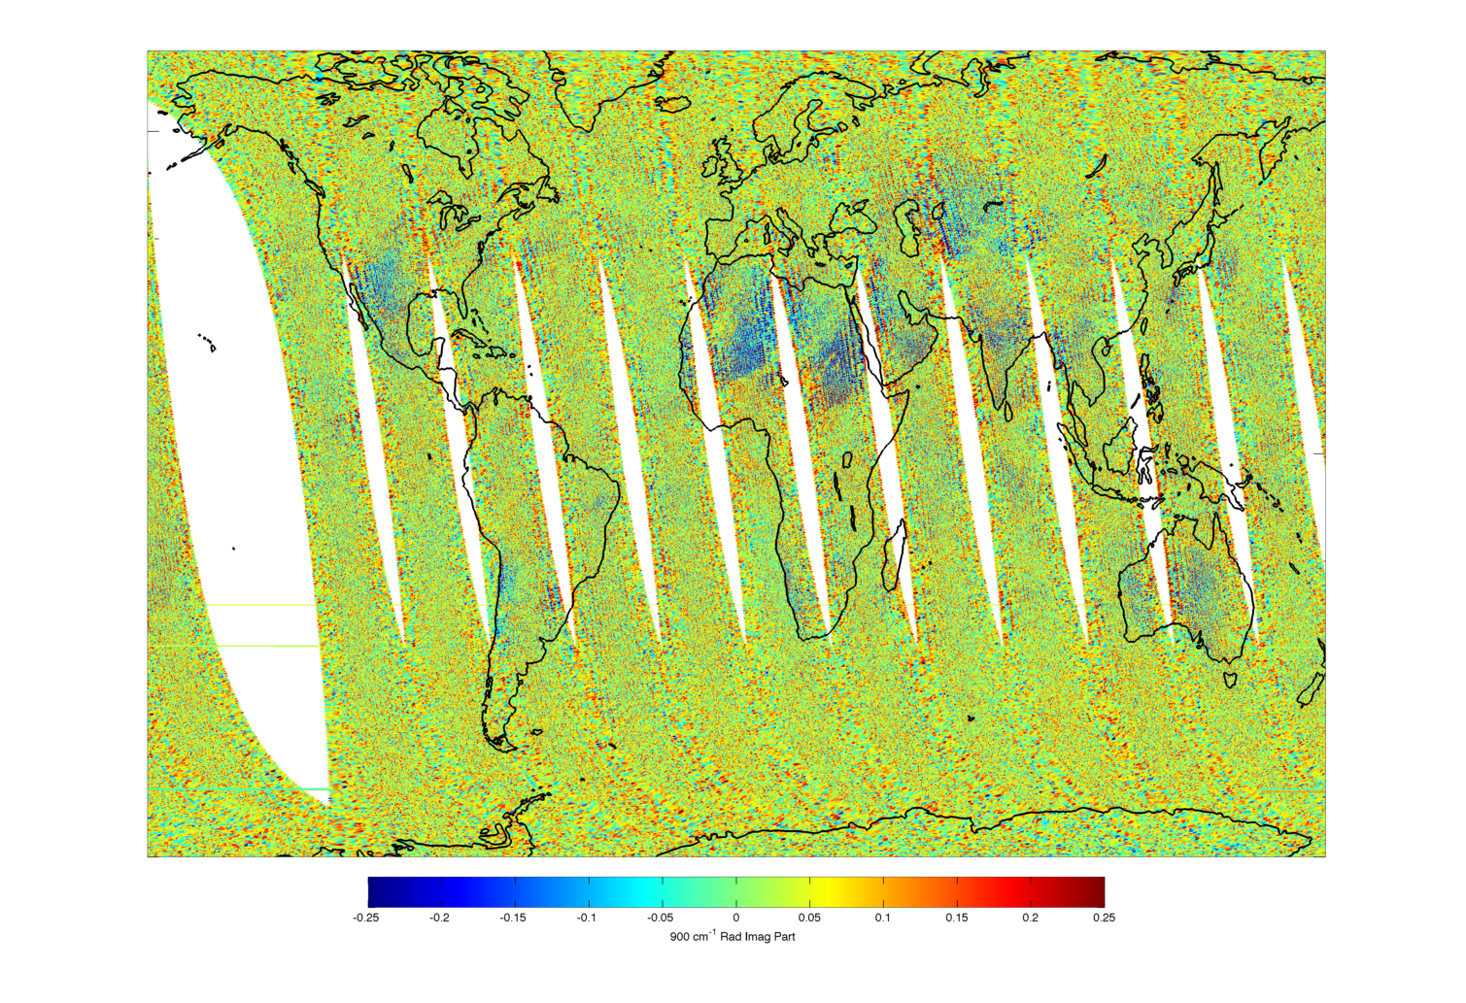
900 cm⁻¹ Imaginary Part, 18 April, IDPS
Old Filter
New Filter

Slide 14
FOR 15/16 Analysis: LW band
FORs adjacent to nadir over mostly clear sky ocean, ~10 minutes of data
(FOR 15 (sweep dir 1) and FOR 16 (sweep dir 2))
Real Part
Imaginary Part
Difference from Mean of FORs 15 and 16:
Old Filter
New Filter

Slide 15
FOR 15/16 Analysis: SW band
FORs adjacent to nadir over mostly clear sky ocean, ~10 minutes of data
(FOR 15 (sweep dir 1) and FOR 16 (sweep dir 2))
Real Part
Imaginary Part
Difference from Mean of FORs 15 and 16:
Old Filter
New Filter

Slide 16
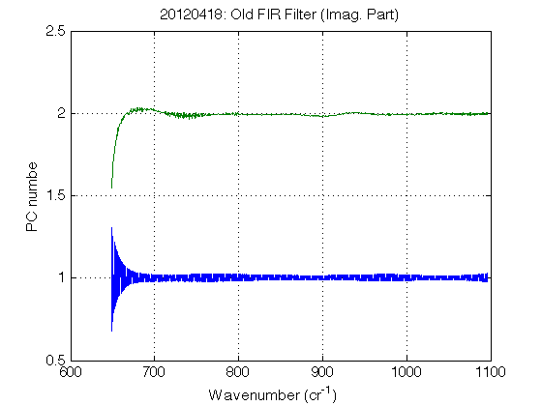
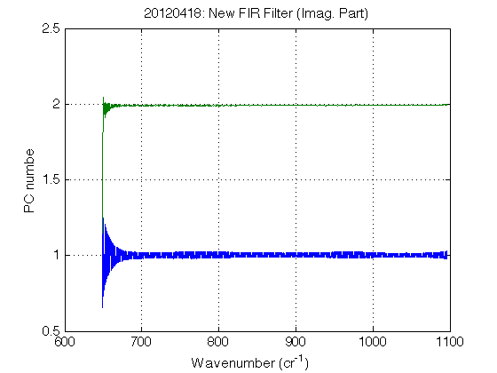
PCA of Imaginary Parts
The new FIR filter removes the imaginary part artifact seen in PC #2 but the "ringing" artifact in PC #1 remains.

Slide 17
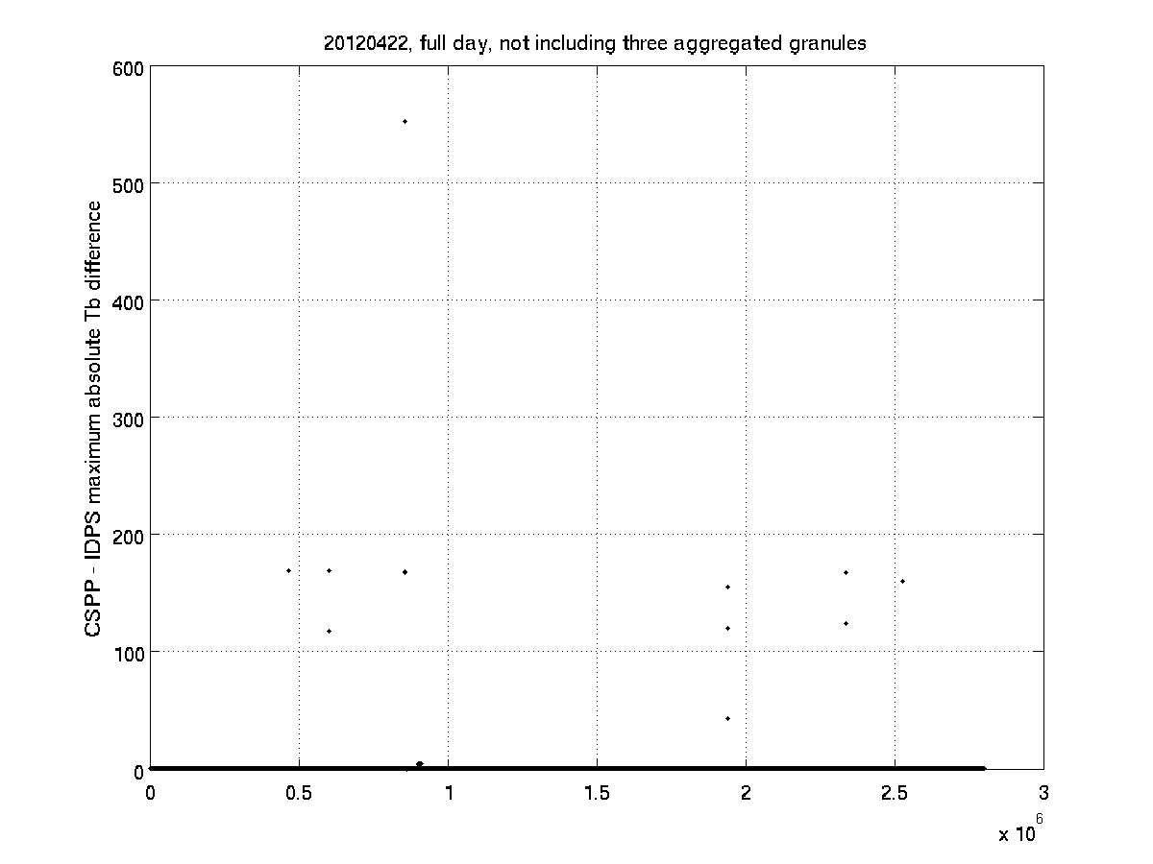
IDPS/ADL comparisons
max(abs(ADL-IDPS)) for LW band on 22 April
for records where IDPS and ADL time stamps match exactly
time
(Not including three 8-minute aggregated IDPS granules for which IDPS and ADL/CSPP times did not match)

Slide 18
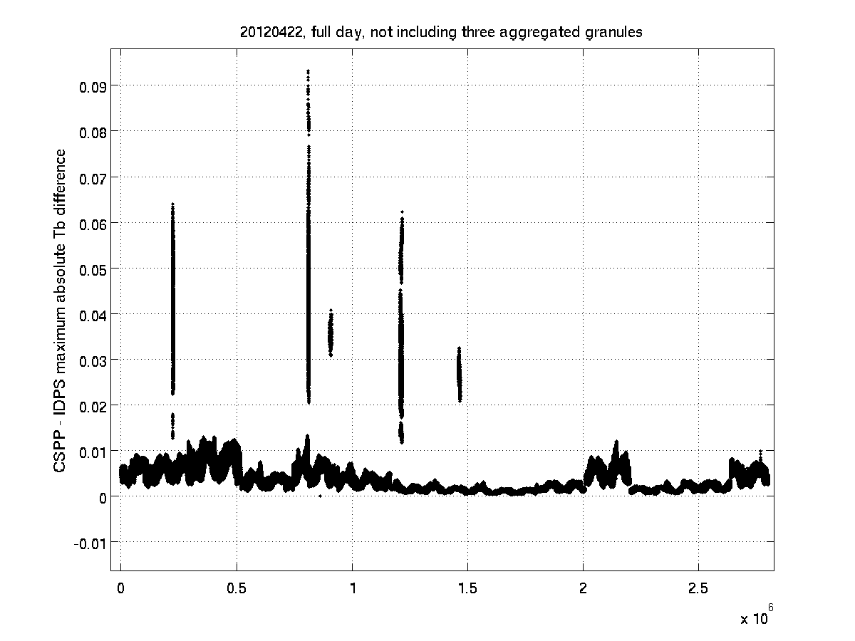
IDPS/ADL comparisons
max(abs(ADL-IDPS)) for LW band on 22 April
for records where IDPS and ADL time stamps match exactly
Y-axis zoom of previous plot
time
(Not including three 8-minute aggregated IDPS granules for which IDPS and ADL/CSPP times did not match)

Slide 19
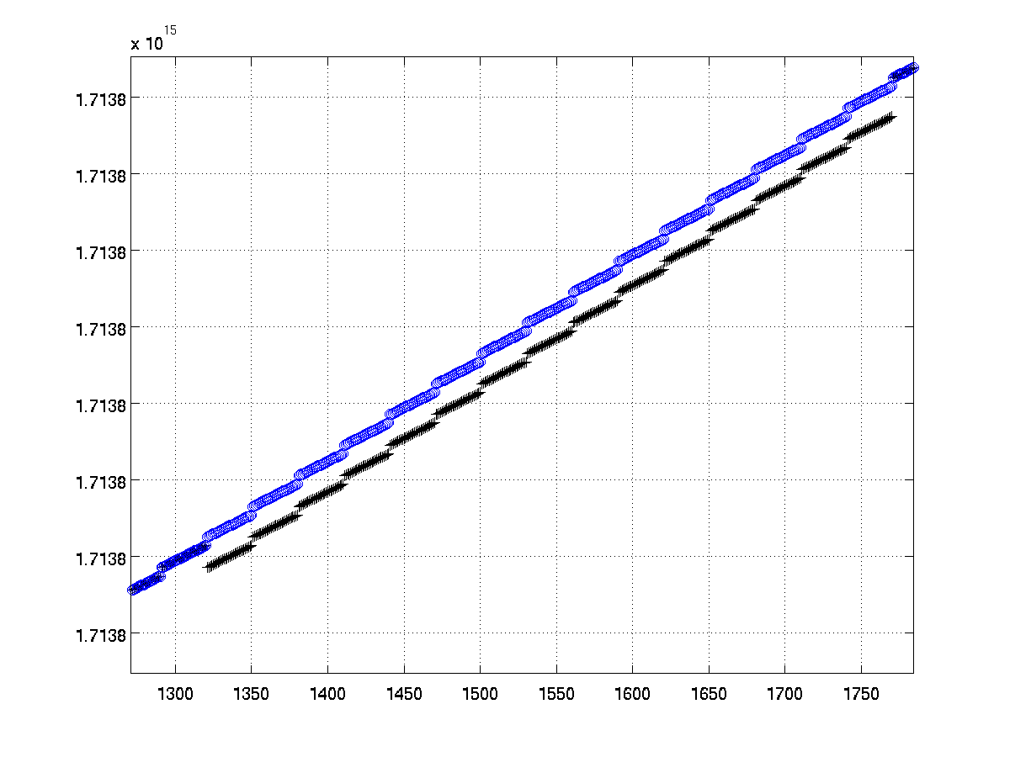
IDPS/ADL comparisons
Three 8-minute aggregated IDPS granules for which IDPS and ADL/CSPP times did not match exactly:
SCRIS_npp_d20120422_t0153389_e0201367_b02507_c20120422080133516572_noaa_ops.h5 SCRIS_npp_d20120422_t0649389_e0657367_b02510_c20120422125731591062_noaa_ops.h5 SCRIS_npp_d20120422_t1657309_e1705287_b02516_c20120422230528657419_noaa_ops.h5
times for first of above granules:
CSPP time
IDPS time
time
Times ok (?) but indices offset
duplicate IDPS times
record index

Slide 20
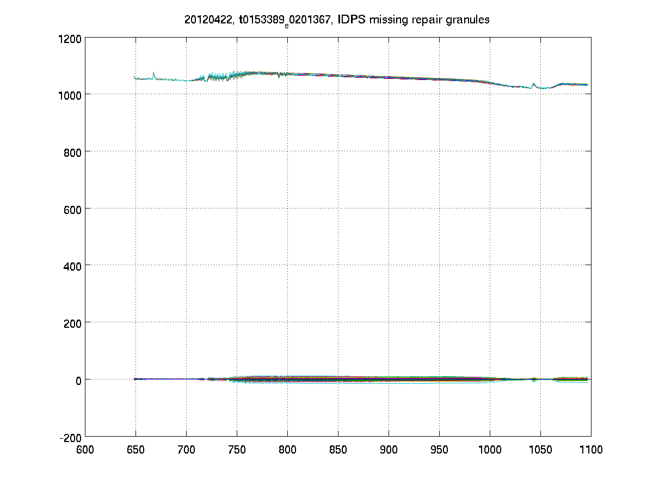
IDPS/ADL comparisons
30 records for which there are duplicate IDPS times and IDPS radiance values are -999.8
CSPP-IDPS (Rad Units)
wavenumber

Slide 21
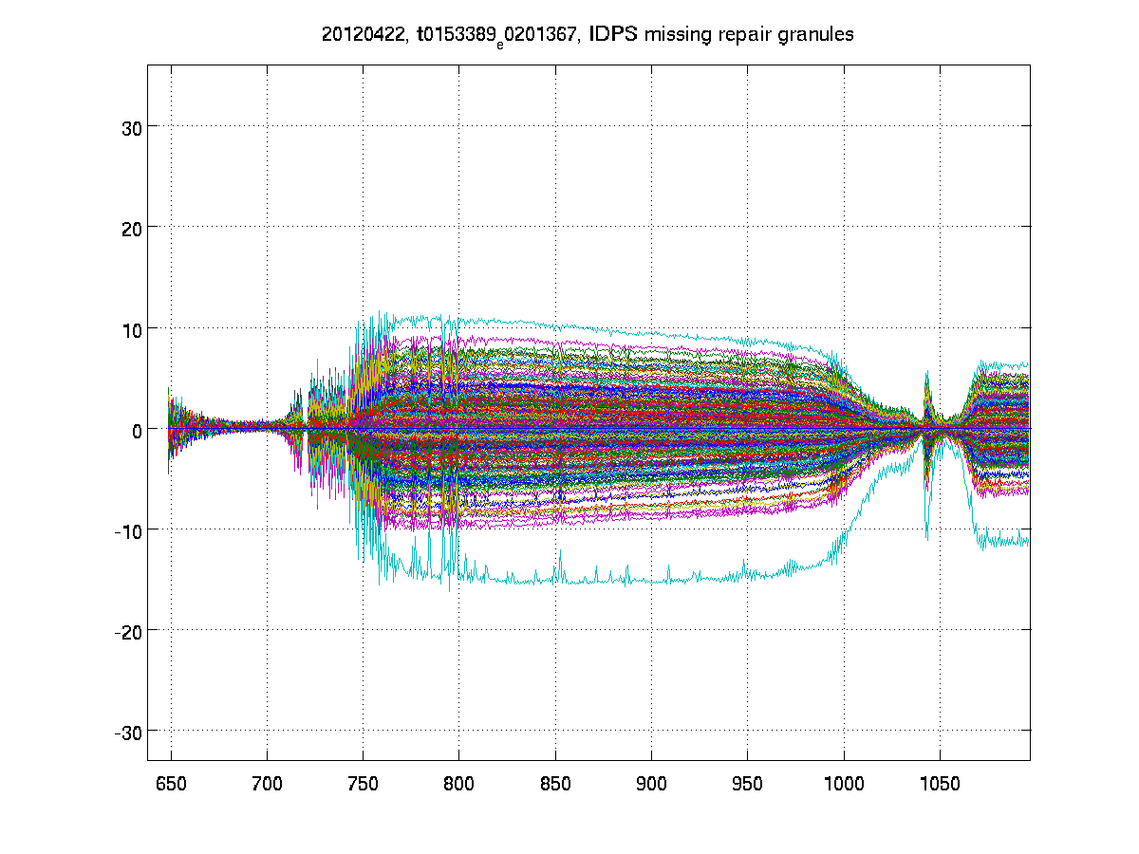
IDPS/ADL comparisons
Y-axis zoom of previous plot
CSPP-IDPS (Rad Units)
wavenumber

Slide 22
Back-Up slides
(Nonlinearity)

Slide 23
Assessment of UW v02 “a2”
R. Knuteson, L. Borg, D. DeSlover,
H. Revercomb, J. Taylor, D. Tobin
UW-SSEC
24 April 2012

Slide 24
UW Assessment Methodology
ADL/CSPP used to compute SDR granules for two sets of “a2” coefficients for selected Golden Days.
UW “a2” V00 – Pre-launch values from CrIS packet v32
UW “a2” V02 – Values used in CrIS packet v33
FOV-to-FOV relative radiance spectra computed for each granule using LW FOV5 and MW FOV9 references using selection criteria for uniform Fields of Regard.
Jacobian perturbation method used to estimate “a2” change relative to UW a2 V02.
Daily global mean (24 hour) of “a2” scale factor estimated
Mean of three daily mean values used for the assessment.
Standard deviation computed from daily mean estimates.

Slide 25
UW a2 version “02” Verified Using Golden Days: 2/24, 2/25, 3/2/2012
[Values represent implied change to the “UW v02” baseline.]
FOV | 1 | 2 | 3 | 4 | 5 | 6 | 7 | 8 | 9
LW Mean | 1.0038 | 1.0020 | 1.0084 | 0.9977 | 1.0000 | 0.9992 | 0.9932 | 0.9795 | 0.9915
(%) | 0.4 | 0.2 | 0.8 | -0.2 | 0 | -0.1 | -0.7 | -2.0 | -0.8
StdDev (%) | 0.4 | 0.2 | 0.1 | 0.1 | 0 | 0.03 | 0.6 | 1.4 | 0.6
MW Mean | 0.9987 | 0.9994 | 0.9974 | 1.0009 | 0.9967 | 0.9992 | 1.0035 | 1.0026 | 1.0000
(%) | -0.1 | -0.1 | -0.3 | 0.1 | -0.3 | -0.1 | 0.3 | 0.3 | 0
StdDev (%) | 0.1 | 0.8 | 0.1 | 0.4 | 0.1 | 0.6 | 0.4 | 0.4 | 0
UW a2 v02 determined using Golden Day 2/24/2012. Repeatability < 2%.

Slide 26
Post-WarmUp a2 Assessment using dates: 3/27, 3/28, 3/29/2012
[Values represent implied change to the “UW v02” baseline.]
FOV | 1 | 2 | 3 | 4 | 5 | 6 | 7 | 8 | 9
LW Mean | 1.0412 | 1.0312 | 1.0739 | 0.9799 | 1.0000 | 1.0181 | 0.9160 | 0.8681 | 0.9662
(%) | 4 | 3 | 7 | -2 | 0 | 2 | -8 | -13 | -3
StdDev (%) | 2 | 1 | 3 | 1 | 0 | 1 | 4 | 4 | 0.5
MW Mean | 0.9753 | 0.9952 | 0.9634 | 0.9932 | 0.9853 | 1.0015 | 1.0207 | 1.0161 | 1.0000
(%) | -2 | -0.5 | -4 | 0.7 | -1.5 | 0.2 | 2 | 1.6 | 0
StdDev (%) | 3 | 1 | 3 | 2 | 1 | 1 | 0.9 | 1 | 0
NPP anomaly on 3/24/2012. Bias > 10% found in LW FOV #8.

Slide 27
Post-FIR Filter Upload a2 Assessment using dates: 4/19, 4/20, 4/21/2012
[Values represent implied change to the “UW v02” baseline.]
FOV | 1 | 2 | 3 | 4 | 5 | 6 | 7 | 8 | 9
LW Mean | 1.0336 | 1.0418 | 1.1412 | 0.9405 | 1.0000 | 1.0529 | 0.8401 | 0.8246 | 0.9920
(%) | 3 | 4 | 14 | -6 | 0 | 5 | -16 | -18 | -1
StdDev (%) | 0.1 | 0.2 | 0.3 | 0.1 | 0 | 0.2 | 0.2 | 0.6 | 0.4
MW Mean | 1.0159 | 0.9431 | 0.9207 | 0.9843 | 0.9635 | 0.9802 | 1.0529 | 1.0428 | 1.0000
(%) | 2 | -6 | -8 | 2 | -4 | -2 | 5 | 4 | 0
StdDev (%) | 7 | 2 | 0.3 | 3 | 1 | 1 | 1 | 1 | 0
New FIR filter uploaded 4/18/2012. Biases > 10% found in LW3, LW7, & LW8.

Slide 28
Post-FIR Filter Upload a2 Assessment using dates: 4/19, 4/20, 4/21/2012
Current a2 estimates for LW FOV 3, 7 & 8 exceed a 10% change threshold.

Slide 29
UW a2 Assessment Summary (24 April 2012)
Original V02 “a2” coefficients determined using Golden Day 24 Feb 2012
Golden Days 24, 25 Feb & 02 March used to independently confirm V02 “a2” values to within 2% for that three day period.
NPP anomaly lead to detector warm-up on 24 March 2012.
Assessment of “a2” values using 27, 28, 29 March 2012 indicated changes for LW 3, 7, and 8 greater than > 5%, relative to V02.
New FIR filter uploaded on 18 April 2012.
Assessment of “a2” values using 19, 20, 21 April 2012 indicate changes for LW 3, 7, and 8 greater than 10%, relative to V02.
Tentative Conclusions:
There is no direct evidence that the recent FIR filter upload has introduced changes in the optimal “a2” coefficient values.
Values of the “a2” coefficients should be estimated periodically (daily?) and trends closely monitored.
Threshold criteria leading to updating the “a2” coefficients in the future should be discussed by the Cal/Val team.

