Slide 1
SDL CrIS Provisional SDR Status Review
October 23, 2012
Mark Esplin, Vladimir Zavyalov, Mark Greenman, Ben Esplin, Deron Scott, Kevin Grant, Brandon Graham, Charles Mayor and Lee Phillips

Slide 2
SDL Cal/Val Tasks
CrIS Task #1 Interferometer Optimization (Completed)
CrIS Task #3 Amplifier Gain Check and Adjustment (Completed)
CrIS Task #4 Bit Trim and Impulse Mask Check (Completed for present resolution, assessing full resolution bit-trim mask)
CriIS Task #5 Radiometric Noise Assessment (NEdN)
CrIS Task #8 Geolocation Calibration
CrIS Task #9 ICT External Environmental Model Tuning
CrIS Task #12 Spikes and Saturated Interferogram Analysis
CrIS Task #13 Ice Contamination Analysis
CrIS Task #14 Correlated/Uncorrelated noise characterization

Slide 3
CrIS Task 4: Bit-Trim and Impulse Mask Check
OBJECTIVE: Insure that the bit-trim and impulse masks are set properly
DESCRIPTION:
  Search data for occurrences of bit-trim and impulse mask errors
  Find very warm scenes
  Find maximum magnitude of interferograms for each displacement position
  Insure maximum interferogram values are below bit-trim mask
  Evaluate bit-trim masks for adequate margins
RESULTS:
The bit-trim mask is properly set for CrIS present resolution
Impulse mask errors are rare and are properly flagged in the SDR when they occur
Evaluation of the proper bit-trim mask for the full resolution data is ongoing
Notes:
References:
Tobin, D., H. Revercomb, L. Strow, S. Hannon, H. Motteler Analysis of Cross-track Infrared Sounder (CrIS) Prelaunch Test Data: OSA Topical Meeting on Fourier Transform Spectroscopy; Alexandria, Virginia, 31 January – 3 February, 2005.
Taylor et al., Analysis of CrIS Flight Model 1 Radiometric Linearity and Radiometric Noise, CALCON 2008.

Slide 4
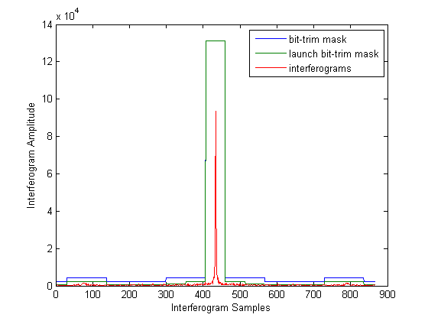
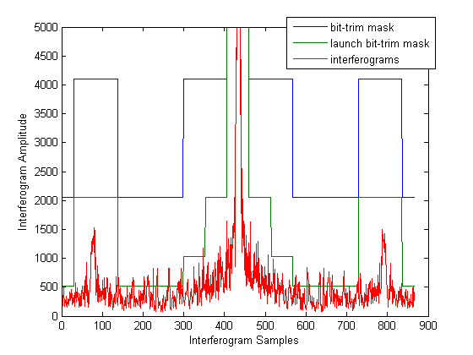
Present LWIR Bit-Trim Mask
Absolute value of maximum interferogram at each position
Launch bit-trim mask was inadequate
Present bit-trim mask shows margin against bit-trim errors
Hot scenes (orbit 01444 over Australia) (Feb 7, 2012)

Slide 5
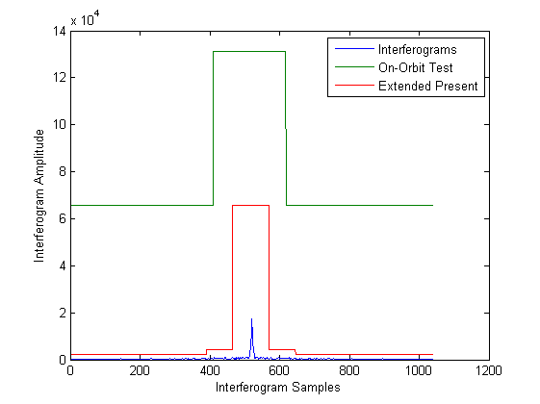
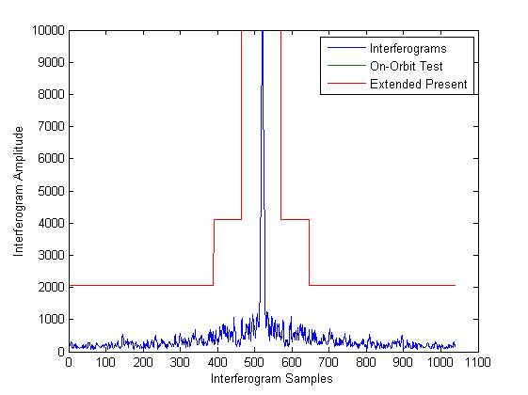
Full Resolution MWIR Bit-Trim Mask
On-orbit test bit-trim mask excessively conservative
Extended present bit-trim mask shows margin
Orbit 1671 over Australia (February 23,2012)
Australian outback very warm in February

Slide 6
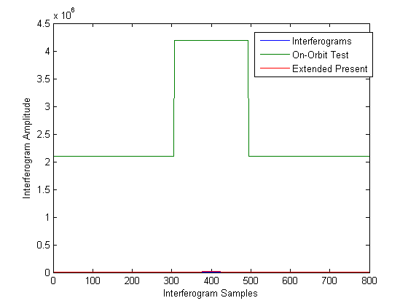
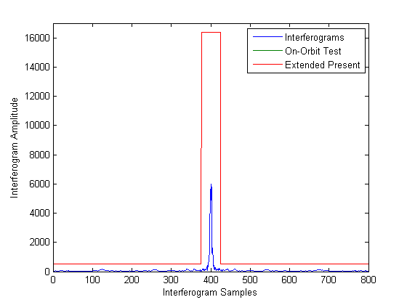
Full Resolution SWIR Bit-Trim Mask
On-orbit test SWIR bit-trim mask wasteful of bandwidth
  Interferogram would saturate before hitting bit-trim mask
Extended present bit-trim mask has margin
Orbit 1671 over Australia (February 23,2012)

Slide 7
CrIS Task 5: Radiometric Noise Assessment
TASK LEAD: SDL
OBJECTIVE: Characterize the CrIS NEDN and its trending over time
DESCRIPTION:
  NEdN is calculated using a minimum of 300 interferogram measurements of ICT and DS targets for each FOV
  Random component of the NEdN is also estimated analyzing Earth Scene (ES) data through the PCA tools and compared with NEdN estimated using ICT and DS data
  Compare on-orbit NEdN to ground-based measurements and predicted performance
  Trend NEdN performance through different phases of Cal/Val
  Cal/Val phases: All
  Data type: RDRs and SDRs
RESULTS:
On-orbit NEdN is well within spec and is the same as during ground TVAC tests
NEdN is very stable. No outages are observed during almost twelve months on-orbit
CrIS NEdN is smaller than AIRS and IASI NEdN
Notes:
References:
Tobin, D., H. Revercomb, L. Strow, S. Hannon, H. Motteler Analysis of Cross-track Infrared Sounder (CrIS) Prelaunch Test Data: OSA Topical Meeting on Fourier Transform Spectroscopy; Alexandria, Virginia, 31 January – 3 February, 2005.
Taylor et al., Analysis of CrIS Flight Model 1 Radiometric Linearity and Radiometric Noise, CALCON 2008.

Slide 8
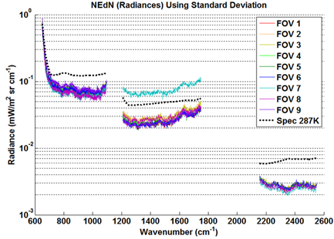
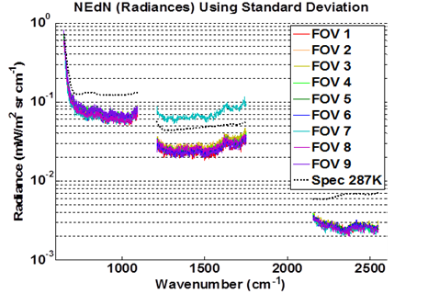
Golden day 09/20/12 vs 01/23/12:
NEdN estimated from ICT data
Orbit # 4656, September 20, 2012
Orbit # 1241, January 23, 2012
Results from IDPS SDR product are practically the same as SDL NEdN ICT data
MWIR FOV7 is out family as it was during ground TVAC4 and S/C TVAC ground tests
NEdNs of all other FOVs are well within spec values.
NEdN is very stable from the instrument activation in January 21,2012

Slide 9
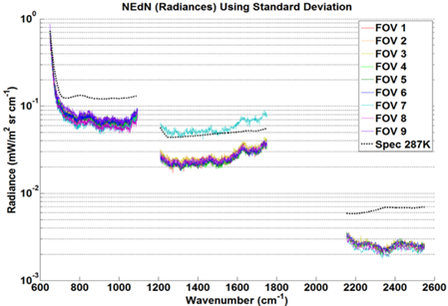
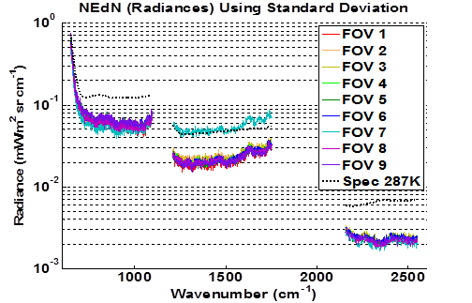
Golden day 09/20/12 vs. 01/23/12:
NEdN estimated from DS data
Orbit # 4656, September 20, 2012
Orbit # 1241, January 23, 2012
NEdN estimated from all three targets (ES, ICT, and DS) agree very well,
Small differences between ICT and DS derived NEdN are most probably due to different target temperatures (radiance fluxes)
NEdN stability is illustrated on trend graphs

Slide 10
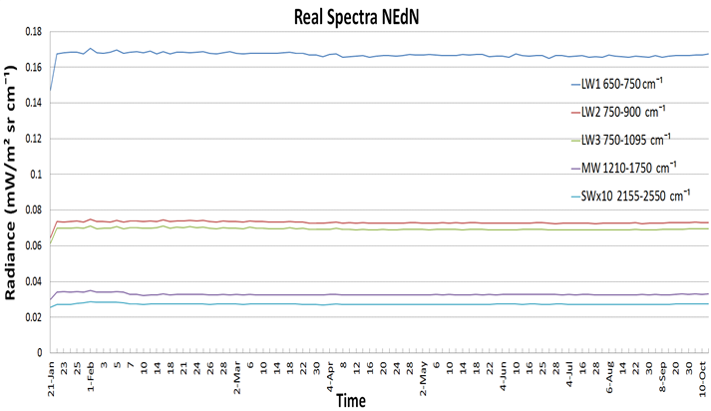
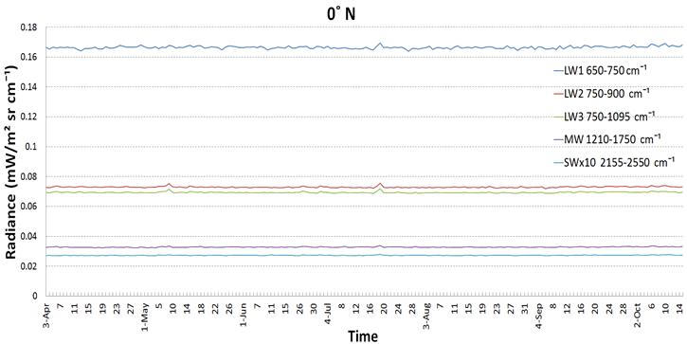
ICT NEdN trending
ICT derived NEdN (from January 21)
IDPS NEdN product (from April 4)
NEdN was averaged over all FOVs and over spectral regions:
    LWIR: 650-750 ; 750-900 (ice contamination); and 750-1095 cm⁻¹ MWIR: Entire band 1210-1750 cm⁻¹
    SWIR: Entire band 2155-2550 cm⁻¹
NEdN derived from both ICT and DS real spectra is very stable

Slide 11
CrIS NEdT vs. AIRS and IASI
NEdT, ⁰K
CrIS NEdT performance better than spec requirements (T=270K)
CrIS has smaller noise levels than AIRS and IASI even at full spectral resolution in MWIR and SWIR spectral bands
NEdT was estimated using SDL PCA approach from ES data retaining 30 PCs
CrIS exhibits smaller noise level in LWIR (~x3.5) and SWIR (~x3) spectral bands than noise estimated from IASI and AIRS spectra reduced to CrIS spectral resolution

Slide 12
CrIS Task 8: Geolocation Calibration
OBJECTIVE: Verify CrIS geolocation mapping parameters to sub-pixel accuracy (requirement is less than 1 km)
DESCRIPTION:
  Use the radiance contrast between sea and land to determine shoreline positions
  Compare measured shoreline crossing with known shoreline positions
  Method that found the inflection point of a cubic fit to 4 consecutive field-of-views resulted in ambiguous results
  Simulations show that non-uniform CrIS spatial sampling likely cause for difficulties
  Method that models shoreline radiances (land/sea fraction) developed
  We will apply method to enough data to give statistically significant results
RESULTS:
Preliminary results show geolocation shifts
Continuing analysis needed to quantify shifts and uncertainties
Notes:
References:
Tobin, D., H. Revercomb, L. Strow, S. Hannon, H. Motteler Analysis of Cross-track Infrared Sounder (CrIS) Prelaunch Test Data: OSA Topical Meeting on Fourier Transform Spectroscopy; Alexandria, Virginia, 31 January – 3 February, 2005.
Taylor et al., Analysis of CrIS Flight Model 1 Radiometric Linearity and Radiometric Noise, CALCON 2008.

Slide 13
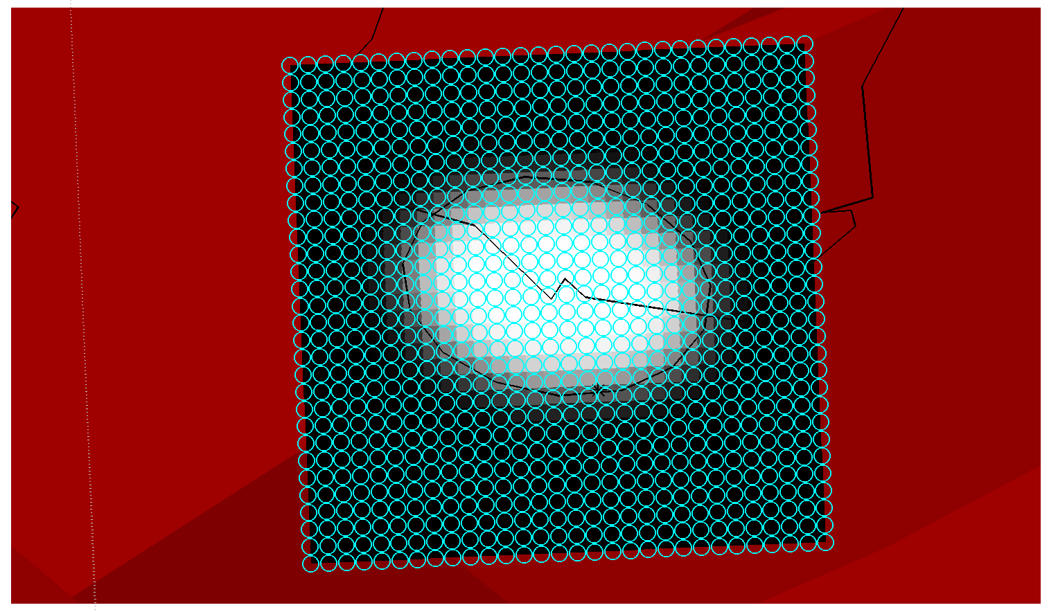
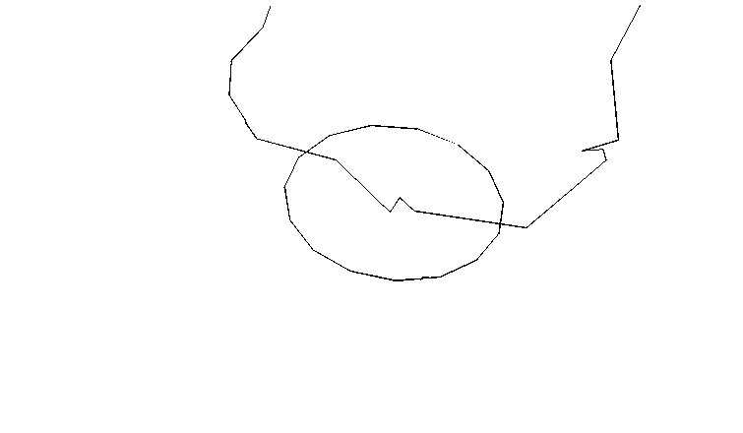
Geolocation Method
Land
CrIS FOV footprint
Calculate the land/sea fraction
Estimate expected radiance for each CrIS FOV
Shift FOV footprint locations to minimize squared differences between observed and calculated radiances
Method used by Ralf Bennartz (1998)
Notes:
SCRIS orbit 02726

Slide 14
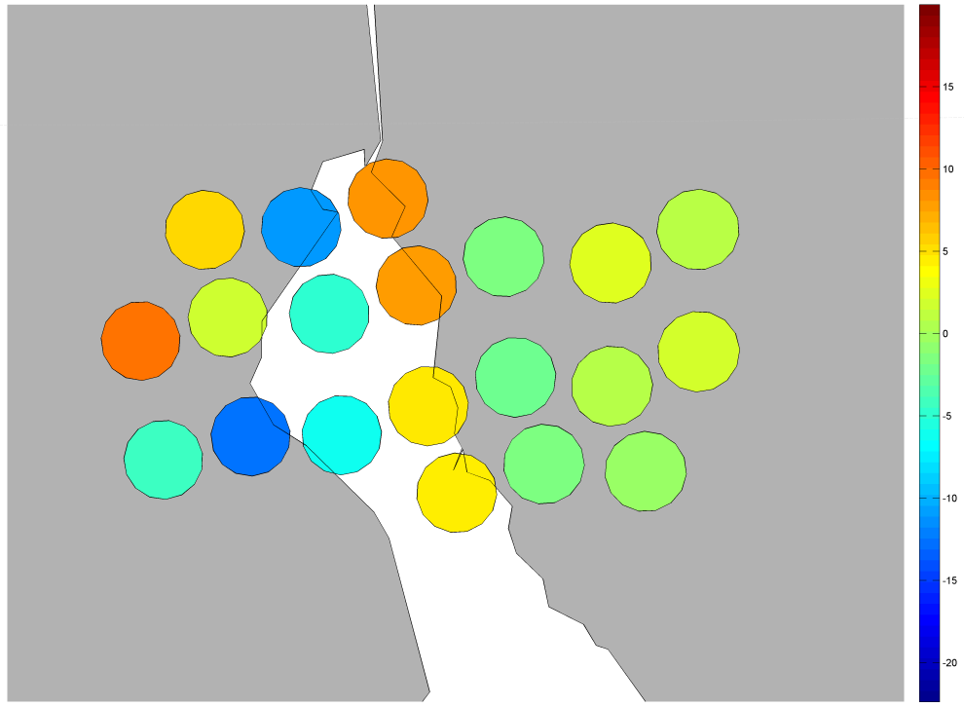
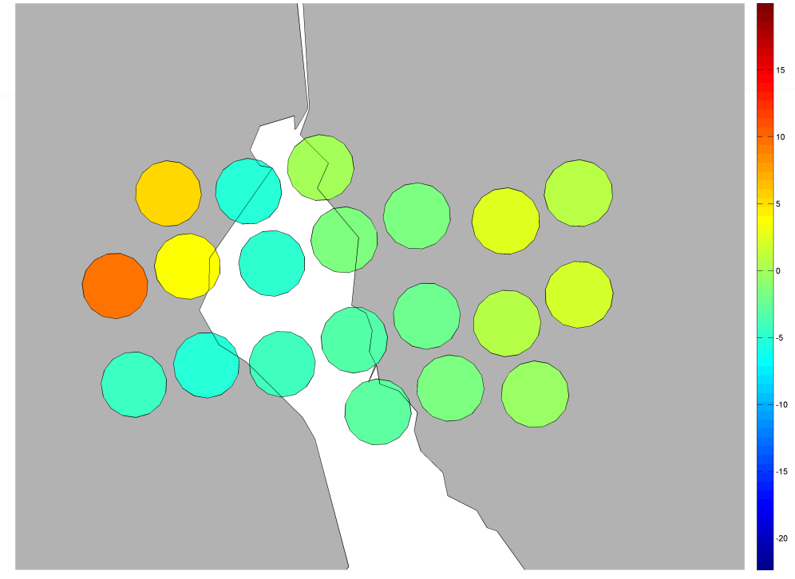
Residuals between Calculated and Observed Radiances
Before Shift
After Shift
Gulf of Suez at 900 cm⁻¹
IDPS SDRs, June 17, 2012 orbit 03307
Continuing to optimize for higher computation speed
Plan to apply to more cases to build up statistics
Will compare result with NOAA/STAR

Slide 15
CrIS Task 9: ICT External Environmental Radiance Model Assessment and Tuning
OBJECTIVE: Verify that CrIS radiance calibration is not being significantly affected by changes in ICT external environmental or other effects
DESCRIPTION:
  Evaluate changes in CrIS response through an orbit
  Examine FOV to FOV differences
  Examine changes in radiance when the sun impinges on the spacecraft
  Compare radiance with other sensors such as VIIRS, AIRS and IASI
  Compare radiance with ground truth
RESULTS:
The radiometer calibration of the CrIS sensor is within specification
There are small radiometer uncertainties that continue to be investigated
Notes:
References:
Tobin, D., H. Revercomb, L. Strow, S. Hannon, H. Motteler Analysis of Cross-track Infrared Sounder (CrIS) Prelaunch Test Data: OSA Topical Meeting on Fourier Transform Spectroscopy; Alexandria, Virginia, 31 January – 3 February, 2005.
Taylor et al., Analysis of CrIS Flight Model 1 Radiometric Linearity and Radiometric Noise, CALCON 2008.

Slide 16
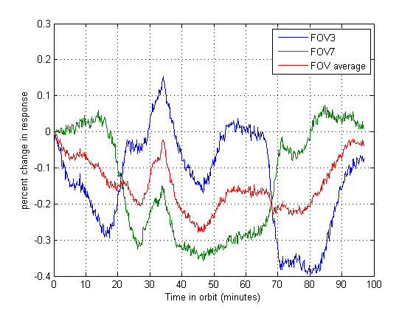
SWIR Response Change During an Orbit
Difference in response averaged over the SWIR band to reduce channel spectra effects
FOV3 and FOV7 are negatively correlated
Averaged over 4 orbits (04351 to 04354) on August 30, 2012
Change in response do not necessarily result in a change in calibrated radiance

Slide 17
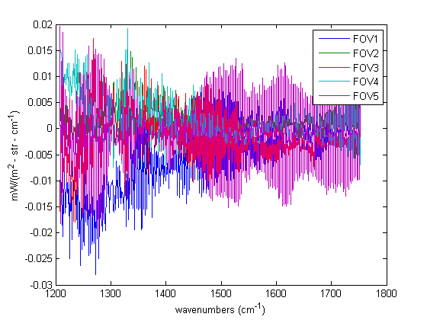
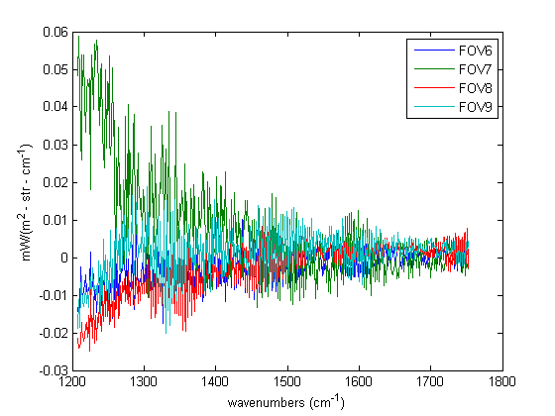
MWIR FOV to FOV Differences For Nadir FORs
5 Day average (August 27 – 31, 2012)
Average radiance over FOVs subtracted
Ringing differences in FOV5 shows up very strongly
MWIR FOV7 is out of family with other FOVs
Notes:
SpecFOVdiff20120827p5MWnadir.h5

Slide 18
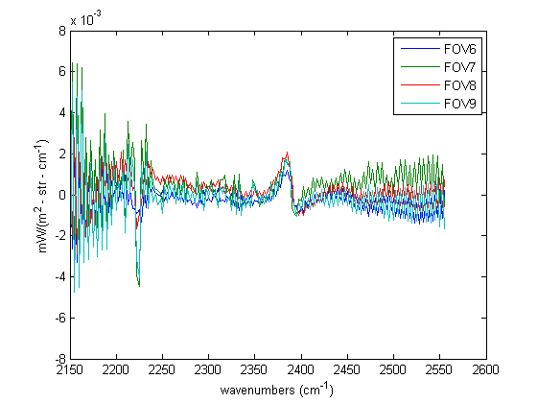
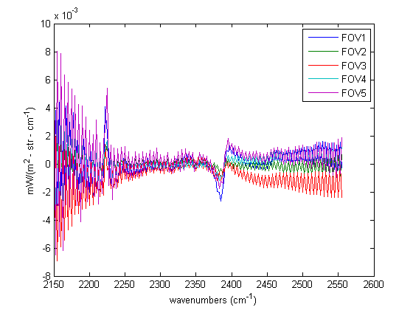
SWIR FOV to FOV Differences For Nadir FORs
Some FOV to FOV difference particularly between FOV3 and FOV7 observed
5 Day average (August 27 – 31, 2012)
FORs 15 and 16
Notes:
SpecFOVdiff20120827p5SWnadir.h5

Slide 19
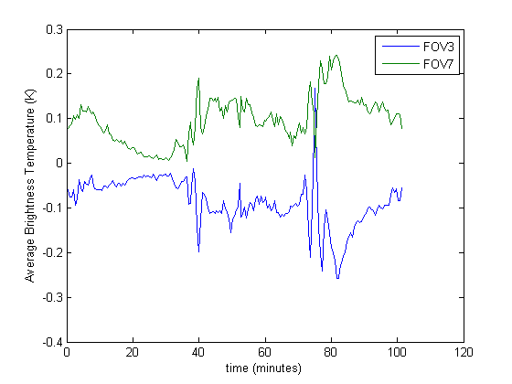
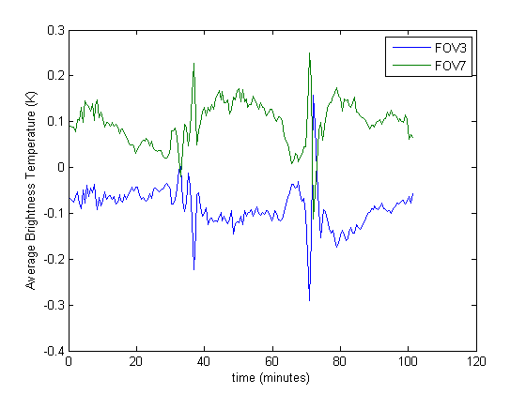
Spikes Seen in FOV to FOV Brightness Temperature
May 16, 2012
August 30, 2012
Averaged over one day (FOV average subtracted)
Cold opaque spectral region 2256 to 2302 cm⁻¹
Spikes consistently visible on different days
Only uniform granules used
Notes:
May 16, 2012 and August 30, 2012 (averaged over day)
2256 to 2302 cm⁻¹
North Pole is at 25 minutes
South Pole is at 75 minutes
FORs with STD larger than 10 K not used

Slide 20
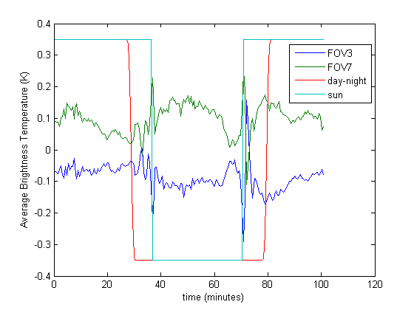
Spikes Correspond to Sun on NPP Spacecraft
day
night
day
Plot “day-night” from day-night flag in SDR files
Plot “sun” is from calculation with STK when NPP is in sunlight
Flags have been scaled to fit plot
Spikes not seen in LWIR opaque region (670 – 680 cm⁻¹)
Notes:
August 30, 2012 (averaged over day)
FORs with FOV STD > 10 K not used
2256 to 2302 cm⁻¹

Slide 21
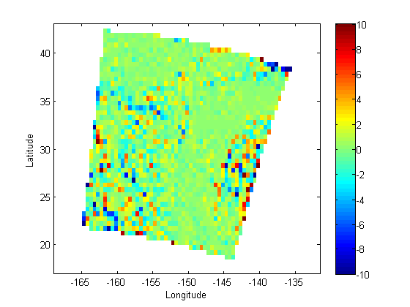
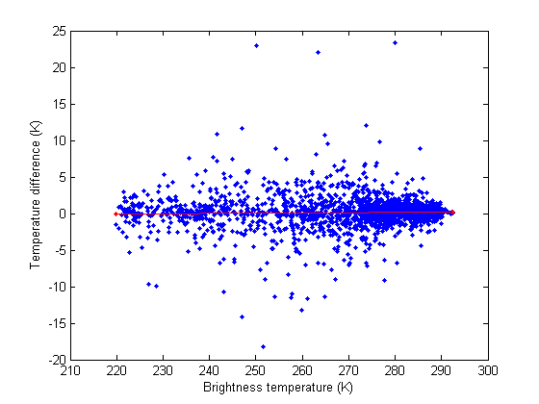
Example CrIS - VIIRS Intercomparison
Temperature difference (K)
CrIS – VIIRS Difference
Pacific Ocean near Hawaii February 25, 2012
VIIRS band M15
Average difference 161 mK with standard deviation 2.3 K
Selecting uniform scenes can be used to reduce scatter
Notes:
SCRIS_npp_d20120225_t1148259_e1148557_b01704_c20120305160341393719_devl_dev.h5 - SCRIS_npp_d20120225_t1154179_e1154477_b01704_c20120305161452168914_devl_dev.h5
SVM15_npp_d20120225_t1148427_e1150069_b01704_c20120225181353288462_noaa_ops.h5 to SVM15_npp_d20120225_t1152589_e1154231_b01704_c20120225182702352691_noaa_ops.h5

Slide 22
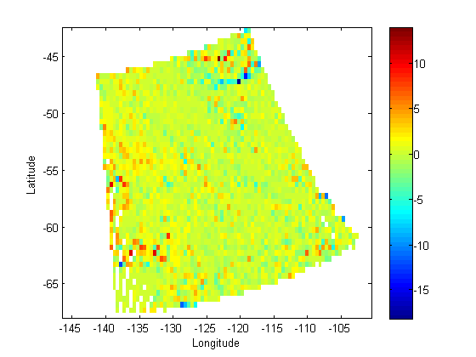
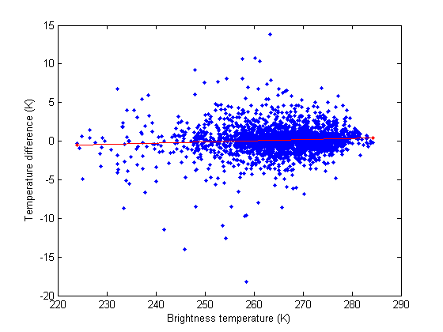
Example CrIS - AIRS Intercomparison
Temperature Difference (K)
CrIS AIRS SNO (Simultaneous Nadir Overpass) occurred February 25, 2012 at 22:42 over the South Pacific
Average difference 159 mK with standard deviation 1.8 K
Averaged into 0.5 degree latitude and longitude bins
Averaged over LWIR window region (911 to 915 cm⁻¹)
Notes:
AIRS.2012.02.25.227.L1B.AIRS_Rad.v5.0.0.0.G12057105052 bin 771
SCRIS_npp_d20120225_t2241139_e2241437_b01710_c20120306193555014851_devl_dev to SCRIS_npp_d20120225_t2246339_e2247037_b01710_c20120306192441971696_devl_dev
AIRS bin 770 to 781, CrIS 911.59 to 915.5 cm-1

Slide 23
Example of Brightness Temperature (BT) in CrIS window channels–collocated SST
LWIR: 900, 904 cm⁻¹
MWIR: 1231, 1232.5 cm⁻¹
SWIR: 1293 cm⁻¹
Mean ~0K
SDV=0.66K
Mean ~0K
SDV=0.60K
Mean~0K
SDV=0.30K
672 collocated radiosonde (over ocean, clear sky, nigh time) data were collected during June-July 2012
173 locations passed clear-sky criterion
BT in selected window channels were corrected for atmospheric transmission (AIRS team approach: H. Aumann, SPIE proc., 2003)
Corrected BT in selected window channels is then compared with SST from MyOcean site (satellite observations and modeling field data)

Slide 24
CrIS Task 12: Spikes and Saturated Interferogram Analysis
OBJECTIVE: Investigate interferogram saturations and spikes and see if they are related to the South Atlantic Anomaly
DESCRIPTION:
  Search RDRs for interferogram errors
  Investigate cases of spikes and saturated interferograms
  Cal/Val Phase: All
Results:
Saturated SWIR interferogram occur every few days
Saturated interferograms caused by sun glints and fires
Impulse mask spikes are exceedingly rare with months between occurrences
Errors are properly flagged in RDRs

Slide 25
CrIS Task 13: Ice Contamination Analysis
TASK LEAD: SDL
OBJECTIVE: Timely detect possible ice contamination and other artifacts that can reduce optical transmission
DESCRIPTION:
  Monitor NEdN and its trend in the LWIR 750-900 cm⁻¹ spectral region sensitive to the ice contamination
  Trend the spectral responsivity of the CrIS sensor
  Check to see if any reduction in responsivity have the spectral signature of ice
  Cal/Val Phase: All
Results:
No signs of ice buildup have been found in NEdN or response

Slide 26
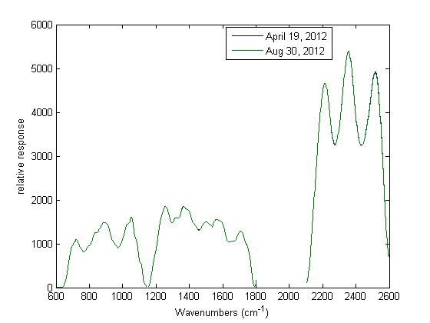
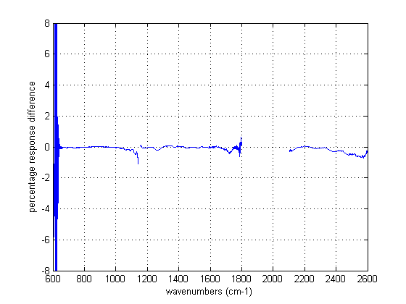
Change in Response Is Very Stable
Very stable response since digital filter change
Stable before filter change but at different value
Small response changes do not have spectral signature of H₂O ice
Notes:
iusestart = 550 FOR Aug 30, 2012;

Slide 27
CrIS Task 14: CrIS Correlated/Uncorrelated noise characterization
TASK LEAD: SDL
OBJECTIVE: Characterize the contribution of random and correlated noise components of CrIS spectra
DESCRIPTION:
  ICT and DS interferogram (IGM) are transformed to the spectral domain (SDR) and calibrated using SDR science algorithm
  Using PCA approach perform estimation of random and spectrally correlated components of total NEdN using calibrated ICT and DS SDRs
  Perform the same analysis of the imaginary NEdN - imaginary part of the spectra is most sensitive to the external vibration and other artifacts
  Statistical analysis of the results
  Cal/Val Phase: All
  Data type: RDRs and SDRs
Results:
On-orbit correlated NEdN component is stable and smaller than what was seen during ground tests
No signs of vibration or other artifacts are seen in the on-orbit NEdN data derived from real and imaginary parts of the ICT and DS spectra

Slide 28
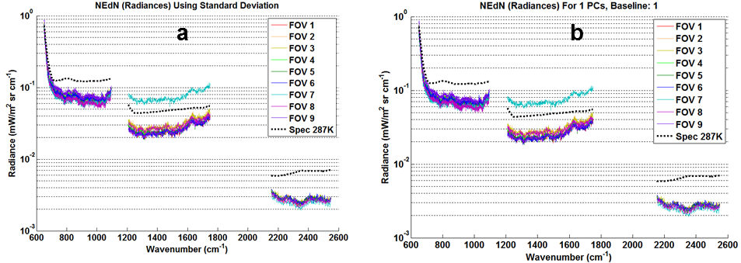
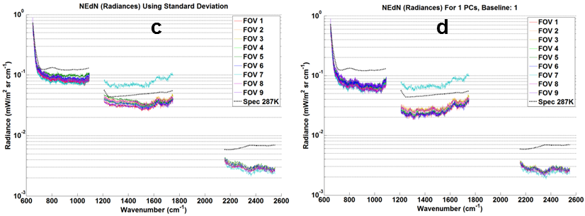
Golden Day 09/20/12 Orbit 4656 :
NEdN estimated from ICT and DS spectra
ICT Real spectra NEdN: total (a) and random components (b)
No contribution of correlated Noise is observed in the real NEdN
Little contribution of correlated noise is seen in the ICT imaginary NEdN
DS exhibits small contribution of correlated noise in the imaginary NEdN
ICT Imaginary NEdN: total (c) and random components (d)

Slide 29
Contribution of correlated noise in the imaginary spectra to total NEdN
 | On-orbit | TVAC4 MN | TVAC4 PQH
ES-EST | LWIR – small MWIR – small SWIR – small | LWIR- large MWIR – large SWIR – large | LWIR – large MWIR – large SWIR – large
ICT | LWIR - small MWIR – small SWIR – little | LWIR – little MWIR – little SWIR – little | LWIR – small MWIR – small SWIR – small
DS | SWIR – small MWIR – small SWIR – small | SWIR – very large MWIR – very large SWIR – very large | SWIR – very large MWIR – very large SWIR – very large
little - barely noticed
small - comparable with random noise
large - exceed random noise
very large - several times exceed random noise
On-orbit NEdN estimated from the imaginary spectra (ES, ICT, and DS) exhibits much smaller contribution of correlated noise as compared to the ground test data
No signs of vibration seen in the real NEdN data
Small contribution of correlated noise in the imaginary NEdN does not affect calibrated radiances

Slide 30
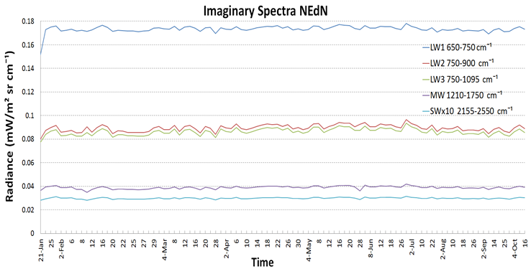
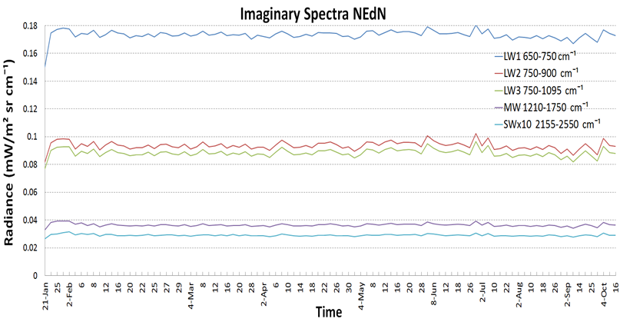
Imaginary noise trending
ICT derived NEdN
DS derived NEdN
Imaginary NEdN is stable over almost twelve months in orbit
Imaginary NEdN exhibit larger fluctuations as compared to the real NEdN
Small fluctuations in imaginary NEdN correlate with NPP orbital position

Slide 31
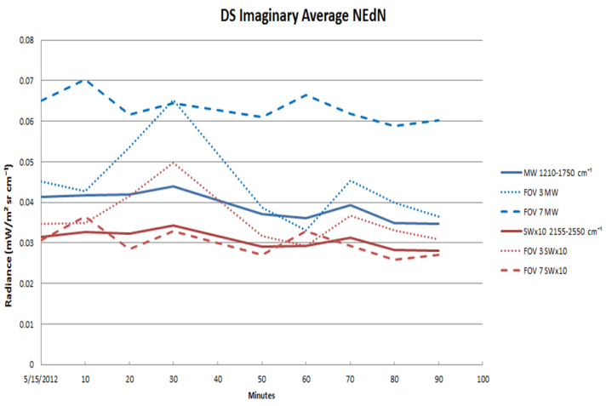
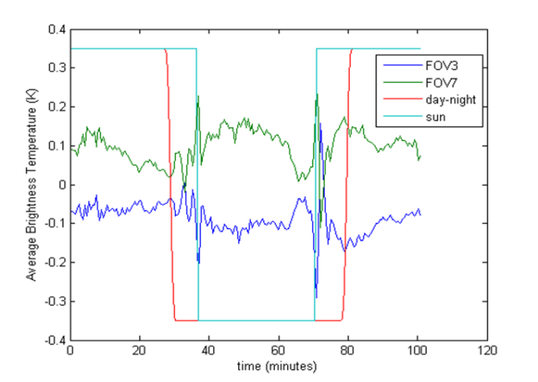
Orbital variations in the imaginary NEdN and BT for corner FOVs
DS imaginary average NEdN
MWIR and SWIR , FOV3 and 7
BT difference with respect to mean BT
SWIR, FOV 3 and 7
Two points in the orbit with large FOV-to-FOV differences
North pole at time 25 minutes, South pole at 76 minutes
Largest effects are seen near where NPP crosses the terminator
Note: negligible small change in calibrated radiances

Slide 32
Summary
CrIS sensor is performing extremely well
CrIS SDR has reached the Provisional maturity level
CrIS performance trending and monitoring will continue
Fine instrument tuning and calibration analysis will continue
Support implementation of full resolution data collection and analysis
Continue to support pre-launch characterization and optimization of CrIS JPSS J1

Slide 33
Backup Slides

Slide 34
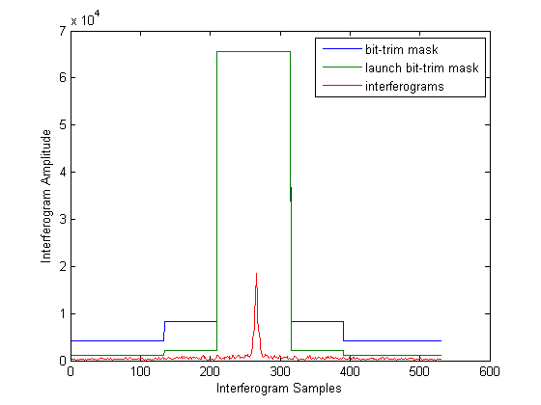
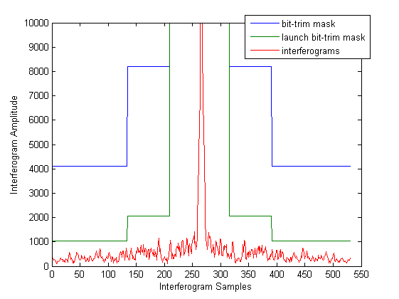
MWIR Bit-Trim Mask
Absolute value of maximum interferogram at each position
MWIR bit-trim mask shows the largest margin
Orbit 01444 over Australia (Feb 7, 2012)

Slide 35
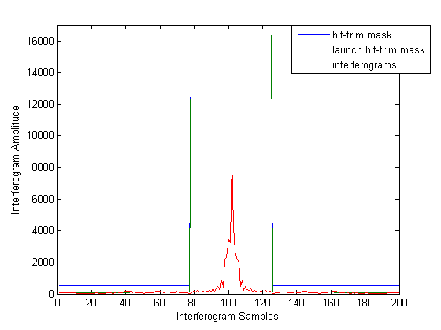
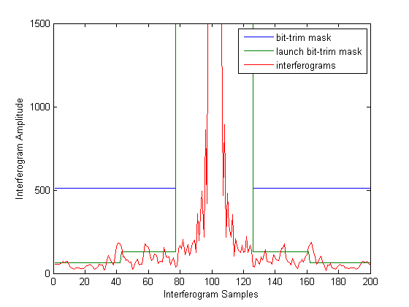
SWIR Bit-Trim Mask
Absolute value of maximum interferogram at each position
Present bit-trim mask shows margin against bit-trim errors
Orbit 01444 over Australia (Feb 7, 2012)

Slide 36
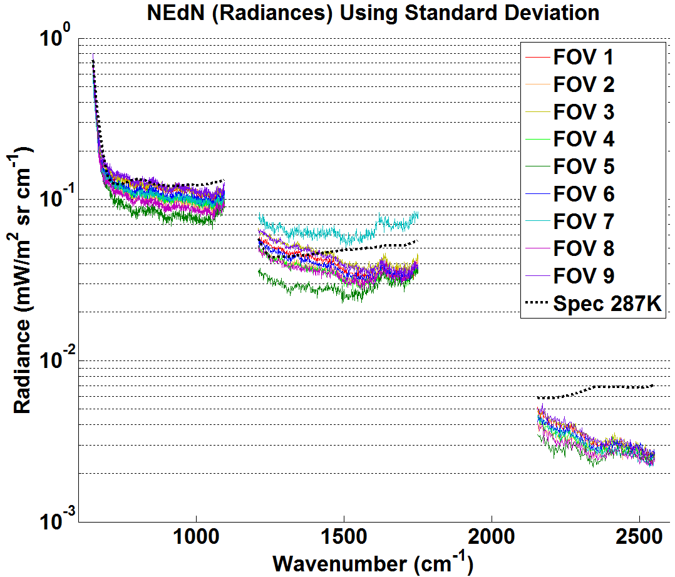
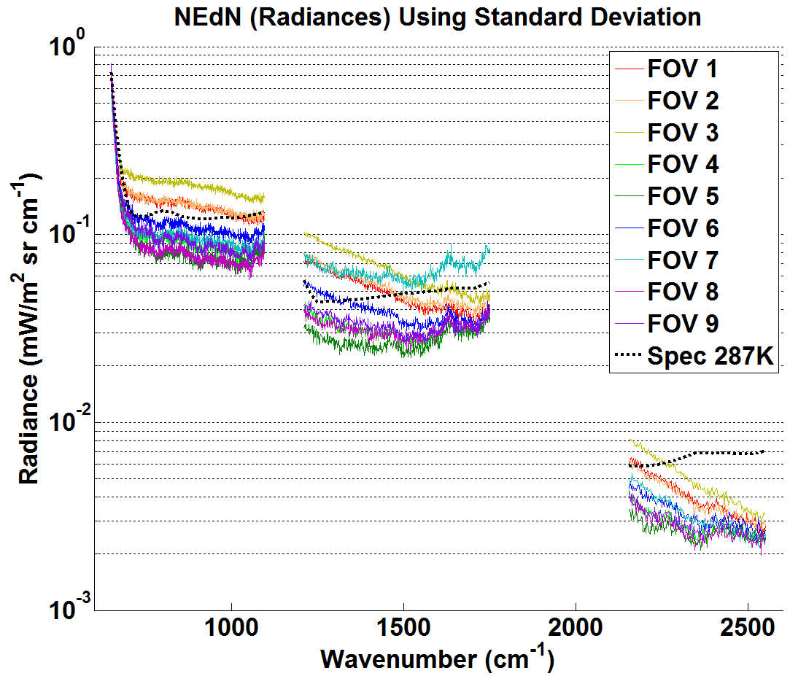
DS derived Total Imaginary NEdN
Time 0 near Equator
Time 30 near North Pole
Increased FOV3 NEdN near north pole for corner FOVs
Higher NEdN is due to correlated component (PCA analysis)

Slide 37
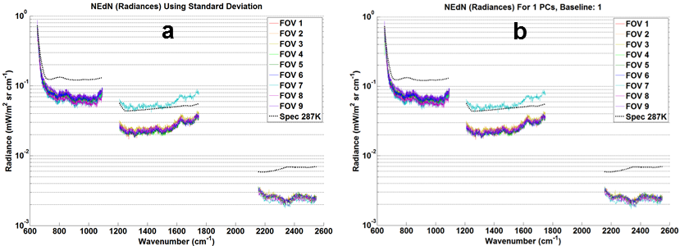
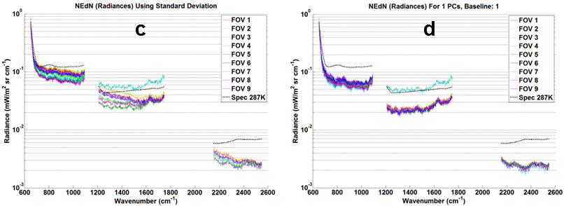
Golden Day: 09/20/12 Orbit 4656:
NEdN estimated from DS real spectra
Real spectra NEdN: total (a) and random components (b)
No contribution of correlated Noise is observed in the real NEdN
Small contribution of correlated noise is seen in the imaginary NEdN
Imaginary NEdN: total (c) and random components (d)

Slide 38
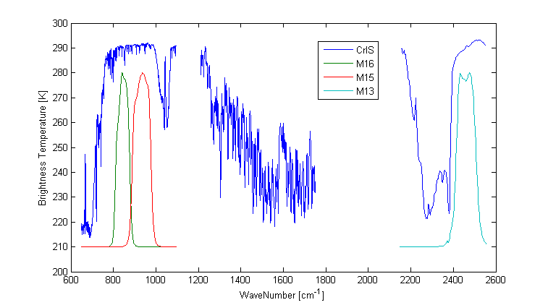
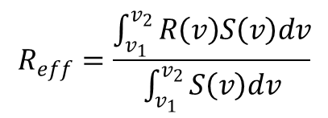
CrIS - VIIRS Intercomparison
$$R_{eff}=\frac{\int_{v_{1}}^{v_{2}}{R\left(v\right)S\left(v\right)dv}}{\int_{v_{1}}^{v_{2}}{S\left(v\right)dv}}$$
Where:
R_{eff} = Effective radiance
R = CrIS radiance
S = VIIRS spectral response function
An effective CrIS radiance is formed for each VIIRS bands using the indicated equation
Both CrIS and VIIRS spatial radiances are averaged into 0.5 degree latitude and longitude bins

Slide 39
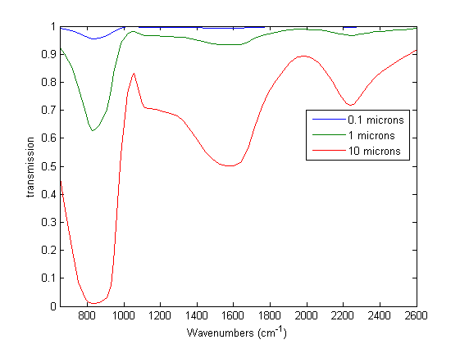
Infrared Transmission of H₂O Ice Films
Calculated from imaginary part of the refractive index
  Data from Owen B. Toon et. el. “Infrared optical constants of H₂0 ice, amorphous nitric acid solutions, and nitric acid hydrates,” Journal of Geophysical Research, Vol. 99, NO. D12, pp 25,631-25,654, 1994.
Does not include reflection or scattering losses

Slide 40
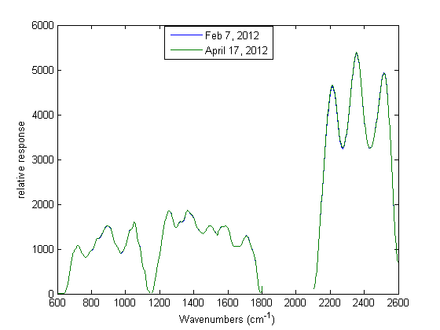
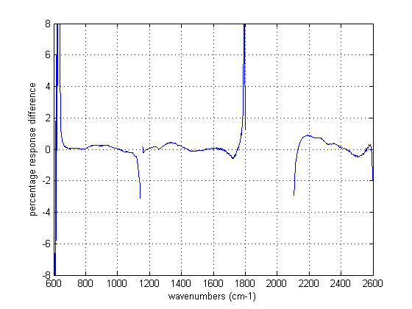
CrIS Relative Spectral Response is Stable
Spectral response has not changed significantly for months
Between April 17 and April 19 there was a significant difference due to upload of a new digital filter

Slide 41
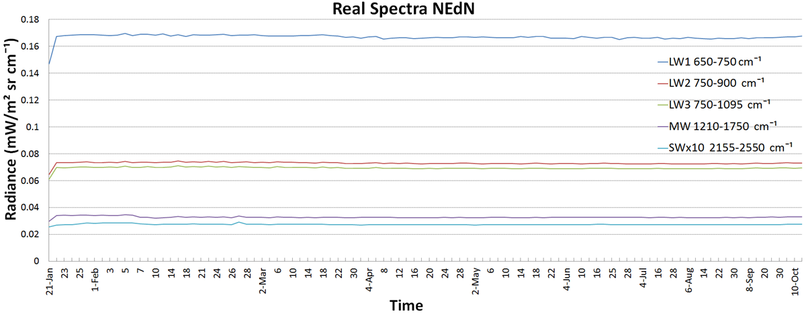
DS NEdN trending
Real spectra NEdN
NEdN was averaged over all FOVs and over spectral regions:
LWIR: 650-750 ; 750-900 (ice contamination); and 750-1095 cm⁻¹
MWIR: Entire band 1210-1750 cm⁻¹
SWIR: Entire band 2155-2550 cm⁻¹
NEdN derived from both ICT and DS real spectra is very stable

Slide 42
IASI Instrument Radiometric Noise
Ice contamination signature
IASI radiometric noise as a function of wave numbers and time for pixel 1.
The impact of ice pollution is clearly visible around 850 cm ⁻¹
Also can be detected in optical transmission (decrease in spectral response)
Courtesy of B. Tournier, CNES, ANGLET, 13–16 November 2007
No ice contamination is seen in CrIS NEdN (see NEdN trend graphs)

Slide 43


Sun Glints Can Cause Saturated Interferograms
Real Spectrum
Imaginary Spectrum
Over Pacific Ocean Feb 10, 2012
SWIR approximately 2522.5 cm⁻¹
Imaginary pixels in addition to the saturated pixels are also affected
Notes:
Using ADL

Slide 44


LWIR FOV to FOV Differences For Nadir FORs
Average radiance over FOVs subtracted
Difference in spectral ringing among FOVs very noticeable
Nadir FORs 15 and 16 averaged over 5 days
August 27 – 31, 2012
Notes:
SpecFOVdiff20120827p5MWnadir.h5

