Slide 1
Request for VIIRS Sea Ice Characterization EDR (Ice Age) Beta Maturity
DR # 7132
CCR # 474-CCR-13-0945
DRAT discussion: April 19, 2013
AERB presentation: April 24, 2013
Cryosphere Products Validation Team
Jeff Key, NOAA/NESDIS/STAR, Team Lead
Paul Meade, Cryosphere Products JAM

Slide 2
Outline
VIIRS Sea Characterization EDR Users
Beta EDR Maturity Definition
Summary of Sea Characterization EDR
VIIRS Sea Ice Characterization Requirements
History of Algorithm Changes/Updates
Beta Maturity Evaluation
Beta Justification Summary
Caveats of Operational VIIRS Sea Ice Characterization EDR
Additional Supporting Documentation
Future Plans Toward Provisional Status
Conclusions

Slide 3
VIIRS Sea Characterization EDR (Ice Age) Product Users
U.S. Users
NSIDC, National Snow Ice Data Center
NIC, National/Naval Ice Center
OSPO, Office of Satellite and Product Operations
STAR, Center for Satellite Applications and Research
GSFC, NASA/Goddard Space Flight Center Hydrological Sciences Branch
NWS, National Weather Service, including the Alaska Ice Desk
CLASS, Comprehensive Large Array-data Stewardship System
User Community
Navigation
Emergency Management
Operational Weather Prediction
Climate Research
DOD

Slide 4
Beta EDR Maturity Definition
Early release product.
Minimally validated.
May still contain significant errors.
Versioning not established until a baseline is determined.
Available to allow users to gain familiarity with data formats and parameters.
Product is not appropriate as the basis for quantitative scientific publication studies and applications.

Slide 5
Summary of the VIIRS Sea Ice Characterization EDR
The VIIRS Sea Characterization EDR (Ice Age) consists of ice classifications for Ice Free, New/Young and Other Ice at VIIRS moderate spatial resolution (750 m @ nadir), for both day and night, over oceans poleward of 36ºN and 50ºS latitude.
New or Young ice is discriminated from thicker ice (Other Ice) by a threshold ice thickness of 30 cm. Discrimination of New/Young ice from thicker ice is achieved by two algorithms:
1. Energy (heat) balance based retrieval for night and high solar zenith angles
2. Reflectance/ice thickness retrieval using modeled Sea Ice Reflectance LUT for daytime
Inputs: Ice Reflectance/Temperature IP, Ice Quality Flags IP, AOT IP, granulated ancillary surface wind speed, surface air pressure, surface air temperature and surface air specific humidity. Modeled Snow Depth/Sea Ice Climatology LUT, modeled sea ice reflectance LUT, sea ice spectral albedo and broadband albedo LUTs, atmospheric transmittance LUT
Heritage: No operational Visible/IR heritage. AVHRR research heritage (Comiso and Massom 1994, Yu and Rothrock 1996 and Wang et al. 2010)

Slide 6
Summary of the VIIRS Characterization EDR (Ice Age) Algorithm Inputs
NPOESS xDRs & IPs
Output EDRs & IPs
VIIRS 375m TC GEO
VIIRS 750m TC GEO
VIIRS Ice Quality Flags IP
VIIRS Ice Weights IP
VIIRS Ice Concentration IP
VIIRS Ice Refl./Temp. IP
VIIRS Surface Temperature IP
OMPS Tot. Col. Ozone 1st gues IP
Sea Ice Characterization (Ice Age) EDR
VIIRS Sea Ice Age EDR
Auxiliary Data
VIIRS Ice Age Tunable Parameter File
Sea Ice Modeled Refl. and Shortwave BB Albedo LUT
Snow-Depth-Ice-Thickness Climatology LUT
Atmos. Broadband Transmittance LUT
Ancillary Data
NCEP Gran. Anc. Sfc. Air Temp.
NCEP Gran. Anc. Sfc. Air Pressure
NCEP Gran. Anc. Sfc. Wind Speed
NCEP Gran. Anc. Sfc. Specific Humidity
NCEP Gran. Anc. Precipitable Water
Notes:
Ancillary
GFS forecast surface pressure, lapse rate, and air temperature (for topography corrected surface pressure)
Look-up tables
DEM for surface altitude
Infrared and Microwave OSS coefficients
Local Angle Correction
IR emissivity and reflectivity covariance
MW emissivity covariance
AVTP and AVMP and Ozone covariance

Slide 7
Summary of VIIRS Sea Characterization EDR (Ice Age) Algorithm Overview
Reflectance Threshold Branch (Day Region Algorithm)
Input ice tie point reflectance (I1, I2), VCM IP, AOT IP
Input granulated NCEP gridded precipitable water, total ozone fields
Obtain snow depth for each ice thickness bin obtained from climatology modeled snow depth/ice thickness LUT
Retrieve ice thickness from sea ice reflectance LUT using ice tie point reflectances, modeled snow depth, AOT, precip. water and solar and satellite view geometry
Classify by comparing retrieved ice thickness to 30 cm ice thickness threshold
Energy Balance Branch (Terminator and Night Region Algorithm)
Input Ice Temperature Tie Point IP
Input granulated NCEP gridded surface fields (sfc.P, sfc air temp, specific hum. etc…)
Compute snow depth for 30cm ice thickness threshold from heat/energy balance
Classify by comparing computed and climatology LUT snow depth for a 30 cm ice thickness threshold
The Snow-Depth-Ice Thickness Climatology LUT contains:
predicted snow accumulation depths for modeled ice thickness threshold growth times
based on monthly climatology surface air temperatures and precipitation rates

Slide 8
VIIRS Sea Ice Characterization EDR L1RD Requirements
Sea Ice Characterization (SIC)
“Sea ice age is defined as the time that has passed since the formation of the surface layer of an ice-covered region of the ocean. The sea ice characterization EDR provides an ice age class. Sea ice concentration, which is the fraction of a horizontal cell covered by ice, is an intermediate product (IP)”
8

Slide 9
VIIRS Sea Ice Characterization EDR L1RD Requirements (Continued)
Sea Ice Characterization Requirements from L1RD version 2.4
EDR Attribute | Threshold | Objective
a. Vertical Coverage | Ice Surface | Ice Surface
b. Horizontal Cell Size Clear All weather | 1.0 km No capability | 0.5 km 1 km
c. Mapping Uncertainty, 3 sigma Clear Cloudy | 5 km No capability | 0.5 km 1 km
d. Measure Range Ice Age 2. Ice Concentration | Ice Free, New Young, all other ice 0/10 to 10/10 | Ice free, Nilas, Gray White Grey, White, First Year Medium, First Year Thick, Second Year, Multiyear, Smooth and Deformed Ice 0/10 to 10/10
e. Measurement Uncertainty Probability of Correct Typing (Ice Age) Ice Concentration | 70% Note 1 | 90% 5%
f. Refresh | At least 90% coverage of the global every 24 hours (monthly average) | 6 hrs
g. Geographic coverage | All Ice-covered regions of the global ocean | All Ice-covered regions of the global ocean
Notes: 1. VIIRS produces a sea ice concentration IP in clear sky conditions, which is provided as an input to the ice surface temperature calculation
RGB Image shows dense smoke (high absorption) in northwest, north central and central coastal portions of image.
9

Slide 10
History of Algorithm changes/updates
Date | Update/DR# | Reason | Status
2/27/2013 | DR 7068 | RTN Sev2 PCR (VIIRS-SIC-EDR fill conditions not applied to both fields in the EDR) | open
02-03-2011 | DR 4197 | Sea Ice Model based problems | Future Re-Evaluation
07-17-2009 | DR 2844 | Sea ice age ATBD does not meet scientific standards | open
07-17-2009 | DR 2723 | Snow-depth-on-sea-ice-LUT | To be re-evaluated

Slide 11
VIIRS Sea Ice Characterization EDR Beta Maturity Evaluation
Beta Maturity Evaluation Approaches
Our analysis has focused on the Beaufort Sea, but other regions in the Arctic and Antarctic, as well as global coverage, have been analyzed for one or more days
Comparison of Summer Sea Ice Characterization (SIC) EDR to ice coverage shown by 4-km IMS data
At this time of year, all ice should be “other ice” (not new/young) so comparison is possible
Manual inspection of SIC EDR images in specific regions and globally
Comparison of SIC EDR ice classification to National Ice Center charts

Slide 12
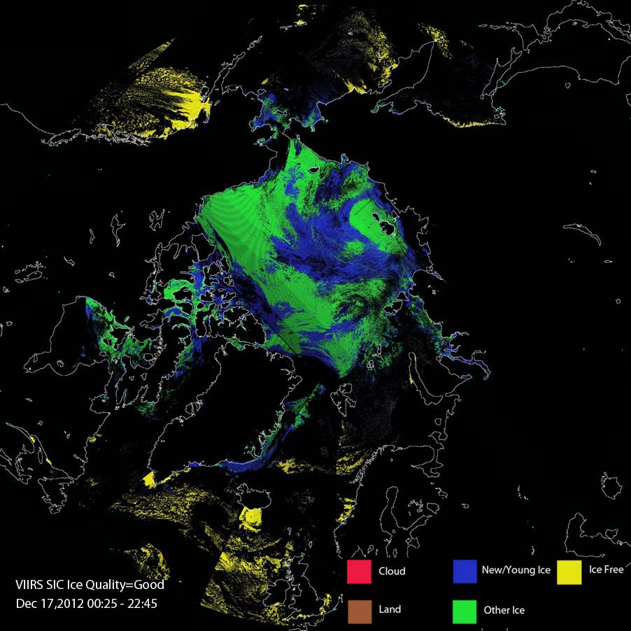
VIIRS Sea Ice Characterization EDR Beta Maturity Evaluation
VIIRS SIC EDR for Dec 17, 2012, with ice quality = good. Ice coverage here looks reasonable, but note large areas of New/Young ice, which are incorrectly classified.

Slide 13
Beta Maturity Evaluation VIIRS Sea Ice Characterization EDR vs. Passive Microwave
Sea ice extent is realistic, but with some false ice over open water, misclassification of new/young vs. other ice, and some misplacement of land values.

Slide 14
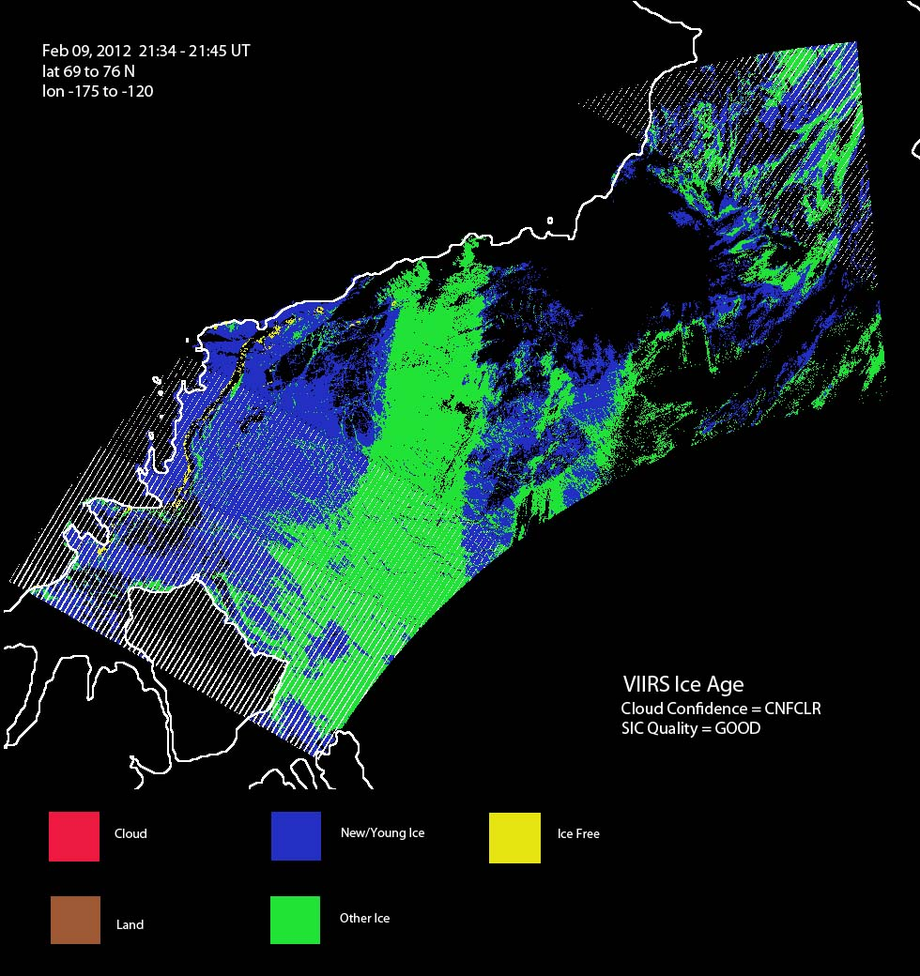
Beta Maturity Evaluation Ice Type Misclassification Due to Cloud
VIIRS SIC on Feb 9, 2012 in the Beaufort Sea for VIIRS cloud mask confidently clear and good SIC quality flag data. New/Young ice (in blue) on left is misclassified, likely due to the presence of cloud.

Slide 15
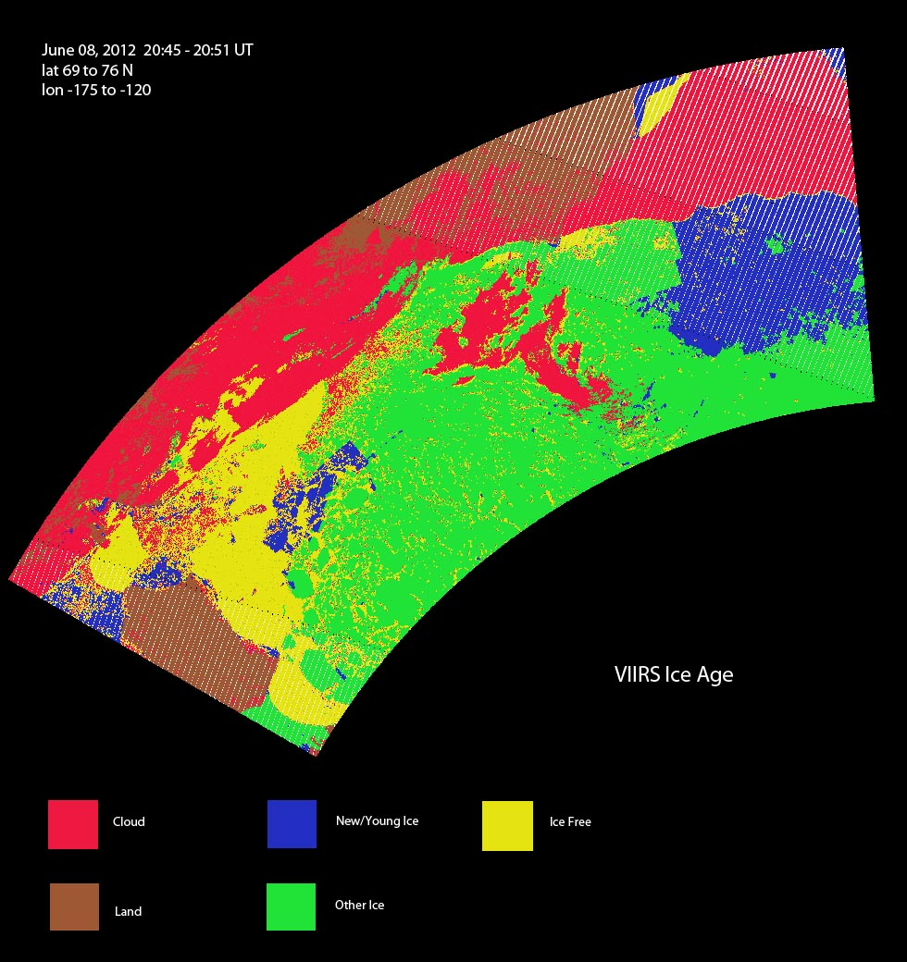
Beta Maturity Evaluation Misclassification during melt season
SIC EDR for June 8, 2012, Beaufort Sea. New/Young ice (blue) is misclassified. It should not exist in June.

Slide 16
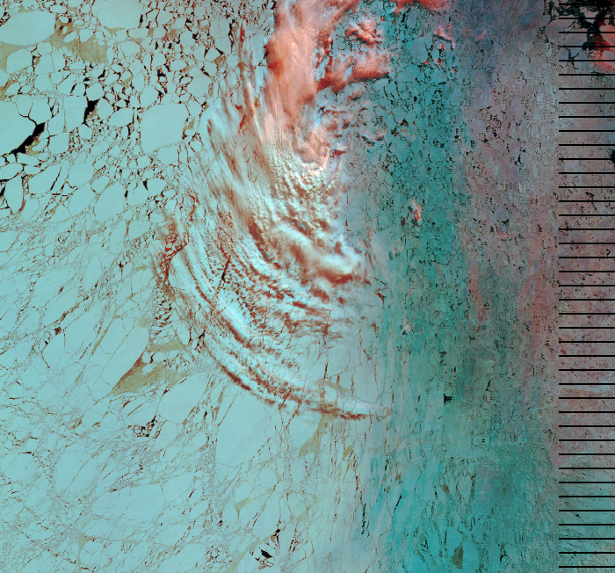
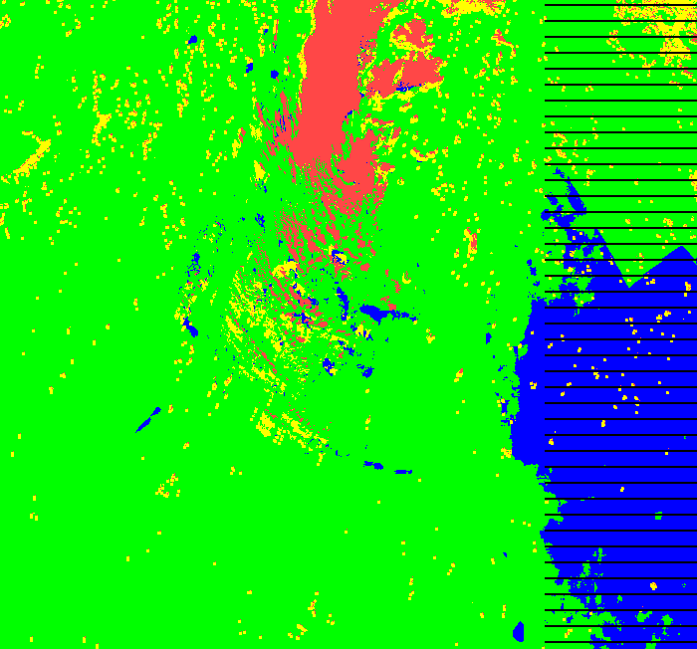
VIIRS Sea Ice Characterization EDR Anomalies over Beaufort Sea (June 8, 2012)
Some misclassification evident due to VCM IP cloud leakage and cloud shadows
Discontinuities detected along lat/lon boundaries spaced 0.5 deg.
72.5 N
73.0 N
163.0 W
Large region misclassified where ice tie point reflectance values drop below ~ 0.53
Several discontinuities that align along 0.5 steps of latitude and longitude are evident as shown along the black dashed lines. The reflectance based day algorithm has dependencies on the coarse resolution NCEP ancillary fields for precipitable water and total column ozone. In addition the algorithm also has a dependency on the climatological snow depth/ice thickness LUT (modeled using 2.5 deg. surface air and precipitation rate climatology data) . The 0.5 deg. are strongly suggestive of sensitivity to the NCEP precipitable water field.

Slide 17
Ice Age Day (reflectance based) Algorithm Dependencies on Ancillary Data and LUTs
Data Type | Description
O3 | NCEP granulated Total Col. Ozone
PW | NCEP granulated Precip.Water
Snow Depth/Ice Thickness Climatology LUT | Modeled snow depth accumulation as a function of ice thickness (based on computed ice thickness growth time from long term monthly NCEP climatology precip. rate and surface. air temp)
Sea Ice Reflectance LUT | Sea Ice reflectance (RTM modeled) for I1, I2 as a function of : ice thickness, snow depth, precip. water , total ozone, aot , aerosol model(2), solar zenith, relative azimuth, sat. view zenith
The 0.5 deg. are strongly suggestive of sensitivity to the NCEP granulated ancillary fields.

Slide 18
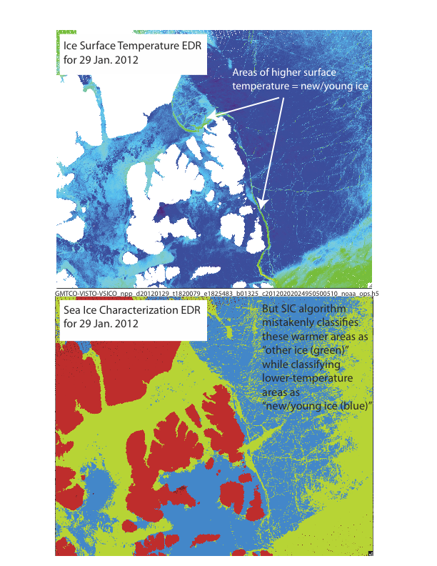
Beta Maturity Evaluation Ice Type Misclassification
Winter scenes show misclassification of new/young ice and other ice. Sea ice “leads” consisting of relatively warm and thin ice should be classified as new/young ice. SIC winter scenes examined instead show some of this ice as “other ice” while thick, cold ice is mapped to “new/young ice” in some locations.

Slide 19
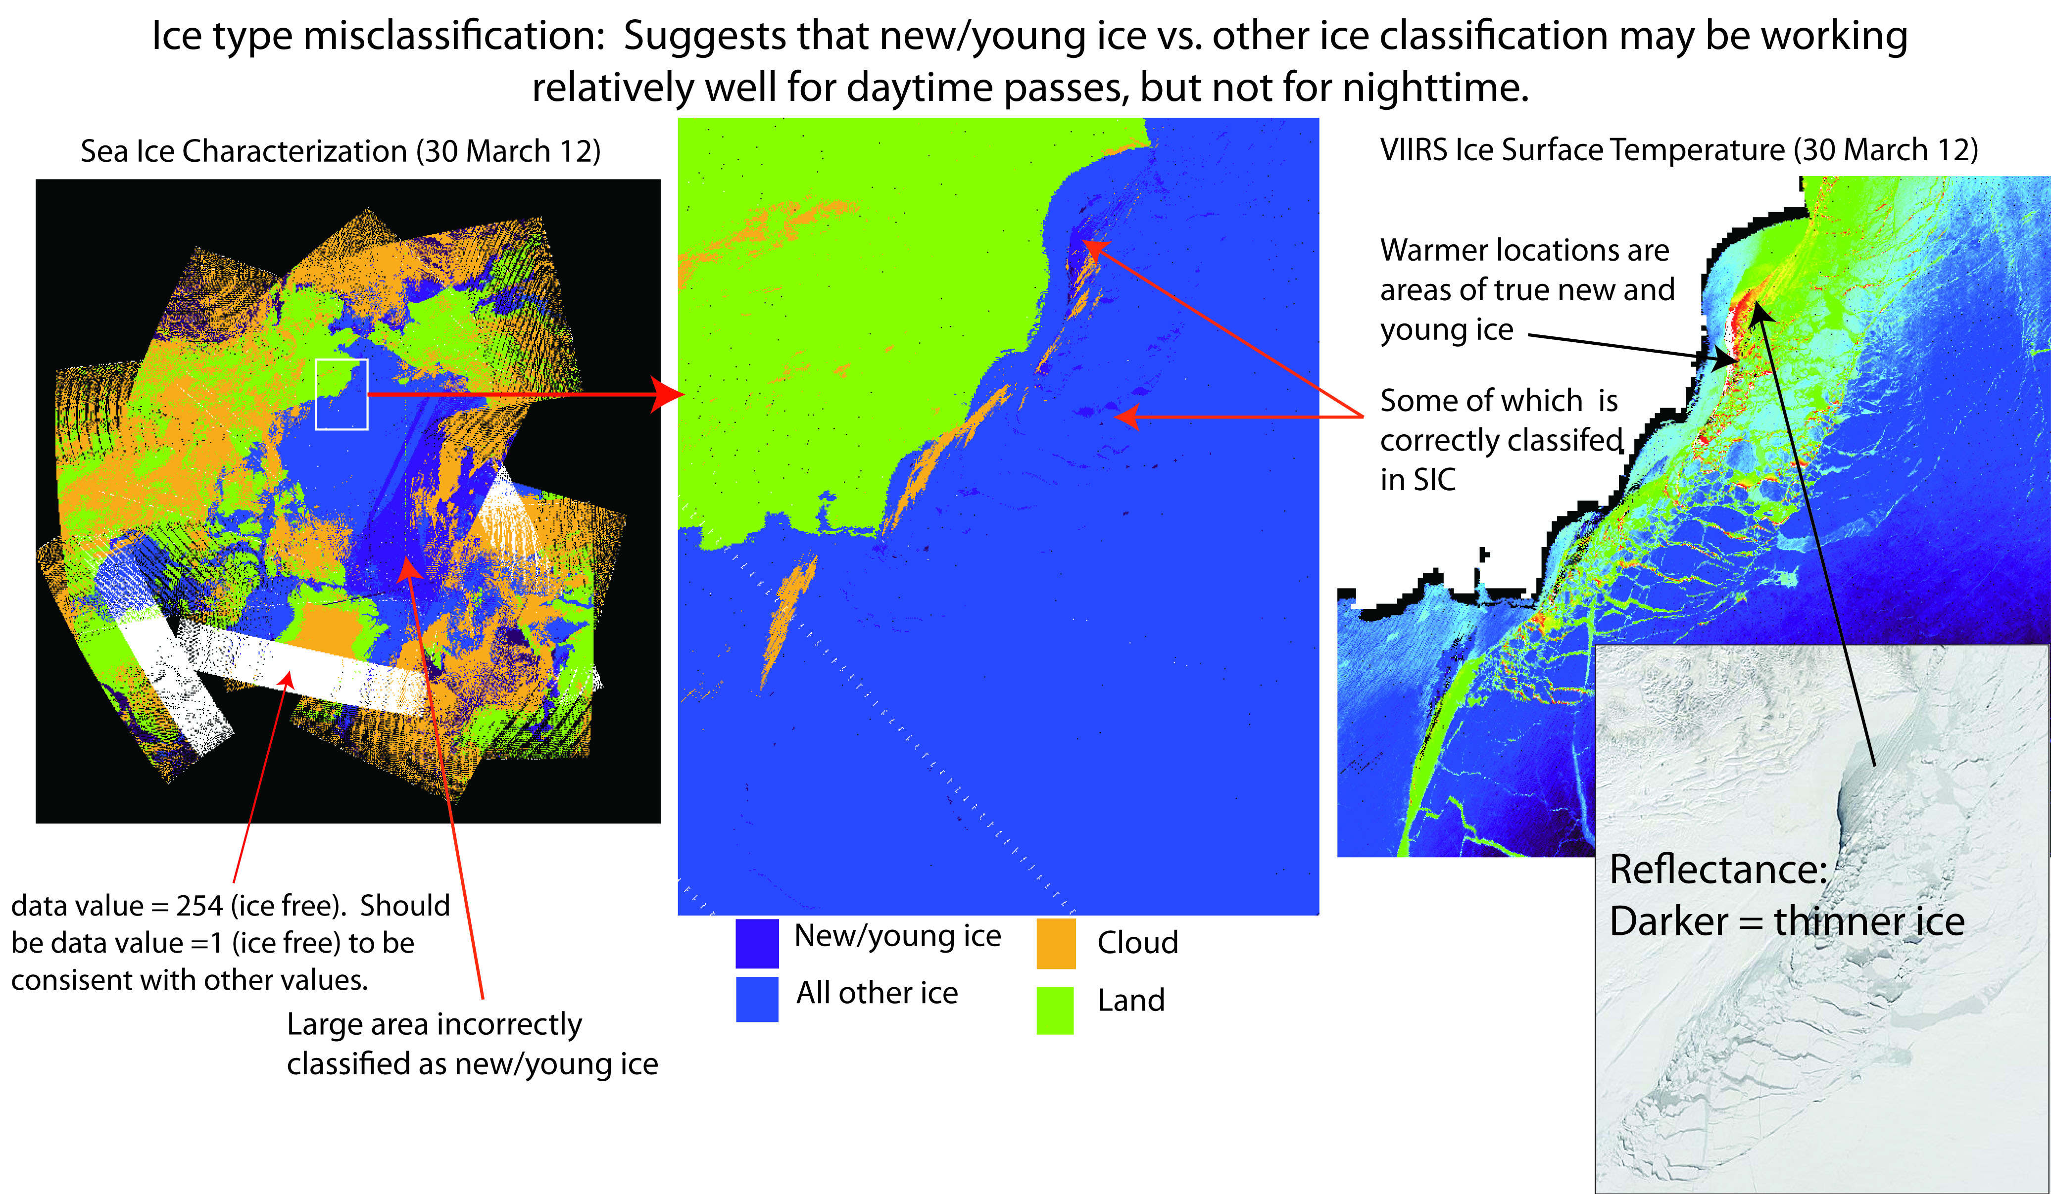
Beta Maturity Evaluation Ice Type Misclassification

Slide 20
Beta Maturity Evaluation SIC EDR vs. MODIS Ice Extent
 | ALLCLD ALLQUAL #1 | ALLCLD GOOD #2 | CNFCLR ALLQUAL #3 | CNFCLR GOOD #4
MODIS Ice Pix | 63252 | 27889 | 40190 | 27889
VIIRS Ice Pix | 45136 | 32458 | 33368 | 32458
VIIRS New/Young Ice Pix | 42708 (94.6%) | 31867 (98.2%) | 32485 (97.4%) | 31867 (98.2%)
VIIRS Other Ice Pix | 2428 (5.4%) | 591 (1.8%) | 883 (2.6%) | 591 (1.8%)
Ice Agree | 30695 (48.5%) | 27608 (99.0%) | 27902 (69.4%) | 27608 (99.0%)
MODIS Ice Free Pix | 83064 | 59067 | 62080 | 59067
VIIRS Ice Free Pix | 109187 | 61632 | 80778 | 61632
Ice Free Agree | 74192 (89.3%) | 58511 (99.1%) | 61479 (99.0%) | 58511 (99.1%)
MODIS ICE VIIRS Cloud | 15599 | N/A | N/A | N/A
MODIS Ice VIIRS Free | 16958 | 281 | 12288 | 281
Ice Type Classification Accuracy* | 5.4% | 1.8% | 2.6% | 1.8%
SIC EDR is compared to MODIS over sea ice during the melt period, when only “other ice” is expected.
Beaufort Sea, July 23, 2012
NOTE BOTTOM ROW
ALLCLD=No Cloud Cover Quality Flag Filter
ALLQUAL=No Ice Quality Flag Filter
CNFCLR=Only Pixels with Confidently Clear Cloud Cover Flag
GOOD=Only pixels with Good Ice Quality Flag

Slide 21
Beta Justification Summary
Criteria: Early release product
Sea Characterization EDR performance is dependent on VIIRS Imagery resolution SDRs and the VIIRS Surface Temperature IP tie points.
It is also dependent on the VIIRS Cloud Mask IP, and AOT IP through the Ice Quality Flags IP and Ice Weights IP, and NCEP ancillary surface data. Dependencies on LUTs include LUTs for model TOA snow/ice reflectance, broadband albedo, atmospheric transmittance and a modeled climatology based snow depth/ice thickness LUT.
VIIRS SDR Cal and Geo products reached provisional maturity in Mar. 2013
VIIRS Cloud Mask IP reached provisional maturity in Feb. 2013
VIIRS Aerosol Optical Thickness reached beta maturity in Sep. 2013
VIIRS Surface Temperature IP beta maturity pending approval

Slide 22
Beta Maturity Evaluation Criteria
Criteria: Minimally validated
Evaluation is based on a limited number of focus days (hemispheric comparisons for retrieval products)
NH data: 1/29/2012, 2/1/2012, 2/27/2012
Antarctica: 10/12/2012
Some detailed analysis has been done on other days with a limited set of granules focused on a region
Beaufort Sea: 1/29/2012, 2/9/2012, 3/30/2012, 4/5/2012, 6/8/2012, 7/23/2012

Slide 23
Beta Justification Summary
Criteria: Available to allow users to gain familiarity with data formats and parameters
Cryosphere team has evaluated IDPS EDR products available from CLASS
Users can access and read the products and the product compares reasonably with the heritage satellite snow map products
Beta release will allow other users within the community to gain experience with the data formats and parameters.
This is important to allow users to complement the validation activity.

Slide 24
Beta Justification Summary
Criteria: Product is not appropriate as the basis for quantitative scientific publication studies and applications
The product has known flaws (see caveats slides later in this presentation). It is clearly not suitable for use in publications.

Slide 25
Caveats for Operational VIIRS Sea Ice Characterization EDR
Known problems and proposed technical solutions
In general, significant discontinuities in ice classification between New Young and Other Ice have been observed in the granule level mapped composite data.
Ice classification discontinuities are most evident near the terminator region where the algorithm transitions from the day reflectance based algorithm to the night energy balance based algorithm
Proposed solution: Nighttime algorithm could be revised to utilize a local sliding IST window. For example, if the IST for the pixel is greater than the mean plus a threshold of the IST in the moving window, then it would be re-classified as new/young ice.
The snow depth thresholds based on the snow/depth ice thickness climatology LUT are problematic
Proposed solution: Investigate use of ancillary precipitation to derive snow depth and compute an ice thickness based on that snow depth. Dependence on the problematic SnowDepth/IceThickness Climatology LUT can then be eliminated.

Slide 26
Caveats for Operational VIIRS Sea Ice Characterization EDR (additional issues)
False ice is frequently observed near cloud edges
Proposed solution: Implement additional quality checks for extended cloud adjacency and partly cloudy conditions within the ice tie point search window in the Sea Ice Concentration IP
Ice misclassifications occur due to low opacity clouds or ice fog, particularly during nighttime
Proposed solution: Assistance from VCM to improve cloud vs. ice detection
Lower reflectance of melting sea ice appears to cause the SIC EDR to indicate New/Young Ice, although this type of ice cannot be present this time of year.
Proposed solutions: Define and utilize melt season period where New/Young ice cannot exist. Could do this by date/latitude or possibly with IST or NCEP air temp input. During this time, ALL ice would be classified as “other ice.”
Investigate reflectance and temperature thresholds used in the algorithm
Investigate and mitigate sensitivity of retrievals to NCEP ancillary data inputs
Replace the algorithm
It is not known if the proposed solutions above will be sufficient. It may therefore be necessary to test a completely different algorithm. One possibility is the one-dimensional thermodynamic ice model (OTIM) of Wang et al. (2010). A simpler approach based only on temperature may also be possible.

Slide 27
Additional Supporting Documentation
TIM Meetings and Presentations
Cal/Val Team Meeting, April 2012
Monthly/weekly reports https://groups.ssec.wisc.edu/groups/jpss/cryosphere/reports

Slide 28
Future Plans and Issues
We are working to get these changes into the IDPS
Implement additional quality checks for extended cloud adjacency and partly cloudy conditions within the ice tie point search window in the Sea Ice Concentration IP
Detailed performance characterization requires:
Analysis of sensitivity of retrievals to NCEP ancillary data inputs and snow depth on sea ice
Major actions for the provisional maturity justification and schedule
Revision, testing and implementation of SIC EDR Nighttime Algorithm, possibly utilizing a local sliding IST window.
Revision, testing and implementation of SIC EDR Daytime Algorithm to possibly include:
Definition and utilization of melt season period where New/Young ice cannot exist, or utilize IST checks to assist with ice type definition (Oct. 2013)
Use of ancillary precip. field to improve snow depth estimates and to derive ice age based on ice thickness computed from snow depth (Oct. 2013)
Mapping of fresh-water ice

Slide 29
Conclusion
VIIRS Sea Ice Characterization EDR has met the beta maturity stage based on the definitions and the evidence shown
It exceeds the definition of beta in most cases
Off-line product performance appears to be of sufficient quality for Beta maturity
Some issues have been uncovered during validation and solutions are being evaluated.

