Slide 1
Request for
VIIRS Sea Ice Concentration IP
Beta Maturity
DR # 7132
CCR # 474-CCR-13-0945
DRAT discussion: April 19, 2013
AERB presentation: April 24, 2013
Cryosphere Products Validation Team
Jeff Key, NOAA/NESDIS/STAR, Team Lead
Paul Meade, Cryosphere Products JAM

Slide 2
Outline
VIIRS Sea Ice Concentration IP Users
Beta EDR Maturity Definition
Summary of Sea Ice Concentration IP
VIIRS Sea Ice Concentration IP requirements
History of Algorithm Changes/Updates
Beta Maturity Evaluation
Beta Justification Summary
Caveats of Operational VIIRS Sea Ice Concentration IP
Additional Supporting Documentation
Future Plans Toward Provisional Status
Conclusions

Slide 3
VIIRS Sea Ice Concentration IP Product Users
  U.S. Users
    NSIDC, National Snow Ice Data Center
    NIC, National/Naval Ice Center
    OSPO, Office of Satellite and Product Operations
    STAR, Center for Satellite Applications and Research
    GSFC, NASA/Goddard Space Flight Center Hydrological Sciences Branch
    NWS, National Weather Service, including the Alaska Ice Desk
    CLASS, Comprehensive Large Array-data Stewardship System
  User Community
    Navigation
    Emergency Management
    Operational Weather Prediction
    Climate Research
    DOD

Slide 4
Beta EDR Maturity Definition
Early release product.
Minimally validated.
May still contain significant errors.
Versioning not established until a baseline is determined.
Available to allow users to gain familiarity with data formats and parameters.
Product is not appropriate as the basis for quantitative scientific publication studies and applications.

Slide 5
Summary of the VIIRS Sea Ice Conc. IP
The VIIRS Sea Ice Concentration IP consists of retrieved ice concentration at VIIRS Imagery spatial resolution (375 m @ nadir), for both day and night, over oceans pole ward of 36º N and 50º S latitude.
The Ice Concentration algorithm computes ice fractions based on ice and water tie points determined from VIIRS I1 (0.64 µm and I2 (0.865 µm) reflectance and VIIRS I5 band (11.5 µm) based retrieved surface temperature from the VIIRS Surface Temperature IP.
Ice/water thresholds are determined from the local minimum of the distribution of reflectance and temperature. Ice and water tie points are derived from the local maxima of the reflectance and temperature distribution within a sliding search window centered on each pixel.
Inputs are TOA reflectance (VIIRS I1 and I2 bands) and Surface Temperature IP at
VIIRS imagery resolution. Cloud and quality information input are provided by the Ice Quality Flags and IP, Ice Weights IP
Outputs Ice Concentration IP and Reflectance/Temperature IP

Slide 6
Summary of the VIIRS Sea Ice Conc. IP
Algorithm Inputs
NPOESS xDRs & IPs
Output EDRs & IPs
VIIRS 375m SDR
VIIRS Ice Quality Flags IP
VIIRS Ice Weights IP
VIIRS Surface Temperature IP
Sea Ice Concentration IP
VIIRS Sea Ice Concentration IP
VIIRS Reflectance/Temperature IP
Auxiliary Data
VIIRS Ice Concentration Tunable Parameters
Notes:
Ancillary
GFS forecast surface pressure, lapse rate, and air temperature (for topography corrected surface pressure)
Look-up tables
DEM for surface altitude
Infrared and Microwave OSS coefficients
Local Angle Correction
IR emissivity and reflectivity covariance
MW emissivity covariance
AVTP and AVMP and Ozone covariance

Slide 7
Summary of VIIRS Sea Ice Conc. IP
Processing Flow
Read SDRs, IPs, Tunable Parameters
Function: IC_threshold
Compute Ice/Water Threshold
Function: IC_tiepoint
Compute local ice tie points using fixed size sliding widow
Compute global water tie points
Function: IC_tiepoint_plus
Compute local ice tie points using expandable size sliding window
Compute global water tie points
T
if max_wsize <= min_wsize
F
Function: IC_local_water_tiepoint
Compute local water tie points using fixed size sliding widow
Function: IC_local_water_tiepoint
Compute ice fraction
Ice Concentration IP
Reflectance/Temperature IP

Slide 8
VIIRS Sea Ice Characterization L1RD Requirements
Sea Ice Characterization (SIC)
“Sea ice age is defined as the time that has passed since the formation of the surface layer of an ice-covered region of the ocean. The sea ice characterization EDR provides an ice age class. Sea ice concentration, which is the fraction of a horizontal cell covered by ice, is an intermediate product (IP).”
8

Slide 9
VIIRS Sea Ice Characterization L1RD Requirements (Continued)
Sea Ice Characterization Requirements from L1RD version 2.4
EDR Attribute | Threshold | Objective
a. Vertical Coverage | Ice Surface | Ice Surface
b. Horizontal Cell Size Clear All weather | 1.0 km No capability | 0.5 km 1 km
c. Mapping Uncertainty, 3 sigma Clear Cloudy | 5 km No capability | 0.5 km 1 km
d. Measure Range Ice Age 2. Ice Concentration | Ice Free, New Young, all other ice 0/10 to 10/10 | Ice free, Nilas, Gray White Grey, White, First Year Medium, First Year Thick, Second Year, Multiyear, Smooth and Deformed Ice 0/10 to 10/10
e. Measurement Uncertainty Probability of Correct Typing (Ice Age) Ice Concentration | 70% Note 1 | 90% 5%
f. Refresh | At least 90% coverage of the global every 24 hours (monthly average) | 6 hrs
g. Geographic coverage | All Ice-covered regions of the global ocean | All Ice-covered regions of the global ocean
Notes: 1. VIIRS produces a sea ice concentration IP in clear sky conditions, which is provided as an input to the ice surface temperature calculation
RGB Image shows dense smoke (high absorption) in northwest, north central and central coastal portions of image.
9

Slide 10
History of Algorithm changes/updates
Date | Update/DR# | Reason | Status
04-09-2013 | DR 7139 | Correct Sea Ice Conc. OAD flow chart figure | Request closure with Beta Maturity 474-CCR-13-0945
12-13-2012 | DR 5017 | RTN Sev2 PCR Ice IPs Maneuver | open
11-27-2012 | DR 4987 | Sea Ice Quality/Ice Concentration IP: Additional quality checks for identifying regions with potential VCM cloud leakage | open
10-17-2012 | DR 4959 | Sea Ice Conc. Tie Point Fill Fix | open
01-19-2012 | DR 4524 | OAD for VIIRS Sea Ice Concentration (SIC) Intermediate Product (IP) Mx6 Updates (ECR-ALG-0034) (CDRL A031) | open
12-08-2010 | DR 4129 | Ice concentration weights not initialized before final ice concentration calculation | open
07-17-2009 | DR 2863 | Latency impact due to valid point count methodology | Deferred for re-evaluation

Slide 11
Beta Maturity Evaluation
Beta Maturity Evaluation Approaches
  Visualizations of daily global VIIRS Sea Ice Concentration and comparison with passive microwave ice concentration
Criteria: Minimally validated
  Evaluation is based on a limited number of focus days (hemispheric comparisons for retrieval products)
    NH data: 1/29/2012, 2/1/2012, 2/27/2012
    Antarctica: 10/12/2012
  Some detailed analysis has been done on other days with a limited set of granules focused on a region
    Beaufort Sea: 1/29/2012, 2/9/2012, 4/5/2012, 6/8/2012, 7/23/2012
    Gulf of Alaska: 12/17/2012
    Terra Nova Bay: 10/12/2012

Slide 12
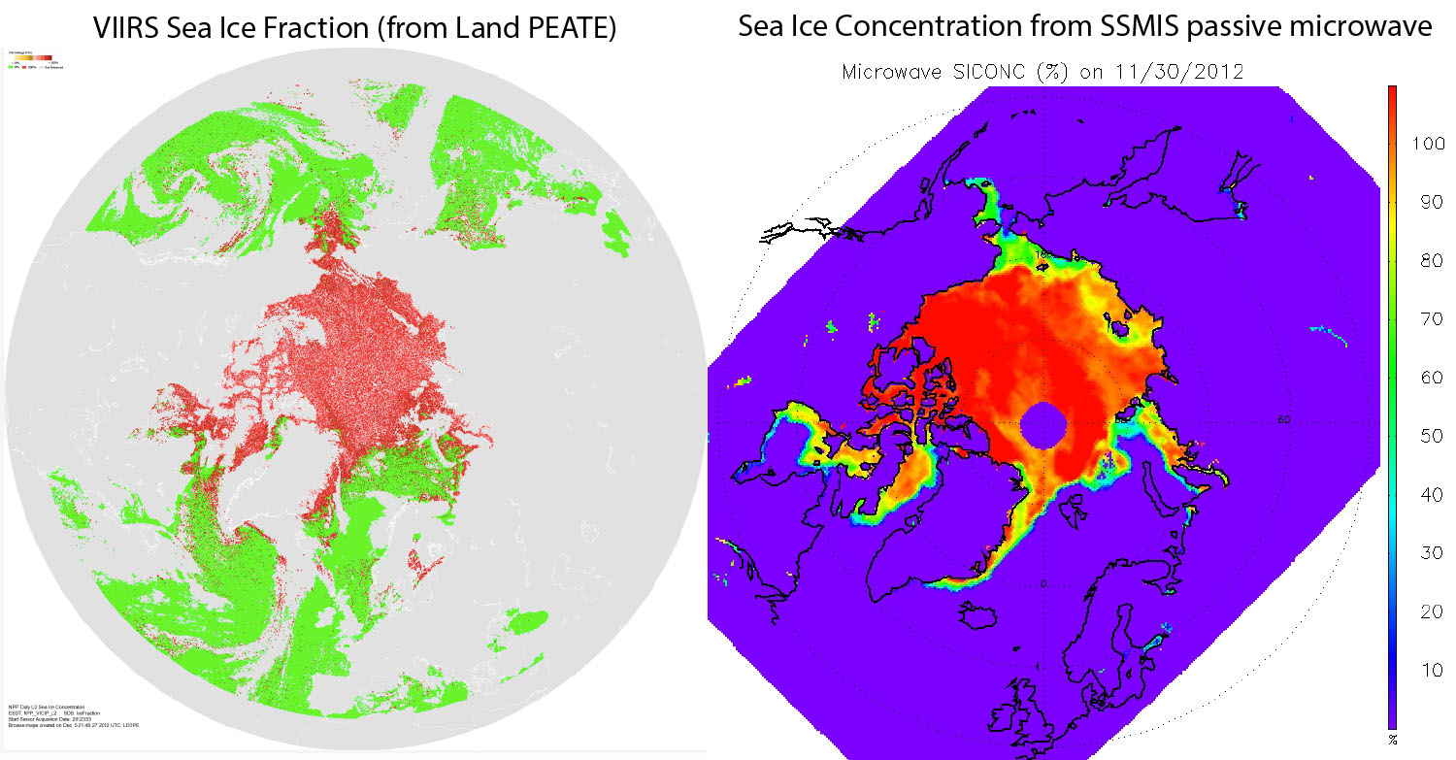
Beta Maturity Evaluation – Comparison of VIIRS Ice Conc. to Passive Microwave

Slide 13
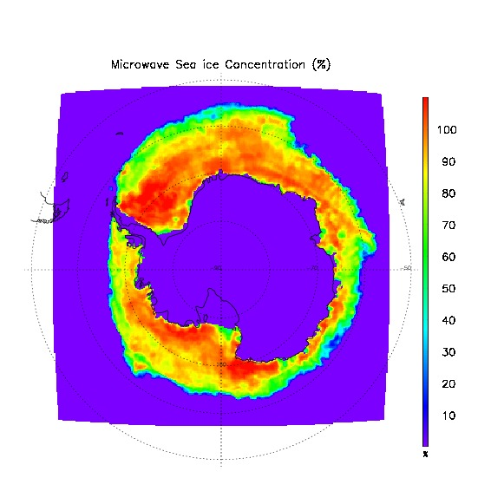
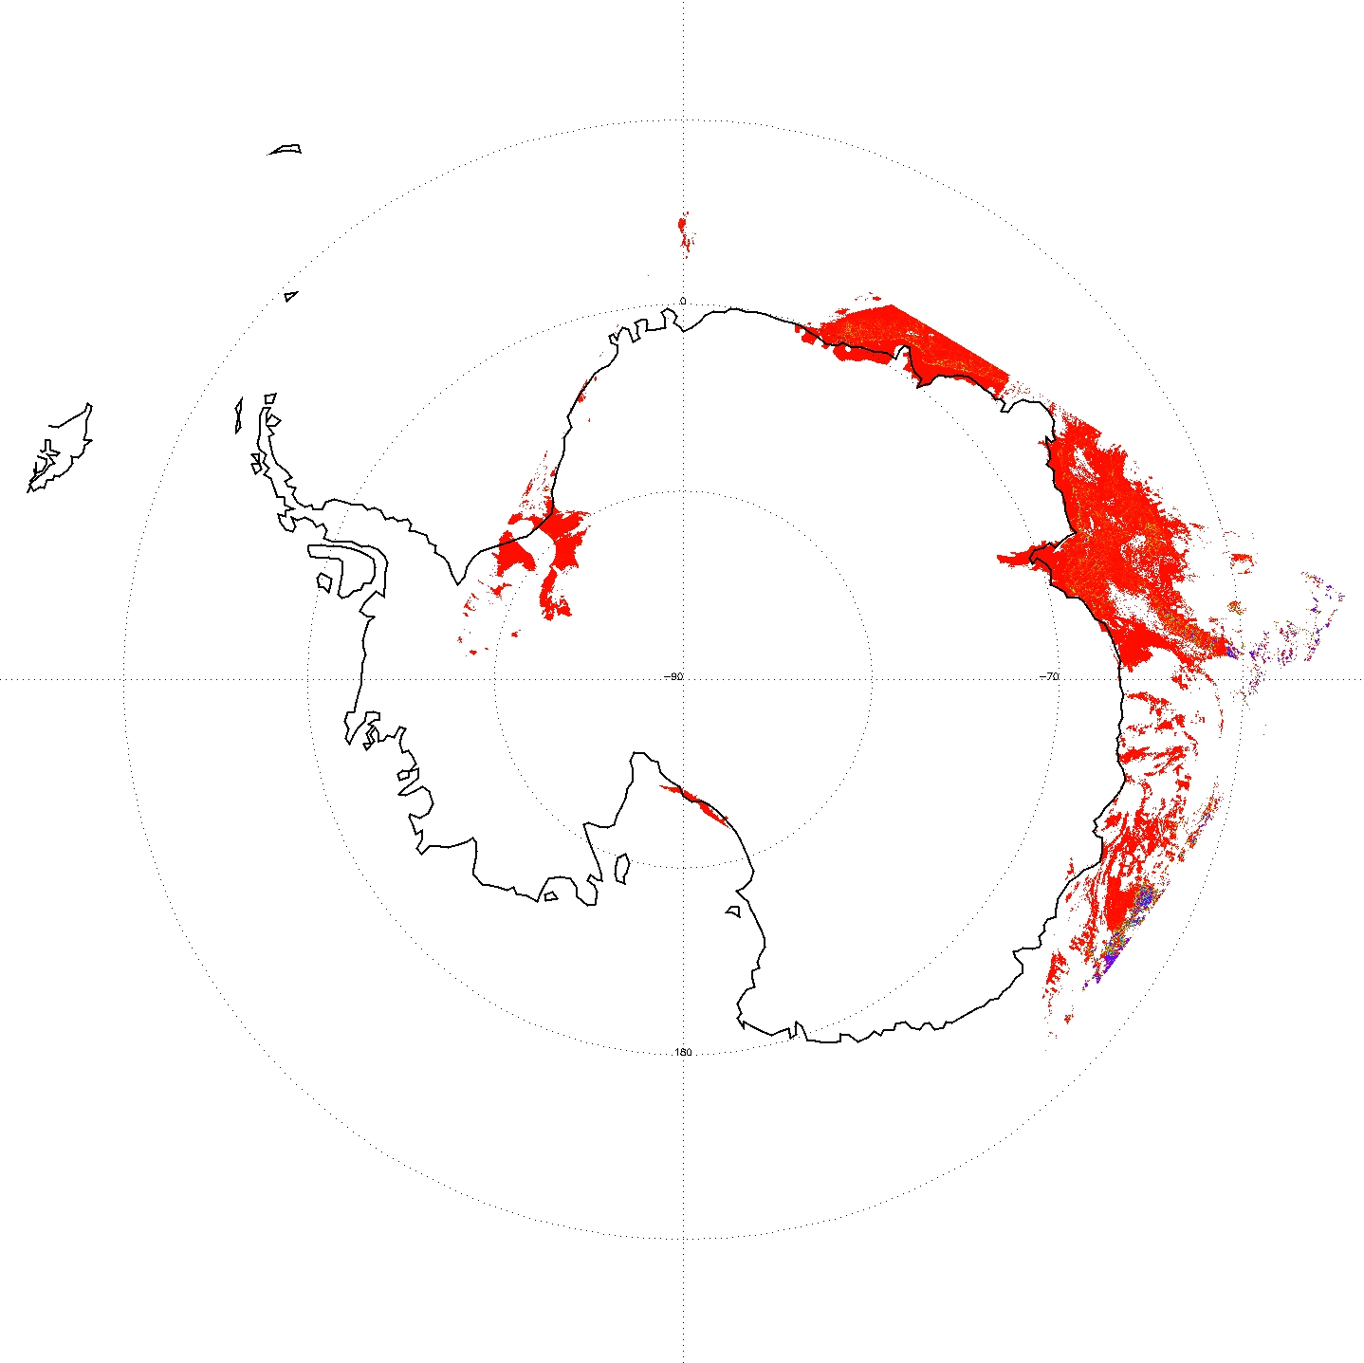
Beta Maturity Evaluation – Comparison of VIIRS Ice Conc. to Passive Microwave
VIIRS Sea Ice Concentration IP (left) vs. SSM/I Ice Concentration (right) for 10/12/2012, Antarctica.

Slide 14
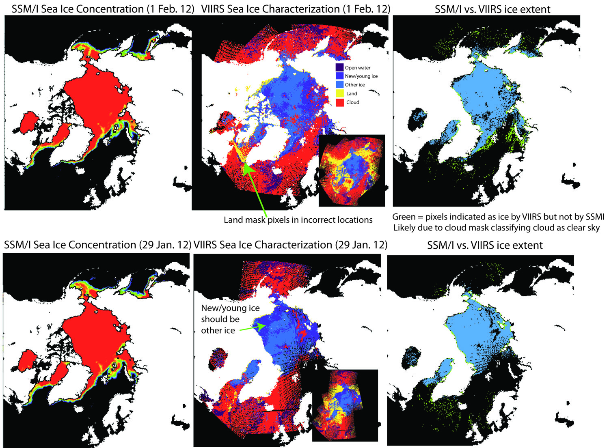
Beta Maturity Evaluation – Comparison VIIRS Ice Conc. Passive Microwave
Sea ice extent is realistic, but with some false ice over open water, misclassification of new/young vs. other ice (in SIC EDR), and some misplacement of land values

Slide 15
Beta Justification Summary
Criteria: Early release product
  Ice Concentration IP performance is directly dependent on VIIRS Imagery resolution SDRs and the VIIRS Surface Temperature IP. It is also dependent on the VIIRS Cloud Mask IP, and AOT IP through the Ice Quality Flags IP and Ice Weights IP
    VIIRS SDR Cal and Geo products reached provisional maturity in March, 2013.
    VIIRS Cloud Mask IP reached provisional maturity in February, 2013
    VIIRS Aerosol Optical Thickness reached beta maturity in September 2013
    VIIRS Surface Temperature IP beta maturity pending approval

Slide 16
Beta Justification Summary
Criteria: Available to allow users to gain familiarity with data formats and parameters
  Cryosphere team has evaluated IDPS EDR products available from CLASS
    Users can access and read the products and the product compares reasonably with the heritage satellite snow map products
  Beta release will allow other users within the community to gain experience with the data formats and parameters.
    This is important to allow users to complement the validation activity.

Slide 17
Beta Justification Summary
Criteria: Product is not appropriate as the basis for quantitative scientific publication studies and applications
  The product has known flaws (see caveats slides later in this presentation), but these products are of sufficient quality to justify use by a broader community
  Most of the issues
    VIIRS Sea Ice Concentration IP contains retrievals over false ice. The SST team has reported instances of missing ice. Some of the false ice retrieved by the VIIRS Sea Ice Concentration IP has been linked to a cloud leakage from a VIIRS Cloud Mask (VCM) which is still maturing and out of date (not update daily) Grid-VIIRS-Snow-Ice-Cover-Rolling Tiles that affects the VCM performance.
    Significant discontinuities false and missing ice have been observed transitioning from day to night. Nighttime performance is poorer than daytime.
    Ice Concentration performance bias exists but is expected to improve with additional quality checks, algorithm quality checks and maturation of the VCM and updated Surface Temperature IP regression coefficients

Slide 18
Caveats for Operational VIIRS Ice
Concentration IP (additional issues)
Known problems and proposed technical solutions
  False ice frequently observed near cloud edges.
    Implementation of additional quality checks in the Sea Ice Concentration IP for future builds beyond MX 8.0 should mitigate this problem
  Significant discontinuities in ice concentration evident at 85 deg SZA transition between day/night for VCM and Ice Concentration to thermal based retrievals.
    Such errors may be reduced with subsequent VIIRS Cloud Mask updates. However, such discontinuities will always remain.
  Ice Concentration biases
    Investigate and adjust tunable parameters associated with computation of ice tie points
  Minor discontinuities related to ice tie points evident in the ice concentration
    DR 4959 implementation of running mean based fallback tie points are likely to mitigate this problem

Slide 19
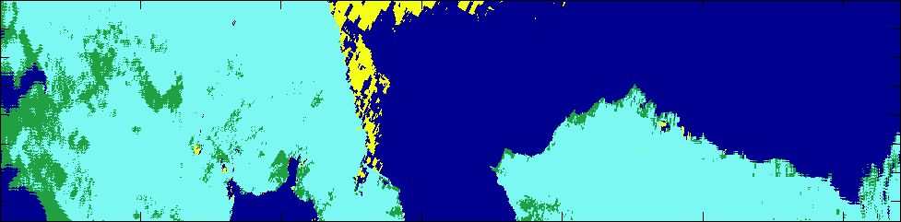
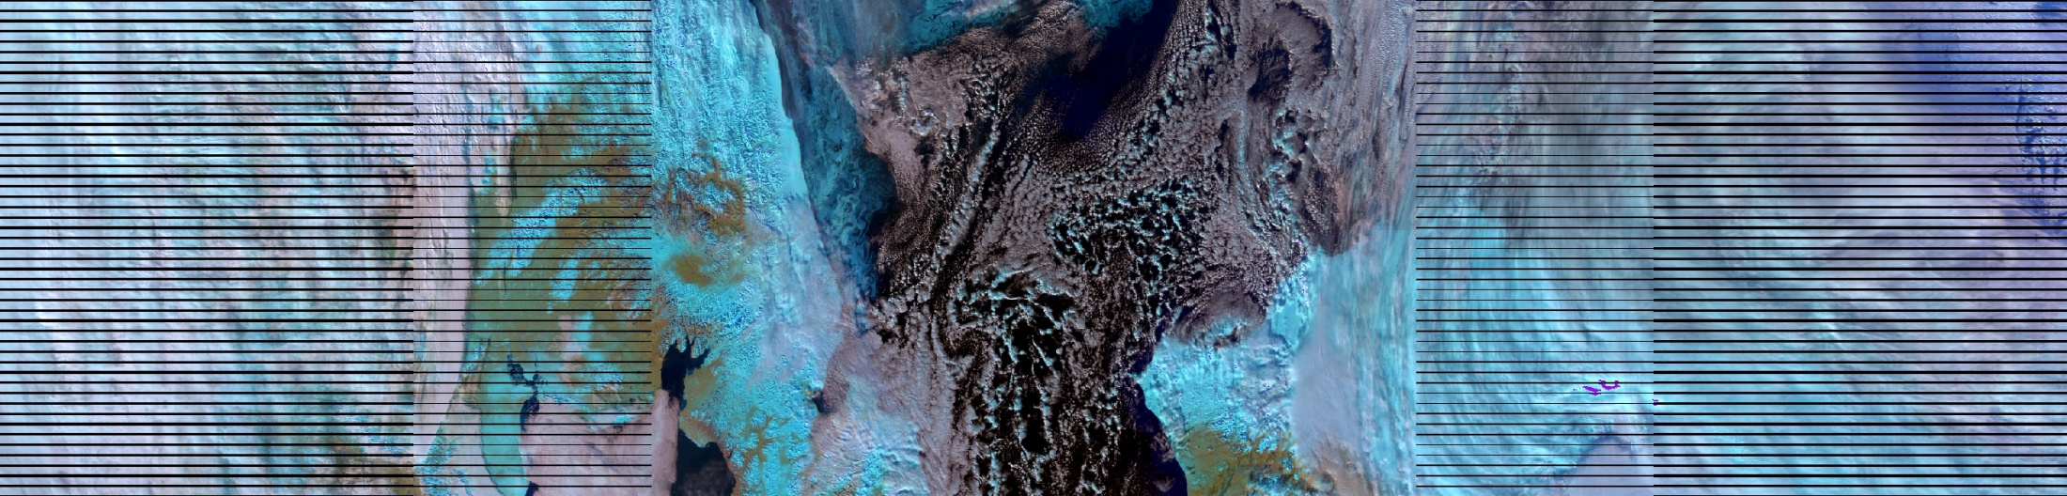
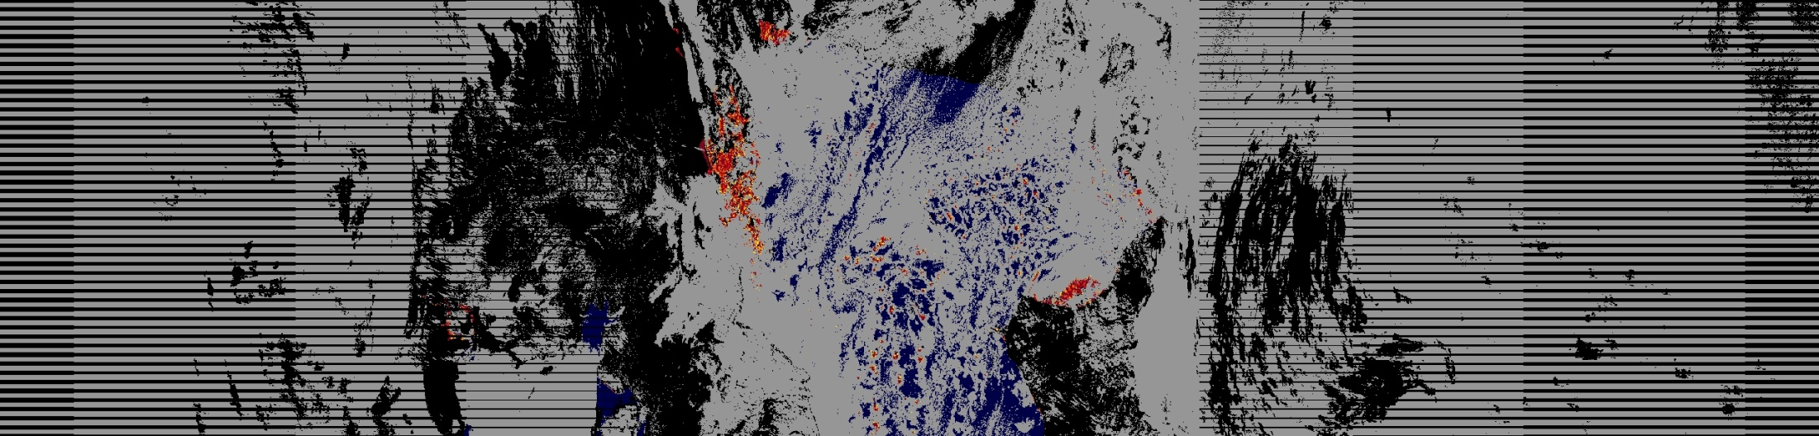
Caveats for Operational Ice Concentration IP False Ice Observed near scattered clouds
d20121017_t2311272_e2312514
North
Sea Ice
Ice Free Ocean
NOAA Global Automated Multisensor Snow/Ice
Snow
No Snow
False Color VIIRS SDR Imagery
Clouds
Clouds
Sea Ice
(correctly retrieved)
VIIRS Sea Ice Conc. IP
Sea Ice Falsely retrieved
R. Mahoney NGAS
Fill
Land
Cloud
0.0
0.01
0.1
0.2
0.3
0.4
0.5
0.6
0.7
0.8
0.85
0.9
0.95
0.96
0.98
0.99
1.0
ice fraction
False ice is observed in regions with scattered clouds for Chukchi Sea/Beaufort Sea scene.

Slide 20
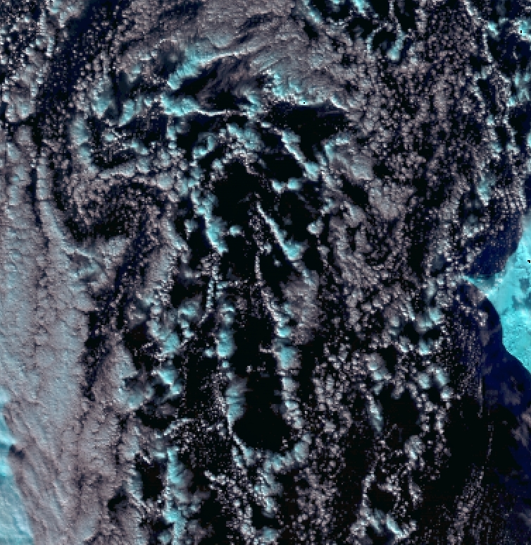
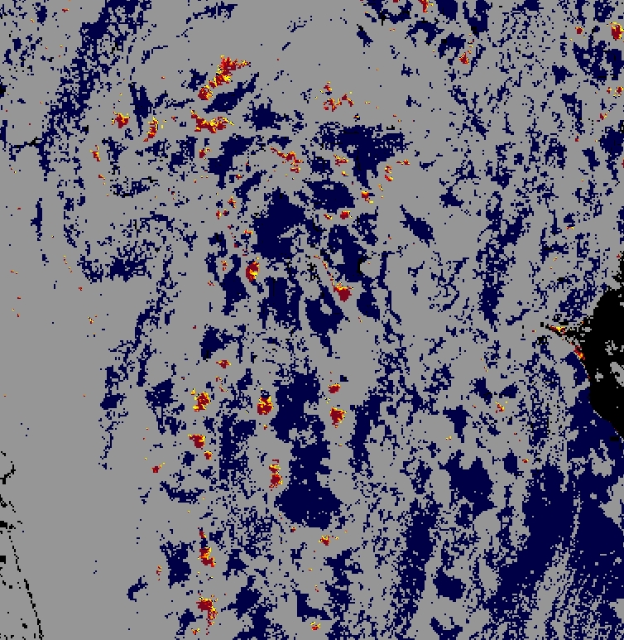

Caveats for Operational Ice Concentration IP False Ice Observed near scattered clouds
False color VIIRS SDRs
VIIRS Sea Ice Conc. IP
Robert Mahoney, NGAS
Robert Mahoney, NGAS
R. Mahoney NGAS
False color of VIIRS SDR reflectance (Red: M10, Green: M7, Blue: M5) for zoomed region (left). False ice shown by the yellow circled regions (right) correspond to clouds misclassified as confidently clear by the VCM and suggests additional quality checks are required in the Ice Concentration IP for extended cloud adjacency and significant partial cloudy regions.

Slide 21
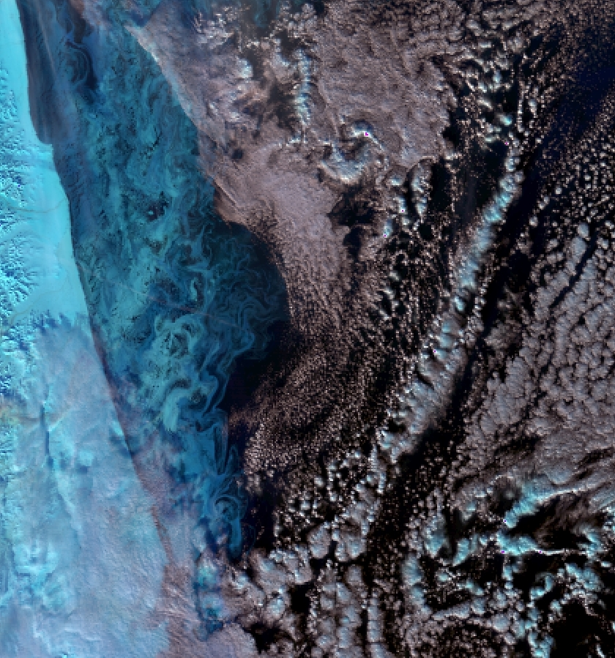
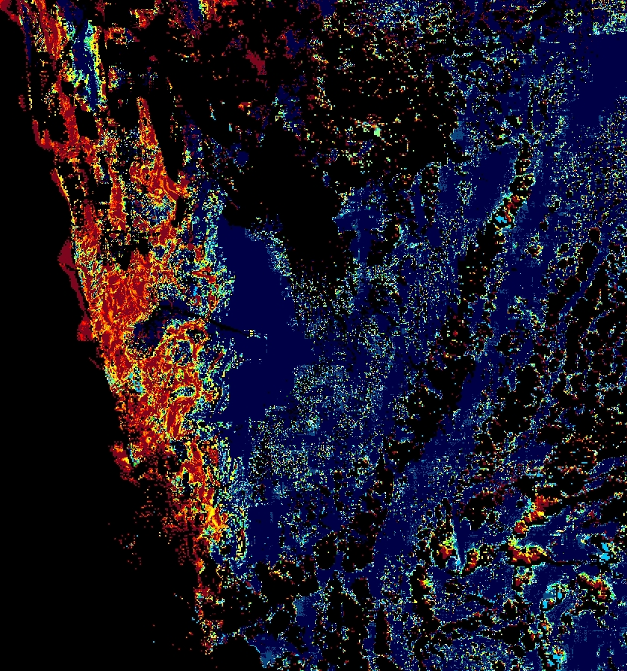
Caveats for Operational Ice Concentration IP
Observed Missing Sea Ice
Fill
Cloud
0.0
0.01
0.1
0.2
0.3
0.4
0.5
0.6
0.7
0.8
0.85
0.9
0.95
0.96
0.98
0.99
1.0
ice fraction
R. Mahoney NGAS
Some regions of missing sea ice have been observed in the VIIRS Ice Concentration IP for thin ice as shown in the circled region. False ice near clouds area also seen and for low ice fractions
Robert Mahoney, NGAS
Robert Mahoney, NGAS

Slide 22
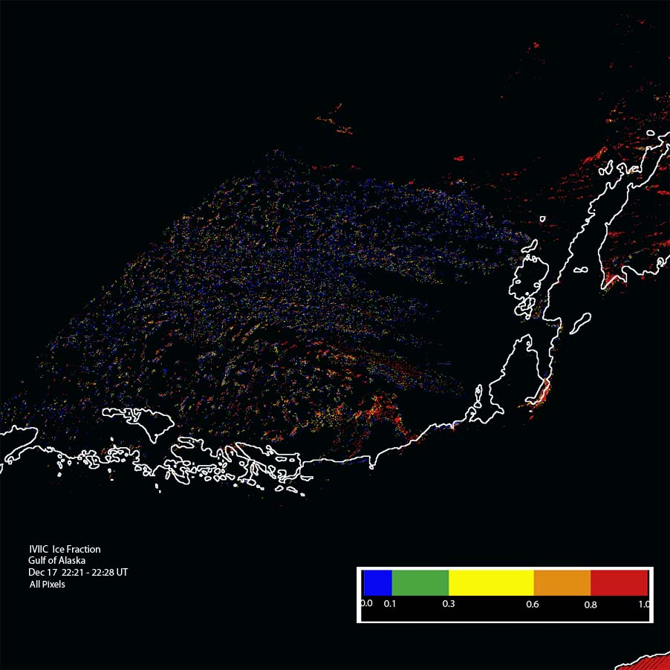
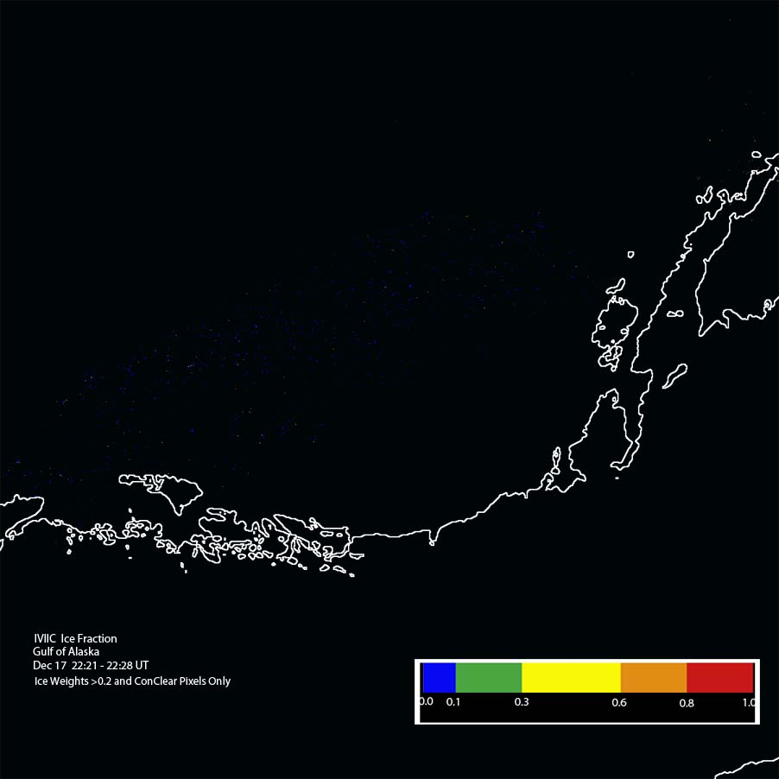
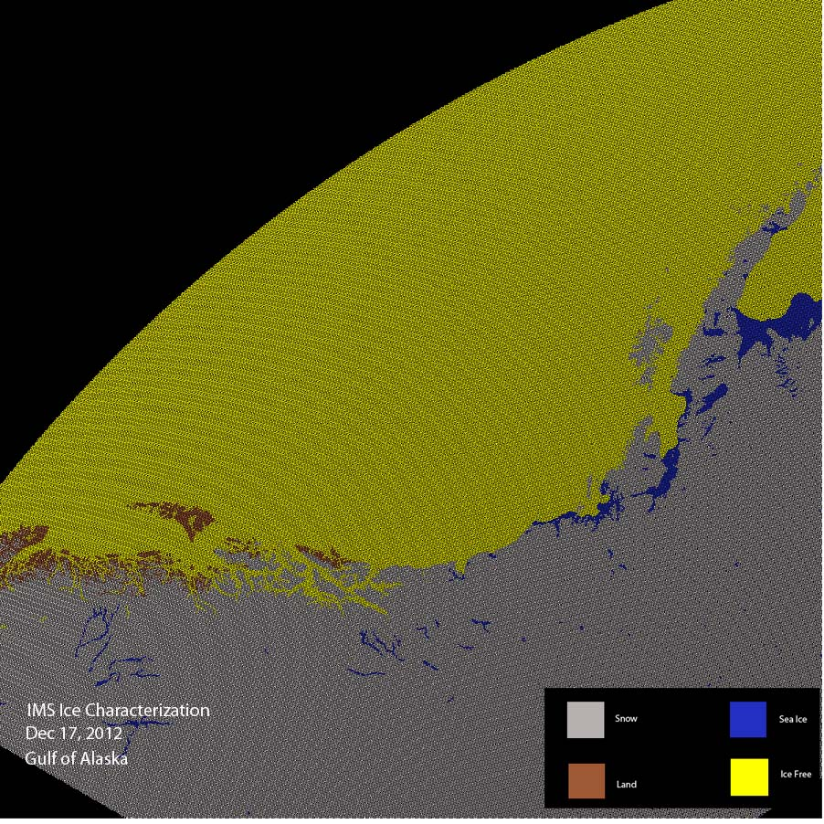
Beta Maturity Evaluation
- test to improve SIC IP
12/17/12: False ice (left) in Gulf of Alaska, removed (center) in local test after applying threshold for ice concentration weights. IMS ice data (right), showing absence of sea ice in this region (all ice-free).

Slide 23
Beta Maturity Evaluation
- Sliding Window Cloud Filtering Test
False Ice near clouds
Fill
Land
Cloud
0.0
0.01
0.1
0.2
0.3
0.4
0.5
0.6
0.7
0.8
0.85
0.9
0.95
0.96
0.98
0.99
1.0
ice fraction
R. Mahoney NGAS
Results of partial cloudy filter tests for mosaic of VIIRS Sea Ice Concentration IP granules for Arctic 12-18-2012. Upper figure shows unfiltered ice concentration IP and lower figure shows results after application of a 15% non-confidently clear tie point search window filter. Further tests are required to determine the benefits and drawbacks of such an approach as an additional quality check in the Ice Concentration IP.

Slide 24
Additional Supporting Documentation
TIM Meetings and Presentations
    Cal/Val Team Meeting, April 2012
    DR 4987 Sea Ice Concentration IP: Poor Performance Near Cloud Edges, January 3, 2013
Monthly/weekly reports https://groups.ssec.wisc.edu/groups/jpss/cryosphere/reports
NPP Science Team, Land Report, 12/12/2013

Slide 25
Future Plans and Issues
We are working to get these changes into the IDPS
  DR 7139, 4959, 4987, 4129, 7139
Detailed performance characterization requires:
  Further qualitative and quantitative comparisons with independent ice concentration sources
Major actions for the provisional maturity justification and schedule
  Implementation of additional quality checks and associated quality flags (MX 9.0)

Slide 26
Conclusion
VIIRS Sea Ice Concentration IP has met the beta maturity stage based on the definitions and the evidence shown
  It exceeds the definition of beta in most cases
  Off-line IP product performance appears to be of sufficient quality for use by the Sea Ice Age EDR to identify ice to be classified as well as for Ice Surface Temperature EDR to identify sea ice for retrievals
Some issues have been uncovered during validation and solutions are being evaluated.

