Slide 1
Request for
VIIRS Sea Ice Characterization EDR and Sea Ice Concentration IP Provisional Maturity
Provisional Effectivity Date: 15 October 2012 (MX 6.4)
Cryosphere Products Validation Team
Jeff Key, NOAA/NESDIS/STAR, Team Lead
Paul Meade, Cryosphere Products JAM

Slide 2
Outline
VIIRS Sea Ice Characterization EDR and Ice Concentration IP Users
Provisional EDR Maturity Definition
Sea Ice Characterization EDR and Ice Concentration IP Requirements
Summary of Sea Ice Concentration IP
  History of Algorithm Changes/Updates
  Provisional Maturity Evaluation
  Provisional Justification Summary
  Conclusions
Summary of Sea Ice Characterization EDR
  History of Algorithm Changes/Updates
  Provisional Maturity Evaluation
  Provisional Justification Summary
  Conclusions

Slide 3
VIIRS Sea Ice Characterization EDR and Ice Concentration IP Product Users
  U.S. Users
    NSIDC, National Snow Ice Data Center
    NIC, National/Naval Ice Center
    OSPO, Office of Satellite and Product Operations
    STAR, Center for Satellite Applications and Research
    GSFC, NASA/Goddard Space Flight Center Hydrological Sciences Branch
    NWS, National Weather Service, including the Alaska Ice Desk
    CLASS, Comprehensive Large Array-data Stewardship System
  User Community
    Navigation
    Emergency Management
    Operational Weather Prediction
    Climate Research
    DOD

Slide 4
Provisional EDR Maturity Definition
Product quality may not be optimal
Incremental product improvements are still occurring
Version control is in affect
General research community is encouraged to participate in the QA and validation of the product, but need to be aware that product validation and QA are ongoing
Users are urged to consult the EDR product status document prior to use of the data in publications
Ready for operational evaluation

Slide 5
VIIRS Sea Ice Characterization EDR L1RD Requirements
Sea Ice Characterization (SIC)
“Sea ice age is defined as the time that has passed since the formation of the surface layer of an ice-covered region of the ocean. The sea ice characterization EDR provides an ice age class. Sea ice concentration, which is the fraction of a horizontal cell covered by ice, is an intermediate product (IP)”
5

Slide 6
VIIRS Sea Ice Characterization EDR L1RD Requirements (Continued)
Sea Ice Characterization Requirements from L1RD version 2.4
EDR Attribute | Threshold | Objective
a. Vertical Coverage | Ice Surface | Ice Surface
b. Horizontal Cell Size Clear All weather | 1.0 km No capability | 0.5 km 1 km
c. Mapping Uncertainty, 3 sigma Clear Cloudy | 5 km No capability | 0.5 km 1 km
d. Measure Range Ice Age 2. Ice Concentration | Ice Free, New Young, all other ice 0/10 to 10/10 | Ice free, Nilas, Gray White Grey, White, First Year Medium, First Year Thick, Second Year, Multiyear, Smooth and Deformed Ice 0/10 to 10/10
e. Measurement Uncertainty Probability of Correct Typing (Ice Age) Ice Concentration | 70% Note 1 | 90% 5%
f. Refresh | At least 90% coverage of the global every 24 hours (monthly average) | 6 hrs
g. Geographic coverage | All Ice-covered regions of the global ocean | All Ice-covered regions of the global ocean
Notes: 1. VIIRS produces a sea ice concentration IP in clear sky conditions, which is provided as an input to the ice surface temperature calculation
RGB Image shows dense smoke (high absorption) in northwest, north central and central coastal portions of image.
6

Slide 7
Summary of VIIRS Sea Ice Concentration IP
  Product and Algorithm Processing Summary
  History of Algorithm Changes/Updates
  Provisional Maturity Evaluation
  Provisional Justification Summary
  Conclusions

Slide 8
Summary of the VIIRS Sea Ice Conc. IP
The VIIRS Sea Ice Concentration IP consists of retrieved ice concentration at VIIRS Imagery spatial resolution (375 m @ nadir), for both day and night, over oceans pole ward of 36º N and 50º S latitude.
The Ice Concentration algorithm computes ice fractions based on ice and water tie points determined from VIIRS I1 (0.64 µm and I2 (0.865 µm) reflectance and surface temperature from the VIIRS Surface Temperature IP.
VIIRS Surface Temperature IP is determined using the VIIRS I5 (11.5 µm), M15 (10.8 µm ) and M16 (12.0 µm) bands.
Ice/water thresholds are determined from the local minimum of the distribution of reflectance and temperature. Ice and water tie points are derived from the local maxima of the reflectance and temperature distribution within a sliding search window centered on each pixel.
Inputs are TOA reflectance (VIIRS I1 and I2 bands) and Surface Temperature IP at
VIIRS imagery resolution. Cloud and quality information input are provided by the Ice Quality Flags and IP, Ice Weights IP
Outputs Ice Concentration IP and Reflectance/Temperature IP

Slide 9
Summary of the VIIRS Sea Ice Conc. IP
Algorithm Inputs
NPOESS xDRs & IPs
Output EDRs & IPs
VIIRS 375m SDR
VIIRS Ice Quality Flags IP
VIIRS Ice Weights IP
VIIRS Surface Temperature IP
Sea Ice Concentration IP
VIIRS Sea Ice Concentration IP
VIIRS Reflectance/Temperature IP
Auxiliary Data
VIIRS Ice Concentration Tunable Parameters
Notes:
Ancillary
GFS forecast surface pressure, lapse rate, and air temperature (for topography corrected surface pressure)
Look-up tables
DEM for surface altitude
Infrared and Microwave OSS coefficients
Local Angle Correction
IR emissivity and reflectivity covariance
MW emissivity covariance
AVTP and AVMP and Ozone covariance

Slide 10
Summary of VIIRS Sea Ice Conc. IP
Processing Flow
Read SDRs, IPs, Tunable Parameters
Function: IC_threshold
Compute Ice/Water Threshold
Function: IC_tiepoint
Compute local ice tie points using fixed size sliding widow
Compute global water tie points
Function: IC_tiepoint_plus
Compute local ice tie points using expandable size sliding window
Compute global water tie points
T
if max_wsize <= min_wsize
F
Function: IC_local_water_tiepoint
Compute local water tie points using fixed size sliding widow
Function: IC_fraction
Compute ice fraction
Ice Concentration IP
Reflectance/Temperature IP

Slide 11
History of Algorithm changes/updates
Date | Update/DR# | Reason | Status
04-09-2013 | DR 7139 | Correct Sea Ice Conc. OAD flow chart figure | Request closure with Beta Maturity 474-CCR-13-0945
12-13-2012 | DR 5017 | RTN Sev2 PCR Ice IPs Maneuver | open
11-27-2012 | DR 4987 | Sea Ice Quality/Ice Concentration IP: Additional quality checks for identifying regions with potential VCM cloud leakage | open
10-17-2012 | DR 4959 | Sea Ice Conc. Tie Point Fill Fix | open
01-19-2012 | DR 4524 | OAD for VIIRS Sea Ice Concentration (SIC) Intermediate Product (IP) Mx6 Updates (ECR-ALG-0034) (CDRL A031) | open
12-08-2010 | DR 4129 | Ice concentration weights not initialized before final ice concentration calculation | open
07-17-2009 | DR 2863 | Latency impact due to valid point count methodology | Deferred for re-evaluation
07-17-2009 | DR 2936 | Ice Surface Temp and IST use different emissivities for ice | Plan in place (next slide)

Slide 12
Path Forward Recommendation for DR 2936
Comparison of IST and Surface Temperature IP (ST IP) regression coefficients indicate that the IST coefficients currently implemented on the IDPS system are valid. However, inspection has revealed the ST IP split window coefficient value associated with view zenith angle dependence was erroneously set to 0.
The review also uncovered a sign error in the ATBD equation (second line from the top, page 34). However, the code implementation is correct.
Proposed path forward actions
Deliver updated STIP coefficients to close out DR 2936
Open DR to correct the IST ATBD equation appearing in the ATBD. The Equation should be t11 = tI + (1-f)D instead of t11 = tI - (1-f)D

Slide 13
Path Forward Recommendation for DR 2936
Surface Temperature intermediate product (IP) and the VIIRS Ice Surface Temperature (IST) EDR were producing significantly different (1-3 degrees) temperatures over sea ice for early 2012 data
The correct Surface Temperature IP regression coefficients were also delivered in 2010 but were implemented with the MX 5.0 build before the launch of NPP
The IDPS MX 6.0 build, implemented on August 10, 2012 which included corrected IST regression coefficients that were delivered in 2010
The two products are in much closer agreement now, as illustrated in a comparison with IceBridge aircraft data over the Arctic Ocean where the IST EDR was reprocessed with the corrected coefficients (see next slide)

Slide 14
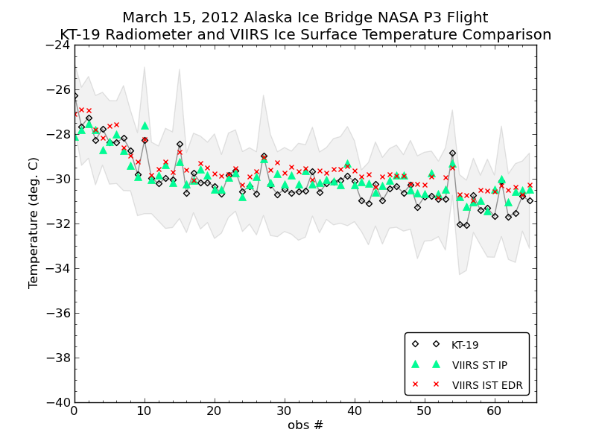
Surface Temperature IP vs IST EDR
RMS STIP : 0.58 K
RMS IST : 0.75 K
RMS STIP-IST: 0.75 K
Surface Temperature IP, IST EDR, and IceBridge KT-19 temperatures over the western Arctic Ocean for March 2012.
Notes:
It was recently discovered that the Surface Temperature intermediate product (IP) and the VIIRS Ice Surface Temperature (IST) EDR were producing significantly different (1-3 degrees) temperatures over sea ice for early 2012 data. It was discovered that on August 10, 2012 the IDPS implemented the MX 6.0 build, which included corrected IST regression coefficients that were delivered in 2010. The correct Surface Temperature IP regression coefficients were also delivered in 2010 but were implemented with the MX 5.0 build before the launch of NPP. The two products are in much closer agreement now, as illustrated in a comparison with IceBridge aircraft data over the Arctic Ocean where the IST EDR was reprocessed with the corrected coefficients.

Slide 15
Status of Upstream Products
  Ice Concentration IP performance is directly dependent on VIIRS Imagery resolution SDRs and the VIIRS Surface Temperature IP. It is also dependent on the VIIRS Cloud Mask IP, and AOT IP through the Ice Quality Flags IP and Ice Weights IP
    VIIRS SDR Cal and Geo products reached provisional maturity in March, 2013.
    VIIRS Cloud Mask IP reached provisional maturity in February, 2013
    VIIRS Aerosol Optical Thickness reached beta maturity in September 2012 and provisional in March 2013
    VIIRS Surface Temperature IP path forward plan in place (DR 2936, see slide 12)

Slide 16
Provisional Maturity Evaluation
Provisional Maturity Evaluation Approaches
  Visualizations of daily global VIIRS Sea Ice Concentration and comparison with passive microwave ice concentration
Criteria:
  Our analysis has focused on the Beaufort Sea, but other regions in the Arctic and Antarctic, as well as global coverage, have been analyzed for one or more days.

Slide 17
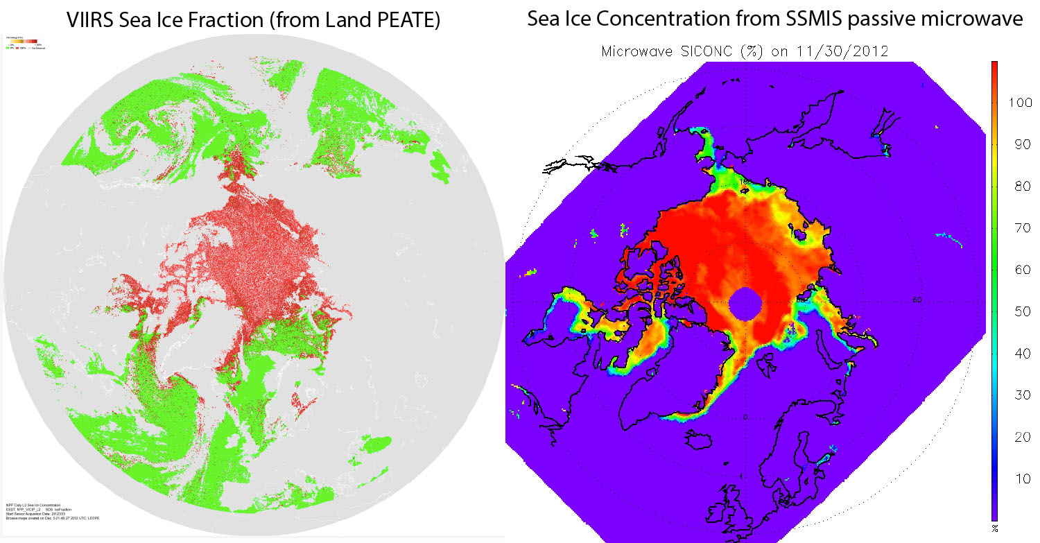
Provisional Maturity Evaluation – Comparison of VIIRS Ice Conc. to Passive Microwave

Slide 18
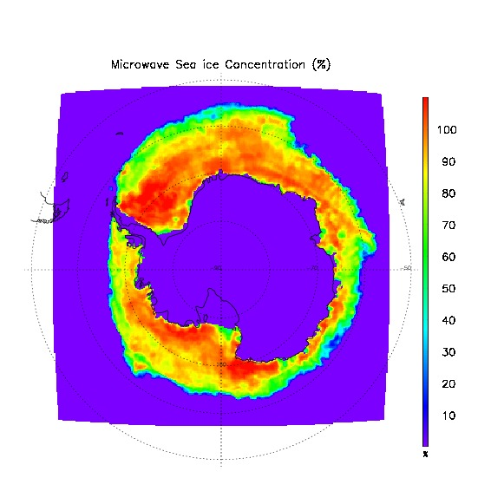
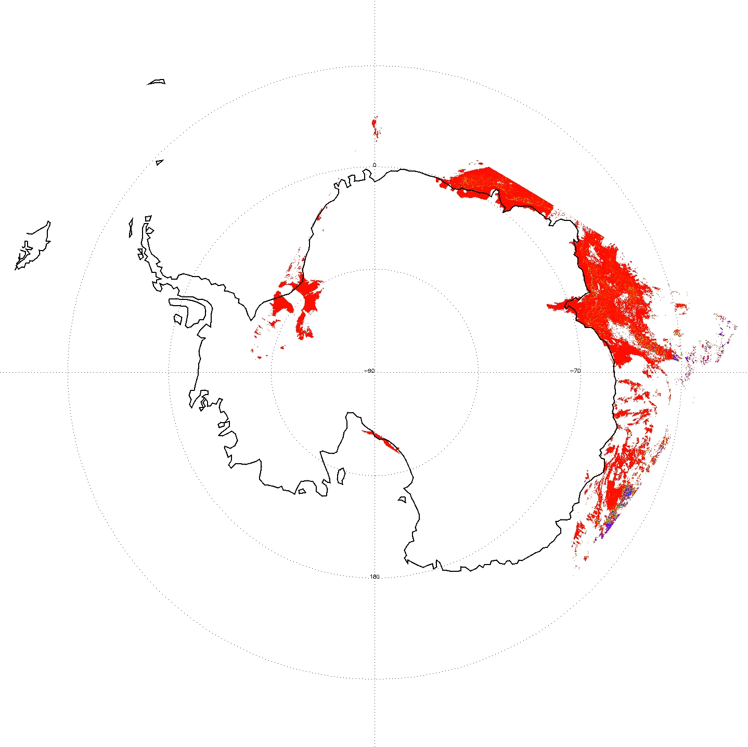
Provisional Maturity Evaluation – Comparison of VIIRS Ice Conc. to Passive Microwave
VIIRS Sea Ice Concentration IP (left) vs. SSM/I Ice Concentration (right) for 10/12/2012, Antarctica.

Slide 19
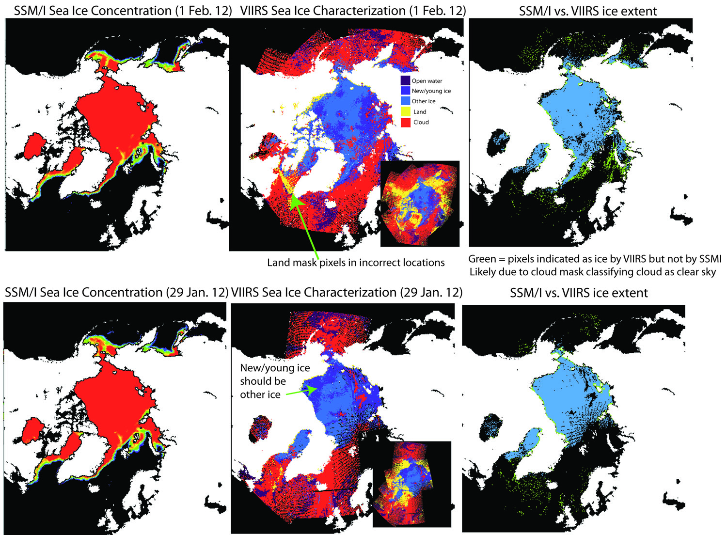
Provisional Maturity Evaluation – Comparison VIIRS Ice Conc. Passive Microwave
Sea ice extent is realistic, but with some false ice over open water, misclassification of new/young vs. other ice (in SIC EDR), and some misplacement of land values

Slide 20
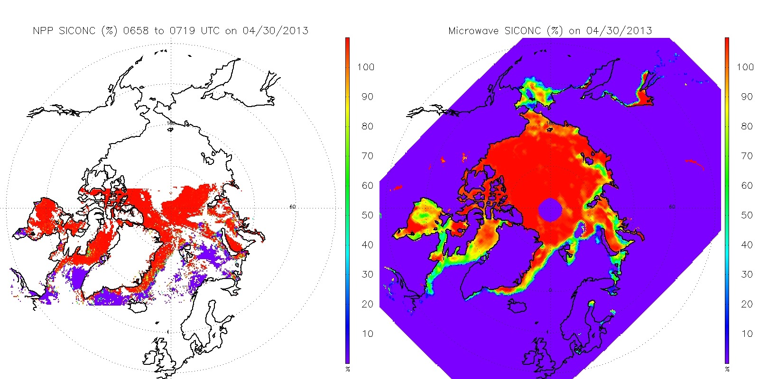
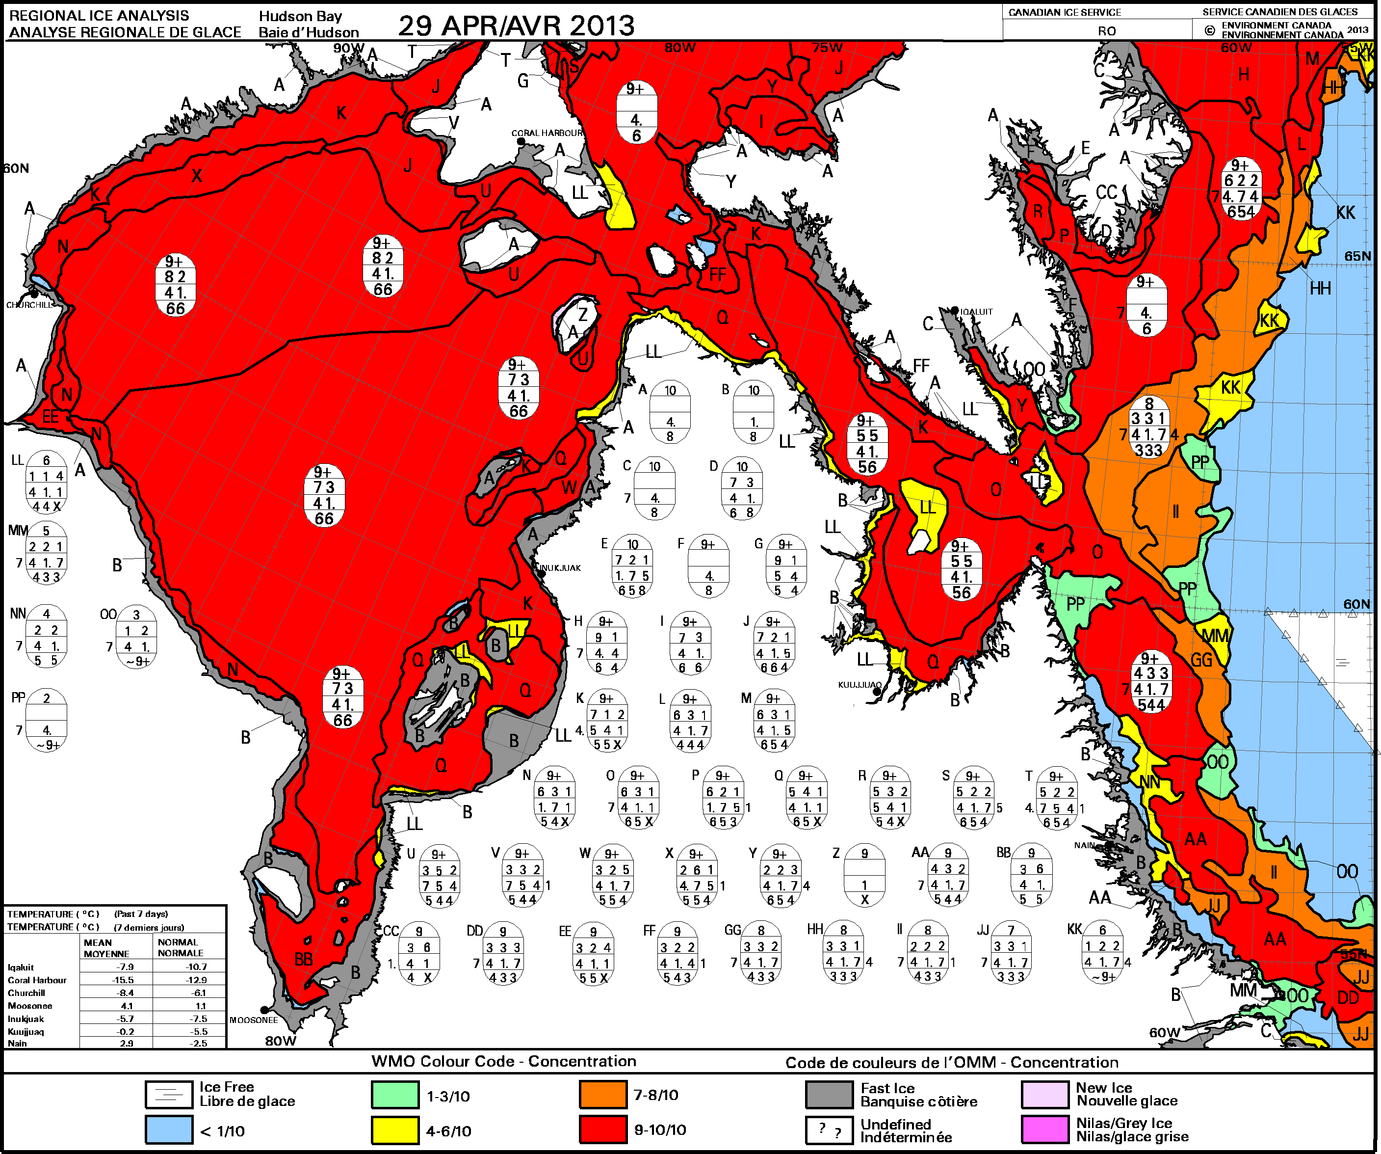
Provisional Maturity Evaluation – Comparison of VIIRS Ice Conc. to Passive Microwave and Ice Chart
Sea ice concentration from Suomi NPP VIIRS IP (upper left), from the SSMIS using NASA team algorithm (center) on April 30, 2013, and from the weekly ice chart on April 29th 2013 from the Canadian Ice Service (upper right).
Notes:
An example of the collocated VIIRS and passive microwave sea ice concentration on April 30, 2013 is given in Figure 6. The microwave product shows a reduction in the sea ice concentration from the pack ice to the ice edge, while the VIIRS product does not. This difference can partly be attributed to the differences in instrument sensitivities, instrument field-of-view, and the fundamental differences in the retrieval algorithms. Sea ice concentration retrievals from microwave sensors tend to underestimate due to factors including water attenuation due to melt, weather contamination, and etc., and the estimation are also more common along the marginal ice zone, This underestimation is shown in Figure 6 when VIIRS and passive microwave sea ice concentration are compared to the sea ice concentration from ice chart. Over the Hudson Bay, Hudson Strait, and Davis Strait, both ice chart and VIIRS show higher than 90% sea ice concentration, while microwave product shows sea ice concentration around 50%. This also explains the large sea ice concentration differences for the intermediate values from microwave product shown in next slide.

Slide 21
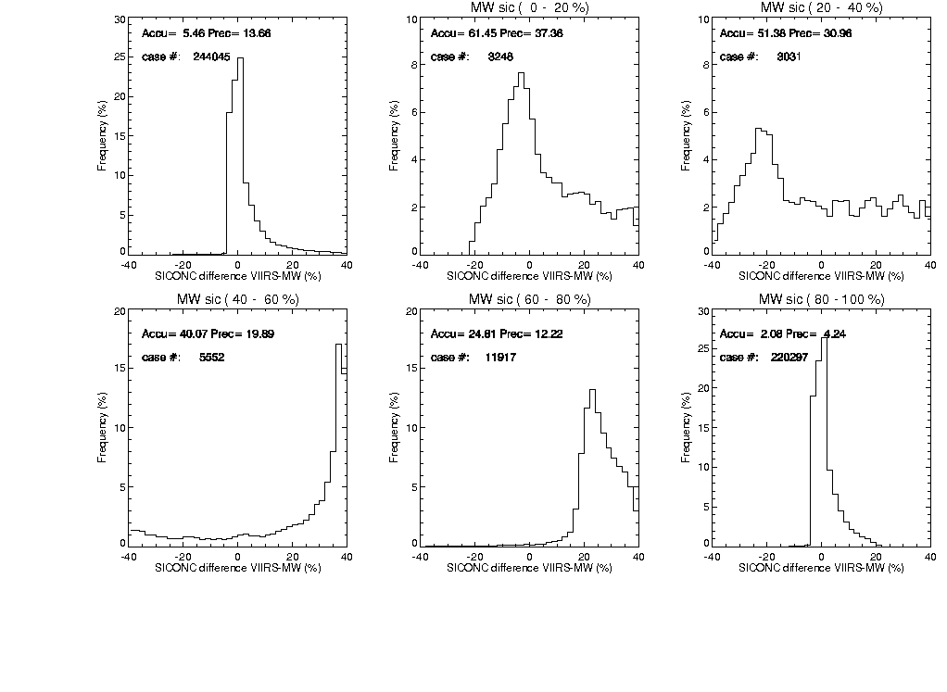
Provisional Maturity Evaluation – Comparison of VIIRS Ice Concentration to Passive Microwave
Histogram of sea ice concentration differences of Suomi NPP VIIRS and Microwave using NASA team algorithm in February 2013 in the Arctic for all cases (upper left), and cases with Microwave sea ice concentration in the ranges 0-20%, 20-40%, 40-60%, 60-80%, and 80-100%. Measurement accuracy (Accu) and measurement precision (Prec) are indicated for each bin.
Notes:
All collocated VIIRS and passive microwave sea ice concentration retrievals in each month were collected from August 2012 to May 2013 over both the Arctic and Antarctic. In each month, histograms of sea ice concentration differences between the VIIRS and passive microwave products were plotted for all cases and for cases with passive microwave sea ice concentrations in the bins 0-20%, 20-40%, 40-60%, 60-80%, and 80-100%.
An example of the histogram and statistical analysis in February 2013 is shown in this slide. Over 200,000 collocated cases were collected in that month. The VIIRS sea ice concentration retrievals show the smallest bias and precision, defined as the standard deviation of the measurement errors, for surface sea ice concentration between 80 and 100%. With lower sea ice concentration, the VIIRS retrievals show larger values of measurement bias and precision. Overall, the measurement accuracy and precision of VIIRS sea ice concentration retrievals are approximately 5% and 15%, respectively. These relatively small values are due to the larger percentage of cases with sea ice concentration between 80 and 100%. In the Arctic, the accuracies of VIIRS sea ice concentration are under 10% for most months, while the precision increases from 15% in February to 30% in July due to the. In the Antarctic, the accuracies increases from 13% in July and August to over 20% in February; and the precisions increases from 13% in July to 30% in February. The underestimation of microwave sea ice product for intermediate sea ice concentration may be the main reason of such differences.

Slide 22
Provisional Justification Summary
  Users are urged to consult the EDR product status document prior to use of the data in publications
  The product has known flaws (see caveats slides later in this presentation), but these products are of sufficient quality to justify use by a broader community
  Most of the issues
    VIIRS Sea Ice Concentration IP contains retrievals over false ice. The SST team has reported instances of missing ice. Some of the false ice retrieved by the VIIRS Sea Ice Concentration IP has been linked to a cloud leakage from a VIIRS Cloud Mask (VCM) which is still maturing and out of date (not updated daily) Grid-VIIRS-Snow-Ice-Cover-Rolling Tiles that affects the VCM performance.
    Significant discontinuities, false and missing ice have been observed transitioning from day to night. Nighttime performance is poorer than daytime.
    Ice Concentration performance bias exists but is expected to improve with additional quality checks, algorithm quality checks and maturation of the VCM and updated Surface Temperature IP regression coefficients

Slide 23
Caveats for Operational VIIRS Ice
Concentration IP (additional issues)
Known problems and proposed technical solutions
  False ice frequently observed near cloud edges.
    Implementation of additional quality checks (extended cloud adjacency) in the Sea Ice Concentration IP for future builds beyond MX 9.0 should mitigate this problem
  Performance of VCM cloud confidence for night is still not fully characterized. Unusually large confidently clear regions suggestive of VCM cloud leakage at night has been observed.
  Significant discontinuities in ice concentration evident at 85 deg SZA transition between day/night for VCM and Ice Concentration to thermal based retrievals.
    Such errors may be reduced with subsequent VIIRS Cloud Mask updates. However, such discontinuities will always remain.
  Ice Concentration biases
    Investigate and adjust tunable parameters associated with computation of ice tie points
    Possible minor performance improvement after update of Surface Temperature IP regression coefficients (DR 2936)
  Minor discontinuities related to ice tie points evident in the ice concentration
    DR 4959 implementation of running mean based fallback tie points are likely to mitigate this problem

Slide 24
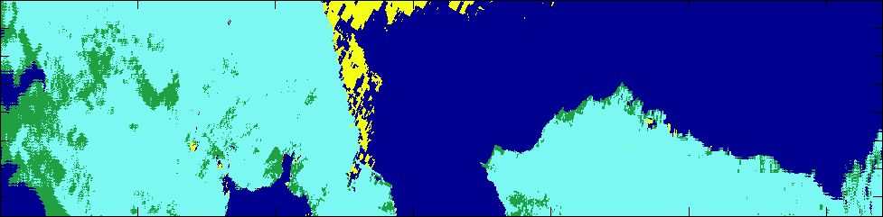
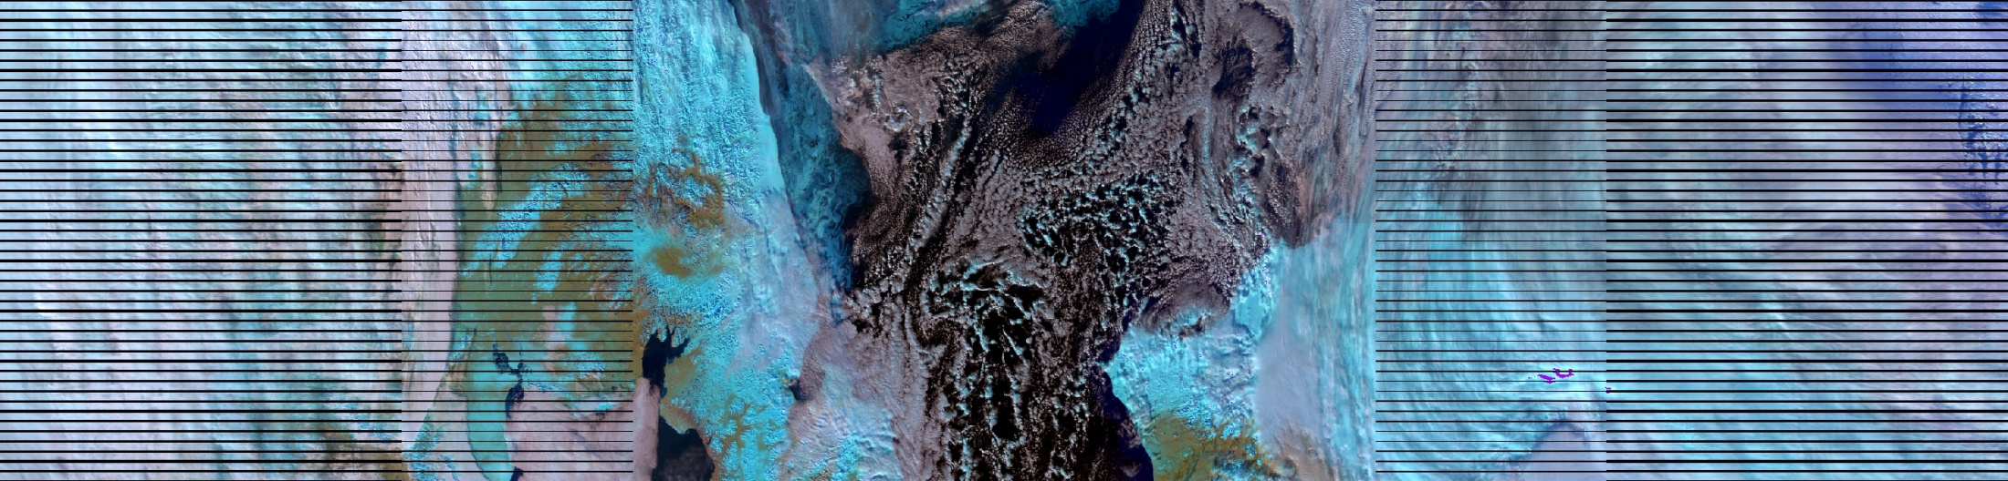

Caveats for Operational Ice Concentration IP False Ice Observed near scattered clouds
d20121017_t2311272_e2312514
North
Sea Ice
Ice Free Ocean
NOAA Global Automated Multisensor Snow/Ice
Snow
No Snow
False Color VIIRS SDR Imagery
Clouds
Clouds
Sea Ice
(correctly retrieved)
VIIRS Sea Ice Conc. IP
Sea Ice Falsely retrieved
R. Mahoney NGAS
Fill
Land
Cloud
0.0
0.01
0.1
0.2
0.3
0.4
0.5
0.6
0.7
0.8
0.85
0.9
0.95
0.96
0.98
0.99
1.0
ice fraction
False ice is observed in regions with scattered clouds for Chukchi Sea/Beaufort Sea scene.

Slide 25
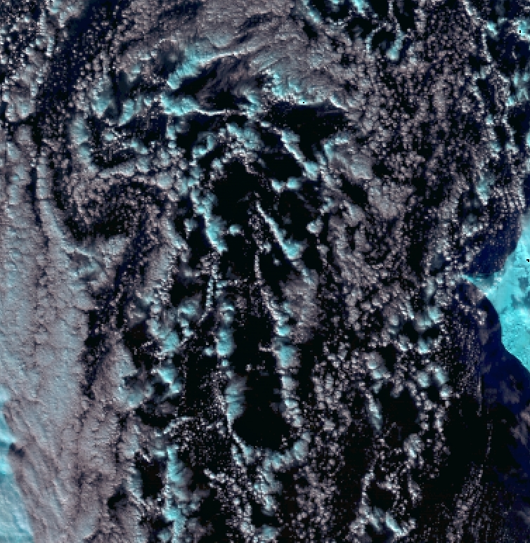
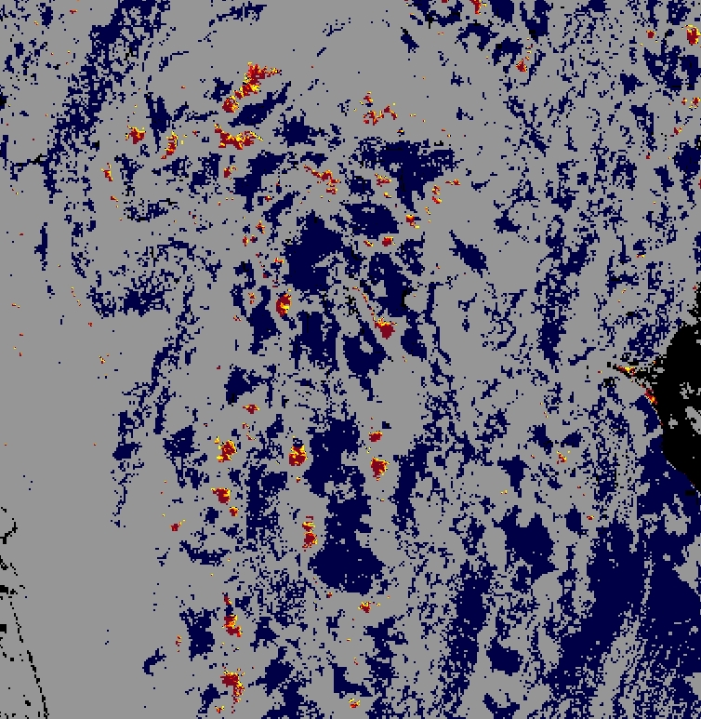

Caveats for Operational Ice Concentration IP False Ice Observed near scattered clouds
False color VIIRS SDRs
VIIRS Sea Ice Conc. IP
Robert Mahoney, NGAS
Robert Mahoney, NGAS
R. Mahoney NGAS
False color of VIIRS SDR reflectance (Red: M10, Green: M7, Blue: M5) for zoomed region (left). False ice shown by the yellow circled regions (right) correspond to clouds misclassified as confidently clear by the VCM and suggests additional quality checks are required in the Ice Concentration IP for extended cloud adjacency and significant partial cloudy regions.

Slide 26
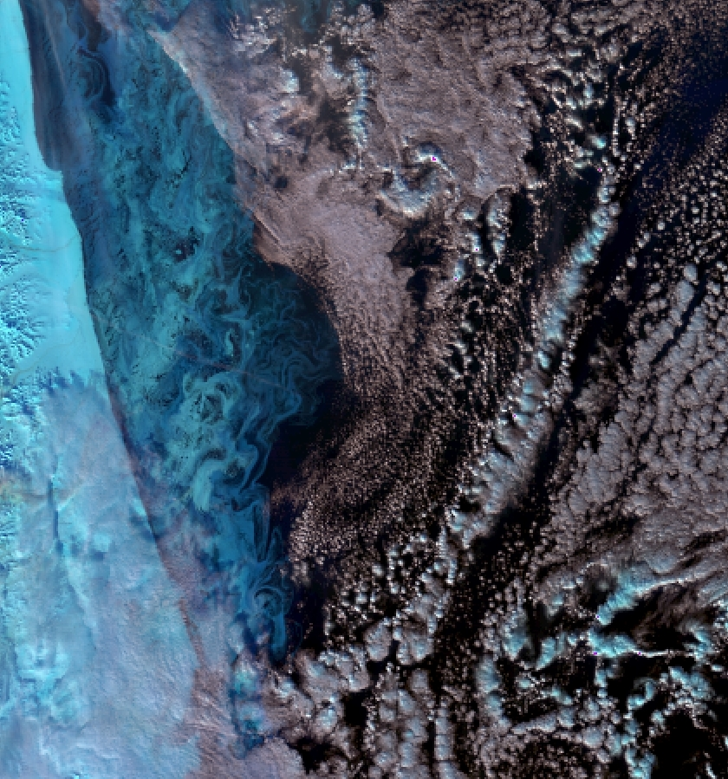
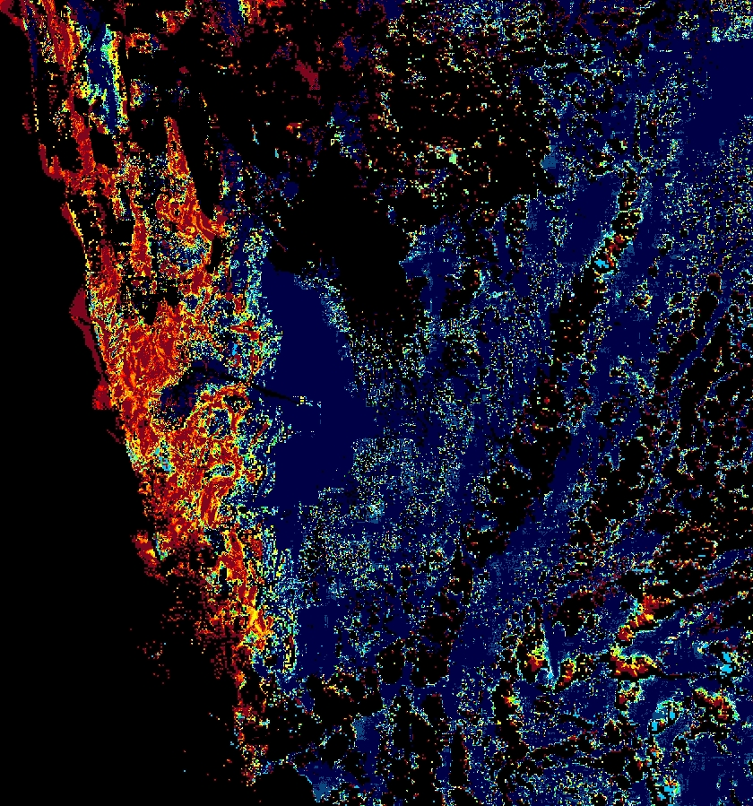
Caveats for Operational Ice Concentration IP
Observed Missing Sea Ice
Fill
Cloud
0.0
0.01
0.1
0.2
0.3
0.4
0.5
0.6
0.7
0.8
0.85
0.9
0.95
0.96
0.98
0.99
1.0
ice fraction
R. Mahoney NGAS
Some regions of missing sea ice have been observed in the VIIRS Ice Concentration IP for thin ice as shown in the circled region. False ice near clouds area also seen and for low ice fractions
Robert Mahoney, NGAS
Robert Mahoney, NGAS

Slide 27
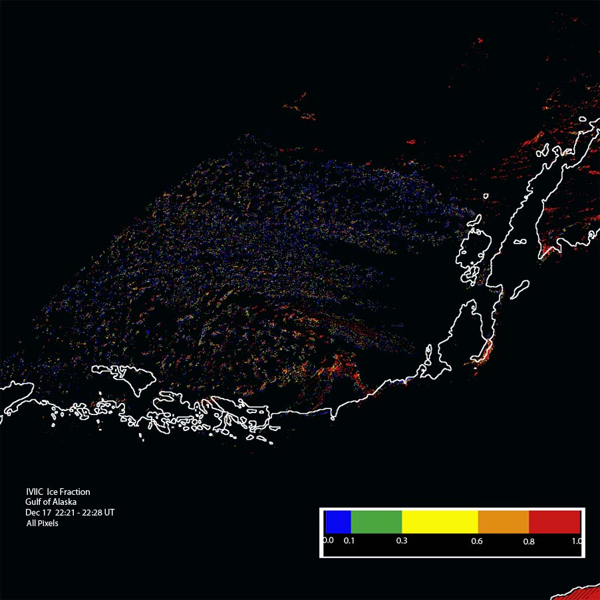
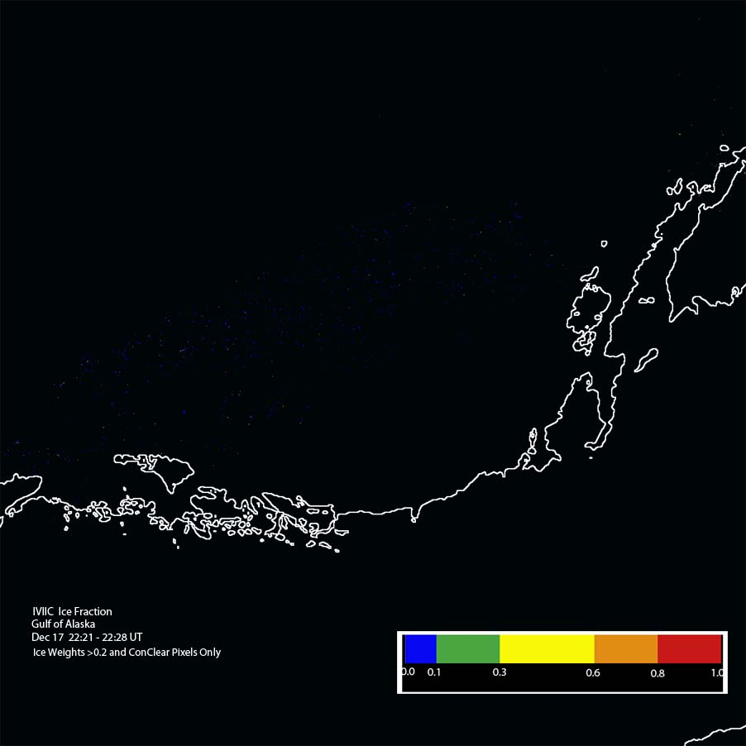
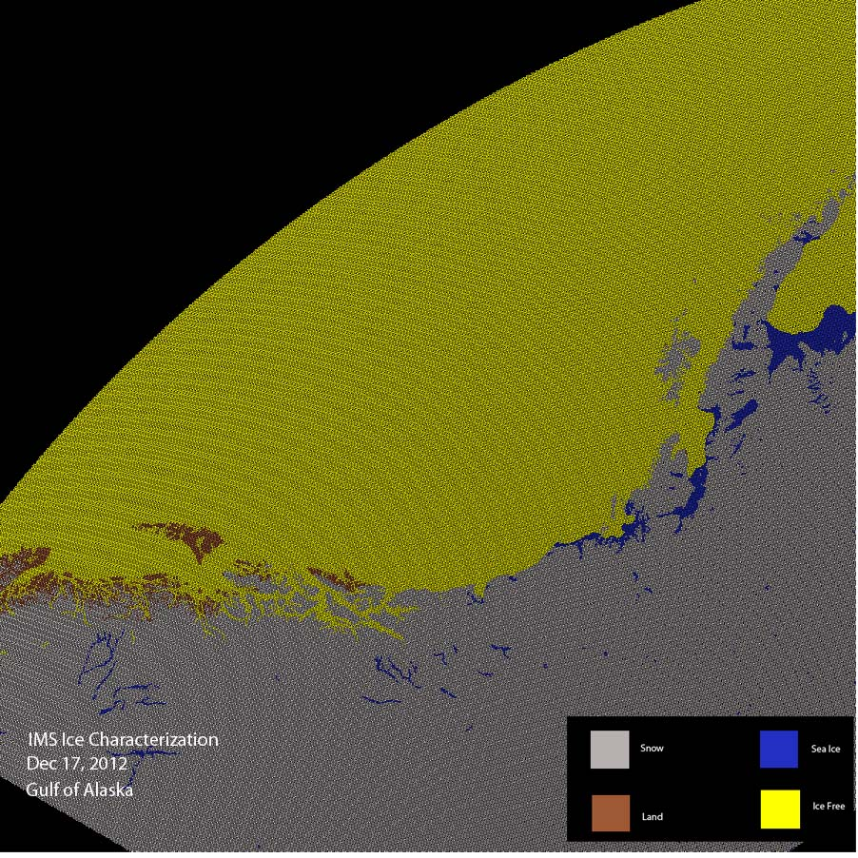
Provisional Maturity Evaluation
- test to improve SIC IP
12/17/12: False ice (left) in Gulf of Alaska, removed (center) in local test after applying threshold for ice concentration weights. IMS ice data (right), showing absence of sea ice in this region (all ice-free).

Slide 28
Provisional Maturity Evaluation
- Sliding Window Cloud Filtering Test
False Ice near clouds
Fill
Land
Cloud
0.0
0.01
0.1
0.2
0.3
0.4
0.5
0.6
0.7
0.8
0.85
0.9
0.95
0.96
0.98
0.99
1.0
ice fraction
R. Mahoney NGAS
Results of partial cloudy filter tests for mosaic of VIIRS Sea Ice Concentration IP granules for Arctic 12-18-2012. Upper figure shows unfiltered ice concentration IP and lower figure shows results after application of a 15% non-confidently clear tie point search window filter. Further tests are required to determine the benefits and drawbacks of such an approach as an additional quality check in the Ice Concentration IP.

Slide 29
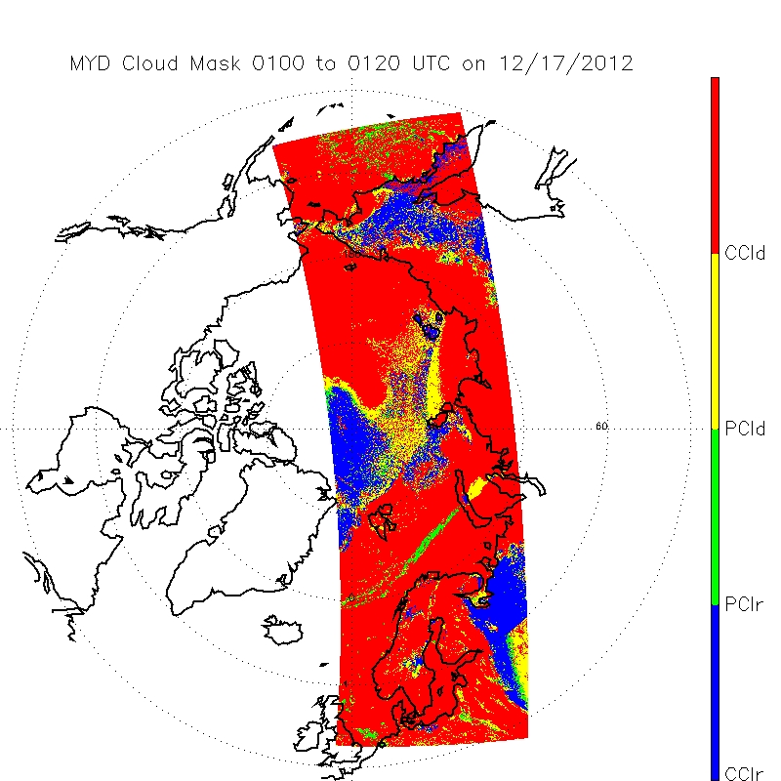
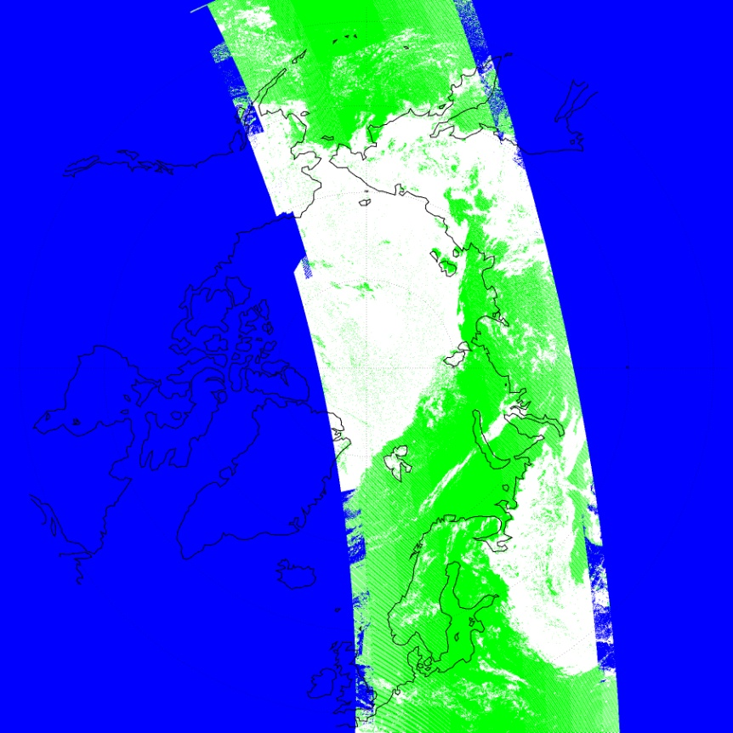
VIIRS/MODIS Cloud Confidence Discrepancy Observed in Night Arctic Scenes
MODIS Cloud Mask 17 Dec . 2012 (0100-0120)
VIIRS Cloud Mask 17 Dec . 2012 (0023-0047)
d20121217_t0023488
d20121217_t0025142
d20121217_t0026369
d20121217_t0028050
d20121217_t0029304
d20121217_t0030558
d20121217_t0032212
d20121217_t0033466
d20121217_t0035120
d20121217_t0036374
d20121217_t 0038028
d20121217_t0039265
d20121217_t0040506
d20121217_t0042173
d20121217_t0043427
Red = Conf. Cldy.
Blue = Conf. Clear
Confidently Cloud = Green
Confidently Clear = White
Region of discrepancy
Large region shown by MODIS cloud mask as confidently cloudy is shown as confidently clear in the VCM.

Slide 30

VIIRS SDR False Color Brightness Temperature Difference and Brightness Temperatures (Red: M15-M16, Green: M16, Blue: M12)
Confidently cloudy (red)
Land water mask
Confidently clear (blue)
thin cirrus
VCM misses many area s of cloud but appears to correctly show some areas of clear regions when compared to MODIS cloud mask. Clouds identifiable in thermal band difference imagery above suggests VCM night performance improvements may be possible based on IR thresholding techniques.

Slide 31
Additional Supporting Documentation
TIM Meetings and Presentations
    Cal/Val Team Meeting, April 2012
    DR 4987 Sea Ice Concentration IP: Poor Performance Near Cloud Edges, January 3, 2013
Monthly/weekly reports https://groups.ssec.wisc.edu/groups/jpss/cryosphere/reports
NPP Science Team, Land Report, 12/12/2012

Slide 32
Future Plans and Issues
We are working to get these changes into the IDPS
  DR 7139, 4959, 4987, 4129, 7139
Detailed performance characterization requires:
  Further qualitative and quantitative comparisons with independent ice concentration sources
Major actions for the provisional maturity justification and schedule
  Implementation of additional quality checks and associated quality flags (MX 9.0)

Slide 33
Conclusion
VIIRS Sea Ice Concentration IP has met the provisional maturity stage based on the definitions and the evidence shown
  It exceeds the definition of provisional in most cases
  Off-line IP product performance appears to be of sufficient quality for use by the Sea Ice Age EDR to identify ice to be classified as well as for Ice Surface Temperature EDR to identify sea ice for retrievals
Some issues have been uncovered during validation and solutions are being evaluated.

Slide 34
Summary: VIIRS Sea Ice Characterization EDR
Summary of Sea Ice Characterization (SIC) EDR
History of Algorithm Changes/Updates
Provisional Maturity Evaluation
Provisional Justification Summary
Caveats of Operational VIIRS SIC EDR
Conclusions

Slide 35
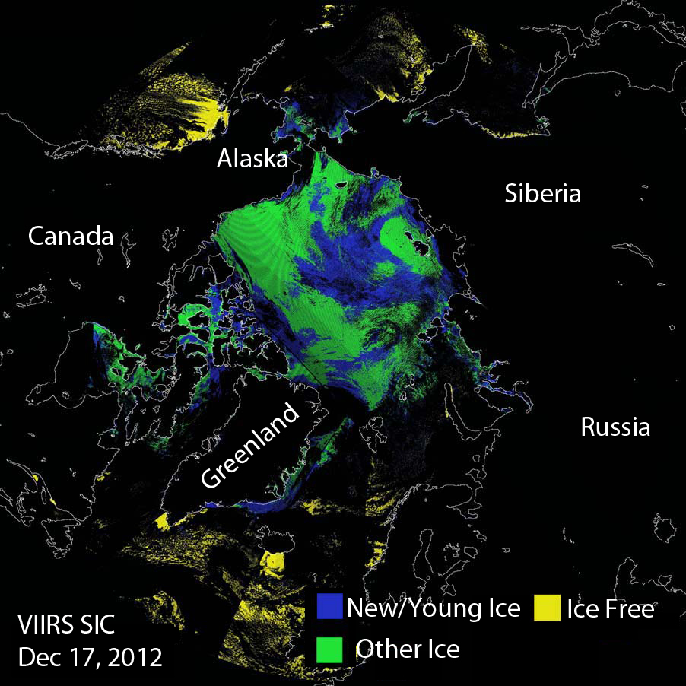
VIIRS Sea Ice Characterization

Slide 36
Summary of VIIRS Sea Ice Characterization EDR
The VIIRS Sea Characterization EDR (Ice Age) consists of ice classifications for Ice Free, New/Young and Other Ice at VIIRS moderate spatial resolution (750 m @ nadir), for both day and night, over oceans poleward of 36ºN and 50ºS latitude.
New or Young ice is discriminated from thicker ice (Other Ice) by a threshold ice thickness of 30 cm. Discrimination of New/Young ice from thicker ice is achieved by two algorithms:
  1. Energy (heat) balance based retrieval for night and high solar zenith angles
  2. Reflectance/ice thickness retrieval using modeled Sea Ice Reflectance LUT for daytime
Inputs: Ice Reflectance/Temperature IP, Ice Quality Flags IP, AOT IP, granulated ancillary surface wind speed, surface air pressure, surface air temperature and surface air specific humidity. Modeled Snow Depth/Sea Ice Climatology LUT, modeled sea ice reflectance LUT, sea ice spectral albedo and broadband albedo LUTs, atmospheric transmittance LUT
Heritage: No operational Visible/IR heritage. AVHRR research heritage (Comiso and Massom 1994, Yu and Rothrock 1996 and Wang et al. 2010)

Slide 37
Summary of the VIIRS Characterization EDR (Ice Age) Algorithm Inputs
NPOESS xDRs & IPs
Output EDRs & IPs
VIIRS 375m TC GEO
VIIRS 750m TC GEO
VIIRS Ice Quality Flags IP
VIIRS Ice Weights IP
VIIRS Ice Concentration IP
VIIRS Ice Refl./Temp. IP
VIIRS Surface Temperature IP
OMPS Tot. Col. Ozone 1st gues IP
Sea Ice Characterization (Ice Age) EDR
VIIRS Sea Ice Age EDR
Auxiliary Data
VIIRS Ice Age Tunable Parameter File
Sea Ice Modeled Refl. and Shortwave BB Albedo LUT
Snow-Depth-Ice-Thickness Climatology LUT
Atmos. Broadband Transmittance LUT
Ancillary Data
NCEP Gran. Anc. Sfc. Air Temp.
NCEP Gran. Anc. Sfc. Air Pressure
NCEP Gran. Anc. Sfc. Wind Speed
NCEP Gran. Anc. Sfc. Specific Humidity
NCEP Gran. Anc. Precipitable Water
Notes:
Ancillary
GFS forecast surface pressure, lapse rate, and air temperature (for topography corrected surface pressure)
Look-up tables
DEM for surface altitude
Infrared and Microwave OSS coefficients
Local Angle Correction
IR emissivity and reflectivity covariance
MW emissivity covariance
AVTP and AVMP and Ozone covariance

Slide 38
Summary of VIIRS Sea Characterization EDR (Ice Age) Algorithm Overview
Reflectance Threshold Branch (Day Region Algorithm)
Input ice tie point reflectance (I1, I2), VCM IP, AOT IP
Input granulated NCEP gridded precipitable water, total ozone fields
Obtain snow depth for each ice thickness bin obtained from climatology modeled snow depth/ice thickness LUT
Retrieve ice thickness from sea ice reflectance LUT using ice tie point reflectances, modeled snow depth, AOT, precip. water and solar and satellite view geometry
Classify by comparing retrieved ice thickness to 30 cm ice thickness threshold
Energy Balance Branch (Terminator and Night Region Algorithm)
Input Ice Temperature Tie Point IP
Input granulated NCEP gridded surface fields (sfc.P, sfc air temp, specific hum. etc…)
Compute snow depth for 30cm ice thickness threshold from heat/energy balance
Classify by comparing computed and climatology LUT snow accumulation for a 30 cm ice thickness threshold
The Snow-Depth-Ice Thickness Climatology LUT contains:
predicted snow accumulation depths for modeled ice thickness threshold growth times
based on monthly climatology surface air temperatures and precipitation rates

Slide 39
History of Algorithm changes/updates
Date | Update/DR# | Reason | Status
2/27/2013 | DR 7068 | RTN Sev2 PCR (VIIRS-SIC-EDR fill conditions not applied to both fields in the EDR) | open
02-03-2011 | DR 4197 | Sea Ice Model based problems | Future Re-Evaluation
07-17-2009 | DR 2844 | Sea ice age ATBD does not meet scientific standards | open
07-17-2009 | DR 2723 | Snow-depth-on-sea-ice-LUT | To be re-evaluated

Slide 40
Ice Age Day (reflectance based) Algorithm Dependencies on Ancillary Data and LUTs
Data Type | Description
O3 | NCEP granulated Total Col. Ozone
PW | NCEP granulated Precip.Water
Snow Depth/Ice Thickness Climatology LUT | Modeled snow depth accumulation as a function of ice thickness (based on computed ice thickness growth time from long term monthly NCEP climatology precip. rate and surface. air temp)
Sea Ice Reflectance LUT | Sea Ice reflectance (RTM modeled) for I1, I2 as a function of : ice thickness, snow depth, precip. water , total ozone, aot , aerosol model(2), solar zenith, relative azimuth, sat. view zenith
Discontinuities in the ice age sometimes observed aligned along 0.5 deg. lat/lon boundaries are strongly suggestive of sensitivity to the NCEP granulated ancillary fields.

Slide 41
VIIRS Sea Ice Characterization EDR
Provisional Maturity Evaluation
Provisional Maturity Evaluation Approaches
  Our analysis has focused on the Beaufort Sea, but other regions in the Arctic and Antarctic, as well as global coverage, have been analyzed for one or more days
  Comparison of Summer Sea Ice Characterization (SIC) EDR to ice coverage shown by 4-km IMS data
    At this time of year, all ice should be “other ice” (not new/young) so comparison is possible
  Manual inspection of SIC EDR images in specific regions and globally
  Comparison of SIC EDR ice classification to National Ice Center charts
  Comparisons to limited amount of airborne ice thickness data

Slide 42
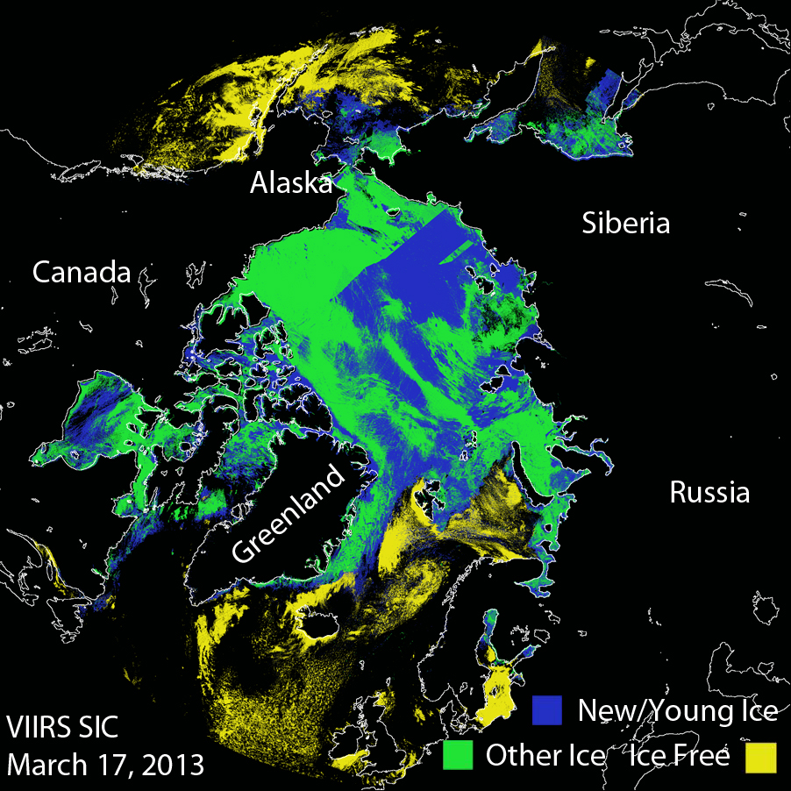
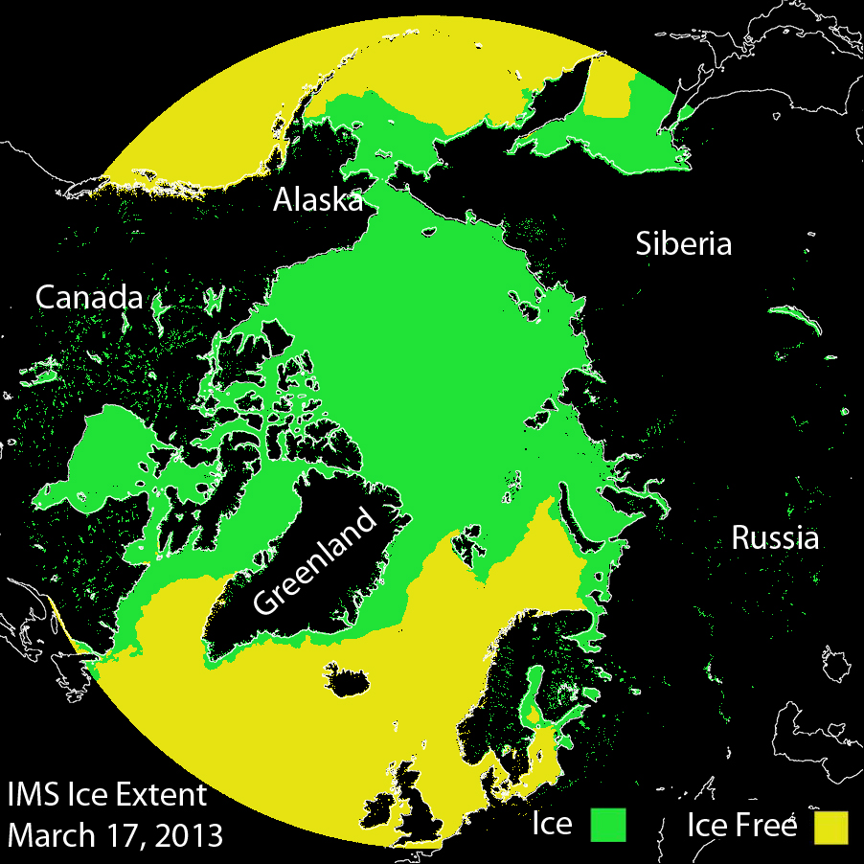
VIIRS Sea Ice Characterization EDR
Provisional Maturity Evaluation
SIC EDR (left) vs. IMS Ice Extent (right). Ice coverage is similar, but new/young ice is too extensive (as seen by manual interpretation).

Slide 43
Provisional Maturity Evaluation VIIRS Sea Ice Characterization EDR vs. Passive Microwave
Sea ice extent is realistic, but with some false ice over open water, misclassification of new/young vs. other ice, and some misplacement of land values.

Slide 44
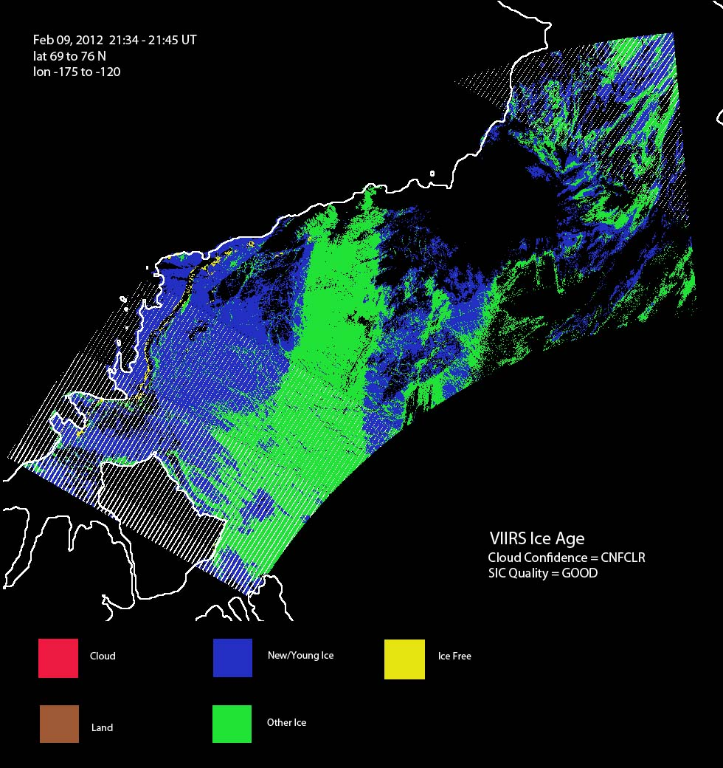
Provisional Maturity Evaluation
Ice Type Misclassification Due to Cloud
VIIRS SIC on Feb 9, 2012 in the Beaufort Sea for VIIRS cloud mask confidently clear and good SIC quality flag data. New/Young ice (in blue) on left is misclassified, likely due to the presence of cloud.

Slide 45
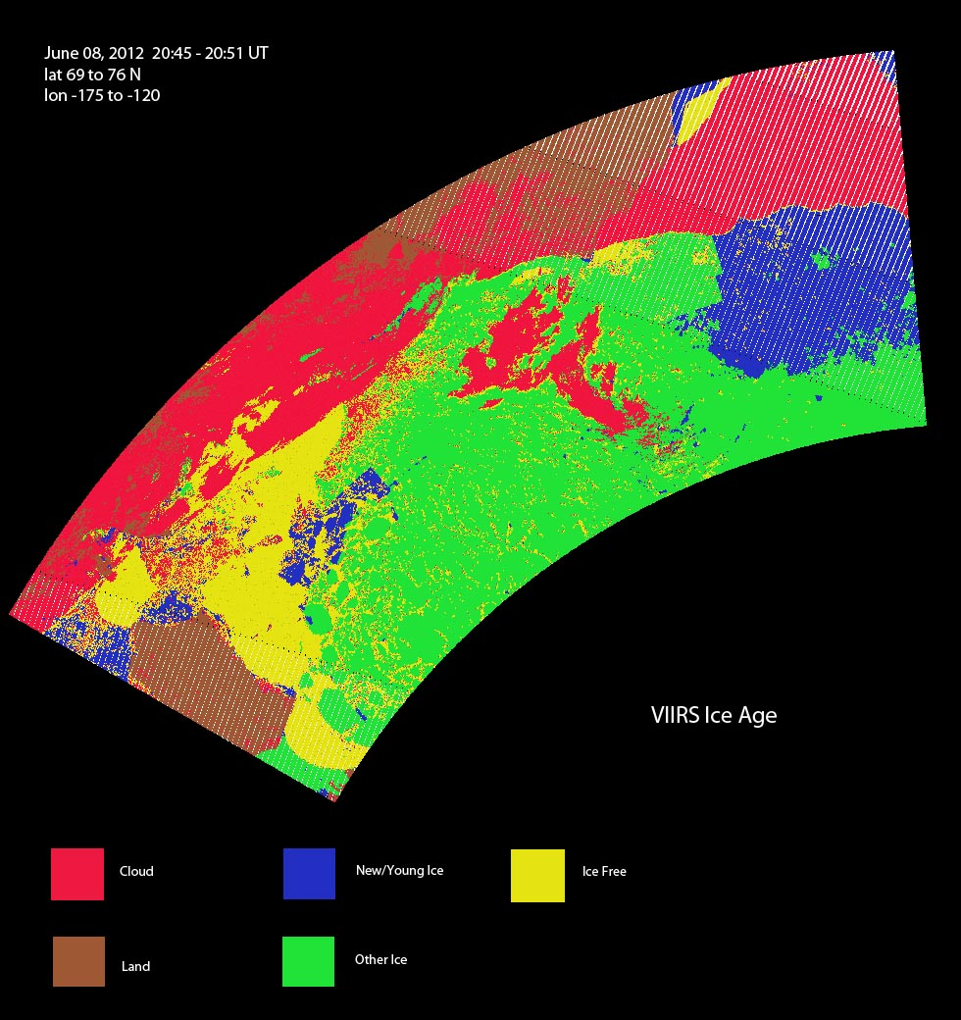
Provisional Maturity Evaluation
Misclassification during melt season
SIC EDR for June 8, 2012, Beaufort Sea. New/Young ice (blue) is misclassified. It should not exist in June.

Slide 46
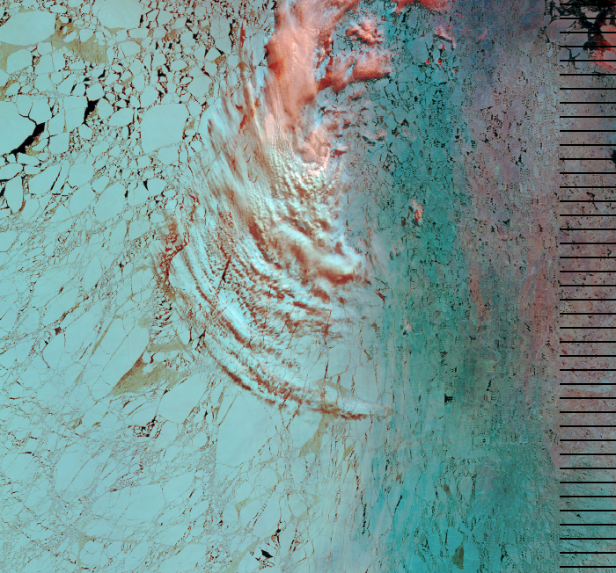
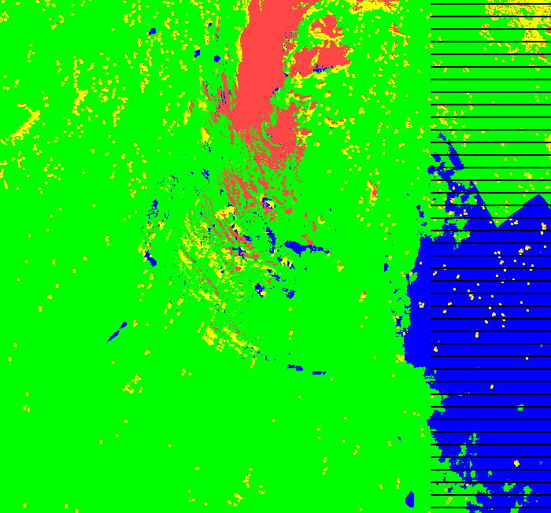
VIIRS Sea Ice Characterization EDR Anomalies over Beaufort Sea (June 8, 2012)
Some misclassification evident due to VCM IP cloud leakage and cloud shadows
Discontinuities detected along lat/lon boundaries spaced 0.5 deg.
72.5 N
73.0 N
163.0 W
Large region misclassified where ice tie point reflectance values drop below ~ 0.53
Discontinuities that align along 0.5 steps of latitude and longitude are evident as shown along the dashed lines are strongly suggestive of sensitivity to the NCEP precipitable water field. The reflectance based day algorithm has dependencies on the coarse resolution , gridded NCEP ancillary fields for precipitable water and total column ozone. In addition the algorithm also has a dependency on the climatological snow accumulation depth/ice thickness LUT (modeled using 2.5 deg. surface air and precipitation rate climatology data) .

Slide 47
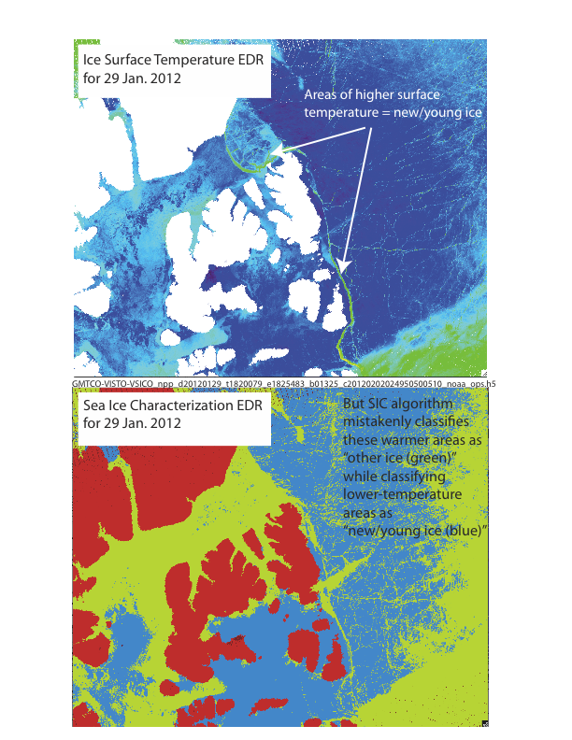
Provisional Maturity Evaluation
Ice Type Misclassification
Winter scenes show misclassification of new/young ice and other ice. Sea ice “leads” consisting of relatively warm and thin ice should be classified as new/young ice. SIC winter scenes examined instead show some of this ice as “other ice” while thick, cold ice is mapped to “new/young ice” in some locations.

Slide 48
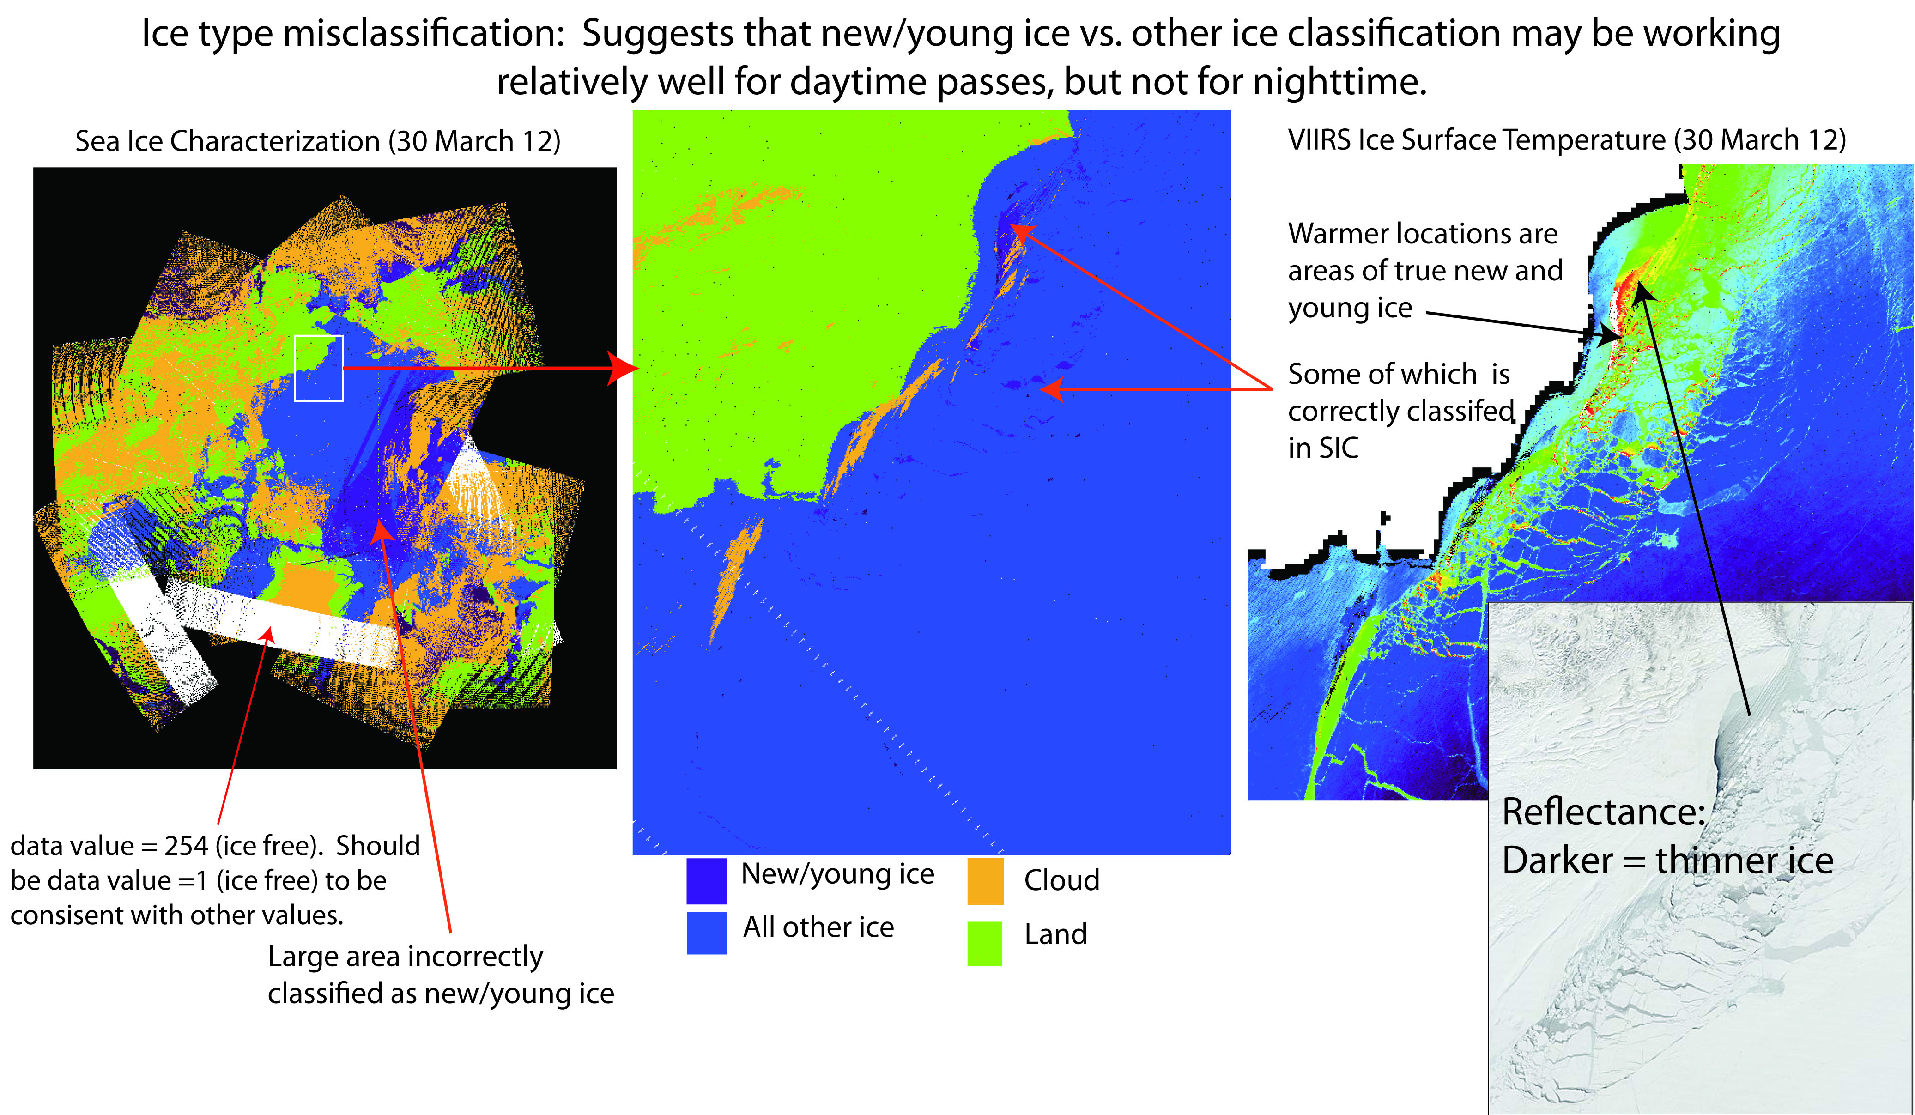
Provisional Maturity Evaluation
Ice Type Misclassification

Slide 49
Provisional Maturity Evaluation
SIC EDR vs. MODIS Ice Extent
 | ALLCLD ALLQUAL #1 | ALLCLD GOOD #2 | CNFCLR ALLQUAL #3 | CNFCLR GOOD #4
MODIS Ice Pix | 63252 | 27889 | 40190 | 27889
VIIRS Ice Pix | 45136 | 32458 | 33368 | 32458
VIIRS New/Young Ice Pix | 42708 (94.6%) | 31867 (98.2%) | 32485 (97.4%) | 31867 (98.2%)
VIIRS Other Ice Pix | 2428 (5.4%) | 591 (1.8%) | 883 (2.6%) | 591 (1.8%)
Ice Agree | 30695 (48.5%) | 27608 (99.0%) | 27902 (69.4%) | 27608 (99.0%)
MODIS Ice Free Pix | 83064 | 59067 | 62080 | 59067
VIIRS Ice Free Pix | 109187 | 61632 | 80778 | 61632
Ice Free Agree | 74192 (89.3%) | 58511 (99.1%) | 61479 (99.0%) | 58511 (99.1%)
MODIS ICE VIIRS Cloud | 15599 | N/A | N/A | N/A
MODIS Ice VIIRS Free | 16958 | 281 | 12288 | 281
Ice Type Classification Accuracy* | 5.4% | 1.8% | 2.6% | 1.8%
SIC EDR is compared to MODIS over sea ice during the melt period, when only “other ice” is expected.
Beaufort Sea, July 23, 2012
NOTE BOTTOM ROW
ALLCLD=No Cloud Cover Quality Flag Filter
ALLQUAL=No Ice Quality Flag Filter
CNFCLR=Only Pixels with Confidently Clear Cloud Cover Flag
GOOD=Only pixels with Good Ice Quality Flag
* note: all pixels with good ice quality are confidently clear, so columns 2 & 4 are identical.

Slide 50
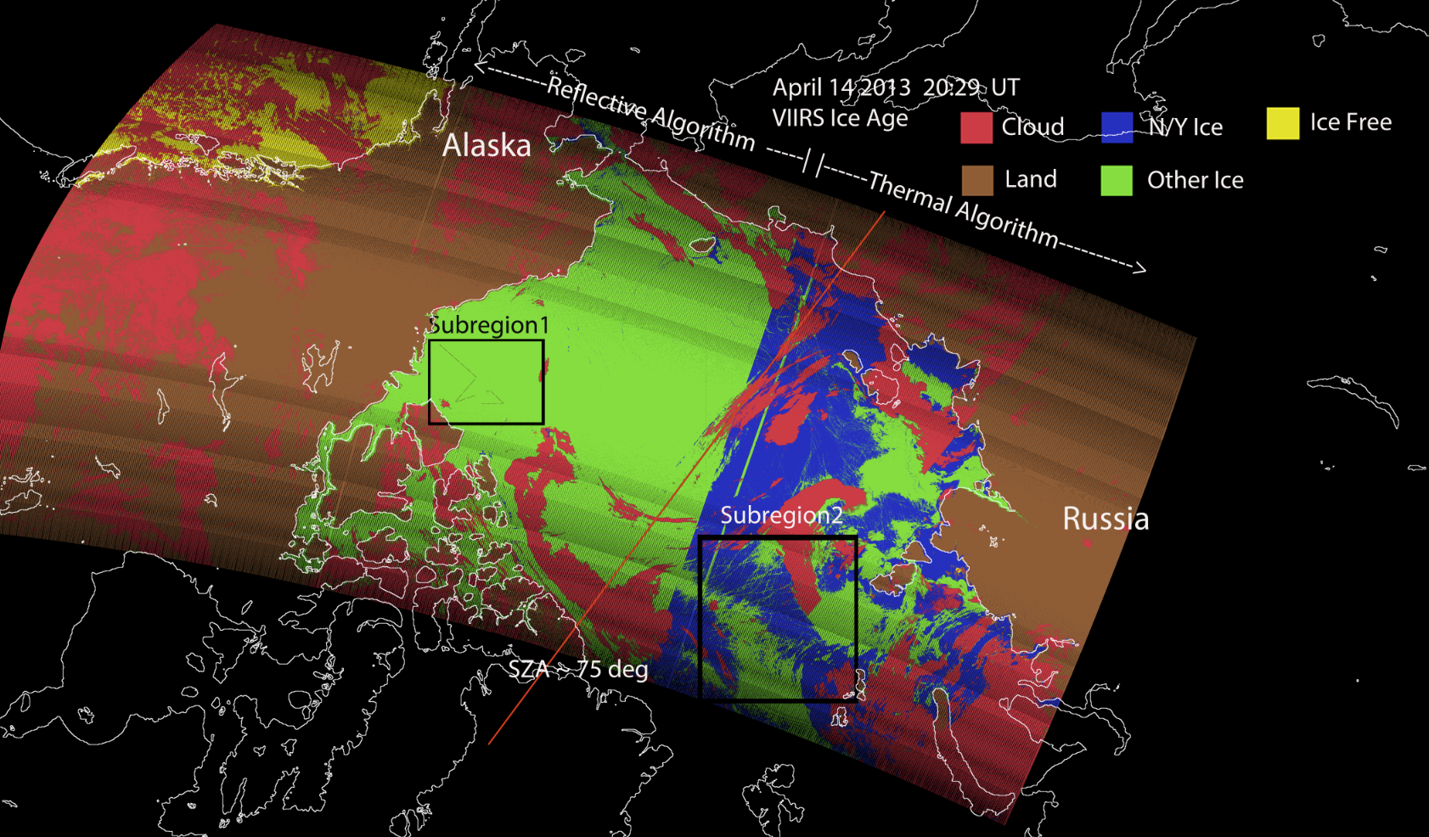
Provisional Maturity Evaluation
Note Sub Region 1 – Airborne Ice Thickness Data

Slide 51
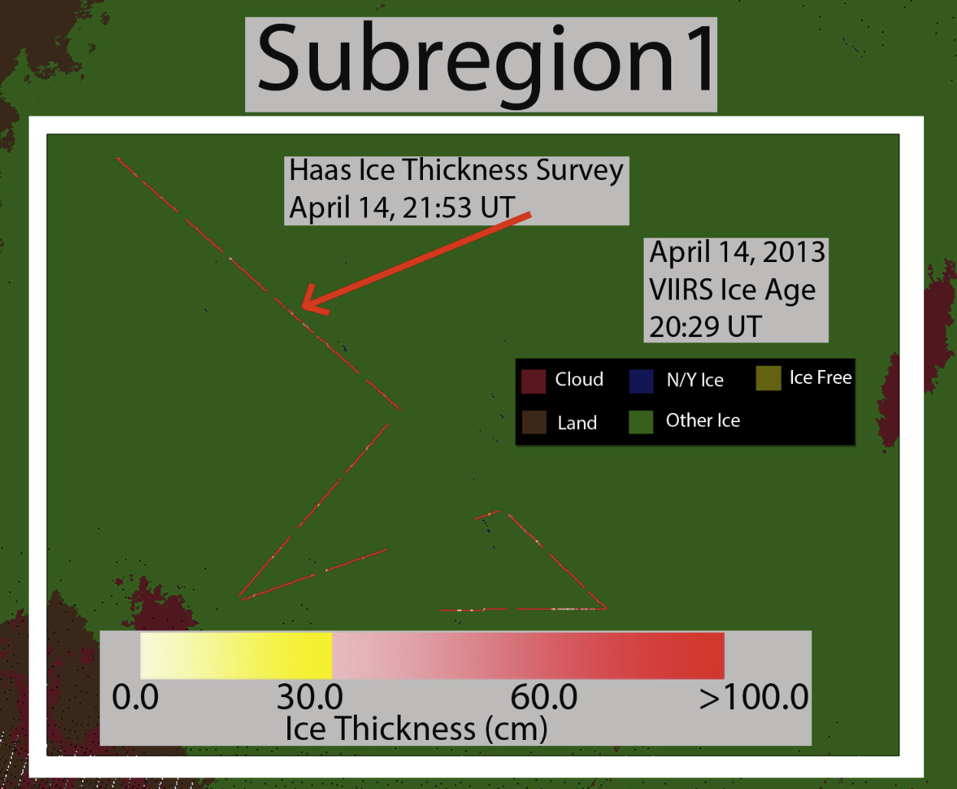
Provisional Maturity Evaluation
Airborne Ice Thickness Data
Thickness (cm) courtesy of C. Haas: Airborne EM & Lidar
All ice for VIIRS SIC EDR is “other ice” (> 30 cm)
1004 airborne data points: 99% > 30 cm (in agreement with VIIRS SIC EDR)

Slide 52
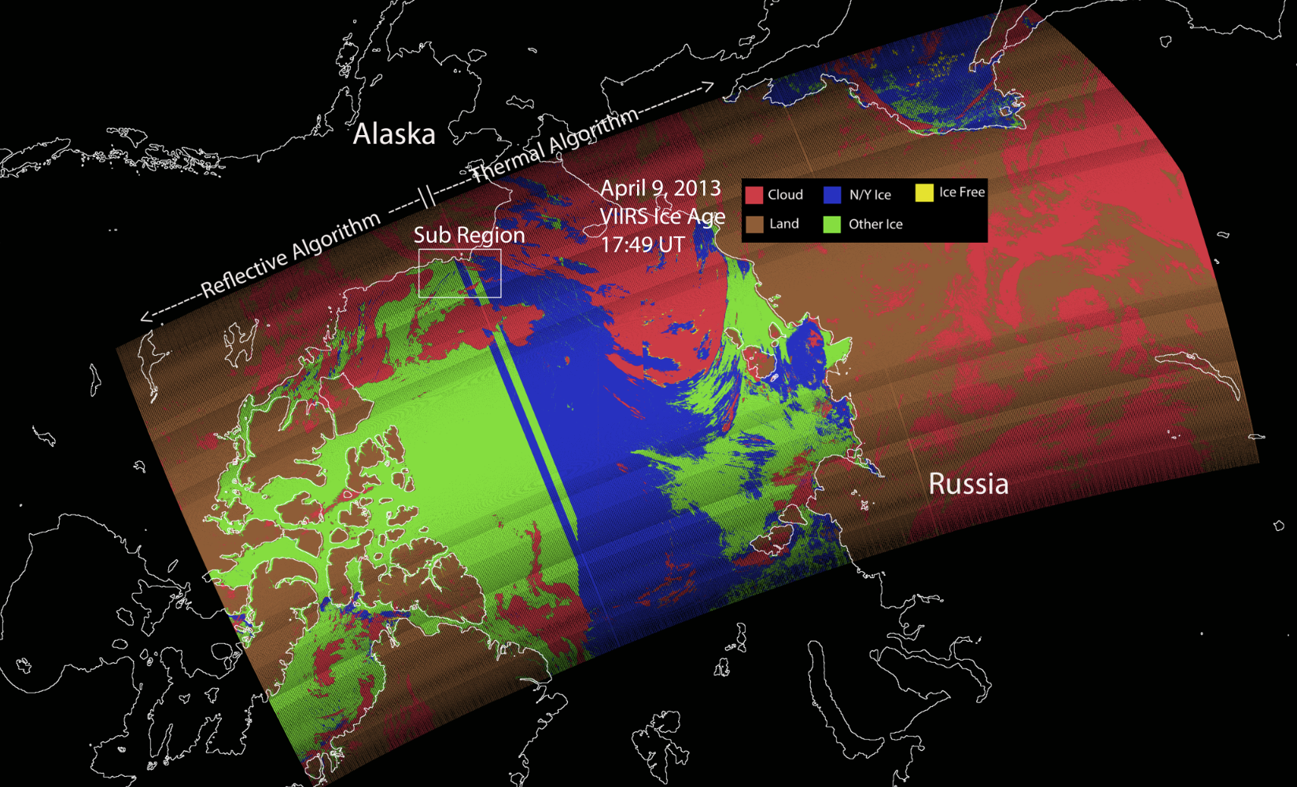
Provisional Maturity Evaluation note Sub Region - Airborne Ice Thickness Data -
Also note classification issues transitioning from VIIRS SIC EDR daytime (reflective) to nighttime (thermal) algorithm.

Slide 53
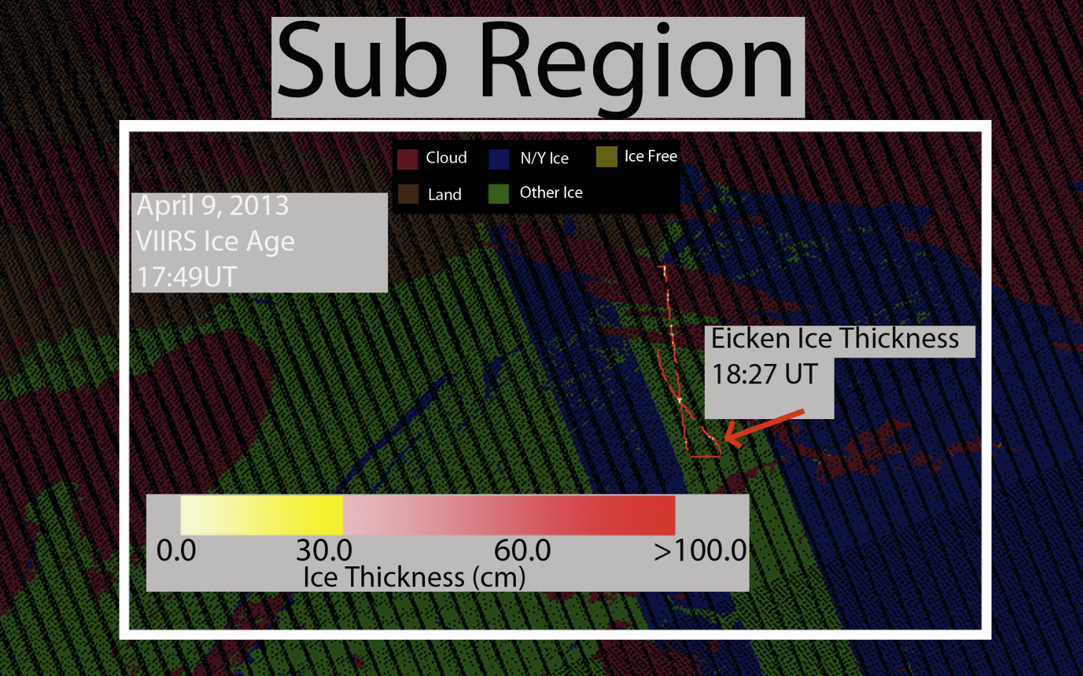
Provisional Maturity Evaluation
Airborne Ice Thickness Data
SIZONET data (Eicken et al.)
Airborne EM & Lidar, same system used by Haas et al. (2007)
Note: this is quicklook data and has not been qc’d, so will be used as a future data source for validation.
Before QC, classification accuracy is 42% correct (VIIRS SIC vs Aircraft data)
Note that aircraft validation data is VERY limited (In this survey, only 130 points collected)

Slide 54
Provisional Maturity Evaluation
Note Sub Region 2 – Test of Validation Algorithm

Slide 55
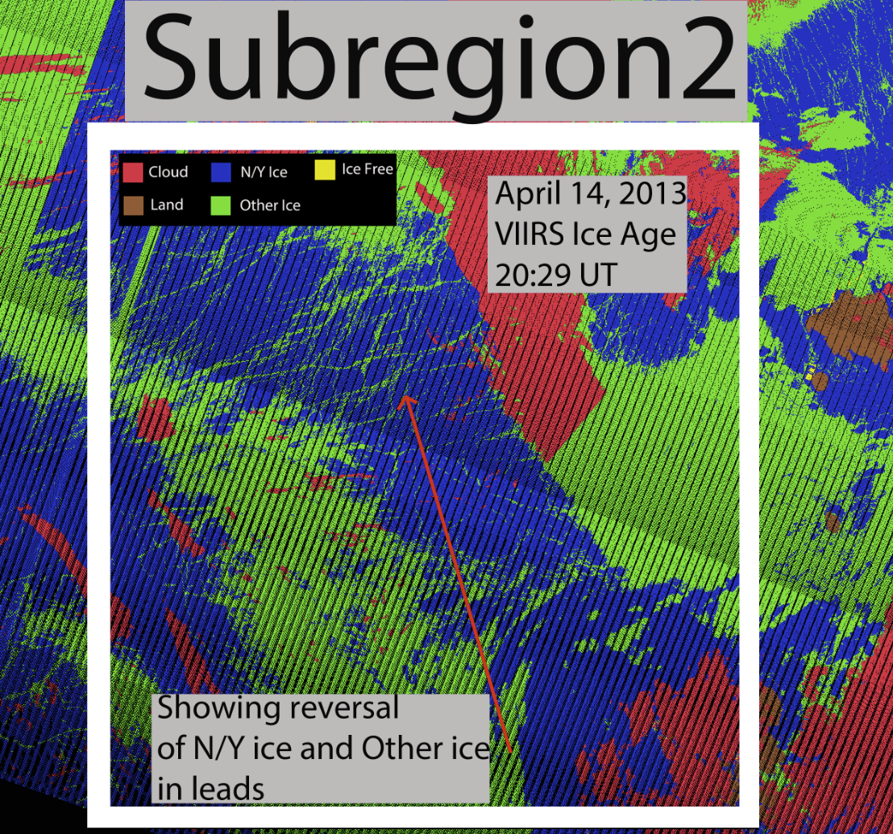
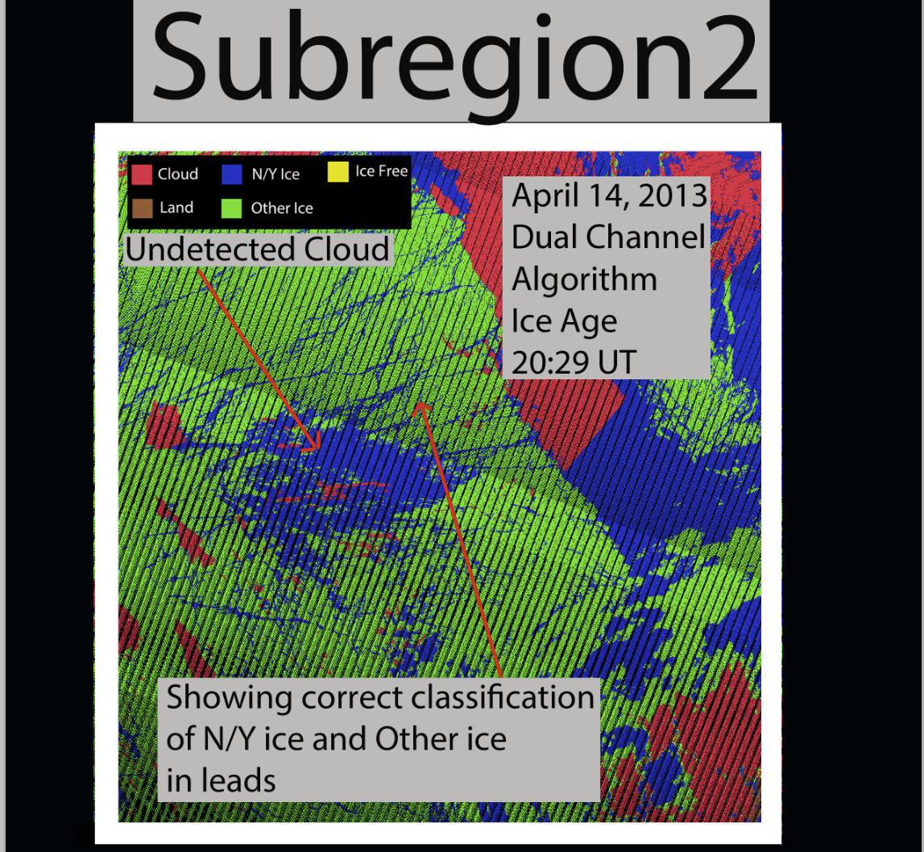
Provisional Maturity Evaluation
Test of Simplified Daytime Algorithm for Validation
Leads misclassified as “other ice”
Ice surrounding leads misclassified as “new/young ice”
Using a simple M7 / IST “dual channel algorithm,” areas of new/young and other ice are identified, assisting with estimates of classification accuracy.

Slide 56
Provisional Justification Summary
Version control is in affect
IDPS build number: Mx6.7 and earlier for validation results
ATBDs are accurate, up-to-date and consistent with the product running.
General research community is encouraged to participate in the QA and validation of the product, but need to be aware that product validation and QA are ongoing
  Cryosphere SIC EDR team has evaluated IDPS EDR products available from CLASS. Users can access and read the products and the product compares reasonably with the heritage satellite snow map products

Slide 57
Provisional Justification Summary
Users are urged to consult the EDR product status document prior to use of the data in publications
  Sea Characterization EDR performance is dependent on VIIRS Imagery resolution SDRs and the VIIRS Surface Temperature IP tie points.
  It is also dependent on the VIIRS Cloud Mask IP, and AOT IP through the Ice Quality Flags IP and Ice Weights IP, and NCEP ancillary surface data. Dependencies on LUTs include LUTs for model TOA snow/ice reflectance, broadband albedo, atmospheric transmittance and a modeled climatology based snow depth/ice thickness LUT.
    VIIRS SDR Cal and Geo products reached provisional maturity in Mar. 2013
    VIIRS Cloud Mask IP reached provisional maturity in Feb. 2013
    VIIRS Aerosol Optical Thickness reached beta maturity in Sep. 2013
    VIIRS Surface Temperature IP path forward plan in place (DR 2936, slide 12)

Slide 58
Provisional Justification Summary
Criteria: Product is not appropriate as the basis for quantitative scientific publication studies and applications
  The product has known flaws (see caveats slides later in this presentation). It is clearly not suitable for use in publications.

Slide 59
Caveats for Operational VIIRS Sea Ice Characterization EDR
Known problems and proposed technical solutions
  In general, significant discontinuities in ice classification between New Young and Other Ice have been observed in the granule level mapped composite data.
    Proposed solution: Investigate and mitigate sensitivity of retrievals to NCEP ancillary data inputs. Mitigation strategies include use of parameterizations or climatology
  Ice classification discontinuities are very evident near the terminator region where the algorithm transitions from the day reflectance based algorithm to the night energy balance based algorithm
    Proposed solution: Nighttime algorithm could be revised to utilize a local sliding IST window. For example, if the IST for the pixel is greater than the mean plus a threshold of the IST in the moving window, then it would be re-classified as new/young ice. )
    Proposed solution: Investigate whether there is a problem with the solar energy flux term used by the heat balance for solar zenith angles between 80° and 90° and correct the implementation if necessary.
  The snow depth thresholds based on the snow accumulation depth/ice thickness climatology LUT are problematic
    Proposed solution: LUT generation logic requires modification to correct climatologically unrealistic values of snow accumulation depth identified the current LUT
    Proposed solution: Investigate use of ancillary precipitation to derive snow depth and compute an ice thickness based on that snow depth. Dependence on the problematic SnowDepth/IceThickness Climatology LUT can then be eliminated.

Slide 60
Caveats for Operational VIIRS Sea Ice Characterization EDR (additional issues)
  False ice is frequently observed near cloud edges
    Proposed solution: Implement additional quality checks for extended cloud adjacency and partly cloudy conditions within the ice tie point search window in the Sea Ice Concentration IP and pass quality flag to Sea Ice Characterization EDR
  Ice misclassifications occur due to low opacity clouds or ice fog, particularly during nighttime
    Proposed solution: Assistance from VCM to improve cloud vs. ice detection
  Thin ice in small leads are evident in SDR imagery are sometimes not detected and are classified as thicker “Other ice”
    Proposed solution: Investigate using VIIRS SDR reflectance and Surface Temperature IP value at each pixel for retrievals instead of the ice tie point
    Proposed solution: Add an ice temperature threshold hold test to the day reflectance algorithm as a consistency check for the day, reflectance based retrievals
  Lower reflectance of melting sea ice appears to cause the SIC EDR to indicate New/Young Ice, although this type of ice cannot be present this time of year.
    Proposed solutions: Define and utilize melt season period where New/Young ice cannot exist. Could do this by date/latitude or possibly with IST or NCEP air temp input. During this time, ALL ice would be classified as “other ice”
    Investigate reflectance and temperature thresholds used in the algorithm
    Investigate and mitigate sensitivity of retrievals to NCEP ancillary data inputs
    Change the category “New/Young Ice” to “Thin Ice”. Thin ice can occur, through melt, in the warm season.

Slide 61
Additional Supporting Documentation
TIM Meetings and Presentations
    Cal/Val Team Meeting, April 2012
Monthly/weekly reports https://groups.ssec.wisc.edu/groups/jpss/cryosphere/reports

Slide 62
Future Plans and Issues
We are working to get these changes into the IDPS
  Implement additional quality checks for extended cloud adjacency and partly cloudy conditions within the ice tie point search window in the Sea Ice Concentration IP
Detailed performance characterization requires:
  Analysis of sensitivity of retrievals to NCEP ancillary data inputs and snow depth on sea ice
Major actions for the provisional maturity justification and schedule
      Revision, testing and implementation of SIC EDR Nighttime Algorithm, possibly utilizing a local sliding IST window. Fall 2014?
      Revision, testing and implementation of SIC EDR Daytime Algorithm to possibly include:
        Redefine the category to be thin ice (< 30 cm) or define a melt season period where New/Young ice cannot exist, or utilize IST checks to assist with ice type definition Mid-2014?
        Use of ancillary precip. field to improve snow depth estimates and to derive ice age based on ice thickness computed from snow depth. Mid-2014?

Slide 63
Conclusion
VIIRS Sea Ice Characterization EDR has met the provisional maturity stage based on the definitions and the evidence shown
Some issues have been uncovered during validation and solutions are being evaluated.

