Slide 1
VIIRS land Surface Temperature (LST) Provisional Status
Dr. Yunyue YU – LST EDR Lead
Dr. Ivan Csiszar – Land Product EDR Lead
Dr. Jeffrey Privette – Land Product Validation Lead
Contributors:
Yuling Liu, Zhuo Wang, Pierre Guillevic, Peng Yu, Leslie Belsma
May 31, 2013

Slide 2
LST Calibration Approach
Improvement for LST EDR is based on update of algorithm coefficients. The algorithm keeps the same format as baseline split window algorithm.
Two steps of calibration:
calibration from the radiance based simulation
calibration from comparisons to the reference dataset, i.e. ground truth and MODIS Aqua LST product.
All the 34 coefficients sets need to be calibrated (17 surface types, day and night conditions).
Calibration is based on the annual performance rather than the seasonal performance.
Notes:
Alg same format: surface type dependent
Fund restriction/cut limit the activities
Seasonal variation of errors cannot be calibrated on the 34 coeffs sets.

Slide 3
Flow chart of LST Calibration
LUT IDPS MX6.3
Radiance based Simulation
First Step
Regression calibration
Second Step Regression Calibration
Ground calibration
MODIS calibration
IGBP
4,6,7,8,10,12,14,16
IGBP
1,2,3,5,9,11,13,15,17
Day | Night
Day | Night

Slide 4
Calibration Equations
Split Window Algorithm:
Regression Calibration :
First step calibration :
Second step calibration :
Calibrated LST:

Slide 5
Data sets for LST calibration
Data sets
Radiance based simulation data set
Ground truth data set for the time period from Jan. 2012 to March 2013.
MODIS Aqua LST (MYD11_L2).
VIIRS LST data set retrieved from baseline split window algorithm using LUT compatible to MX6.3 build in IDPS.

Slide 6
Calibrated LUT
Table : Calibrated coefficient sets for daytime
Surface Type | a₀ | a₁ | a₂ | a₃ | a₄
1 | 14.09725 | 0.952054 | 3.628772 | 1.063013 | -0.72116
2 | 46.49631 | 0.84317 | 3.630332 | 2.42386 | -0.46282
3 | 19.15561 | 0.93878 | 2.243532 | 0.813863 | -0.16193
4 | 83.20458 | 0.717731 | 0.66112 | -2.70106 | 1.030025
5 | 21.09595 | 0.928608 | 3.659621 | 1.246776 | -0.75761
6 | 34.68417 | 0.892991 | 2.057732 | 0.370878 | -0.11038
7 | 23.29719 | 0.929813 | 2.111201 | 1.213785 | -0.17932
8 | 14.12894 | 0.961051 | 3.660384 | 1.372316 | -0.56754
9 | -19.2834 | 1.067944 | 2.605338 | 1.021086 | -0.28965
10 | 29.04222 | 0.908072 | 0.834016 | 0.059388 | 0.091796
11 | 41.10021 | 0.854104 | 5.427233 | 1.036486 | -0.82492
12 | 87.5046 | 0.694267 | 6.799456 | 2.728394 | -1.57036
13 | -8.22047 | 1.032807 | 1.166056 | 0.978909 | 0.306121
14 | 36.49564 | 0.879512 | 2.740735 | 2.379238 | -0.2124
15 | 51.80619 | 0.813552 | 0.487301 | 0.352144 | 2.713991
16 | 46.3273 | 0.85738 | 2.404385 | 0.889798 | -0.15684
17 | -13.4006 | 1.053738 | -0.07923 | 1.479963 | 0.327909

Slide 7
LUT after Calibration
Table : Calibrated coefficient sets for nighttime
Surface Type | a₀ | a₁ | a₂ | a₃ | a₄
1 | -13.0319 | 1.050311 | -1.3172 | 0.397226 | 0.444173
2 | -17.1079 | 1.064144 | -0.03215 | 1.192763 | 1.273679
3 | -5.53066 | 1.023238 | -0.51264 | 0.782135 | 2.940489
4 | -0.67262 | 1.008506 | 1.782233 | 1.031163 | 0.193119
5 | -6.20065 | 1.025126 | -0.74568 | 0.874003 | 1.161099
6 | 16.87514 | 0.956207 | 1.272964 | 0.40632 | 0.273115
7 | 8.16033 | 0.985068 | 1.112239 | 0.974629 | -0.69782
8 | -6.7826 | 1.027303 | 1.131303 | 0.819621 | 0.519747
9 | -10.5868 | 1.041501 | -1.04836 | 1.250769 | 1.219346
10 | -1.92048 | 1.016412 | 2.017803 | 1.304318 | 0.193718
11 | 5.66736 | 0.979304 | -0.58598 | 0.313569 | 1.468379
12 | -0.98175 | 1.010598 | 1.322288 | -0.39396 | 0.397286
13 | -6.66112 | 1.028283 | 0.94247 | 0.363574 | -0.78628
14 | 25.0644 | 0.914246 | 2.680287 | 0.810411 | 0.093822
15 | 3.73122 | 0.985113 | -1.38143 | 0.251886 | 1.766198
16 | 8.40627 | 0.984474 | 0.974452 | 0.83134 | 0.913031
17 | -4.65634 | 1.019516 | -0.07639 | 1.511793 | 0.162857

Slide 8
Provisional Definition
Product quality may not be optimal
Optimal would be LST attains all of its requirements
Incremental product improvements still occurring
DR history and future planned efforts will be shown
Version control is in effect
General research community is encouraged to participate
LST status and issues are posted and discussed in meetings
International cooperative activities involved
Users urged to consult the EDR product status
May be replaced in the archive
Ready for operational evaluation
Notes:
To be modified

Slide 9
Product Quality
Product quality is evaluated using ground data from SURFRAD and MODIS Aqua LST over the four representative months of January, April, July and October.
The latest coefficients set are implemented and compared with the IDPS LST built using the latest LUT in Mx6.3 build.
Results for the ground comparison and cross-satellite comparison are shown.
The product is expected for an improvement over a whole year not necessarily favor a certain season.
Only high quality data is used for the evaluation.

Slide 10
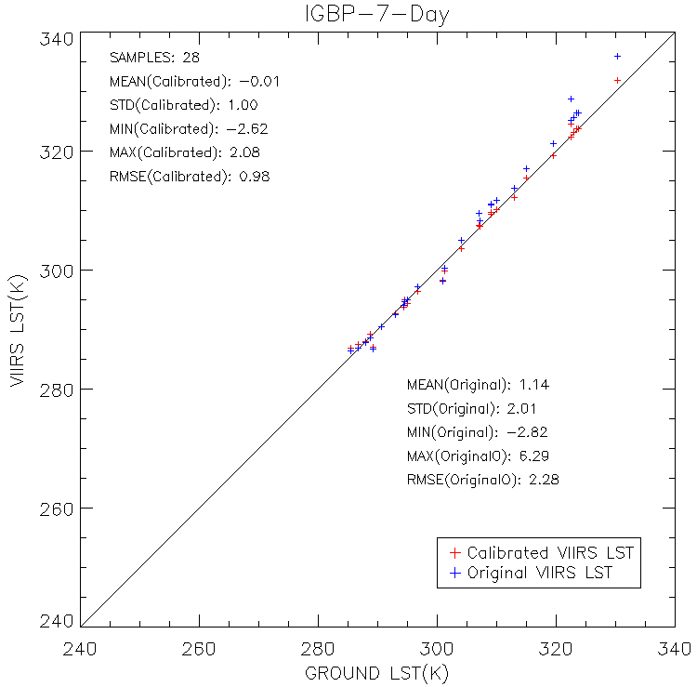
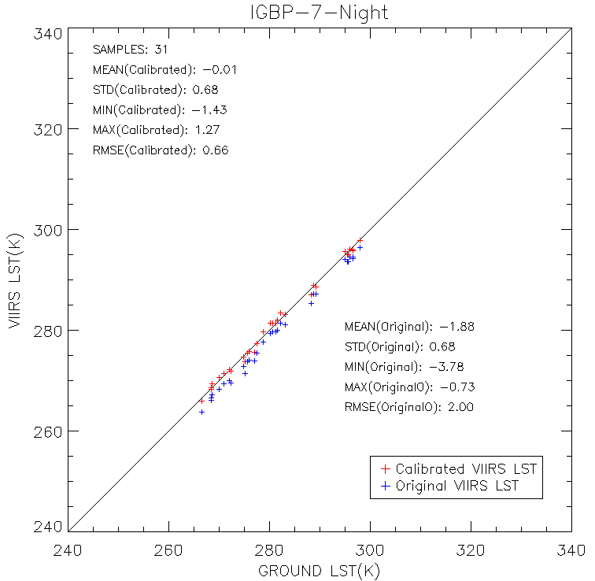
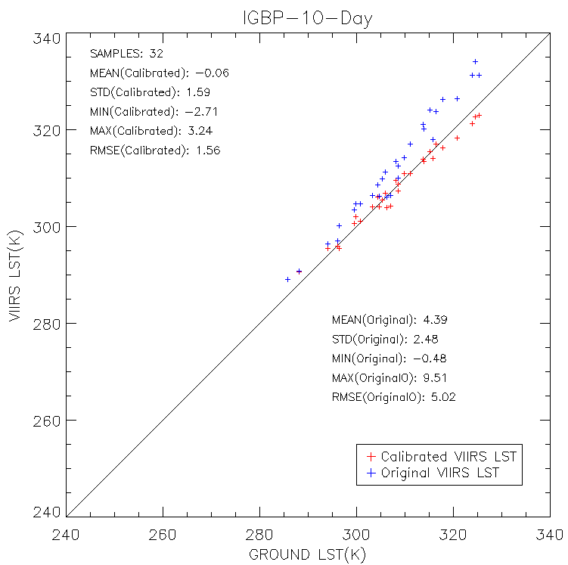
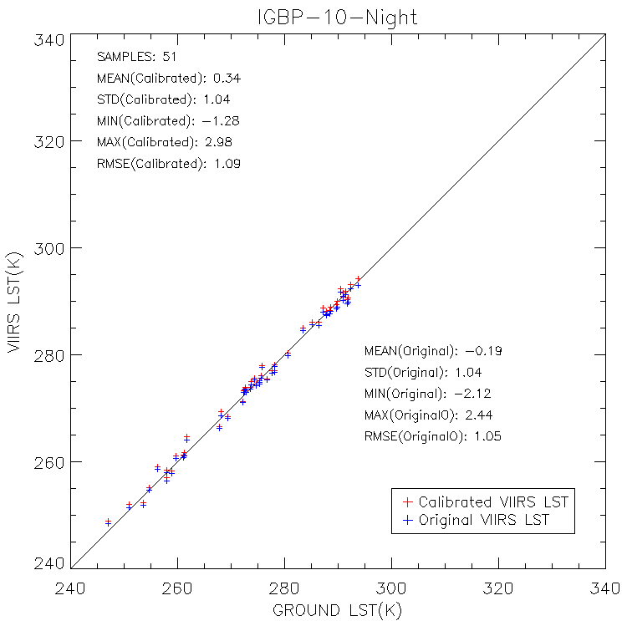
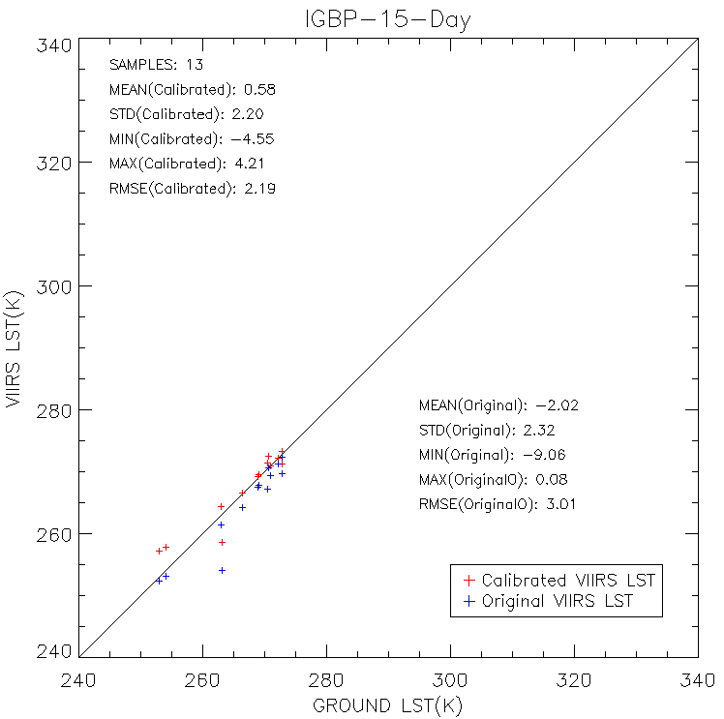
Provisional Evaluation against Ground truth
The Calibrated LSTs are evaluated using SURFRAD data in January, April, July and October, the four months representing winter, spring, summer and fall seasons.

Slide 11
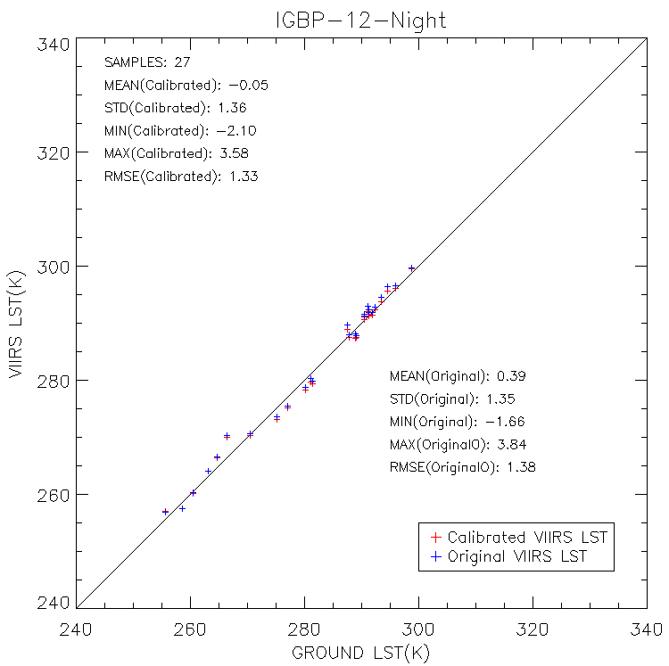
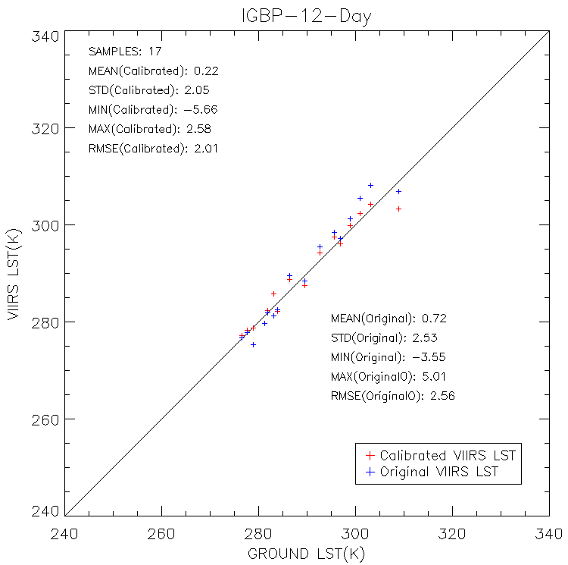
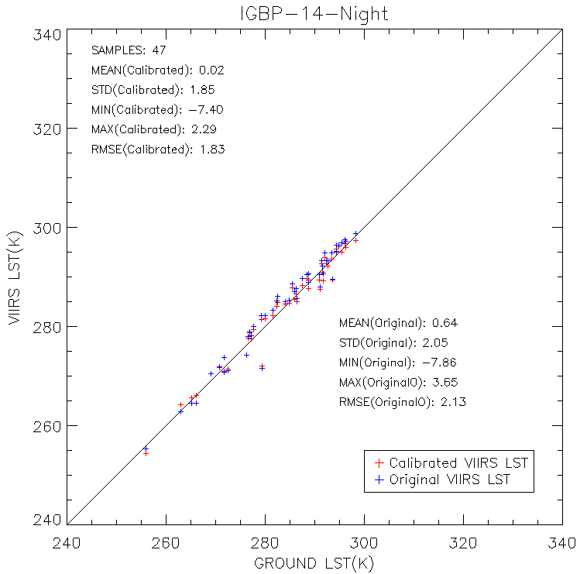
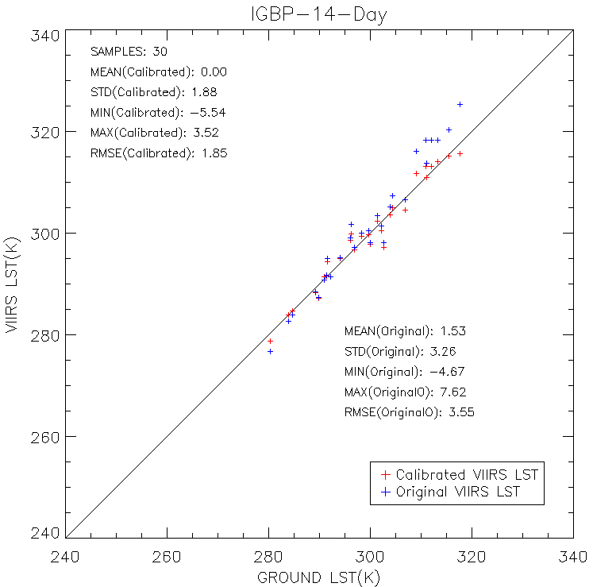
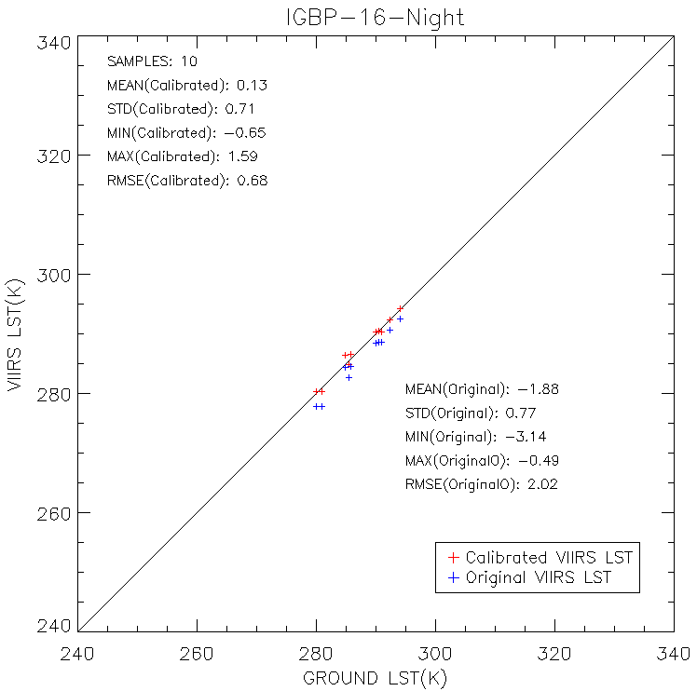
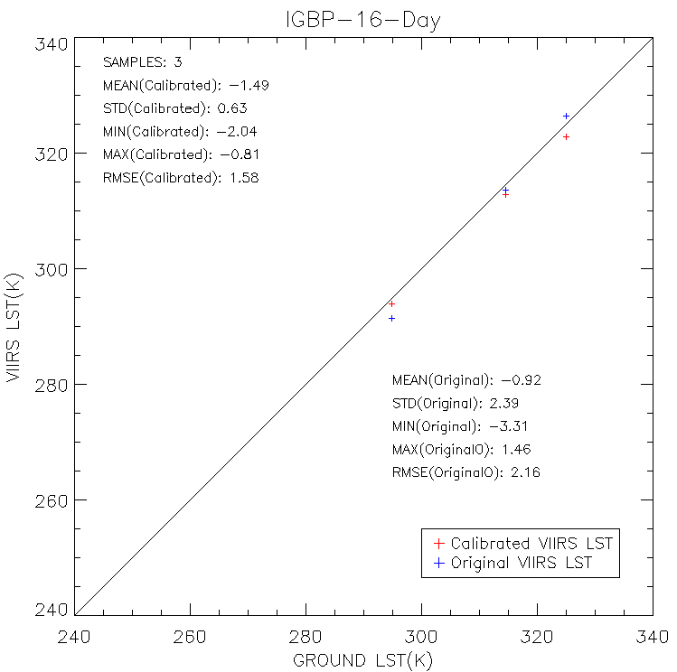
Provisional Evaluation against Ground truth Conti.
Some more …

Slide 12
Summary of evaluation against ground in-situ
Table : Evaluation of calibration performance using SURFRAD data in January,
April, July and October.
Surface type & Day/night | After Calibration |  | Before Calibration |  | Samples
 | BIAS | STD | BIAS | STD
16-day | -1.49 | 0.63 | -0.92 | 2.39 | 3
16-night | 0.13 | 0.71 | -1.88 | 0.77 | 10
15-day | 0.58 | 2.20 | -2.02 | 2.32 | 13
14-day | 0.00 | 1.88 | 1.53 | 3.26 | 30
14-night | 0.02 | 1.85 | 0.64 | 2.05 | 47
12-day | 0.22 | 2.05 | 0.72 | 2.53 | 17
12-night | -0.05 | 1.36 | 0.39 | 1.35 | 27
10-day | -0.06 | 1.59 | 4.39 | 2.48 | 32
10-night | 0.34 | 1.04 | -0.19 | 1.04 | 51
8-day | -0.28 | 1.39 | -2.14 | 1.48 | 4
8-night | 0.97 | 0.79 | 1.57 | 0.79 | 3
7-day | -0.01 | 1.00 | 1.14 | 2.01 | 28
7-night | -0.01 | 0.68 | -1.88 | 0.68 | 31
6-day | 0.13 | 1.04 | 1.3 | 1.95 | 5
6-night | 0.63 | 0.36 | -1.31 | 0.21 | 4
4-day | -0.45 | 1.43 | 3.31 | 1.06 | 5
4-night | -0.55 |  | -0.55 |  | 1
Notes:
The improvement is reflected either a significant bias reduction e.g. IGBP 16 at nighttime, IGBP 14 at daytime or standard deviation reduction e.g. IGBP 16 at daytime, IGBP 7 at daytime.
And for some surface type both bias and std get improved e.g. IGBP 14 for nighttime. It is note that the accuracy or precision exceeds the requirement for some surface types e.g. IGBP 10 for daytime

Slide 13
Evaluation of Calibration Performance
Calibration performance is evaluated using MODIS Aqua LST as a reference. Two SNOs for both day and night between NPP and AQUA in each month of January, April, July and October are selected. Below is the table for the SNOs obtained for evaluation
Index | Date (AQUA) | Time (AQUA) | AQUA Lat,Lon | Time (NPP) | NPP Lat,Lon
1 | 01/08/2013 | 08:58:00 | 49.94,-100.82 | 08:59:29 | 50.45,-103.41
2 | 01/10/2013 | 19:56:10 | 50.00,-105.05 | 19:49:46 | 49.67,-107.02
3 | 04/06/2013 | 06:32:38 | 41.51, -66.84 | 06:31:11 | 41.89, -68.97
4 | 04/08/2013 | 20:46:15 | 49.96,-117.41 | 20:42:01 | 49.55,-119.91
5 | 07/08/2012 | 06:32:19 | 40.13, -67.27 | 06:30:29 | 40.46, -69.32
6 | 07/18/2012 | 21:31:06 | 36.43,-124.99 | 21:27:35 | 35.94,-127.42
7 | 10/04/2012 | 07:18:57 | 48.14, -76.73 | 07:18:26 | 48.53, -78.91
8 | 10/22/2012 | 19:55:35 | 49.97,-104.94 | 19:49:45 | 49.60,-107.02

Slide 14
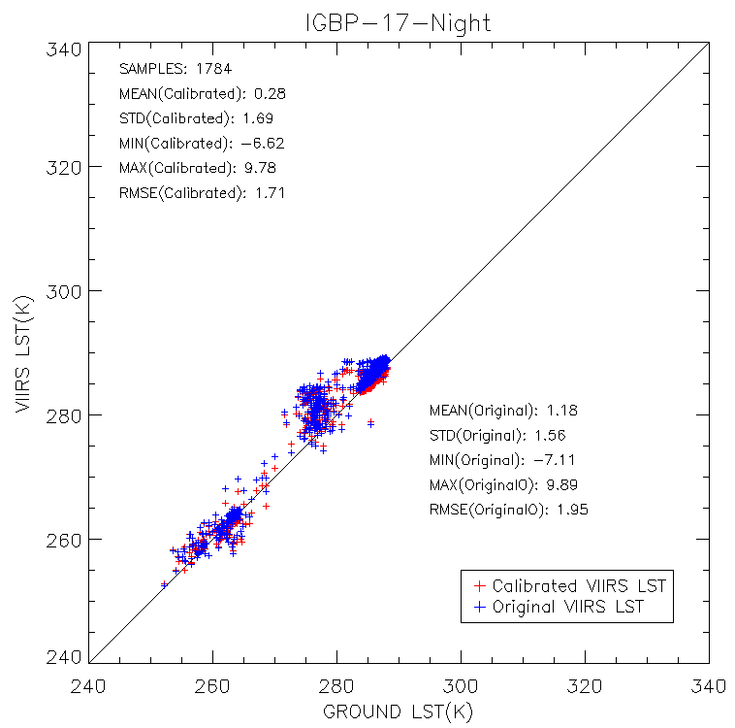
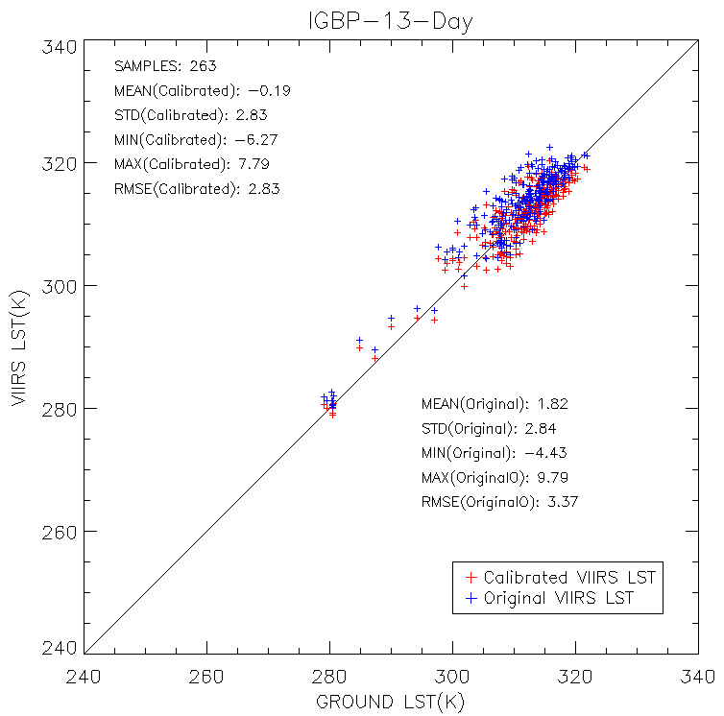
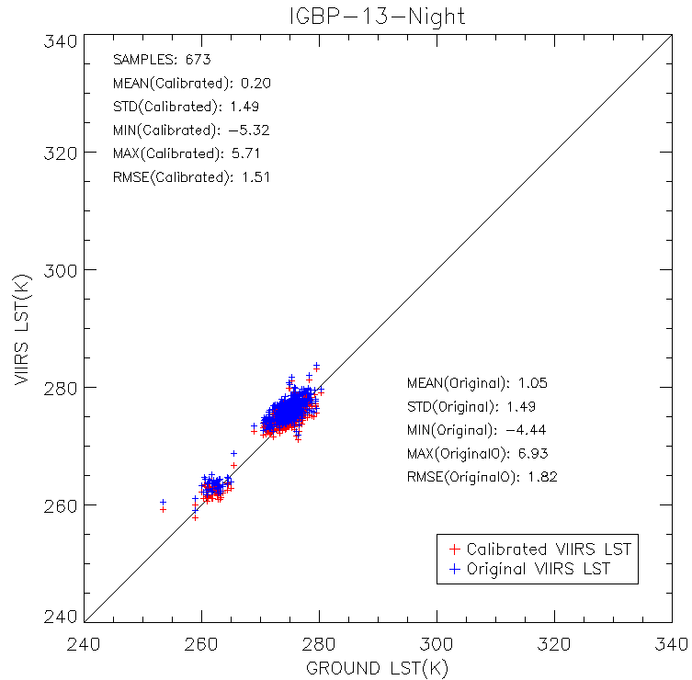
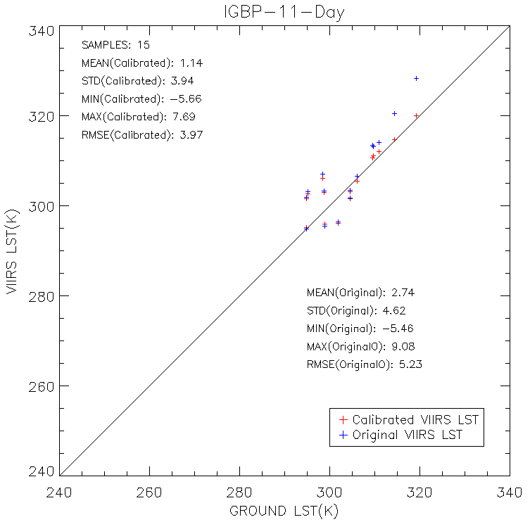
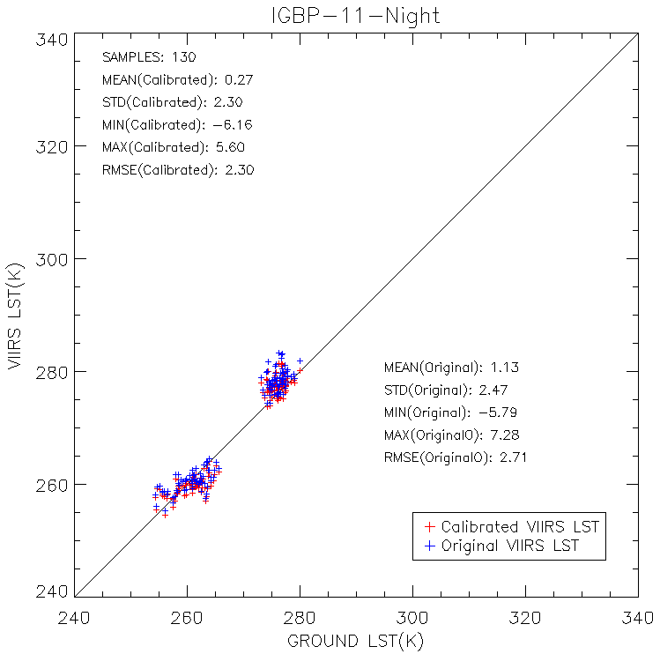
Provisional LSTs against MODIS LST
The Calibrated LSTs are evaluated using MODIS LSTs ….

Slide 15
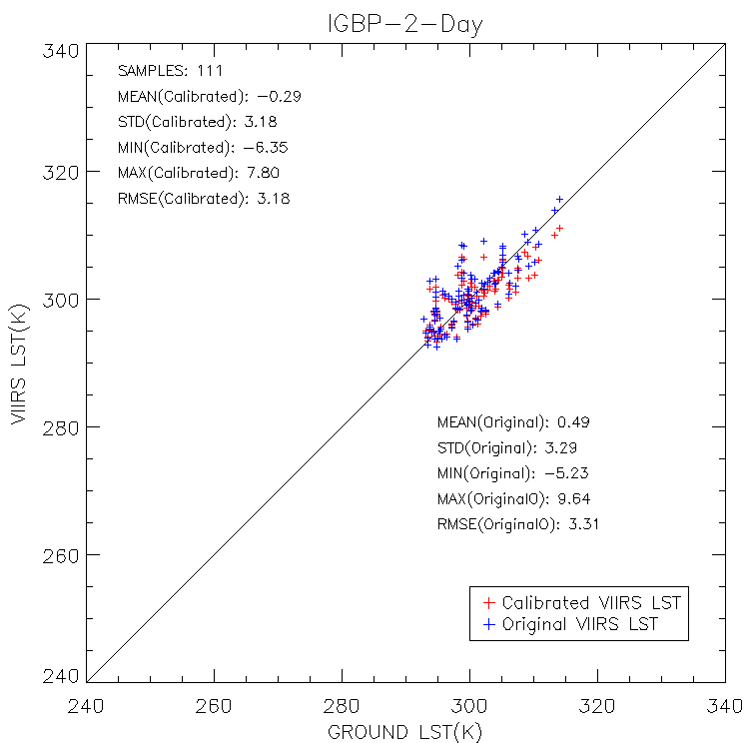
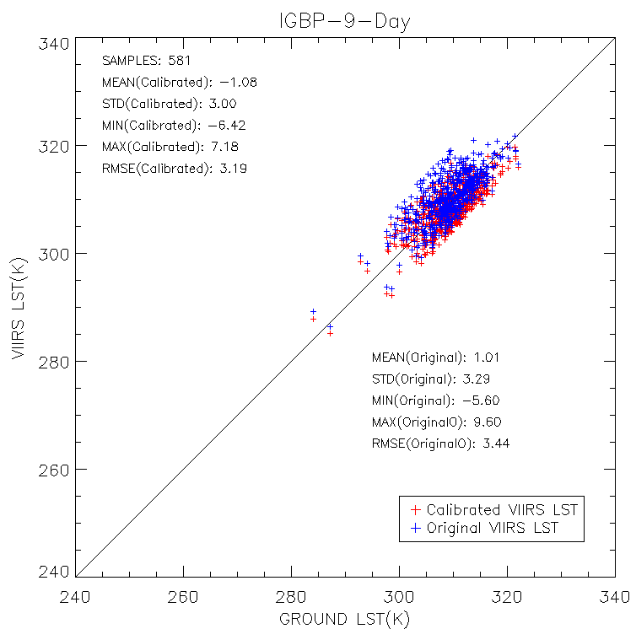
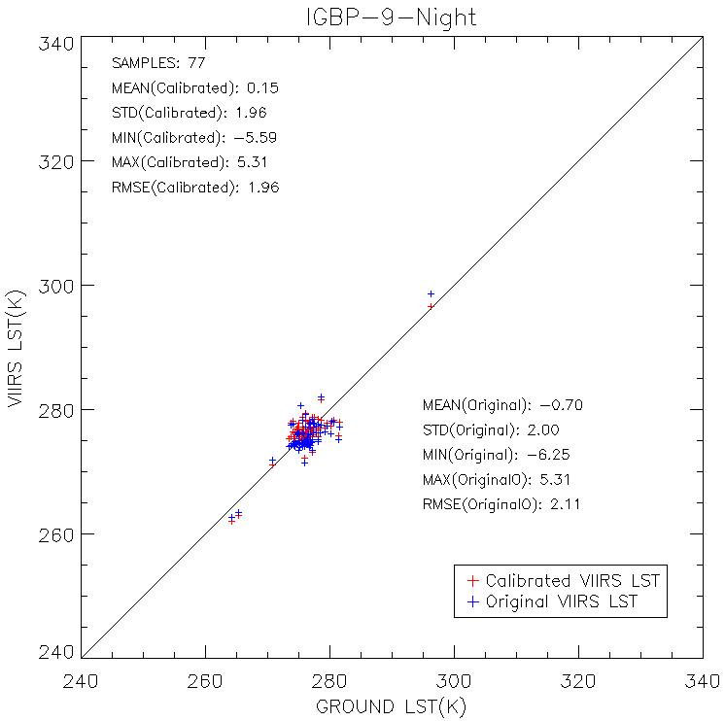
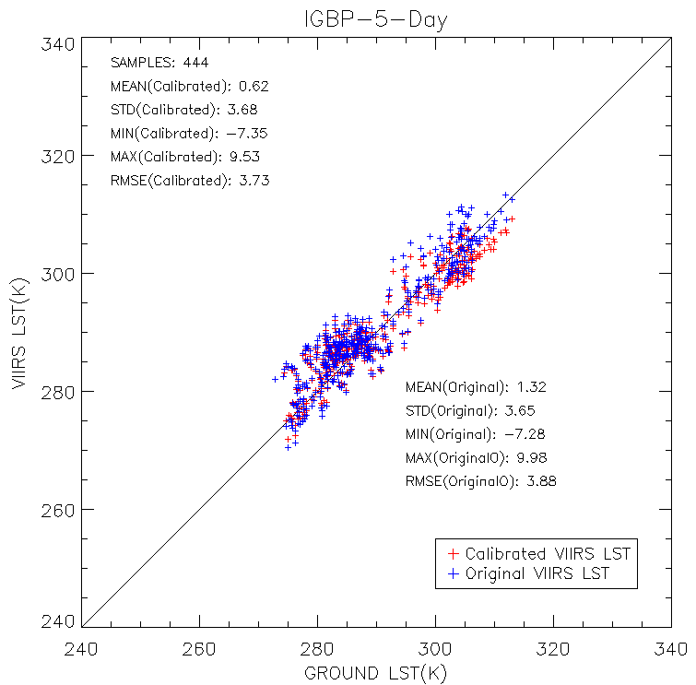
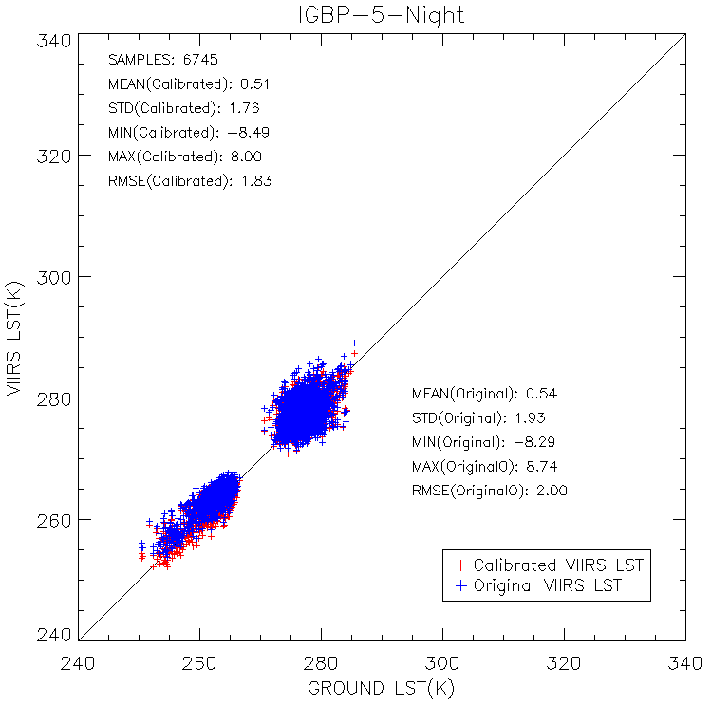
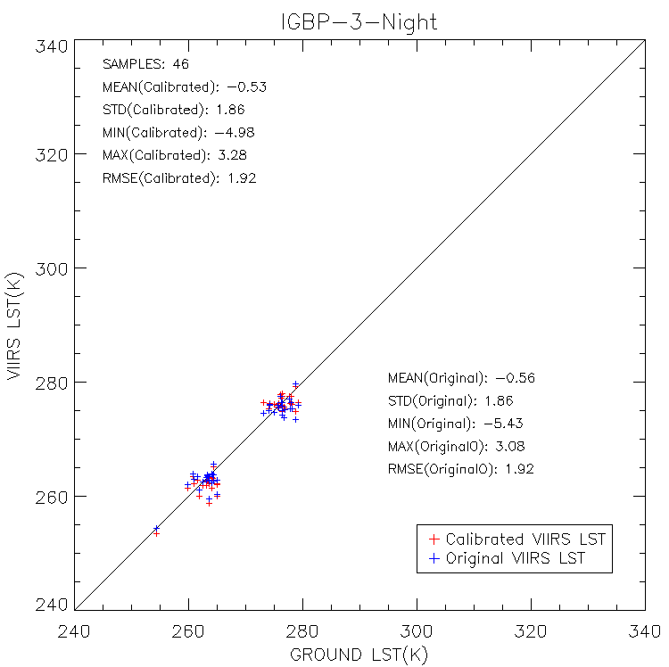
Provisional LSTs against MODIS LST
Some more …

Slide 16
Summary of provisional evaluation against MODIS LST
Table : Evaluation of calibration performance using MODIS Aqua LST data in January, April, July and October.
Surface type &Day/Night | After Calibration |  | Before Calibration |  | Samples
 | BIAS | STD | BIAS | STD
1-day | -0.56 | 3.45 | 0.13 | 3.42 | 1835
1-night | 0.75 | 1.98 | 0.07 | 2.31 | 1207
2-day | -0.29 | 3.18 | 0.49 | 3.29 | 111
2-night | -1.31 | 3.69 | -1.91 | 3.83 | 4
3-day | 1.80 | 0.57 | 0.81 | 0.6 | 4
3-night | -0.53 | 1.86 | -0.56 | 1.86 | 46
5-day | 0.62 | 3.68 | 1.32 | 3.65 | 444
5-night | 0.51 | 1.76 | 0.54 | 1.93 | 6745
9-day | -1.08 | 3.00 | 1.01 | 3.29 | 581
9-night | 0.15 | 1.96 | -0.7 | 2.00 | 77
11-day | 1.14 | 3.94 | 2.74 | 4.62 | 15
11-night | 0.27 | 2.30 | 1.13 | 2.47 | 130
13-day | -0.19 | 2.83 | 1.82 | 2.84 | 263
13-night | 0.2 | 1.49 | 1.05 | 1.49 | 673
17-day | 0.13 | 3.29 | -0.01 | 3.16 | 166
17-night | 0.28 | 1.69 | 1.18 | 1.56 | 1784
Notes:
Reveals an closer measurement to MODIS LST over cases such as IGBP 3 at daytime, IGBP 8 at daytime, IGBP 9 both at daytime and nighttime, IGBP 11 at daytime.
The result shows no much change for some cases like IGBP 1 at daytime, IGBP 15 at daytime.

Slide 17
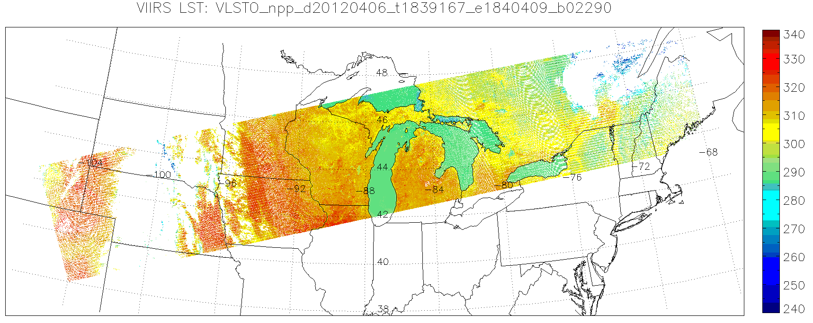
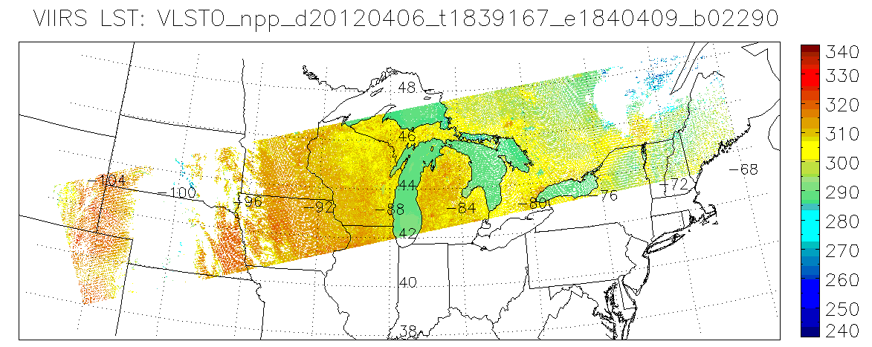
Image comparison before and after
Daytime single granule
Beta
Provisional

Slide 18
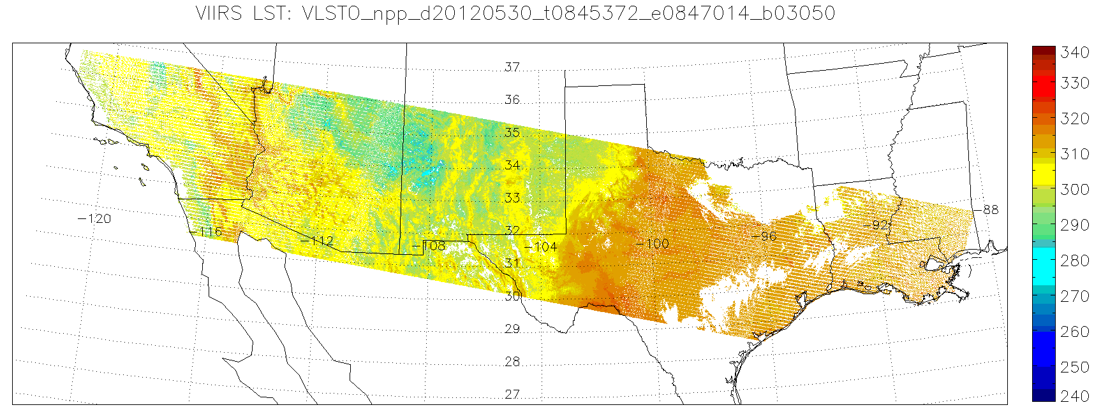
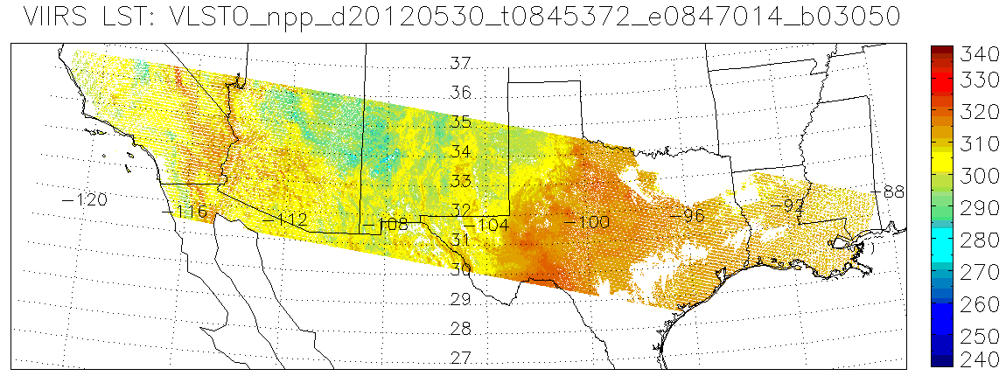
Image comparison before and after
Nighttime single granule
Beta
Provisional

Slide 19
Product Quality Summary
LST has shown marked improvement after beta release
Evaluation result shows an improved performance for some surface types such as IGBP 6,7,10,12,14 and 16.
Daytime LST gets significantly improved over some surface types and the performance is close or better than requirements e.g. IGBP 7,12 daytime.
VIIRS LSTs presents closer measurement with MODIS LSTs after calibration over some cases e.g. IGBP 1 at nighttime, IGBP 9 at daytime.
The seasonal pattern gets weak in the provisional version
The LST meets provisional criteria
Feedback from users and our continuous evaluations have been occurring since beta
Documentation up-to-date
Notes:
More edits needed

Slide 20
Incremental Improvement
Second version of LST validation report is finalized which summarizes the LST evaluation efforts since the beta release
A radiance-based satellite LST evaluation tool has been established
The LST algorithm coefficients have been calibrated using cross-satellite, simulation and ground measurement data
All Discrepancy Reports related to LST have been closed except DR7055 which is in DPE functional test
Longer term validation efforts using ground measurement data from Europe and from Asia are in progress, and will be reported before the next version (validated version) release
Notes:
TBD

Slide 21
Incremental Improvement
The LST team has developed a list of activities either in progress or to be worked as priorities and resources allow
Coefficients updates
Built up high quality regression data set for the update of algorithm coefficients, correlation analysis with VI, water vapor for possible corrections.
Software/code improvements
Ongoing validation efforts
continued match-up analysis, ADA/ADL upgrades, continual presentation needs ( conferences, workshops and communications with users, related SDR and EDR teams)
Notes:
Discuss with Yuling for more details

Slide 22
Incremental Improvement
Date | DR# | Reason | Status
2/9/13 | 7055 | LST QA is “low quality” when thin cirrus/active fire is et | In Work. Algorithm Change delivered to DPE for functional testing. Targeting IDPS Mx8
12/12/12 | 5028 | LST QA not set correctly in all-ocean granules | Closed 3/31/13. Rejected b/c No land products over ocean will ever be used; illustrates larger IDPS architecture issue that land products should not be produced over ocean
11/26/12 | 4983 | VIIRS LST beta Maturity | Closed 1/25/13 474-CCR-12-0773 deployed in ops
02/28/12 | 4608 | Split-window algorithm - Baseline Coefficient files. LUT update #2 (same as"Updated LUT" in slides): DR 4608/CCR 12-0355: Corrects errors for both dual split window and split window. | Closed 06/10/12 Split Window algorithm implemented in IDPS baseline on 10 Aug, 2012.
02/15/12 | 4582 | LST Day Night Land Water Misidentification, The LST EDR appears to have a coding error that may have incorrectly mixed up the Day/Night flag with the Land/Water and Surface Type QA Flag within the QF Byte 3 of the LST EDR... This same Day/Night flag is being correctly encoded in the bit3 of QF Byte1 of the LST EDR. | Closed 03/29/12 Rejected because EDR team did not observe such error.
09/14/11 | 4353 | Snow/ice field is always "no snow" at night if the Quarterly Surface Type does not indicate so. “Temporal snow” can only be directed daytime by snow/ ice EDR | Closed 04/26/12. Reallocated to Cryo team as new DRs: 4699 Out of Date snow cover seeded grid & 4700 Alternative snow/ice grid needed to support algorithms; Both have been addressed.
02/14/11 | 4203 | The OPS LST code, both v1.5.00.48 and v1.5.03.00, do not verify that the value for the Surface Type input falls within the valid range prior to calculating LST | Closed 1/9/13 Rejected because not a problem to LST production since LST code does check the ST.
12/12/12 | 5027 | VIIRS LST should have NA fill in all-ocean granules | Waiting to learn status.
Notes:
Need input from Leslie

Slide 23
Considerations, Known Issues
Nighttime snow/ice cover information maybe incorrectly identified.
DR 4699 was issued; Cryosphere team is working on it
Strong surface type dependency of the retrieval performance
Consistency
Surface type mixed pixel
Misuse of surface type info
Seasonal dependency of the retrieval performance
Cloud residual impact
May need additional cloud filter
Validation difficulties
Limited high quality in-situ data
Heterogeneity in a pixel
Fund issue
Fund shortage since 2010 (less than 1 FTE)
Current fund (1.2 FTE)

Slide 24
Version Control
Worked with DPE and Raytheon team for document changes, LUT updates, QA modification
ATBD, OAD, CDFCB-X all match operational LST as of these versions
474-00051_LandSurfTemp_Rev-_20110422.pdf
474-00070_OAD-VIIRS-LST-EDR_B.pdf
474-00001-04-03_JPSS-CDFCB-X-Vol-IV-Part-3_0123A.pdf
Upcoming LUT/code deliveries will require updates to all three documents noted above

Slide 25
Community Interaction
Bi-weekly telecoms are used, in part, to maintain open communication for both internal and external LST members with ongoing work and implementation dates
Regular (bi-weekly) meetings with Land CalVal team
Regular (bi-weekly) meetings with NASA VIIRS/MODIS and LPEATE groups
Consistent contact is maintained with NCEP Land forecast model group; individual technical interactive meetings and discussion
Invitations to LST research scientists participating special discussion meeting for the VIIRS LST issues, improvement and applications
We will continue to keep communications with other land product teams
E.g. progress of surface type may have positive impact to LST

Slide 26
Archive of the LST
The LST as a EDR product, is archived by CLASS
There are no plans the LST team is aware of to reproduce and replace what is in the archive
The LST team does not currently have any plans to reproduce the LST in the archive

Slide 27
Ready for Operational Evaluation
The LST provisional data is preliminary evaluated during the development period; further evaluation is planned after this release.
It has always been the intent that the LST would be ready for outside evaluation after the 30-day spin-up
The operational evaluation is critical for the validated version release by the end of 2013.
Proposed caveats for the LST at the provisional stage are:
All users should explore the quality flags present in the LST
Snow/ice bit at nighttime might not be correct
Thin cirrus/active fire might be not included in quality criteria matrix yet
Coastal pixel LST quality might be degraded by the surface type fraction

Slide 28
Path Forward
Monitoring of the provisional LST production
Continue the evaluation and validation of provisional LST product
Global coverage of in situ validation
Upscaling model improvement
Users feedback
The further improvement before the validation I
Improve the quality further over surface types especially those without ground in-situ as a reference.
Improved quality control procedure for regression analysis
Address the water vapor correction
Investigate on the possible improvement of the LST algorithm
Notes:
More edits needed

Slide 29
END

