Slide 1
SNPP VIIRS SRIP Provisional Maturity (DR 7344) 474-CCR-13-1243
Eric Vermote NASA-GSFC
Sadashiva Devadiga, Land PEATE/NASA-GSFC

Slide 2
SNPP VIIRS SR Provisional Maturity 474-CCR-13-1243
This CCR declared that SNPP VIIRS Surface Reflectance Intermediate Product (VIIRS-Surf-Refl-IP) be upgraded to provisional maturity level with implementation of 474-CCR-13-1078 containing DRs 4488, 7141 and 7142 at IDPS.
Algorithm build version Mx8.3 implemented 474-CCR-13-1078 and was put in operation at IDPS on March 18, 2014.
Analysis of SR-IP from IDPS operation confirms successful implementation of the DRs with no negative impact on any downstream EDRs.
Following slides present the DRs and verification of these DRs in the operational Mx83 data.

Slide 3
DRs in CCR-1078
DR# | Description | Status
4488 | Retrieve reflectance under all atmospheric conditions for all non-ocean (not sea-water) pixels except for night pixels and where input L1B is invalid | Included in the operational build version Mx83
7141 | Include an additional QF Byte (QF7) in the SR-IP. The additional QF byte Bit 0: Snow (0 - No, 1 – Yes). Copied from Cloud Mask IP Bit 1: Adjacent Cloud (0 – No, 1 –yes). Copied from Cloud Mask IP Bits 2-3: Aerosol quantity (00 – Climatology, 01 – low, 10 – Average, 11 – High). Code segment from MODIS PGE11 updated for VIIRS. Bit 4: Thin Cirrus (0 – No, 1-Yes) copied from Cloud Mask IP | Included in the operational build version Mx83
7142 | Replace NAAPS/Climatology with MODIS Climatology (0.06) within the surface reflectance algorithm. This doesn’t change the AOTIP product. | Included in the operational build version Mx83

Slide 4
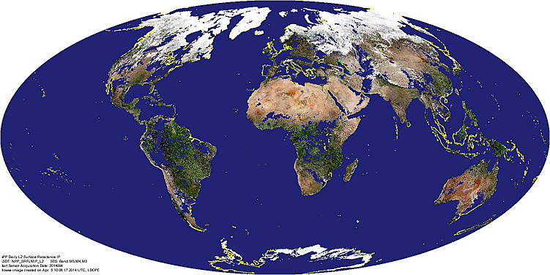
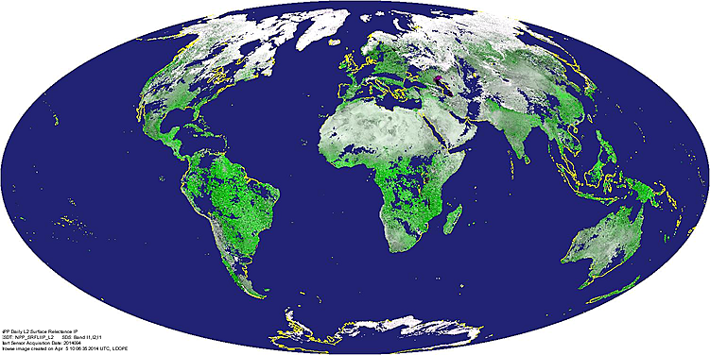
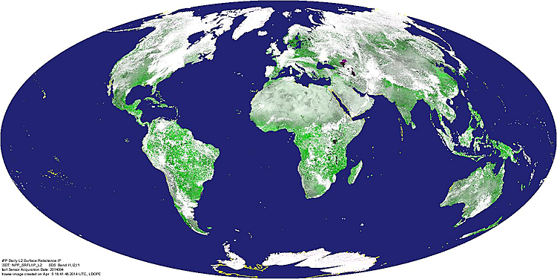
Surface Reflectance IP from Day 2014094 (4/4/2014) Retrieved under all atmospheric conditions for all non-ocean (not sea-water) pixels except for night pixels and where input L1B is invalid
Moderate Res
Image Res
Retrieval using Mx73 at Land PEATE – SRIP not retrieved under confidently cloud and heavy aerosol, using NAAPS/Climatology when AOTIP is not retrieved.
Moderate Res
Image Res
Retrieval using Mx83 at IDPS – SRIP retrieved under all atmospheric condition replacing NAAPS/Climatology with MODIS Climatology..

Slide 5
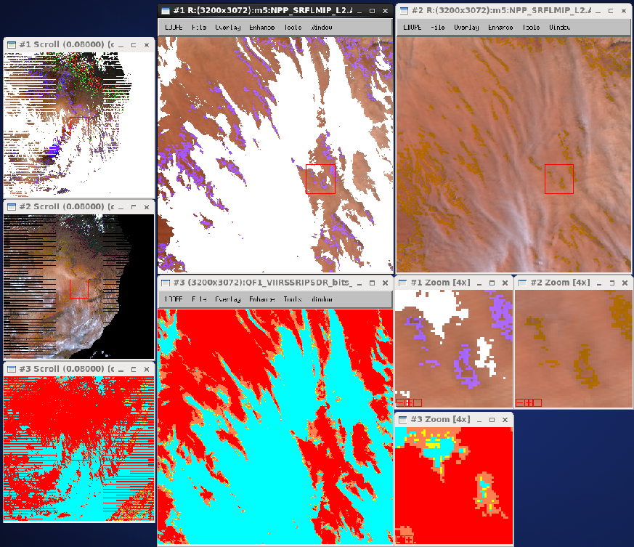
SR IP: Retrieved under Confident Cloud Day 2014101, Granule 13:50
Windows
1: SR-IP, Mx73
2: SR-IP Mx83
3: VCM Mx83
VCM – Cloud detection
Confident clear
Probable clear
Probable cloud
Confident cloud

Slide 6
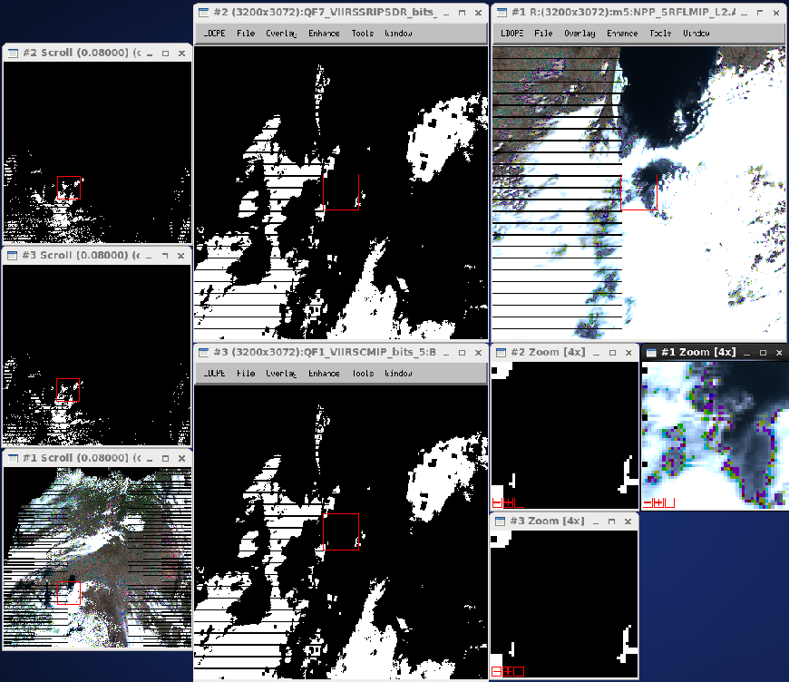
QF7 in SR IP: Bit 0 (Snow/Ice – Copied from VCM) Day 2014101, Granule 19:00
Windows
1: SR-IP, Mx83
2: SR-IP, QF7-Bit0, Mx83
3: VCM, QF1-Bit5, Mx83

Slide 7
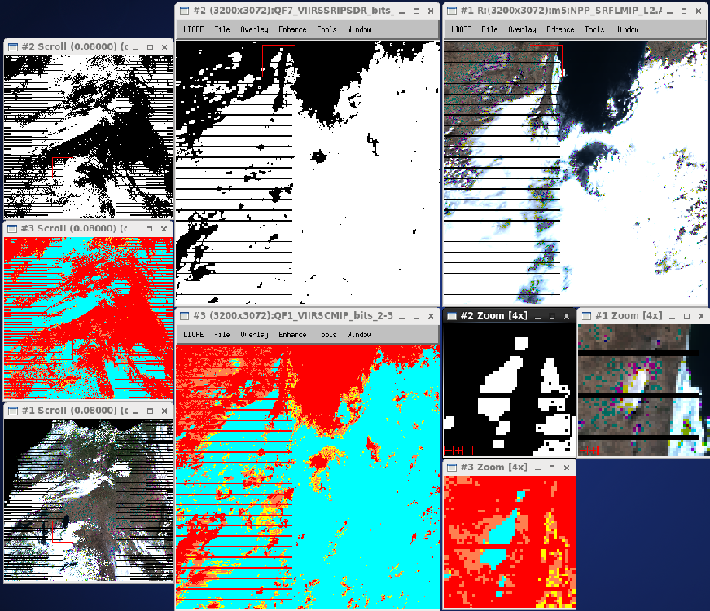
QF7 in SR IP: Bit 1 (Adjacent Cloud – Copied from VCM) Day 2014101, Granule 19:00
Windows
1: SR-IP, Mx83
2: SR-IP, QF7-Bit1, Mx83
3: VCM, QF1-Bit2-3, Mx83
VCM – Cloud detection
Confident clear
Probable clear
Probable cloud
Confident cloud

Slide 8
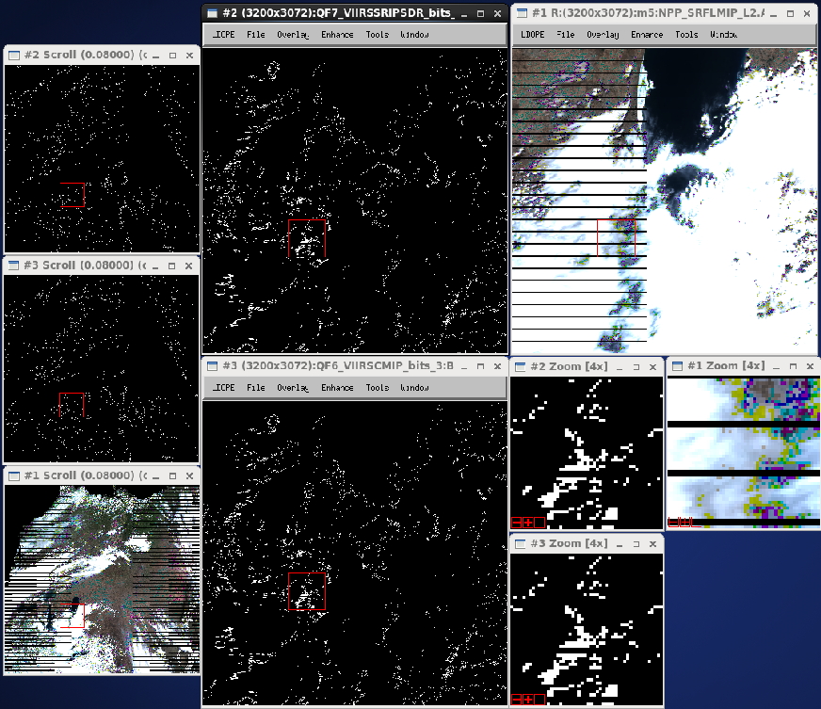
QF7 in SR IP: Bit 4 (Thin Cirrus – Copied from VCM) Day 2014101, Granule 19:00
Windows
1: SR-IP, Mx83
2: SR-IP, QF7-Bit4, Mx83
3: VCM, QF6-Bit3, Mx83

Slide 9
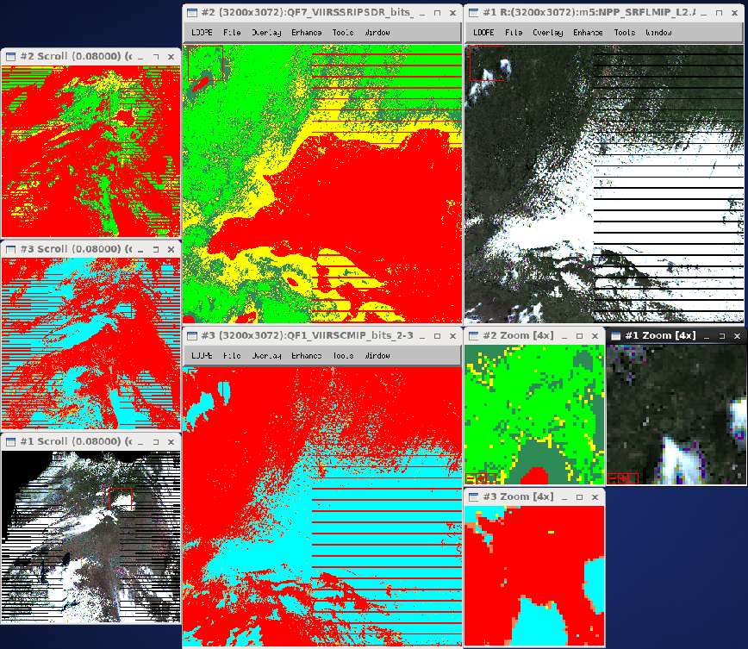
QF7 in SR IP: Bit 2-3 (Aerosol Quantity - MODIS Approach) Day 2014101, Granule 19:00
Windows
1: SR-IP, Mx83
2: SR-IP, QF7, Bit2-3, Mx83
3: VCM, QF1-Bit2-3, Mx83
SR-IP – Aerosol Quantity
Climatology
Low
Average
High
VCM – Cloud detection
Confident clear
Probable clear
Probable cloud
Confident cloud

Slide 10
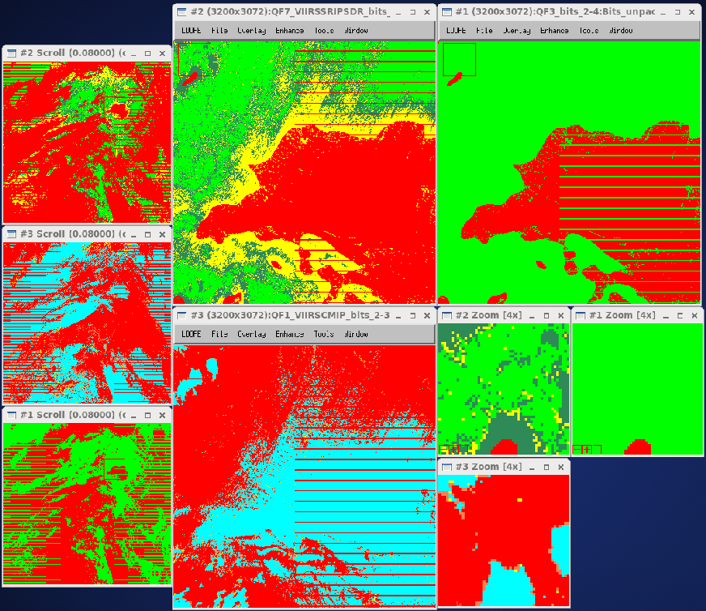
QF7 in SR IP: Bit 2-3 (Aerosol Quantity - MODIS Approach) Day 2014101, Granule 19:00
Windows
1: AOT-IP, QF3, Bit2-4, Mx83
2: SR-IP, QF7, Bit2-3, Mx83
3: VCM, QF1-Bit2-3, Mx83
AOTIP – Aerosol Processing
NAAPS/Climatology
Retrieved/Interpolated
SR-IP – Aerosol Quantity
Climatology
Low
Average
High
VCM – Cloud detection
Confident clear
Probable clear
Probable cloud
Confident cloud

Slide 11
SNPP VIIRS SR Provisional Maturity Conclusion
Analysis of SR-IP from IDPS with Mx83 in operation confirms successful implementation of the DRs required for provisional maturity of the product
Review of downstream products since the transition of Mx83 into operation did not reveal any adverse impact.
Science team recommends reconfirmation of approval of provisional maturity for the product.

