Slide 1
JPSS STAR Algorithm and Data Products (ADP)
Beta Review
Suomi NPP Vegetation Index EDR
Marco Vargas VI-EDR Algorithm Lead
Tomoaki Miura VI-EDR Cal/Val Lead
12/19/2012

Slide 2
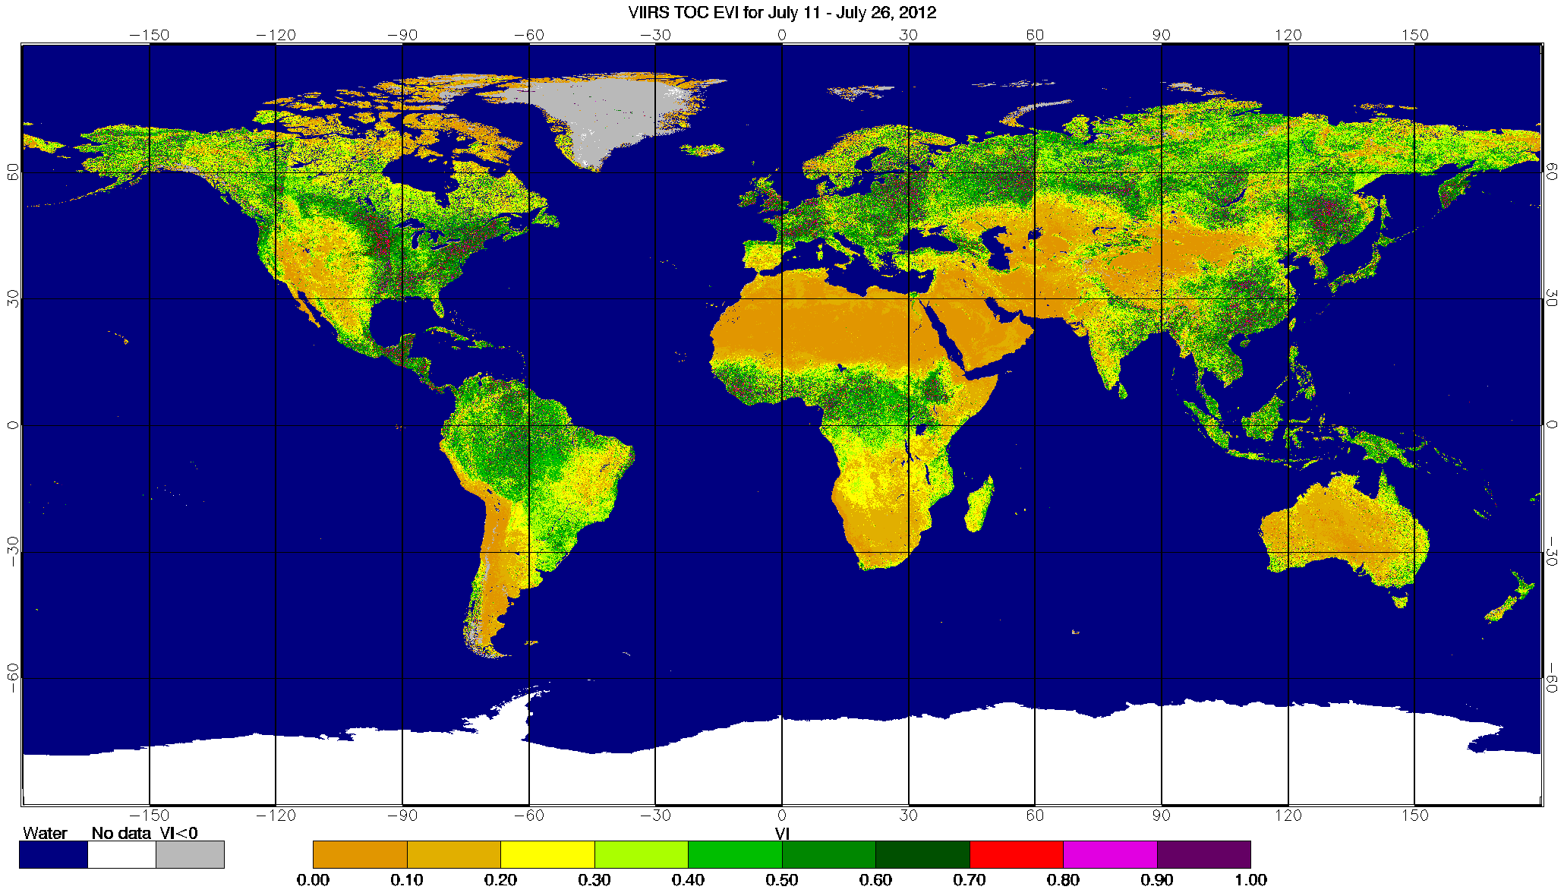
Overview of VI EDR Data Products
SNPP VIIRS TOC EVI 16-day composite

Slide 3
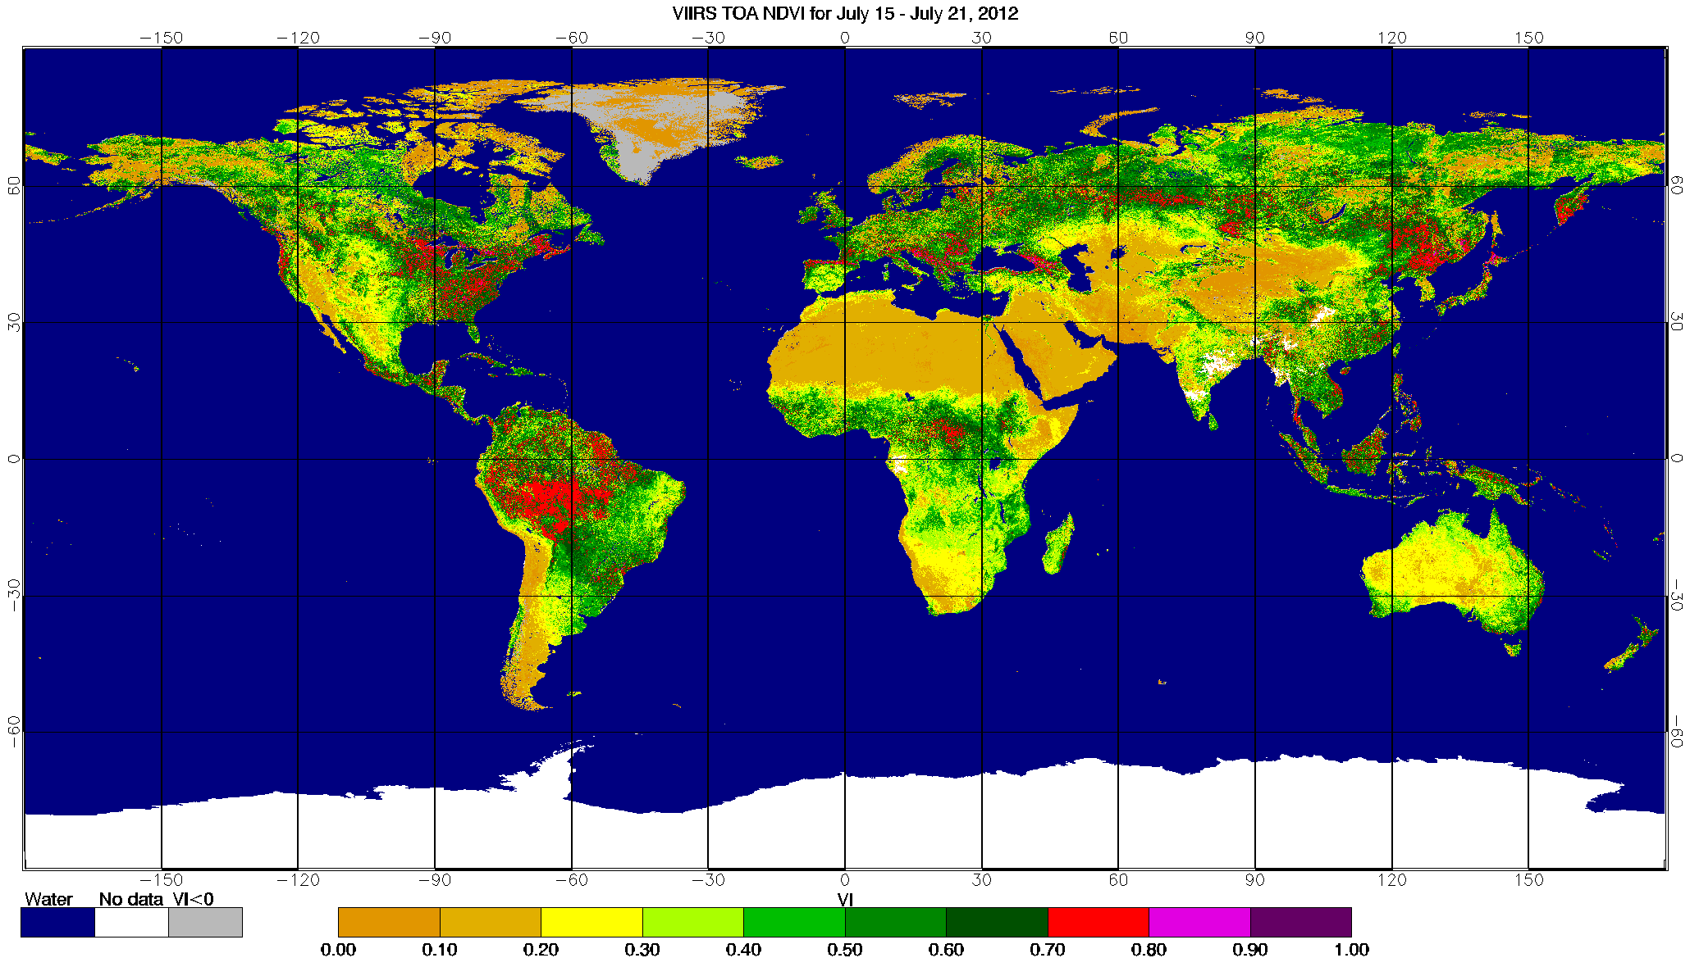
Overview of VI EDR Data Products
SNPP VIIRS TOA NDVI 7-day composite

Slide 4
Vegetation Index EDR Team Members
Marco Vargas (NOAA/NESDIS/STAR) STAR VI EDR algorithm lead
Tomoaki Miura (University of Hawaii) VI Cal/Val lead
Nikolay Shabanov (STAR/IMSG) Product monitoring and validation, algorithm development
Alfredo Huete (UTS) Cal/Val Team Member
Leslie Belsma (Aerospace) Land JAM
Alain Sei (NGAS) External Partner, Consultant
Michael Ek (NOAA/NCEP) User readiness
Jesse Meng (NOAA/NCEP) User readiness
Ivan Csiszar (NOAA/NESDIS/STAR) STAR Land EDRs Chair
Jeff Privette (NOAA/NESDIS/NCDC) Product validation lead, Land EDRs Co-Chair
RGB Image shows dense smoke (high absorption) in northwest, north central and central coastal portions of image.
4

Slide 5
Beta Maturity Definition
Early release product
Minimally validated
May still contain significant errors
Versioning not established until a baseline is
determined
Available to allow users to gain familiarity
with data formats and parameters
Product is not appropriate as the basis for
quantitative scientific publications, studies or
applications

Slide 6
Background of VI EDR Product
VI EDR consists of two vegetation indices: the TOA Normalized Difference Vegetation Index (TOA-NDVI) and the TOC Enhanced Vegetation Index (TOC-EVI).
VI EDR provides continuity with NASA EOS MODIS and NOAA POES AVHRR.
TOA - NDVI:Top of the Atmosphere Normalized difference vegetation index is most directly related to absorption of photosynthetically active radiation, but is often correlated with biomass or primary productivity.
TOC – EVI: Top of the Canopy Enhanced Vegetation Index EVI was developed to optimize the vegetation signal with improved sensitivity in high biomass regions and improved vegetation monitoring through a reduction in atmosphere influences.
Vegetation Index (VI) is one key parameter to specify the boundary condition in global climate models, weather forecasting models and numerous remote sensing applications for monitoring environmental state and its change.
6

Slide 7
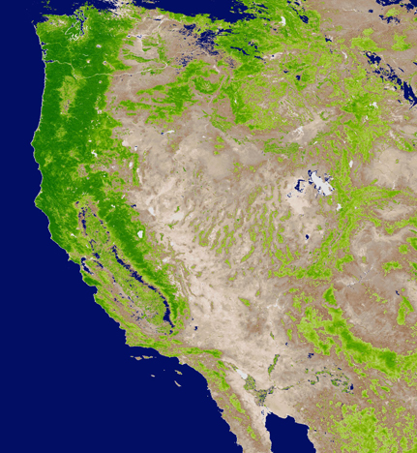
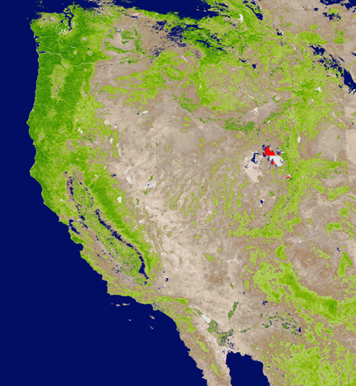


VIIRS Vegetation Index EDR
Product Description: Provides the Normalized Difference Vegetation Index (NDVI) and the Enhanced Vegetation Index (EVI) at 375 m on a daily basis.
Retrieval Strategy:
  The NDVI derived from TOA reflectance:
  The EVI derived from TOC reflectance
  with a different gain factor from that of
  the MODIS equation:
Product Layers:
Includes quality flags on
  Land/water
  Cloud confidence
  including thin cirrus
  Heavy aerosol loadings
  Exclusion conditions
TOA NDVI
TOC EVI
VIIRS VI EDR
Oct. 1, 2012
(Mx 6.3)

Slide 8
Overview of Vegetation Index EDR
TOA NDVI will provide continuity with the AVHRR heritage product
TOC EVI will provide continuity with the MODIS heritage product
These indices are produced at the VIIRS image channel resolution (i.e. nominally 375m at nadir).
VI EDR uses Spectral bands I1, I2 and M3
The VIIRS Vegetation Index EDR is computed after the RDR, SDR, and intermediate products processing is complete.
Product style: Swath
File Format: HDF5
Measurement Exclusion Conditions:
1) SZA > 85 deg for both NDVI and EVI (NIGHT TIME)
2) AOT > 1.0 for EVI
3) Confidently cloudy
Retrievals are not performed over ocean or coastal
VI calculated for LAND retrievals including inland water bodies and rivers.
Assumption for EDR validation is that the VIIRS SDR is calibrated.
  Beta versions of SDR have been used to help algorithm and instrument assessments during EOC and the early stages of ICV.
8

Slide 9
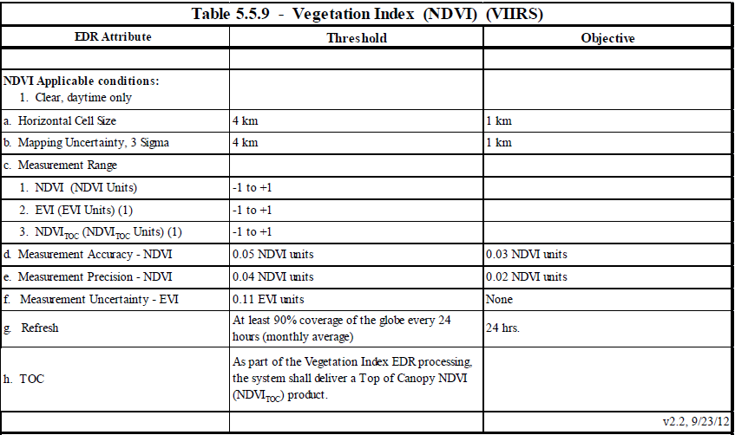
L1RD Requirements
Source: Level 1 Requirements SUPPLEMENT – Final Version 2.3 November 2, 2012

Slide 10
Users of Vegetation Index EDR Products (Point Of Contact)
  NCEP- National Centers for Environmental Prediction (Michael Ek/Jesse Meng/Yihua Wu/Matthew Rosencrans)
  STAR - Center for Satellite Applications and Research (Felix Kogan)
  CLASS - Comprehensive Large Array-data Stewardship System (John Bates)
  USDA - United States Department of Agriculture (Eric Luebehusen)
  The Climate Corporation – Pavel Machalek
  USGS - U.S. Geological Survey
  UH - University of Hawaii
  UA - University of Arizona
  UTS - University of Technology Sydney

Slide 11
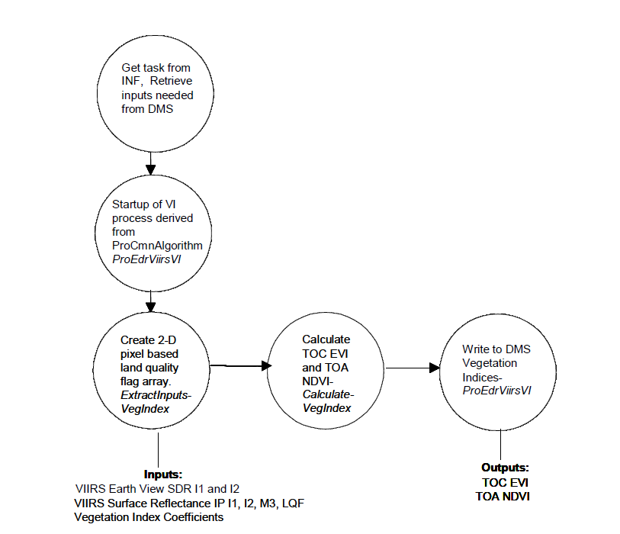
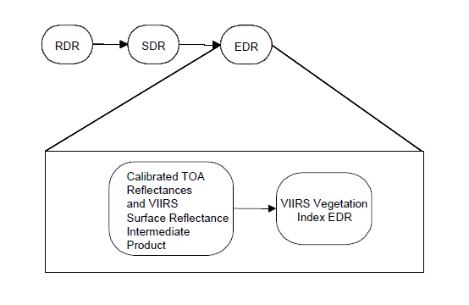
Vegetation Index EDR Dataflow
The VIIRS Vegetation Index EDR requires: calibrated TOA reflectances (bands I1, I2), SDR
auxiliary data (solar zenith angle)
Surface Reflectance (bands I1, I2, M3, Land Quality Flags).
VI coefficients
Figure 2. Data Flow Diagram of Overall VVI EDR Call Sequence from the Main Program (OAD VIIRS VI EDR 474-00063 January 18, 2012).
Figure 1. Processing chain associated with VIIRS Vegetation Index EDR (OAD VIIRS VI EDR 474-00063 January 18, 2012).
11
Notes:
Ancillary
GFS forecast surface pressure, lapse rate, and air temperature (for topography corrected surface pressure)
Look-up tables
DEM for surface altitude
Infrared and Microwave OSS coefficients
Local Angle Correction
IR emissivity and reflectivity covariance
MW emissivity covariance
AVTP and AVMP and Ozone covariance

Slide 12
History of Algorithm changes/updates
DR# | Reason | Status
DR 4622 | Erroneous quality flag for missing input data | VI-EDR team is preparing an enhanced set of QFs to improve the VI product quality. We expect to close this DR before provisional release (Sept 2013)
DR 4380 | EVI requirements in L1RD in error | Open
DR 4379 | L1RD drops wavelengths, needs to be defined | We expect to close this DR before provisional release (Sept 2013)
DR 4377 | Baseline of ephemeral tuning coefficients | We expect to close this DR before provisional release (Sept 2013)
DR 4376 | Vegetation Index: L1RD requires NDVI TOC | Open
DR 4297 | Thin Cirrus Correction and Flagging | Approved for Future Re-evaluation
DR 4290 | EVI Quality should degrade AOT>1 | QF update in preparation, we expect to close this DR before provisional release (Sept 2013)
DR 3375 | Byte 0 Quality Flag Structure | Closed
DR 2887 | Erroneous thin cirrus test in vegetation index | Closed

Slide 13
Beta Maturity Evaluation
Internal performance evaluation
  Assessment of data structure and integrity
  Quality assessment at granule level
  Quality assessment using regional/global mosaics
  Visual assessment of quality flags
External performance evaluation
  Comparison with Aqua MODIS (and AVHRR) using regional/global mosaics
  Assessment of time series using Aqua MODIS (and AVHRR) as a reference

Slide 14
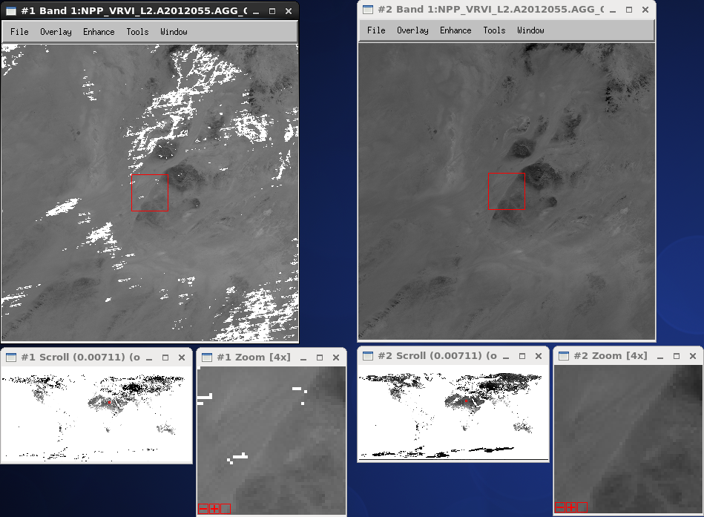
Beta Maturity Evaluation
Many fill-valued pixels found over bright targets
only for TOC-EVI
  Fill-valued M3 surface reflectance, likely due to the overestimation of AOT
QFs of SR IP indicating:
  “Poor M3 SDR”
  (NA_FLOAT32_FILL: -999.9), or
  ERR_FLOAT32_FILL (-999.5)
TOC-EVI
TOA-NDVI
VIIRS EDR over Sahara
2012-055 (Mx 5.2)

Slide 15
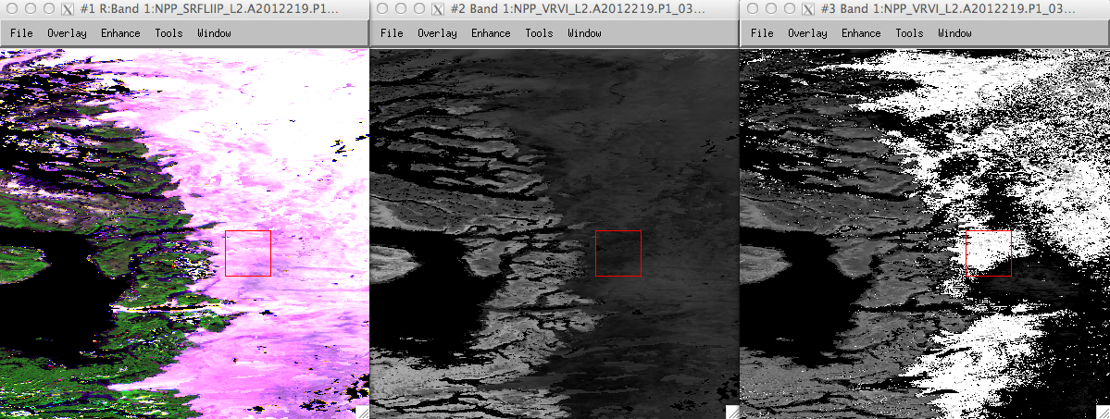

Beta Maturity Evaluation
Erroneous EVI values over snow/ice covered surface
  EVI values become unrealistically high or low.
VIIRS False Color Composite and VI EDR
Greenland, 2012-219 (Mx 5.3)
SR IP
False Color
RGB: I1, I2, M3
TOA-NDVI
TOC-EVI
-0.3
0.0
0.5
1.0

Slide 16
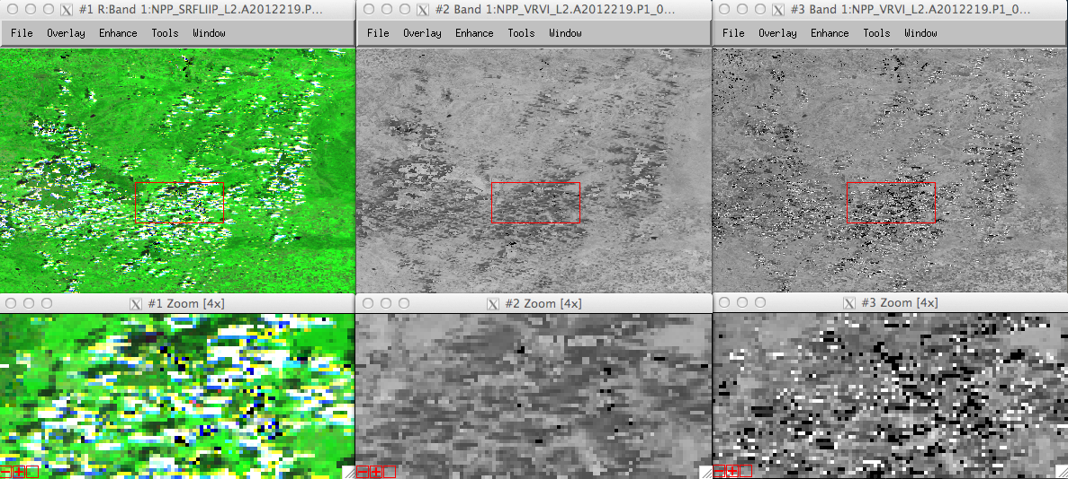
Beta Maturity Evaluation
Erroneous EVI values over residual clouds
  EVI values become unrealistically high or low.
Ukraine, 2012-219, VIIRS False Color Composite and VI EDR (Mx 5.3)
SR IP
False Color
RGB: I1,I2,M3
TOA-NDVI
TOC-EVI
-0.3
0.0
0.5
1.0

Slide 17
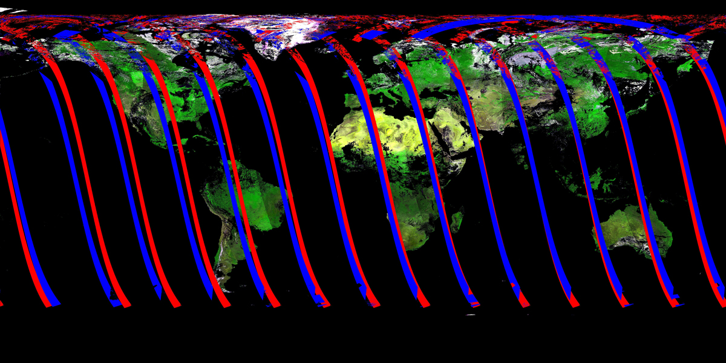
Beta Maturity Evaluation
Regional mosaic comparisons with Aqua MODIS
  Near-simultaneous nadir observations
    Overlapped orbital tracks with view zenith angles < ±10 degrees
    Every 8 days
    Solar zenith angle differences of 1-2 degrees
  Screened by quality flags
    Only using MODIS QA at this point
Orbital Tracks with θ_{v}< ±10º
for 2012-211 (July 29)
Blue: NPP VIIRS
Red: Aqua MODIS

Slide 18
Beta Maturity Evaluation
* APU metrics of VIIRS VI EDR (in reference to Aqua MODIS) consistent over time.
TOA-NDVI
TOC-EVI
APU Summary Tables
2012-147
 | TOA-NDVI | TOC-EVI
A | 0.005 | -0.04
P | 0.007 | 0.005
U | 0.012 | 0.05
2012-211
 | TOA-NDVI | TOC-EVI
A | 0.005 | -0.05
P | 0.007 | 0.006
U | 0.014 | 0.06
2012-243
 | TOA-NDVI | TOC-EVI
A | 0.005 | -0.05
P | 0.007 | 0.006
U | 0.012 | 0.06

Slide 19
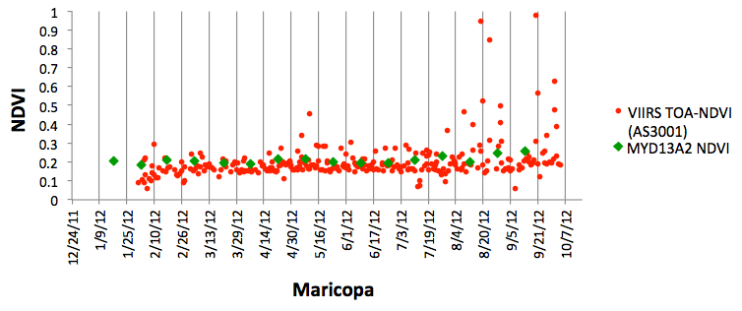
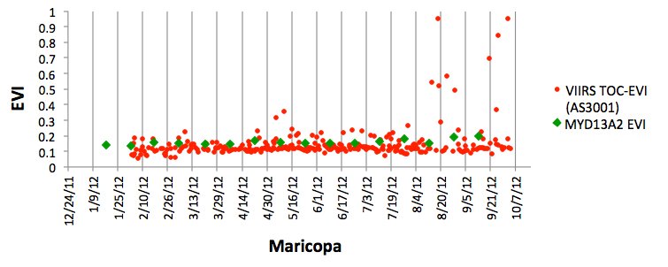
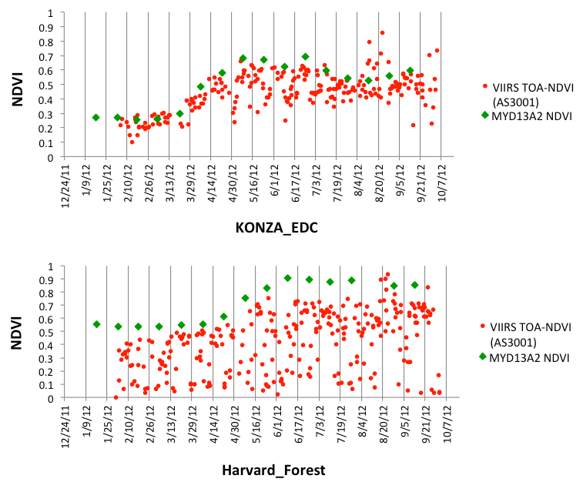
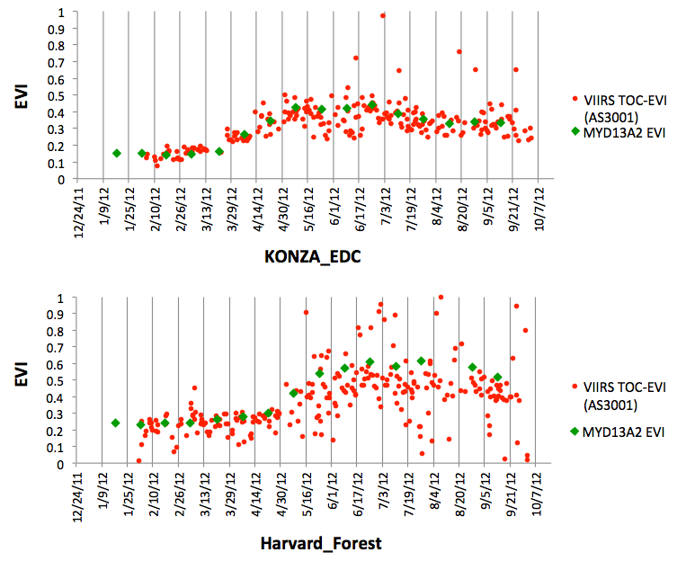
Beta Maturity Evaluation
VIIRS VI temporal profiles (3 km-by-3 km window) depicting seasonal changes comparable to those of Aqua MODIS
TOA-NDVI
TOC-EVI

Slide 20
Beta Maturity Evaluation
Good/intact data structure and integrity:
  Residual clouds
  Missing EVI values over bright surfaces
  Erroneous EVI values over snow/ice and residual clouds
Regional mosaic comparisons:
  Dates examined: 2012-055, 107-251 (every 8 day), & 307.
  Consistent over time
  Bias similar to those predicted from pre-launch validation results (Hyperion spectral synthesis analysis)
Time series:
  Land cover types examined: broadleaf forest, woodland, shrubland, grassland, cropland, urban
  All seasonal trends comparable to those of MODIS although subject to more unsystematic noises (variations)

Slide 21
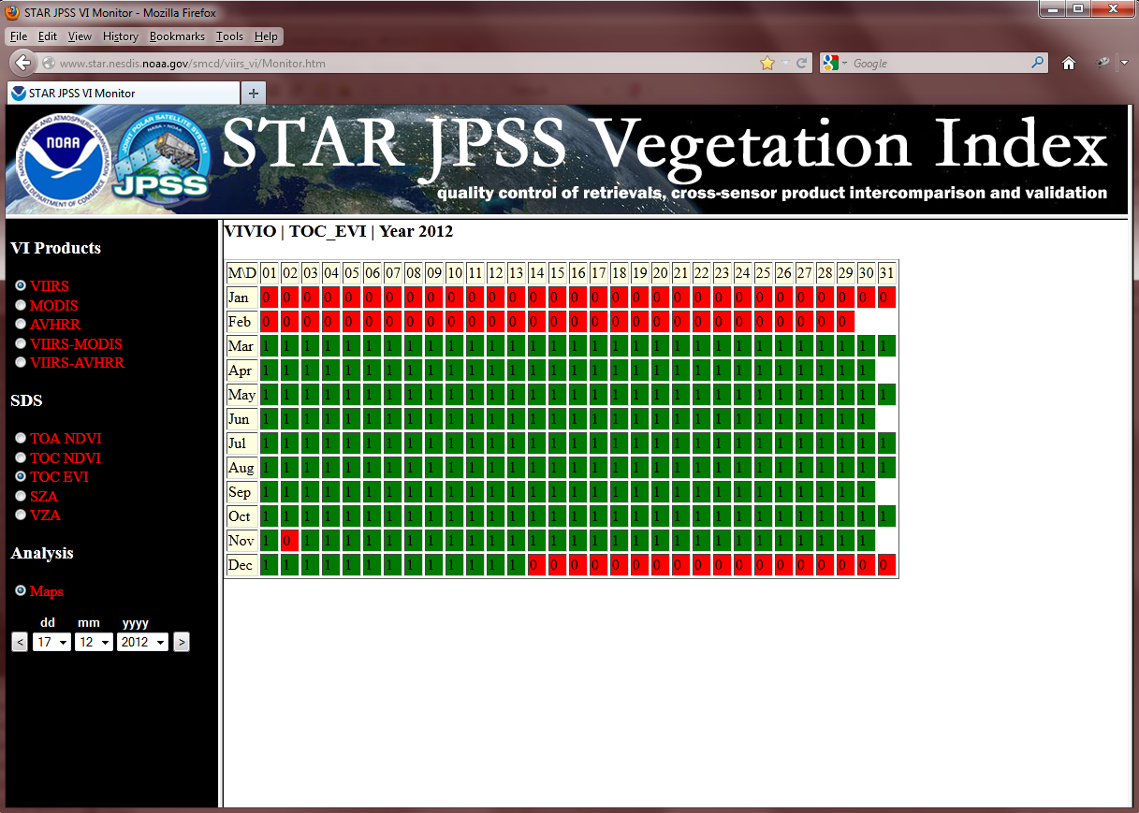
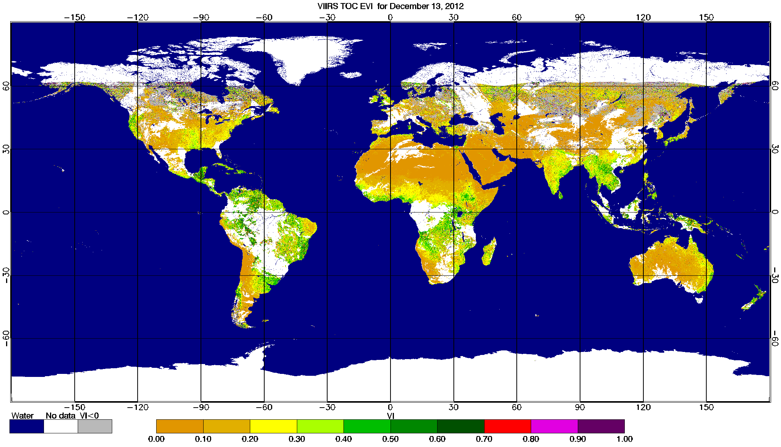
VIIRS VI product Quality Control tool at STAR
Web-based tool was implemented at STAR for continuous (NRT in the future) monitoring of performance of VIIRS VI product time series at global scale (especially important at the early stage of VIIRS mission to detect/trace anomalies, trends and conformity to physically principles).
VIIRS VI product is compared with heritage MODIS and AVHRR VI products.
Analysis includes daily and compositing VI and QC maps, maps of VI difference (VIIRS- MODIS, VIIRS-AVHRR), histograms and time series of statistics at biome-by-biome level and globally.
http://www.star.nesdis.noaa.gov/smcd/viirs_vi/Monitor.htm

Slide 22
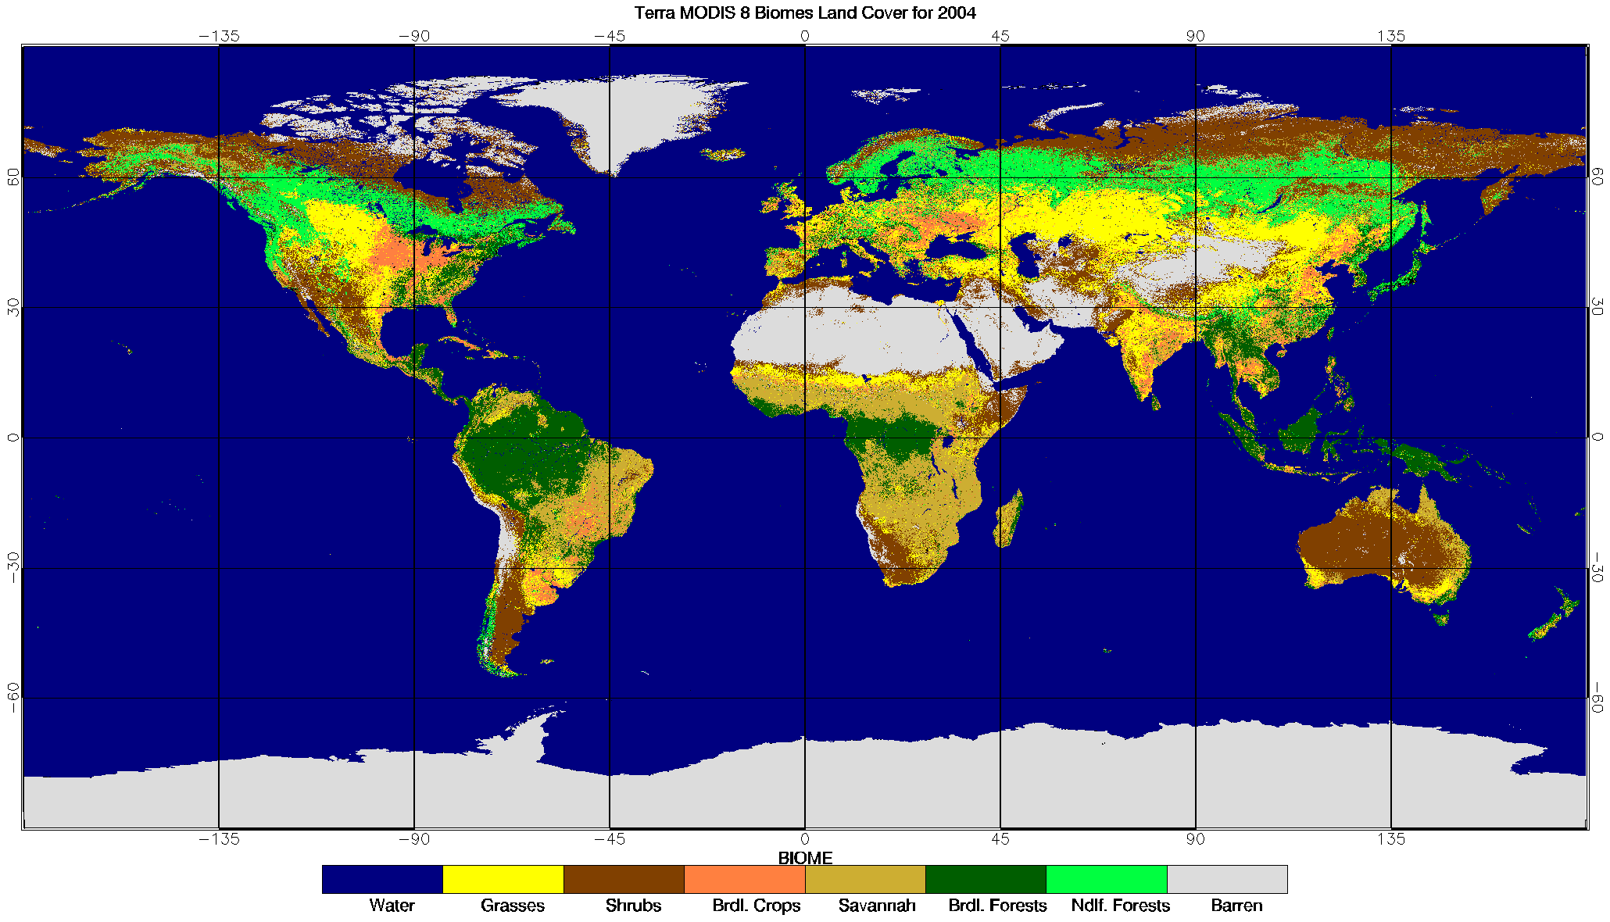
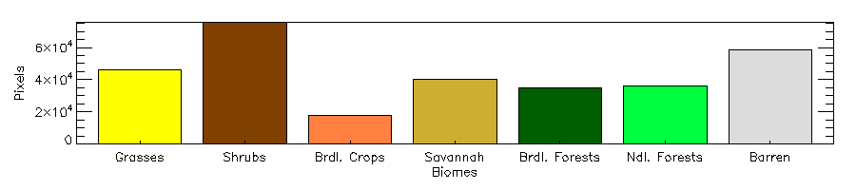
Beta Maturity Evaluation
Data sets analyzed
Global VIIRS, MODIS and AVHRR VI products from March to July 2012.
VIIRS daily and compositing VI products corresponding to MODIS and AVHRR data sets.
MODIS vegetation index TOC-EVI 16-day composites
NOAA-18 AVHRR TOA-NDVI 7day composites.
MODIS Land cover LAI/FPAR
6-biomes land cover, annual product, ancillary data set, allowing biome-level analysis
MODIS LAI/FPAR 6-biome Land Cover

Slide 23
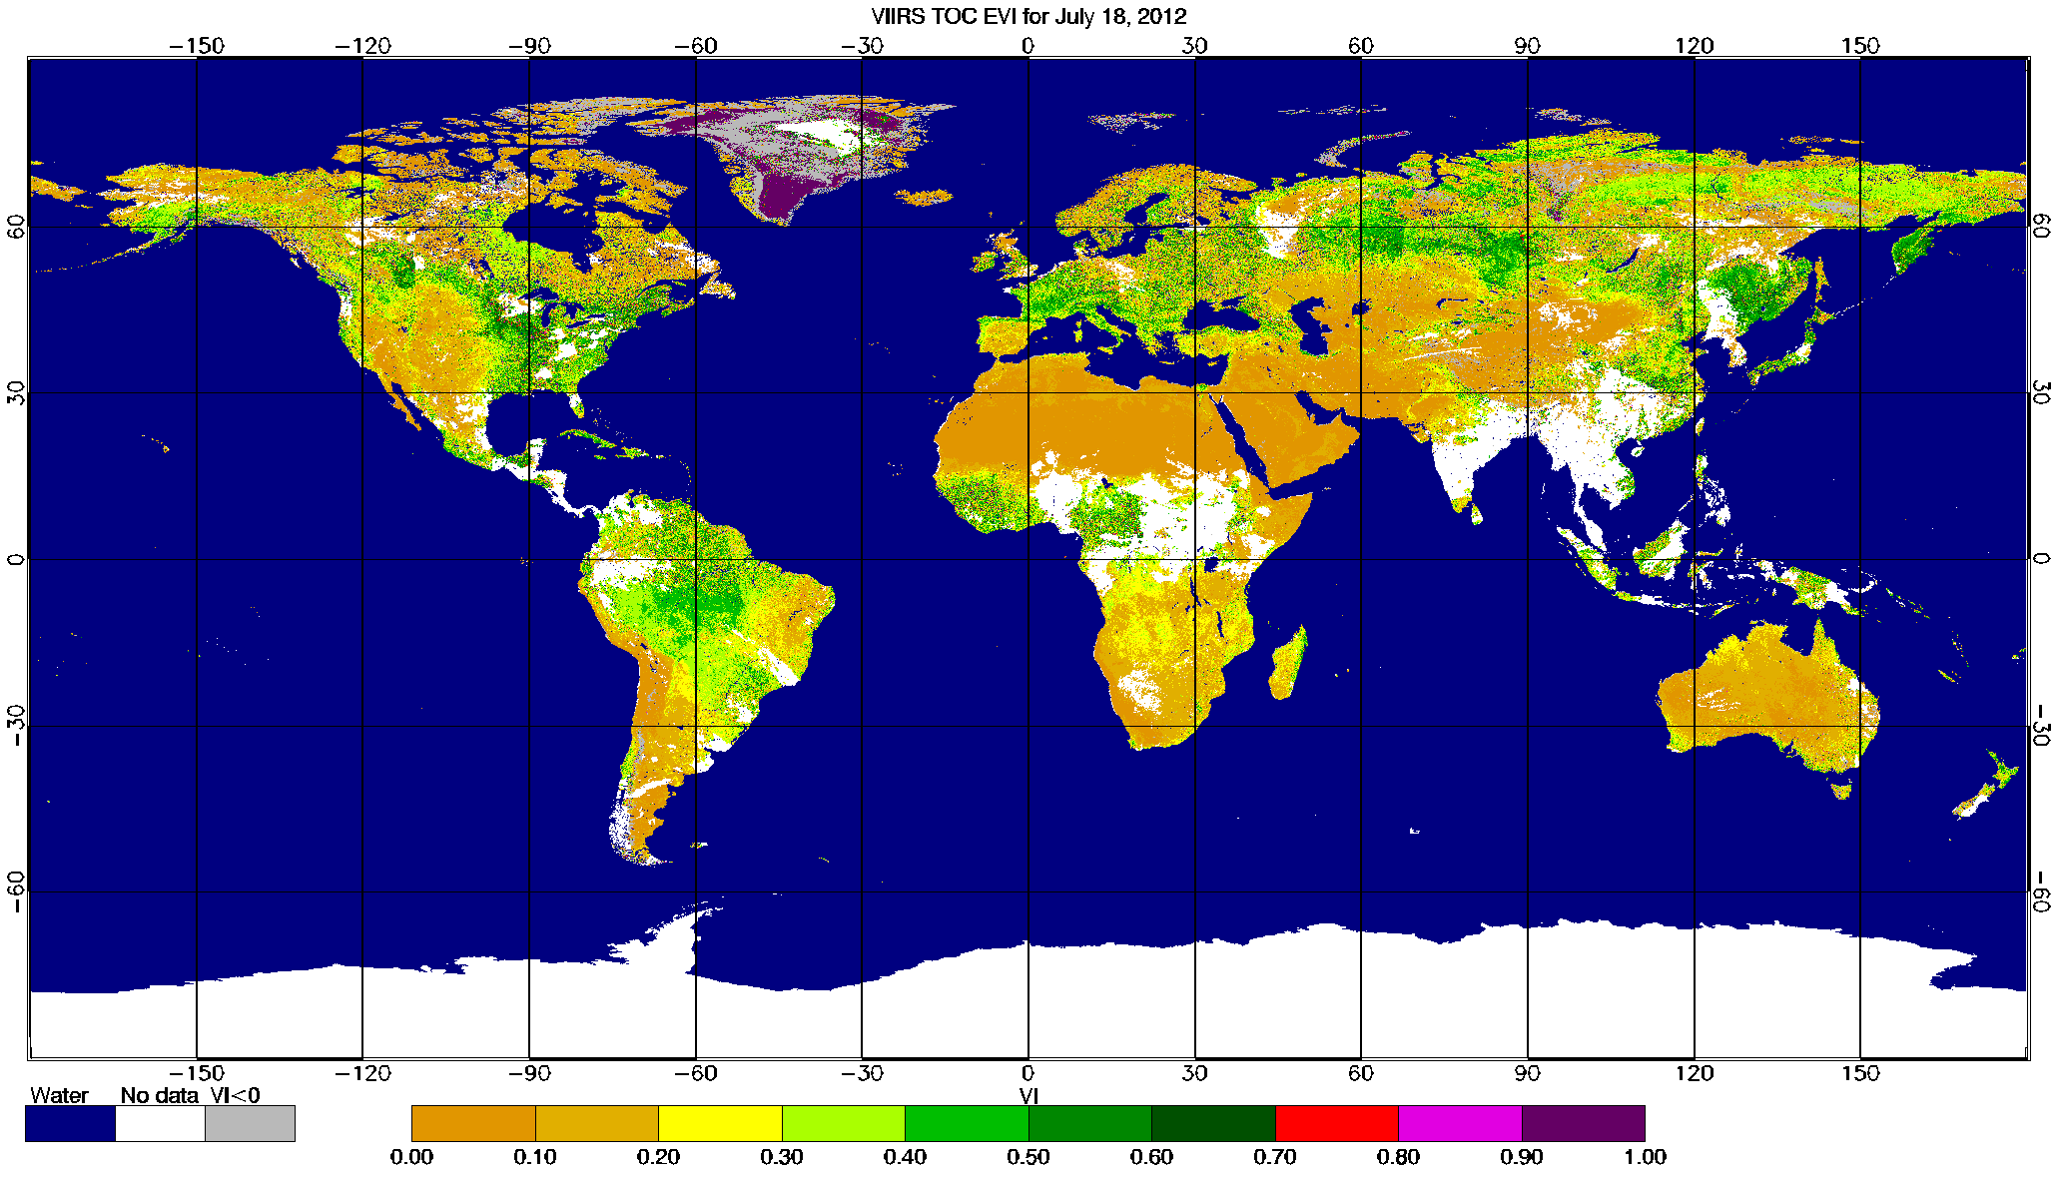
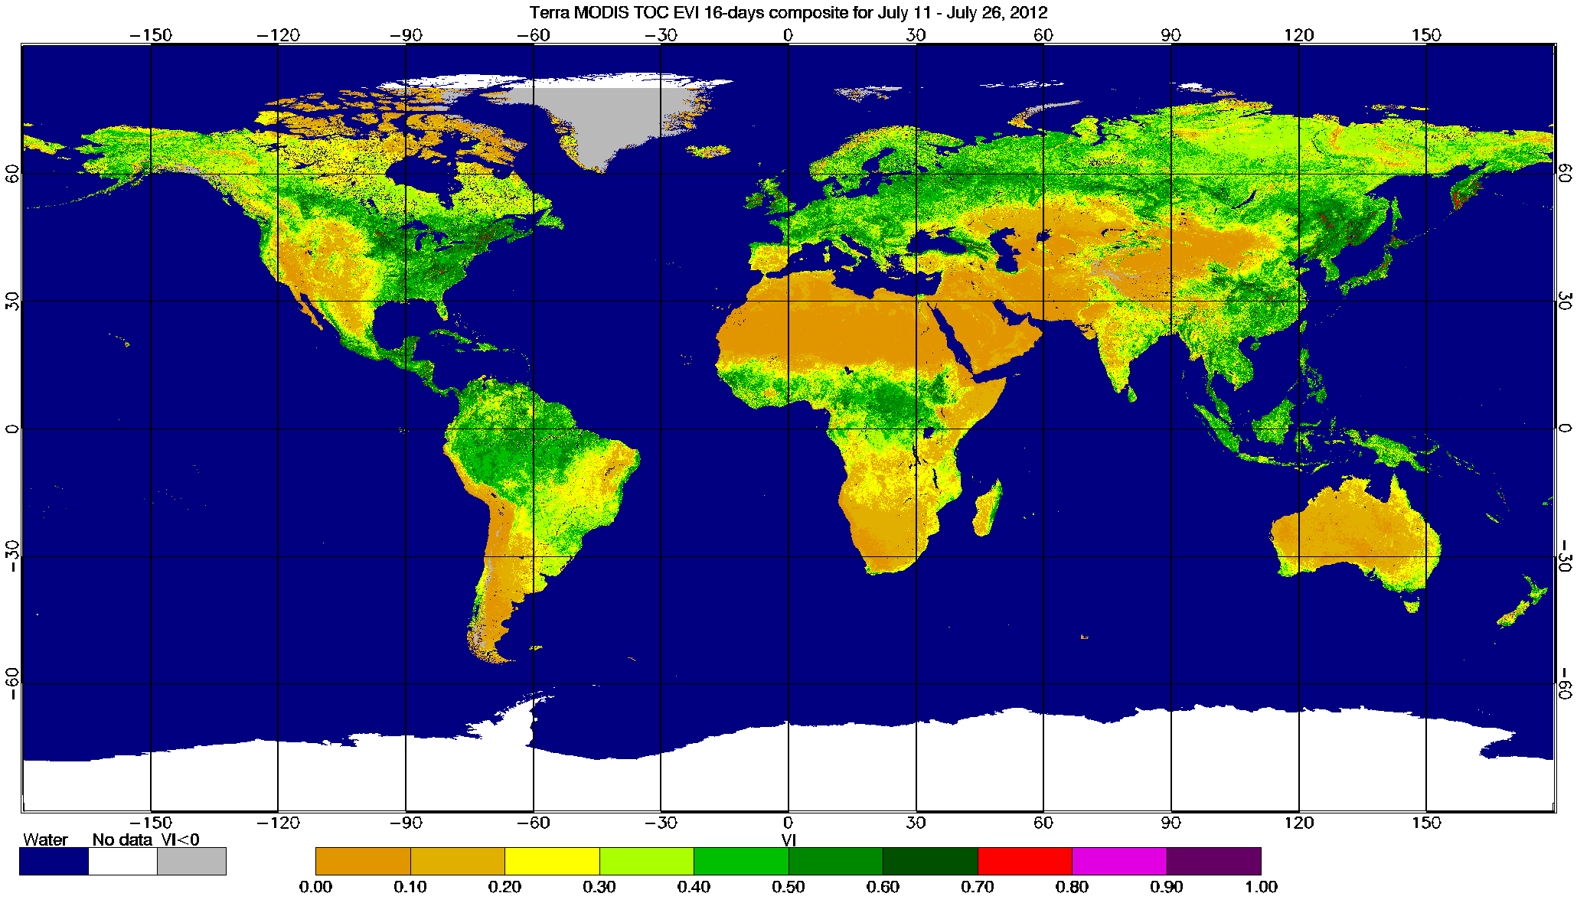
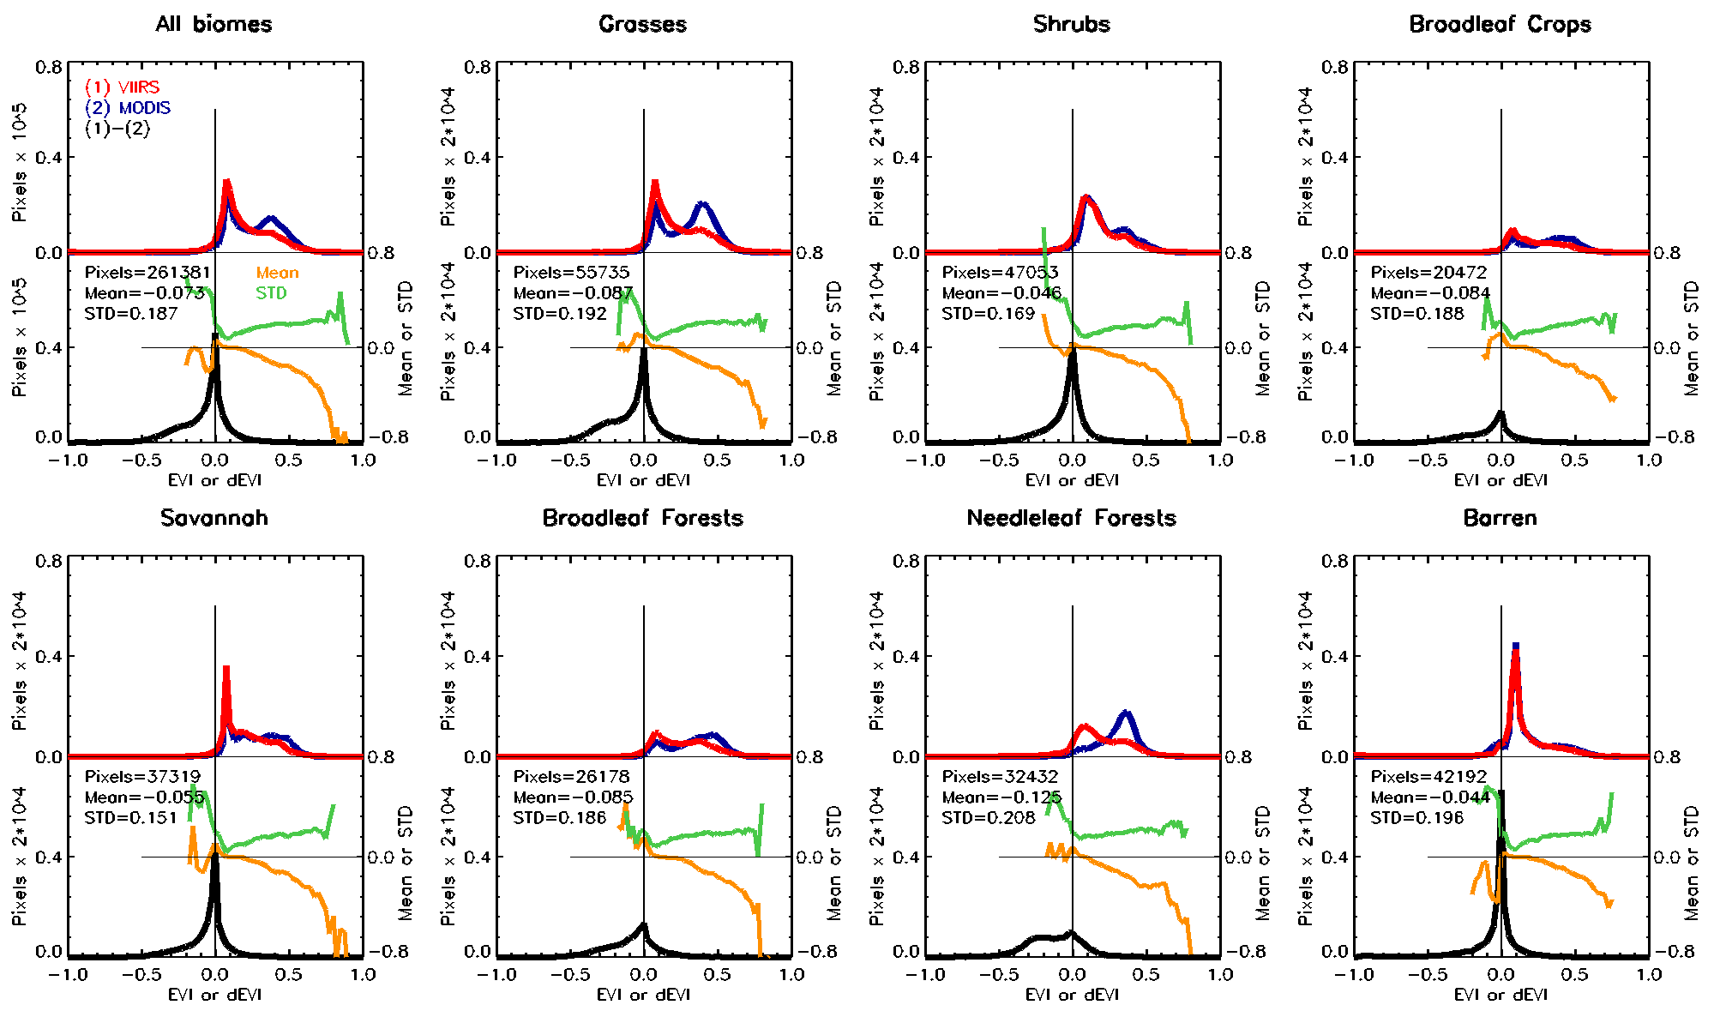
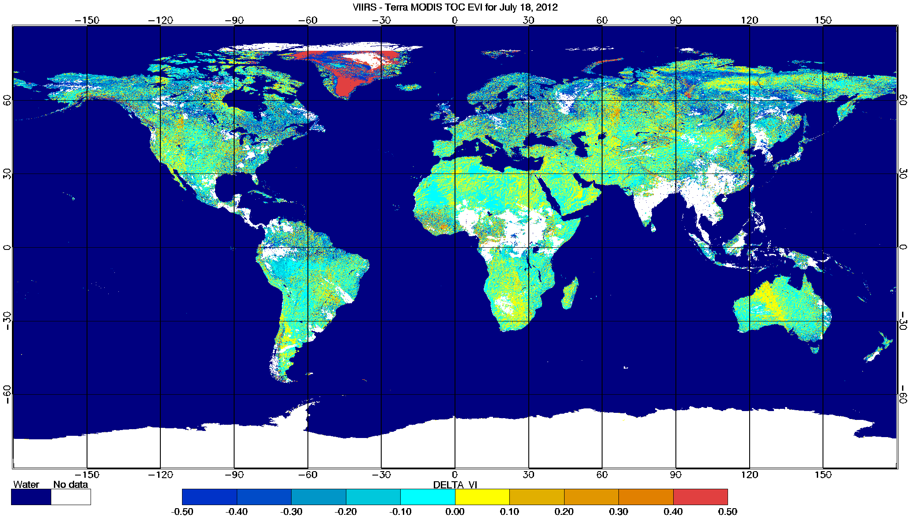
MODIS vs. Suomi NPP VIIRS
Enhanced Vegetation Index (EVI)
Analysis of daily VIIRS TOC-EVI (VIIRS: July 18, 2012, vs. MODIS: July 11 – July 26, 2012)
Overall, spatial patterns and histograms of VIIRS and MODIS TOC EVI are consistent
However, VIIRS TOC EVI exhibits anomalously high values over snow-covered areas at high SZA (i.e., Greenland)
Also cloud leakage is pronounced at Northern latitudes (patterns of unusually low VI or negative difference). Those also can bee seen in histograms, as increased weight at low VI values.
VIIRS MODIS Difference VIIRS minus MODIS

Slide 24
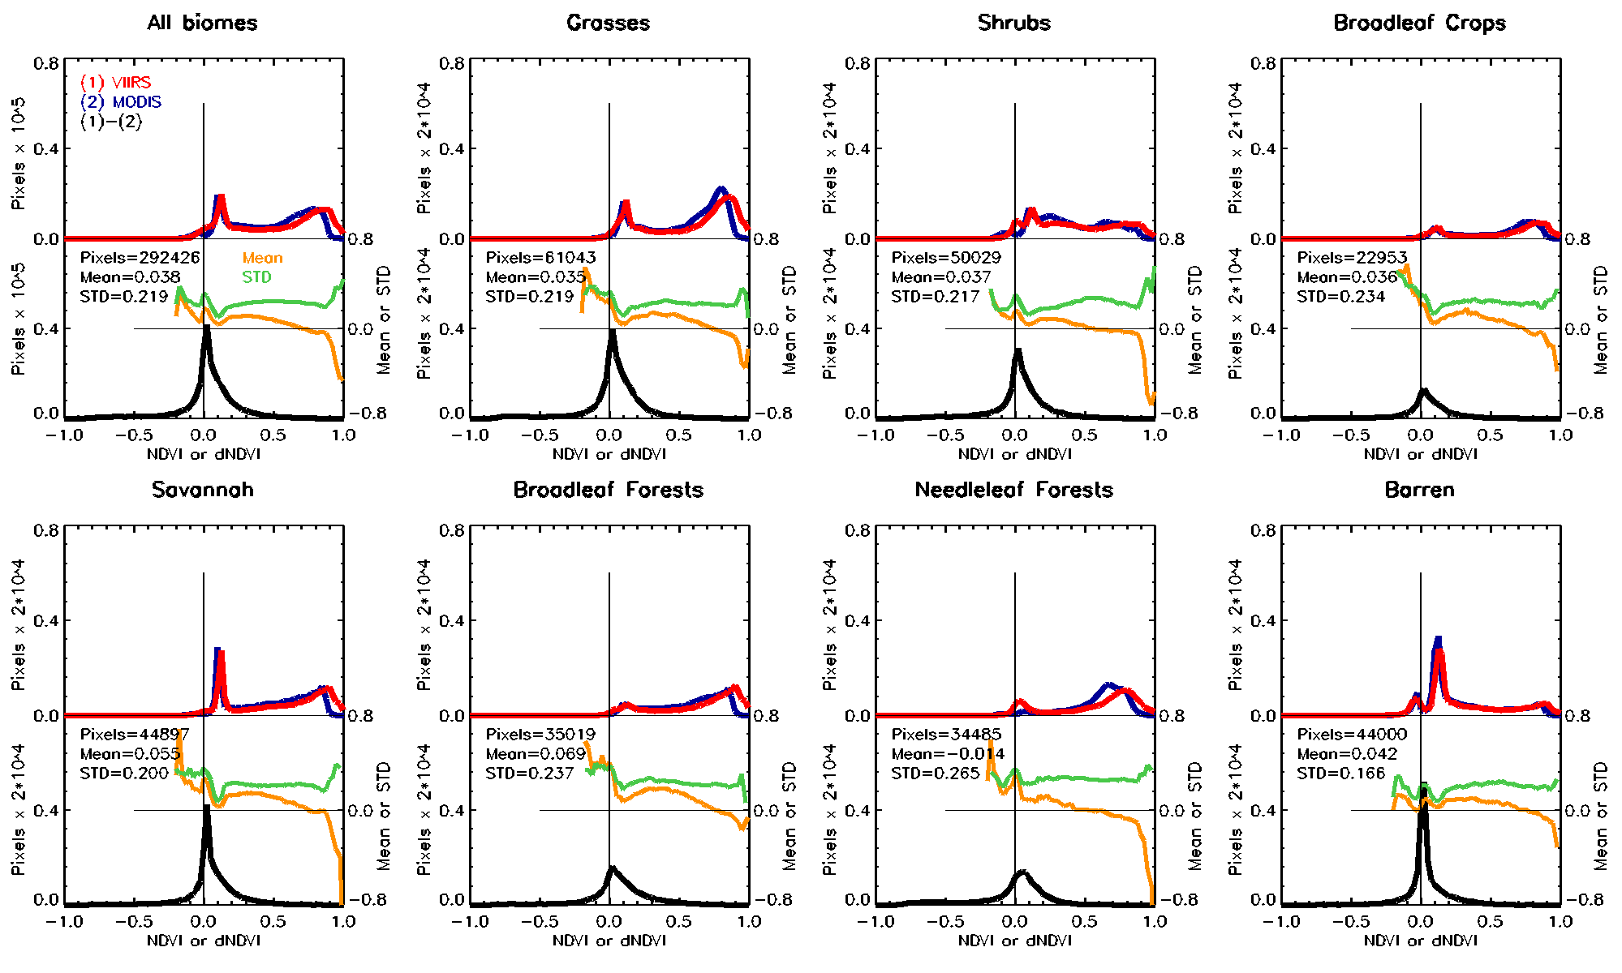
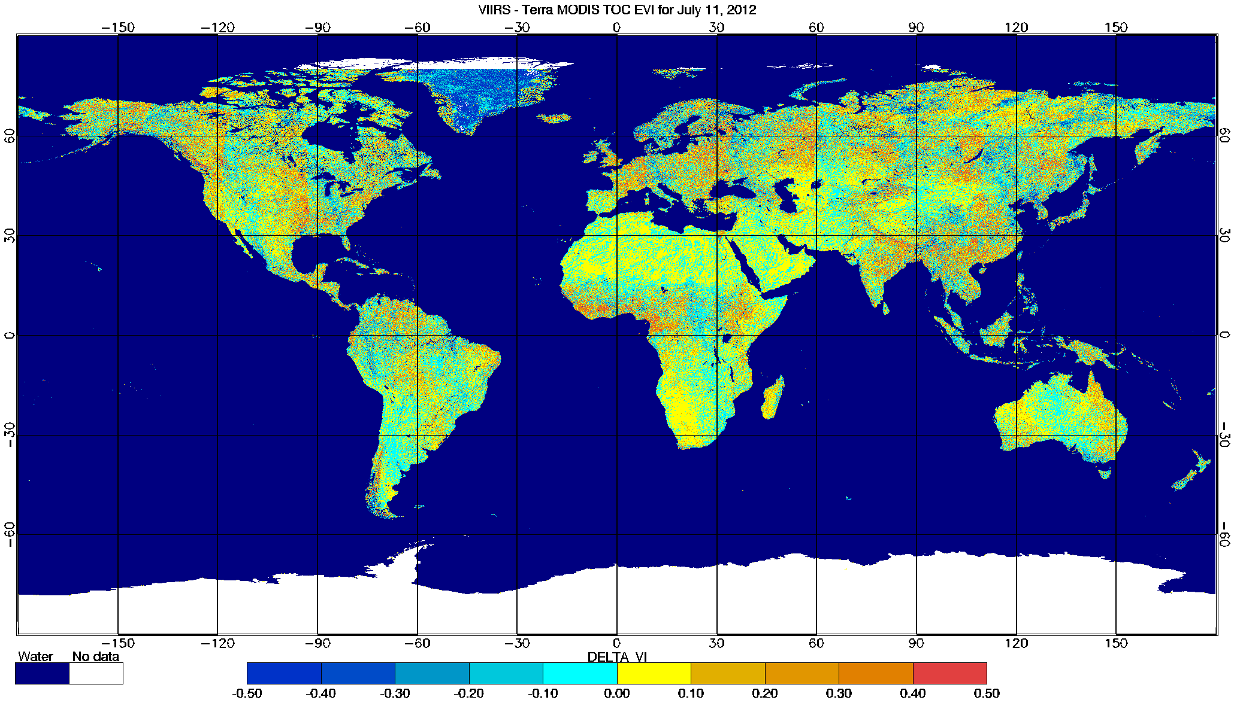
MODIS vs. Suomi NPP VIIRS
Enhanced Vegetation Index (EVI)
Analysis of 16-day compositing VIIRS TOC-EVI (VIIRS and MODIS for: July 11 – July 26, 2012)
16-day Compositing removes gaps associated with cloudy pixels
Compositing also removes low VI values (due to cloud under screening).
However, simplified compositing implemented (selection of closest to nadir observations) is not up to MODIS accuracy, due to current limitations of VIIRS QC (i.e., lack of aerosol contamination level)
VIIRS MODIS Difference VIIRS minus MODIS

Slide 25
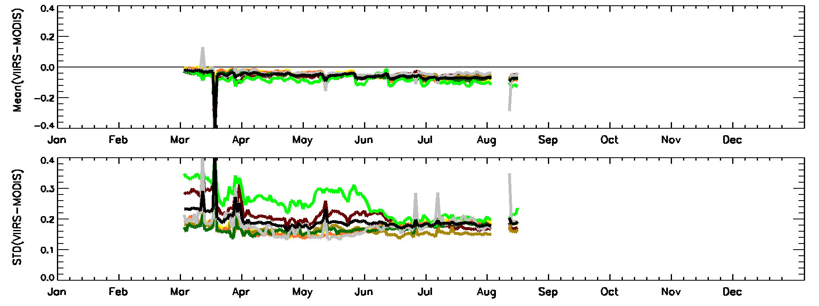
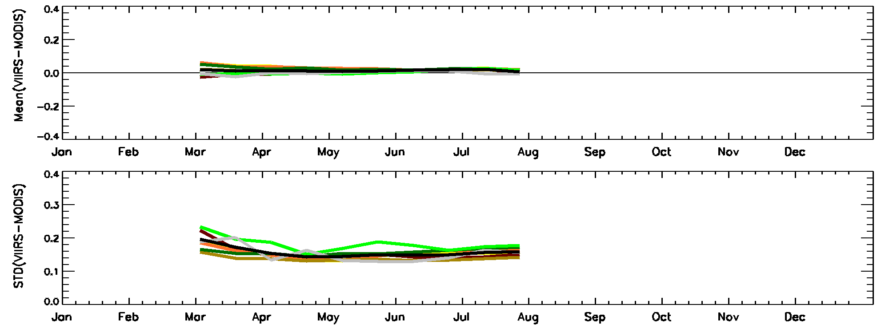
MODIS vs. Suomi NPP VIIRS
Enhanced Vegetation Index (EVI)
Time Series of VIIRS-MODIS TOC EVI
Daily VIIRS TOC EVI systematically underestimates compositing MODIS TOC EVI at the global scale. This is due to cloud leakage in VIIRS Cloud Mask. This is especially noticeable over Needle leaf forest (Northern high latitudes)
This discrepancy has an increasing trend from Spring to Summer probably due to natural seasonality of cloud coverage
Compositing virtually removes systematic bias between VIIRS and MODIS TOC EVI, and decreases STD, especially for Needle leaf forests.

Slide 26
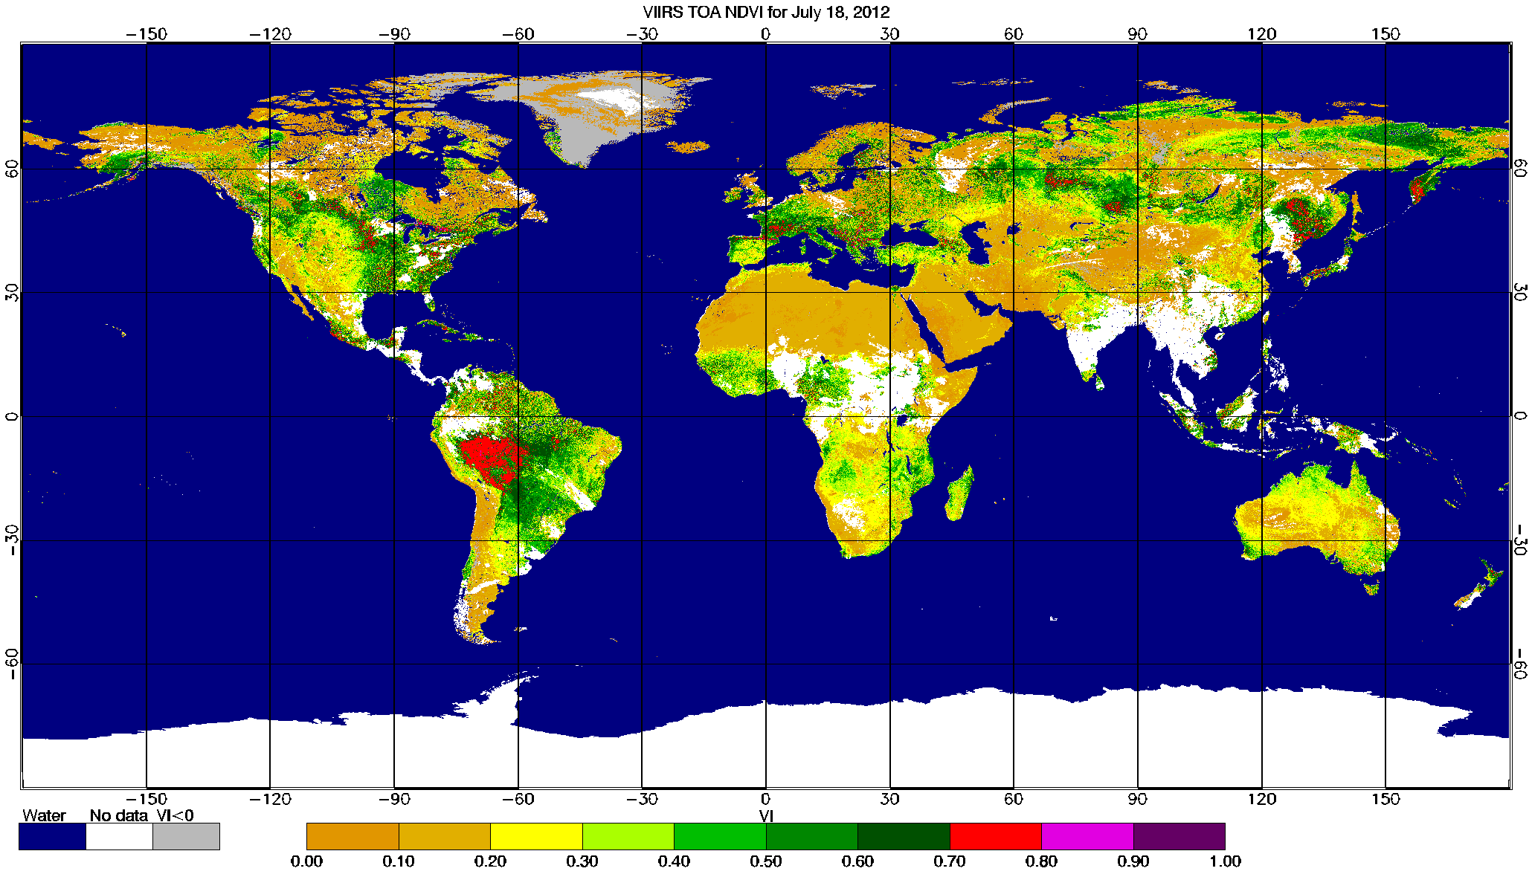

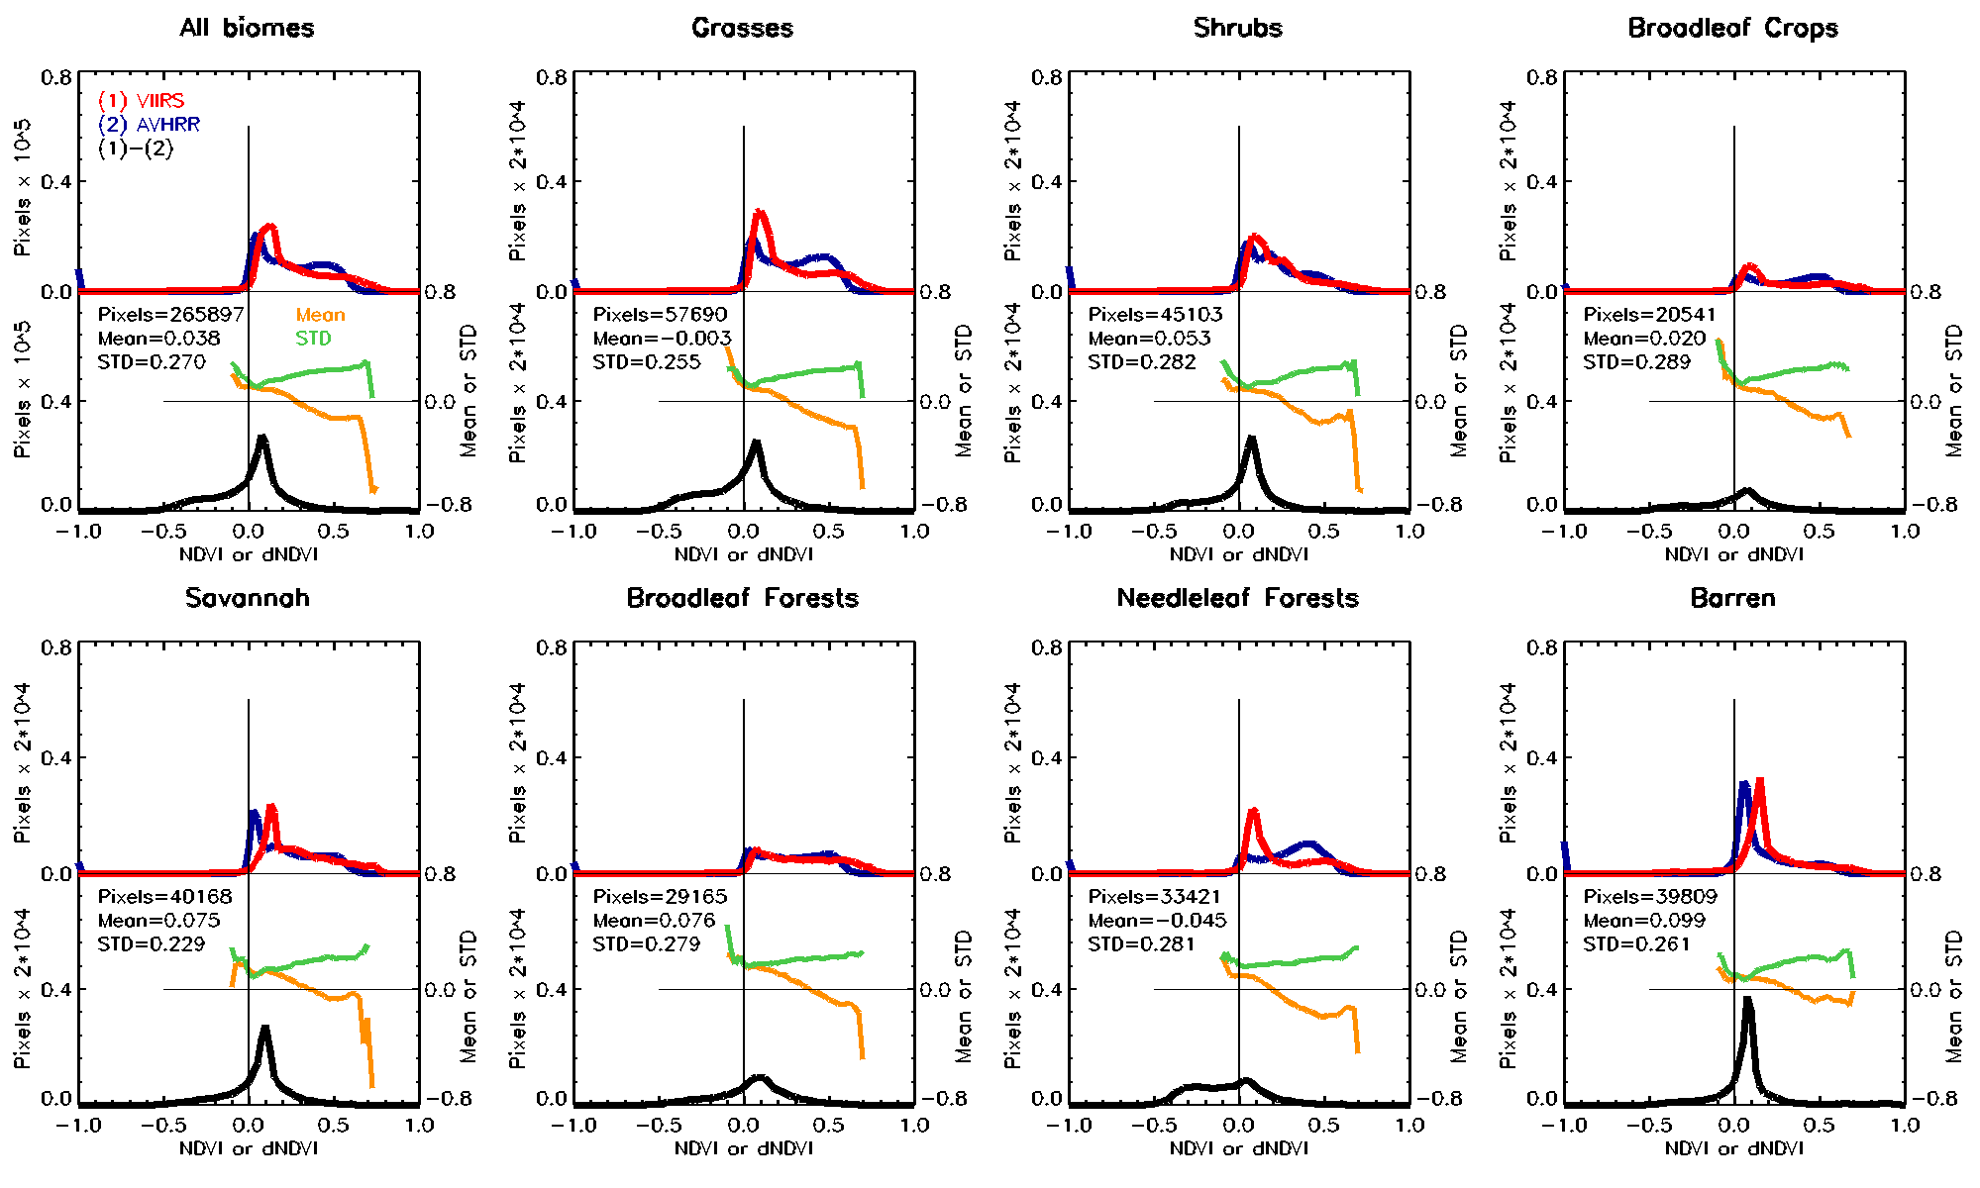
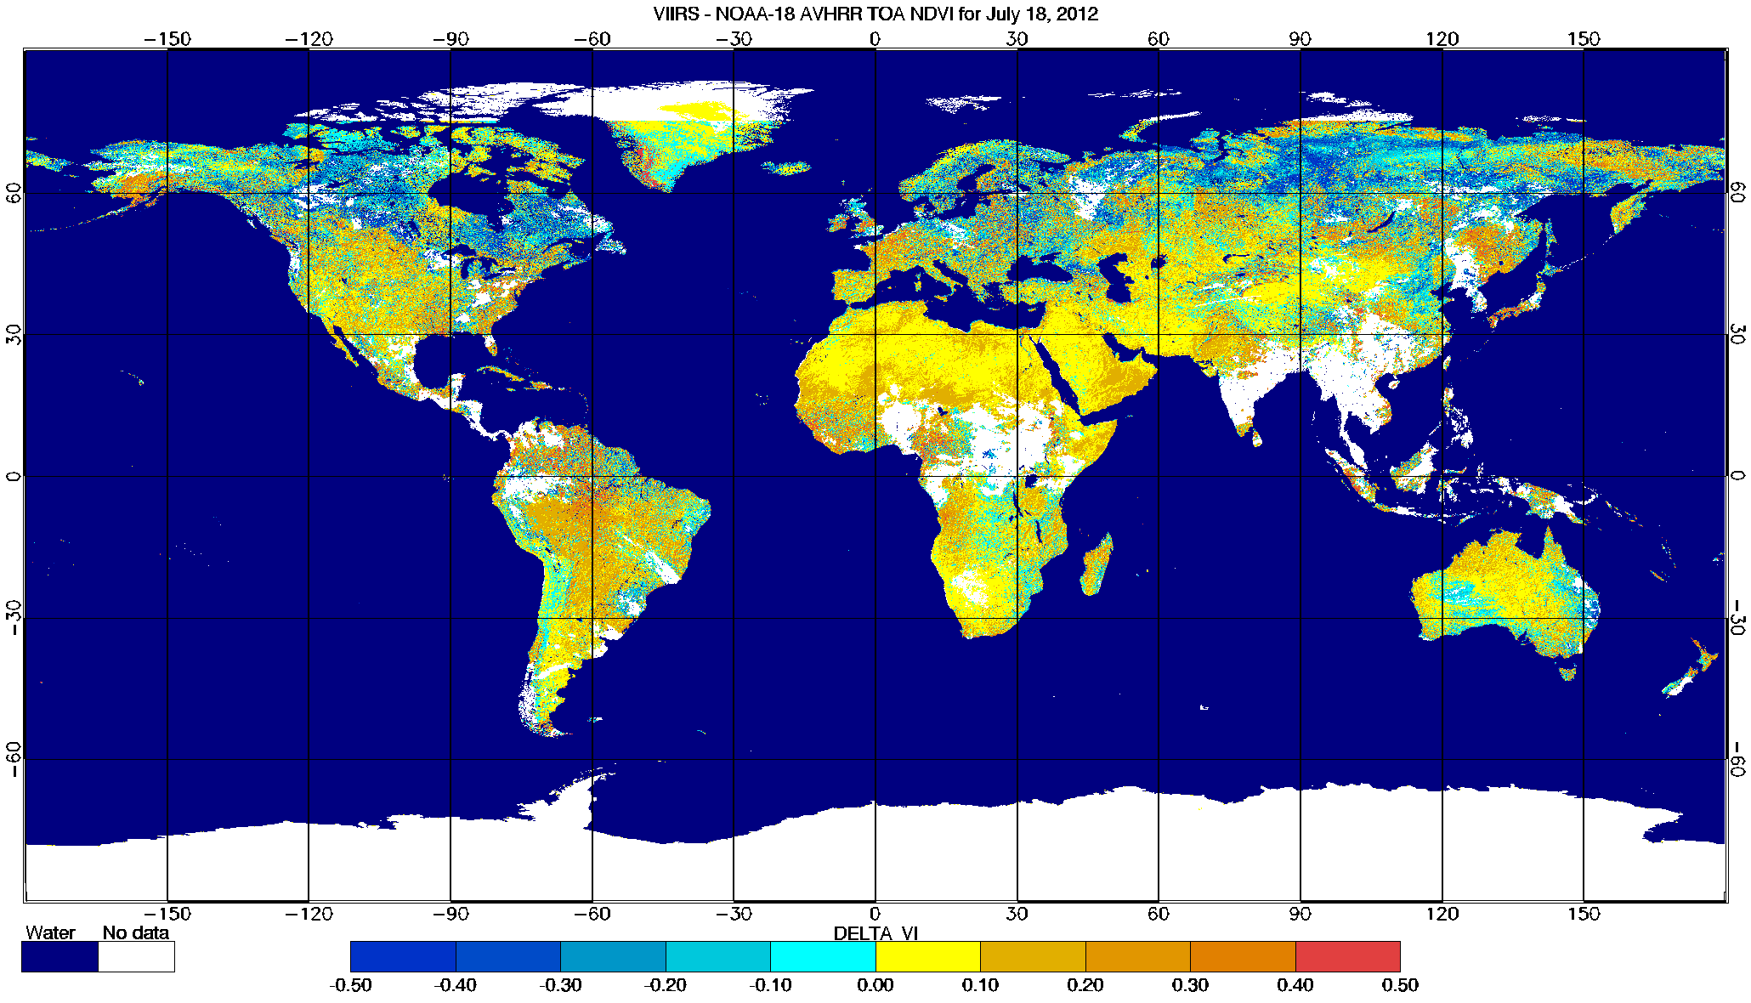
AVHRR vs. Suomi NPP VIIRS
Normalized Difference Vegetation Index (NDVI)
Analysis of daily VIIRS TOA-NDVI (VIIRS: July 15, 2012, vs. NOAA-18 AVHRR: July 15 – July 21, 2012)
Overall, spatial patterns and histograms of VIIRS and AVHRR TOA NDVI are consistent
VIIRS NDVI is higher than AVHRR NDVI especially at the Southern hemisphere (this is probably a radiometric effect arising due to large differences in sensor bandwidths)
However, at the Northern hemisphere cloud leakage in VIIRS data dominates and VIIRS TOA NDVI is lower than AVHRR 7-day NDVI. Cloud leakage exhibits well-pronounced signatures in the histograms
VIIRS AVHRR Difference VIIRS minus AVHRR

Slide 27
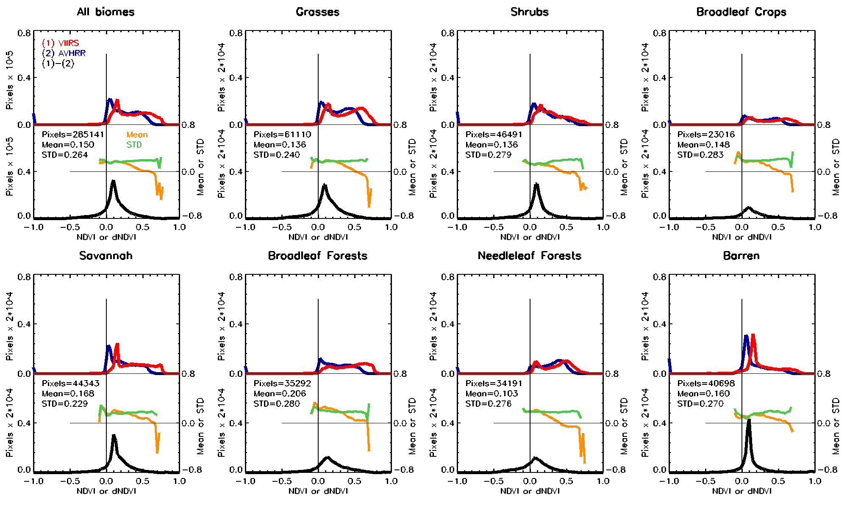
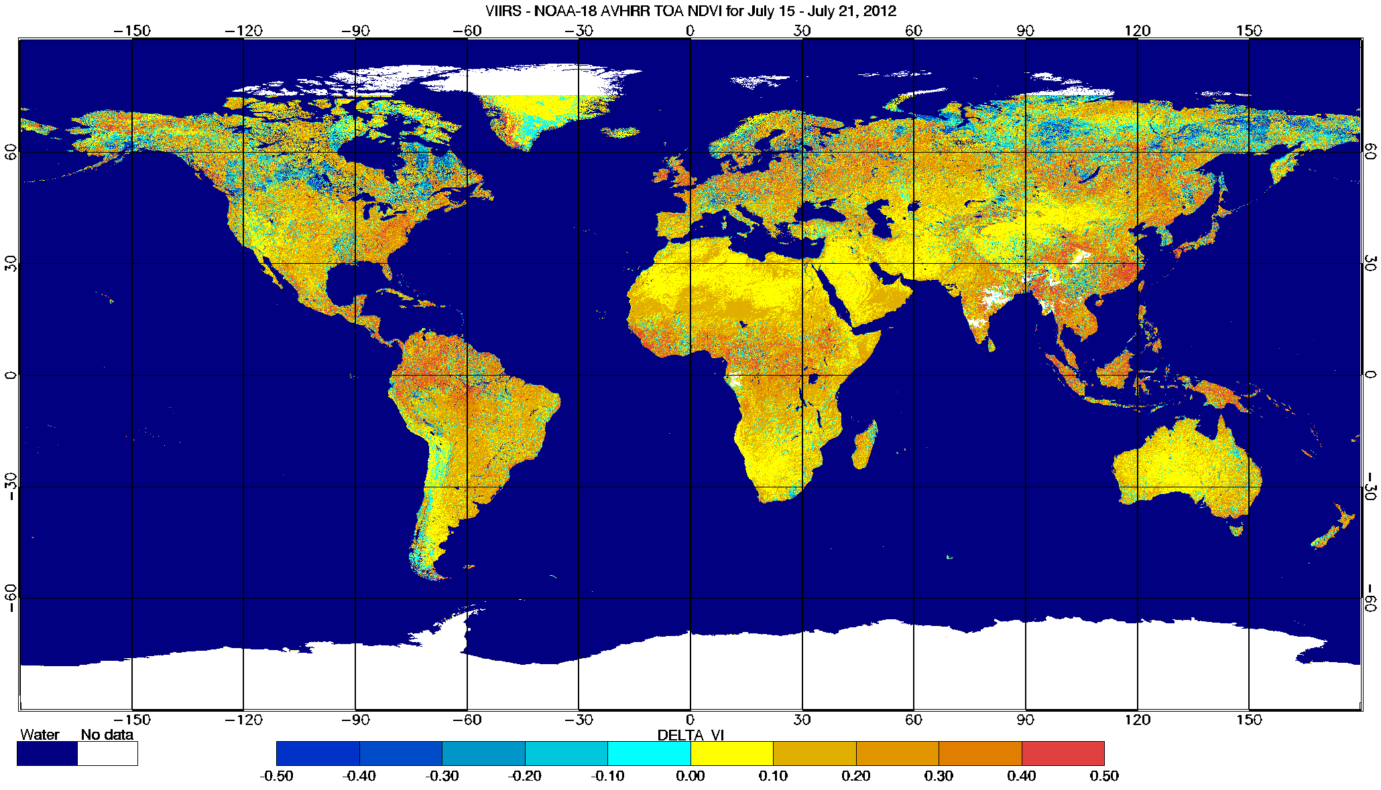
AVHRR vs. Suomi NPP VIIRS
Normalized Difference Vegetation Index (NDVI)
Analysis of 7-day compositing VIIRS TOA-EVI (VIIRS and NOAA-18 AVHRR for: July 15 – July 21, 2012)
7-day Compositing removes gaps and cloud leakage. However, due to short time interval and simplified compositing, residual cloud leakage may persist at some areas at the Northern latitudes (map of difference)
After compositing it becomes clear that AVHRR data are systematically lower all over the globe). This systematic bias is seen over global and biome-by-biome histograms.
VIIRS AVHRR Difference VIIRS minus AVHRR

Slide 28
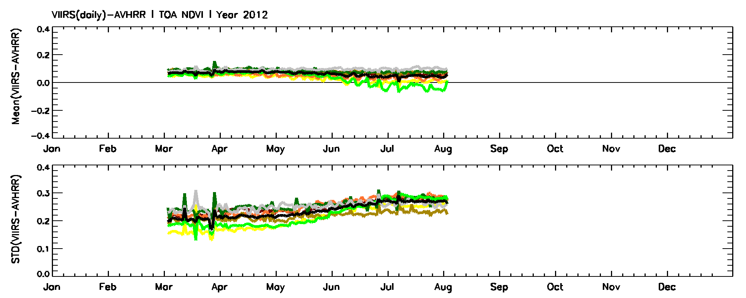
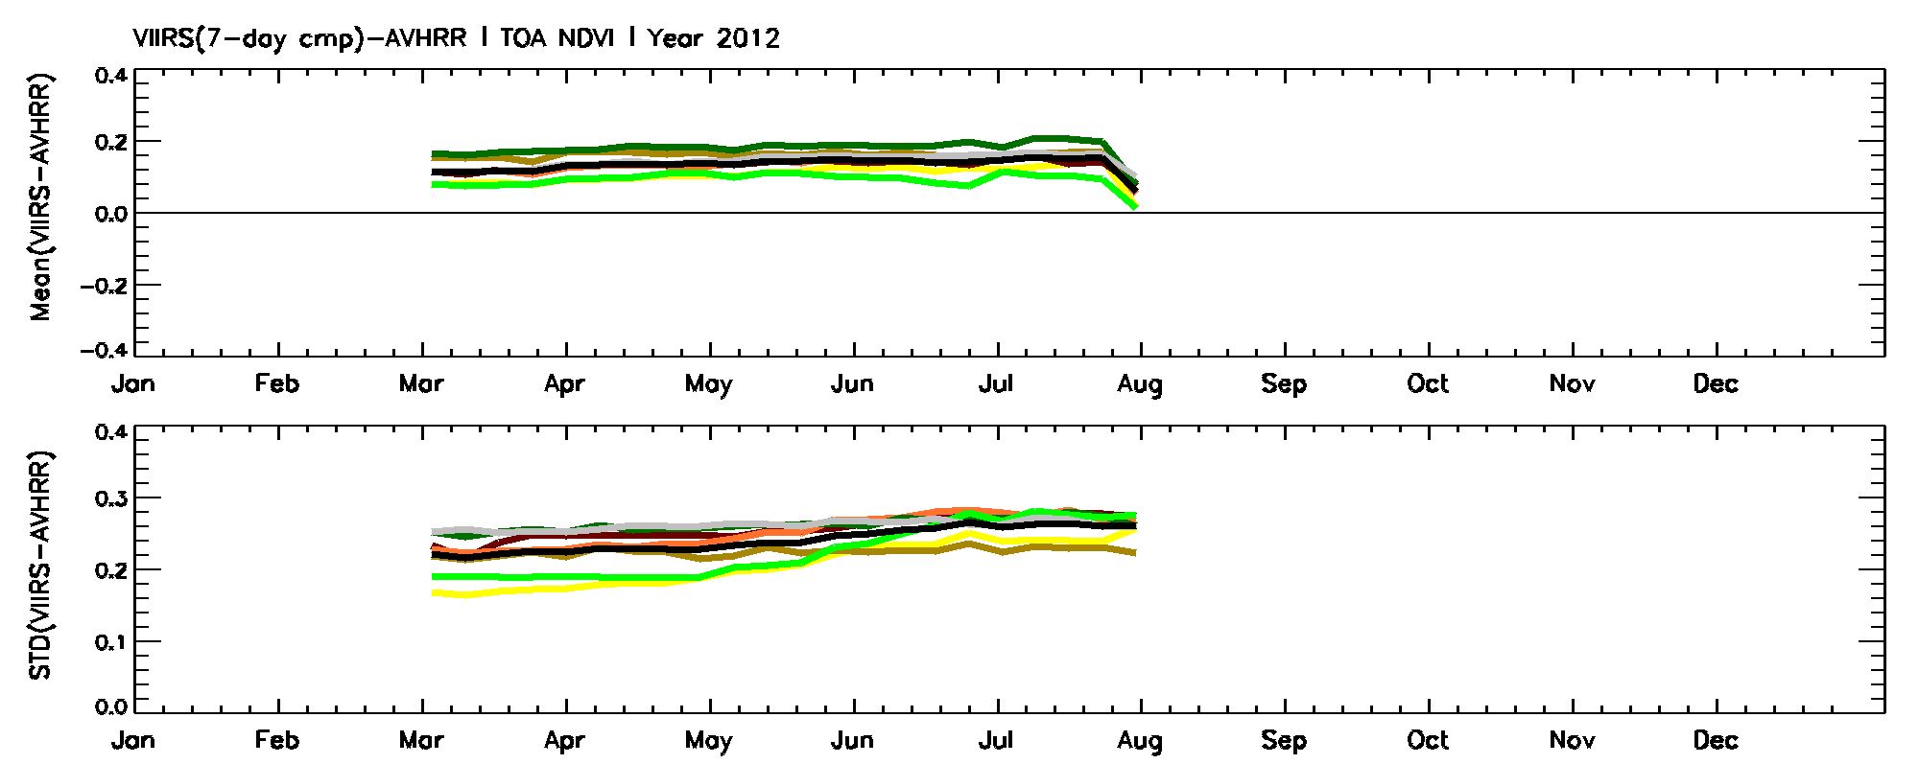
AVHRR vs. Suomi NPP VIIRS
Normalized Difference Vegetation Index (NDVI)
Time Series of VIIRS- NOAA-18 TOA NDVI
Daily VIIRS TOA NDVI systematically overestimates compositing AVHRR TOA NDVI at global scale. This is due to cloud leakage in VIIRS Cloud Mask.
However, this discrepancy decreases from Spring to Summer due to counter-balancing effect of increasing cloud leakage.
Compositing removes effect of cloud leakage and make clear systematic bias between VIIRS and AVHRR TOA NDVI.

Slide 29
Summary of VIIRS VI Performance at Global Scale
VIIRS VI data | TOA NDVI | TOC EVI
Reference | NOAA-18 AVHRR | MODIS
Mean (VIIRS-Reference) | +0.05 | -0.05
STD (VIIRS-Reference) | 0.25 | 0.20
Detected anomalies | 1) Trend of increasing negative anomalies over Northern high latitudes from Spring to Summer. This is under-screening of atmospheric impact and can be reduced by compositing. 2) However, aside from cloud impact, TOA NDVI from VIIRS is higher compared to that from AVHRR. This can be seen even in the daily VIIRS data affected by clouds. Most probable reason for overestimation is an impact of sensors bandwidth differences. | 1)Trend of increasing negative anomalies over Northern high latitudes from Spring to Summer. This is an effect of cloud leakage which can be eliminated by compositing. 2)Large positive TOC EVI anomalies are observed over Northern high latitudes (Greenland and Siberia during winter). This is due to retrievals under snow at high SZA. Anomalies can be screened away by tracing data with negative denominator in the equation of TOC EVI.

Slide 30
Beta Maturity Evaluation
Consistency of global spatial patterns between VIIRS-VI and heritage VI (AVHRR TOA-NDVI and MODIS TOC EVI)
Time series of global VI EDR generally match heritage VI
However, daily VIIRS TOC EVI data are (1) substantially affected by residual clouds and (2) anomalously high values at snow covered areas are present at Northern high latitudes. Compositing of VIIRS TOC EVI removes atmospheric effect and makes VIIRS TOC EVI highly consistent with MODIS
Daily VIIRS TOA NDVI are also affected by residual clouds in the same way as TOC EVI. However, after compositing, VIIRS data are systematically higher than AVHRR data

Slide 31
Beta Considerations/Remaining Issues
Enhancements to be proposed/examined for
the VI EDR
Adding TOC-NDVI
Updating/revising QA fields (same as MODIS)
Refining the EVI algorithm
  A backup algorithm over snow/ice covered areas
  Coefficient adjustment or an EVI2 algorithm
Temporal compositing
EVI equation revision: the gain factor
VIIRS
MODIS

Slide 32
Future Plan
Near-term
  Algorithm refinement
  Evaluate Top Of Canopy (TOC) NDVI produced from Surface Reflectance IP
  ASRVN, Tower Reflectance, FLUXNET: obtain initial APU estimates before provisional release; continue the analysis to increase a number of sites with longer time series
Mid-to-long term
  Full evaluation of updated science algorithm and code
  Provisional release of VI EDR by September 2013
  Validated Version 1 status by July 2014

Slide 33
Summary of Findings
Initial results show that the VIIRS Vegetation Index EDR product is performing well.
  No obvious problems present at this time, including data structure
  Retrievals expected to improve significantly with improvements in upstream processing.
VI EDR has met the beta stage based on the definitions and the evidence shown
  Exceeding the definition of beta in most cases

