Slide 1
474-CCR-13-1218
VI-EDR Changes: Additional quality flags for VI EDR Correct Low Sun Angle in Documents (DRs 7038, 4377)

Slide 2
Summary and Rationale
As recommended in the VI beta maturity report, the following additional quality flags (QFs) are desirable for VI EDR in order to screen suspicious quality pixels that cannot be screened by the current set of VI EDR QFs:
Adjacency clouds (yes or no)
Cloud shadows (yes or no)
Snow/ice (yes or no)
Aerosol quantity (climatology, low, average, high)
With the addition of these new QFs and the implementation of DR 4488 (Retrieval of surface reflectance for all pixels), the “confident cloud” check should be removed. The original QFs allow for screening of those pixels with a “confident cloudy” flag.
In addition to documentation changes needed for DR7038 code changes, this CCR includes documentation updates to correct the low sun angle threshold to 65 degrees: the current production code and system specs use 65 degrees, but some documents list 70 degrees. This discrepancy was reported to the DRAT as DR4377. The DR was closed with instructions to include the documentation correction to change low sun angle threshold from 70 to 65 degrees with document updates submitted in this change package for DR7038.

Slide 3
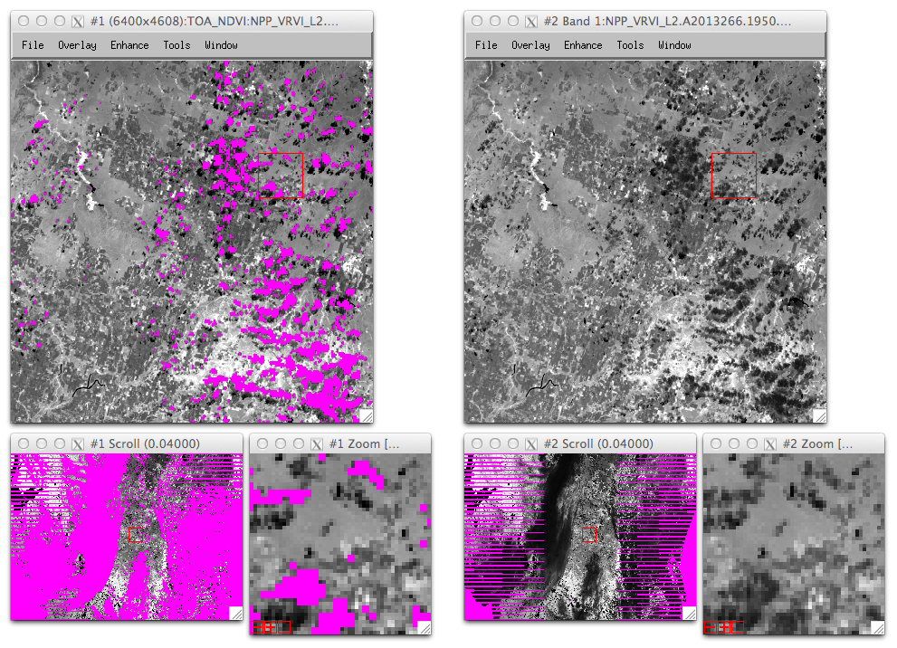
Granule Date.Time: 2013266.1950 (N. America)
IDPS Current
TOA NDVI
DR 7038 for Mx8.2
TOA NDVI

Slide 4
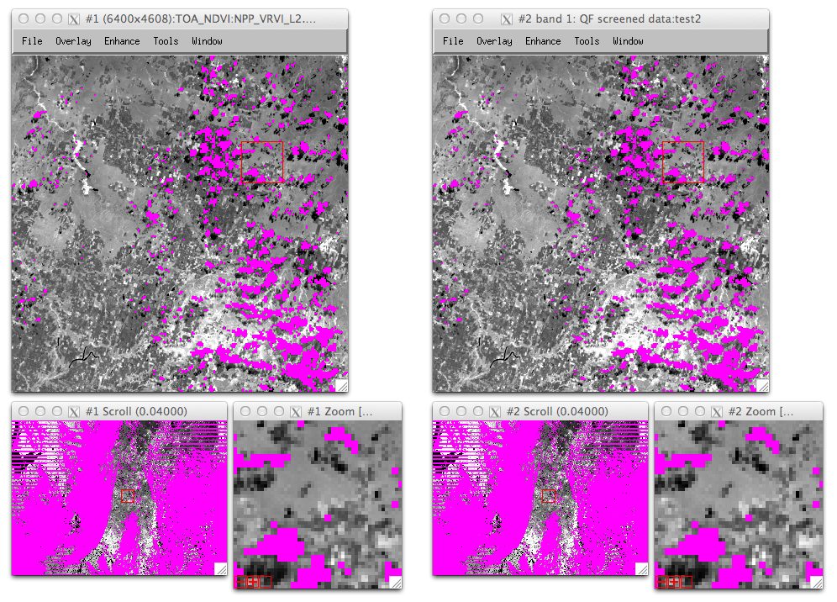
Granule Date.Time: 2013266.1950 (N. America)
IDPS Current
TOA NDVI
DR 7038 for Mx8.2
TOA NDVI
Screened for “Confident Cloudy” & “AOT > 1.0”

Slide 5
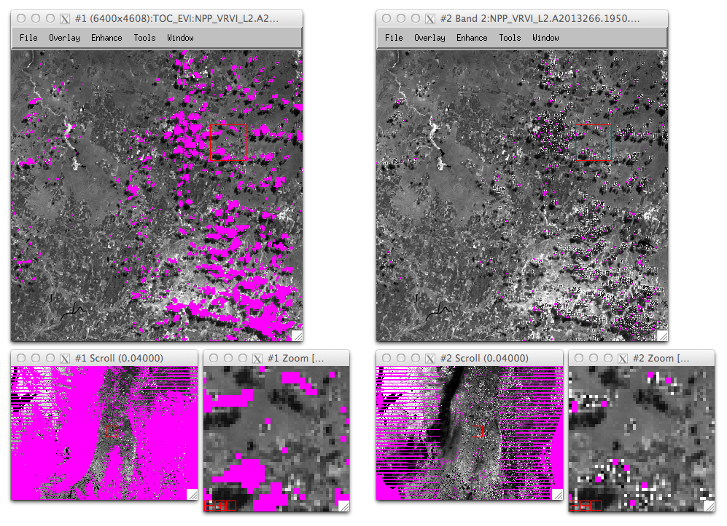
Granule Date.Time: 2013266.1950 (N. America)
IDPS Current
TOC EVI
DR 7038 for Mx8.2
TOC EVI

Slide 6
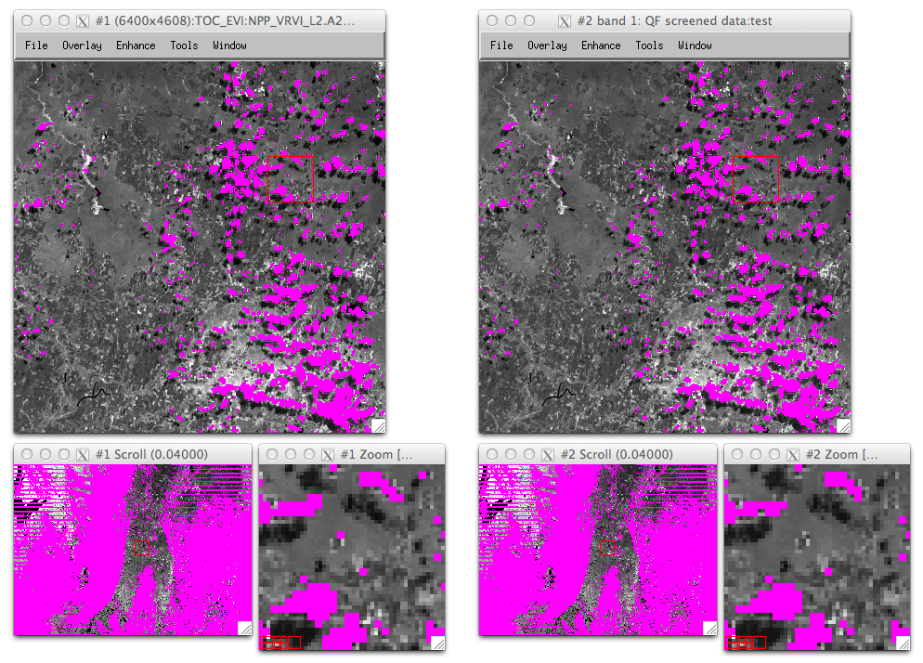
Granule Date.Time: 2013266.1950 (N. America)
IDPS Current
TOC EVI
DR 7038 for Mx8.2
TOC EVI
Screened for “Confident Cloudy” & “AOT > 1.0”

Slide 7
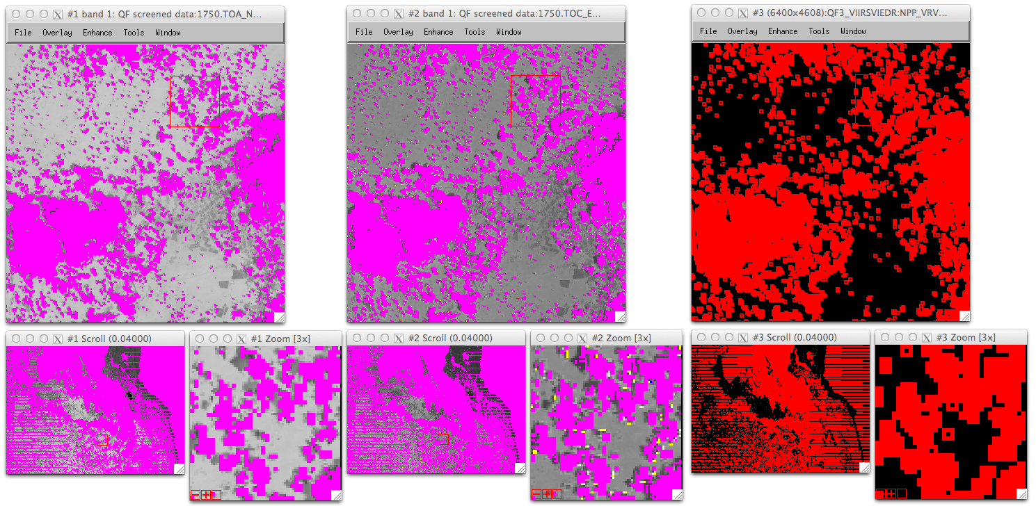
QF3 Bit 4: Adjacent to Clouds
There still remain cloud-contaminated pixels adjacent to cloud screened zones. These pixels are labeled and screened by Adjacency Cloud QF.
TOA NDVI
(Conf/Prob Cloudy & AOT >1.0 screened)
TOC EVI
(Conf/Prob Cloudy & AOT >1.0 screened)
2013266.1750 (Amazon, Brazil)
Adjacency Clouds
-0.2
1.0
< -0.2
> 1.0
Fill Value
Red: On / Black: Off

Slide 8
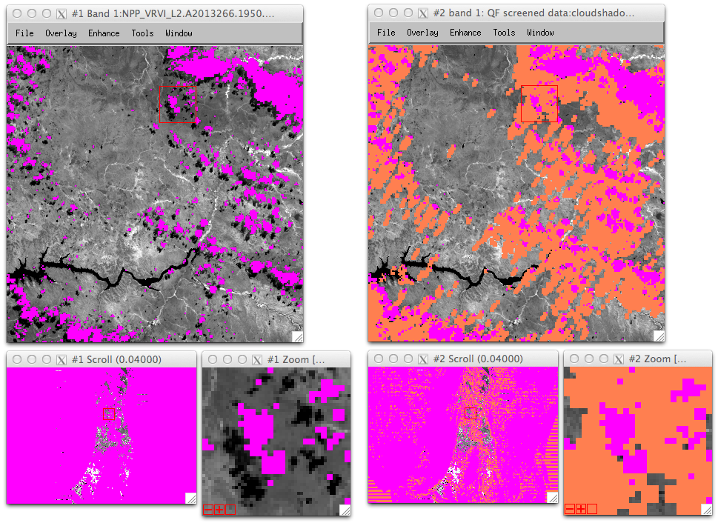
Additional QF3 Bit 7: Cloud Shadows
TOA NDVI:
Screened for “Confident Cloudy” & “AOT > 1.0”
TOA NDVI:
Screened for “Cloud Shadows”
“Cloud shadow” QF can be used to screen shadow-affected pixels which produce faulty low NDVI or EVI values.

Slide 9
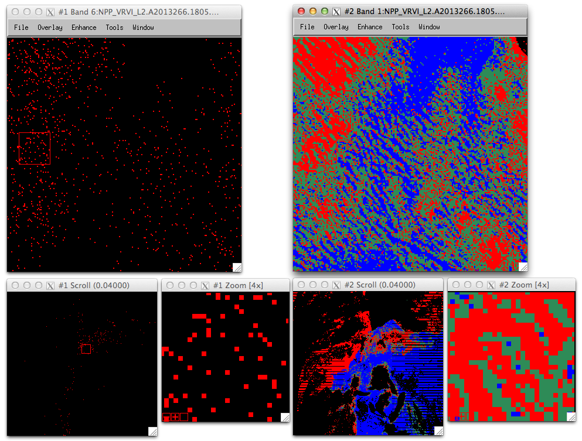
Granule Date.Time: 2013266.1805 (N. America)
QF3 Bit 5-6: Aerosol Quantity
IDPS Current: AOT > 1.0
Aerosol Quantity
DR 7038 for Mx8.2
Aerosol quantity can be assessed on a per-pixel basis. The same flag is used in the MODIS products.
Climat.
Low
Ave.
High

Slide 10
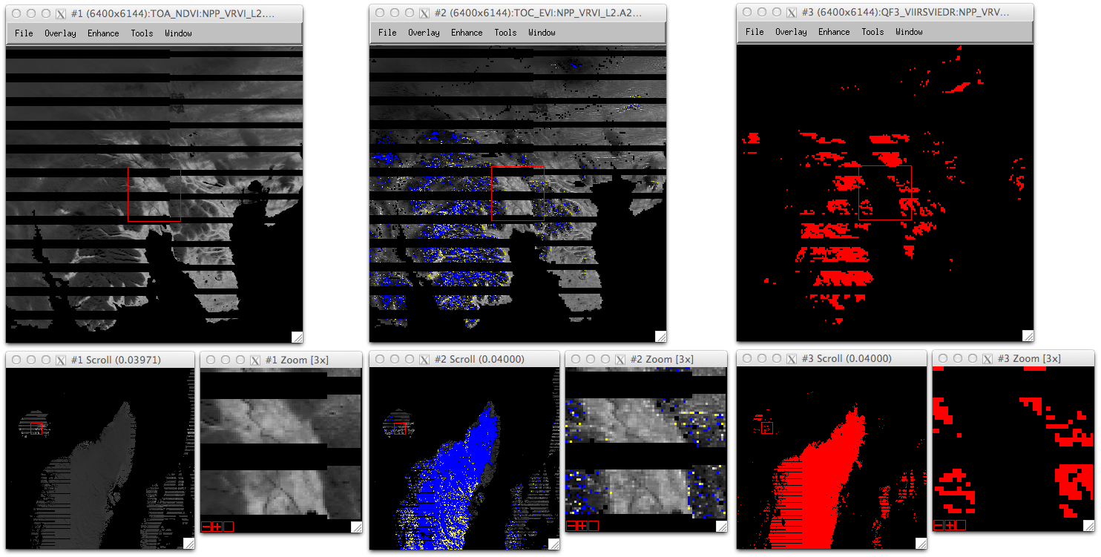
QF3 Bit 3: Snow/Ice
Snow/ice QF can be used to screen faulty EVI values (EVI >> 1.0 or << -0.2) over snow covered areas.
2013266.1450 (Iceland & Greenland)
TOA NDVI
TOC EVI
Snow/Ice QF
-0.2
1.0
< -0.2
> 1.0
Red: On / Black: Off

