Slide 1
Findings for the OMPS
Nadir Mapper 1st Guess Total Column Ozone (INCTO)
Nadir Mapper Total Column Ozone EDR (OOTCO) in Support of Promotion to Beta Maturity
Compiled by L. Flynn from
JPSS and NPP OMPS Teams
Last Updated July 16, 2012

Slide 2
Outline
Beta & Provisional Definitions
OMPS Background
INCTO/OOTCO Performance
  Internal Evaluation
    Flags – Error Code, QF1, and QF2
    Reflectivity Map
    Total Column Ozone Map, Latitude Zonal Means
    Aerosol Index Map
    Cross-Track Dependence
    Geolocation of Small FOV
  External Evaluation
    Comparisons to OMPS V8TOZ
    Comparisons to SBUV/2, OMI and GOME-2 V8TOZ
  Known Deficiencies (repeated)
Summary of Findings and Recommendations (repeated)
  Promotion to Beta
  Monitoring plots
  http://www.star.nesdis.noaa.gov/icvs/PROD/proOMPSbeta.TOZ_INCTO.php
  OMPS NM EDR: OOTCO Mutatis Mutandis
  Upgrade to V8TOZ

Slide 3
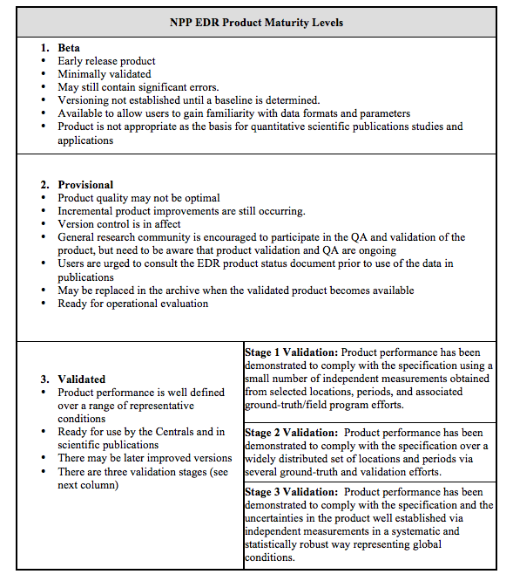
Data Product Beta Maturity Definition
Notes:
Bullet three of Provisional should be “in effect” not “in affect”.

Slide 4
INCTO/OOTCO Summary of Findings and Recommendations
OMPS Nadir Mapper (NM) Total Colum (TC) First Guess IP (INCTO)
  The INCTO product is producing reasonable values for total column ozone, effective reflectivity and aerosol index values. Most error flags are functioning as designed. Several problems with the product have been identified and there is progress on implementing corrections and adjustments.
  The OMPS Team recommends that the INCTO Product be promoted to Beta Maturity.
Monitoring Figures are available at
  http://www.star.nesdis.noaa.gov/icvs/PROD/proOMPSbeta.TOZ_INCTO.php
OMPS Nadir Mapper (NM) Total Colum (TC) EDR (OOTCO) Status
  The OMPS NM EDR product (OOCTO) uses the same algorithm and measurements as the INCTO product. Differences are present because of the use of external data, e.g., CrIS Temperature Profiles and VIIRS Cloud Top Pressures are used in OOTCO in place of forecasts or climatologies. We plan to replace the VIIRS cloud top pressure initially with the UV climatology and eventually with OMPS-measurement-based estimates. We need to turn off the use of the VIIRS cloud fraction in the algorithm as applied for OOCTO. It is producing significant errors in the retrieval product.
  The OOTCO product is producing erroneous values but also satisfies the Beta Maturity standard. The inputs and corrections needed to improve the product are known.
Upgrade to V8TOZ
  The team is investigating an upgrade from the OMPS EDR multiple triplet algorithm to the V8TOZ algorithm currently in use with SBUV/2, OMI and GOME-2 measurements for climate data records and operational products. As of July 1, 2012, the V8TOZ algorithm has been used to process the first five months of OMPS data independently at NOAA STAR and the NASA Ozone PEATE. The OMPS NPP Science Team is adapting OMI algorithms to create better cloud top pressures, aerosol indices and SO2 indices from the OMPS measurements for use with the V8 algorithm.

Slide 5
INCTO/OOTCO Known Product Deficiencies
Problems with fixes in the pipeline or changed over the course of the study
  Preliminary Day 1 Solar (Implemented the middle of June 11, 2012^)
  EDR RT LUT – corrected bandpasses (CCR #343)
  Cloud Top Pressure – new UV climatology (CCR #385)
    Need to replace VIIRS cloud top pressure with climatology in OOTCO
  Partial Cloud Logic – consistent surface reflectivity (CCR #419)
    Need to switch from VIIRS Cloud Fraction to measurement-based estimates for OOTCO
  Preliminary Day One Solar (CCR #411)
  SDR Dark current updates (DR #4750)
  Adjustment to Solar spectra for varying Earth/Sun distance (DR #4798, CCR 0481)
Problems under investigation / in preparation
  Snow/Ice Data not updated* (DR #4678)
  Ozone values out of range (infrequent TOZ > 650 DU) (DR #4692)
  SDR Smear values not consistent with expectations (DRs #4749, #4818)
  Broken Ascending/Descending Flag (DR #4804)
  Definitive Day One Solar & Radiance/Irradiance Calibration
Longer term refinements and improvements
  Stray Light Correction / Radiance Coefficients
  Wavelength Scale and Adjustments
    Day 1 Scale (Preliminary update May 7, 2012^) and trending
    Radiance/Irradiance Doppler Shift adjustment
    Intra-orbit scale drift
^ Both of these created large discontinuities in the product performance. Similar effects can be expected as further changes enter the system.
*The action to repair this product is beyond the domain of the OMPS team. We could change to a forecast or climatology.
Notes:
DRs are Discrepancy Reports. They document problems and allow management of the resources and activities to resolve them. CCRs are Configuration Change Requests. They are provide the requests to implement the solutions.

Slide 6
OMPS Fundamentals
NOAA, through the Joint Polar Satellite System (JPSS) program, in partnership with National Aeronautical Space Administration (NASA), launched the Suomi National Polar-orbiting Partnership (Suomi NPP) satellite on October 28, 2011. The Ozone Mapping and Profiler Suite (OMPS) consists of two telescopes feeding three detectors measuring solar radiance scattered by the Earth's atmosphere and solar irradiance by using diffusers. The measurements are used to generate estimates of total column ozone and vertical ozone profiles.
The nadir mapper (total column) sensor uses a single grating monochromator and a CCD array detector to make measurements every 0.42 nm from 300 nm to 380 nm with 1.0-nm resolution. It has a 110° cross-track FOV and 0.27° along-track slit width FOV. The measurements are currently combined into 35 cross-track bins: 3.35° (50 km) at nadir, and 2.84° at ±55°. The resolution is 50 km along-track at nadir, with a 7.6-second reporting period. The instrument is capable of making measurements with much better horizontal resolution.
The nadir profiler sensor uses a double monochromator and a CCD array detector to make measurements every 0.42 nm from 250 nm to 310 nm with 1.0-nm resolution. It has a 16.6° cross-track FOV, 0.26° along-track slit width. The current reporting period is 38 seconds giving it a 250 km x 250 km cell size collocated with the five central total column cells.
The limb profiler sensor is a prism spectrometer with spectral coverage from 290 nm to 1000 nm. It has three slits separated by 4.25° with a 19-second reporting period that equates to 125 km along-track motion. The slits have 112 km (1.95°) vertical FOVs equating to 0 to 60 km coverage at the limb, plus offsets for pointing uncertainty, orbital variation, and Earth oblateness. The CCD array detector provides measurements every 1.1 km with 2.1-km vertical resolution. The products for the Limb Profiler are not discussed here.

Slide 7
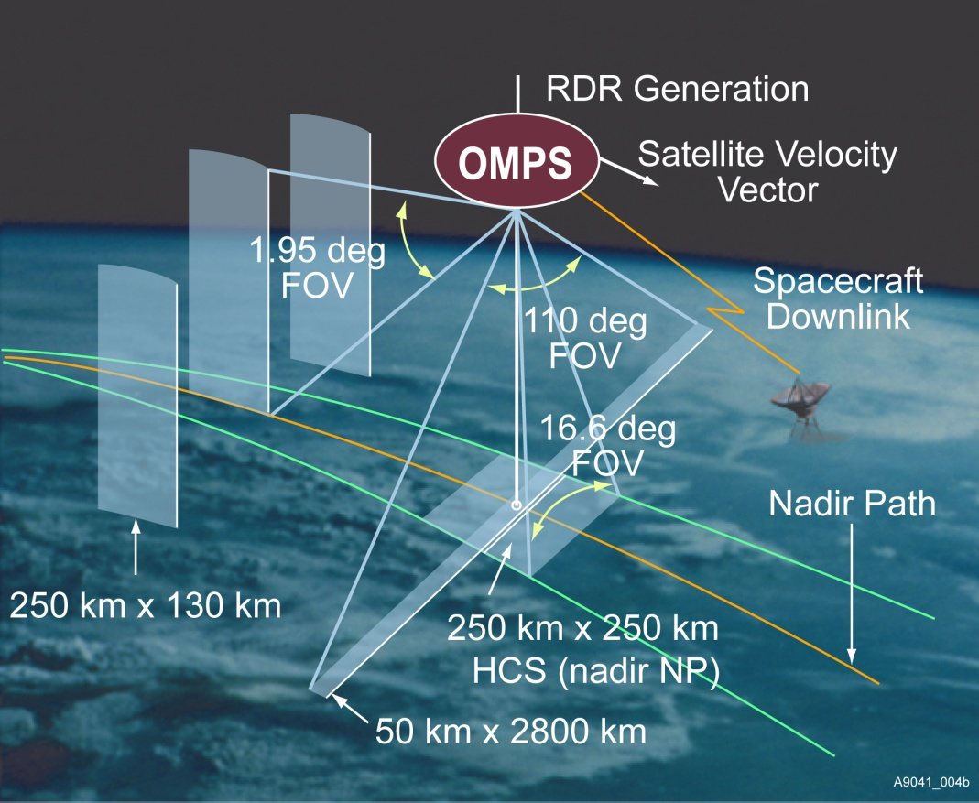
Instrument Fields of View. Schematic from Ball Aerospace and Technology Corporation.

Slide 8
Nadir Mapper & Profiler
The instruments measure radiance scattered from the Earth’s atmosphere and surface. They also make solar measurements using pairs of diffusers. Judicious operation of working and reference diffusers allows analysts to track the diffuser degradation. The solar measurements also provide checks on the wavelength scale and bandpass. The instruments have completed multiple passes through their internal dark and nonlinearity calibration sequences and are beginning to make regular solar measurements. (See information on the OMPS SDRs.)
Main
Electronics
Limb
Profiler
Diagram from Ball Aerospace and Technology Corporation
Entrance Aperture
Entrance Aperture
Earth
Mode
Solar
Mode
Diffuser
Each instrument can view the Earth or either of two solar diffusers; a working and a reference.
Notes:
The OMPS instruments (Nadir Mapper, Nadir Profiler, and Limb Profiler) are designed to take a set of measurements to allow analysts to maintain the instrument characterization and calibration.[2] For each of the instruments, this task can be broken into two components, tracking the performance of the CCD array detectors and electronics, and tracking the performance of the optical components, that is, the telescopes and spectrometers. The instruments make measurements on the night side of orbits with the apertures closed. One set is made without any sources and is used to track CCD array dark currents. Another set is made with illumination by an LED and is used to track CCD non-linearity and pixel-to-pixel non-uniformity response. The instruments also make solar measurements using pairs of diffusers. Judicious operation of working and reference diffusers allows analysts to track the diffuser degradation. The solar measurements also provide checks on the wavelength scale and bandpass. The instruments have completed multiple passes through their internal dark and nonlinearity calibration sequences and are beginning to make regular solar measurements.

Slide 9
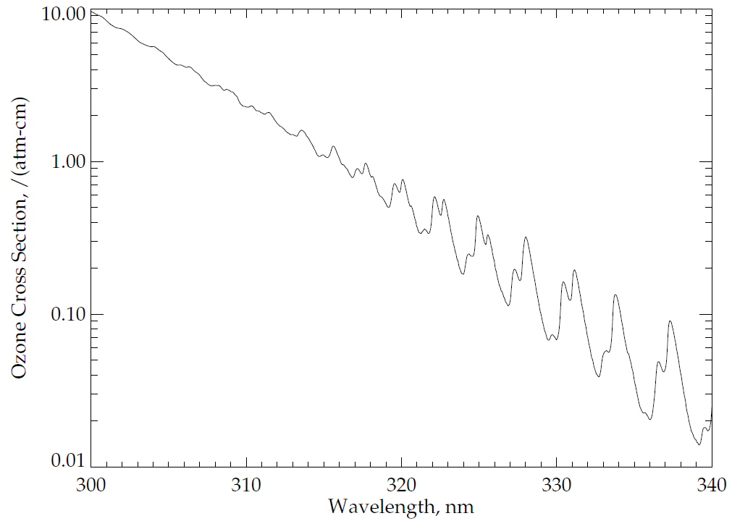
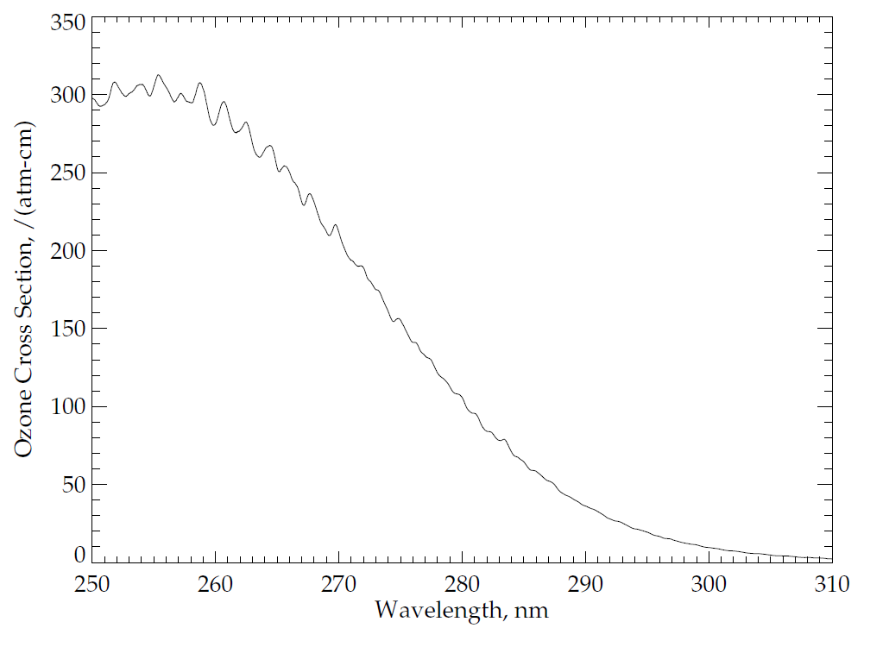
Ozone Absorption Cross Sections:
Ozone has four main absorption bands in the ultraviolet, visible and near-infrared as follows: the Hartley bands from 200 nm to 310 nm, the Huggins bands from 310 nm to 380 nm, the Chappuis bands from 400 nm to 650 nm, and the Wulf bands from 600 nm to 1100 nm. The OMPS nadir telescope directs photons to two spectrometers, one with a wide, cross-track field-of-view (FOV) and spectral coverage in the Huggins ozone absorption bands, and the other with a smaller, nadir FOV and spectral coverage in the Hartley ozone absorption bands. Figures (a) and (b) show the ozone absorption cross-sections at a nominal atmospheric temperature for parts of these bands. These cross-sections are for -50ºC as estimated from a quadratic fit in temperature of the Brion-Daumont-Malicet data set.
(a)
Patterns in Ozone
Absorption
(b)
Dramatic Increase in Ozone
Absorption
Notes:
See J. Malicet, D. Daumont, J. Charbonnier, C. Parisse, A. Chakir, and J. Brion, "Ozone UV spectroscopy. II. Absorption cross-sections and temperature dependence," J. Atmos. Chem. 21, 263-273 (1995) and references therein.
Quadratic fit provided by D. Haffner.
Figure by L. Flynn.

Slide 10
OMPS Nadir Mapper Spectra
The plot at the top of the following slide shows a sample OMPS Nadir Mapper solar spectrum measured in January. The initial calibration, goniometry and wavelengths scales have been applied. Notice the Fraunhofer lines, e.g., a deep one near 360 nm.
The plot in the middle shows a sample spectrum for the Earth View data for the nadir field-of view.
The plot on the bottom shows the ratio of the first two spectra. Notice that much of the structure in the solar spectrum cancels out in the ration. Also notice the variations between 320 and 330 nm produced by differential ozone absorption with wavelength as illustrated in the Figure (a) from two slides earlier.

Slide 11
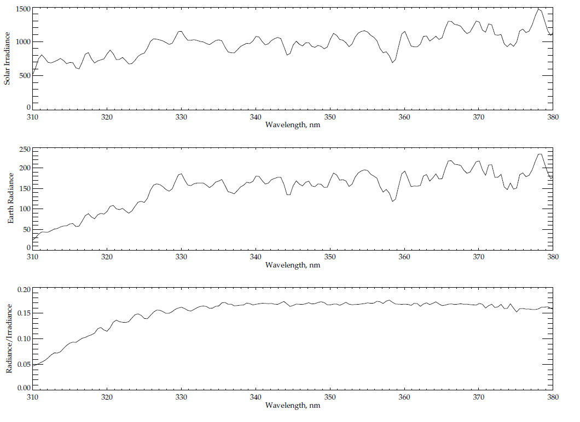
Typical spectra from 310 to 380 nm for OMPS Nadir Mapper
Solar Line
Solar Irradiance
Earth Radiance
Ozone Absorption Features
Radiance/Irradiance Ratio
310
380
Wavelength, nm

Slide 12
Total Column Ozone* Products
The spectral measurements from the OMPS Nadir Mapper* of the radiances scattered by the Earth’s atmosphere are used to generate estimates of the total column ozone. The algorithm uses ratios of Earth radiance to Solar irradiance at triplets of wavelengths to obtain estimates of the total column ozone, effective reflectivity, and the wavelength dependence of the reflectivity.
Table values computed for a set of standard profiles, cloud heights, latitudes and solar zenith angles are interpolated and compared to the measured top-of-atmosphere albedos. The triplets combine an ozone insensitive wavelength channel (at 364, 367, 372 or 377 nm) to obtain cloud fraction and reflectivity information, with a pair of measurements at shorter wavelengths.
The pairs are selected to have one “weak” and one “strong” ozone absorption channel. The hyperspectral capabilities of the sensor are used to select multiple sets of triplets to balance ozone sensitivity across the range of expected ozone column amounts and solar zenith angles. The "strong" ozone channels are placed at 308.5, 310.5, 312.0, 312.5, 314.0, 315.0, 316.0, 317.0, 318.0, 320.0, 322.5, 325.0, 328.0, or 331.0 nm. They are paired with a longer “weak” channel at 321.0, 329.0, 332.0, or 336.0 nm. The ozone absorption cross-sections decrease from 3.0 (atm. cm)⁻¹ to 0.3 (atm. cm)⁻¹ over the range of “strong” wavelengths. Typical ozone columns range from 100 DU or 0.1 atm-cm to 600 DU or 0.6 atm-cm.
*There is sometimes confusion on what to call the OMPS instruments and products. The OMPS Nadir Mapper (NM) makes the principal measurements that are used to create the Total Column Ozone (TC or TOZ) Products.

Slide 13
The 1st Guess Total Ozone Product INCTO
The Multiple Triplet algorithm described in the previous slide is applied twice for each FOV. This was done to resolve the “Who goes first?” problem created by the desires to use information from other sensors in the retrieval algorithms, e.g., OMPS wanted to use the CrIS temperature profile, and CrIS wanted to use the OMPS ozone estimates.
The “1st Guess” OMPS products (INCTO) use climatological or forecast fields for surface reflectivity and pressure, snow/ice coverage, cloud optical centroid depth, and atmospheric temperature. They use internally calculated estimates of cloud fractions and effective reflectivity from measurements at non-ozone absorbing UV wavelengths. The logic is undergoing changes to allow additional flexibility in adjusting the surface reflectivity. As we will show, this application of the algorithm is performing well. This product is sometimes called the Total Ozone Intermediate Product (TOZ IP).
REFERENCES – Additional information is in the OMPS Total Column Algorithm Theoretical Basis and Operational Algorithm Description Documents, and a volume of the Common Data Format Control Book:
Available at http://npp.gsfc.nasa.gov/documents.html
OMPS Total Column Ozone ATBD 474-00029_Rev-Baseline.pdf
OMPS Total Column Ozone OAD 474-00066_OAD-OMPS-TC-EDR-SW_RevA_20120127.pdf
Atmospheric EDRs CDFCB 474-0001-04-02_Rev-Baseline.pdf

Slide 14
The 2nd Pass Total Ozone Product, OOTCO
The “2nd Pass or EDR” OMPS product (OOTCO) uses cloud top pressures, cloud fractions, and snow/ice coverage from VIIRS products and temperature profiles from CrIS products.
Recent studies have found that the estimates of geometric cloud coverage and cloud top pressure from an infrared or visible sensor do not provide the correct quantities for use with UV radiances, e.g., thin cirrus may be optically opaque in the IR but optically thin in the UV.
The VIIRS cloud fraction information was incorrectly used globally and deficiencies in the program logic lead to effective reflectivity values that are inconsistent with the UV measurements. This in turn leads to poor total ozone estimates.
We are proceeding with changes to improve the logic and to remove the use of this information from the OOTCO processing but as will be seen the deleterious effects are in the current products. This product is sometimes called the Total Ozone Environmental Data Record (TOZ EDR).
The INCTO and OOTCO products use identical sets of measurements from the OMPS Nadir Mapper.
REFERENCES – Additional information for this product is available in the documents listed for INCTO on the previous slide.

Slide 15
INCTO/OOTCO Error and Quality Flags
Error Flag
  Bit1 0 good, 1 large residual; Bit2 1 large SO2 Index; Bit3 1 triplet inconsistency; Bit4 1 ozone out of range; Bit5 1 surface reflectivity out of range
Quality Flag 1
  Bit1/Bit2 Quality 0 no retrieval, 1 low, 2 medium, 3 high; Bit3 1 input data quality is not good; Bit4 1 triplet selection is not consistent; Bit5 1 inconsistent residuals; Bit6/Bit7 0 SZA<80, 1 80<SZA<88, 2 SZA>88
Quality Flag 2 – Duplicates other flags or information
  Bit1 1 snow/ice present; Bit2 1 sun glint geometry over open water; Bit3 1 solar eclipse in FOV; Bit4 1 TOZ<50 or TOZ>650; Bit5/6 0 TOZ> 450*, 1 250<TOZ<450, 2 TOZ<250, 3 not used; Bit7 1 Aerosol Index Too Large, AI> 0.5; Bit8 Spare
South Atlantic Anomaly Flag – Climatological intensity
  0 0-10%, 1 10-20%, 2 20-30%, 3 30-40%, 4 40-50%, 5 50-60%, 6 60-70%, 7 70-80%, 8 >80%
Scene Condition Flag
  Bit1 0 Descending, 1 Ascending^; Bit2 1 Snow/Ice present #; Bit3 1 Troposheric Aerosols present; Bit4 1 Snow/Ice Fraction > 0; Bit5 1 Solar Zenith Angle (>80º); Bit6 1 Surface Reflectivity (>1.2 or <-0.05)
See references on the previous slide for more details on these flags.
*QF2 B5/6 can be 0 when the condition is not checked in addition to when the total column ozone is greater than 450 DU.
^SCF B1 is not currently set properly according to the orbital path, i.e., by checking the changes in latitude during a measurement. It is almost always set to 1, except for the first and last granules in a sequence of measurements as processed at IDPS.
# SCF B2 is not currently set properly. It is set to snow/ice present almost everywhere. It is inconsistent with SCF B4 Snow/Ice Faction > 0.

Slide 16
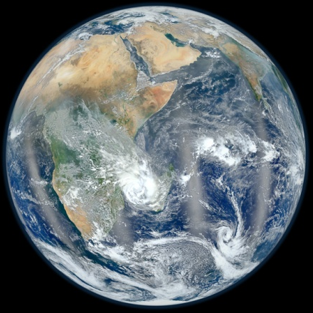
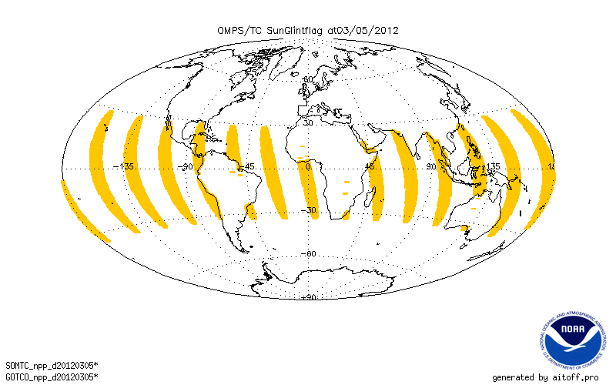
Sun Glint Flags
VIIRS Blue Marble
January 23, 2012
This figure gives the location of pixels with the OMPS NM Sun Glint flag set to 1 – viewing geometry has the potential for sun glint and the location is over open water – for the OMPS Nadir Mapper for March 5, 2012. The code is consistent in assigning this condition. (The VIIRS image in the upper left corner shows similar locations for Sun Glint but shifted to the South as the image is for Sun angles in January.) This flag is passed through from the SDR to both the TOZ IP and EDR products.
Notes:
VIIRS Figure from http://www.nasa.gov/topics/earth/features/viirs-globe-east.html
Glint Figure From Y. Hao

Slide 17
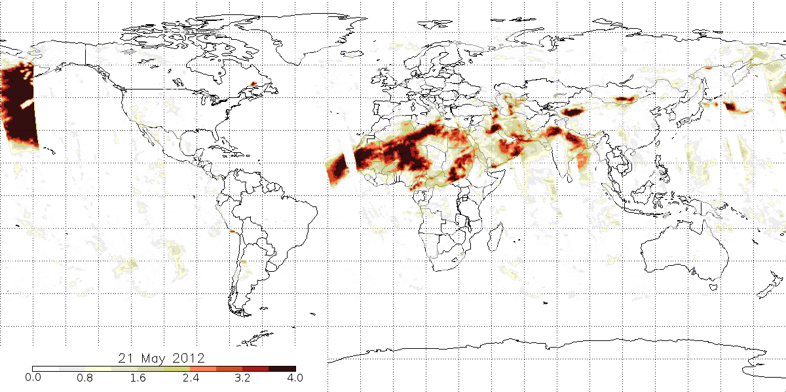
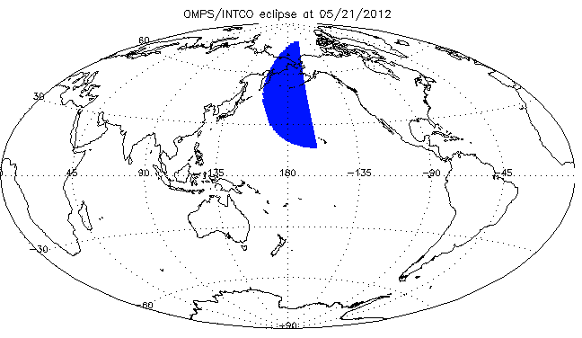
INCTO Eclipse Flag and Aerosol Index:
These two figures compare the occurrences of Eclipse Flags and elevated Aerosol Index values. The figure below looks at the Eclipse Flag for the recent Solar Eclipse on May 20/21, 2012. The flag is activated for the proper times and locations. The reduced sunlight in eclipse conditions leads to poor values for the Aerosol Index as shown on the Left.
↑ Map showing locations of high Aerosol Index values for May 21, 2012. The large values in the Northwestern Pacific are present because the algorithm does not account for the low radiances in the Moon’s shadow
↑ Location of Eclipse Flags for OMPS Nadir Mapper First Guess Total Column Ozone Product for May 21, 2012. The map for OOTCO is identical.
Notes:
Eclipse flag figure from Y. Hao. Aerosol Index figure from C. Seftor.

Slide 18
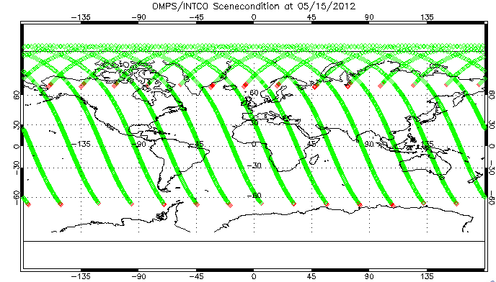
Scene Condition Flag: Ascending/Descending
Nadir FOV locations for May 15, 2012. Each orbit starts near 60ºS and ascends to 80ºN and then descends to 70ºN. The Green FOVs are where the Scene Condition Flag is set to Ascending, and the Red FOVs are where the flag is set to Descending. This flag erroneously identifies most descending orbit locations as ascending and erroneously identifies the first ascending location as descending. For all of the descending, it only correctly identifies the last location as descending. This may not be set at all and just have zeros from initialization. It is supposed to be passed through from SDR.
Notes:
Figs. From Y. Hao

Slide 19
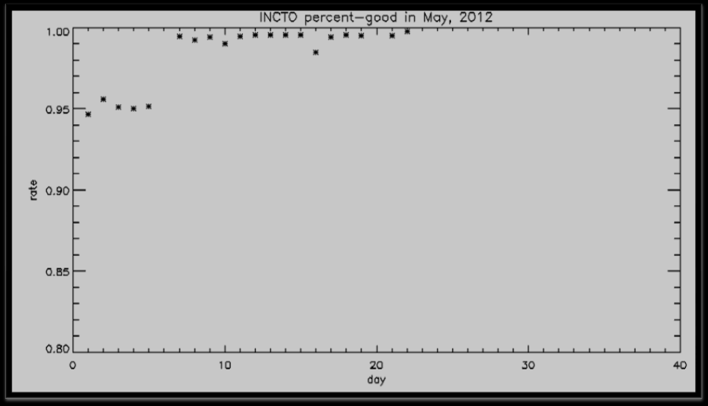
Time Series of Percent Good for INCTO Error Flag
The Error Flag in INCTO had been running at approximately 95% good values through February, March and April. Starting in the second week of May, this statistic jumped up to approximately 99%. That is the number of non-good flags decreased from 5% to 1%. The specifics changes in bad flags and changes in the SDR values that produce this new statistic are explored in the following slides.
The root source of the changes is a preliminary update of the wavelength scale calibration table that went into effect on May 7, 2012. The shift ranges from approximately 0.1 nm for the shorter wavelengths to 0.08 nm for the longer ones.
Notes:
Figure From Y. Hao

Slide 20
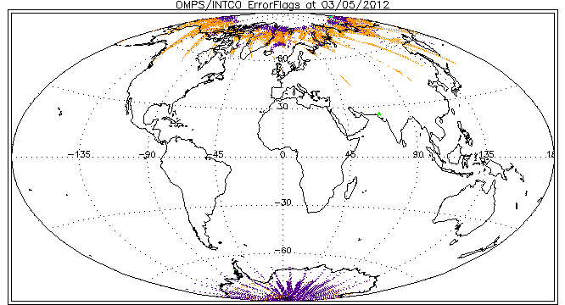
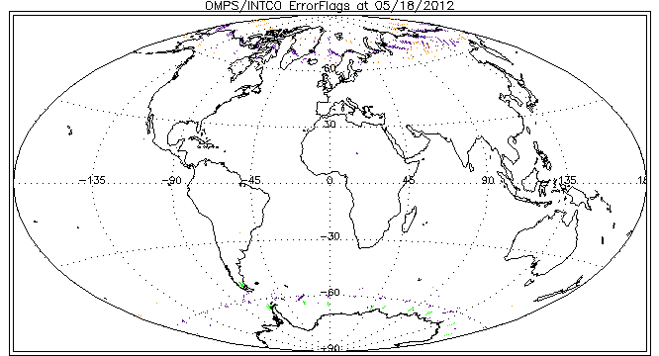
Daily Maps of Error Flags for OMPS INCTO for March 5th and May 18th, 2012:
Purple 1 Large Residual;
Orange 2 SO2 Index;
Green 16 Surface Reflectivity out of range.
Since SO2 is produce from residuals, both of the reduced flag frequencies from March to May are related to residuals.
Notes:
Figs. From Y. Hao

Slide 21
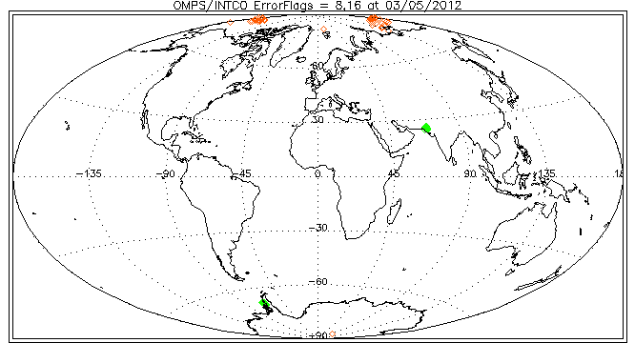
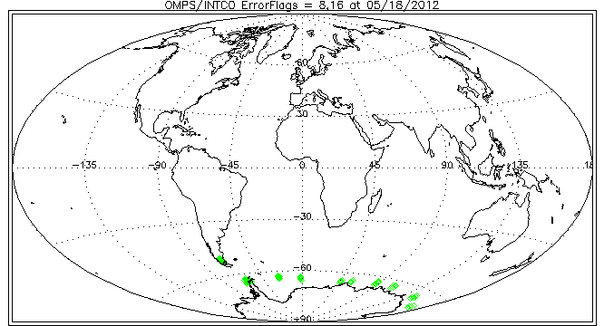
Daily Maps of Error Flags for OMPS INCTO for March 5th and May 18th, 2012:
Since they were hard to distinguish in the previous plots, two of the less frequent flags are replotted here.
Red 8 Ozone out of range (This flag is not activated for May 18th.);
Green 16 Surface Reflectivity out of range.
Notes:
Figs. From Y. Hao

Slide 22
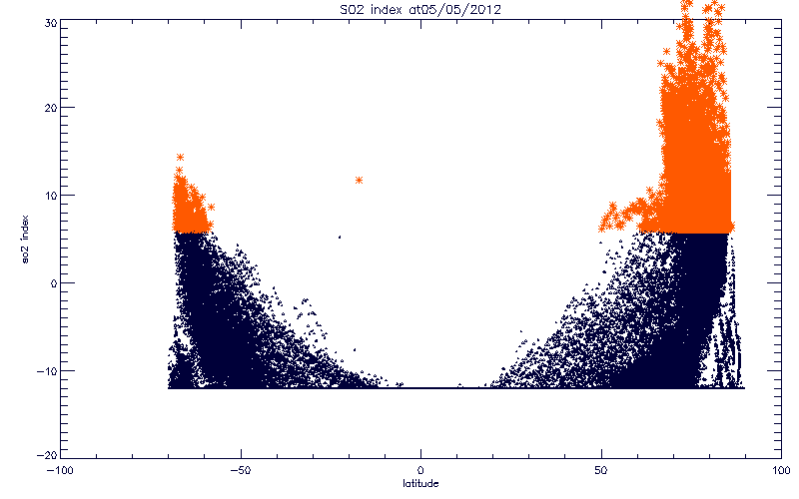
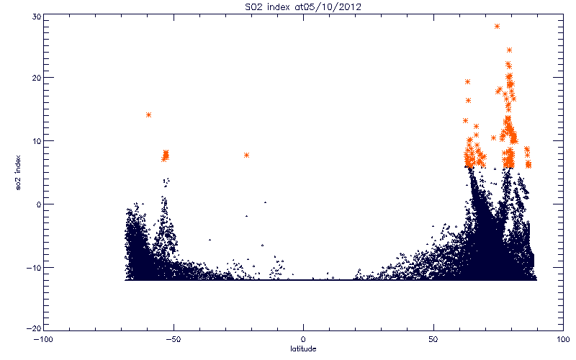
SO2 Index values for INCTO versus Latitude in Degrees North for two days – May 5th and May 10th. Notice that the distribution has shifted down so that the there are fewer values above the Error Flag threshold of 6 DU. The algorithm has a cutoff in values at -12 DU. Much of the variation in this index is caused by deficiencies in the current calibration, not real atmospheric SO2 content. Similar changes in the product will occur as the day 1 solar spectra, wavelength scales and radiance calibration are adjusted during the coming months.
Notes:
Figs. From Y. Hao

Slide 23
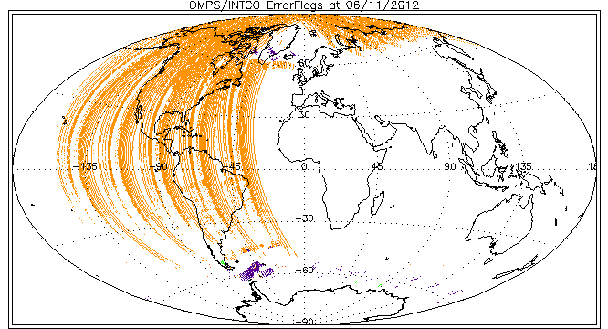
Daily Maps of Error Flags for OMPS INCTO for June 11th:
Purple 1 Large Residual;
Orange 2 SO2 Index;
Green 16 Surface Reflectivity out of range.
Since SO2 is produce from residuals, both of the increased flag frequencies from May to June are related to residuals.
The first eight orbits (Eastern Hemisphere) have low occurrences of non-zero error flags.
Another update (in the middle of the day on June 11, 2012), this time for the Day 1 solar spectra, reduced the percent good for the INCTO Error Flag from 99% down to approximately 50%. The new solar spectra had +-5% variations relative to the prelaunch values. The decrease in good error flags was primarily due to increased SO2 flagging. Until definitive inter-channel calibration values are determined and in the system, users can expect similar shifts in the product behavior.
Notes:
Figs. From Y. Hao

Slide 24
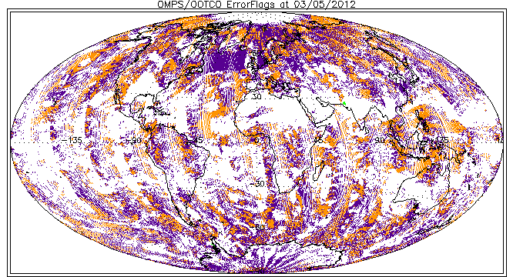
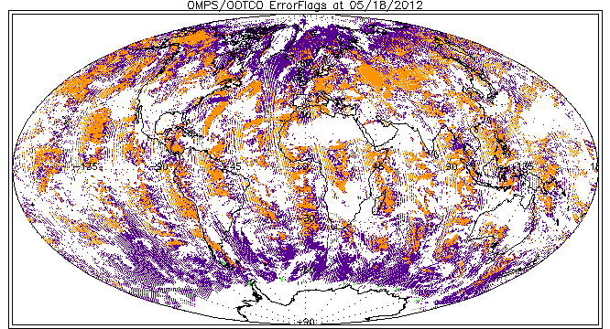
Daily Maps of Error Flags for OMPS OOTCO for March 5th and May 18th, 2012:
Purple 1 Large Residual;
Orange 2 SO2 Index;
Green 16 Surface Reflectivity out of range.
The OOTCO product is suffering from problems associated with the use of VIIRS cloud fraction estimates. The plan is to remove this dependence in future processing.
Notes:
Figs. From Y. Hao

Slide 25
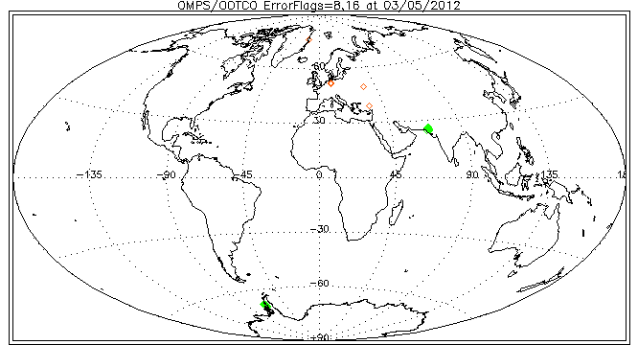
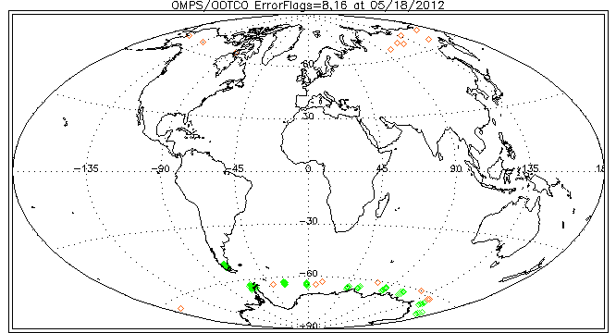
Daily Maps of Error Flags for OMPS OOTCO for March 5th and May 18th, 2012:
Since they were hard to distinguish in the previous plots, two of the less frequent flags are plotted here.
Red 8 Ozone out of range, and
Green 16 Surface Reflectivity out of range
are replotted here.
Notes:
Figs. From Y. Hao

Slide 26
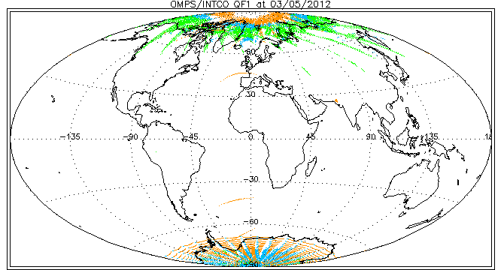
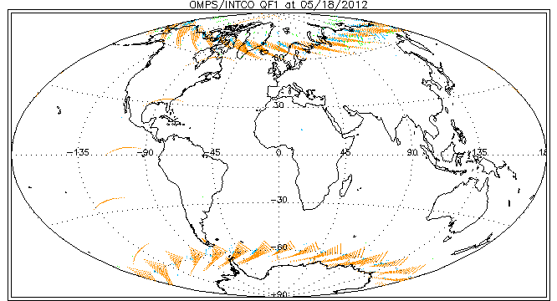
INCTO Quality Flag 1 for March 5th (top) and May 18th (bottom), 2012: Orange is QF1=4 (input data quality is not good),
Blue is QF1=16 (Residuals are not consistent),
Green is QF1=32 (SO2 index ≥ 6 DU).
There are no QF1=8 (O3 triplet selection is not consistent) values.
Again the change in frequency is for residual related flags.
Notes:
Figs. From Y. Hao

Slide 27
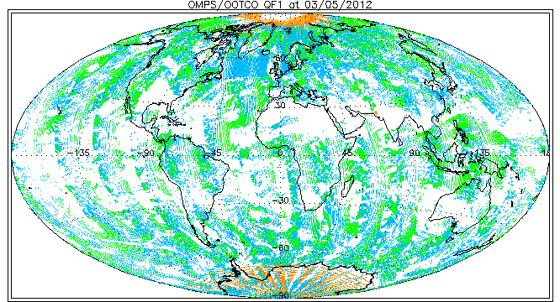
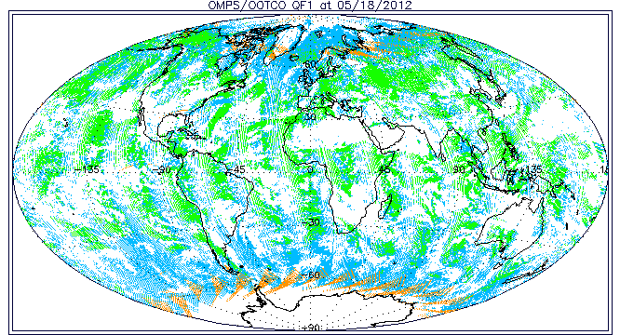
OOTCO Quality Flag 1 for March 5th (top) and May 18th (bottom), 2012: Orange is QF1=4 (input data quality is not good),
Blue is QF1=16 (Residuals are not consistent),
Green is QF1=32 (SO2 index ≥ 6 DU).
The inconsistent effective reflectivity calculations are producing widespread errors.
Notes:
Figs. From Y. Hao

Slide 28
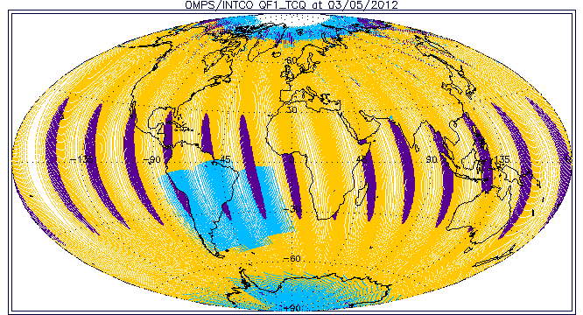
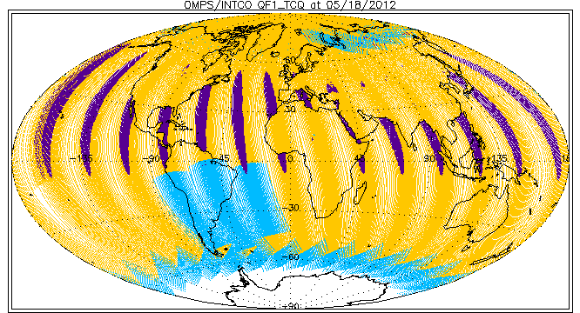
INCTO Quality Flag 1; Total Column Quality:
Orange – 3 High Quality,
Blue – 2 Medium Quality (large residue, input quality, triplet, SZA>80, SO2, SAA, or bad surface reflectivity), and Purple – 1 Poor Quality (Sun Glint, Eclipse, or Bad TOZ).
Poor quality is frequently due to Sun Glint, and Medium quality is frequently due to SAA flagging or Solar Zenith Angles greater than 80º. The white areas are regions where there is no sunlight for the FOV, so measurements can not be made. Two sets of observations are made at high latitudes for May 18th in the North so parts of earlier orbits are covered up by the results of later ones.
Notes:
Figs. From Y. Hao

Slide 29
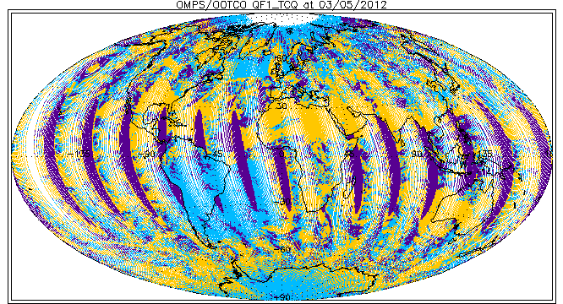
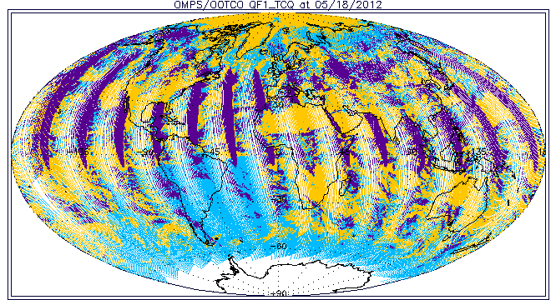
OOTCO Quality Flag 1; Total Column Quality:
Orange – 3 High Quality,
Blue – 2 Medium Quality (large residue, input quality, triplet, SZA>80, SO2, SAA, or bad surface reflectivity), and Purple – 1 Poor Quality (Sun Glint, Eclipse, or Bad TOZ).
Poor quality is frequently due to Sun Glint, and Medium Quality flags are now present over much of the world. Two sets of observations are made at high latitudes for May 18th in the North so parts of earlier orbits are covered up by the results of later ones.
Notes:
Figs. From Y. Hao

Slide 30
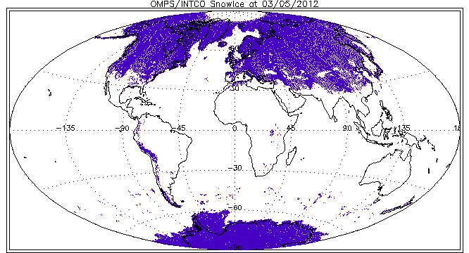
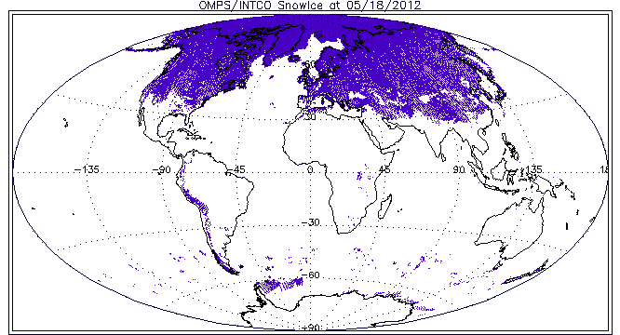
INCTO Quality Flag 2, Bit1, Purple Snow/Ice
These are the values provided in the initial pre-launch data file. They are static; they are not being properly updated. The differences between the two figures are produced solely by changes in the OMPS coverage.
Notes:
Figs. From Y. Hao

Slide 31
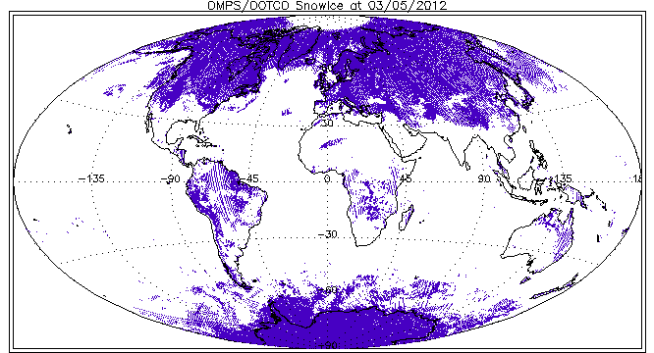
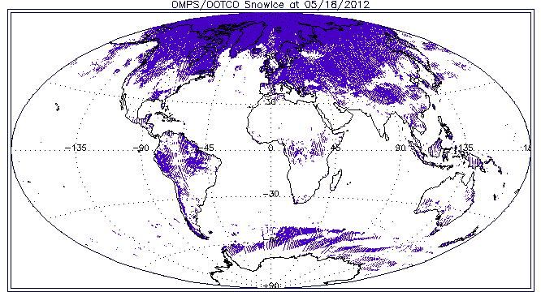
OOTCO Quality Flag 2, Bit1, Purple Snow/Ice.
The snow/ice data is not correct. This problem is under investigation.
Notes:
Figs. From Y. Hao

Slide 32
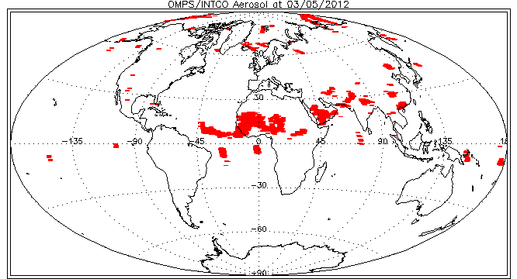
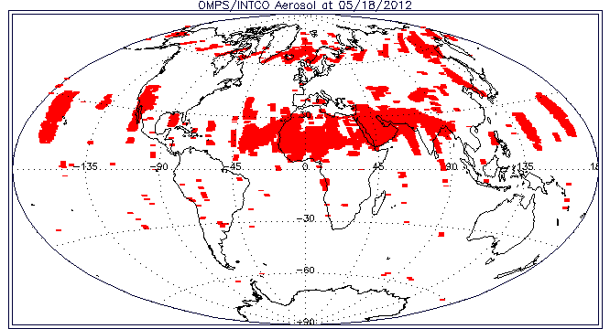
INCTO Quality Flag 2, Bit7, Red Aerosol Index limit exceeded. These are set consistent with the Aerosol Index values. The regions above the Sahara Desert and Arabian Peninsula are from elevated dust. The regions in the Equatorial Pacific are dues to cross-track differences in the biases between longer wavelengths and effects of sun glint.
Notes:
Figs. From Y. Hao

Slide 33
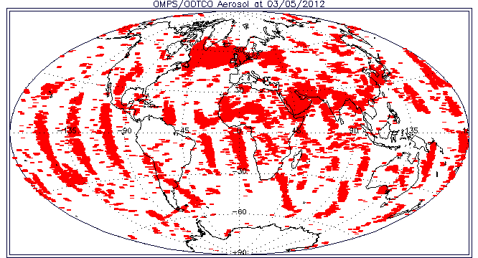
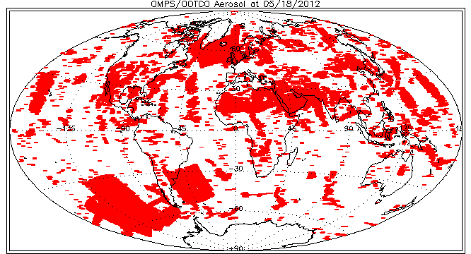
OOTCO Quality Flag 2, Bit7, Red Aerosol Index limit exceeded. These are set consistently with the Aerosol Index values. The Aerosol Index is sensitive to discrepancies in the effective reflectivity and to Sun glint.
The blocked region in the lower left on the lower map is where the VIIRS cloud fraction was not available and the algorithm set the cloud fraction to zero.
Notes:
Figs. From Y. Hao

Slide 34
Typical Distribution of Non-Fill Effective Reflectivity
The two figures on the next slide show the distribution of non-fill effective reflectivity values for the OOTCO (top) and INCTO (bottom) for April 6, 2012 with latitude. The two figures on the slide following it show the histograms of effective reflectivity for the two products for the same day.
The OOTCO estimates are a mixture of calculations produced by the surface reflectivity (adjusted for snow/ice fractional coverage from auxiliary data values times 95%), the VIIRS cloud fraction (times a minimum of 80%), and partial cloud calculations if no VIIRS cloud fraction is reported. Notice the plateaus of values at 80% (for cloud fractions of 1) and 95% (for snow/ice fractions of 1). The algorithm logic does not currently allow it to adjust the values downward. The IR cloud fractions are frequently much larger than those modeled for UV measurements, and the snow/ice tiles are not currently updated. These factors produce reflectivity errors that lead to large errors in the current OOTCO ozone products.
The INCTO estimates are derived directly from the OMPS UV measurements for selected channels between 330 and 380 nm. Fewer than 1% of the 120000 values computed in the INCTO product for this day are greater than 100 and only four values are less than 0. 2.5 % of the effective reflectivity have fill values with most of these occurring for SZA ≥ 88º and all are for cases with N-values containing fill – no other error flags are set by the algorithm for fill N-value cases. The algorithm does not currently adjust the surface reflectivity properly for low reflectivity cases but this logic is include in the next build scheduled for implementation in Fall of 2012.
Notes:
Figure from L. Flynn
119815 119445
106026 105744

Slide 35
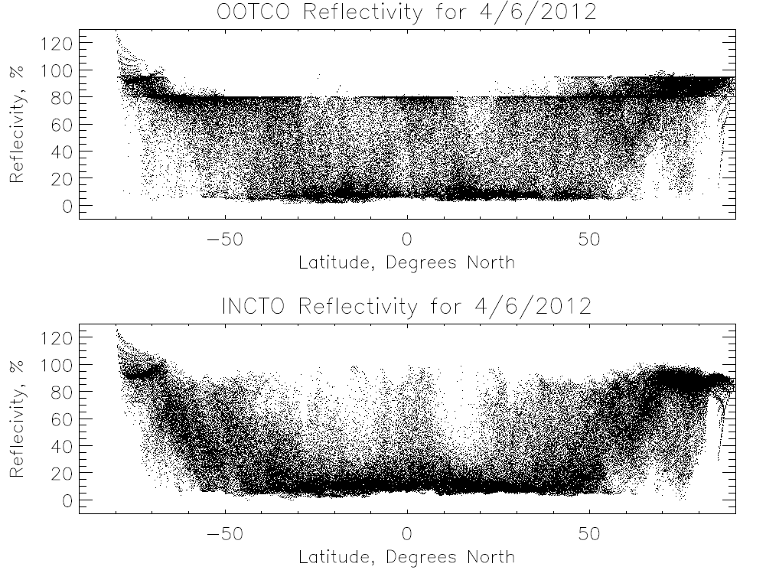

Slide 36
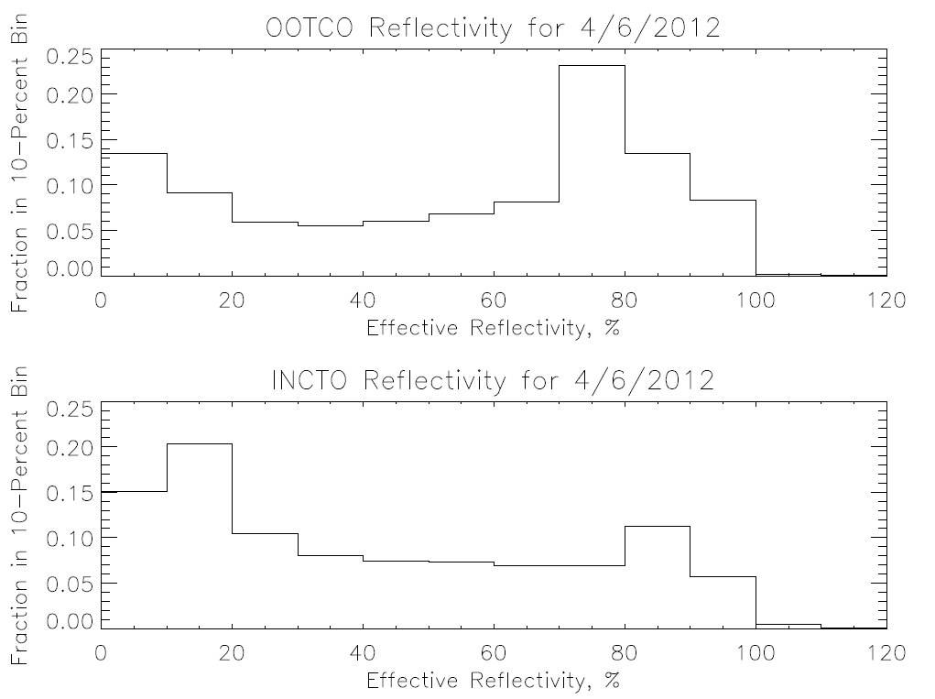

Slide 37
OMPS NM INCTO Minimum Reflectivity Cross-Track Dependence
The lines in the figure on the next slide show the weekly, one-percentile effective reflectivity values for the months of March and April for all the data in a latitude/longitude box in the Equatorial Pacific versus cross-track view position. (17 is the nadir position and 0 and 34 are the extreme viewing angles.) The April values are given by the top four lines and are offset +4% relative to the y-axis scale on the left. We expect the one-percentile effective reflectivity values to be approximately 4% for this region of the globe from climatological measurements made by other instruments. The larger values observed here are due to inaccuracies in the initial solar spectrum and radiance calibration. Some of the changes between the two months are due to a lack of adjustment for the Earth/Sun distance in the solar spectrum. This particular annually varying bias will be rectified with changes in the code scheduled for implementation in Fall 2012.

Slide 38
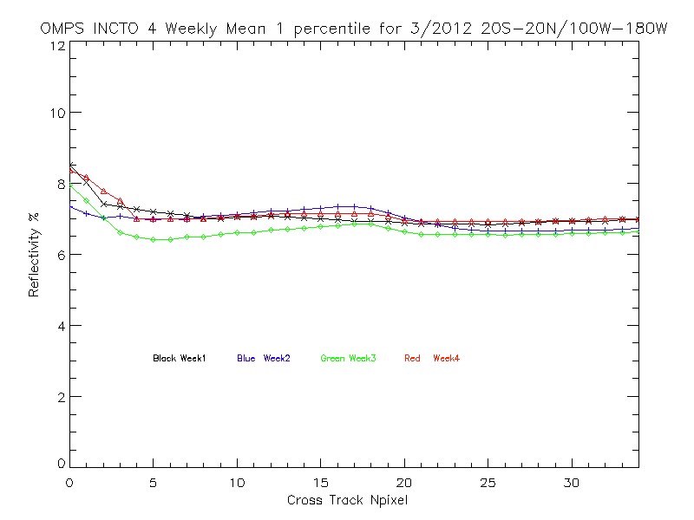
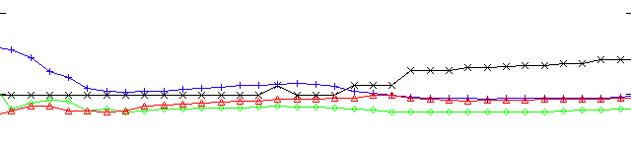
IINCTO One-Percentile Reflectivity
Cross-Track Dependence for March & April
Shifted up 4%
Reflectivity, %
|Lat|<20
Lon<-100
Black Week 1
Blue Week 2
Green Week 3
Red Week 4
Cross-track View Position
Notes:
Figure from W. Yu
http://www.star.nesdis.noaa.gov/icvs/PROD/proOMPSbeta.TOZ_INCTO.php

Slide 39
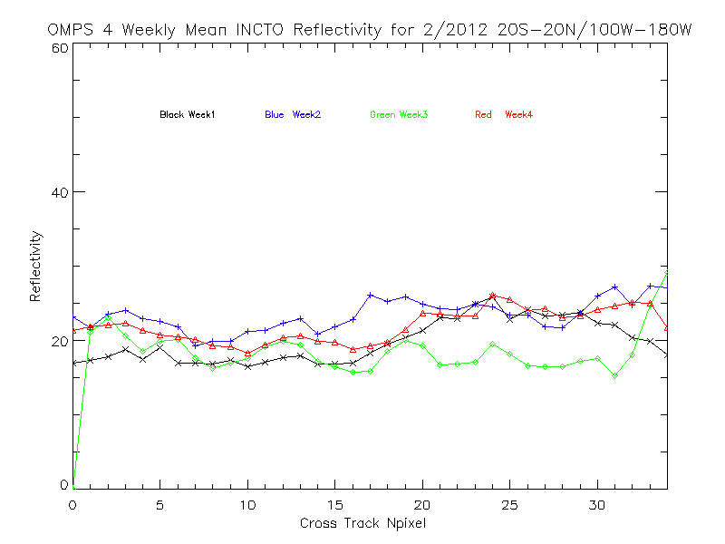
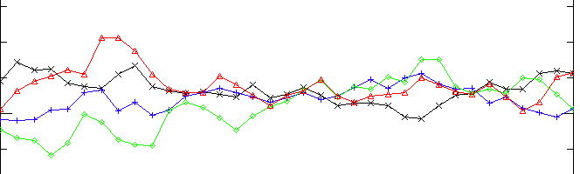
INCTO Effective Reflectivity Cross-Track Dependence for February and May 2012
Shifted up 20%
Black Week 1
Blue Week 2
Reflectivity, %
Green Week 3
Red Week 4
Weekly average effective reflectivity, in percent, for February (bottom four lines) and May (top four) for a latitude / longitude box in the Equatorial Pacific versus cross track pixel. The top lines for May are offset by 20% relative to the y-axis.
Notes:
Figure from W. Yu
http://www.star.nesdis.noaa.gov/icvs/PROD/proOMPSbeta.TOZ_INCTO.php

Slide 40
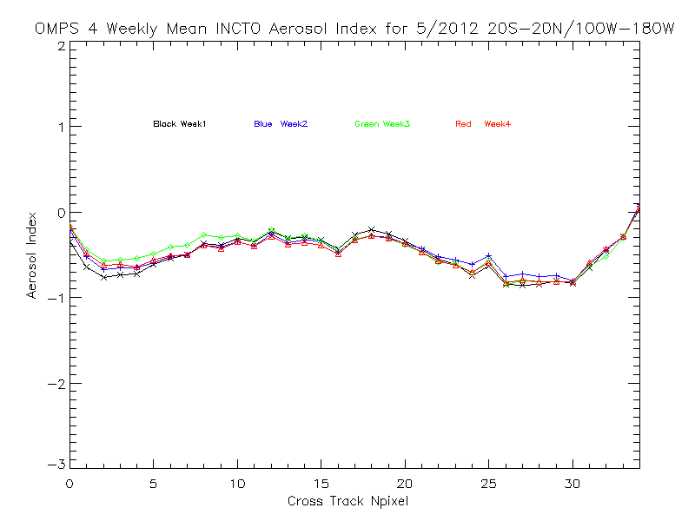
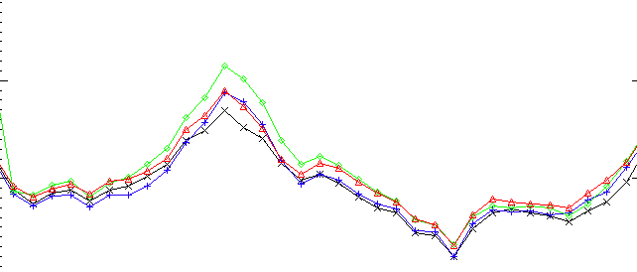
INCTO Aerosol Index Cross-Track Dependence for February and May 2012
Black Week 1
Blue Week 2
Green Week 3
Red Week 4
|Lat|<20
Lon<-100
Shifted down 1%
Weekly average Aerosol Index values, for February (bottom four) and May (top four) for a latitude / longitude box in the Equatorial Pacific versus cross track pixel. The bottom lines for February are offset by -1 from the y-axis scale. The larger variation for the February results for pixels 9 to 14 are probably due to Sun Glint effects.
Notes:
Figure from W. Yu
http://www.star.nesdis.noaa.gov/icvs/PROD/proOMPSbeta.TOZ_INCTO.php

Slide 41
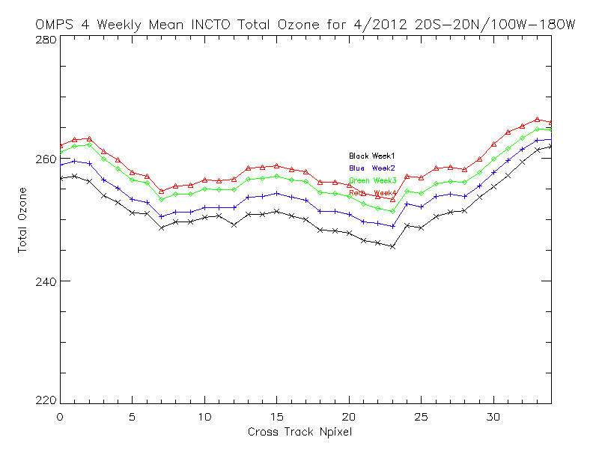
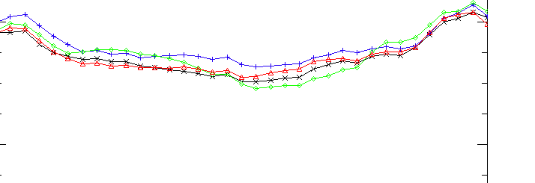
INCTO Cross-Track Ozone Dependence
Shifted up 10 DU
Total Ozone, DU
2%
|Lat|<20
Lon<-100
Black Week 1
Blue Week 2
Green Week 3
Red Week 4
April (bottom) and May (top – shifted up by 10 DU) weekly-mean total column ozone (OMPS Nadir Mapper First-Guess Multiple-Triplet algorithm retrievals) as a function of the cross-track view angle for a Latitude/Longitude in the Equatorial Pacific. The persistent cross-track bias could be caused by deficiencies in the initial calibration or solar data values.
Notes:
Figure from W. Yu
http://www.star.nesdis.noaa.gov/icvs/PROD/proOMPSbeta.TOZ_INCTO.php

Slide 42
Total Ozone Map for INCTO and OOTCO
The false color daily maps (May 18, 2012) of Total
Column Ozone on the next three slides show the expected distribution of global ozone values for
May with high values at the higher latitudes and
lower values in the Equatorial regions. The OOTCO map (first) has greatly varying quality depending on the consistency of the VIIRS cloud fraction and snow/ice imputed reflectivity values as compared with the UV measurements.
Some “scallopping” is evident in the INCTO map (second) due to the cross-track bias about each of the 14 orbital tracks. The distribution of ozone reported by the INCTO is similar to that seen in the EOS Aura OMI map for its total ozone product for the same day on the third slide.
Notes:
OMI results from ftp://toms.gsfc.nasa.gov/pub/omi/images/global/Y2012/IM_ozgbl_omi_20120512.png

Slide 43
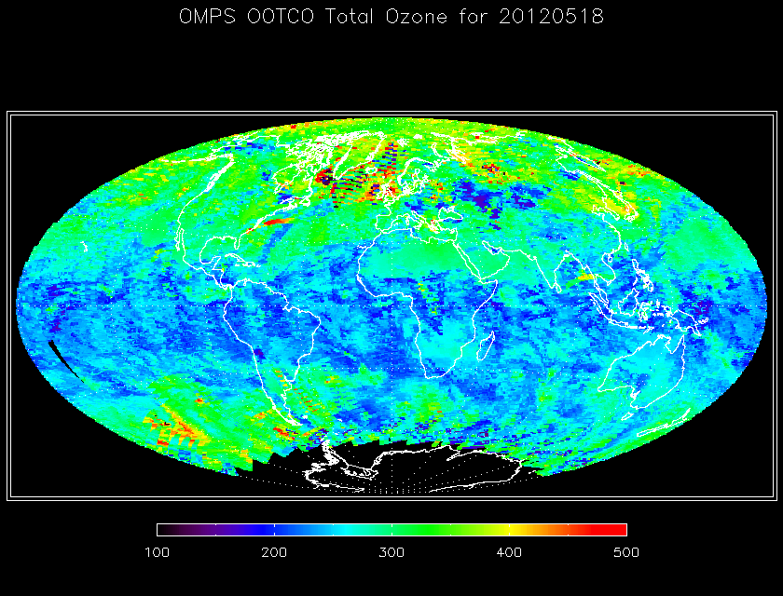
Sample OOTCO Total Ozone Map

Slide 44
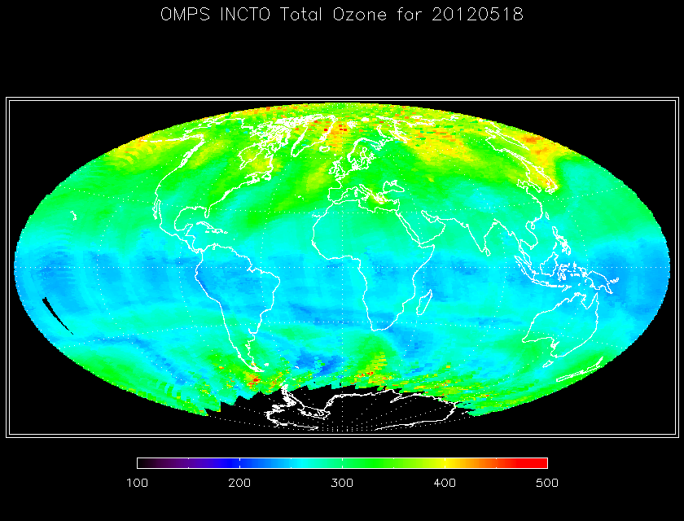
Sample INCTO Total Ozone Map
Notes:
Figure from W. Yu
http://www.star.nesdis.noaa.gov/icvs/PROD/proOMPSbeta.TOZ_INCTO.php

Slide 45

Sample EOS Aura OMI Total Ozone Map
Notes:
OMI results from ftp://toms.gsfc.nasa.gov/pub/omi/images/global/Y2012/IM_ozgbl_omi_20120512.png

Slide 46

Effective Reflectivity Map for INCTO
The false color daily map (May 12, 2012) of Effective Reflectivity on the next slide shows the expected distribution of global values for May with high values over Greenland and low values over desert regions.
Bands of clouds are also evident. For example, there is a
feature in the western Atlantic running parallel to
The US coastline. The OMI UV
Cloud Fraction for the same
day is given to the right.
Clouds are found in consistent
locations between the two
maps.
Notes:
OMI results from http://toms.gsfc.nasa.gov/reflect/reflect_v8.html

Slide 47

Sample INCTO Effective Reflectivity Map
Notes:
Figure from W. Yu
http://www.star.nesdis.noaa.gov/icvs/PROD/proOMPSbeta.TOZ_INCTO.php

Slide 48
Effective Reflectivity Map for OOTCO
The false color daily map (May 12, 2012) of Effective Reflectivity on the next slide shows the expected distribution of global values for May with high values over Greenland and low values over desert regions. Bands of clouds are also evident.
However, the combination of VIIRS cloud fractions with the UV cloud reflectivity assumption (minimum of 80%) in the Multiple Triplet algorithm leads to larger UV effective reflectivity estimates than are actually observed. (Compare to the INCTO reflectivity map on the preceding slide and notice the increased presence of orange coloring in the mid-latitudes.)

Slide 49

Sample OOTCO Effective Reflectivity Map
Notes:
Figure from W. Yu

Slide 50

Aerosol Index Map for INCTO
The false color daily map (May 12, 2012) of Aerosol Index on the next slide shows the expected distribution of global aerosol with high values over Northern Africa and the Middle East due to desert dust. The North-South bands evident
in the Southern Hemisphere
are caused by cross-track
bias across each of the
14 orbital tracks. The OMI
Aerosol Index for the same
day is given to the right.
Notes:
OMI results from http://toms.gsfc.nasa.gov/aerosols/aerosols_v8.html

Slide 51

Sample INCTO Aerosol Index Map
Notes:
Figure from W. Yu
http://www.star.nesdis.noaa.gov/icvs/PROD/proOMPSbeta.TOZ_INCTO.php

Slide 52
Aerosol Index Map for OOTCO
The false color daily map (May 12, 2012) of Aerosol Index on the next slide shows a very variable product with reasonable values in regions with small cloud fractions reported by VIIRS (e.g., the high Aerosol Index values over Northern Africa and the Middle East, due to desert dust, where the VIIRS cloud fraction and UV cloud fraction are both close to zero) but poor performance over most of the globe where the computed effective reflectivity does not match the UV measurements.

Slide 53

Sample OOTCO Aerosol Index Map
Notes:
Figure from W. Yu

Slide 54



← 331-nm Channel Radiances
for the first eight orbits of OMPS Nadir Mapper measurement (end of 1/26/2012 and start of 1/27/2012). This image shows the expected range of values and variations across the orbital track and with solar zenith angles at the times of the measurements. The white circle around the North Pole is the region of polar night during the Northern Hemisphere Winter. The OMPS needs scattered sunlight to make its measurements, so there are no data there.
Effective Reflectivity →
from the multiple triplet retrieval algorithm in IDPS for the same eight orbits. The quantity represents the UV reflectivity of the clouds and surface in each Field-of-View. Again, the range of values from bright clouds to dark open ocean scenes is as expected.
Total Ozone
from the multiple triplet retrieval algorithm first guess product in IDPS for the same eight orbits for the first pass ozone retrieval (IP product without CrIS or VIIRS information). The values show some cross track variations and are offset approximately 5% from another satellite ozone product. These uncertainty levels for preliminary products are consistent with the use of prelaunch calibration parameters and tables in the initial operational system.
First Light Products are Beta Quality
Notes:
Figures from J. Niu.

Slide 55

OMPS Geolocation
This image shows the effective reflectivity for the 380-nm Channel for part of an orbit of small Field-of-View (5 KM X 10 KM at Nadir) made by the OMPS Nadir Mapper in a special diagnostic mode. The Qatar peninsula sticking into the Persian Gulf in the middle of the picture lies along the nadir view of the orbital track and gives a preliminary assurance of the geolocation at better the 5 KM.
C. Seftor, NASA/GSFC (SSAI) 1/26-27/2012
Notes:
Figure provided by C. Seftor

Slide 56

Comparison of daily mean total column ozone estimates from SBUV/2 NOAA-18 (BLACK) & NOAA-19 (GREEN), NPP OMPS NM INCTO (RED) and MetOP-A GOME-2 NOAA V8 Processing (BLUE) for February 2012 for a latitude/longitude box in the Equatorial Pacific.
The OMPS NM total column ozone values track the others well but with an offset of approximately 10 DU from the NOAA SBUV/2 products. The NOAA GOME-2 product is using an extrapolated calibration for this period.
Red OMPS
Blue GOME-2
Black N19 SBUV/2
Green N18 SBUV/2
Total ozone, DU
Notes:
Figure from W. Yu

Slide 57



(a)
(c)
(b)
Daily Total Column Ozone map comparisons between (a) IDPS OMPS First Guess Multiple Triplet product, (b) NOAA OMPS V8 product, and (c ) NASA OMI V8.6 product for March 30, 2012. Cross-track features in OMPS products are related to the use of preliminary calibration values.
DU 100 300 500
Notes:
Figure from W. Yu
http://www.star.nesdis.noaa.gov/icvs/PROD/proOMPSbeta.TOZ_INCTO.php

Slide 58


Overlain comparison of total ozone maps for OMPS (INCTO) and GOME-2 (V8TOZ) for March 5, 2012. The magnitude and location of ozone features match very well.
Notes:
Animation to fade from GOME-2 V8TOZ to OMPS NM INCTO

Slide 59




Total Ozone Maps for OMPS INCTO, OMPS V8, OMI V8.6, and GOME-2 V8 for June 15, 2012

Slide 60
INCTO/OOTCO Known Product Deficiencies
Problems with fixes in the pipeline or changed over the course of the study
  Preliminary Day 1 Solar (Implemented the middle of June 11, 2012^)
  EDR RT LUT – corrected bandpasses (CCR #343)
  Cloud Top Pressure – new UV climatology (CCR #385)
    Need to replace VIIRS cloud top pressure with climatology in OOTCO
  Partial Cloud Logic – consistent surface reflectivity (CCR #419)
    Need to switch from VIIRS Cloud Fraction to measurement-based estimates for OOTCO
  Preliminary Day One Solar (CCR #411)
  SDR Dark current updates (DR #4750)
  Adjustment to Solar spectra for varying Earth/Sun distance (DR #4798, CCR 0481)
Problems under investigation / in preparation
  Snow/Ice Data not updated* (DR #4678)
  Ozone values out of range (infrequent TOZ > 650 DU) (DR #4692)
  SDR Smear values not consistent with expectations (DRs #4749, #4818)
  Broken Ascending/Descending Flag (DR #4804)
  Definitive Day One Solar & Radiance/Irradiance Calibration
Longer term refinements and improvements
  Stray Light Correction / Radiance Coefficients
  Wavelength Scale and Adjustments
    Day 1 Scale (Preliminary update May 7, 2012^) and trending
    Radiance/Irradiance Doppler Shift adjustment
    Intra-orbit scale drift
^ Both of these created large discontinuities in the product performance. Similar effects can be expected as further changes enter the system.
*The action to repair this product is beyond the domain of the OMPS team. We could change to a forecast or climatology.
Notes:
DRs are Discrepancy Reports. They document problems and allow management of the resources and activities to resolve them. CCRs are Change Requests ..

Slide 61
INCTO/OOTCO Summary of Findings and Recommendations
OMPS NM First Guess IP (INCTO)
  The INCTO product is producing reasonable values for total column ozone, effective reflectivity and aerosol index values. Most error flags are functioning as designed. Several problems with the product have been identified and there is progress on implementing corrections and adjustments.
  The OMPS Team recommends that the INCTO Product be promoted to Beta Maturity.
Monitoring Figures are available at
  http://www.star.nesdis.noaa.gov/icvs/PROD/proOMPSbeta.TOZ_INCTO.php
OMPS NM EDR (OOTCO) Status
  The OMPS NM EDR product (OOCTO) uses the same algorithm and measurements as the INCTO product. Differences are present because of the use of external data, e.g., CrIS Temperature Profiles and VIIRS Cloud Top Pressures are used in OOTCO in place of forecasts or climatologies. We plan to replace the VIIRS cloud top pressure initially with the UV climatology and eventually with OMPS-measurement-based estimates. We need to turn off the use of the VIIRS cloud fraction in the algorithm as applied for OOCTO. It is producing significant errors in the retrieval product.
  The OOTCO product is producing erroneous values but also satisfies the Beta Maturity standard. The inputs and corrections needed to improve the product are known.
Upgrade to V8TOZ
  The team is investigating an upgrade from the OMPS EDR multiple triplet algorithm to the V8TOZ algorithm currently in use with SBUV/2, OMI and GOME-2 measurements for climate data records and operational products. As of July 1, 2012, the V8TOZ algorithm has been used to process the first five months of OMPS data independently at NOAA STAR and the NASA Ozone PEATE. The OMPS NPP Science Team is adapting OMI algorithms to create better cloud top pressures, aerosol indices and SO2 indices from the OMPS measurements for use with the V8 algorithm.

