Slide 1
Findings for the OMPS
Nadir Profiler Ozone Profile (IMOPO)
Products
Compiled by L. Flynn
from JPSS and S-NPP OMPS Teams
Last Updated August 14, 2012

Slide 2
Outline
Beta & Provisional Definitions
OMPS Background
IMOPO Performance
  Internal Evaluation
    Flags SAA, tozcod, procod,
    Initial and Final Residuals (also to V8Pro and SBUV/2)
  External Evaluation
    Effective Reflectivity to INCTO & SBUV/2
    Total Column Ozone to INCTO & SBUV/2
    Layer Amounts and Mixing Ratios
      Comparisons to SBUV/2 V6PRO
  Known Deficiencies (repeated)
Summary of Findings and Recommendations (repeated)
  Monitoring plots
  http://www.star.nesdis.noaa.gov/icvs/PROD/proOMPSbeta.O3PRO_IMOPO.php
  Promotion to Beta
  Upgrade to V8PRO

Slide 3
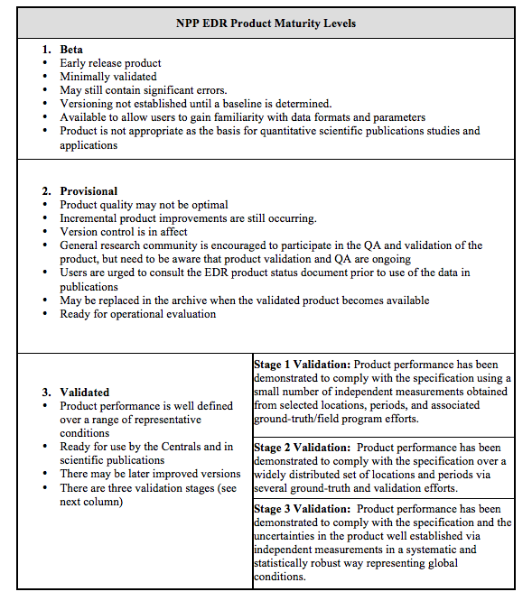
Data Product Beta Maturity Definition
Notes:
Bullet three of Provisional should be “in effect” not “in affect”.

Slide 4
IMOPO Summary of Findings & Recommendations
Promotion to Beta
  The IMOPO algorithm is functioning correctly. The product precision and accuracy are affected by the current state of the calibration, solar spectrum and wavelength scale. These will continue to change as improved characterizations are brought into the system.
  The OMPS Team recommends that the IMOPO Product be promoted to Beta Maturity.
Monitoring Figures are available at
http://www.star.nesdis.noaa.gov/icvs/PROD/proOMPSbeta.O3PRO_IMOPO.php
Upgrade to V8TOZ
  The team recommends an upgrade of the current Version 6 ozone profile retrieval algorithm to the V8Pro algorithm in use with the SBUV/2 measurements for both climate data records and operational products. (This is captured in the JPSS system under DR #4256.)

Slide 5
IMOPO Known Product Deficiencies
Day One Solar needs a definitive spectrum. (Preliminary update expected in August 2012 – DR #4797, #CCR 0458^)
  Profile and total ozone error flags are switched in the output. (Parent PCR 27740 – Expected correction Fall 2012)
Snow/Ice data is all zeroes (DR #4802)
The input-out-of-bound flag (Error Code 20) is set with an incorrect check on surface pressure (DR #4860)
Stray Light / Radiance Coefficients^
  Correction subroutine and definitive estimates of coefficients are under development (DR #4823)
Dark and Smear tables need work in the SDR (DRs #4749, #4818)
Wavelength Scale and adjustments^
  Working on definitive Day 1
  Working on adjustments for intra-orbit scale drift
^ These may create large discontinuities in the product performance as they and similar changes enter the system.
Notes:
DR – Discrepancy Report
CCR – Configuration Control Request

Slide 6
OMPS Fundamentals
NOAA, through the Joint Polar Satellite System (JPSS) program, in partnership with National Aeronautical Space Administration (NASA), launched the Suomi National Polar-orbiting Partnership (S-NPP) satellite on October 28, 2011. The Ozone Mapping and Profiler Suite (OMPS) consists of two telescopes feeding three detectors measuring solar radiance scattered by the Earth's atmosphere and solar irradiance by using diffusers. The measurements are used to generate estimates of total column ozone and vertical ozone profiles.
The nadir mapper (total column) sensor uses a single grating monochromator and a CCD array detector to make measurements every 0.42 nm from 300 nm to 380 nm with 1.0-nm resolution. It has a 110° cross-track FOV and 0.27° along-track slit width FOV. The measurements are currently combined into 35 cross-track bins: 3.35° (50 km) at nadir, and 2.84° at ±55°. The resolution is 50 km along-track at nadir, with a 7.6-second reporting period. The instrument is capable of making measurements with much better horizontal resolution.
The nadir profiler sensor uses a double monochromator and a CCD array detector to make measurements every 0.42 nm from 250 nm to 310 nm with 1.0-nm resolution. It has a 16.6° cross-track FOV, 0.26° along-track slit width. The current reporting period is 38 seconds giving it a 250 km x 250 km cell size collocated with the five central total column cells.
The limb profiler sensor is a prism spectrometer with spectral coverage from 290 nm to 1000 nm. It has three slits separated by 4.25° with a 19-second reporting period that equates to 125 km along-track motion. The slits have 112 km (1.95°) vertical FOVs equating to 0 to 60 km coverage at the limb, plus offsets for pointing uncertainty, orbital variation, and Earth oblateness. The CCD array detector provides measurements every 1.1 km with 2.1-km vertical resolution. The products for the Limb Profiler are not discussed here.

Slide 7
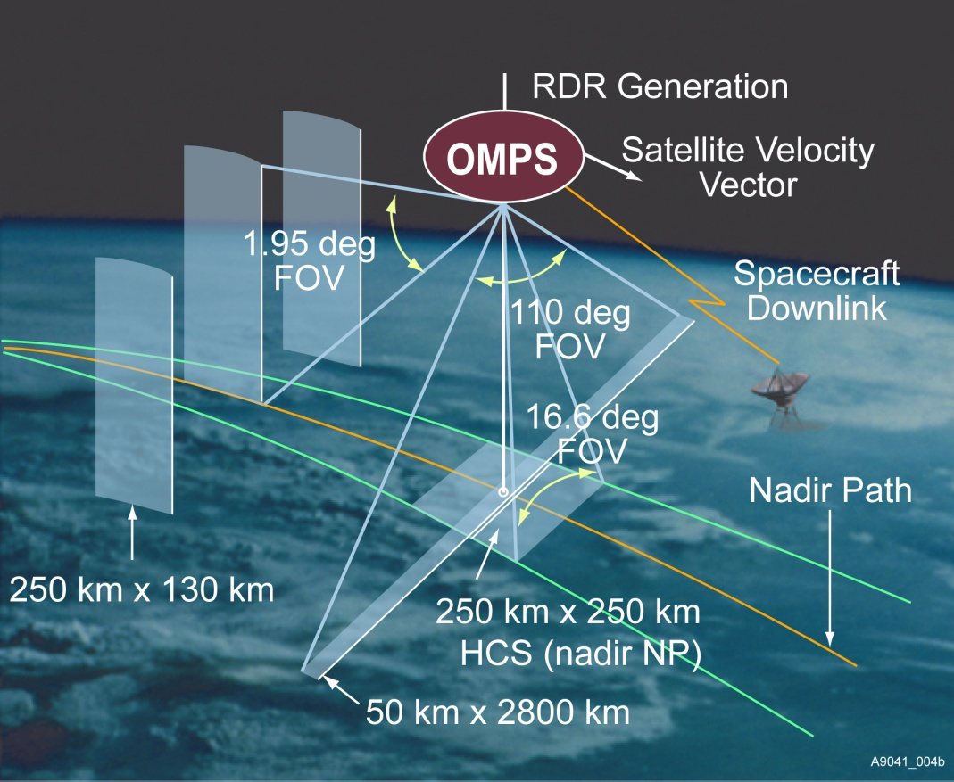
Instrument Fields of View. Schematic from Ball Aerospace and Technology Corporation.

Slide 8
Nadir Mapper & Profiler
The instruments measure radiance scattered from the Earth’s atmosphere and surface. They also make solar measurements using pairs of diffusers. Judicious operation of working and reference diffusers allows analysts to track the diffuser degradation. The solar measurements also provide checks on the wavelength scale and bandpass. The instruments have completed multiple passes through their internal dark and nonlinearity calibration sequences and are beginning to make regular solar measurements. (See information on the OMPS SDRs.)
Main
Electronics
Limb
Profiler
Diagram from Ball Aerospace and Technology Corporation
Entrance Aperture
Entrance Aperture
Earth
Mode
Solar
Mode
Diffuser
Each instrument can view the Earth or either of two solar diffusers; a working and a reference.
Notes:
The OMPS instruments (Nadir Mapper, Nadir Profiler, and Limb Profiler) are designed to take a set of measurements to allow analysts to maintain the instrument characterization and calibration.[2] For each of the instruments, this task can be broken into two components, tracking the performance of the CCD array detectors and electronics, and tracking the performance of the optical components, that is, the telescopes and spectrometers. The instruments make measurements on the night side of orbits with the apertures closed. One set is made without any sources and is used to track CCD array dark currents. Another set is made with illumination by an LED and is used to track CCD non-linearity and pixel-to-pixel non-uniformity response. The instruments also make solar measurements using pairs of diffusers. Judicious operation of working and reference diffusers allows analysts to track the diffuser degradation. The solar measurements also provide checks on the wavelength scale and bandpass. The instruments have completed multiple passes through their internal dark and nonlinearity calibration sequences and are beginning to make regular solar measurements.

Slide 9
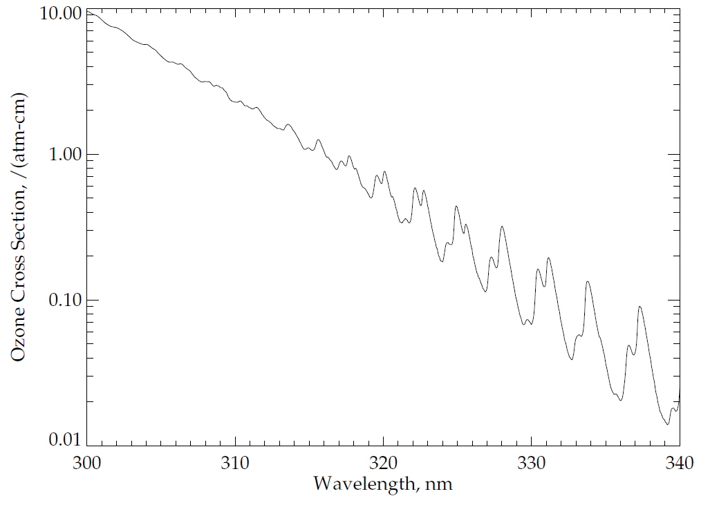
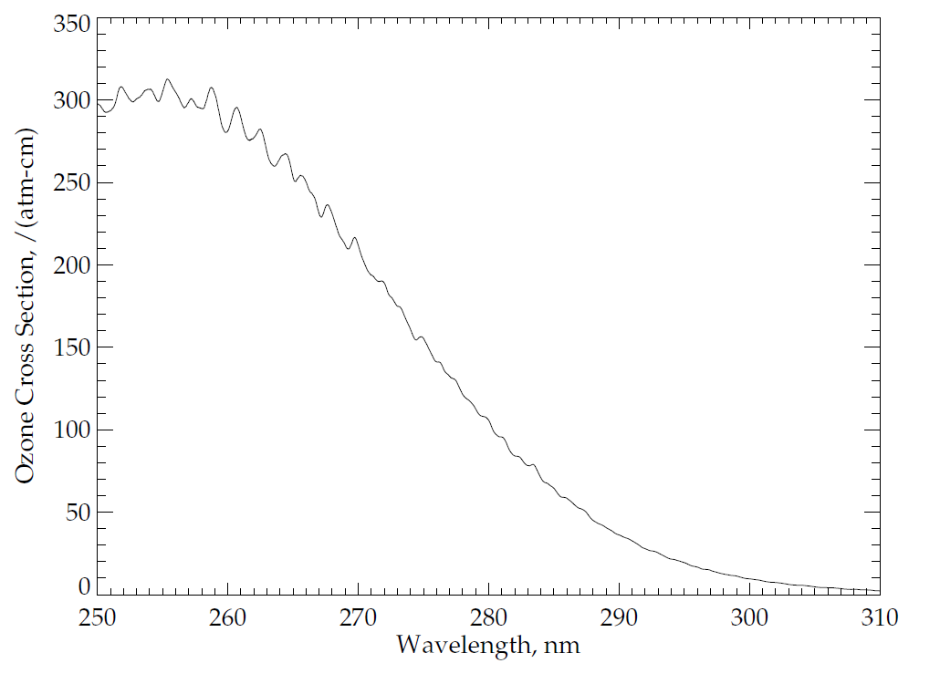
Ozone Absorption Cross Sections:
Ozone has four main absorption bands in the ultraviolet, visible and near-infrared as follows: the Hartley bands from 200 nm to 310 nm, the Huggins bands from 310 nm to 380 nm, the Chappuis bands from 400 nm to 650 nm, and the Wulf bands from 600 nm to 1100 nm. The OMPS nadir telescope directs photons to two spectrometers, one with a wide, cross-track field-of-view (FOV) and spectral coverage in the Huggins ozone absorption bands, and the other with a smaller, nadir FOV and spectral coverage in the Hartley ozone absorption bands. Figures (a) and (b) show the ozone absorption cross-sections at a nominal atmospheric temperature for parts of these bands. These cross-sections are for -50ºC as estimated from a quadratic fit in temperature of the Brion-Daumont-Malicet data set.
(a)
Patterns in Ozone
Absorption
(b)
Dramatic Increase in Ozone
Absorption
Notes:
See J. Malicet, D. Daumont, J. Charbonnier, C. Parisse, A. Chakir, and J. Brion, "Ozone UV spectroscopy. II. Absorption cross-sections and temperature dependence," J. Atmos. Chem. 21, 263-273 (1995) and references therein.
Quadratic fit provided by D. Haffner.
Figure by L. Flynn.

Slide 10
OMPS Nadir Mapper Spectra
The plot at the top of the following slide shows a sample OMPS Nadir Mapper solar spectrum measured in January. The initial calibration, goniometry and wavelengths scales have been applied. Notice the Fraunhofer lines, e.g., a deep one near 360 nm.
The plot in the middle shows a sample spectrum for the Earth View data for the nadir field-of view.
The plot on the bottom shows the ratio of the first two spectra. Notice that much of the structure in the solar spectrum cancels out in the ratio. Also notice the variations between 320 nm and 330 nm produced by differential ozone absorption with wavelength as illustrated in the Figure (a) from two slides earlier.

Slide 11
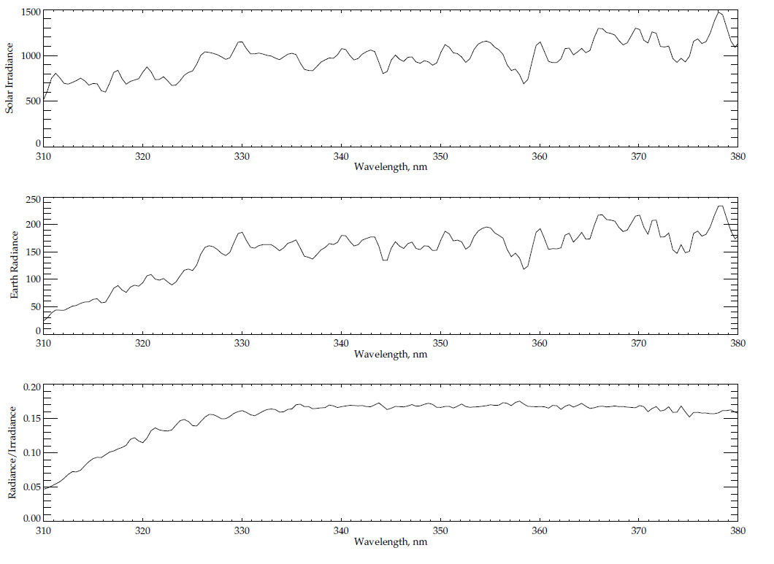
Typical spectra from 310 to 380 nm for OMPS Nadir Mapper
Solar Line
Solar Irradiance
Earth Radiance
Ozone Absorption Features
Radiance/Irradiance Ratio
310
380
Wavelength, nm

Slide 12
OMPS Nadir Profiler Spectra
The plot at the top of the following slide shows a synthetic OMPS Nadir Profiler solar spectrum measured currently in use. The spectrum was created by combining the laboratory bandpass characterization with a high spectral resolution reference solar spectrum. Notice the Fraunhofer lines, e.g., a deep Mg one near 280 nm.
The plot in the middle shows a sample spectrum for the Earth View data. The initial calibration, goniometry and wavelengths scales have been applied.
The plot on the bottom shows the ratio of the first two spectra. Notice that much of the structure in the solar spectrum cancels out in the ratio. Also notice the rapid drop in albedo from 310 nm to 290 nm produced by differential ozone absorption with wavelength as illustrated in the Figure (b) from four slides earlier.

Slide 13
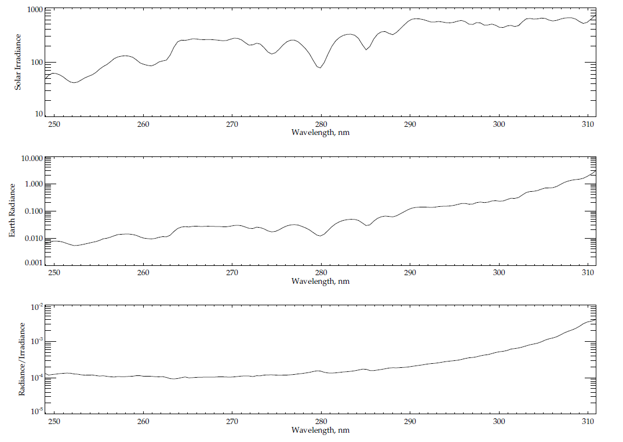
Typical spectra from 250 to 310 nm for OMPS Nadir Profiler
Solar Lines
Solar Irradiance
Earth Radiance
Radiance/Irradiance Ratio
Relative Ozone Absorption Effects
250
310
Wavelength, nm

Slide 14
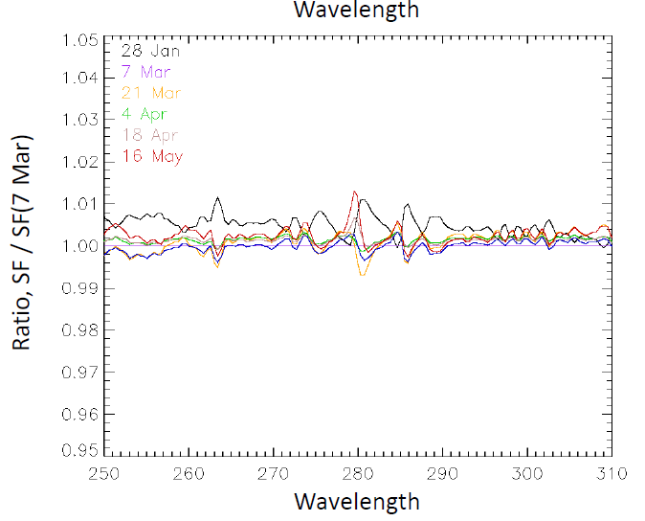
OMPS NP Solar Flux Measurements
Comparison of the first six solar measurements from the working diffuser.
The lines give the ratios of the five other measurements to the March 7th one. The instrument / diffuser throughput shows little change over the four months, especially as there should be some differences due to real solar spectrum changes. Possible additional sources (e.g., goniometric characterization, minor wavelength scale drift, and dark current evolution) are under investigation.
A future reference solar diffuser measurement will add more information.
Wavelength, nm
Notes:
From C. Seftor

Slide 15
Ozone Profile Product, IMOPO
The spectral measurements from the OMPS Nadir Profiler and Nadir Mapper of the radiances scattered by the Earth’s atmosphere are used to generate estimates of the ozone vertical profile along the orbital track (IMOPO). The algorithm uses ratios of Earth radiance to Solar irradiance at a set of 12 wavelengths (at approximately 253, 273, 283, 288, 292, 298, 302, 306, 313, 318, 331 and 340 nm) with eight from the Nadir Profiler and four from the Nadir Mapper to obtain estimates of the total column ozone, effective reflectivity, and the ozone vertical profile in 12 Umkehr Layers. The radiances for the four longer wavelength are obtained from the 25 Nadir Mapper FOVs co-located with a single Nadir Profiler FOV. The longer channel radiance/irradiance ratios are used to generate estimates of the total column ozone and scene effective reflectivity. The total column ozone is used to generate a first guess ozone profile that becomes the A Priori for a maximum likelihood ozone profile retrieval using the ratios for the seven shortest wavelengths (omitting the 253 nm channel and including 313 nm at high SZA). Additional information is in the OMPS Nadir Profile Algorithm Theoretical Basis and Operational Algorithm Description Documents, and a volume of the Common Data Format Control Book at: http://npp.gsfc.nasa.gov/documents.html
OMPS NP ATBD 474-00026_Rev-Baseline.pdf
OMPS NP OAD 474-00067_OAD-OMPS-NP-IP-SW_RevA_201
Intermediate Product CDFCB
474-00001-04-01_CDFCB-Vol4-Part1_Rev-_Block-1-1_31Mar2011.pdf20127.pdf

Slide 16
Matching the FOVs for the Nadir Mapper and Nadir Profiler
The Nadir Mapper and Nadir Profiler each produce data in 37.5 S(econd) granules. The Nadir Profiler IFOV is designed to coincide with the five central IFOVs of the Nadir Mapper, and a single measurement of the Nadir Profiler aggregated over 37.5 S matches up with five Nadir Mapper rows each aggregated for 7.5 S. The two instruments may begin their granules at different times relative to the southern terminator crossing offset by multiples of 7.5 S.
The Figures on the next slide show the results of an investigation into the alignment of Nadir Mapper and Nadir Profiler granules in their respective geolocation products, GOTCO and GONPO. The first three plots (top left, bottom left, and top right) each display the FOV center locations of three consecutive granules for both the Nadir Mapper and the Nadir Profiler. Each set of 25 small symbols show the location for the five nadir cross track FOVs (nadir and two nearest on both sides) for the five rows of measurements in a granule. The large symbols are the FOV center locations for the Nadir Profiler. Notice that the Nadir Profiler may matchup with a Nadir Profiler granule or it may be offset by one or two rows.
The figure on the bottom right shows an unusual case where there is a Nadir Mapper granule that only contains four rows – 30 S of measurements instead of 37.5 S. This can lead to changes in the offset between the granules for the Nadir Mapper and Nadir Profiler within an orbit. The IMOPO products follow the Nadir Profiler granularity.

Slide 17
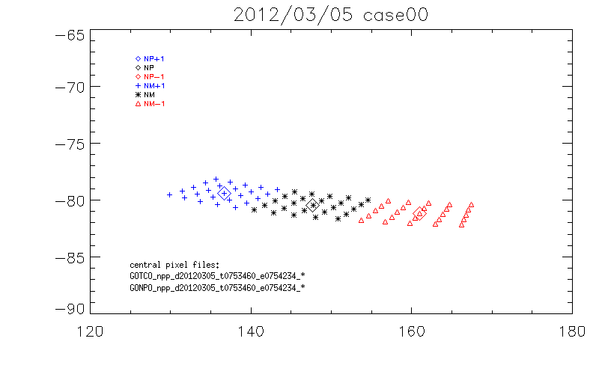
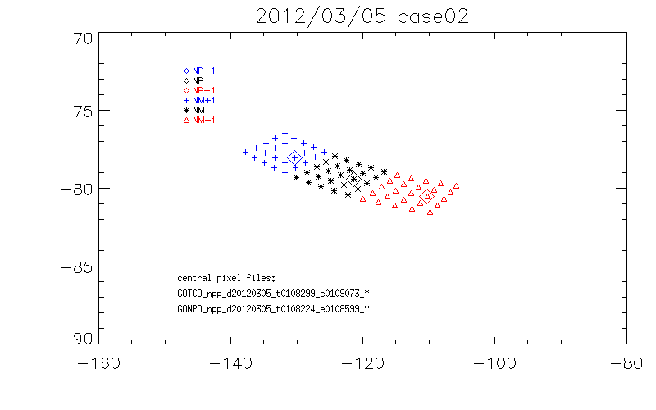
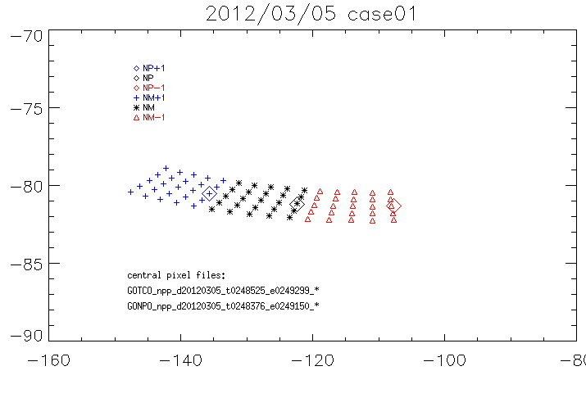
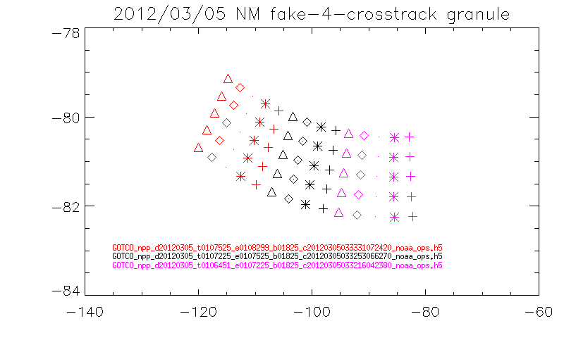
Longitude & Latitude Locations for GOTCO and GONPO Granule Matching Cases
Longitude, Degrees East
Longitude, Degrees East
Longitude, Degrees East
Longitude, Degrees East
Notes:
Figs. From J. Niu

Slide 18
IMOPO Error Flags
Individual Flags
  Sun Glint, SAA, and Eclipse are all set correctly
  SO2 Index is running too negative; it and the Volcano Contamination Index (VMI) are affected by initial calibration uncertainties.
  Snow/Ice is always zero – DR #4802
Profile Error Codes*
  Code 1 is set correctly (Lower three layers)
  Code 2 is set correctly (BestTOZ vs ProTOZ)
  Code 3 is set correctly (large final residuals – often for data in SAA)
  Code 5 is set correctly (C outside of range – often for data in SAA)
  Codes 4, 6, 7 & 8 conditions are not met in samples
  Code 9 (Bad counts/missing measurements)
  Code 20 Invalid or out-of-range inputs – Flagging all terrain pressure > 1.001 atm.
  Descending Flag (+10) set incorrectly – A simple check of latitude changes will work.
Total Ozone Error Codes*
  Codes 1 & 2 are set correctly by comparing S x Omega to 1.5 and 3.5 atm-cm, respectively
  Code 4 is set correctly (Pair differences)
  TOZ Error Code 5 matches PRO Code 2
  Code 7 not seen; Photometer Reflectivity difference is not in the output.
  Codes 8 & 9 conditions are not met in samples; Codes 3 & 6 are Spares
  Code 20 Invalid or out-of-range inputs – Flagging all terrain pressure > 1.001 atm.
  Descending Flag (+10) matches Profile Error behavior
  *Profile and total ozone error flags are switched in the HDF5 output. This should be repaired with the implementation of PCR 27740 in Fall 2012.
Notes:
For total ozone code 7, the subroutine BESTOZ.F has 0.15; the OAD has 0.05 – although ecode is used as a name for both error codes and the OAD has 0.15 for the profile Code 7.
Is 252 nm channel turned off? Yes. Check IOPTS for NO_2520_RAD_INDEX = 8 in NP_CONSTANTS.F

Slide 19
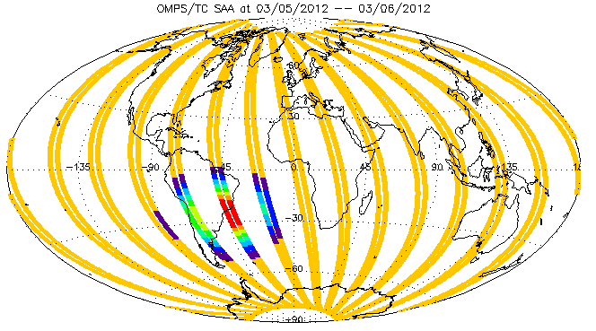
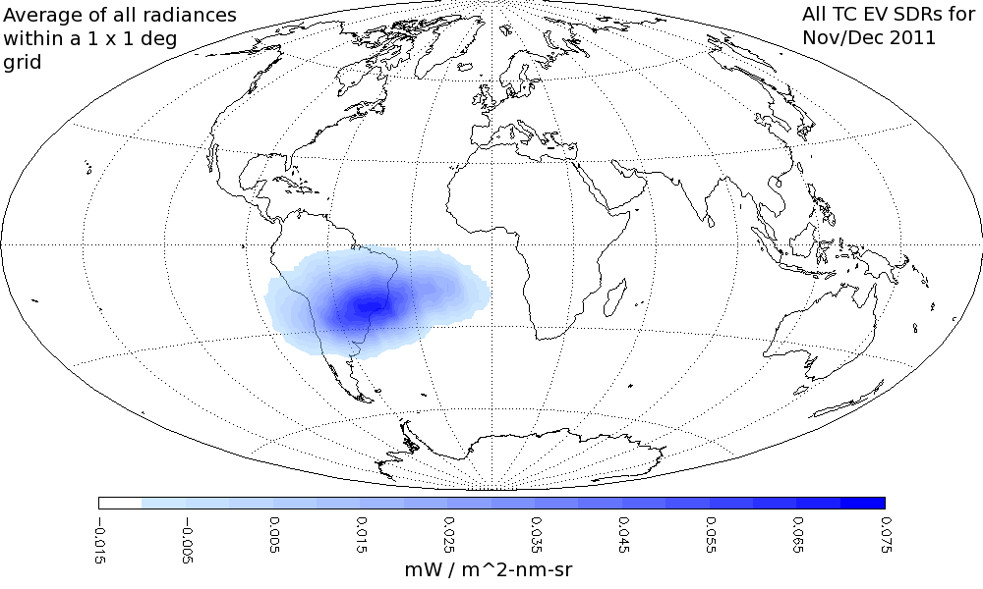
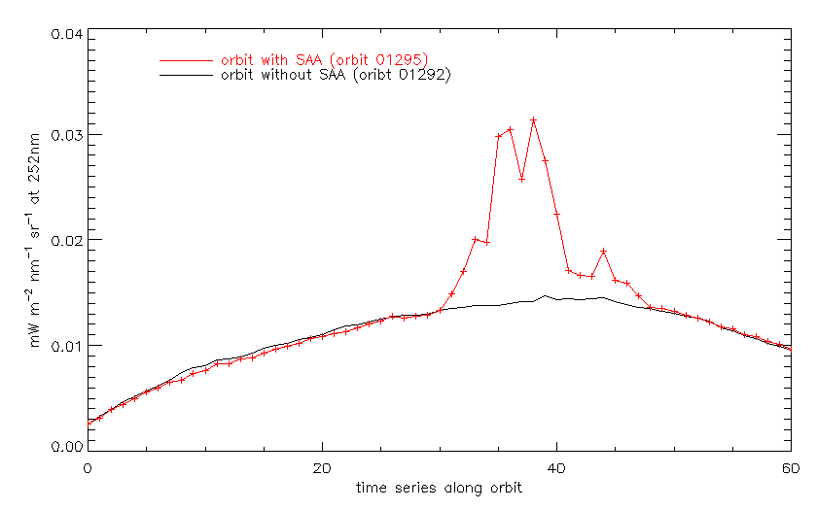
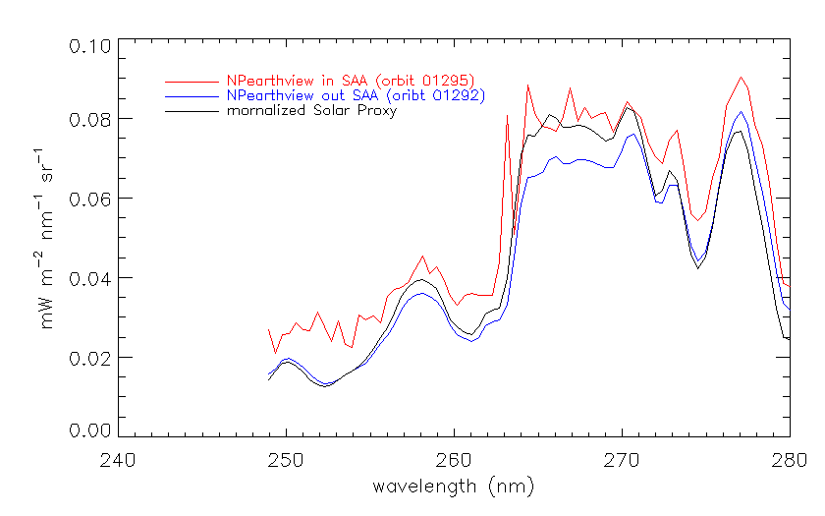
Examination of South Atlantic Anomaly (SAA) effects and product flagging.
The noise/spikes below show the expected increases when an orbital path falls with within the SAA but return to normal levels after passing through it.
The OMPS was designed to use the OMPS Limb Profiler retrievals in the SAA where the OMPS Nadir Profiler is so greatly affected by charged particles that it cannot be used to produce ozone profiles.
Map of South Atlantic Anomaly effects on OMPS NM closed-door dark current measurements in December and November 2011, overlaid with OMPS NP SAA Flags (0 to 8) for 3/5-6/2012
Wavelength, nm
Notes:
Radiance map C. Seftor, SSAI, Flag map Y. Hao, IMSG
Radiance Line Plots J. Niu, ERT

Slide 20
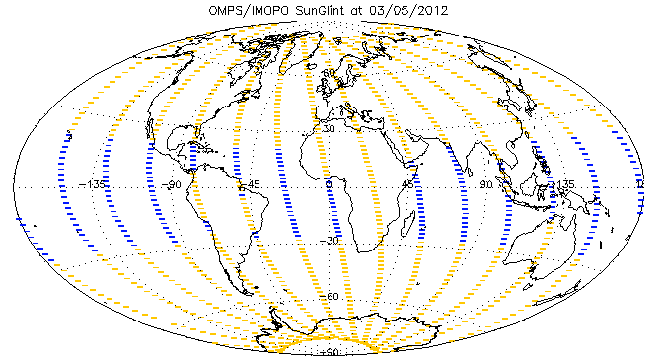
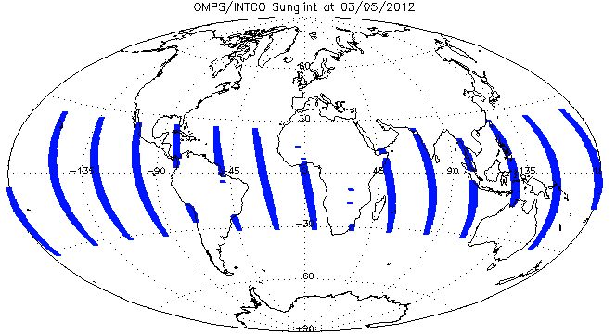
Daily Maps of Sun Glint for INCTO Nadir FOVs versus IMOPO. The two products are consistently and correctly passing these values through from the SDRs.
Notes:
Figs. From Y. Hao

Slide 21
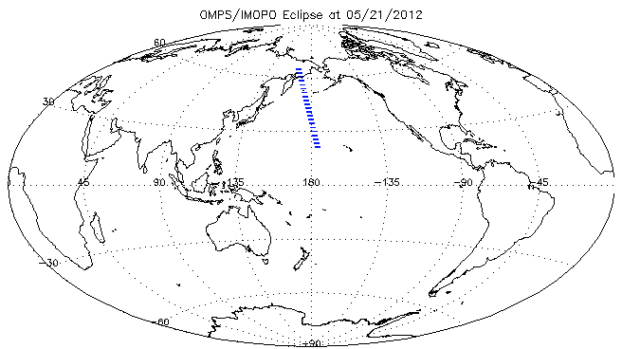
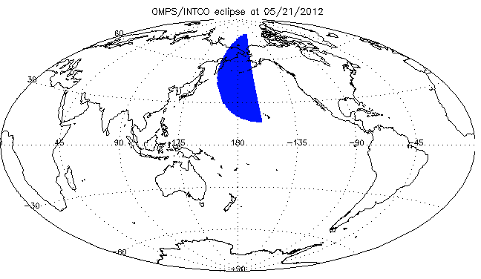
← Map showing locations of IMOPO Eclipse Flags for May 21, 2012.
The two products are giving correct and consistent results for the near nadir FOVS.
Location of Eclipse Flags for OMPS Nadir Mapper First Guess Total Column Ozone INCTO Product for May 21, 2012. →
Notes:
Eclipse flag figures from Y. Hao.

Slide 22
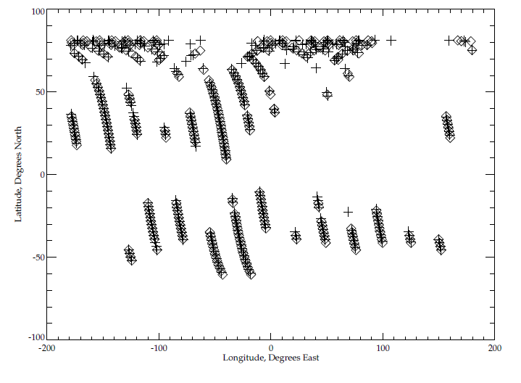
Map of Error Code 20 for IMOPO and of
Terrain Pressure > 1.001 atm. for INCTO
This map shows the location of two sets of conditions. One is the location of Error Code 20 (inputs out of range) for IMOPO for May 16, 2012. The diamond symbols show the locations of these FOVs. The others are the locations where the Nadir Mapper INCTO total column ozone product reports values of terrain pressure greater than 1.001 atm. for the same day. The plus sign symbols are placed where the terrain pressure for the nadir FOV (cross track position 17) for the first row (of five rows) of a Nadir Mapper Granule satisfies this condition. Almost all of the Error Code 20 values are set because of this condition. The check is too restrictive and needs to be reset to a larger value. The highest pressure recorded on Earth was 1.071 atm. The Dead Sea is at ~1.045 atm.
Latitude, Degrees North
Longitude, Degrees East

Slide 23
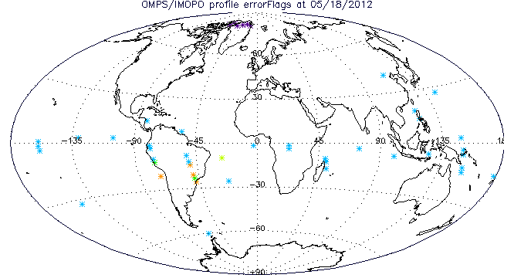
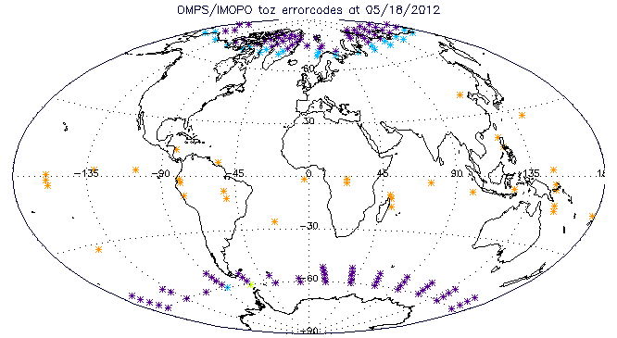
These maps show the distribution of non-zero (except for 20s) error codes for IMOPO May 18, 2012.
The top map shows the locations for the ozone profile errors (actual not as misnamed in the HDF). The colors (and frequencies) are as follows: 1 Lower Layer Anomaly (6); 2 Best Total Ozone difference with Profile Total Ozone (34); 3 Large Final Residual (2); 4 Large Initial Residual (1); and 5 C-Parameter Outside of Range (4).
The bottom map shows the locations for the total ozone errors (again actual). The colors are as follows: 1 High Path (100); 2 Very High Path (23); 4 Pair Total Ozone Difference (1); and 5 same as Profile Code 2 (33).
Notes:
Figure from Y. Hao.

Slide 24
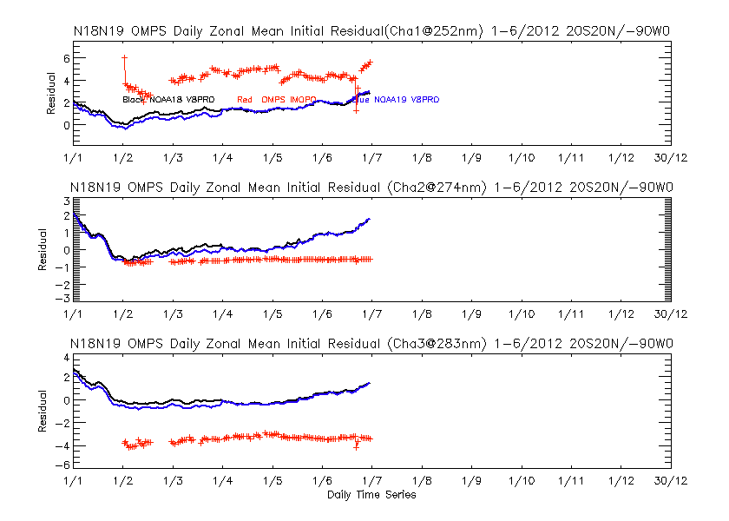
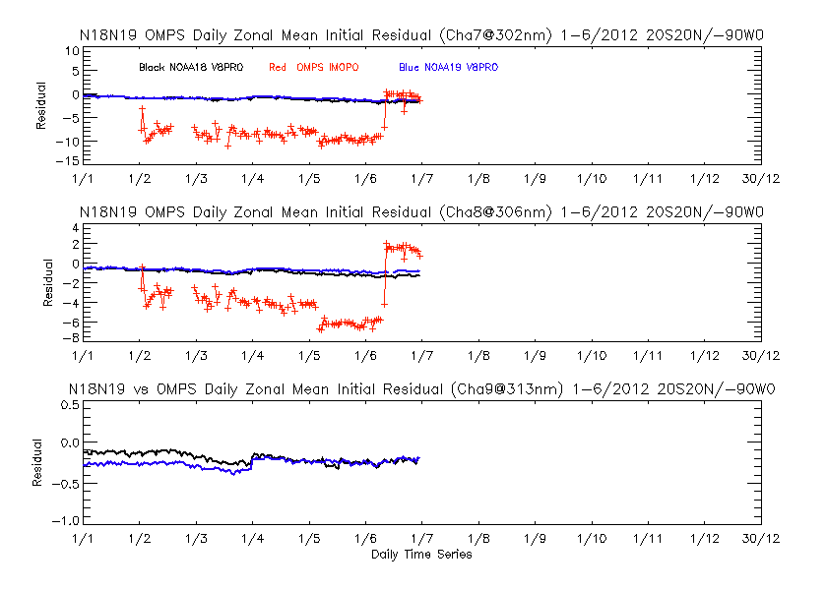
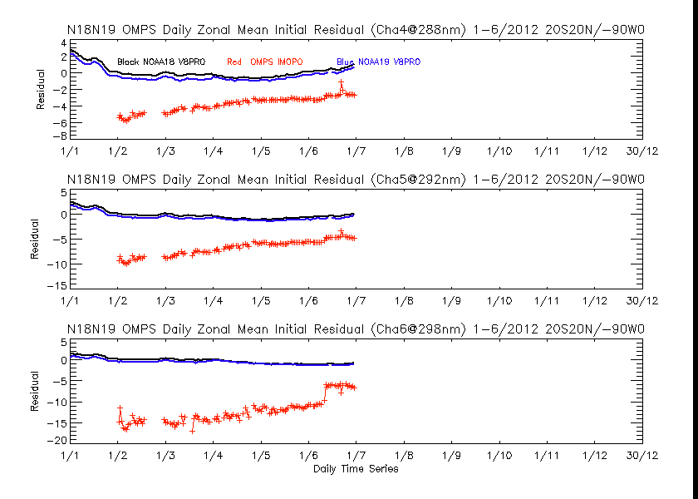
Time series of initial IMOPO residuals for OMPS NP February through June
The nine figures show the initial residuals for profile wavelengths [252, 274, 283, 288, 292, 298, 302, 306 and 313 nm, (a) to (i), respectively] for the V6PRO (IMOPO) product from OMPS compared to the V8PRO product for the operational NOAA-18 and NOAA-19 SBUV/2 for the equatorial daily zonal means (20N to 20S) with 0-90W removed to avoid the SAA effects. The residuals are in N-values (1 N ~ 2.3%). The time period is the end of February through April of 2012. The residuals are computed with respect to differing first guess profiles for the two algorithms. The V6PRO does not use the 313 nm directly in its ozone profile retrievals at these latitudes, so no corresponding curve is present on the ninth plot. The jump in the initial residuals in early June is coincident with the introduction of a new Day 1 Solar Spectrum for the Nadir Mapper.
Notes:
Figures from W. Yu at
http://www.star.nesdis.noaa.gov/icvs/PROD/proOMPSbeta.O3PRO_IMOPO.php

Slide 25
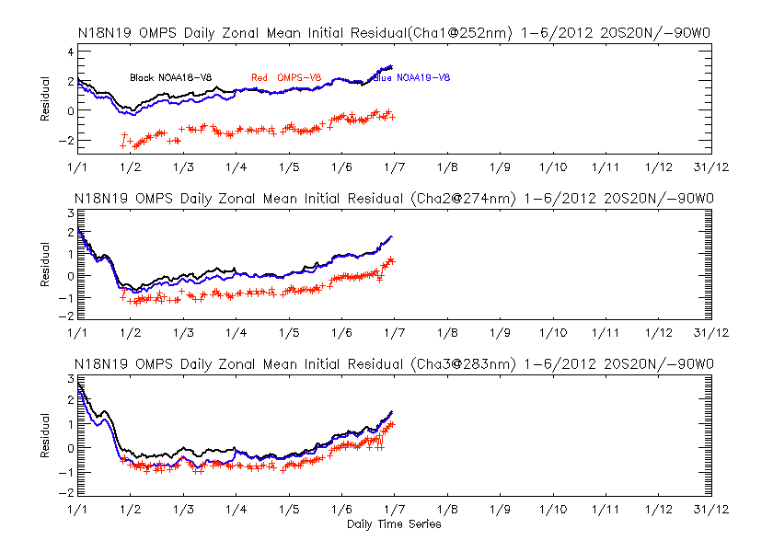
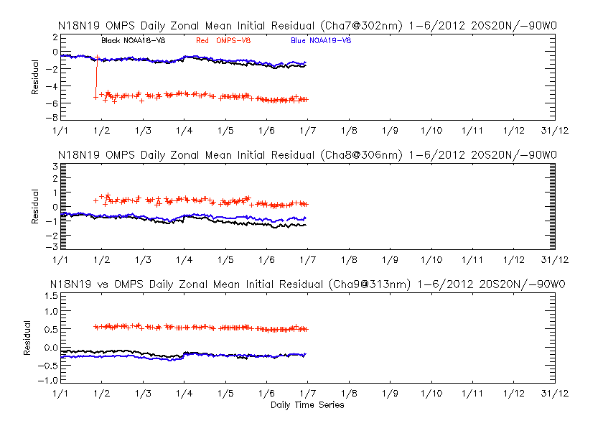
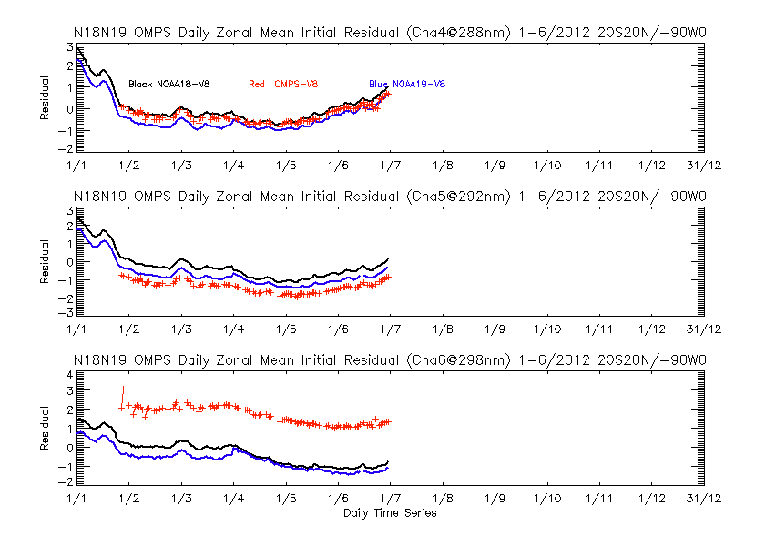
Time series of initial V8PRO residuals for OMPS NP February through June
Initial Measurement Residuals for the OMPS NP Version 8 Profile Product: The nine figures show the initial residuals for profile wavelengths [252, 274, 283, 288, 292, 298, 302, 306 and 313 nm, (a) to (i), respectively] for the V8PRO product from OMPS compared to the same product for the operational NOAA-18 and NOAA-19 SBUV/2 for the equatorial daily zonal means (20N to 20S) with 0-90W removed to avoid the SAA. The residuals are in N-values (1 N ~ 2.3%). The time period is the first six months of this year (February to May for OMPS).
Notice that the residuals for OMPS, have maintained a persistent bias relative to the SBUV/2 residuals. This processing uses a fixed day one solar spectrum only adjusted for Earth/Sun distance.
Notes:
Figures from W. Yu at
http://www.star.nesdis.noaa.gov/icvs/PROD/proOMPSbeta.O3PRO_V8.php

Slide 26
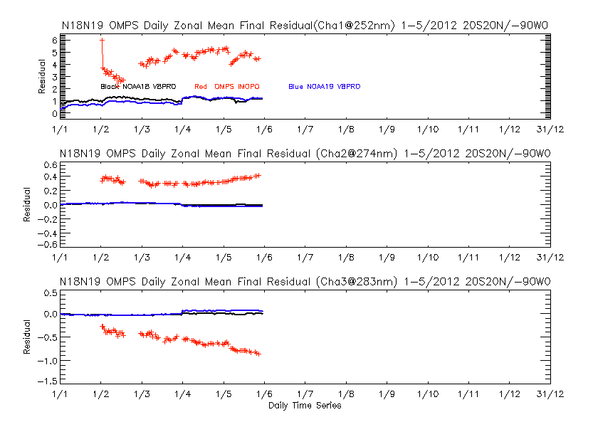
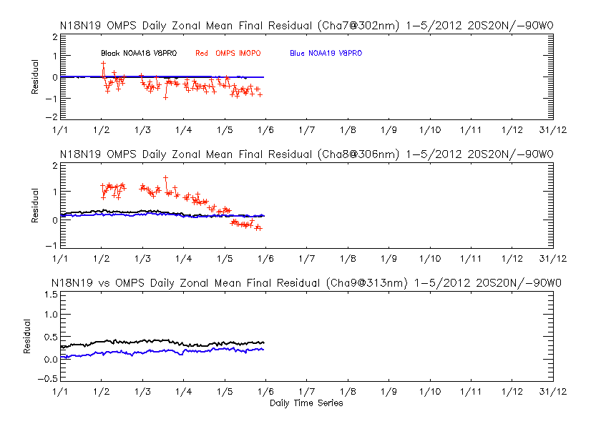
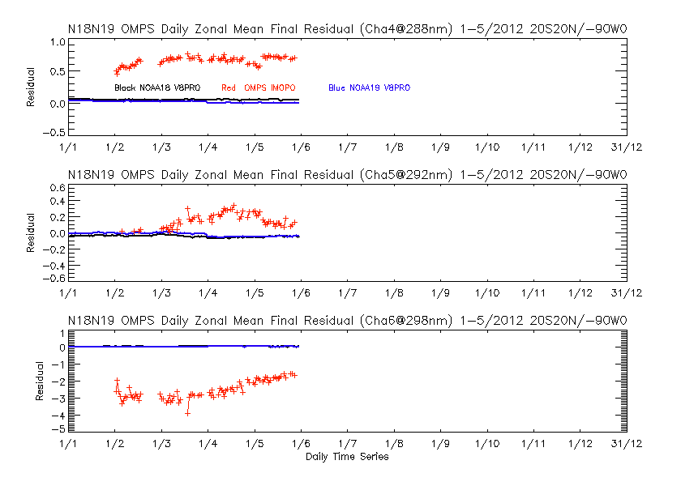
Time series of final IMOPO residuals for OMPS NP February through May
The nine figures show the final residuals for profile wavelengths [252, 274, 283, 288, 292, 298, 302, 306 and 313 nm, (a) to (i), respectively] for the V6PRO (IMOPO) product from OMPS compared to the V8PRO product for the operational NOAA-18 and NOAA-19 SBUV/2 for the equatorial daily zonal means (20N to 20S) with 0-90W removed to avoid the SAA effects. The residuals are in N-values (1 N ~ 2.3%). The time period is the end of February through May of 2012. The residuals are computed with respect to differing retrieved profiles for the two algorithms. The larger values for the IMOPO product are symptomatic of inter-channel calibration biases in the preliminary characterization. The V6PRO does not use the 313 nm directly in its ozone profile retrievals at these latitudes, so no corresponding curve is present on the ninth plot.
Notes:
Figures from W. Yu at
http://www.star.nesdis.noaa.gov/icvs/PROD/proOMPSbeta.O3PRO_IMOPO.php

Slide 27
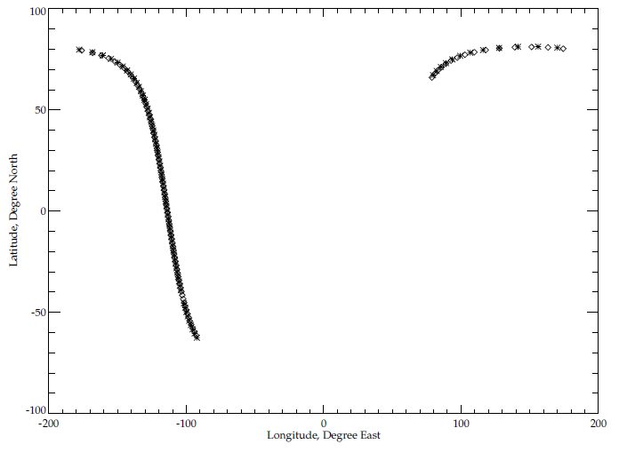
Well-matched Orbits for May 16, 2012
Map of location for sample formation orbit. The NOAA-19 POES is in a similar orbit as the S-NPP spacecraft (sun-synchronous polar orbit with close to 1:30 PM local time ascending node equator crossing). Approximately every 12 days the two satellites’ orbits align very well in both space and time. The figure to the left shows the measurements locations for a pair of orbits on May 16, 2012 the asterisks are S-NPP OMPS NP FOV locations and the diamonds are NOAA-19 SBUV/2 FOV locations.
Given the large fields-of-view of the two instruments, these matchup orbits provide a good source of comparisons. The near coincidences are exploited in the results presented in the next sets of figures.
Latitude, Degrees North
Longitude, Degrees East

Slide 28
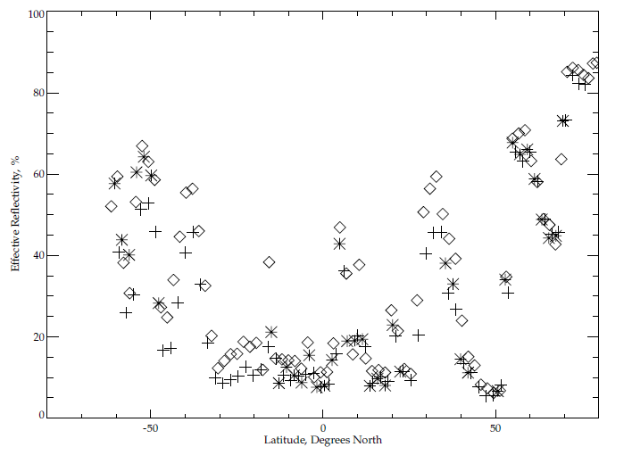
Reflectivity Comparisons to INCTO & SBUV/2
Comparisons of effective reflectivity estimates between IMOPO and the OMPS total ozone first guess product (INCTO) and between IMOPO and the NOAA-19 SBUV/2 processed with the Version 6 ozone profile retrieval algorithm. The data are from a single pair of orbits on May 16, 2012 where the two satellites are flying in formation (orbital tracks within 50 KM and sensing times with 10 minutes). The OMPS Nadir Profiler values are shown with asterisks (*), the OMPS Nadir Mapper values are shown with plus signs (+) and the SBUV/2 are shown with diamonds (<>). A significant number of the OMPS Nadir Profilers retrievals produce fill values because of Error Codes incorrectly set to 20.
Effective Reflectivity, %
The.
Latitude, Degrees North
Notes:
NOAA-19 POES EQCT ~1:32PM
The INCTO values are the averages of 25 retrievals – five consecutive retrievals for the five nadirmost FOVs.

Slide 29
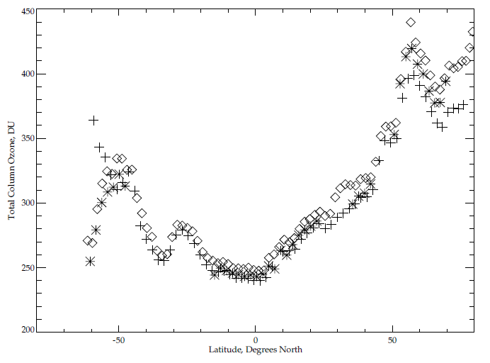
Total Ozone Comparisons to INCTO & SBUV/2
Comparisons of total column ozone estimates between IMOPO and the OMPS total ozone first guess product (INCTO) and between IMOPO and the NOAA-19 SBUV/2 processed with the Version 6 ozone profile retrieval algorithm. The column amounts are the profile totals for the two Version 6 products. The data are from the same pair of orbits on May 16, 2012 used for the previous slide. The OMPS Nadir Profiler values are shown with * (asterisks), the OMPS Nadir Mapper values are shown with + (plus signs) and the SBUV/2 are shown with <> (diamonds). A significant number of the OMPS Nadir Profilers retrievals produce fill values because of Error Codes incorrectly set to 20.
Total Column Ozone, DU
Latitude, Degrees North

Slide 30
Profile Comparisons between OMPS & SBUV/2 V6Pro
The figures on the next two slides show comparisons of the ozone profile retrievals estimates between IMOPO and the NOAA-19 SBUV/2 processed with the Version 6 ozone profile retrieval algorithm. The data are from another single pair of orbits on May 16, 2012 where the two satellites are flying in formation (orbital tracks within 50 KM and sensing times with 10 minutes).
The next slide compares the ozone profile retrievals in 12 pressure layers in Dobson Units versus Latitude. The 12 layers are defined by the following 13 layer boundaries:
[0.0,0.247,0.495,0.99,1.98,3.96,7.92,15.8,31.7,63.3,127.0,253.0,1013] hPa.
The top three layers’ results are in the top row with the topmost layer on the upper left. The lowest layer’s results are in the figure on the bottom right. The OMPS Nadir Profiler values are in Pink and the SBUV/2 are shown in Black. A significant number of the OMPS Nadir Profilers contain fill values because of Error Codes incorrectly set to 20.
The second slide shows the results of comparison for the ozone mixing ratios at 19 pressure levels: [0.3,0.4,0.5,0.7,1.0,1.5,2.0,3.0,4.0,5.0,7.0,10.,15.,20.,30.,40.,50.,70.,100.] hPa.
The arrangement from top to bottom follows the same convention as for the layers.
The two sets of figures show similar results with general agreement between the retrievals for the two instruments but with the OMPS NP retrieving much smaller values at the top of the profiles. This is probably due to the inaccuracies in the initial calibration of the shorter wavelength channels but could also be symptomatic of stray light in the shorter wavelength channels providing information at those levels.

Slide 31
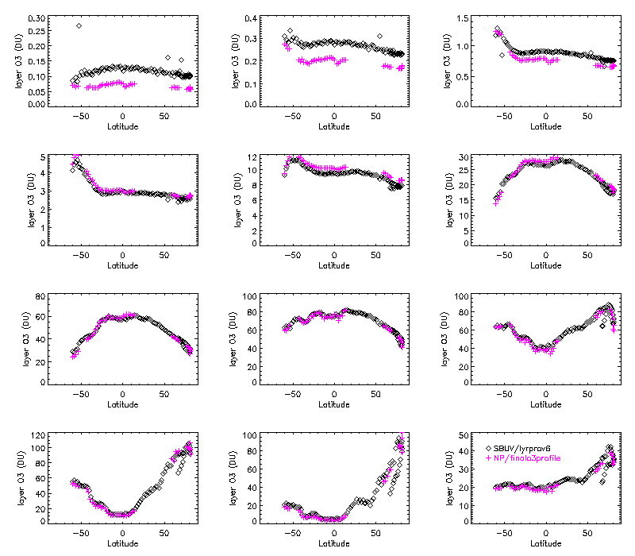
The.
Latitude, Degrees North
Notes:
From J. Niu.

Slide 32
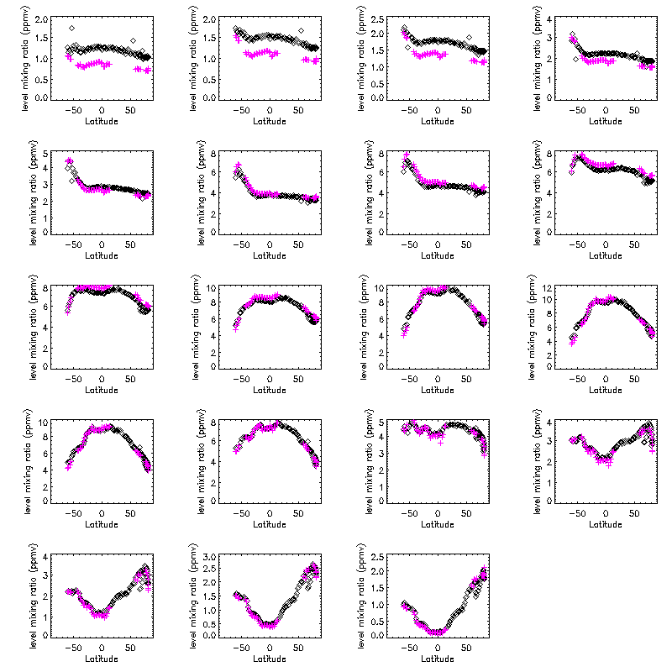
The.
Notes:
From J. Niu.

Slide 33
IMOPO Known Product Deficiencies
Day One Solar needs a definitive spectrum. (Preliminary update expected in August 2012 – DR #4797, #CCR 0458^)
  Profile and total ozone error flags are switched in the output. (Parent PCR 27740 – Expected correction Fall 2012)
Snow/Ice data is all zeroes (DR #4802)
The input-out-of-bound flag (Error Code 20) is set with an incorrect check on surface pressure (DR #4860)
Stray Light / Radiance Coefficients^
  Correction subroutine and definitive estimates of coefficients are under development (DR #4823)
Dark and Smear tables need work in the SDR (DRs #4749, #4818)
Wavelength Scale and adjustments^
  Working on definitive Day 1
  Working on adjustments for intra-orbit scale drift
^ These may create large discontinuities in the product performance as they and similar changes enter the system.
Notes:
DR – Discrepancy Report
CCR – Configuration Control Request

Slide 34
IMOPO Summary of Findings & Recommendations
Promotion to Beta
  The IMOPO algorithm is functioning correctly. The product precision and accuracy are affected by the current state of the calibration, solar spectrum and wavelength scale. These will continue to change as improved characterizations are brought into the system.
  The OMPS Team recommends that the IMOPO Product be promoted to Beta Maturity.
Monitoring Figures are available at
http://www.star.nesdis.noaa.gov/icvs/PROD/proOMPSbeta.O3PRO_IMOPO.php
Upgrade to V8TOZ
  The team recommends an upgrade of the current Version 6 ozone profile retrieval algorithm to the V8Pro algorithm in use with the SBUV/2 measurements for both climate data records and operational products. (This is captured in the JPSS system under DR #4256.)

Slide 35
Backup

Slide 37
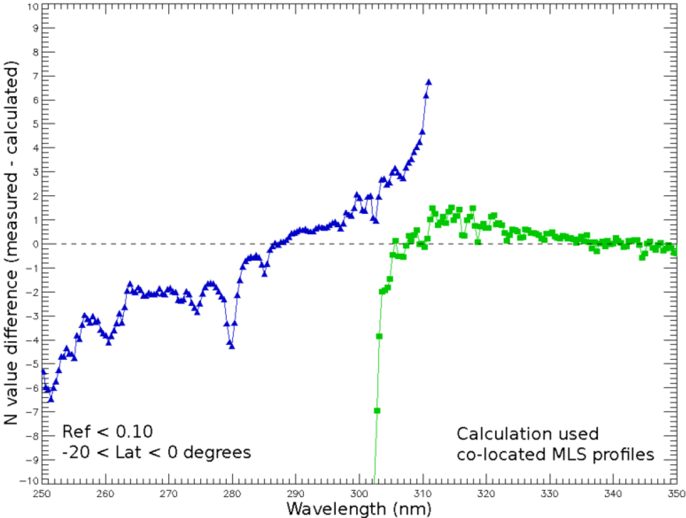
Comparison of radiance/irradiance ratios from OMPS with forward model
calculations using EOS Aura Microwave Limb Sounder ozone profile retrievals as input. The Blue points are differences in N-value (1 N-value Unit ~ 2.3%) for the OMPS Nadir Profiler measurements with the MLS predicted values and the Green points are the differences for measurements averaged over the near-Nadir FOVs for the OMPS Nadir Mapper with the MLS predicted values.
Notes:
Comparison of NASA S-NPP Science Team SDR processing provided by C. Seftor of SSAI.

