Slide 1
Findings for the OMPS
Nadir Mapper 1st Guess Total Column Ozone (INCTO)
&
Nadir Mapper Total Column Ozone EDR (OOTCO) in
Support of Promotion to Provisional Maturity
Compiled by L. Flynn from
JPSS and NPP OMPS Teams
Last Updated March 16, 2013
Notes:
Team lead overview presentations
Criteria for provisional maturity status
EDR specifications
On-orbit performance results
Challenges and remaining issues
Updates of ATBD
Critical DRs
Caveats listed in the Beta ReadMe files
Updates/proposed caveats for the Provisional ReadMe file
Path Forward

Slide 2
Outline
Provisional Definition
Performance Requirements
OMPS Background
SOMTC Caveats
INCTO/OOTCO Performance
  Internal Evaluation
    Flags – Error Code, QF1, QF2, Scene Condition
    INCTO/OOTCO comparisons
    Cross-Track Dependence
    Geolocation of Small FOV
  External Accuracy Evaluation
    Comparisons to OMPS V8TOZ
    Comparisons to SBUV/2, OMI and GOME-2 V8TOZ
    Comparisons to ground-based Dobson and Brewer
  Known Deficiencies (repeated)
Summary of Findings and Recommendations (repeated)
  Promotion to Provisional
  Monitoring plots
  http://www.star.nesdis.noaa.gov/icvs/PROD/proOMPSbeta.TOZ_OOTCO.php
  http://www.star.nesdis.noaa.gov/icvs/PROD/proOMPSbeta.TOZ_INCTO.php
  Upgrade to V8TOZ

Slide 3
Provisional Definition | Artifacts (Deliverables)
Product quality may not be optimal | Product accuracy is determined for a broader (but still limited) set of conditions. No requirement to demonstrate compliance with specifications.
Incremental product improvements are still occurring | Narrative, listing and discussing known errors. All DRs are identified and prioritized (1-5). Provisional readiness will address priorities 1-2. Pathway towards algorithm improvements to meet specifications is demonstrated.
Version control is in affect | Description of the development environment, algorithm version (IDPS build number), and LUTs/PCTs versions used to generate the product validation materials. ATBDs are accurate, up-to-date and consistent with the product running.
General research community is encouraged to participate in the QA and validation of the product, but need to be aware that product validation and QA are ongoing | ADP STAR will request feedback from appropriate users for the product. The notification letter will include a Provisional Maturity disclaimer. DPA will send request to Project Science to post Provisional Maturity disclaimer on CLASS. DPA will submit readme document to CLASS.
Users are urged to consult the EDR product status document prior to use of the data in publications | Warning of potential non-reproducibility of results due to continuing calibration and code changes. Identify known deficiencies regarding product quality.
May be replaced in the archive when the validated product becomes available | Technical evaluation of limited data reprocessing is presented.
Ready for operational evaluation | Key NOAA and non-NOAA end users are identified and feedback requested.

Slide 4
Table 4.2.3 - Ozone Total Column (OMPS-NM)
EDR Attribute | Threshold | Objective
Ozone TC Applicable Conditions: 1. Threshold requirements only apply under daytime conditions with Solar Zenith Angles (SZA) up to 80 degrees. 2. The EDR shall be delivered for all SZA.
a. Horizontal Cell Size | 50 x 50 km2 @ nadir | 10 x 10 km2
b. Vertical Cell Size | 0 -60 km | 0 -60 km
c. Mapping Uncertainty, 1 Sigma | 5 km at Nadir | 5 km
d. Measurement Range | 50 -650 milli-atm-cm | 50-650 milli-atm-cm
e. Measurement Precision
1. X < 0.25 atm-cm | 6.0 milli-atm-cm | 1.0 milli-atm-cm
2. 0.25 < X < 0.45 atm-cm | 7.7 milli-atm-cm | 1.0 milli-atm-cm
3. X > 0.45 atm-cm | 2.8 milli-atm-cm + 1.1% | 1.0 milli-atm-cm
f. Measurement Accuracy
1. X < 0.25 atm-cm | 9.5 milli-atm-cm | 5.0 milli-atm-cm
2. 0.25 < X < 0.45 atm-cm | 13.0 milli-atm-cm | 5.0 milli-atm-cm
3. X > 0.45 atm-cm | 16.0 milli-atm-cm | 5.0 milli-atm-cm
g. Refresh | At least 90% coverage of the globe every 24 hours (monthly average) | 24 hrs.
 |  | v2.0, 9/22/12
Notes: 1. Reserved
Notes:
4.2.3 Ozone Total Column (Ozone-TC)
Ozone Total Column Description: Ozone Total Column (also called Atmospheric Ozone) is defined as the amount of ozone in a vertical column of the atmosphere measured in Dobson Units (milli-atm-cm). All threshold values for ozone total column/profile are based on national climate requirements as detailed by the Workshop on NPOESS Ozone Measurements Requirements.

Slide 5
INCTO/OOTCO Summary of Findings and Recommendations
OMPS NM EDR (OOTCO) Status
  The OOTCO product is producing reasonable values for total column ozone and effective reflectivity. Sulfur Dioxide (SO2) Index and Aerosol Index values show large variations with cross-track view angle and latitude due to inter-channel biases. Most error flags are functioning as designed. The OMPS NM EDR product (OOCTO) and IP product (INCTO) use the same algorithm and measurements. Differences are present because of the use of external data, e.g., CrIS Temperature Profiles and NRT VIIRS Snow/Ice fields are used in OOTCO in place of climatologies, monthly tilings and forecasts. We are replacing the VIIRS cloud top pressure initially with the UV climatology (CCR #736) and eventually with OMPS-measurement-based estimates. We have turned off the use of the VIIRS cloud fraction in the algorithm as previously applied for OOCTO. The inputs and corrections to the EDR and SDR algorithms and input data sets (e.g., VIIRS snow/ice fields) needed to further improve the product are known.
  The OMPS Team recommends that the OOTCO Product be promoted to Provisional Maturity.
OMPS NM First Guess IP (INCTO)
  The INCTO product is producing reasonable values for total column ozone and effective reflectivity.
  The OMPS Team recommends that the INCTO Product be promoted to Provisional Maturity.
Monitoring Figures are available at
  http://www.star.nesdis.noaa.gov/icvs/PROD/proOMPSbeta.TOZ_INCTO.php
Upgrade to V8TOZ
  The team is investigating an upgrade from the OMPS EDR multiple triplet algorithm to the V8TOZ algorithm currently in use with SBUV/2, OMI and GOME-2 measurements for climate data records and operational products. As of January 1, 2013, the V8TOZ algorithm has been used to process the first year of OMPS data independently at NOAA STAR and the NASA Ozone PEATE. The OMPS NPP Science Team is adapting OMI algorithms to create better cloud top pressures, aerosol indices and SO2 indices from the OMPS measurements for use with the V8 algorithm.

Slide 6
INCTO/OOTCO Known Product Deficiencies
Problems with fixes in the pipeline or changed over the course of the study
  Preliminary Day 1 Solar (CCR #411 Implemented the middle of June 11, 2012^)
  EDR RT LUT – corrected bandpasses (CCR #343, August 10, 2012)
  Cloud Top Pressure – new UV climatology (CCR #385, CCR #736 Mx7.0, August 10, 2012)
    Replace IR climatology in INCTO and VIIRS cloud top pressure in OOTCO
  Partial Cloud Logic – consistent surface reflectivity (DR #4266, CCR #419 October 15, 2012)
    Switched from VIIRS Cloud Fraction to measurement-based, partial-cloud estimates
  SDR weekly dark current updates (DR #4750, etc. Started 12/22/2012)
  Adjustment to Solar spectra for varying Earth/Sun distance (DR #4798, CCR #481 in Mx6.6 March 2-13)
  Incorrect SO2 Coefficients (DR #4918; CCR #829 implemented 3/7/2013).
  Broken Ascending/Descending Flag (DR #4804; CCR #893 Mx7.0)
Problems under investigation / in preparation
  VIIRS Snow/Ice Data (DR #4678). New tilings under evaluation. Work on NRT product by VIIRS team.
  Ozone values out of range (infrequent TOZ > 650 DU) (DR #4692)
  Radiance/Irradiance Calibration/Adjustments (DR #5047)
  Stray Light correction (DR #4907)
  Incorrect SO2 Coefficients (DR #4918). This is a table change and went in February 2013.
Longer term refinements and improvements
  Soft internal calibration/adjustments, e.g., cross track bias (DR #5047)
  Wavelength Scale and Adjustments
    Day 1 Scale (Preliminary update May 7, 2012^) and trending
    Radiance/Irradiance Doppler Shift adjustment
    Intra-orbit scale drift
^ Both of these created large discontinuities in the product performance. Similar effects can be expected as further changes enter the system.
Notes:
DRs are Discrepancy Reports. They document problems and allow management of the resources and activities to resolve them. CCRs are Configuration Change Requests. They are provide the requests to implement the solutions.

Slide 7
OMPS Fundamentals
NOAA, through the Joint Polar Satellite System (JPSS) program, in partnership with National Aeronautical Space Administration (NASA), launched the Suomi National Polar-orbiting Partnership (Suomi NPP) satellite on October 28, 2011. The Ozone Mapping and Profiler Suite (OMPS) consists of two telescopes feeding three detectors measuring solar radiance scattered by the Earth's atmosphere and solar irradiance by using diffusers. The measurements are used to generate estimates of total column ozone and vertical ozone profiles.
The nadir mapper (total column) sensor uses a single grating monochromator and a CCD array detector to make measurements every 0.42 nm from 300 nm to 380 nm with 1.0-nm resolution. It has a 110° cross-track FOV and 0.27° along-track slit width FOV. The measurements are currently combined into 35 cross-track bins: 3.35° (50 km) at nadir, and 2.84° at ±55°. The resolution is 50 km along-track at nadir, with a 7.6-second reporting period. The instrument is capable of making measurements with much better horizontal resolution.
The nadir profiler sensor uses a double monochromator and a CCD array detector to make measurements every 0.42 nm from 250 nm to 310 nm with 1.0-nm resolution. It has a 16.6° cross-track FOV, 0.26° along-track slit width. The current reporting period is 38 seconds giving it a 250 km x 250 km cell size collocated with the five central total column cells.
The limb profiler sensor is a prism spectrometer with spectral coverage from 290 nm to 1000 nm. It has three slits separated by 4.25° with a 19-second reporting period that equates to 125 km along-track motion. The slits have 112 km (1.95°) vertical FOVs equating to 0 to 60 km coverage at the limb, plus offsets for pointing uncertainty, orbital variation, and Earth oblateness. The CCD array detector provides measurements every 1.1 km with 2.1-km vertical resolution. The products for the Limb Profiler are not discussed here.

Slide 8
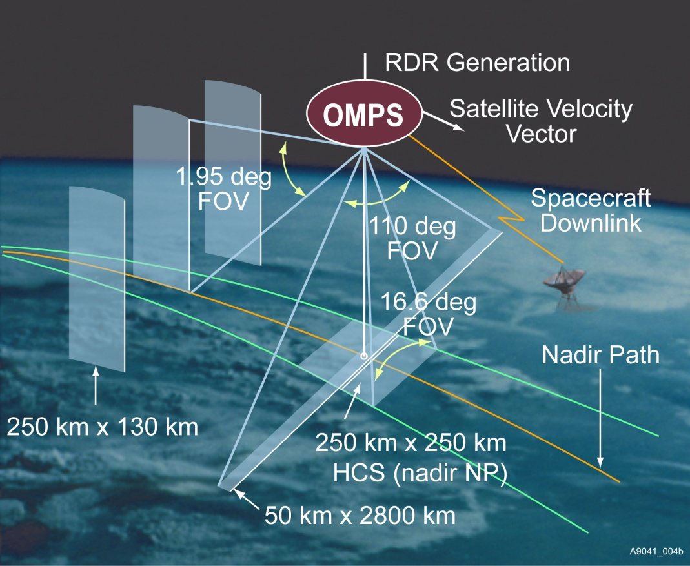
Instrument Fields of View. Schematic from Ball Aerospace and Technology Corporation.

Slide 9
Nadir Mapper & Profiler
The instruments measure radiance scattered from the Earth’s atmosphere and surface. They also make solar measurements using pairs of diffusers. Judicious operation of working and reference diffusers allows analysts to track the diffuser degradation. The solar measurements also provide checks on the wavelength scale and bandpass. The instruments have completed multiple passes through their internal dark and nonlinearity calibration sequences and are beginning to make regular solar measurements. (See information on the OMPS SDRs.)
Main
Electronics
Limb
Profiler
Diagram from Ball Aerospace and Technology Corporation
Entrance Aperture
Entrance Aperture
Earth
Mode
Solar
Mode
Diffuser
Each instrument can view the Earth or either of two solar diffusers; a working and a reference.
Notes:
The OMPS instruments (Nadir Mapper, Nadir Profiler, and Limb Profiler) are designed to take a set of measurements to allow analysts to maintain the instrument characterization and calibration.[2] For each of the instruments, this task can be broken into two components, tracking the performance of the CCD array detectors and electronics, and tracking the performance of the optical components, that is, the telescopes and spectrometers. The instruments make measurements on the night side of orbits with the apertures closed. One set is made without any sources and is used to track CCD array dark currents. Another set is made with illumination by an LED and is used to track CCD non-linearity and pixel-to-pixel non-uniformity response. The instruments also make solar measurements using pairs of diffusers. Judicious operation of working and reference diffusers allows analysts to track the diffuser degradation. The solar measurements also provide checks on the wavelength scale and bandpass. The instruments have completed multiple passes through their internal dark and nonlinearity calibration sequences and are beginning to make regular solar measurements.

Slide 10
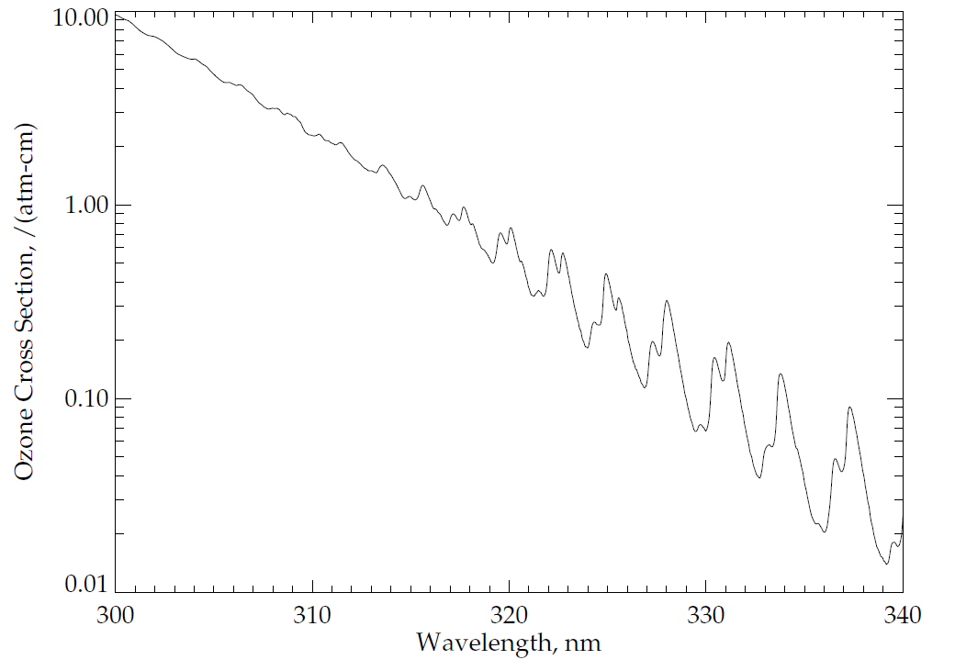
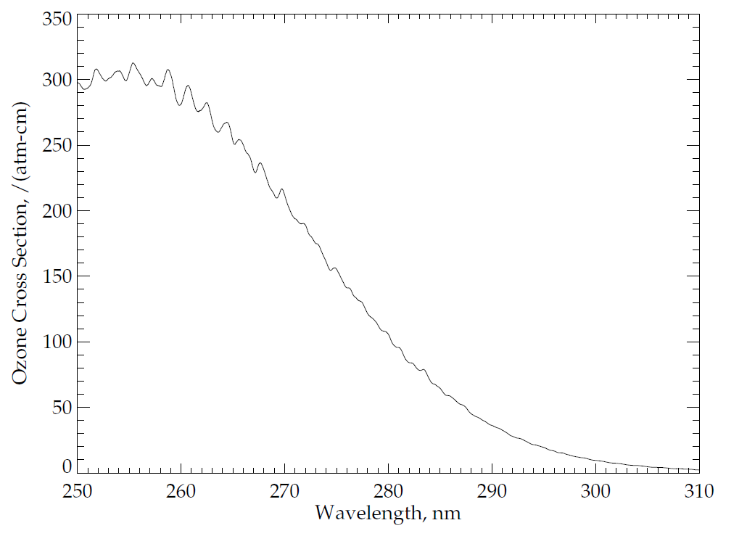
Ozone Absorption Cross Sections:
Ozone has four main absorption bands in the ultraviolet, visible and near-infrared as follows: the Hartley bands from 200 nm to 310 nm, the Huggins bands from 310 nm to 380 nm, the Chappuis bands from 400 nm to 650 nm, and the Wulf bands from 600 nm to 1100 nm. The OMPS nadir telescope directs photons to two spectrometers, one with a wide, cross-track field-of-view (FOV) and spectral coverage in the Huggins ozone absorption bands, and the other with a smaller, nadir FOV and spectral coverage in the Hartley ozone absorption bands. Figures (a) and (b) show the ozone absorption cross-sections at a nominal atmospheric temperature for parts of these bands. These cross-sections are for -50ºC as estimated from a quadratic fit in temperature of the Brion-Daumont-Malicet data set.
(a)
Patterns in Ozone
Absorption
(b)
Dramatic Increase in Ozone
Absorption
Notes:
See J. Malicet, D. Daumont, J. Charbonnier, C. Parisse, A. Chakir, and J. Brion, "Ozone UV spectroscopy. II. Absorption cross-sections and temperature dependence," J. Atmos. Chem. 21, 263-273 (1995) and references therein.
Quadratic fit provided by D. Haffner.
Figure by L. Flynn.

Slide 11
OMPS Nadir Mapper Spectra
The plot at the top of the following slide shows a sample OMPS Nadir Mapper solar spectrum measured in January. The initial calibration, goniometry and wavelengths scales have been applied. Notice the Fraunhofer lines, e.g., a deep one near 360 nm.
The plot in the middle shows a sample spectrum for the Earth View data for the nadir field-of view.
The plot on the bottom shows the ratio of the first two spectra. Notice that much of the structure in the solar spectrum cancels out in the ration. Also notice the variations between 320 and 330 nm produced by differential ozone absorption with wavelength as illustrated in the Figure (a) from two slides earlier.

Slide 12
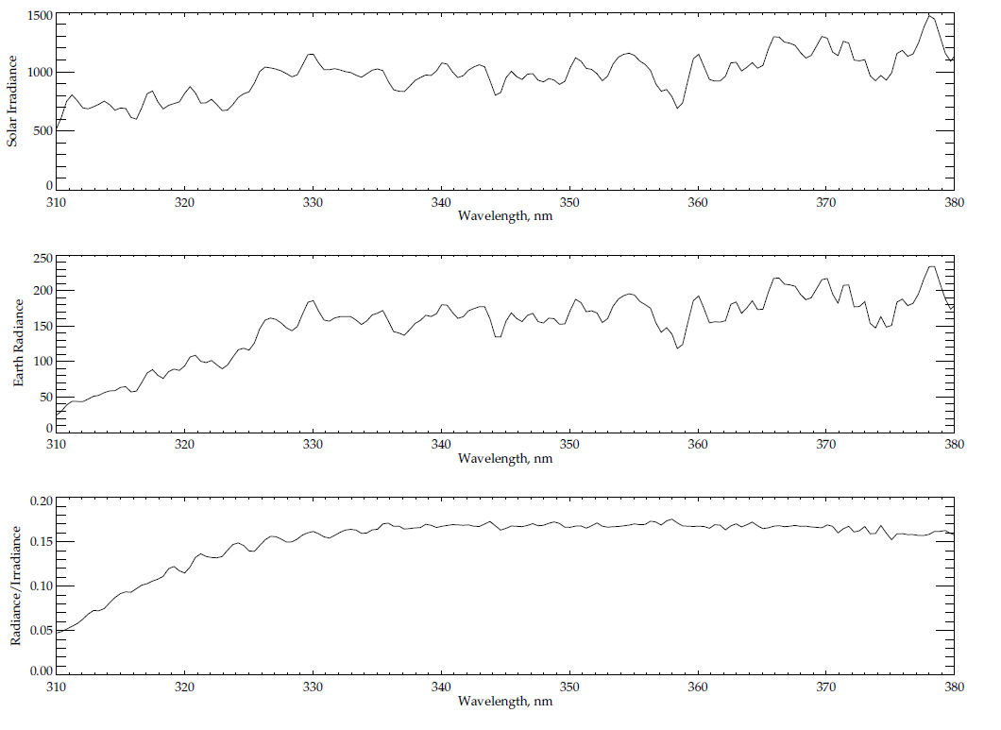
Typical spectra from 310 to 380 nm for OMPS Nadir Mapper
Solar Line
Solar Irradiance
Earth Radiance
Ozone Absorption Features
Radiance/Irradiance Ratio
310
380
Wavelength, nm

Slide 13
Caveats for OMPS NM Earth-View SDR SOMTC
The OMPS NM and NP dark will be updated weekly. This can result in small but systematic positive bias (higher than truth) in SDR. For NM, the bias is negligible for most wavelength. In rare cases where signals are extreme weak, such as near the terminator and for wavelength shorter than 305 nm, the bias can reach 0.2%. For NP, the bias generally decreases with wavelength, from as much as 0.02% for wavelengths shorter than 255 nm and down to 0.002% for wavelengths longer than 285 nm.
The spectral solar irradiances have been updated with on-orbit measurements for both NM and NP. Further analysis and update of Day One solar irradiance may be provided in future. These preliminary and additional updates of Day One solar have been planned before launch as part of normal calibration update.
The wavelength scales for the OMPS NM and NP for both Earth and solar spectra have been updated with on-orbit measurements. The adjustments were somehow larger than expected from pre-launch thermal analysis. We will monitor and re-evaluate periodically.
Out-of-band stray light was expected before launch and confirmed after launch for the OMPS NM, especially for wavelength less than 305 nm. The impact can be severe, up to 5%, but limited to wavelength less than 310 nm that are less critical for ozone retrieval. Improvements to the stray light correction will be a continuing effort in the coming months.

Slide 14
SDR Requirements and Performance
Requirements | Specification or Prediction | On-Orbit Performance
Non-linearity Knowledge | < 0.5% | ~0.1%
Non-linearity | < 2% full well | < 0.46%
On-orbit Wavelength Calibration | < 0.01 nm | average ~0.01 nm RMS
Stray Light NM | ≤ 2 | average ~± 2%
Intra-Orbit Wavelength Stability | <0.02 nm | < 0.013 nm
SNR | >1000 | > 1000 from SV and EV
Inter-Orbital Thermal Wavelength Shift | <0.02 nm | <0.013 nm
CCD Read Noise | <60 –e RMS | < 25 –e RMS
Detector Gain | >46 | ~42
Absolute Irradiance Calibration Accuracy | < 7% | 5%
Absolute Radiance Calibration Accuracy | < 8% | < 5%

Slide 15
SDR Table 3: Open DRs
DR # | Short Description
7053 | TC Dark table updates for SAA
4978 | TC EDR fails for Sample Table with extra pixel column
4951 | Large error in TLE geo calculation
4927 | FT document 474-00181 need update
4920 | Indicate Graceful Degradation mode when using TLE geolocation
4914 | OMPS TC and NP GEO
4907 | TC needs Stray light correction
4879 | NP and TC Darks need to be updated
4823 | The NP stray light needs to be corrected.
4799 | Inconsistent structure between OAD and EV SDR
4749 | OMPS darks have negative values
4693 | Cal SDR strategy study
4676 | Radiance error associated with aggregation
4673 | Correction for different linearity slope T_{up} for CCD2
4672 | Linearity correction update for xml file
4671 | OMPS Data quality threshold tables non existence for SDR
4627 | Quantization introduced by linearity correction error - Cal SDR
4615 | Transient filter issue
4602 | Spatial pixel mismatch in Cal SDR

Slide 16
Total Column Ozone* Products
The spectral measurements from the OMPS Nadir Mapper* of the radiances scattered by the Earth’s atmosphere are used to generate estimates of the total column ozone. The algorithm uses ratios of Earth radiance to Solar irradiance at triplets of wavelengths to obtain estimates of the total column ozone, effective reflectivity, and the wavelength dependence of the reflectivity. Table values computed for a set of standard profiles, cloud heights, latitudes and solar zenith angles are interpolated and compared to the measured top-of-atmosphere albedos. The triplets combine an ozone insensitive wavelength channel (at 364, 367, 372 or 377 nm) to obtain cloud fraction and reflectivity information, with a pair of measurements at shorter wavelengths. The pairs are selected to have one “weak” and one “strong” ozone absorption channel. The hyperspectral capabilities of the sensor are used to select multiple sets of triplets to balance ozone sensitivity across the range of expected ozone column amounts and solar zenith angles. The "strong" ozone channels are placed at 308.5, 310.5, 312.0, 312.5, 314.0, 315.0, 316.0, 317.0, 318.0, 320.0, 322.5, 325.0, 328.0, or 331.0 nm. They are paired with a longer “weak” channel at 321.0, 329.0, 332.0, or 336.0 nm. The ozone absorption cross-sections decrease from 3.0 (atm. cm)⁻¹ to 0.3 (atm. cm)⁻¹ over the range of “strong” wavelengths. Typical ozone columns range from 100 DU or 0.1 atm-cm to 600 DU or 0.6 atm-cm.
*There is sometimes confusion on what to call the OMPS instruments and products. The OMPS Nadir Mapper (NM) makes the principal measurements that are used to create the Total Column Ozone (TC or TOZ) Products.

Slide 17
The 1st Guess Total Ozone Product INCTO
The Multiple Triplet algorithm described in the previous slide is applied twice for each FOV. This was done to resolve the “Who goes first?” problem created by the desires to use information from other sensors in the retrieval algorithms, e.g., OMPS wanted to use the CrIS temperature profile, and CrIS wanted to use the OMPS ozone estimates. The “1st Guess” OMPS products (INCTO) use climatological or forecast fields for surface reflectivity and pressure, snow/ice coverage, cloud optical centroid depth, and atmospheric temperature. They use internally calculated estimates of cloud fractions and effective reflectivity from measurements at non-ozone absorbing UV wavelengths. As we will show, this application of the algorithm is performing well. This product is sometimes called the Total Ozone Intermediate Product (TOZ IP).
REFERENCES – Additional information is in the OMPS Total Column Algorithm Theoretical Basis and Operational Algorithm Description Documents, and a volume of the Common Data Format Control Book:
Available at http://npp.gsfc.nasa.gov/documents.html
OMPS Total Column Ozone ATBD 474-00029_Rev-Baseline.pdf
OMPS Total Column Ozone OAD 474-00066_OAD-OMPS-TC-EDR-SW_RevA_20120127.pdf
Atmospheric EDRs CDFCB 474-0001-04-02_Rev-Baseline.pdf

Slide 18
The 2nd Pass Total Ozone Product, OOTCO
The “2nd Pass or EDR” OMPS products (OOTCO) use cloud top pressures (soon to be replaced with the UV climatology) and snow/ice coverage from VIIRS near-real-time products and temperature profiles from CrIS products. Recent studies have found that the estimates cloud top pressure from an infrared or visible sensor do not provide the correct quantities for use with UV radiances, e.g., thin cirrus may be optically opaque in the IR but optically thin in the UV. CCR #736 implements a switch to a UV-based cloud top climatology. The products use internally calculated estimates of cloud fractions and effective reflectivity from measurements at non-ozone absorbing UV wavelengths. As we will show, this application of the algorithm is performing well. This product is sometimes called the Total Ozone Environmental Data Record (TOZ EDR). The INCTO and OOTCO products use identical sets of measurements from the OMPS Nadir Mapper. The INCTO final ozone estimate is included as a parameter in the OOTCO output files.
REFERENCES – Additional information for this product is available in the documents listed for INCTO on the previous slide.

Slide 19
INCTO/OOTCO Error and Quality Flags
Error Flag
  Bit1 0 good, 1 large residual; Bit2 1 large SO2 Index; Bit3 1 triplet inconsistency; Bit4 1 ozone out of range; Bit5 1 surface reflectivity out of range
Quality Flag 1
  Bit1/Bit2 Quality 0 no retrieval, 1 low, 2 medium, 3 high; Bit3 1 input data quality is not good; Bit4 1 triplet selection is not consistent; Bit5 1 inconsistent residuals; Bit6/Bit7 0 SZA<80, 1 80<SZA<88, 2 SZA>88
Quality Flag 2 – Duplicates other flags or information
  Bit1 1 snow/ice present; Bit2 1 sun glint geometry over open water; Bit3 1 solar eclipse in FOV; Bit4 1 TOZ<50 or TOZ>650; Bit5/6 0 TOZ> 450*, 1 250<TOZ<450, 2 TOZ<250, 3 not used; Bit7 1 Aerosol Index Too Large, AI> 0.5; Bit8 Spare
South Atlantic Anomaly Flag – Climatological intensity
  0 0-10%, 1 10-20%, 2 20-30%, 3 30-40%, 4 40-50%, 5 50-60%, 6 60-70%, 7 70-80%, 8 >80%
Scene Condition Flag
  Bit1 0 Descending, 1 Ascending^; Bit2 1 Snow/Ice present #; Bit3 1 Troposheric Aerosols present; Bit4 1 Snow/Ice Fraction > 0; Bit5 1 Solar Zenith Angle (>80º); Bit6 1 Surface Reflectivity (>1.2 or <-0.05)
See references on the previous slide for more details on these flags.
*QF2 B5/6 can be 0 when the condition is not checked in addition to when the total column ozone is greater than 450 DU.
^SCF B1 is not currently set properly according to the orbital path, i.e., by checking the changes in latitude during a measurement. It is almost always set to 1, except for the first and last granules in a sequence of measurements as processed at IDPS. A fix will be implemented with Mx7.1 in June 2013.
# SCF B2 is not currently set properly. It is set to snow/ice present almost everywhere. It is inconsistent with SCF B4 Snow/Ice Faction > 0.

Slide 20
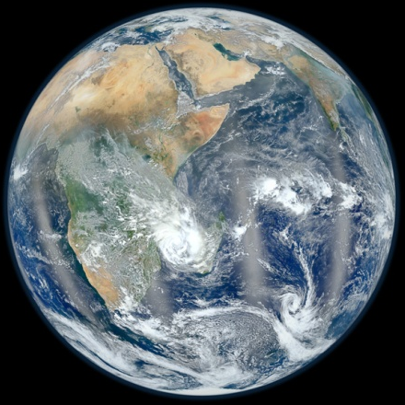
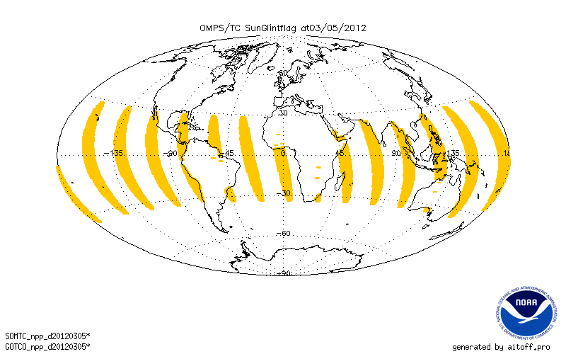
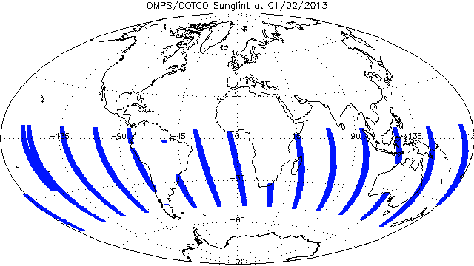
Sun Glint Flags
VIIRS Blue Marble
January 23, 2012
This figure gives the location of pixels with the OMPS NM Sun Glint flag set to 1 – viewing geometry has the potential for sun glint and the location is over open water – for the OMPS Nadir Mapper for March 5, 2012. The code is consistent in assigning this condition. (The VIIRS image in the upper left corner shows similar locations for Sun Glint but shifted to the South as the image is for Sun angles in January.) This flag is passed through from the SDR to both the TOZ IP and EDR products.
Notes:
VIIRS Figure from http://www.nasa.gov/topics/earth/features/viirs-globe-east.html
Glint Figure From Y. Hao

Slide 21
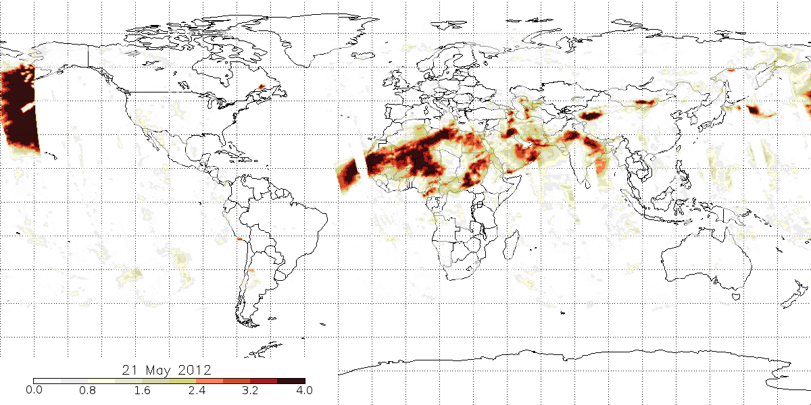
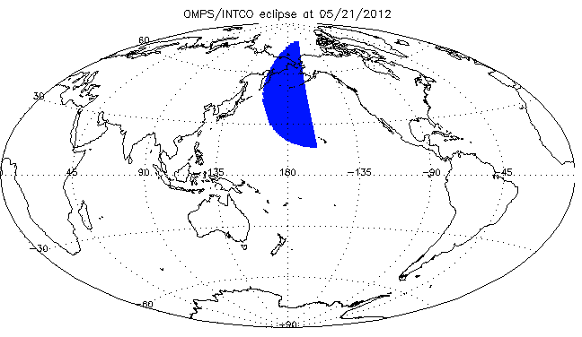
INCTO Eclipse Flag & Aerosol Index:
These two figures compare the occurrences of Eclipse Flags and elevated Aerosol Index values. The figure below looks at the Eclipse Flag for the recent Solar Eclipse on May 20/21, 2012. The flag is activated for the proper times and locations. The reduced sunlight in eclipse conditions leads to poor values for the Aerosol Index as shown on the Left.
↑ Map showing locations of high Aerosol Index values for May 21, 2012. The large values in the Northwestern Pacific are present because the algorithm does not account for the low radiances in the Moon’s shadow
↑ Location of Eclipse Flags for OMPS Nadir Mapper First Guess Total Column Ozone Product for May 21, 2012. The map for OOTCO is identical.
Notes:
Eclipse flag figure from Y. Hao. Aerosol Index figure from C. Seftor.

Slide 22
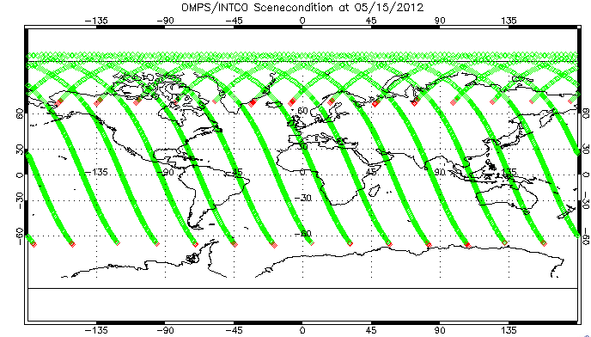
Scene Condition Flag: Ascending/Descending
Nadir FOV locations for May 15, 2012. Each orbit starts near 60ºS and ascends to 80ºN and then descends to 70ºN. The Green FOVs are where the Scene Condition Flag is set to Ascending, and the Red FOVs are where the flag is set to Descending. This flag erroneously identifies most descending orbit locations as ascending and erroneously identifies the first ascending location as descending. For all of the descending, it only correctly identifies the last location as descending. This may not be set at all and just have zeros from initialization. It is supposed to be passed through from SDR. DR #4804 is open on this issue.
Notes:
Figs. From Y. Hao

Slide 23
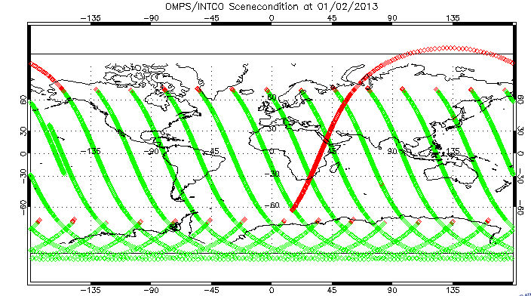
Scene Condition Flag: Ascending/Descending
Nadir FOV locations for January 2, 2013. Each orbit starts near 60ºS and descends to 80ºS and then ascends to 70ºN. The Green FOVs are where the Scene Condition Flag is set to Ascending, and the Red FOVs are where the flag is set to Descending. This flag erroneously identifies most descending orbit locations as ascending and erroneously identifies the first ascending location as descending. For all of the descending, it only correctly identifies the last location as descending. This may not be set at all and just have zeros from initialization. It is supposed to be passed through from the SDR. DR #4804 is open on this issue.
Notes:
Figs. From Y. Hao

Slide 24
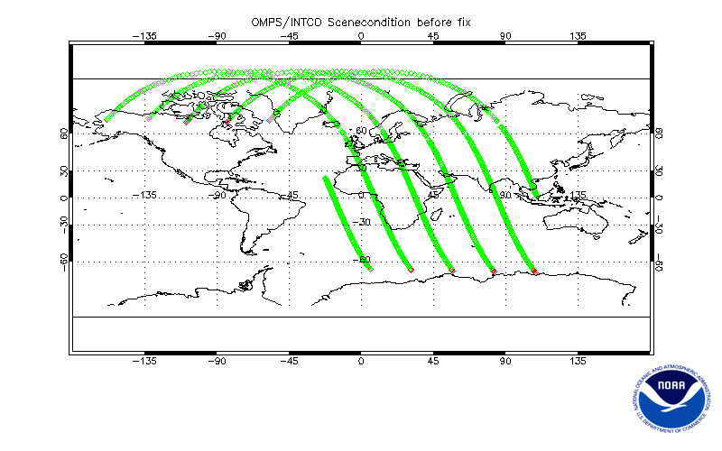
Current Bad Flags
This figure shows the golden day ascending/ descending bit in the Current INCTO Scene Condition Flag. The X symbols are where the flag is set to ascending (1) and the X symbols are where it is set to descending (0). The geolocation is the nadir view location as the spacecraft motion is used to set the flag. All of the values except the first in an orbit are set to ascending.

Slide 25
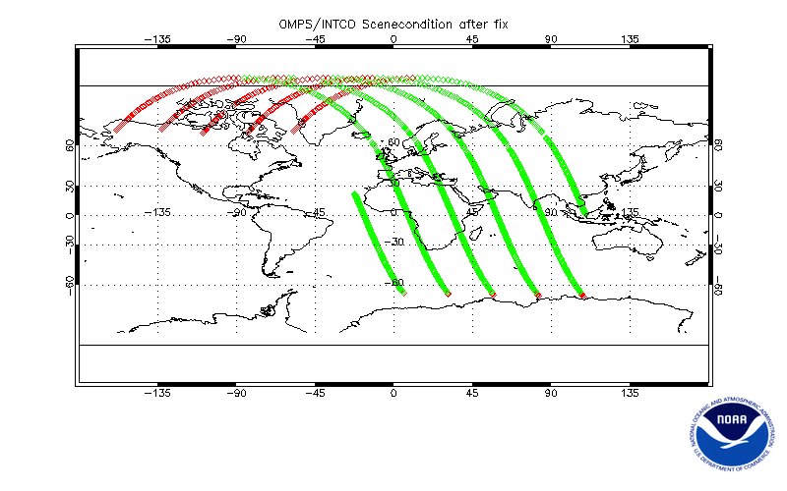
New Correct Flags (Implementation July 2013)
This figure shows five orbits for the golden day ascending/ descending bit in the New INCTO Scene Condition Flag. The X symbols are where the flag is set to ascending (1) and the X symbols are where it is set to descending (0). The geolocation is the nadir view location as the spacecraft motion is used to set the flag. The A/D locations are now correct. (The descending at the start of orbits are where the middle of the swath is not processed.)

Slide 26
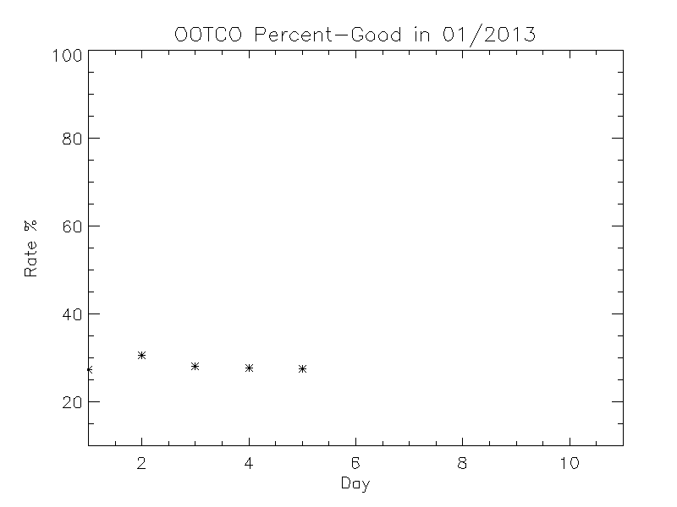
Time Series of Percent Good for OOTCO Error Flag
The Error Flag in OOTCO had been running at approximately 30% good values since mid-October.
The primary failures are high values of the SO2 Index
and large values for the Aerosol Index.
Notes:
Figure From Y. Hao

Slide 27
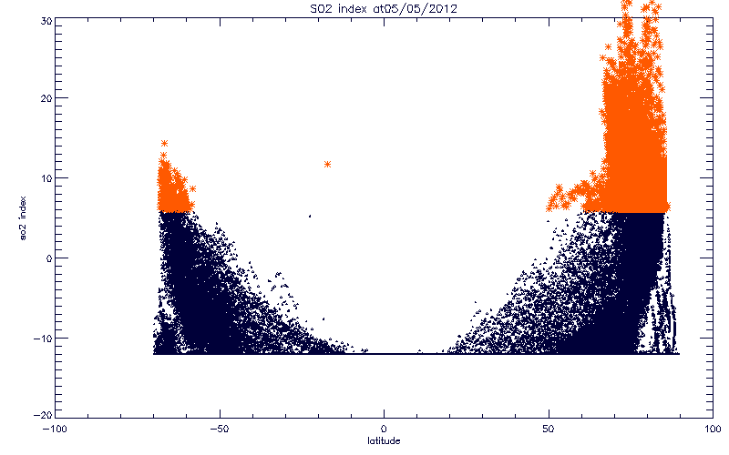
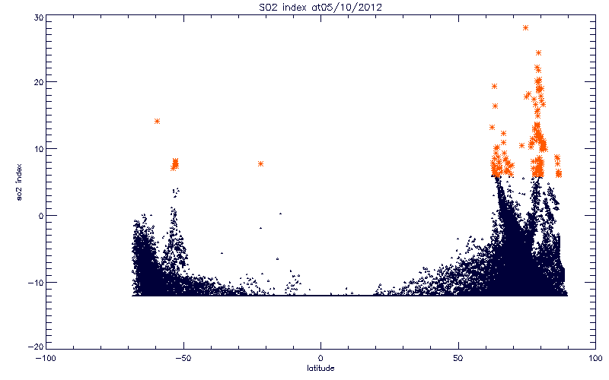
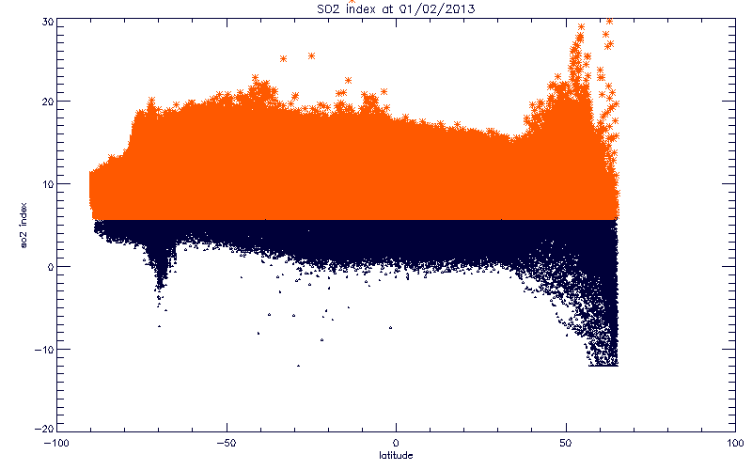
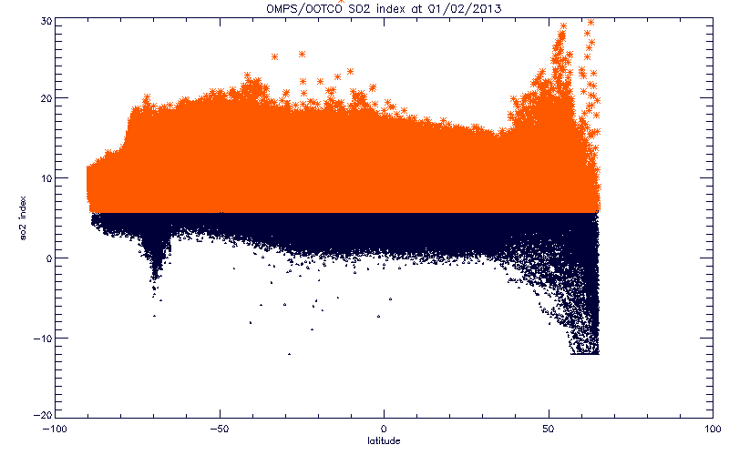
SO2 Index values for INCTO versus Latitude in Degrees North for two days – May 5th and May 10th. Notice that the distribution shifted down so that the there were fewer values above the Error Flag threshold of 6 DU. The algorithm has a cutoff in values at -12 DU. Much of the variation in this index is caused by deficiencies in the current calibration, not real atmospheric SO2 content. The lower figure for January 2, 2013 shows further changes in the product after the day 1 solar spectra and wavelength scales were adjusted.
Notes:
Figs. From Y. Hao

Slide 28
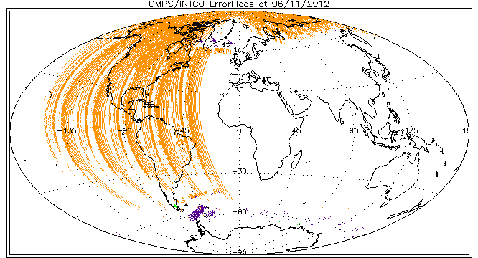
Daily Maps of Error Flags for OMPS INCTO for June 11th:
Purple 1 Large Residual;
Orange 2 SO2 Index;
Green 16 Surface Reflectivity out of range.
Since SO2 is produce from residuals, both of the increased flag frequencies from May to June are related to residuals.
The first eight orbits (Eastern Hemisphere) have low occurrences of non-zero error flags.
Another update (in the middle of the day on June 11, 2012), this time for the Day 1 solar spectra, reduced the percent good for the INCTO Error Flag from 99% down to approximately 50%. The new solar spectra had +-5% variations relative to the prelaunch values. The decrease in good error flags was primarily due to increased SO2 flagging. Until definitive inter-channel calibration values are determined and in the system, users can expect similar shifts in the product behavior.
Notes:
Figs. From Y. Hao

Slide 29
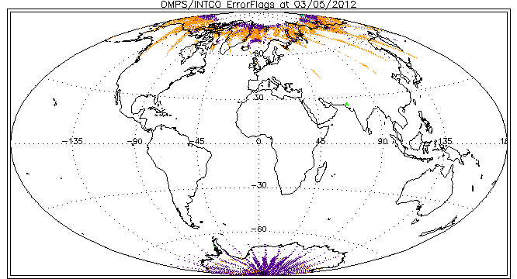
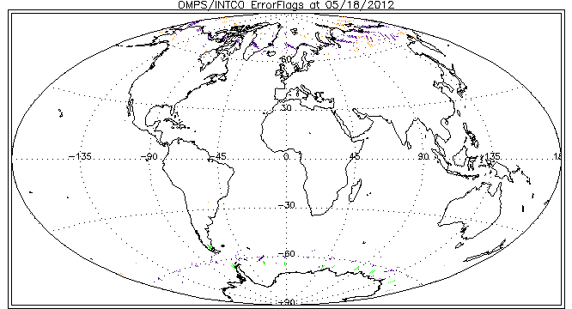
Daily Maps of Error Flags for OMPS INCTO for March 5th and May 18th, 2012:
Purple 1 Large Residual;
Orange 2 SO2 Index;
Green 16 Surface Reflectivity out of range.
Since SO2 is produce from residuals, both of the reduced flag frequencies from March to May are related to residuals.
Notes:
Figs. From Y. Hao

Slide 30
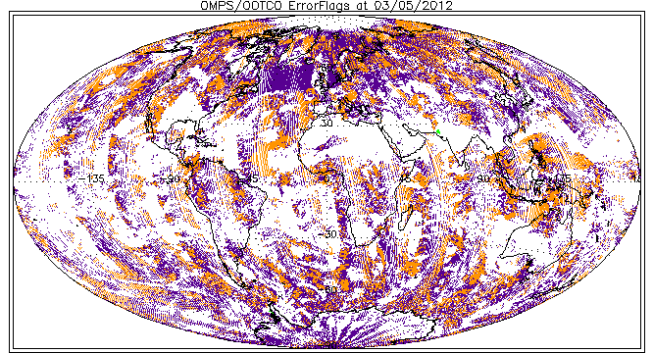
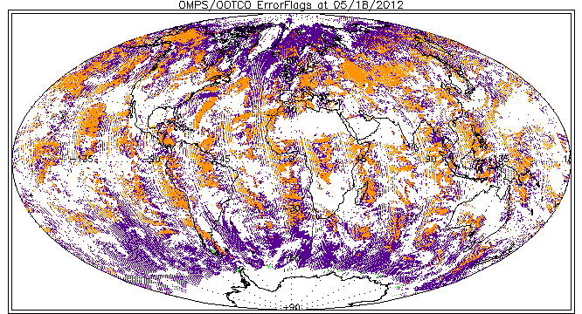
Daily Maps of Error Flags for OMPS OOTCO for March 5th and May 18th, 2012:
Purple 1 Large Residual;
Orange 2 SO2 Index;
Green 16 Surface Reflectivity out of range.
The OOTCO product in this time period is suffering from problems associated with the use of VIIRS cloud fraction estimates.
Notes:
Figs. From Y. Hao

Slide 31
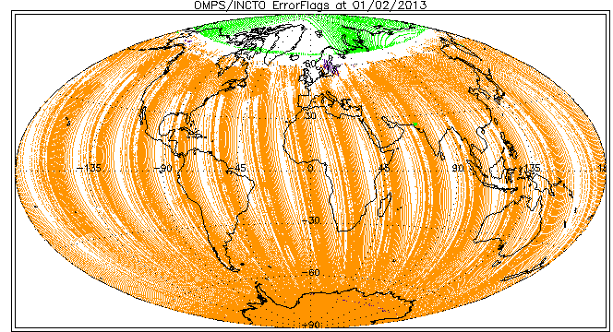
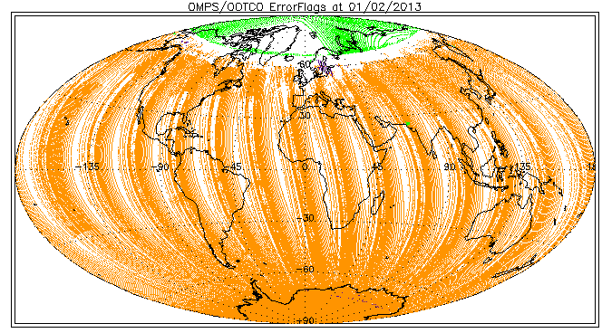
Daily Maps of Error Flags for OMPS INCTO (Top) and OOTCO Bottom for January 2, 2013 :
Purple 1 Large Residual;
Orange 2 SO2 Index;
Green 16 Surface Reflectivity out of range.
The OOTCO product is suffering from problems associated with the use of VIIRS cloud fraction estimates. The plan is to remove this dependence in future processing.
Notes:
Figs. From Y. Hao

Slide 32
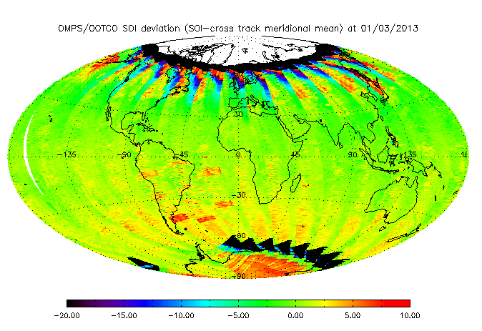
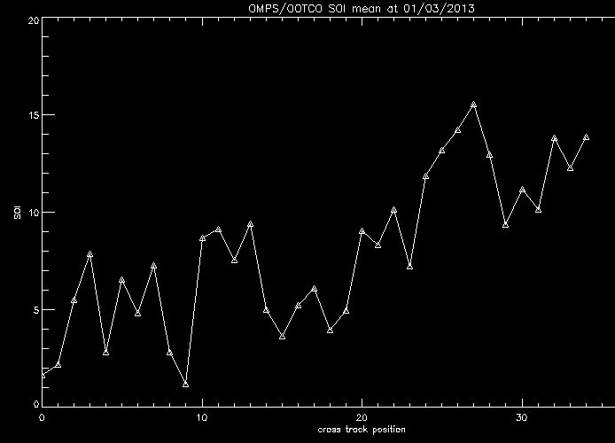
SO2 Index with Equatorial Cross-track Mean Removed
The figure to the left shows the SO2 Index for OOTCO with the average equatorial cross-track dependence removed. The features in the South Atlantic are produced by bad dark corrections in those regions. The deviations at high latitudes show the influence of stray light.
The figure to the right shows the cross track average subtracted from the data above. The large deviations from zero are symptomatic of inter channel calibration errors for the triplet used to create the index.

Slide 33
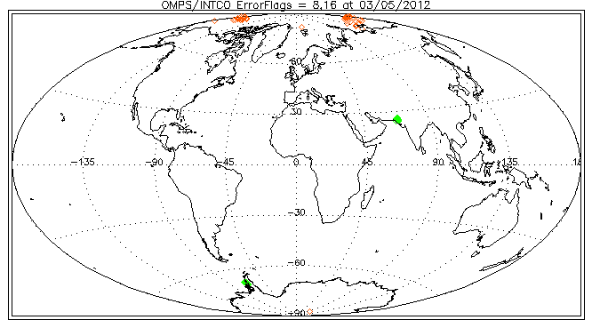
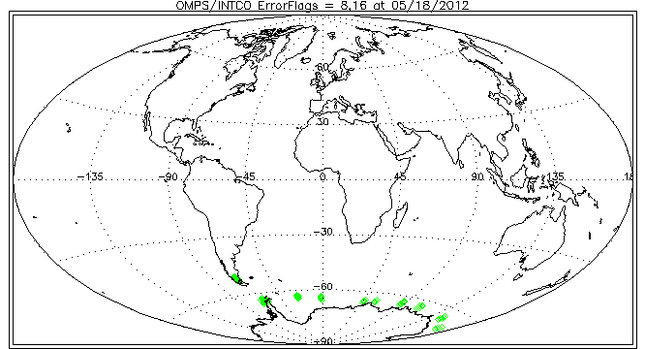
Daily Maps of Error Flags for OMPS INCTO for March 5th and May 18th, 2012:
Since they were hard to distinguish in the previous plots, two of the less frequent flags are re-plotted here.
Red 8 Ozone out of range (This flag is not activated for May 18th.);
Green 16 Surface Reflectivity out of range.
Notes:
Figs. From Y. Hao

Slide 34
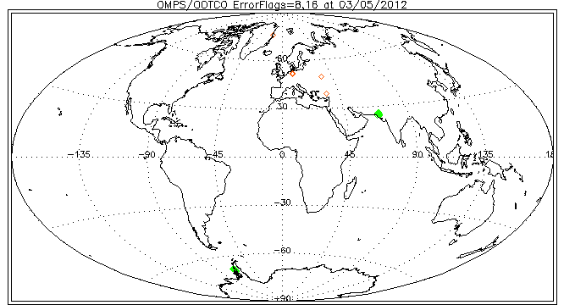
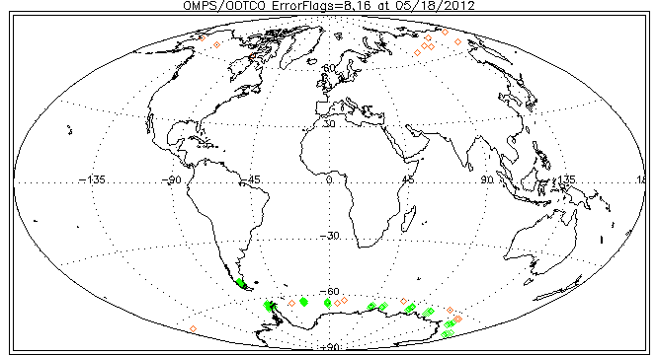
Daily Maps of Error Flags for OMPS OOTCO for March 5th and May 18th, 2012:
Since they were hard to distinguish in the previous plots, two of the less frequent flags are plotted here.
Red 8 Ozone out of range, and
Green 16 Surface Reflectivity out of range are replotted here.
Notes:
Figs. From Y. Hao

Slide 35
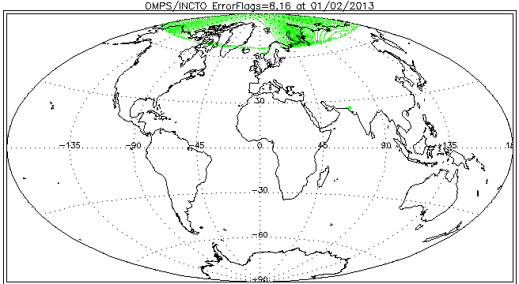

Daily Maps of Error Flags for OMPS INCTO (Top) and OOTCO (Bottom) for January 2, 2013:
Since they were hard to distinguish in the previous plots, two of the less frequent flags are plotted here.
Red 8 Ozone out of range, and
Green 16 Surface Reflectivity out of range are replotted here.
Notes:
Figs. From Y. Hao

Slide 36
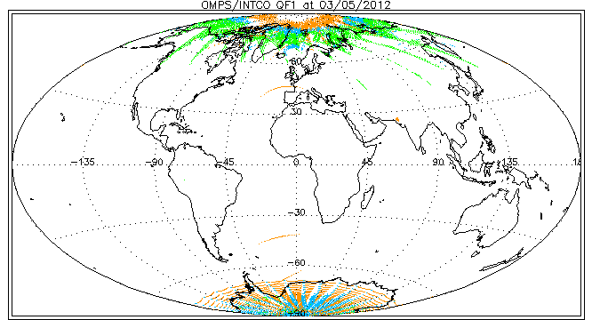
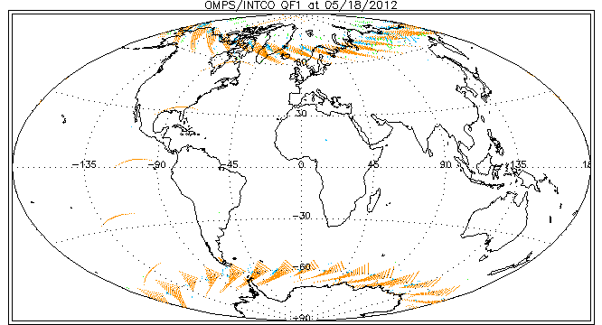
INCTO Quality Flag 1 for March 5th (top) and May 18th (bottom), 2012: Orange is QF1=4 (input data quality is not good),
Blue is QF1=16 (Residuals are not consistent),
Green is QF1=32 (SO2 index ≥ 6 DU).
There are no QF1=8 (O3 triplet selection is not consistent) values.
Again the change in frequency is for residual related flags.
Notes:
Figs. From Y. Hao

Slide 37
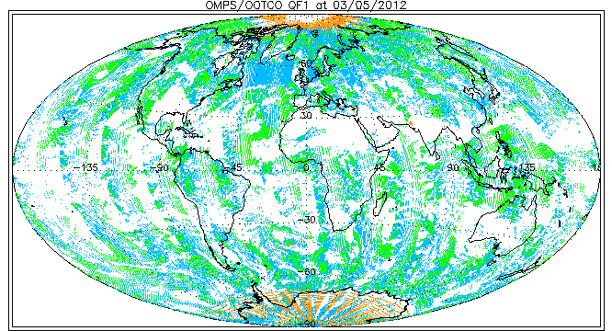
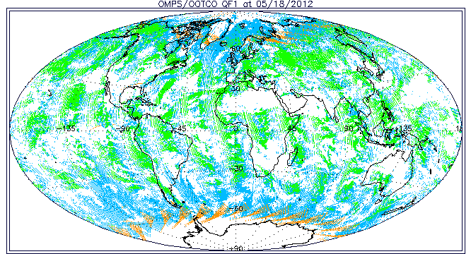
OOTCO Quality Flag 1 for March 5th (top) and May 18th (bottom), 2012: Orange is QF1=4 (input data quality is not good),
Blue is QF1=16 (Residuals are not consistent),
Green is QF1=32 (SO2 index ≥ 6 DU).
The inconsistent effective reflectivity calculations are producing widespread errors.
Notes:
Figs. From Y. Hao

Slide 38
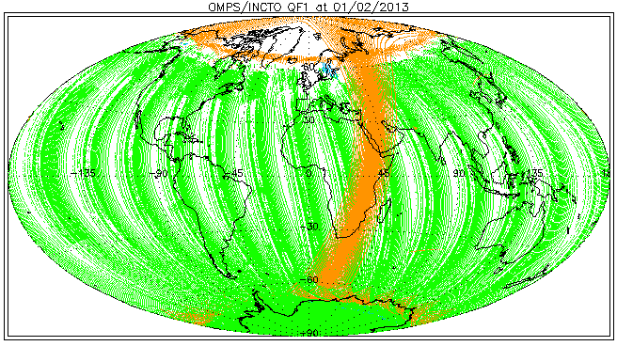
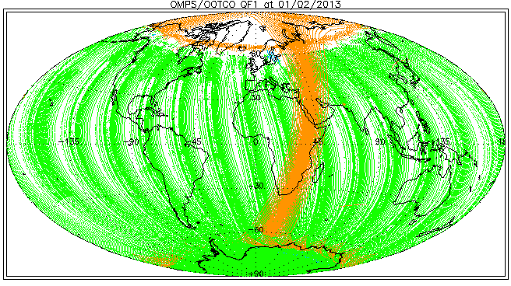
INCTO (Top) and OOCO (Bottom) Quality Flag 1 for January 2, 2013: Orange is QF1=4 (input data quality is not good),
Blue is QF1=16 (Residuals are not consistent),
Green is QF1=32 (SO2 index ≥ 6 DU).
There are no QF1=8 (O3 triplet selection is not consistent) values.
Again the change in frequency is for residual related flags. This day had an orbit that continued taking data on the night-side
Notes:
Figs. From Y. Hao

Slide 39
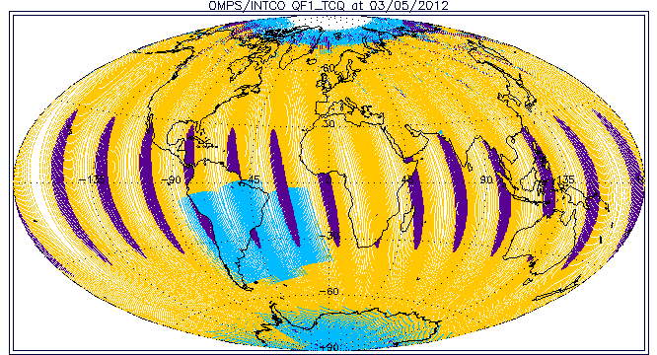
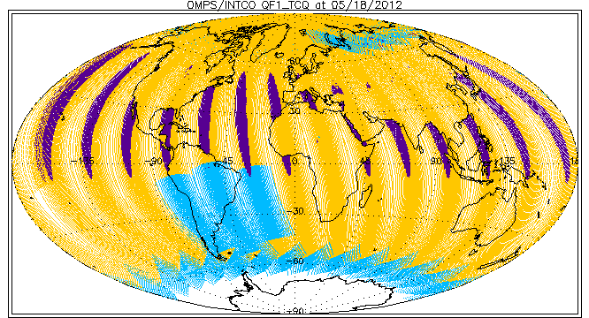
INCTO Quality Flag 1; Total Column Quality:
Orange – 3 High Quality,
Blue – 2 Medium Quality (large residue, input quality, triplet, SZA>80, SO2, SAA, or bad surface reflectivity), and Purple – 1 Poor Quality (Sun Glint, Eclipse, or Bad TOZ).
Poor quality is frequently due to Sun Glint, and Medium quality is frequently due to SAA flagging or Solar Zenith Angles greater than 80º. The white areas are regions where there is no sunlight for the FOV, so measurements can not be made. Two sets of observations are made at high latitudes for May 18th in the North so parts of earlier orbits are covered up by the results of later ones.
Notes:
Figs. From Y. Hao

Slide 40
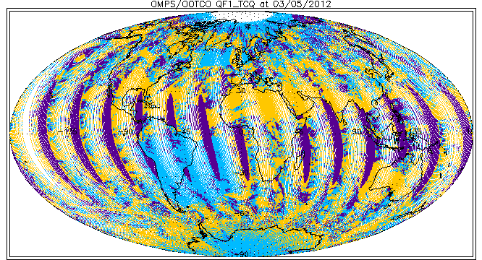
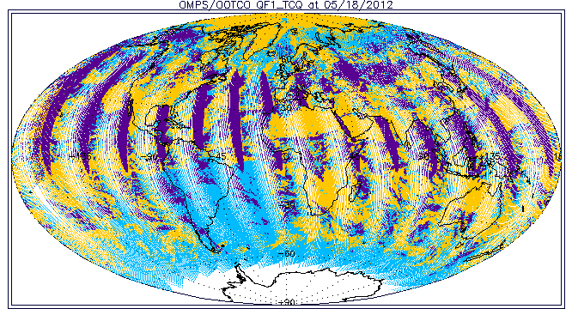
OOTCO QualityFlag 1; Total Column Quality:
Orange – 3 High Quality,
Blue – 2 Medium Quality (large residue, input quality, triplet, SZA>80, SO2, SAA, or bad surface reflectivity), and Purple – 1 Poor Quality (Sun Glint, Eclipse, High SO2, or Bad TOZ).
Poor quality is frequently due to Sun Glint or SO2, and Medium Quality flags are now present over much of the world. Two sets of observations are made at high latitudes for May 18th in the North so parts of earlier orbits are covered up by the results of later ones.
Notes:
Figs. From Y. Hao

Slide 41
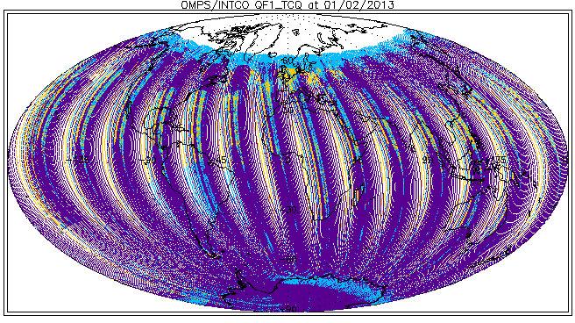

January 2, 2013 INCTO (Top) and OOTCO (Bottom) Quality Flag 1; Total Column Quality:
Orange – 3 High Quality,
Blue – 2 Medium Quality (large residue, input quality, triplet, SZA>80, SO2, SAA, or bad surface reflectivity), and Purple – 1 Poor Quality (Sun Glint, Eclipse, Bad SO2 or Aerosol Index, or Bad TOZ).
Poor quality is frequently due to SO2, and Medium quality is frequently due to SAA flagging or Solar Zenith Angles greater than 80º. The white areas are regions where there is no sunlight for the FOV, so measurements can not be made. Two sets of observations are made at high latitudes for May 18th in the North so parts of earlier orbits are covered up by the results of later ones.
Notes:
Figs. From Y. Hao

Slide 42
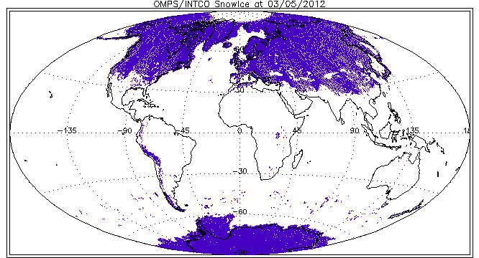
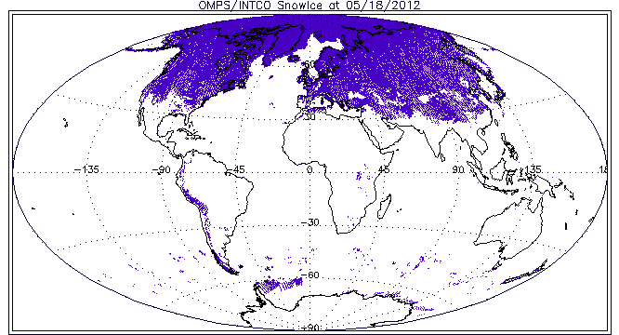
INCTO Quality Flag 2, Bit1, Purple Snow/Ice
These are the values provided in the initial pre-launch data file. They are static; they are not being properly updated. The differences between the two figures are produced solely by changes in the OMPS coverage.
Notes:
Figs. From Y. Hao

Slide 43
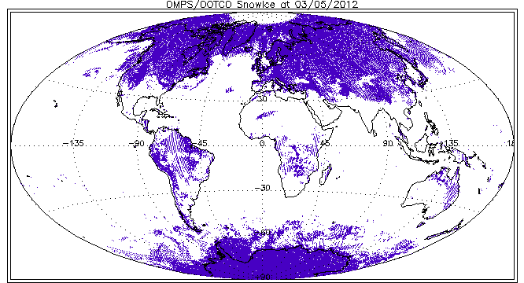
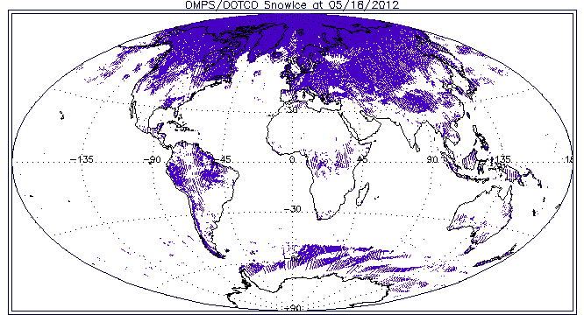
OOTCO Quality Flag 2, Bit1, Purple Snow/Ice.
The snow/ice data is not correct. This problem is under investigation.
Notes:
Figs. From Y. Hao

Slide 44
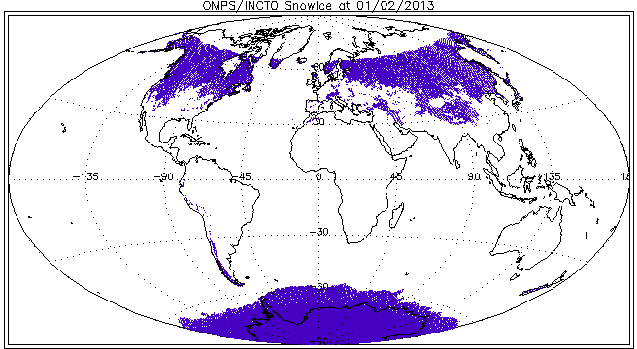
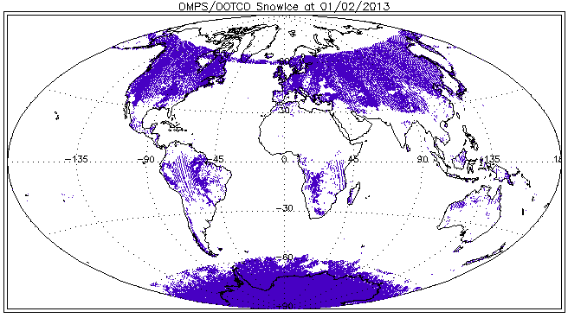
INCTO (Top) and OOTCO (Bottom) Quality Flag 2, Bit1, Purple Snow/Ice. The snow/ice for INCTO is probably the November VIIRS tiling.
The snow/ice data is not correct in the OOTCO using the NRT VIIRS, e.g., in the Amazon. This problem is under investigation.
Notes:
Figs. From Y. Hao

Slide 45
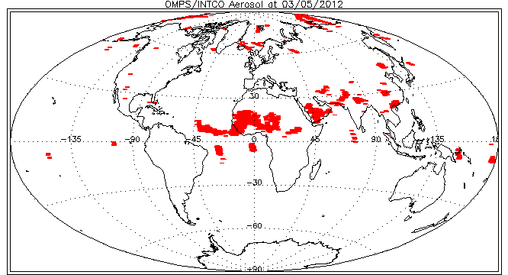

INCTO Quality Flag 2, Bit7, Red Aerosol Index limit exceeded. These are set consistent with the Aerosol Index values. The regions above the Sahara Desert and Arabian Peninsula are from elevated dust. The regions in the Equatorial Pacific are dues to cross-track differences in the biases between longer wavelengths and effects of sun glint.
Notes:
Figs. From Y. Hao

Slide 46


OOTCO Quality Flag 2, Bit7, Red Aerosol Index limit exceeded. These are set consistently with the Aerosol Index values. The Aerosol Index is sensitive to discrepancies in the effective reflectivity and to Sun glint.
The blocked region in the lower left on the lower map is where the VIIRS cloud fraction was not available and the algorithm set the cloud fraction to zero.
Notes:
Figs. From Y. Hao

Slide 47


January 2, 2013 INCTO (Top) and OOTCO (Bottom) Quality Flag 2, Bit7, Red Aerosol Index limit exceeded. These are set consistently with the Aerosol Index values. The Aerosol Index is sensitive to discrepancies in the effective reflectivity and to Sun glint.
The blocked region in the lower left on the upper map is where the VIIRS cloud fraction was not available and the algorithm set the cloud fraction to zero.
c
Notes:
Figs. From Y. Hao

Slide 48


November 23, 2012
OOTCO Ozone (Top) and Input Data Quality Flag (Bottom) during VIIRS roll maneuver. Satellite View Angles exceed 70 degrees,

Slide 49
Typical Distribution of Non-Fill Effective Reflectivity
The two figures on the next slide show the distribution of non-fill effective reflectivity values for the OOTCO (top) and INCTO (bottom) for April 6, 2012 with latitude. The two figures on the slide following it show the histograms of effective reflectivity for the two products for the same day.
The OOTCO estimates are a mixture of calculations produced by the surface reflectivity (adjusted for snow/ice fractional coverage from auxiliary data values times 95%), the VIIRS cloud fraction (times a minimum of 80%), and partial cloud calculations if no VIIRS cloud fraction is reported. Notice the plateaus of values at 80% (for cloud fractions of 1) and 95% (for snow/ice fractions of 1). The algorithm logic does not currently allow it to adjust the values downward. The IR cloud fractions are frequently much larger than those modeled for UV measurements, and the snow/ice tiles are not currently updated. These factors produce reflectivity errors that lead to large errors in the current OOTCO ozone products.
The INCTO estimates are derived directly from the OMPS UV measurements for selected channels between 330 and 380 nm. Fewer than 1% of the 120000 values computed in the INCTO product for this day are greater than 100 and only four values are less than 0. 2.5 % of the effective reflectivity have fill values with most of these occurring for SZA ≥ 88º and all are for cases with N-values containing fill – no other error flags are set by the algorithm for fill N-value cases. The algorithm does not currently adjust the surface reflectivity properly for low reflectivity cases but this logic is included in the next build scheduled for implementation in Fall of 2012.
Notes:
Figure from L. Flynn
119815 119445
106026 105744

Slide 50


Slide 51


Slide 52
OOTCO/INCTO Differences on Next Slide
Top Left – Cloud Top Pressure differences (UV climatology versus VIIRS IR estimates)
Bottom Right – Snow/Ice differences (Monthly tiles versus near-real time both from VIIRS)
Top Left – Cloud Fraction differences (Most are produced by Snow/Ice differences and how the pressure is handled for cloudy scenes over snow)
Bottom Right – Total Ozone differences (These are a result of the different cloud heights and interacting with the assumed below cloud ozone column and reflectivity contributions to the ozone sensitive channel)

Slide 53




Cloud Top Pressure Differences Cloud Fraction Differences
Total Ozone Differences Snow/Ice Differences
Notes:
Figures from Y. Hao

Slide 54
OOTCO/INCTO Ozone Differences on the next Slide
We expect that the IR Cloud Top Pressures currently used in OOTCO will usually be smaller (higher clouds) than the UV climatology values used in INCTO. This will lead to differences in the retrieved total ozone, both for the column above the assumed cloud top and for the ghost column below it. These differences will be greater when a cloud covers a larger fraction of the scene. The four plots on the following slide examine this for November 11, 2012.
Top Left, Ozone differences in DU plotted versus Cloud Top Pressure differences in atm.
Bottom Left, Ozone differences in DU plotted versus INCTO Cloud Fraction.
Top Right, Ozone Differences in DU plotted versus Cloud Fraction differences.
Bottom Right, Ozone Differences in DU plotted versus the product of the INCTO Cloud Fraction times the Cloud Top Pressure difference in atm.

Slide 55




Ozone differences between OOTCO and INCTO versus
CTP difference Cloud Fraction difference
INCTO Cloud Fraction CTP diff * CF(INCTO)
Notes:
Figure from Y. Hao

Slide 56
OMPS NM OOTCO Minimum Reflectivity Cross-Track Dependence
The lines in the figure on the next slide show the weekly, one-percentile effective reflectivity values for the months of November and December for all the data in a latitude/longitude box in the Equatorial Pacific versus cross-track view position. (17 is the nadir position and 0 and 34 are the extreme viewing angles.) The December values are given by the lower four lines and are offset -2% relative to the y-axis scale on the left. We expect the one-percentile effective reflectivity values to be approximately 4% for this region of the globe from climatological measurements made by other instruments. The larger values observed here are due to inaccuracies in the radiance calibration. Some of the changes between the two months are due to a lack of adjustment for the Earth/Sun distance in the solar spectrum. This particular, annually-varying bias was rectified with changes in the code in early 2013.

Slide 57


OOTCO One-Percentile Reflectivity
Cross-Track Dependence for November/December
Reflectivity, %
|Lat|<20
Lon<-100
Black Week 1
Blue Week 2
Green Week 3
Red Week 4
Shifted down 2%
Cross-track View Position
Notes:
Figure from W. Yu
http://www.star.nesdis.noaa.gov/icvs/PROD/proOMPSbeta.TOZ_INCTO.php

Slide 58
OMPS NM OOTCO/INCTO Aerosol Index Cross-Track Dependence
The lines in the figure on the next slide show the weekly, average aerosol index values for the months of November for all the data in a latitude/longitude box in the Equatorial Pacific versus cross-track view position. (17 is the nadir position and 0 and 34 are the extreme viewing angles.) The INCTO values are given by the upper four lines and are offset +1% relative to the y-axis scale on the left. The cross-track variation is probably related to calibration uncertainty for the radiances relative to the irradiances with some contributions from sun glint.

Slide 59


OOTCO/INCTO Aerosol Index Cross-Track Dependence for November 2012
INCTO shifted up 1 unit
OOTCO
|Lat|<20
Lon<-100
Black Week 1
Blue Week 2
Green Week 3
Red Week 4
Weekly average Aerosol Index values, for November for a latitude / longitude box in the Equatorial Pacific versus cross track pixel..
Notes:
Figure from W. Yu
http://www.star.nesdis.noaa.gov/icvs/PROD/proOMPSbeta.TOZ_INCTO.php

Slide 60


OOTCO Cross-Track Ozone Dependence
|Lat|<20
Lon<-100
Black Week 1
Blue Week 2
Green Week 3
Red Week 4
Total Ozone, DU
2%
OOTCO Ozone
INCTO Ozone – 20 DU
November weekly-mean total column ozone (OMPS Nadir Mapper EDR Multiple-Triplet algorithm retrievals) as a function of the cross-track view angle for a Latitude/Longitude in the Equatorial Pacific. The persistent cross-track bias is caused by deficiencies in the initial calibration/solar data values. The INCTO results are shifted down 20 DU relative to the scale on the left vertical axis.
Notes:
Figure from W. Yu
http://www.star.nesdis.noaa.gov/icvs/PROD/proOMPSbeta.TOZ_INCTO.php

Slide 61
Total Ozone Maps for INCTO and OOTCO
The false color daily maps (October 15, 2012) of Total Column Ozone on the next two slides show the expected distribution of global ozone values for October including the Antarctic Ozone Hole. The OOTCO map (first) has greatly varying quality depending on the consistency of the VIIRS cloud fraction for the first half of the day followed by a transition to the use of a measurement-based calculation for the second half of the day (the Western Hemisphere).
Notes:
OMI results from ftp://toms.gsfc.nasa.gov/pub/omi/images/global/Y2012/IM_ozgbl_omi_20120512.png

Slide 62

Sample OOTCO Total Ozone Map
Notes:
Figure from W. Yu
http://www.star.nesdis.noaa.gov/icvs/PROD/proOMPSbeta.TOZ_OOTCO.php

Slide 63

Sample INCTO Total Ozone Map
Notes:
Figure from W. Yu
http://www.star.nesdis.noaa.gov/icvs/PROD/proOMPSbeta.TOZ_INCTO.php

Slide 64
Total Ozone Maps
OOTCO, INCTO, OMI, GOME-2 & V8TOZ
The false color daily maps (Nov 29, 2012) of Total Column Ozone on the next five slides show the expected distribution of global ozone values for late November. The OOTCO map (first) has varying quality depending on the consistency of the VIIRS cloud top pressure and NRT snow/ice imputed reflectivity values as compared with the UV measurements used for INCTO (second). Both maps
show some “scallopping” due to the cross-track bias about each of the 14 orbital tracks. The distributions of ozone reported by the INCTO/ OOTCO are similar to that seen in the EOS Aura OMI map and MetOp-A GOME-2 total ozone products for the same day on the third and fourth slides, and the OMPS Version 8 retrievals on the fifth slide.
Notes:
OMI results from ftp://toms.gsfc.nasa.gov/pub/omi/images/global/Y2012/IM_ozgbl_omi_20120512.png

Slide 65

Sample OOTCO Total Ozone Map
Notes:
Figure from W. Yu
http://www.star.nesdis.noaa.gov/icvs/PROD/proOMPSbeta.TOZ_OOTCO.php

Slide 66

Sample INCTO Total Ozone Map
Notes:
Figure from W. Yu
http://www.star.nesdis.noaa.gov/icvs/PROD/proOMPSbeta.TOZ_INCTO.php

Slide 67

Sample EOS Aura OMI Total Ozone Map
Notes:
OMI results from ftp://toms.gsfc.nasa.gov/pub/omi/images/global/Y2012/IM_ozgbl_omi_20120512.png

Slide 68

Sample MetOp-A GOME-2 Total Ozone Map
Notes:
Figure from W. Yu for NOAA Operational Version 8 product.

Slide 69

Sample OMPS V8TOZ Total Ozone Map
Notes:
OMPS results from http://www.star.nesdis.noaa.gov/icvs/PROD/proOMPSbeta.TOZ_OOTCO.php
OMI results from ftp://toms.gsfc.nasa.gov/pub/omi/images/global/Y2012/IM_ozgbl_omi_20120512.png

Slide 70
Time Series of Equatorial Pacific zonal means for INCTO and OOTCO versus other satellite measurements
The next two slides show time series of zonal means for ozone estimates from NOAA-18 and NOAA-19 SBUV/2, MetOp-A GOME-2, NASA EOS Aura OMI and JPSS S-NPP OMPS INCTO, OOTCO and V8. The SBUV/2 and GOME-2 estimates are from Version 8 algorithms. The GOME-2 has not been adjusted for known degradation in the scan mirror.
The figure on the first slides shows a bias of ~3% between the OMPS and SBUV/2 products. This is just below the accuracy performance limit.
The second figure shows that the OOTCO product drop down in the middle of October after the change from using the VIIRS cloud fraction.

Slide 71

Time series of daily zonal mean ozone for Pacific Box for 2012

Slide 72

Time series of daily zonal mean ozone Pacific Box for October
Notes:
Figure from W. Yu.
The figure below shows that as of October 16, the OMPS total ozone products are running approximately 3% lower
than the SBUV/2 operational products. Such a difference is large enough, and our understanding of the measurements
and algorithms is good enough that we should be able to explain most of it. We will (although some of the explanation
may be that the instruments day 1 calibration differ by 1%). That said the accuracy requirement at 245 DU is 9.5 DU
and the differences between the SBUV/2 and the OMPS are smaller than that. Here are the Accuracy requirements:
1. O3 < 250 DU Error < 9.5 DU
2. 250 DU < O3 < 450 DU Error < 13 DU
3. O3 > 450 DU Error < 16 DU
The two questions as I see them are whether we think we can identify and correct the sources of these differences.
The products will be stable and have known defects until we change things. That is, we are in control of how and
when these products will be improved and can alert the users on these events and how the products will change.
This seems appropriate for a Provisional Product to me.
So what sources of differences are known and what are we doing to remove them?
1. OMPS NM Stray Light -- open DR with corrections in development.
There is an existing module in the OMPS system to make stray light corrections. The SDR team is testing/refining
a set of parameters to replace the current 0-filled table of adjustment coefficients.
2. OMPS NM Radiance Coefficients, 300-310 nm overlap, Day 1 solar
The OMPS NM IDPS SDR algorithms are currently using the stray light corrected radiance
calibration coefficients. These should give more consistent radiance/irradiance ratios
once the correction is in place. We will revisit the comparisons between the OMPS NP
and OMPS NM in the 300-310 nm interval where both make measurements. The
influence of stray light on the solar measurements will also be checked.
3. The operational SBUV/2 are using Radiative Transfer Look Up Tables with an older set of
ozone cross-sections. We will compare the operational V8 products to the V8.6 which uses the
new cross sections (and was used for OMI calibration) to determine the contribution of this
data to the OMPS differences. We are adding the OMI daily means to the Pacific Box comparisons.
We should have a new set of figures next week.
4. The OMPS NM effective reflecitivity products are running at 1 to 2% higher than expected
from ocean clear-sky scenes. The cause, effects and corrections are under study. We also use
high reflectivity (Greenland and Antarctic Ice fields) to check the calibration of the reflectivity
channel.
5. The OMPS NM IDPS ozone products have 2% cross track variations.
We can make adjustments based on this internal analysis to remove these.
6. Intra-orbit wavelength scale shift adjustments.
We will probably wait until V8 to implement this. It is a +-0.5% effect in ozone.

Slide 74

Effective Reflectivity Map for INCTO
The false color daily map (Nov 29, 2012) of Effective Reflectivity on the next slide shows the expected distribution of global values for November with high values over Greenland and low values over desert regions.
Bands of clouds are also evident. For example, there is a
feature in the western Atlantic running parallel to
The US coastline. The OMI UV
Cloud Fraction for the same
day is given to the right.
Clouds are found in consistent
locations between the two
maps.
Notes:
OMI results from http://toms.gsfc.nasa.gov/reflect/reflect_v8.html

Slide 75

Sample INCTO Effective Reflectivity Map
Notes:
Figure from W. Yu
http://www.star.nesdis.noaa.gov/icvs/PROD/proOMPSbeta.TOZ_INCTO.php

Slide 76

Sample OOTCO Effective Reflectivity Map
Notes:
Figure from W. Yu

Slide 77

Aerosol Index Map for INCTO
The false color daily map (Nov 29, 2012) of Aerosol Index on the next slide shows the expected distribution of global aerosol with high values over Northern Africa and the Middle East due to desert dust. The North-South bands evident along the
the eastern side of each orbit
are caused by cross-track
bias across the 14 orbital
tracks. The OMI Aerosol
Index for the same
day is given to the right.
Notes:
OMI results from http://toms.gsfc.nasa.gov/aerosols/aerosols_v8.html

Slide 78

Sample INCTO Aerosol Index Map
Notes:
Figure from W. Yu
http://www.star.nesdis.noaa.gov/icvs/PROD/proOMPSbeta.TOZ_INCTO.php

Slide 79

Sample OOCTO Aerosol Index Map

Slide 80
Aerosol Index Map for OOTCO
The false color daily map (May 12, 2012) of Aerosol Index on the next slide shows a very variable product with reasonable values in regions with small cloud fractions reported by VIIRS (e.g., the high Aerosol Index values over Northern Africa and the Middle East, due to desert dust, where the VIIRS cloud fraction and UV cloud fraction are both close to zero) but poor performance over most of the globe where the computed effective reflectivity does not match the UV measurements. This changes starting on October 15, 2012 as shown on the better map on the preceding slide.

Slide 81

Sample OOTCO Aerosol Index Map
Notes:
Figure from W. Yu

Slide 82



← 331-nm Channel Radiances
for the first eight orbits of OMPS Nadir Mapper measurement (end of 1/26/2012 and start of 1/27/2012). This image shows the expected range of values and variations across the orbital track and with solar zenith angles at the times of the measurements. The white circle around the North Pole is the region of polar night during the Northern Hemisphere Winter. The OMPS needs scattered sunlight to make its measurements, so there are no data there.
Effective Reflectivity →
from the multiple triplet retrieval algorithm in IDPS for the same eight orbits. The quantity represents the UV reflectivity of the clouds and surface in each Field-of-View. Again, the range of values from bright clouds to dark open ocean scenes is as expected.
Total Ozone
from the multiple triplet retrieval algorithm first guess product in IDPS for the same eight orbits for the first pass ozone retrieval (IP product without CrIS or VIIRS information). The values show some cross track variations and are offset approximately 5% from another satellite ozone product. These uncertainty levels for preliminary products are consistent with the use of prelaunch calibration parameters and tables in the initial operational system.
First Light Products are Beta Quality
Notes:
Figures from J. Niu.

Slide 83

Geolocation Verification
The image on the left above shows the OMPS-calculated UV effective reflectivity over the Persian Gulf region for 30 January 2012 for a special set of high spatial resolution measurements. The image on the right is an Aqua MODIS RGB image for the same day. Comparison of the two indicate the capability of the OMPS TC sensor to identify surface features and characteristics of 5 km or less.
From a presentation by C. Seftor/NASA NPP ST(SSAI)

Slide 84
Comparisons to MLO Dobson Station
The next slide has a time series showing the matchup overpass data from the OOTCO for Mauna Loa compared to the Dobson station measurements. The OMPS values are a weighted average of all measurements within a 1x1.06 degree^2 latitude x longitude box centered at the station.
The slide following it shows a scatter plot comparing the Dobson values for Direct Sun measurement to the matchup (Weighted Average wavg) data from OMPS and from OMI

Slide 85

March to December 2012
OOTCO is averaging ~3% above the Dobson
Satellite sees to sea level, MLO misses ~7DU
Notes:
Bob Evans NOAA/ESRL

Slide 86

Notes:
Bob Evans NOAA/ESRL

Slide 87
INCTO/OOTCO Known Product Deficiencies
Problems with fixes in the pipeline or changed over the course of the study
  Preliminary Day 1 Solar (CCR #411 Implemented the middle of June 11, 2012^)
  EDR RT LUT – corrected bandpasses (CCR #343, August 10, 2012)
  Cloud Top Pressure – new UV climatology (CCR #385, CCR #736 Mx7.0, August 10, 2012)
    Replace IR climatology in INCTO and VIIRS cloud top pressure in OOTCO
  Partial Cloud Logic – consistent surface reflectivity (DR #4266, CCR #419 October 15, 2012)
    Switched from VIIRS Cloud Fraction to measurement-based, partial-cloud estimates
    OOTCO should not be used prior to October 15, 2012
  SDR weekly dark current updates (DR #4750, etc. Started 12/22/2012)
  Adjustment to Solar spectra for varying Earth/Sun distance (DR #4798, CCR #481 in Mx6.6)
  Incorrect SO2 Coefficients (DR #4918; CCR #829 implemented 3/7/2013).
  Broken Ascending/Descending Flag (DR #4804; CCR #893 Mx7.0)
Problems under investigation / in preparation
  VIIRS Snow/Ice Data (DR #4678). New tilings under evaluation. Work on NRT product by VIIRS team.
  Ozone values out of range (infrequent TOZ > 650 DU) (DR #4692)
  Definitive Day One Solar & Radiance/Irradiance Calibration/Adjustments (DR #5047)
  Stray Light correction (DR #4907 in testing)
Longer term refinements and improvements
  Soft internal calibration/adjustments, e.g., cross track bias (DR #5047)
  Wavelength Scale and Adjustments
    Day 1 Scale (Preliminary update May 7, 2012^) and trending
    Radiance/Irradiance Doppler Shift adjustment
    Intra-orbit scale drift
^ Both of these created large discontinuities in the product performance. Similar effects can be expected as further changes enter the system.
Notes:
DRs are Discrepancy Reports. They document problems and allow management of the resources and activities to resolve them. CCRs are Configuration Change Requests. They are provide the requests to implement the solutions.

Slide 88
Timeline of major changes in OMPS Nadir Products
Problem with wavelength scale in NM February
Problem with wavelength scale in NP February (DOY error) Final data at CLASS – No.
May 7, 2012 – New OMPS NM and OMPS NP Wavelength Scales CCR #389
June 11, 2012 – New OMPS NM Day 1 Solar Irradiance CCR #411
July 17, 2012 – OMPS NP Day 1 Solar Irradiance CCR #458
August 10, 2012 – New NM RT LUT CCR #343 (Mx6.1)
August 10, 2012 – CTP to UV for INCTO CCR #385 (Mx6.2)
October 15, 2012 – OMPS NM E/S distance CCR #481 (Mx6.3)
October 15, 2012 – Partial cloud and VIIRS CF CCR #419 (Mx6.3)
TLE in use for Ephemeris Mx6.3 until emergency fix with Mx6.4
Updates to VIIRS Snow/Ice monthly Tiles with a one month lag
February 2013 – Adjust solar for Earth/Sun distance
February 2013 – IMOPO Surface Pressure limit too restrictive CCR #595 (Mx6.6)
Future
June 2013 – CTP for OOTCO CCR #736 (Mx7.0)
June 2013 – Profile and TOZ flags switched in IMOPO PCR (Mx7.0)

Slide 89
INCTO/OOTCO Summary of Findings and Recommendations
OMPS NM First Guess IP (INCTO) Status
  The INCTO product is producing reasonable values for total column ozone, effective reflectivity and aerosol index values. Most error flags are functioning as designed. Several problems with the product have been identified and there is progress on implementing corrections and adjustments.
  The OMPS Team recommends that the INCTO Product be promoted to Provisional Maturity.
Monitoring Figures are available at
http://www.star.nesdis.noaa.gov/icvs/PROD/proOMPSbeta.TOZ_INCTO.php
http://www.star.nesdis.noaa.gov/icvs/PROD/proOMPSbeta.TOZ_OOTCO.php
http://www.star.nesdis.noaa.gov/icvs/PROD/proOMPSbeta.php
  OMPS NM EDR (OOTCO) Status
  The OMPS NM EDR product (OOCTO) uses the same algorithm and measurements as the INCTO product. Differences are present because of the use of external data, e.g., CrIS Temperature Profiles and VIIRS Cloud Top Pressures are used in OOTCO in place of forecasts or climatologies. We plan to replace the VIIRS cloud top pressure initially with the UV climatology and eventually with OMPS-measurement-based estimates. We have turned off the VIIRS cloud fraction in the algorithm as applied for OOCTO as of October 15, 2012.
  The OMPS Team recommends that the OOTCO Product be promoted to Provisional Maturity. The inputs and corrections needed to improve the product further are known.
Upgrade to V8TOZ
  The team is investigating an upgrade from the OMPS EDR multiple triplet algorithm to the V8TOZ algorithm currently in use with SBUV/2, OMI and GOME-2 measurements for climate data records and operational products. As of July 1, 2012, the V8TOZ algorithm has been used to process the first five months of OMPS data independently at NOAA STAR and the NASA Ozone PEATE. The OMPS NPP Science Team is adapting OMI algorithms to create better cloud top pressures, aerosol indices and SO2 indices from the OMPS measurements for use with the V8 algorithm.

Slide 90
Comparisons of CrIS IR Ozone Products to OMPS UV Ozone Products
The next four slides show some qualitative comparisons of the IR and UV ozone products.
The IIROO product is from the IDPS combined CrIS physical retrieval.
The NUCAPS product is from the NDE sequential statistical CrIS retrieval
Both products are good over much of the Globe but have difficulty retrieving the ozone column over the cold Antarctic Plateau.
The NUCAPS product is described at
http://www.star.nesdis.noaa.gov/smcp/spb/osdpd/qadocs/
The IIROO product is described at
http://npp.gsfc.nasa.gov/science/documents.html
  OAD 474-00056_RevABaseline.pdf
  ATBD 474-00065_OAD-CrIMSS-EDR_B.pdf
  CDFCB 474-00001-04-01_CDFCB-Vol4-Part1_Rev-_Block-1-1_31Mar2011.pdf20127.pdf
The NUCAPS product is described in
www.star.nesdis.noaa.gov//smcd/spb/iosspdt/qadocs/NUCAPS_CDR/NUCAPS_ATBD.doc

Slide 91

Comparison of
CrIS IIROO (left) to OMPS INCTO (right) for October 16, 2012

Slide 92

Comparison of
CrIS IIROO (left) to OMPS INCTO (right) for October 16, 2012

Slide 93


Comparison of
CrIS NUCAPS Ozone (l) to OMPS INCTO (r) for November 2, 2012
INCTO 11/2/2012

Slide 94

Comparison of
CrIS NUCAPS Ozone (l) to OMPS INCTO (r) for November 2, 2012

Slide 97
Northrop Grumman
Algorithms and Data Products
OMPS Team Task Status
Oct 10, 2012

Slide 98



Mx6.3 Preview Data Analysis: Comparison of INCTO and OOTCO Retrievals
The difference in total column ozone retrieval between the IP and EDR (top left panel) appears to correlate with cloud fraction (top right panel). The cloud fraction difference between the IP and EDR (bottom right panel) does not show the same pattern, so this is not the primary cause of the differences. (M. Novicki and B. Sen, NGAS)

Slide 99

Mx6.3 Preview Analysis: Cause of difference in cloud fraction
M. Novicki, NGAS
Most of the differences in the cloud fraction between the IP and EDR can be explained by differences in the snow/ice fraction used by the algorithm. The snow/ice fraction used by the IP comes from the Snow/Ice Rolling Tile, while the snow/ice fraction used by the EDR is derived from the VIIRS Snow and Ice EDRs. (M. Novicki and B. Sen, NGAS)

Slide 100

Mx6.3 Preview Analysis: Comparison of difference in total column ozone with cloud fraction
While the differences in total column retrievals between the IP and EDR appear to be correlated (see slide 1), the comparison shown above does not qualitatively show a correlation. Further statistical analysis needs to be done to determine if any correlation exists. This analysis is based on only two orbits of data and may show a different trend when examined over a whole day. (M. Novicki and B. Sen, NGAS)

