Slide 1
Justification for CrIMSS EDR Provisional Maturity Presented: Jan. 17, 2013 (updated Jan. 18th, 2013) (cover page only updated March 21, 2013)
ADR #: 7089
CCR # 474-CCR-13-0923
DRAT discussion: March 12, 2013
AERB presentation: March 27, 2013
Christopher Barnet, former CrIMSS EDR Validation and Algorithm Lead
Tony Reale, acting CrIMSS EDR Validation and Algorithm Lead
Significant inputs were made from the entire CrIMSS EDR Algorithm and Validation Team Members.

Slide 2
Outline of this presentation
CrIMSS EDR Team (3-slides)
Users of CrIMSS EDR (2-slides)
Provisional EDR Maturity Definition (1 slide)
Summary of CrIMSS EDR (4 slides)
CrIMSS EDR requirements (3 slides)
SIDEBAR: Discussion on AVMP statistics definition (7 slides)
History of Algorithm Changes, DR Summary (6 slides)
Provisional Maturity Evaluation (35 slides)
Known issues with the Provisional CrIMSS EDR (3 slides)
Additional supporting documentation (2 slides)
Provisional Justification Summary (2 slides)
Future plans (1 slide)
Conclusions (1 slide)

Slide 3
CrIMSS EDR Team Members’ Roles and Responsibilities (part of CrIMSS EDR budget)
Lead for Activity | Organization | Task
Chris Barnet | NOAA/NESDIS/STAR | CrIS/ATMS EDR algorithm lead (Wilson) and validation (Nalli, Xiong)
Mitch Goldberg (C. Barnet) | NOAA/NESDIS/STAR | NGAS-code analysis (Divakarla, Tan)
Anthony Reale | NOAA/NESDIS/STAR | NPROVS operational RAOB comparisons
Ralph Ferraro | NOAA/NESDIS/STAR | Precipitation Flag
Lead for Activity | Organization | Task
Allan Larar | NASA/LaRC | Comparisons to aircraft (S-HIS, NAST-I) EDRs
Xu Liu | NASA/LaRC | CrIMSS EDR Algorithm Validation (Kizer)
Hank Revercomb | SSEC | AVMP/AVTP validation (Knuteson), AVTP/AVMP validation (Li)
Dave Tobin | SSEC | ARM-RAOBS at NWP, SGP, NSA
Larrabee Strow | UMBC | OSS validation and comparisons to SARTA
Brown=funding reduced in FY13, RED = not funded in FY13,
GREEN = FY13 funding removed from CrIMSS-EDR team
3

Slide 4
External CrIMSS EDR members of validation team (not funded by CrIMSS EDR budget)
SDR/EDR | Lead for Activity | Organization | Task
ATMS SDR, CrIS SDR, CrIMSS EDR | Degui Gu / Denise Hagan / Xia-Lin Ma | NGAS | EDR /SDR Validation, code integration
ATMS TDR/SDR | Sid Boukabara | NOAA/STAR | MiRS EDR
CrIMSS EDR | Lars Peter Riishojgaard | JCSDA | NCEP analysis
CrIMSS SDR | Steven Beck | Aerospace Corp. | RAOB,LIDAR
CrIMSS SDR | Steven English | UKMET | UKMET analysis
CrIMSS SDR | William Bell | ECMWF | ECMWF analysis
AVTP/AVMP | Steve Freidman | NASA/JPL | Sounder PEATE
CrIMSS SDR | Ben Rustin | NRL | NOGAPS/NAVDAS analysis
4

Slide 5
CrIMSS EDR Team (3/3)
STAR coordinates the algorithm activities
ensures algorithm changes are consistent with algorithm architecture and the DPA/DPE change process.
provides datasets and methodologies to the team to ensure a consistent analysis.
This presentation summarizes the work of the entire algorithm and validation team.
Individual team members have made significant contributions (figures and analysis) during telecons and meetings.
STAR has consolidated these contributions from individual team members into this document.
As a result, many of the figures and analysis shown are from STAR.
This should NOT be misconstrued as a lack of contribution by any individual member of the team.
See list of AMS presentations under “Additional Supporting Documentation” for some of the individual contributions.

Slide 6
Users of CrIMSS EDR (1/2) ATMS/CrIS SDRs and Sounding EDR Products
U. S. Users:
AWIPS-II – Advanced Weather Interactive Processing System (Brian Gockel)
NCEP- National Centers for Environmental Prediction (Jim Jung/Dennis Keyser)
GMAO- Global Modeling and Assimilation Office (Emily Liu)
NRL – Naval Research Laboratory (Ben Ruston)
FNMOC – Fleet Numerical Meteorology and Oceanography Center (Yiping Wang)
STAR – Center for Satellite Applications and Research (Tony Reale, Murty Divakarla)
CLASS - Comprehensive Large Array-data Stewardship System (John Bates)
Foreign Users:
UK Met Office (Nigel Atkinson)
JMA- Japan Meteorological Agency (Yoshiaki Takeuchi)
ECMWF- European Center for Medium range Weather Forecasting (Tony McNally)
DWD- Germany’s National Meteorological Service (Reinhold Hess)
Meteo-France- France’s National Weather service (Lydie Lavanant)
CMC- Canadian Meteorological Center (Louis Garand)
EUMETSAT – Simon Elliott

Slide 7
Users of CrIMSS EDR (2/2) In reality, CrIMSS EDR has a very limited user base
NOAA-TOAST product considering use of CrIMSS O3-IP (within NDE)
AWIPS has decided to use the NOAA-Unique CrIS/ATMS Processing System (NUCAPS) products
Desire 100 level product
Desire continuity with IASI product EDR formats
Desire rapid R2O environment
NUCAPS had a successful Alg. Readiness Review on Jan. 14, ready for operations
Product will be available to users from CLASS in summer 2013
CrIMSS-EDR is a baseline operational product
Physical-only 1DVAR approach is unique for hyperspectral IR
Can explore capabilities for NWP applications.
Retrievals are a “test-bed” for exploitation of CrIS radiances.
These capabilities are usually imbedded directly into NWP
Other developers use it as a “standard” to explore trade-offs in methodologies
Historically, the users of these kinds of products are varied (e.g., climate, air-quality, process studies, etc.)
Users tend to be access data as needed for their study, not a 24/7 user.
AIRS EDR products are used in ~30-40 publications/year in recent years.
AIRS project has identified 100’s of unique users of it’s EDR standard and support products; however, it is not clear how much volume of data they use.
NASA/AIRS team reprocesses the entire Aqua/AIRS dataset at maturity level transitions (v3 beta, v4 provisional, v5 stage.1, v6 stage.2, etc.) → could attract users.

Slide 8
Provisional EDR Maturity Definition (1/1) (adapted from Dec. 18, 2012 ADP guidance)
Product quality may not be optimal.
Product accuracy is determined for a broader (but still limited) set of conditions.
No requirement to demonstrate compliance with specifications.
Incremental product improvements are still occurring.
Narrative, listing and discussing known errors.
All DRs are identified and prioritized
Pathway towards algorithm improvements to meet specifications is demonstrated.
Version control is in effect.
Description of the IDPS algorithm version and LUTs/PCTs versions used to generate the product validation materials.
ATBDs are accurate, up-to-date and consistent with the product running.
General research community is encouraged to participate in the QA and validation of the product, but need to be aware that product validation and QA are ongoing.
DPA will submit readme document to CLASS.
Users are urged to consult the EDR product status document prior to use of the data in publications.
Identify known deficiencies regarding product quality.
May be replaced in the archive when the validated product becomes available.
Technical evaluation of limited data reprocessing is presented.
Ready for operational evaluation.
Key NOAA and non-NOAA end users are identified and feedback requested

Slide 9
Summary of the CrIMSS EDR (1/4)
The CrIMSS EDR algorithm utilizes all of the radiances from CrIS and ATMS within a CrIS field-of-regard (FOR) to produce a single sounding of the AVTP, AVMP, and O3-IP.
The FOR is derived from ~25 ATMS fields-of-view (FOV) that are optimally averaged along with an optimal spatial combination of the 9 CrIS FOVs (called cloud clearing) within a single interferogram sweep.
The AVPP product is derived from geopotential height computed from AVTP and AVMP.
The CrIMSS EDRs are heavily dependent on the upstream SDRs as well as empirically derived bias corrections (a.k.a. tuning) with respect to the CrIMSS forward model (called the Optimal Spectral Sampling (OSS) model).
As calibration of the CrIS or ATMS SDRs improves, so does the quality of the CrIMSS EDR.

Slide 10
Summary of the CrIMSS EDR (2/4)
CrIS RDR
CrIS SDR
Apodization
CrIMSS EDR Processing Code
ATMS RDR
ATMS TDR
Remap SDR
ATMS SDR
GFS
Ancillary
Look-up Tables
CrIS Blackman-Harris apodized radiances and ATMS spatially convolved (i.e., Backus Gilbert) radiances are used to produce CrIMSS EDR products.
Configurable Parameters
Notes:
Ancillary
GFS forecast surface pressure, lapse rate, and air temperature (for topography corrected surface pressure)
Look-up tables
DEM for surface altitude
Infrared and Microwave OSS coefficients
Local Angle Correction
IR emissivity and reflectivity covariance
MW emissivity covariance
AVTP and AVMP and Ozone covariance

Slide 11
Summary of CrIMSS EDR (3/4)
Preprocessed CrIS, ATMS, GFS
Initialization
Preprocessing
ATMS R’s Available?
No
NWP First Guess
Next FOR
Yes
No
2-stage ATMS-only Retrieval
Yes
All FOR finished?
EDR Post Processing
42L AVTP, 22L AVMP
100L MW-only IP
Both of these are used for validation
No
CrIS R’s Available?
Quality Control
Yes
ATMS + CrIS retrieval
.or.
NWP + CrIS retrieval
Scene Classification
100L AVTP & AVMP IP

Slide 12
Summary of CrIMSS EDR (4/4)
The CrIMSS EDR derives AVTP, AVMP, AVPP, O3-IP, surface temperature, surface emissivity simultaneously.
AVTP reconstructed from 20 EOF’s, AVMP from 10 EOF’s
Also 1 surface temperature, 5 MW EOF’s, 12 IR emissivity and reflectivity hingepoints, MW cloud top pressure and cloud liquid water path
These products are not currently in HDF5 file(s)
There is an inter-dependence within products
Therefore, entire atmospheric state needs to be assessed in order to validate these products.
Assumption for EDR validation is that CrIS and ATMS SDRs are calibrated.
Beta versions of SDR will be used to help algorithm and instrument assessments during EOC
Assessment is “hierarchal” using NWP model(s) and operational RAOBs for global assessment and dedicated radiosondes for detailed site characterization.
Characterization improves as more in-situ data is acquired.

Slide 13
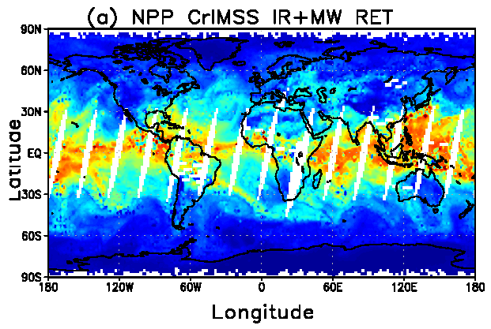
CrIMSS EDR Requirements (1/3)
Atmospheric Vertical Moisture Profile (AVMP).
Used for initialization of high-resolution NWP models, atmospheric stability, etc.
Lower tropospheric moisture layers are no longer Key Performance Parameters (KPPs) .
Parameter (KPP in Blue) | IORD-II, JPSS-L1RD
AVMP Partly Cloudy, surface to 600 mb | Greater of 20% or 0.2 g/kg
AVMP Partly Cloudy, 600 to 300 mb | Greater of 35% or 0.1 g/kg
AVMP Partly Cloudy, 300 to 100 mb | Greater of 35% or 0.1 g/kg
AVMP Cloudy, surface to 600 mb | Greater of 20% of 0.2 g/kg
AVMP Cloudy, 600 mb to 300 mb | Greater of 40% or 0.1 g/kg
AVMP Cloudy, 300 mb to 100 mb | Greater of 40% or 0.1 g/kg
Example of AVMP (shown as total precipitable water) on May 15, 2012 from the CrIMSS off-line EDR
Results are from the coupled algorithm without QC
RGB Image shows dense smoke (high absorption) in northwest, north central and central coastal portions of image.
13

Slide 14
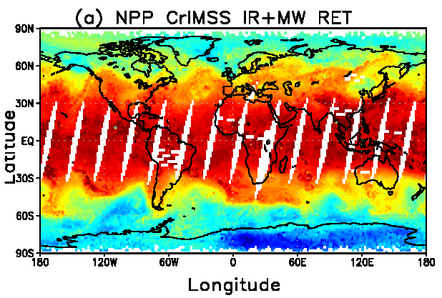
CrIMSS EDR Requirements (2/3)
Atmospheric Vertical Temperature Profile (AVTP).
Used for initialization of high-resolution NWP models, atmospheric stability, etc.
Lower tropospheric temperature are no-longer KPPs.
Parameter (KPP in Blue) | IORD-II, JPSS-L1RD
AVTP Partly Cloudy, surface - 300 mb | 1.6 K/1-km layer
AVTP Partly Cloudy, 300 to 30 mb | 1.5 K/3-km layer
AVTP Partly Cloudy, 30 mb to 1 mb | 1.5 K/5-km layer
AVTP Partly Cloudy, 1 mb to 0.5 mb | 3.5 K/5-km layer
AVTP Cloudy, surface to 700 mb | 2.5 K/1-km layer
AVTP Cloudy, 700 mb to 300 mb | 1.5 K/1-km layer
AVTP Cloudy, 300 mb to 30 mb | 1.5 K/3-km layer
AVTP Cloudy, 30 mb to 1 mb | 1.5 K/5-km layer
AVTP Cloudy, 1 mb to 0.05 mb | 3.5 K/5-km layer
Example of AVTP at 500 hPa on May 15, 2012 from the CrIMSS off-line EDR
Results are from the coupled algorithm without QC
RGB Image shows dense smoke (high absorption) in northwest, north central and central coastal portions of image.
14

Slide 15
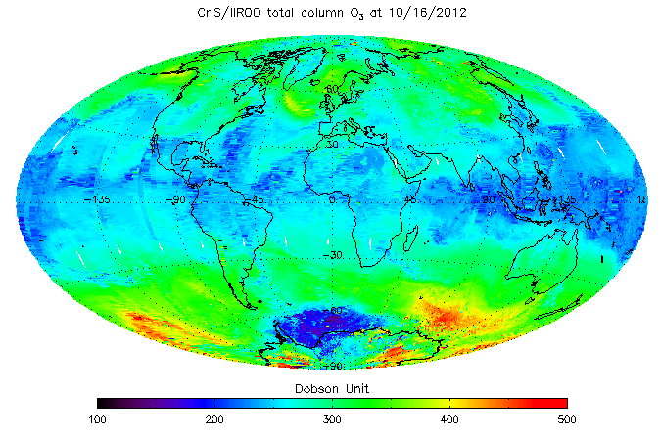
Overview of CrIMSS EDR Products
Pressure product is a EDR derived product that requires validation.
Ozone is an intermediate product (IP) used by the OMPS team.
CO, CH4 and CO2 are pre-planned product improvements(P³I)
SOAT has recommended full-resolution RDR’s for CrIS SW and MW bands to support these products..
Example of CrIMSS total column ozone IP product (day+night) from CrIS for Oct. 16, 2012.
Parameter (P³I in Blue) | IORD-II / JPSS-L1RD
Pressure Profile | 4 mb threshold, 2 mb goal
Ozone IP | 20% precision for ~5 km layers from 4 hPa to 260 hPa
CH4 (methane) column | 1% ± 5% / 1% ± 4% (precison ± accuracy)
CO (carbon monoxide) column | 3% ± 5% / 35% ± 25% (precision ± accuracy)
RGB Image shows dense smoke (high absorption) in northwest, north central and central coastal portions of image.

Slide 16
Discussion on AVMP statistic definition (1/7) How Statistics are computed
In the following figures I used ECMWF as the truth water
q_tru, given as gm/cm^2 within 2-km statistical layers
Layer boundaries are shown as horizontal dotted line on figures
The retrieval water, q_ret, is an old v5 AIRS run (Sep. 2008) on ~5000 accepted cases from Sep. 2, 2002 observations.
Statistics of % water error, g = (q_ret-q_tru)/q_tru, are
%RMS = 100*SQRT{sum{w*g²}} / SQRT{sum{w}}
%BIAS = 100*sum{w*g} / sum{w}
%SDV = SQRT{%RMS² - %BIAS²}
Historically, for %RMS w=(q_tru)² and %BIAS used w=q_tru
This creates a mathematic inconsistency and %SDV is not well-behaved
Weighting by (q_tru)² was originally proposed so that polar cases, presumed to have high errors, would not dominate the statistic

Slide 17
Discussion on AVMP statistic definition (2/7) Investigated 3 Methods of Weighting
Ran an experiment in which 3 weights were used
W1 = 1
W2 = q_tru
W3 = (q_tru)²
There is no change in the profiles themselves
Only difference in the figures on the next page are in the statistic itself
Level-1 requirements document is sufficiently vague
Historically, these requirements were derived from the w=q_tru² weighting for RMS from AIRS simulation experiments.

Slide 18
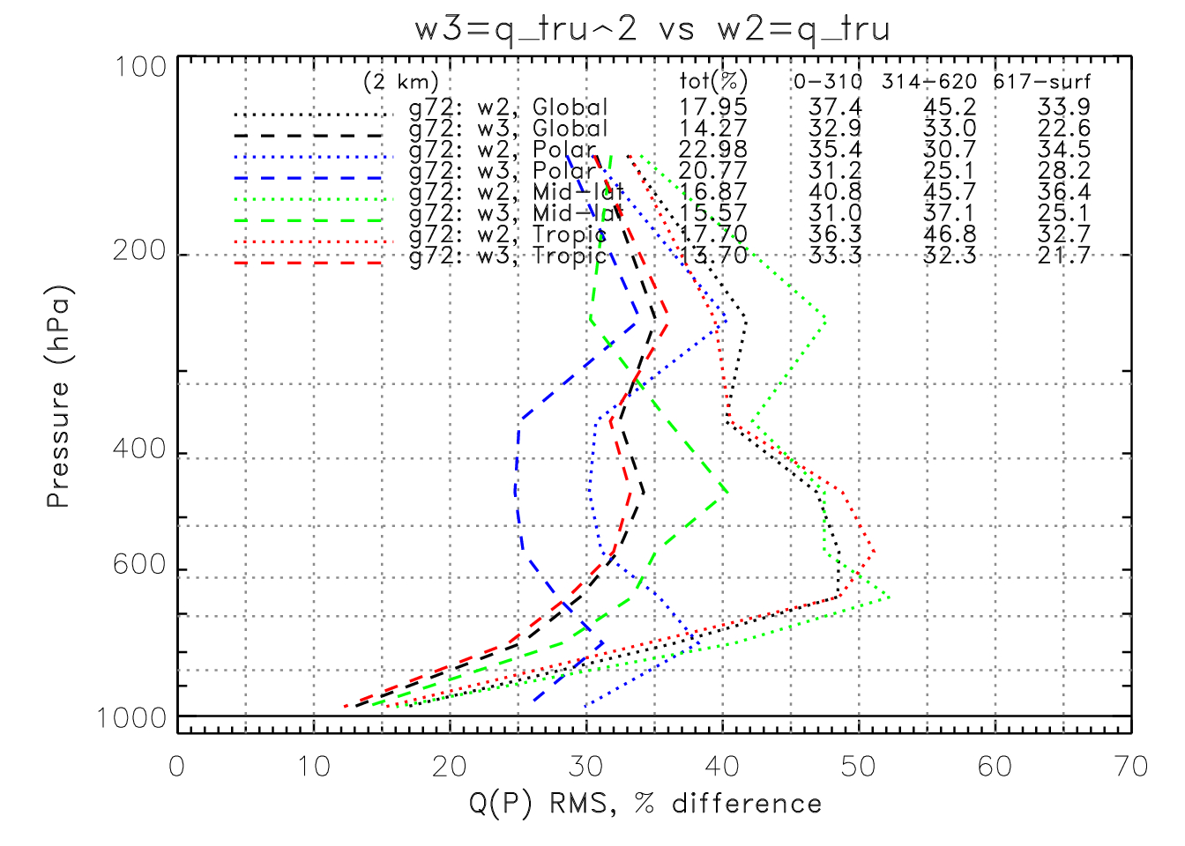
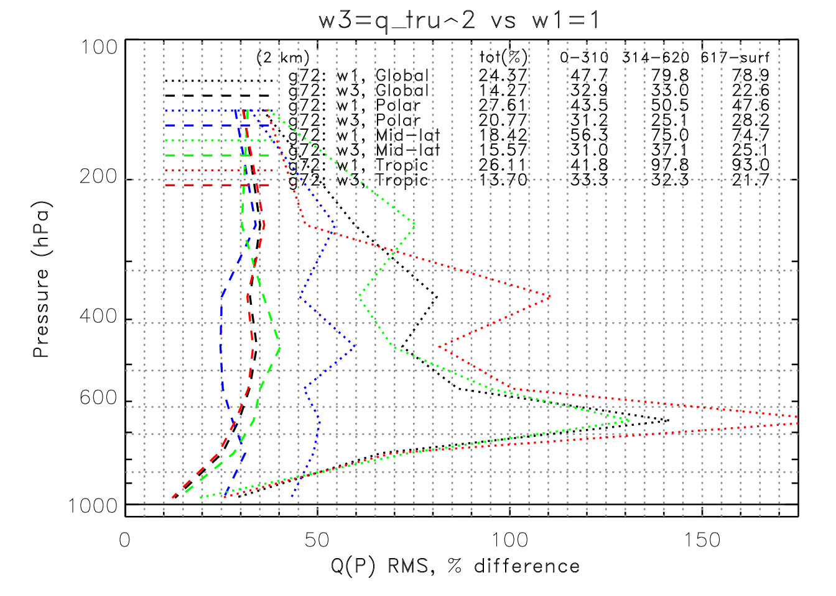
Discussion on AVMP statistic definition (3/7)
Results from 3 Methods of Weighting
In the plots below the dashed lines are for w3=q_tru^2 for global (black), polar(blue), mid-latitudes (green), and tropical (red) cases.
Alternative weightings are shown as dotted lines. On the left are RMS statistics for w2=q_tru and on the right are for w1=1.
Statistics are computed for the “2-km” layering scheme (dotted horizontal lines)
Obviously, the w2=q_tru and w1=1 would cause us to not meet requirements.
In boxes at left are the average from 300-600 and 600-surf
Global statistic is Summarized below
 | 300-600 | 600-surf
L1RD | 35% | 20%
W1 | 80% | 79%
W2 | 45% | 34%
W3 | 33% | 23%
As weight goes from w3 (dashed lines) to w2 (dotted on left) to w1 (dotted on right) the statistics get worse (see table)

Slide 19
Discussion on AVMP statistic definition (4/7)
What are the implications?
These results were somewhat surprising and confirmed what Bomin Sun had showed with the RAOB statistics
But, the statistic for the polar cases is least sensitive to the choice of weighting than mid-latitude and tropical case.
The original thinking that the q_tru^2 weighting would lessen the impact of polar (i.e., very cold) cases is not the main contribution to higher statistics for w=q_tru or w=1 weighting
Polar cases don’t seem to be a problem
But, since water decreases rapidly with altitude this effect is more in the middle troposphere
Decided to take a closer look at the 500-600 hPa layer

Slide 20
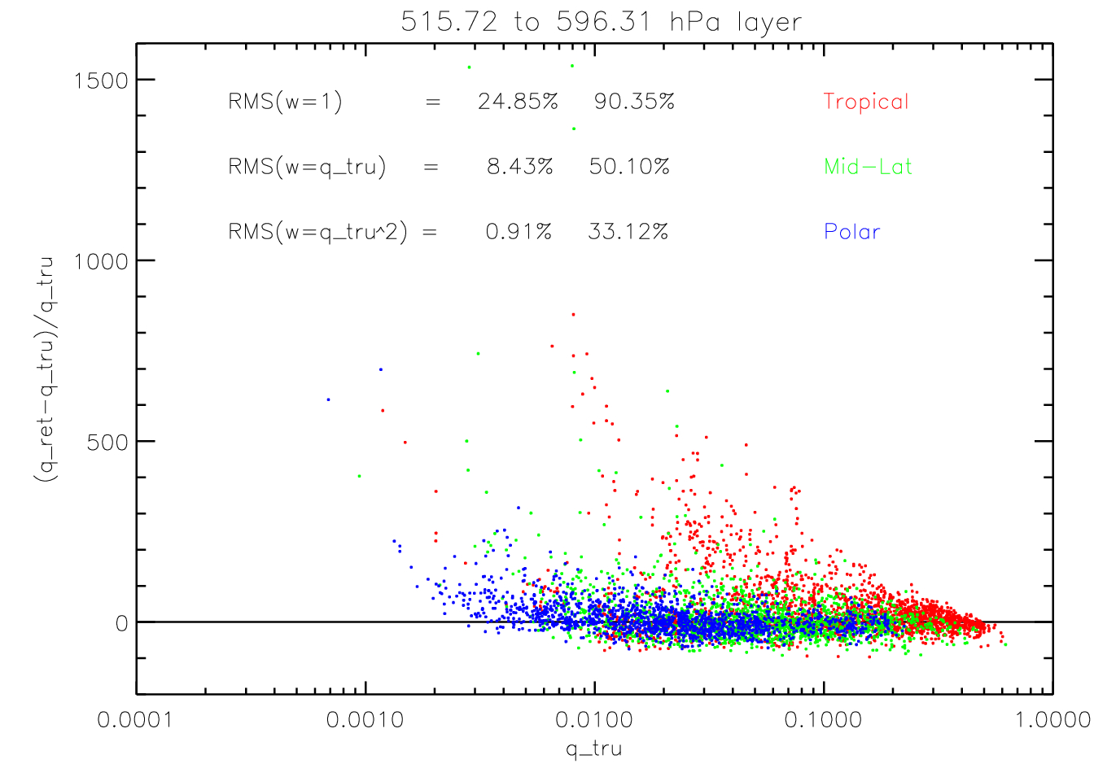
Discussion on AVMP statistic definition (5/7)
A detailed look at 550 mbar region
Below is a scatter plot of (g vs q_tru) the individual retrievals for the 515-600 hPa layer. The three colors show cases for tropical (red), mid-latitude (green), and polar (blue).
Also shown is the %bias and %rms statistic for the 3 weighting schemes for the global ensemble.
Circled point will be looked in the next slide
Note that in each latitude band (red, green, blue) there are large outliers, but these outliers and the overall error tends to increase for small q_tru in this layer.
Also, there are more positive outliers (wet retrieval) than there are negative outliers.

Slide 21
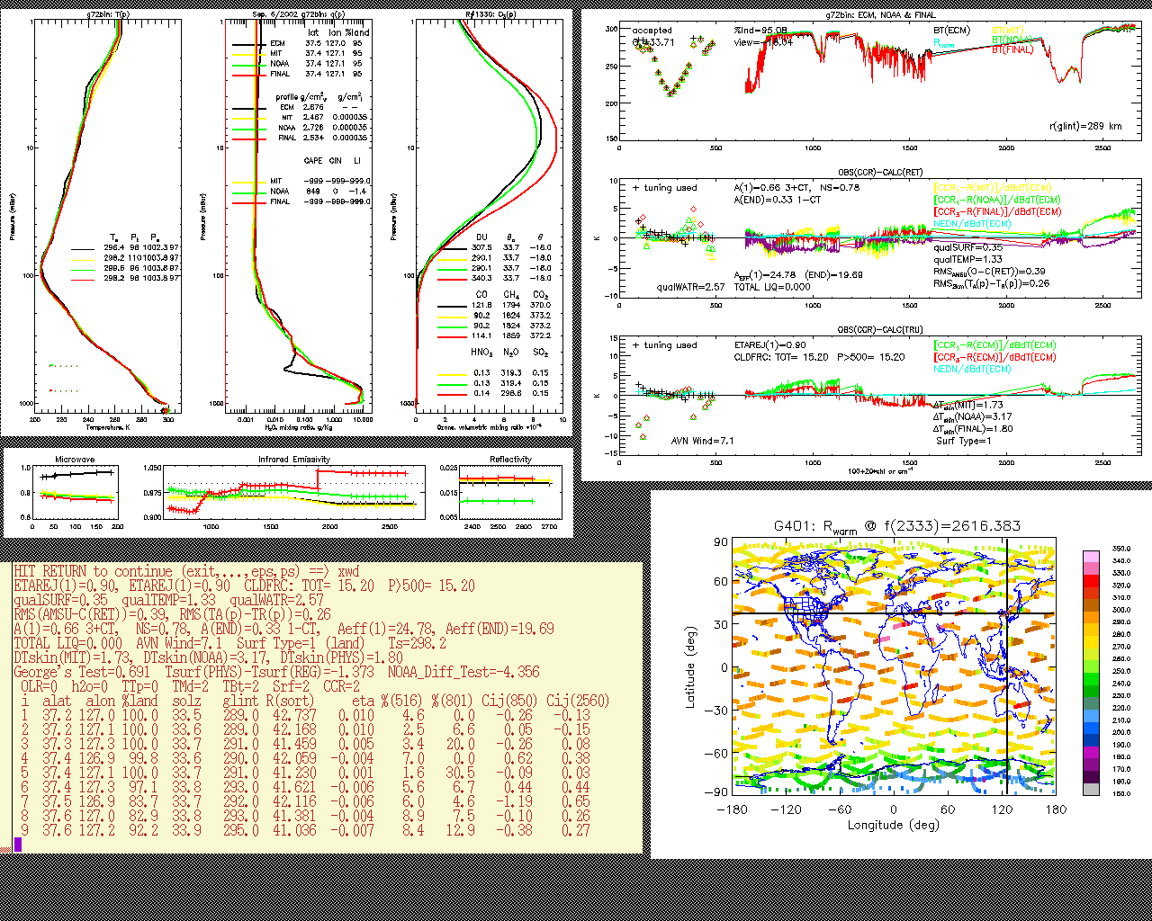
Discussion on AVMP statistic definition (6/7)
A detailed look at one case with large error.
Here is a detailed diagnostic for one of the mid-latitude outliers. Lots of info on this plot, but if you look at the 2nd panel in the upper left profile plot (highlighted in red) you will see that ECMWF has a dry layer (NOTE: this is a log scale) that the smooth retrieval doesn’t capture – but this is a “good” retrieval.
This case is the one in previous plot with g=1533, q_tru=0.0028 g/cm^2 at latitude=37.4 (index = 1330 in granule 401)

Slide 22
Discussion on AVMP statistic definition (7/7)
What should the weighting be?
The higher resolution level truth (ECMWF) has dry layers that the lower resolution retrieval cannot capture
ECMWF could be in error both in the sense of
Placing the dry layer in the wrong vertical bin
Or – the dry layer could be displaced spatially
When looking at many of the diagnostic plots you tend to see the retrieval capture the dry layer a few fields of regard to the east or west of where ECMWF sees it, albeit at lower resolution.
This effect will be seen in all “truth” datasets.
A mathematically correct procedure would be to adjust the truth datasets with the retrieval averaging kernal (AK)
This would not eliminate cases where the truth was in error (due to temporal or spatial differences between truth and retrieval)
Current CrIMSS EDR code does not compute or output AK’s.
Given the historical nature of AVMP statistics shown with w=(q_tru)², all the figures in this presentation and future validation efforts will adopt this weighting for requirements assessment.
Issue with bias and rms having different weighting will be fixed – both will use (q_tru)² – which has the net effect of reducing previous estimates of bias (i.e., accuracy); however, these were not turned into requirements.
Figures in this document use the old AIRS methodology for BIAS – hence they cannot be used to infer standard deviation.

Slide 23
History of Algorithm changes (1/6) DR’s leading up to beta maturity
Date | Update/DR# | Reason | Completed
Nov. 2010 | 4068 & 4079 | Precip flag is out of date | In-work, expect to install May 2013
Dec. 2010 | 4090 (same as 4045) | Derivatives w.r.t. emissivity | Cancelled
Feb. 2011 | 4207 & 4208 | Interpolation of AVTP/AVMP is incorrect, bottom layer missing | Have not confirmed that this is a real problem
Mar. 2011 | 4233 | Surface pressure has Gaussian Noise (for simulation) | Completed and closed
Mar. 2011 | 4234 | State.2 (increased spatial resol.) | Deferred to J1
Aug. 2011 | 4325, CCR707 | ATMS bias correction | LUT and code installed in Mx6.4
Aug. 2011 | 4334, CCR707 | CrIS bias correction | Code completed pre-launch (Mx5.0), LUT updated in Mx6.4
Aug. 2011 | 4335, CCR707 | Updates of post-launch LUTs | OSS (both IR and MW) completed in Mx5.3, emissivity covariance LUT installed in Mx6.4
Sep. 2011 | 4346 | Pressure inconsistencies at TOA | Closed

Slide 24
History of Algorithm Changes (2/6) Mx7.1 changes, in IDPS June 2013
Date | DR#/CCR#* | Description | Status
Sep 2012 | 4922/0707 | Code bug: non-LTE & ozone channel indexing is off by 22 chl | Scheduled for Mx6.6
Oct. 2012 | 4923 | Code Bug: Surface pressure exceeds reasonable values | In-work, Raytheon investigating
Oct. 2012 | 4926/0739 | Code bug: Fix noise used by retrieval for clear scenes | Approved for Mx7.1
Oct. 2012 | 4942/0739 | More conservative clear scene detection | Approved for Mx7.1
Oct. 2012 | 4943/0740 | Replace CrIS sensor noise and forward model error LUTs with post-launch derived values | Approved for Mx7.1
Oct. 2012 | 4944 | Replace CrIS and ATMS bias correction LUTs | In-work, current tables are reasonable
Oct. 2012 | 4945/0739 | Modify surface constraint for daytime land scenes (current constraint too tight). | Approved for Mx7.1
Oct. 2012 | 4946/0739 | Modify the selection criteria for warm ocean climatology (current code selects warm ocean too often) | Approved for Mx7.1
Oct. 2012 | 4958/0740 | Optimize chi^2 threshold parameters to allow higher yield for IR retrieval | Approved for Mx7.1

Slide 25
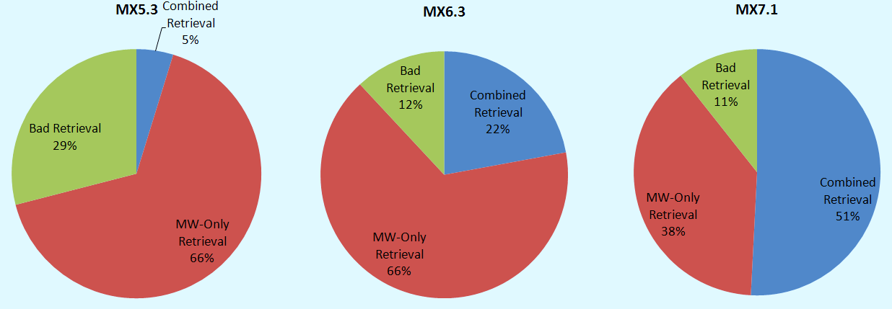
History of Algorithm Changes (3/6) Four “baseline” systems will be discussed
Mx5.3, operational since April 1, 2012
This is the beta maturity system
Mx6.4 (a.k.a. Mx6.3), operational since Oct. 12, 2012
Added empirical bias corrections for ATMS, updated CrIS
Mx6.6, expected to be operational in Feb. 2012
Fixed an indexing bug for non-LTE and ozone channels
Significant improvements in daytime yield (from 4% to 50%)
Mx7.1, expected to be operational in June 2012
Improvements in both performance and yield

Slide 26
History of Algorithm Changes (4/6) Example of how we test changes
List of Changes
Changes made in MX6.4 (E5 is baseline):
MW Bias File
IR Bias File
CLIM-LUT File
Changes in Mx6.6 (E10 is baseline):
d) non-LTE issue (main program)
e) Indexing issue (ozone)
Changes proposed for Mx 7.1 (E19 is baseline)
f) Fix to SPLF (using Xiaozhen’s SPLF as proxy)
DR Submissions for code:
g) Rtmerror bug (fix calculation of IR noise)
h) Turn off stratification
i) Change warm ocean constraint
j) Loosen Tskin-Tair constraint over land
New LUTs:
k) New IR-NOISE-LUT file.
l) New IR-ATM-NOISE file.
 | a | b | c | d | e | f | g | h | i | j | k | l
E1
E2 | ✓
E3 |  | ✓
E4 |  |  | ✓
E5 | ✓ | ✓ | ✓
E6 | ✓ | ✓ | ✓ | ✓
E7 | ✓ | ✓ | ✓ |  | ✓
E8 | ✓ | ✓ | ✓ | ✓ | ✓
E9 | ✓ | ✓ | ✓ |  |  | ✓
E10 | ✓ | ✓ | ✓ | ✓ | ✓ | ✓
E11 | ✓ | ✓ | ✓ | ✓ | ✓ | ✓ | ✓
E12 | ✓ | ✓ | ✓ | ✓ | ✓ | ✓ |  | ✓
E13 | ✓ | ✓ | ✓ | ✓ | ✓ | ✓ |  |  | ✓
E14 | ✓ | ✓ | ✓ | ✓ | ✓ | ✓ |  |  |  | ✓
E15 | ✓ | ✓ | ✓ | ✓ | ✓ | ✓ | ✓ |  | ✓ | ✓
E16 | ✓ | ✓ | ✓ | ✓ | ✓ | ✓ |  |  |  |  | ✓
E17 | ✓ | ✓ | ✓ | ✓ | ✓ | ✓ |  |  |  |  |  | ✓
E18 | ✓ | ✓ | ✓ | ✓ | ✓ | ✓ |  |  |  |  | ✓ | ✓
E19 | ✓ | ✓ | ✓ | ✓ | ✓ | ✓ | ✓ |  | ✓ | ✓ | ✓ | ✓
Note: h) and i) are two options for the same fix. (i) is the primary fix
NOTE: we are now up to E33 with many inter-combinations being tested.

Slide 27
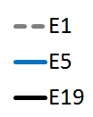
History of Algorithm Changes (5/6) How changes are packaged to DPA/DPE
During telecons and e-mails the potential problems are identified by the algorithm team (mostly NGAS, LaRC and sounder PEATE members) and potential solutions are discussed.
Algorithm lead submits DRs based on a consensus of the problem.
STAR coordinates the analysis with significant contributions from the entire algorithm and validation team and decides on the best course of action as well as evaluate the interaction between proposed changes – package is then submitted to STAR AIT group.
 |  | Temp. Bias | WV Bias |  | QC(1) | QC(4) | QC(5) | QC(1&4)
E1 |  | 1.55 K | 30.05% |  | 44.36% | 5.23% | 68.08% | 4.03%
E5 |  | 1.31 K | 30.39% |  | 63.09% | 30.02% | 87.10% | 22.06%
E19 |  | 1.25 K | 33.88% |  | 43.36% | 24.63% | 89.13% | 13.60%
Example at right is an example of the metrics used and a sample of one plot used to decide what baseline systems should be proposed to the AERB.
List of Changes
E1: Mimics Mx5.3
E5: Mimics MX6.4 (bias and clim files)
E19: Mimics candidate Mx7.1 (code + LUTs)

Slide 28
History of Algorithm Changes (6/6) Example of metrics and evaluation
 | a | b | c | d | e | f | g | h | i | j | k | l |  | QC Improvement | Temperature Improvement | Water Vapor Improvement
E1 |  |  |  |  |  |  |  |  |  |  |  |  |  | N/A | N/A | N/A
E2 | ✓ |  |  |  |  |  |  |  |  |  |  |  |  | Worse | Worse | Better
E3 |  | ✓ |  |  |  |  |  |  |  |  |  |  |  | Better QC(5): No Change | Worse | Better
E4 |  |  | ✓ |  |  |  |  |  |  |  |  |  |  | Better | Better | Better
E5 | ✓ | ✓ | ✓ |  |  |  |  |  |  |  |  |  |  | Better | Better | Worse
E6 | ✓ | ✓ | ✓ | ✓ |  |  |  |  |  |  |  |  |  | Better QC(5): No Change | Better | Better
E7 | ✓ | ✓ | ✓ |  | ✓ |  |  |  |  |  |  |  |  | No Change | No Change | No Change
E8 | ✓ | ✓ | ✓ | ✓ | ✓ |  |  |  |  |  |  |  |  | Better QC(5): No Change | Better | Better
E9 | ✓ | ✓ | ✓ |  |  | ✓ |  |  |  |  |  |  |  | QC(4,1&4): Better QC(1,5): Worse | Worse | Better
E10 | ✓ | ✓ | ✓ | ✓ | ✓ | ✓ |  |  |  |  |  |  |  | Better QC(5): Worse | Better | Better
E11 | ✓ | ✓ | ✓ | ✓ | ✓ | ✓ | ✓ |  |  |  |  |  |  | Better QC(5): No Change | No Change | Better
E12 | ✓ | ✓ | ✓ | ✓ | ✓ | ✓ |  | ✓ |  |  |  |  |  | Better | Better | Worse
E13 | ✓ | ✓ | ✓ | ✓ | ✓ | ✓ |  |  | ✓ |  |  |  |  |  | Worse | Better
E14 | ✓ | ✓ | ✓ | ✓ | ✓ | ✓ |  |  |  | ✓ |  |  |  |  | Better | Worse
E15 | ✓ | ✓ | ✓ | ✓ | ✓ | ✓ | ✓ |  | ✓ | ✓ |  |  |  |  | Better | Worse
E16 | ✓ | ✓ | ✓ | ✓ | ✓ | ✓ |  |  |  |  | ✓ |  |  | Worse QC(5): No Change | Worse | Worse
E17 | ✓ | ✓ | ✓ | ✓ | ✓ | ✓ |  |  |  |  |  | ✓
E18 | ✓ | ✓ | ✓ | ✓ | ✓ | ✓ |  |  |  |  | ✓ | ✓
E19 | ✓ | ✓ | ✓ | ✓ | ✓ | ✓ | ✓ |  | ✓ | ✓ | ✓ | ✓ |  | Worse QC(5): Better | Worse | Worse

Slide 29
Provisional Maturity Evaluation (1/35): Cal/Val Plan is Hierarchical
Dataset | Sampling | Characteristics
ECMWF/GFS | Global | ±3 hour, model errors, select focus days
NUCAPS EDR | Global, exact match | Different algorithm approach using CrIS/ATMS Significant diagnostic capability
AIRS EDR Products | Nearly global | Orbits are aliased, 16d repeat, different algorithm and instrument
IASI EDR Products | Polar SNO’s, global DD | 4 hour orbit difference, different algorithm and instrument
GPS | ~1000 matchup/day | Limb vs. nadir, mid- to upper-trop
Op. RAOB | ~200 matchup/day | ±3 hours, ±100 km, regional w.r.t. op.systems
Dedicated RAOB | ~600 matchup/year | Only a handful of locations
CrIMSS EDR cal/val Team has maintained an “off-line” capability to provide reprocessing for these data sets on many systems (e.g., Mx5.3, 6.4, 6.6, 7.1) including individual changes made for each DR
Allows demonstration of improvements on historical datasets
Allows maximizing the impact of the investment in “truth” datasets

Slide 30
Provisional Maturity Evaluation (2/35) Definition of Systems
The graphic on the next page shows the various pathways of data that have been used to analyze the CrIMSS EDRs
Most of the analysis of the CrIMSS EDR has been done with the “Off-line” version of the future IDPS Mx7.1
This is our sand-box where we can make changes and run many granules (focus days, matchups, etc.).
Demonstrated that off-line, ADL, and IDPS get the same results.
Most validation is done with 100L IP’s.
In Off-line version it is possible to do runs on large ensembles of cases.
Once a change packet is defined it is then tested with ADL (STAR AIT group) and submitted as change package to DPA/DPE.
NGAS also uses their science code to do similar evaluations
Science code is the original source of the IDPS code.
We have confirmed that the NGAS science-code and off-line code get the same answers
In many instances, problems with the IDPS have been discovered using this process.
IDPS (and ADL) versions lags the off-line capability by many months.
Most recent changes for CrIMSS EDR occurred in Oct. 2012 (Mx6.4)
CCR739/740 took 3 full months to get through regression testing
AERB approved these changes on Jan. 16, 2013 for implementation in Mx7.1 (scheduled for IDPS in June 2013)

Slide 31
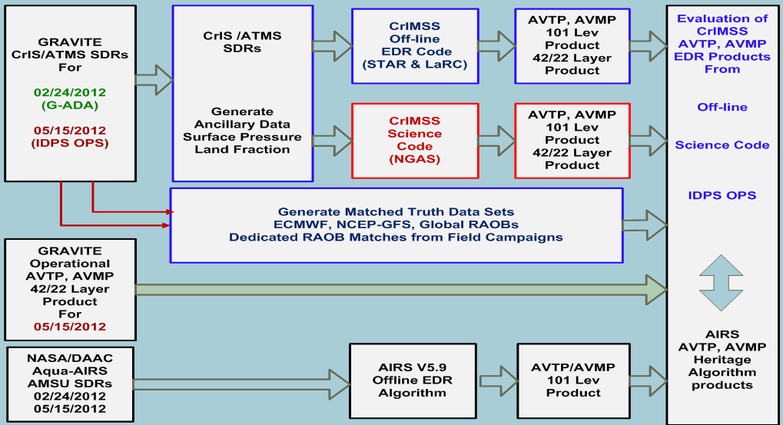
Provisional Maturity Evaluation (3/35) Origin of Comparison Datasets
Graphic to illustrate CrIMSS EDR data pathways
(discussed on previous slides)

Slide 32
Provisional Maturity Evaluation (4/35) CrIMSS EDR Datasets
Focus days Comparison to other products
ECMWF is used as a proxy for “truth”
It is also used as a “transfer standard” for other retrieval systems such as AIRS and NUCAPS
May 15, 2012 and Sep. 20, 2012 are the primary focus days because both ATMS and CrIS were calibrated and at the beta maturity level.
Subset of globally representative 108 granule set is used for evaluations of individual DRs
Feb. 24th and 25th was also used
NOTE: Feb. 25th is same orbit configuration as May 15th)
We plan on collecting ≈4 focus days per year
Focus day collections include Aqua, Metop SDRs and EDRs, ECMWF, GFS, etc.
Comparisons to GPS RO Products
Large number of days were used in May, to get reasonable statistics.
Primary validation is dedicated radiosondes
Very few radiosondes have been launched to date
~500 sondes were purchased by the JPSS project office and most have been launched at 3 sites (Alaska, Oklahoma, Tropical Pacific) in support of provisional and stage.1 validation.
33 radiosondes were launched by Aerospace Corp. from Hawaii in May.

Slide 33
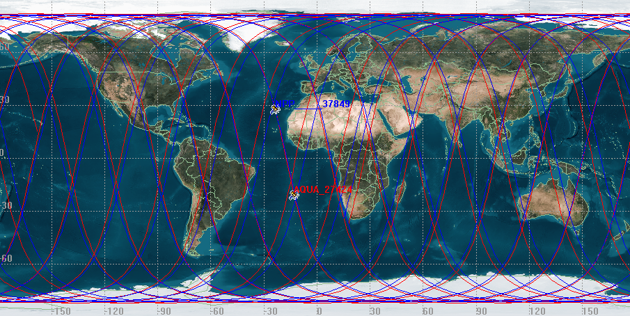
Provisional Maturity Evaluation (5/35) Selection of Focus Days
May 15 focus day was chosen because:
It had very good overlap between NPP and Aqua satellites
It was same the orbital configuration as other focus days (Feb. 25, 2012, Sep. 20, 2012)
Simultaneous nadir overpasses with Aqua occurred in many places:
west coast of Africa
East coast of S.America
Northeast of Australia
Many polar cases

Slide 34
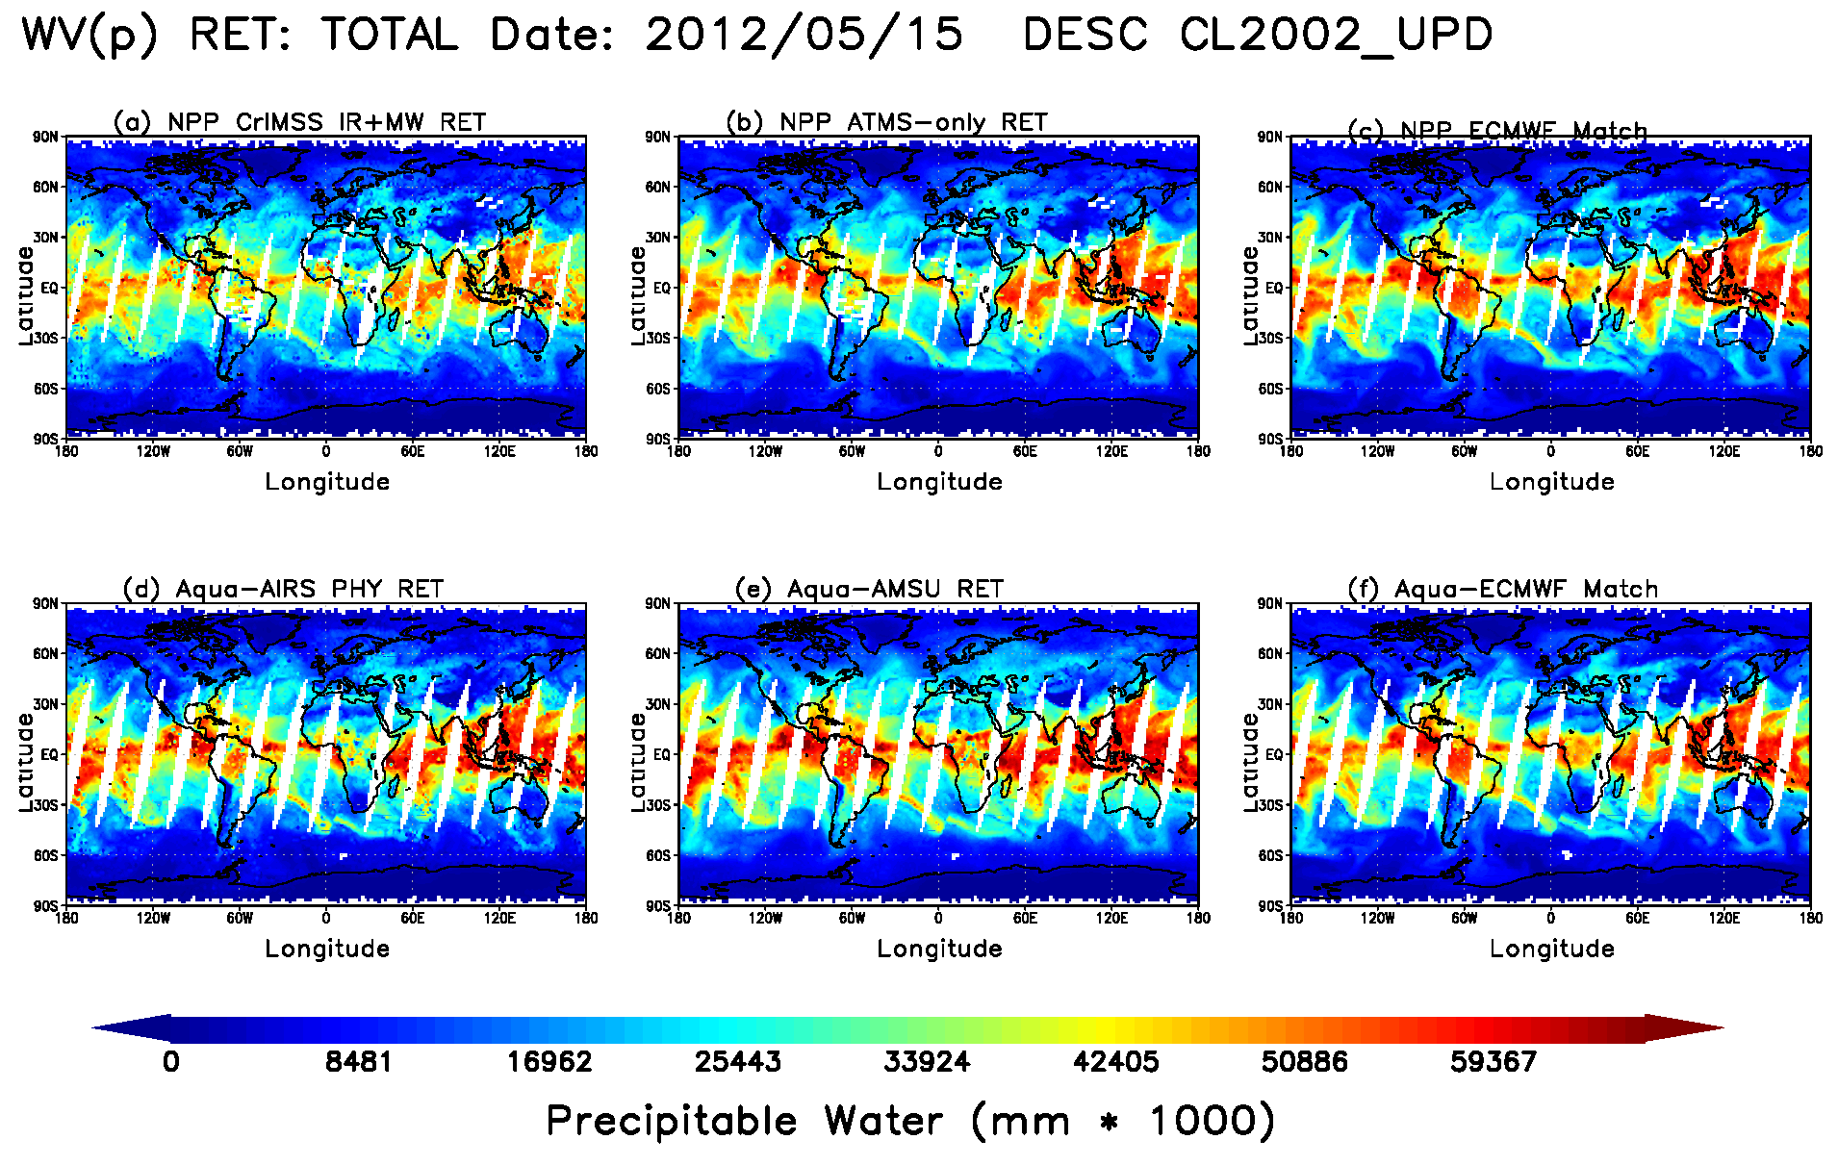
Provisional Maturity Evaluation (6/35) First look at a Focus Day AVMP Dataset
AVMP total precipitable water (integral of AVMP) for May 15, 2012
CrIMSS IR+MW (upper left) and MW-only (upper middle)
AIRS IR+MW (lower left) and AMSU-only (lower middle)
Co-located ECMWF for CrIS (upper right) and AIRS (lower right)

Slide 35
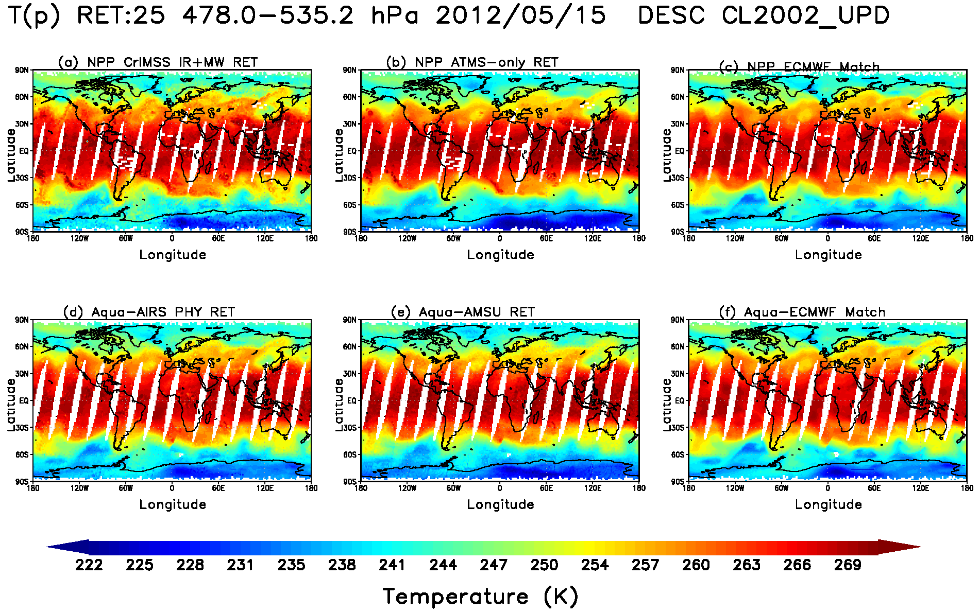
Provisional Maturity Evaluation (7/35) Example of a Focus Day AVTP Dataset
AVTP (850 hPa-surface layer) temperature product for May 15, 2012
CrIMSS IR+MW (upper left) and MW-only (upper middle)
AIRS IR+MW (lower left) and AMSU-only (lower middle)
Co-located ECMWF for CrIS (upper right) and AIRS (lower right)

Slide 36
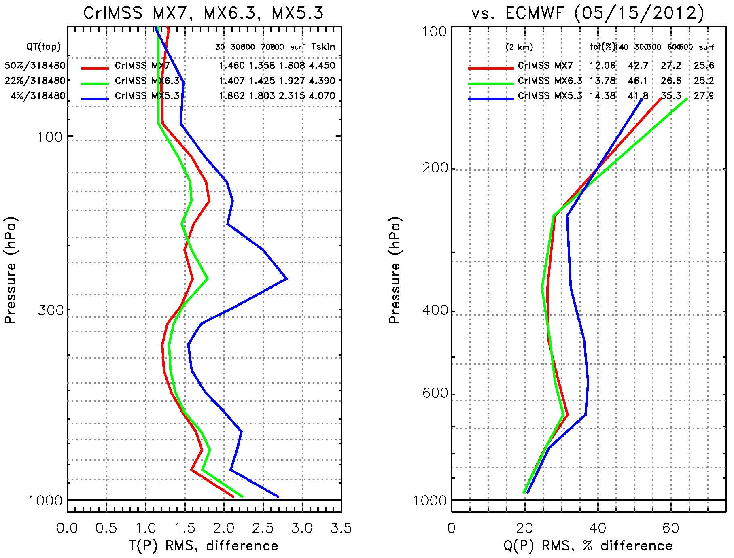
Provisional Maturity Evaluation (8/35) T(p), q(p) Global RMS for May 15, 2012 IDPS 5.3 (Past), IDPS 6.4 (Present) and IDPS 7.1 (future) Yield : IR+MW
Yield has increased from 4% (Mx5.3) to 50% (Mx7.1)
Results are shown w.r.t. ECMWF
Specifications shown as dotted red line (only relevant for GLOBAL RMS) and numerical (red boxes)
Performance has improved with IDPS version (will be summarized in table later)

Slide 37
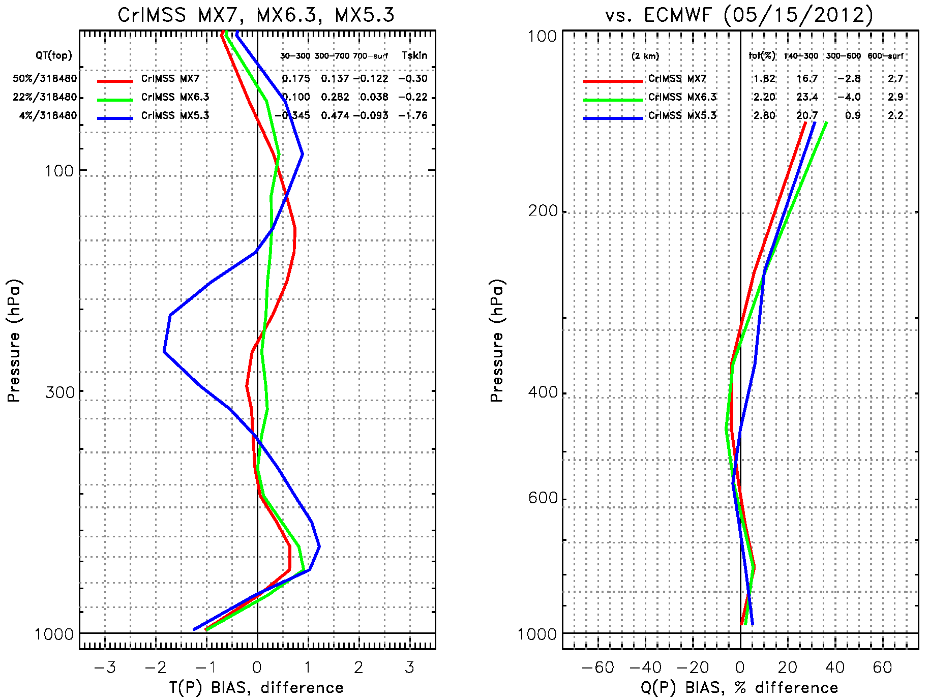
Provisional Maturity Evaluation (9/35) T(p), q(p) Global BIAS for May 15, 2012 IDPS 5.3 (Past), IDPS 6.4 (Present) and IDPS 7.1 (future) Yield : IR+MW
Same as previous figure, except BIAS w.r.t. ECMWF is shown.

Slide 38
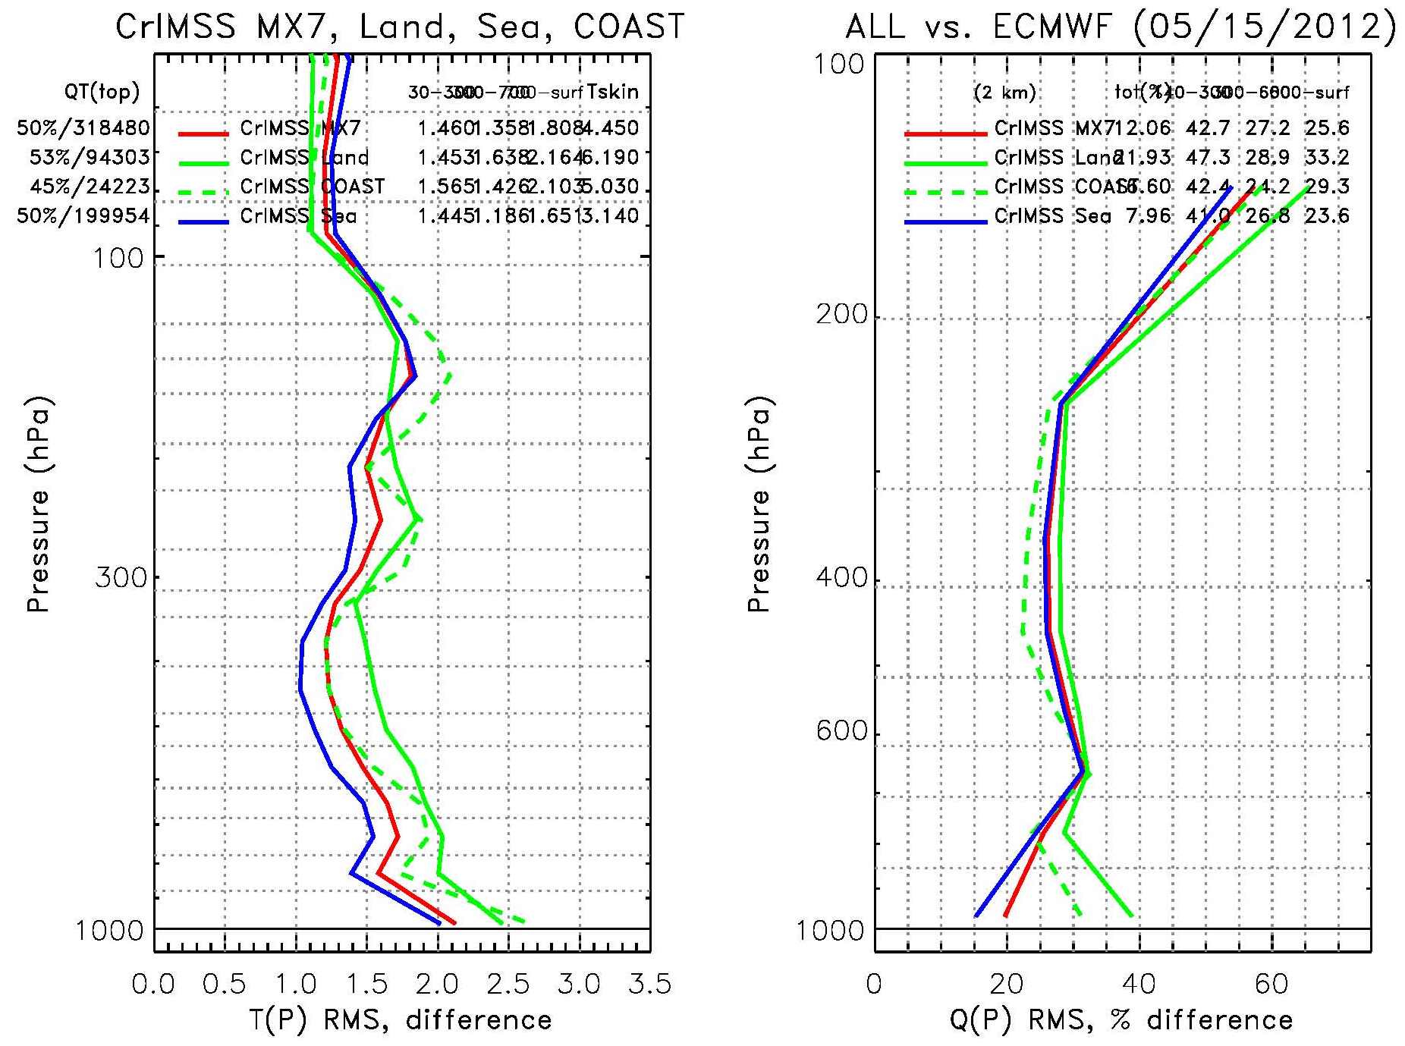
Provisional Maturity Justification (10/35) T(p), q(p) RMS Global, Land, Sea, Coast for May 15, 2012: IR+MW
Performance is better over ocean than land or coastlines
This is expected from previous experience with HIRS, AIRS, and IASI.
Requirements not drawn, since these RMS’s are not GLOBAL.

Slide 39
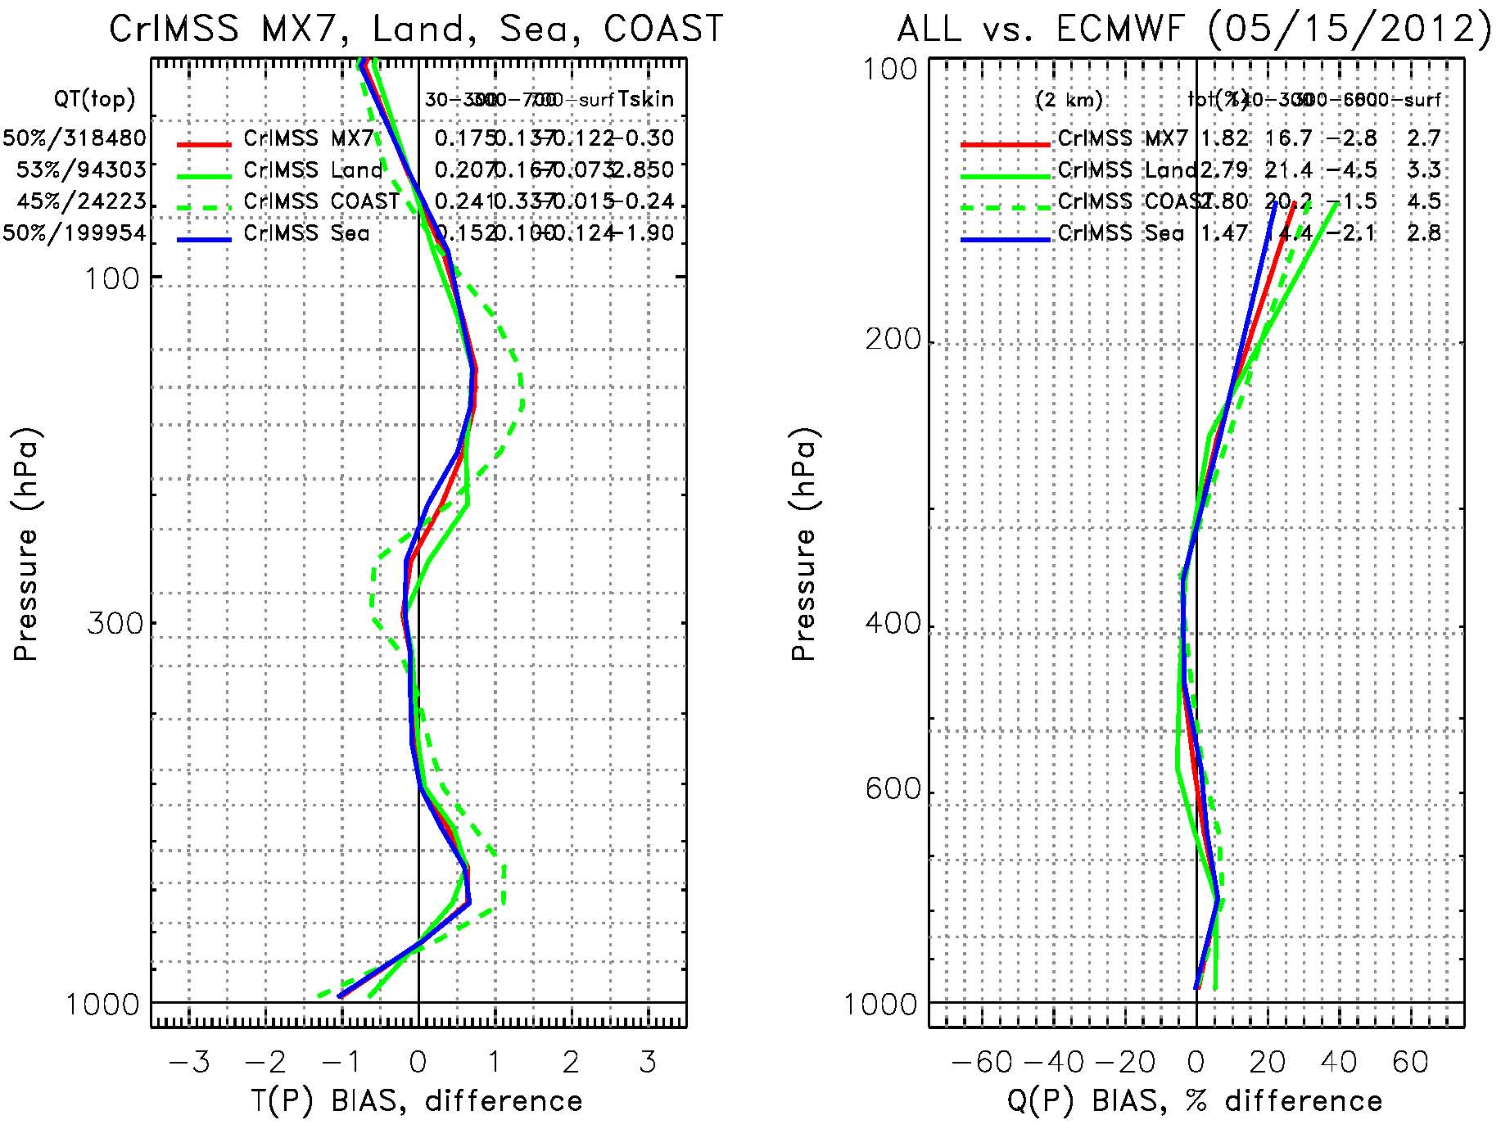
Provisional Maturity Justification (11/35) T(p), q(p) BIAS Global, Land, Sea, Coast for May 15, 2012: IR+MW
Same as previous slide except BIAS is shown.
No requirements (at this time for BIAS).
Our desired is to have BIAS be as small as possible.
Given that this is w.r.t. ECMWF we are not yet certain if the bias shown at right is in our product or ECMWF.

Slide 40
Provisional Maturity Justication (12/35) Yield is stable: May 15 versus Sept. 20, 2012
Offline Mx7.1 configuration for full focus day
 | % of Profiles in Category |  | % Passing QC(1) (IR ChiSq Test) |  | % Passing QC(4) (MW ChiSq Test in combined retr.) |  | % Passing QC(5) (MW ChiSq Test in MW-only retr.) |  | % Passing BOTH QC(1) and QC(4)
 | May 15 | Sept 20 | May 15 | Sept 20 | May 15 | Sept 20 | May 15 | Sept 20 | May 15 | Sept 20
All Profiles | 100% | 100% | 79.76% | 81.10% | 53.38% | 53.05% | 89.36% | 89.82% | 50.81% | 51.15%
Day Profiles | 49.17% | 49.31% | 77.69% | 80.37% | 53.16% | 54.18% | 91.08% | 90.93% | 49.74% | 51.74%
Night Profiles | 50.83% | 50.69% | 81.76% | 81.82% | 53.60% | 51.95% | 87.71% | 88.74% | 51.85% | 50.58%
Clear Profiles | 9.21% | 8.31% | 75.47% | 85.23% | 48.35% | 60.99% | 89.32% | 93.62% | 45.64% | 58.14%
Partly Cloudy Profiles | 80.11% | 80.58% | 79.11% | 79.70% | 53.31% | 51.77% | 89.32% | 89.05% | 50.75% | 50.01%
Cloudy Profiles | 10.67% | 11.11% | 88.34% | 88.21% | 58.22% | 56.43% | 89.75% | 92.58% | 55.74% | 54.19%
Ocean Profiles | 62.60% | 62.52% | 80.95% | 82.08% | 51.01% | 50.89% | 91.46% | 91.97% | 50.10% | 50.21%
Land Profiles | 29.25% | 29.33% | 77.77% | 80.47% | 60.12% | 60.26% | 87.67% | 88.88% | 53.77% | 55.55%
Coast Profiles | 8.14% | 8.15% | 77.76% | 75.91% | 47.41% | 43.65% | 79.36% | 76.68% | 45.65% | 42.52%

Slide 41
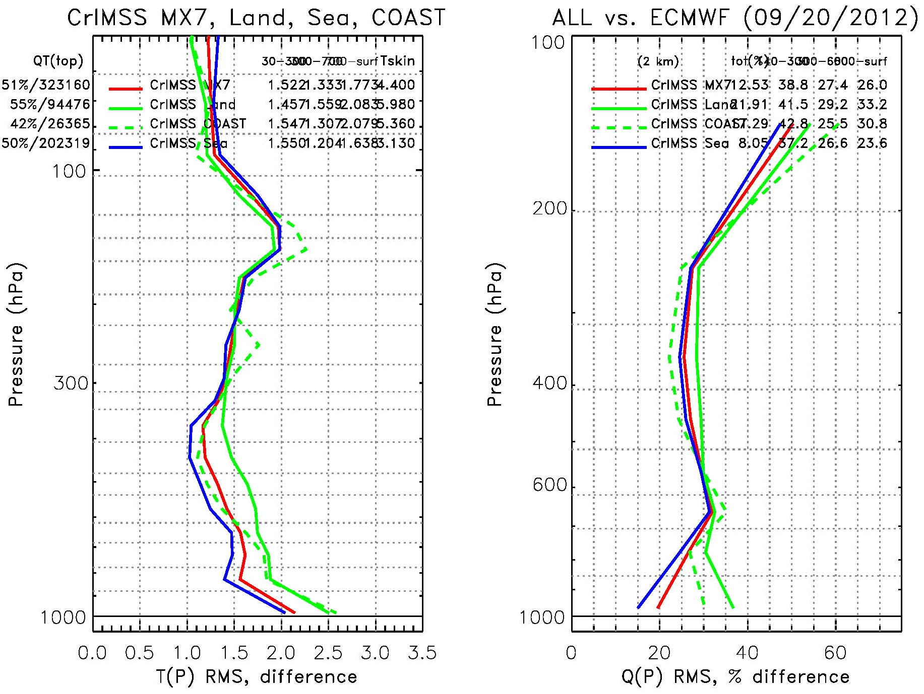
Provisional Maturity Justification (13/35) T(p), q(p) RMS Global, Land, Sea, Coast for Sep. 20, 2012: IR+MW
Here we repeat the analysis for the Sep. 20 focus day.
If you compare this figure to the May 15th figure there is very little difference.
CrIMSS EDR is stable over 2 seasons.

Slide 42
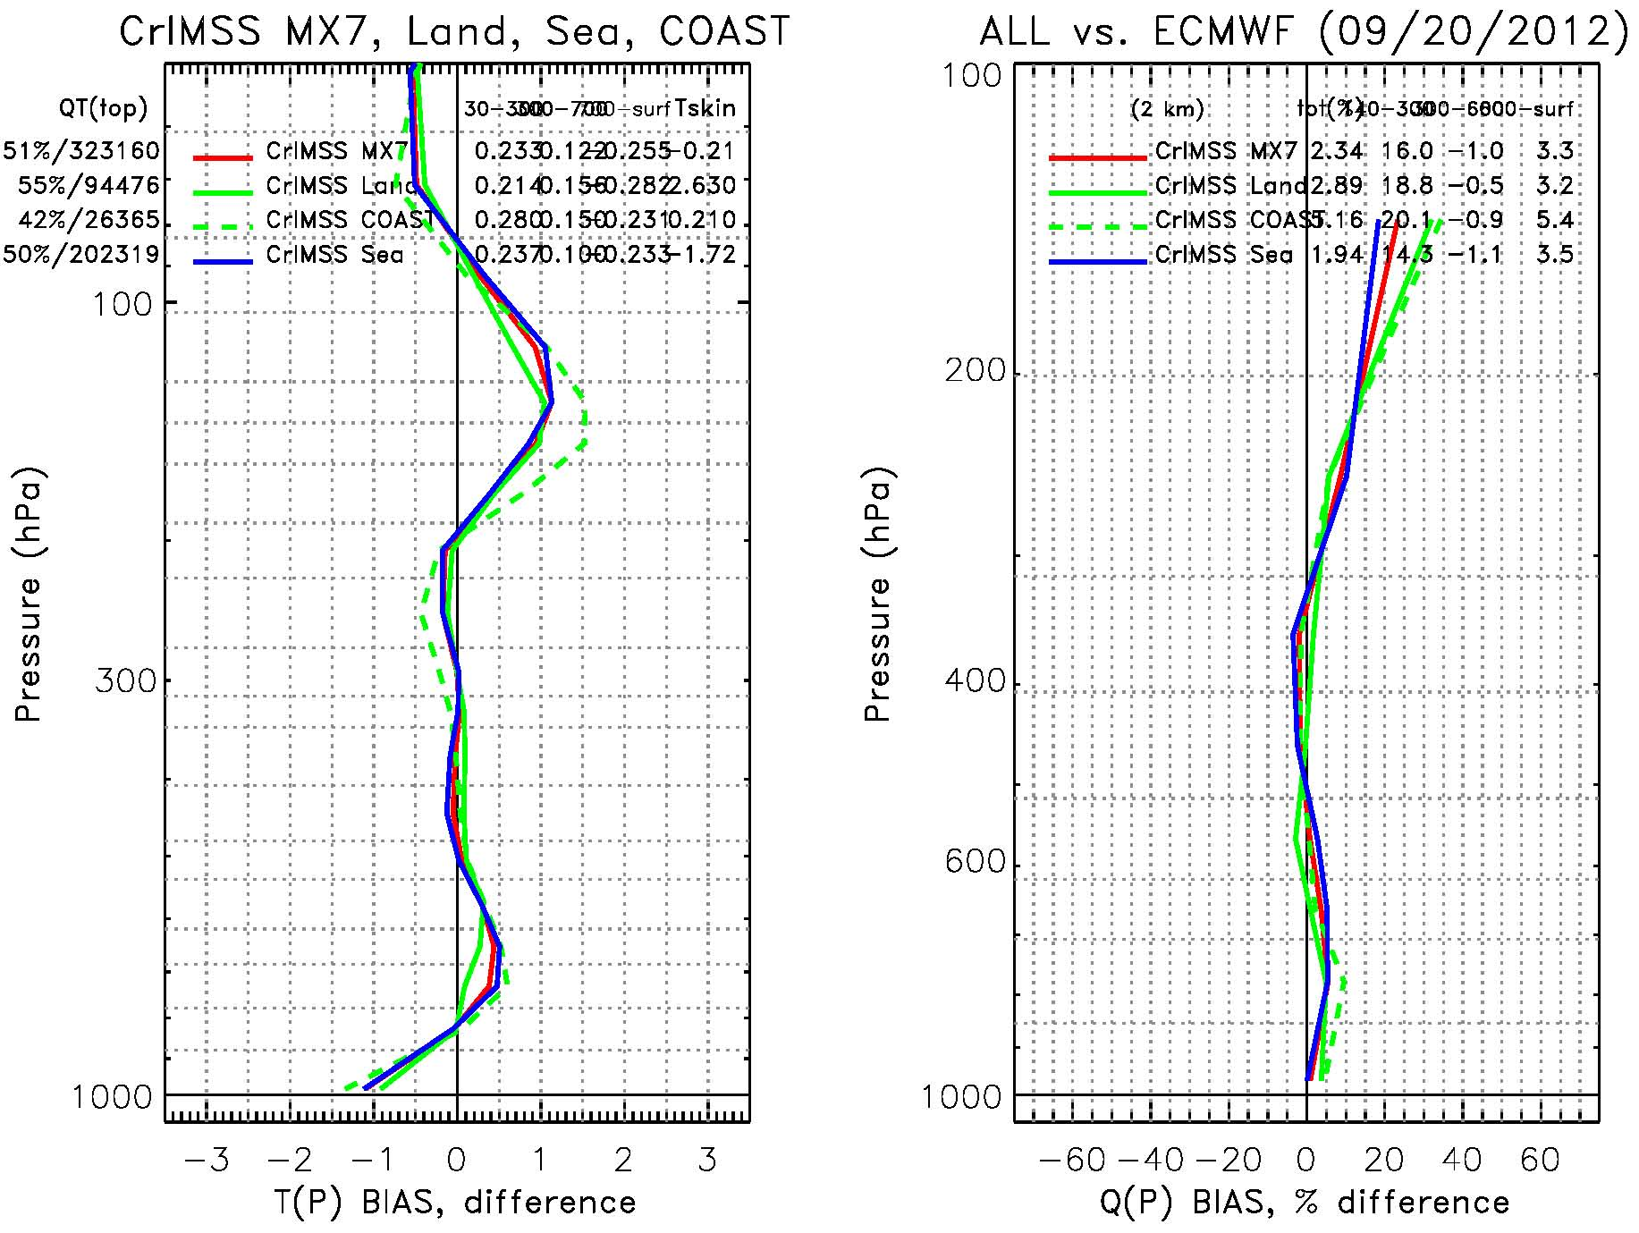
Provisional Maturity Justification (14/35) T(p), q(p) BIAS Global, Land, Sea, Coast for Sep. 20, 2012: IR+MW
Here we repeat the analysis for the Sep. 20 focus day.
If you compare this figure to the May 15th figure there is very little difference.
May 15th clear scenes were used for tuning (bias correction).
This day was not used in any manner to optimize the algorithm.

Slide 43
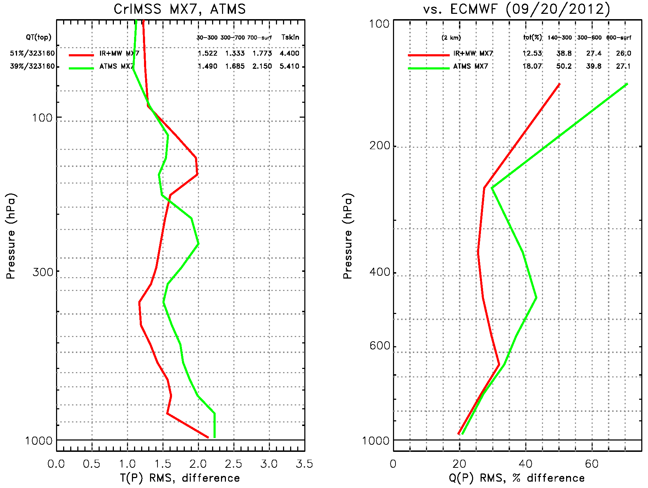
Provisional Maturity Justification (15/35) T(p), q(p) RMS for Sep. 20, 2012: MW-only vs. IR+MW
The MW-only (green line) is shown versus the IR+MW (red line)
It is close to meeting requirements.
Dotted Red line are the cloudy requirements.
Note: In 300-700 hPa region the MW-only requirements are actually more difficult than the IR+MW requirement

Slide 44
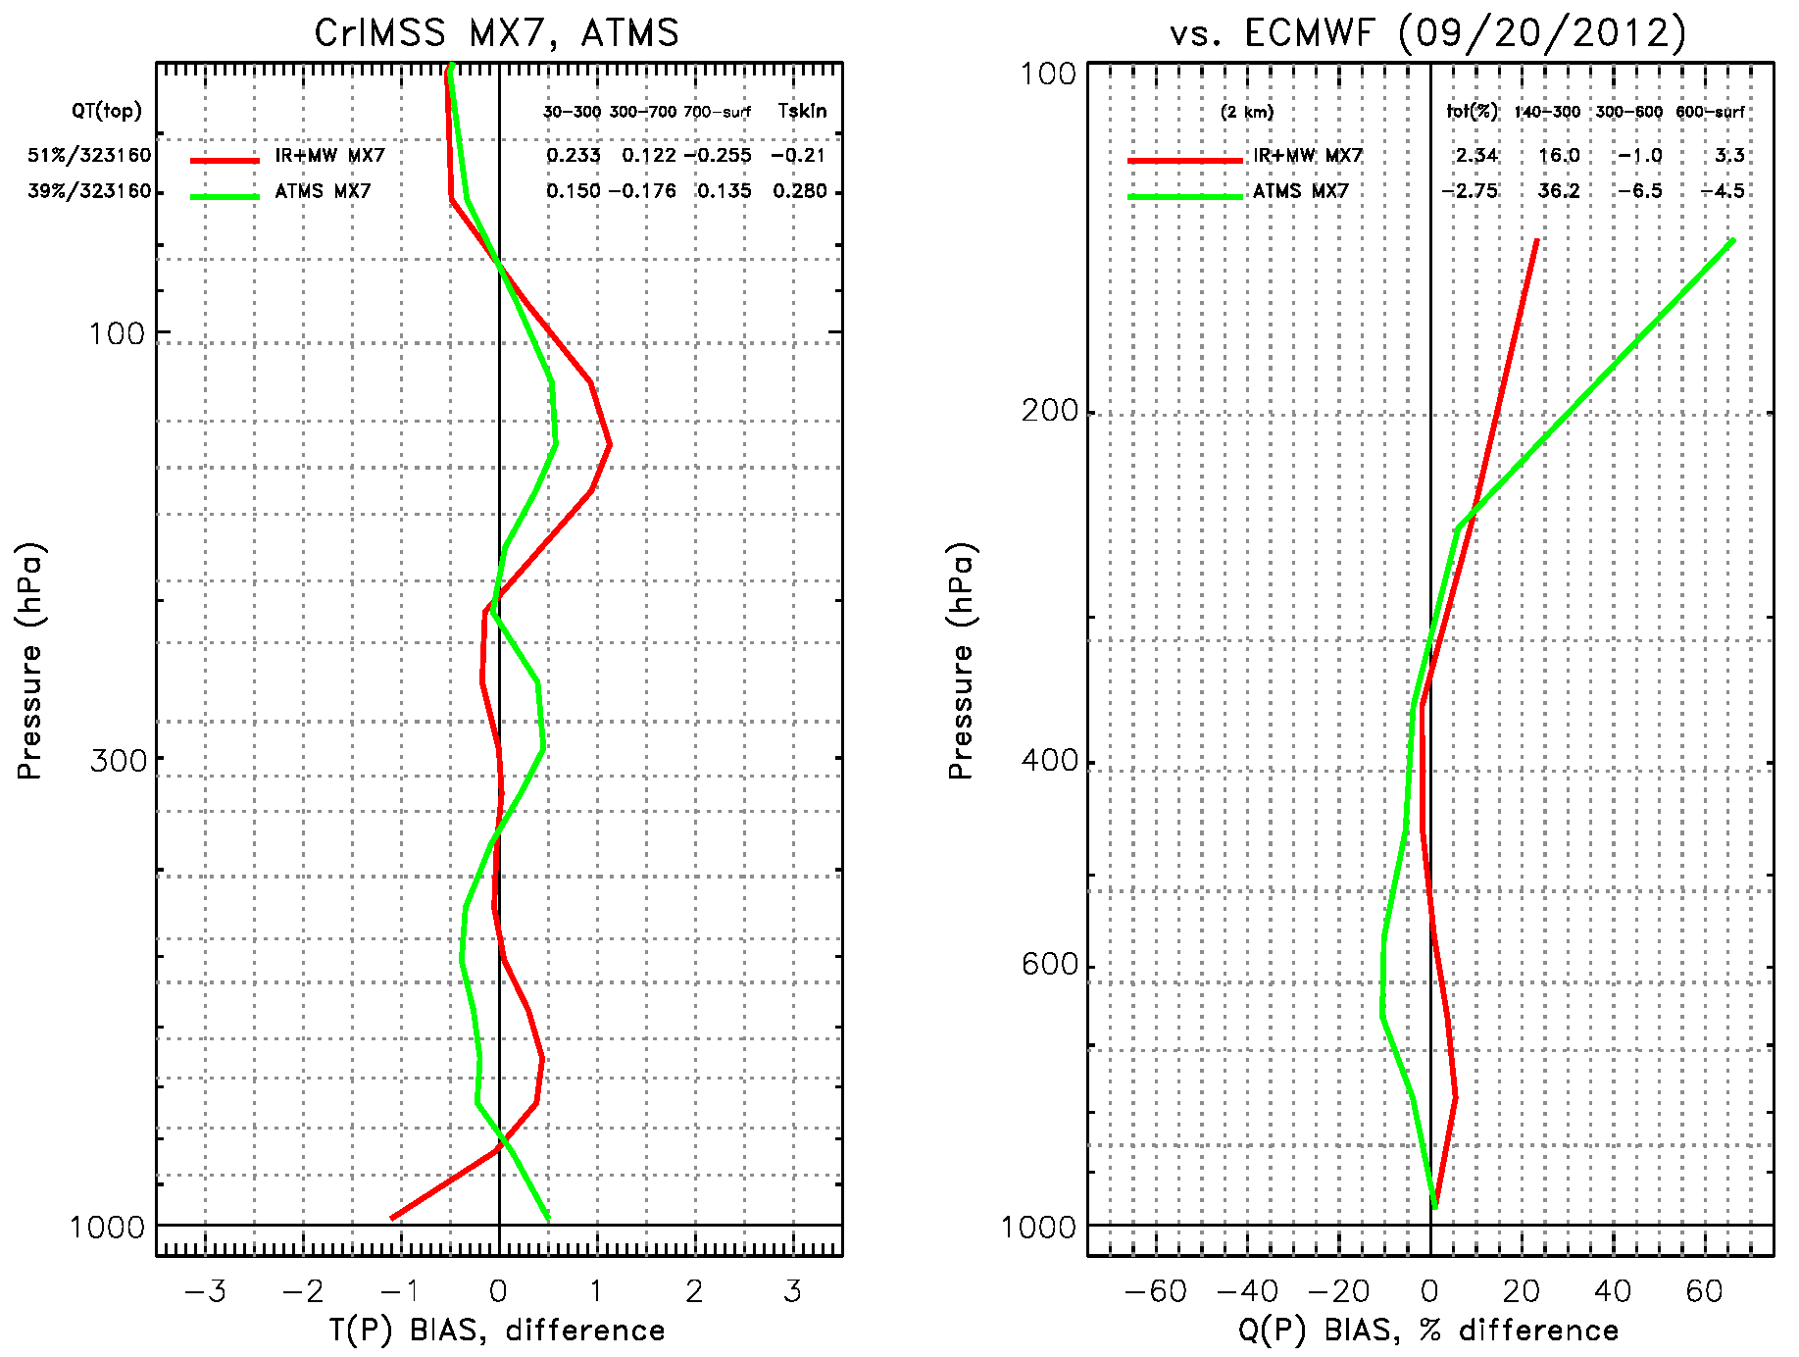
Provisional Maturity Justification (16/35) T(p), q(p) BIAS for Sep. 20, 2012: MW-only vs. IR+MW
Same as previous figure except BIAS is shown

Slide 45
Provisional Maturity Justification (17/35) Summary of Statistics from Previous Slides
In the table below we show how the provisional CrIMSS EDR compares to requirements using ECMWF
Some error exists in ECMWF itself, hence real error is less
This will be assessed with dedicated radiosondes in the future.
IR+MW (pt.cloudy) | yield | AVTP(p) 30-300 | AVTP(p) 300-srf | AVMP(p) 300-600 | AVMP(p) 600-srf
Mx5.3 | 4% | 1.86 K | 2.1 K | 35.3 % | 27.9 %
Mx6.4 | 22% | 1.41 K | 1.7 K | 26.6 % | 25.2 %
Mx7.1 | 50% | 1.46 K | 1.6 K | 27.2 % | 25.6 %
Rqmts | ~50% | 1.5 K | 1.6 K | 35 % | 20 %
MW-only (cloudy) | yield | AVTP(p) 30-300 | AVTP(p) 300-700 | AVTP(p) 700-srf | AVMP(p) 300-600 | AVMP(p) 600-srf
Mx7.1 | 39% | 1.5K | 1.7K | 2.2K | 40% | 27%
Rqmts | ~50% | 1.5 K | 1.5 K | 2.5 K | 40% | 20 %

Slide 46
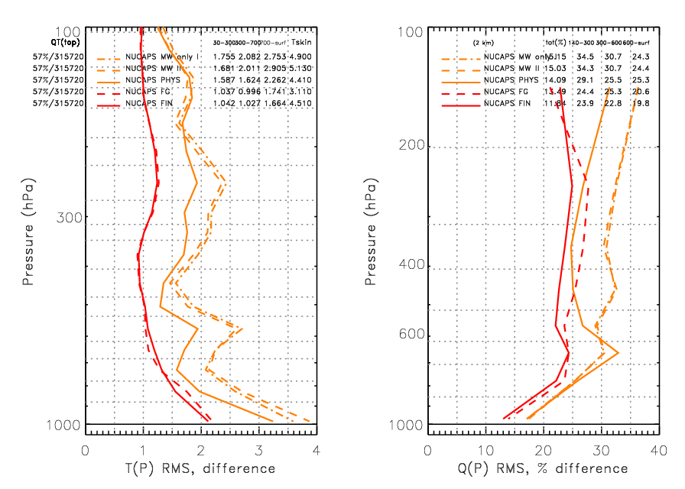
Provisional Maturity Justification (18/35) NUCAPS: Analysis of Physical Only vs. Regression Systems
Statistics shown at each step
MIT AMSU-only (gold dash-dot)
GSFC AMSU-only (gold dash)
Cloud cleared regression (red dash)
Final physical (red solid)
Physical-only a system (gold-solid) is also shown (no statistical operator, uses AMSU-only as 1st guess).
Note that regression is trained on 5/15/2012 and 9/20/2012 (evenly weighted).
Independent focus day (July 13, not shown) show this is not the case.
AMSU-only results are quite reasonable and shows that physical retrieval improves on that state (CrIS adds information content)
Very little improvement is seen between regression and final physical retrieval.

Slide 47
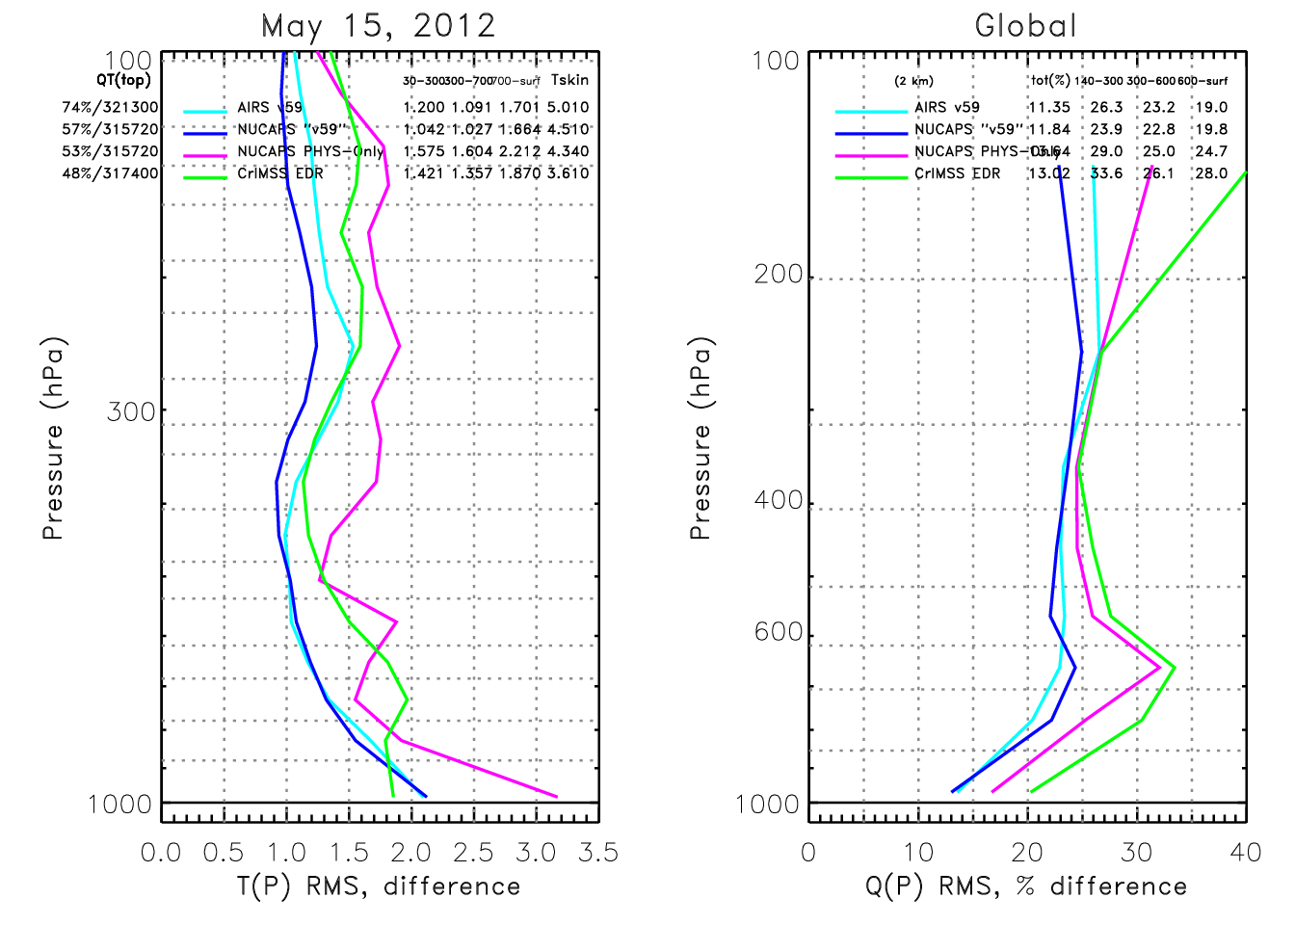
Provisional Maturity Justification (19/35) Comparison of CrIMSS-EDR, NUCAPS, AIRS
AIRS/AMSU v5.9 (CYAN) is AIRS v5 with correction for instrument changes.
NUCAPS “v5.9” uses CrIS/ATMS and the same spectroscopy and retrieval methodology as AIRS v5.9.
NUCAPS PHYS-only has no statistical operators
CrIMSS-EDR (GREEN) results have all changes installed (it is an emulation of Mx7.1 (May 2013) system).
Statistics for May 15, 2012 focus day in which Aqua and NPP orbits has high coincidence.
NUCAPS -PHYS(Magenta) and CrIMSS EDR (GREEN) have similar yield and performance
AIRS v5.9 and NUCAPS statistics are remarkably close
However, yield of NUCAPS is significant lower

Slide 48
Provisional Maturity Evaluation (20/35) Introduction to COSMIC Comparison
Next Set of slides (courtesy of Bob Knuteson and Michelle Feltz, Univ. of Wisconsin) show IDPS CrIMSS EDR products relative to co-located GPS sondes
AIRS results are shown in top panels
CrIMSS results from Mx5.3 and Mx6.4 are shown in bottom panels
GPS comparisons are only valid from ~300 hPa to 30 hPa
In general, GPS results are an independent confirmation of what we have shown relative to ECMWF
Statistics are similar to the heritage AIRS EDR products
CrIMSS EDR has larger biases
Because IDPS system does not have ATMS bias corrections
CrIMSS EDR has slightly larger standard deviation (SDV)
IDPS code is not fully optimized
Slide courtesy of Michelle Feltz and Robert Knuteson (see AMS presentation for details).

Slide 49
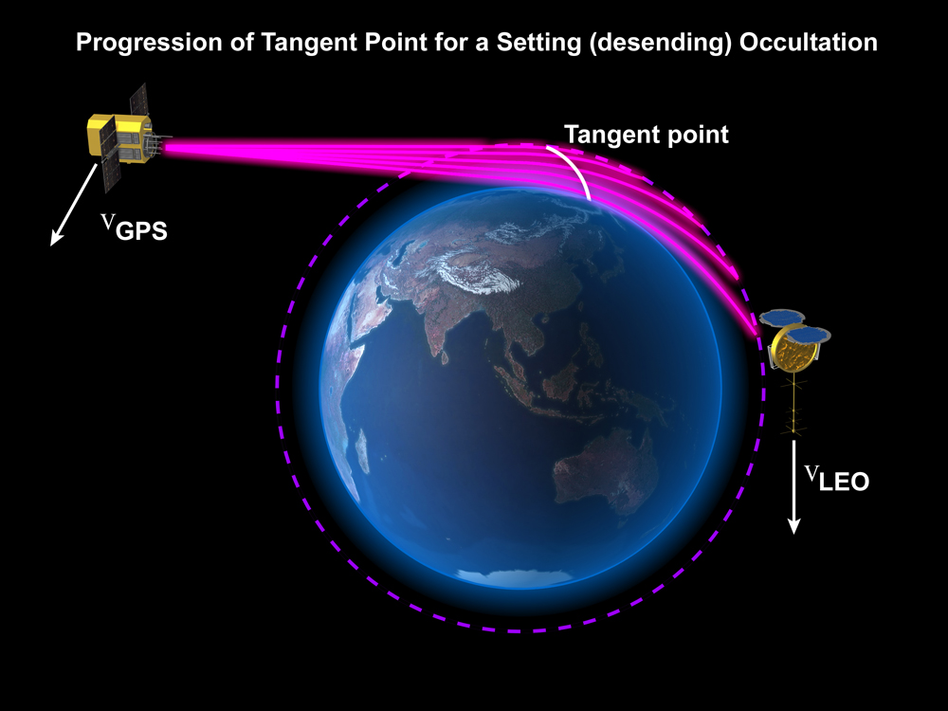
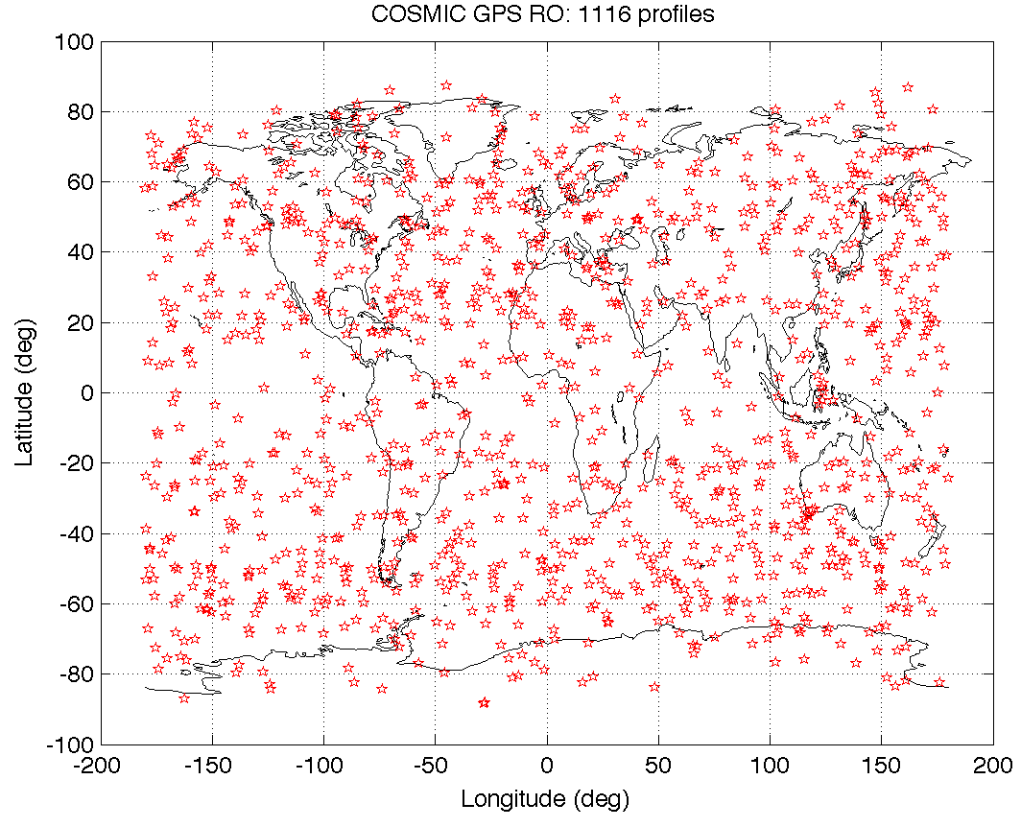
Provisional Maturity Evaluation (21/35)
Matchups were found between COSMIC and CrIMSS retrievals of temperature (collocated and within 1 hour). The COSMIC data is used a common reference to compare CrIMSS and AIRS retrievals on a daily basis. The COSMIC dry temperature is valid in the range 30 – 300 mb.
COSMIC Dry Temperature Profile
http://www.cosmic.ucar.edu/launch/GPS_RO_cartoon.jpg
Illustration of the closest (black square), circular (blue circle), and ray path (red dots) methods for a single GPS profile (green) for the circle centered at the GPS RO level of 100 hPa
One Day of COSMIC Profiles

Slide 50
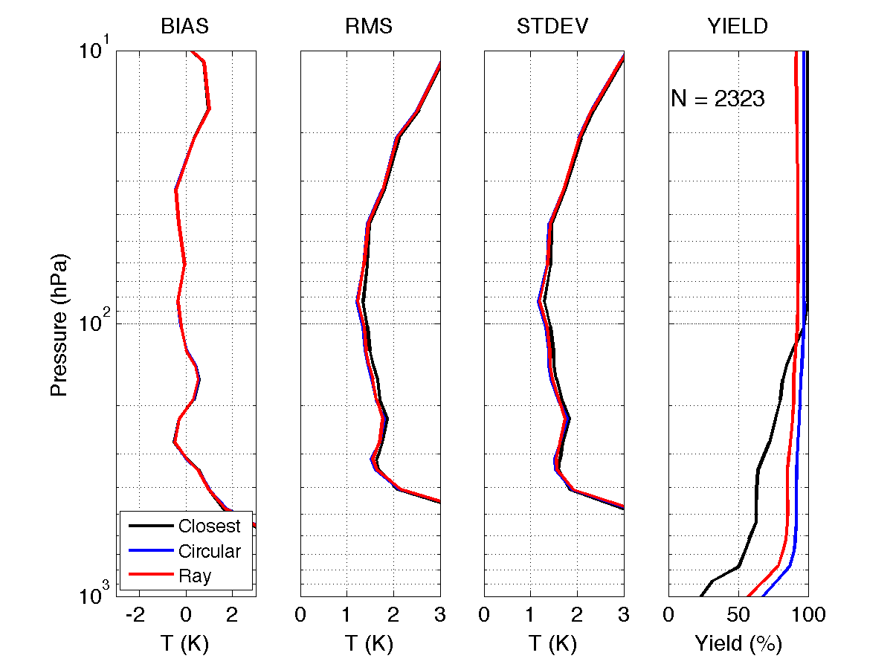
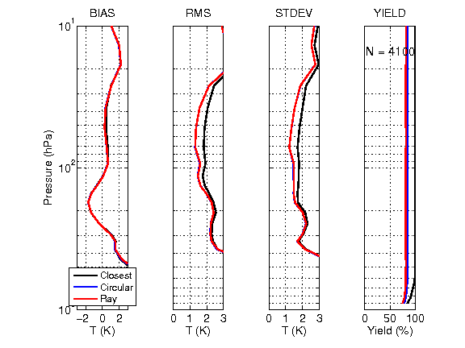
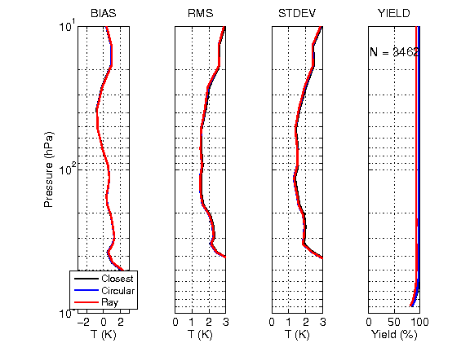
Provisional Maturity Evaluation (22/35)
GPS comparisons: Global (90S-90N)
AIRS - COSMIC
CLASS
Mx 5.3
Product
Oct. 1-10
CLASS
Mx 6.4
Product
Oct. 22-31
Slide courtesy of Michelle Feltz and Robert Knuteson (see AMS presentation for details).
Notes:
From B. Knuteson and M. Feltz Jan. 7, 2013
Yields (from original plots to verify I put them into here correctly
Global 60N-90N 30N-60N 30S-30N 30S-60S 60S-90S | Height Width X-pos Y-pos
AIRS 2323 459 378 445 531 510 | 1.80 7.28 2.07 1.27
CrIS 1-10 4100 1001 794 507 849 949 | 1.82 7.94 1.71 3.11
CrIS22-31 3462 808 527 498 718 911 | 1.82 7.94 1.71 4.92

Slide 51
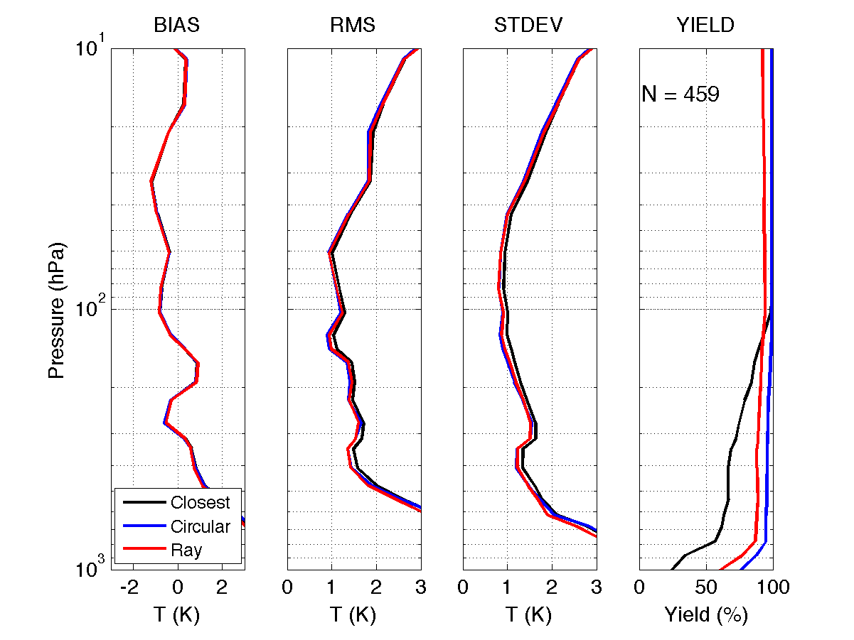
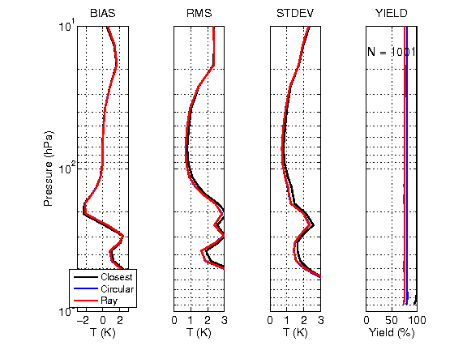
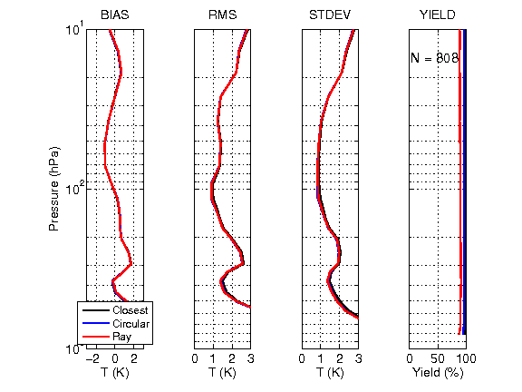
Provisional Maturity Evaluation (23/35)
GPS comparisons: N.H. Polar (60N-90N)
AIRS - COSMIC
CLASS
Mx 5.3
Product
Oct. 1-10
CLASS
Mx 6.4
Product
Oct. 22-31
Slide courtesy of Michelle Feltz and Robert Knuteson (see AMS presentation for details).

Slide 52
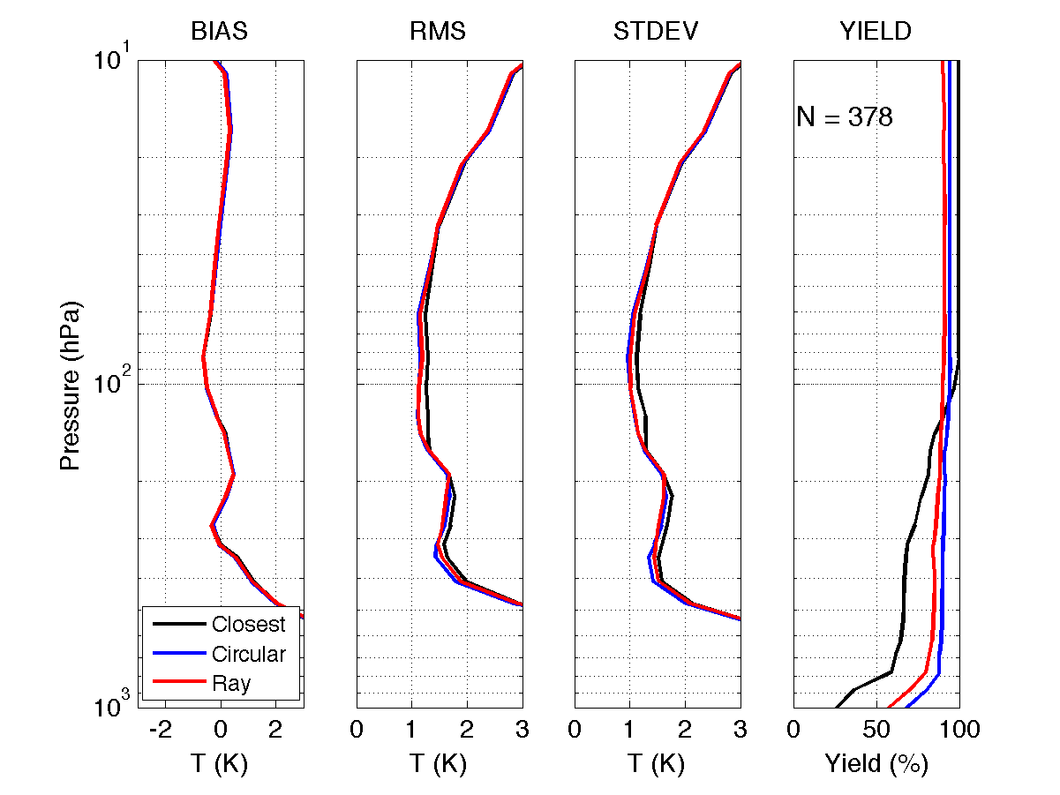
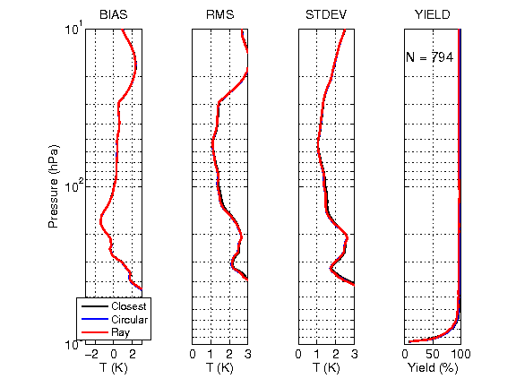
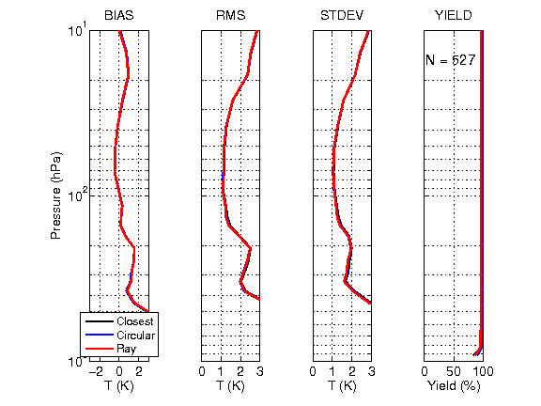
Provisional Maturity Evaluation (24/35)
GPS comparisons: N.H. Mid-Lat (30N-60N)
AIRS - COSMIC
CLASS
Mx 5.3
Product
Oct. 1-10
CLASS
Mx 6.4
Product
Oct. 22-31
Slide courtesy of Michelle Feltz and Robert Knuteson (see AMS presentation for details).

Slide 53
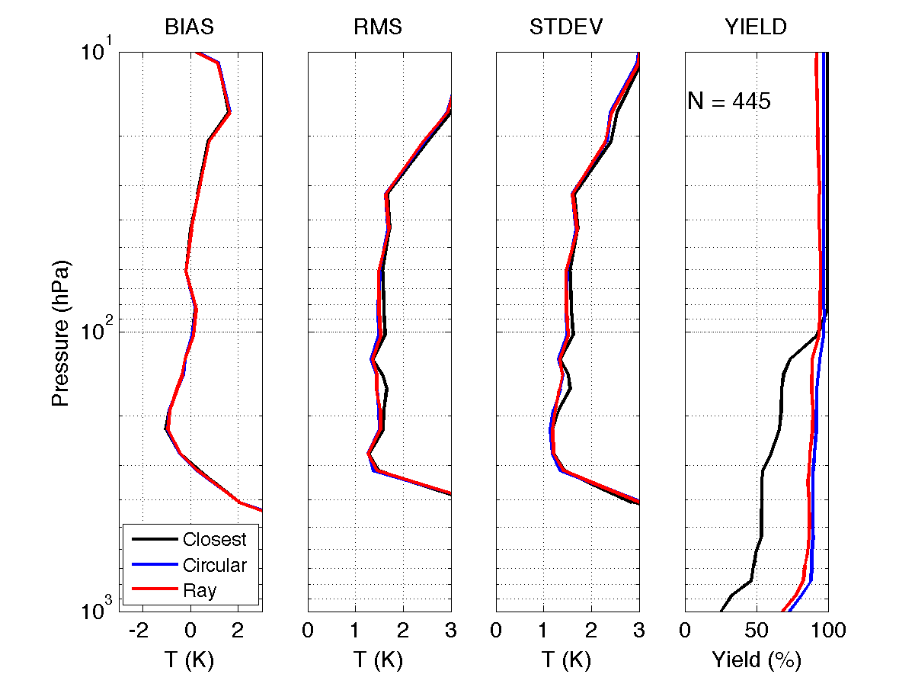
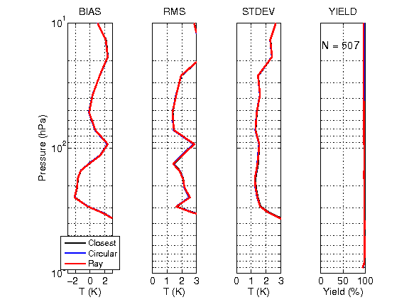
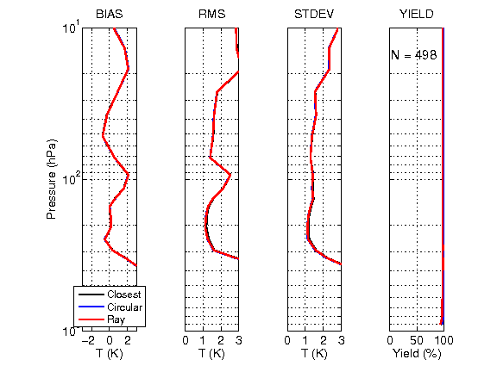
Provisional Maturity Evaluation (25/35)
GPS comparisons: Tropical (30S-30N)
AIRS - COSMIC
CLASS
Mx 5.3
Product
Oct. 1-10
CLASS
Mx 6.4
Product
Oct. 22-31
Slide courtesy of Michelle Feltz and Robert Knuteson (see AMS presentation for details).

Slide 54
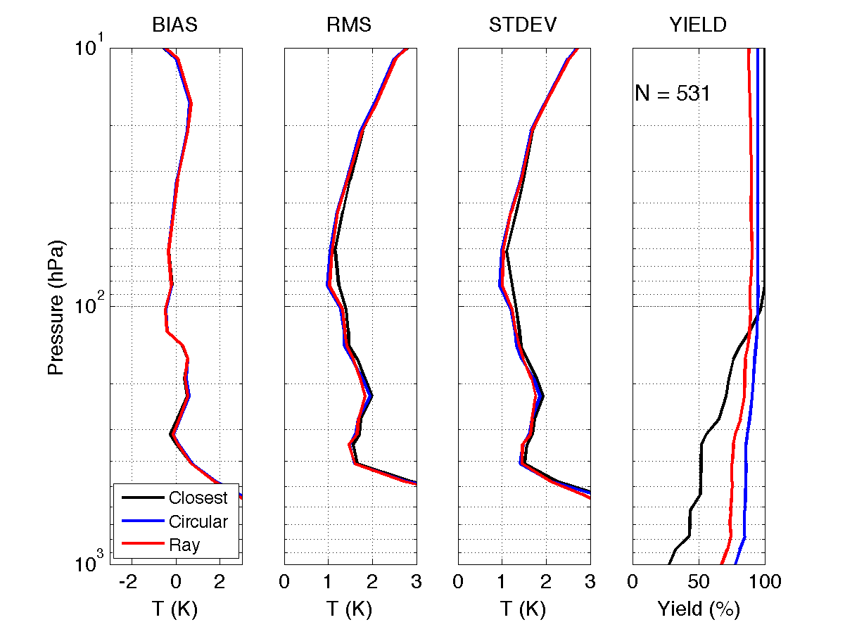
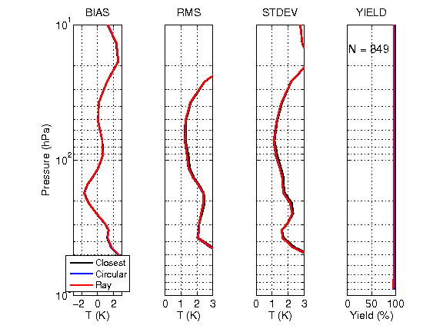
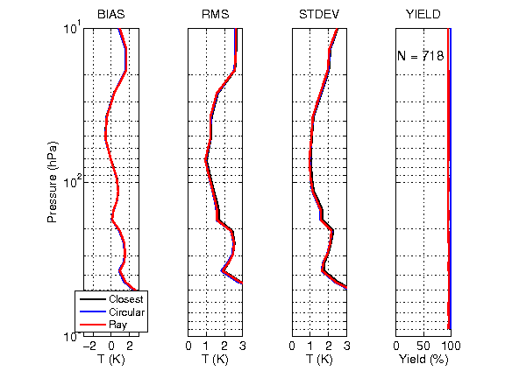
Provisional Maturity Evaluation (26/35)
GPS comparisons: S.H. Mid-Lat (30S-60S)
AIRS - COSMIC
CLASS
Mx 5.3
Product
Oct. 1-10
CLASS
Mx 6.4
Product
Oct. 22-31
Slide courtesy of Michelle Feltz and Robert Knuteson (see AMS presentation for details).

Slide 55
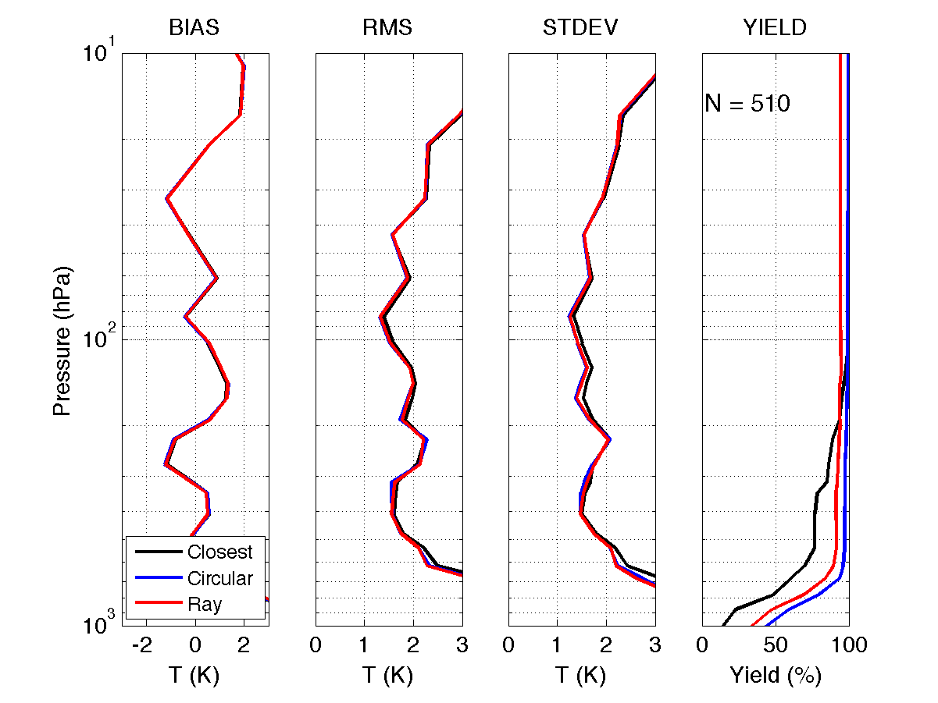
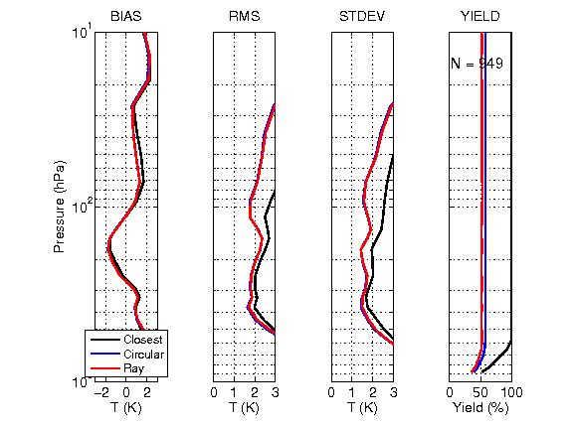
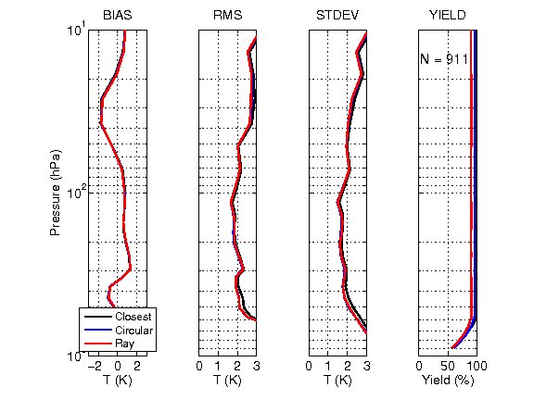
Provisional Maturity Evaluation (27/35)
GPS comparisons: S.H. Polar (60S-90S)
AIRS - COSMIC
CLASS
Mx 5.3
Product
Oct. 1-10
CLASS
Mx 6.4
Product
Oct. 22-31
Slide courtesy of Michelle Feltz and Robert Knuteson (see AMS presentation for details).

Slide 56
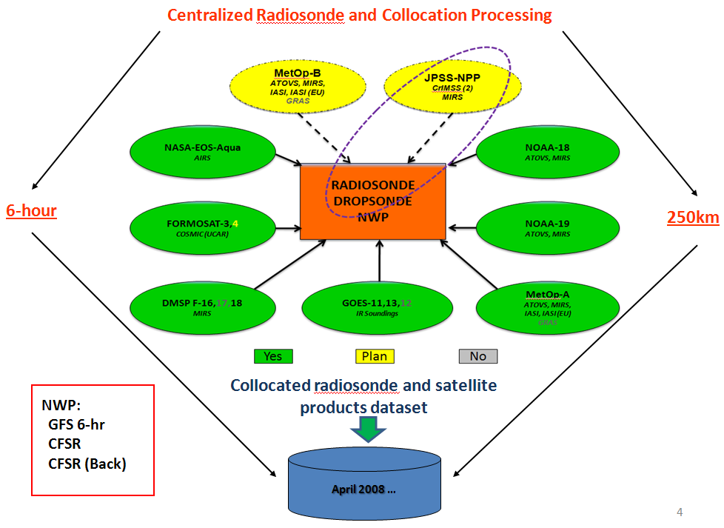
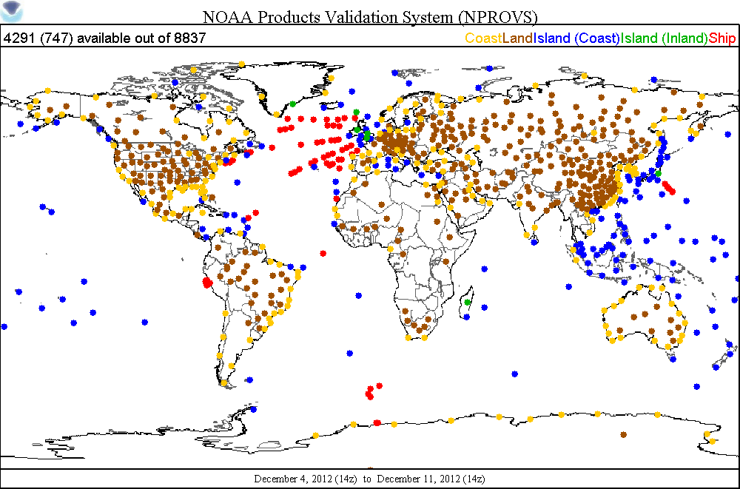
Provisional Maturity Evaluation (28/35) Introduction to NPROVS (Tony Reale)
NOAA Products Validation System (NPROVS) is a powerful interactive system.
Can compare a number of operation systems to the operational radiosonde database
Lower right: Locations of matchups (6 hour, 250 km) between NPP soundings and operational radiosondes during the week of Dec. 4-11, 2012.
4291 potential soundings

Slide 57
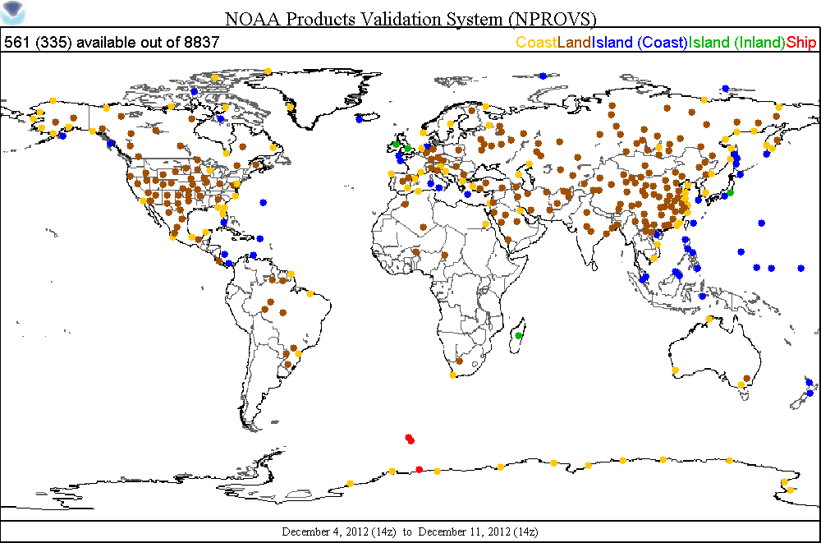
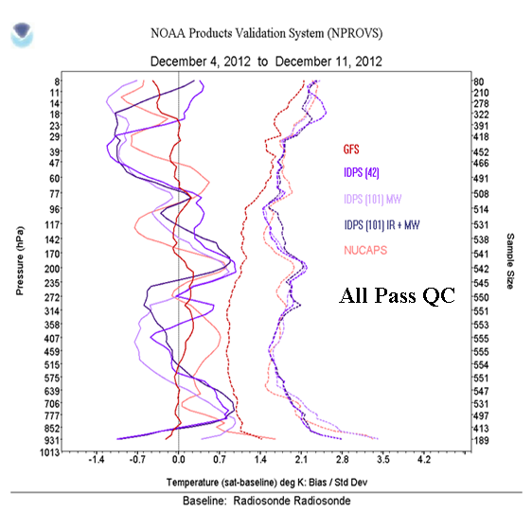
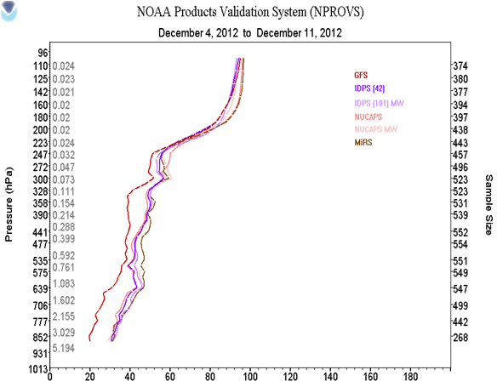
Provisional Maturity Evaluation (29/35) NPROVS evaluation of Mx6.4
The subset of 561 radiosondes where there is a successful Mx6.4 CrIMSS EDR and a successful pre-op NUCAPS sounding is shown in upper right.
Statistics of differences with radiosondes are shown below for AVTP (left) and AVMP (right).
ALL Pass QC

Slide 58
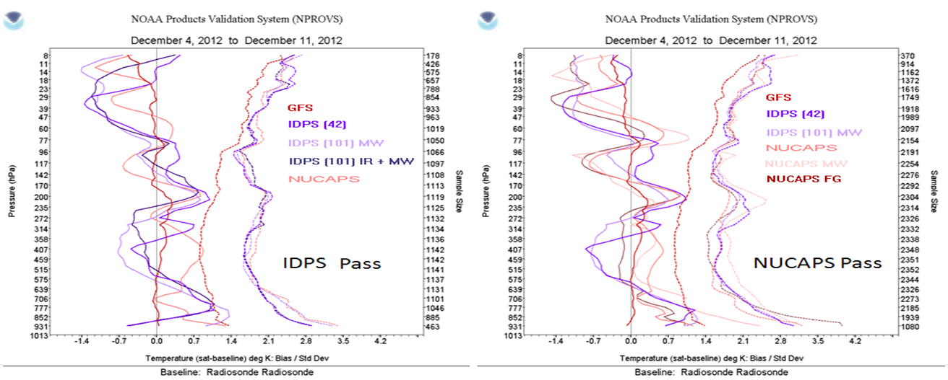
Provisional Maturity Evaluation (30/35)
In Mx6.4 the IDPS is still rejecting many cases (fix will be in place in Mx6.6)
Below is shown the AVTP statistics for both CrIMSS EDR and NUCAPS if CrIMSS EDR QC is used (left, ≈1150 cases) and if NUCAPS QC is used (right, ≈2350 cases)
The fact that the CrIMSS EDR statistic doesn’t change significantly is an indication that the performance of provisional CrIMSS EDR will not be degraded with higher yield.

Slide 59
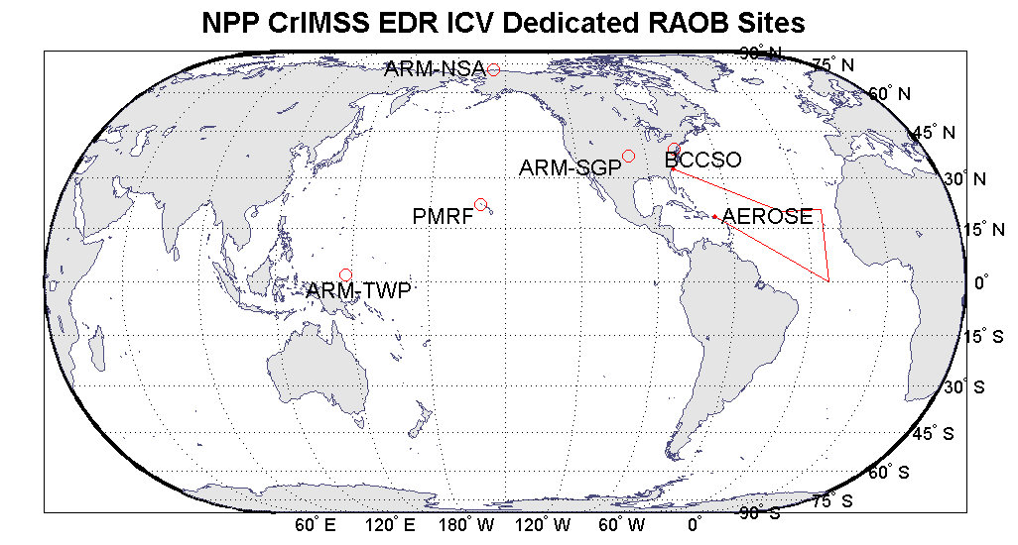
Provisional Maturity Justification (31/35) Coordinated Dedicated RAOB Campaign Status
 | ARM-TWP | ARM-SGP | ARM-NSA | PMRF | BCCSO | NOAA AEROSE
Location | Manus Island, Papua New Guinea | Ponca City, Oklahoma, USA | Barrow, Alaska, USA | Kauai, Hawaii, USA | Beltsville, Maryland, USA | Tropical North Atlantic Ocean
Regime | Tropical Pacific Warm Pool, Island | Midlatitude Continent, Rural | Polar Continent | Tropical Pacific, Island | Midlatitude Continent, Urban | Tropical Atlantic, Ship
Planned N | 90 | 180 | 180 | 40 | — | ≈ 60–120 (partitioned between NPP+IASI)
Launched n ₁ | 47 | 93 | 93 | 40 | 23 | 23 (NPP + IASI) (in progress)
Launched n ₂ | — | 89 | 90 | — | — | 0
Time Frame | Aug–present | Jul–present | Jul–present | May, Sep | Jun–Jul, Sep–present | Jan–Feb 2013
NOTE: we will use other GRUAN sites if data are provided – however, we do not have a commitment for those.
Notes:
BCCSO – Beltsville Center for Climate System Operation
PMRF – Pacific Missile Range Facility
ARM Sites (n = 450)
Tropical Western Pacific (TWP, island) (90)
Southern Great Plains (SGP) (180)
North Slope Alaska (NSA) (180)
Kauai, Hawaii (PMRF) Site (n = 40)
Tropical Central Pacific (island)
May (20)
Sep (20)
Collocated nighttime lidar
Collaborator: The Aerospace Corp.
Beltsville, MD (BCCSO) Site (n = 21+)
Urban midlatitude; lidar, MW radiometer
Jun–Jul, Sep 2012 ongoing
Collaborator: HU/NCAS
NOAA AEROSE Campaign (n ≈ 60-120)
Tropical Atlantic (ship), Charleston, SC to San Jan, PR
Jan-Feb 2013 (rescheduled cruise)
Collaborators: HU/NCAS, NOAA/ESRL
Sep 2012 (2) test sondes during return transit leg from Bermuda to Charleston
“Best Estimate” (2/overpass) soundings are a possibility

Slide 60

Provisional Maturity Evaluation (32/35) Example of PMRF Radiosonde
In May 2012, Aerospace Corp. launched 20 sondes from Hawaii.
Add’l 20 in Sep. 2012
At right is one sonde (black), the Off-line optimized CrIMSS EDR result (blue), the IDPS EDR (red), and NUCAPS EDR (cyan) for ATVP (left) and AVMP (right)
While these results are preliminary, we are investigating the possibility that the EDR product, which is reported on coarse layers, is offset (DR4207/4208) .

Slide 61

Provisional Maturity Justification (33/35) Example of Beltsville comparison

Slide 62

Provisional Maturity Justification (34/35) AEROSE “2012”
Aug. 2012 campaign was postponed due to propulsion problems with R.H. Brown
Campaign is now underway (Jan. 8-Feb.13)
~60-100 RS-92
Partitioned between Metop and NPP overpasses
~20-25 ozone sondes
After the usual problems getting shipboard systems to function (including fire in engine room), 1st radiosonde launched Jan. 9th.
As of Jan. 15, 23 RS-92’s and 5 O3 sondes have been launched
AEROSE provides unique measurements in under-sampled region
Allows assessment of impacts due to dust and smoke.
These sondes and “site” statistics never entered NWP analysis
Allows unique assessment of ECMWF/GFS errors

Slide 63

Provisional Maturity Justification (35/35) Ozone: OMPS vs CrIMSS-EDR
OMPS nadir mapper beta EDR
CrIMSS Mx6.4 O3-IP
Total column ozone (integral of CrIMSS ozone IP profile)
Quick Look slides and analysis by OMPS team
Slides courtesy of OMPS team (P.I. Larry Flynn, Jianguo Niu, Eric Beach)

Slide 64
Known Issues with the Provisional CrIMSS EDR (1/3): General Issues
Known problem with surface pressure exceeding reasonable values (DR4923)
Has negligible impact on product performance.
Amplification factor value in EDR file has incorrect value for ATMS-only retrievals.
Can be screened out using QC flags
Earth scenes during maneuvers should be marked invalid
If satellite is not in nadir configuration, but is still viewing Earth scene the LUTs for local angle correction are invalid and will cause subtle errors.
AVMP super-saturation test sometimes causes unrealistic structure in UTH profiles.

Slide 65
Known Issues with the Provisional CrIMSS EDR (2/3): Precip Flag
Precipitation flag is sub-optimal (DR4068 and 4069)
Precipitation flag is needed for excluding cases from the performance statistics.
Current flag is using out of date algorithm (1998) and incorrect coefficients (AMSU coefficients used)
Has a high failure rate (both false positives and negatives).
Does not impact quality of CrIMSS EDR directly.
Flag is unreliable.
Mostly affects performance assessment
Bad cases can be included with false negative, making statistics worse
Good cases can be excluded, making yield appear lower than it is.
New algorithm is being tested now (with 6 months of rain estimates) and being compared with MiRS products over CONUS.
Current approach converts ATMS into AMSU-like channels.
New code and coefficient’s will be installed into the off-line code in April-May 2013.

Slide 66




Known Issues with the Provisional CrIMSS EDR (3/3): Precip Flag
Ascending Orbit
Descending Orbit
MSPPS
Mx5.3 CrIMSS EDR

Slide 67
Additional Supporting Documentation (1/2) Presentations at the 93rd Annual AMS Meeting (Jan. 6-10, 2013)
Murty Divakarla, STAR, “Evaluation of CrIS/ATMS Proxy Data Generation Algorithms with Observed Radiances and Retrieval Products”
Murty Divakarla, STAR, “Provisional Maturity Assessment of Cross Track Infrared Sounder (CrIS) Temperature and Moisture Profile Products “
Poster: Tony Reale, STAR, “Validation of pending Suomi-NPP Operational Sounding Retrievals Using Global Radiosondes and Future Plans”
Poster: Xu Liu, NASA/LaRC, “Atmospheric Temperature and Moisture Profiles Retrieved from Suomi NPP CrIMSS Data”
Poster: Susan Kizer, NASA/LaRC, “Suomi NPP CrIMSS EDR Operational Code Porting and Algorithm Validation”
Poster: Mike Wilson, STAR, “A Global Perspective of the Current and Future CrIMSS EDR Algorithm”
Poster: Changyi Tan, STAR, “On Empirical Bias Corrections of the NPP CrIMSS OSS Forward Model “
Poster: Ralph Ferraro, STAR, “Evaluation and Improvement of the NPP CrIMSS Rain Flag”
Zhenglong Li, CIMSS, “NPP sounding validation and evaluation”
Feltz and Knuteson, CIMSS, “Validation of Temperature Profile Environmental Data Records (EDRs) from the Cross-Track Infrared Microwave Sounding Suite (CrIMSS) Using COSMIC Dry Temperature Profiles”
Denise Hagan, NGAS, “Performance of the ATMS Intermediate Product Suite”
Denise Hagan, NGAS, “CrIMSS Single FOV EDR Retrieval”

Slide 68
Additional Supporting Documentation (2/2) (Published papers related to CrIMSS EDR)
Gambacorta, A. and C. Barnet 2012. Methodology and information content of the NOAA NESDIS operational channel selection for the Cross-Track Infrared Sounder (CrIS). IEEE TGARS, In-Press, June 2012
Discusses methodology of selection of CrIS channels sent to NWP centers
More details in published NOAA Technical Report v.133
Maddy, E.S., S. DeSouza-Machado, N.R. Nalli, C.D. Barnet, L.L. Strow, W.W. Wolf, H. Xie, A. Gambacorta, T.S. King, E. Joseph, V. Morris, S.E. Hannon and P. Schou 2012. On the effect of dust aerosols on AIRS and IASI operational level 2 products. Geophys. Res. Lett. v.39 L10809 doi:10.1029/2012GL052070, 5 pgs.
Direct result of analysis of AEROSE data
Nalli, N.R., C.D. Barnet, E.S. Maddy and A. Gambacorta 2012. On the angular effect of residual clouds and aerosols in clear-sky infrared window radiance observations: Sensitivity analyses. J. Geophys. Res. v.117 D12208 doi:10.1029/2012JD017667, 19 pgs.
Direct result of analysis of AEROSE data
Reale, T., B. Sun, F.H. Tilley and M. Pettey 2012. The NOAA Products Validation System (NPROVS). J. Atmos. Oceanic Tech. v.29 p.629-645.
Demonstration of the NOAA CrIMSS EDR validation system
Nalli, N., Joseph, E., Morris, V.R., Barnet, C.D., Wolf, W.W., Wolfe, D., Minnett, P.J., Szczodrak, M., Izaquirre, M.A., Lumpkin, R., Xie, H, Smirnov, A., King, T.S., Wei, J. 2011. Multi-year observations of the tropical Atlantic atmosphere: Multidisciplinary applications of the NOAA Aerosols and Ocean Science Expeditions (AEROSE). Bull. Amer. Meteor. Soc. v.92, p.765-789 doi:10.1175/2011BAMS52997.1 (June 2011 and was cover of that issue)

Slide 69
Provisional Justification Summary (1/2)
Criteria: Product accuracy is determined for a broader (but still limited) set of conditions
Majority of evaluation is based on 2 focus days using off-line code
CrIS and ATMS SDRs were both at beta maturity
Demonstration of improvements is based on understanding of code theoretical basis and architecture.
Product has been enhanced: yield has increased substantially with significant improvement in performance
Criteria: All DRs are identified and prioritized
Known bugs have been fixed
Priority has been given to improving yield and performance.
Outstanding issues are mostly related to file format and quality control during rare events.

Slide 70
Provisional Justification Summary (2/2)
Criteria: General research community is encouraged to participate in the QA and validation of the product, but need to be aware that product validation and QA are ongoing
CrIMSS EDR team has evaluated IDPS EDR products available from CLASS now (Mx6.4) and in the future.
Yield is reasonable (both IR+MW and MW-only) and product quality is high.
Provisional release will allow other users within the community to gain experience with the parameters.
This is important to allow users to complement the validation activity.

Slide 71
Future Plans and Issues
We are working to get these changes into the IDPS
IDPS version is significantly behind the off-line and ADL versions.
Change process has been a learning process, but they have been approved for implementation in Mx7.1 (to be available June 2013).
Once implemented in IDPS, we will verify performance.
At that time, product can be declared provisional.
In the meantime: detailed performance characterization will be done w.r.t. dedicated radiosondes
Hopefully, we will have completed a successful AEROSE campaign
The ARM-CART radiosonde launches from North Slope of Alaska (NSA), Southern Great Plains (SGP), and Tropical Western Pacific TWP) are continuing.
~90 overpasses at each site (SGP and NSA have 2 sondes/overpass)
Aerospace PMRF sondes complement the ARM TWP sondes
Beltsville sondes complement the ARM SGP sondes
Radiosonde analysis will be basis of the stage.1 validated maturity justification scheduled for Nov/Dec 2013.

Slide 72
Conclusion
Many issues were uncovered during validation and solutions were evaluated, change packages submitted (and accepted by AERB)
Proposed Mx7.1 CrIMSS EDR has met the Provisional stage based on the definitions and the evidence shown
It exceeds the definition of provisional in most cases
Lower troposphere AVTP and AVMP still need work.
Off-line EDR product performance is close to meeting requirements at this time (and continuing to improve).
Once Mx7.1 is running on IDPS the analysis will be repeated to ensure performance is the same as described in this document.
Open question: Do we submit provisional DR/CCR now or wait until the analysis is completed using the IDPS EDR products?

