Slide 1
VIIRS NCC Imagery at Beta CCR 12-0683 DR 4859
Dr. Thomas Kopp – Imagery Validation Lead
Dr. Donald Hillger – Imagery Product Lead
Mr. Ryan Williams - Imagery JAM

Slide 2
Brief summary of NCC Imagery
The NCC Imagery EDR takes VIIRS DNB SDRs and transfers the appropriate values on as Ground Track Mercator (GTM) projection
GTM uses the nearest pixel, it does not use an average unless an isolated pixel has a bad value
Creating NCC Imagery includes two additional steps not taken for any other imagery product
It computes an albedo for each pixel
It mitigates solar/lunar variations across scan lines through the use of Look-Up Tables (LUTs)

Slide 3
Typical Terminator NCC Image
Image is extreme northern Canada
Transition from light to dark not obvious

Slide 4
NCC Imagery Requirements
Current requirements based on the Level 1 Requirements Document (L1RD) are restricted to resolution, mapping accuracy, and latency
Quality requirements found in the old NPOESS program are no longer present
Actually use of NCC Imagery tied to ability of a human analyst to determine his/her features of interest through Imagery
If the operational user is not satisfied, the Imagery EDR has failed, independent of any quantitative requirements
The Imagery validation team has focused on the later in the early stages of validation

Slide 5
General Guidelines
The two fundamental features the Imagery Cal/Val team focused on for NCC Imagery at this stage was its performance in the terminator and under lunar illumination conditions
The terminator is where the LUTs have their greatest impact
Nighttime visual imagery is unique to the NCC product
Other aspects were deferred to the SDR team
Quantitative validation of resolution and latency handled by other teams
Geolocation qualitatively addressed at this time
Earlier issues have been resolved

Slide 6
Beta Definition
Early release product
Initial calibration applied
Minimally validated and may still contain significant errors
Available to allow users to gain familiarity with data formats and parameters
Product is not appropriate as the basis for quantitative scientific publication studies and applications

Slide 7
Beta Evaluation
Early release product
NCC Imagery has not been extensively analyzed by operational users
Imagery is not available to real-time users on a timely basis
Neither NDE or AFWA can make Imagery available to their general set of customers in near real time as of this briefing
Only the Navy is regularly reviewing the product in a near real time environment
NCC only useful at night within 48 hours of the full moon
Therefore only 5 nights out of the 29 day lunar cycle
Initial calibration of the DNB is complete
VIIRS DNB SDRs declared “beta” in May 2012
No software changes have yet been made to the NCC Imagery EDR

Slide 8
Beta Evaluation
Minimally validated and may still contain significant errors
Significant errors have been identified and are documented as Discrepancy Reports
Fill values in the shape of triangles at corners of the Imagery
This issue is related to the ground system and has already been mitigated
Stray light evident on the dark side of the terminator
Dark pixels contain fill indicating albedos are out-of-bounds
Missing data exists in granules crossing the 105 solar angle boundary
Examples of the three issues in work follow

Slide 9
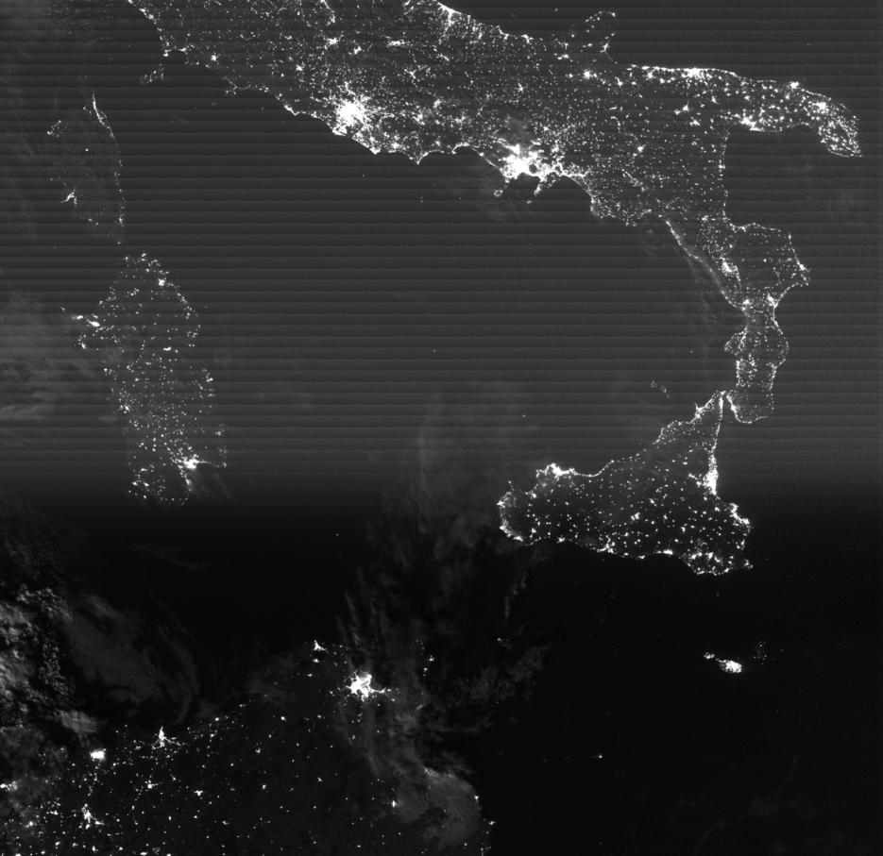
Stray Light
Root cause is sunlight shining into the sensor
Work in progress to mitigate through software

Slide 10
Fill in Very Dark Pixels
Root cause unknown, likely from multiple causes
Number of pixels affected increase as lunar illumination decreases

Slide 11
No NCC Imagery at 105 Solar Angle
Root cause unknown
Speculation is an adverse effect from a granule level flag indicating the entire granule is “day”
Diagonal follows the 105 solar angle

Slide 12
Beta Evaluation
Available to allow users to gain familiarity with data formats and parameters
NCC Imagery may be retrieved through CLASS or GRAVITE
Both NDE and AFWA working towards real-time support
AFWA is shipping NCC Imagery to NRL-Monterey in near real time
Some of this Imagery appears on their NexSat web site
Product is not appropriate as the basis for quantitative scientific publication studies and applications
NCC Imagery, in general, does not contain quantitative applications
VIIRS DNB SDRs only at beta stage
Also note the issues just shown

Slide 13
Conclusion
NCC Imagery has met the beta stage based on the definitions and the evidence shown
It exceeds the definition of beta in some cases
Remaining issues are known and at least a preliminary way ahead has been established
Each of the four identified issues has been mitigated or is actively being resolved
NCC imagery has reached the beta stage of validation

