Slide 1
Suomi NPP Imagery EDR Team
Don Hillger¹ and Tom Kopp²
17-18 April 2012
VIIRS Cal-Val Workshop
GSFC Building 8
¹NOAA/NESDIS/StAR, Don.Hillger@NOAA.gov
²The Aerospace Corporation, Thomas.J.Kopp@aero.org

Slide 2
VIIRS EDR Imagery Team
NESDIS/StAR (D. Hillger, D. Molenar, D. Lindsey, T. Schmit – GOES liaison)
CIRA/CSU (S. Miller, S. Kidder, S. Finley, H. Gosden, R. Brummer, C. Seaman)
CIMSS/SSEC (T. Achtor, T. Jasmin, T. Rink)
Aerospace (T. Kopp, J. Drake, J. Feeley)
NOAA/NGDC (C. Elvidge)
AFWA (J. Cetola)
NIC (P. Clemente-Colon)
Northrop Grumman (K. Hutchison, R. Mahoney)
NASA (W. Thomas, P. Meade)
NOAA/OSPO (A. Irving)
NASA/SPoRT (G. Jedlovec, M. Smith)
FNMOC (J. Tesmer)
NRL (J. Hawkins, K. Richardson, J. Solbrig)
Northrup Grumman (K. Hutchinson, P. Meade)
NOAA/OSPO (A. Irving, M, Ruminski)
NASA/SPoRT (G. Jedlovec, M. Smith)

Slide 3
VIIRS bands and bandwidths
VIIRS Band | Central Wavelength (μm) | Bandwidth (μm) | Wavelength Range (μm) | Band Explanation | Spatial Resolution (m) @ nadir
M1 | 0.412 | 0.02 | 0.402 - 0.422 | Visible | 750 m
M2 | 0.445 | 0.018 | 0.436 - 0.454
M3 (blue) | 0.488 | 0.02 | 0.478 - 0.488
M4 (green) | 0.555 | 0.02 | 0.545 - 0.565
M5 (red) | 0.672 | 0.02 | 0.662 - 0.682
M6 | 0.746 | 0.015 | 0.739 - 0.754 | Near IR
M7 | 0.865 | 0.039 | 0.846 - 0.885
M8 | 1.240 | 0.020 | 1.23 - 1.25 | Shortwave IR
M9 | 1.378 | 0.015 | 1.371 - 1.386
M10 | 1.61 | 0.06 | 1.58 - 1.64
M11 | 2.25 | 0.05 | 2.23 - 2.28
M12 | 3.7 | 0.18 | 3.61 - 3.79 | Medium-wave IR
M13 | 4.05 | 0.155 | 3.97 - 4.13
M14 | 8.55 | 0.3 | 8.4 - 8.7 | Longwave IR
M15 | 10.763 | 1.0 | 10.26 - 11.26
M16 | 12.013 | 0.95 | 11.54 - 12.49
DNB | 0.7 | 0.4 | 0.5 - 0.9 | Visible | 750 m across full scan
I1 (red) | 0.64 | 0.08 | 0.6 - 0.68 | Visible | 375 m
I2 | 0.865 | 0.039 | 0.85 - 0.88 | Near IR
I3 | 1.61 | 0.06 | 1.58 - 1.64 | Shortwave IR
I4 | 3.74 | 0.38 | 3.55 - 3.93 | Medium-wave IR
I5 | 11.45 | 1.9 | 10.5 - 12.4 | Longwave IR
M bands highlighted in pale yellow are default EDRs (only 6 of 16 M bands).

Slide 4
CIRA NPP INFRASTRUCTURE
DATA INGEST
2 SERVERS FOR AUTOMATED ‘REAL-TIME’ INGEST
SHARED/REDUNDANT PROCESSING
PEATE = PRIMARY DATA SOURCE, GRAVITE=BACKUP + DATA NOT ON PEATE
CONUS SECTORS
FLOATING TROPICAL SECTORS
NPP ORBIT PREDICTION RUNS EACH DAY TO DETERMINE INGEST GRANULES
~2400 files/~105 GB per day
REAL-TIME ROTATING ARCHIVE CAN HOLD 5-7 DAYS OF DATA
INGEST AND ARCHIVE SOFTWARE DEVELOPED IN-HOUSE (PERL)
DATA PROCESSING & ANALYSIS
SOME PROCESSING DONE ON INGEST SERVERS
2 ADDITIONAL USER WORKSTATIONS
Imagery EDR CAL/VAL
Cloud CAL/VAL
‘ON THE FLY’ PROCESSING ALSO DONE ON VARIOUS INDIVIDUAL WORKSTATIONS
STORAGE
2 14 TB NAS UNITS
LONG TERM ARCHIVE OF SPECIAL ANALYSIS CASES + TC GRANULES

Slide 5
PEATE vs. GRAVITE
Analyzed data from 13 March 2012 over and near the CONUS
GRAVITE has many duplicate files—earlier versions of reprocessed files. PEATE has only the final version of files.
PEATE has more files than GRAVITE. All GRAVITE files have PEATE equivalents, but not vice versa.
Final versions of files are effectively identical on PEATE and GRAVITE
PEATE files are on average about 40% smaller than GRAVITE files, probably due to slightly different file structures

Slide 6
Suomi NPP Imagery Team page http://rammb.cira.colostate.edu/projects/npp/

Slide 7
Imagery Team Suomi NPP Blog http://rammb.cira.colostate.edu/projects/npp/blog/

Slide 8
SDR to EDR software
Ground Track Mercator (GTM) remapping software.
GTM is a remapping of the data, but the same radiances (temperatures or reflectances)
Environmental Data Record (EDR)
Sensor Data Record (SDR)
GTM software
GTM software
NCC = Near Constant Contrast (EDR)
DNB = Day Night Band (SDR)

Slide 9
VIIRS display tools
McIDAS-V
VIIRS ready, a new version expected soon
Java based
Freely available to anyone (SSEC/CIMSS/Wisconsin)
http://www.ssec.wisc.edu/mcidas/software/v/
McIDAS-X
VIIRS capabilities under development
VIIRS available via ADDE server (from PEATE)
Fortran and C-based
User group subscription service only (SSEC/CIMSS/Wisconsin)
http://www.ssec.wisc.edu/mcidas/software/x/
TeraScan / NexSat (web display)
Currently used at NRL
CIRA has capabilities
Other (IDL, ENVI, ?)

Slide 10
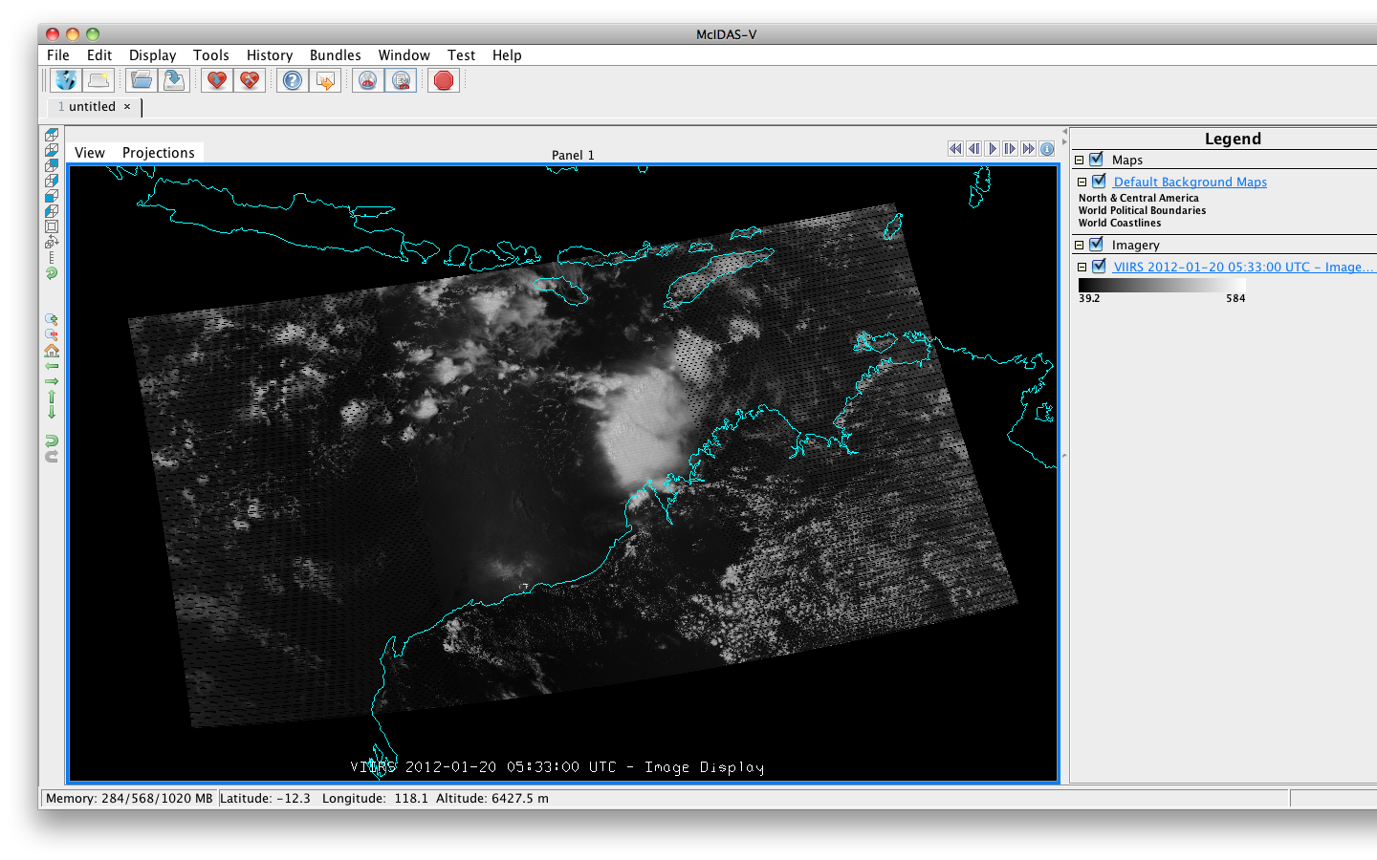
VIIRS M1 3 Granule Aggregation
Notes:
A three-granule aggregation of VIIRS Chanel M1 in McIDAS-V. Northwest Australia and south Indonesia. Area outlined is highlighted in next slide using all 16 VIIRS M Bands.

Slide 11
Notes:
Island of Sumba, south Indonesia. Indian Ocean to the south, further would be Australia.

Slide 12
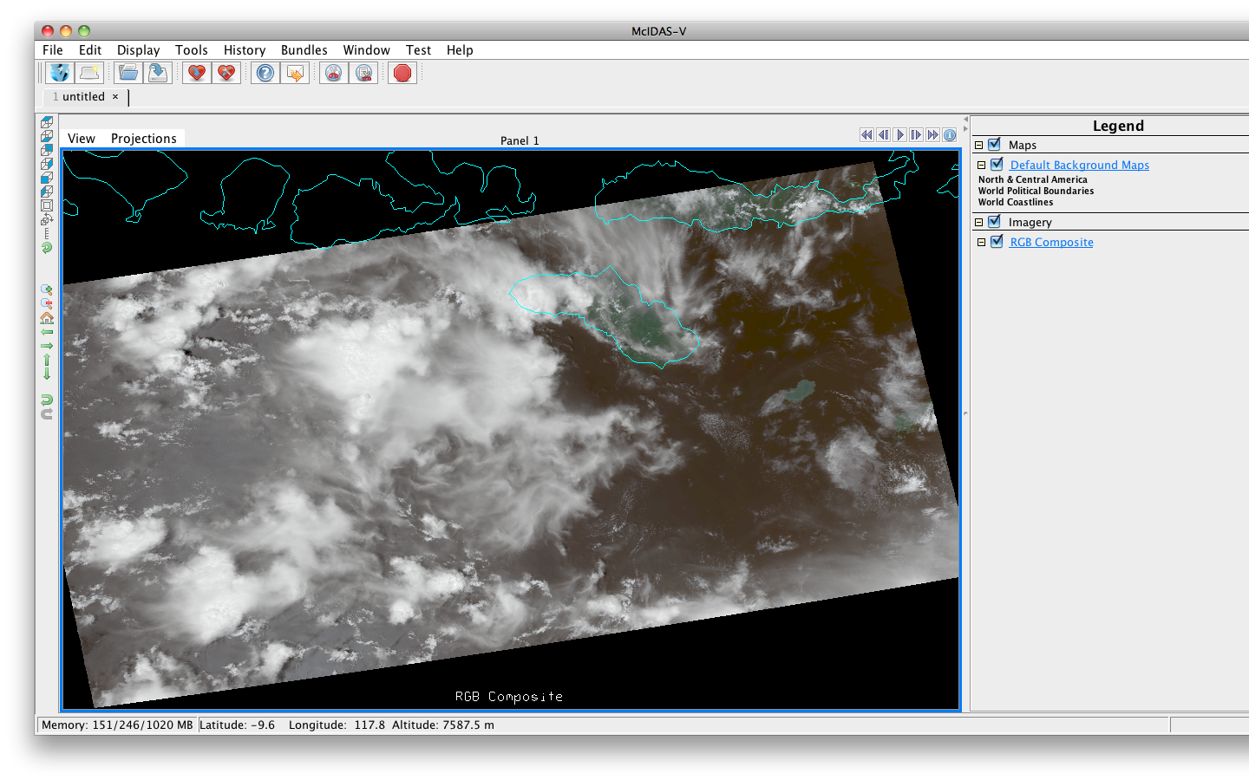
VIIRS M5-M4-M3 RGB, Indonesia

Slide 13
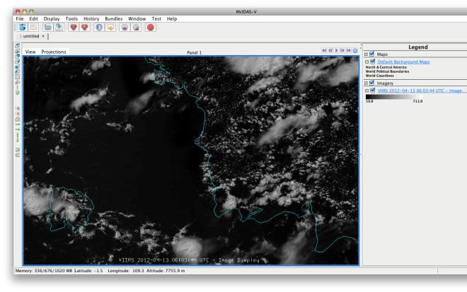
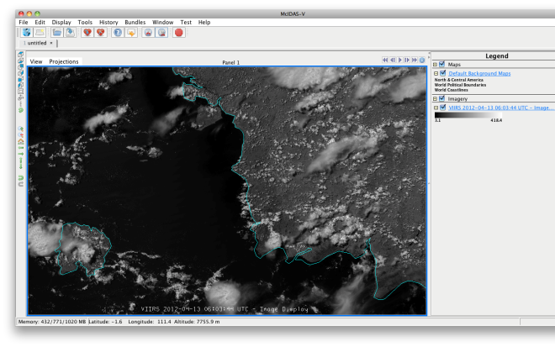
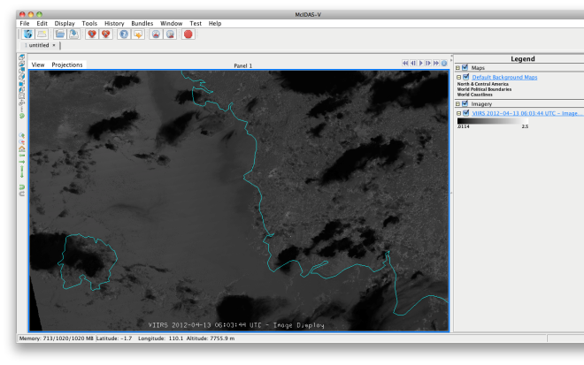
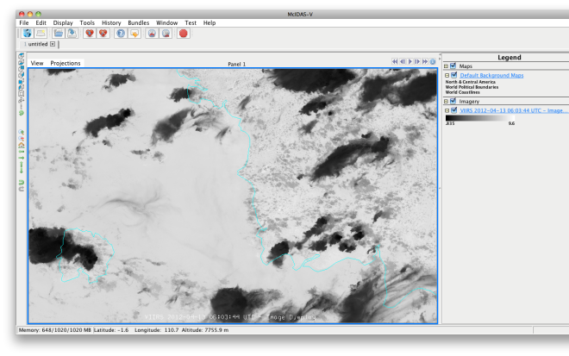
VIIRS I Bands, Indonesia
I-1
I-2
I-3
I-4
I-5

Slide 14
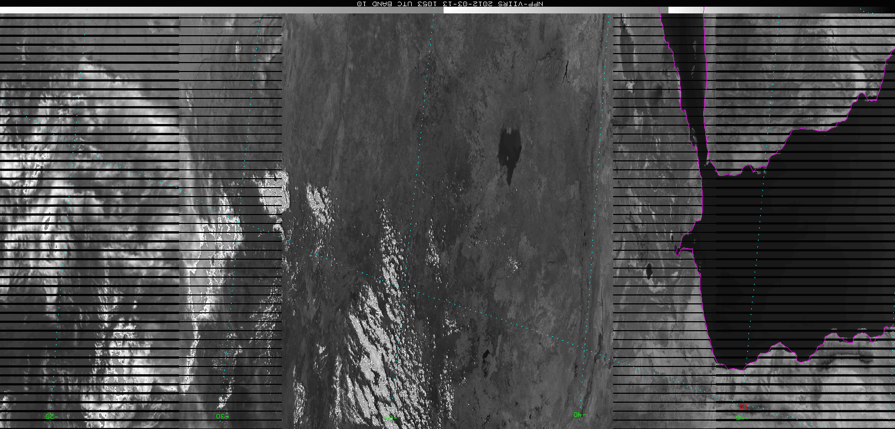
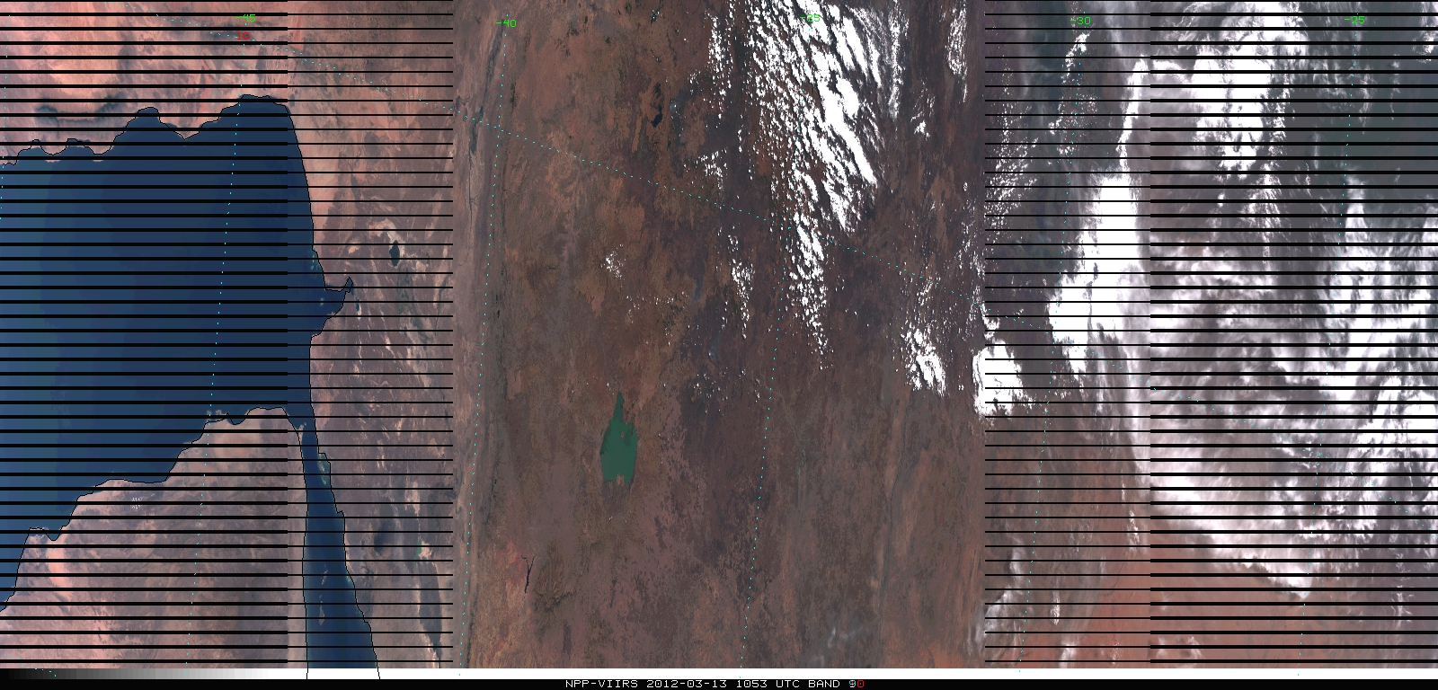
McIDAS-X and VIIRS (SDR example from PEATE) [not yet ready for prime time!]
M5 band (red)
RGB
(true-color)

Slide 15
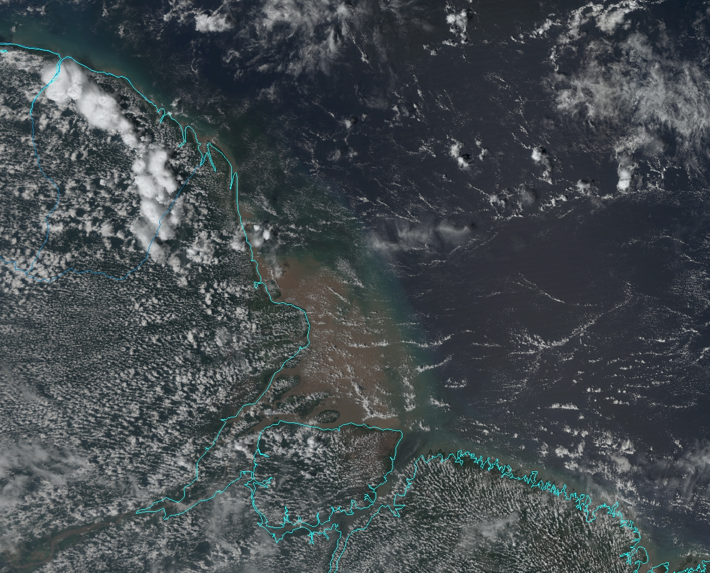
VIIRS M-band (750 m) true-color/RGB images created from the first data from VIIRS is the following image of the Brazilian coast created using McIDAS-V. [Image courtesy of Tom Rink, CIMSS]

Slide 16
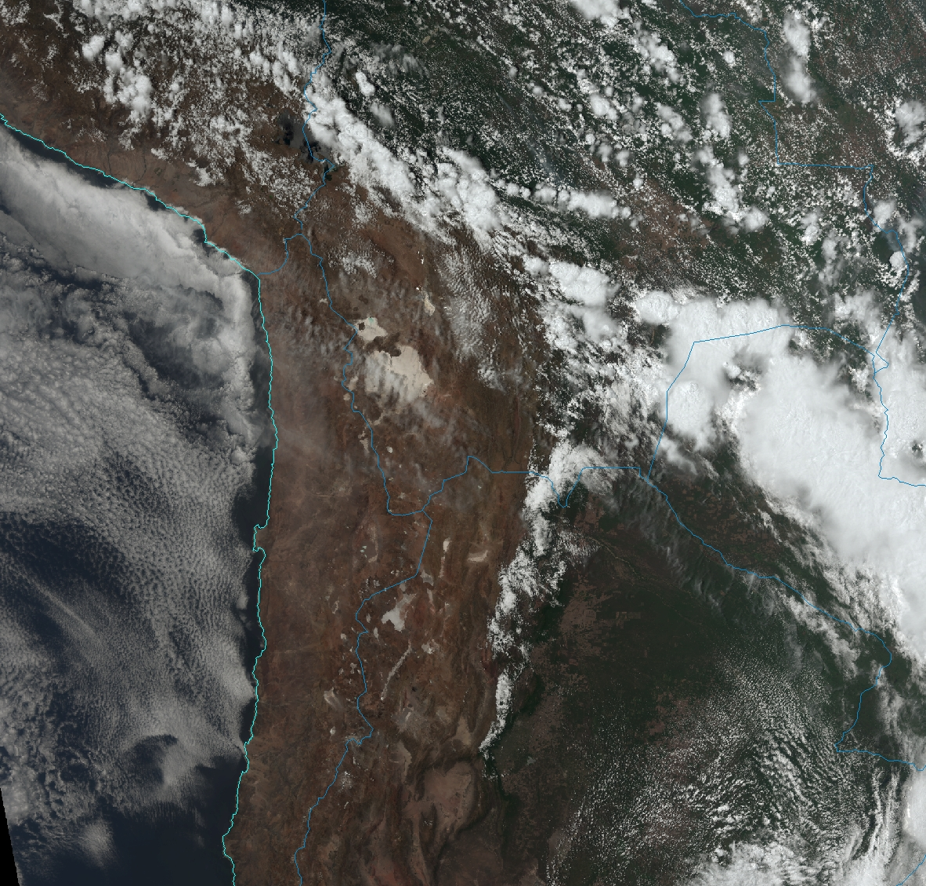
VIIRS M-band (750 m) true-color/RGB image of the western coast of South America. [Image courtesy of Tom Rink, CIMSS]

Slide 17
VIIRS M-band (750 m) true-color/RGB image (for 14 December 2011) over northeastern India and Nepal. Note the large amount of pollution over India relative to Tibet, and how the mountains keep it all to the south. [Image courtesy of Dan Lindsey, NOAA/StAR]

Slide 18
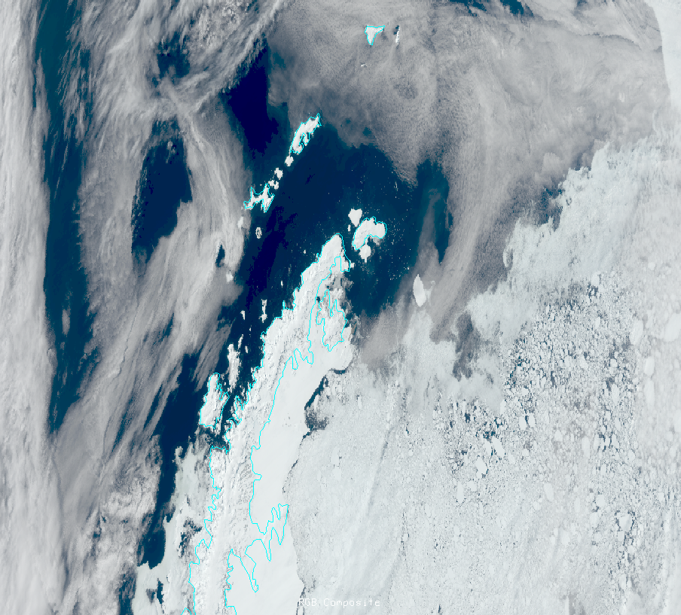
VIIRS M-band (750 m) true-color/RGB image (for 25 November 2011) with a nice contrast of the open ocean vs. ice. The map is the Antarctic Peninsula which extends toward the tip of S. America, and the Weddell Sea on the right in the image. [Image courtesy of Dan Lindsey, NOAA/StAR]

Slide 19
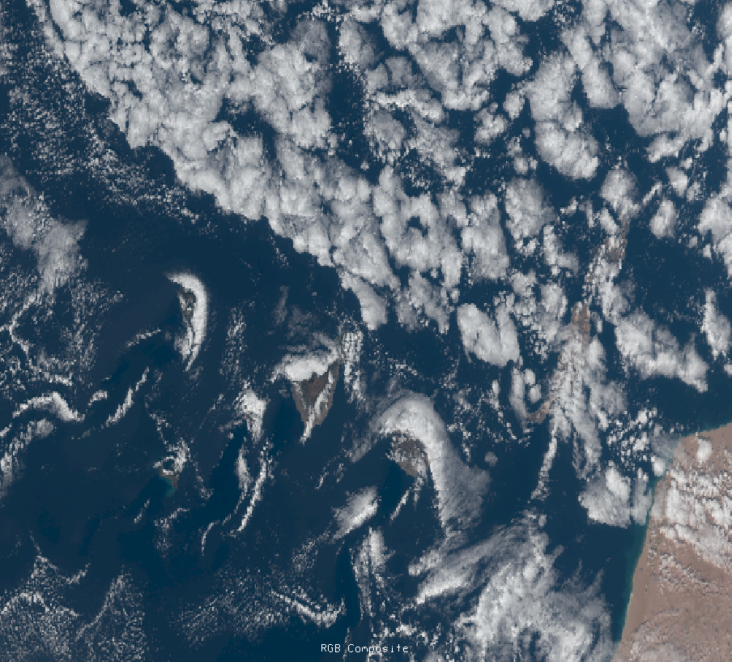
VIIRS M-band (750 m) true-color/RGB image (for 3 December 2011) with cloud vortices over the Canary Islands, just off of NW Africa. [Image courtesy of Dan Lindsey, NOAA/StAR]

Slide 20
VIIRS M-band (750 m) true-color/RGB image (for 9 December 2011) over the U.S. Upper Midwest. [Image courtesy of Dan Lindsey, NOAA/StAR]

Slide 21
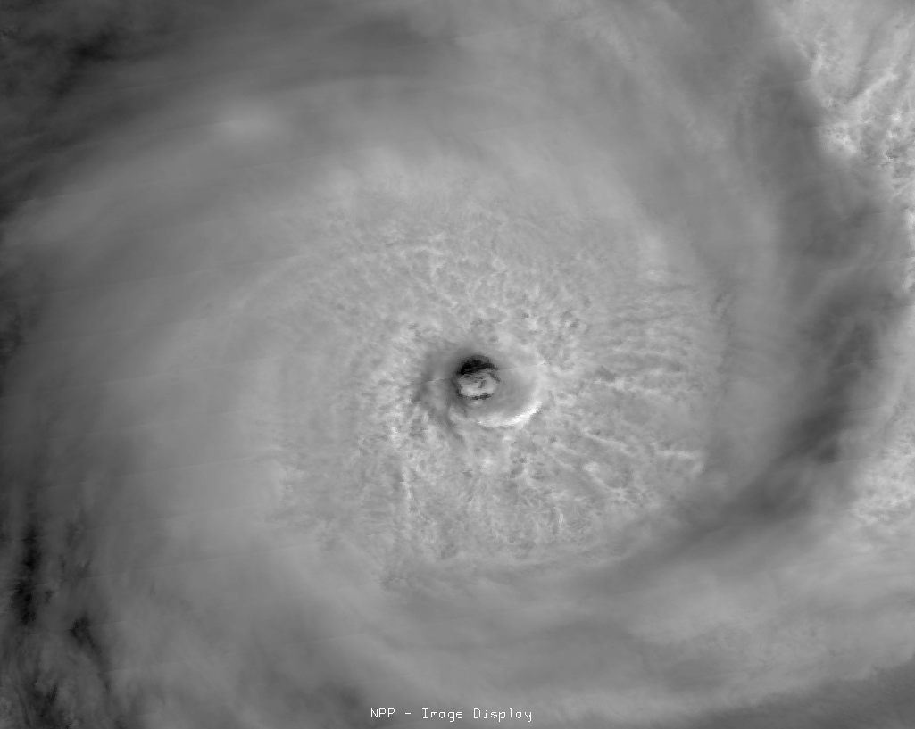
VIIRS I-band-1 (375 m) IR image for 24 January 2012 @ ~1102 UTC over the eye of TC Funso. Note the sloping eyewall at this resolution. [Image courtesy of Dan Lindsey, NOAA/StAR]

Slide 22
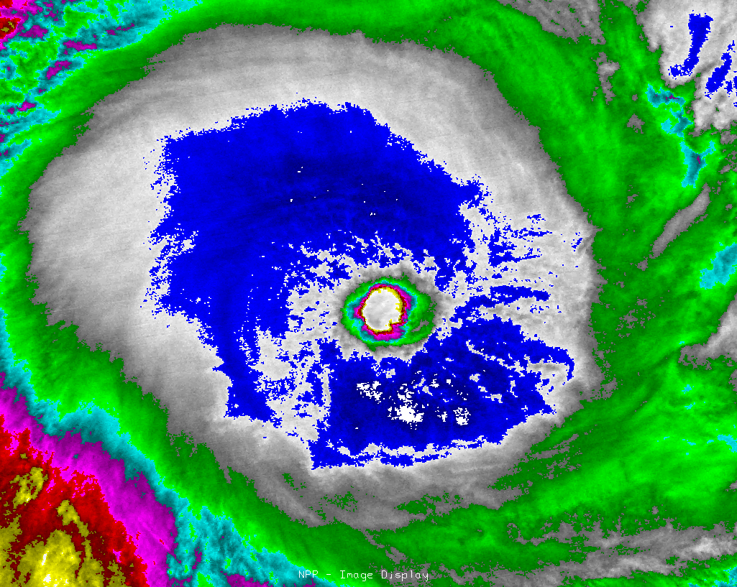
VIIRS I-band-5 (375 m) color-enhanced IR image for 24 January 2012 @ ~1102 UTC over the eye of TC Funso. [Image courtesy of Dan Lindsey, NOAA/StAR]

Slide 23
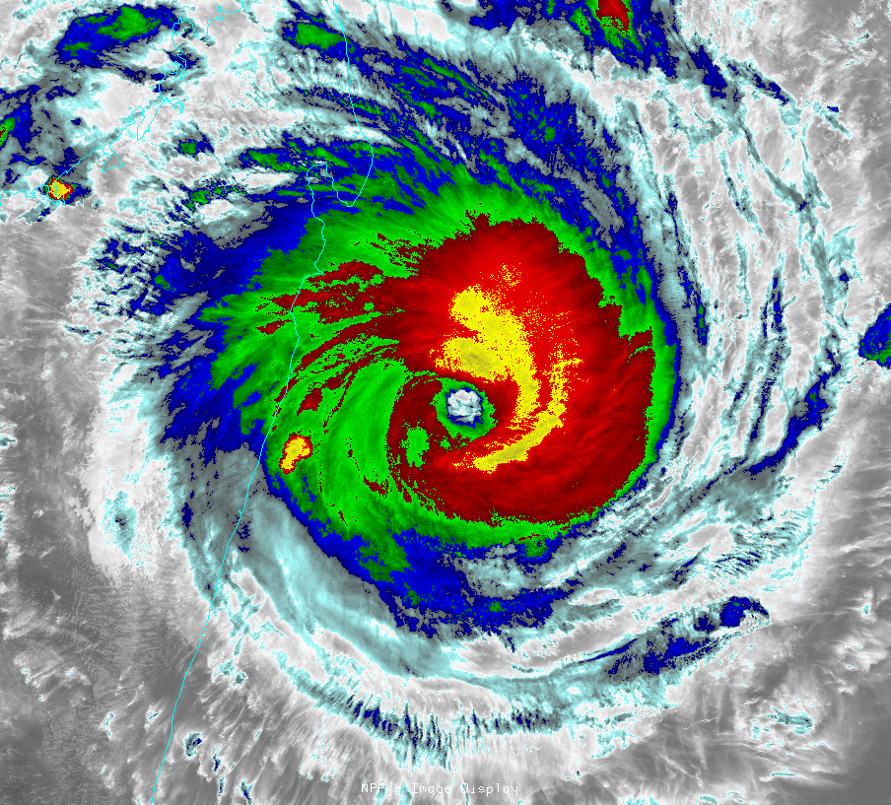
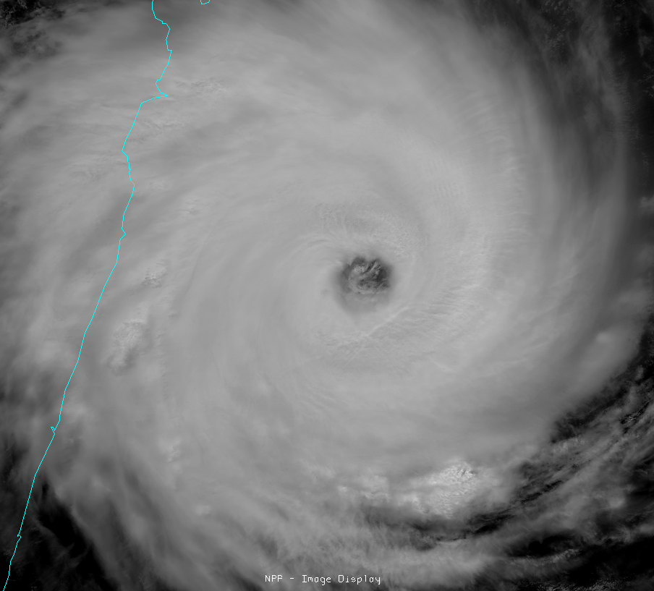
VIIRS Imagery Examples: Tropical Cyclone Giovanna east of Madagascar 13 February 2012 at 0947 UTC
VIIRS channel I-5 (IR window, 11.45 µm)
VIIRS channel I-1 (visible, 0.64 µm )
Courtesy of Dan Lindsey

Slide 24
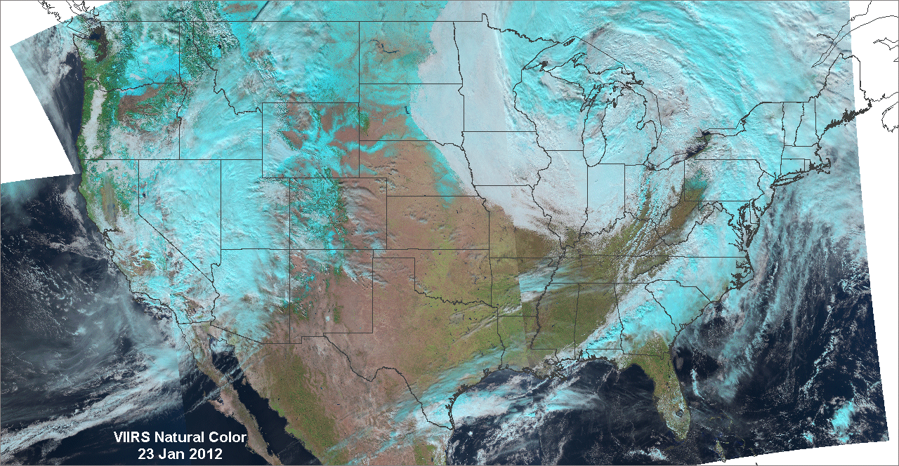
1.6/0.8/0.6 µm (R/G/B) “natural color” image for 23 January 2012. Advantages over true color: (a) less Rayleigh scattering, (b) vegetation shows up as unmistakable green, (c) cloud phase is indicated (cyan clouds are ice, white are liquid), and (d) snow on the ground is easy to distinguish from low clouds (but not from high clouds). [Image courtesy of Stan Kidder, CIRA]

Slide 25
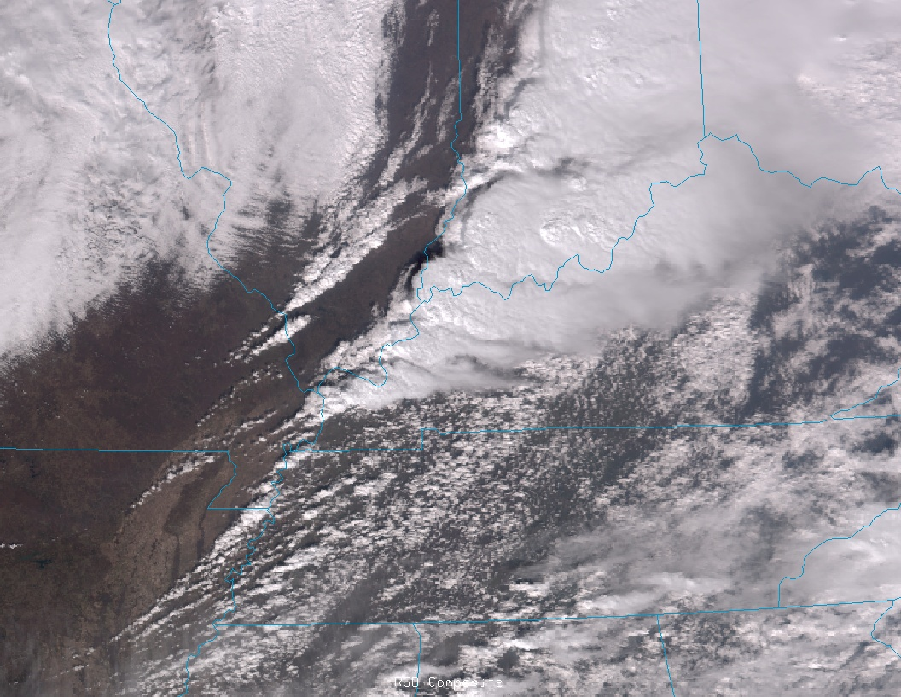
VIIRS true color image: Severe storms over Indiana 2 March 2012 at 1935 UTC
NPP/VIIRS passed over Southern Indiana on March 2 about thirty minutes before the most devastating tornadoes struck the towns of New Pekin and Henryville (among others). At 1935 UTC, a pair of rotating thunderstorms, also known as supercells, were advancing eastward across Indiana. The easternmost storm spawned the most damaging tornadoes. (Courtesy of Curtis Seaman)

Slide 26
DNB: Kuwait Gas Flares 2012-02-07 @ 2237

Slide 27
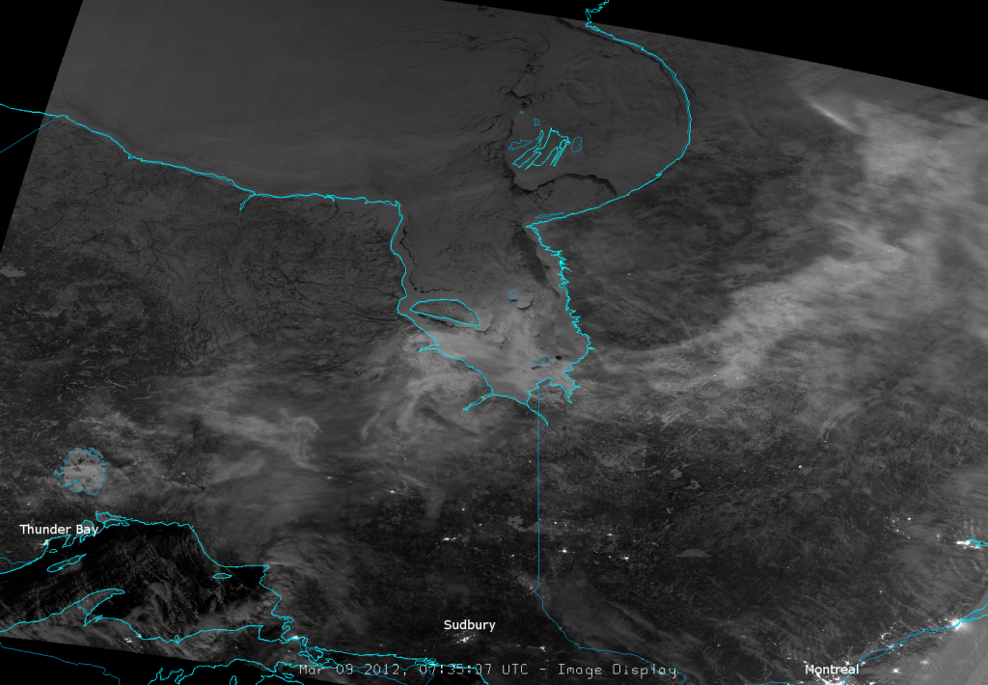
VIIRS Day/Night Band -9 March 2012
The Day/Night band (DNB) is a visible-wavelength band, centered at 0.7 µm, is highly sensitive to low levels of light, so that it behaves like a visible channel even at night when the moon is out. As seen in the image, the DNB clearly shows the location of towns and cities at night. Since 8 March 2012 was a full moon, clouds, snow and ice (particularly over Lake Winnipeg) are also visible. The brightest swirl, extending from north of Saskatoon, over Reindeer Lake and into northwestern Manitoba is the aurora borealis. (Courtesy of Steve Miller )

Slide 28
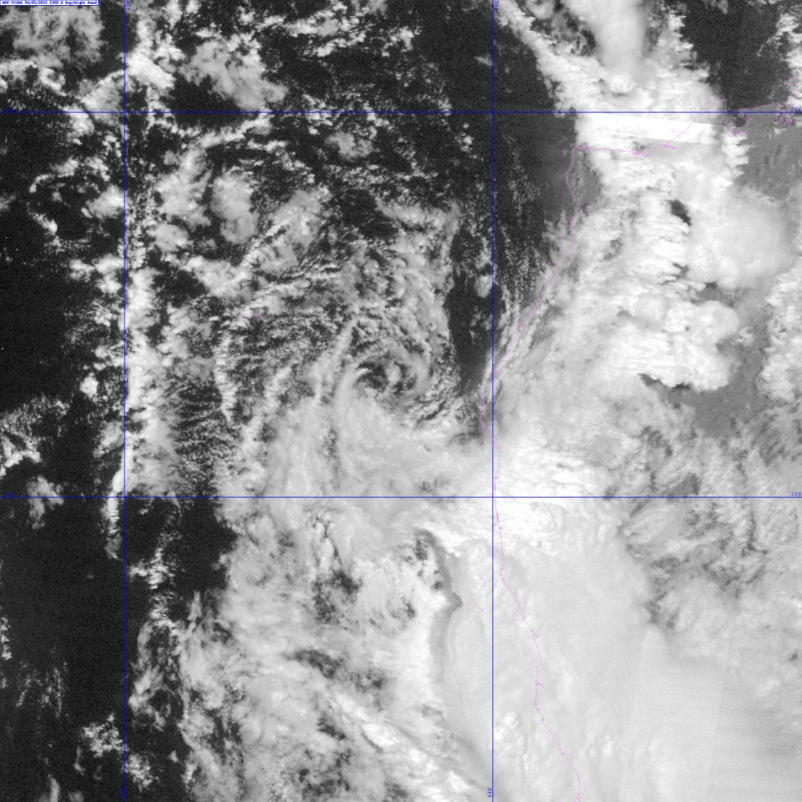
NCC Imagery: Low-light images of TC low level circulation (97S Invest, 5 April 2012)

Slide 29
NRL true-color example – Northwest Africa

Slide 30
NRL true-color example – Middle East

Slide 31
NRL true-color example – Horn of Africa

Slide 32
NRL true-color example – North Korea

Slide 33
VIIRS imagery issues/problems so far:
Missing geo-location values in granules
Missing data in granules
Other server (GRAVITE) issues
Missing (or delayed) granules
Duplicate granules
Lack of DNB EDR (NCC) imagery at night under conditions other than a full moon
Padding stripes (fill values) from the use of GTM and a constant array size in the Imagery EDR
Triangular regions of missing data due to remapping from SDRs to EDRs.
Long latency due to complex data flow thru GRAVITE and CLASS.
These issues are being addressed as Discrepancy Reports, and sent up the chain of command for resolution.
Coordination with VIIRS SDR Team.
Input for many other EDR Teams.
Prepare for operational use of JPSS-1 (2016) and JPSS-2 (2022)

Slide 34
Imagery EDR issue: Triangular areas of missing (zero) data
SDR image composite
EDR image composite with missing data in triangular region, due to out of sequence processing of EDRs.

Slide 35
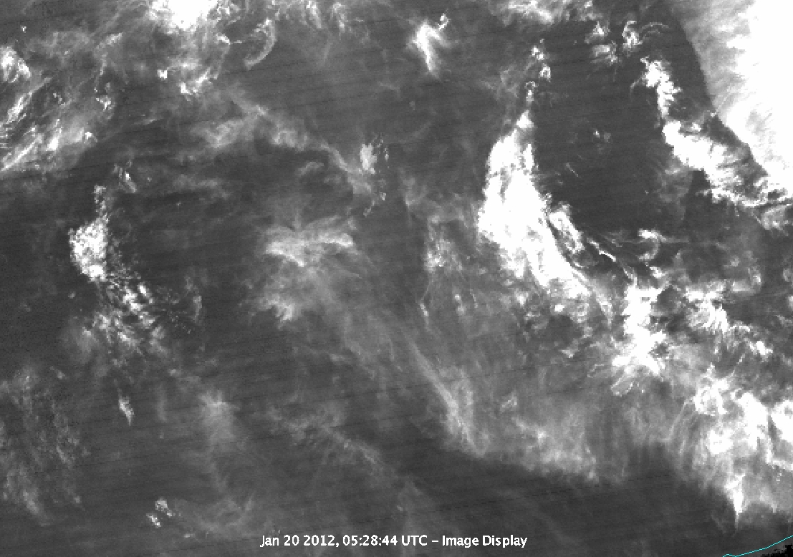
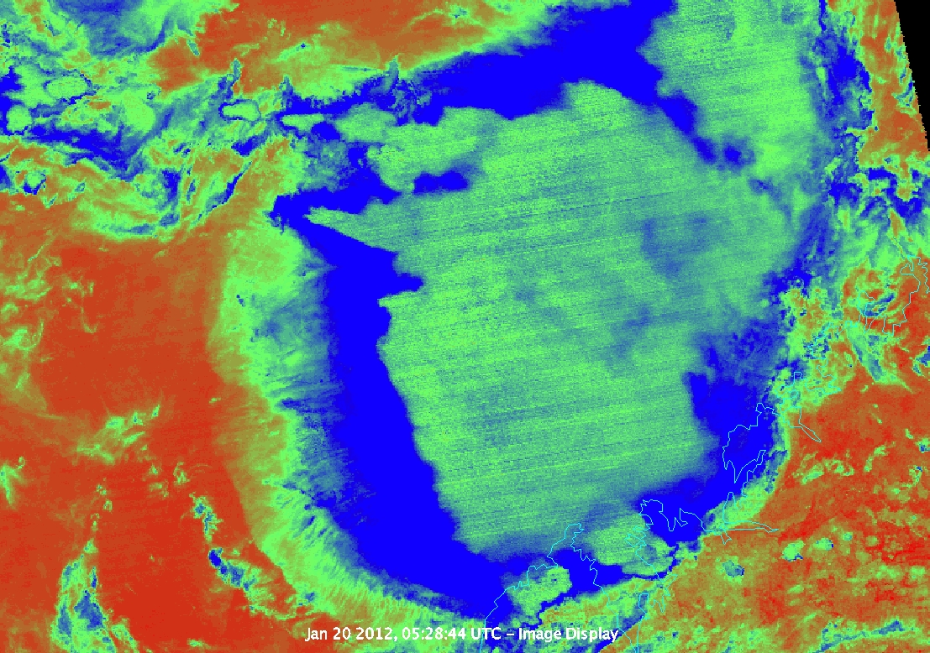
Imagery issue: Striping noted by SST and Ocean Color Teams
Striping noted in these M14-M15 band-difference images
Question: where is the best place to do de-striping for all Teams?

Slide 36
9 April 2012 19Z
Block of data analyzed
New Orleans
Sun Glint Area (good for finding striping)

Slide 37
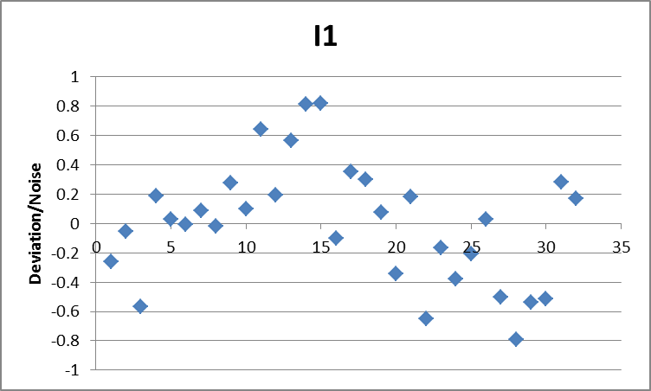
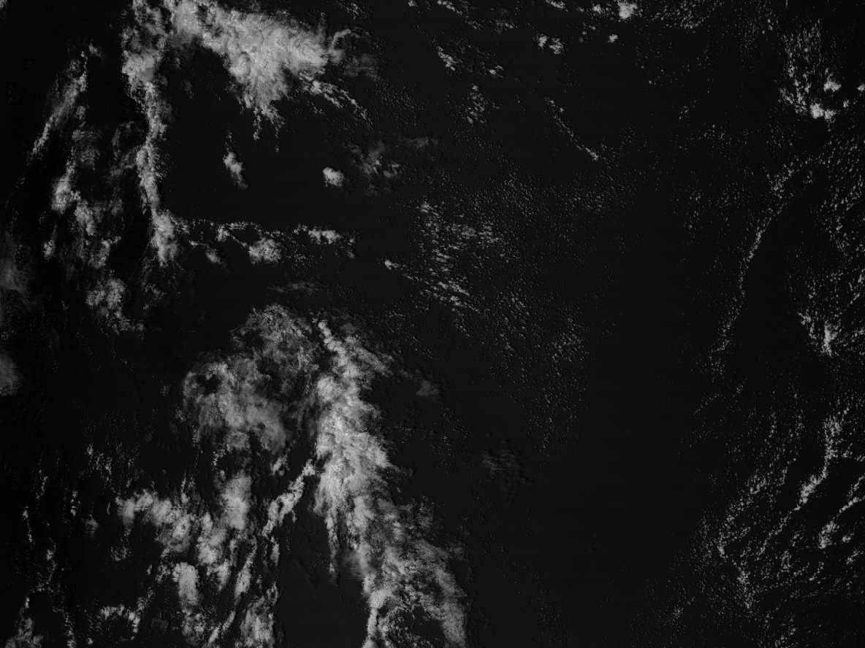
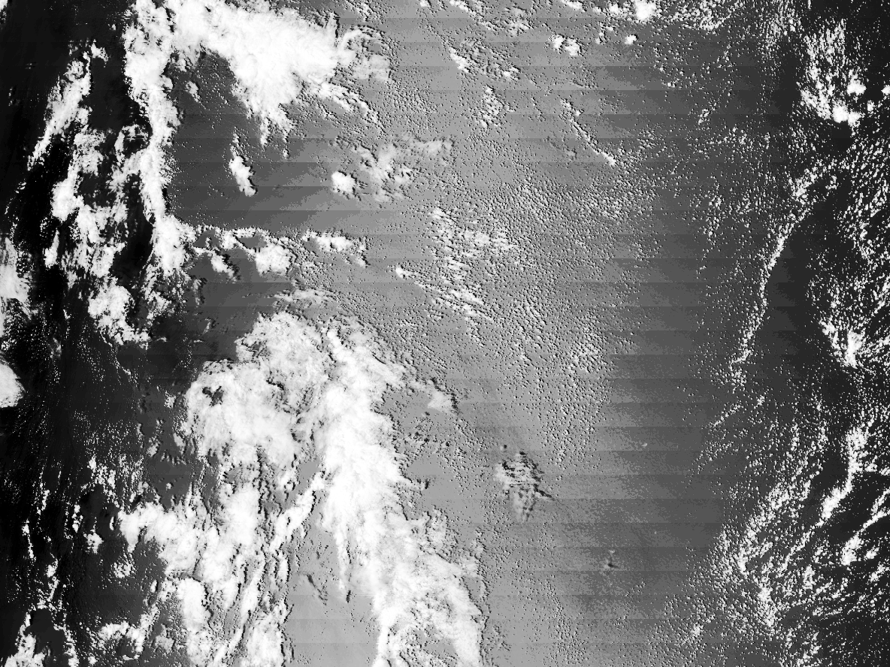
I1 − 0.64μm
Very small deviation from Block Mean Radiance
No noticeable striping
Highly Enhanced Image

Slide 38
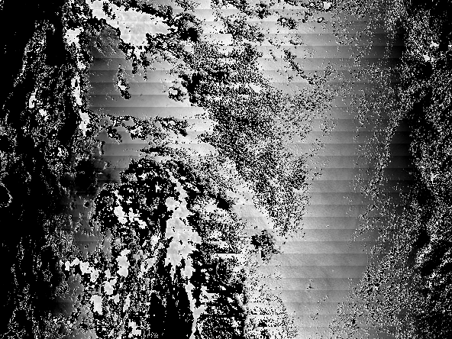
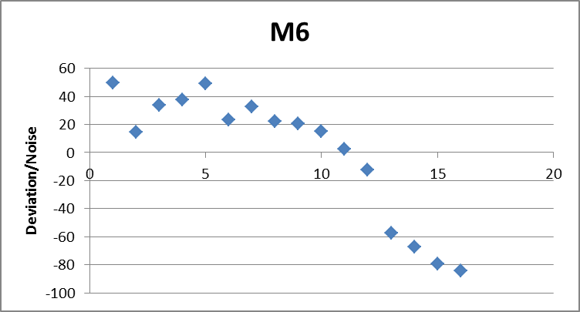
M6 – 0.747 μm
Very Large Striping
Unenhanced Image

Slide 39
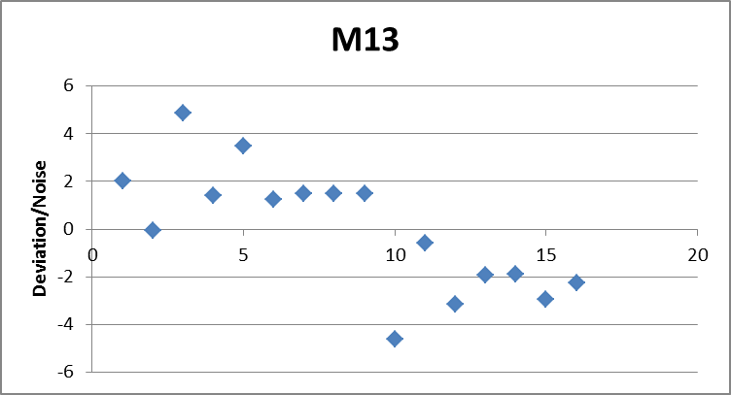
M13 – 4.05 μm
Moderate deviations from Block Mean Radiance, but hard to find striping

Slide 40
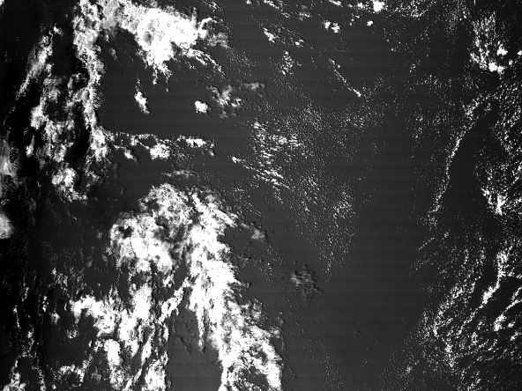
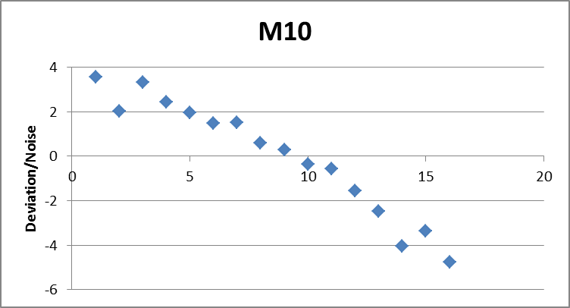
M10 – 1.61 μm
Moderate deviations—some striping visible in unenhanced image

Slide 41
Table of Normalized Deviations
Band | Range (max - min) of normalized deviation
M06 | 133.58
M13 | 9.45
M10 | 8.32
M03 | 4.52
M07 | 3.76
M01 | 3.52
M02 | 3.29
M08 | 3.25
M04 | 2.98
M05 | 2.86
M12 | 2.67
I03 | 2.56
I01 | 1.61
I02 | 1.60
M15 | 1.58
M16 | 1.47
I04 | 1.15
M14 | 0.86
M11 | 0.76
I05 | 0.66
M09 | 0.66

Slide 42
The VIIRS Imagery Team work continues
Quantitative analyses:
Noise levels
More detector-to-detector striping
Inter-satellite comparisons
Overall imagery assessment, for use as image products
Multi-spectral products, as a means of assessing image quality, where signal-to-noise ratio is reduced.

Slide 43
FY 11 CIRA VIIRS Imagery Cal/Val Project Milestones and Accomplishments Proposal Period: August 1, 2011 – March 31 2012
Gather information on available VIIRS proxy data sets and prepare/enable display/visualization tools (such as McIDAS-V) for immediate use during the post-launch checkout phase.
A large amount of VIIRS proxy data was collected and archived. Display/visualization tools (such as McIDAS-V) were successfully prepared and enabled.
These tools were ready to be used immediately after the VIIRS post-launch checkout phase.
VIIRS imagery and products on tropical cyclones, dust enhancement, aerosols, and snow, were created and shared with NESDIS managment.
VIIRS imagery was depicted on the Imagery Team Website, CIRA’s NPP Blog, and occasionaly on the NESDIS and StAR pages.
http://rammb.cira.colostate.edu/projects/npp/blog/

Slide 44
FY 11 Milestones and Accomplishments (cont.)
Receive and display in near real-time the Imagery EDRs (and SDRs as needed) from available sources (e.g. GRAVITE and IDPS).
Preparations were made so that CIRA was able to receive and display (in near real-time) the Imagery EDRs and SDRs from available sources (GRAVITE and PEATE).
Coordinate activities with other VIIRS EDR and SDR team members to accomplish the checkout of imagery and image product quality. (Quality of the imagery includes such things as: data noise levels, detector-to-detector striping, sensor lag/point-spread-function analysis, sensor saturation levels, navigation and registration, and inter-satellite calibration.)
Activities with other VIIRS EDR and SDR team members were coordinated to accomplish the checkout of imagery and image product quality.
Weekly telecons were conducted to discuss the quality of the imagery, including such things as: data access, image quality, image and data processing problems, and discrepancy reporting.
CIRA scientists participated in the identification of bad and duplicate imagery EDR granules with “missing triangles” of data. These examples were supplied to the IDPS team, who subsequently identified the issues and corrections are pending.

Slide 45
New FY 12 CIRA VIIRS Imagery Cal/Val Milestones Proposal Period: 1 April 2012 – 31 December 2012
Continue the collection of near real-time Imagery EDRs (and SDRs as needed) from available sources (e.g. GRAVITE and PEATE).
Create VIIRS imagery and image products on special weather events like tropical cyclones, severe weather events, and mid-latitude cyclones.
Generate and analyze data and examine selected higher-order image products. These include multi-spectral image combinations, such as those used in the detection of fog/stratus, blowing dust, fires and smoke, aerosols, etc.
Demonstrate true-color applications for assessing land and atmospheric phenomena (such vegetation, blowing dust, smoke, haze, etc.).
Leverage the real-time web displays of VIIRS imagery and higher-order image products as a source of material for training of NWS and other meteorologists, especially for those spectral bands that are new to the operational satellite data stream (i.e., in comparison to AVHRR).

