Slide 1
VIIRS Imagery at Beta CCR 12-417 DR 4545
Dr. Thomas Kopp – Imagery Validation Lead
Dr. Donald Hillger – Imagery Product Lead
Mr. Ryan Williams - Imagery JAM

Slide 2
Brief summary of the Imagery EDR
The Imagery EDR takes selected VIIRS SDRs and transfers radiance/reflectance/brightness temperature values on as Ground Track Mercator projection
All 5 I-bands
Six selectable M-bands
Near Constant Contrast derived from the Day Night Band
GTM uses the nearest pixel, it does not use an average unless an isolated pixel has a bad value
The NCC Imagery is on a separate schedule and is not part of this CCR

Slide 3
Imagery Requirements
Current requirements based on the Level 1 Requirements Document (L1RD) are restricted to resolution, mapping accuracy, and latency
Quality requirements found in the old NPOESS program are no longer present
Actually use of Imagery tied to ability of a human analyst to determine his/her features of interest through Imagery
If the operational user is not satisfied, the Imagery EDR has failed, independent of any quantitative requirements
The Imagery validation team has focused on the later in the early stages of validation

Slide 4
General Guidelines
The two most fundamental features of the Imagery at this stage was determination of clouds and sea ice edge
Quantitative validation of resolution and latency handled by other teams
Geolocation qualitatively addressed at this time
No issues found
The fundamental question, may a user satisfactorily use Imagery without the presence of significant distractions (i.e. striping)?

Slide 5
Beta Definition
Early release product
Initial calibration applied
Minimally validated and may still contain significant errors
Available to allow users to gain familiarity with data formats and parameters
Product is not appropriate as the basis for quantitative scientific publication studies and applications

Slide 6
Beta Evaluation
Early release product
Imagery has not been extensively analyzed by operational users
Imagery is not available to real-time users on a timely basis
Neither NDE or AFWA can make Imagery available to their general set of customers in near real time as of this briefing
Initial calibration applied
VIIRS SDRs declared “beta” earlier this month
No software changes have yet been made to the Imagery EDR

Slide 7
Beta Evaluation
Minimally validated and may still contain significant errors
Striping has been identified but the overall impact has not yet been assessed
Typical users would not notice the striping under standard use
Other issues have dealt with missing data, not tied to the Imagery product or the algorithm directly
No other artifacts have been noted by Imagery SMEs
The only DRs written to non-NCC Imagery was to expand daytime beyond 85 degree solar zenith angle and to expand the number of available M-bands produced as Imagery
Available to allow users to gain familiarity with data formats and parameters
Imagery may be retrieved through CLASS, GRAVITE, or the Atmosphere PEATE
Both NDE and AFWA working towards real-time support sometime this summer

Slide 8
Beta Evaluation
Product is not appropriate as the basis for quantitative scientific publication studies and applications
Imagery, in general, does not contain quantitative applications
VIIRS SDRs only at beta stage
In fact, Imagery performance has been touted as good to excellent at many conferences that have already taken place (i.e. AMS)
In reality, Imagery is past this point

Slide 9
Beta Evaluation
Many examples have been already shown at other forums
AMS Annual Meeting
VIIRS Cal/Val Workshop
NOAA Science Week
JPSS System Readiness Review
With this in mind, only a few examples of Imagery are shown

Slide 10
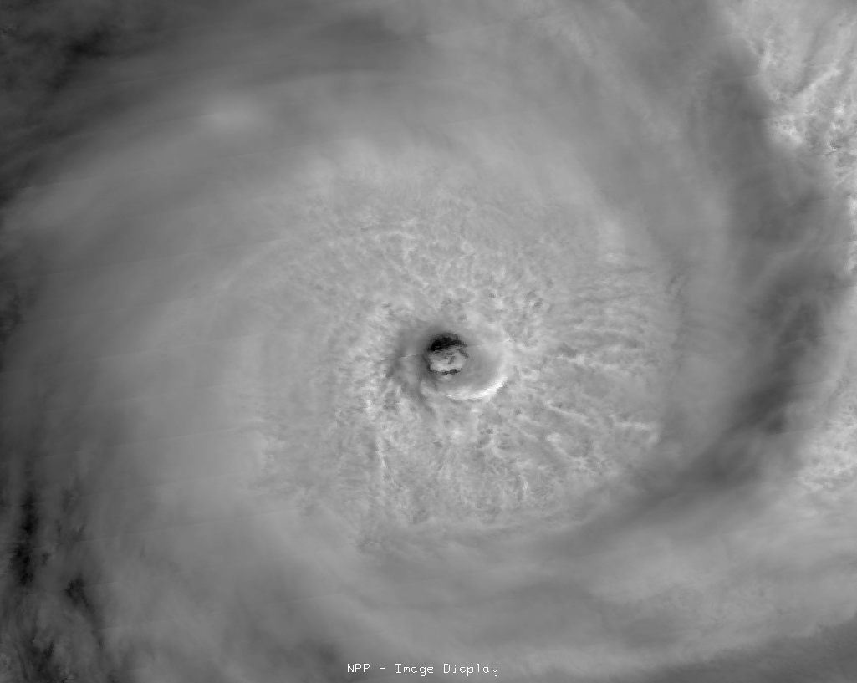
Tropical Storm Funso (IR)
I5 – courtesy of Dan Lindsey (NOAA/STAR)

Slide 11
California Coast
I3 (red), I2 (green), I1 (blue)

Slide 12
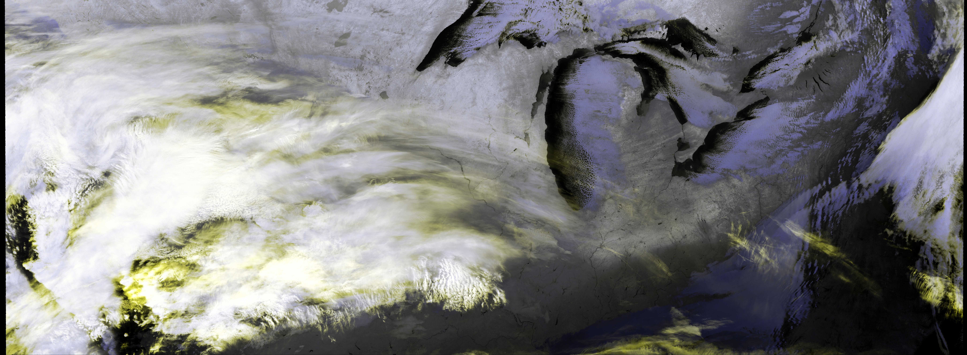
Great Lakes - Night
I5 (red), I5 (green), I4 (blue)

Slide 13
Conclusion
Non-NCC Imagery has met the beta stage based on the definitions and the evidence shown
It exceeds the definition of beta in some cases
Remaining issues are known and at least a preliminary way ahead has been established
De-striping techniques are known
Striping not evident in most Imagery applications to date
Although we are seeking the beta stage, note the only circumstance preventing operational use immediately is the lack of access to the Imagery in near real time by operational users

