Slide 1
Suomi NPP VIIRS Near Constant Contrast (NCC) Imagery EDR Review - Provisional
Don Hillger¹, Thomas Kopp²,
and the
EDR Imagery and Visualization Team
22 August 2013
¹NOAA/NESDIS/StAR
²The Aerospace Corporation

Slide 2
VIIRS EDR Imagery (and Visualization) Team
NESDIS/StAR (D. Hillger, D. Molenar, D. Lindsey, T. Schmit – GOES liaison)
CIRA/CSU (C. Seaman, S. Miller, S. Kidder, S. Finley, R. Brummer)
CIMSS/SSEC (T. Jasmin, T. Rink, W. Straka)
Aerospace (T. Kopp, J. Feeley)
NOAA/NGDC (C. Elvidge)
NRL (J. Hawkins, K. Richardson, J. Solbrig, T. Lee)
AFWA (J. Cetola)
Northrop Grumman (C. Liang, S. Weiss, R. Mahoney)
NASA (R. Williams, W. Thomas)
NOAA/OSPO (S. Qiu)
COAST/Raytheon (B. Johnson)
NASA/SPoRT (G. Jedlovec, M. Smith)
StAR (V. Mikles, M. Tsidulko)

Slide 3
VIIRS Environmental Data Record (EDR)s
VIIRS Band | Central Wavelength (μm) | Bandwidth (μm) | Wavelength Range (μm) | Band Explanation | Spatial Resolution (m) @ nadir
M1 | 0.412 | 0.02 | 0.402 - 0.422 | Visible | 750 m
M2 | 0.445 | 0.018 | 0.436 - 0.454
M3 | 0.488 | 0.02 | 0.478 - 0.488
M4 | 0.555 | 0.02 | 0.545 - 0.565
M5 (B) | 0.672 | 0.02 | 0.662 - 0.682
M6 | 0.746 | 0.015 | 0.739 - 0.754 | Near IR
M7 (G) | 0.865 | 0.039 | 0.846 - 0.885
M8 | 1.240 | 0.020 | 1.23 - 1.25 | Shortwave IR
M9 | 1.378 | 0.015 | 1.371 - 1.386
M10 (R) | 1.61 | 0.06 | 1.58 - 1.64
M11 | 2.25 | 0.05 | 2.23 - 2.28
M12 | 3.7 | 0.18 | 3.61 - 3.79 | Medium-wave IR
M13 | 4.05 | 0.155 | 3.97 - 4.13
M14 | 8.55 | 0.3 | 8.4 - 8.7 | Longwave IR
M15 | 10.763 | 1.0 | 10.26 - 11.26
M16 | 12.013 | 0.95 | 11.54 - 12.49
DNB | 0.7 | 0.4 | 0.5 - 0.9 | Visible | 750 m across full scan
I1 (B) | 0.64 | 0.08 | 0.6 - 0.68 | Visible | 375 m
I2 (G) | 0.865 | 0.039 | 0.85 - 0.88 | Near IR
I3 (R) | 1.61 | 0.06 | 1.58 - 1.64 | Shortwave IR
I4 | 3.74 | 0.38 | 3.55 - 3.93 | Medium-wave IR
I5 | 11.45 | 1.9 | 10.5 - 12.4 | Longwave IR
Notes:
M-bands highlighted in pale yellow are available as EDRs, in addition to SDRs.
True-color component bands are highlighted in red, green, and blue.
Natural-color component bands are noted with R, G, and B.
M6 on Suomi NPP has a high radiance fold-over issue with many saturated pixels.

Slide 4
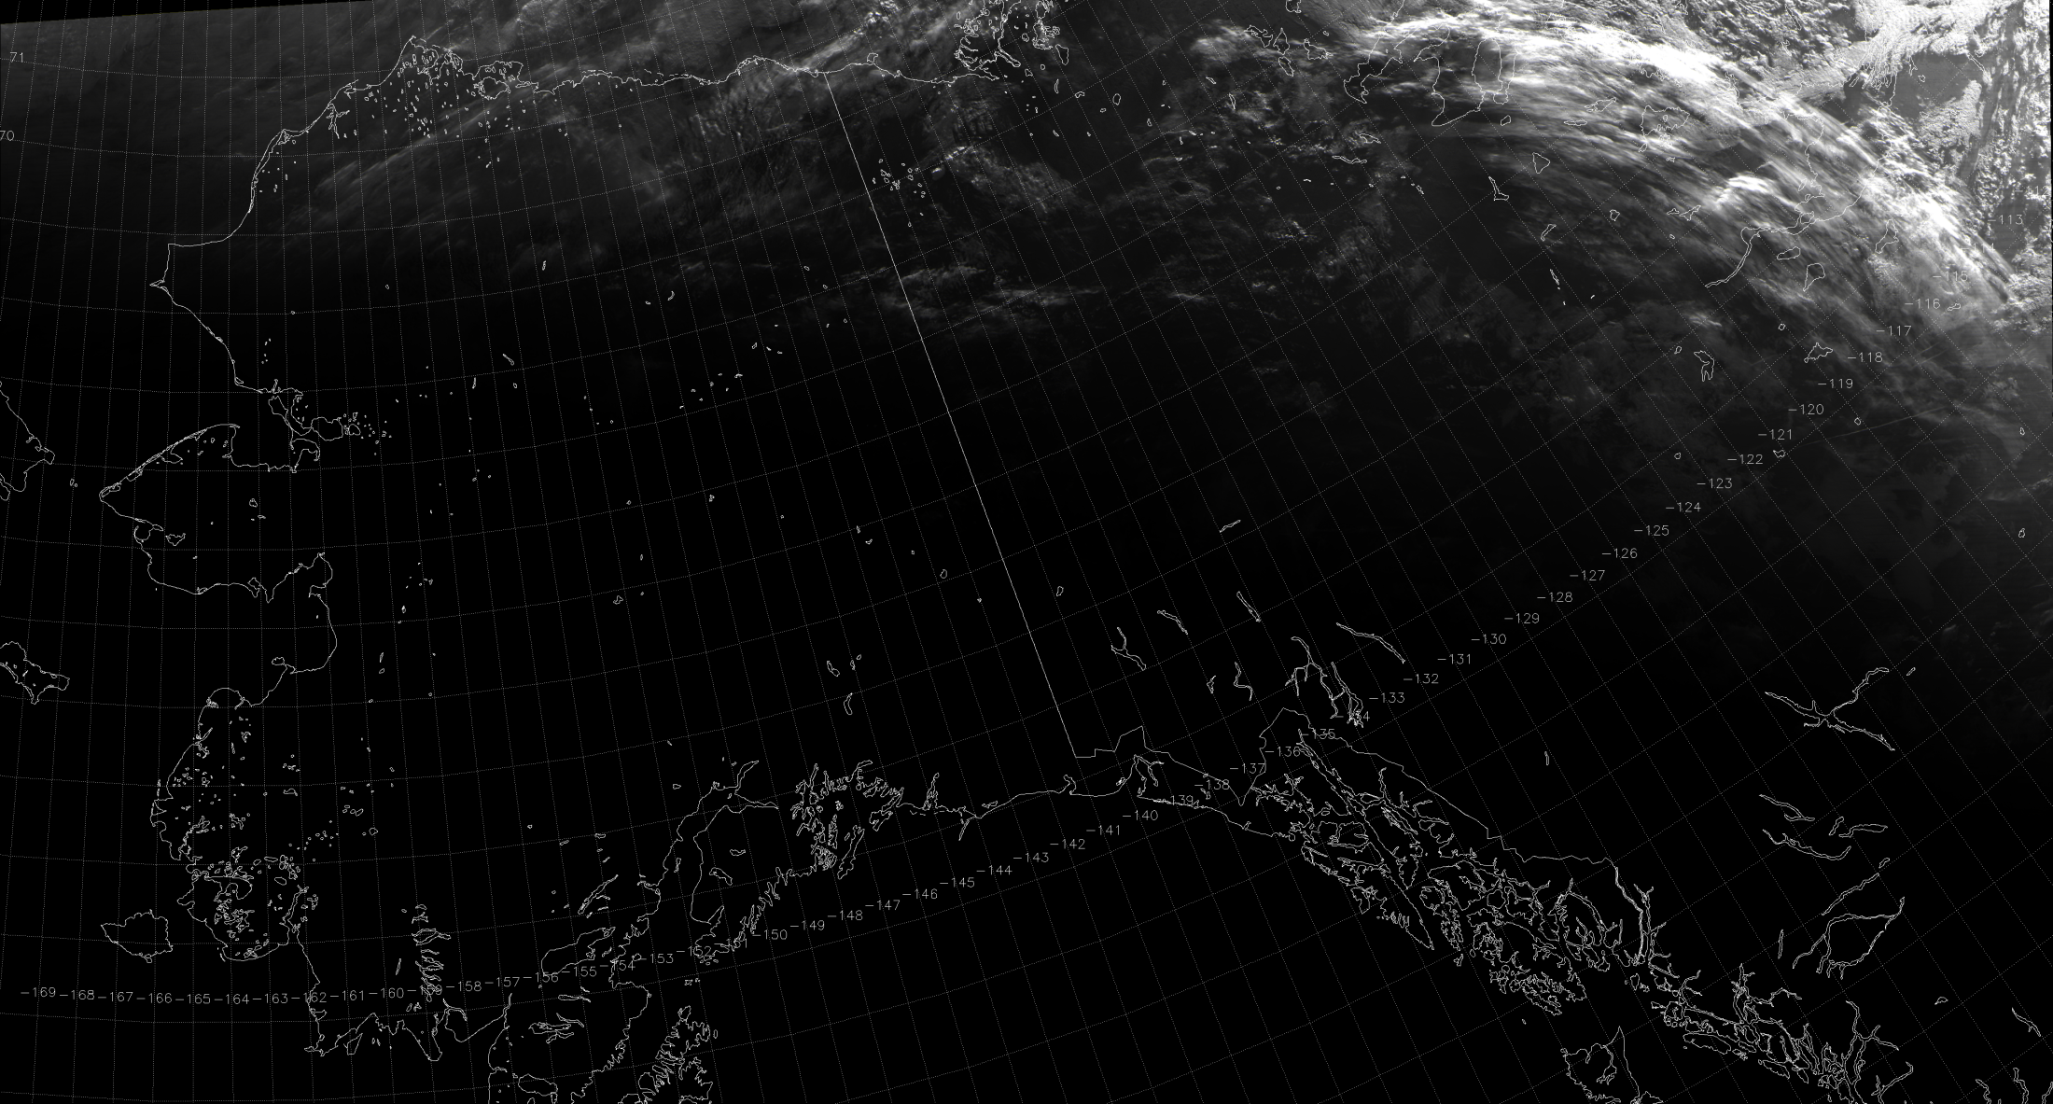
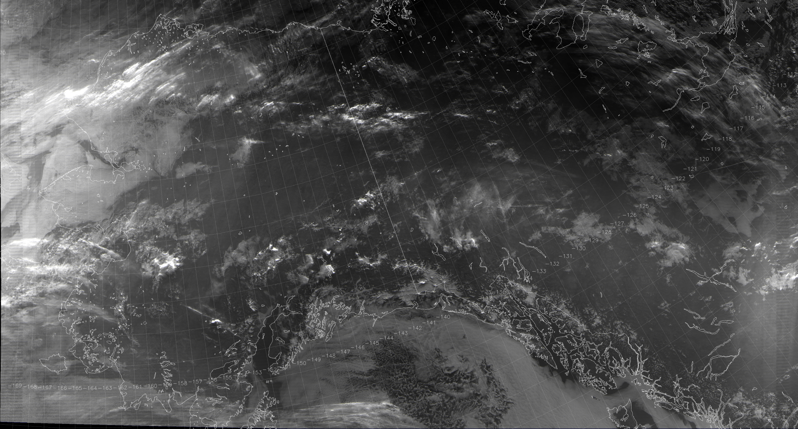
At the Day/Night Terminator
SDR
NCC EDR
11:53 UTC 31 July 2013

Slide 5
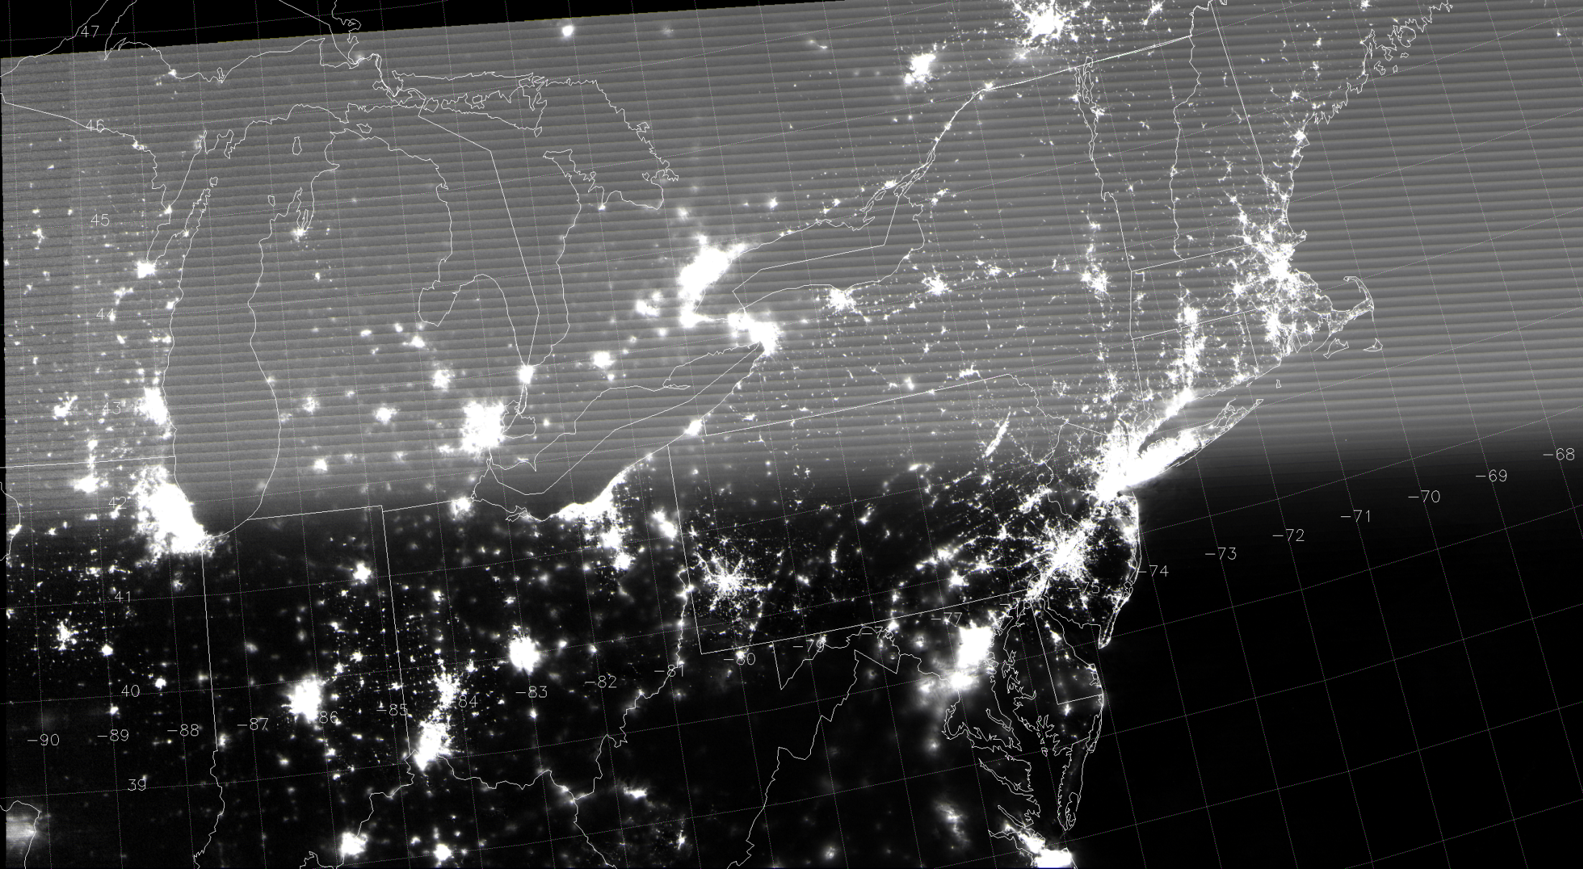
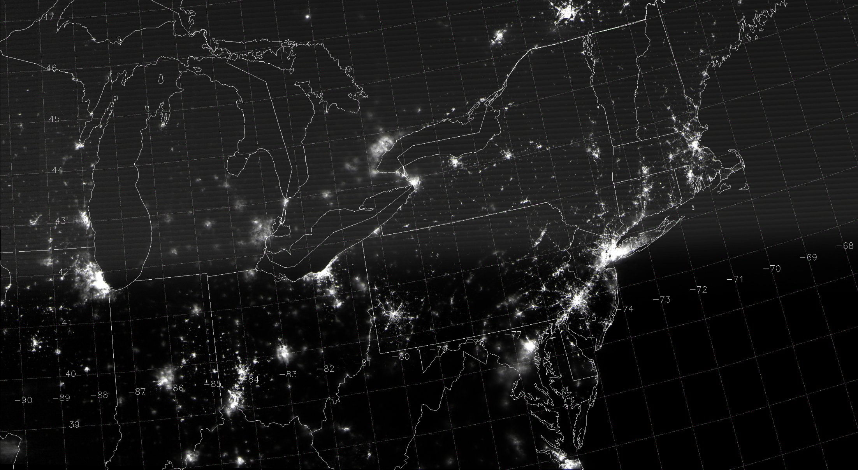
During a New Moon
SDR
NCC EDR
Stray light
Stray light
06:43 UTC 6 August 2013

Slide 6
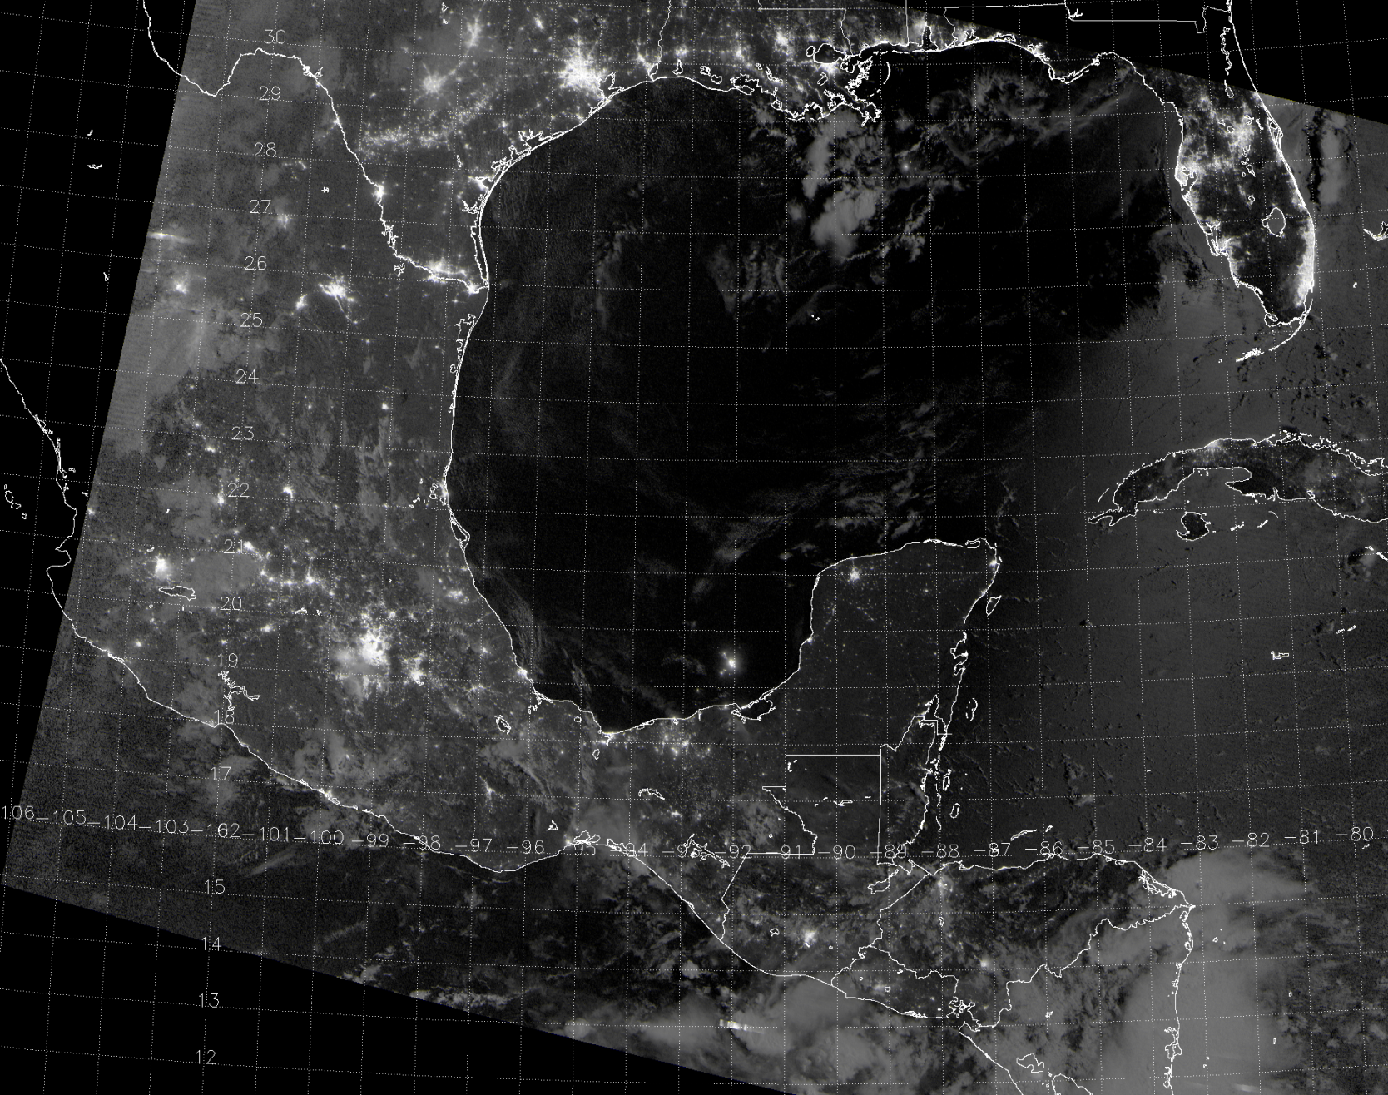
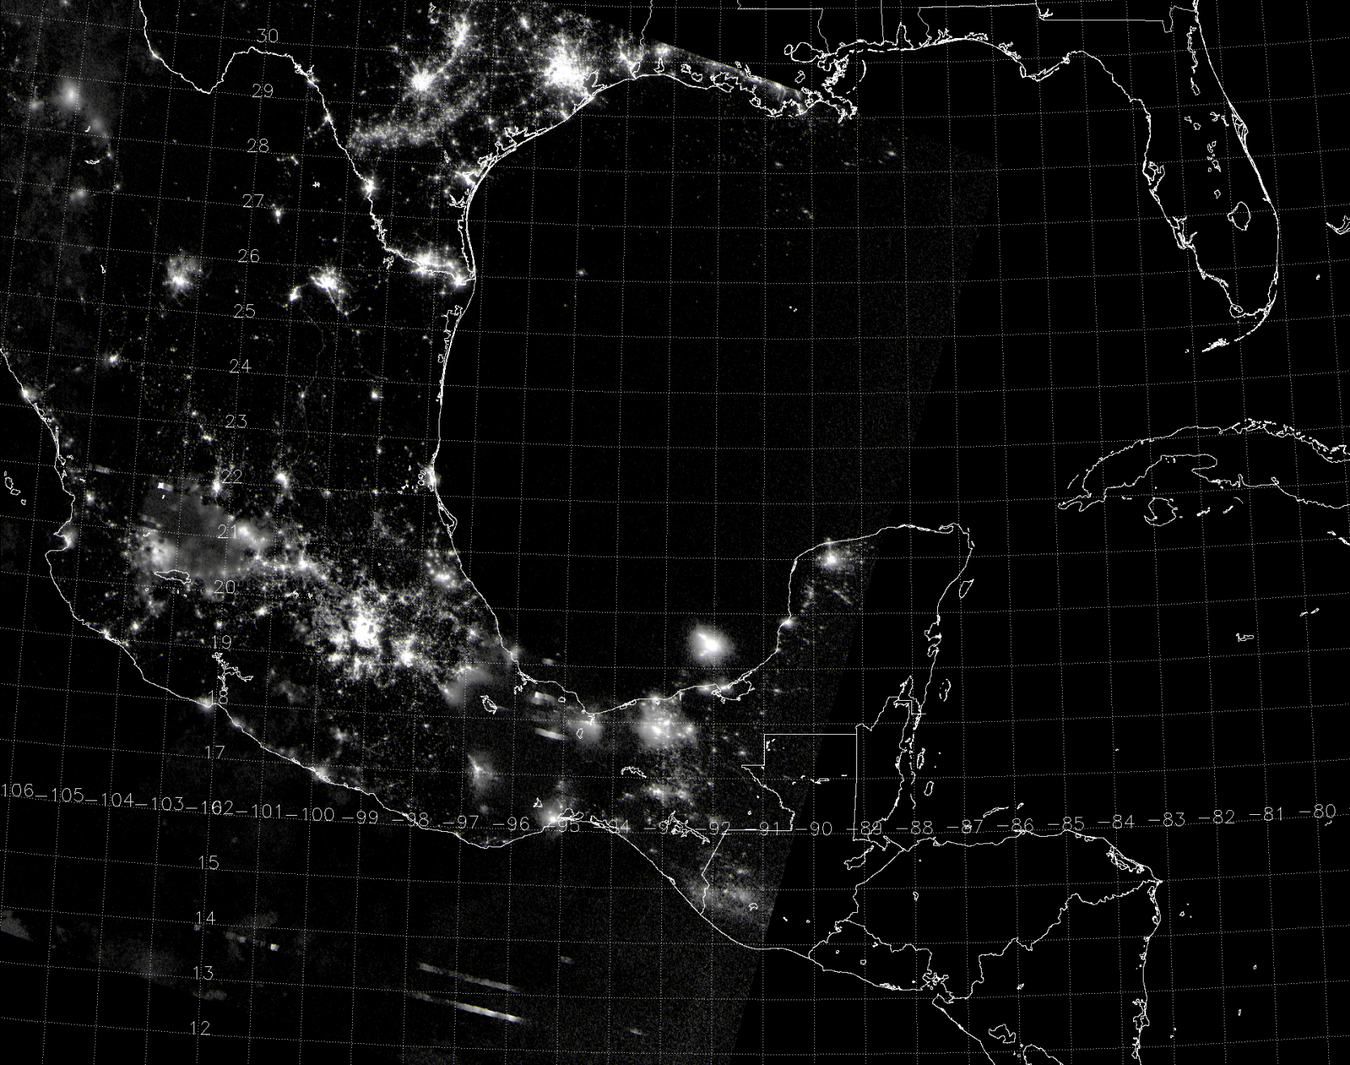
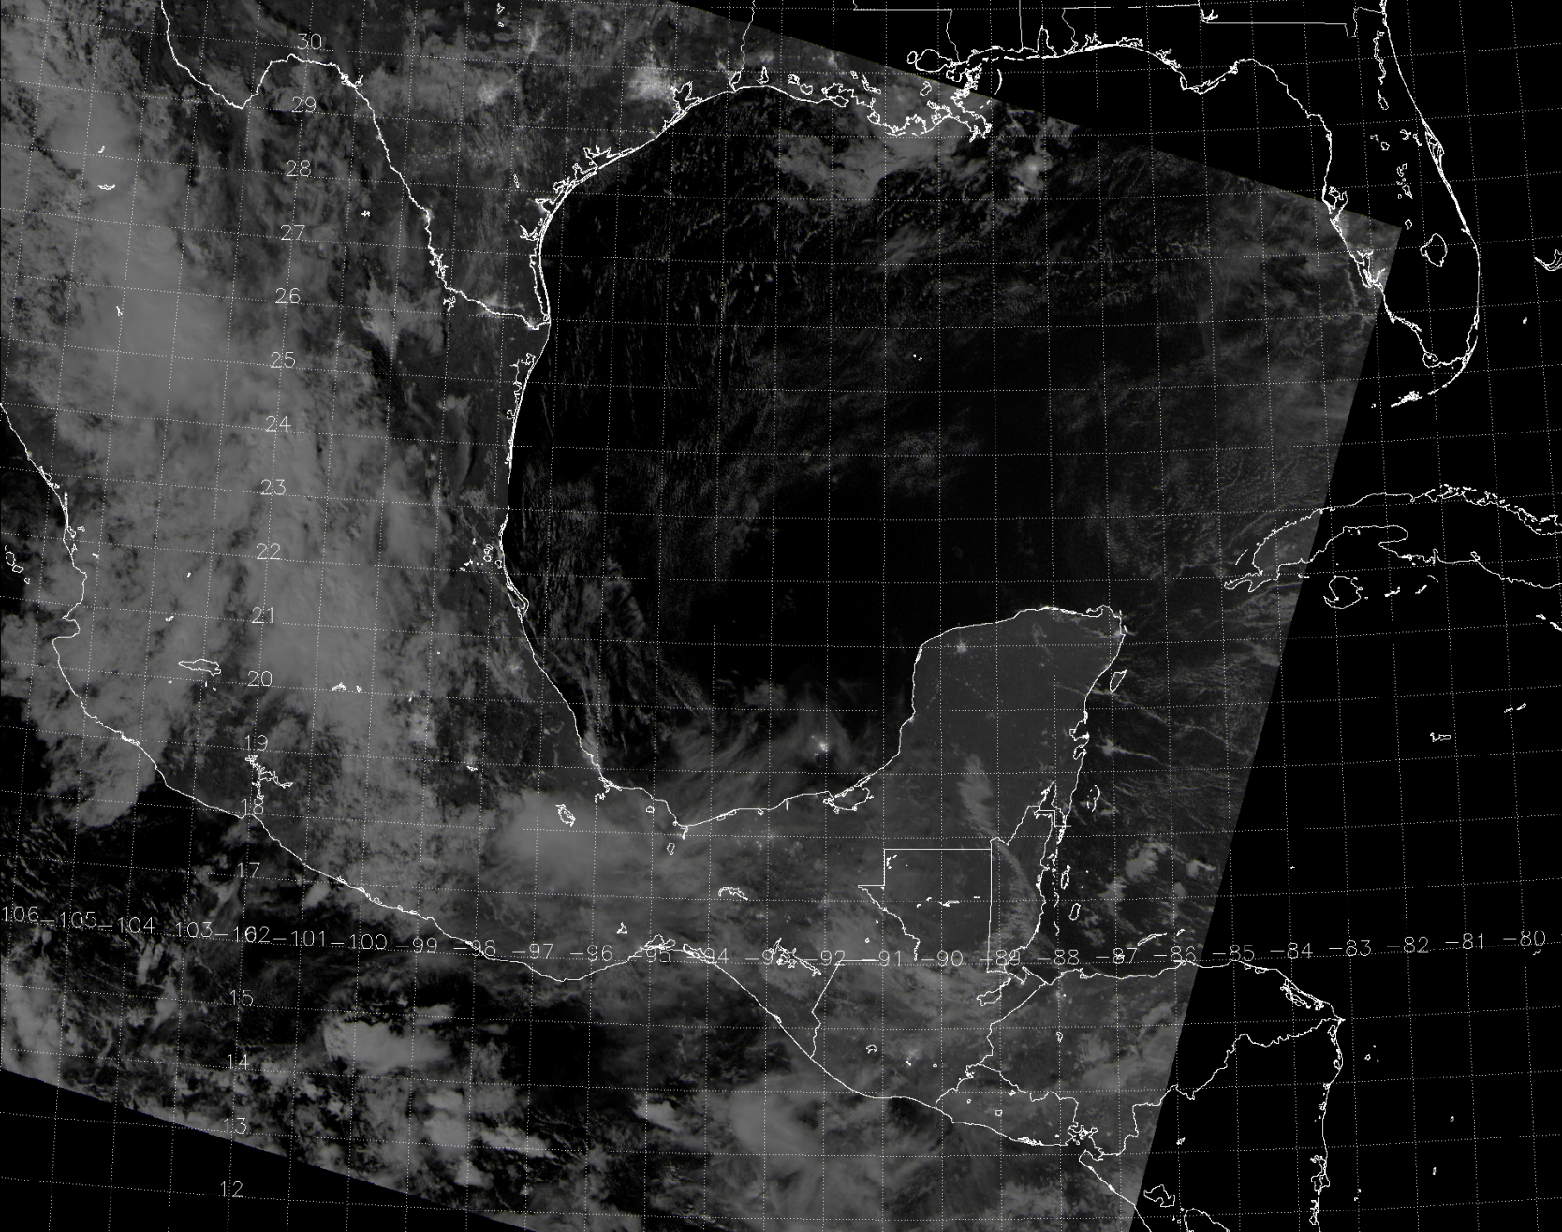
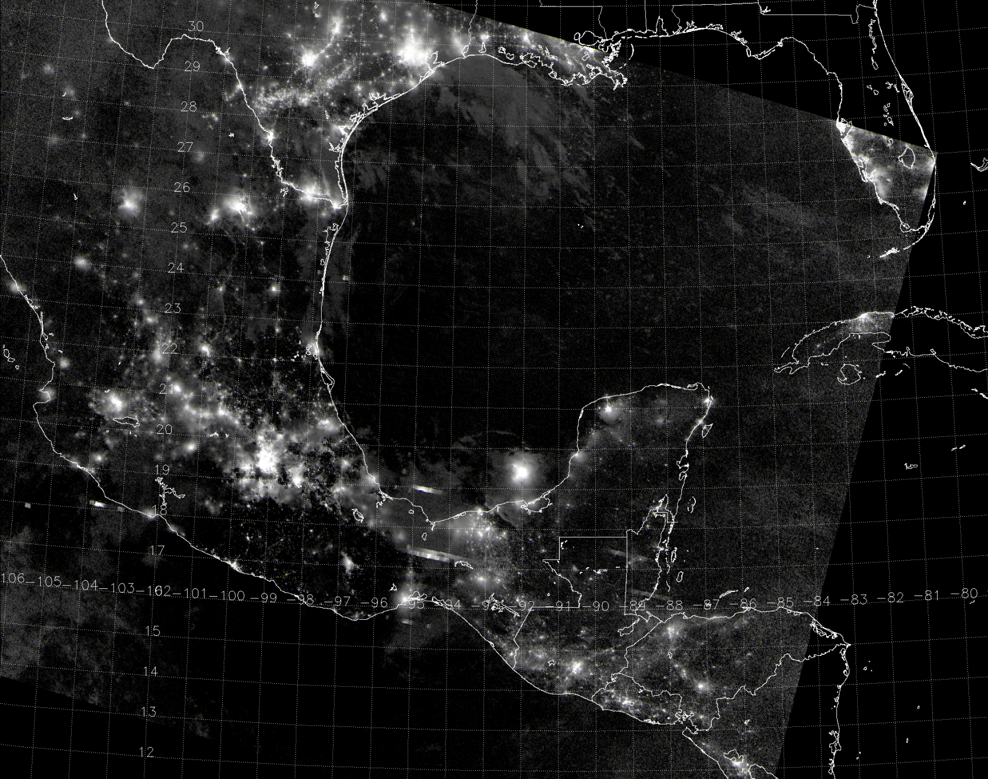
NCC Over a Full Lunar Cycle
Oil rigs
Moon glint
Lightning
08:09 UTC 22 July 2013
07:43 UTC 29 July 2013
08:28 UTC 6 August 2013
08:02 UTC 17 July 2013

Slide 7
NPP/JPSS data sources
GRAVITE¹ (Suitland, 7-hour delay)
NOAA CLASS² (Asheville, 7-hour delay) – not actively used
Atmosphere PEATE³ (Wisconsin, 7-hour delay)
ADDE server for McIDAS-X
FTP and HTML
Direct Readout (Wisconsin, minimal delay, but provides data only over North America, when the satellite is with sight of Madison)
AFWA IDPS⁴ (Omaha, near real-time)
¹Government Resource for Algorithm Verification, Independent Test, and Evaluation
²Comprehensive Large Array-data Stewardship System
³Product Evaluation and Algorithm Test Elements
⁴Air Force Weather Agency Interface Data Processing Segment

Slide 8
VIIRS display tools
McIDAS-V (VIIRS capable) – SSEC/CIMSS/Wisconsin
McIDAS-X (VIIRS capabilities still under development) – SSEC/CIMSS/Wisconsin
CSPP (Community Satellite Processing Package) (CIMSS/Wisconsin) for users of Direct Broadcast VIIRS
TeraScan / NexSat (web display) – NRL
IDL

Slide 9
Suomi NPP Imagery and Visualization Team web page http://rammb.cira.colostate.edu/projects/npp/

Slide 10
Suomi NPP VIIRS Online http://rammb.cira.colostate.edu/ramsdis/online/npp_viirs.asp

Slide 11
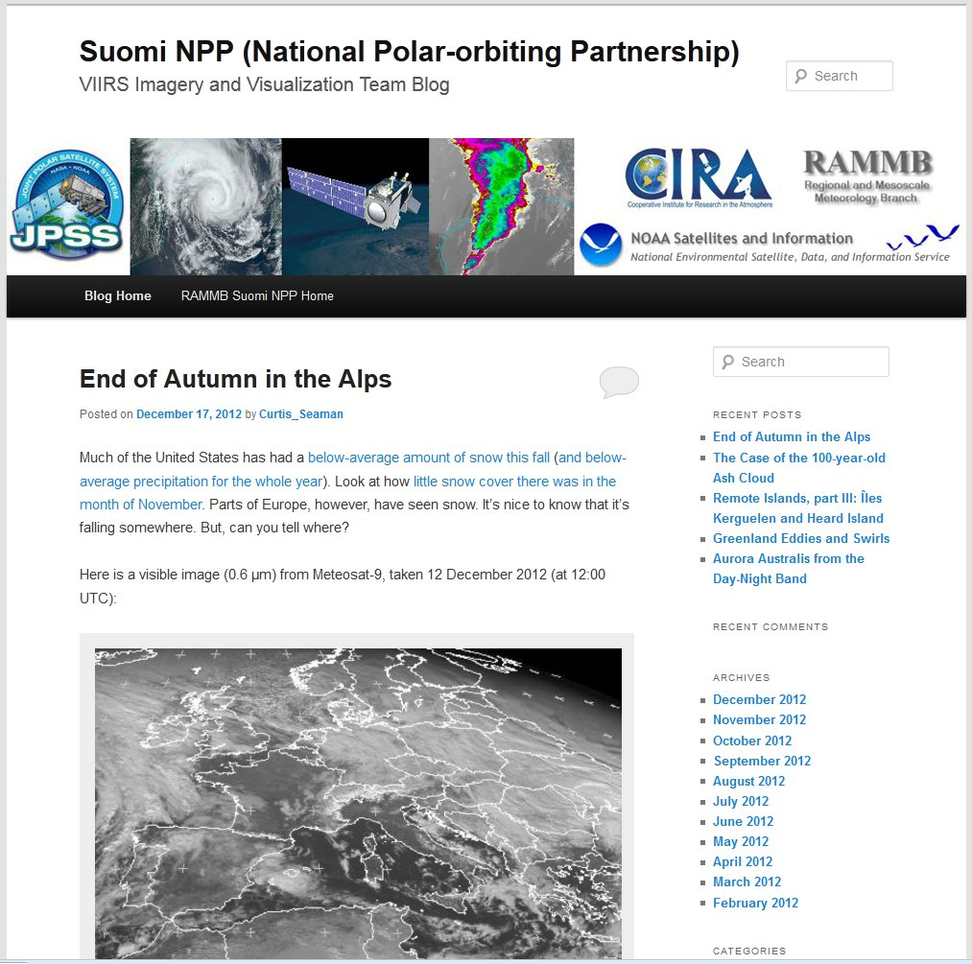
JPSS/Suomi NPP VIIRS Imagery Blog
http://rammb.cira.colostate.edu/projects/npp/blog/
Blog maintained at CIRA to highlight capabilities of VIIRS instrument.
Designed to provide education/outreach of VIIRS imagery applications.
Blog covers wide range of topics: tropical cyclones, severe weather, fire detection, auroras, volcanic eruptions, flooding, snow and ice detection, DNB applications, RGB composites and other interesting high-resolution imagery from VIIRS

Slide 12
Journal articles from the Imagery Team
Hillger, D., T. Kopp, T. Lee, D. Lindsey, C. Seaman, S. Miller, J. Solbrig, S. Kidder, S. Bachmeier, T. Jasmin, and T. Rink, 2013: First-Light Imagery from Suomi NPP VIIRS. Bull. Amer. Meteor. Soc., 94(7), 1019-1029, plus cover images. doi:10.1175/BAMS-D-12-00097.1
Hillger, D., C. Seaman, C. Liang, S. Miller, D. Lindsey, and T. Kopp, 2013: Suomi NPP VIIRS Imagery Calibration and Validation. Submitted to Journal of Geophysical Research-Atmospheres (JGR) for publication in a “Special Issue of AGU JGR-Atmospheres on Suomi NPP Cal/Val Science Results”. Invited to submit a cover figure.

Slide 13
Sensor Data Record (SDR) to Environmental Data Record (EDR)
Ground Track Mercator (GTM) remapping software.
GTM is a remapping of the data, but the same radiances/reflectances/temperatures for Non-NCC bands only.
For NCC imagery, which is derived from the Day Night Band (DNB), there is additional radiance (reflectance) processing
Environmental Data Record (EDR)
Sensor Data Record (SDR)
GTM software
GTM software
plus
DNB (SDR)
radiance
NCC (EDR) pseudo-albedo

Slide 14
Near Constant Contrast Process Adjusts for Solar/Lunar Effects
Process uses large Look-Up Tables, referred to as GVVSSE (pronounced “goosey”) tables, to mitigate variations in the scene caused solely by solar or lunar differences in illumination across the granule
These Gain Value Versus Scene Source Elevation tables use curves of solar and lunar radiances based on solar/lunar angles (and for the moon, its phase) to remove variations caused only by sensor/solar/lunar angle variations
The greatest impact from these computations is in the terminator region
These tables only require updating when major characteristics of the DNB are altered (such as stray light, Build 7.2)

Slide 15
NCC Algorithm Itself is a Straightforward Process
The NCC algorithm first reads in the necessary GVVSSE tables and radiances from the Day Night Band (DNB)
Using the DNB geolocation, determine the latitude, longitude, solar and lunar viewing angles, sensor viewing angle, and the phase of the moon
Each of these is employed within the GVVSSE table
Compute a pseudo-albedo based on the adjustments determined from the LUT
Map these albedos to the GTM grid

Slide 16
Unique features of VIIRS/NCC, as compared with its predecessors
The only predecessor to NCC (DNB) is the DMSP Operational Line Scanner (OLS)
The OLS is an Imager, and not a Radiometer
Hence OLS did not provide radiances and was not intended for any quantitative use
NCC Imagery is able to produce useful imagery at lower lunar reflectances than the OLS
Because the NCC Imagery is created on the same projection as the M-bands, it is straightforward to use NCC in a multi-spectral image (OLS has only a single IR with its’ day-night band)
Examples follow (used alone, and combined with other VIIRS M band imagery)

Slide 17
VIIRS NCC imagery issues so far:
Many issues were the same as with non-NCC Imagery, and these were covered in the non-NCC provisional brief
Server (GRAVITE) issues
Missing geo-location values in granules
Missing data “triangles” in granules
Padding stripes (fill values) from the use of GTM and a constant array size
Each of these has been resolved
Non-NCC Imagery EDR was declared provisional in January 2013

Slide 18
VIIRS NCC imagery issues so far:
NCC had two major issues that delayed movement to provisional, both tied to the lack of NCC Imagery at night outside of the full moon phase
The first was an artificial limit discovered in a LUT, that in turn impacted the application of the GVVSSE tables and resulted in unnecessary FILL
This was resolved by an adjustment to the GVVSSE tables and a small change to the appropriate LUT that improved results to near the half-moon phase
The second issue was related to the inability of the original NCC algorithm to deal with very small radiances as the lunar reflectance decreased
This was resolved via a software update implemented with Build 7.1 that allows an increased range of albedo values, which in turn permitted consideration of very small radiances that previously had led to FILL values inside NCC
Both are now resolved

Slide 19
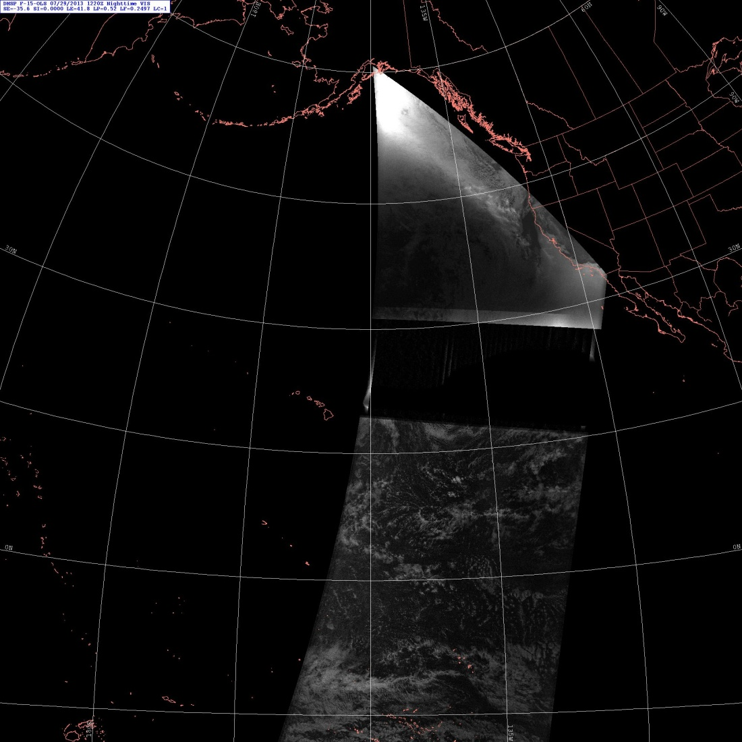
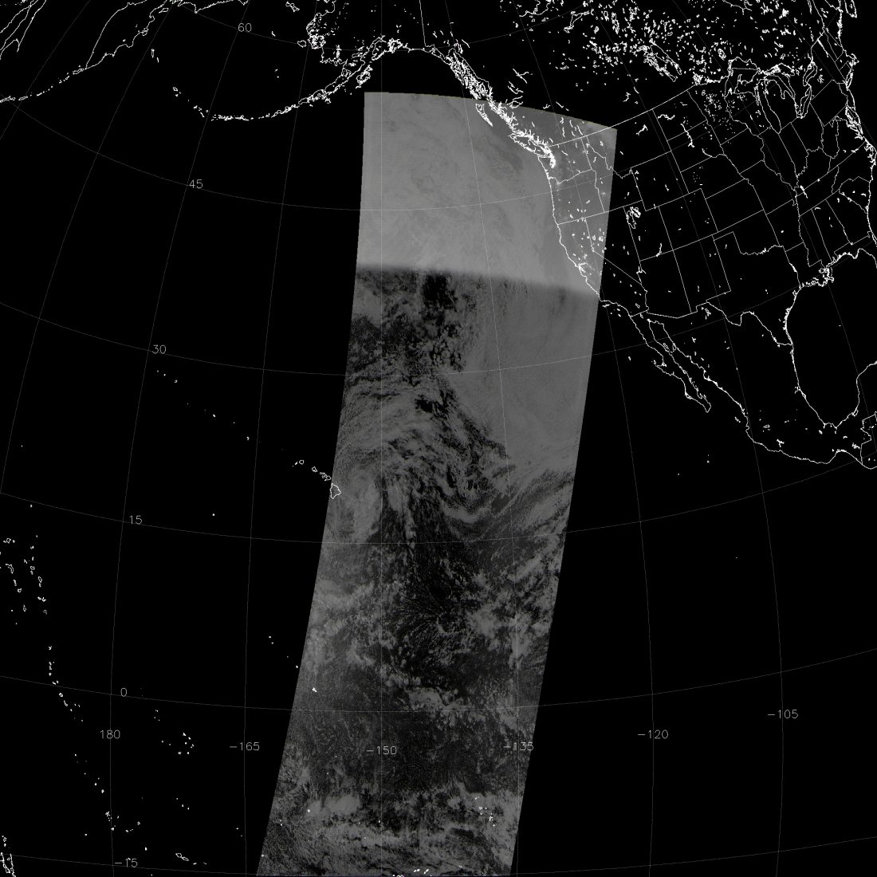
VIIRS NCC vs. DMSP OLS
OLS
NCC
Stray light suppression
15
-150
-135
0
12:20 UTC 29 July 2013
10:54 UTC 29 July 2013

Slide 20
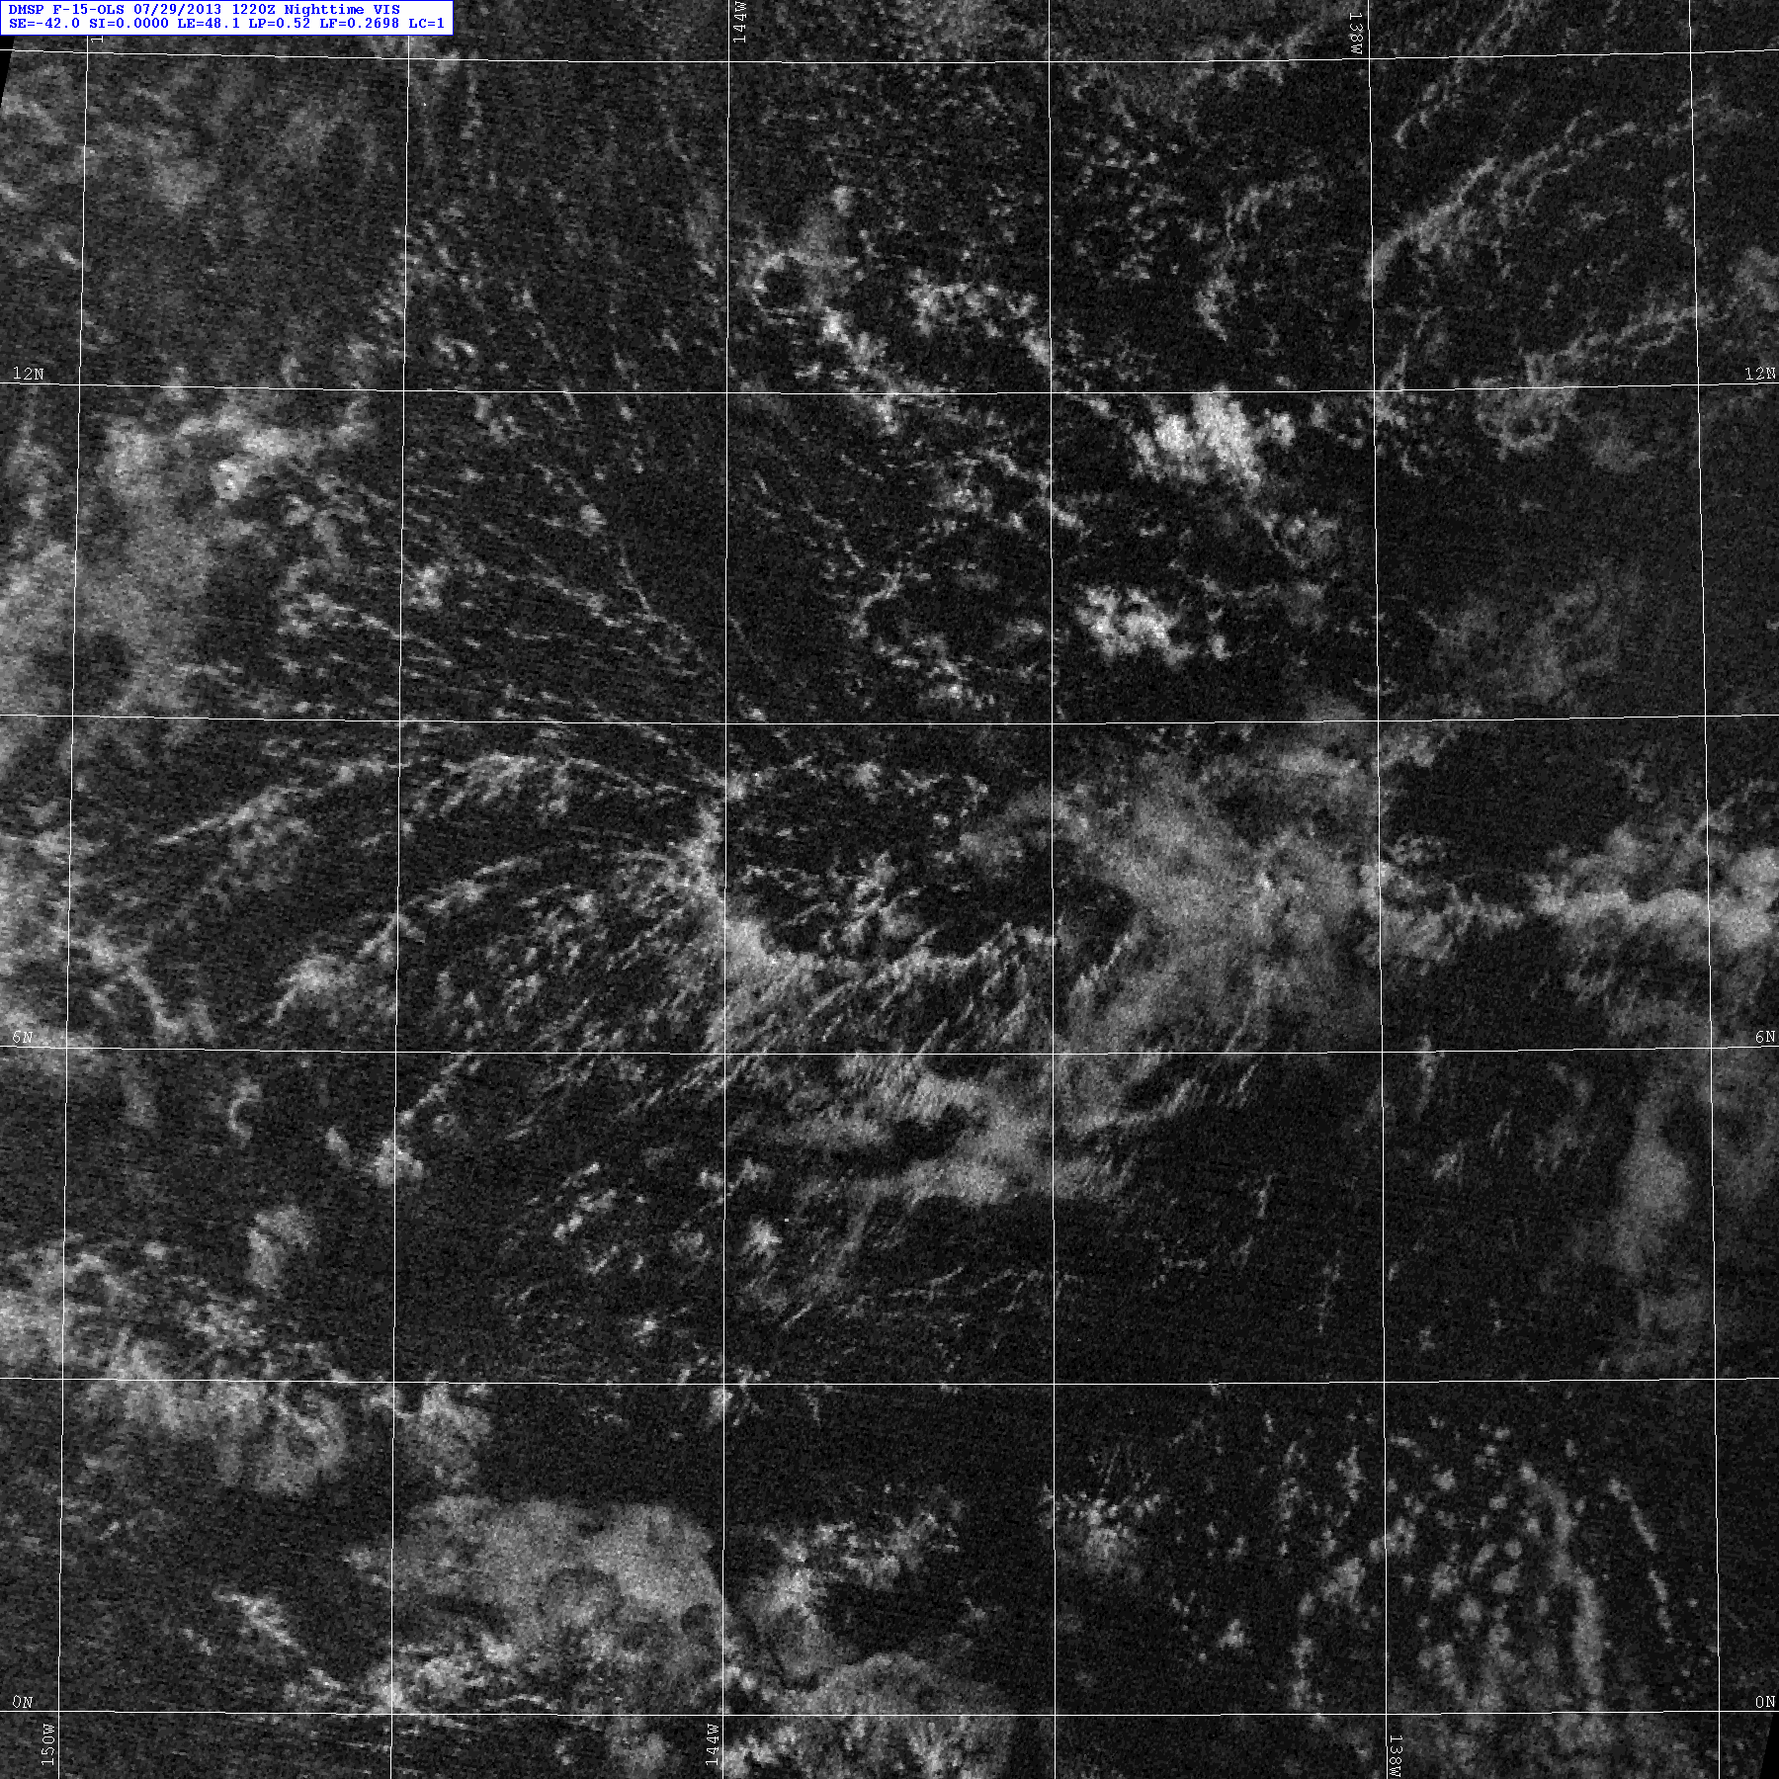
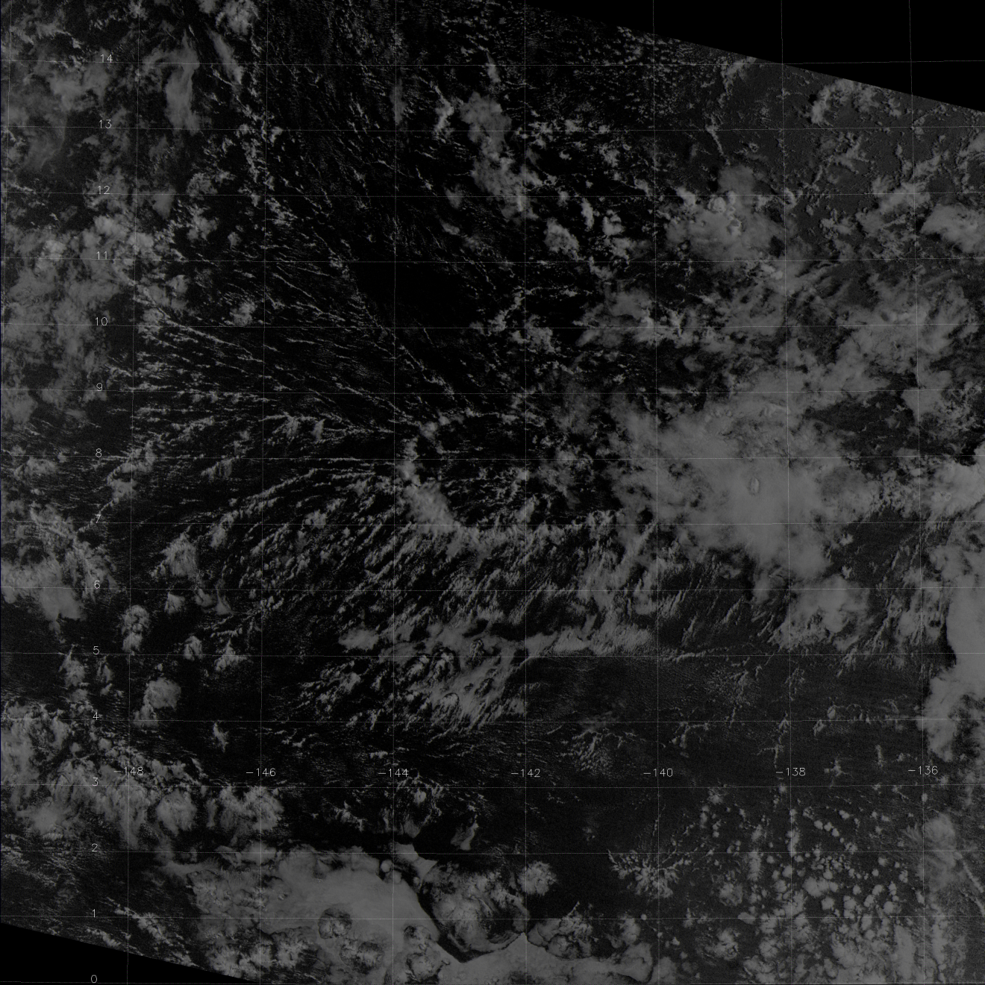
OLS
NCC

Slide 21
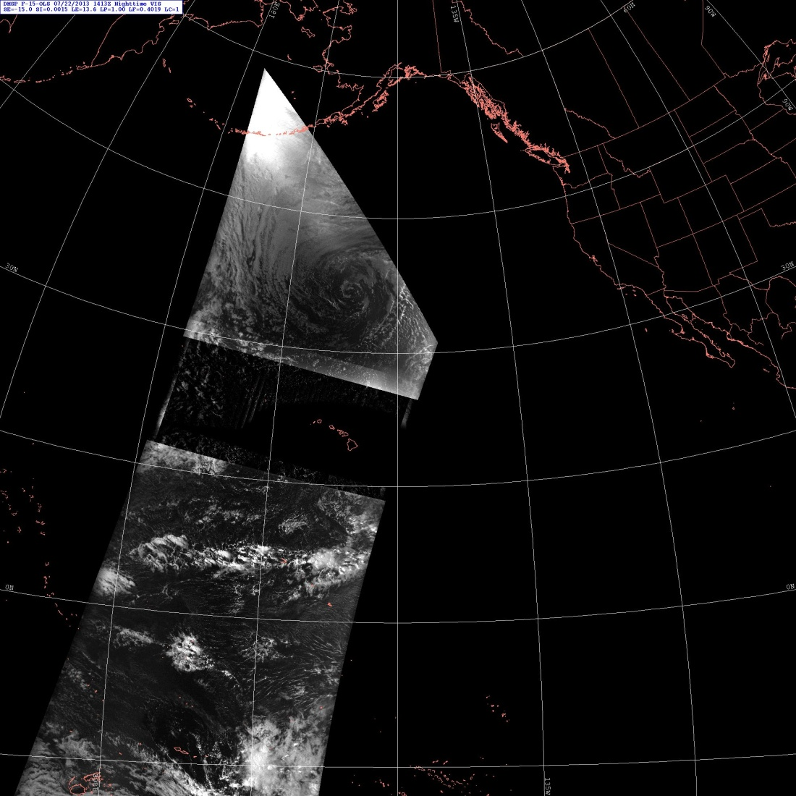
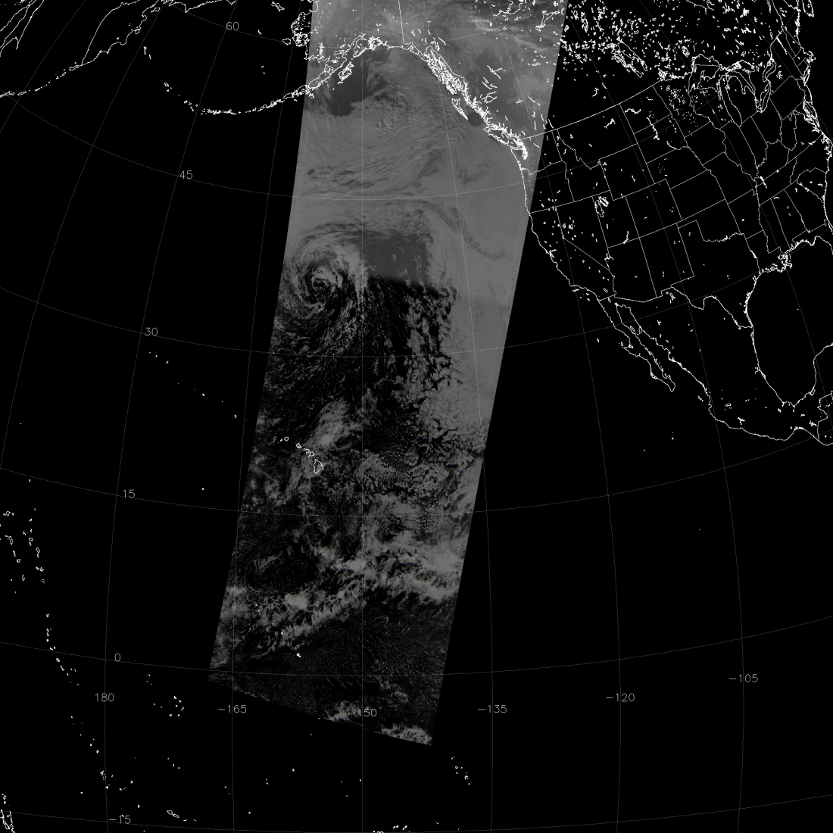
VIIRS NCC vs. DMSP OLS
OLS
NCC
15
Stray light suppression
-165
-150
0
14:13 UTC 22 July 2013
11:20 UTC 22 July 2013

Slide 22
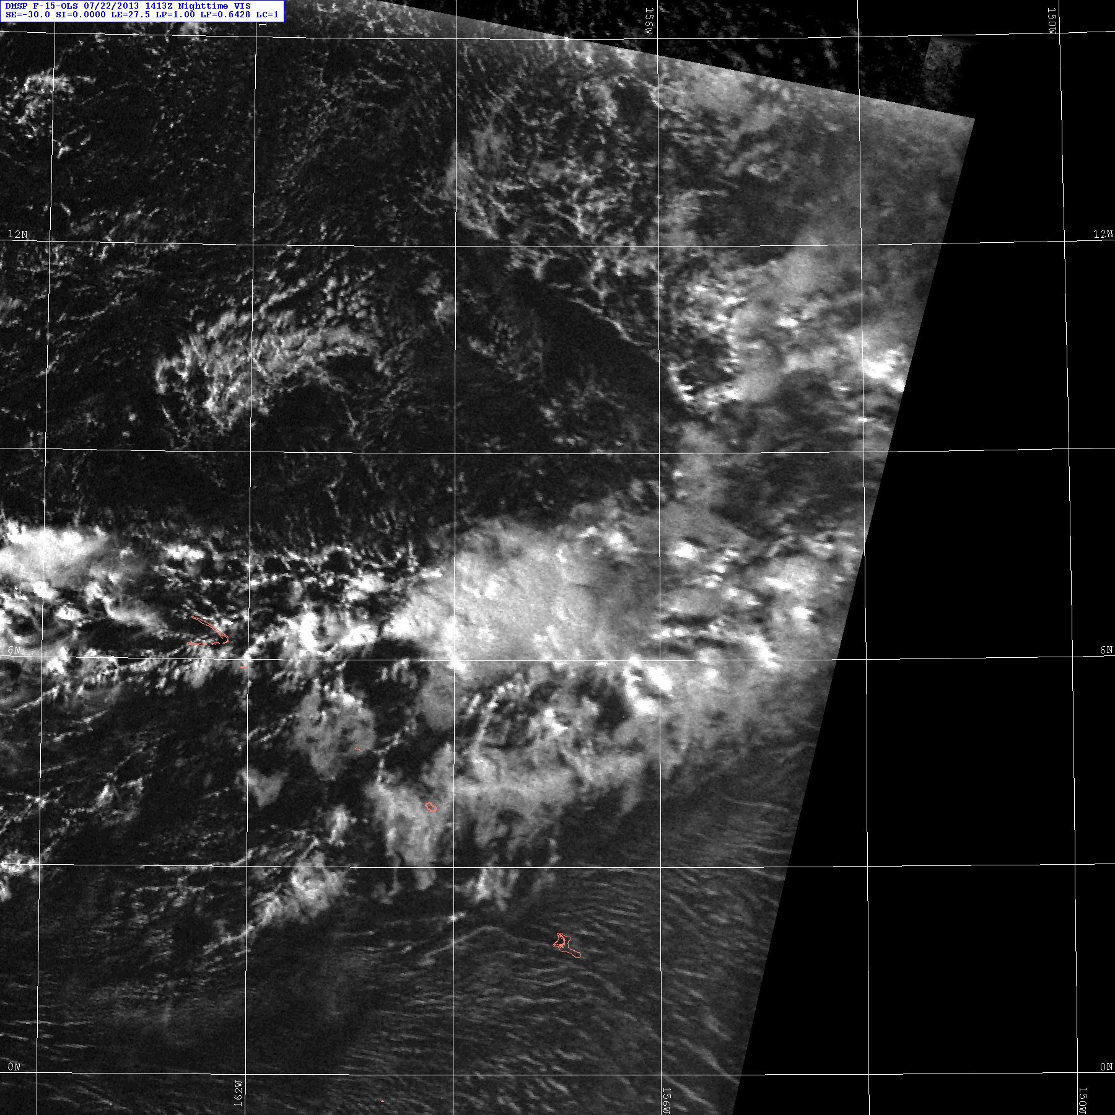
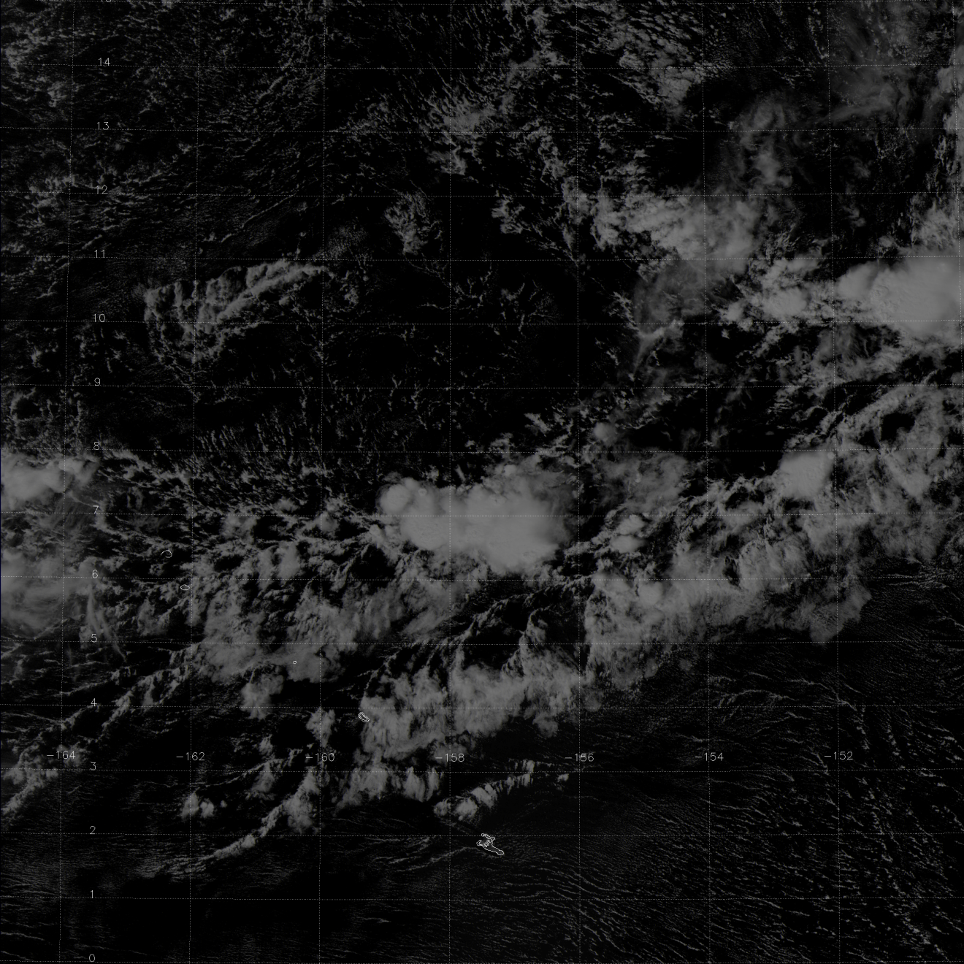
OLS
NCC

Slide 23
VIIRS NCC vs. DMSP OLS
OLS
NCC
45
-165
-150
30
Stray light suppression
14:13 UTC 22 July 2013
11:20 UTC 22 July 2013

Slide 24
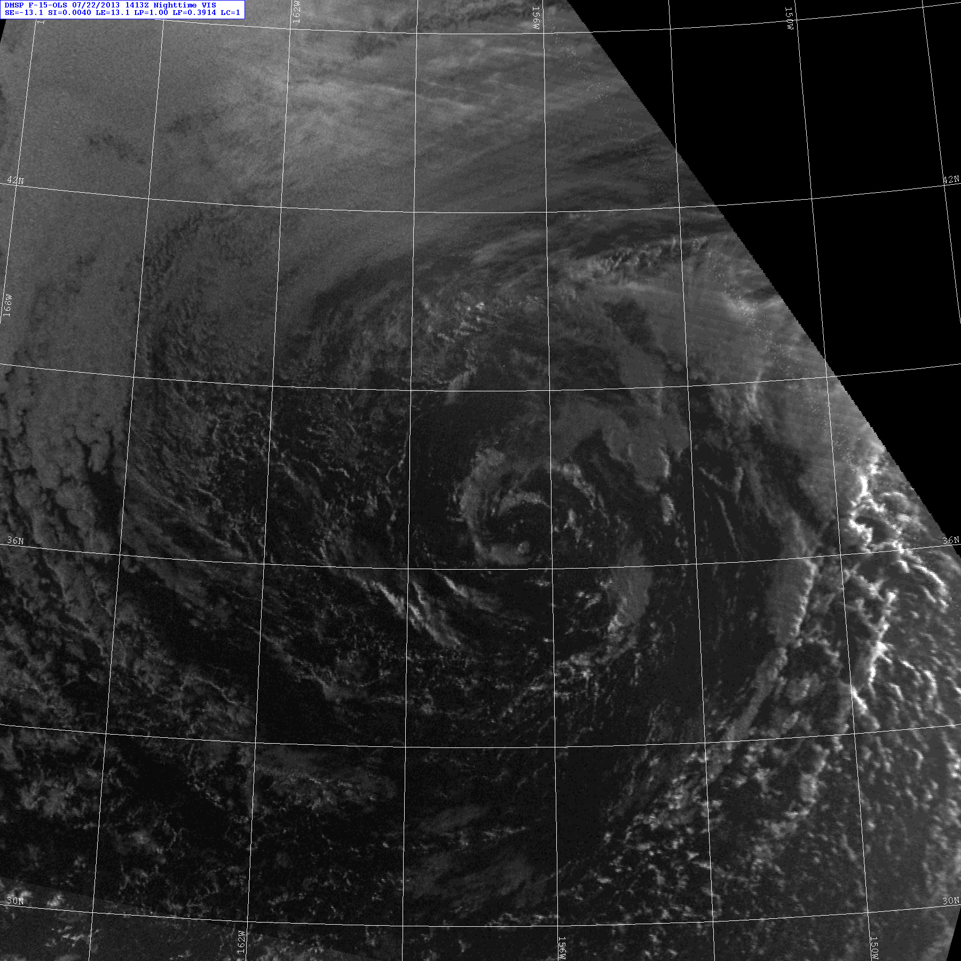
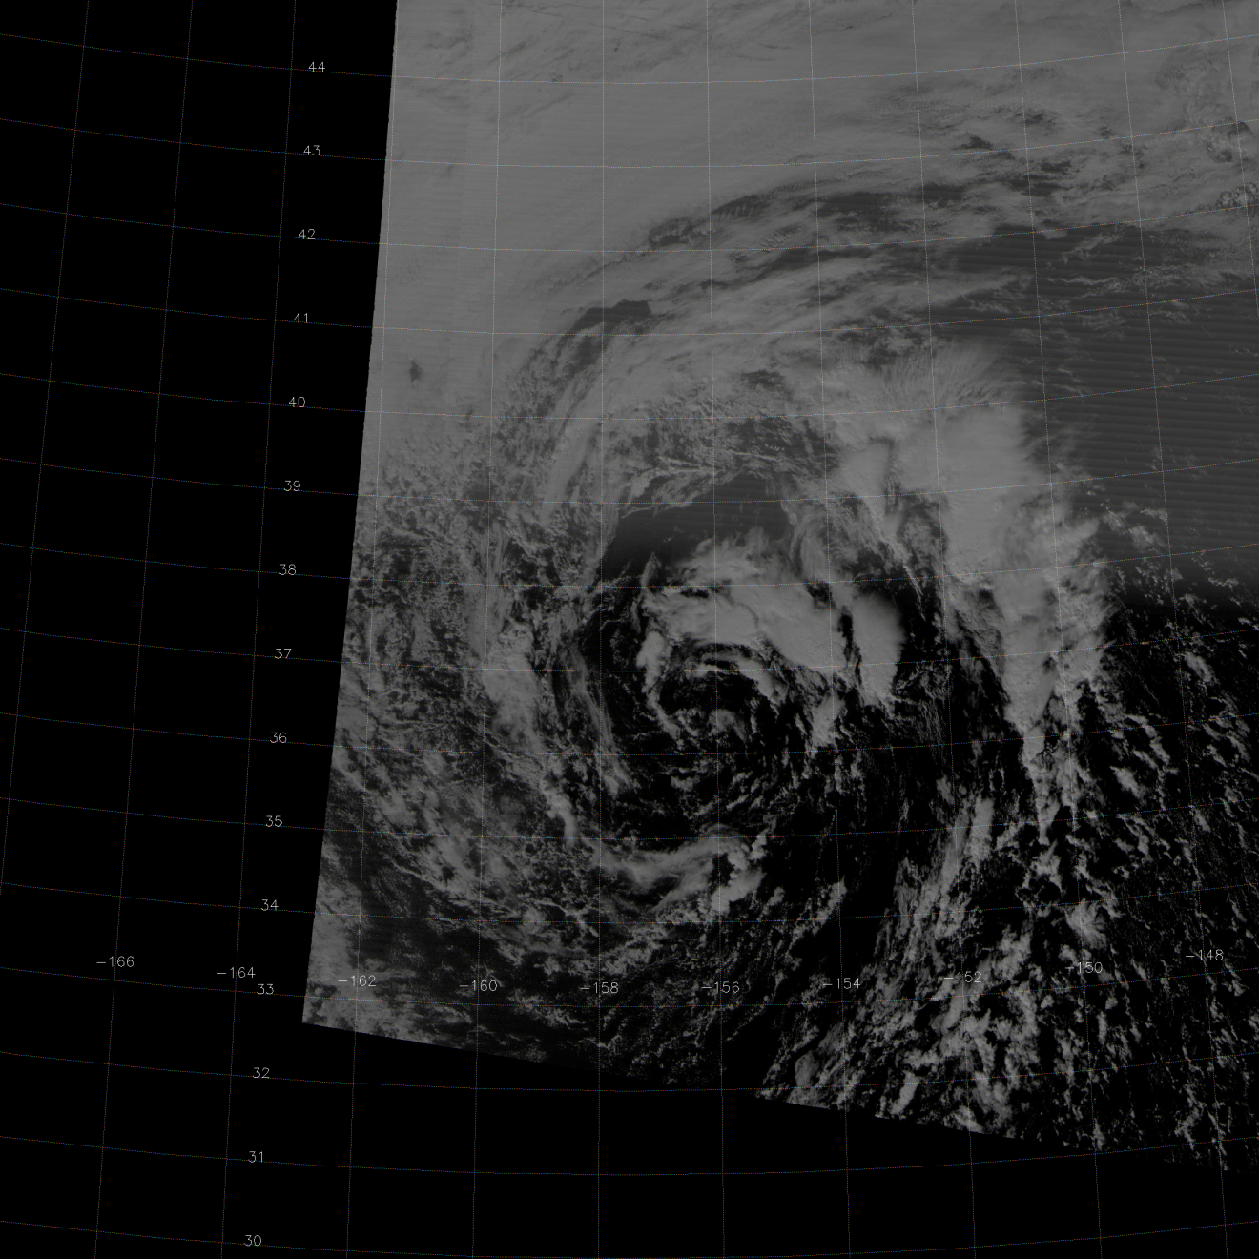
OLS
NCC

Slide 25
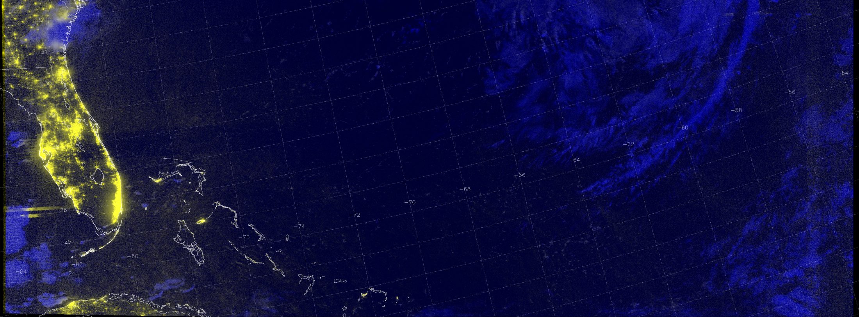
RGB Composite Using NCC
M-15 EDR, NCC, NCC
06:15 UTC 13 August 2013

Slide 26
EDR Provisional Criteria – Imagery
Provisional Definition | Artifacts (Deliverables) | Imagery EDR
Product quality may not be optimal | Product accuracy is determined for a broader (but still limited) set of conditions. No requirement to demonstrate compliance with specifications. | Clouds and sea ice edge at a minimum, but many others are possible
Incremental product improvements are still occurring | Narrative, listing and discussing known errors. All DRs are identified and prioritized (1-5). Provisional readiness will address priorities 1-2. Pathway towards algorithm improvements to meet specifications is demonstrated. | No known performance issues . DRs (mostly resolved for non-NCC imagery)
Version control is in affect | Description of the development environment, algorithm version (IDPS build number), and LUTs/PCTs versions used to generate the product validation materials. ATBDs are accurate, up-to-date and consistent with the product running. | ATBD is up-to-date, as is all other documentation
General research community is encouraged to participate in the QA and validation of the product, but need to be aware that product validation and QA are ongoing | ADP STAR will request feedback from appropriate users for the product. The notification letter will include a Provisional Maturity disclaimer. DPA will send request to Project Science to post Provisional Maturity disclaimer on CLASS. DPA will submit readme document (#3 below) to CLASS. | Some feedback from users already exists (NRL/McIDAS): - Minor near-noise-level striping has been noticed. Multi-spectral analysis is common - Comparison to (improvements over) other satellites
Users are urged to consult the EDR product status document prior to use of the data in publications | Warning of potential non-reproducibility of results due to continuing calibration and code changes. Identify known deficiencies regarding product quality. | Non-reproducibility is irrelevant, because imagery is not a climate product
May be replaced in the archive when the validated product becomes available | Technical evaluation of limited data reprocessing is presented. | Not directly relevant
Ready for operational evaluation | Key NOAA and non-NOAA end users are identified and feedback requested | Users are already involved (as seen by Imagery Team makeup)

Slide 27
NCC Imagery DRs
DR 4470 – No NCC imagery for nighttime granules
Resolved in Build 7.1, July 10, 2013
DR 4484 – NCC Imagery needs to match OLS Coverage (useful imagery to near half-moon phase)
Resolved in LUT update in November 2012
DR 4718 – Update GVVSSE LUTs
Resolved in LUT update in July 2012
DR 4902 – Too many FILL values in very dark pixels
Resolved in Build 7.1, July 10, 2013
DR 4867 – Discontinuity at the 105 solar angle
Resolved in Build 7.1, July 10, 2013

Slide 28
NCC Imagery DRs
DR 4653 – Request for all 16 M-bands as Imagery EDRs in S-NPP. This was written in April 2012 when two users disagreed on which 6 bands should be the default bands
DR 7257 – Written in June 2013, this DR is essentially the same request for JPSS-1, but adds our identification of inconsistent requirements in the various JPSS Level 1 documents
The JPSS requirements added specific M-bands not noted in earlier NPOESS specifications, but does not specify the precise number of M-band Imagery EDRs expected

Slide 29
Beta and Provisional ReadMe Caveats
Imagery detector-to-detector striping:
Currently significant where stray light exists in the DNB
Expected to be sharply mitigated in Build 7.2
Striping may also appear depending on the enhancement used on NCC Imagery, especially when the initial radiances are low
Data latency:
Not improved yet!
Hoping for improvement within NDE
Carryovers to Provisional ReadMe
Continue data availability/latency issue

Slide 30
Path Forward to Validation Stage 1
Continued feedback from users:
Expand to additional users
NIC
Navy
NWS
Quantitative analysis of EDR imagery geo-location, details in discussion with DPA
Limited quantitative analysis of EDR striping, details in discussion with the SDR team and DPA

Slide 31
Summary
We’ve made excellent progress with VIIRS Imagery after 18 months!
NCC Imagery now non-FILL even under new moon conditions
NCC Imagery now exceeds the only similar capability in existence today (DMSP OLS)
NCC has now reached provisional status
Date this was achieved is 10 July 2013, with the implementation of Build 7.1

