Slide 1
Suomi NPP Non-NCC VIIRS Imagery EDR Product Review - Provisional
Don Hillger¹ and Tom Kopp², and the EDR Imagery Team
18 January 2013
¹NOAA/NESDIS/StAR
²The Aerospace Corporation

Slide 2
VIIRS EDR Imagery (and Visualization) Team
NESDIS/StAR (D. Hillger, D. Molenar, D. Lindsey, T. Schmit – GOES liaison)
CIRA/CSU (S. Miller, S. Kidder, S. Finley, H. Gosden, R. Brummer, C. Seaman)
CIMSS/SSEC (T. Jasmin, T. Rink, W. Straka)
Aerospace (T. Kopp, J. Feeley)
NOAA/NGDC (C. Elvidge)
NRL (J. Hawkins, K. Richardson, J. Solbrig, T. Lee)
AFWA (J. Cetola)
Northrop Grumman (K. Hutchison, R. Mahoney)
NASA (W. Thomas, P. Meade)
NOAA/OSPO (A. Irving)
NASA/SPoRT (G. Jedlovec, M. Smith)

Slide 3
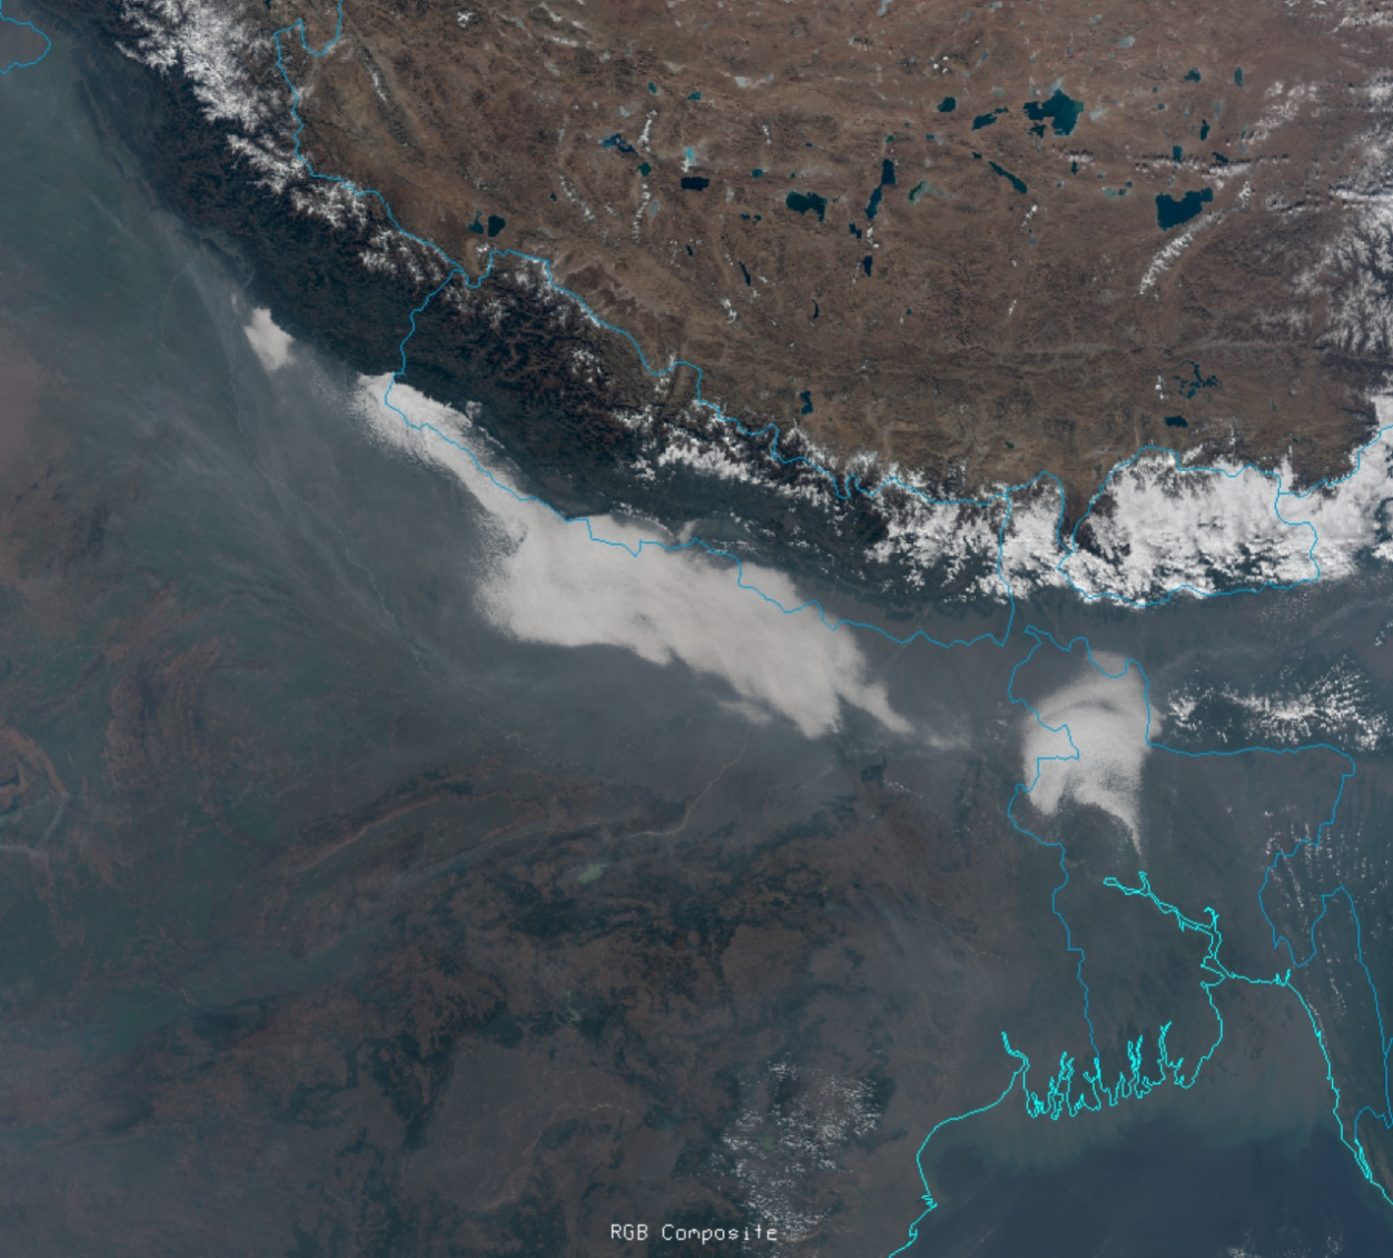
VIIRS true-color image from bands M3 (0.488 µm), M4 (0.555 µm), and M5 (0.672 µm) over northern India and Tibet on 14 December 2011 at 0725 UTC. Note the large contrast in aerosol scattering between the cooler and drier and shallower air mass to the north of the Himalayan chain and the warm and humid and deeper air mass to the south.

Slide 4
VIIRS Environmental Data Record (EDR)s
VIIRS Band | Central Wavelength (μm) | Bandwidth (μm) | Wavelength Range (μm) | Band Explanation | Spatial Resolution (m) @ nadir
M1 | 0.412 | 0.02 | 0.402 - 0.422 | Visible | 750 m
M2 | 0.445 | 0.018 | 0.436 - 0.454
M3 | 0.488 | 0.02 | 0.478 - 0.488
M4 | 0.555 | 0.02 | 0.545 - 0.565
M5 (B) | 0.672 | 0.02 | 0.662 - 0.682
M6 | 0.746 | 0.015 | 0.739 - 0.754 | Near IR
M7 (G) | 0.865 | 0.039 | 0.846 - 0.885
M8 | 1.240 | 0.020 | 1.23 - 1.25 | Shortwave IR
M9 | 1.378 | 0.015 | 1.371 - 1.386
M10 (R) | 1.61 | 0.06 | 1.58 - 1.64
M11 | 2.25 | 0.05 | 2.23 - 2.28
M12 | 3.7 | 0.18 | 3.61 - 3.79 | Medium-wave IR
M13 | 4.05 | 0.155 | 3.97 - 4.13
M14 | 8.55 | 0.3 | 8.4 - 8.7 | Longwave IR
M15 | 10.763 | 1.0 | 10.26 - 11.26
M16 | 12.013 | 0.95 | 11.54 - 12.49
DNB | 0.7 | 0.4 | 0.5 - 0.9 | Visible | 750 m across full scan
I1 (B) | 0.64 | 0.08 | 0.6 - 0.68 | Visible | 375 m
I2 (G) | 0.865 | 0.039 | 0.85 - 0.88 | Near IR
I3 (R) | 1.61 | 0.06 | 1.58 - 1.64 | Shortwave IR
I4 | 3.74 | 0.38 | 3.55 - 3.93 | Medium-wave IR
I5 | 11.45 | 1.9 | 10.5 - 12.4 | Longwave IR
Notes:
M-bands highlighted in pale yellow are available as EDRs, in addition to SDRs.
True-color component bands are highlighted in red, green, and blue.
Natural-color component bands are noted with R, G, and B.
M6 on Suomi NPP has a high radiance fold-over issue with many saturated pixels.

Slide 5
VIIRS bands (I1-I5, DNB/NCC, M1-M16)

Slide 6
NPP/JPSS data sources
GRAVITE¹ (Suitland, 7-hour delay)
NOAA CLASS² (Asheville, 7-hour delay) – not actively used
Atmosphere PEATE³ (Wisconsin, 7-hour delay)
ADDE server for McIDAS-X
FTP and HTML
Direct Readout (Wisconsin, minimal delay, but provides data only over North America, when the satellite is with sight of Madison)
AFWA IDPS⁴ (Omaha, near real-time)
¹Government Resource for Algorithm Verification, Integration, Test and Evaluation
²Comprehensive Large Array-data Stewardship System
³Product Evaluation and Algorithm Test Elements
⁴Air Force Weather Agency Interface Data Processing Segment

Slide 7
VIIRS display tools
McIDAS-V (VIIRS ready) – SSEC/CIMSS/Wisconsin
McIDAS-X (VIIRS capabilities still under development) – SSEC/CIMSS/Wisconsin
TeraScan / NexSat (web display) – NRL
IDL

Slide 8
Sensor Data Record (SDR) to Environmental Data Record (EDR)
Ground Track Mercator (GTM) remapping software.
GTM is a remapping of the data, but the same radiances/reflectances for Non-NCC bands only.
For NCC imagery there is additional radiance processing
Environmental Data Record (EDR)
Sensor Data Record (SDR)
GTM software
GTM software
plus
DNB (SDR)
NCC (EDR)

Slide 9
Suomi NPP Imagery and Visualization Team web page http://rammb.cira.colostate.edu/projects/npp/

Slide 10
Suomi NPP VIIRS Online http://rammb.cira.colostate.edu/ramsdis/online/npp_viirs.asp

Slide 11
Unique features of VIIRS, as compared with its predecessors
Finer spatial resolution for all bands (down to 375 m)
Finer spatial resolution at swath edge in particular
A benefit of aggregation
Limit degradation of spatial resolution from nadir to edge-of-scan
Wider (3000 km) swath, leaving no gaps between adjacent orbits

Slide 12
Better spatial resolution at swath edge

Slide 13
BAMS article to appear in 2013
Hillger, D., T. Kopp, T. Lee, D. Lindsey, C. Seaman, S. Miller, J. Solbrig, S. Kidder, S. Bachmeier, T. Jasmin, and T. Rink, 2013: First-Light Imagery from Suomi NPP VIIRS. Manuscript accepted by BAMS.
Examples that follow are from that manuscript.

Slide 14
a) GOES-13 10.7 µm image from 0815 UTC on 6 June 2012
b) Zoomed-in GOES over the highlighted thunderstorm complex in the southwestern Gulf of Mexico,
c) Aqua MODIS band 31 (11.0 µm) view of the same thunderstorm complex at 0816 UTC
d) NPP VIIRS band I5 (11.45 µm) view at 0817 UTC.
e and f) Extreme close-ups approximately covering the circled region from the MODIS and VIIRS images.

Slide 15
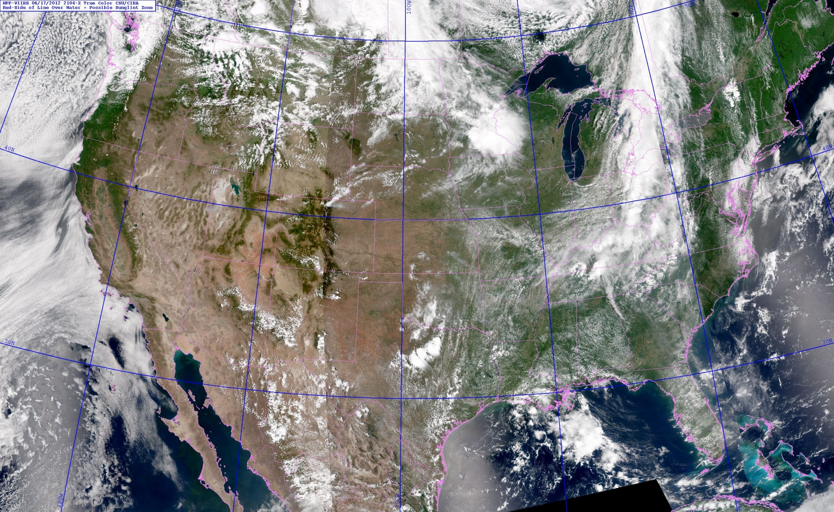
NRL VIIRS true-color composite http://www.nrlmry.navy.mil/VIIRS.html

Slide 16
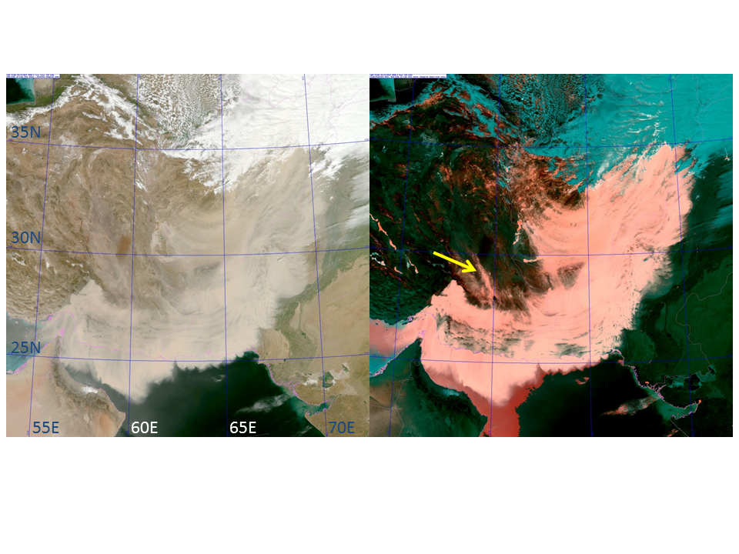
Suomi NPP VIIRS true color (left) and enhanced dust (right) imagery over Middle East.
Dust appears as pink, clouds in cyan, and land in shades of green. Images are from 19 March 2012 at 0905 UTC. The enhanced imagery is particularly useful for identifying dust over bright land surface backgrounds, such as the narrow plume indicated in the enhancement by the yellow arrow.

Slide 17
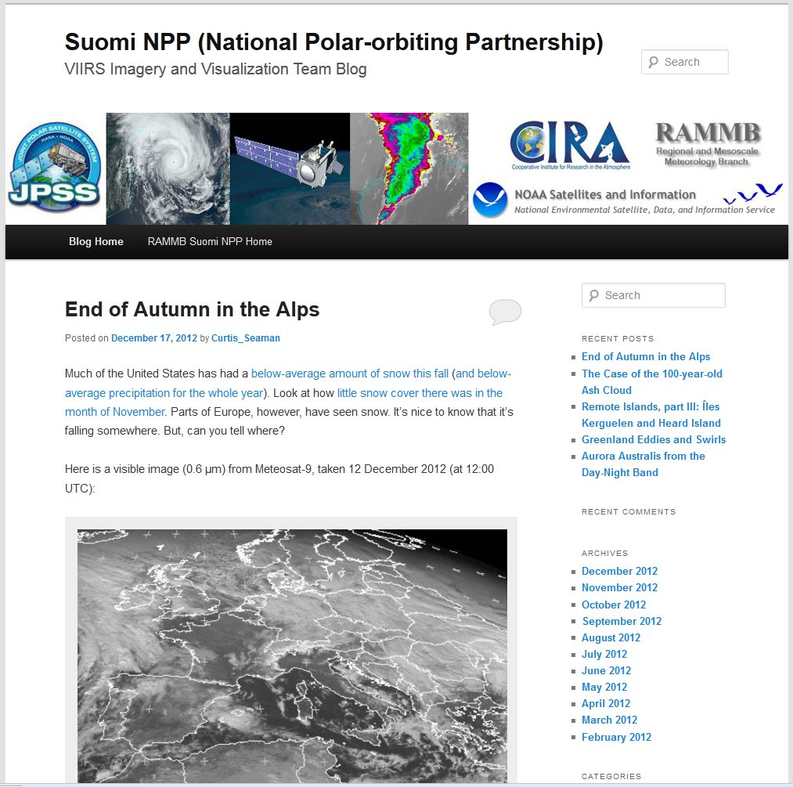
JPSS/Suomi NPP VIIRS Imagery Blog
http://rammb.cira.colostate.edu/projects/npp/blog/
Blog maintained at CIRA to highlight capabilities of VIIRS instrument.
Designed to provide education/outreach of VIIRS imagery applications.
Blog covers wide range of topics: tropical cyclones, severe weather, fire detection, auroras, volcanic eruptions, flooding, snow and ice detection, DNB applications, RGB composites and other interesting high-resolution imagery from VIIRS

Slide 18
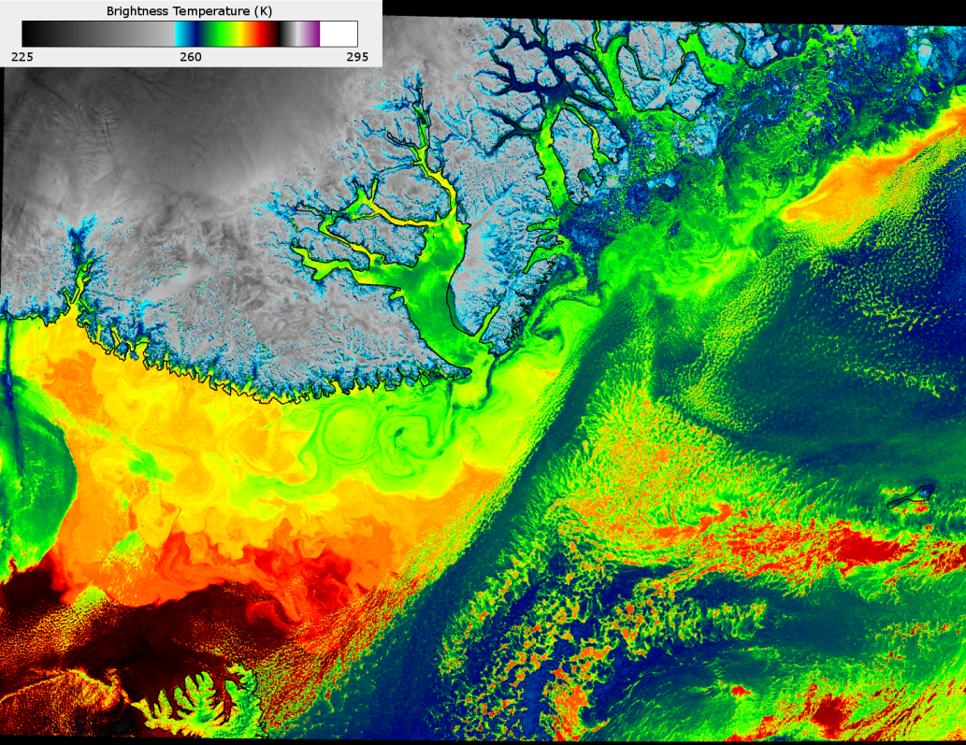
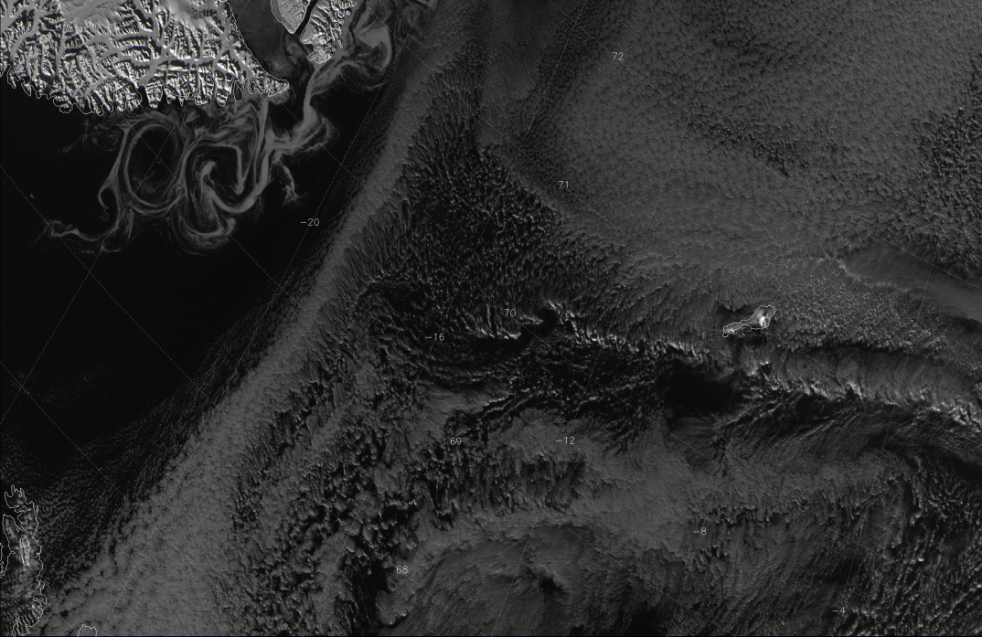
Greenland Swirls
http://rammb.cira.colostate.edu/projects/npp/blog/
I-01 (0.64 μm)
I-05 (11.4 μm)
Visible and IR images from 12:43 UTC 18 October 2012 (C. Seaman)
Interaction of East Greenland Current and North Atlantic Drift represented by swirling ribbons of ice (left) caught in eddies as a result of the SST contrast (right)
Many details visible at ~375 m resolution

Slide 19
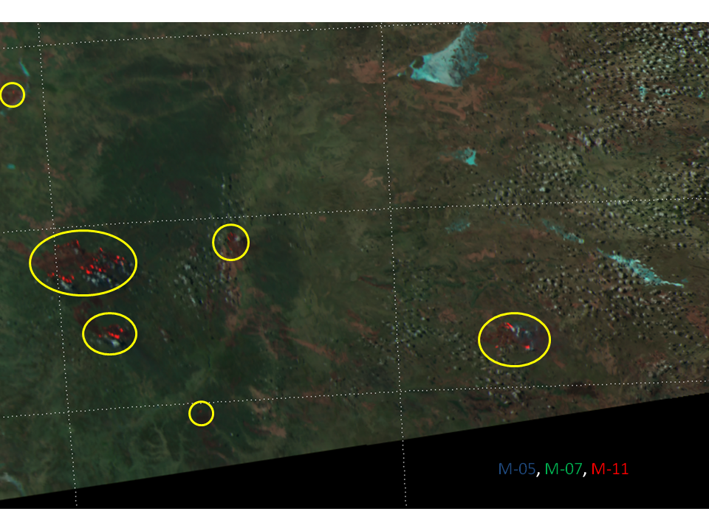
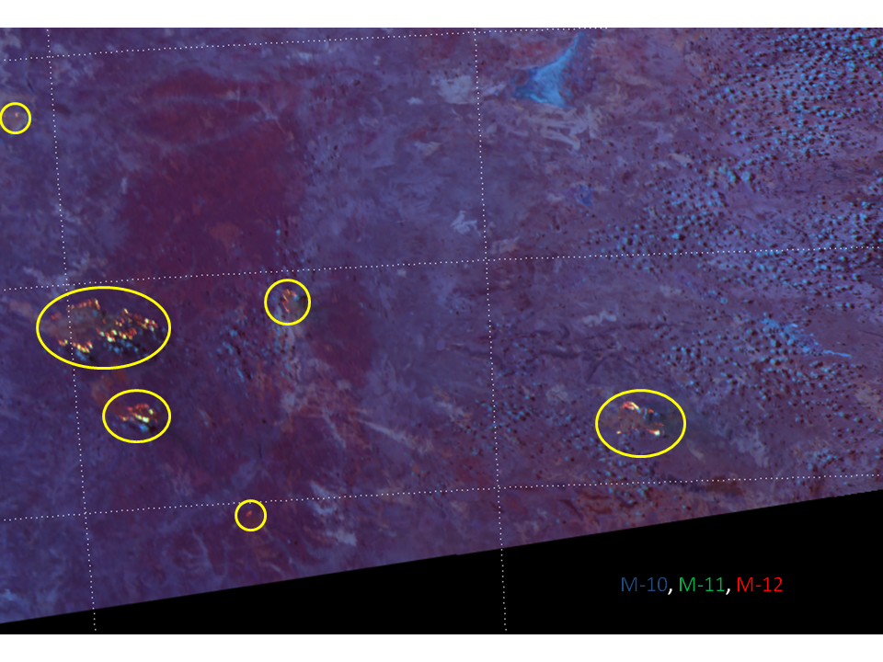
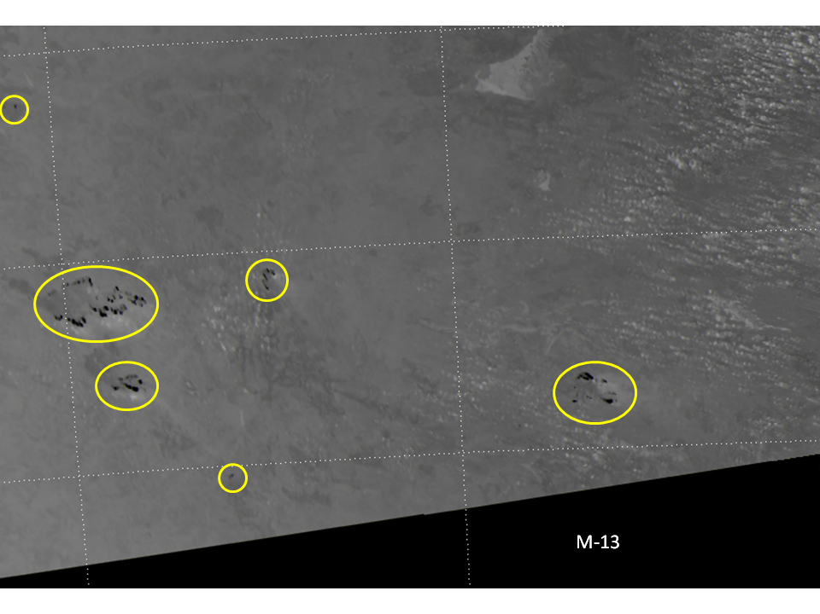
Fires in Australia
http://rammb.cira.colostate.edu/projects/npp/blog/
Numerous fires visible in 3.9 μm image (M-13) of the Australian Outback
04:34 UTC 19 September 2012
“Natural Fire Color RGB” composite of 0.67 μm (M-5), 0.87 μm (M-7) and 2.25 μm (M-11)
“Fire Power RGB” composite of 1.61 μm (M-10), 2.25 μm (M-11) and 3.7 μm (M-12)
(C. Seaman)
Exploring new RGB composites to aid in fire detection
VIIRS has detected fires at wavelengths as short as 1.61 μm

Slide 20
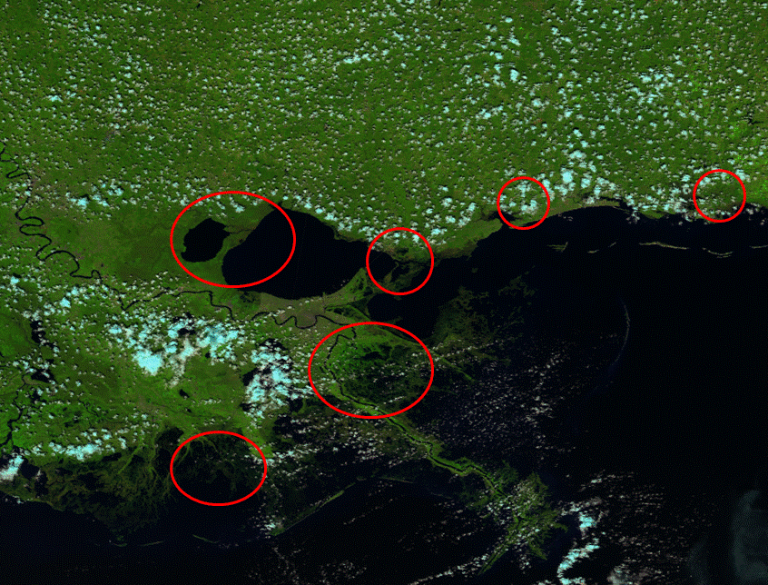
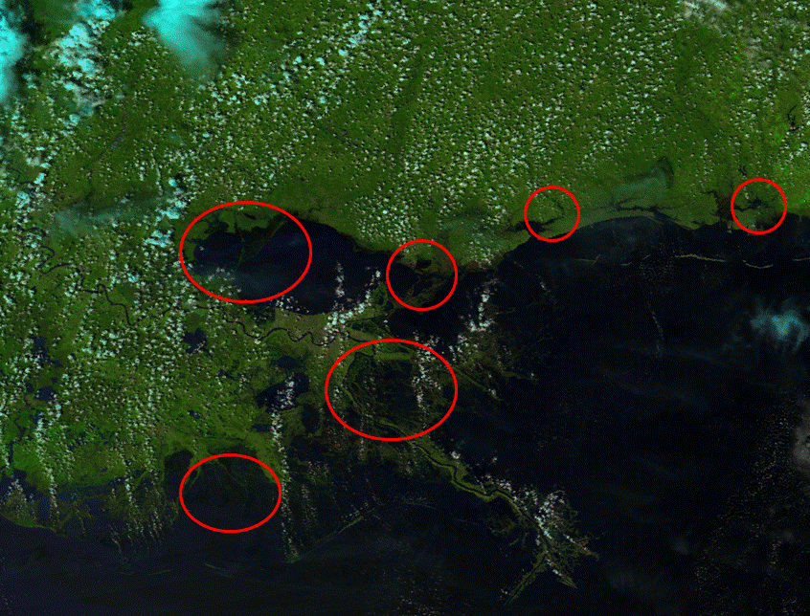
Flooding from Hurricane Isaac
http://rammb.cira.colostate.edu/projects/npp/blog/
“Natural Color” RGB composite (0.64 μm [I-01], 0.87 μm [I-02], 1.61 μm [I-03]) shows the extent of the flooding caused by Hurricane Isaac
The isthmus between Lake Pontchartrain and Lake Maurepas disappears under water
Flooding also visible along the Mississippi River below New Orleans, and along the Gulf Coast
26 August 2012 (C. Seaman)
1 September 2012 (C. Seaman)

Slide 21
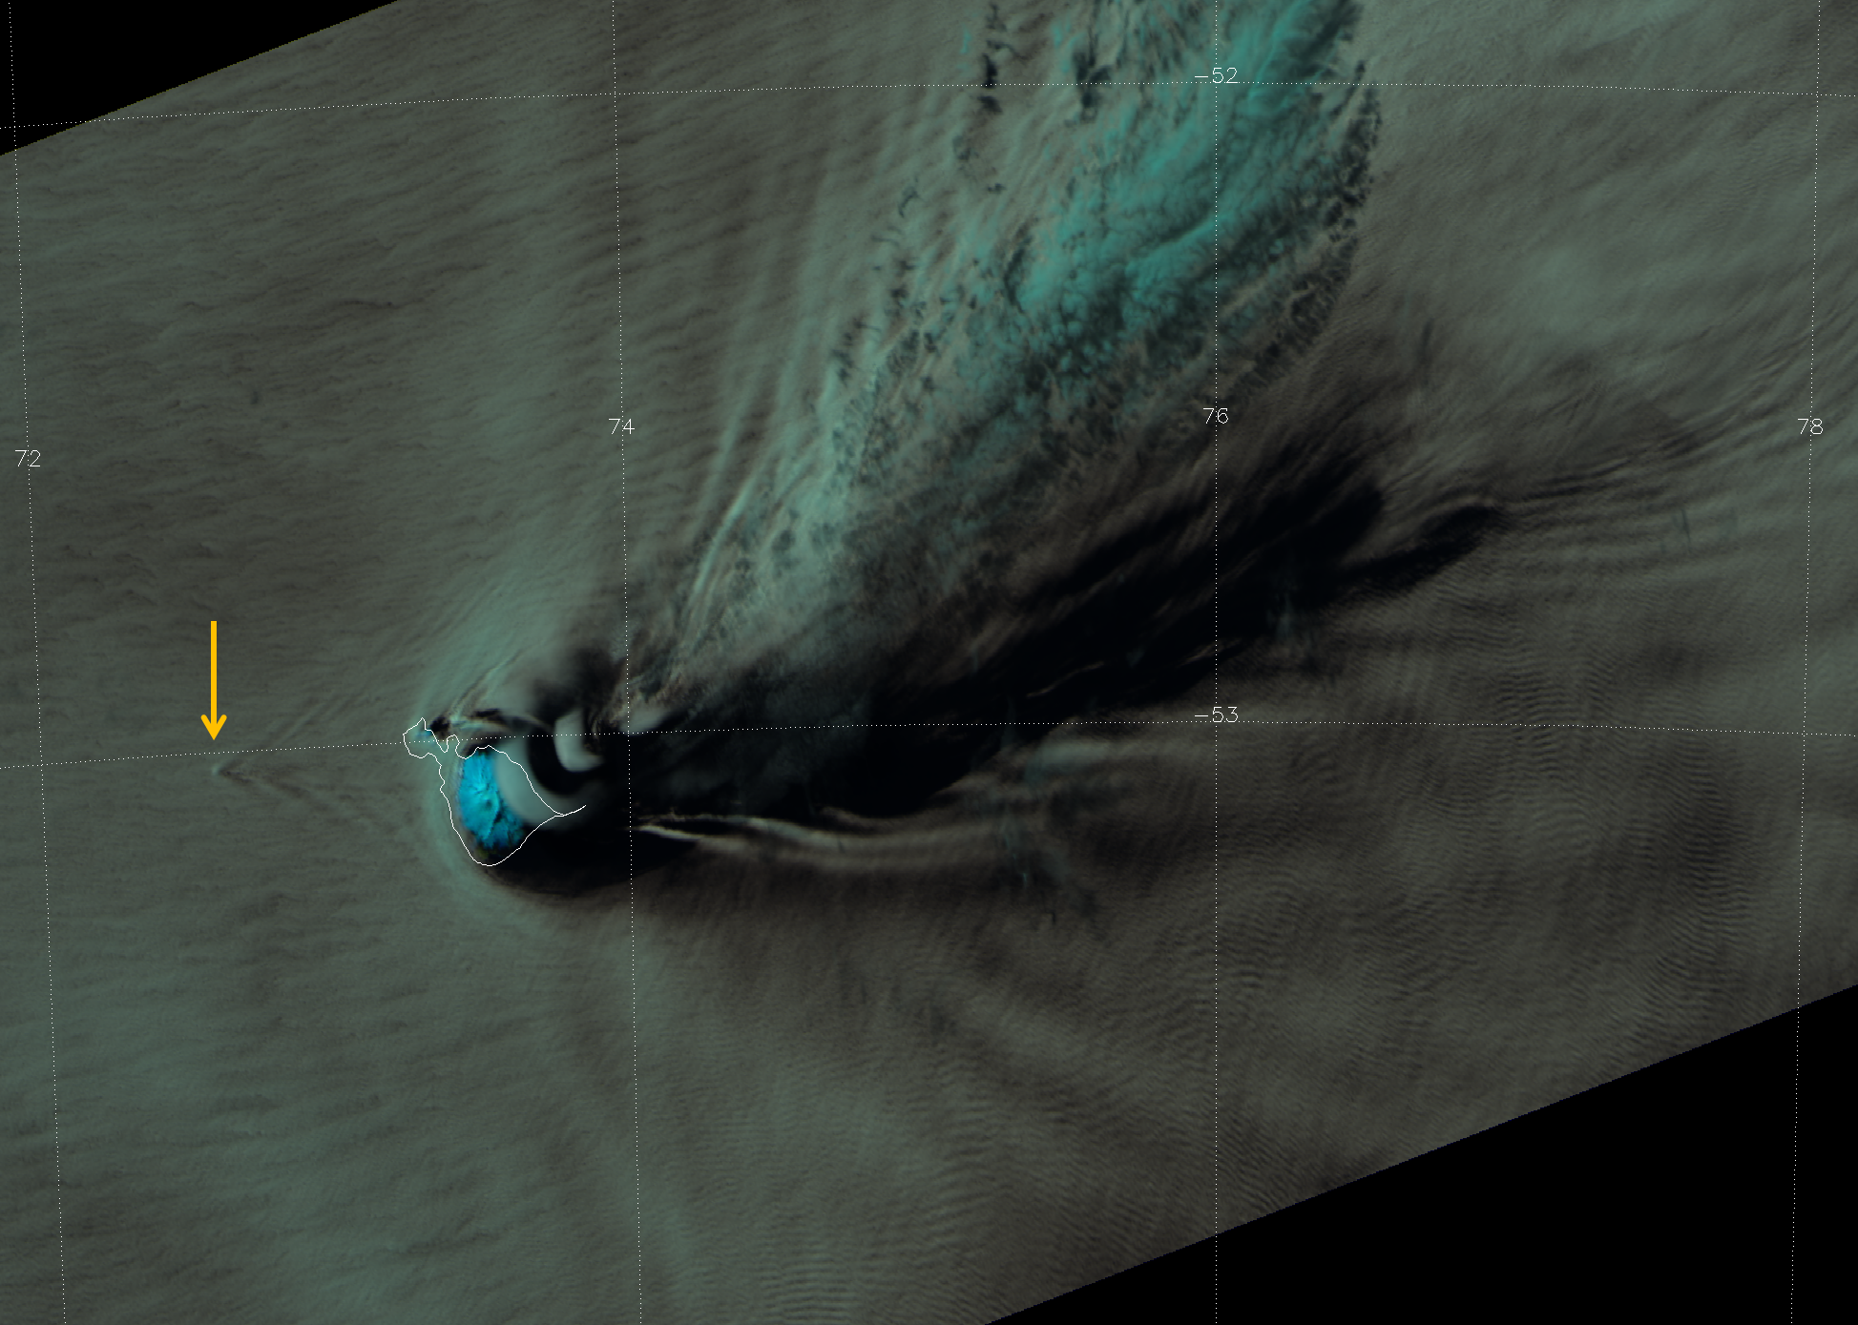
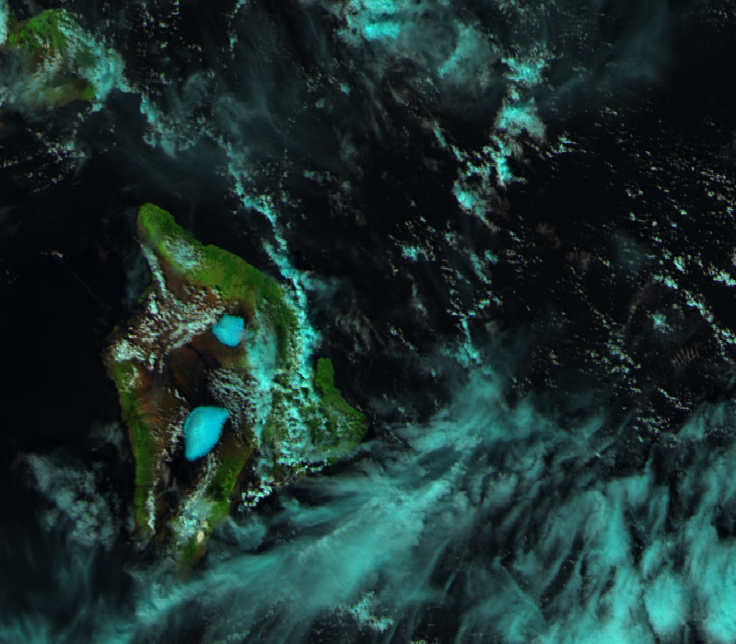
High-resolution Images of Remote Islands
http://rammb.cira.colostate.edu/projects/npp/blog/
Lenticular clouds and other waves caused by Heard and McDonald Islands
27 October 2012
Natural color RGB of Snow on Hawaii
12 February 2012
(C. Seaman)

Slide 22
VIIRS imagery issues/problems so far:
Server (GRAVITE) issues
Missing (or delayed) granules
Duplicate granules
Missing geo-location values in granules
Missing data “triangles” in granules
Padding stripes (fill values) from the use of GTM and a constant array size

Slide 23
EDR Provisional Criteria – Imagery
Provisional Definition | Artifacts (Deliverables) | Imagery EDR
Product quality may not be optimal | Product accuracy is determined for a broader (but still limited) set of conditions. No requirement to demonstrate compliance with specifications. | Clouds and sea ice edge at a minimum, but many others are possible
Incremental product improvements are still occurring | Narrative, listing and discussing known errors. All DRs are identified and prioritized (1-5). Provisional readiness will address priorities 1-2. Pathway towards algorithm improvements to meet specifications is demonstrated. | No known performance issues . DRs (mostly resolved for non-NCC imagery)
Version control is in affect | Description of the development environment, algorithm version (IDPS build number), and LUTs/PCTs versions used to generate the product validation materials. ATBDs are accurate, up-to-date and consistent with the product running. | ATBD is up-to-date, as is all other documentation
General research community is encouraged to participate in the QA and validation of the product, but need to be aware that product validation and QA are ongoing | ADP STAR will request feedback from appropriate users for the product. The notification letter will include a Provisional Maturity disclaimer. DPA will send request to Project Science to post Provisional Maturity disclaimer on CLASS. DPA will submit readme document (#3 below) to CLASS. | Some feedback from users already exists (NRL/McIDAS): - Minor near-noise-level striping has been noticed. Multi-spectral analysis is common - Comparison to (improvements over) other satellites
Users are urged to consult the EDR product status document prior to use of the data in publications | Warning of potential non-reproducibility of results due to continuing calibration and code changes. Identify known deficiencies regarding product quality. | Non-reproducibility is irrelevant, because imagery is not a climate product
May be replaced in the archive when the validated product becomes available | Technical evaluation of limited data reprocessing is presented. | Not directly relevant
Ready for operational evaluation | Key NOAA and non-NOAA end users are identified and feedback requested | Users are already involved (as seen by Imagery Team makeup)

Slide 24
Non-NCC Imagery DRs
DR 4579 – Triangular fill regions – closed.
DR 4525 – OAD update to make a unit superscripted – In MX 7.
DR 4468 – Imagery EDR has inappropriate fill values along edge of data – In MX7
DR 4653 – Change L1 requirements to go from 6 M bands to 16 M bands – Deferred. Need users to state that they need/want the other bands
DR 4775 – Non-NCC Provisional – Deferred

Slide 25
Beta and Provisional ReadMe Caveats
Imagery detector-to-detector striping:
Relatively minor for most imagery
Most noticeable under high enhancement or for multi-spectral image differencing
Data latency:
Not improved yet!
Hoping for improvement within NDE
Carryovers to Provisional ReadMe
Continue data availability/latency issue

Slide 26
Path Forward to Operational Stage 1
Continued feedback from users:
Expand to additional users
NIC
AFWA
NWS
Quantitative analysis of EDR imagery geo-location
Limited quantitative analysis of EDR radiances and striping
Especially related to higher-order image products
RGB combinations
Image products/differences

Slide 27
Summary
We’ve made excellent progress with VIIRS Imagery after 1 year!
NRL “user” presentation (to follow)

