Slide 1
VIIRS Imagery Validation 1 Stage
Dr. Don Hillger – Imagery Product Lead
Dr. Thomas Kopp – Imagery Validation Lead
Mr. Ryan Williams – Imagery JPSS Algorithm Manager
7 January 2014

Slide 2
Imagery Basics
Fundamentally the Imagery EDR is the projection of Sensor Data Records (SDRs) on a Ground Track Mercator (GTM) layout
The Near Constant Contrast (NCC) EDR is the only Imagery product that has additional calculations involved
That calculation is for a “pseudo-albedo” that accounts for variations in solar or lunar illumination across the scan
Imagery is defined by JPSS as a “two-dimensional array of numbers, in digital format, each representing the brightness of a small elemental area” (JPSS-L1RD Supplemental, Appendix C)
The applicable JPSS Level 1 Requirements sections, including the Supplemental, are the requirements we are considering today
This is our “target”
Numerous quantitative requirements from NPOESS that influenced the development of the Imagery EDR were not continued into JPSS
The JPSS requirements are inadequate to show the Imagery is a useful product, and the consequences of this will be noted

Slide 3
EDR Imagery Cal/Val Team
NESDIS/StAR (D. Hillger, D. Molenar, D. Lindsey, T. Schmit – GOES liaison)
CIRA/CSU (C. Seaman, S. Miller, S. Kidder, S. Finley, R. Brummer)
CIMSS/SSEC (T. Jasmin, T. Rink, W. Straka)
Aerospace (T. Kopp, J. Feeley)
Stellar Solutions (R. Williams)
NOAA/NGDC (C. Elvidge)
NRL (J. Hawkins, K. Richardson, J. Solbrig)
AFWA (J. Cetola)
Northrop Grumman (K. Hutchison, R. Mahoney, C. Liang)
NASA (W. Thomas, P. Meade)
NOAA/OSPO (A. Irving)
NASA/SPoRT (G. Jedlovec, M. Smith)

Slide 4
Validation 1 Stage
A product at Validation 1 stage will, using a limited set of samples, be shown to meet all threshold requirements
Evaluation factors include impacts from: SDRs, all quality flags, and inputs from other users
Documentation, to include appropriate versions of all Look-Up Tables (LUTs), must be up-to-date
This is true for Imagery, details to follow
All DRs should be accounted for
All open DRs deal with documentation or potential future enhancements
There are no science-related open DRs
Imagery meets all of these conditions, as we will show

Slide 5
Imagery Requirements – Part 1
The Imagery requirements are detailed in the JPSS Level 1 Requirements Document, section 5.0, and the Supplemental, section 5.3.5
There are Key Performance Parameters tied to the Imagery EDR
Six bands (I1, I4, I5, M14, M15, M16) are required as Imagery “for latitudes greater than 60 North in the Alaskan region”
There is no explicitly written requirement that the Imagery is a global product
The latency must be 96 minutes or better
The Imagery Validation Team is not responsible for proving data latency

Slide 6
Imagery Requirements – Part 2
Imagery is to be “delivered” under all weather conditions
No indication if this is tied to only Alaska or global
Imagery contains three horizontal spatial resolution requirements for I-bands, and three for M-bands
Nadir is 0.4 km (I-band) and 0.8 km (M-band)
Edge of Swath (EOS) is 0.8 km (I-band) and 1.6 km (M-band)
Nighttime visible (DNB is not specifically mentioned, but assumed) is 2.6 km, nadir only
These requirements are met through the appropriate application of the Ground Track Mercator (GTM) layout
Mapping requirements are not tied to the resolution of the bands, and are 1 km (nadir), 3 km (EOS)
We have deferred resolution issues to the VIIRS SDR Team, which has already shown this to be easily met

Slide 7
Imagery Requirements – Part 3
The Imagery requirements represent a minimalist mentality which presents dilemmas for the Imagery Validation Team
There are no requirements that relate to “quality” of any kind
By quality we mean features the imagery would be expected to identify and resolve
There are no specific requirements tied to the creation or use of NCC Imagery
The current requirements are a mix of heritage from the NPOESS era, what the operational system actually produces, and how the operational community actually applies imagery
The “requirements” therefore state that properly mapped imagery over Alaska from six specific bands is all that is needed to pass the JPSS Imagery EDR requirements.
However we all acknowledge the use of Imagery goes far beyond that limited case

Slide 8
Imagery Requirements – Part 4
The Imagery Team has therefore taken a common sense approach to the validation of the Imagery EDR
The Imagery is validated globally
The Imagery is validated with all bands produced operationally by the IDPS
We will also show any M-band Imagery may be produced using output produced on GRAVITE, as requested by the program
Examples will be shown covering many potential applications, as an operational user would exploit them
Imagery is a fundamentally successful product, that has not been fully exploited due to external forcing functions
Such as data latency (noted at the end of this briefing)

Slide 9
The Strange Case of M-band Imagery
The most common question we get on the Imagery Team is “Why only 6 M-bands?”
The initial Imagery EDR requirements on NPOESS did not require M-band Imagery, only I-band and NCC
The program realized circa 2005 that requirements to identify 17 cloud types and sea ice edge might not be met from the 6 Imagery products required (I-band and NCC)
Aside: these requirements did not propagate to JPSS
After months of debate, key participants acknowledged additional Imagery products were needed to attain these requirements
However there was deep concern that the additional products would compromise the latency requirements
In 2006 a compromise solution of 6 M-bands developed
This solution has held to this day
It has never been reflected in any subsequent requirement documents from either NPOESS or JPSS
M-band Imagery is not archived (all others are)

Slide 10
VIIRS Bands Created as EDR Imagery
VIIRS Band | Central Wavelength (μm) | Wavelength Range (μm) | Band Explanation | Spatial Resolution (m) at nadir
M1 | 0.412 | 0.402 - 0.422 | Visible | 750 m
M2 | 0.445 | 0.436 - 0.454
M3 | 0.488 | 0.478 - 0.488
M4 | 0.555 | 0.545 - 0.565
M5 (B) | 0.672 | 0.662 - 0.682
M6 | 0.746 | 0.739 - 0.754 | Near IR
M7 (G) | 0.865 | 0.846 - 0.885
M8 | 1.240 | 1.23 - 1.25 | Shortwave IR
M9 | 1.378 | 1.371 - 1.386
M10 (R) | 1.61 | 1.58 - 1.64
M11 | 2.25 | 2.23 - 2.28
M12 | 3.7 | 3.61 - 3.79 | Medium-wave IR
M13 | 4.05 | 3.97 - 4.13
M14 | 8.55 | 8.4 - 8.7 | Longwave IR
M15 | 10.763 | 10.26 - 11.26
M16 | 12.013 | 11.54 - 12.49
DNB | 0.7 | 0.5 - 0.9 | Visible | 750 m across full scan
I1 (B) | 0.64 | 0.6 - 0.68 | Visible | 375 m
I2 (G) | 0.865 | 0.85 - 0.88 | Near IR
I3 (R) | 1.61 | 1.58 - 1.64 | Shortwave IR
I4 | 3.74 | 3.55 - 3.93 | Medium-wave IR
I5 | 11.45 | 10.5 - 12.4 | Longwave IR
Bands highlighted in pale yellow are specifically-required Imagery EDRs.
Other Imagery EDRs are highlighted in grey.

Slide 11
M-band Imagery Products
In the summer of 2013 the JPSS program requested, as part of the Validation 1 stage process, to prove each of the 16 M-bands could be produced as imagery
The request was tied to the IDPS capability that allowed a Central to choose which 6 M-bands would actually be created as Imagery
All 16 M-band SDRs were successfully processed into Imagery EDRs
The EDR software works as intended
Any set of 6 M-band SDRs may be converted to EDRs
Minimal effort required to change from the default set of 6.
Theoretically, it would be easy to produce all 16 M-bands as EDRs on the operational system
Adding 10 extra EDRs to the operational stream would not produce a significant increase on the total operational data output (~2% increase in date volume)
However, file names would need to be changed to accommodate the additional EDRs
Examples follow

Slide 12
M-1 as 1st EDR
Test #1: Bands M-1 through M-6 as EDRs.
Radiance values are shown. Error fill values are highlighted according to the color scale below.
Granule start time: 08:27:53.2 UTC 30 April 2013.
M-2 as 2nd EDR
M-3 as 3rd EDR
M-4 as 4th EDR
M-5 as 5th EDR
M-6 as 6th EDR

Slide 13
M-7 as 1st EDR
Test #2: Bands M-7 through M-12 as EDRs.
Radiance values are shown. Error fill values are highlighted according to the color scale below.
Granule start time: 08:27:53.2 UTC 30 April 2013.
M-8 as 2nd EDR
M-9 as 3rd EDR
M-10 as 4th EDR
M-11 as 5th EDR
M-12 as 6th EDR

Slide 14
M-7 as 1st EDR
Test #3: Bands M-7, M-8, M-13, M-14, M-15, M-16 as EDRs.
Radiance values are shown. Error fill values are highlighted according to the color scale below.
Granule start time: 08:27:53.2 UTC 30 April 2013.
M-8 as 2nd EDR
M-13 as 3rd EDR
M-14 as 4th EDR
M-15 as 5th EDR
M-16 as 6th EDR

Slide 15
Pre-launch Work on Imagery
Imagery was a KPP (priority 1 requirement) under NPOESS, but most work was limited to synthetic data or applications that used MODIS as a surrogate for VIIRS
This approach was a challenge of NCC Imagery, and significantly limited pre-launch work with that band
Limited work was primarily done by Northrop Grumman, Aerospace, and NRL-Monterey
NRL-Monterey work was tied to applications being developed for their NexSat web site
The Imagery Team was expanded shortly before launch with the addition of the CIRA and McIDAS communities

Slide 16
Post-Launch Work (Beta), non-NCC
The usefulness of VIIRS Imagery was made evident within 24 hours of the activation of the VIIRS visible/reflective channels
See example in the next slide
Odd artifacts were identified in a few of the Imagery EDRs that required correction
Triangles of FILL values in corners
Missing geolocation values
Beta was declared for non-NCC Imagery in Feb 2012 as these issues became fully understood
Note this was only one month after the activation of the emissive bands

Slide 17
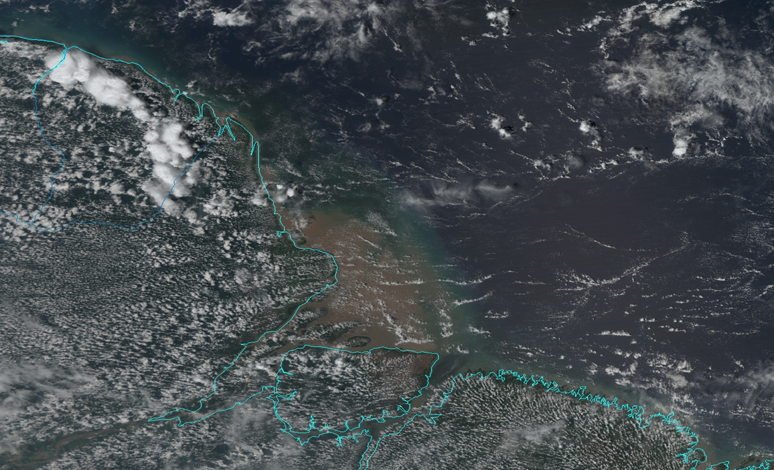
VIIRS Visible Imagery Example
True-color VIIRS image from Nov 2011 (first orbit after activation), off NE coast of South America

Slide 18
Status at Provisional (non-NCC)
Provisional for non-NCC Imagery was declared in January 2013 after all quality-related Discrepancy Reports (DRs) were resolved and closed
No quality-related DRs have been written with regard to non-NCC Imagery since that date
Work therefore has focused on operational and unique applications of Imagery from VIIRS
EDR | Beta (AERB) | Beta (Backdated) | Provisional (AERB) | Provisional (Backdated)
Non-NCC | 2012-05-30 | 2012-02-07 | 2013-02-20 | 2013-01-18
NCC | 2012-10-24 | 2012-07-18 | 2013-09-04 | 2013-08-21

Slide 19
NCC Imagery Since Launch – Part 1
As expected from the difficulty of pre-launch testing, the NCC Imagery had more issues that needed resolution
Nighttime NCC imagery was initially non-fill only within 72 hours of the full moon
Aspects of the associated LUTs were initially inadequate on the dark side of the terminator
Stray light in the DNB existed in these locations
The NCC could not handle negative DNB radiances
NCC was declared Beta as of 18 July 2012
The NCC imagery had to resolve these issues, especially the fill issue at night, to attain Provisional

Slide 20
NCC Imagery Since Launch – Part 2
Resolving the nighttime issues with NCC was successful after a series of steps taken by the Imagery Team
The initial limits of the pseudo-albedo were increased to account for very dark backgrounds
This included negative radiances
The NCC algorithm was altered slightly to create more appropriate results under low lunar illumination conditions
The appropriate LUTs were updated
The VIIRS SDR Team corrected for stray light in the DNB
Closing of this DR lies with the VIIRS SDR Team
Once all of these were implemented (August 2013) the NCC Imagery was declared Provisional
All DRs associated with the creation of NCC Imagery are now closed

Slide 21
NCC Imagery Advantages
The following slides show examples of VIIRS NCC Imagery:
1. Cross-terminator advantage of NCC Imagery EDR pseudo-albedos
2. NCC Imagery at night with no lunar illumination (due to airglow illumination)
NCC imagery is the single most useful band of VIIRS Imagery, with a huge advantage over heritage imagery from either MODIS or AVHRR!

Slide 22
Cross-terminator DNB SDR (top) versus NCC Imagery EDR (bottom)
The top image shows a DNB (SDR) granule that crosses the day/night terminator. The lower image shows the associated NCC (EDR) granule (with edge fill values highlighted in blue). The normally-observed horizontal stripes in the DNB SDR (from the bow tie deletion process) have been filled (in the top image) to avoid being a distraction. The removal of these stripes is actually part of the GTM algorithm. The NCC process reduces the contrast from solar and lunar illumination gradients across the granule (which spans over 7 orders of magnitude between day and night) by converting it to a quantity with reduced dynamic range (i.e. pseudo-albedo). The result is images with nearly constant contrast across the entire scene. By this process, nighttime images of clouds should, in principle, appear very similar to solar reflectance-based daytime imagery

Slide 23
NCC Imagery at night with no lunar illumination
The NCC Imagery EDR is produced under all solar and lunar illumination conditions, including cases where there is no illumination from either the sun or moon (i.e. new moon phase). The DNB is sensitive enough that air glow is sufficient to create an image, although such an image appears quite noisy. Here is an example of NCC Imagery at night when the moon was below the horizon. The example is Super Typhoon Phielin taken on the night of 10 October 2013. The typhoon, along with convective elements and its eye, are evident despite the extremely low levels of radiance present in the DNB spectrum. This is, in essence, the “worst case” scenario for NCC Imagery. As lunar illumination increases, the SNR improves and the noisiness in the DNB SDR decreases, with subsequent benefits to the NCC Imagery EDR.

Slide 24
Major Imagery Issues resolved
Imagery issues by example:
1. (Non-NCC) Imagery I-band EDR from 25 January 2012 with an all-fill triangular area in the upper right – resolved in mid-year 2012
2. Stray light in DNB: NCC Imagery before versus NCC after removal (bottom) – resolved in mid-year 2013

Slide 25
Imagery I-band EDR from 25 January 2012 with an all-fill triangular area in the upper right
The only issues noted shortly after launch with the GTM process was fill values in the Imagery product tied to cross granule processing. The structure of the GTM grid was such that, near the edge of the granule, SDRs from pixels in the adjacent granule were required. If they were not available, an odd shaped triangle of fill would occur as shown in this figure. This granule was taken in the vicinity of New Zealand on 25 January 2012. The root cause of the fill data was determined not to be in the GTM processing but with so-called repair granules, a larger concern the program successfully addressed in mid-2012. The triangles no longer appear in the Imagery EDR output.

Slide 26
Stray light in NCC Imagery before (top) versus NCC after removal (bottom)
Artifacts in the DNB SDR are inherited by the NCC Imagery EDR. Before August 2013 the most significant of these was a stray light issue with the DNB on the dark side of the terminator. The DNB SDR algorithm was adjusted to correct for this error in August 2013. The impact on the NCC Imagery EDR was profound. The removal of the stray light is evident in the bottom image, taken from the granule over the upper Midwest of the United States on 9 August 2013. As a reference, Lake Michigan may be seen in the middle of the granule

Slide 27
Benefits of M-band Imagery
The following slides show cases where near-real-time imagery applications make a difference:
1. Subtropical Storm Melissa, 18-20 Nov 2013
2. Tropical Storm Flossie, 28-29 July 2013
3. Super Typhoon Haiyan (Yolanda), 7 Nov 2013
4. Fire Detection, 11 June 2013
5. Severe Weather in Argentina, 5 Dec 2013
In each case the analysis of the VIIRS Imagery in near-real-time (2 hours or less) would have benefits to operational weather interests

Slide 28
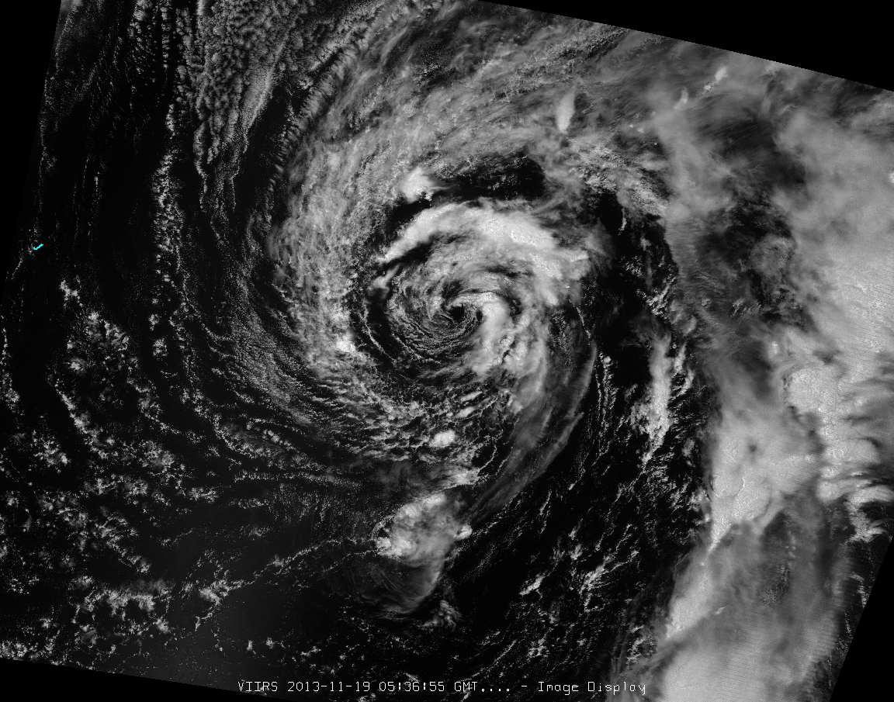
1st Example: Subtropical Storm Melissa, 18-20 Nov 2013
Chris Landsea, the Science and Operations Officer at the National Hurricane Center, sent email on 18 Nov asking why there is no access to the day-night band for storms in the central Atlantic.
Landsea said that having the Day Night Band “in operations in a more timely fashion would be of considerable interest and assistance. For the nearly full moon conditions, having night-time visible imagery can help better determine the position of the tropical cyclone and, at times, also be relevant for the Dvorak intensity estimates.”
VIIRS Day-Night Band of Subtropical Storm Melissa from 19 Nov 2013 at 0536 UTC

Slide 29
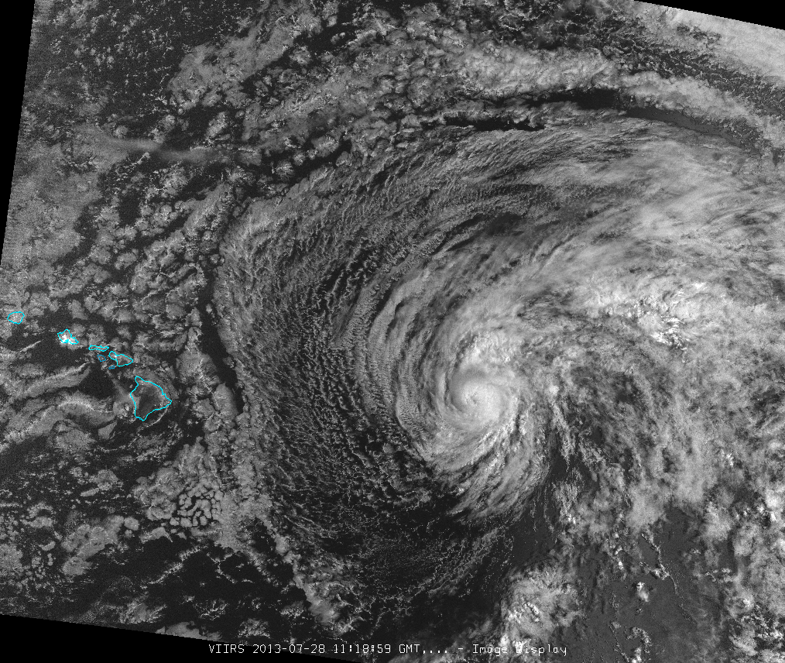
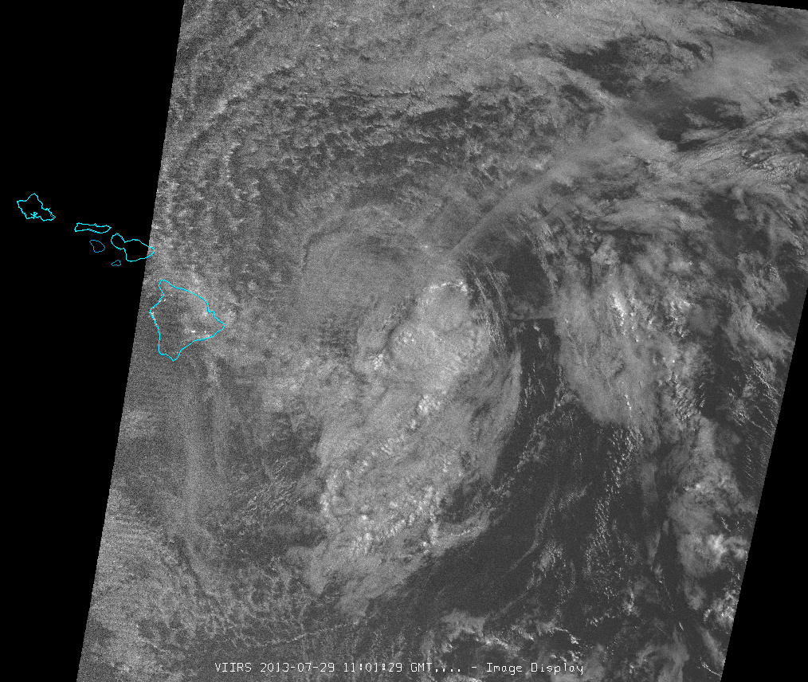
2nd Example: Tropical Storm Flossie, 28-29 July 2013
Central Pacific Hurricane Center discussion from 29 July 2013 at 0500 UTC:
THE CENTER OF FLOSSIE WAS HIDDEN BY HIGH CLOUDS MOST OF THE NIGHT BEFORE VIIRS NIGHTTIME VISUAL SATELLITE IMAGERY REVEALED AN EXPOSED LOW LEVEL CIRCULATION CENTER FARTHER NORTH THAN EXPECTED. WE RE-BESTED THE 0600 UTC POSITION BASED ON THE VISIBLE DATA.
http://www.prh.noaa.gov/cphc/tcpages/archive/2013/TCDCP1.EP062013.019.1307291511
Day-Night Band, 28 July
Day-Night Band, 29 July

Slide 30
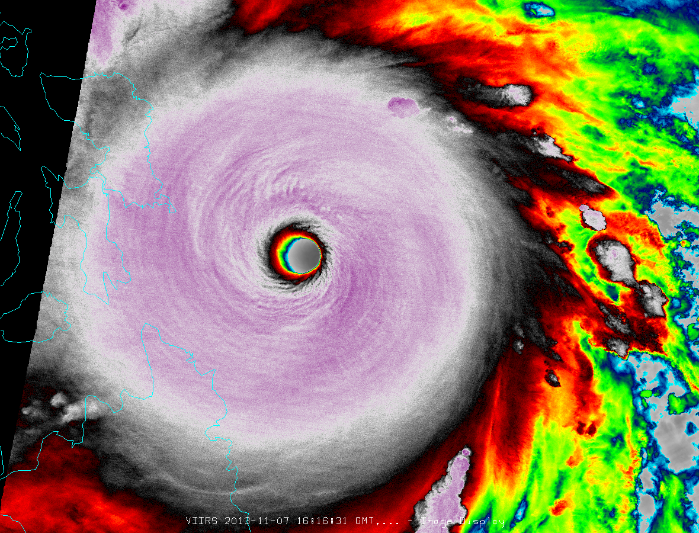
3rd Example: Super Typhoon Haiyan (Yolanda), 7 Nov 2013
Super Typhoon Haiyan (Yolanda) approached the Philippines on 7 Nov 2013, and VIIRS passed over at 1616 UTC, about 3 hours prior to landfall.
The data required to generate the image below was obtained around 00 UTC on 8 Nov, a few hours after the storm had already made landfall.
Had the Joint Typhoon Warning Center and other forecasters had access to this imagery in near real time, it may have provided for a better intensity analysis.
VIIRS I-band 5 IR image of Super Typhoon Haiyan (Yolanda) from 7 Nov 2013 at 1616 UTC

Slide 31
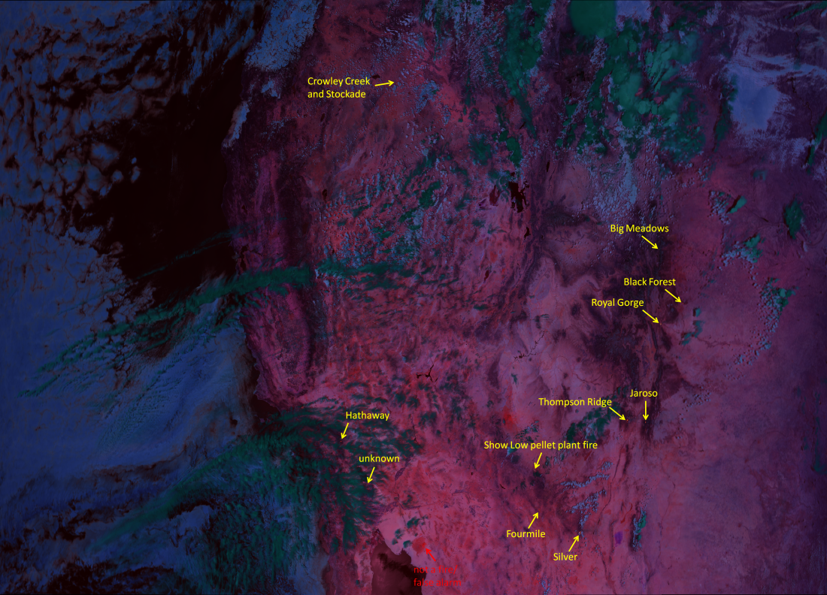
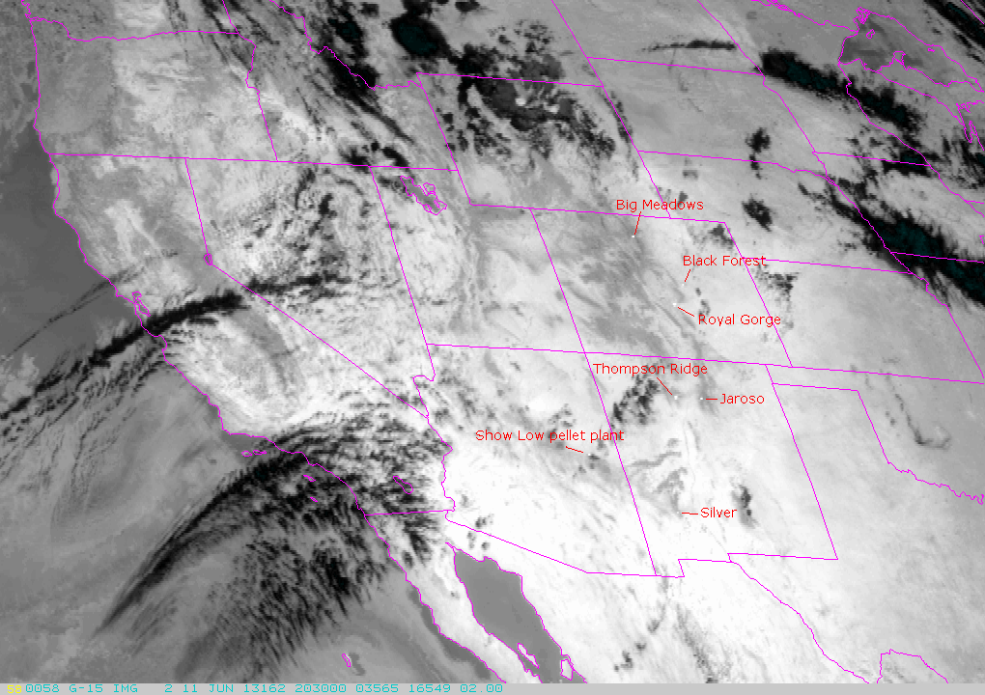
4th Example: Fire Detection, 11 June 2013
12 wildfires were observed in VIIRS imagery over the southwestern US at 20:36 UTC. In GOES imagery from 20:30 UTC, only 7 of those fires could be discerned. (details on next slide)
VIIRS has multiple channels sensitive to wildfire detection. The image below is an example of the “Fire Temperature” RGB composite currently in development at CIRA. GOES currently has only one channel useful in detecting fires.
Operational fire monitoring activities (like the US Forest Service and NWS) would benefit from value-added VIIRS products. In order to demonstrate the utility of these products, developers at CIRA need access to near-real time VIIRS data.
VIIRS Fire Temperature RGB composite image from 20:36 UTC 11 June 2013
GOES Channel 3 image from 20:30 UTC 11 June 2013

Slide 32
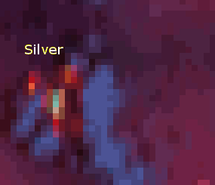
4th Example, part II: Fire Detection, 11 June 2013
VIIRS
GOES
These images are zoomed in on several fires that were detected by both VIIRS and GOES identified on the previous slide. Bars in the lower right corner of each image identify the scale.
4 km
10 km
The resolution of VIIRS combines with the additional spectral information provided in the RGB composite to offer more information than GOES provides.
VIIRS
4 km
GOES
The RGB composite is sensitive to changes in the temperature of fires and more accurately identifies active fire lines.
10 km

Slide 33
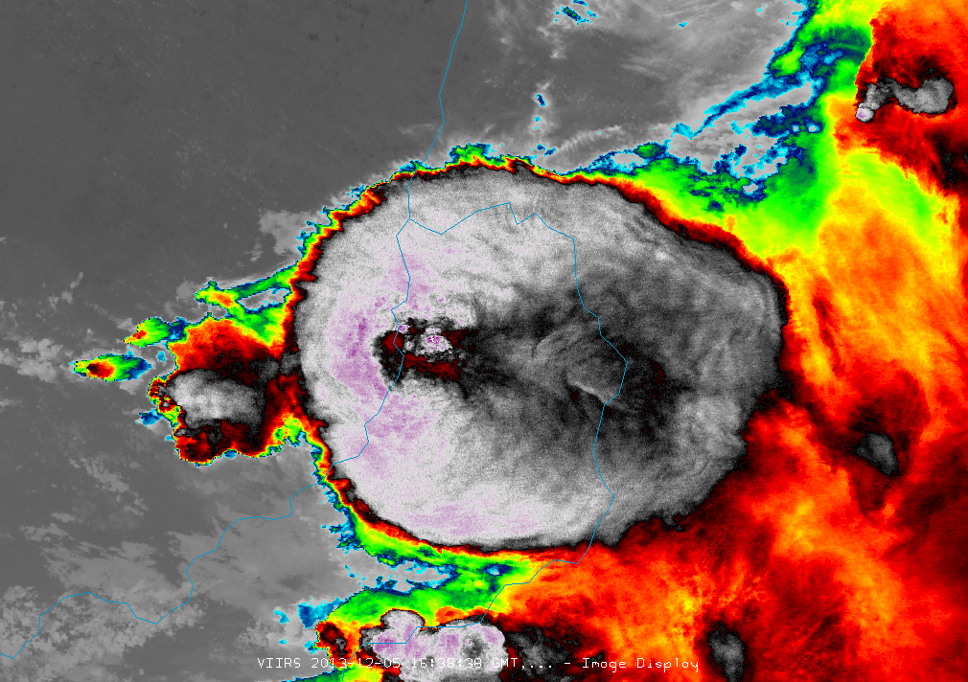
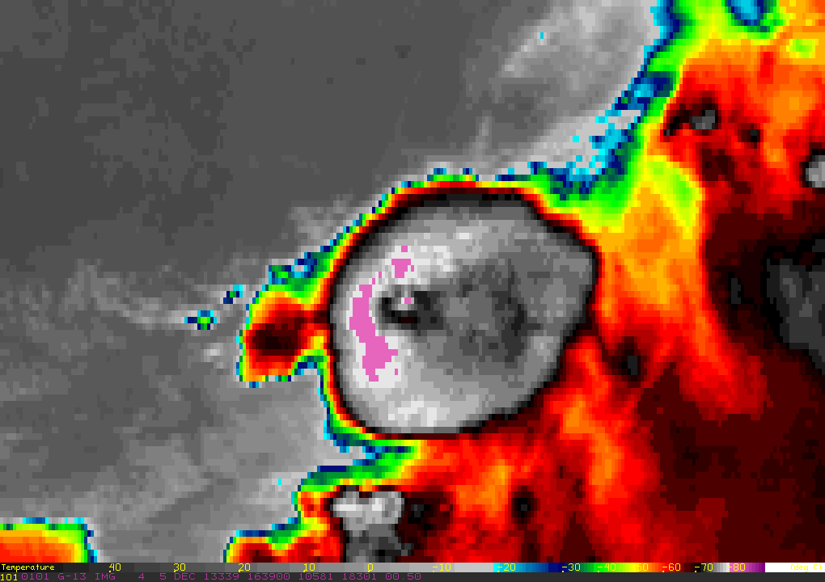
5th Example: Severe Weather in Argentina – 5 Dec 2013
VIIRS provides a significant improvement in resolution for infrared bands (375 m) compared to GOES (4 km at subpoint)
This results is a clearer picture of storm-top features, such as overshooting tops and enhanced –V’s
The example below from northern Argentina shows a comparison of a thunderstorm from VIIRS vs. GOES. The minimum brightness temperature from VIIRS was -99°C, and from GOES -82°C
When GOES-13 is in rapid scan, South America only gets 1 scan every 3 hours, so polar imagery is very useful for filling in time gaps and radar gaps (spatially)
With real-time VIIRS data, imagery can be provided to forecasters in South America
VIIRS 375-m I-Band 5 - 1640 UTC
GOES 4-km Band 4 – 1639 UTC

Slide 34
Additional Examples: Selected “Operational Relevance” Value-Added Applications of Multi-Spectral VIIRS Imagery (The following slides address each point, courtesy S. Miller, CIRA)
Snow fields: Alter the radiative cooling and moisture flux of the surface and can become focal points for nocturnal fog formation under clear sky conditions, which presents a significant transportation hazard.
Blowing dust: Users can issue/revise visibility hazard warnings based on knowledge of incoming significant blowing dust. These storms have been responsible for significant (fatality) multi-car accidents in recent years.
Dust storms: Occur worldwide and can change dramatically over timescales < 1 h. Timely information is critical for making use of dust information in decision aids.
Sea ice: All maritime commerce & transportation related activities, including crab fishing industry. Cloud cover is ubiquitous in the high latitude winter, and these clouds obscure views of the surface.
Tropical Cyclone tracking: Avoiding the ‘sunrise surprise’ of a misplaced low-level center of circulation. In the case of Flossie, an adjustment was made based on the DNB information.
Nocturnal fire lines and biomass smoke: Ability to observe active fires at night and the low-level wind direction via smoke plumes (realizing that large fires influence the local environmental flow) can help firefighters get an upper-hand on a blaze during the nighttime hours when it would generally be easier to fight due to lower temperatures, higher humidity, and lighter winds.
Power outages: Assist emergency managers identify broad scale impacts of a disaster. Depending on timing of the event, this information may provide a more complete picture of impacts than what can be put together from various surface-based reports.
The following examples are the types of VIIRS image products that are of potential use to NWS and other users.

Slide 35
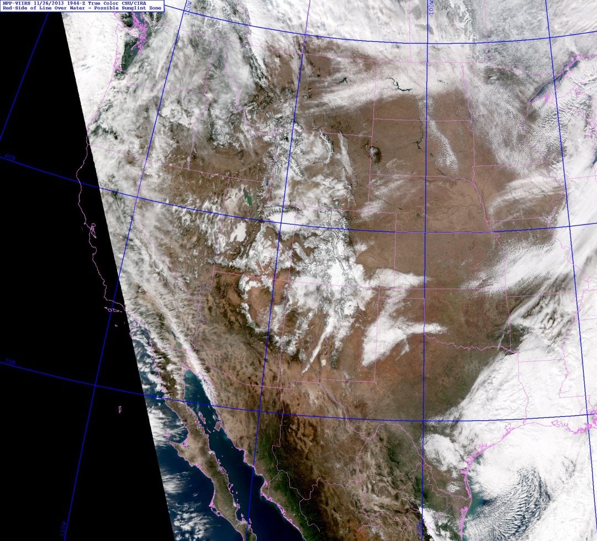
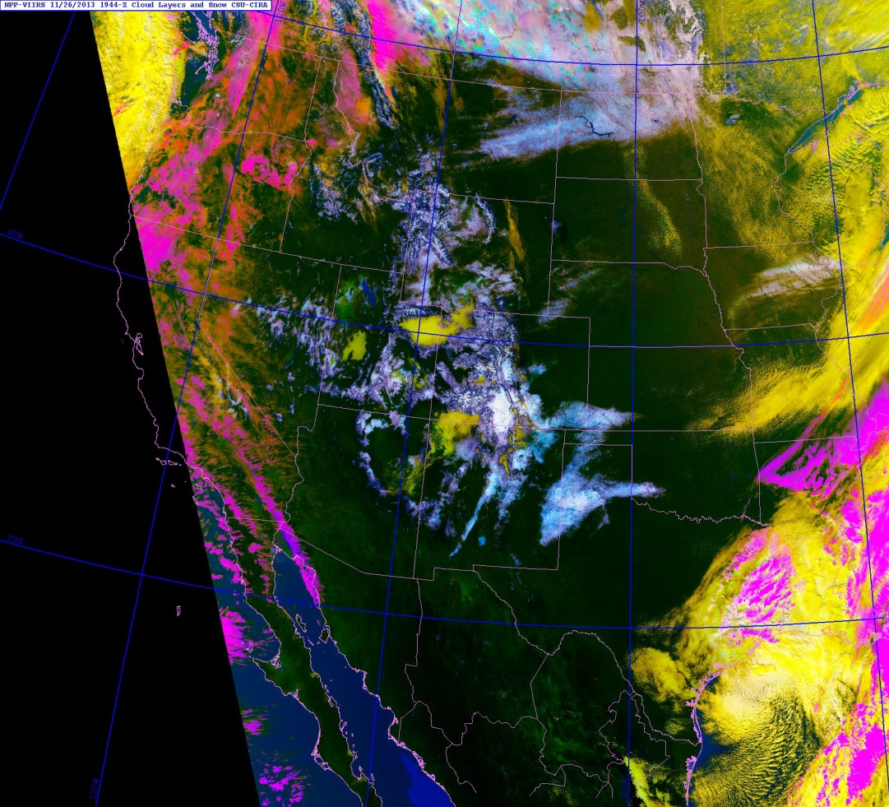
Snow/Cloud Discrimination
26 November 2013 1944 UTC
Snow
Cover
Despite the lack of a 6.7 μm water vapor band, the cloud/snow enhancement of Miller et al (JAM-C; 2005) has been adapted to work with VIIRS bands and shows comparable performance to MODIS versions of the algorithm.
Notes:
Operational relevance: snow fields alter the radiative cooling and moisture flux of the surface and can become focal points for nocturnal fog formation under clear sky conditions, which presents a significant transportation hazard.

Slide 36
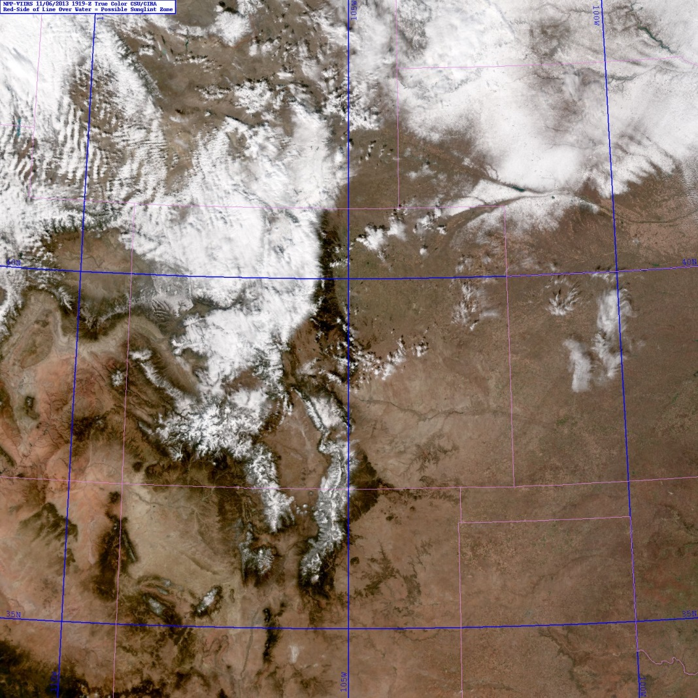
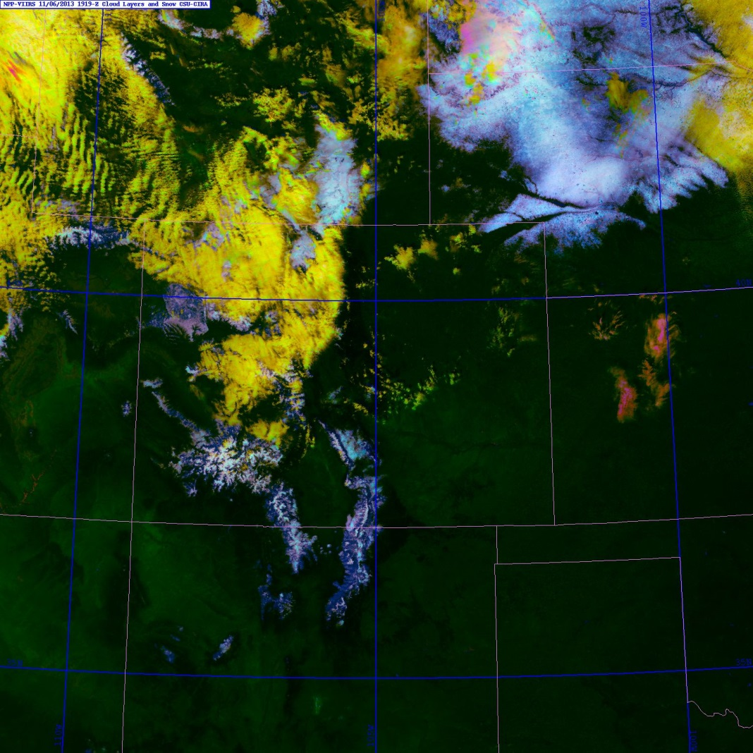
Snow/Cloud Discrimination (Regional)
6 November 2013 1919 UTC
Snow
Cover
Snow
Cover
Translation of the MODIS cloud/snow enhancement of Miller et al (JAM-C; 2005) has to VIIRS bands has enabled visually intuitive identification of snow fields present within complex cloudy scenes.
Notes:
Operational relevance: snow fields alter the radiative cooling and moisture flux of the surface and can become focal points for nocturnal fog formation under clear sky conditions, which presents a significant transportation hazard.

Slide 37
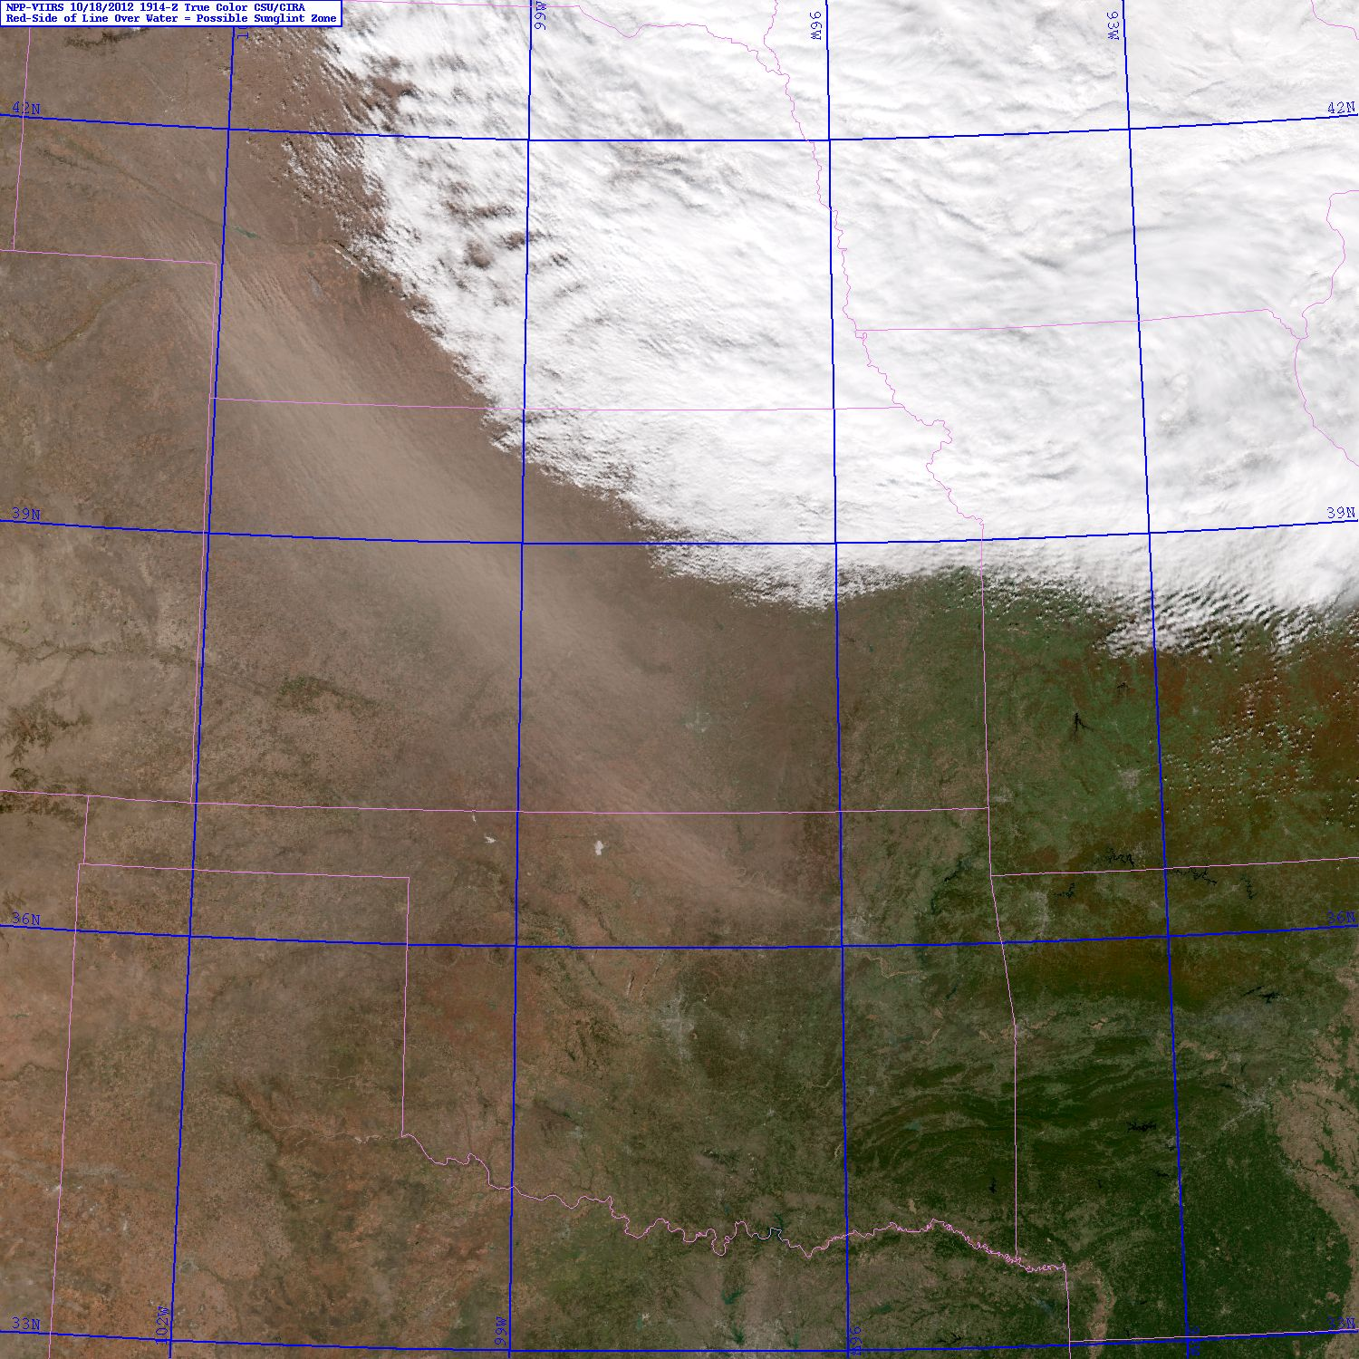
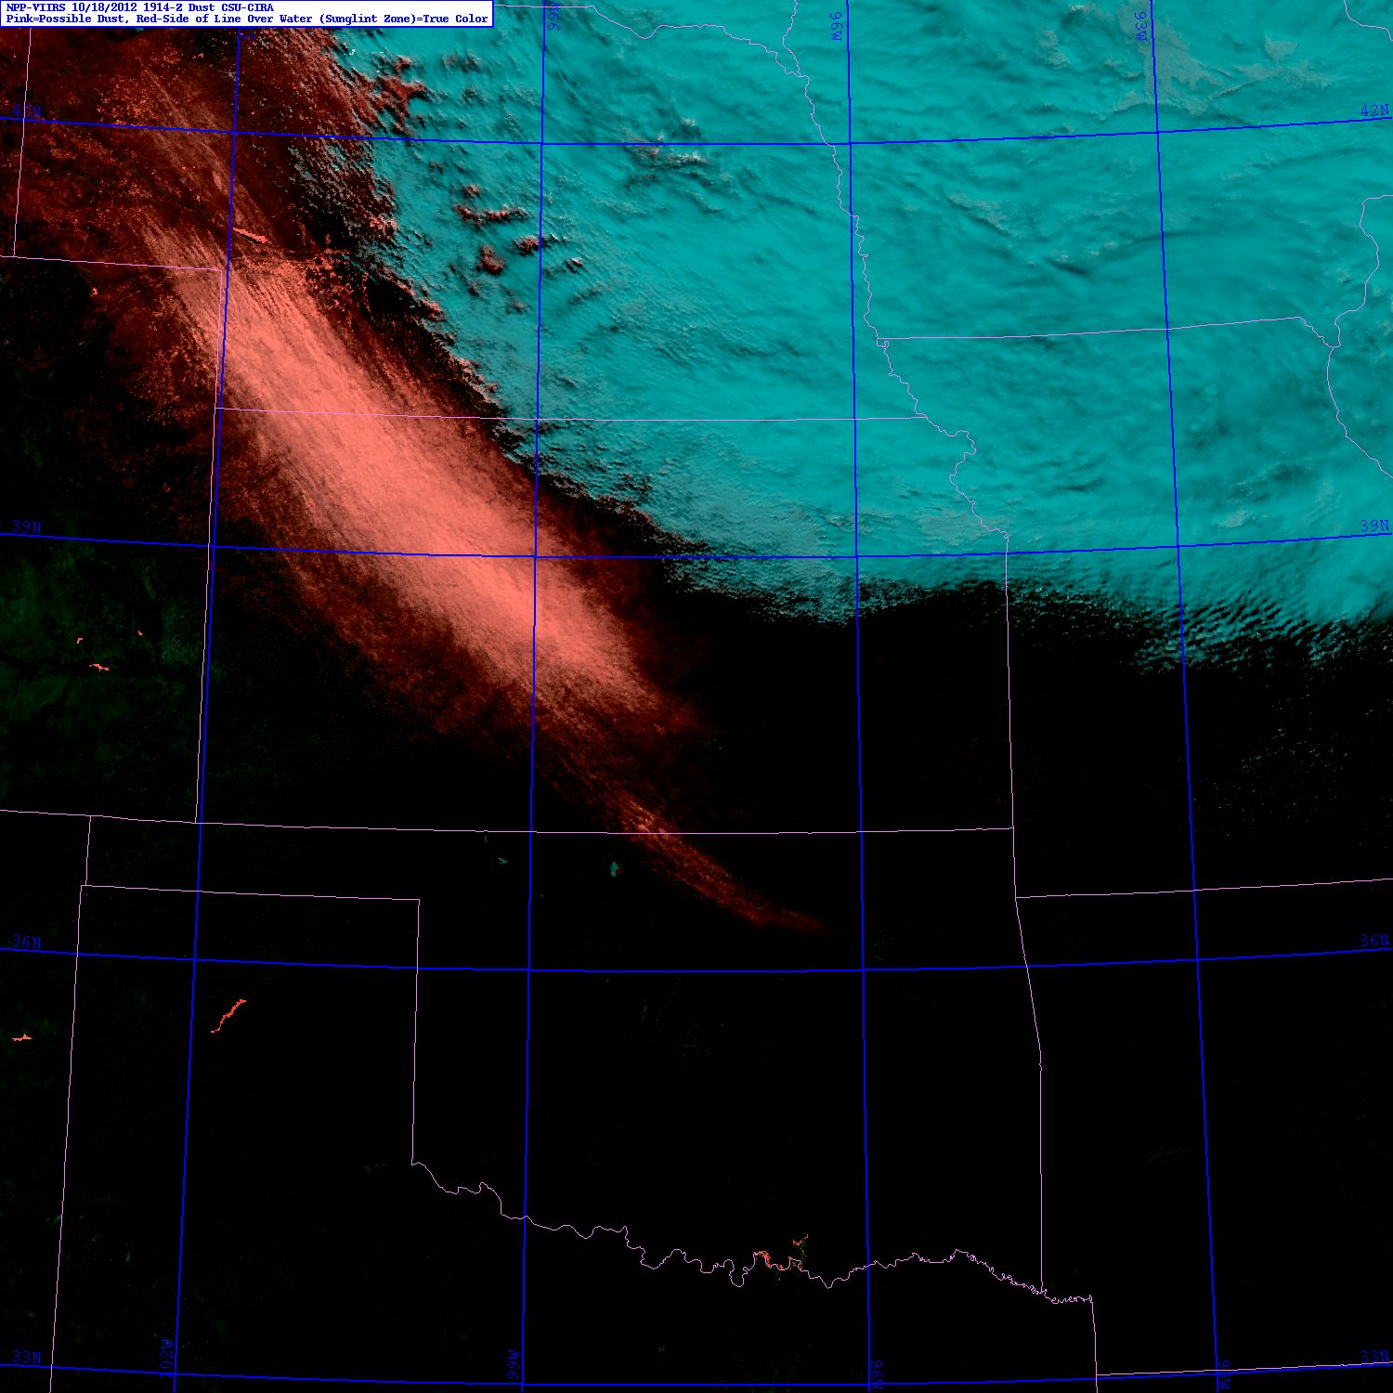
Multi-Spectral Dust Storm Detection
18 October 2012 1914 UTC
CO
KS
Dust
Storm
OK
TX
VIIRS provides a the required spectral suite of bands required to reproduce the MODIS
‘blue light absorption’ mineral dust enhancement algorithm of Miller(GRL; 2003).
Notes:
Operational relevance: issue/revise visibility hazard warnings based on knowledge of incoming significant dust. These storms have been responsible for significant (fatality) multi-car accidents in recent years.

Slide 38
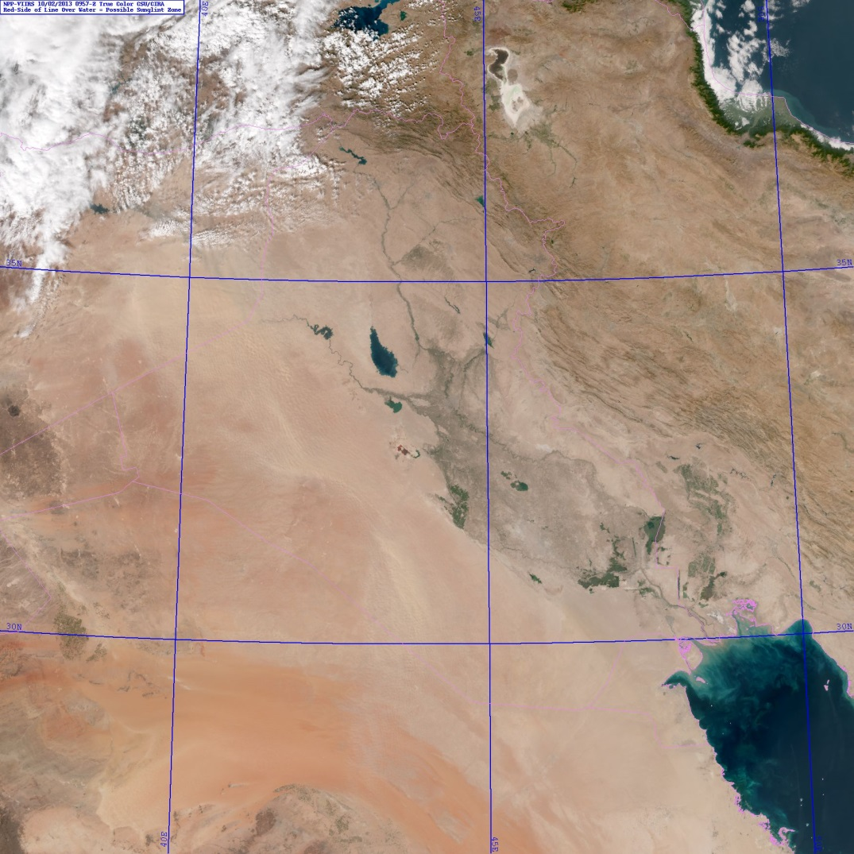
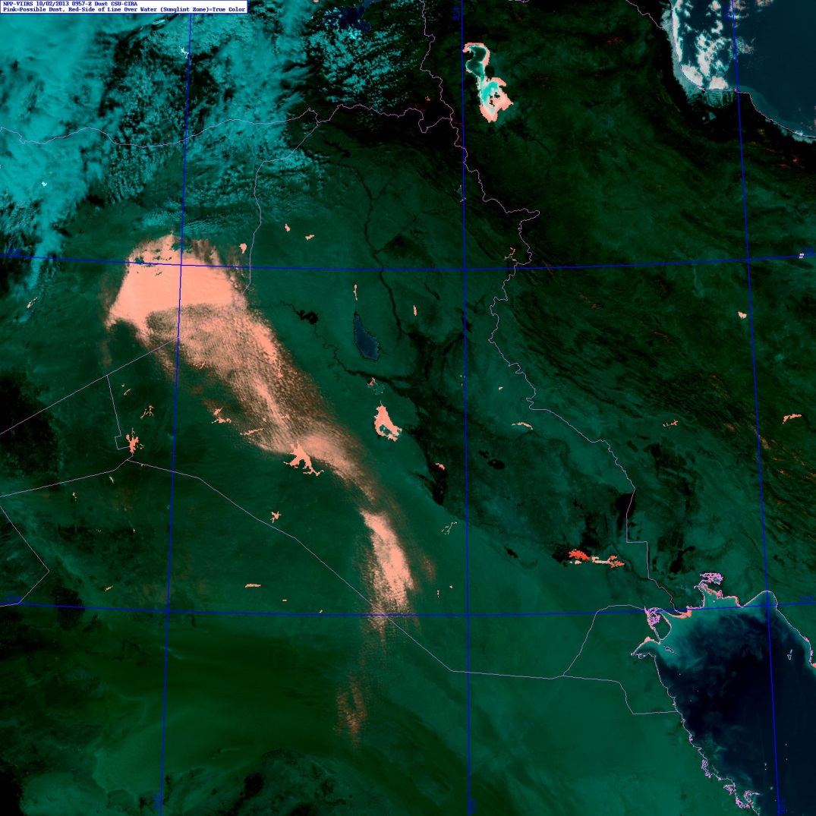
Multi-Spectral Dust Storm Detection
2 October 2013 0957 UTC
Dust
Storm
VIIRS provides a the required spectral suite of bands required to reproduce the MODIS
‘blue light absorption’ mineral dust enhancement algorithm of Miller(GRL; 2003).
Notes:
Operational relevance: dust storms occur worldwide and can change dramatically over timescales < 1 hr. Timely information is critical for making use of dust information in decision aids.

Slide 39
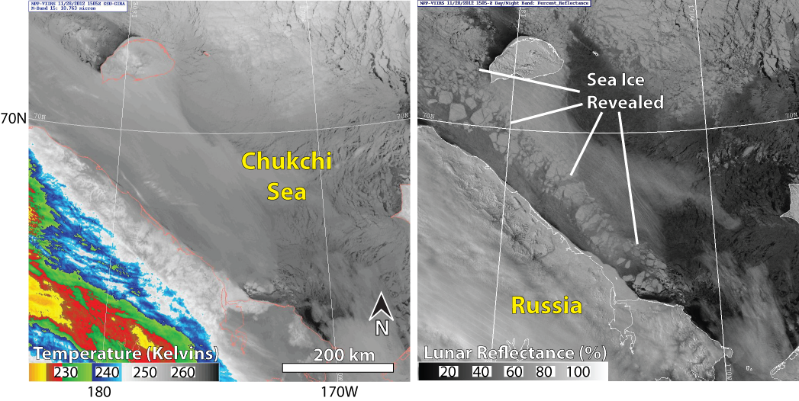
Sea Ice
28 November 2012 1505 UTC
Infrared Only Day/Night Band
Similar to the Flossie example, using moonlight to probe clouds that are optically thin at visible wavelengths but opaque at conventional thermal infrared wavelengths helps to reveal the details of sea ice, particularly during periods of extended darkness in Winter months.
Notes:
Operational relevance: all maritime commerce & transportation related activities, including crab fishing industry. Cloud cover is ubiquitous in the high latitude winter, and these clouds obscure views of the surface.

Slide 40
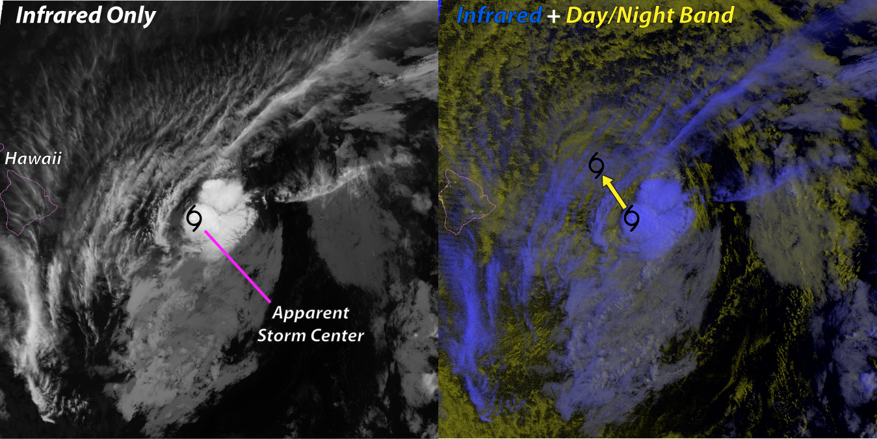
Nocturnal Tropical Cyclone Tracking
29 July 2013 11100 UTC
Moonlight provides a means to peering through cirrus, which are optically thin at visible light wavelengths. This enabled the VIIRS Day/Night band to detect low cloud structures that revealed the true center of low-level circulation associated with Hurricane Flossie.
Notes:
Operational relevance: avoiding the ‘sunrise surprise’ of a misplaced low-level center of circulation. In the case of Flossie, an adjustment was made based on the DNB information:
“THE CENTER OF FLOSSIE WAS HIDDEN BY HIGH CLOUDS MOST OF THE NIGHT BEFORE VIRS NIGHTTIME VISUAL SATELLITE IMAGERY REVEALED AN EXPOSED LOW LEVEL CIRCULATION CENTER FARTHER NORTH THAN EXPECTED. WE RE-BESTED THE 0600 UTC POSITION BASED ON THE VISIBLE DATA.” –NWS CENTRAL PACIFIC HURRICANE CENTER HONOLULU HI, 500 AM HST MON JUL 29 2013

Slide 41
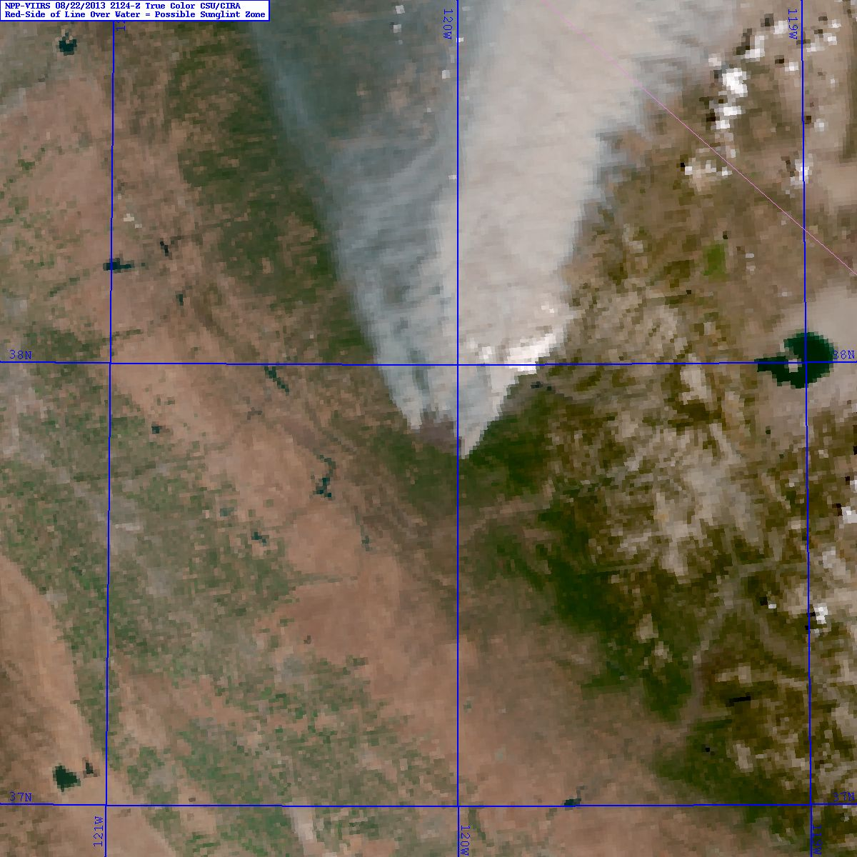
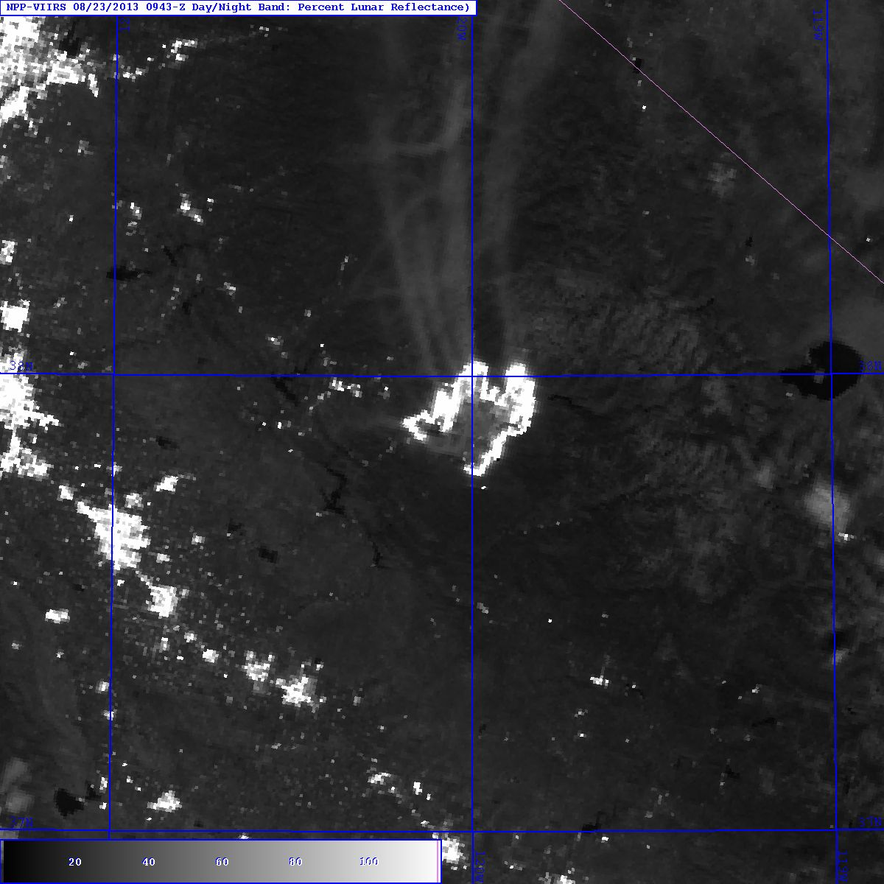
Nocturnal Fire Lines & Biomass Smoke
22 August 2013 2124 UTC 23 August 2013 0943 UTC
Rim Fire
San Joaquin
Valley, CA
The VIIRS Day/Night Band provides a unique ability to detect visible light from active flames as well as smoke plumes via lunar reflectance (invisible to thermal IR bands).
Notes:
Operational relevance: ability to observe active fires at night and the low-level wind direction via smoke plumes (realizing that large fires influence the local environmental flow) can help firefighters get an upper-hand on a blaze during the nighttime hours when it would generally be easier to fight due to lower temperatures, higher humidity, and lighter winds.

Slide 42
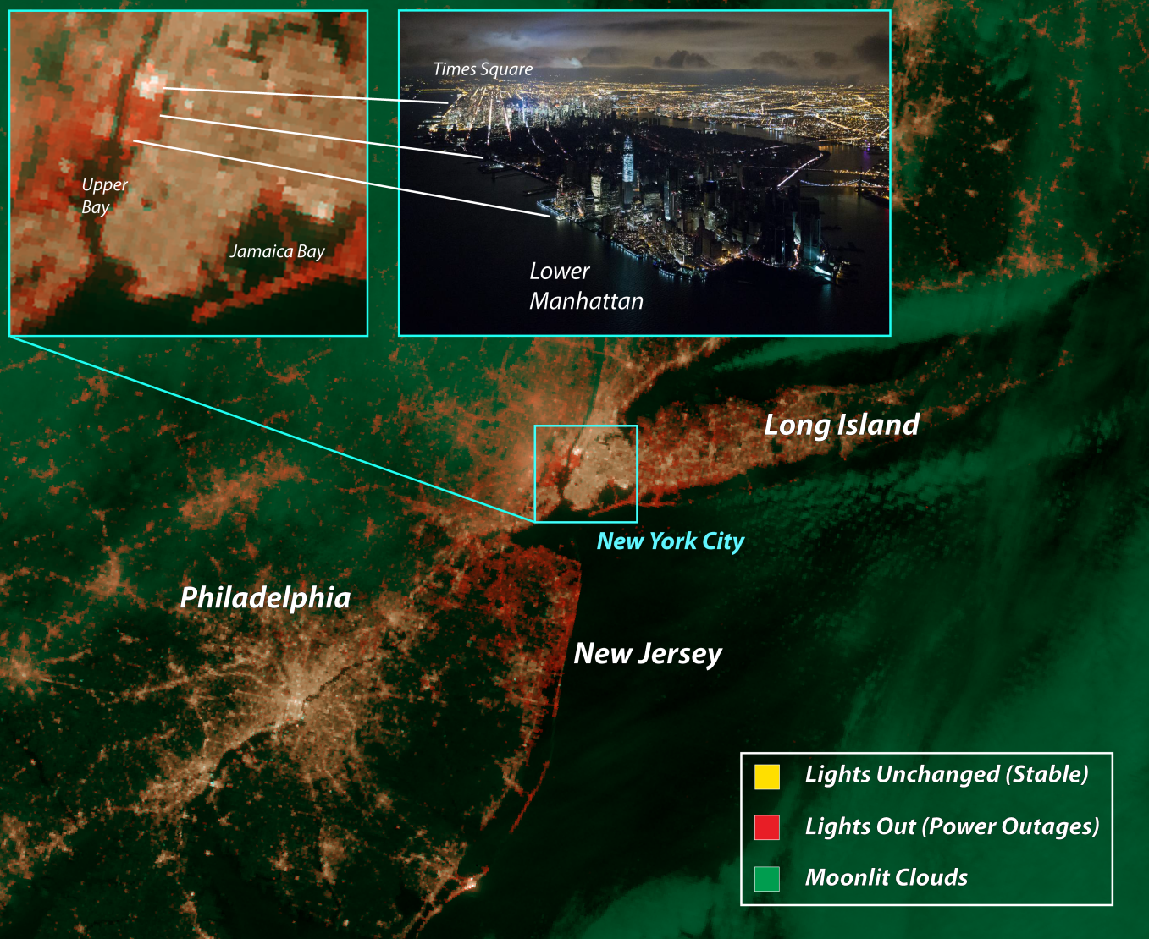
Power Outages
1 November 2012 0653 UTC
Comparing baseline stable light imagery with current imagery from the Day/Night Band offers a way to identify power outages, as shown in this example in the aftermath of Hurricane Sandy.
Notes:
Operational relevance: assist emergency managers identify broad scale impacts of a disaster. Depending on timing of the event, this information may provide a more complete picture of impacts than what can be put together from various surface-based reports.

Slide 43
Open DRs
With one exception, the current list of open DRs deals with documentation and Product Profile (PP) items
DR 7426: NCC PP does not reflect updated pseudo-albedo limits in the CDFCB - X
Being worked by Raytheon
DR 7447: Remove I-band DQTT tables
For the short term, the values within the DQTT will be set such that the function is essentially turned off
DR 7453: NCC OAD update
DR 7459: Imagery ATBD update
DR 7489: Establish NCC DQTT values
In coordination with Raytheon
DR 7490: Update Product Profile for M-band Imagery EDR
DR 4653/7257: Expand system to create 16 M-bands instead of the artificial limit of 6 M-bands as Imagery

Slide 44
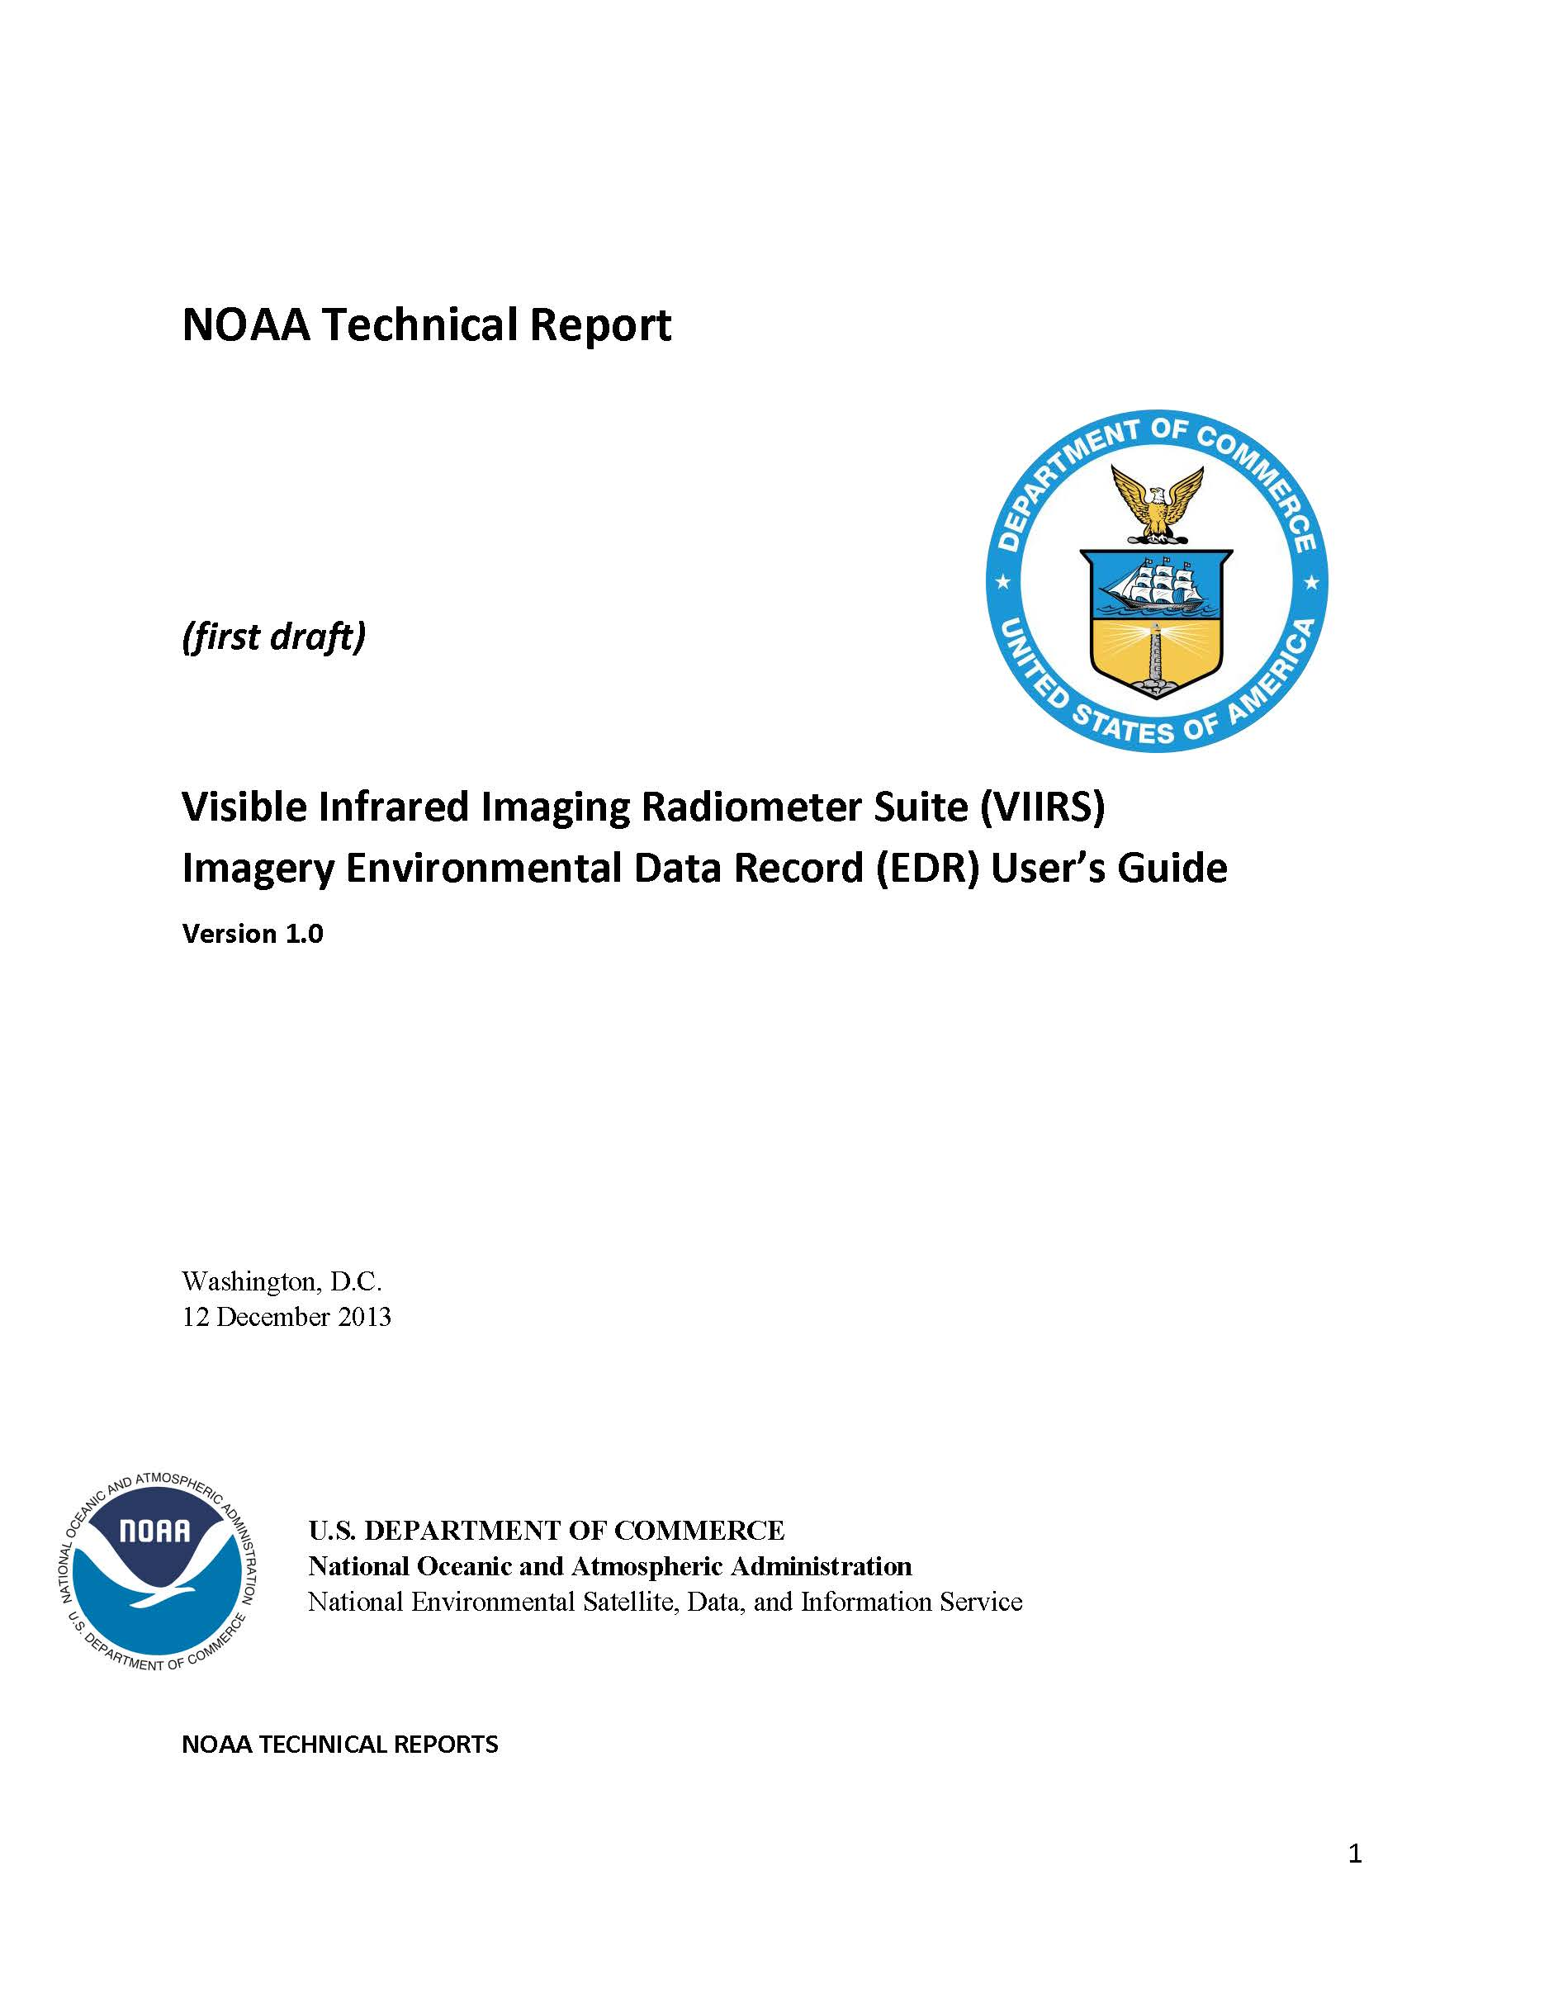
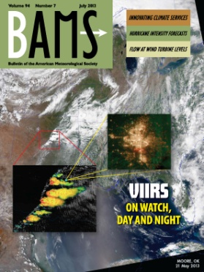
Version Control - Documents
All key documents are up-to-date
ATBD and OAD both match the operational Imagery product
ATBD is version B and in coordination
The GTM OAD is version B and is complete
The NCC OAD is version C and is in coordination
The format of the Imagery EDR (CDFCB-X) has not changed since before launch
The format of the output is stable and not expected to change for Block 2.0
A EDR Imagery User’s Guide has been created for Imagery
To be produced as a NOAA Technical Report
A major BAMS article has been published.
Hillger, D., T. Kopp, T. Lee, D. Lindsey, C. Seaman, S. Miller, J. Solbrig, S. Kidder, S. Bachmeier, T. Jasmin, and T. Rink, 2013: First-Light Imagery from Suomi NPP VIIRS. Bull. Amer. Meteor. Soc., 94(7), 1019-1029, plus cover images. doi:10.1175/BAMS-D-12-00097.1

Slide 45
Version Control - Code
The non-NCC Imagery EDR has not had any algorithm changes or LUT updates since provisional
Algorithm has been stable since Build 6.3
NCC Imagery was updated in Build 7.1, both the code and the associated LUTs, to account for fill values under very low illumination conditions
This was the last direct change to any Imagery EDR
A stray light correction to the DNB SDR was part of Build 7.2 (20 August 2013)
This update to the SDR had direct benefits to NCC Imagery
The NCC Imagery EDR was declared provisional after this stray light correction was implemented
In reality, all Imagery EDRs met Validation 1 stage criteria with Build 7.2
Formally, the associated LUTs are at version 3 (CCR-13-806)

Slide 46
Users and Product Status
Only two items were noted at the Provisional stage in the CLASS ReadMe document for Imagery
Striping is a rare occurrence in the Imagery product
In non-NCC Imagery it is all but non-existent, and only can be seen when very high enhancement curves are employed
In NCC Imagery striping can be found in nighttime granules as the amount of lunar illumination decreases
This is consistent with expectations as the signal-to-noise ratio decreases and detector-to-detector variations become more evident
Latency of the data to operational users remains an extreme concern
Though the IDPS itself produces the Imagery product as required, the infrastructure at neither NESDIS (NDE) nor AFWA can support sending Imagery to most real-time users
The only users who can access Imagery within practical time frames today are the Alaskan Proving Ground, the Navy (via AFWA), and field terminal (direct broadcast) users

Slide 47
Conclusion
Imagery has now achieved Validation 1 stage
All requirements have been met or exceeded
All documentation is up-to-date
All Imagery EDR quality-related DRs are closed
Note stray light is a DNB DR and not an Imagery DR
The Imagery Team remains deeply concerned with the disconnects between the requirements themselves, the capabilities of today’s IDPS, and the feedback we are receiving from those we interact with on a monthly basis
Non-NCC Imagery has no “quality” requirements
NCC Imagery has no requirements
Key products (such as true-color imagery) are not available from the operational system
The number of KPP (priority 1) bands (6), the number of bands created as Imagery from the operational system (12), and the total number of bands (22), do not match
Validation 2 stage will increase interactions with real-time operational users to the maximum extent possible

Slide 48
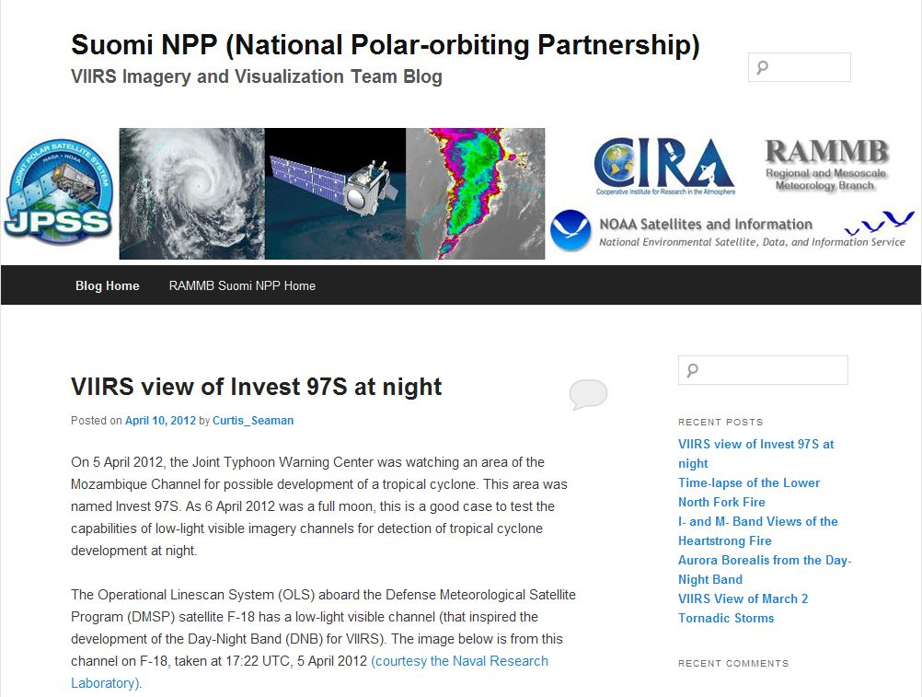
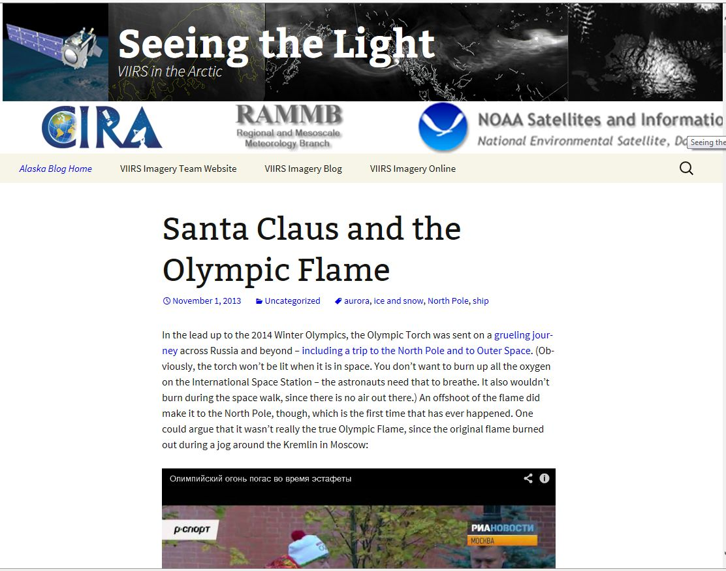
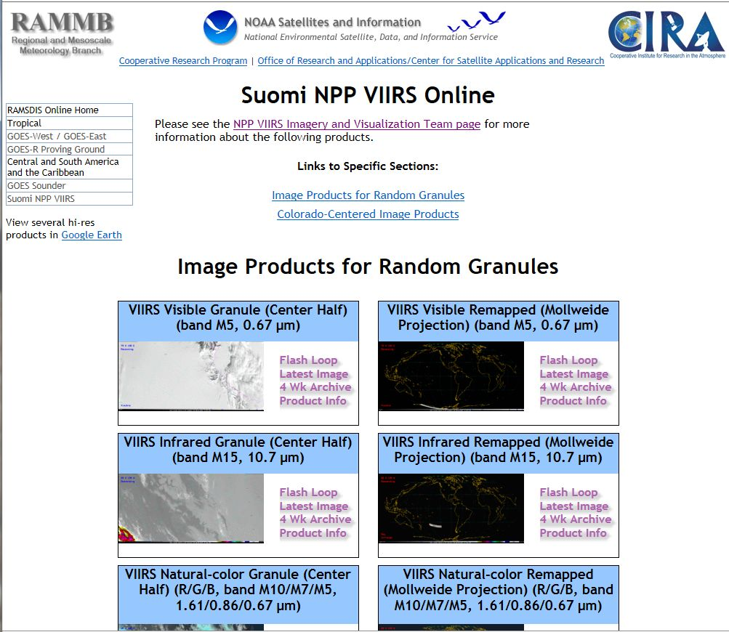
VIIRS Imagery outreach at RAMMB/CIRA
VIIRS Imagery and image products outreach:
VIIRS Imagery and Visualization Team Blog (http://rammb.cira.colostate.edu/projects/npp/blog/)
Seeing the Light: VIIRS in the Arctic (http://rammb.cira.colostate.edu/projects/alaska/blog/)
Suomi NPP VIIRS Online (including direct-broadcast imagery) (http://rammb.cira.colostate.edu/ramsdis/online/npp_viirs.asp)

Slide 49
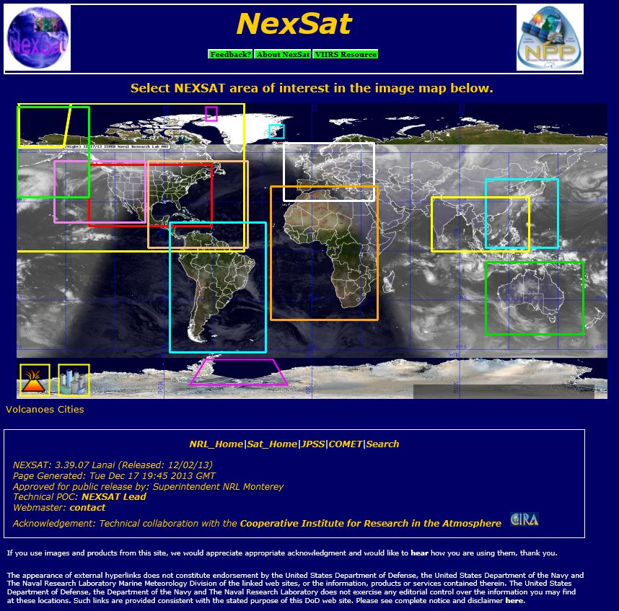
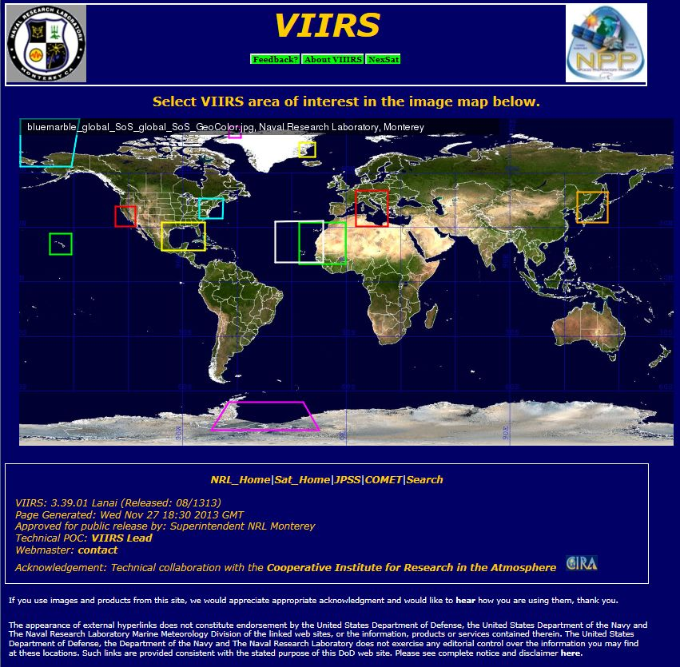
User (NRL) Presentation
NRL-Monterey use of VIIRS in their NexSat websites:
NexSat: http://www.nrlmry.navy.mil/NEXSAT.html
VIIRS Cal/Val: http://www.nrlmry.navy.mil/VIIRS.html

