Slide 1
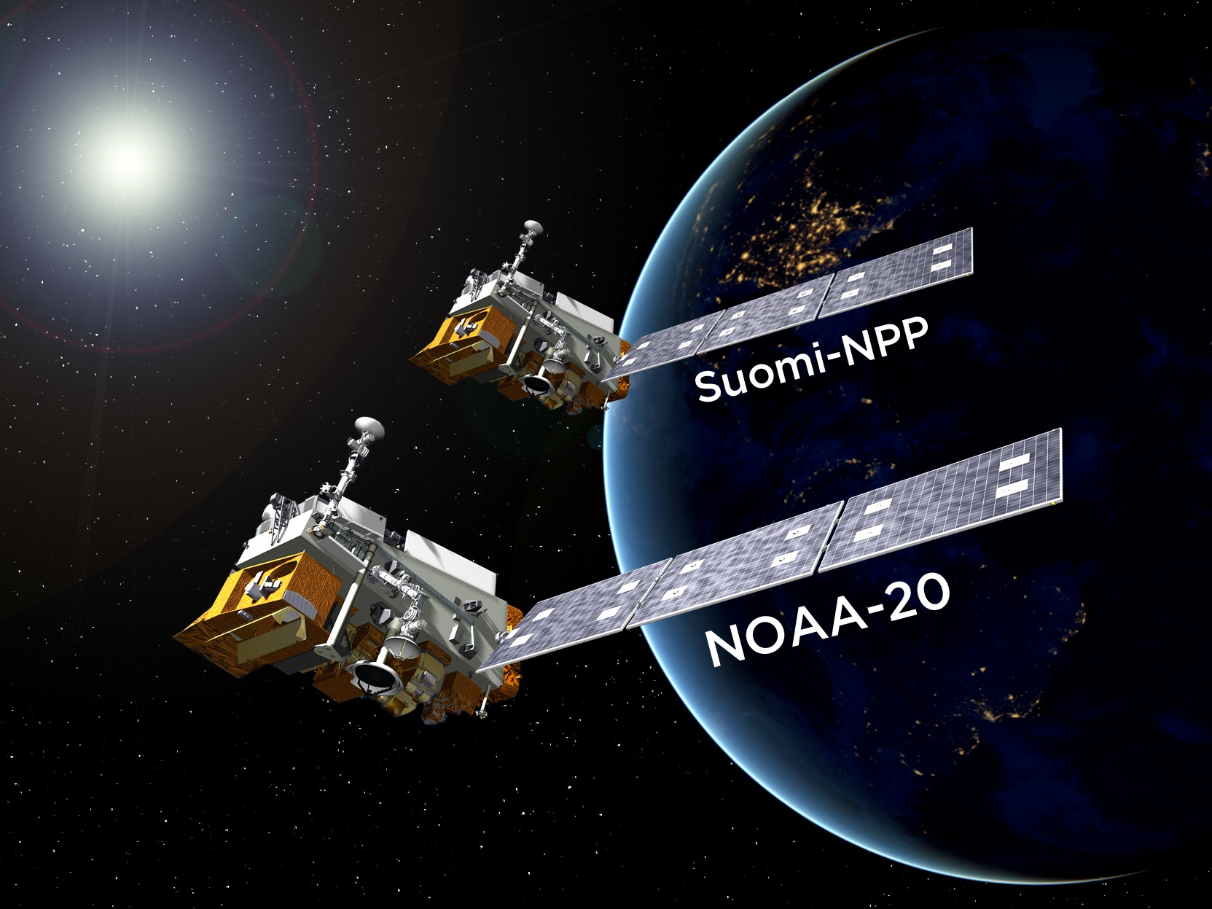

Provisional Maturity Science Review
For {NOAA-20 Algorithm}
Presented by {Name}
Date: {YYYY/MM/DD}

Slide 2
JPSS Data Products Maturity Definition
Beta Product is minimally validated, and may still contain significant identified and unidentified errors. Information/data from validation efforts can be used to make initial qualitative or very limited quantitative assessments regarding product fitness-for-purpose. Documentation of product performance and identified product performance anomalies, including recommended remediation strategies, exists.
Provisional Product performance has been demonstrated through analysis of a large, but still limited (i.e., not necessarily globally or seasonally representative) number of independent measurements obtained from selected locations, time periods, or field campaign efforts. Product analyses are sufficient for qualitative, and limited quantitative, determination of product fitness-for-purpose. Documentation of product performance, testing involving product fixes, identified product performance anomalies, including recommended remediation strategies, exists. Product is recommended for potential operational use (user decision) and in scientific publications after consulting product status documents.
Validated Product performance has been demonstrated over a large and wide range of representative conditions (i.e., global, seasonal). Comprehensive documentation of product performance exists that includes all known product anomalies and their recommended remediation strategies for a full range of retrieval conditions and severity level. Product analyses are sufficient for full qualitative and quantitative determination of product fitness-for-purpose. Product is ready for operational use based on documented validation findings and user feedback. Product validation, quality assurance, and algorithm stewardship continue through the lifetime of the instrument.

Slide 3
Provisional Maturity Review - Entry Criteria
Product Requirements
Pre-launch Performance Matrix/Waivers
Provisional Maturity Performance Validation
On-orbit instrument performance assessment
Identify all of the instrument and product characteristics you have verified/validated as individual bullets
Identify pre-launch concerns/waivers, mitigation and evaluation attempts with on-orbit data
Users/EDRs feedback
Risks, Actions, Mitigations
Potential issues, concerns
Path forward to Validated Maturity
Summary

Slide 4
Provisional Maturity Review - Exit Criteria
Provisional Maturity Performance is well characterized and meets/exceeds the requirements:
On-orbit instrument performance assessment
Provide summary for each identified instrument and product characteristic you have validated/verified as part of the entry criteria
Provide summary of pre-launch concerns/waivers mitigations/evaluation and address whether any of them are still a concern that raises any risk.
Updated Provisional Maturity Slide Package addressing review committee’s comments for:
Cal/Val Plan and Schedules
Product Requirements
Provisional Maturity Performance
Risks, Actions, Mitigations
Path forward to Validated Maturity

Slide 5
PROVISIONAL Maturity Review Material

Slide 6
Outline
Algorithm Cal/Val Team Members
Product Overview/Requirements
Evaluation of algorithm performance to specification requirements
Algorithm version, processing environment
Evaluation of the effect of required algorithm inputs
Quality flag analysis/validation
Error Budget
User Feedback
Downstream Product Feedback
Risks, Actions, and Mitigations
Documentation (Science Maturity Check List)
Conclusion
Path Forward

Slide 7
{NOAA-20 Algorithm} Cal/Val Team (1 slide)
Algorithm Cal/Val Team Members
Name | Organization | Major Task

Slide 8
Product Overview/Requirements (2 slides)
Product Overview
Product performance requirements from JPSS L1RD supplement (threshold) versus observed/validated/JERD Vol. II
Attribute | Threshold | Observed/validated
Geographic coverage
Vertical Coverage
Vertical Cell Size
Horizontal Cell Size
Mapping Uncertainty
Measurement Range
Measurement Accuracy
Measurement Precision
Measurement Uncertainty

Slide 9
Processing Environment and Algorithms (1 slide)
Description of processing environment and algorithms used to achieve Provisional maturity stage:
Algorithm version
Version of LUTs used
Version of PCTs used
Effective date

Slide 10
Evaluation of algorithm performance to specification requirements (3-5 slides)
Findings/Issues from Beta Review
Improvements since Beta Review
Algorithm Improvements
LUT / PCT updates
Algorithm performance evaluation
Validation data sets (type, periods, coverage)
Validation strategies / methods
Validation results
Long term monitoring readiness

Slide 11
Evaluation of the effect of required algorithm inputs (2-5 slides)
Required Algorithm Inputs
Primary Sensor Data
Ancillary Data
Upstream algorithms
LUTs / PCTs
Evaluation of the effect of required algorithm inputs
Study / test cases
Results

Slide 12
Quality flag analysis/validation (2-5 slides)
Defined Quality Flags
Variable
Description
Value
Quality flag analysis/validation
Test / example / ground truth data sets
Analysis / validation results
Analysis / validation plan

Slide 13
Error Budget (1 slide)
Compare analysis/validation results against requirements, present as a table. Error budget limitations should be explained. Describe prospects for overcoming error budget limitations with future improvements of the algorithm, test data, and error analysis methodology.
Attribute Analyzed | L1RD Threshold | Pre-Launch Performance | On-orbit Performance | Meet Requirement? | Additional Comments

Slide 14
User Feedback
Name | Organization | Application | User Feedback - User readiness dates for ingest of data and bringing data to operations

Slide 15
Downstream Product Feedback
Algorithm | Product | Downstream Product Feedback - Reports from downstream product teams on the dependencies and impacts

Slide 16
Risks, Actions, and Mitigations
Provide updates for the status of the risks/actions identified during the previous maturity review(s); add new ones as needed
Identified Risk | Description | Impact | Action/Mitigation and Schedule

Slide 17
Documentations (Check List, 1 slide)
Science Maturity Check List | Yes ?
ReadMe for Data Product Users
Algorithm Theoretical Basis Document (ATBD)
Algorithm Calibration/Validation Plan
(External/Internal) Users Manual
System Maintenance Manual (for ESPC products)
Peer Reviewed Publications (Demonstrates algorithm is independently reviewed)
Regular Validation Reports (at least annually) (Demonstrates long-term performance of the algorithm)

Slide 18
Check List - Provisional Maturity
Provisional Maturity End State | Assessment
Product performance has been demonstrated through analysis of a large, but still limited (i.e., not necessarily globally or seasonally representative) number of independent measurements obtained from select locations, periods, and associated ground truth or field campaign efforts.
Product analysis is sufficient to communicate product performance to users relative to expectations (Performance Baseline).
Documentation of product performance exists that includes recommended remediation strategies for all anomalies and weaknesses. Any algorithm changes associated with severe anomalies have been documented, implemented, tested, and shared with the user community.
Product is ready for operational use and for use in comprehensive cal/val activities and product optimization.

Slide 19
Conclusion (1 slide)
Cal/Val results summary:
Team recommends algorithm provisional maturity
Address pre-launch concerns/waivers
Caveats

Slide 20
Path Forward (1-2 slides)
Lessons learned for N20 Cal Val
Planned improvements
Future Cal/Val activities / milestones

