Slide 1



Validated Stage 1 Science Maturity Readiness Review for Surface Type EDR
Presented by Xiwu Zhan
December 11, 2014

Slide 2
Outline
Algorithm Cal/Val Team Members
Product overview and requirements
Previous validation results revisit
Evaluation of algorithm performance to specification requirements
  Evaluation of the effect of required algorithm inputs
  Quality flag analysis/validation
  Error Budget
Documentation
Identification of Processing Environment
Users & User Feedback
Path Forward
Summary

Slide 3
Surface Type EDR Cal/Val Team
Name | Organization | Major Task
Xiwu Zhan | NOAA/STAR | Surface Type EDR team lead, User outreach
Chengquan Huang | UMD/Geography | Algorithm development lead
Rui Zhang | UMD/Geography | Algorithm development, user readiness
Mark Friedl | BU/Geography | Validation lead
Damien Sulla-Menashe | BU/Geography | Ground truth data development and product validation
Marina Tsidulko | STAR/AIT | Product delivery

Slide 4
Overview of VIIRS Surface Type EDR
Describes surface condition at time of each VIIRS overpass
Produced for every VIIRS swath/granule
  Same geometry as any VIIRS 750m granule
Two major components
  Gridded Quarterly Surface Type (QST) IP
  Remapped to the swath/granule space for each VIIRS acquisition
  Requires at least one full year of VIIRS composited data
  Includes flags to indicate snow and fire based on
    Active fire Application Related Product (ARP/EDR)
    Snow EDR
Vegetation Fraction is included, but is replaced with NDE GVF (By Marco Vargas)

Slide 5
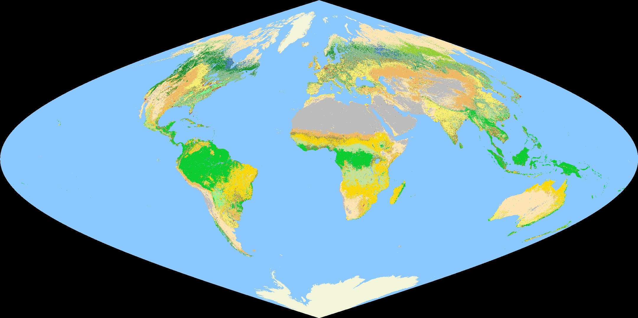
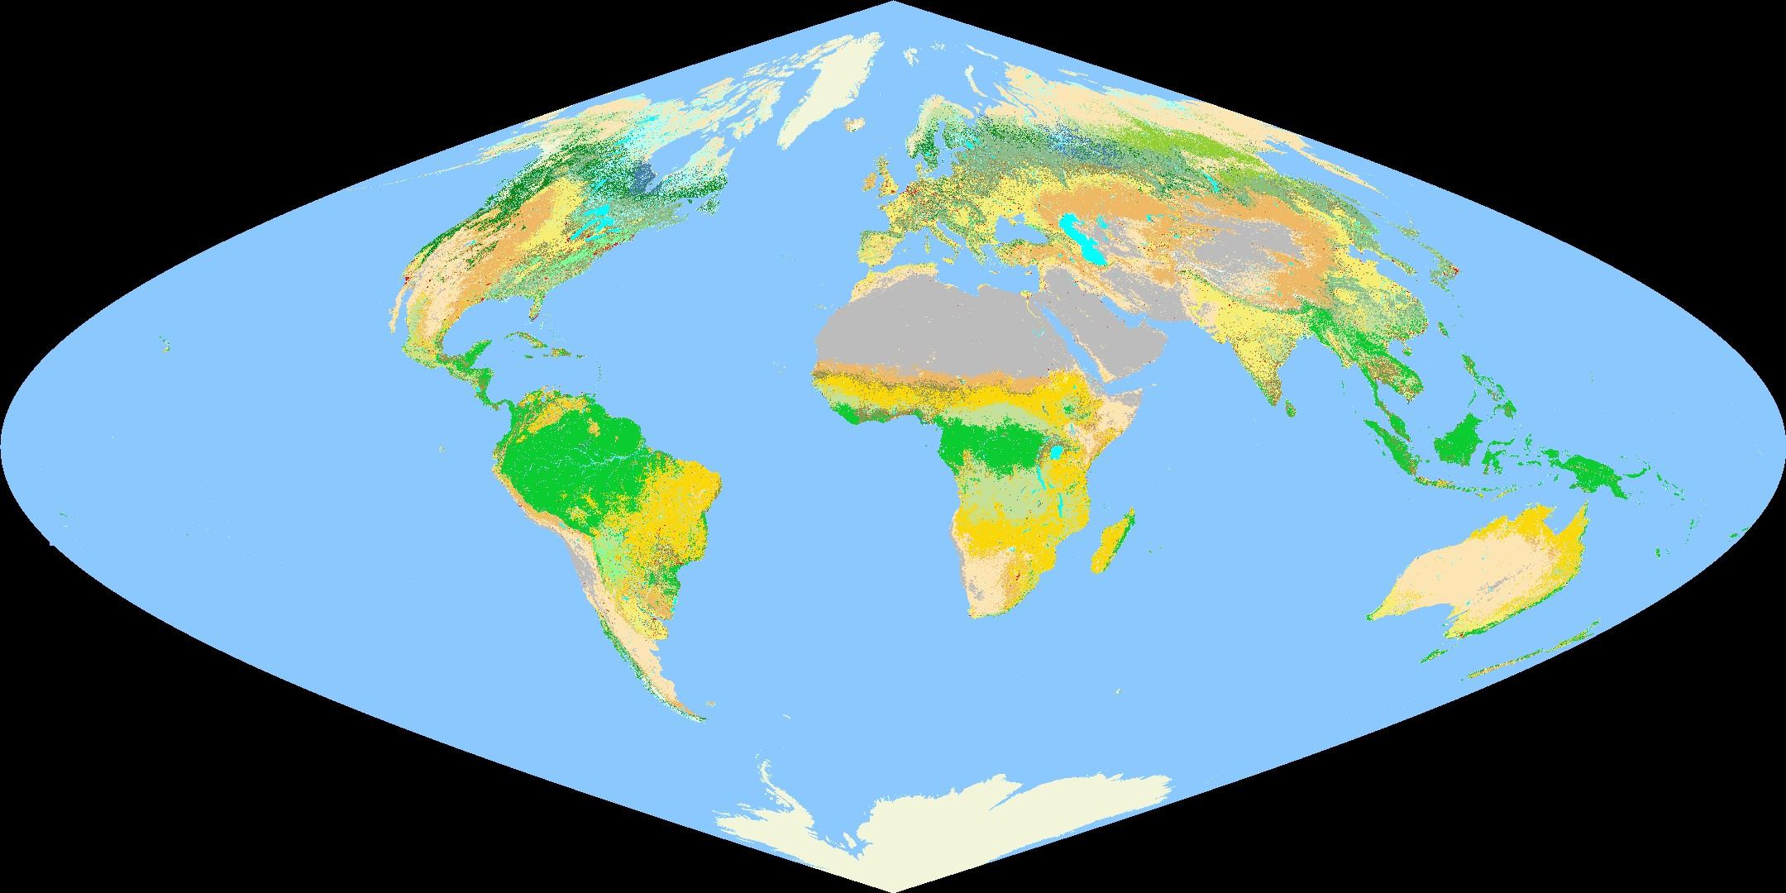
VIIRS ST IP Overview
Global surface type / land water mask product
  Gridded, 1km, 17 IGBP surface type classes. Required typing accuracy ~70%
  Generated annually to reflect recent changes
    Based on gridded surface reflectance products
    Use decision tree (C5.0) classifier, requires training data
Global VIIRS Surface Type IP
Global Surface Type IP with land water mask

Slide 6
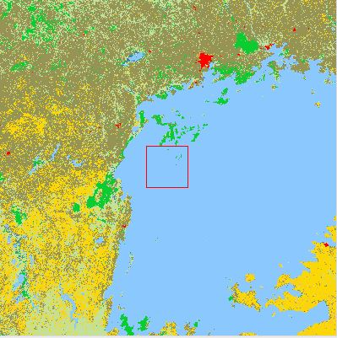
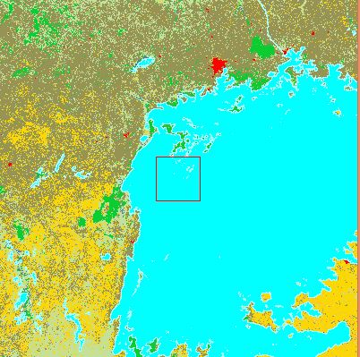
VIIRS QST IP Overview
Global surface type / land water mask product
  Gridded, 1km, 17 IGBP surface type classes. Required typing accuracy ~70%
  Generated annually to reflect recent changes
    Based on gridded surface reflectance products
    Use decision tree (C5.0) classifier, requires training data
Water body
Inland water
Global VIIRS Quarterly Surface Type IP
VIIRS QST IP with land water mask

Slide 7
Requirements
ST EDR/QST IP Requirements from JPSS L1RD
Attribute | Threshold | Objective
Geographic coverage | Global | Global
Vertical Coverage
Vertical Cell Size | N/A | N/A
Horizontal Cell Size | 1 km at nadir | 1 km at edge of scan
Mapping Uncertainty | 5 km | 1 km
Measurement Range | 17 IGBP classes | 17 IGBP classes
Measurement Accuracy | 70% correct for 17 types | 70% correct for 17 types
Measurement Precision | 10% | 10%
Measurement Uncertainty

Slide 8
Current Status of Surface Type EDR
Provisional maturity science review done in Jan 2014
  1st VIIRS QST IP (gridded) based on pure VIIRS 2012 data was generated and reviewed in Jan 2014;
  Preliminary quality check indicates reasonable quality in Apr 2014
Provisional maturity AERB review done in Oct 2014
  CCR-1653 approved: VIIRS ST EDR Veg Fraction fixes in May 2014;
  CCR-1700 approved: Improved VIIRS QST IP implemented in IDPS in Oct 2014;
  CCR-1700 verified: VIIRS ST EDR from Mx8.5 offline verified consistent with QST IP delivered from science team in Nov 2014

Slide 9
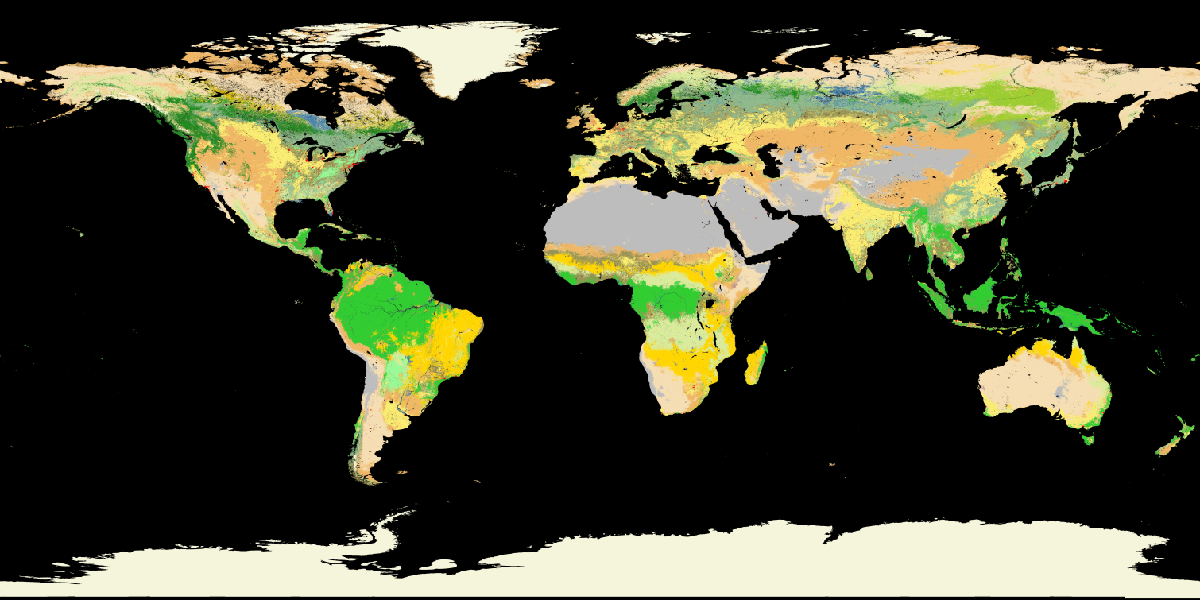
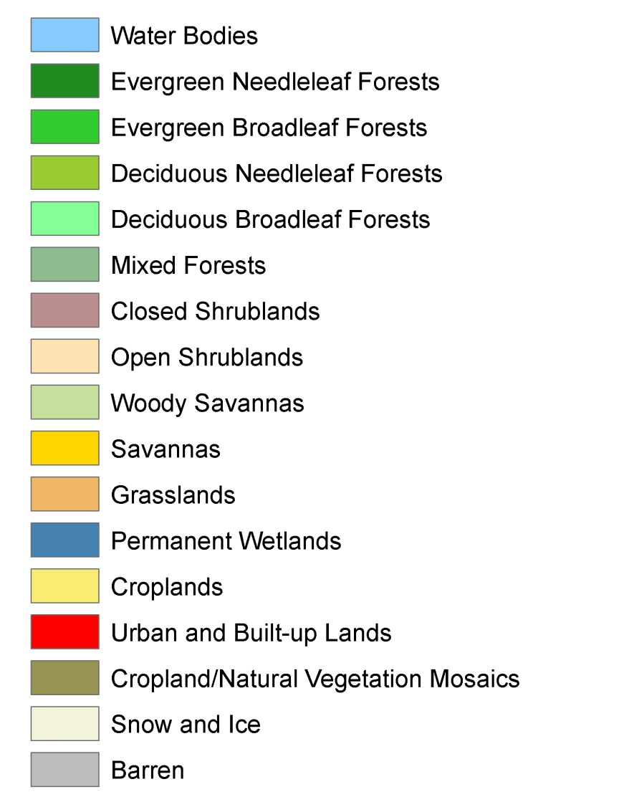
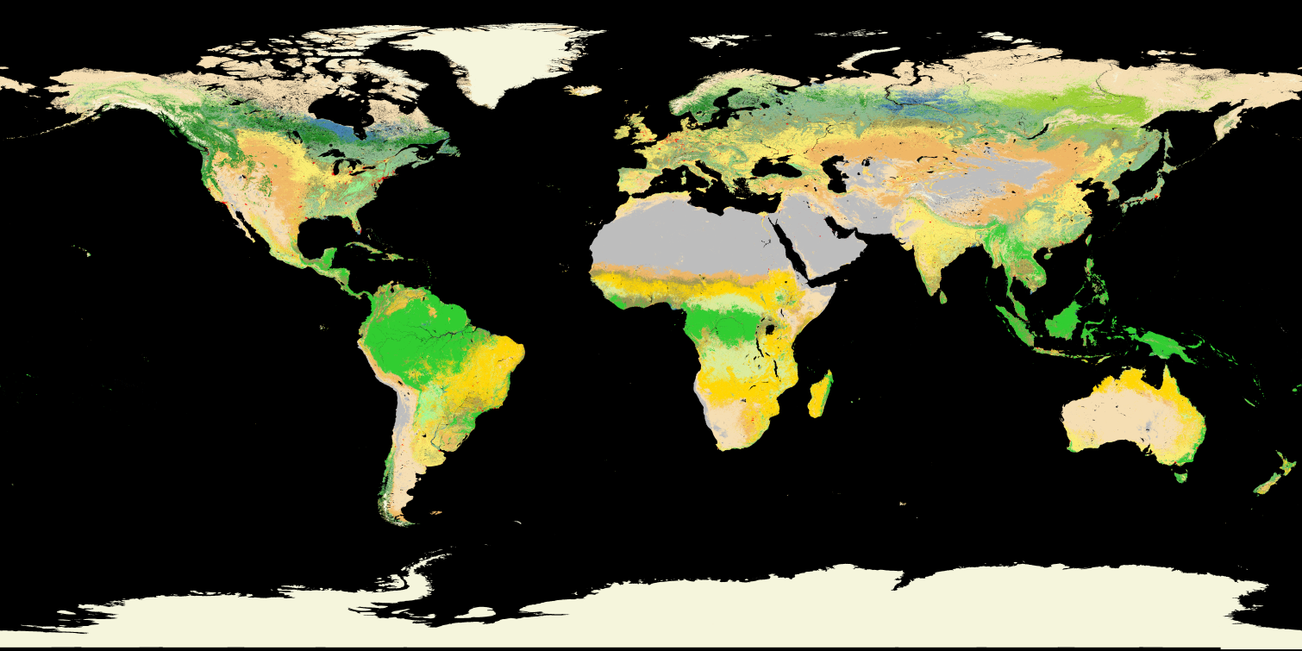
Previous Validation: VIIRS QST vs MODIS LC
IGBP Legend
MODIS
The new VIIRS ST map compares favorably to the MODIS C5 (IDPS seed).
VIIRS

Slide 10
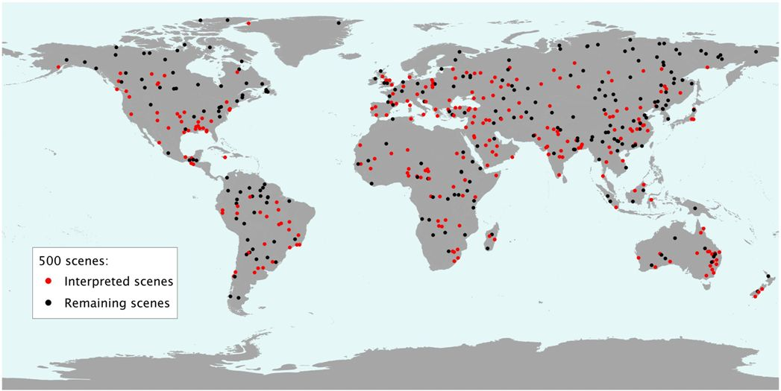
Previous Validation: 500 Validation Site Blocks
BU has completed 290 of the 500 sample blocks (5km x 5km) (red points).

Slide 11
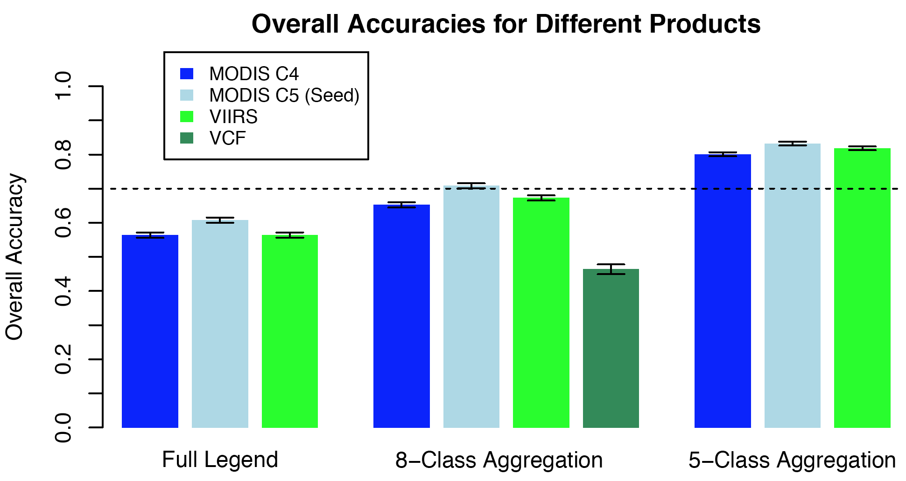
Previous Validation: Result
70% Accuracy Threshold
BU’s previous validation suggested that overall accuracies are similar between the MODIS seed and the new VIIRS ST-IP.

Slide 12
Data Product Maturity Definition
Validated Stage 1:
  Using a limited set of samples, the algorithm output is shown to meet the threshold performance attributes identified in the JPSS Level 1 Requirements Supplement with the exception of the S-NPP Performance Exclusions

Slide 13
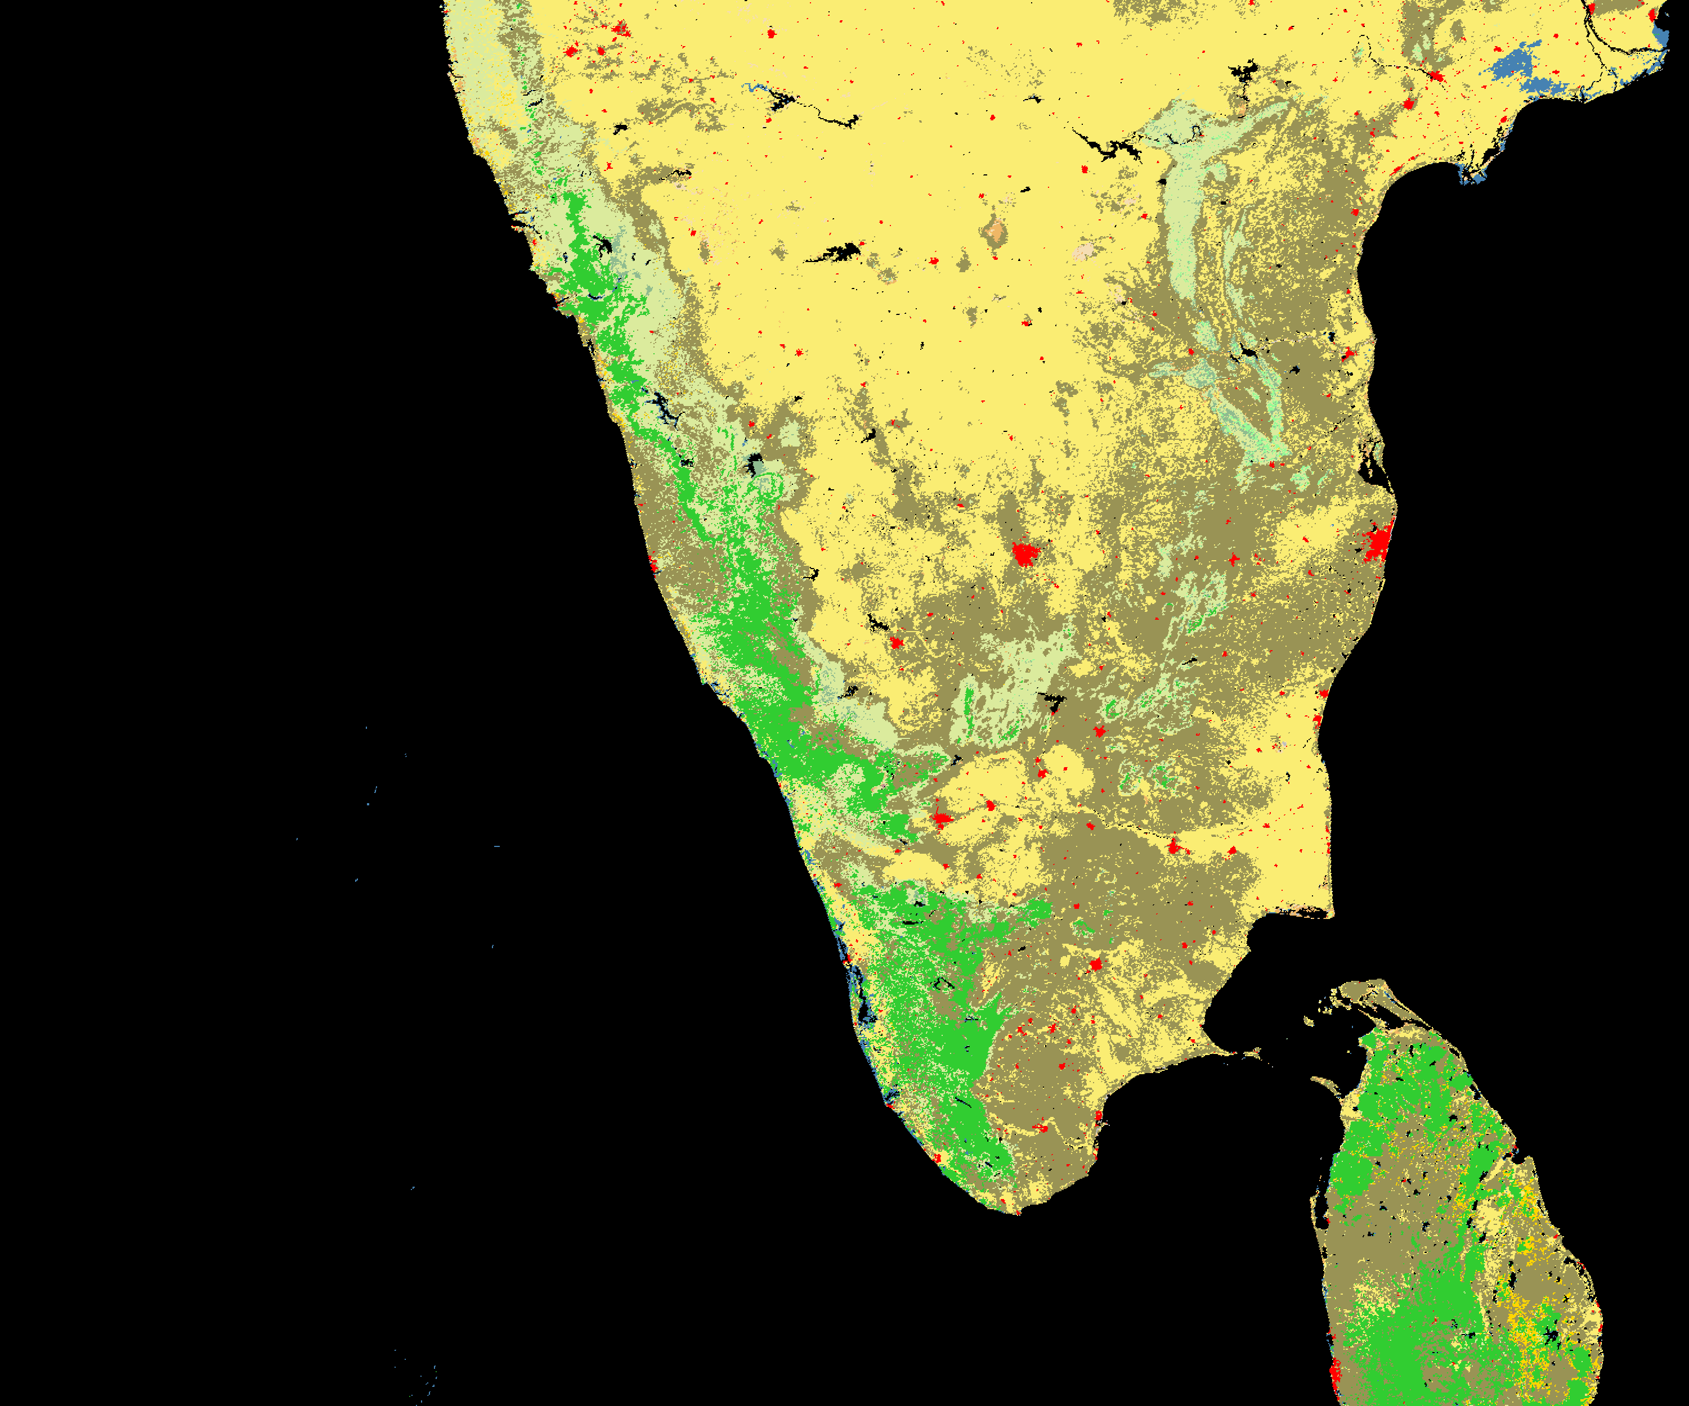
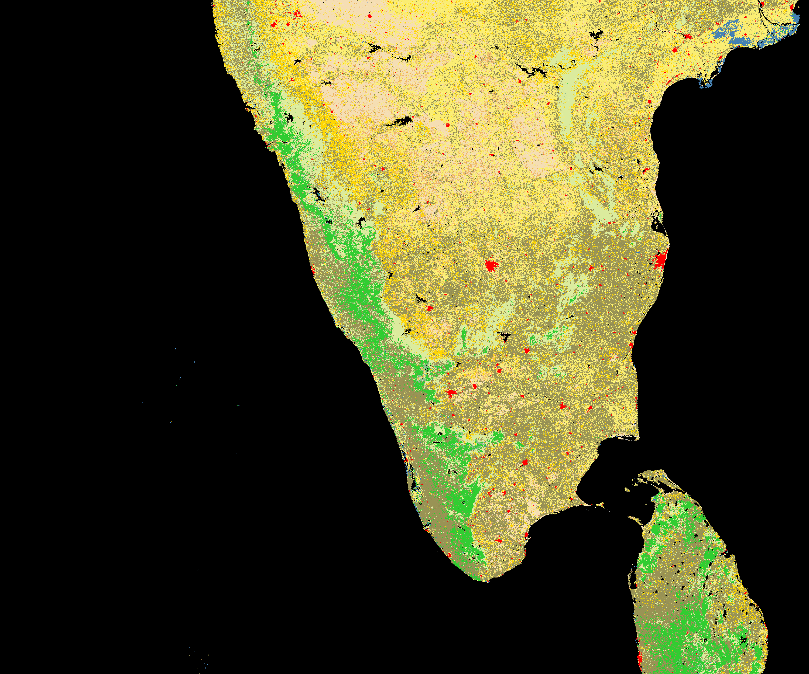

Evaluation of algorithm performance to specification requirements
Findings/Issues from Provisional Review
  Confusions among croplands, cropland/natural vegetation mosaics, and other similar vegetative type, such as grasslands, savannas, and open shrublands
MODIS LC
VIIRS ST

Slide 14
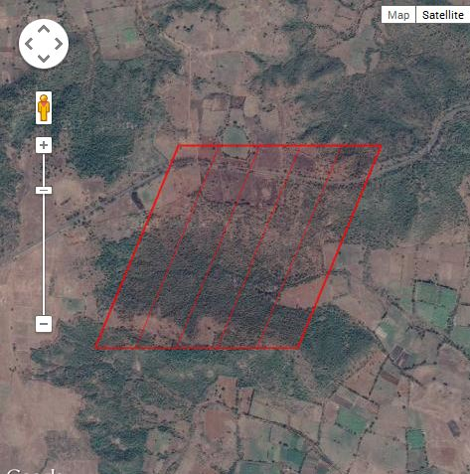
Evaluation of algorithm performance to specification requirements
Findings/Issues from Provisional Review
  Confusions among croplands, cropland/natural vegetation mosaics, and other similar vegetative type, such as grasslands, savannas, and open shrublands
MODIS LC
VIIRS ST
Not pure cropland, but mosaic

Slide 15
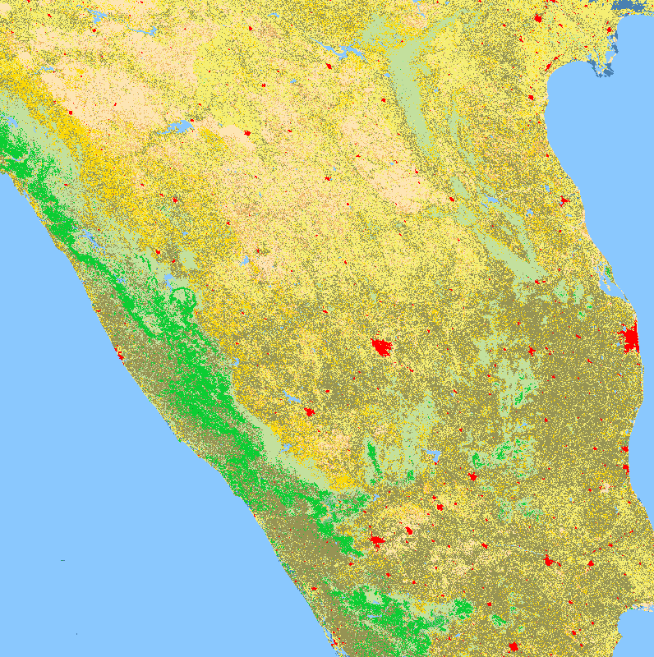
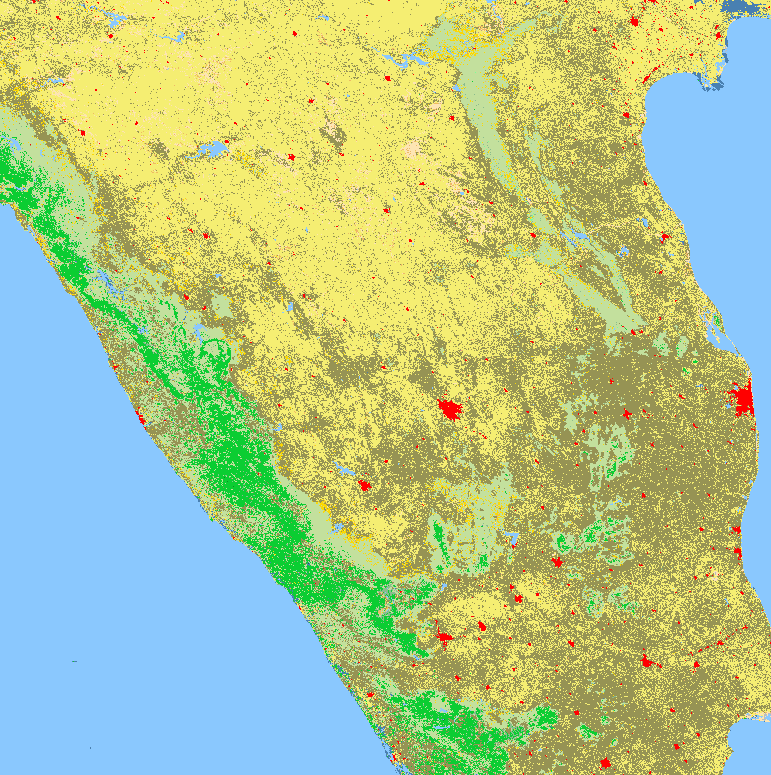
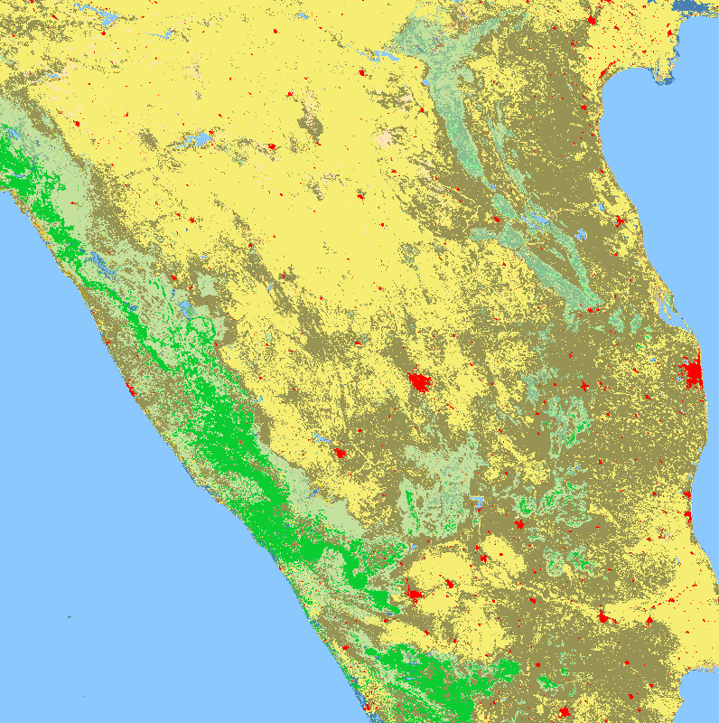
Evaluation of algorithm performance to specification requirements
Improvements since Provisional
  Algorithm Improvements: post-classification modeling for croplands. An four land cover (GLC2000, GLC, MODIS LC, UMD LC) agreement data set is used as reference to improve croplands class.
Initial QST IP (April’14)
Improved QSTIP (post-classification modeling)
MODIS-based Seed

Slide 16
Evaluation of algorithm performance to specification requirements
Cal/Val Activities for evaluating algorithm performance: Validation strategy / method
  Additional validation after Provisional
    Confusion matrices and total accuracy are used to assess the classification performances.
    Reference data derived through visual interpretation of high resolution satellite images.
      Google Map
      Google Earth
      Other existing surface type products for references
    Developed an integrated GUI tool to improve visual interpretation efficiency

Slide 17
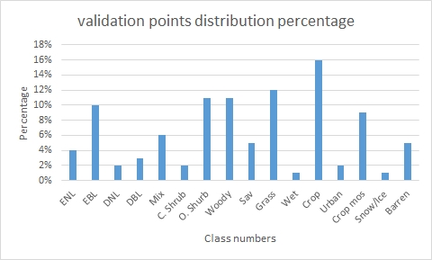
Evaluation of algorithm performance to specification requirements
Cal/Val Activities for evaluating algorithm performance: Test / ground truth data sets
  5000 validation pixels were selected globally using stratified random sampling strategy (Olofsson et al., 2012 in IJRS), the same method with previous validations conducted by BU.
Stratified random sampling
More emphasis on
  Important classes
  Classes affected by human activities
  Rare classes

Slide 18
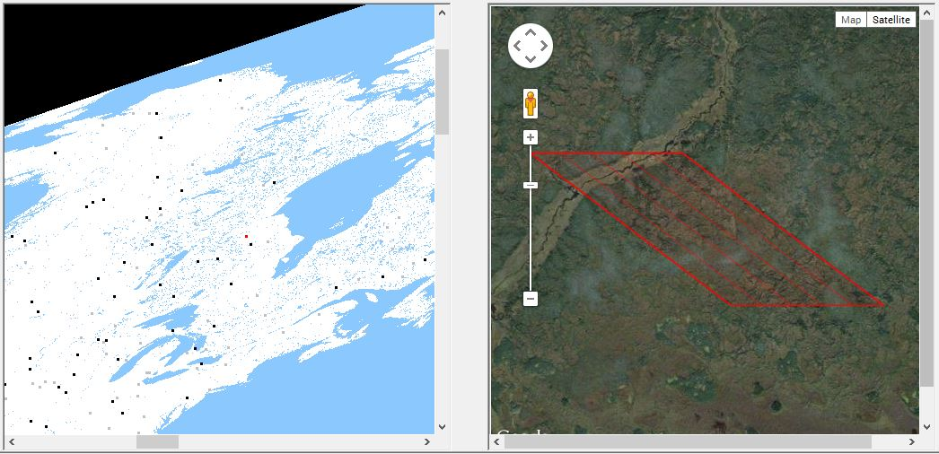
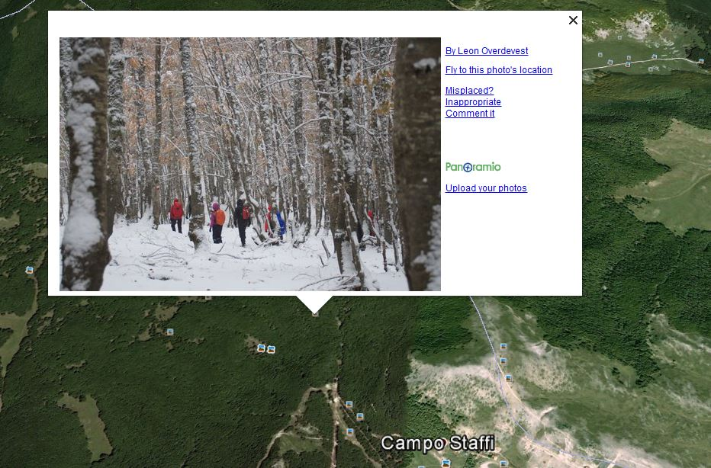
Evaluation of algorithm performance to specification requirements
Cal/Val Activities for evaluating algorithm performance: Test / ground truth data sets
  Integrated validation GUI tool developed.
2. Ground photo from Google Earth can be used to improve interpretation confidence.
1. Automatically load in Google map high resolution image for each reference point (1km)

Slide 19
Evaluation of algorithm performance to specification requirements
Cal/Val Activities for evaluating algorithm performance: Validation results
  Overall accuracy: 73.92% (required 70%)
  Confusion Matrix (in percent):
 | ENL | EBL | DNL | DBL | Mix | C. Shurb | O. Shurb | Woody | Sav | Grass | Wet | Crop | Urban | Crop mos | Snow/Ice | Barren
ENL | 85.98 | 0 | 3.85 | 1.43 | 10.74 | 0 | 0.2 | 3.4 | 1.12 | 0.18 | 2.38 | 0.13 | 0 | 0 | 0 | 0
EBL | 0 | 94.09 | 0 | 1.9 | 3.7 | 0 | 0 | 4.29 | 2.8 | 0 | 0 | 0.13 | 0 | 0.73 | 0 | 0
DNL | 2.44 | 0 | 71.15 | 0 | 2.59 | 0.9 | 0 | 1.61 | 0.28 | 0 | 0 | 0 | 0 | 0 | 0 | 0
DBL | 0 | 0 | 0.96 | 55.24 | 2.59 | 0 | 0 | 2.15 | 2.52 | 0.36 | 0 | 0 | 0 | 0.73 | 0 | 0
Mix | 4.88 | 0.61 | 17.31 | 22.38 | 66.3 | 0 | 0 | 6.44 | 1.68 | 0.36 | 0 | 0.13 | 1.02 | 1.95 | 0 | 0
C. Shrub | 0.61 | 0 | 0 | 1.43 | 0.37 | 62.16 | 1.81 | 0.36 | 0.84 | 0 | 0 | 0.13 | 0 | 0.97 | 0 | 0
O. Shurb | 1.22 | 0 | 0 | 0.48 | 1.48 | 15.32 | 80.89 | 0.89 | 0.84 | 9.79 | 9.52 | 1.73 | 1.02 | 2.19 | 0 | 8.42
Woody | 3.05 | 2.24 | 4.81 | 9.05 | 6.3 | 5.41 | 1.21 | 64.04 | 15.69 | 1.42 | 2.38 | 1.33 | 2.04 | 7.3 | 0 | 0
Sav | 0 | 0.61 | 0 | 0.48 | 0.74 | 4.5 | 1.41 | 4.83 | 47.9 | 1.42 | 0 | 0.66 | 1.02 | 3.41 | 0 | 0
Grass | 0.61 | 0 | 0 | 1.9 | 1.11 | 9.91 | 10.06 | 2.33 | 5.88 | 72.06 | 0 | 6.12 | 2.04 | 3.41 | 0 | 5.26
Wet | 0.61 | 0 | 0 | 0.48 | 1.48 | 0 | 0.8 | 0.36 | 1.12 | 0.36 | 80.95 | 0.13 | 0 | 0 | 0 | 0
Crop | 0.61 | 0 | 0.96 | 1.9 | 0.74 | 0.9 | 1.01 | 0.89 | 5.32 | 9.07 | 4.76 | 83.38 | 8.16 | 15.57 | 0 | 0
Urban | 0 | 0.2 | 0 | 0 | 0 | 0 | 0.2 | 0.36 | 0.28 | 0.18 | 0 | 1.33 | 81.63 | 0.97 | 0 | 0.35
Crop mos | 0 | 2.24 | 0.96 | 3.33 | 1.85 | 0.9 | 1.81 | 8.05 | 13.73 | 4.27 | 0 | 4.65 | 3.06 | 62.77 | 0 | 0.35
Snow/Ice | 0 | 0 | 0 | 0 | 0 | 0 | 0 | 0 | 0 | 0 | 0 | 0 | 0 | 0 | 100 | 0
Barren | 0 | 0 | 0 | 0 | 0 | 0 | 0.6 | 0 | 0 | 0.53 | 0 | 0.13 | 0 | 0 | 0 | 85.61

Slide 20
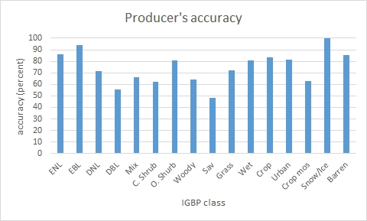
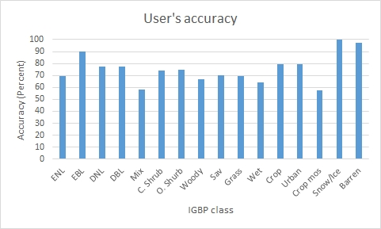
Evaluation of algorithm performance to specification requirements
Cal/Val Activities for evaluating algorithm performance: Validation results
  Producer’s accuracy and user’s accuracy

Slide 21
Evaluation of the effect of required algorithm inputs
Required Algorithm Inputs for QST-IP
  Primary Sensor Data
    TOA reflectance or surface reflectance data
  Ancillary Data
    Training samples from BU and agreement dataset (both from non VIIRS sources)
  Upstream algorithms
    Snow Cover EDR, Active Fire, Cloud Mask, TOC NDVI
  LUTs / PCTs
    EDR processing coefficients

Slide 22
Evaluation of the effect of required algorithm inputs
Evaluation of the effect of required algorithm inputs
  Individual VIIRS acquisitions very noisy
    Cloud/cloud shadow
  Multi-stage compositing to remove/reduce cloud/shadow contamination
    Cloud/shadow greatly reduced in 32-day and annual composites
    Classification by pattern classifiers has high tolerance on residual bad data in the annual metrics
  Other upstream EDR inputs look normal based on examinations of the quality flags

Slide 23
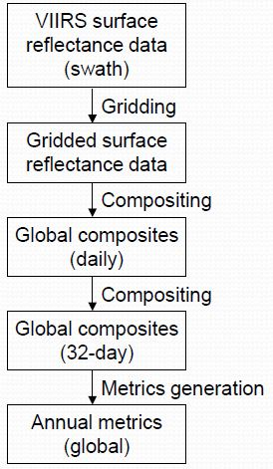
Evaluation of the effect of required algorithm inputs
Evaluation of the effect of required algorithm inputs
Only is QST-IP generation required reflectance data evaluated.
A series of gridding, compositing and metrics calculation were performed in processing required reflectance input data, quality of individual reflectance has minimum impact on final annual metrics.
The procedure is designed to filter out all kinds of noises, such as cloud and anomaly data, therefore, the algorithm has relatively high tolerance to negative effects of input data errors as long as their spectral resolutions are satisfactory.

Slide 24
Evaluation of the effect of required algorithm inputs
Evaluation of the effect of required algorithm inputs
  Study / test cases
Daily (2012/200)
Cloud reduction through composting
8day (2012/193-200)
32day (2012/193-2224)

Slide 25


Evaluation of the effect of required algorithm inputs
Noises reduced further in annual metrics
2012 Median NDVI
Median of the Three Warmest 32-day Composites

Slide 26
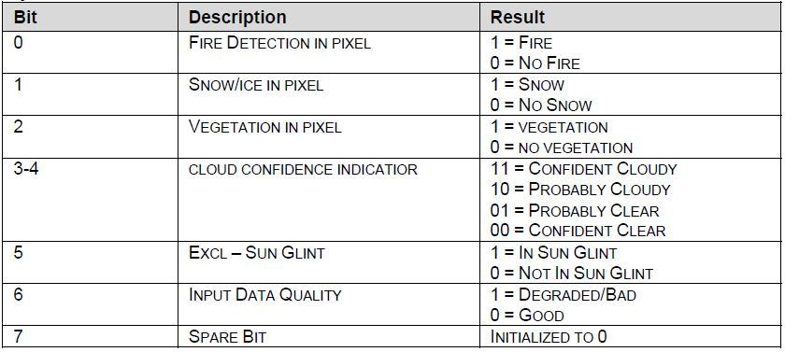
Quality flag analysis/validation
Defined Quality Flags (ST EDR)

Slide 27
Comparison of Fire ARP and Fire QC flag in ST EDR
Quality flag analysis/validation
ST EDR
  Swath, 750 m @ nadir
  Fire pixels has value of 1 in QC flag
  From LPEATE’s IDPS copy
Fire ARP
  Vector format showing location of fire pixels, no imagery product
  From LPEATE’s IDPS copy
Data preparation for comparison
  Convert Fire ARP vector file to imagery product (used in the following comparison)
  Compare Fire ARP with fire flag in ST EDR

Slide 28
Granule Fire Pixel Counts Identical in ST EDR and Fire EDR
Quality flag analysis/validation
All Granules Acquired on 12/31/2012
All Granules Acquired on 02/05/2013
Each point represent one VIIRS granule

Slide 29


Quality flag analysis/validation
Zoom-in Comparison of Fire Flags
Fire ARP
Fire Flag in ST EDR
Algeria
Acquired @ 23:55 on 02/05/2013
Legend
Fire
Non-fire
El Salvador
Acquired @ 18:05 on 02/05/2013

Slide 30


Quality flag analysis/validation
Zoom-in Comparison of Fire Flags
Fire ARP
Fire Flag in ST EDR
Nigeria
Acquired @ 12:35 on 12/31/2012
Legend
Fire
Non-fire
Scandinavia
Acquired @ 11:20 on 02/05/2013

Slide 31
Comparison of Snow EDR and Snow QC flag in ST EDR
Quality flag analysis/validation
ST EDR
  Swath, 750 m @ nadir
  Snow pixels has value of 1 in QC flag
  From LPEATE’s IDPS copy
Snow EDR
  Swath, 375 m @ nadir
  From LPEATE’s IDPS copy
Data processing for comparison
  Every 2 x 2 snow EDR pixels aggregated to match ST EDR pixels
  If > 2 pixels in the 2x2 snow EDR window are snow, flag snow in the ST EDR
  To avoid impact of resampling, comparison made in swath space

Slide 32
Granule-Level Snow Pixel Counts Near Identical in ST EDR and Snow EDR
Quality flag analysis/validation
All Granules Acquired on 12/31/2012
All Granules Acquired on 02/05/2013
Each point represent one VIIRS granule

Slide 33


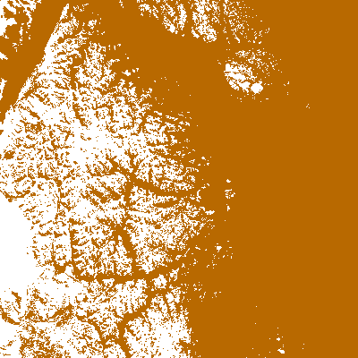
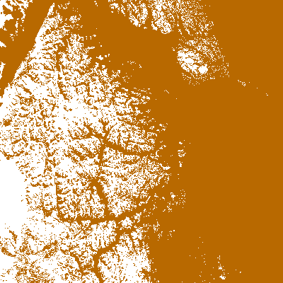
Quality flag analysis/validation
Detailed Comparison of Snow Flags in ST EDR and VIIRS Snow EDR
Snow in Snow EDR
Snow in ST EDR
North Antarctica
Acquired @ 08:50 on 12/31/2012
Legend
Snow
Non-snow
Eastern Siberia
Acquired @ 21:15 on 12/31/2012

Slide 34
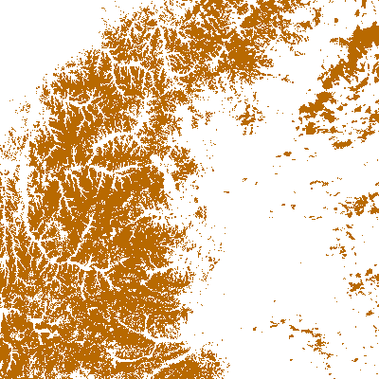
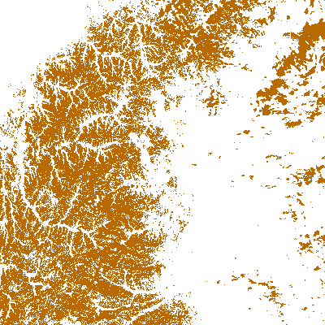
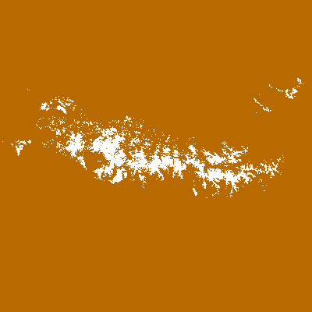
Quality flag analysis/validation
More Comparison of Snow Flags in ST EDR and VIIRS Snow EDR
Snow in Snow EDR
Snow in ST EDR
North of Baikal Russia
Acquired @ 04:45 on 02/05/2013
Legend
Snow
Non-snow
North Spain
Acquired @ 13:10 on 02/05/2013

Slide 35
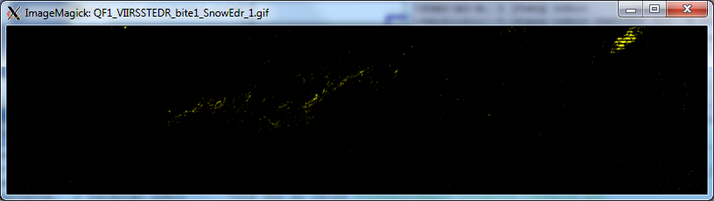
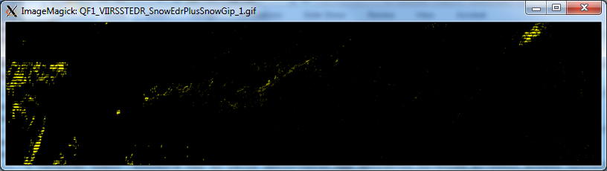
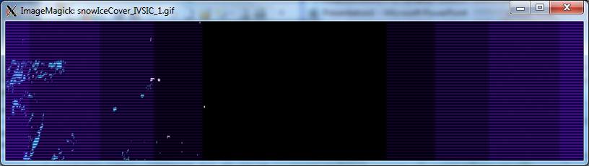
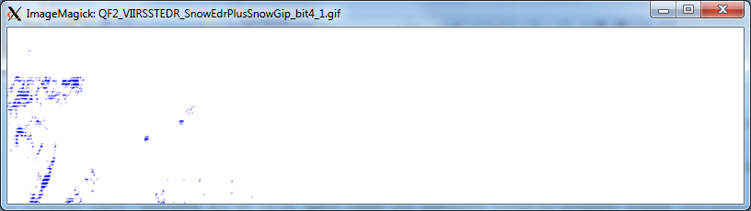
Quality flag analysis/validation
Quality flag analysis/validation:
  CCR-1264 approved in Oct 2013
    Use IVSIC when Snow EDR not available
Baseline Surface Type output:
QF1, bit1: Snow (yellow) updated with SnowFraction EDR
Proposed Surface Type output:
QF1, bit1: Snow (yellow) updated with GIP Snow (IVSIC)
Proposed Surface Type output:
QF2, bit4: Snow source: 0 (white) - SnowFraction EDR; 1(blue) - GIP Snow (IVSIC)
GIP Snow (IVSIC) (blue)

Slide 36
Error Budget
Compare analysis/validation results against requirements, present as a table. Error budget limitations should be explained. Describe prospects for overcoming error budget limitations with future improvement of the algorithm, test data, and error analysis methodology.
Attribute Analyzed | L1RD Threshold | Analysis/Validation Result | Error Summary
Surface type classification accuracy | 70% | 73.92% | meets the L1RD threshold spec

Slide 37
Documentation
The following documents will be updated and provided to the EDR Review Board before AERB approval:
  ATBD latest update Jan 29th, 2014
  OAD last update Apr 30th, 2014
  README file for CLASS provided in Nov, 2014
  Product User’s Guide (Recommended): document standard to be provided

Slide 38
Identification of Processing Environment
IDPS or NDE build (version) number and effective date
  Mx8.5, Nov. 14, 2014
Algorithm version
  1.O.000.004
Version of LUTs used
  NA
Version of PCTs used
  NA
Description of environment used to achieve validated stage 1
  Mx8.5

Slide 39
Identification of Processing Environment
VIIRS surface type EDR is produced in IDPS
VIIRS QST IP:
  It is an ancillary data layer (tiles) for VIIRS surface type EDR
  Its production requires at least one whole year VIIRS gridded composited data of VI, BT and surface reflectance
  MODIS experience proved that it could not be reliably and practically generated every three months
  It will be generated once a year at science computing facility (STAR/University of Maryland) and delivered to IDPS by Algorithm Integration Team

Slide 40
Users & User Feedback
User list
  Modeling studies
    Land surface parameterization for GCMs
    Biogeochemical cycles
    Hydrological processes
  Carbon and ecosystem studies
    Carbon stock, fluxes
    Biodiversity
Feedback from users (Primary user: NCEP land team led by M. Ek)
Downstream product list
  Land surface temperature (direct)
  Cloud mask, aerosol products, other products require global land/water location information (indirect)
Reports from downstream product teams on the dependencies and impacts
  No significant impacts reported from LST and VCM team

Slide 41
Path Forward
Planned further improvements of QST IP
  Better compositing algorithm
  Use multiple year data
  More training data with better representative
  SVM classification will replace C5.0 decision tree classification
  Post-classification improvements
  Name may be revised to “Global Surface Type”
Potential improvement for ST EDR:
  To include flags for standing water, burned area in addition to active fire and snow
  To be used as an surface type change product as well as down stream product input

Slide 42
Path Forward
Planned Cal/Val activities / milestones
  Validate SVM generated surface type EDR
  Improve validation tool for next phase validation and long term monitoring
  Develop quality flag monitoring tools

Slide 43
Summary
Surface Type EDR/QST IP Validation:
  Overall accuracy from the new validation effort suggested that the classification accuracy on surface type intermediate product meets the required 70% correct rate.
  Quality flags verified, no errors found.
  Team recommends algorithm validated stage 1 maturity

Slide 44
Thanks!

Slide 45
Backup slides

Slide 46
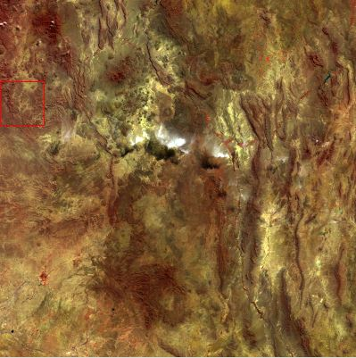
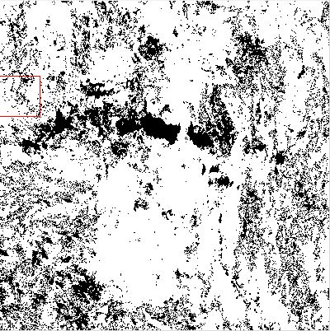
Quality flag analysis/validation
Quality flag analysis/validation: example
  Vegetation, validation successful
Nov. 18, 2014, M7, M5, M3 Composite over Texas/Louisiana area, USA
Extracted vegetation quality flag from VSTYO_npp_d20141118_t2000204_e2001446_b15854_c20141119022854205831_noaa_ops.h5

Slide 47
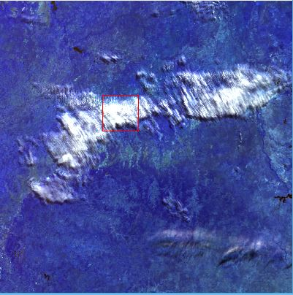
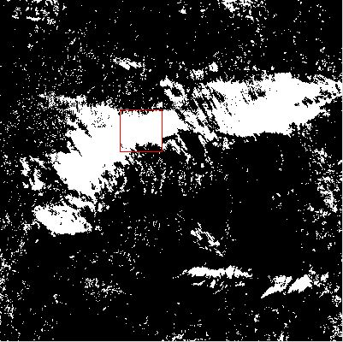
Quality flag analysis/validation
Quality flag analysis/validation: example
  Cloud cover, validation successful
Nov. 18, 2014, M3, M5, M7 Composite over Texas/Louisiana area, USA
Extracted cloud cover quality flag from VSTYO_npp_d20141118_t2000204_e2001446_b15854_c20141119022854205831_noaa_ops.h5

Slide 48
Quality flag analysis/validation
Quality flag analysis/validation
  Analysis/validation results
    Comparisons and analyses suggested all quality flags in documents have been implemented successfully in the ST-EDR, and no errors were found.
  Analysis/validation plan for next validated stages
    Quality flag monitoring tools will be developed to automatically check the flags.
    Input data quality will be evaluated.

Slide 49
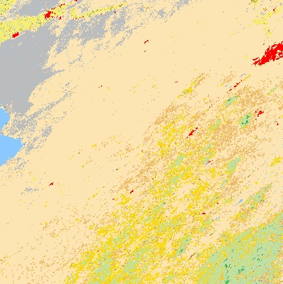

Identification of Processing Environment
Mx8.5 ST data verification
  Compare the operational produced ST EDR data with science team delivered ST IP data, should be identical
ST data from Mx8.5 ST-EDR.
Nov. 16, 2014 North America
Delivered VIIRS ST-IP
Comparisons suggest the delivered VIIRS based ST-IP has been implemented in Mx8.5

