Slide 1
Validated Stage 1 Science Maturity Review for Soundings
Presented by
Quanhua (Mark) Liu
September 3, 2014

Slide 2
Outline
Algorithm Cal/Val Team Members
Product Requirements
Evaluation of algorithm performance to specification requirements
Evaluation of the effect of required algorithm inputs
Quality flag analysis/validation
Error Budget
Documentation
Identification of Processing Environment
Users & User Feedback
Conclusion
Path Forward

Slide 3
Sounding EDR Cal/Val Team
Name | Organization | Major Task
M. Liu, T. Reale, W.Wolf | NOAA/STAR | Management leads
A. Gambacorta | IMSG@STAR | NUCAPS algorithm lead, X. Xiong, C. Tan, F. Iturbide-Sanchez, K. Zhang:NUCAPS algorithm team member AVTP, AVMP, O₃, OLR, trace gases
N. Nalli | IMSG@STAR | NUCAPS product validation lead
C. Barnet | STC | NOAA CrIS/ATMS EDRs in complex weather regimes
B. Sun, M. Pettey, Frank Tilley, Charlie Brown | IMSG@STAR | NPROVS/NPROVS+
X. Liu | NASA/LaRC | NUCAPS independent assessment
P. J. Mather | DOE | support validation of EDRs
D. Tobin | UW | ARM-RAOBS at NWP, SGP, NSA
Special thanks to T. King, M. Wilson, and Y. Zhou. NUCAPS codes are now under
version control in ClearCase.

Slide 4
Temperature Profile Requirements
Attribute | Threshold | Objective
Geographic coverage | 90% every 18 hours | > 90%
Vertical Coverage | Surface to 0.5 mb | Surface to 0.5 mb
Vertical Cell Size | 0.2 ~50 mb | 0.1 ~ 10 mb
Horizontal Cell Size | 50 km at nadir | 1 km at nadir
Mapping Uncertainty | 5 km | 0.5 km
Measurement Range | Propose 150 ~ 400 K | Propose 100 ~ 500 K
Measurement Uncertainty
Cloud < 50%: Surface to 300 mb | 1.6 K per km layer | 0.5 K per km layer
300 to 30 mb | 1.5 K per 3 km layer | 0.5 K per 3 km layer
30 to 1 mb | 1.5 K per 5 km layer | 0.5 K per 5 km layer
1 to 0.5 mb | 3.5 K per 5 km layer | 0.5 K per 5 km layer
Cloud >= 50%: Surface to 700mb | 2.5 K per km layer | 0.5 K per km layer
700 to 300 mb | 1.5 K per km layer | 0.5 K per km layer
300 to 30 mb | 1.5 K per 3 km layer | 0.5 K per 3 km layer
30 to 1 mb | 1.5 K per 5 km layer | 0.5 K per 5 km layer
1 to 0.5 mb | 3.5 K per 5 km layer | 0.5 K per 5 km layer
L1RD
p43
IR
+
MW
MW
only

Slide 5
Moisture Profile Requirements
Attribute | Threshold | Objective
Geographic coverage | 90% every 18 hours | 3 hrs
Vertical Coverage | Surface to 0.5 mb | Surface to 0.5 mb
Vertical Cell Size | 20 ~50 mb | 5 ~ 10 mb
Horizontal Cell Size | 50 km at nadir | 1 km at nadir
Mapping Uncertainty | 5 km | 0.5 km
Measurement Range | Propose 0.001 ~ 100 g/kg | Propose 0.001 ~ 100 g/kg
Measurement Uncertainty | Expressed as a percent of average ratio in 2 km layers
Cloud < 50%: Surface to 600 mb | Greater of 20% or 0.2 g/kg | 10%
600 to 300 mb | Greater of 35% or 0.1 g/kg | 10%
300 to 100 mb | Greater of 35% or 0.1 g/kg | 10%
Cloud >= 50%: Surface to 600mb | Greater of 20% or 0.2 g/kg | 10%
600 to 300 mb | Greater of 40% or 0.1 g/kg | 10%
300 to 100 mb | Greater of 40% or 0.1 g/kg | 10%
L1RD
p41
IR
+
MW
MW
only

Slide 6
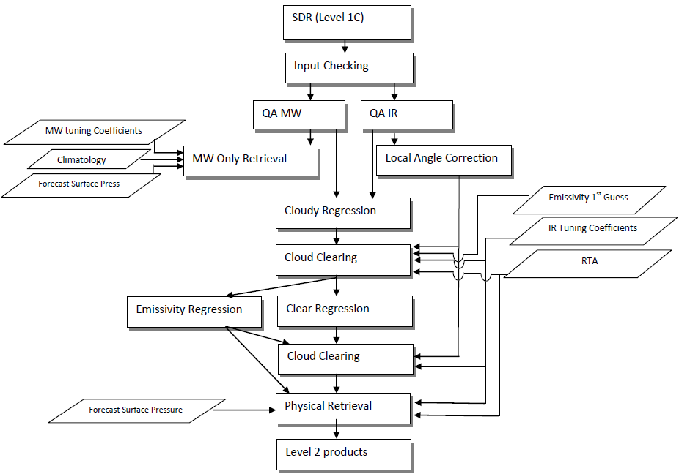
NOAA Unique CrIS/ATMS Processing System (NUCAPS) Retrieval System
Antonia Gambacorta and Chris Barnet, 2012: 10.1109/TGRS.2012.2220369.

Slide 7
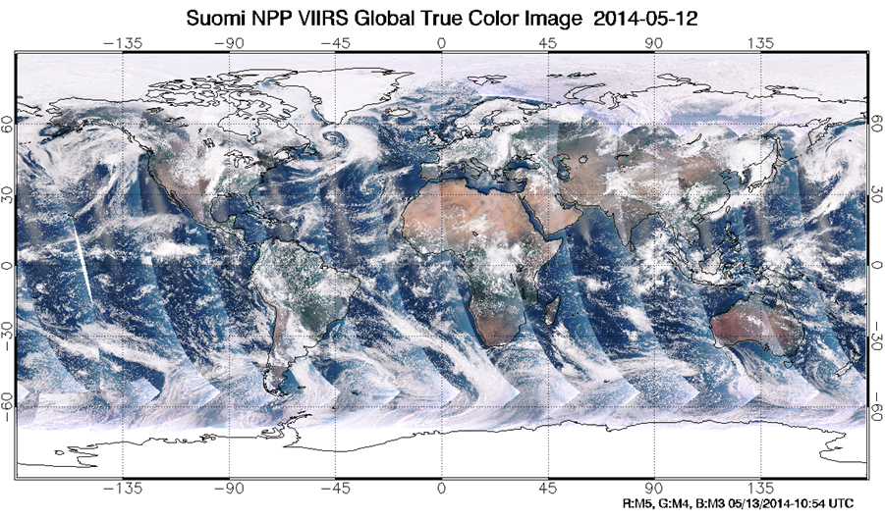
Cloud Coverage, May 12, 2014
from
STAR
ICVS
Clear | 1-10 | 10-20 | 20-30 | 30-40 | 40-50 | 50-60 | 60-70 | 70-80 | 80-90 | 90-99 | 100%
8.61 | 13.92 | 6.16 | 5.67 | 4.52 | 3.94 | 3.68 | 3.80 | 4.32 | 8.66 | 18.28 | 18.44
Cloud coverage = 57%
Data from Haibing Sun
CCR (CF< 80%)
Using cloud-clearing radiance, IR retrieval data increases from 8.6% to 55%.

Slide 8
Validation Methodology, NPROVS and VALAR
Numerical Model (e.g., ECMWF, NCEP/GFS)
Global Comparisons
Large, global samples acquired from Focus Days
Useful for early sanity checks, bias tuning and regression
However, not independent truth data
Satellite EDR (e.g., CrIS, AIRS, ATOVS, COSMIC)
Intercomparisons
Global samples acquired from Focus Days (e.g., CrIS/ATMS)
Consistency checks; merits of different retrieval algorithms
However, IR sounders have similar error characteristics;
must take rigorous account of averaging kernels of
both systems (e.g., Rodgers and Connor, 2003)
Conventional RAOB Matchup Assessments
Conventional WMO/GTS operational sondes launched
~2/day for NWP (e.g., NPROVS)
Useful for representation of global zones and long-term
monitoring
Large statistical samples acquired after a couple
months’ accumulation
Limitations:
Skewed distribution toward NH-continental sites
Significant mismatch errors, potentially systematic at individual sites
Non-uniform, less-accurate and poorly characterized
radiosonde types used in data sample
Dedicated/Reference RAOB Matchup Assessments
Dedicated for the purpose of satellite validation
Well-specified error characteristics and optimal accuracy
Minimal mismatch errors
Include atmospheric state “best estimates” or
“merged soundings”
Reference sondes: CFH, corrected RS92, Vaisala RR01 under
Development
Traceable measurement
Detailed performance specification and regional
Characterization
Limitation: Small sample sizes and geographic coverage
E.g., ARM sites (e.g., Tobin et al., 2006), GRUAN sites, NOAA
AEROSE
Intensive Field Campaign Dissections
Include dedicated RAOBs, especially those not assimilated
nto NWP models
Include ancillary datasets (e.g., ozonesondes, lidar, M-AERI,
MWR, sunphotometer, etc.)
Ideally include funded aircraft campaign using aircraft IR
sounder (e.g., NAST-I, S-HIS) underflights
Detailed performance specification; state specification; SDR
cal/val; EDR “dissections”
E.g., AEROSE, JAIVEX, WAVES, AWEX-G, EAQUATE, CalWater-2
Nalli et al., 2013: JGR; Divakarla, et al., 2014: JGR-Atmosphere.

Slide 9
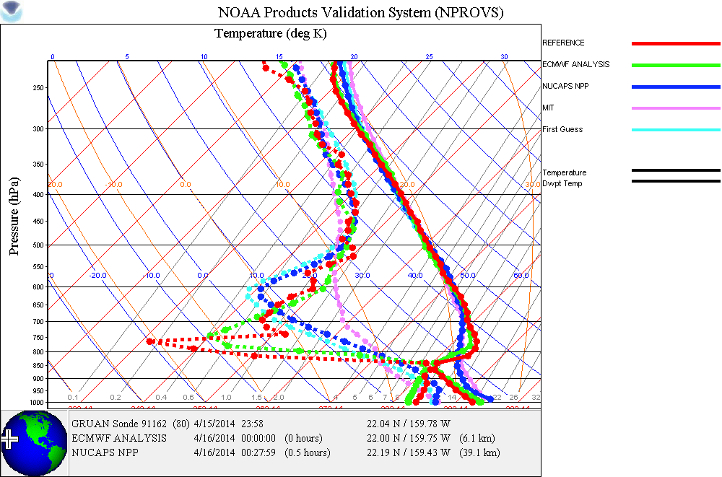
Notes:
Collocation from PMRF
IR+MW pass qc … may be cloudy, in any case sensor cannot delineate sharp dry layer. The dryness spike in raob (red) between 750-800 hpa is caused by the air subsidence at the top of marine boundary layer.

Slide 10
Data Product Maturity Definition
Validated Stage 1:
Using a limited set of samples, the algorithm output is shown to meet the threshold performance attributes identified in the JPSS Level 1 Requirements Supplement with the exception of the S-NPP Performance Exclusions.
Validation Data Set
Qualitative Analysis
Product global distribution
Quantitative Analysis
a. Aerosols and Ocean Science Expeditions (AEROSE)
b. ECMWF Global Analysis
c. Dedicated radiosondes
ARM-SGP : Mid-latitude land
ARM-TWP: Tropical western pacific
ARM-NSA: Polar area
NUCAPS Products

Slide 11
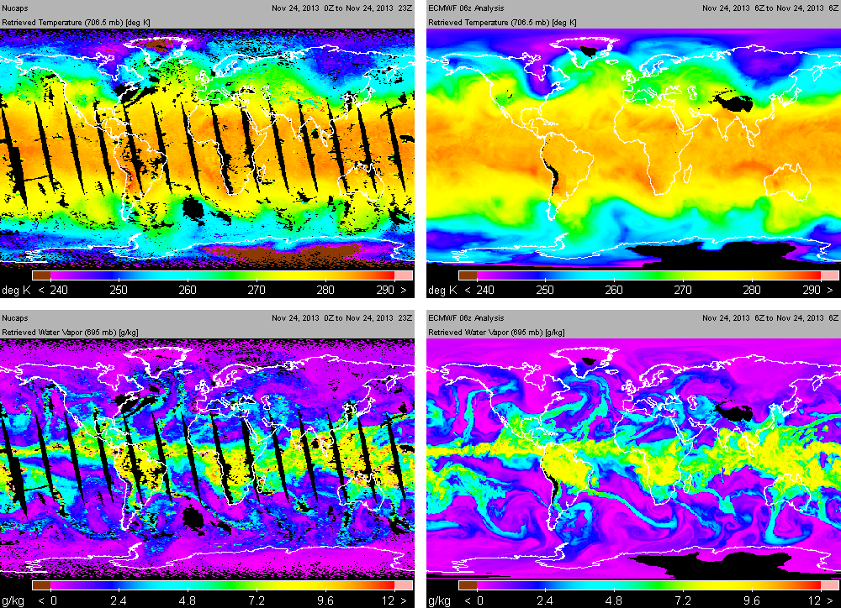
NUCAPS vs ECMWF, T and H₂O
Black indicate where IR+MW and MW-only failed qc …

Slide 12
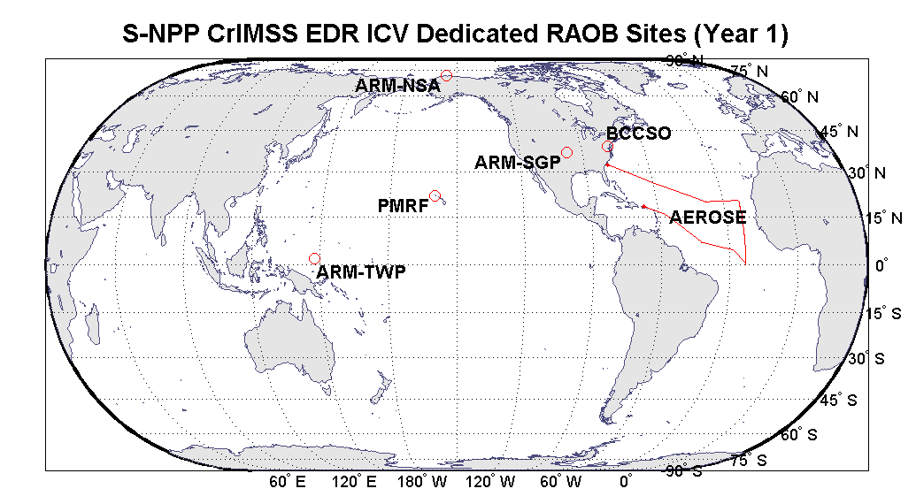
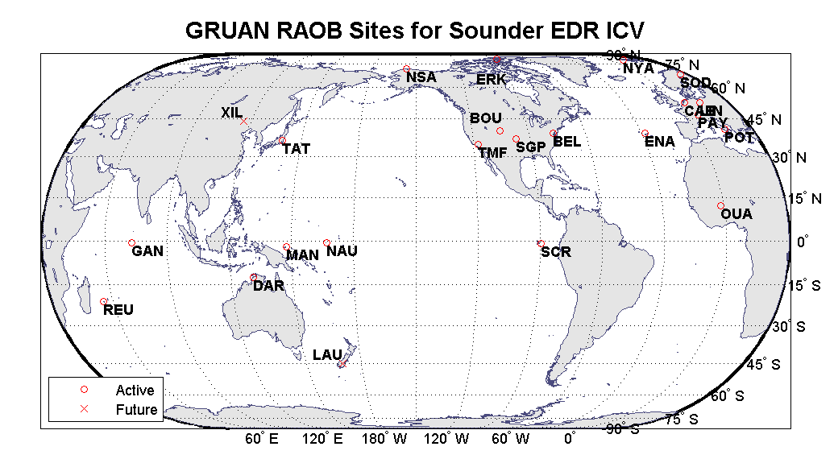
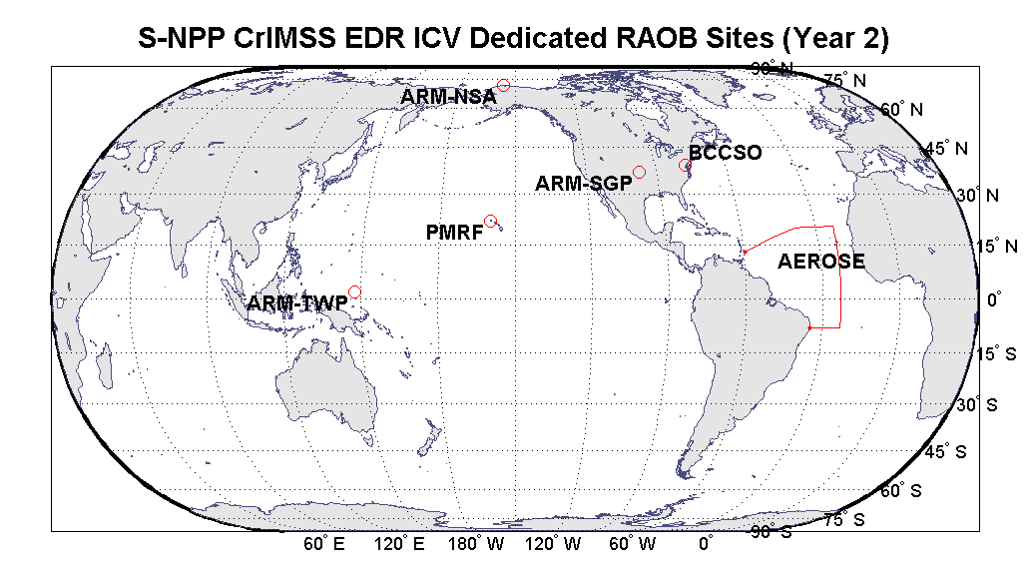
Dedicated and GRUAN Reference RAOB
JPSS S-NPP Dedicated
GRUAN Reference Sites (NPROVS+ Collocation)
Location | BEL | BOU | CAB | DAR | ENA | ERK | GAN | HIH | LAU | LIN | MAN | NAU
Lat (deg) | 39.05 | 39.95 | 52.1 | -12.475 | 39.05 | 79.98 | -0.69 | 19.72 | -45.04 | 52.22 | -2.06 | -0.52
Lon(deg) | -76.88 | -105.2 | 5.18 | 130.83 | -28.03 | -85.93 | 73.15 | -155.05 | 169.68 | 14.12 | 147.43 | 166.92
Location | NSA | NYA | OUA | PAY | POT | REU | SRC | SGP | SOD | TAT | TMF | XIL
Lat (deg) | 71.32 | 78.92 | 12.4 | 46.81 | 40.6 | -21.08 | -0.9 | 36.61 | 67.37 | 36.06 | 34.39 | 43.95
Lon(deg) | -156.6 | 11.92 | -1.5 | 6.95 | 15.72 | 55.38 | -89.6 | -97.49 | 26.63 | 140.1 | -117.7 | 116.12
RAOB Site | Lat (deg) | Lon (deg)
ARM-SGP | 36.6 | -97.5
ARM-NSA | 71.3 | -156.6
ARM-TWP | 2.06 | 147.43
PMRF | 22.05 | -159.78
BCCS | 39.05 | -76.88
AEROSE | Tropical Ocean

Slide 13
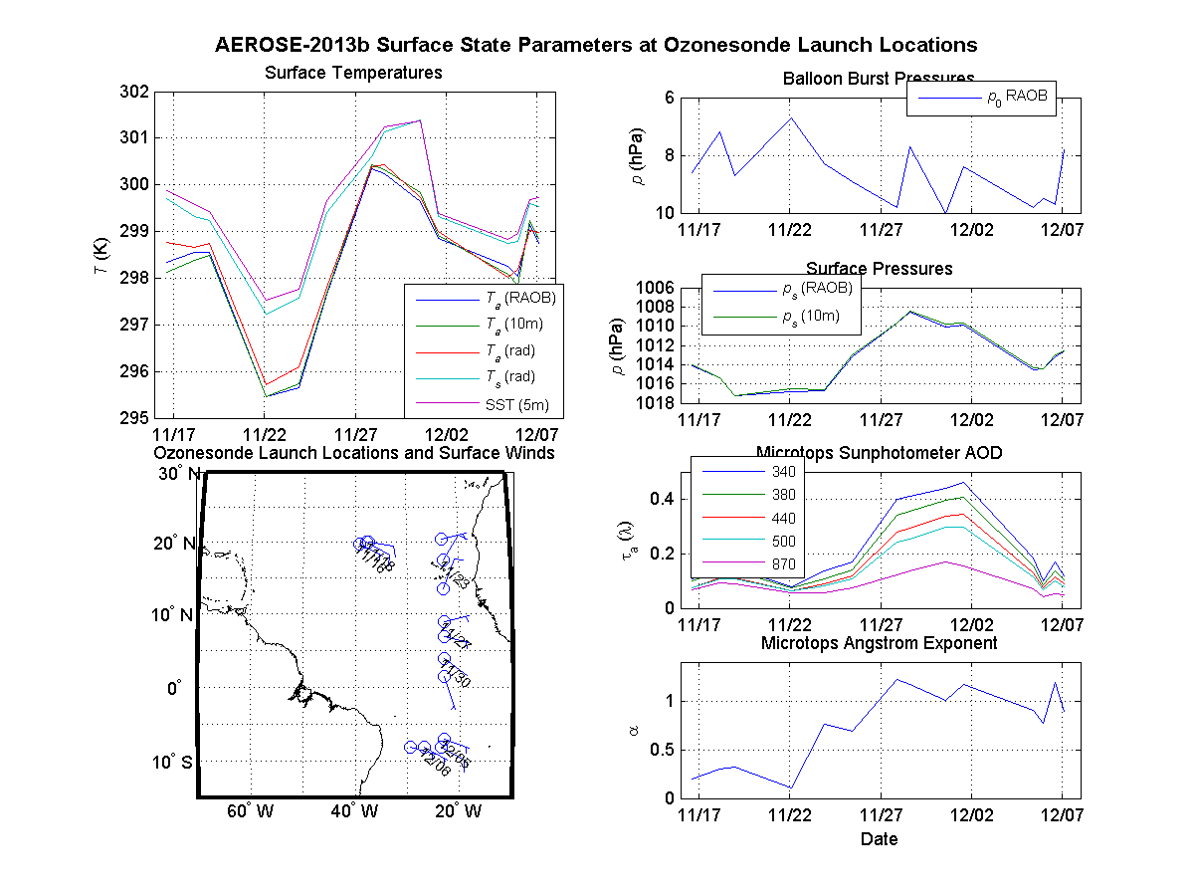
2013 AEROSE State Parameters P(z), T(p), U(p), O₃(p), T_{s} , u_{s} , v_{s} , AOD

Slide 14
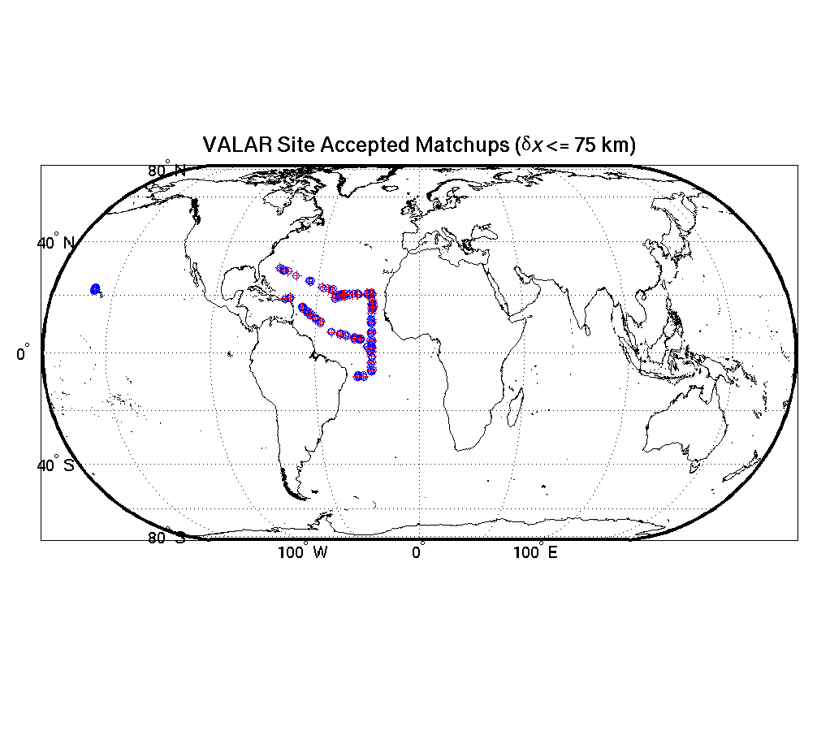
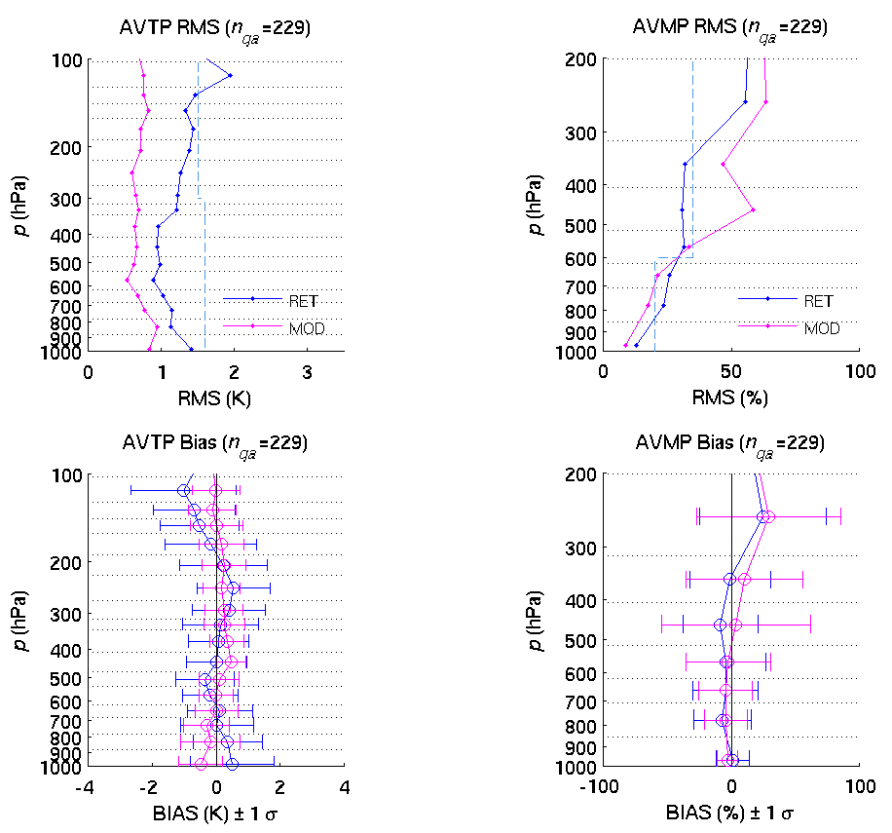
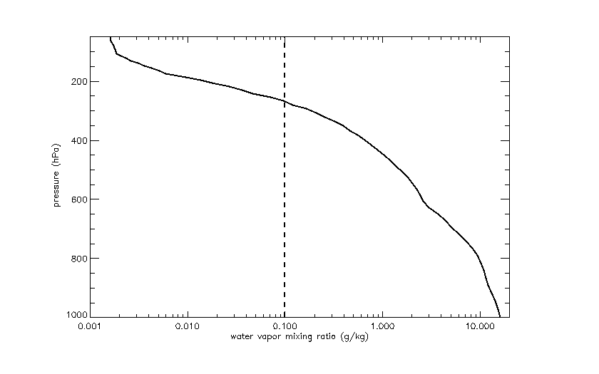
NDE-OPS IR + MW
MOD=ECMWF
Temperature
Moisture
Standard tropical water vapor profile
Notes:
MOD = ECMWF

Slide 15
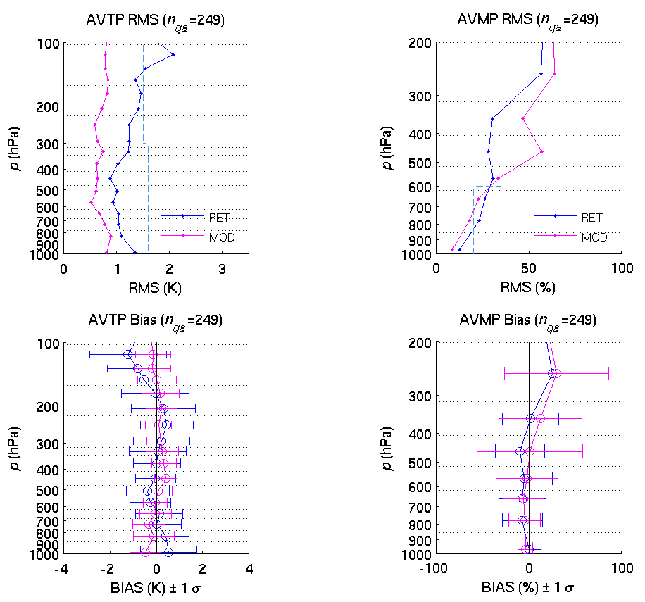
Offline IR + MW
Temperature
Moisture

Slide 16
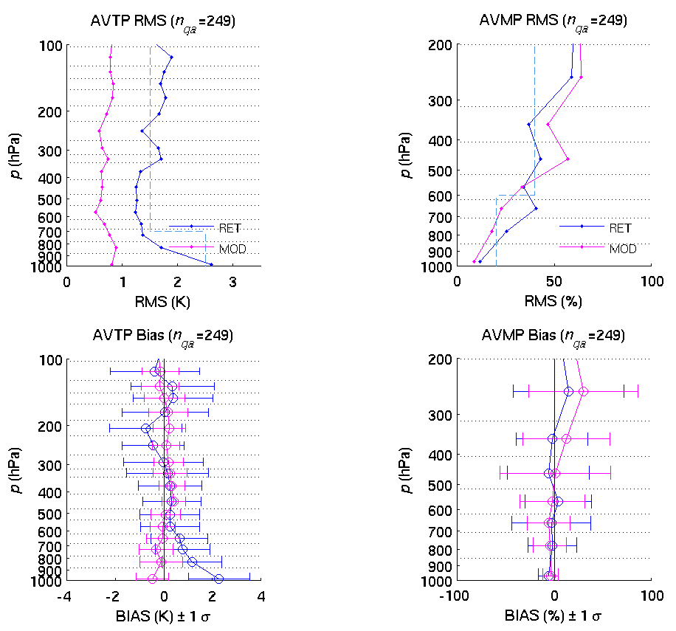
Offline MW-Only (MIT)
Temperature
Moisture

Slide 17
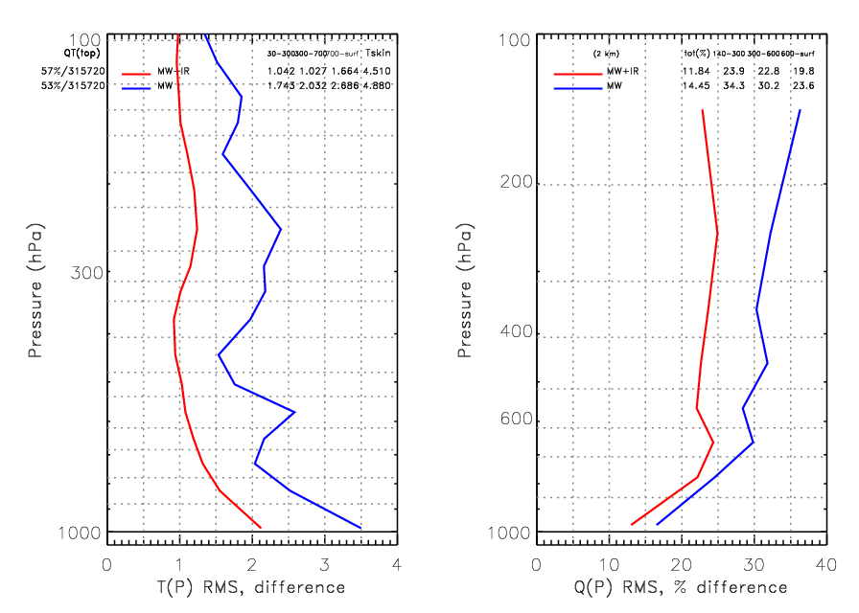
NUCAPS MW+IR & MW Only Global (land+ocean) vs ECMWF Analysis (focus day 2012-05-15)
JPSS L1RD:
(see next slide)
30 – 300mb 300-SURF
1.042K (Req:1.5K) 1.34K (Req:1.6K)
TOA – 700mb 700-SURF
1.88K (Req:1.5K) 2.68K (Req:2.5K)
100 – 600mb 600-SURF
23.3% (Req:35%) 19.8% (Req:20%)
32.2% (Req:40%) 23.6% (Req:20%)

Slide 18
Summary on GLOBAL validation vs ECMWF green = passed yellow = close red = failed
SUMMARY ON MW+IR RESULTS vs JPSS L1RD REQUIREMENTS
MW+IR TEMPERATURE | RESULTS | JPSS L1RD | MW+IR WATER VAPOR | RESULTS | JPSS L1RD
30 – 300mb | 1.04K | 1.5K | 100 - 600mb | 23.3% | 35%
300mb - SURF | 1.34K | 1.6K | 600mb -SURF | 19.8% | 20%
SUMMARY ON MW-ONLY RESULTS vs JPSS L1RD REQUIREMENTS
MW-ONLY TEMPERATURE | RESULTS | JPSS L1RD | MW-ONLY WATER VAPOR | RESULTS | JPSS L1RD
30 – 700mb | 1.88K | 1.5K | 100 - 600mb | 32.2% | 40%
700mb - SURF | 2.68K | 2.5K | 600mb -SURF | 23.6% | 20%
NUCAPS MW+IR fully meets requirements globally
NUCAPS MW-Only is close to fully meets spec.
Possible isues are:
Residual temporal and spatial mismatch between retrievals and model: ECMWF mismatch is +/- 1.5 hour and +/- 0.25 deg and we use both forecast and analysis depending on UT time.
Uncertainty in the model
Uncertainty in the retrievals
Ongoing NUCAPS improvement activity:
Improve NUCAPS look up tables (RTA tuning and first guess)
Improve validation methodology by using dedicated RAOBs: see ahead

Slide 19
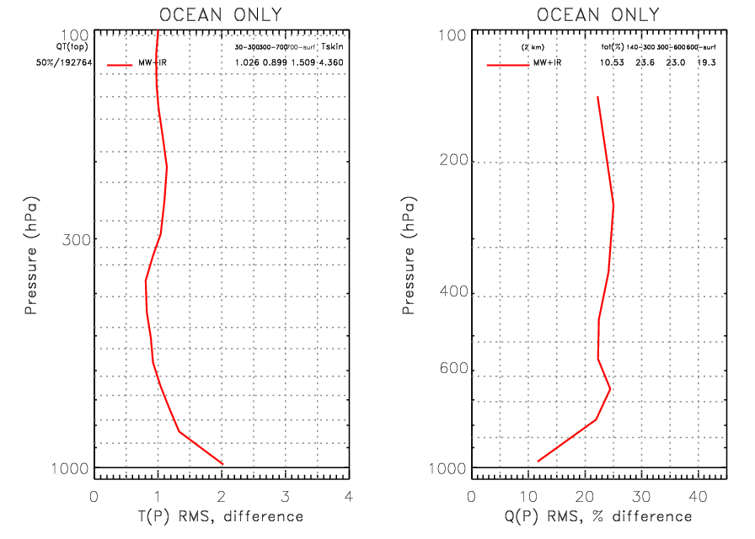
GLOBAL OCEAN VALIDATION NUCAPS MW+IR vs ECMWF Analysis (focus day 2012-05-15)
SUMMARY ON OCEAN MW+IR RESULTS vs JPSS L1RD REQUIREMENTS
MW+IR TEMPERATURE | RESULTS | JPSS L1RD | MW+IR WATER VAPOR | RESULTS | JPSS L1RD
30 – 300mb | 1.02K | 1.5K | 100 - 600mb | 23.3% | 35%
300mb - SURF | 1.20K | 1.6K | 600mb -SURF | 19.3% | 20%

Slide 20
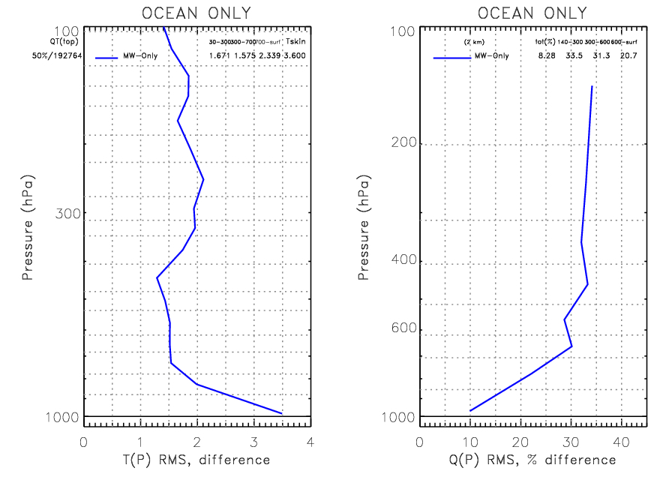
GLOBAL OCEAN VALIDATION NUCAPS MW Only vs ECMWF Analysis (focus day 2012-05-15)
SUMMARY ON OCEAN MW-ONLY RESULTS vs JPSS L1RD REQUIREMENTS
MW-ONLY TEMPERATURE | RESULTS | JPSS L1RD | MW-ONLY WATER VAPOR | RESULTS | JPSS L1RD
30 – 700mb | 1.55K | 1.5K | 100 - 600mb | 32.4% | 40%
700mb - SURF | 2.33K | 2.5K | 600mb -SURF | 20.7% | 20%

Slide 21
Summary on OCEAN validation vs ECMWF green = passed yellow = close red = failed
SUMMARY ON OCEAN MW+IR RESULTS vs JPSS L1RD REQUIREMENTS
MW+IR TEMPERATURE | RESULTS | JPSS L1RD | MW+IR WATER VAPOR | RESULTS | JPSS L1RD
30 – 300mb | 1.02K | 1.5K | 100 - 600mb | 23.3% | 35%
300mb - SURF | 1.20K | 1.6K | 600mb -SURF | 19.3% | 20%
SUMMARY ON OCEAN MW-ONLY RESULTS vs JPSS L1RD REQUIREMENTS
MW-ONLY TEMPERATURE | RESULTS | JPSS L1RD | MW-ONLY WATER VAPOR | RESULTS | JPSS L1RD
30 – 700mb | 1.55K | 1.5K | 100 - 600mb | 32.4% | 40%
700mb - SURF | 2.33K | 2.5K | 600mb -SURF | 20.7% | 20%
NUCAPS MW+IR fully meets requirements over ocean
NUCAPS MW-Only is close to fully meet spec.
Possible issues are:
Residual temporal and spatial mismatch between retrievals and model: ECMWF mismatch is +/- 1.5 hour and +/- 0.25 deg and we use both forecast and analysis depending on UT time.
Uncertainty in the ECMWF model
Uncertainty in the retrievals
Ongoing NUCAPS improvement activity:
Improve NUCAPS look up tables (RTA tuning and first guess)
Improve validation methodology by using dedicated RAOBs: see ahead

Slide 22
NUCAPS validation vs ARM
JPSS funded dedicated (time and location) wrt NPP
Global ensemble, ~ 3 month field campaign (2012):
Tropical Western Pacific (TWP)
Southern Great Plans (SGP)
North Slope of Alaska (NSA)
RAOB Site | Lat (deg) | Lon (deg)
ARM-SGP | 36.6 | -97.5
ARM-NSA | 71.3 | -156.6
ARM-TWP | 2.06 | 147.43

Slide 23
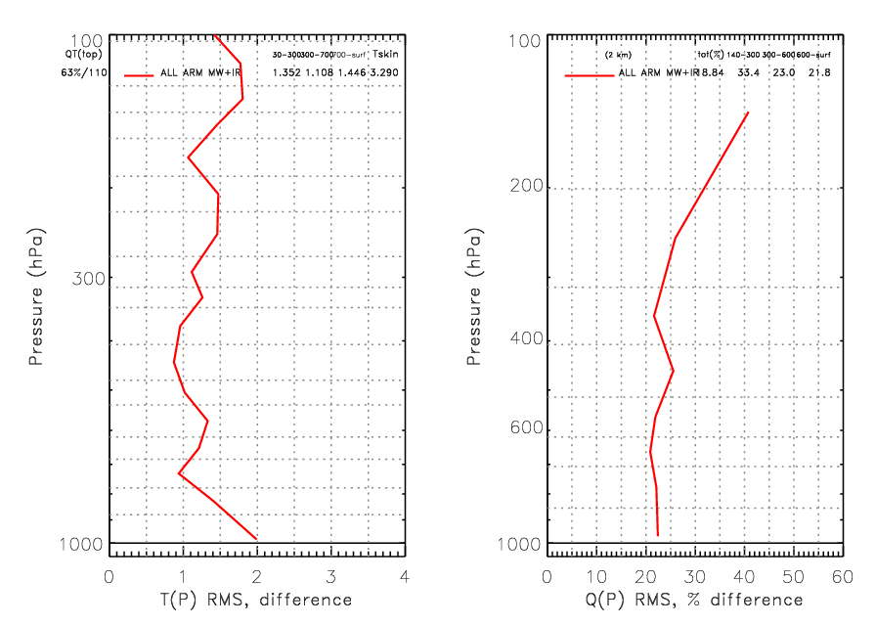
NUCAPS MW+IR RMS Statistics vs ARM TWP, SGP, NSA Dedicated RAOBs
SUMMARY ON MW+IR RESULTS vs JPSS L1RD REQUIREMENTS
MW+IR TEMPERATURE | RESULTS | JPSS L1RD | MW+IR WATER VAPOR | RESULTS | JPSS L1RD
30 – 300mb | 1.35K | 1.5K | 100 - 600mb | 28.2% | 35%
300mb - SURF | 1.25K | 1.6K | 600mb -SURF | 21.8% | 20%

Slide 24
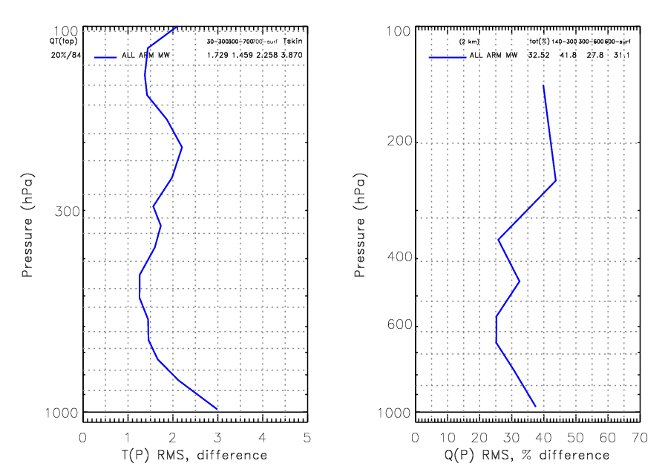
NUCAPS MW Only RMS Statistics vs ARM TWP, SGP, NSA Dedicated RAOBs
SUMMARY ON MW-ONLY RESULTS vs JPSS L1RD REQUIREMENTS
MW-ONLY TEMPERATURE | RESULTS | JPSS L1RD | MW-ONLY WATER VAPOR | RESULTS | JPSS L1RD
30 – 700mb | 1.59K | 1.5K | 100 - 600mb | 34.8% | 40%
700mb - SURF | 2.25K | 2.5K | 600mb -SURF | 31.1% | 20%

Slide 25
Summary on global validation vs ARM dedicated RAOBs green = passed yellow = close red = failed
SUMMARY ON MW+IR RESULTS vs JPSS L1RD REQUIREMENTS
MW+IR TEMPERATURE | RESULTS | JPSS L1RD | MW+IR WATER VAPOR | RESULTS | JPSS L1RD
30 – 300mb | 1.35K | 1.5K | 100 - 600mb | 28.2% | 35%
300mb - SURF | 1.25K | 1.6K | 600mb -SURF | 21.8% | 20%
SUMMARY ON MW-ONLY RESULTS vs JPSS L1RD REQUIREMENTS
MW-ONLY TEMPERATURE | RESULTS | JPSS L1RD | MW-ONLY WATER VAPOR | RESULTS | JPSS L1RD
30 – 700mb | 1.59K | 1.5K | 100 - 600mb | 34.8% | 40%
700mb - SURF | 2.25K | 2.5K | 600mb -SURF | 31.1% | 20%
The NUCAPS system meets requirements globally except for water vapor MW-only (31.1% vs 20%) in the layer 600mb – surface and the water vapor MW+IR (21.8% vs 20%) in the layer 600mb - surface .
Possible issues are:
Residual temporal and spatial mismatch (75km) between retrievals and RAOBs considerably affects water vapor statistics (up to 10% due to 50km mismatch, especially in the UTH due to RAOB drift)
Uncertainty in the RAOBs (supersaturation, calibration uncertainty)
Uncertainty in the retrievals: we are aware that there is a need for updating the look up tables and a possible bug in the MW-only retrieval module but just did not have enough time to fix it (ongoing NUCAPS improvement activity)

Slide 26
VALIDATION SUMMARY
NUCAPS MW+IR
meets requirements globally vs ECMWF
meets requirements over ocean vs ECMWF
Close to meet requirements globally and over selected areas vs Dedicated RAOBs
NUCAPS MW – Only
NUCAPS MW Only close to meet requirements globally vs ECMWF
NUCAPS MW only close to meet requirements over ocean vs ECMWF
meets requirements over tropical western pacific dedicated RAOBs
Present issues in the validation truth:
Residual temporal and spatial mismatch between retrievals and model: ECMWF mismatch is +/- 1.5 hour and +/- 0.25 deg and we use both forecast and analysis depending on UT time.
Uncertainty in the ECMWF model
Residual temporal and spatial mismatch (75km) between retrievals and RAOBs considerably affects water vapor statistics (up to 10% due to 50km mismatch, especially in the UTH due to RAOB drift)
Uncertainty in the RAOBs (supersaturation, calibration uncertainty)
Ongoing activity:
We are aware that there is a need for updating the look up tables for both the MW-Only and MW+IR retrieval:
A priori, First guess, radiance bias correction

Slide 27
Evaluation of the effect of required algorithm inputs (1)
Required Algorithm Inputs
Primary Sensor Data: CrIS, ATMS
Ancillary Data: GFS surface pressure
Upstream algorithms: UV O₃
LUTs:
ATMS bias correction
CrIS bias correction
Regression Coefficients for the first guess
tuning parameters
CRTM cloud and aerosol optical properties, surface emissivity, transmittance coefficients

Slide 28
Evaluation of the effect of required algorithm inputs (2)
Evaluation of the effect of required algorithm inputs
Study / test cases
CrIS/ATMS, IASI/AMSU/MHS
ECMWF global analysis and 6h forecast
Conventional radiosondes
Trace gases from various sources
GFS surface pressure
Results
CrIS/ATMS
GFS global analysis
Dedicated radiosondes
Aerosols and Ocean Science Expeditions (AEROSE)
ECMWF global analysis

Slide 29
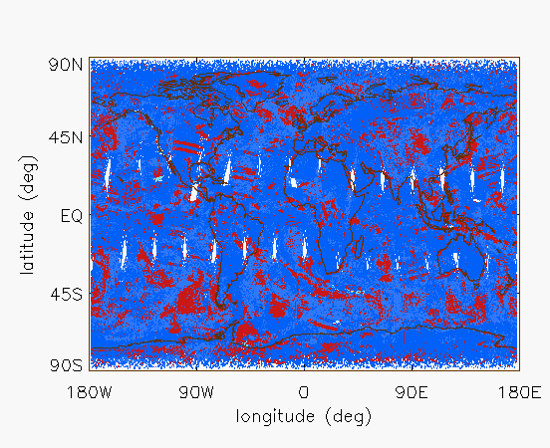
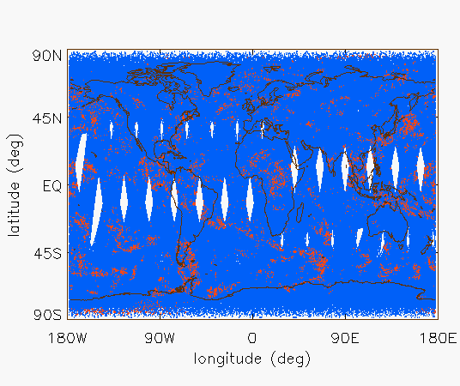
NUCAPS vs AIRS v59 acceptance yield (blue = accepted red = rejected)
NUCAPS AIRS v59
NUCAPS global acceptance yield is ~60% (focus day 2012/05/15)
AIRS v59 global acceptance yield is ~75% (focus day 2012/05/15)
Ongoing activity: QA optimization reflecting instrument properties

Slide 30
Error Budget for Temperature Profile
Attribute Analyzed | L1RD Threshold | Analysis/Validation Result | Error Summary
Geographic coverage | 90% every 18 hours | > 90%
Vertical Coverage | Surface to 0.5 mb | Surface to 0.016 mb
Vertical Cell Size | 0.2 ~50 mb | 0.2 ~ 30 mb
Horizontal Cell Size | 50 km at nadir | 50 km at nadir
Mapping Uncertainty | 5 km | 5 km
Measurement Range | Propose 150 ~ 400 K | 200 ~ 310 K
Cloud < 50%: Surface to 300 mb | 1.6 K per km layer | 1.34 K per km layer
300 to 30 mb | 1.5 K per 3 km layer | 1.04 K per 3 km layer
30 to 1 mb | 1.5 K per 5 km layer | 1.04 K per 5 km layer
1 to 0.5 mb | 3.5 K per 5 km layer | 1.04 K per 5 km layer
Cloud >= 50%: Surface to 700mb | 2.5 K per km layer | 2.68 K per km layer | NUCAPS MW only has tougher requirement than MiRS. MiRS 3 K (sea clear), 5.5 K (land)
700 to 300 mb | 1.5 K per km layer | 1.88 K per km layer | MiRS 2 K (sea clear), 2.5 K (land)
300 to 30 mb | 1.5 K per 3 km layer | 1.88 K per 3 km layer | MiRS 2 K
30 to 1 mb | 1.5 K per 5 km layer | 1.88 K per 5 km layer
1 to 0.5 mb | 3.5 K per 5 km layer | 1.88 K per 5 km layer
IR
+
MW
MiRS
Precision
L1RD
p44
MW
only

Slide 31
Error Budget for Moisture Profile
Attribute Analyzed | L1RD Threshold | Analysis/Validation Result | Error Summary
Geographic coverage | 90% every 18 hours | > 90%
Vertical Coverage | Surface to 0.5 mb | Surface to 0.016 mb
Vertical Cell Size | 0.2 ~50 mb | 0.2 ~ 30 mb
Horizontal Cell Size | 50 km at nadir | 50 km at nadir
Mapping Uncertainty | 5 km | 5 km
Cloud < 50%: Surface to 600 mb | Greater of 20% or 0.2 g/kg | 19.8%
600 to 300 mb | Greater of 35% or 0.1 g/kg | 23.3%
300 to 100 mb | Greater of 35% or 0.1 g/kg | 23.3%
Cloud >= 50%: Surface to 600mb | Greater of 20% or 0.2 g/kg | 23.6% | MiRS 36% (sea clear), 53% (land)*
600 to 400 mb | Greater of 40% or 0.1 g/kg | 32.2% | MiRS 63% (sea ocean), 61% (land)*
400 to 100 mb | Greater of 40% or 0.1 g/kg | 32.2% | MiRS 67% (see clear), 67% (land)*
IR
+
MW
MW
only
* MiRS uncertainty is calculated from its precision and accuracy (see L1RD p42).

Slide 32
Documentation
The following documents will be updated and provided to the EDR Review Board before AERB approval:
Current or updated ATBD
YES
Current or updated OAD
No, different documentation requirements specifically for SPSRB to support OSPO
README file for CLASS
http://gis.ncdc.noaa.gov/geoportal/catalog/search/resource/details.page?id=gov.noaa.ncdc:C00868
http://www.ospo.noaa.gov/Products/atmosphere/soundings/nucaps/index.html
Product User’s Guide (Recommended)
NUCAPS External User Manual (Jan. 2013)

Slide 33
Identification of Processing Environment
IDPS or NDE build (version) number and effective date
NDE, version 1. NOAA CLASS publicly released since April 8, 2014.
Algorithm version
NUCAPS Version 1
Version of LUTs used
NUCAPS LUT version 1
Version of PCTs used
NA
Description of environment used to achieve validated stage 1
IBM at NOAA/OSPO
Linux at NOAA/STAR

Slide 34
Users & User Feedback
User list
NOAA CLASS
AWIPS-II
FNMOC – Fleet Numerical Meteorology and Oceanography Center
Nowcasting
Direct broadcast
Support SDR data monitoring, retrieval products and SDR have the same time, the same location, and the same footprint.
Timely temperature and moisture profiles for the warning of severe weather (Mark DeMaria) , e.g. atmospheric stability condition for tropical storm. For tornado warning, retrieval products of higher spatial resolution (~ 10 km) is needed.
Basic and applied geophysical science research/investigation
E.g., over 590 AIRS peer reviewed publications have appeared in the literature since launch of Aqua (Pagano et al., 2013)
Feedback from users
Two meetings with forecasters, color-coded flags to be done for AWIPS II
Downstream product list
No
Reports from downstream product teams on the dependencies and impacts
No

Slide 35
Support CrIS SDR
Full Spectral Requirement
CrIS full spectral data are required for trace gas retrievals.
ILS
Inhomogeneity effect on CrIS spectral shift is < 3 ppm, smaller than noise.
Discard one FOV for direct full-spectral CrIS broadcast
The corner FOV 7 should provide a slight better contrast, but the large noise of FOV 7 degrades the use. Our recommendation is to discard FOV 7 instead of FOV 4 for NPP CrIS full spectral data direct broadcast.

Slide 36
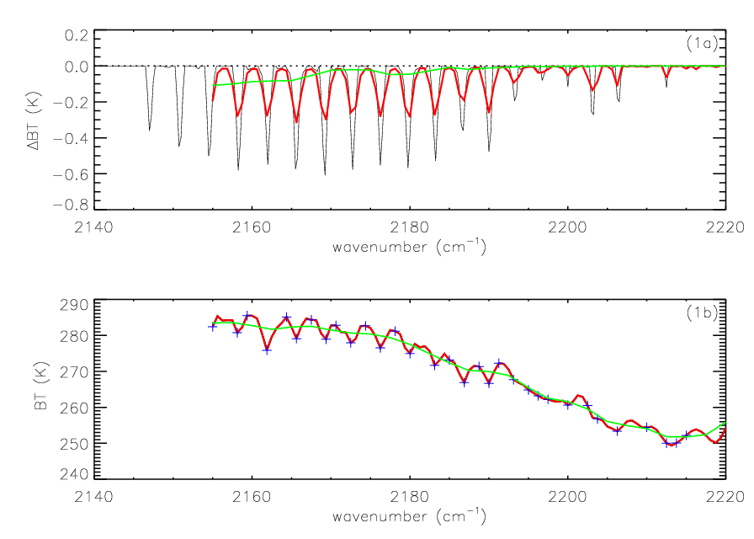
Sensitivity Analysis to 1% CO perturbation
2.5cm^-1 0.625 cm^-1 0.25cm ^-1
Ref: Gambacorta et al., IEEE Geoph. And Rem. Sen. Letters, 2014.
Only when switched to high spectral resolution, CrIS spectrum (red curve, bottom part) shows the distinctive signature of CO absorption (red and black curve, top figure).
Blue cross symbols: CO high resolution channel selection.

Slide 37
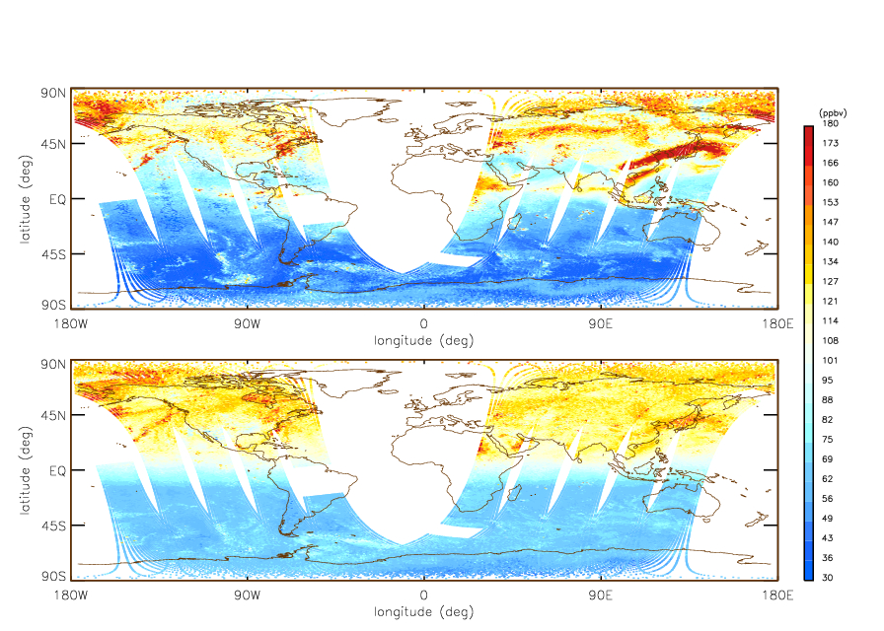
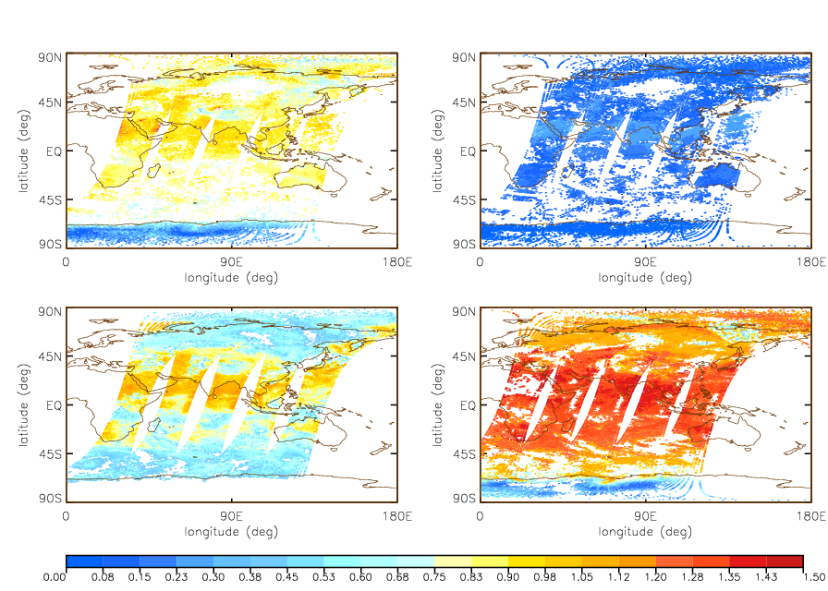
CO high resolution (top) vs operational low resolution results (bottom)
NUCAPS CO retrieval (~450mb)
CO DOF
Ref: Gambacorta et al., IEEE Geoph. And Rem. Sen. Letters, 2014.
The higher information content enables a larger departure from the a priori, hence the increased spatial variability observed in the high spectral resolution map (top left) compared to the low resolution (bottom left).
A demonstration experiment in support for the need of high spectral resolution CrIS measurements.
NUCAPS modular architecture has proven that there is no risk of disruption to the operational processing upon switching to high spectral sampling.
Notes:
We have all is needed to do it, and we have already done it.
The extended regions of heightened CO peak values on the high resolution map (top) are indicative of anthropogenic emissions, biomass burning and atmospheric transport patterns. These key features of the source and sink climatology of carbon monoxide are predominantly missed in the low resolution retrieval map ( left bottom).

Slide 38

IASI vs CrIS FOV geometry
IASI
CrIS
-1.5
-1.5
0.9°
-1
-1
0.83°
-0.5
-0.5
1.1°
0
0
0.5
0.5
0.87°
1
1
1.56°
1.5
1.5
-1.5
-1
-0.5
0
0.5
1
1.5
-1.5
-1
-0.5
0
0.5
1
1.5
Gambacorta et al., Proc. ATOVS Meeting, 2014.
Applying IASI’s δα results to CrIS (assuming surface inhomogeneity and interference ringing are close enough between the two instruments):
CrIS Side Cube (α=1.1°=0.019rad): δν/ν ~ αδα = 1.91e-6
CrIS Corner Cube (α=1.56°=0.027rad): δν/ν ~ αδα = 2.72e-6
< 3ppm

Slide 39
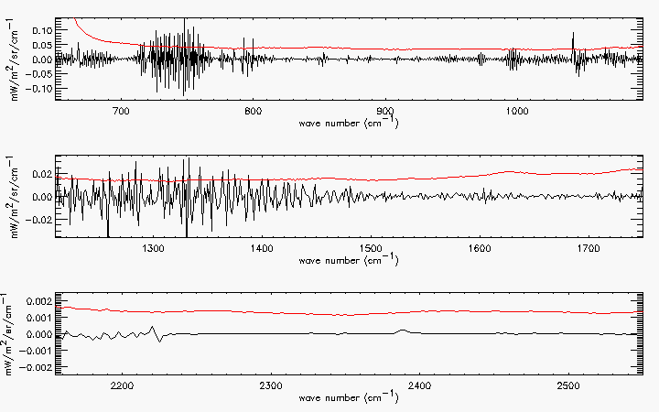
Radiance error induced by ILS shift - corner cube -
NEDN
Gambacorta et al., Proc. ATOVS Meeting, 2014.

Slide 40
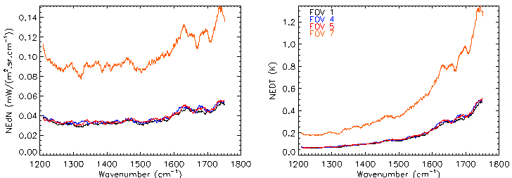
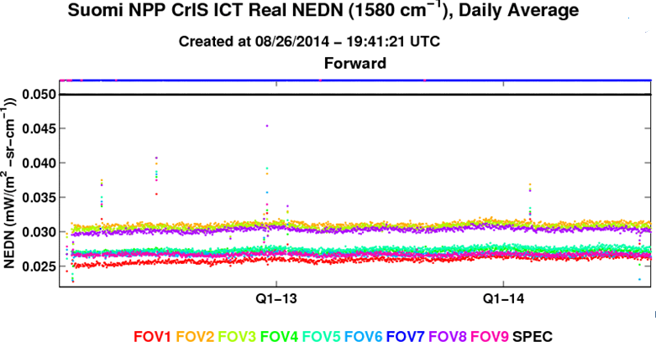
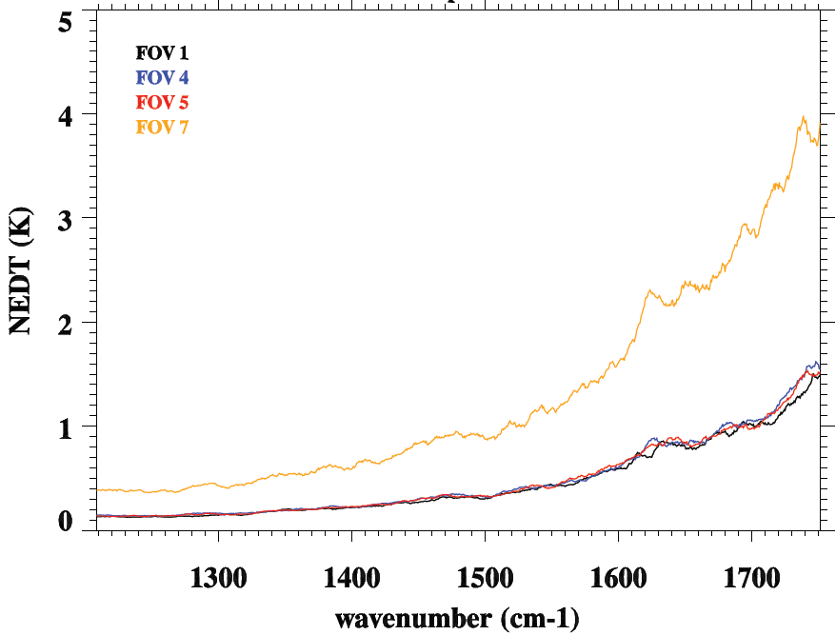
Discard FOV 7 in CrIS full spectral data
Tref=250K
Tref=220K
NeDT depends strongly on scene temperature.
Courtesy of X. Jin, Y. Chen, L. Wang

Slide 41
Conclusion
NUCAPS Validation Results Summary
NUCAPS IR+MW AVTP and AVMP EDRs are demonstrated to meet the threshold requirements (on the coarse coarse-layers) as follows:
Ocean and land versus global ECWMF model
Tropical marine regions (ship and island) versus high-quality dedicated RAOBs (e.g., AEROSE, TWP and PMRF)
NUCAPS MW-only (MIT algorithm) EDRs are demonstrated to be close to meeting the threshold requirements for the same data samples.
NUCAPS AVTP and AVMP EDRs are publicly available on the NOAA CLASS. NUCAPS products are available from AWIPS II and forecasters have started to use the product.
The Sounding Team therefore recommends that the NUCAPS AVTP and AVMP achieve the maturity of the Stage 1 validation.
Caveats:
Color-code quality flag needed for forecasters.
MW retrieval algorithm needs to be further investigated.
Updates IR and MW surface emissivity tables

Slide 42
Path Forward (1)
Planned further improvements
Make quality flag simple
Improve MW only performance
Update IR+MW surface emissivity tables
Standardize retrieval code
Improve trace gas retrieval algorithm
Investigate the impact by using radiance and NEDN directly

Slide 43
Path Forward (2)
Planned Cal/Val activities / milestones
NUCAPS Phase 3 Algorithm Readiness Review – Sep 2014
NUCAPS Phase 3 DAP Delivery – Sep 2014
Improvement of MW only Retrieval – Nov. 2014
MW+IR QC Flag –- Nov. 2014
CrIS OLR Algorithm Tuning, Validation, and Verification – Nov. 2014
SPSRB Phase 3 briefing – Nov. 2014
NUCAPS Phase 3 Operations Commence – Nov. 2014
Unified Hyperspectral Sensors’ Sounding System – Dec. 2014
CrIS full spectral channel selection for NWP and NUCAPS – Mar. 2015
CrIS Full Spectral Data in Sounding System – Sep. 2015
Trace Gas (CO, CO₂, and CH₄) Algorithm Tuning, Validation, and Verification –June 2016
AIRS, IASI, CrIS Full Data Record Reprocessing for Science Application – Dec. 2016.

Slide 44
BACK UP SLIDES

Slide 45
Dedicated Soundings
Soundings for specific weather events
- High spatial resolution (single FOV ~ 12 km at nadir):
needed for monitoring atmospheric stability;
needed for hurricane studies;
high accuracy needed under cloudy conditions;
- Integration of satellite product information:
Cloud EDRs
UV total ozone and stratospheric ozone profile
Surface temperatures
Aerosol EDRs
- Precise radiative transfer calculations for the given small area

Slide 46
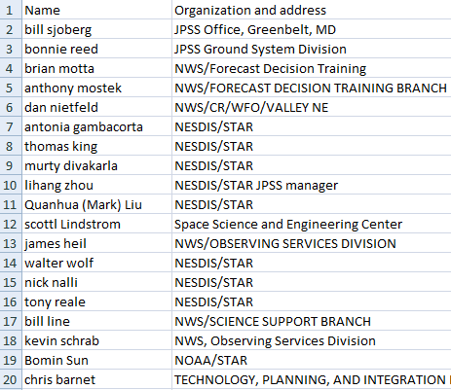
NUCAPS-AWIPS meeting

Slide 47
NUCAPS Products (1)
Mean CO2
Surface Pressure
Skin Temperature
MIT Skin Temperature
First Guess Skin Temperature
Microwave Surface Class
Microwave Surface Emissivity
Number of Cloud Layers
Retrieval Quality Flag
Cloud Top Pressure
Cloud Top Fraction
Pressure (at 100 levels)
Effective Pressure (at 100 levels)
Temperature (at 100 levels)
MIT Temperature (at 100 levels)
First Guess Temperature (at 100 levels)
H2O layer column density (at 100 levels)
H2O mixing ratio (at 100 levels)
First Guess H2O layer column density (at 100 levels)
First Guess H2O mixing ratio (at 100 levels)
MIT H2O layer column density (at 100 levels)
MIT H2O mixing ratio (at 100 levels)

Slide 48
NUCAPS Products (2)
O3 layer column density (at 100 levels)
O3 mixing ratio (at 100 levels)
First Guess O3 layer column density (at 100 levels)
First Guess O3 mixing ratio (at 100 levels)
Liquid H2O layer column density (at 100 levels)
Liquid H2O mixing ratio (at 100 levels)
Ice/liquid flag (at 100 levels)
CH4 layer column density (at 100 levels)
CH4 mixing ratio (at 100 levels)
CO2 mixing ratio (at 100 levels)
HNO3 layer column density (at 100 levels)
HNO3 mixing ratio (at 100 levels)
N2O layer column density (at 100 levels)
N2O mixing ratio (at 100 levels)
SO2 layer column density (at 100 levels)
SO2 mixing ratio (at 100 levels)
Microwave emissivity
MIT microwave emissivity
Infrared emissivity
MIT infrared emissivity
Infrared surface emissivity

Slide 49
NUCAPS Products (3)
First Guess infrared surface emissivity
Infrared surface reflectance
Atmospheric Stability
Cloud infrared emissivity
Cloud reflectivity
Stability

Slide 50
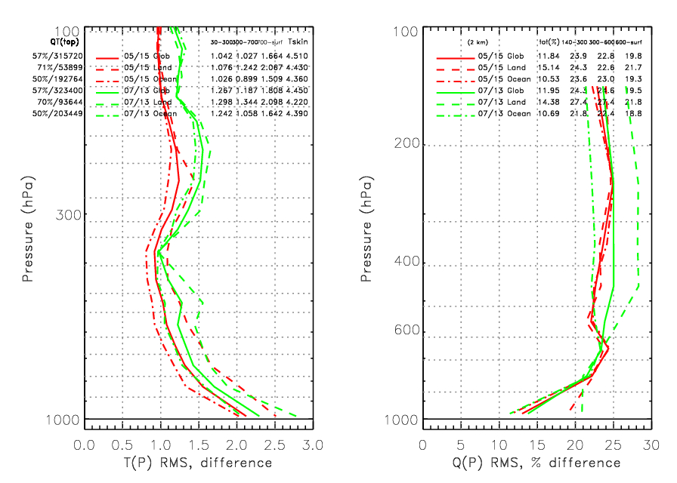
05/15 vs 07/13 focus day RMS statistics
Significance: NUCAPS performance is stable and robust over multiple focus days, including those not used for tuning and regression training :05/15 focus day (red curves) was used for training, 07/13 (green curves) was not.

Slide 51
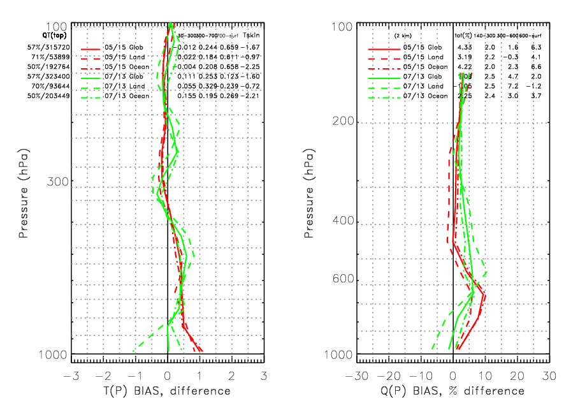
05/15 vs 07/13 focus day BIAS statistics
Significance: NUCAPS performance is stable and robust over multiple focus days, including those not used for tuning and regression training :05/15 focus day was used for training, 07/13 was not.

