Slide 1








S-NPP EDR Validated Maturity Readiness Review
3-4 September 2014, College Park, MD
Validated Stage 3 SST Maturity Review
Alexander Ignatov
And STAR JPSS SST Team:
Prasanjit Dash, Yury Kihai, John Stroup,
Boris Petrenko, Xingming Liang, Irina Gladkova,
Marouan Bouali, Karlis Mikelsons, John Sapper, Feng Xu, Xinjia Zhou
NOAA; CIRA; GST Inc; CUNY
Bruce Brasnett
Canadian Met Centre

Slide 2
Outline
JPSS SST Team & Acknowledgements
Product Requirements & VAL Maturity Stages
Evaluate SST performance to spec requirements
  VIIRS SST Products: IDPS, ACSPO, NAVO
  JPSS SST – ACSPO; Processing Environment – NDE
  VIIRS SST Performance
    One day analysis
    Time Series Jan 2012 – present
    Annual statistics (1 Jun 2013 – 30 May 2014)
    Examples VIIRS SST Imagery
Documentation
Users & Feedback
Conclusion & Path Forward

Slide 3
JPSS SST Team
Name | Affiliation | % Funding | Tasks
Ignatov | STAR | NOAA | Lead, JPSS Algorithm & Cal/Val
Stroup, Kihai, Dash, Liang, Petrenko, Xu, Bouali, Zhou, Gladkova, Mikelsons | STAR/CIRA STAR/STG STAR/GST STAR/GST | JPO, NOAA ORS, GOES-R, NASA | Quality Monitoring of VIIRS SSTs (SQUAM), Radiances (MICROS), and in Situ SSTs (iQuam) Data support; IDPS SST code, Match up, Cloud Mask, SST retrievals; Destriping L1b & SST
May, Cayula, McKenzie, Willis | NAVO | Navy, NJO | NAVO SEATEMP SST & Cal/Val VIIRS Cloud Mask evaluation
Minnett Kilpatrick | U. Miami | JPO, U. Miami | Uncertainty & instrument analyses; RTM; VAL vs. drifters & radiometers; skin to sub-skin conversion
Arnone Fargion | USM/NRL UCSD | NJO, USM | SST Algorithm Analyses, SST improvements at slant view zenith angles/swath edge
LeBorgne Roquet | Meteo France | EUMETSAT | Processing VIIRS and Cal/Val using O&SI SAF heritage; Comparisons with AVHRR/SEVIRI

Slide 4
Acknowledgements
JPSS Program – Mitch Goldberg, Kathryn Schontz, Bill Sjoberg
NASA SNPP Project Scientist – Jim Gleason
NOAA NDE Team – Tom Schott, Dylan Powell, Bonnie Reed
JPSS DPA – Eric Gottshall, Janna Feeley, Bruce Gunther
VIIRS SDR & GSICS – Changyong Cao, Fuzhong Weng, Mark Liu, Frank DeLuccia, Jack Xiong
NOAA STAR JPSS Team – Lihang Zhou, Paul DiGiacomo, Ivan Csiszar, many others
NOAA CRTM Team – Yong Chen, Mark Liu, Yong Han
U. Wisconsin – Liam Gumley, Steve Dutcher, Jim Davies

Slide 5
JPSS Skin SST Requirements
EDR Attribute | Threshold | Objective
a. Horizontal Cell Size (Res) | 1.6km¹ | 0.25km
b. Mapping Uncertainty, 3σ | 2km¹ | 0.1km
c. Measurement Range | 271 K to 313 K | 271 K to 318 K
d. Measurement Accuracy² | 0.2K | 0.05K
e. Measurement Precision² | 0.6K | 0.2K (<55° VZA)
f. Refresh Rate | 12 hrs | 3 hrs
g. Latency | 90 min | 15 min
h. Geographic coverage | Global cloud and ice-free ocean; excluding lakes and rivers | Global cloud and ice-free ocean, plus large lakes and wide rivers
¹ Worst case scenarios corresponding to swath edge; both numbers are ~1km at nadir ² Represent global mean BIAS and STDV validation statistics against QCed drifting buoys (for day & night, and in full VIIRS swath & range of atmospheric conditions). Uncertainty = Square root of Accuracy squared plus Precision squared. Better performance is expected against ship radiometers.
Notes:
Specific for nesdis

Slide 6
SNPP Validation Maturity Stages & SST Schedule
Validated Stage 1 (Jul’2014):
  Using a limited set of samples, the algorithm output is shown to meet the threshold performance attributes identified in the JPSS Level 1 Requirements Supplement with the exception of the S-NPP Performance Exclusions
Validated Stage 2 (Oct’2014):
  Using a moderate set of samples, the algorithm output is shown to meet the threshold performance attributes identified in the JPSS Level 1 Requirements Supplement with the exception of the S-NPP Performance Exclusions
Validated Stage 3 (Apr’2015):
  Using a large set of samples representing global conditions over four seasons, the algorithm output is shown to meet the threshold performance attributes identified in the JPSS Level 1 Requirements Supplement with the exception of the S-NPP Performance Exclusions
  SST Team recommends to declare JPSS SST “Validated Stage 3”. We are ahead of schedule due to the use of mature ACSPO product

Slide 7
JPSS-1 Product Maturity Definition
JPSS/GOES-R Data Product Validation Maturity Stages – COMMON DEFINITIONS (Nominal Mission)
Beta Product is minimally validated, and may still contain significant identified and unidentified errors. Information/data from validation efforts can be used to make initial qualitative or very limited quantitative assessments regarding product fitness-for-purpose. Documentation of product performance and identified product performance anomalies, including recommended remediation strategies, exists.
Provisional Product performance has been demonstrated through analysis of a large, but still limited (i.e., not necessarily globally or seasonally representative) number of independent measurements obtained from selected locations, time periods, or field campaign efforts. Product analyses are sufficient for qualitative, and limited quantitative, determination of product fitness-for-purpose. Documentation of product performance, testing involving product fixes, identified product performance anomalies, including recommended remediation strategies, exists. Product is recommended for operational use (user decision) and in scientific publications.
Validated Product performance has been demonstrated over a large and wide range of representative conditions (i.e., global, seasonal). Comprehensive documentation of product performance exists that includes all known product anomalies and their recommended remediation strategies for a full range of retrieval conditions and severity level. Product analyses are sufficient for full qualitative and quantitative determination of product fitness-for-purpose. Product is ready for operational use based on documented validation findings and user feedback. Product validation, quality assurance, and algorithm stewardship continue through the lifetime of the instrument.

Slide 8
VIIRS SST Products
IDPS – NOAA Interface Data Processing Segment (IDPS)
  Official NPOESS SST EDR, Ownership transferred to NOAA JPSS PO
  Developed by NGAS; Operational at Raytheon; Archived at NOAA CLASS
  As of this review, meets specs at night, but not during the daytime
  Jan 2014: JPO recommends “discontinue IDPS EDR support, concentrate on ACSPO”
  IDPS SST EDR to phase out as soon as ACSPO SST is archived at JPL/NODC
ACSPO – NOAA Advanced Clear-Sky Processor for Ocean (ACSPO)
  Jul 2014: JPO approves reallocation of SST Requirements to NDE ACSPO
  NOAA heritage SST system (building on AVHRR GAC and FRAC)
  Terra/Aqua MODIS experimentally processed at STAR since Jan 2012
  NDE ACSPO: Operational (Mar 2014); GDS2 archived at JPL/NODC (May 2014)
  ftp://podaac-ftp.jpl.nasa.gov/allData/ghrsst/data/GDS2/L2P/VIIRS_NPP/OSPO/
  Meet/exceed APU specs, provides complete global coverage
NAVO – SEATEMP
  Builds on NOAA (pre-ACSPO) / NAVO AVHRR heritage
  VIIRS operational (Mar 2013); GDS2 archived at JPL/NODC (May 2013)
  Meet/exceed APU specs. Coverage is ~3 smaller compared to ACSPO
Notes:
Specific for nesdis

Slide 9
Evaluation of VIIRS SST Products
1. One day global analysis –
23 April 2014
Notes:
Specific for nesdis

Slide 10
All Products Are Continuously Monitored Online
We first compare SST Domain & Performance in IDPS, ACSPO, NAVO against two global reference SSTs
  L4 SST – Canadian Met Centre CMC0.2 Analysis.
  In situ SST – QCed drifting buoys in iQuam www.star.nesdis.noaa.gov/sod/sst/iquam/
  using one day of globally representative data
  – 23 April 2014 – in SST Quality Monitor (SQUAM)
  www.star.nesdis.noaa.gov/sod/sst/squam/
  And then discuss corresponding time series

Slide 11
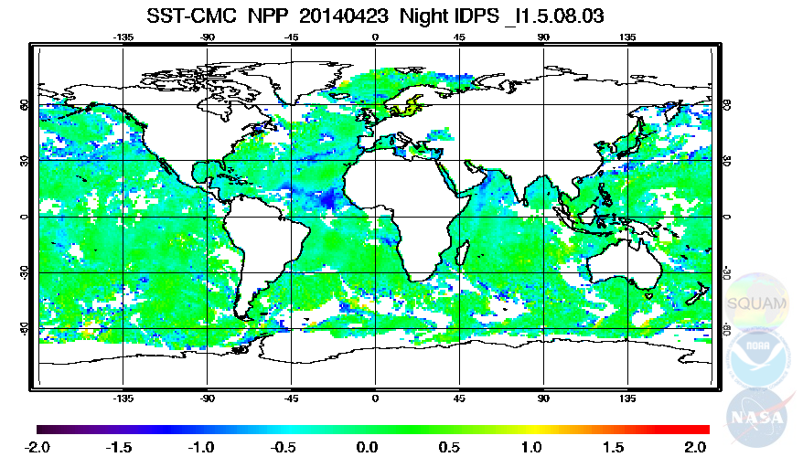
NIGHT: IDPS L2 minus CMC L4
23 April 2014
Impressive global coverage
Delta close to zero as expected
Cold spots – Residual Cloud/Aerosol leakages

Slide 12
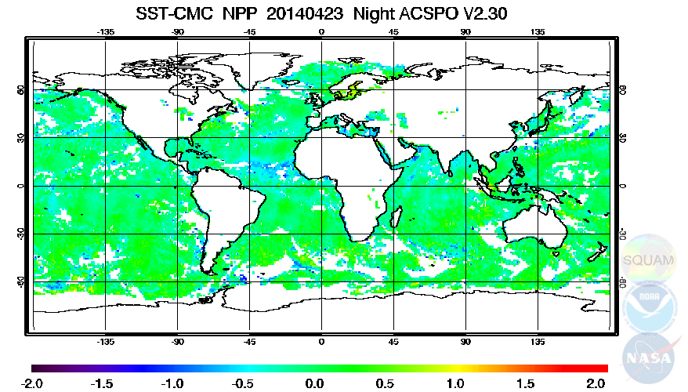
NIGHT: ACSPO L2 minus CMC L4
23 April 2014
ACSPO coverage comparable with IDPS
Delta on average closer to zero
Fewer Cold spots (Cloud/Aerosol leakages)

Slide 13
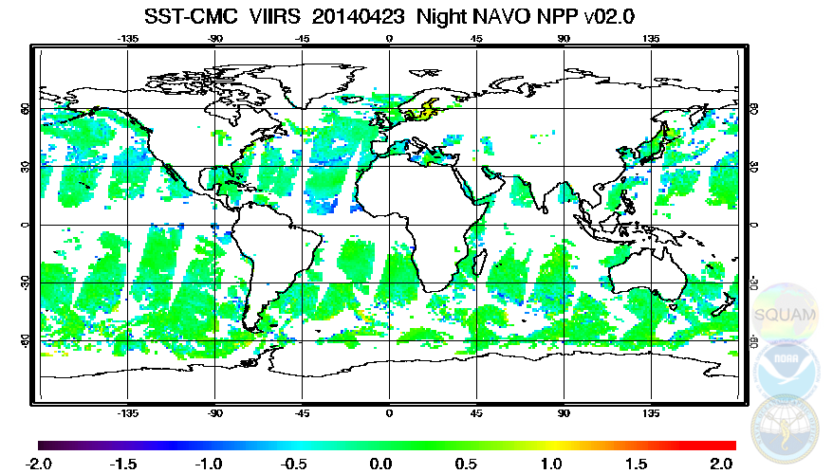
NIGHT: NAVO L2 minus OSTIA L4
23 April 2014
Retrievals limited to VZA<54°
Fewer data in the Tropics and at high latitudes

Slide 14
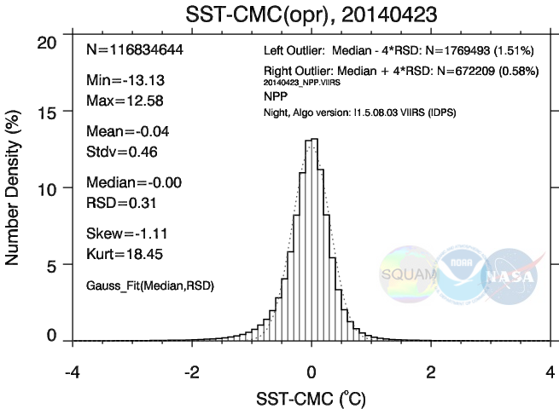
NIGHT: IDPS L2 minus CMC L4
23 April 2014
Shape close to Gaussian
Long tail on the left: Residual Cloud/Aerosol

Slide 15
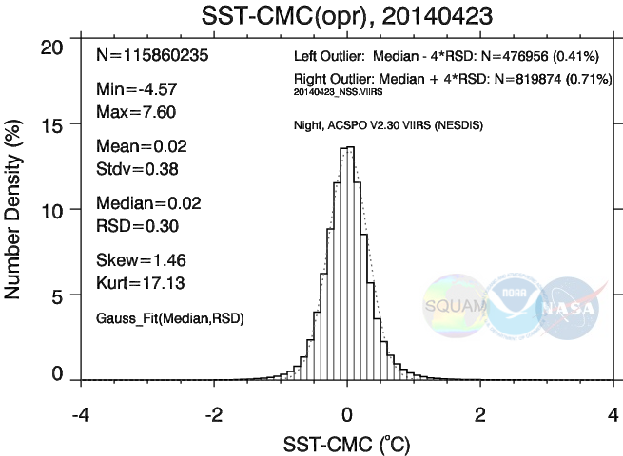
NIGHT: ACSPO L2 minus CMC L4
23 April 2014
ACSPO: Shape closer to Gaussian than IDPS
Tail on the left smaller: Less Cloud/Aerosol

Slide 16
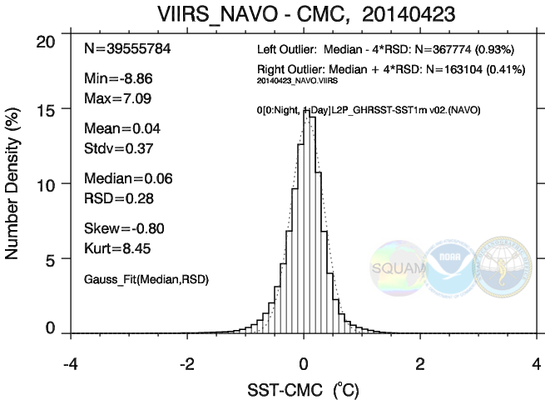
NIGHT: NAVO L2 minus CMC L4
23 April 2014
Shape close to Gaussian
Domain smaller, but STD slightly better

Slide 17
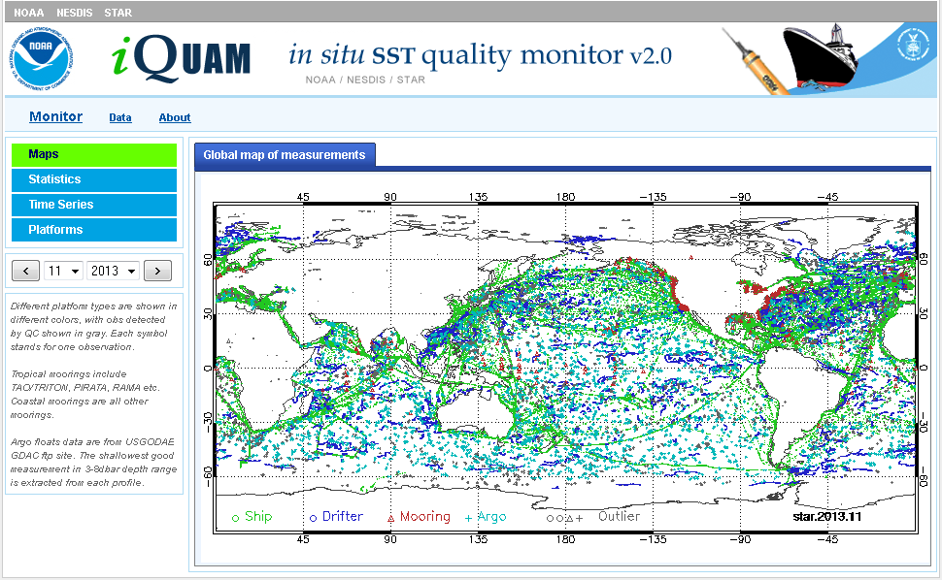
QCed in situ data come from iQuam system
Current Validation standard are drifting buoys
ARGO Floats and Tropical Moorings are being evaluated

Slide 18
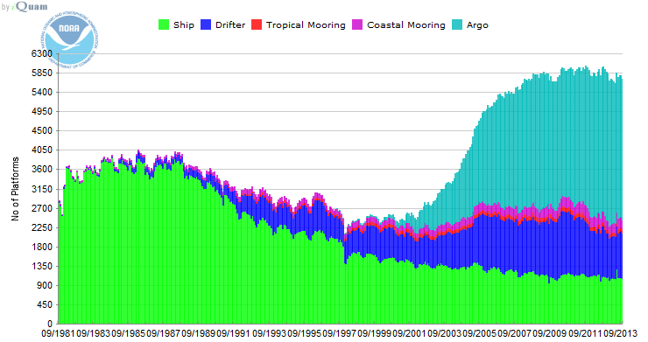
Number of unique IDs
ARGO: Rapid deployment after 2000
Current JPSS in situ validation standard are drifting buoys
ARGO Floats and Tropical Moorings are being evaluated

Slide 19
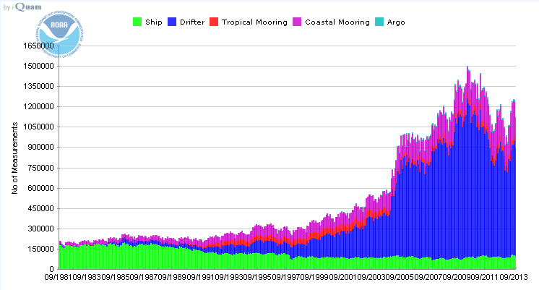
Number of Observations
ARGO take 3 measurements / month
ARGO Floats take relatively infrequent measurements
However, they are high quality and provide most uniform global coverage
Overall, they very well complement data from drifters

Slide 20
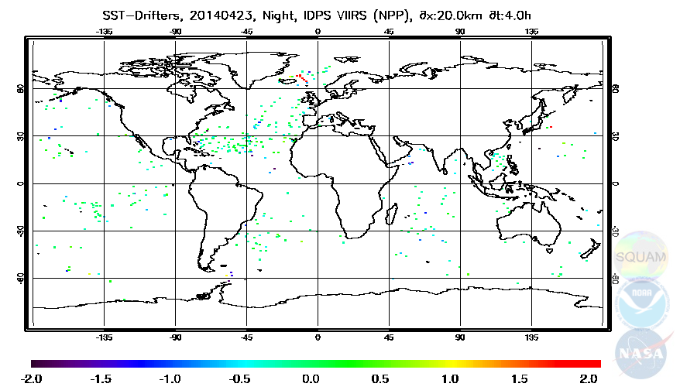
NIGHT: IDPS L2 minus in situ drifter SST
23 April 2014
Much sparser coverage than against L4
Not fully representative of global ocean

Slide 21
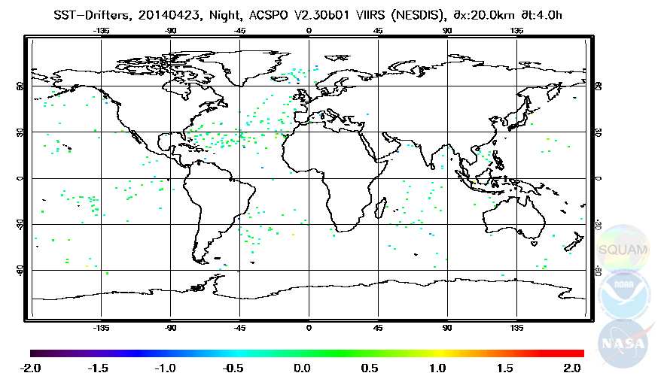
NIGHT: ACSPO L2 minus in situ drifter SST
23 April 2014
ACSPO match-ups: Comparable with IDPS
Fewer cold ΔSSTs than in IDPS

Slide 22
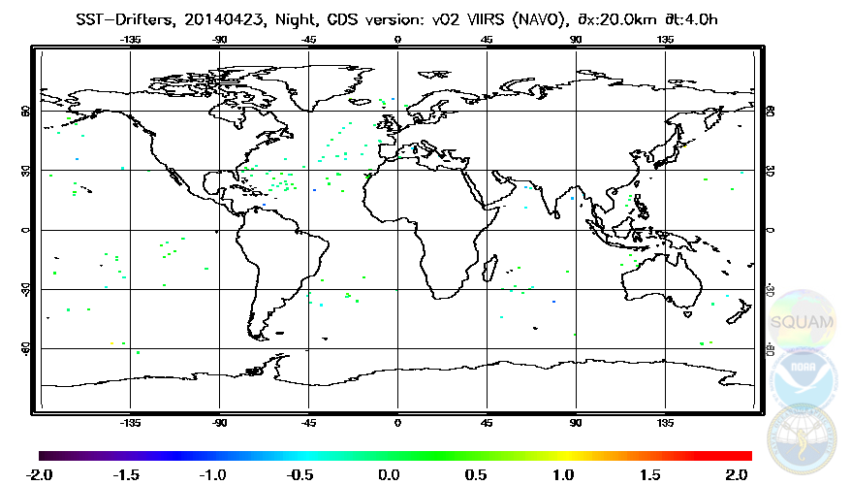
NIGHT: NAVO L2 minus in situ drifter SST
23 April 2014
NAVO match-ups much sparser than IDPS/ACSPO
Similarly to ACSPO, very few cold outliers

Slide 23
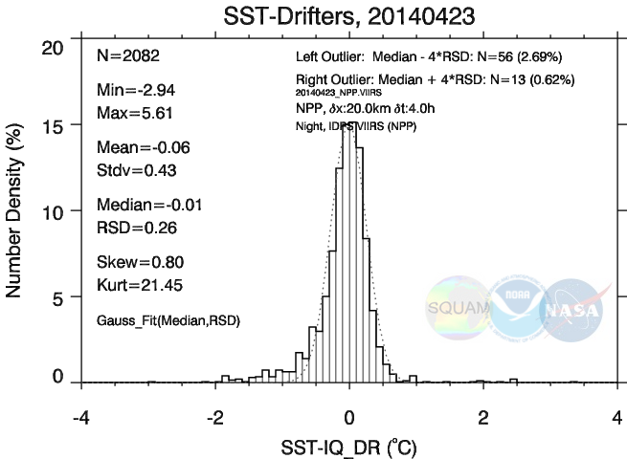
NIGHT: IDPS L2 minus in situ SST
23 April 2014
Shape close to Gaussian – except cold tail & positive outliers
Performance Stats within specs (Bias<0.2K, STD<0.6K)

Slide 24
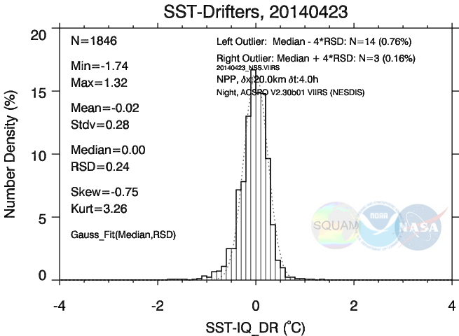
NIGHT: ACSPO L2 minus in situ SST
23 April 2014
ACSPO: Shape closer to Gaussian than IDPS
Performance Stats well within specs (Bias<0.2K, STD<0.6K)

Slide 25
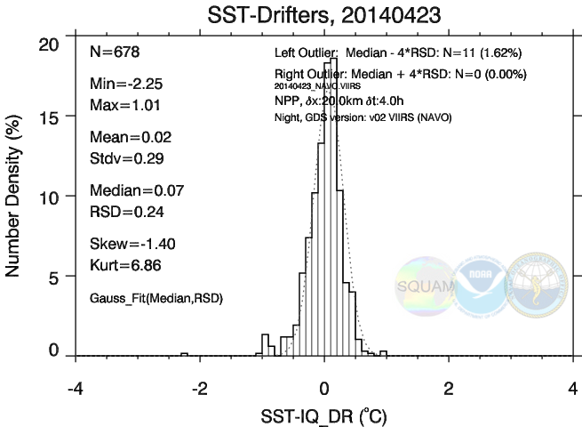
NIGHT: NAVO L2 minus in situ SST
23 April 2014
NAVO: Shape close to Gaussian, Performance Stats within specs
~2.5 fewer matchups compared to ACSPO/IDPS

Slide 26
NIGHT 23 Apr 2014 – Summary
Vs. L4
ΔT = “VIIRS minus CMC” SST (expected ~0)
 | NOBS (%ACSPO) | Min/ Max | Mean/ STD | Med/ RSD
IDPS | 116.8M (101%) | -13.1/+12.6 | -0.04/0.46 | -0.00/0.31
ACSPO | 115.9M (100%) | - 4.6/+7.6 | -0.02/0.38 | -0.02/0.30
NAVO | 39.5M ( 34%) | - 8.9/+7.1 | +0.04/0.37 | +0.06/0.28
IDPS: SST domain is +1% larger than ACSPO, All stats degraded
NAVO: SST domain is factor of ×3 smaller than ACSPO, stats improved
Vs. in situ
ΔT = “VIIRS minus in situ” SST (expected ~0)
 | NOBS (%ACSPO) | Min/ Max | Mean/ STD | Med/ RSD
IDPS | 2,082 (113%) | -2.9/+5.6 | -0.06/0.43 | -0.01/0.26
ACSPO | 1,846 (100%) | -1.7/+1.3 | -0.02/0.28 | -0.00/0.24
NAVO | 678 ( 37%) | -2.3/+1.0 | +0.02/0.29 | +0.07/0.24
IDPS: SST domain is +13% larger than ACSPO, All stats degraded
NAVO: SST domain is factor of ×3 smaller than ACSPO, stats comparable
Notes:
Specific for nesdis

Slide 27
DAY 23 Apr 2014 – Summary
Vs. L4
ΔT = “VIIRS minus CMC” SST (expected ~>0)
 | NOBS (%ACSPO) | Min/ Max | Mean/ STD | Med/ RSD
IDPS | 120.4M (100%) | - 28.7/+10.4 | +0.20/0.77 | +0.24/0.45
ACSPO | 121.0M (100%) | - 5.4/+ 9.2 | +0.29/0.59 | +0.21/0.41
NAVO | 41.3M ( 34%) | - 8.2/+ 7.5 | +0.28/0.56 | +0.22/0.40
IDPS: SST domain is comparable with ACSPO, All stats degraded
NAVO: SST domain is factor of ×3 smaller than ACSPO, stats comparable
Vs. in situ
ΔT = “VIIRS minus in situ” SST (expected ~>0)
 | NOBS (%ACSPO) | Min/ Max | Mean/ STD | Med/ RSD
IDPS | 1,758 (105%) | -5.3/+2.7 | -0.06/0.77 | +0.10/0.48
ACSPO | 1,680 (100%) | -1.4/+2.8 | +0.07/0.42 | +0.06/0.37
NAVO | 510 ( 30%) | -1.2/+2.1 | +0.12/0.35 | +0.07/0.35
IDPS: SST domain is +5% larger than ACSPO, All stats degraded
NAVO: SST domain is factor of ×3 smaller than ACSPO, stats improved
Notes:
Specific for nesdis

Slide 28
Evaluation of VIIRS SST Products
2. Time Series of Daily Statistics
Jan 2012 - Present
Notes:
Specific for nesdis

Slide 29
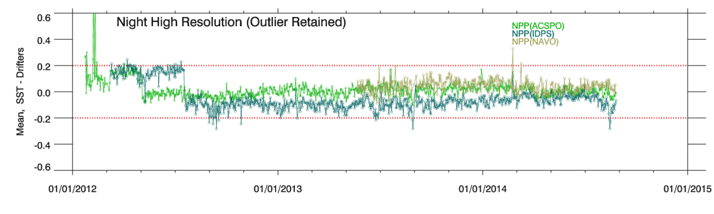
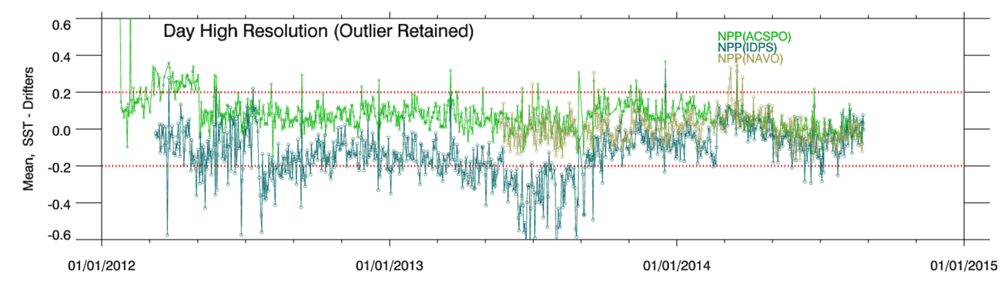
NPP SST Daily Validation: Mean “VIIRS minus Drifters” SST
Maps | Histograms | Time-series | Dependencies | Hovmöller
NIGHT
DAY
ACSPO SST (adjusted by +0.14K for skin-bulk difference) meets accuracy specs ±0.2K
Bias is closer to 0K at night, and slightly positive during daytime
This is expected (satellite skin SST more subject to diurnal warming than in situ bulk SST)

Slide 30
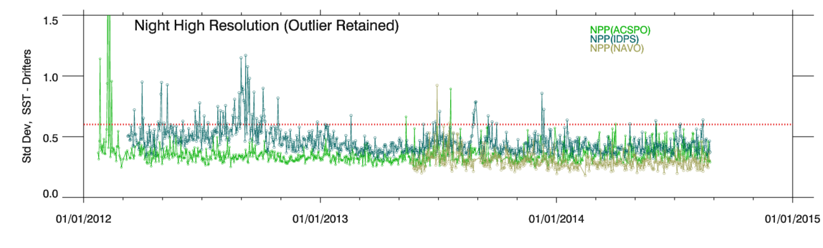
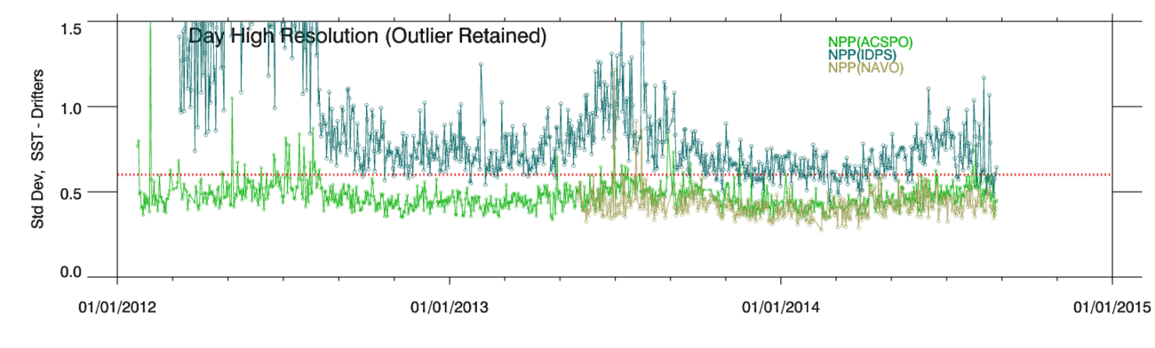
NPP SST Daily Validation: Std Dev “VIIRS minus Drifters” SST
Maps | Histograms | Time-series | Dependencies | Hovmöller
NIGHT
DAY
ACSPO SST meets precision specs 0.6K. STD smaller at night, larger during daytime. This is expected because in situ SST is bulk and retrieved SST is skin
In fact, nighttime STD is deemed to better represent performance of daytime SST

Slide 31
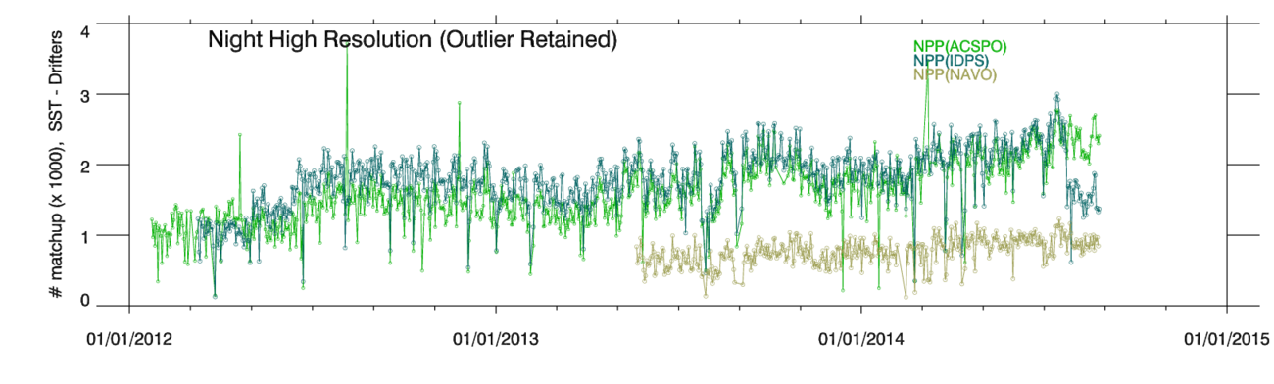
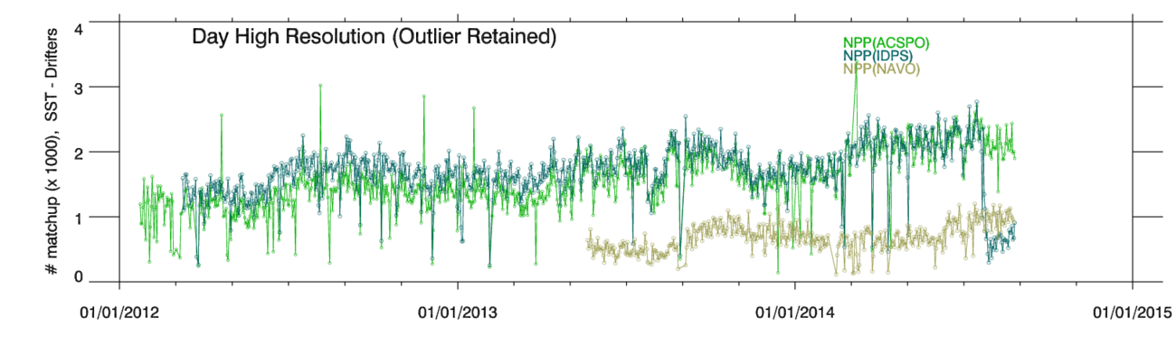
NPP SST Daily Validation: # of matchups with Drifters
Maps | Histograms | Time-series | Dependencies | Hovmöller
NIGHT
DAY
Number of matchups with in situ SST is ~2,000/day and ~2,000/night for ACSPO & IDPS
For NAVO, number of matchups is ~3 smaller
Daily number of matchups is sufficient for daily VAL, but residual day-to-day noise remains

Slide 32
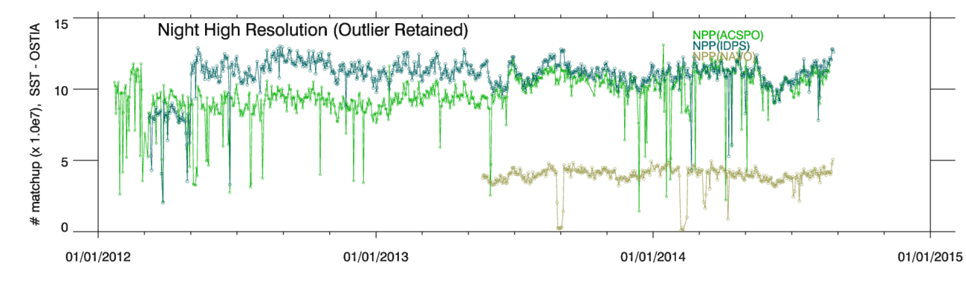
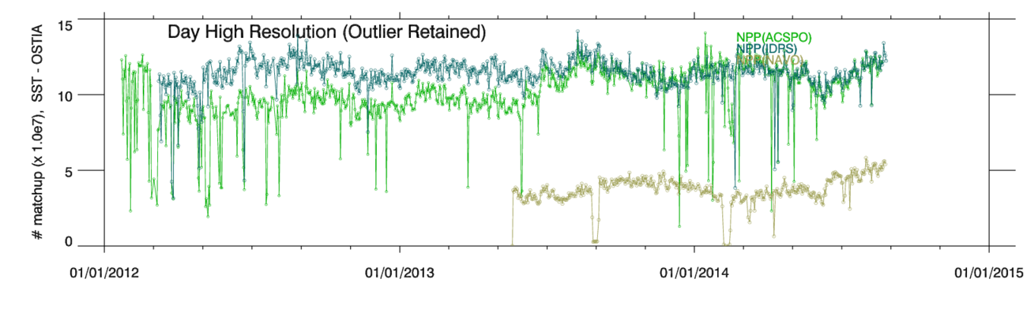
NPP SST Daily Validation: # of matchups with OSTIA
Maps | Histograms | Time-series | Dependencies | Hovmöller
NIGHT
DAY
Number of VIIRS SST retrievals is >100M/day and >100M/night for ACSPO & IDPS
For NAVO, number of SST retrievals is ~3 smaller
Drop-outs in # Obs is due to VIIRS outages & processing at STAR (improved in NDE)

Slide 33
Evaluation of VIIRS SST Products
3. Yearly Statistics
1 June 2013 – 31 May 2014
Notes:
Specific for nesdis

Slide 34
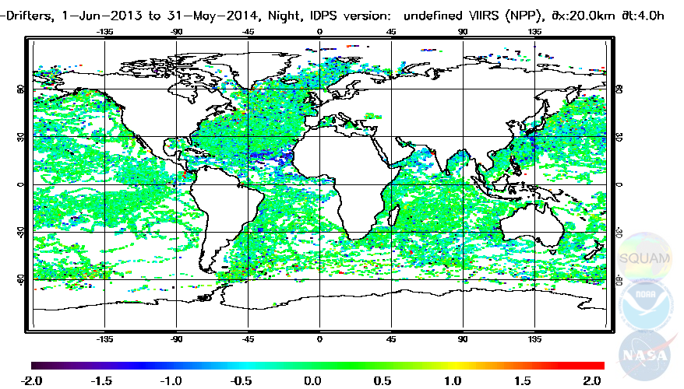
NPP SST Annual Validation: Night IDPS
Maps | Histograms | Time-series | Dependencies | Hovmöller
IDPS VIIRS minus Drifters, 1-Jun-2013 to 31-May-2014
IDPS match-ups cover most global ocean, except a few “white spots”
Cold speckles, suppression off Africa: Due to residual Cloud/Aerosols

Slide 35
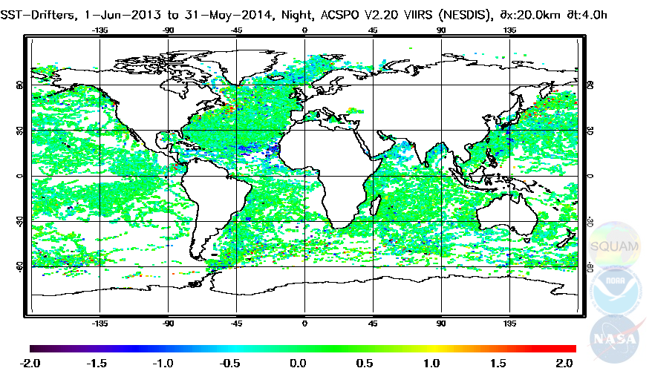
NPP SST Annual Validation: Night ACSPO
Maps | Histograms | Time-series | Dependencies | Hovmöller
ACSPO VIIRS minus Drifters, 1-Jun-2013 to 31-May-2014
ACSPO: Similar coverage to IDPS
Fewer speckles, less suppression: Less residual Cloud/Aerosols

Slide 36
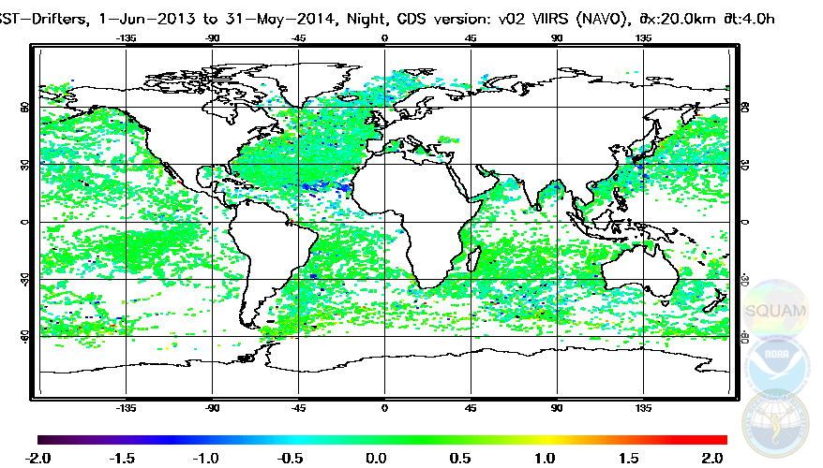
NPP SST Annual Validation: Night NAVO
Maps | Histograms | Time-series | Dependencies | Hovmöller
NAVO VIIRS minus Drifters, 1-Jun-2013 to 31-May-2014
NAVO coverage sparser than IDPS/ACSPO
Fewer speckles, less suppression: Less residual Cloud/Aerosols

Slide 37
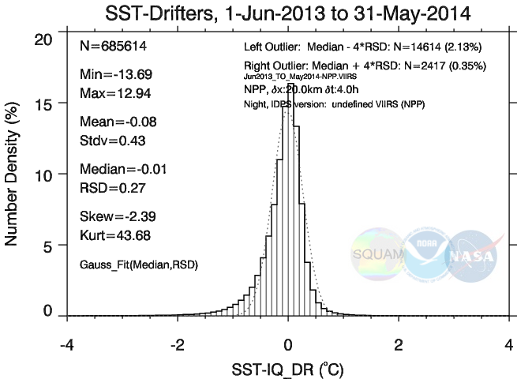
NPP SST Annual Validation: Night IDPS
Maps | Histograms | Time-series | Dependencies | Hovmöller
IDPS histogram: Biased & Skewed negatively
IDPS product meets specs at night

Slide 38
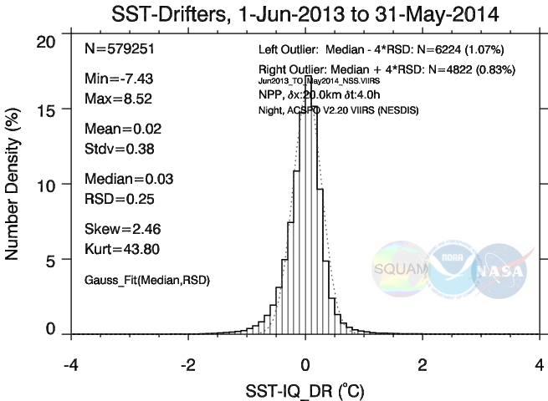
NPP SST Annual Validation: Night ACSPO
Maps | Histograms | Time-series | Dependencies | Hovmöller
ACSPO: Fewer matchups, Reduced Bias / Skew / STD
Meets specs by a wider margin than IDPS

Slide 39
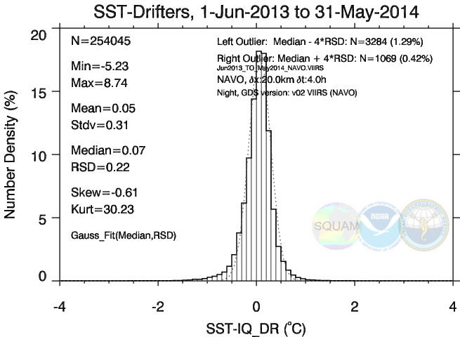
NPP SST Annual Validation: Night NAVO
Maps | Histograms | Time-series | Dependencies | Hovmöller
NAVO: fewer matchups, reduced Bias / Skew / STD
Meets specs by even wider margin, but in a ~2.5 smaller sample

Slide 40
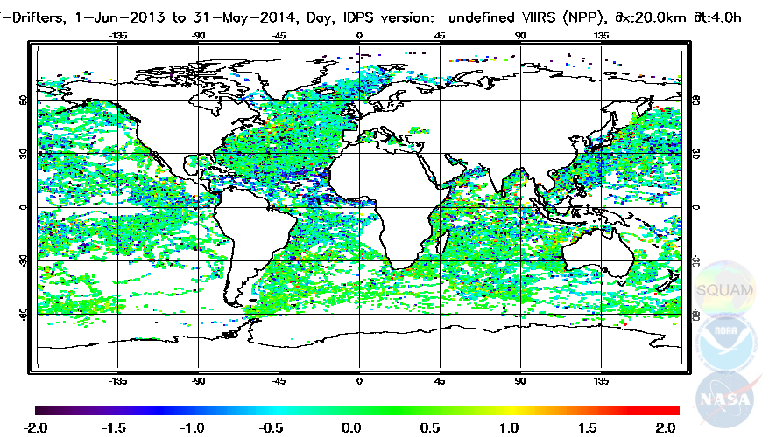
NPP SST Validation: Day IDPS
Maps | Histograms | Time-series | Dependencies | Hovmöller
IDPS VIIRS minus Drifters, 1-Jun-2013 to 31-May-2014
IDPS match-ups cover most global ocean, except a few “white spots”
Cold speckles, suppression off Africa: Due to residual Cloud/Aerosols

Slide 41
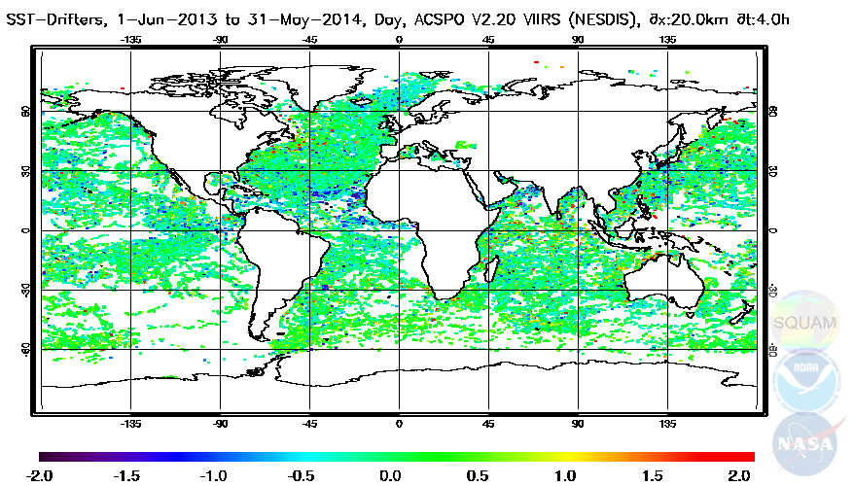
NPP SST Validation: Day ACSPO
Maps | Histograms | Time-series | Dependencies | Hovmöller
ACSPO VIIRS minus Drifters, 1-Jun-2013 to 31-May-2014
ACSPO coverage: Similar to IDPS
Fewer speckles, less suppression: Less residual Cloud/Aerosols

Slide 42
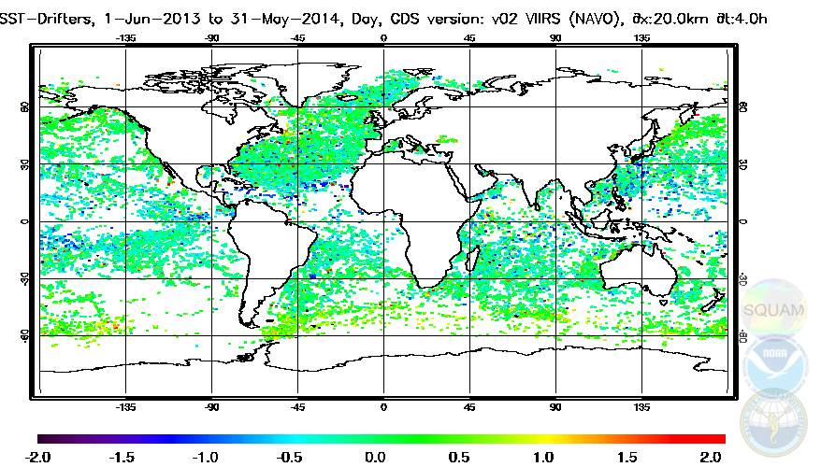
NPP SST Validation: Day NAVO
Maps | Histograms | Time-series | Dependencies | Hovmöller
NAVO VIIRS minus Drifters, 1-Jun-2013 to 31-May-2014
NAVO coverage sparser than IDPS/ACSPO, warm bias at Hi-Lat
Fewer speckles, less suppression: Less residual Cloud/Aerosols

Slide 43
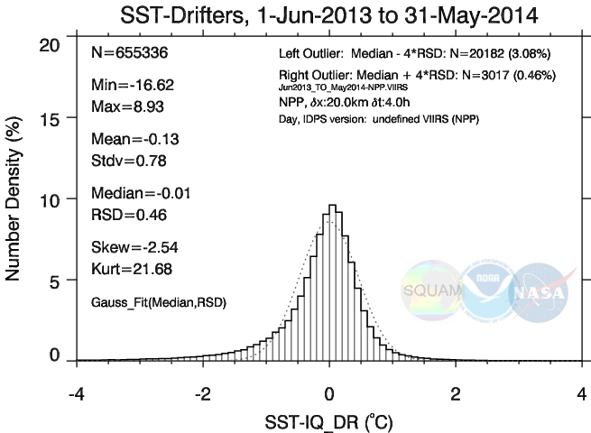
NPP SST Validation: Day IDPS
Maps | Histograms | Time-series | Dependencies | Hovmöller
IDPS histogram: Biased/skewed negatively
STD~0.78K: IDPS product out of spec

Slide 44
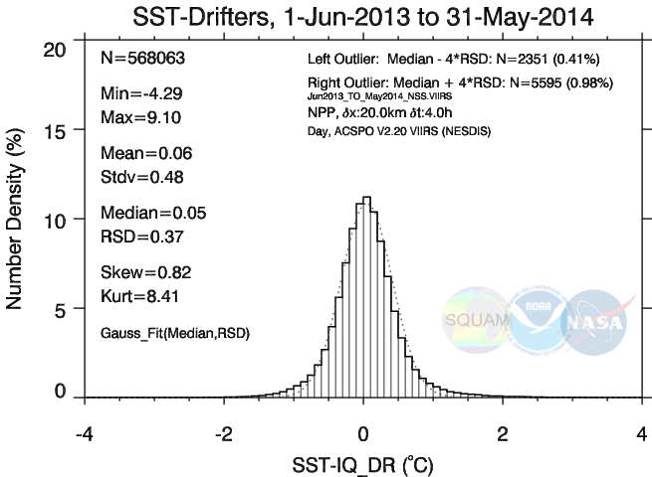
NPP SST Validation: Day ACSPO
Maps | Histograms | Time-series | Dependencies | Hovmöller
ACSPO: fewer matchups, reduced Bias / Skew / STD
Meets JPSS specs, by a wide margin

Slide 45
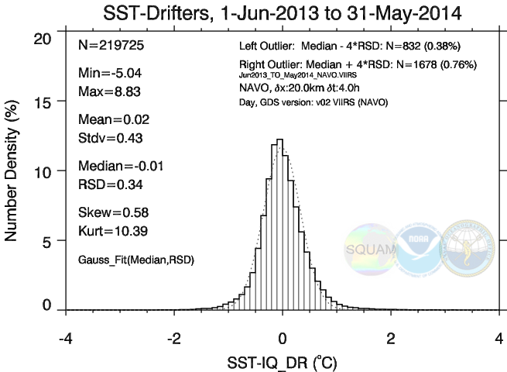
NPP SST Validation: Day NAVO
Maps | Histograms | Time-series | Dependencies | Hovmöller
NAVO: ~2.5 fewer matchups, reduced Bias / Skew / STD
Meets specs by even wider margin, nut in a smaller domain

Slide 46
Annual Validation statistics against drifters
summary for “01-JUN-2013 to 31-MAY-2014”
Night
Processor | NOBS (%ACSPO) | Min / Max | Mean / STD | Med / RSD
IDPS | 685,614 (118%) | -13.69 / +12.94 | -0.08 / 0.43 | -0.01 / 0.27
ACSPO | 578,851 (100%) | - 7.43 / +8.52 | +0.01 / 0.36 | +0.03 / 0.25
NAVO | 254,045 ( 44%) | - 5.23 / +8.74 | +0.05 / 0.31 | +0.07 / 0.22
Day
Processor | NOBS (%ACSPO) | Min / Max | Mean / STD | Med / RSD
IDPS | 655,336 (115%) | -16.62 /+8.93 | -0.13 / 0.78 | -0.01 / 0.46
ACSPO | 568,610 (100%) | - 4.29 / +9.10 | +0.06 / 0.48 | +0.05 / 0.37
NAVO | 219,725 ( 39%) | - 5.04 / +8.83 | +0.02 / 0.43 | -0.01 / 0.34

Slide 47
Evaluation of VIIRS SST Products
4. Examples SST Imagery
NAVO images shown below are from the then-operational product. Following STAR feedback, NAVO has fixed imagery artifacts.
Notes:
Specific for nesdis

Slide 48
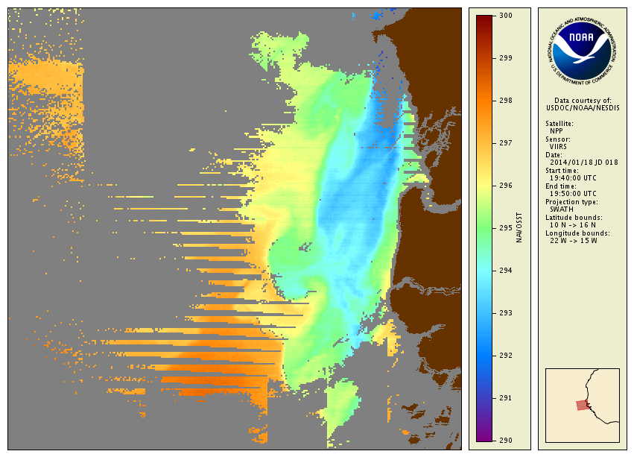
ACSPO_V2.30b01_NPP_VIIRS_2014-01-18_1440-1450_20140314.174252_NAVO
Africa
Missed lines?
NAVO
Rectangular shapes?

Slide 49
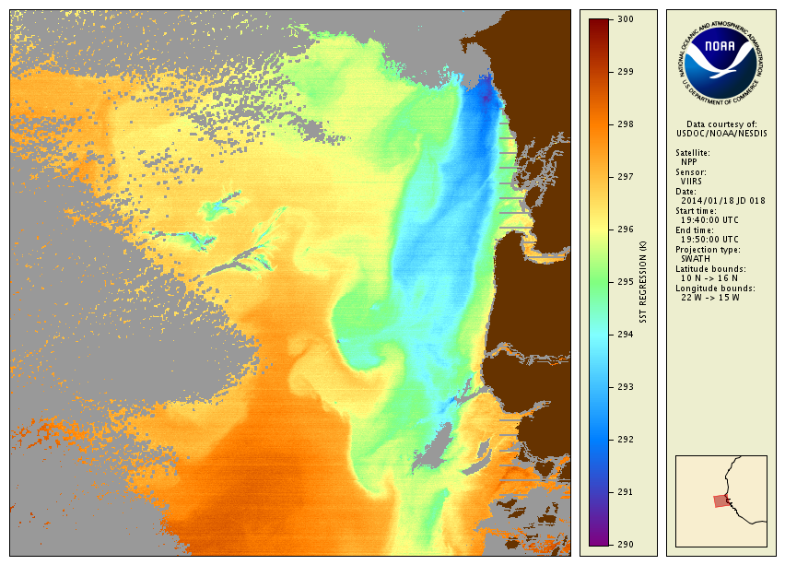
Africa
ACSPO

Slide 50
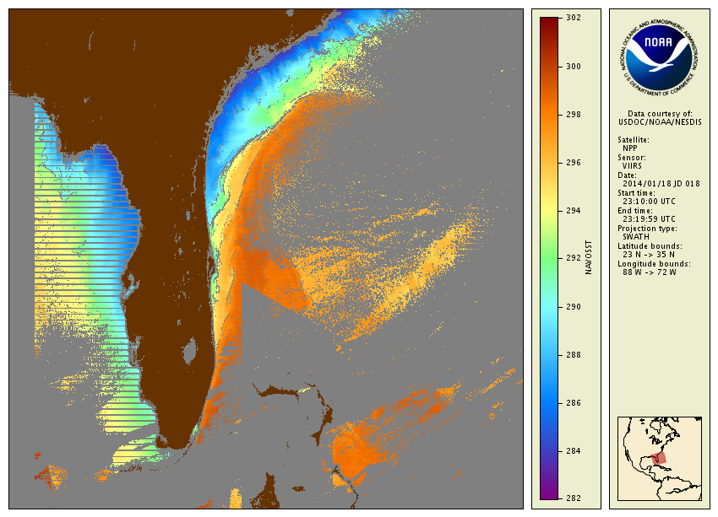
ACSPO_V2.30b01_NPP_VIIRS_2014-01-18_1810-1819_20140314.184153_NAVO
Florida
Tri-angular shape?
NAVO

Slide 51
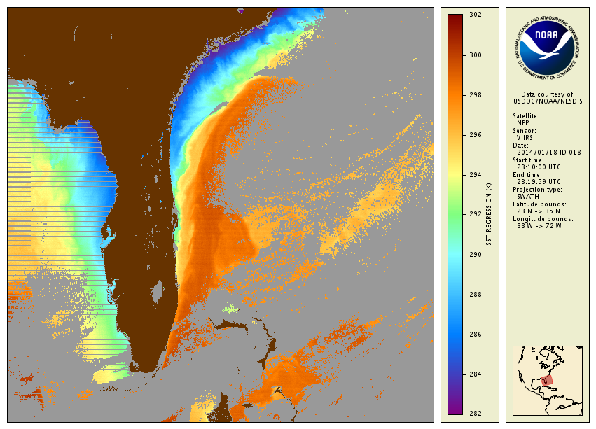
Florida
ACSPO

Slide 52
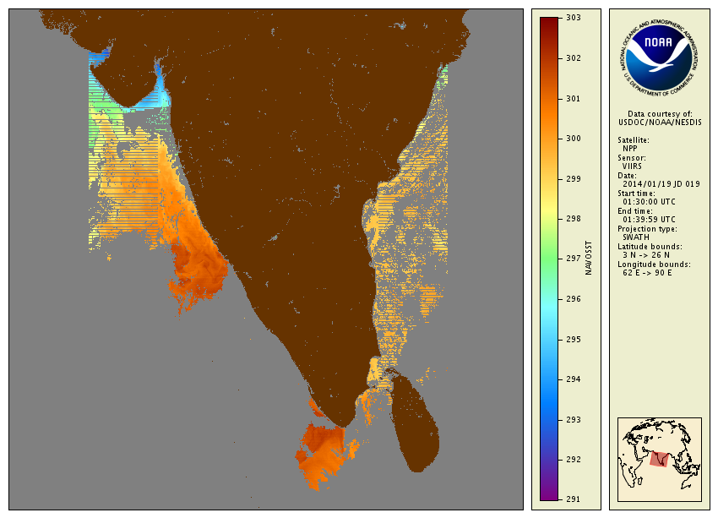
ACSPO_V2.30b01_NPP_VIIRS_2014-01-18_2030-2039_20140314.192134_NAVO
India
Too-Regular shapes?
NAVO

Slide 53
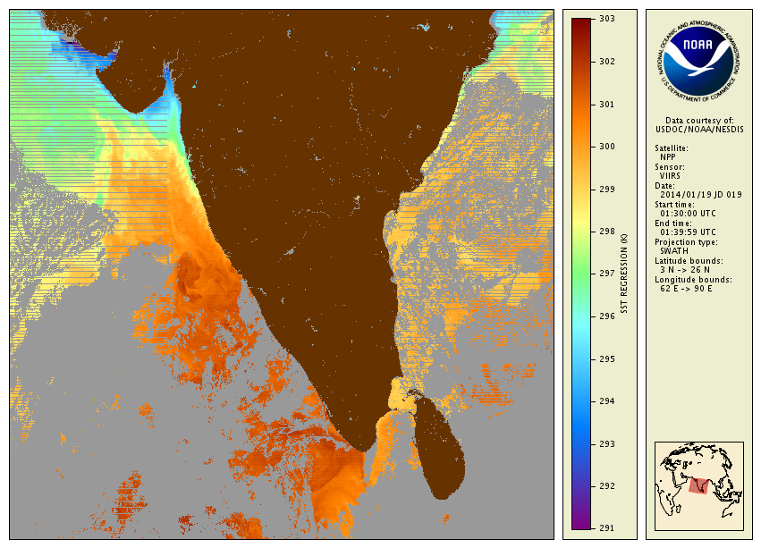
India
ACSPO

Slide 54
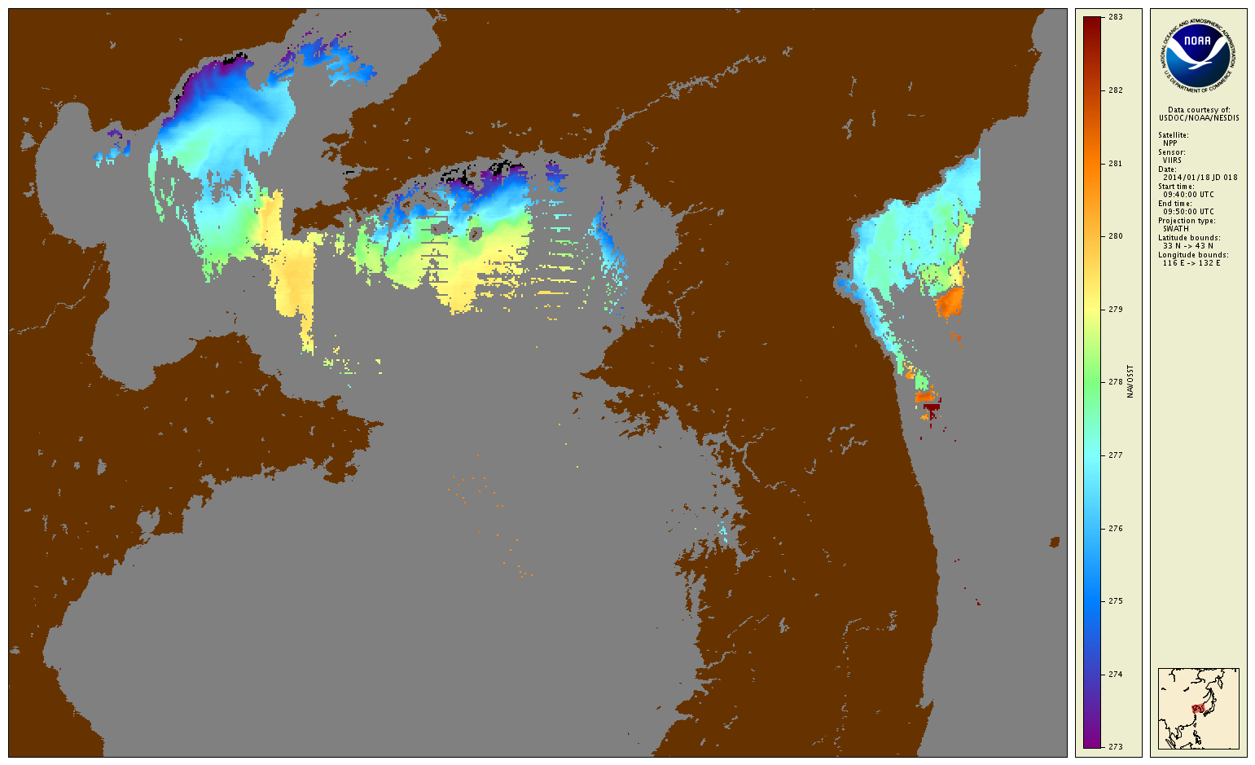
ACSPO_V2.30b01_NPP_VIIRS_2014-01-18_0440-0450_20140314.145310_NAVO
Missed lines?
China
Tri-angular shape?
Korea
SEATEMP

Slide 55
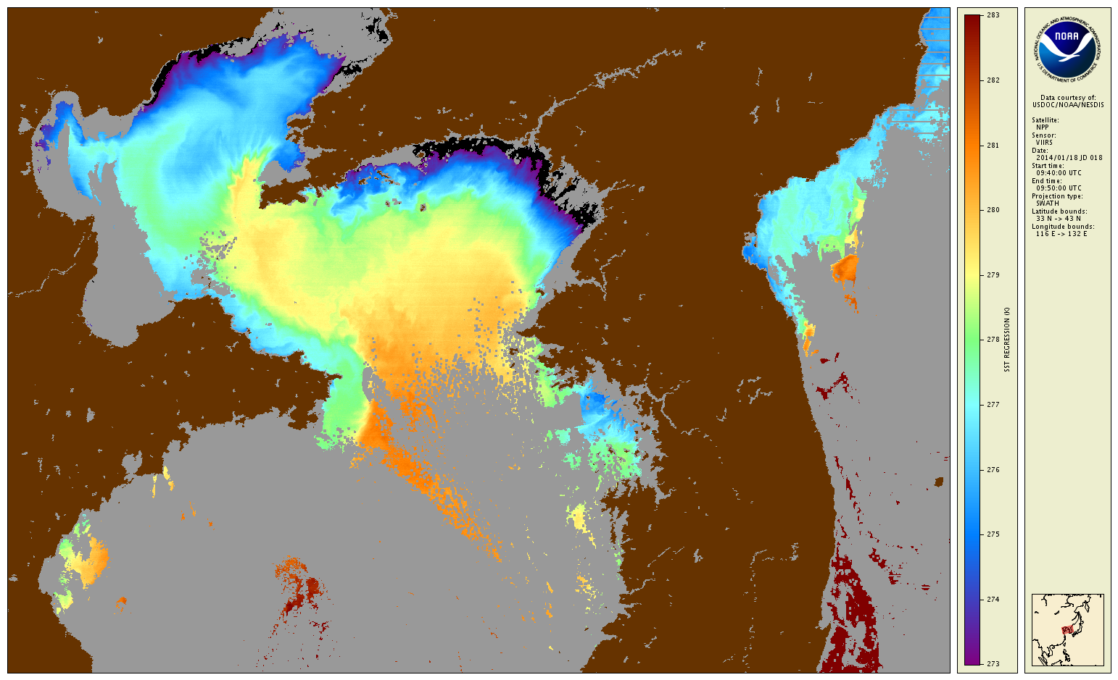
China
Korea
ACSPO

Slide 56
Documentation
Notes:
Specific for nesdis

Slide 57
JPSS SST Documentation
Liang, X., and A. Ignatov, 2013: AVHRR, MODIS and VIIRS Radiometric Stability and Consistency in SST Bands. JGR, 118, 6, 3161-3171, doi:10.1002/jgrc.20205.
Bouali, M., A. Ignatov, 2014: Adaptive Reduction of Striping for improved SST Imagery from S-NPP VIIRS. JTech, 31, 150-163, doi:10.1175/JTECH-D-13-00035.1
Xu, F., A. Ignatov, 2014: In situ SST Quality Monitor (iQuam). JTech, 31, 164-180, doi:10.1175/JTECH-D-13-00121.1
Petrenko, B., A. Ignatov, Y. Kihai, J. Stroup, P. Dash, 2014: Evaluation and Selection of SST Regression Algorithms for JPSS VIIRS. JGR, 119, 8, 4580-4599, doi:10.1002/2013JD020637.
Liu, Q., A. Ignatov, F. Weng, and X. Liang, 2014: Removing Solar Radiative Effect from the VIIRS M12 Band at 3.7 µm for daytime SST Retrievals. JTech, in press, doi:10.1175/JTECH-D-14-00051.1
Gladkova, I., Y. Kihai, A. Ignatov, F. Shahriar, and B. Petrenko, 2014: SST Pattern Test in ACSPO Clear-Sky Mask for VIIRS. RSE, in review.
ACSPO SST ATBD, ACSPO SST External Users Manual (NDE)

Slide 58
ACSPO VIIRS SST Users
Notes:
Specific for nesdis

Slide 59
NASA and NOAA JPSS SST Users
Current and/or Interested Users
NOAA STAR (GEO/POLAR Blended L4) – Eileen Maturi
NOAA STAR (Coral Reef Watch) – Mark Eakin
NOS (Chesapeake Bay Ecosystem analysis) – Chris Brown
NCDC (Reynolds SST L4) – Viva Banzon
NASA JPL (JPL MUR L4) – Mike Chin
Work also underway with
NCEP/CPC/OPC – Bob Grumbine, Avichal Mehra; Joe Sienkiewicz
NASA GMAO (MERRA) – Ricardo Todling
Coast Watch – John Sapper
NMFS – Cara Wilson/John Sapper
URI – Peter Cornillon

Slide 60
International JPSS SST Users
Current and/or Interested Users
Canadian Met Centre (CMC L4) – Bruce Brasnett
Australian Bureau of Meteorology (GAMSSA L4) – Helen Beggs
UK Met Office (OSTIA L4) – Emma Fiedler
Japanese Met Agency (MGD L4) – Shiro Ishizaki
DMI, Denmark (DMI L4) – Jacob L. Høyer
EUMETSAT (EUMETCAST) – Simon Elliott
JPL/PO DAAC (Archive) – Ed Armstrong
IFREMER, France (Odyssea L4) – Jean-François Piolle, Emmanuelle Autret
To be polled
Other users to be polled at GHRSST Meeting, June 2014, Cape Town

Slide 61
Users’ Feedback
Notes:
Specific for nesdis

Slide 62
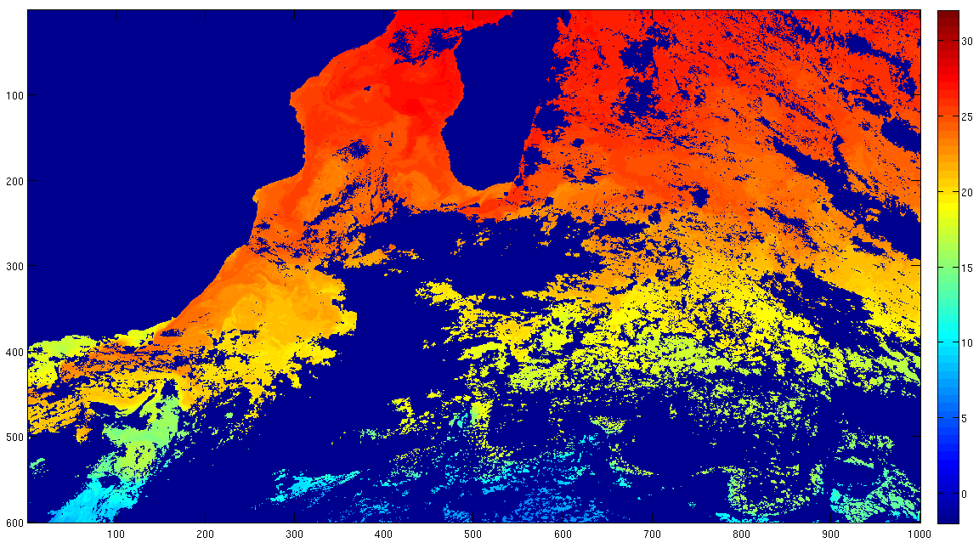
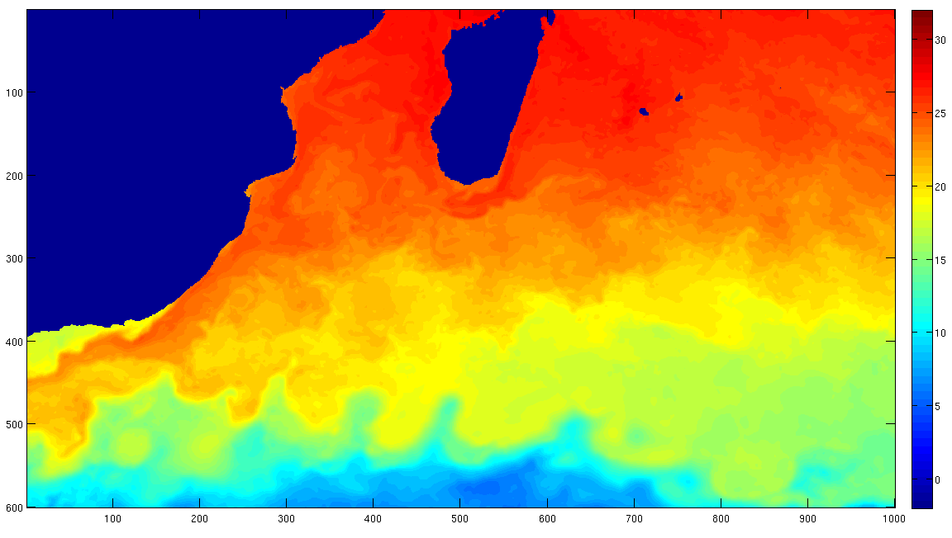
Harris – NOAA Geo-Polar Blended L4 SST
VIIRS successfully incorporated into Geo-Polar Blended 5-km global SST analysis
Final SST analysis
Super-Ob’d VIIRS SST data

Slide 63

Results of Assimilating ACSPO VIIRS L2P Datasets
Bruce Brasnett
Canadian Meteorological Centre
May, 2014

Slide 64
ACSPO VIIRS L2P Datasets
Received courtesy of colleagues at STAR
Two periods: 1 Jan – 31 Mar 2014 & 15 Aug – 9 Sep 2013
Daily coverage is excellent with this product
Experiments carried out assimilating VIIRS data only and VIIRS data in combination with other satellite products
Rely on independent data from Argo floats to verify results
Argo floats do not sample coastal regions or marginal seas

Slide 65
Assessing relative value of 2 VIIRS datasets: NAVO vs. ACSPO
Using ACSPO instead of NAVO improves CMC assimilation
Notes:
Period: Jan. 1 to Feb. 5, 2014. A data outage of the NAVO data made it impossible to use a 3-month comparison period.

Slide 66
CMC Summary
ACSPO VIIRS L2P is an excellent product
Based on the Jan – Mar 2014 sample, VIIRS contains more information than either NAVO VIIRS, OSI-SAF Metop-A or the RSS AMSR2 datasets
L2P ancillary information: quality level flags and wind speeds are useful
CMC started assimilating ACSPO VIIRS L2P dataset on 29 May 2014

Slide 67
CMC Feedback – Bruce Brasnett
7 July 2014, “We are now running with ACSPO VIIRS and are very happy with the results. You and your team have done an outstanding job with the VIIRS product. Any idea when the backfilled data to Jan. 2012 will be available?”
28 July 2014, “For years, we at CMC have wanted more retrievals of lake temperatures. Unfortunately, all we were getting from NAVO was retrievals for the largest lakes... nothing for medium and small lakes. This is one reason why we are excited about the ACSPO VIIRS product (many other reasons to be excited about the ACSPO product, by the way)”
19 August 2014, “We have been assimilating ACSPO VIIRS data (downloaded from JPL) for a couple of months now and I am very happy with the results. Excellent global coverage and good performance at high latitudes.”

Slide 68
Summary
JPSS ACSPO SST Product
  Has been validated online in NRT, globally and continuously since opening VIIRS cryoradiator doors on 18 Jan 2012. It meets JPSS L1RD specs and validated 3 stage requirements
  IDPS SST domain is comparable with ACSPO. At night, IDPS VAL stats are degraded compared to ACSPO but meet specs. During the daytime, IDPS SST does not meet specs
  NAVO SST meets L1RD specs, by a slightly wider margin than ACSPO. However, the retrieval domain is ~2.5 smaller
  ACSPO SST is assimilated into two global L4 analyses: NOAA geo-polar blended and Canadian Met Centre CMC02. Positive feedback received on excellent global coverage, and in particular, coverage in high latitudes and over internal waters
  SST Team recommends to declare SNPP SST Validated stage 3
Notes:
Specific for nesdis

Slide 69
Near-Term ACSPO Priorities & Plans
  Priority of SST Team is to focus on ACSPO users: Work individually, customize product, ensure meeting their needs
  Continue monitoring ACSPO SST in SQUAM, cross-evaluate against IDPS and NAVO, and validate all against iQuam
  Generate Level 3 SST product (multiple users requests)
  Establish VIIRS SST reprocessing capability (in conjunction with UW). Back-fill ACSPO L2/L3 SSTs to Jan’2012
  Archive ACSPO L2/3 at JPL/NODC, discontinue IDPS
  Focus on dynamic, coastal and high-latitude areas
  Enhance ACSPO clear-sky and ice masks, using pattern recognition approach and day-night band
  Improve Single Scanner Error Statistics (SSES; part of GDS2)
  Implement destriping operationally
  Explore optional VIIRS bands for aerosol correction/flagging
Notes:
Specific for nesdis

