Slide 1
Validated Stage 1 Science Maturity Readiness Review for
Sea Ice Characterization
Presented by Jeff Key
Cryosphere Products Validation Team
September 4, 2014

Slide 2
Outline
Algorithm Cal/Val Team Members
Product Requirements
Evaluation of algorithm performance to specification requirements
  Evaluation of the effect of required algorithm inputs
  Quality flag analysis/validation
  Error Budget
Documentation
Identification of Processing Environment
Users & User Feedback
Conclusion
Path Forward

Slide 3
Cryosphere Team Membership
EDR | Name | Organization
Lead | Jeff Key | NESDIS/STAR
Co-Lead | Pablo Clemente-Colón | NESDIS/STAR and NIC
Wisconsin:
Ice | Yinghui Liu | CIMSS/U. Wisconsin
Ice | Xuanji Wang | CIMSS/U. Wisconsin
Ice | Rich Dworak | CIMSS/U. Wisconsin
Maryland:
Snow | Peter Romanov | CREST/CCNY
Snow | Igor Appel | IMSG
Colorado:
Ice | Mark Tschudi | U. Colorado
Ice | Dan Baldwin | U. Colorado
Other:
All | Paul Meade | DPE
3

Slide 4
Overview of Data Products
Sea ice characterization - Provisional
  Currently this is an age category: no ice, new/young ice, other ice
Sea Ice concentration IP
  Fractional coverage of ice in each pixel
Ice surface temperature (IST) – Val 1
  Radiating temperature of the surface (ice with or without snow)
Snow cover
  4a. Binary snow cover – Val 1
  4b. Fractional snow cover – Provisional
  Notes:
  Information on ice and snow cover is needed by other EDRs.
  AMSR2 on GCOM-W1 will be used to generate other snow and ice products: Ice Characterization, Snow Cover, Snow Depth, and Snow Water Equivalent (SWE).
RGB Image shows dense smoke (high absorption) in northwest, north central and central coastal portions of image.
4

Slide 5
SNPP Validation Stages Maturity Definition
Validated Stage 1:
  Using a limited set of samples, the algorithm output is shown to meet the threshold performance attributes identified in the JPSS Level 1 Requirements Supplement with the exception of the S-NPP Performance Exclusions
Validated Stage 2:
  Using a moderate set of samples, the algorithm output is shown to meet the threshold performance attributes identified in the JPSS Level 1 Requirements Supplement with the exception of the S-NPP Performance Exclusions
Validated Stage 3:
  Using a large set of samples representing global conditions over four seasons, the algorithm output is shown to meet the threshold performance attributes identified in the JPSS Level 1 Requirements Supplement with the exception of the S-NPP Performance Exclusions

Slide 6
Sea Ice Characterization EDR L1RD Requirements
Sea Ice Characterization Requirements from L1RD version 2.9
EDR Attribute | Threshold | Objective
a. Vertical Coverage | Ice Surface | Ice Surface
b. Horizontal Cell Size Clear All weather | 1.0 km No capability | 0.5 km 1 km
c. Mapping Uncertainty, 3 sigma Clear Cloudy | 5 km No capability | 0.5 km 1 km
d. Measure Range Ice Age 2. Ice Concentration | Ice Free, New Young, all other ice 0/10 to 10/10 | Ice free, Nilas, Gray White Grey, White, First Year Medium, First Year Thick, Second Year, Multiyear, Smooth and Deformed Ice 0/10 to 10/10
e. Measurement Uncertainty Probability of Correct Typing (Ice Age) Ice Concentration | 70% Note 1 | 90% 5%
f. Refresh | At least 90% coverage of the global every 24 hours (monthly average) | 6 hrs
g. Geographic coverage | All Ice-covered regions of the global ocean | All Ice-covered regions of the global ocean
Notes: 1. VIIRS produces a sea ice concentration IP in clear sky conditions, which is provided as an input to the ice surface temperature calculation
Note that because the percentage of N/Y ice is, on the annual average, very small, the 70% probability of correct typing of both types together could be met by simply labeling all ice pixels as “Other Ice”!
RGB Image shows dense smoke (high absorption) in northwest, north central and central coastal portions of image.
6

Slide 7
Evaluation of algorithm performance to specification requirements (3-5 slides)
Findings/Issues from Provisional Review:
  “VIIRS Sea Ice Characterization EDR has met the provisional maturity stage based on the definitions and the evidence shown
  Some issues have been uncovered during validation and solutions are being evaluated.” (Specific issues are too numerous to list here but are in the additional slides.)
Improvements since Provisional
  A number of improvements have been made to the VIIRS Cloud Mask (by the Cloud Team) and to snow/ice gridding, which have resulted in improvements to SIC.
  However, no changes have been made to the SIC algorithm. In-depth testing and analysis has not resulted in any solutions.
Cal/Val Activities for evaluating algorithm performance:
  See the following slides…

Slide 8
Summary of VIIRS Sea Ice Characterization EDR
The VIIRS Sea Characterization EDR (Ice Age) consists of ice classifications for Ice Free, New/Young and Other Ice at VIIRS moderate spatial resolution (750m @ nadir), for both day and night, over oceans poleward of 36ºN and 50ºS latitude.
New or Young ice is discriminated from thicker ice (Other Ice) by a threshold ice thickness of 30 cm. Discrimination of New/Young ice from thicker ice is achieved by two algorithms:
  1. Energy (heat) balance based retrieval for night and high solar zenith angles
  2. Reflectance/ice thickness retrieval using modeled Sea Ice Reflectance LUT for daytime
Heritage: No operational visible/IR heritage. AVHRR research heritage (Comiso and Massom 1994, Yu and Rothrock 1996 and Wang et al. 2010)

Slide 9
Summary of VIIRS Sea Characterization EDR
(Ice Age) Algorithm Overview
Reflectance Threshold Branch (Day Region Algorithm)
Input ice tie point reflectance (I1, I2), VCM IP, AOT IP
Input granulated NCEP gridded precipitable water, total ozone fields
Obtain snow depth for each ice thickness bin obtained from climatology modeled snow depth/ice thickness LUT
Retrieve ice thickness from sea ice reflectance LUT using ice tie point reflectances, modeled snow depth, AOT, precip. water and solar and satellite view geometry
Classify by comparing retrieved ice thickness to 30 cm ice thickness threshold
Energy Balance Branch (Terminator and Night Region Algorithm)
Input Ice Temperature Tie Point IP
Input granulated NCEP gridded surface fields (sfc.P, sfc air temp, specific hum. etc…)
Compute snow depth for 30cm ice thickness threshold from heat/energy balance
Classify by comparing computed and climatology LUT snow accumulation for a 30 cm ice thickness threshold
The Snow-Depth-Ice Thickness Climatology LUT contains:
predicted snow accumulation depths for modeled ice thickness threshold growth times
based on monthly climatology surface air temperatures and precipitation rates

Slide 10
Performance Evaluation of the VIIRS Sea Ice Characterization EDR (Ice Age) Algorithm
Detailed analysis of 20 Arctic scenes including four seasons: July 2012, March – May 2013, December 2013, and April 2014
Golden granule: March 17, 2013
  Examined performance of daytime, nighttime and terminator (transition) areas
Comparisons to other products:
  VIIRS SDR reflectance
  NOAA IMS ice extent
  CU ice age
  One-dimensional Thermodynamic Ice Model (OTIM)
  Airborne ice thickness
    IceBridge ice thickness
    Airborne EM & Lidar

Slide 11
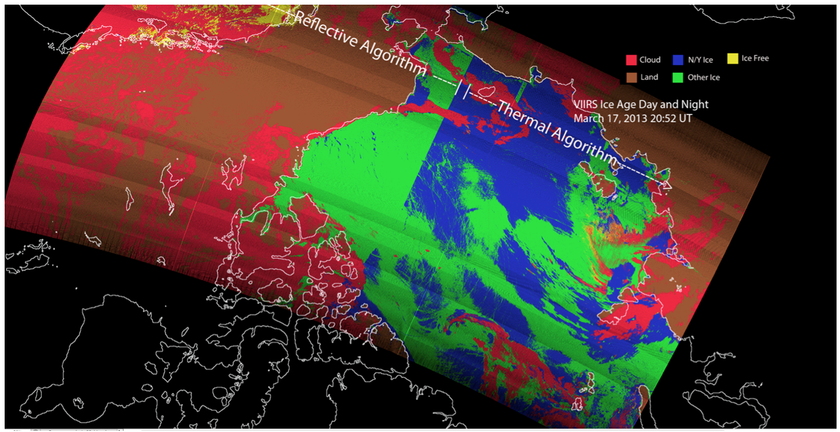
Assessment of the
Sea Ice Characterization EDR
Summary: There are times when performance is good, and other times (too many) when performance is not good. Overall, it does not appear to be meeting the accuracy requirements. This is a complex algorithm where improvements would be required in a number of components.
March 17, 2013 20:52 UTC scene (above) shows a broad region of Other Ice (green) misclassified as New Young ice (blue) in the terminator region where the algorithm transitioned from the reflective algorithm (left half) to the thermal heat balance branch (right half)

Slide 12
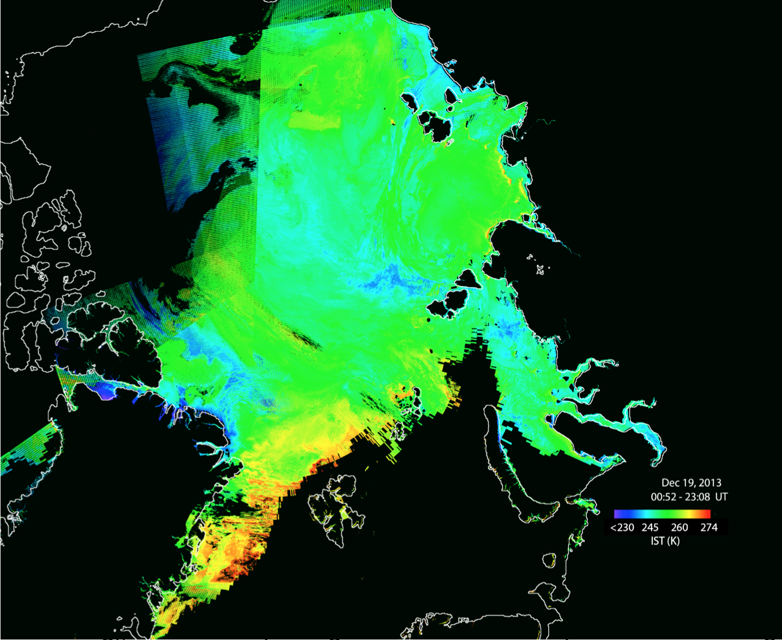
Case Study: December 2013
VIIRS Ice Surface Temperature composite on Dec 19, 2013. Note warmer temperatures in the Greenland Sea, extending north. We would expect thinner ice here (it’s December, so no melting), hence “New/Young” ice should be most prevalent in this region.
Notes:
1) large discontinuities in the terminator region
2) inconsistent orbit to orbit results for daytime
3) classification reversal of leads for night scenes
4) large areas of N/Y ice that are likely erroneous in the nighttime algorithm

Slide 13
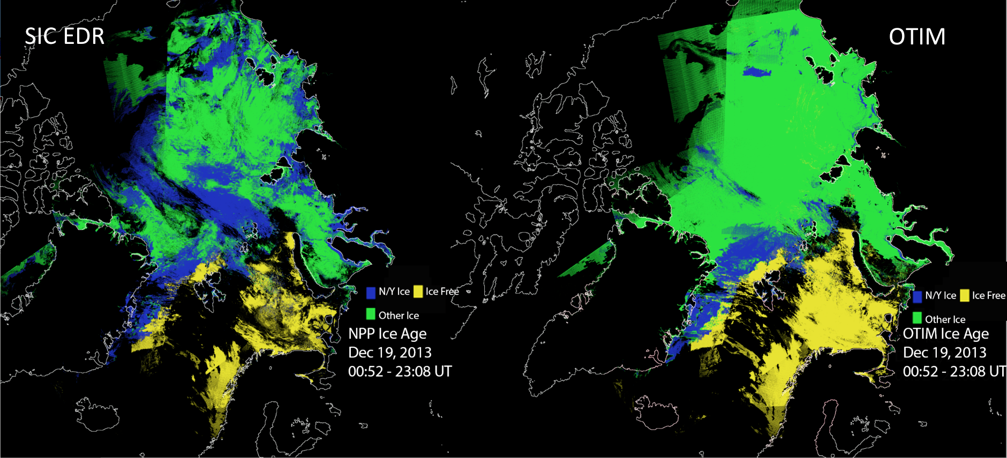
SIC EDR
OTIM
The VIIRS Sea Ice Characterization EDR nighttime algorithm composite (left) and the OTIM* algorithm (right). Note that OTIM calculates sea ice thickness – here the thickness is binned into either “New/Young” (NY) ice for ice <= 30 cm, or “Other Ice” for thickness > 30 cm, to match the classification for Ice Age. Both the VIIRS and OTIM algorithms identify the thin ice near Greenland, but overall VIIRS appears to over-estimate NY ice, while OTIM appears to underestimate it.
*OTIM (One-dimensional Thermodynamic Ice Model) was developed for GOES-R ABI and will run in NDE on VIIRS data.

Slide 14
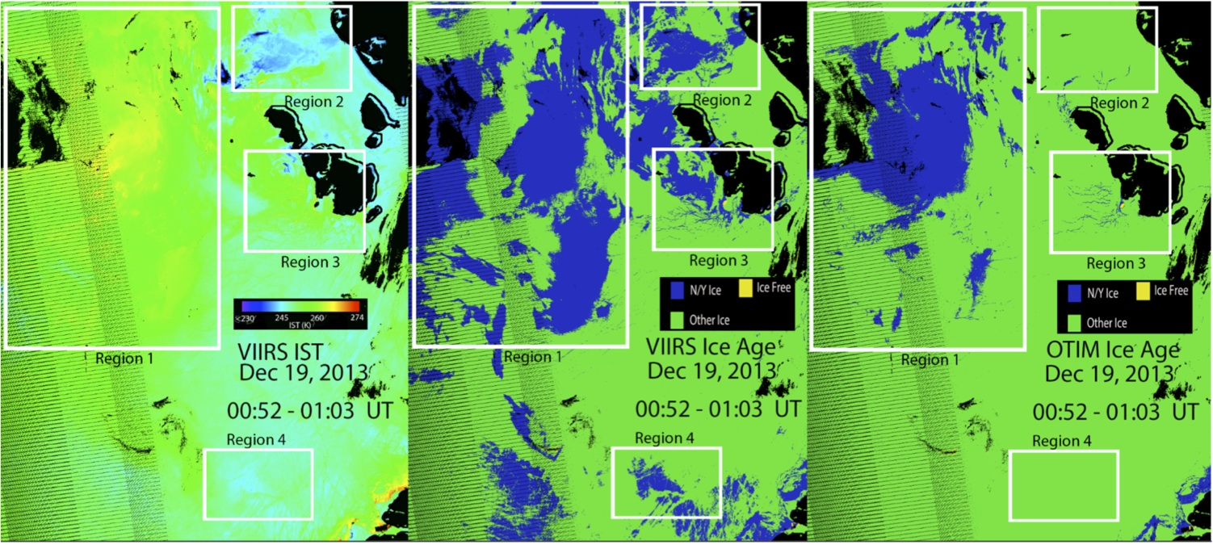
Now we zoom into the Laptev / East Siberian Seas for a single overpass.
Region 1: VIIRS ice age nighttime algorithm appears to overestimate N/Y ice; OTIM classification appears to be more accurate
Region 2: VIIRS algorithm misclassifies cold pixels as N/Y ice, OTIM does not
Region 3: OTIM estimates much less N/Y ice than the VIIRS algorithm
Region 4: VIIRS algorithm misclassifies N/Y ice, OTIM appears to be more accurate

Slide 15
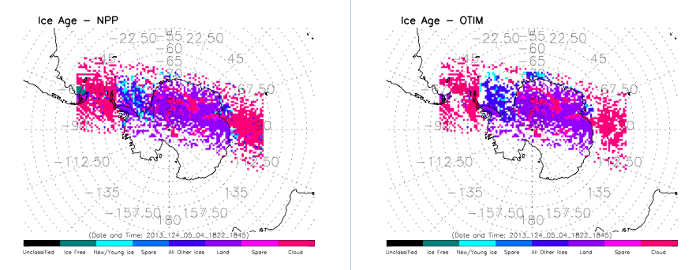
Ice Thickness and Age
IDPS and NDE (OTIM) Comparison
Sea ice age categories from VIIRS sea ice age classification (left) and OTIM ice thickness converted to the same categories (right) on May 4, 2013 over the Arctic.
Notes:
15

Slide 16
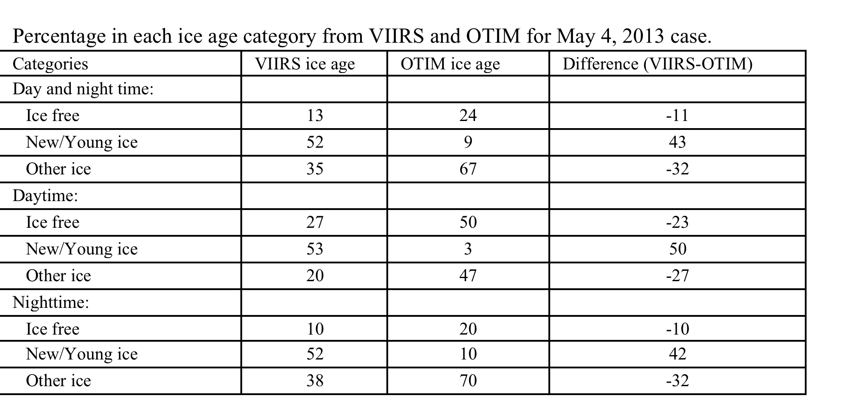
Ice Thickness and Age
IDPS and NDE (OTIM) Comparison
Statistics for figure on previous slide:
Notes:
16

Slide 17
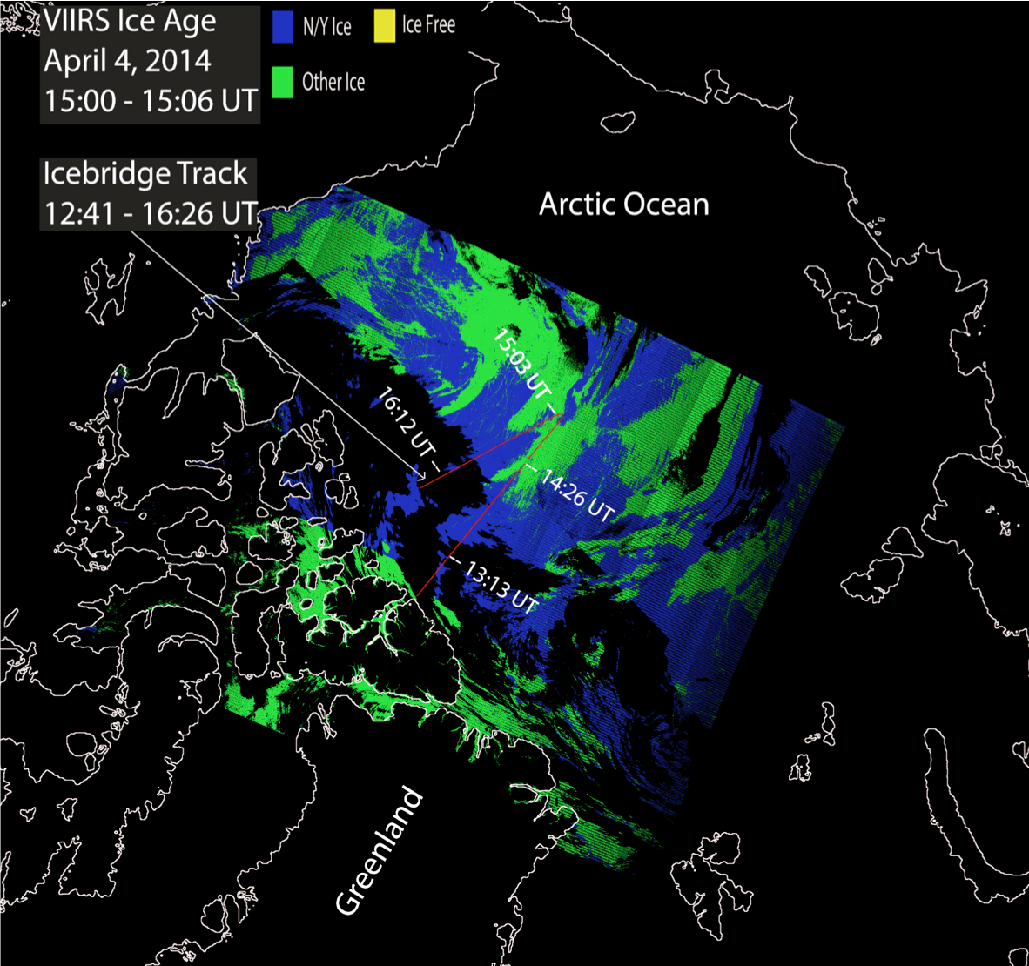
Validation with IceBridge
For some NASA IceBridge Arctic flights, sea ice thickness was estimated from lidar (ice freeboard) and radar (snow depth) (NSIDC: Kurtz et al., 2012, updated 2014)
IceBridge thickness compared to correct typing of SIC EDR New/Young Ice (<30cm) and Other Ice (>30cm)
April 4, 2014 (shown at left):
  2307 total pixels
  19% N/Y pixels correct
  2% N/Y incorrect
  18% Other correct
  60% Other incorrect
March 17, 2014:
  13535 total pixels
  <1% N/Y correct
  1% N/Y incorrect
  96% Other correct
  4% Other incorrect
Notes:
Interpretation: For April 4 case, 21% of the IceBridge thicknesses were < 30 cm (i.e., N/Y ice) and 78% were > 30 cm (i.e., Other). Of all the pixels (both categories), the SIC EDR was correct 19+18=37% of the time. For March 17, the probability of correct typing was 96%.

Slide 18
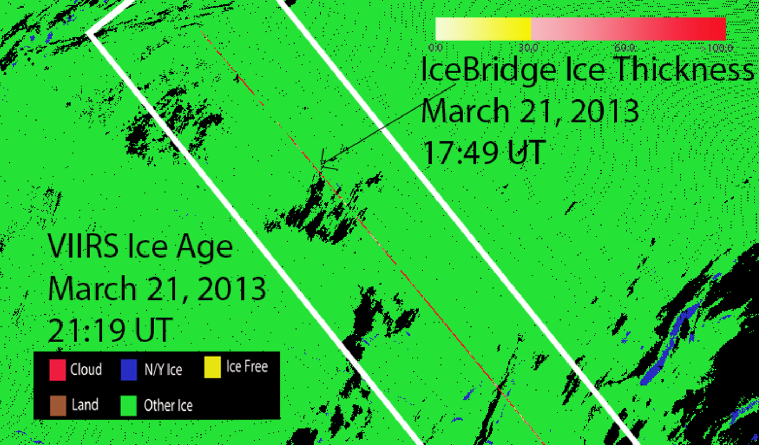
IceBridge Ice Thickness [Kurtz et al, 2012]
Validation with IceBridge
All ice is “Other” ice in this case
SIC EDR, daytime algorithm
Classification accuracy for 1155 pixels = 76%

Slide 19
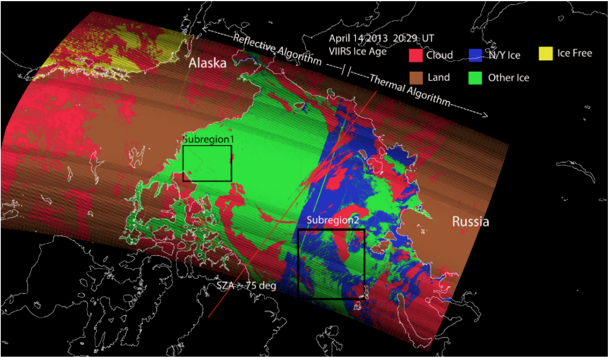
Validation with EM & Lidar
Dan Baldwin/CU, Mark Tschudi/CU

Slide 20
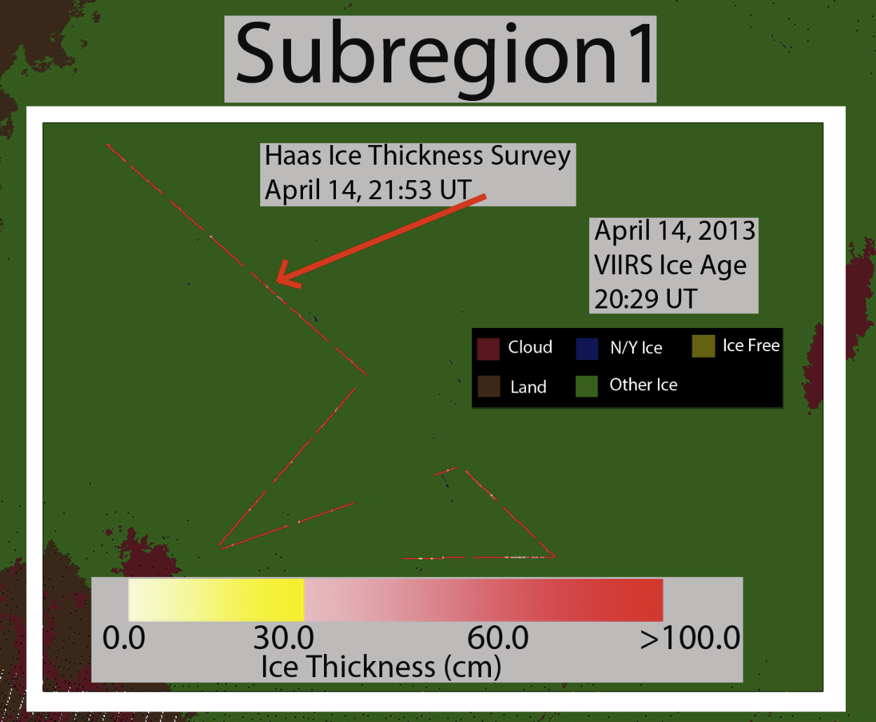
Validation with EM & Lidar
Thickness (cm) courtesy of C. Haas: Airborne EM & Lidar
All ice for VIIRS SIC EDR is “other ice” (> 30 cm)
1004 airborne data points: 99% > 30 cm (in agreement with VIIRS SIC EDR)

Slide 21
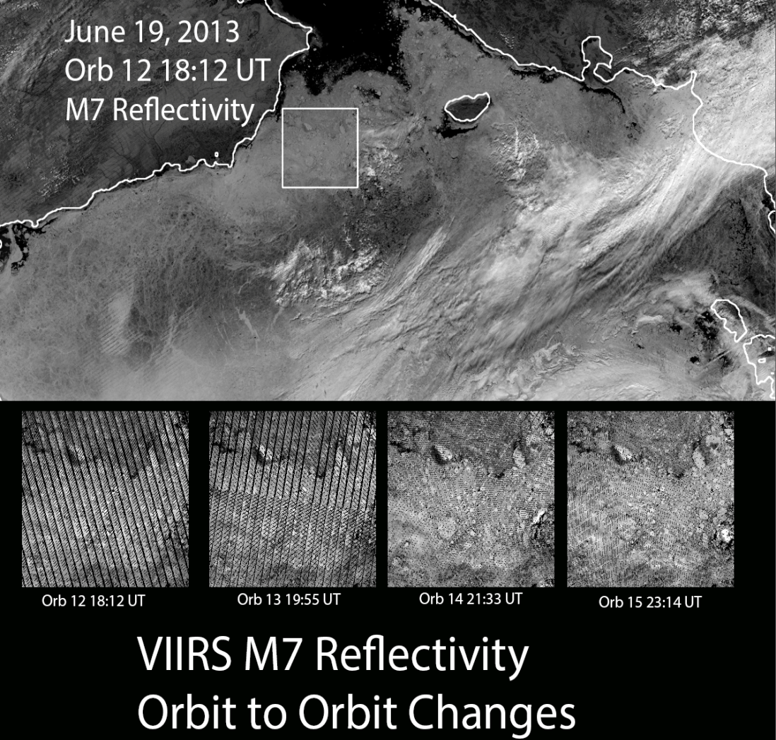
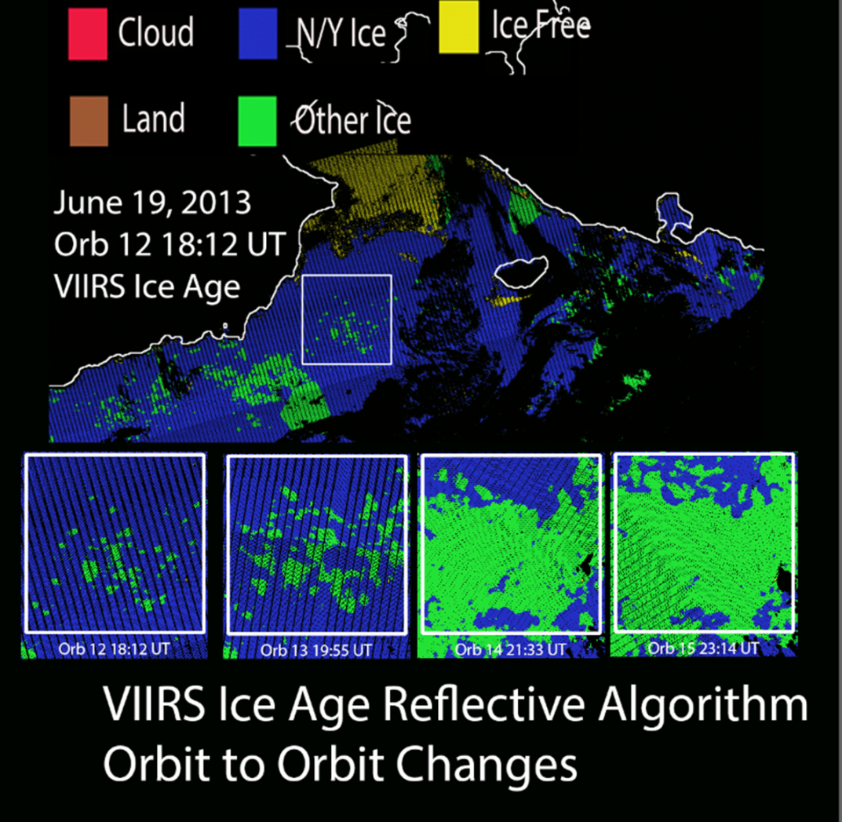
Other issues: Orbit-to-Orbit Classification Variability
Note: This is with the daytime algorithm. The problem has been observed on multiple days.

Slide 22
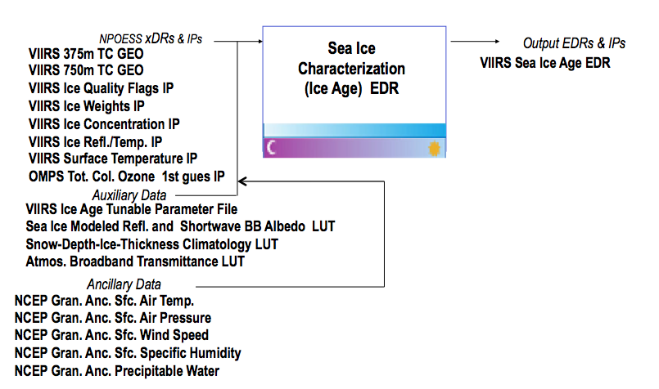
Evaluation of the effect of required algorithm inputs
Required Algorithm Inputs
  Ice Reflectance/Temperature IP, Ice Quality Flags IP, AOT IP
  Granulated ancillary surface wind speed, surface air pressure, surface air temperature and surface air specific humidity
  Modeled Snow Depth/Sea Ice Climatology LUT, modeled sea ice reflectance LUT, sea ice spectral albedo and broadband albedo LUTs, atmospheric transmittance LUT Ancillary Data

Slide 23
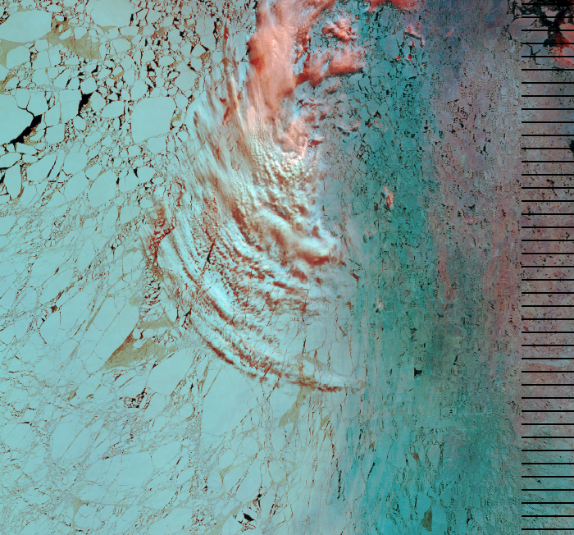
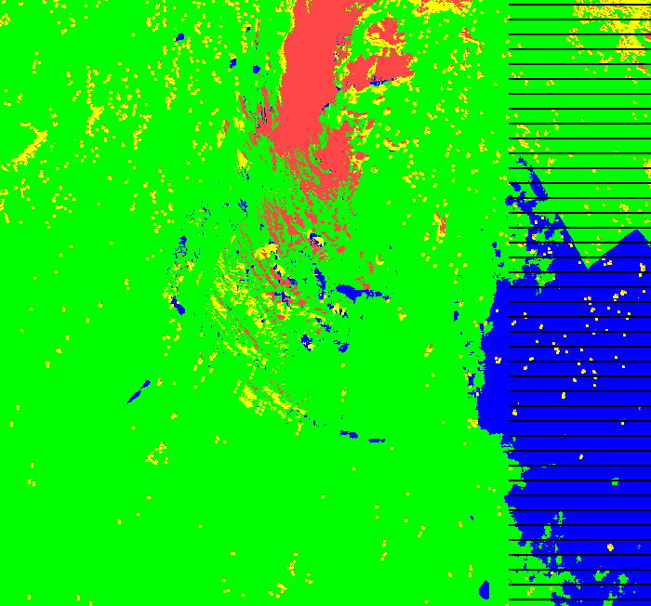
Impact of Errors in Inputs
Some misclassification evident due to VCM IP cloud leakage and cloud shadows
Discontinuities detected along lat/lon boundaries spaced 0.5 deg.
72.5 N
73.0 N
163.0 W
Large region misclassified where ice tie point reflectance values drop below ~ 0.53
Several discontinuities that align along 0.5 steps of latitude and longitude are evident as shown along the black dashed lines. The reflectance based day algorithm has dependencies on the coarse resolution NCEP ancillary fields for precipitable water and total column ozone. In addition the algorithm also has a dependency on the climatological snow depth/ice thickness LUT (modeled using 2.5 deg. surface air and precipitation rate climatology data) . The 0.5 deg are strongly suggestive of sensitivity to the NCEP precipitable water field. (Data from June 8, 2012)

Slide 24
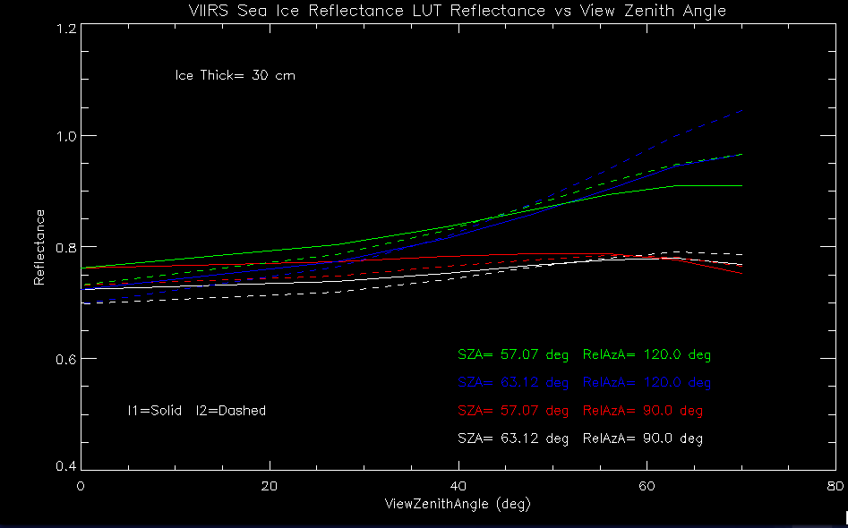
Daytime Ice Age Dependency Reflectance LUT
Examination of the Modeled Sea Ice TOA Reflectance LUT:
I2 ice tie point reflectance for 22:43 UTC orbit for low value of sensor zenith is above that of the corresponding modeled Sea Ice Reflectance LUT.
I2 ice tie point reflectance for 19:23 UTC orbit for high value of sensor zenith is below that of the corresponding modeled Sea Ice Reflectance LUT.
Snow depth = 3 cm
Water Vapor = 0.4 cm
Total Ozone = 0.2 atm-cm
I2 Ice Tie Point Reflectance
22:43 UTC scene
I2 Ice Tie Point Reflectance
19:23 UTC scene
Dan Baldwin U. Colorado
VIIRS I1 (640 nm) and I2 (865 nm) band reflectances extracted from the Modeled Sea Ice Reflectance LUT are shown as function of satellite view zenith angle for two solar zenith angle and relative azimuth bins that bound the scene conditions. The fact that the I2 band modeled reflectances are greater than that of the I1 band reflectances is unexpected since the spectral albedo of snow decreases with increasing wavelength beyond about 0.5 μm.

Slide 25
Evaluation of Cloud and Ice Quality Flags
 | ALLCLD ALLQUAL #1 | ALLCLD GOOD #2 | CNFCLR ALLQUAL #3 | CNFCLR GOOD #4
MODIS Ice Pix | 63252 | 27889 | 40190 | 27889
VIIRS Ice Pix | 45136 | 32458 | 33368 | 32458
VIIRS New/Young Ice Pix | 42708 (94.6%) | 31867 (98.2%) | 32485 (97.4%) | 31867 (98.2%)
VIIRS Other Ice Pix | 2428 (5.4%) | 591 (1.8%) | 883 (2.6%) | 591 (1.8%)
Ice Agree | 30695 (48.5%) | 27608 (99.0%) | 27902 (69.4%) | 27608 (99.0%)
MODIS Ice Free Pix | 83064 | 59067 | 62080 | 59067
VIIRS Ice Free Pix | 109187 | 61632 | 80778 | 61632
Ice Free Agree | 74192 (89.3%) | 58511 (99.1%) | 61479 (99.0%) | 58511 (99.1%)
MODIS ICE VIIRS Cloud | 15599 | N/A | N/A | N/A
MODIS Ice VIIRS Free | 16958 | 281 | 12288 | 281
Ice Type Classification Accuracy* | 5.4% | 1.8% | 2.6% | 1.8%
SIC EDR is compared to MODIS over sea ice during the melt period, when only “other ice” is expected.
Beaufort Sea, July 23, 2012
NOTE BOTTOM ROW
ALLCLD=No Cloud Cover Quality Flag Filter
ALLQUAL=No Ice Quality Flag Filter
CNFCLR=Only Pixels with Confidently Clear Cloud Cover Flag
GOOD=Only pixels with Good Ice Quality Flag
* note: all pixels with good ice quality are confidently clear, so columns 2 & 4 are identical.

Slide 26
Error Budget
Attribute Analyzed | L1RD Threshold | Analysis/Validation Result | Error Summary
SIC uncertainty (probability of correct typing) | 70% | Comparison with MODIS ice extent: 2-5% correct typing | Beaufort Sea Melt season – depressed reflectance due to melt affects daytime algorithm
SIC uncertainty (probability of correct typing) | 70% | Comparison with Airborne Lidar & EM: 99% correct | Beaufort Sea Spring - Almost all ice was measured thicker than 30cm and classified as “other”
SIC uncertainty (probability of correct typing) | 70% | Comparison with IceBridge derived thickness: 4/14/14: 37% correct 3/17/14: 97% correct | Beaufort Sea: April 4 had 20% ice <30cm, March 17 had almost no ice < 30 cm
SUMMARY: SIC probability of correct typing | 70% | 2 – 99%, with case study results uniformly distributed in this range | Validation data are limited. Lowest accuracies occur during melt.

Slide 27
Evaluation Summary
The Sea Ice Characterization EDR does meet the requirement for some sample, but does not meet the requirement overall.
Misclassification of ice age was observed to occur for the following categories of conditions:
  Day regions:
    Bias towards misclassification of Other Ice as NY in regions with 1) large values of climatological snow depth, 2) high satellite view zenith angle and regions with 3) low reflectance due to melting ice and 4) cloud shadows
  Night regions
    Reversals of ice age classification
  Terminator regions
    Frequent, broad misclassification of Other Ice as NY and reversals of classification
    Ice classification discontinuities are most evident and frequent where the algorithm transitions from the day reflectance based algorithm to the night energy balance based algorithm

Slide 28
Potential Solutions for Known Issues
Issue | Description | Proposed Solution
Day Region Ice Age Misclassifications | Daytime algorithm shows a bias towards N/Y ice for higher scattering angles | Update Modeled TOA Sea Ice Reflectance LUT to eliminate bias (reconstruct LUT based on CASIO/DISORT Snow/Ice BRDFs and coupled sea/ice/atmosphere RTM)
Night Region Ice Age Classification Reversals | Nighttime algorithm shows numerous classification reversals | Investigate tie point calculation in area of misclassification; investigate energy balance
Terminator Region Ice Age Misclassifications | Frequent misclassification of ice for broad regions, major discontinuities where algorithm transitions from day reflectance based to night energy balance algorithm, frequent reversal of ice classification | Update night algorithm to use a local sliding IST window; investigate energy balance and solar flux term
Climatology Modeled Snow Accumulation/Ice Thickness LUT | Snow depth thresholds based on the monthly, climatology based snow/depth ice thickness LUT are problematic | Investigate use of ancillary precipitation to derive snow depth and compute an ice thickness based on that snow depth. Dependence on the problematic SnowDepth/IceThickness Climatology LUT can then be eliminated.
False ice is frequently observed near cloud edges | False ice is frequently observed near cloud edges due to undetected clouds | Implement additional quality checks for extended cloud adjacency and partly cloudy conditions within the ice tie point search window in the Sea Ice Concentration IP

Slide 29
Known Issues and Potential Solutions, cont.
Issue | Description | Proposed Solution
Ice Age Misclassification due to low opacity clouds | Ice misclassifications occur due to low opacity clouds or ice fog, particularly during nighttime | Continued improvement of VCM to facilitate cloud vs. ice detection
Ice Age Misclassification due to melting ice | Lower reflectance of melting sea ice appears to cause the SIC EDR to indicate New/Young Ice, although this type of ice cannot be present this time of year. | Define and utilize melt season period where New/Young ice cannot exist. Could do this by date/latitude or possibly with IST or NCEP air temp input. During this time, ALL ice would be classified as “other ice.”
Ice Age Misclassification due Cloud Shadows | Lower reflectance of cloud shadow regions cause SIC EDR to indicate New/Young even though surrounding ice is Other Ice | Continued improvement of VCM to extend cloud shadow algorithm and flagging. Add logic to Ice Age algorithm to check VCM cloud shadow flag cloud and set quality flag to indicate degraded Ice Age retrieval quality
While there are potential solutions to the issues that have been identified, there is no guarantee of the outcome should they be implemented. Furthermore, the loss of NGAS support has severely limited our ability to perform the necessary work.

Slide 30
Documentation
Status of documentation:
  Current or updated ATBD: Up to date
  Current or updated OAD: Up to date
  README file for CLASS: Up to date

Slide 31
Identification of Processing Environment
IDPS or NDE build (version) number and effective date:
  Validation results were from July 2012 through April 2014.
  Mx6.6 (Feb 28, 2012) through 8.3 (March 18, 2014). Most validation results based on the EDR from builds 6.7 and 8.0.
  Effective date: N/A; the product is not recommended for Validated Stage 1 maturity
Algorithm version: 1.O.000.001 - 1.O.000.003
LUTS:
  VIIRS-SNOWDEPTH-THICKNESS-LUT: 1-D-NPP-1 (12/02/2009)
  VIIRS-ATMOS-BROAD-TRANSMIT-LUT: 1-D-NPP-1 (11/10/2001) (This is the Broadband Albedo LUT)
  ICE-REFLECTANCE-LUT: 1-D-NPP-1 (12/02/2009)
Description of environment used to achieve val stage 1
  The SIC EDR was obtained from CLASS.
  Build dates are listed above.

Slide 32
User Feedback
From 2014 STAR JPSS Annual Meeting.
Main users
  NIC, National/Naval Ice Center
  Naval Research Laboratory and NAVO
  NWS, including the Alaska Ice Desk and NCEP/EMC
Summary from the NIC: The VIIRS Ice Age Product will be used by NIC on a limited basis to map ice extent, but has no utility for ice age identification. Needs algorithm improvement to be apply Ice Age product in operational ice charting or NWP assimilation. (Same sentiment from the NWS Alaska Ice Desk)
EMC: No plans to use this product.
Other comments:
  Continuity: VIIRS, AMSR2, and ATMS products provide continuity with products from heritage imagers such as AVHRR, MODIS, and OLS for some products.
  What more can we get? Freshwater ice concentration and thickness.

Slide 33
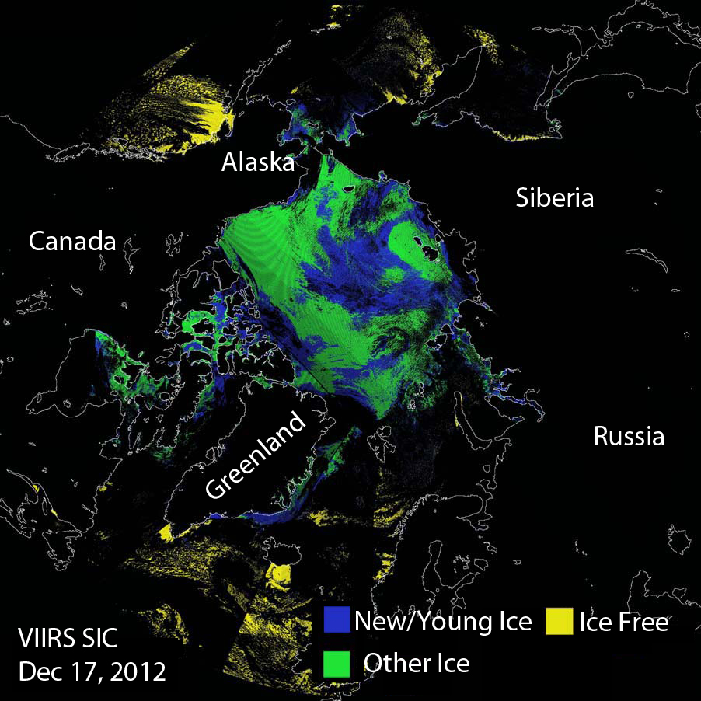
Conclusion
The Sea Ice Characterization EDR does meet the threshold attributes for a limited set of samples, but does not meet the requirements overall, particularly if the 70% probability of correct typing applies to each ice class.
Solutions are elusive. One alternate algorithm has been investigated.
Therefore, the Team defers to the AERB regarding the product maturity level.
Regardless of the maturity level, the Team recommends that the NDE ice thickness product ultimately replace the SIC EDR as its operational ice characterization (age or thickness) product.

Slide 34
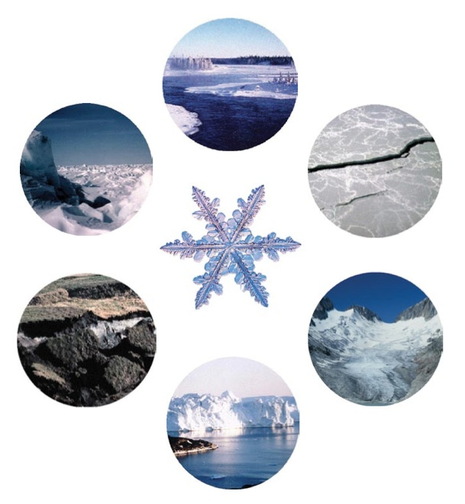

Slide 35
Plans, Milestones
 | Suomi NPP | JPSS J1
FY15 | Validated Stage n (various) maturity reviews Continued validation of all products Improve or recommend replacement of Sea Ice Characterization algorithm Recommendations on snow/ice gridding | JPSS Risk Reduction Projects: Run GOES-R algorithms on VIIRS products Minor algorithm improvements
FY16 | Algorithm maintenance and minor improvements | Hold algorithm preliminary design reviews Define validation plan
FY17 | Long-term validation of VIIRS snow and ice products | Hold algorithm critical design reviews Begin transitioning to JPSS Redefine products if needed Generate LUTs for J1 VIIRS sensor
FY18 | Long-term validation of VIIRS snow and ice products | J1 launch Beta maturity status

Slide 36
Caveats for Operational VIIRS Sea Ice Characterization EDR - from Provisional Review
Known problems and proposed technical solutions
  In general, significant discontinuities in ice classification between New Young and Other Ice have been observed in the granule level mapped composite data.
    Proposed solution: Investigate and mitigate sensitivity of retrievals to NCEP ancillary data inputs. Mitigation strategies include use of parameterizations or climatology
  Ice classification discontinuities are very evident near the terminator region where the algorithm transitions from the day reflectance based algorithm to the night energy balance based algorithm
    Proposed solution: Nighttime algorithm could be revised to utilize a local sliding IST window. For example, if the IST for the pixel is greater than the mean plus a threshold of the IST in the moving window, then it would be re-classified as new/young ice. )
    Proposed solution: Investigate whether there is a problem with the solar energy flux term used by the heat balance for solar zenith angles between 80° and 90° and correct the implementation if necessary.
  The snow depth thresholds based on the snow accumulation depth/ice thickness climatology LUT are problematic
    Proposed solution: LUT generation logic requires modification to correct climatologically unrealistic values of snow accumulation depth identified the current LUT
    Proposed solution: Investigate use of ancillary precipitation to derive snow depth and compute an ice thickness based on that snow depth. Dependence on the problematic SnowDepth/IceThickness Climatology LUT can then be eliminated.

Slide 37
Caveats for Operational VIIRS Sea Ice Characterization EDR (additional issues) - from Provisional Review
  False ice is frequently observed near cloud edges
    Proposed solution: Implement additional quality checks for extended cloud adjacency and partly cloudy conditions within the ice tie point search window in the Sea Ice Concentration IP and pass quality flag to Sea Ice Characterization EDR
  Ice misclassifications occur due to low opacity clouds or ice fog, particularly during nighttime
    Proposed solution: Assistance from VCM to improve cloud vs. ice detection
  Thin ice in small leads are evident in SDR imagery are sometimes not detected and are classified as thicker “Other ice”
    Proposed solution: Investigate using VIIRS SDR reflectance and Surface Temperature IP value at each pixel for retrievals instead of the ice tie point
    Proposed solution: Add an ice temperature threshold hold test to the day reflectance algorithm as a consistency check for the day, reflectance based retrievals
  Lower reflectance of melting sea ice appears to cause the SIC EDR to indicate New/Young Ice, although this type of ice cannot be present this time of year.
    Proposed solutions: Define and utilize melt season period where New/Young ice cannot exist. Could do this by date/latitude or possibly with IST or NCEP air temp input. During this time, ALL ice would be classified as “other ice”
    Investigate reflectance and temperature thresholds used in the algorithm
    Investigate and mitigate sensitivity of retrievals to NCEP ancillary data inputs
    Change the category “New/Young Ice” to “Thin Ice”. Thin ice can occur, through melt, in the warm season.

Slide 38
Backup: JPSS-1 Product Maturity Definition
JPSS/GOES-R Data Product Validation Maturity Stages – COMMON DEFINITIONS (Nominal Mission)
Beta Product is minimally validated, and may still contain significant identified and unidentified errors. Information/data from validation efforts can be used to make initial qualitative or very limited quantitative assessments regarding product fitness-for-purpose. Documentation of product performance and identified product performance anomalies, including recommended remediation strategies, exists.
Provisional Product performance has been demonstrated through analysis of a large, but still limited (i.e., not necessarily globally or seasonally representative) number of independent measurements obtained from selected locations, time periods, or field campaign efforts. Product analyses are sufficient for qualitative, and limited quantitative, determination of product fitness-for-purpose. Documentation of product performance, testing involving product fixes, identified product performance anomalies, including recommended remediation strategies, exists. Product is recommended for operational use (user decision) and in scientific publications.
Validated Product performance has been demonstrated over a large and wide range of representative conditions (i.e., global, seasonal). Comprehensive documentation of product performance exists that includes all known product anomalies and their recommended remediation strategies for a full range of retrieval conditions and severity level. Product analyses are sufficient for full qualitative and quantitative determination of product fitness-for-purpose. Product is ready for operational use based on documented validation findings and user feedback. Product validation, quality assurance, and algorithm stewardship continue through the lifetime of the instrument.
May 2014, GOES-R, JPSS, and STAR Science Teams

