Slide 1
Tracking of Atlantic Tropical Cyclones using Combined S-NPP and NOAA-20 CrIS Observations
JPSS CrIS SDR Team
September 14, 2018

Slide 2
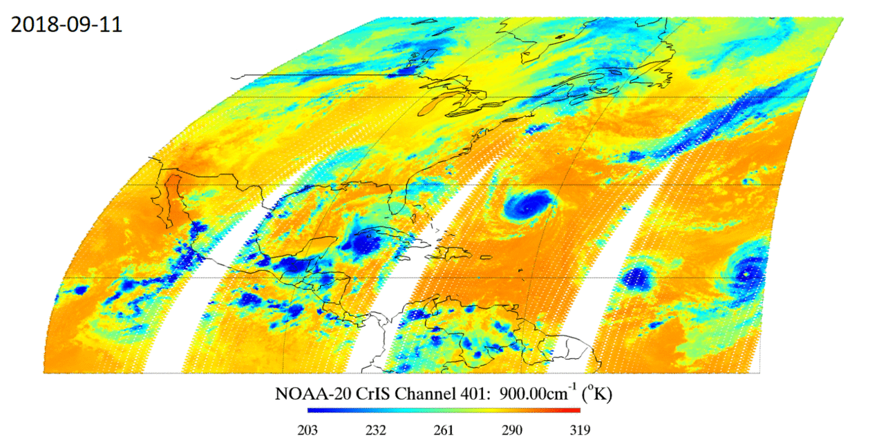
Tracking of Atlantic Tropical Cyclones using Combined S-NPP and NOAA-20 CrIS Observation at 900 cm⁻¹
Florence
Joyce
Helene
Isaac
9 FOVs with no average used
CrIS observations are able to track the location of tropical cyclones by sensing the cold cloud top temperatures associated to the deep convection developed over the tropical cyclones.
Animation Generated by Yong Chen and Flavio Iturbide-Sanchez.
With contributions from Silvia Regina Santos da Silva from UMD.

Slide 3
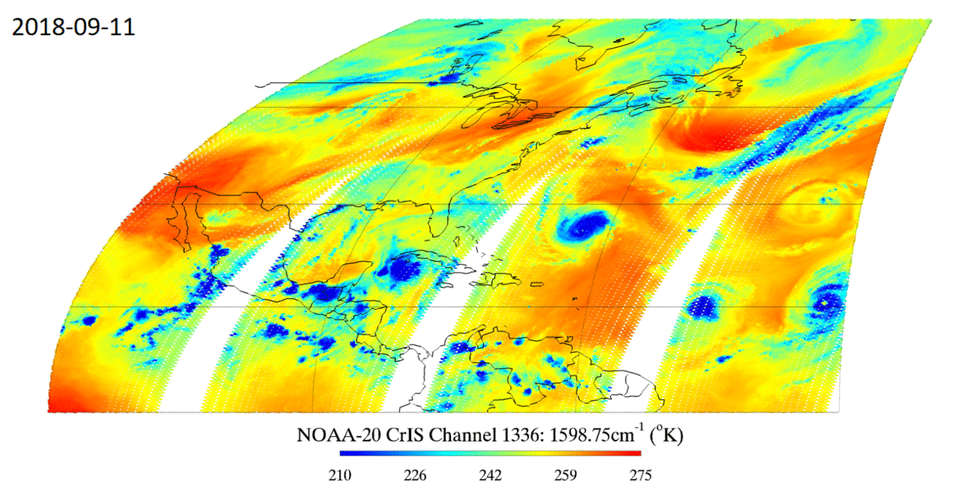
Tracking of Atlantic Tropical Cyclones using Combined S-NPP and NOAA-20 CrIS Observation at 1598.75 cm⁻¹
Florence
Joyce
Helene
Isaac
9 FOVs with no average used
CrIS observations also help to identify different development stages: deep organized convection around hurricane Florence; convection around tropical storm Isaac becoming disorganized between Sep/11 and 13; formation of the tropical storm Joyce on Sep/12 from a low pressure system in the north Atlantic; Helene evolving toward a weaker and disorganized convective pattern on Sep/13.
Animation Generated by Yong Chen and Flavio Iturbide-Sanchez. With contributions from Silvia Regina Santos da Silva from UMD.

