Slide 1

Ordering & Downloading VIIRS L2 Data Files from NOAA CLASS

Slide 2
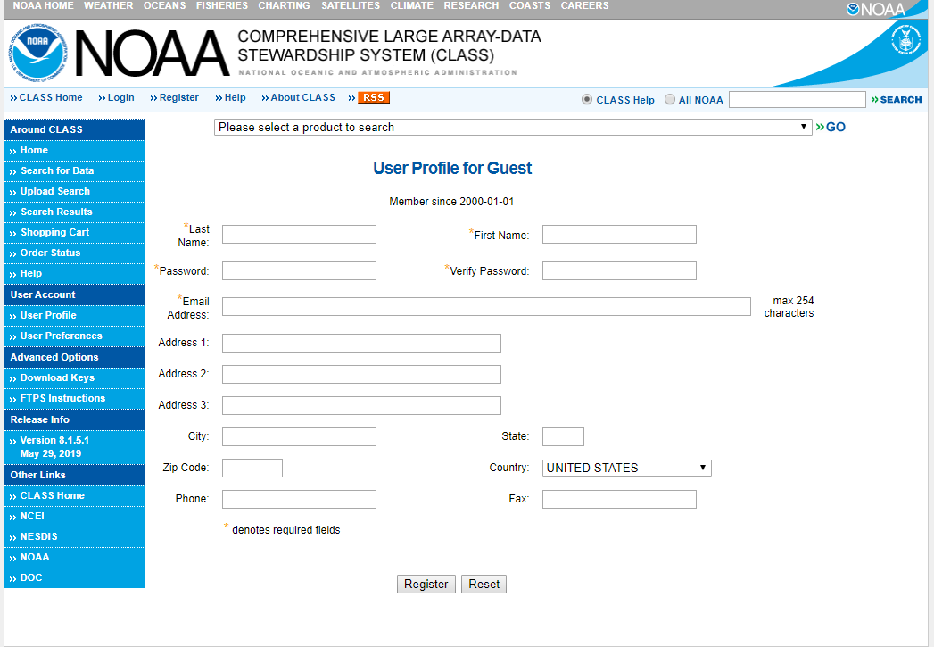
https://www.avl.class.noaa.gov/saa/products/user_profile
In order to download data, you must register with CLASS
You may search and browse for datasets without registering
Once you submit your information, your userID will appear near the top of the page – make a note of it for future logins

Slide 3
VIIRS Aerosol and Fire Products
(Enterprise Processing System Algorithm):
  Aerosol Optical Depth
  Aerosol Detection (smoke/dust)
  Active Fires

Slide 4
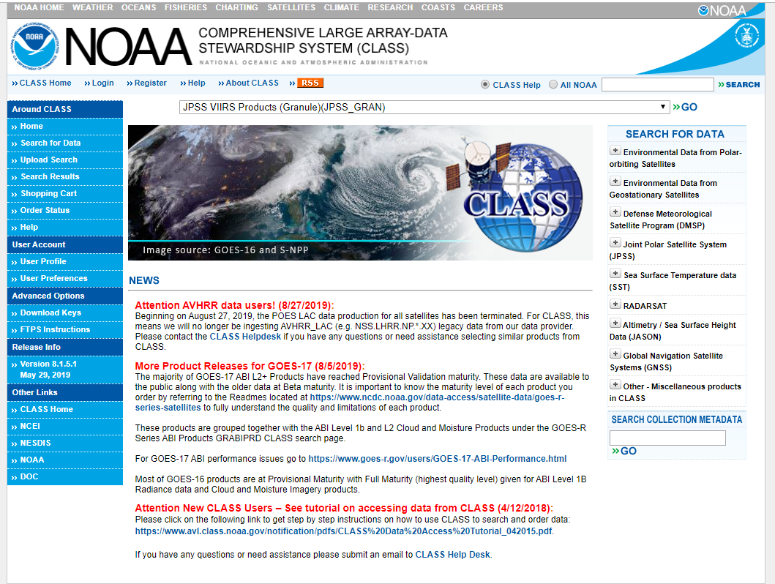
https://www.avl.class.noaa.gov/saa/products/welcome
From the drop-down menu at the top of the CLASS home page, select:
JPSS VIIRS Products(Granule)(JPSS_GRAN)
and click GO

Slide 5
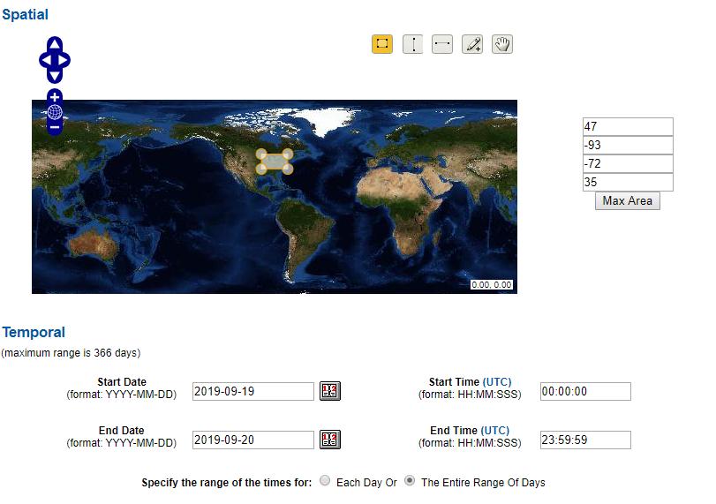
The Search page will open
  Select the desired geographic area from the Spatial section
  Select the date/time period of interest from the Temporal section

Slide 6
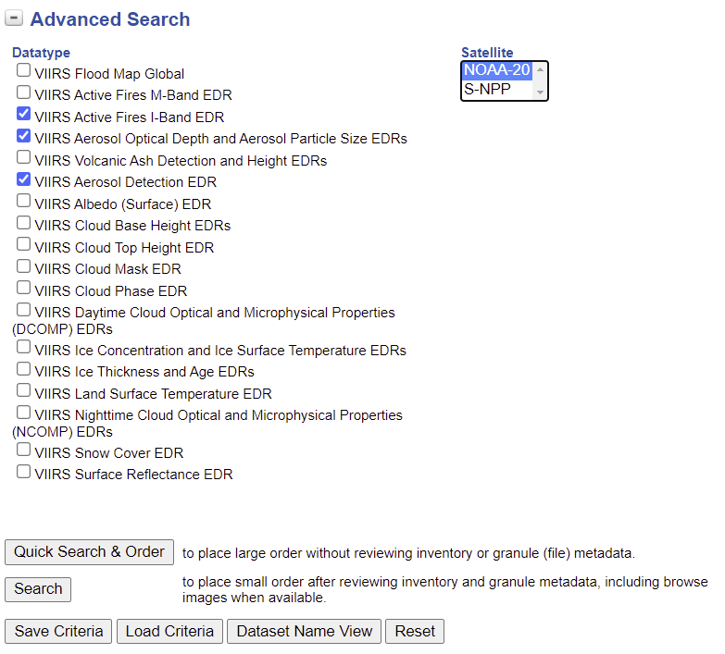
In the Advanced Search section, under Datatype select:
  VIIRS Active Fires I-band EDR and/or
  VIIRS Aerosol Optical Depth and Aerosol Particle Size EDRs and/or
  VIIRS Aerosol Detection EDR
Select the Satellite (NOAA-20 or
S-NPP)
Then click Quick Search & Order or Search, depending on the size of your request

Slide 7
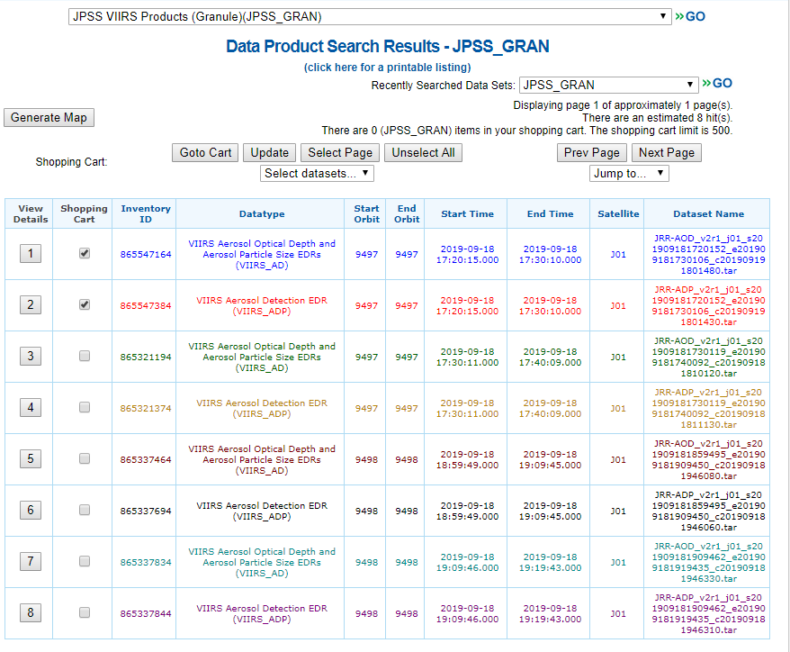
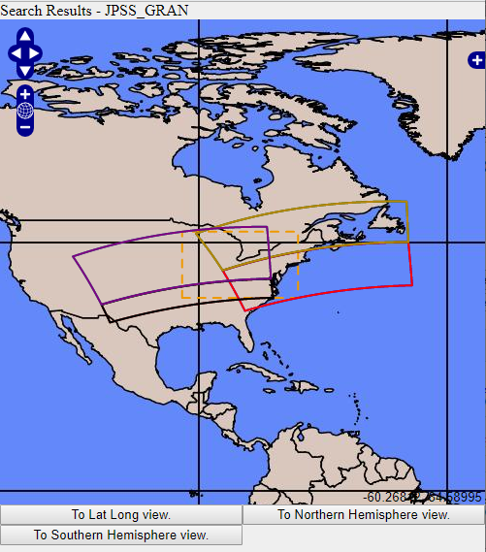
A new page will open
All the files for the time period and geographic area you selected will be listed
  Select the files you want by clicking manually, by using the Select Page and Unselect Page buttons, or the Select datasets… drop down menu
  You can also click on the Generate Map button to see a map of the available data swaths
When you are done, click the Update button and then the Goto Cart button

Slide 8
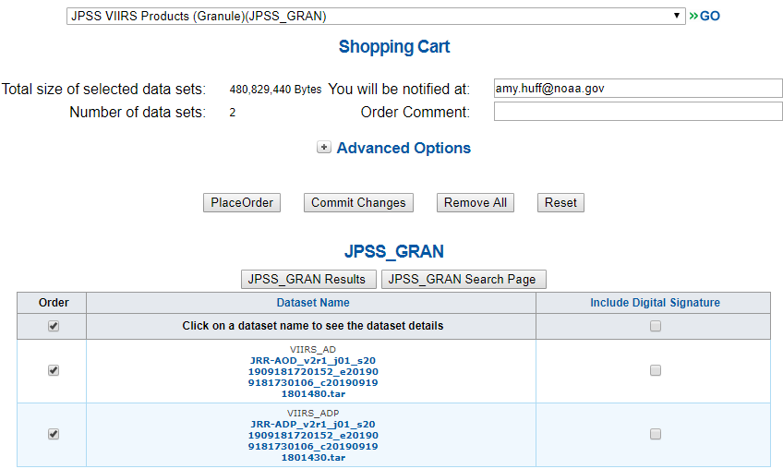
The Shopping Cart page will open
Check the file selection again if needed
Click the Place Order button to place your order
You will receive a verification email saying your order is in progress
When the order is ready, you will receive another email with instructions on how to access the files (see next section)
IMPORTANT: You must be registered in CLASS and logged into your account to place an order!
If you don’t see the Place Order button, you need to register or log in!

Slide 9
How to Download Files from CLASS

Slide 10
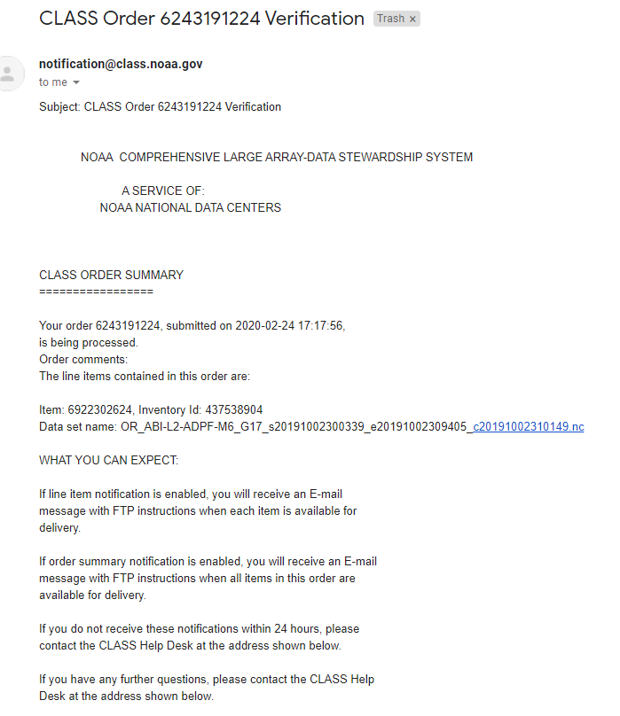
After you submit your order to CLASS, you will get a Verification email, like this one, confirming your order
You don’t need to do anything at this point

Slide 11
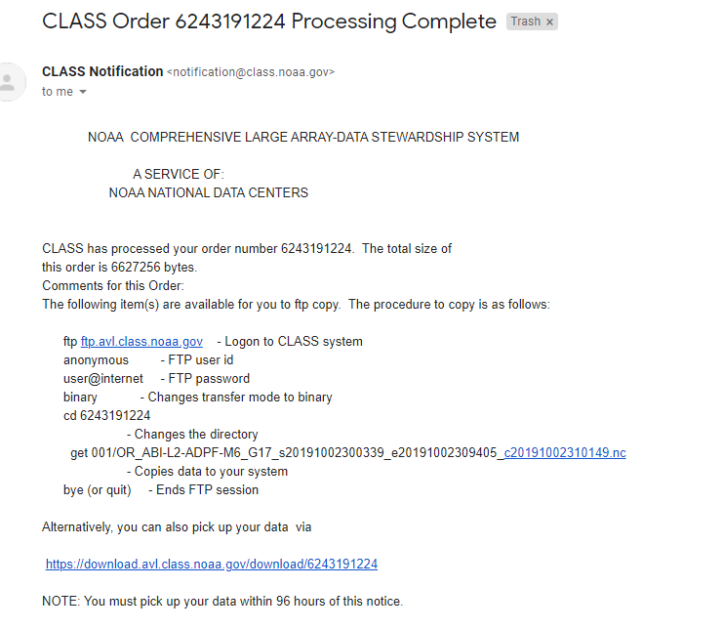
When your order is ready, you will receive a Processing Complete email, like this one
At this point, there are 2 ways to access your files:
download URL
  Best for small orders (a few files)
  Click on the provided URL
  Example on slide 12
anonymous ftp
  Best for large orders (many files)
  See slide 13 for instructions
2.
1.

Slide 12
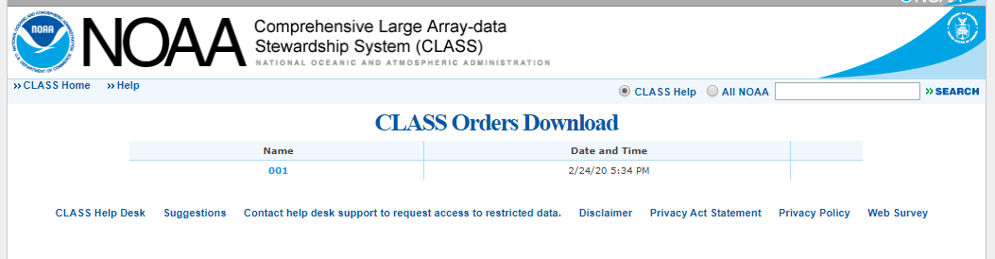
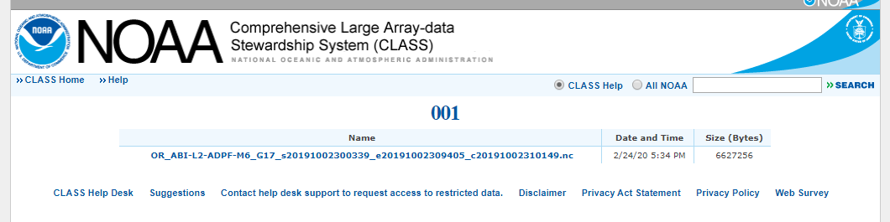
Example of file download via URL
Step 1: Click on “001” near top of the page
Step 2: The list of your files will open. Click on each file to download.

Slide 13
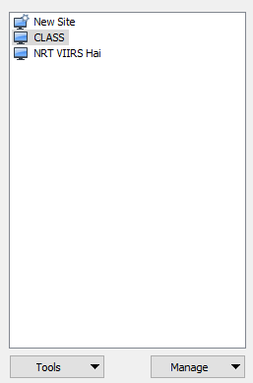
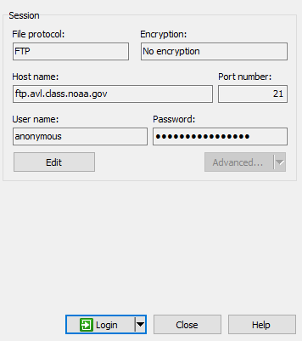
Download via anonymous ftp
Use WinSCP (shown here) or a similar file transfer program
Options to connect to CLASS
  File protocol: FTP
  Encryption: No encryption
  Host name: ftp.avl.class.noaa.gov
  Port number: 21
  User name: anonymous
  Password: user@internet
Once you connect, find the folder corresponding to your order number
  In example from slide 10-11, the order number is: 6243191224
Your files are inside this folder; you can transfer them directly to your computer!

Slide 14
A more in-depth CLASS Data Access Tutorial is available from the CLASS website at: https://www.avl.class.noaa.gov/notification/pdfs/CLASS%20Data%20Access%20Tutorial_042015.pdf

