Slide 1
Load USGS Base Map 500m
86400 x 43200 as global domain
Load 500m Bathymetry data to cover Antarctic
( > 0 is Land)
Start
Geotiff Reader
Global Surface Water Landsat 30m geotiff 2018 (50S - 75N)
With Seasonality Change Scales
40000 x 4000 per 10 degree tiles
Center pixel match with 18x18 pixel average, 70% agreement.
Geotiff Readers
UMD Global Forest Landsat 30m geotiff 2016 (50S - 75N)
40000 x 4000 per 10 degree tiles.
Center pixel match with 16x16 pixel average, 70% agreement
GDAL HDF/NetCDF Reader
MOD44W v6 Landmask data
sinusoidal tile grid convert to geographic projection.
Cubic interpolation
GDAL HDF/NetCDF Reader
MOD44W v6 Landmask quality flag. Sinusoidal tile grid conversion. (flag =1 for high confidence obs, or flag=4 firm water)
Loop through all Base image pixels
If both Landsat data agreed. Pixel updated
If GSW Landsat agreed with MOD c6 + flags, Pixel updated
Base map pixels not satisfied for replacement will remain unchanged
Perform global base Landmask pixel update and create netCDF output
END

Slide 2
Base USGS Grid 500m
43200
86400
GSW LandSAT 30M
UMD
Base grid Lat/Lon pixel Position Matches for Landsat datasets
Matched Lat/Lon < 0.0001 (unique find)
Then conduct neighbor 15 x 15 pixel check. Agreement > 70% to determine water/land
40000 x 40000 per 10 degree tile

Slide 3
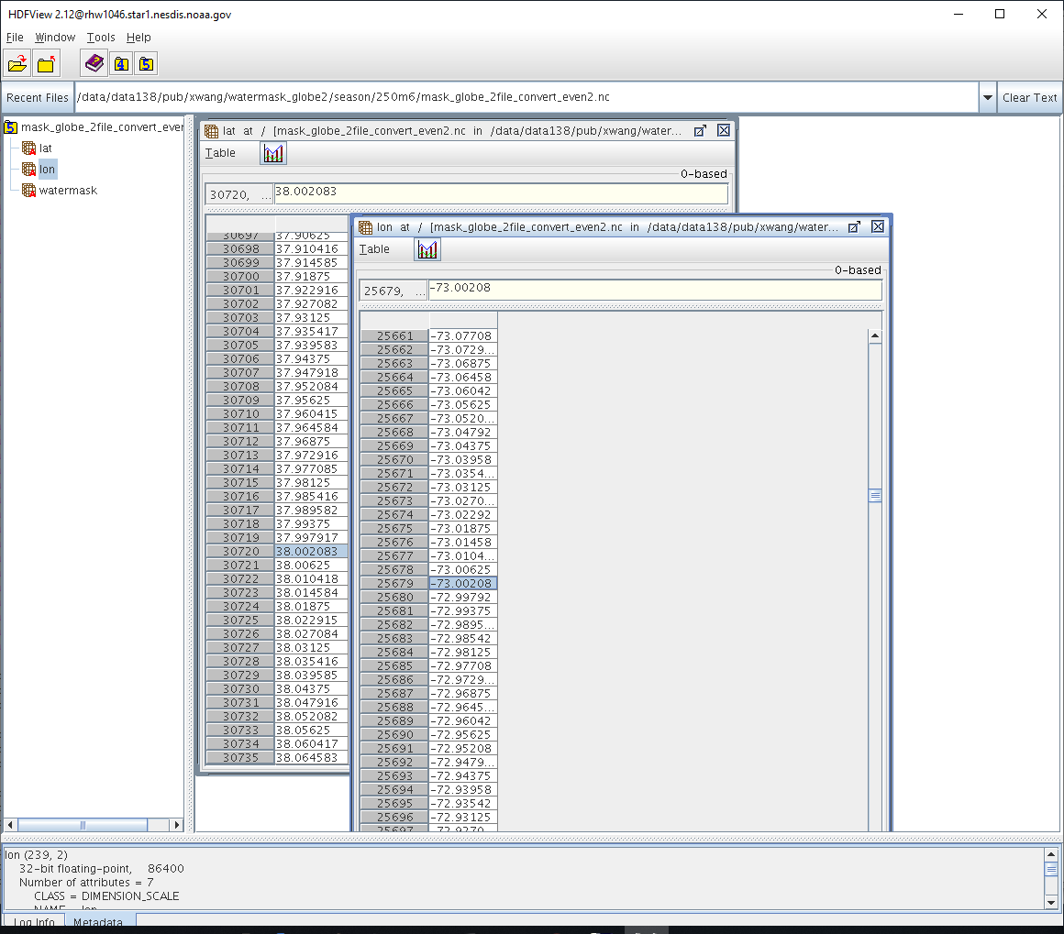
USGS base grid
lat:38.002083 lon:-73.00208
Lat:37.997917 lon:-72.99792
. . . .

Slide 4
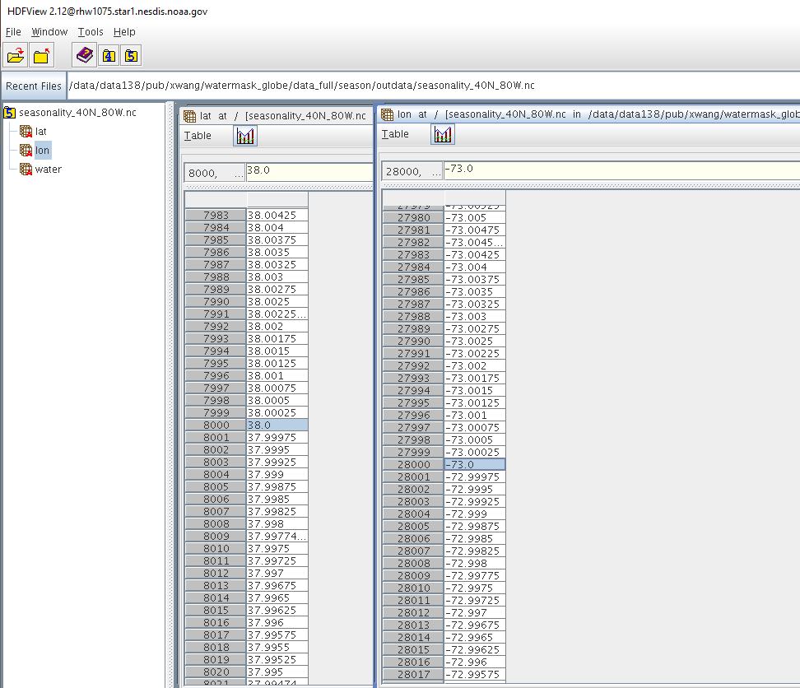
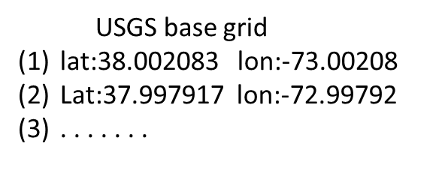
Data View OF Matched Lat/Lon Grid Point
Select data point
Lat = 38N
Lon = 73W
(1)
(1)
(2)
(2)

Slide 5
Pseudo code for Determine UMD Landsat
corresponding pixels are water/land pixels:
P(ix, iy) = matched pixel in UMD 30m Landsat grid.
If total count(umd_image(ix-7 : ix+7, iy-7 : iy+7)) LT 158 then
water_umd(in USGS grid) = 0 (land)
else
water_umd(in USGS grid) = 1 (water)
(15 x 15 box = 225 pixels, 158/225=70.0222%)

Slide 6
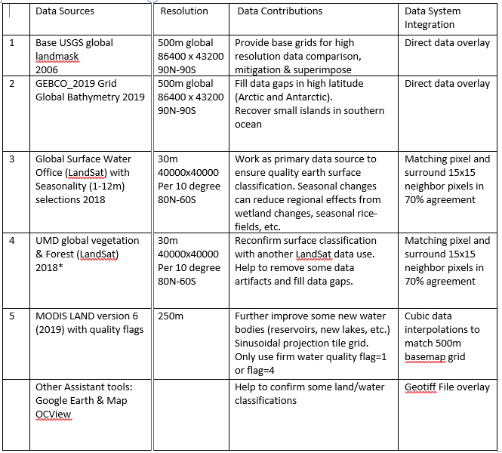
Data Sources used for Landmask Improvement

Slide 7
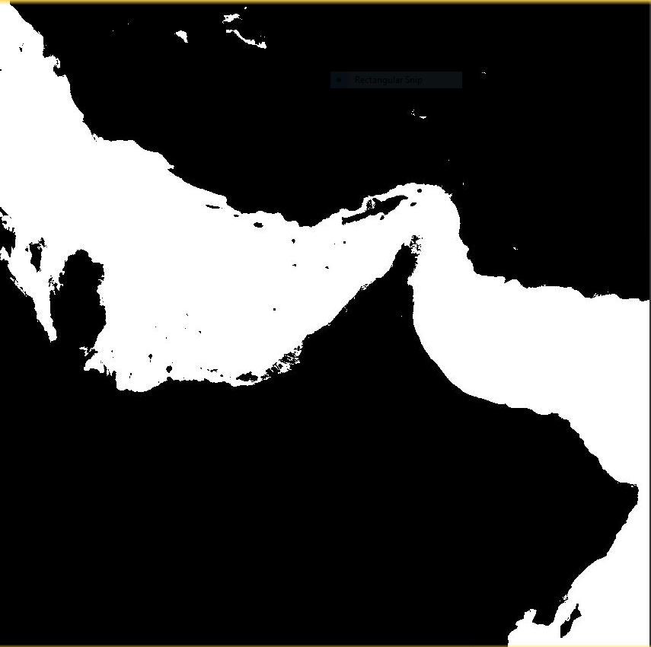
GSW
Landsat
Dubai, United Arab Emirates
UMD Landsat
MODIS Land v6

Slide 8
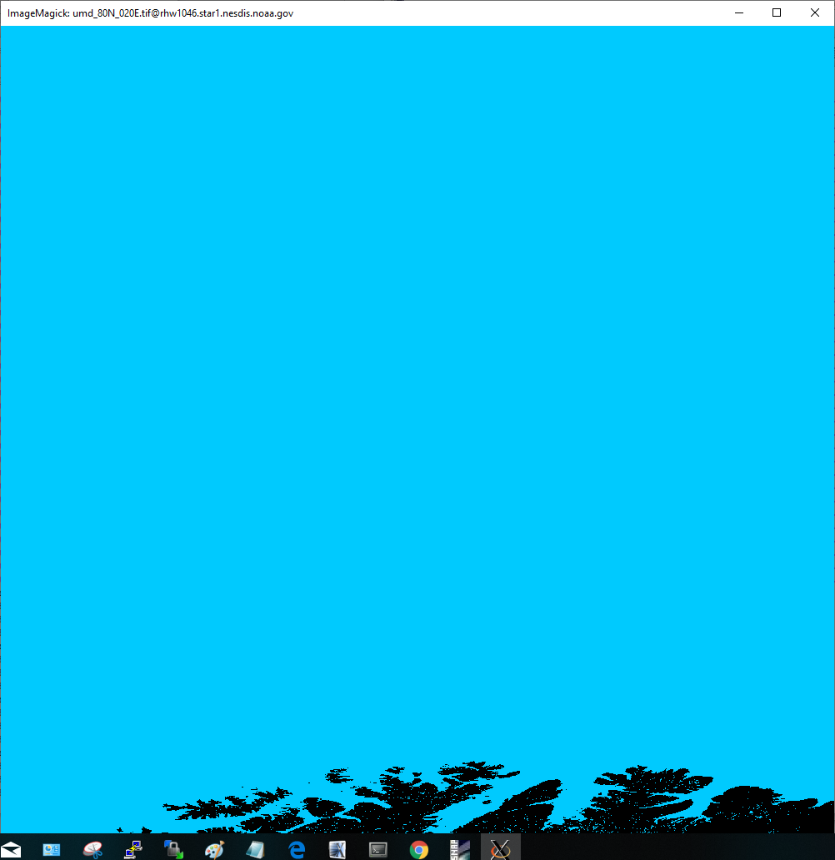
UMD 80N 20E

Slide 9
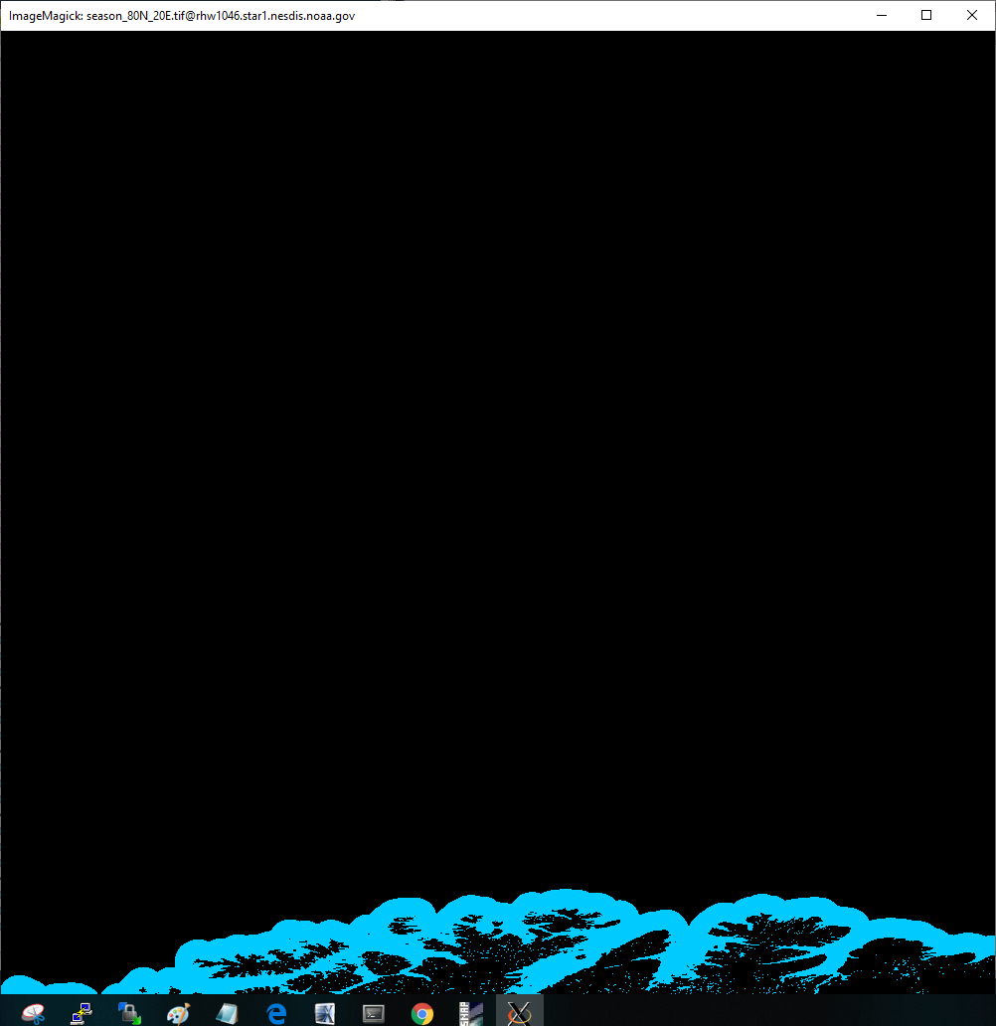
GSW 80N 20E

