Slide 1
Nowcasting Lightning Events with a Cloud-based Deep Learning approach
Valliappa (Lak) Lakshmanan, Jason Hickey, Cenk Gazen, Weam Abu Zaki
@lak_gcp
lak@google.com
Notes:
Short link: http://bit.ly/ams-cloud-deep-learning
In this talk, we develop a nowcasting algorithm to predict lightning events 30 minutes in the future using a modern computing and machine learning approach. The data comes from the GOES-16 satellite infrared channels and GLM channels. The prediction algorithm is formulated both using a traditional machine learning approach and using a modern approach that takes advantage of cloud computing and deep learning. In the traditional machine learning approach, feature engineering is performed manually and the data-sizes are relatively small. Features are extracted from a sequence of infrared and lightning event grids and the label used is the presence or absence of a lightning event. A novel data selection approach is utilized to keep the training dataset relatively balanced. Manual feature engineering is dropped in favor of deep learning using convolutional networks employing many of the standard deep learning tricks. All the work is carried out on a Jupyter notebook on a low-cost compute environment, with scaling delegated to powerful cloud-based components. It is hoped that, beyond this single example, the general approach will provide a template for a plethora of other applications involving remotely sensed imagery and numerical weather model outputs

Slide 2
Problem setup
01
Notes:
To show you what I mean ...

Slide 3
Nowcasting lightning events
Label: Lightning images from 30-K minutes to +30 minutes
t_{-K}
t₀
t₃₀
Inputs:
Current IR (11-micron) image
Lightning images from -K minutes to current image

Slide 4
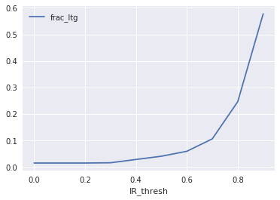
Why would this work?
Predicting lightning 30 minutes into the future (just one image)
+
Lightning systems can persist

Slide 5
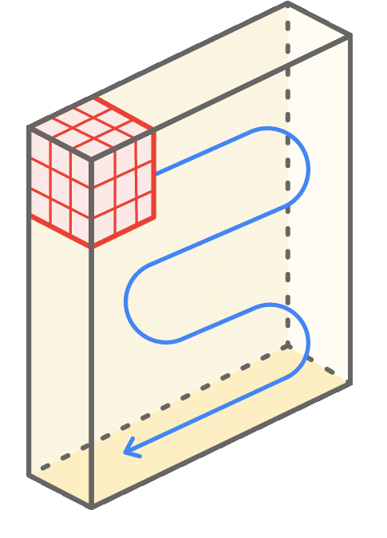
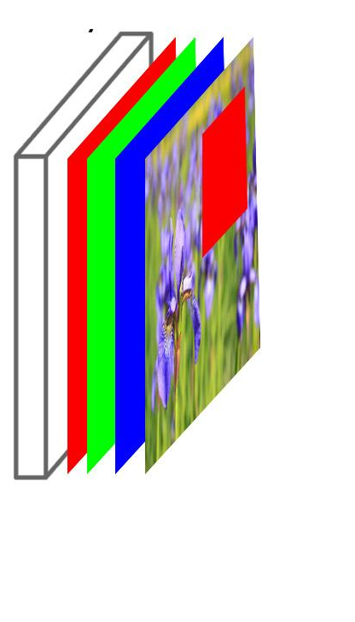
Work with image patches
Instead of considering each image as a whole, or as an individual pixels, extract image patches from them.
The size of the image patches:
Inputs: 65x65
Label: 5x5
0.02-deg (approx 2km) pixels

Slide 6
Dataset creation
02
Notes:
To show you what I mean ...

Slide 7
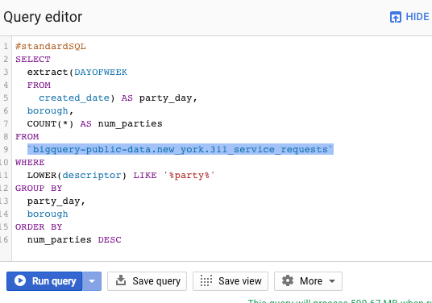
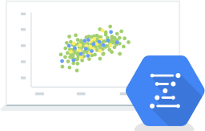
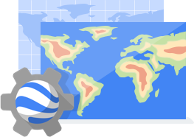
Three types of (public) scientific data on GCP
Google BigQuery
Structured datasets
Query using Standard SQL
Query up to 1TB/month for no charge
Google Genomics
BigQuery for variants, etc.
BAM, VCF, etc. on Cloud Storage
https://github.com/googlegenomics
Geospatial datasets
Landsat, NEXRAD,
GOES-16, -17 on GCS
Earth Engine datasets

Slide 8



Bring ephemeral compute to data
Good for raster, unstructured datasets
Good for structured datasets
Processing
Cloud Dataflow
BigQuery Analytics
Petabit/s bandwidth network
Storage
Cloud Storage
(files)
BigQuery Storage
(tables)
Your datasets are here
How to process Landsat, GOES with Python Dataflow
https://cloud.google.com/blog/big-data/2016/11/how-to-do-distributed-processing-of-landsat-data-in-python

Slide 9
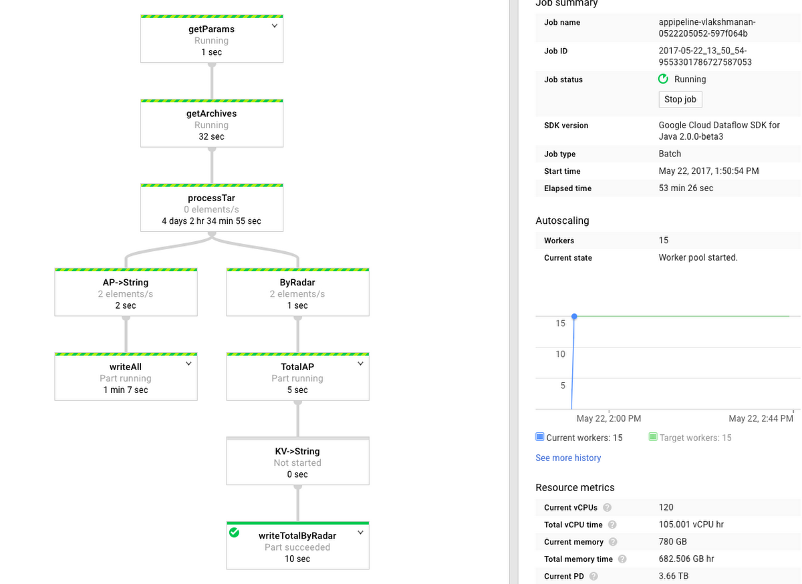
Autoscale the preprocessing of all the satellite data … without downloading any of it
https://cloud.google.com/blog/products/gcp/visualization-and-large-scale-processing-of-historical-weather-radar-nexrad-level-ii-data

Slide 10
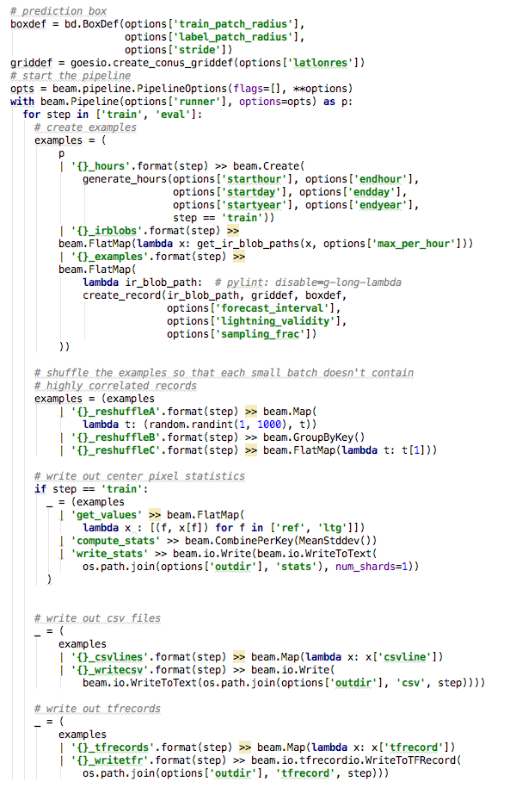
Python program to create ML dataset
Set up moving windows for extracting data
Starting/ending time (split datasets based on date into train/eval)
One training example per image patch
Shuffle all the records so that successive examples are not correlated
https://github.com/GoogleCloudPlatform/training-data-analyst/blob/master/blogs/lightning/ltgpred/preproc/create_dataset.py
Write image patches, but also statistics over entire dataset

Slide 11
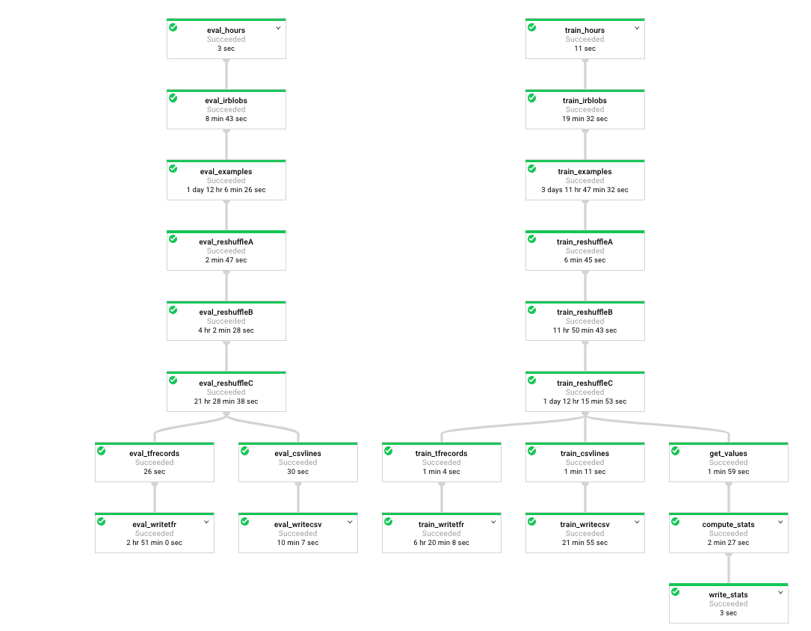
1.5 hours to process 300 days of GOES data
5.5 million examples
33% have label of ltg=1 (use a heuristic to prune null cases)
examples synoptically correlated
Cost: about $17

Slide 12
Machine Learning (traditional)
03
Notes:
To show you what I mean ...

Slide 13
Random Forests in
scikit-learn
Image patches
Features:
Mean, max of lightning in 65x65 and 32x32 boxes
n1-highcpu-32
32 vCPUs
28.8 GB memory
30 min, $4
Validation RMSE=0.47
But only a small (1 %) subset of the data since entire dataset needs to be held in memory
Random Forest (100 trees)
https://github.com/GoogleCloudPlatform/training-data-analyst/blob/master/blogs/lightning/ltgpred/trainer/train_skl.py

Slide 14
Machine Learning (deep-learning)
04
Notes:
To show you what I mean ...

Slide 15
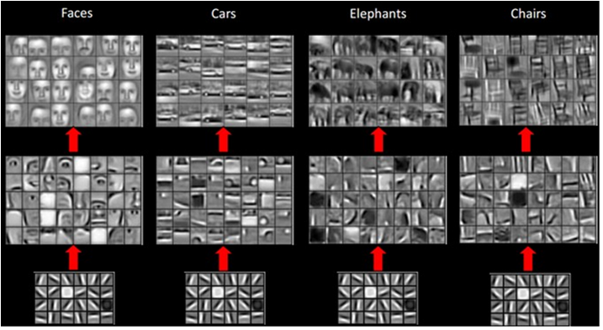
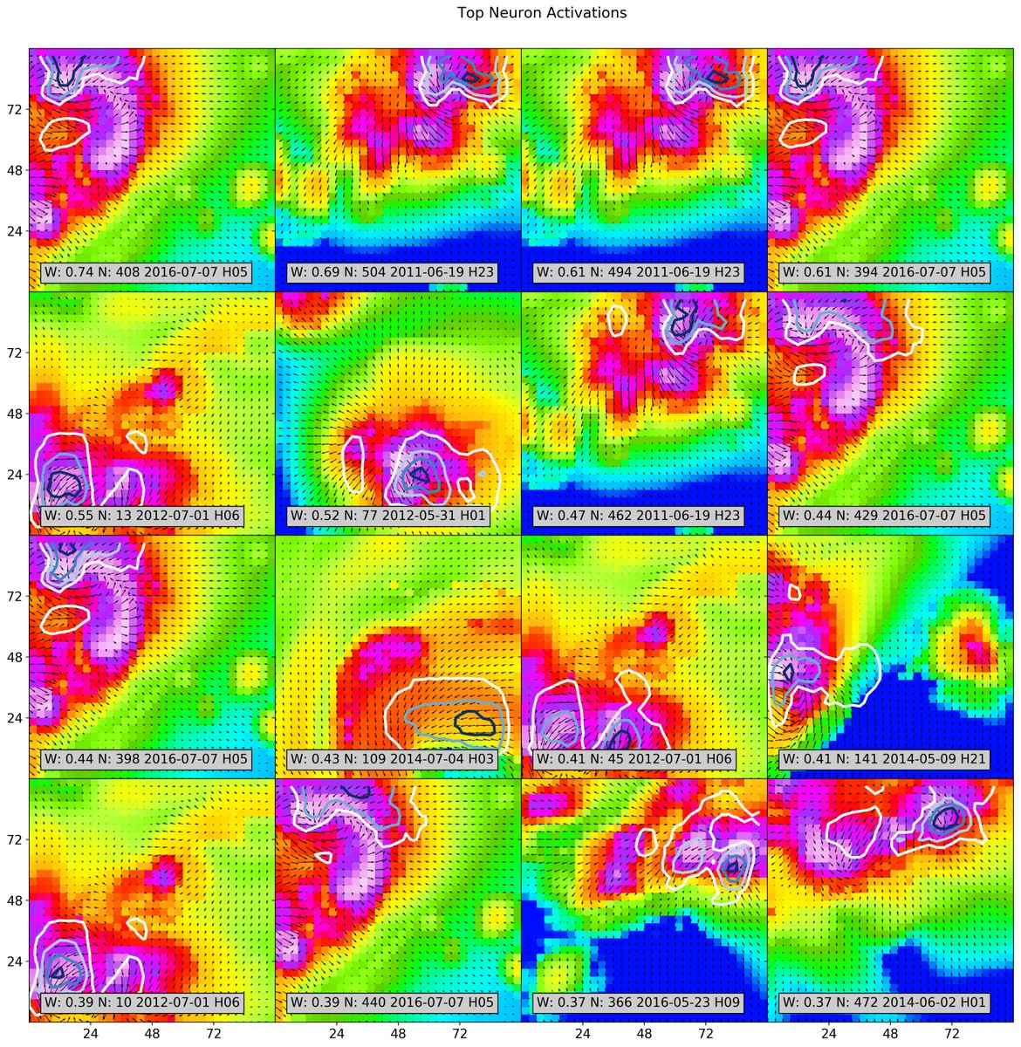
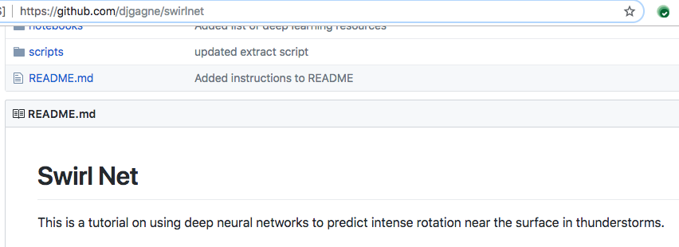
Deep Learning has completely revolutionized ML; it’s catching on in meteorology as well

Slide 16
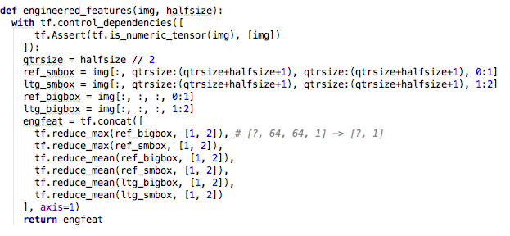
Use feature engineering in TensorFlow
Linear classifier using the mean/max of features (i.e. same as sklearn)
But use all the data
https://github.com/GoogleCloudPlatform/training-data-analyst/blob/master/blogs/lightning/ltgpred/trainer/train_cnn.py

Slide 17
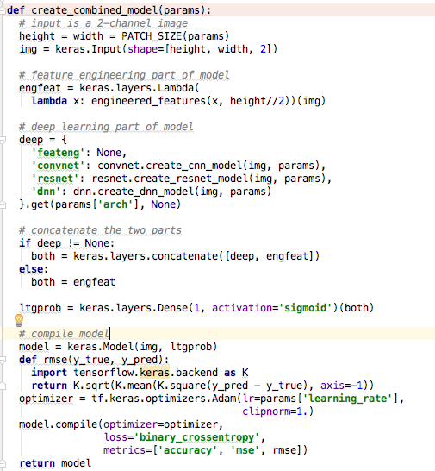
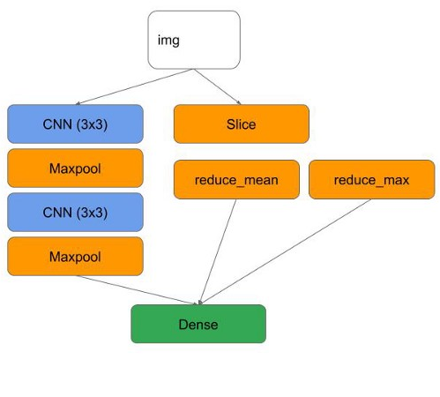
Concatenate feateng with deep layers

Slide 18
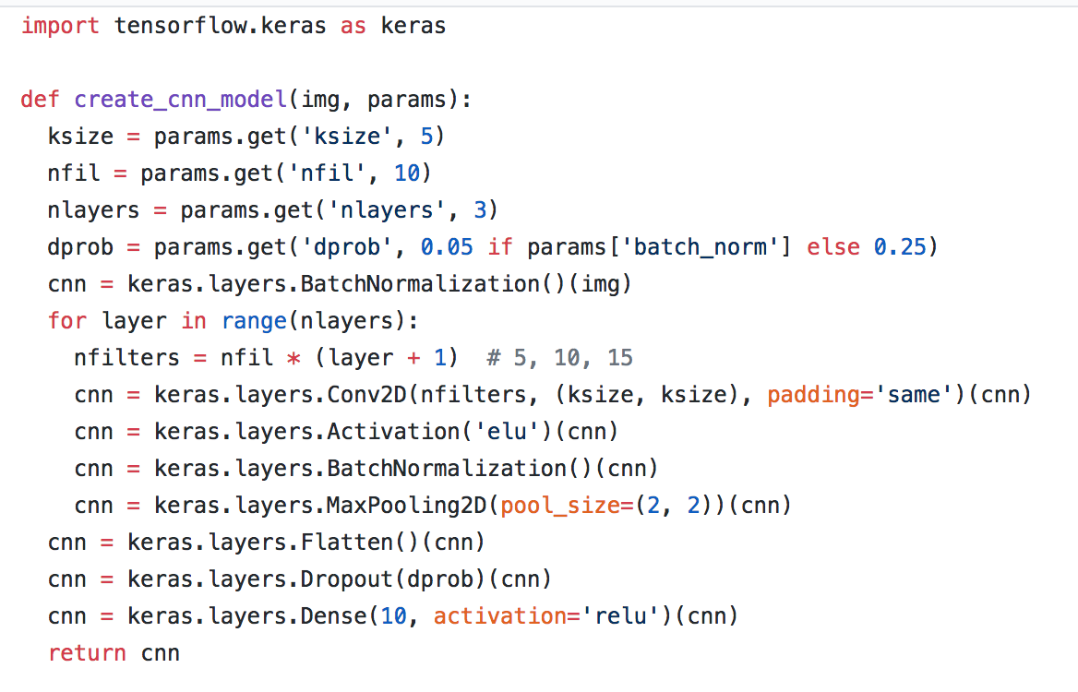
The convnet model
https://github.com/GoogleCloudPlatform/training-data-analyst/blob/master/blogs/lightning/ltgpred/trainer/convnet.py

Slide 19
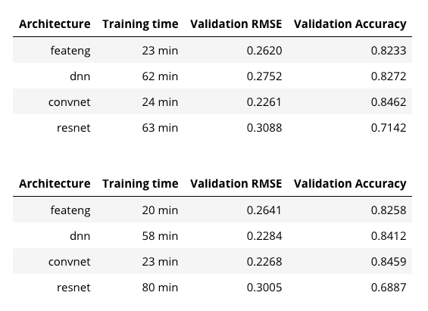
Deep learning helps, but not that much
dropout=0
dropout=0.05
On this problem, feature engineering is pretty much enough
Convnet reduces RMSE by 15%
Costs about $3 to train convnet
(accuracy by far less since only points near 0.5 threshold are affected by accuracy)

Slide 20
More data
More compute
05
Notes:
To show you what I mean ...

Slide 21
In ML, experimentation is necessary
The size of the image patches:
Inputs: 65x65
Label: 1x1 (not 5x5)
Stride=2 (not 4)
Lightning valid: 5 min (not 15)
0.02-deg (approx 2km) pixels ← keep the same
300 days of data ← keep the same (all we’ve got …)
Do hyperparameter tuning …
Number of filters
Number of layers
Learning rate
etc.
4x the data
Harder problem
More compute

Slide 22
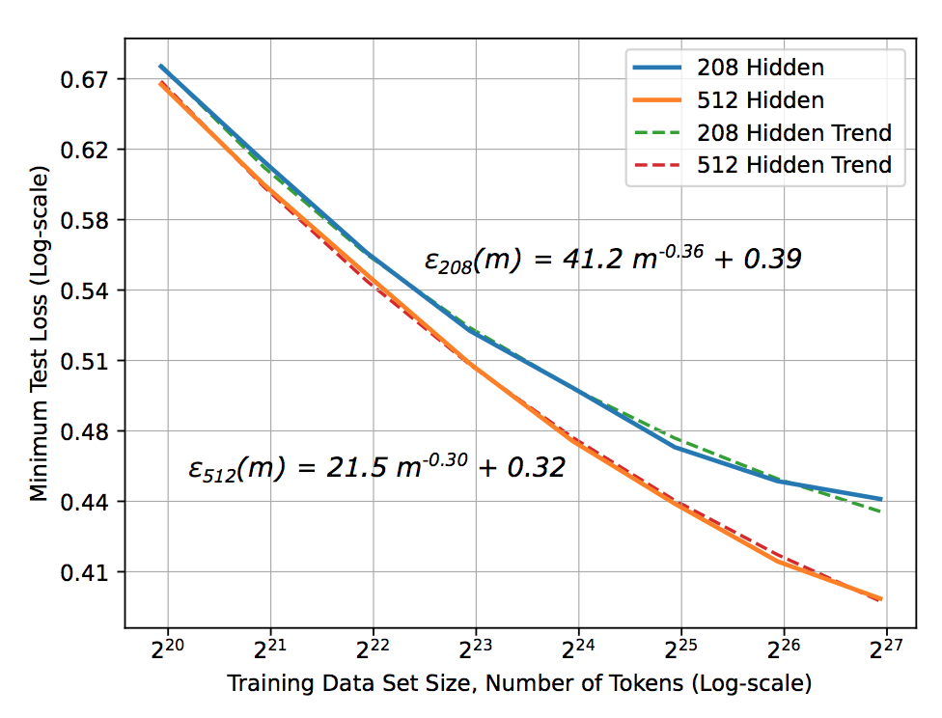
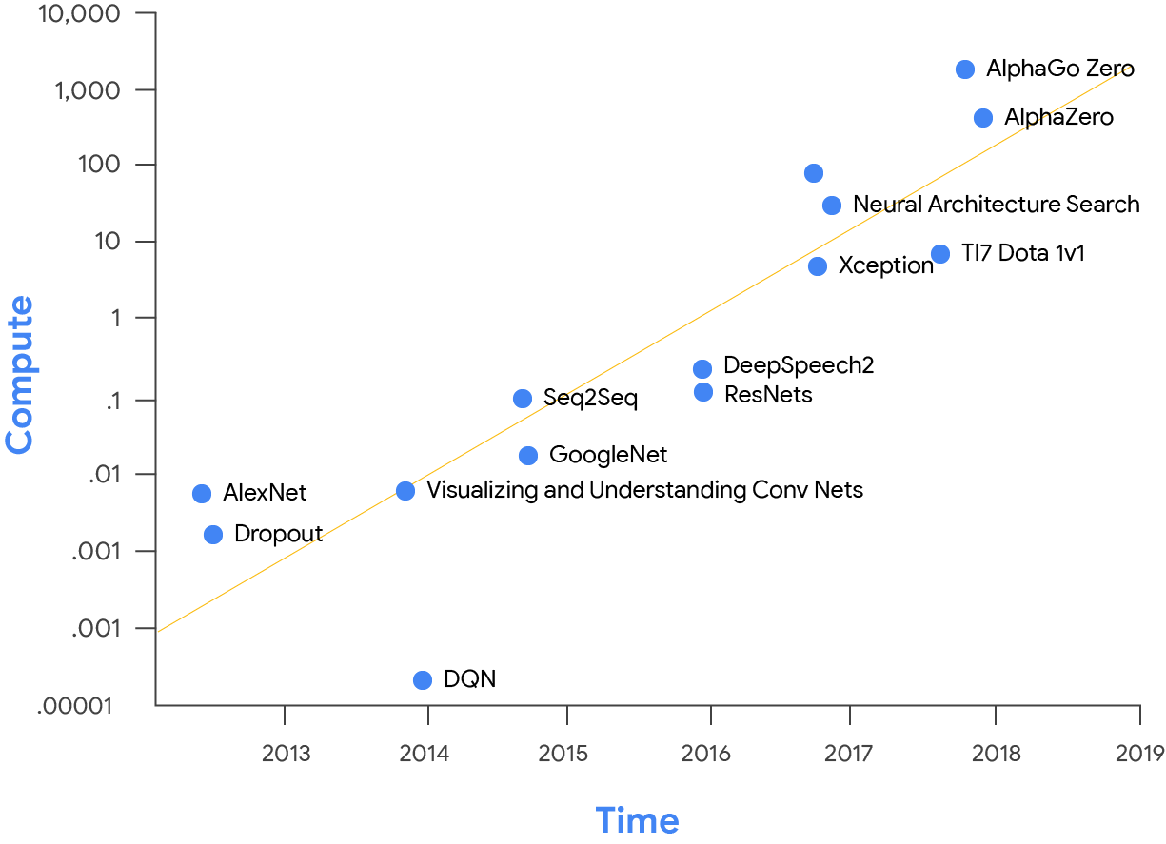
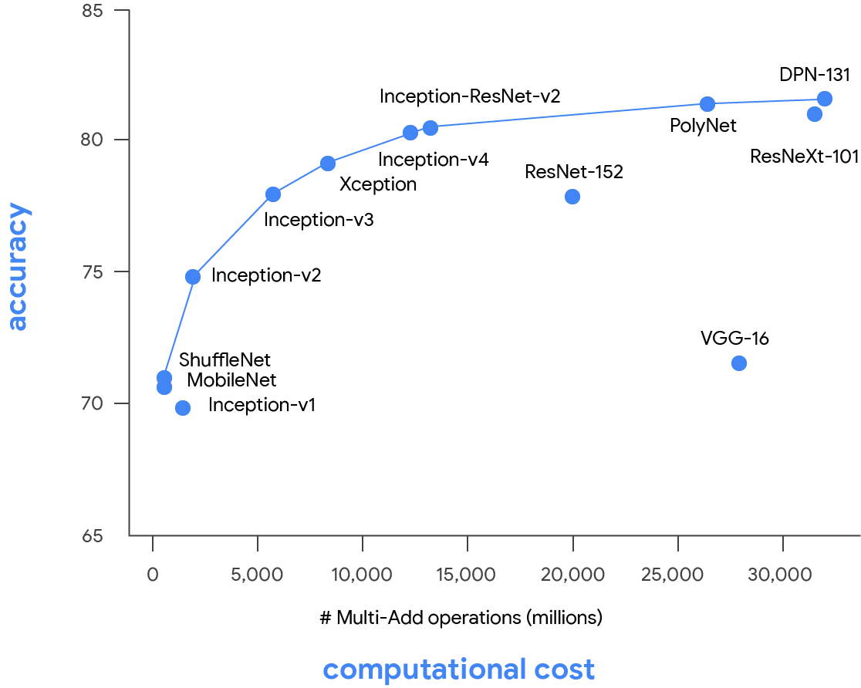
Many recent AI advances can be attributed to increases in data size and compute power
Deep Learning scaling is predictable, empirically
https://arxiv.org/abs/1712.00409
https://blog.openai.com/ai-and-compute/
Notes:
The synergy between the large datasets in the cloud and the numerous computers that power it has enabled remarkable advancements in machine learning, especially in DNNs. Unlike some domains, DNNs are broadly applicable. DNN breakthroughs include reducing word error rates in speech recognition by 30% over traditional approaches, the biggest gain in 20 years;¹¹ cutting the error rate in an image-recognition competition ongoing since 2011 from 26% to 3.5%;^{16,22,34} beating a human champion at Go;³² improved search ranking; and many more. A DNN architecture can benefit from a narrow focus yet still have many applications.

Slide 23
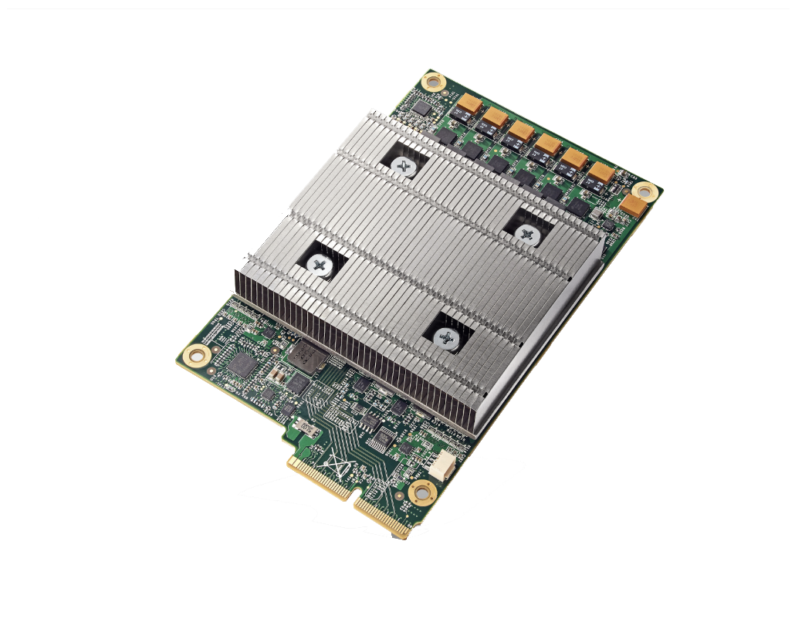
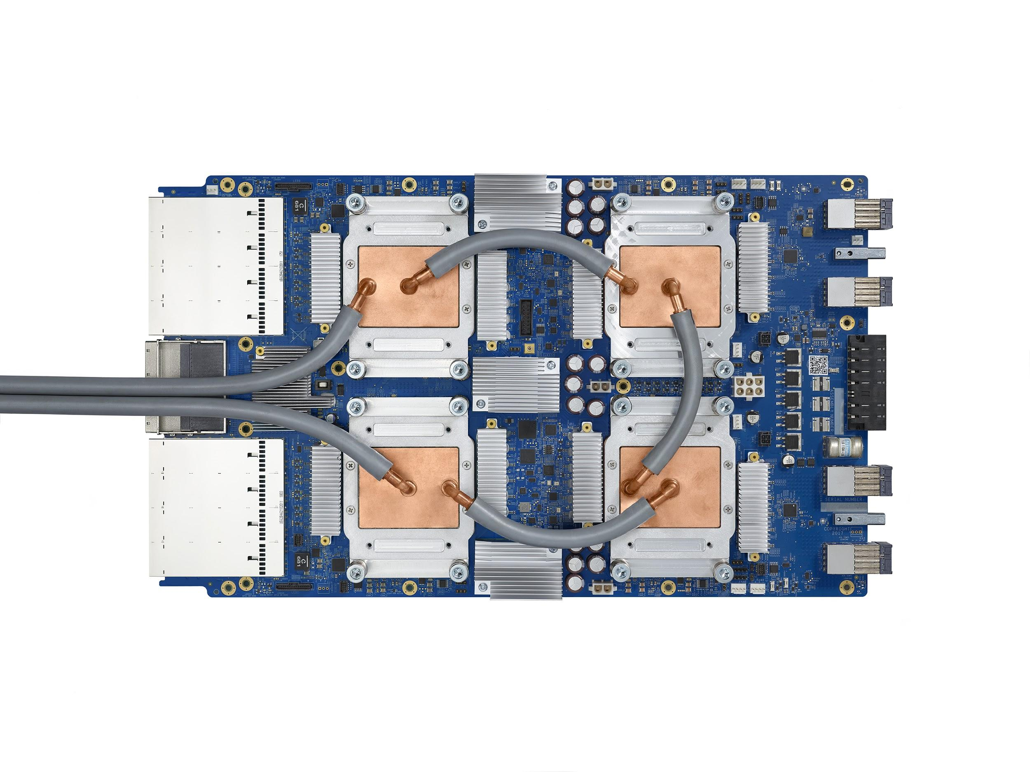
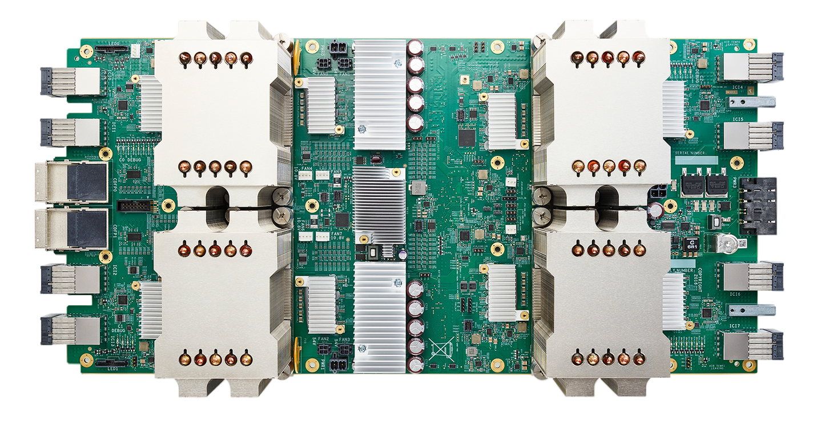
TPUs are ASICs focused on Machine Learning
TPU v2
(2017)
180 teraflops
Available via Google Cloud
TPU v3
(2018)
420 teraflops
Available via Google Cloud
8x the power of v2
TPU v1
(2015)
92 teraops
First Generation
Notes:
Since transistors are not getting much better (reflecting the end of Moore's Law), the peak power per mm² of chip area is increasing (due to the end of Dennard scaling), but the power budget per chip is not increasing (due to electro-migration and mechanical and thermal limits), and chip designers have already played the multi-core card (which is limited by Amdahl's Law), architects now widely believe the only path left for major improvements in performance-cost-energy is domain-specific architectures.¹⁷ They do only a few tasks but do them extremely well.
8x the power because more cores, more memory, faster processor (the flops only shows processor)

Slide 24
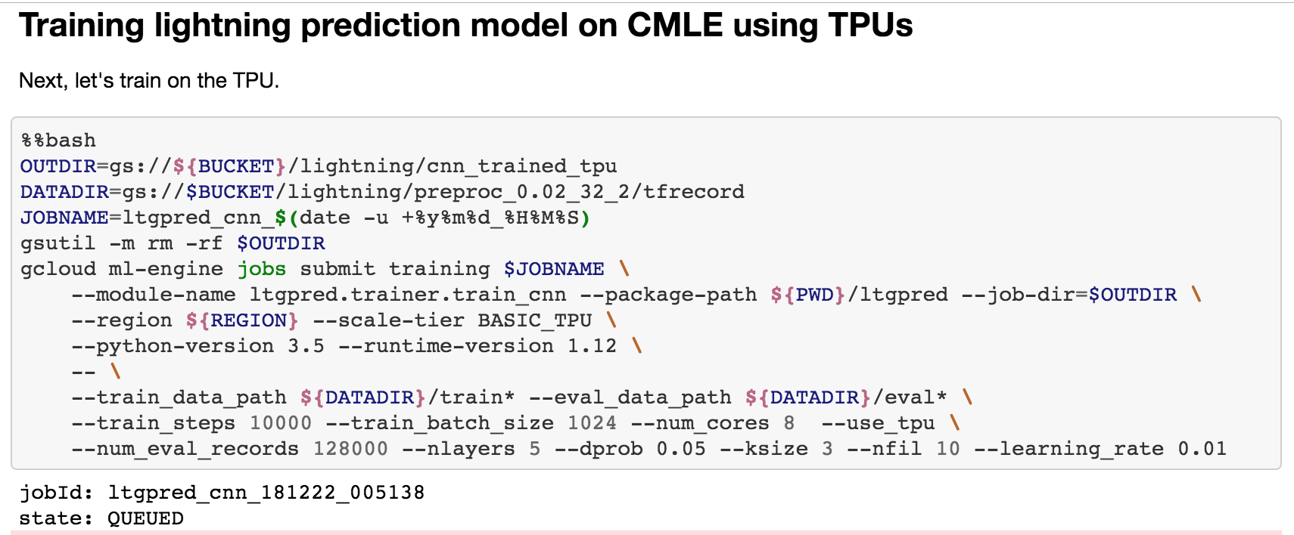
Use TPU instead of GPU ...
Cloud ML Engine is a managed service (no cluster management necessary)
Just send job

Slide 25
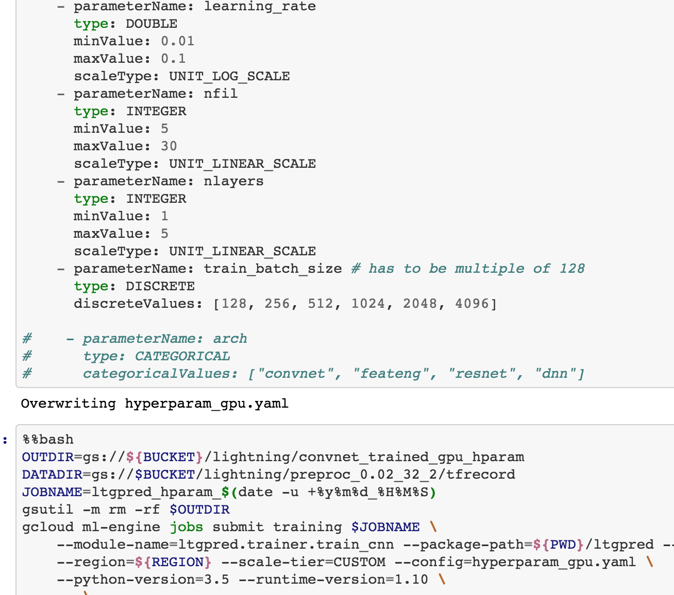
Hyperparameter tuning
Just specify search space
Uses a Bayesian optimization algorithm

Slide 26
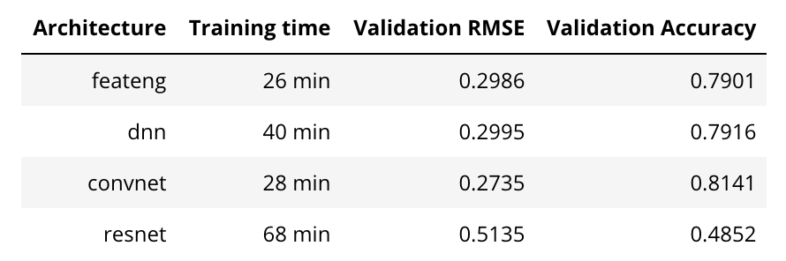
More data
Harder problem
Get accuracy numbers that are similar even though we have reduced label radius significantly!
TBD: what is accuracy in predicting lightning initiation/cessation?
0.25, 0.83 with 400 days

Slide 27
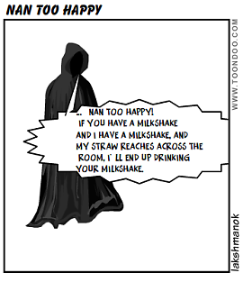
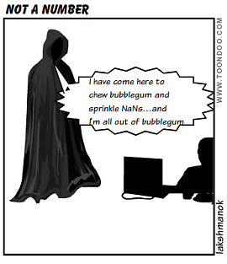


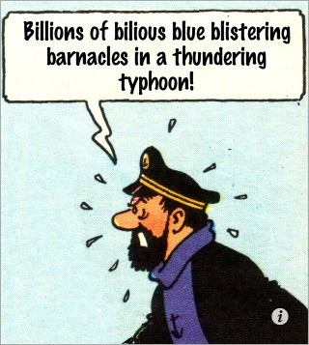
And for your amusement ...
https://medium.com/@lakshmanok/debugging-a-machine-learning-model-written-in-tensorflow-and-keras-f514008ce736
@lak_gcp

