Slide 1


Quantitative Precipitation Estimate Results from a Convolutional Neural Network Machine Learning Model

Slide 2
acknowledgements
Taiwan Central Weather Bureau (CWB)
  Yu-Shuang Tang
  Pao-Liang Chang
  Chia-Rong Chen
  Pin-Fang Lin
  Wei-Peng Huang
National Severe Storms Laboratory / Cooperative Institute for Mesoscale Meteorological Studies
  Jian Zhang
  Kenneth Howard
  Lin Tang
  Ami Arthur
University of Oklahoma School of Meteorology
  Ryan Lagerquist
  Amy McGovern

Slide 3
Qpes
Quantitative Precipitation Estimates (QPEs) are essential for hydrologic and hydrometeorological analyses
High temporal / spatial resolution rain data are necessary
Rain gauge observations and networks → too coarse
Weather radars → Better resolution!

Slide 4
Qpes - difficulties
Evaluation of QPEs often involve intercomparisons between ground-truth (e.g., rain gauge values) and radar estimates.
Limitations from comparisons: radar and non-radar
  Ground clutter
  Blockage
  Terrain
  Beam broadening with range
  Bright band
  Overshooting
  Improper calibration
  Gauge unreliability (clogging, freezing, etc.)

Slide 5
Current study
Machine learning (ML) has been a widely used tool in the meteorological community, with some simulations showing better predictions than competing methods including physically-based methods.
Taiwan has complex topography. Coupled with extreme QPEs due to Typhoons leads to flash flooding and other significant weather hazards over very short time periods
Can machine learning be implemented to improve QPEs compared to a physically-based QPE scheme?

Slide 6
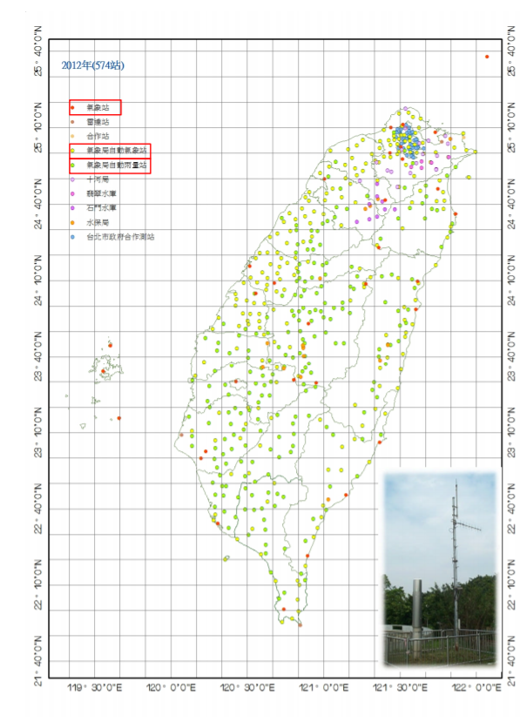
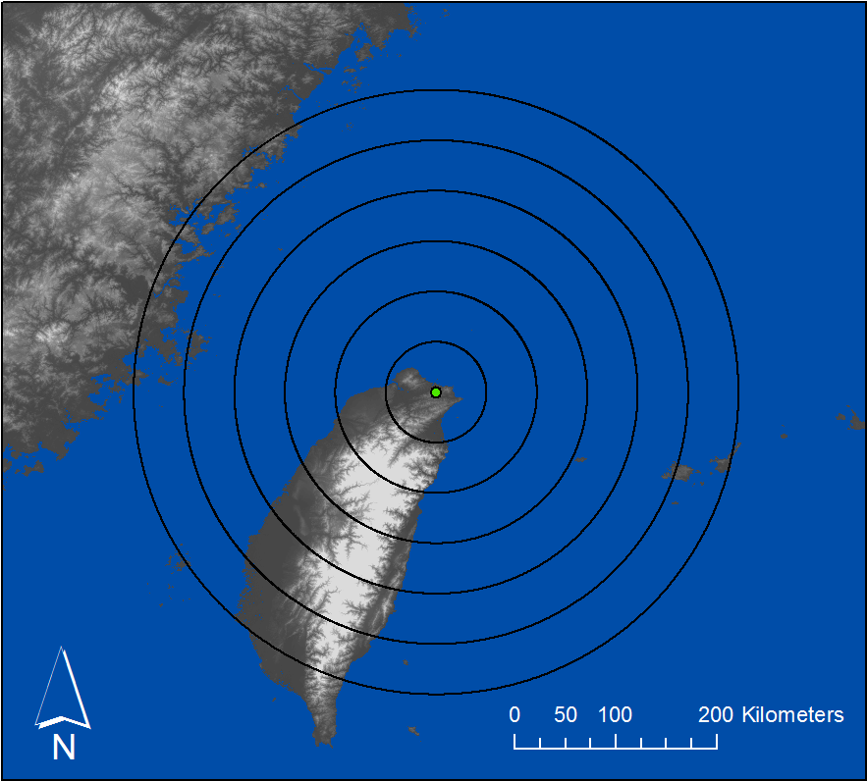
Domain: rcwf

Slide 7
Setting up the data 1
Radar fields were 9 x 9 0.5-km Cartesian grids centered on each gauge
  267 gauges within 300-km radius of RCWF domain
  9 x 9 x 267 → Every gauge file
Gauge values: hourly accumulation every 10-mins
  9 x 9 x 267 x 6 → every hour
Gauge – Radar matching
  Find number of radar scans within previous hour (~ 10 or 11 usually)
    9 x 9 x 267 x 6 x 10
  Accumulate Z values within previous hour
  Accumulate ZDR values within previous hour
    9 x 9 x 267 x 6
Notes:
It is important to note that the addition of Z and ZDR are not converted back to raw values!

Slide 8
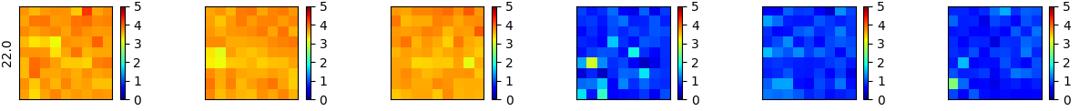
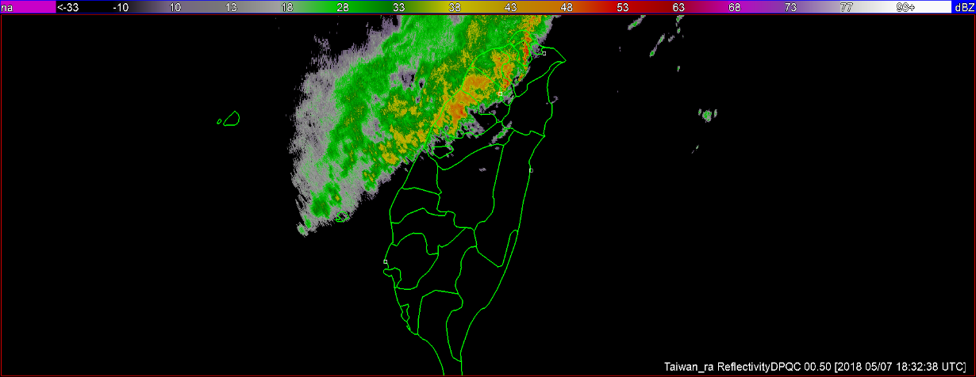
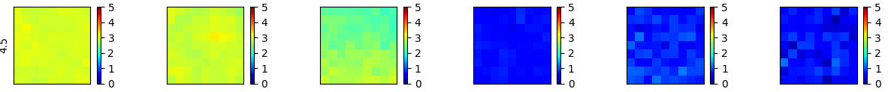
Setting up the data 2
Radar moments
  Accumulate hourly values
    Reflectivity
    Tilts = 00.50°, 01.45°, 02.45°
    Divide by 100 to scale < 10;
    Differential Reflectivity
    Tilts = 00.50°, 01.45°, 02.45°
    Divide by 10 to scale < 10;
Distance from radar up to 300 km
  Divided distance in km / 100 to scale < 10;

Slide 9
Setting up the data 3
Rotated radar fields 90°, 180°, and 270° to increase the training data samples
Shuffled training data to remove autocorrelation impacts
Binned radar fields based on gauge precipitation amounts
  ~ Equal number of precipitation counts per bins
    0 -1
    1 – 3
    3 – 6
    6 – 14
    14 – 60

Slide 10
Cnn model architecture
Layer | Output Shape
Input Layer | (9, 9, 64)
2D – Convolution (linear activation) | (7, 7, 64)
Leaky RelU | (7, 7, 64)
2D - Max Pooling | (3, 3, 64)
Flatten | 576
Dense | 512
Leaky RelU | 512
Dropout | 512
Dense | 32
Leaky RelU | 32
Dropout | 32
Dense | 1
Leaky RelU | 1
1 conv-pool layer
3 dense layers
64 channels
Dropout = 50%
Optimizer = adam
Loss = MAE
100 epochs
Batch size = 100
~5 mins per simulation

Slide 11
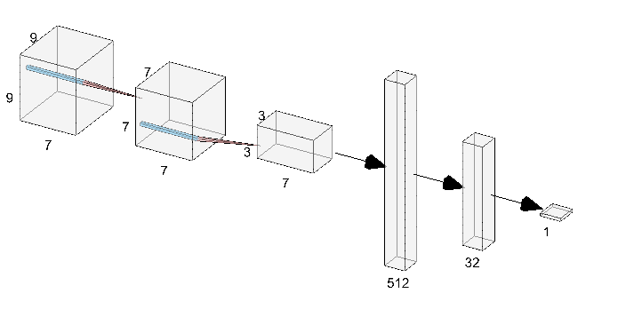
CNN model architecture
1 convolution-pooling layer
3 dense layers
64 channels
Leaky-RelU activator
Dropout = 50%
Optimizer = adam
Loss = MAE
100 epochs
Batch size = 100
~5 mins per simulation
90,000 training radar –gauge pairs
12,000 validation / testing

Slide 12
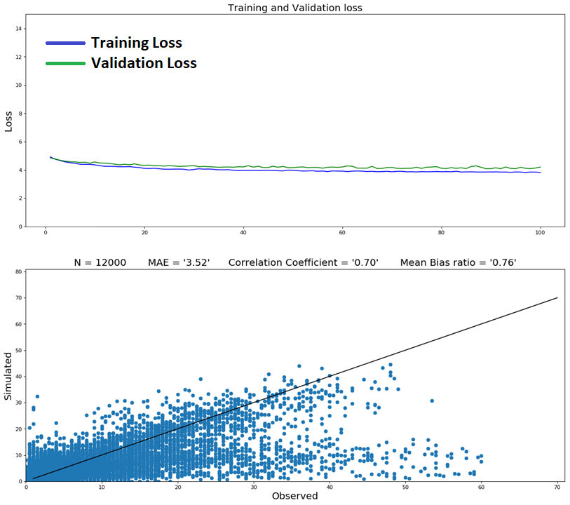
Initial results
Reflectivity at lowest tilt, only (Z1)
Low MAE (3.52 mm/hr)
CC modest ~ 0.70
Number of training data = 90,000
Number of testing data = 12,000
Large underestimation, especially at large observed values → reflected in low mean bias ratio

Slide 13
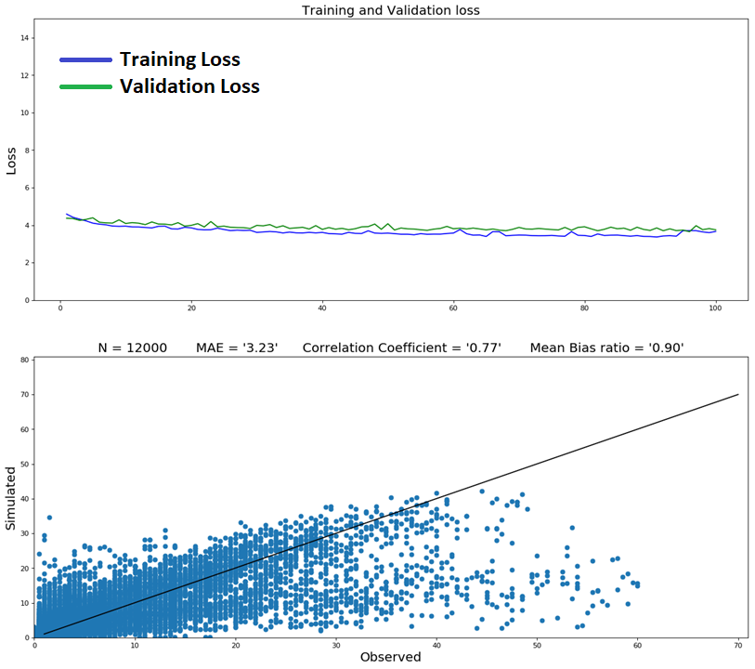
Initial results
Reflectivity at lowest tilt (Z1)
Reflectivity at 2nd lowest tilt (Z2)
Lower MAE (3.52 → 3.23 mm/hr)
CC modest ~ 0.70 → 0.77
Number of training data = 90,000
Number of testing samples = 12,000
Large underestimation, especially at large observed values

Slide 14

Initial results
Reflectivity at lowest tilt (Z1)
Reflectivity at 2nd lowest tilt (Z2)
ZDR at lowest tilt (ZDR1)
Lower MAE (3.23 → 3.03 mm/hr)
CC modest ~ 0.77 → 0.80
Number of training data = 90,000
Number of testing samples = 12,000
Large underestimation, especially at large observed values

Slide 15
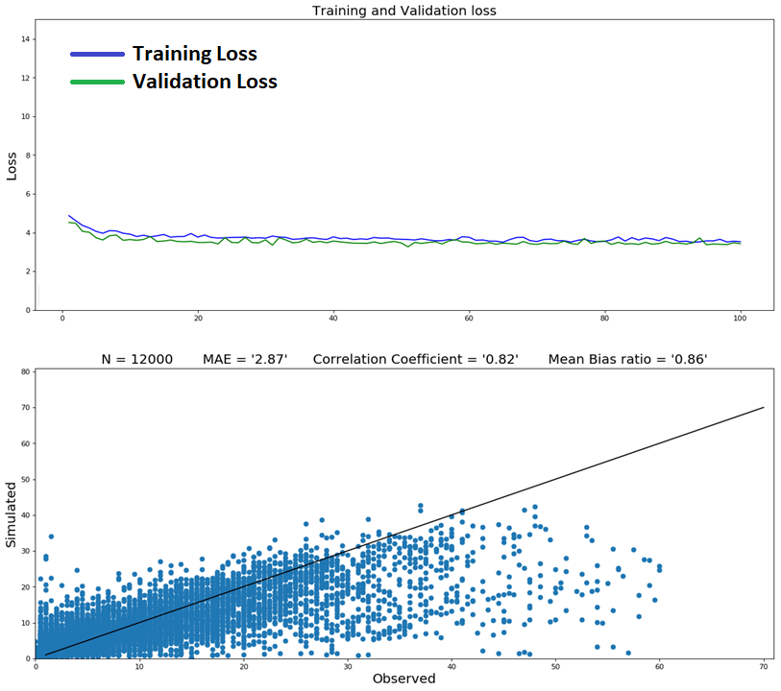
Initial results
Reflectivity at lowest tilt (Z1)
Reflectivity at 2nd lowest tilt (Z2)
ZDR at lowest tilt (ZDR1)
Distance from radar (D)
Lower MAE ( 3.03 → 2.87 mm/hr)
CC modest ~ 0.80 → 0.82
Number of training data = 90,000
Number of testing samples = 12,000
Large underestimation, especially at large observed values – Still!

Slide 16
challenge!
Only two days of training, 12 hours for validation and 12 hours for validation and testing
  Increase to six days of training data and 24 hours of validation / testing.
Large gauge upper bin → redefine
    0 -1
    1 – 3
    3 – 6
    6 – 14
    14 – 60
    0 -1
    1 – 3
    3 – 6
    6 – 15
    15 – 25
    25 – 40
    40 – 55
    55 - 70

Slide 17
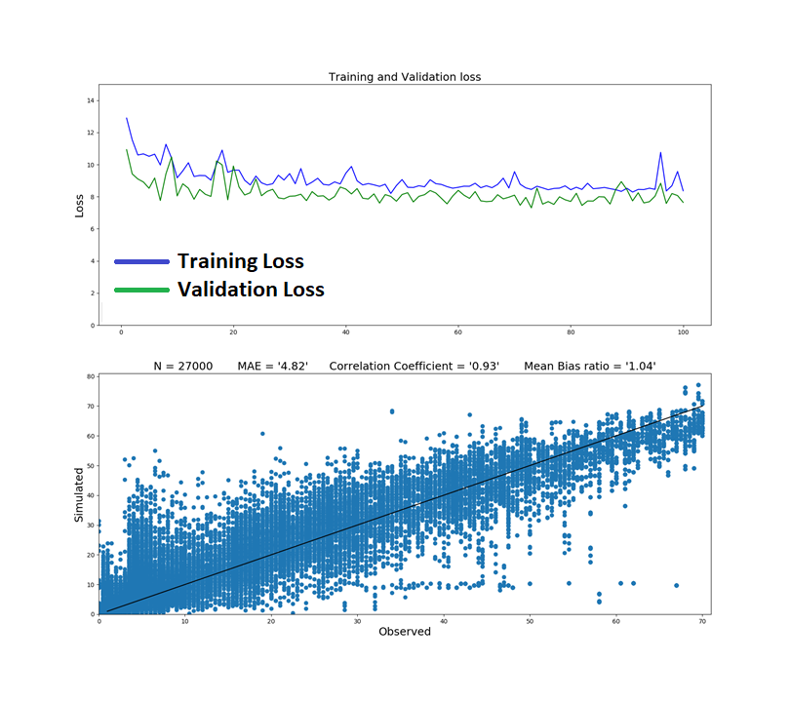
Robust results
Reflectivity at lowest tilt (Z1)
Reflectivity at 2nd lowest tilt (Z2)
Reflectivity at 3rd lowest tilt (Z3)
Reflectivity at lowest tilt (ZDR1)
Reflectivity at 2nd lowest tilt (ZDR2)
Reflectivity at 3rd lowest tilt (ZDR3)
Distance from radar (D)
Decent MAE (4.82 mm/hr)
CC good ~ 0.93
Number of training data = 190,000
Number of testing samples = 27,000

Slide 18
Robust results
Reflectivity at lowest tilt (Z1)
Reflectivity at 2nd lowest tilt (Z2)
Reflectivity at 3rd lowest tilt (Z3)
Reflectivity at lowest tilt (ZDR1)
Reflectivity at 2nd lowest tilt (ZDR2)
Reflectivity at 3rd lowest tilt (ZDR3)
Distance from radar (D)
Decent MAE (4.82 mm/hr)
CC good ~ 1.04
Number of training data = 190,000
Number of testing samples = 27,000
Several underestimated points

Slide 19
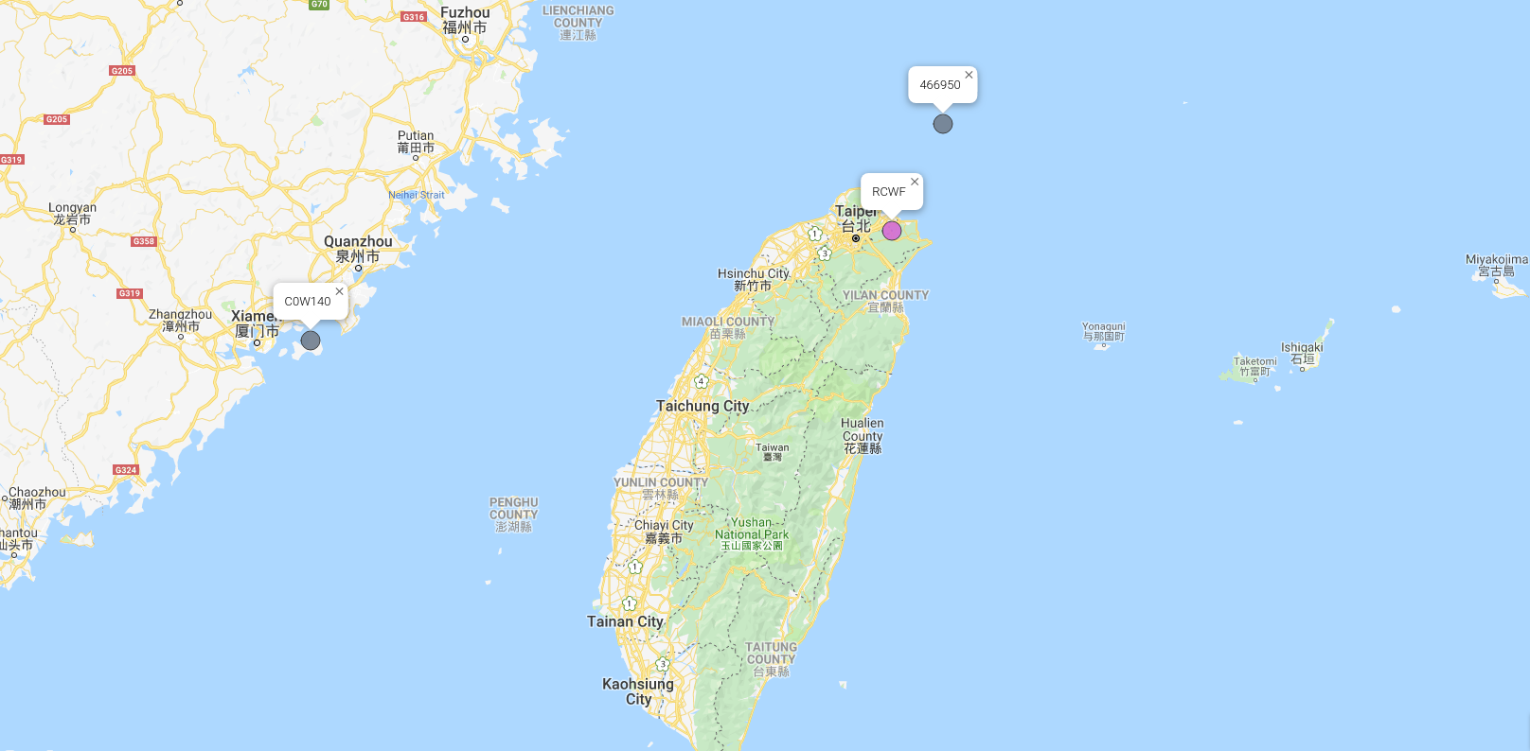
Bad gauge data?
300 km

Slide 20
Gauges
Recurring poor results from gauge / radar pairs to the north
Several gauge / radar pairs were poor to the south
- Terrain impacting significantly?
Some gauges were assessed from mainland China
- 300 km is too far away?
Run simulations without these gauges
Bad
Gauge?
300 km
250 km
and
Mountain

Slide 21
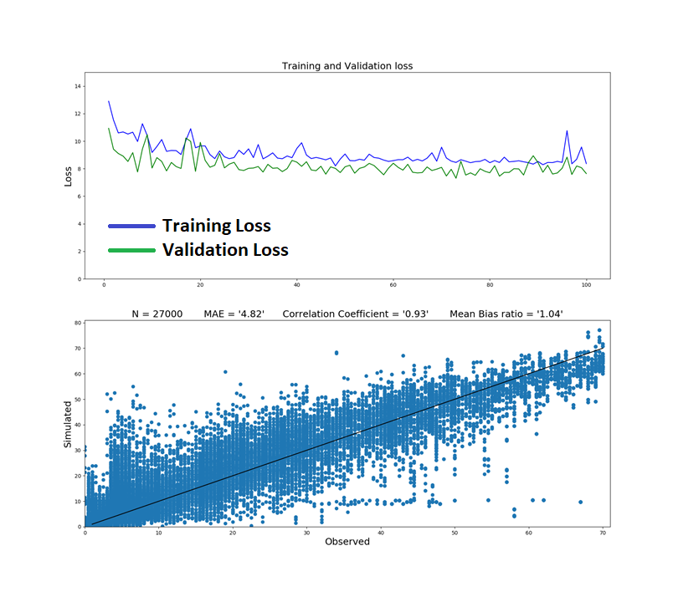
Compare
Reflectivity at lowest tilt (Z1)
Reflectivity at 2nd lowest tilt (Z2)
Reflectivity at 3rd lowest tilt (Z3)
Reflectivity at lowest tilt (ZDR1)
Reflectivity at 2nd lowest tilt (ZDR2)
Reflectivity at 3rd lowest tilt (ZDR3)
Distance from radar (D)
Decent MAE (4.82 mm/hr)
CC good ~ 1.04
Number of training data = 190,000
Number of testing samples = 27,000

Slide 22

Robust results
+ Gauge QC
Same simulation → Impacts from random dropout + Gauge QC
Mean bias increased: 1.04 → 1.06
CC increased: 0.93 → 0.95
MAE decreased: 4.82 → 4.27
Still underestimates, yet better than previous simulation(s)

Slide 23
Robust results
+ Gauge QC
Same simulation → Impacts from random dropout + Gauge QC
Mean bias increased: 1.04 → 1.06
CC increased: 0.93 → 0.95
MAE decreased: 4.82 → 4.27
Still underestimates, yet better than previous simulation(s)
Overestimates at low observed values as well

Slide 24
Preliminary results / future work
Can machine learning be implemented to improve QPEs compared to a physical-based QPE scheme?
  Shows promise!
Future work
  More data!
  Add more variables
  Reduce distance to gauge from radar: 300 → ~200 km
  Further QC gauge / radar data.
  Remove gauges on other side of mountainous terrain
  Reduce overestimates and underestimates in current results
  Directly compare physically-based and AI QPE results

Slide 25
Quantitative Precipitation Estimate Results from a Convolutional Neural Network Machine Learning Model

