Slide 1



Deep learning estimation of tropical cyclone intensity from microwave satellite imagery
Anthony Wimmers, Chris Velden
Cooperative Institute for Meteorological Satellite Studies
University of Wisconsin - Madison
Josh Cossuth
U. S. Naval Research Laboratory
Washington, DC

Slide 2
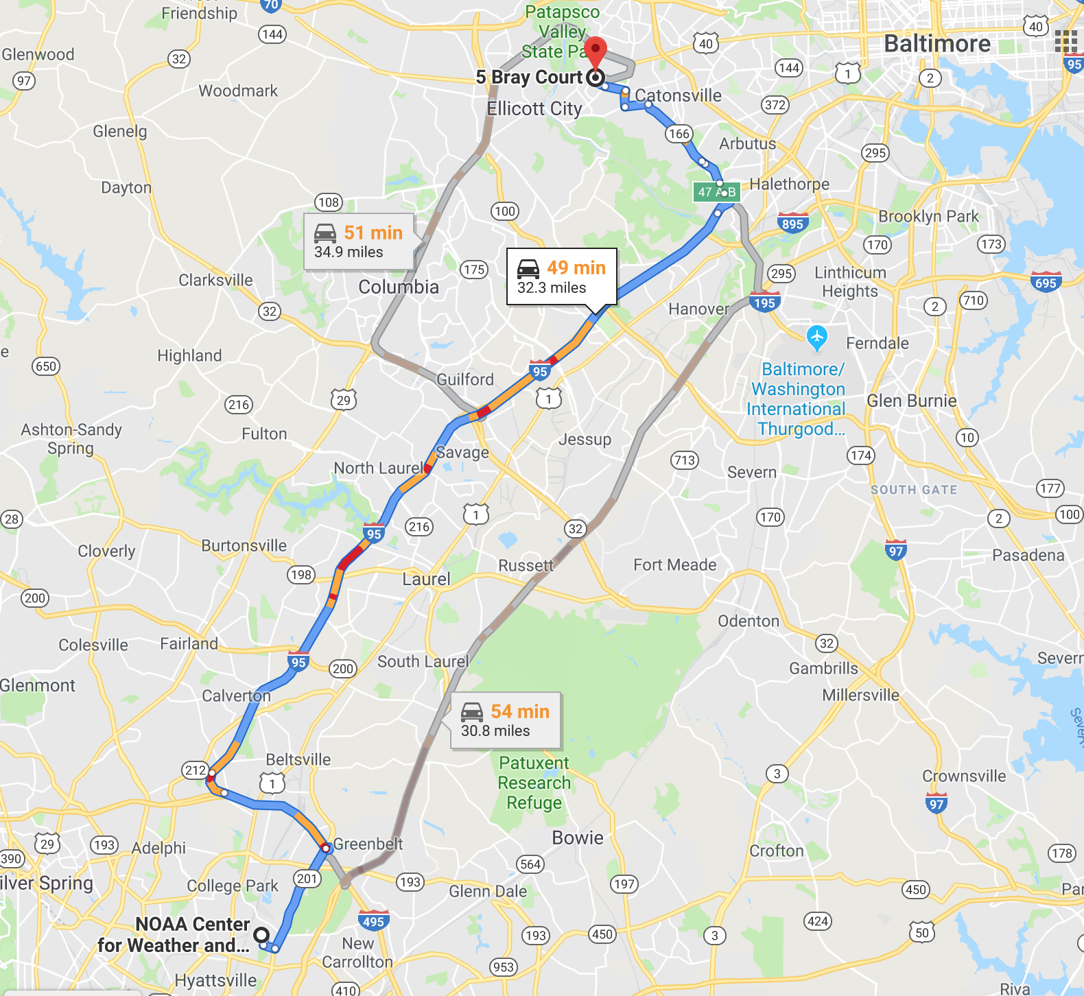
Notes:
2
2
2

Slide 3
Why should you care?
This deals with: Selecting the right problem to solve,
Using probabilistic inputs,
Avoiding the regression-to-mean problem (partially),
Producing uncertainty with a numerical output,
Validating on two tiers of truth data,
Making conclusions that scientists and forecasters care about.
Notes:
3
3
3
You probably don’t care about details with hurricanes
You probably don’t care about basic CNN operations

Slide 4
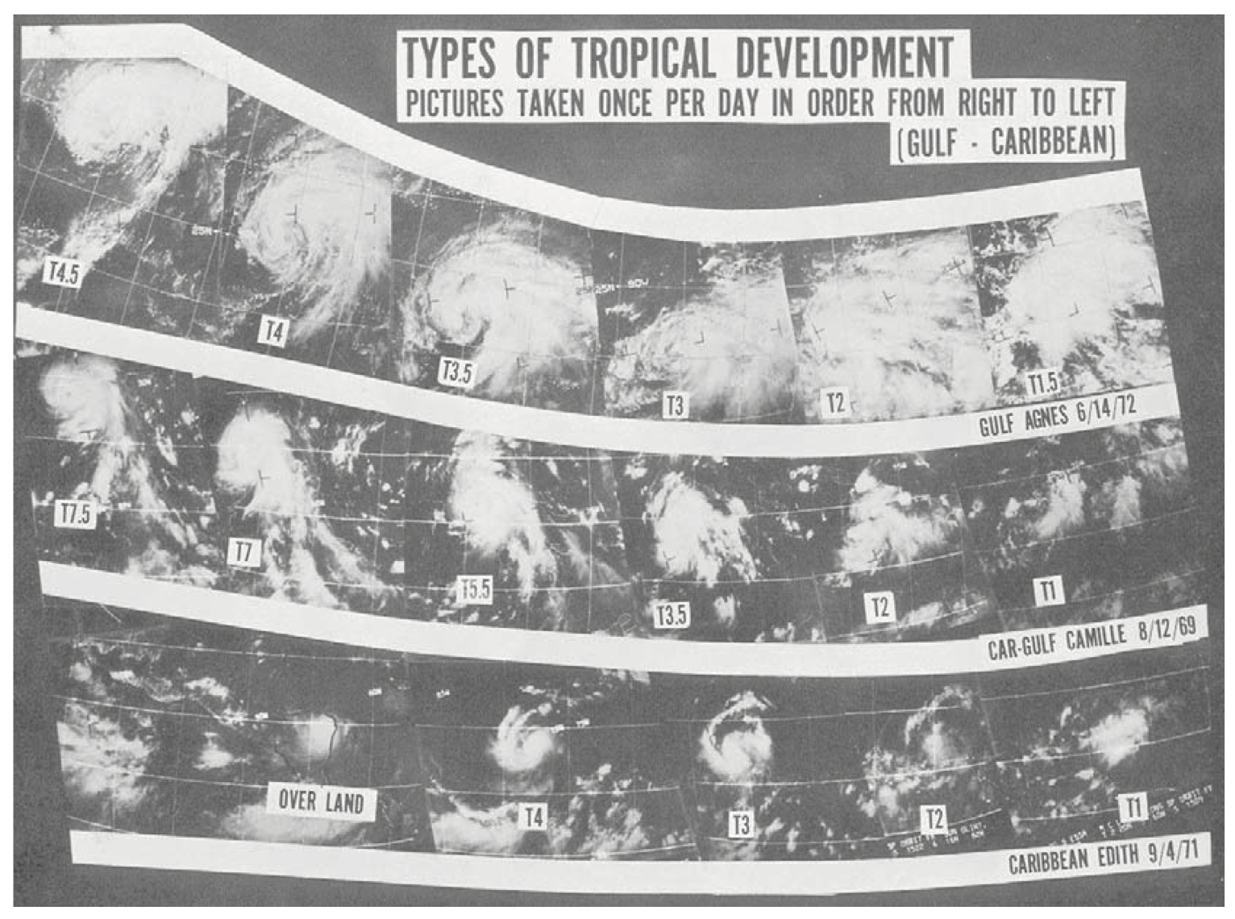
How do TC forecasters estimate intensity today (when limited to satellite)?
“The Dvorak Technique”
Notes:
4
4
4
Image taken from the time it was first developed.
DVT is still the most popular
Note the dates (69, 71, 72) – It’s dated
Note the frequency band (IR, Vis) – It’s not equipped for microwave or GOES-R
Note the low precision of intensities -- ~10 kt
Note the methodology (subjective) – Perfect fit for deep learning

Slide 5
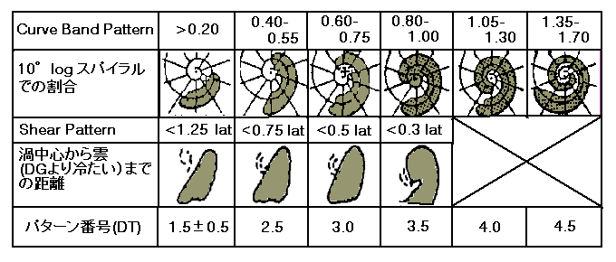
How do TC forecasters estimate intensity today (when limited to satellite)?
“The Dvorak Technique”
Notes:
5
5
5
Used all over the world. In Japan for example.

Slide 6
How do TC forecasters estimate intensity today (when limited to satellite)?
“The Dvorak Technique”
Also, more recently:
Warm core anomaly
Advanced Dvorak Technique (automated, IR differences)
Deviation Angle Variance Technique
SATCON (composite method)
Other CNNs applied to Geo IR
Notes:
6
6
6
So it’s ripe for disruption, which is why you’ll see a lot of papers in 2019 about applying Deep Learning to this

Slide 7
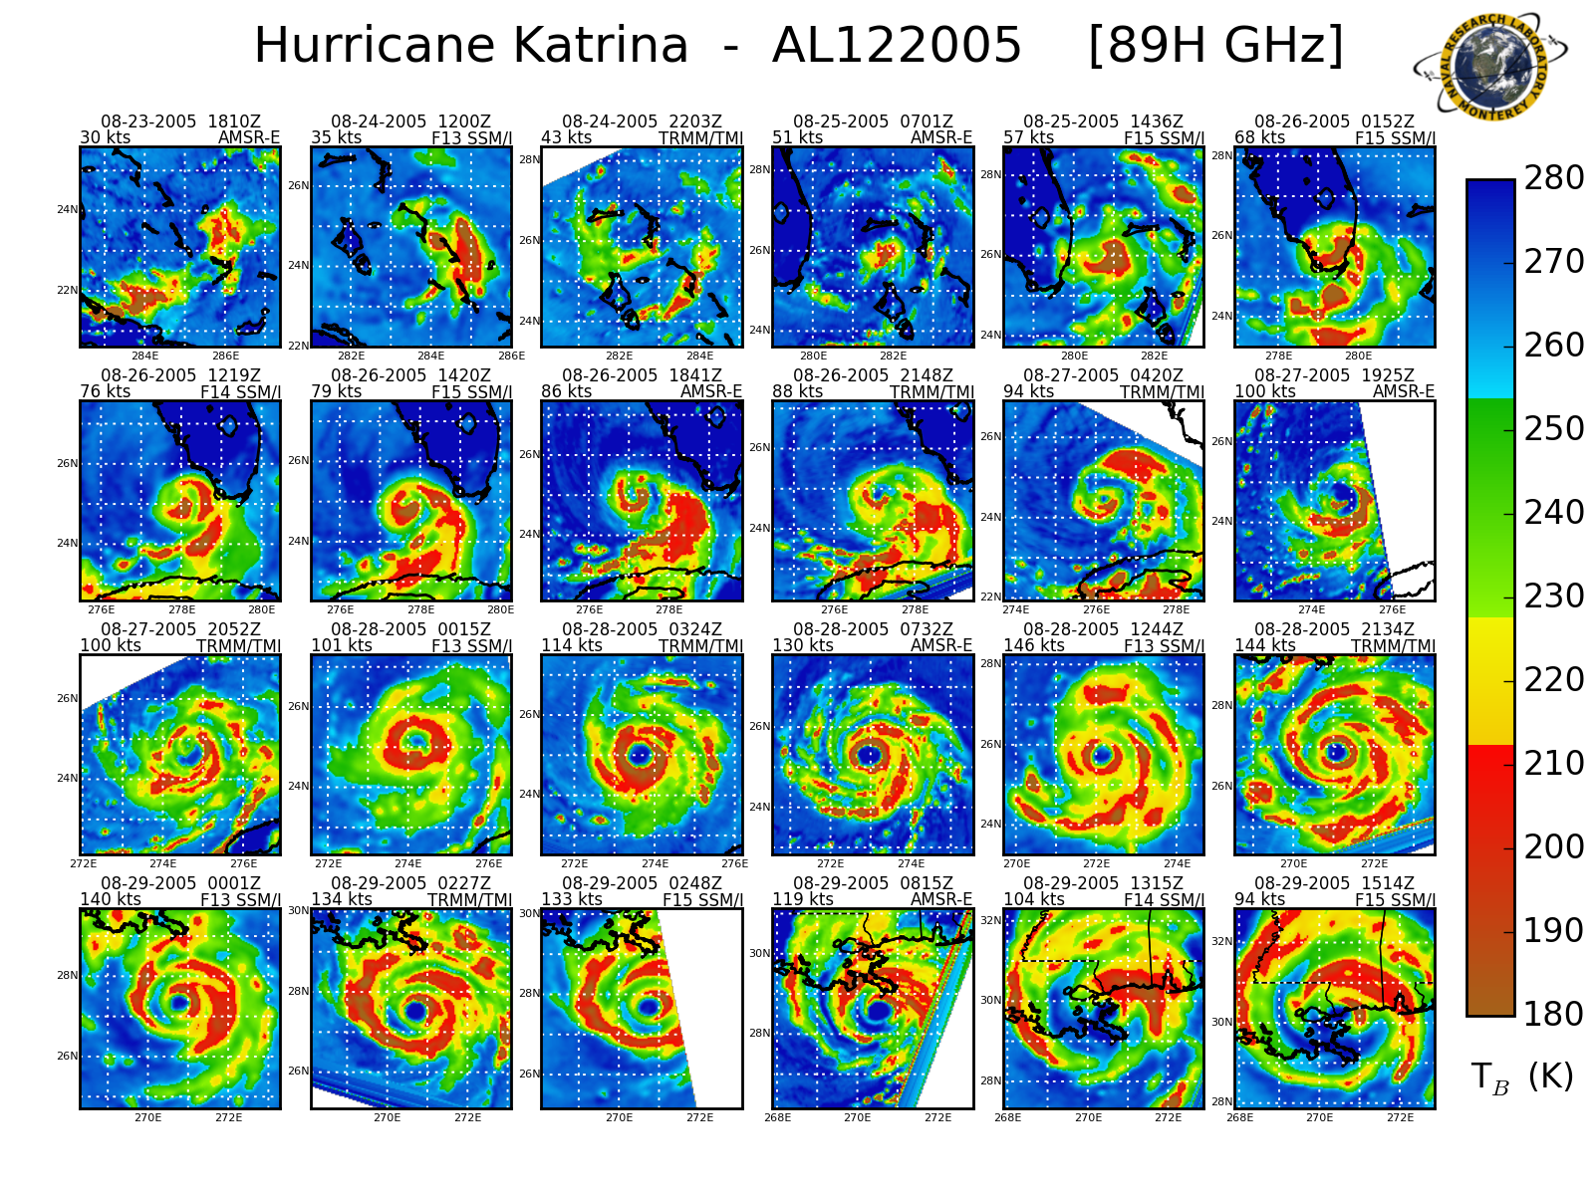
How do TC forecasters estimate intensity today (when limited to satellite)?
But what about high-resolution microwave?
Notes:
7
7
7

Slide 8
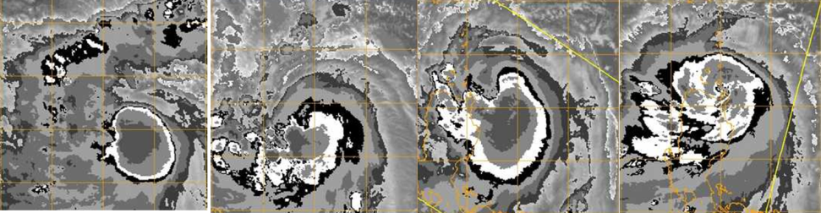
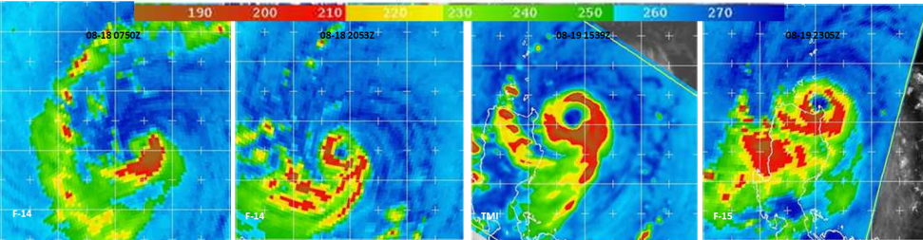
How do TC forecasters estimate intensity today (when limited to satellite)?
But what about high-resolution microwave?
8/18 0750 UTC
8/18 2053 UTC
8/19 1539 UTC
8/19 2305 UTC
39 hr eyewall evolution of Typhoon Nuri (2008)
Notes:
8
8
8

Slide 9
Experiment design:
Train/validate/test a Convolutional Neural Network to estimate TC intensity (Maximum Sustained Winds – MSW) from 37 & 89 GHz microwave imagery
Global image dataset (all basins), 1987-2012: 52,753 images (those are limited to: over water, >65% coverage by satellite scan)
Satellites/Sensors: DMSP SSMI/S, TRMM TMI, AMSR-E
Labels: ”Best Track” records (National Hurricane Center and Joint Typhoon Warning Center)
Further independent testing with TC intensity values observed by aircraft (the gold standard)
Notes:
9
9
9

Slide 10
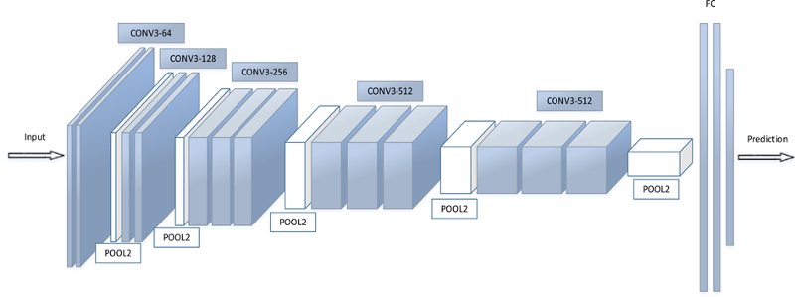
The CNN model: ‘DeepMicroNet’
https://tech.showmax.com/2017/10/convnet-architectures/
Similar to this:
1 or 2 input layers
(37 & 89 GHz)
at 64 x 64 px
15 Convolutional layers
5 Pooling layers
2 Fully connected layers
with 50% dropout
Notes:
10
10
10

Slide 11
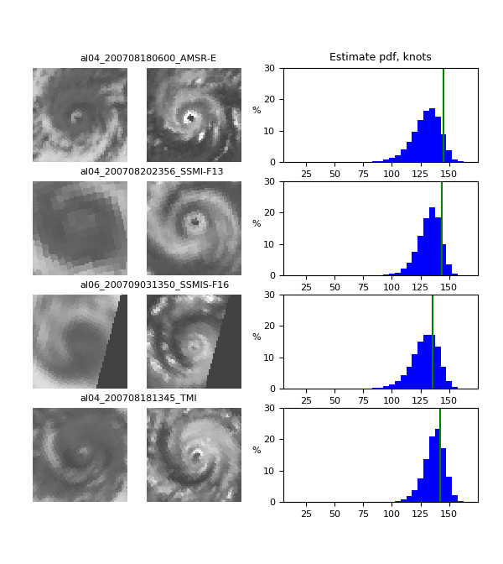
“probabilistic label”:
The CNN model: ‘DeepMicroNet’
Model estimate PDF, knots
Truth
DeepMicroNet is set up as a classification model, not a regression model
Categories: 25 kt, 30 kt, … 160 kt
* Not one-hot labeling. Instead of […, 0, 0, 1, 0, 0, …], it takes […, 0.10, 0.23, 0.34, 0.23, 0.10, …] because of uncertainty in the Best Track values.
Notes:
11
11
11
And if you want to get a single value, just use the mean of the distribution. That’s what we’ll use to validate and test.

Slide 12
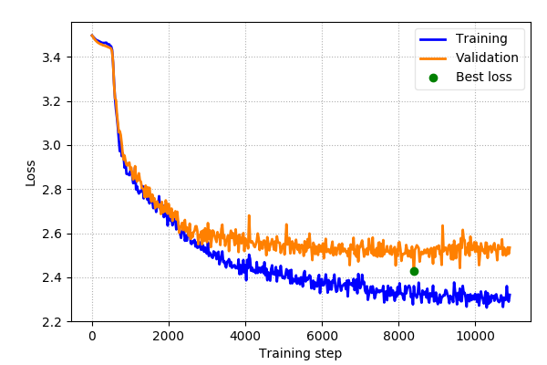
Training
Training process minimizes cross-entropy (“Loss”)
Converges at 20-40 epochs
Notes:
12
12
12

Slide 13
Results
Notes:
13
13
13

Slide 14
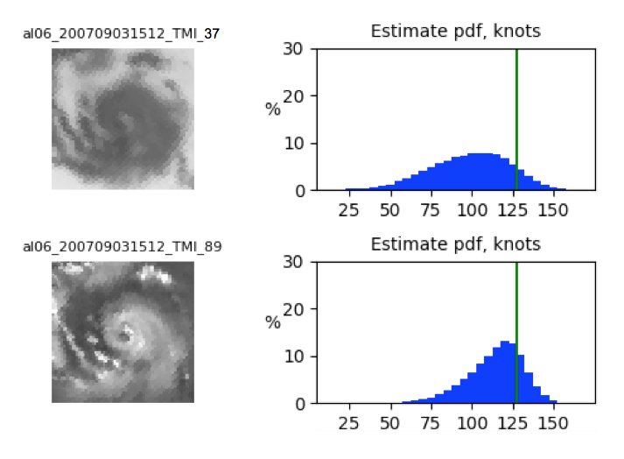
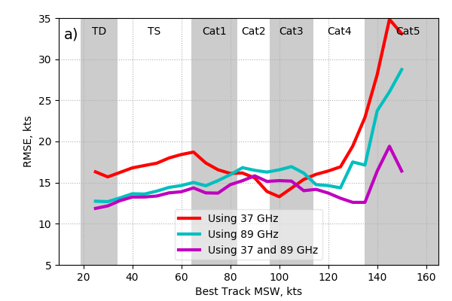
37 vs. 89 GHz imagery vs. both
37 GHz
89 GHz
Both channels supply relevant information, but 89 GHz is clearly better for estimating intensity
Notes:
14
14
14
Also look at how much improvement there is between 89 and “both” in Cat 5. Wasn’t expecting that.

Slide 15
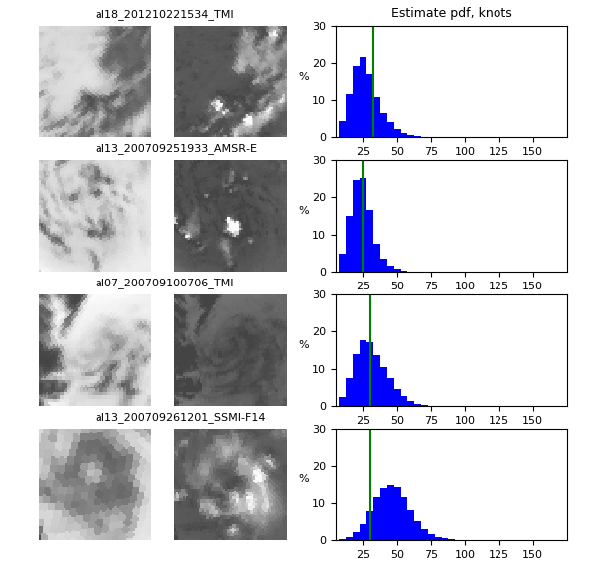
Model performance
37 GHz
89 GHz
Typical model
underestimate
Tropical depression
(25-34 kt)
Typical model
overestimate
Notes:
15
15
15

Slide 16
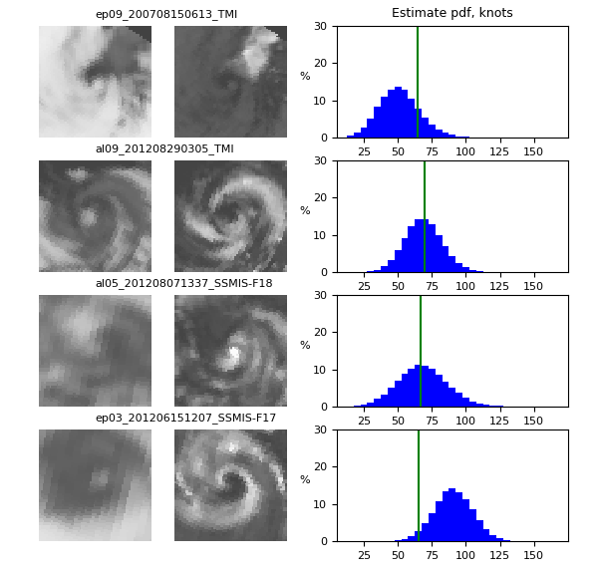
Model performance
37 GHz
89 GHz
Typical model
underestimate
Category 1
(65-83 kt)
Typical model
overestimate
Notes:
16
16
16

Slide 17
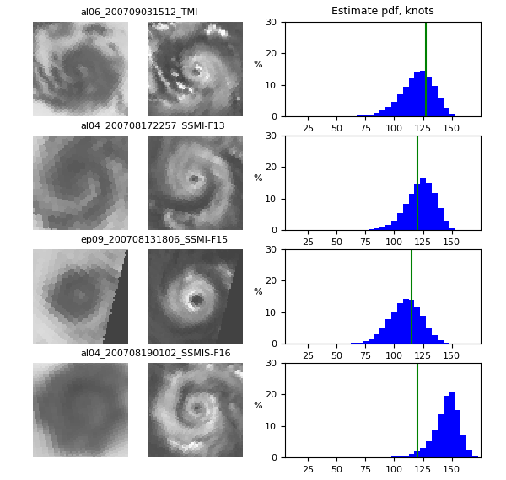
Model performance
37 GHz
89 GHz
Typical model
underestimate
Category 4
(113-135 kt)
Typical model
overestimate
Notes:
17
17
17

Slide 18
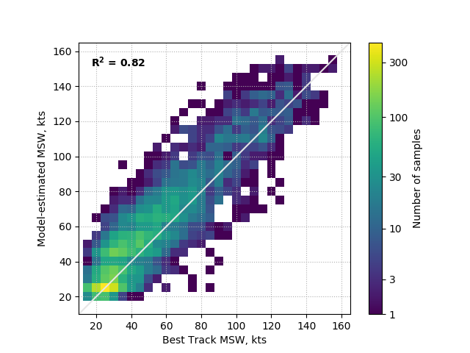
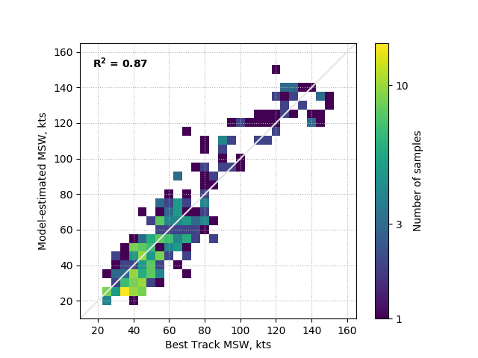
Model statistics
Testing against all Best Track values
Testing against all recon-aided values
2. High bias in Cat 3-4 range
3. Low bias in Cat 5 range
1. Low bias in trop depression – trop storm range
RMSE = 14.6 kt
RMSE = 10.6 kt
Notes:
18
18
18
So it’s pretty consistent with the BT record, but has these biases when compared to the gold standard.
What could be responsible for this?

Slide 19
How do TC forecasters estimate intensity today (when limited to satellite)?
“The Dvorak Technique”
Notes:
19
19
19
It looks like this is the reason.

Slide 20
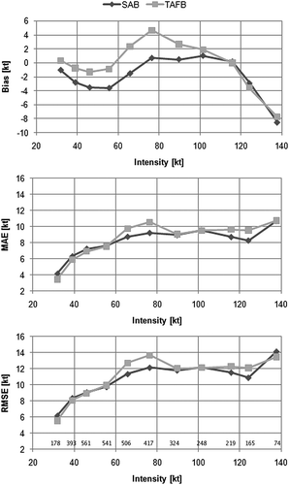
Model statistics
Testing against all recon-aided values
2
2. High bias in Cat 3-4 range
3. Low bias in Cat 5 range
1
3
1. Low bias in trop depression – trop storm range
Figure 3 from Knaff, J., D. Brown, J. Courtney, G. Gallina, and J. Beven II, 2010: An evaluation of Dvorak technique–based tropical cyclone intensity estimates. Wea. Forecasting, 25, 1362–1379.
RMSE = 10.6 kt
Notes:
20
20
20
…
Main point here: Shows that the Dvorak Technique is still affecting the accuracy of our Tropical Cyclone intensity records. (The records that have been used to look for the effect of global warming, for instance.)
Still, the RMSE is very close to the state of the art (within 1 kt)

Slide 21
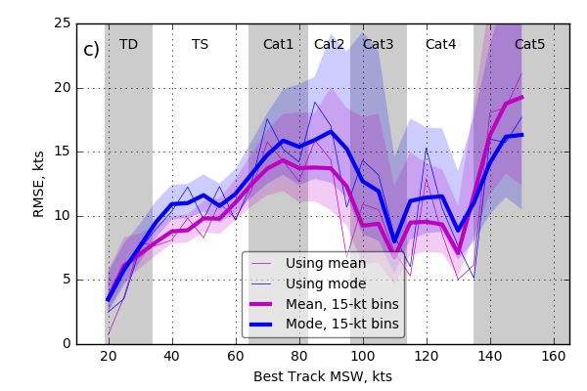
Model statistics
This indicates a strong hypothesis that the microwave channels simply have less sensitivity in the Cat 1-2 (and Cat 5) range.
(Not shown): Model uncertainty matches Best Track uncertainty correctly
Notes:
21
21
21

Slide 22
Model performance: Additional notes
These results are as reliable as the methods used on geo imagery for the last 45 years, require no expert knowledge, and will improve with more development.
Thanks to deep learning, we have a new capability of probabilistic estimation of TC intensity from satellite.
Deep learning also reveals aspects of the data that came as a surprise:
Sensitivity of 37 GHz to Cat 5 intensities?
Potential for “fixing” the Best Track record (subtracting bias)?
Notes:
22
22
22

Slide 23

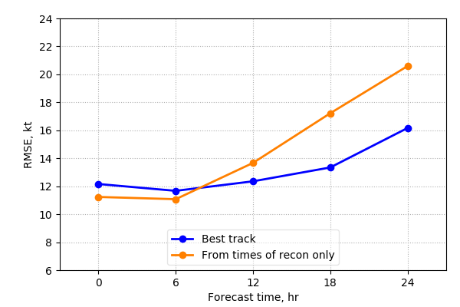
Q/A?
Mon. Wea. Rev., in press:
Notes:
23
23
23

Slide 24
Model performance: Summary
When DeepMicroNet tests on the type of data used to train, RMSE = 14.3 kt. When it tests on a more accurate type of data, RMSE = 10.6 kt.
Thus, DeepMicroNet is able to overcome much of the random error in the labeling data without help.
But DeepMicroNet retains the same biases as the labeling data (the Best Track).
Thus there is still room for substantial improvement in the model by correcting biases in the labeling data.
Still, RMSE = 10.6 kt is already close to the state of the art for satellite-based intensity estimation (within 1 kt).
Notes:
24
24
24

