Slide 1
Using Machine Learning to Improve Prediction and Understanding of Convective Hazards
Amy McGovern
Professor, School of Computer Science
Adjunct Professor, School of Meteorology
University of Oklahoma
amcgovern@ou.edu

Slide 2
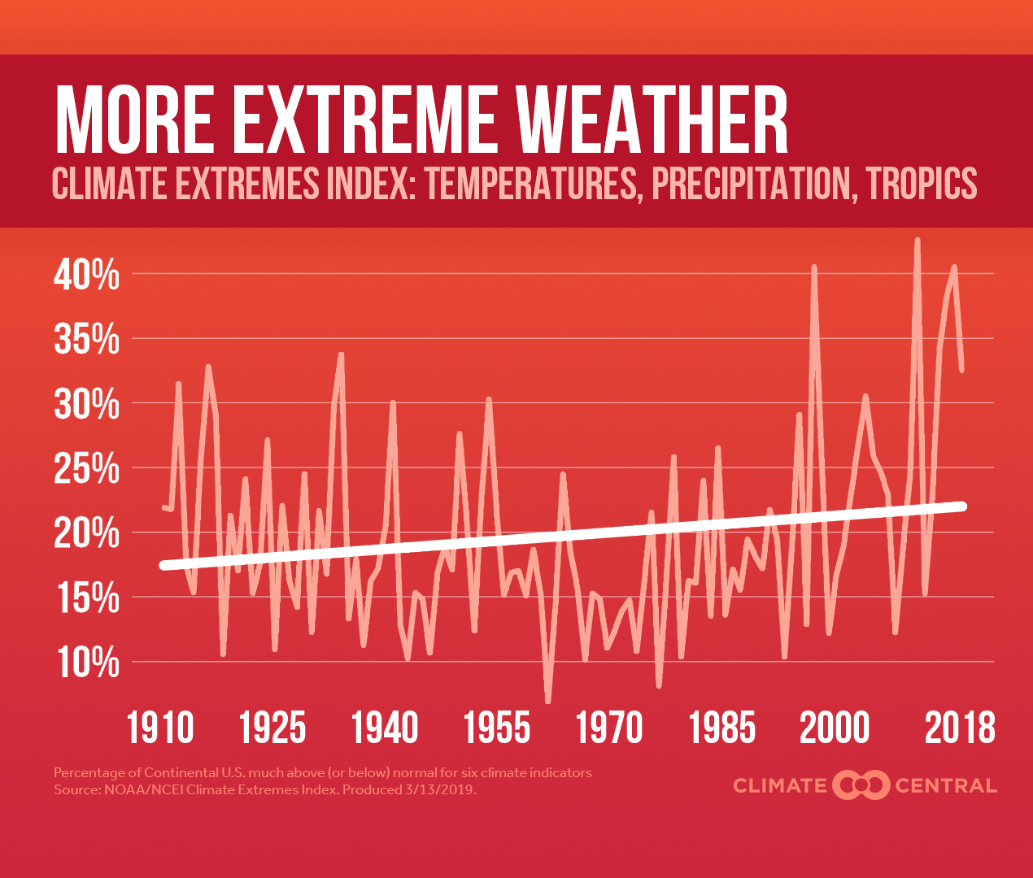
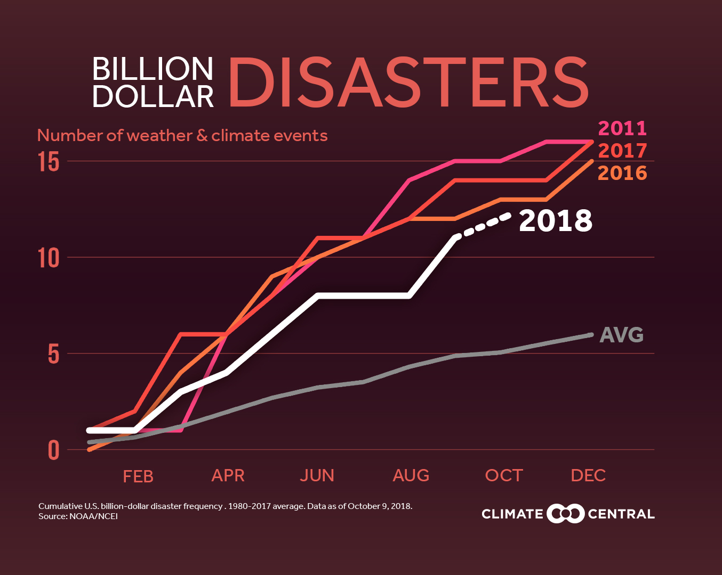
Use AI/ML to Improve Societal Resilience to Climate Change and Extreme Weather
Wicked problems:
How can humans adapt to a changing climate? Where do we need to build and grow our communities? How do they need to change from current practices?
How can we improve the prediction of new weather extremes?
How can we improve the adaptation of other species? Migration patterns, land use changes, etc.
Proposal: create a joint university, industry, and government alpha-institute to bring together researchers in AI/ML and climate and weather

Slide 3

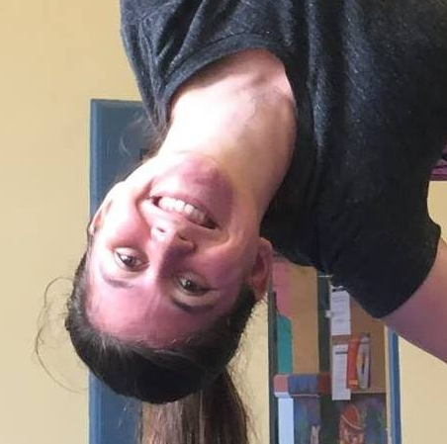
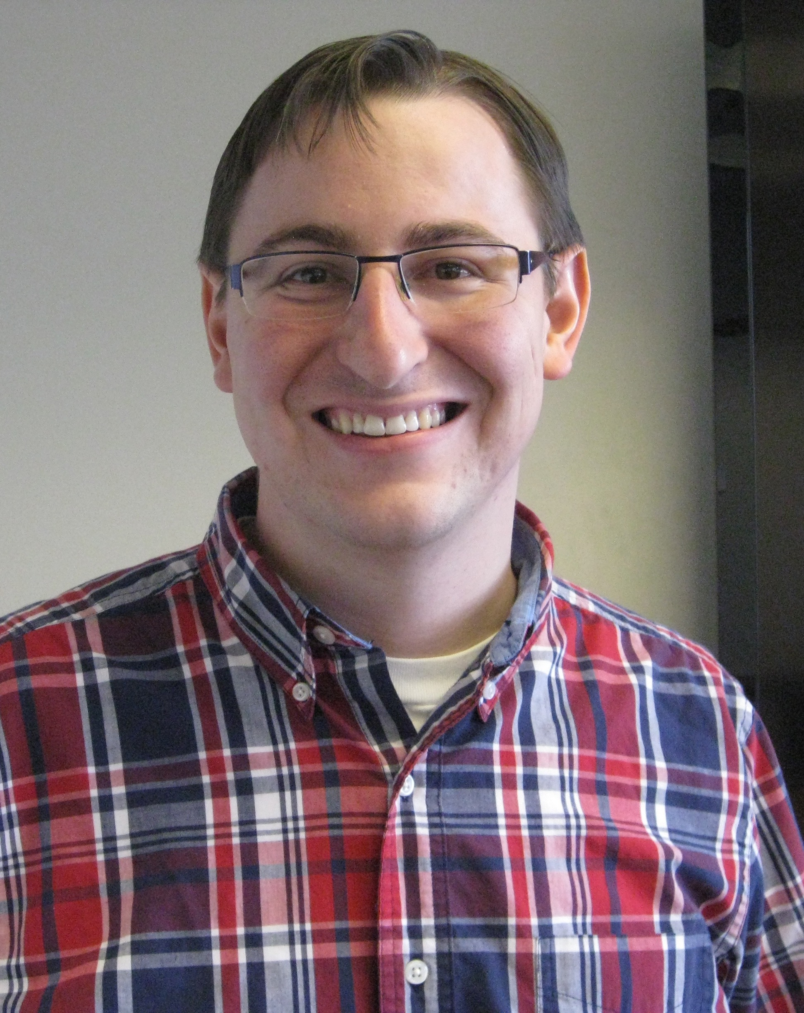

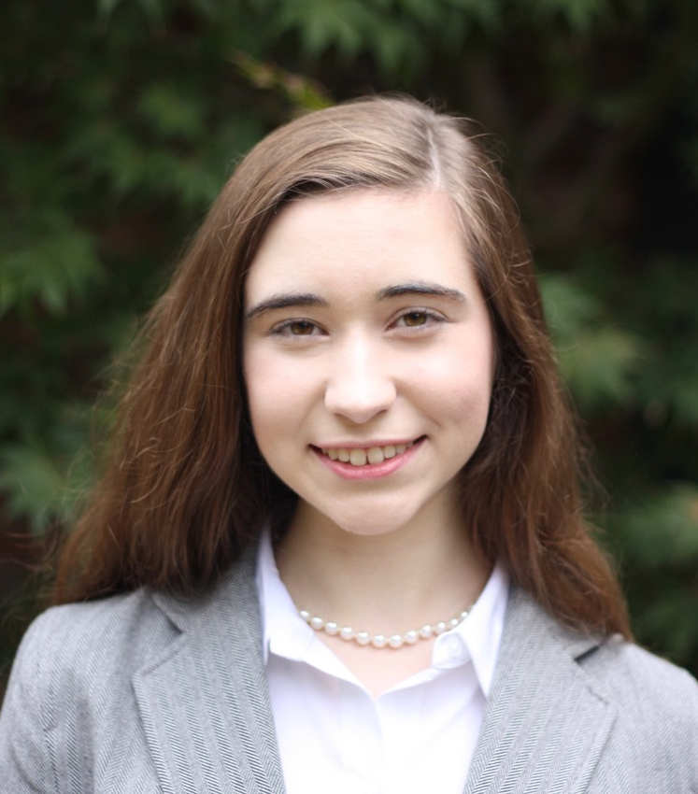




Thank you to my students (current and former)
Carmen Chilson
OU CS MS, now at Google
Will Booker
OU CS MS
David John Gagne II
OU SOM PhD
@DJGagneDos
NCAR
Ryan Lagerquist
@ralager_Wx
OU/CIMMS SOM PhD
Katherine Avery
OU, CS BS
Amanda Burke
OU, SOM MS
Katy Felkner
OU, CS and Letters BS
David Harrison
OU/CIMMS/SPC SOM PhD
Eli Jergensen
OU, Math/Physics BS

Slide 4
ML for Weather Outline
Using ML for severe weather prediction
Improving hail forecasting 24-48 hours in advance (traditional ML)
Improving nowcasting for tornadoes (deep learning/convolutional neural networks)
Using ML to track biological species over time
Identifying bird roosts in non-QC radars (deep learning)

Slide 5
Storm-Based Hail Forecasting
Overall steps:
Create training data from NWP models
Train ML models (random forests)
Prediction and evaluation
Implemented and tested in NOAA’s Hazardous Weather Testbed
Details:
Gagne et al 2017, WAF
Burke et al, in preparation

Slide 6
Decision Trees
Human-readable ML model
Can predict:
Class labels (hail/no hail)
Real-values (hail size, shape parameters)
Probabilities
Demonstrated success in meteorology
Selective model

Slide 7
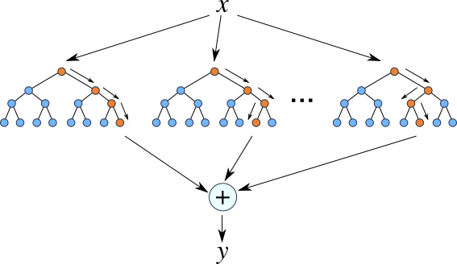
Ensembles of Trees
Random Forests
Individual trees trained on bootstrap resampled subsets of data
Trees use subsets of attributes at each level
Each tree votes or averages its prediction
http://ncbi-hackathons.github.io/Pharmacogenomics_Prediction_Pipeline_P3/

Slide 8
NWP Convection Allowing Models (CAMs)
CAMs have high spatial and temporal resolution across CONUS
Resolution too low to resolve hazards such as hail
ML can predict missing hazards and correct spatial or temporal forecast errors
Gagne et al 2017
CAPS Spring Experiment ensemble
NCAR ensemble
Current work (Burke et al, in preparation)
High Resolution Ensemble Forecast version 2 (HREFv2)
Operational in Storm Prediction Center (SPC)
High Resolution Rapid Refresh Ensemble (HRRRE, summer 2019)

Slide 9
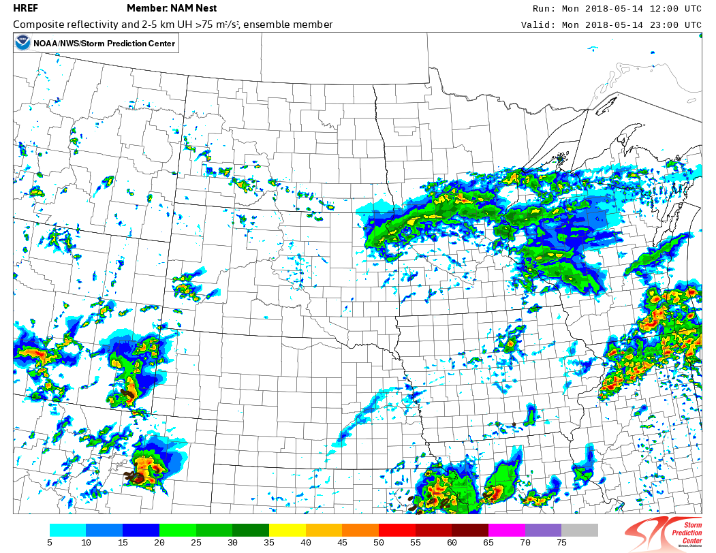
ML Input
Extract data for each storm object/track
Storm data: updraft/downdraft, reflectivity, precipitation, etc
Environment: temperature, CAPE, wind, sounding data, etc
Morphological: Area, shape, etc
Location: Forecast hour, duration, motion
Each CAM has slightly different data
ML model trained for that CAM

Slide 10
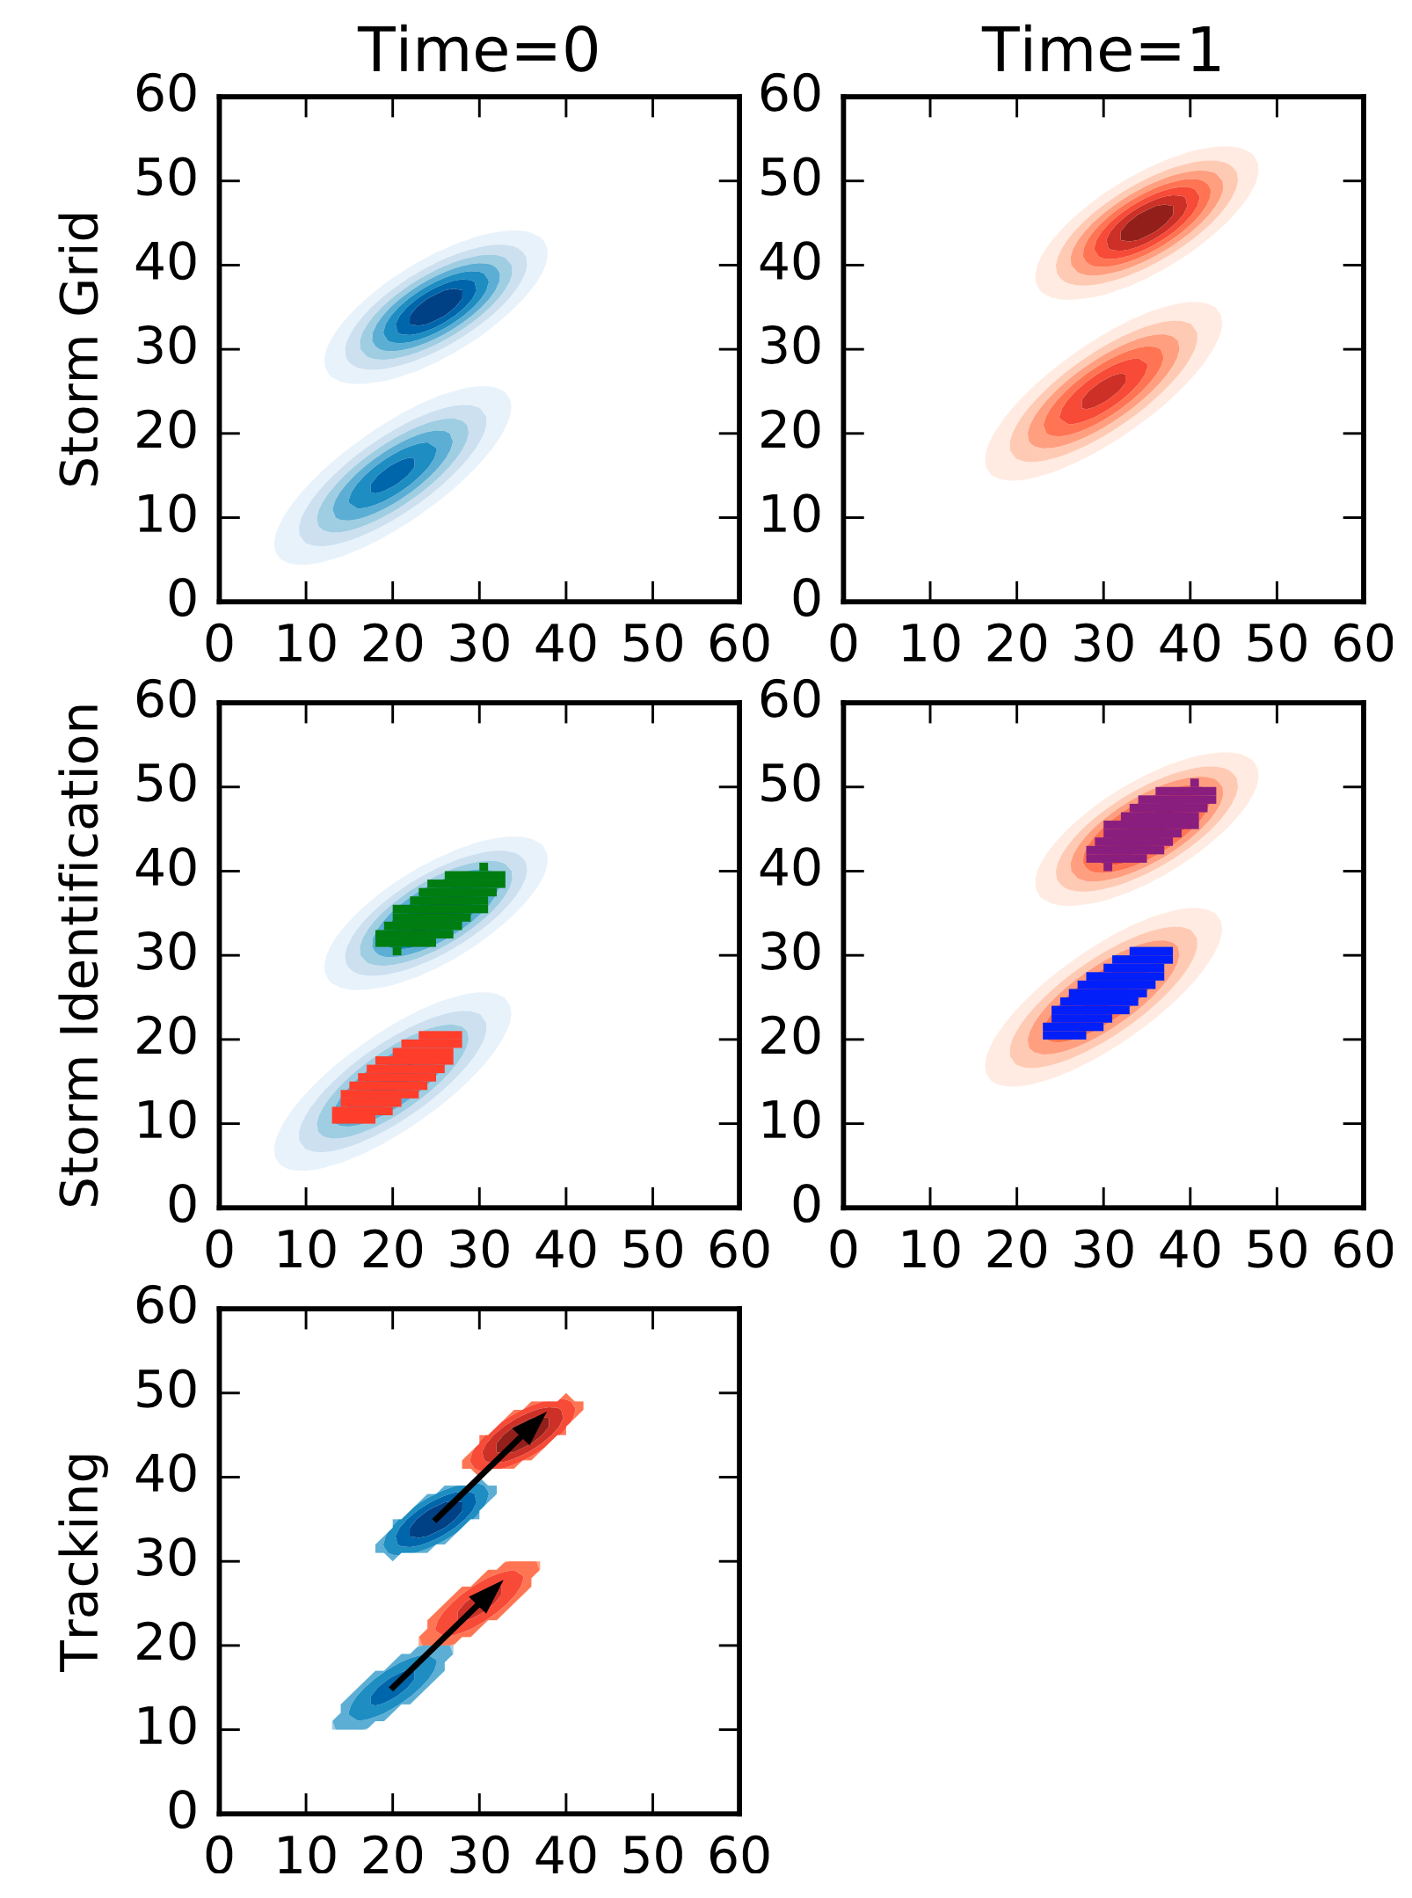
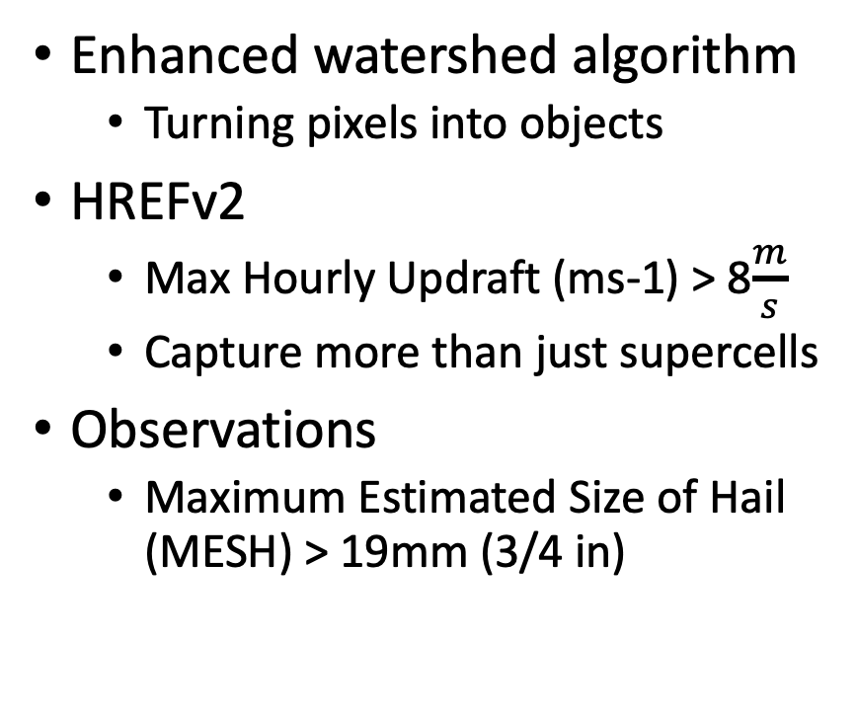
Identifying and Tracking Hail Objects
Enhanced watershed algorithm
Turning pixels into objects
HREFv2
Max Hourly Updraft (ms-1) > 8$\frac{m}{s}$
Capture more than just supercells
Observations
Maximum Estimated Size of Hail (MESH) > 19mm (3/4 in)

Slide 11
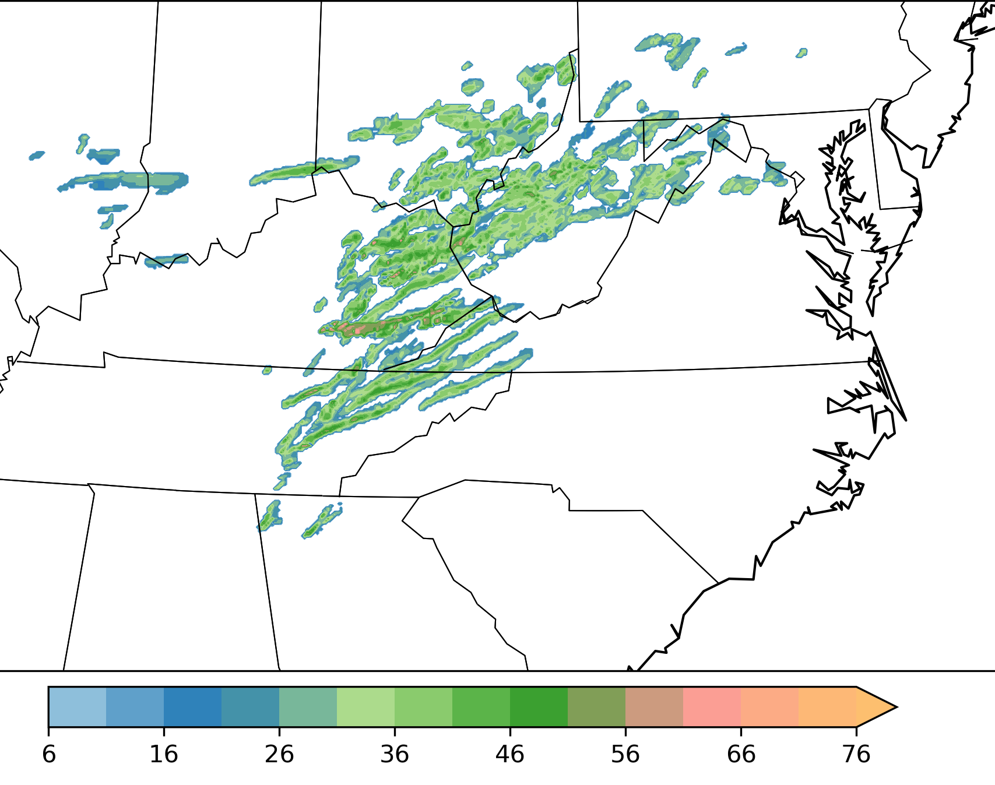
ML Hail prediction
Two step prediction
Hail or no hail?
If hail:
Predict shape and scale parameters of gamma distribution
Estimate ensemble neighborhood probabilities
Bootstrapping

Slide 12
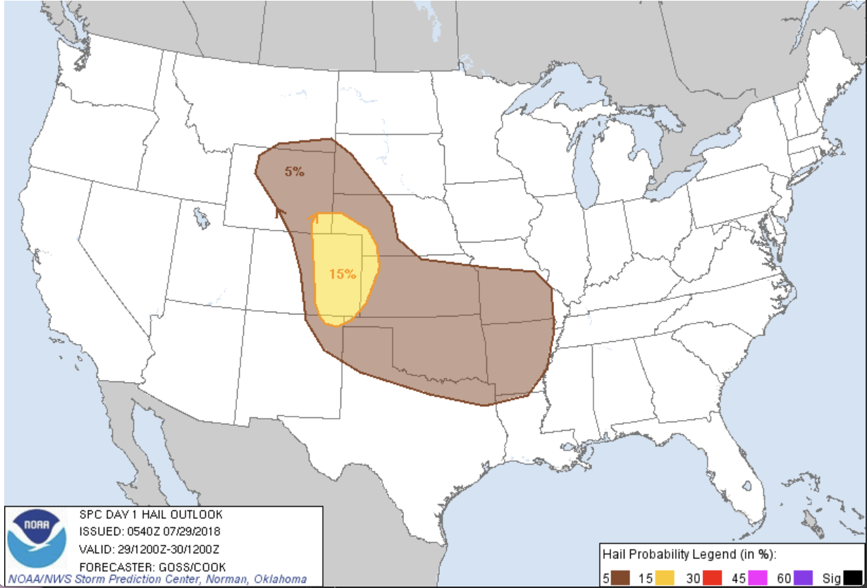
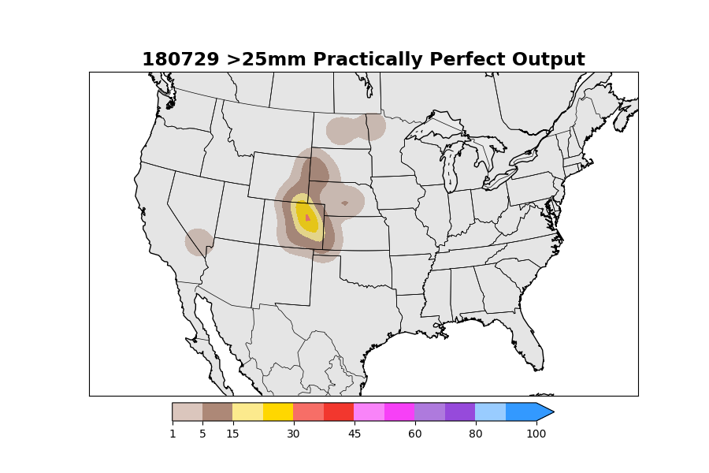
Case Study: High-End Hail Day
Notes:
Severe hail threshold

Slide 13
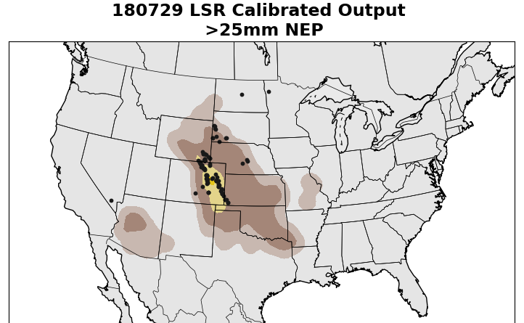
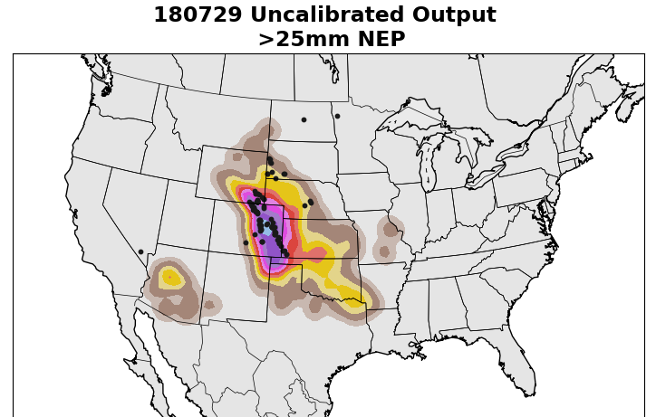
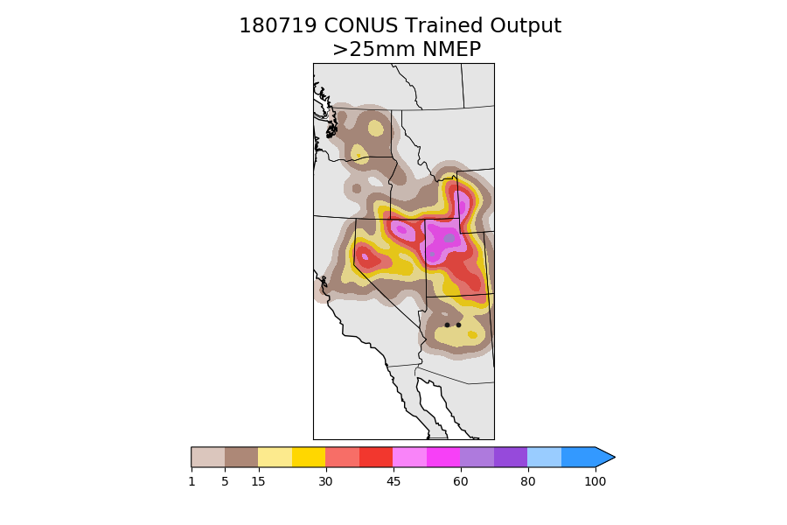

Slide 14
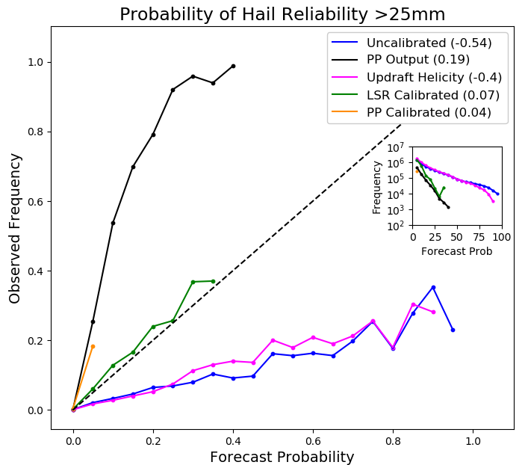
Reliability Diagram
Notes:
Go over the specifics about a reliability diagram what each of the things mean

Slide 15
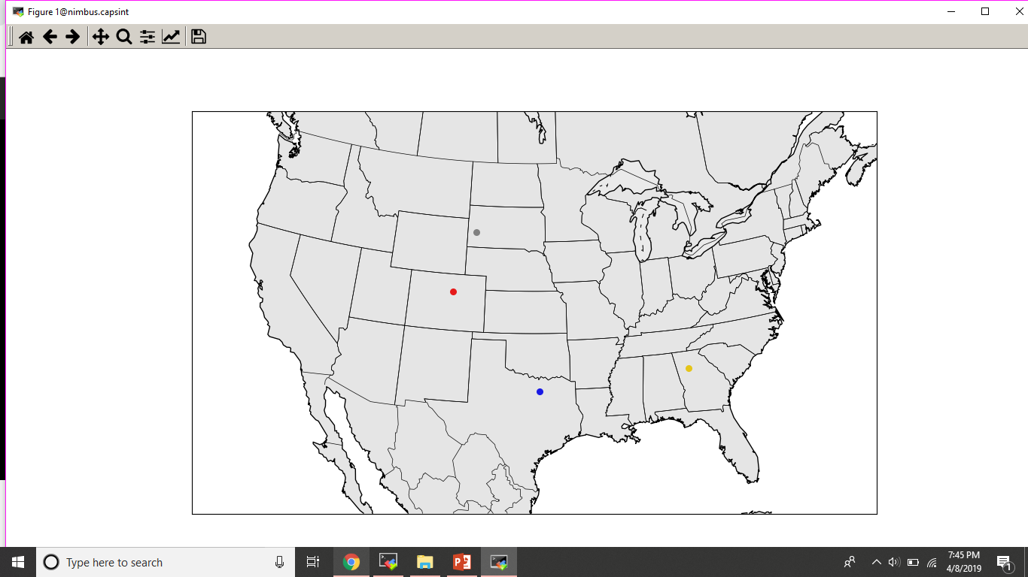
Regions
Train regional models by weighting CONUS storms
Rapid City, SD
Denver, CO
Atlanta, GA
Dallas, TX
Notes:
Center points based on high-impact hail sites within in the 4 testing regions

Slide 16
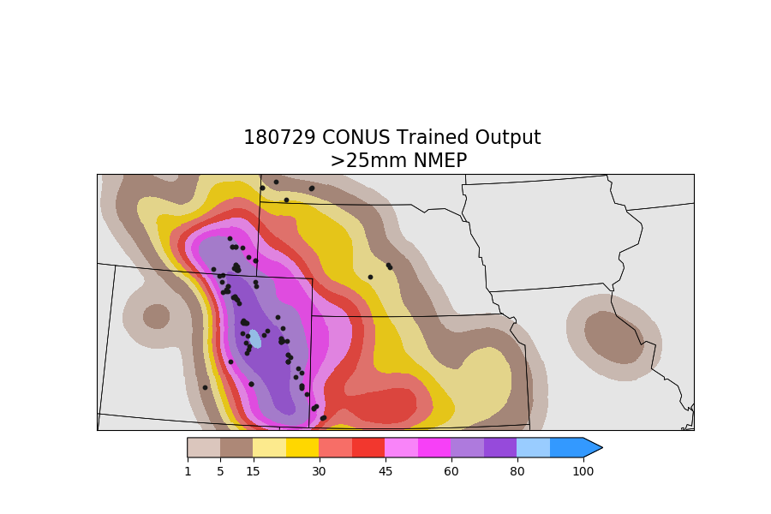
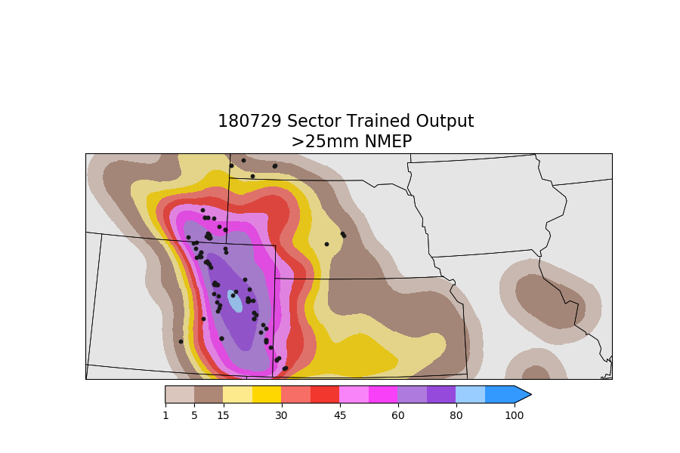
Case Study: Central Plains Sector

Slide 17
ML for Weather Outline
Using ML for severe weather prediction
Improving hail forecasting 24-48 hours in advance (traditional ML)
Improving nowcasting for tornadoes (deep learning/convolutional neural networks)
Using ML to track biological species over time
Identifying bird roosts in non-QC radars (deep learning)

Slide 18
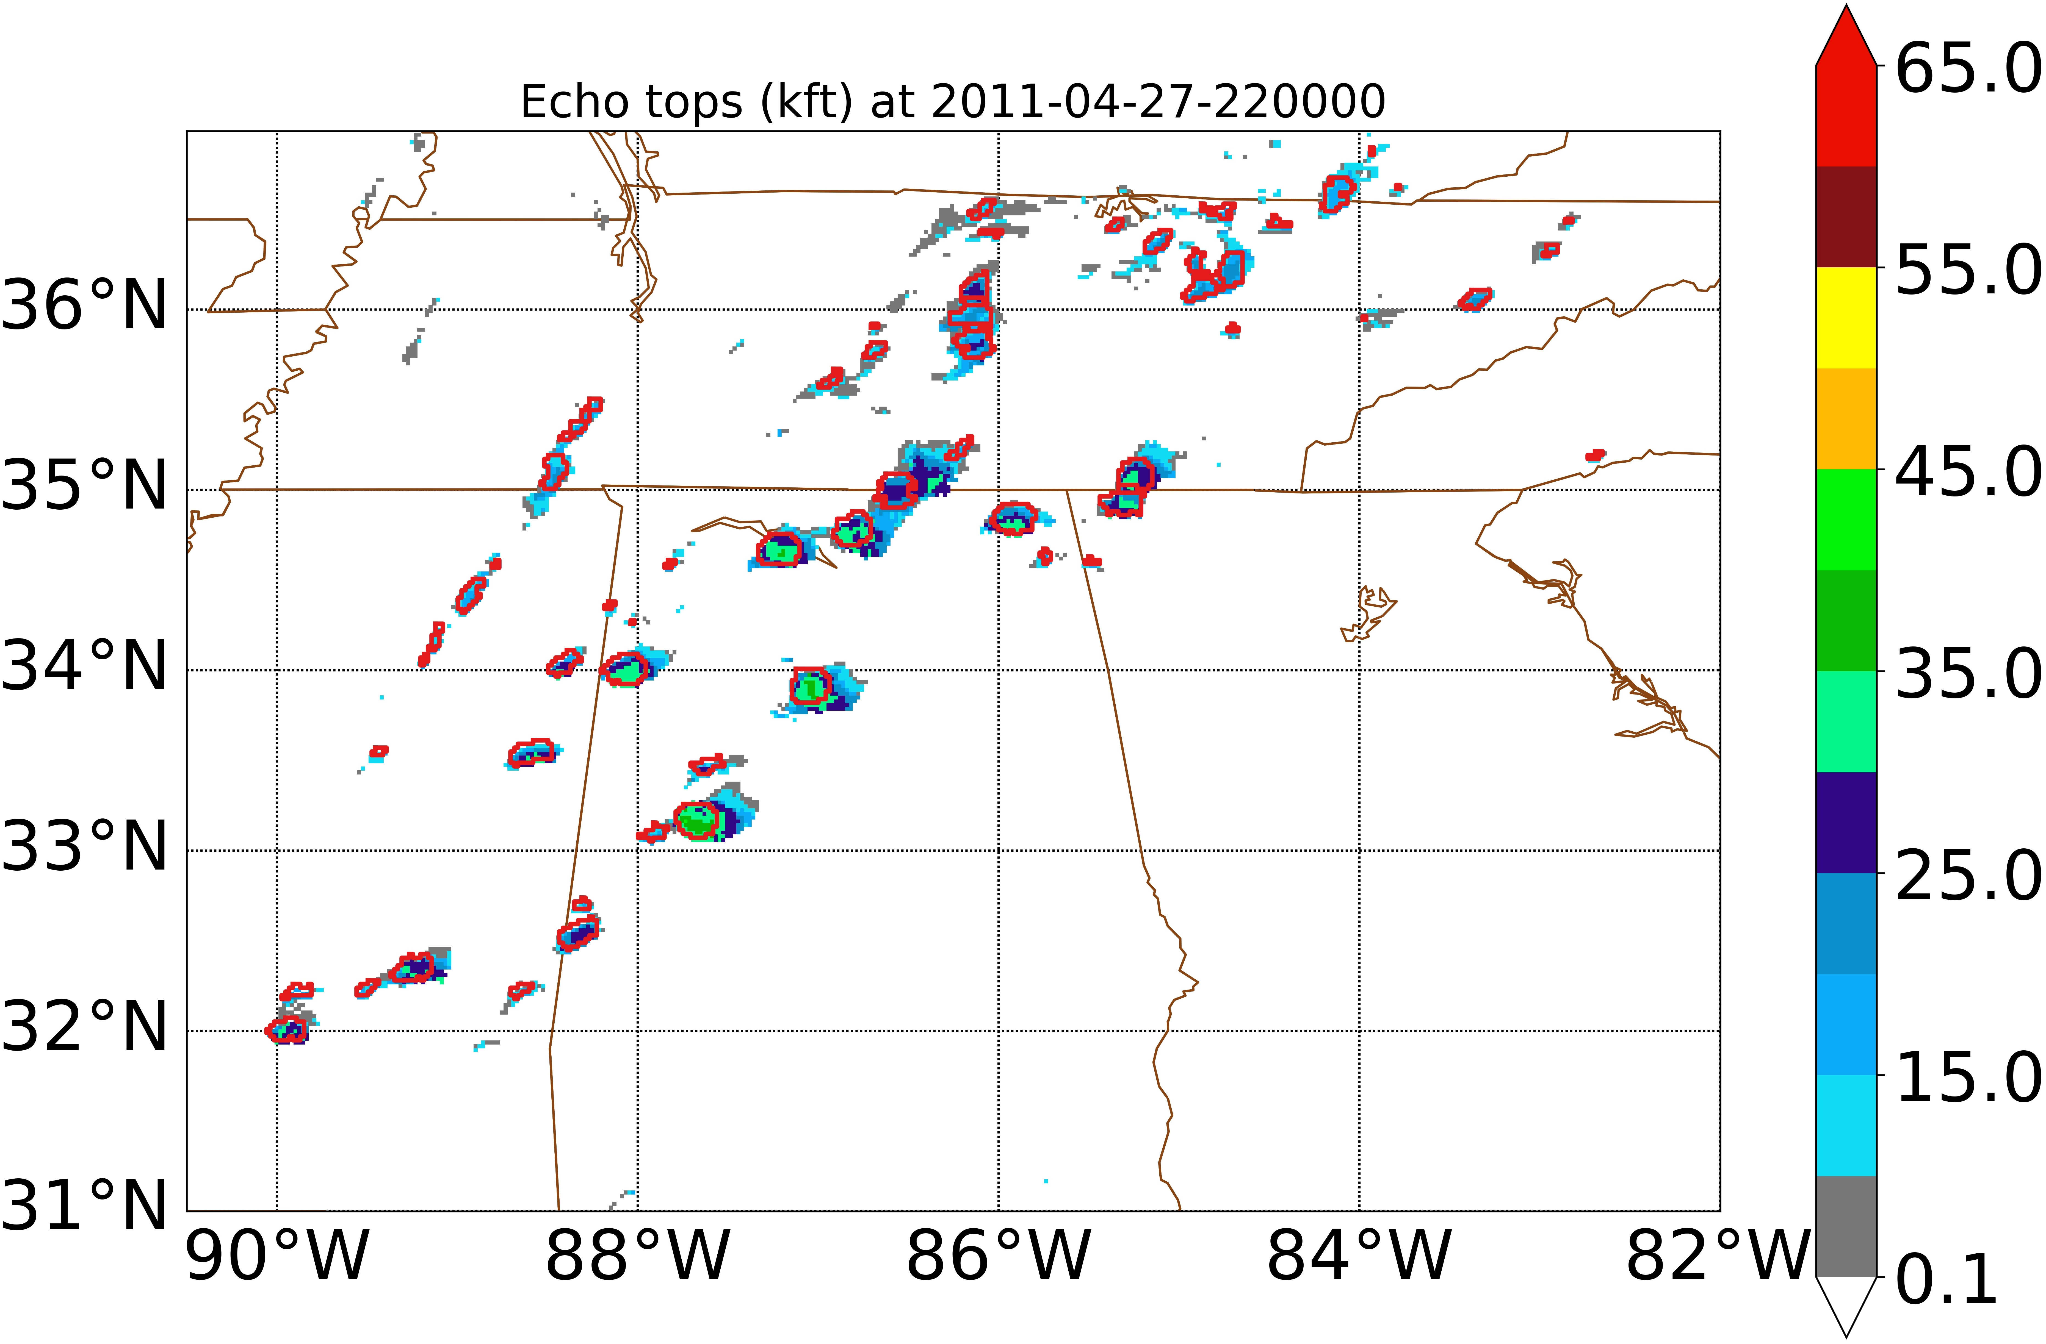
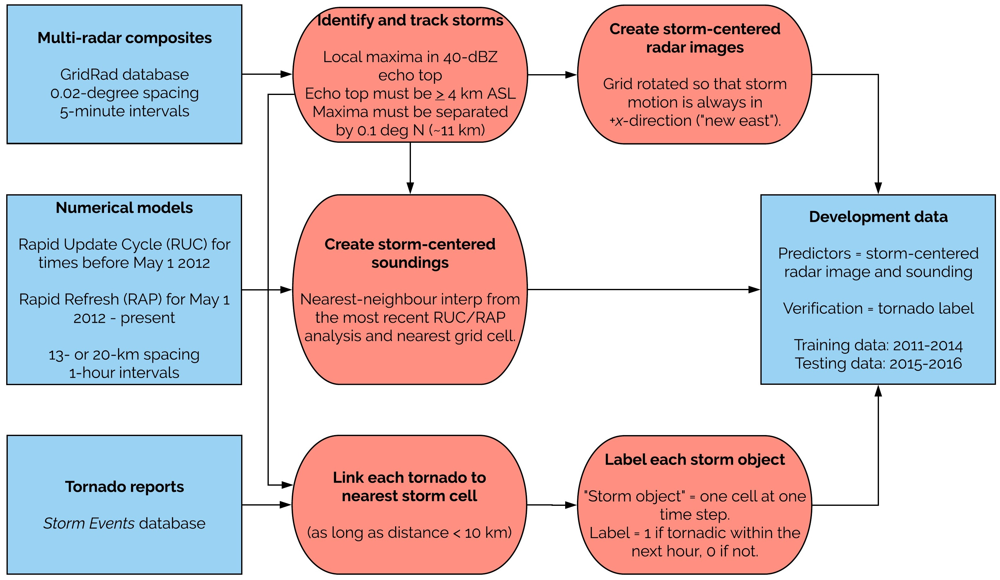
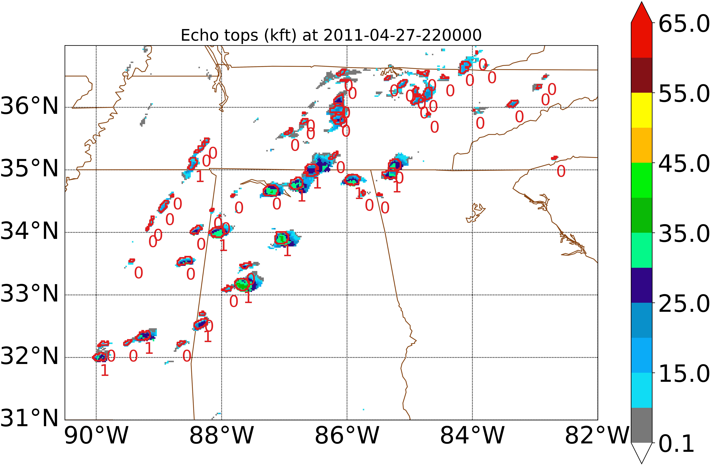
Tornado Prediction with Deep Learning

Slide 19
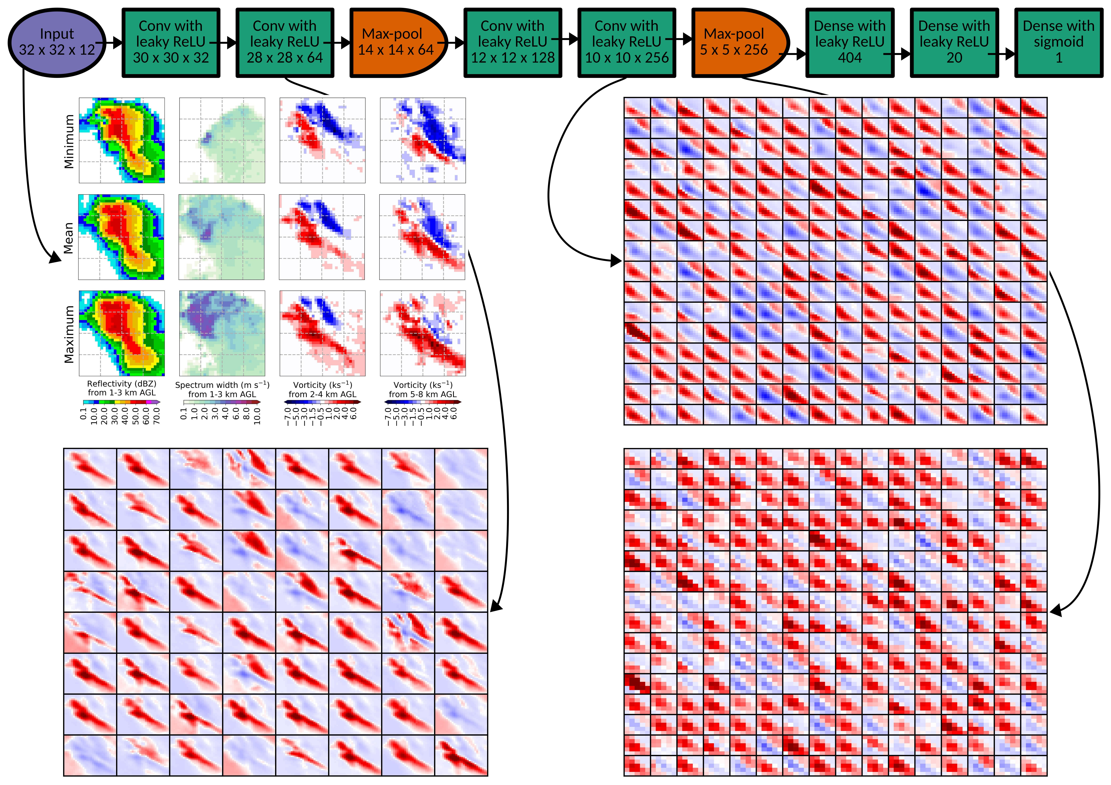
CNN architecture

Slide 20
Tornado Experimental Data
1 storm object = 1 storm cell at one time step
Training set: 2011-14
Tornadic objects: 8385
Non-tornadic (no tornado in the next hour): 447,922
Downsample non-tornadic to 50/50
Testing set: 2015-16
Tornadic: 1420
Non-tornadic: 39,639

Slide 21
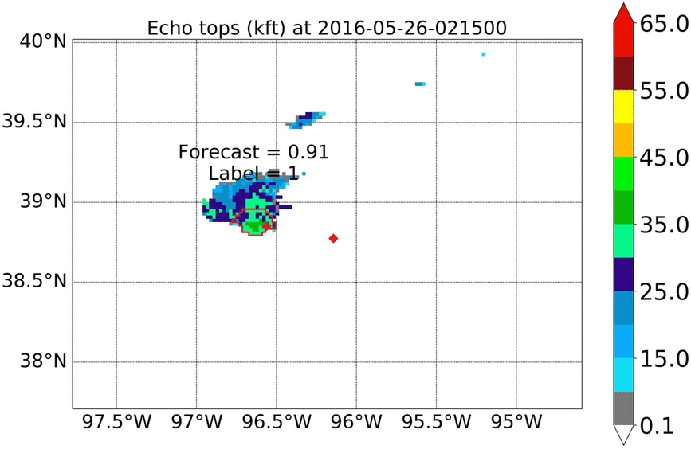
Tornado Labels

Slide 22
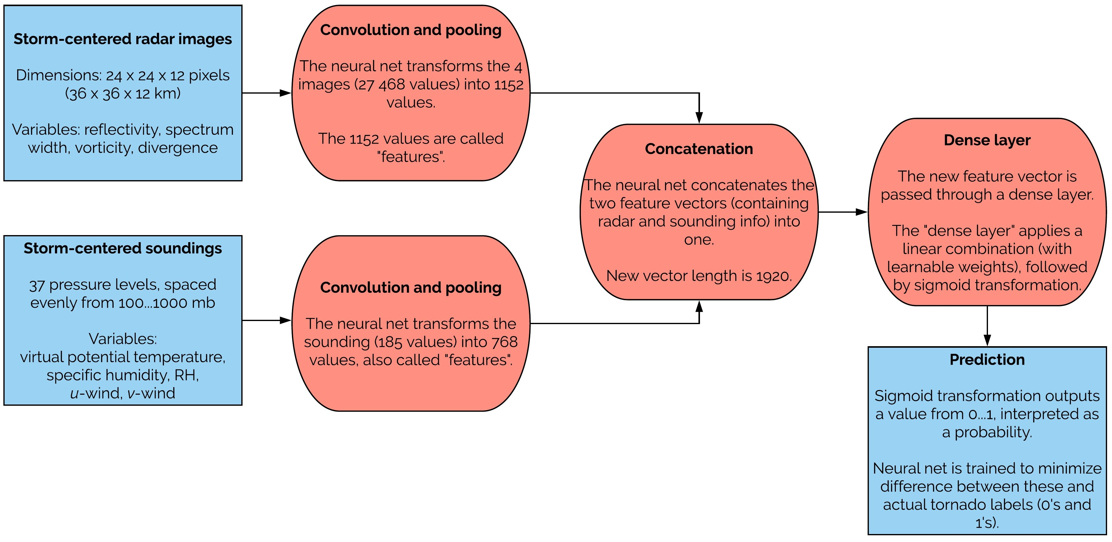
Convolutional Net Architecture

Slide 23
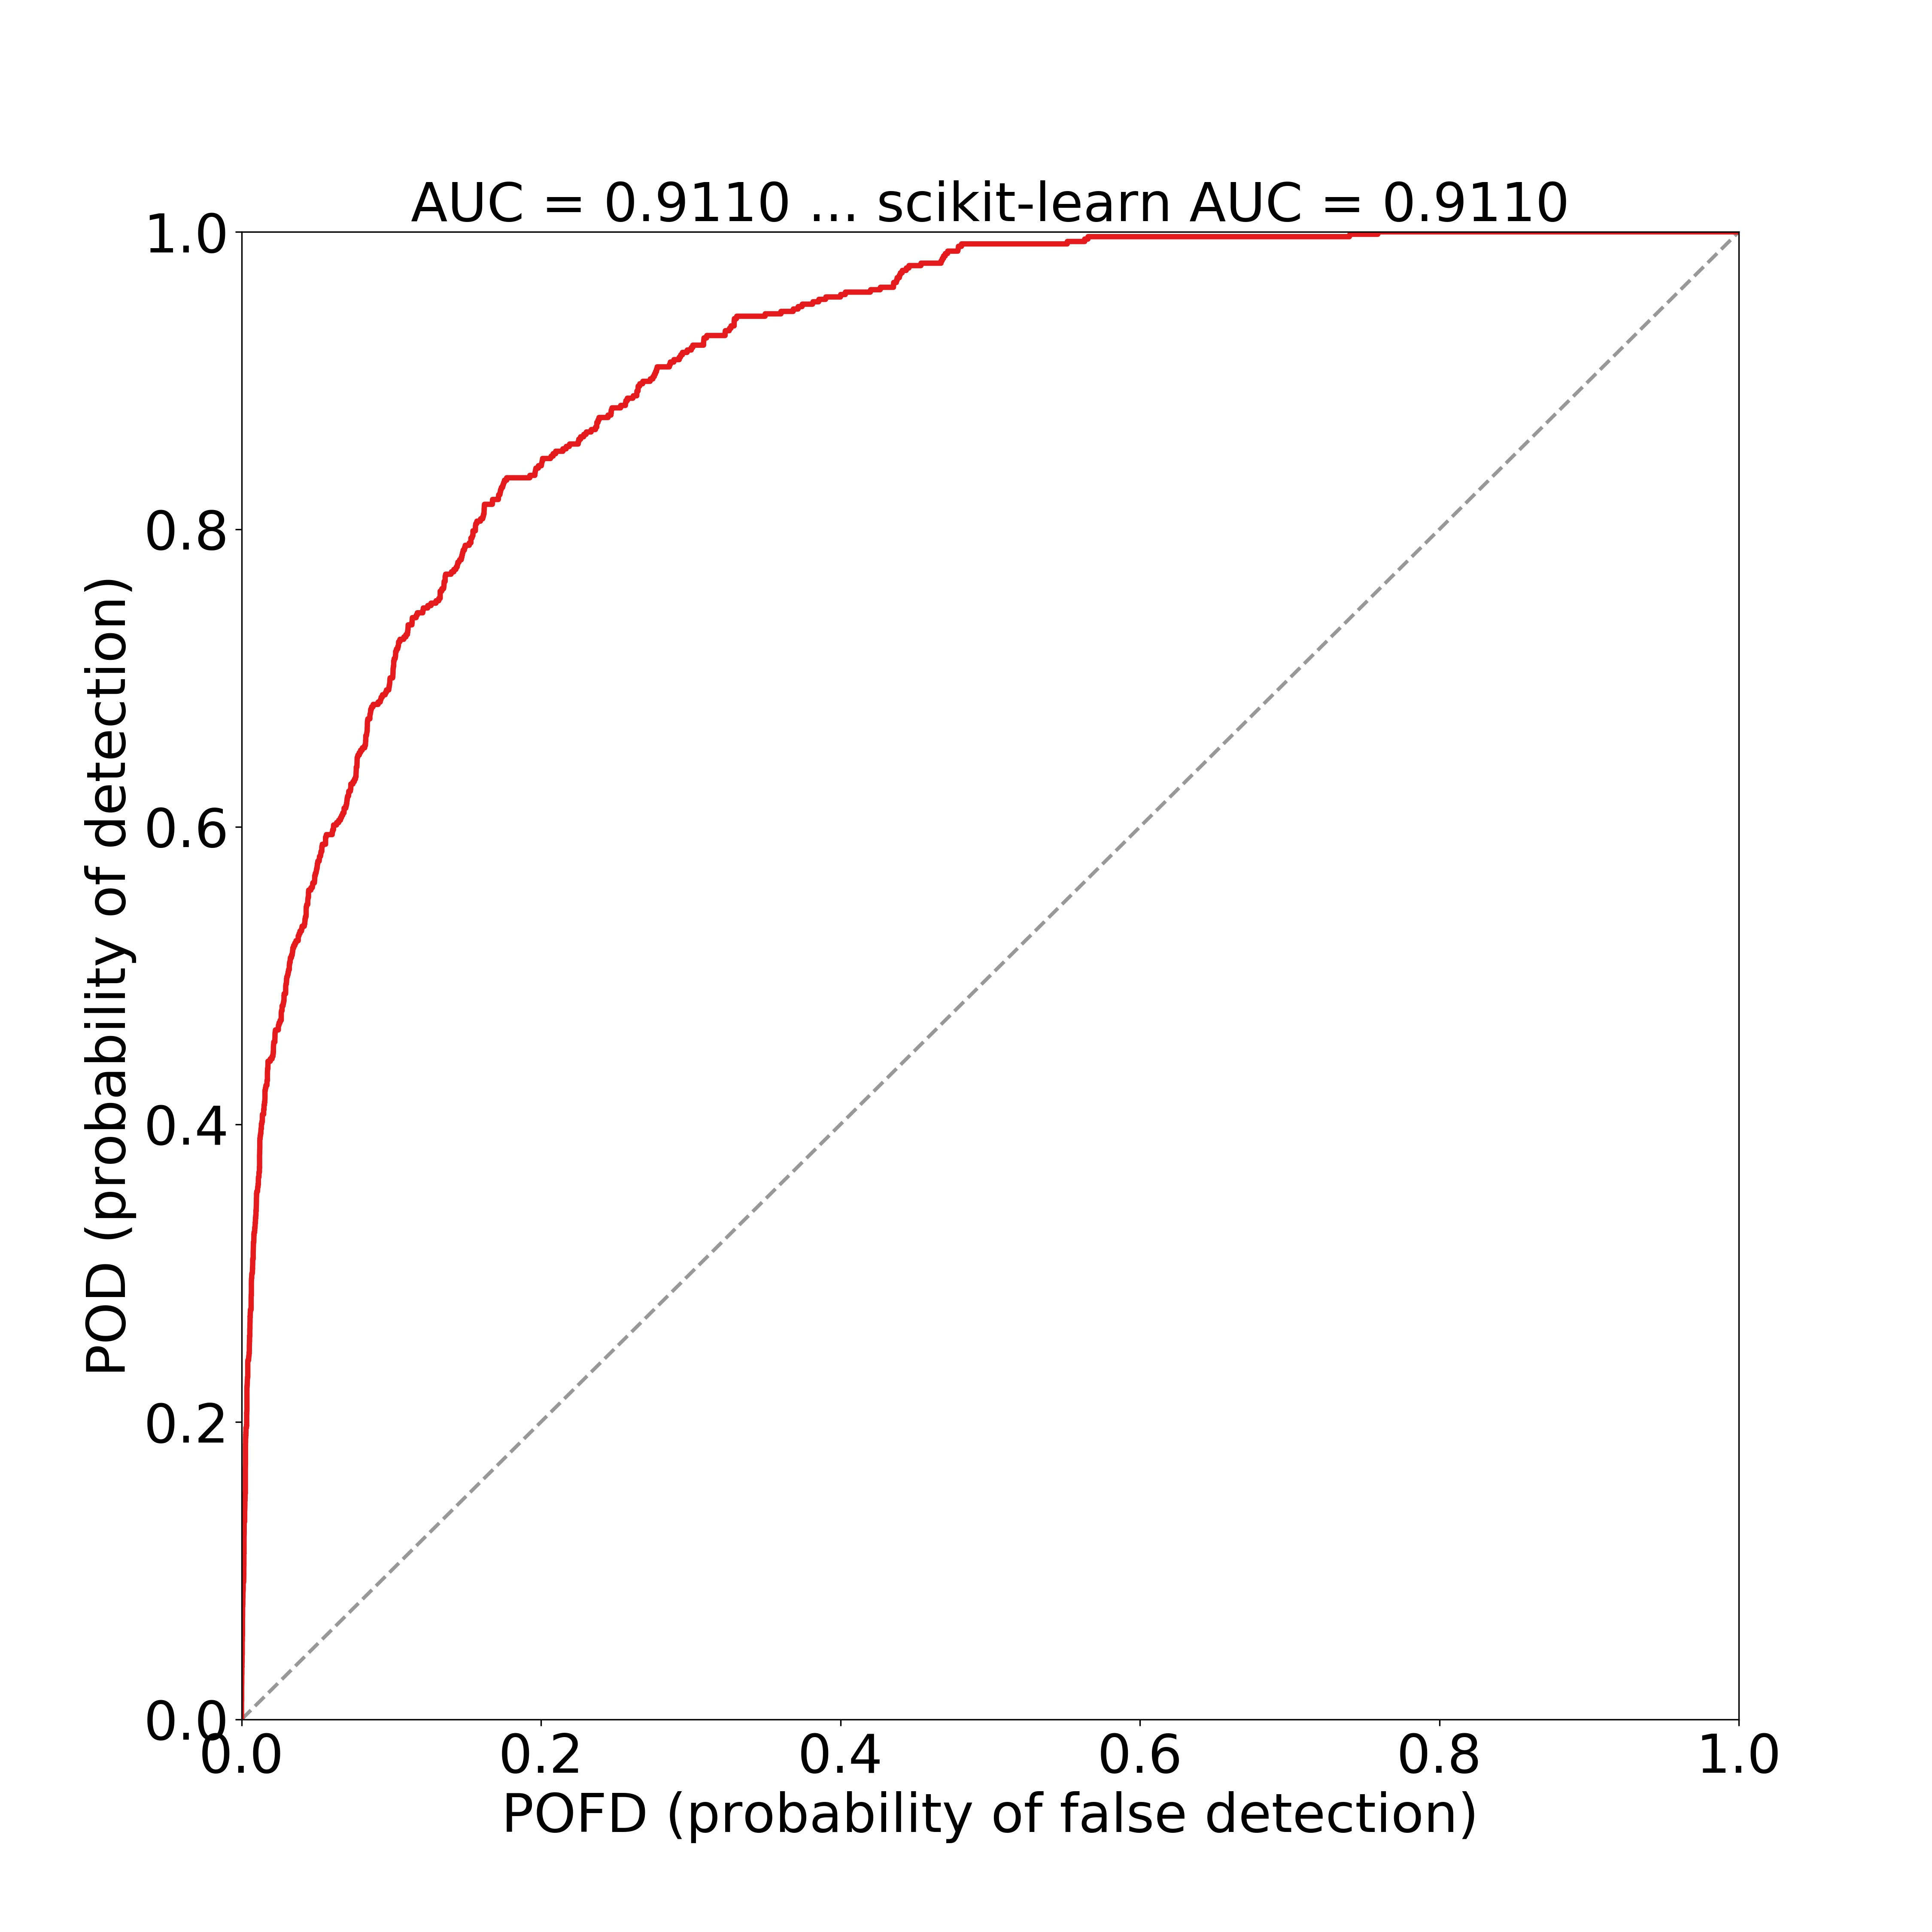
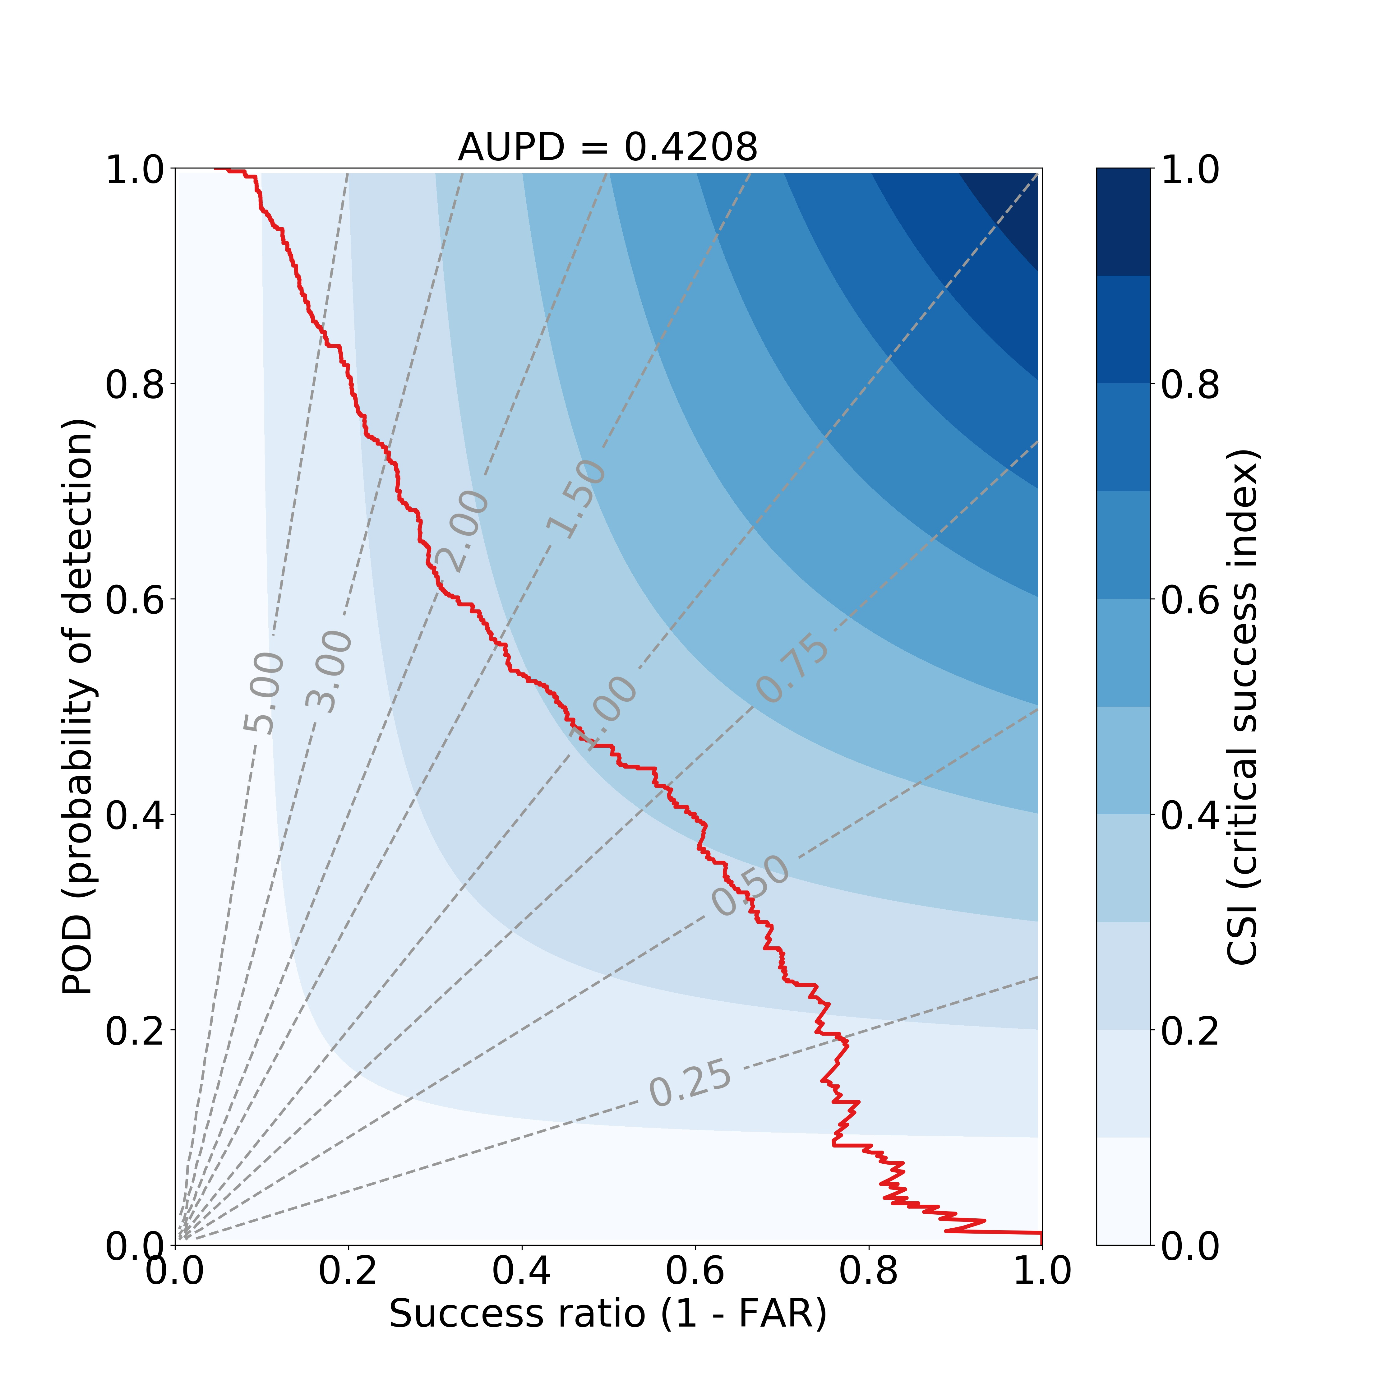
ROC and Performance

Slide 24
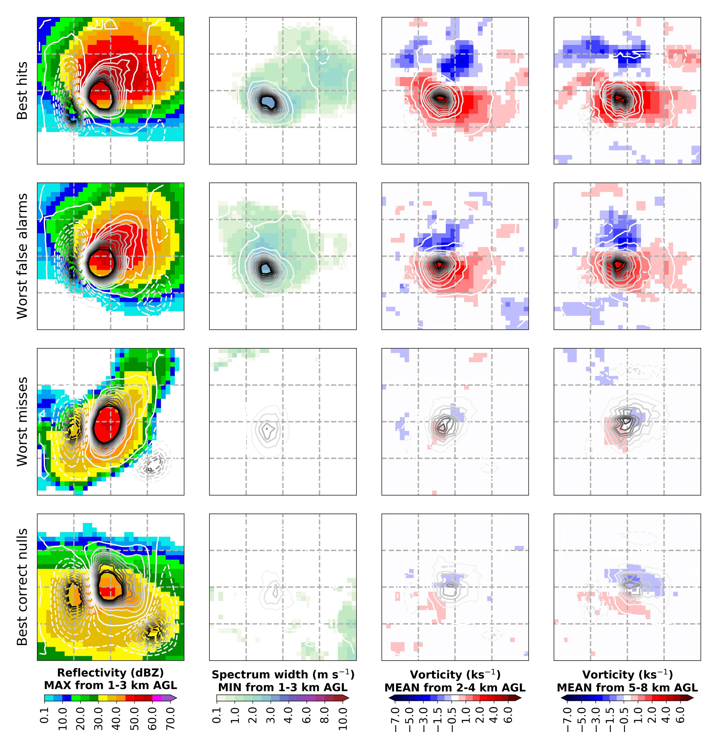
What the model is learning: Saliency
Strong reflectivity core
with hints of a hook
Region of vorticity near ”hook”
Disorganized storm with weak reflectivity
No strong vorticity

Slide 25
ML for Weather Outline
Using ML for severe weather prediction
Improving hail forecasting 24-48 hours in advance (traditional ML)
Improving nowcasting for tornadoes (deep learning/convolutional neural networks)
Using ML to track biological species over time
Identifying bird roosts in non-QC radars (deep learning)

Slide 26
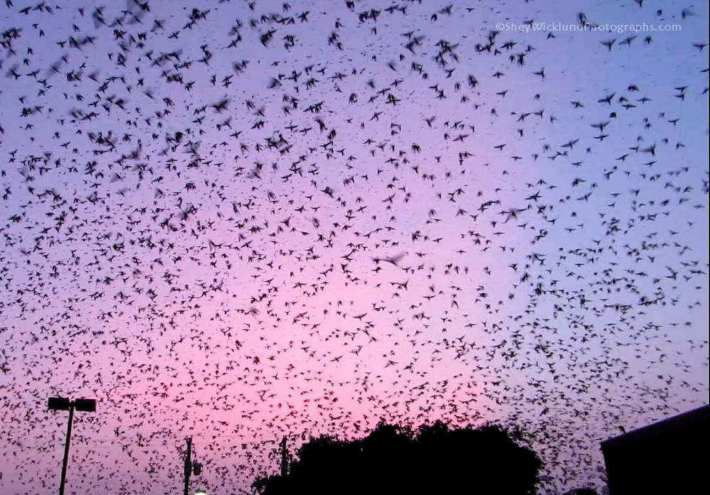
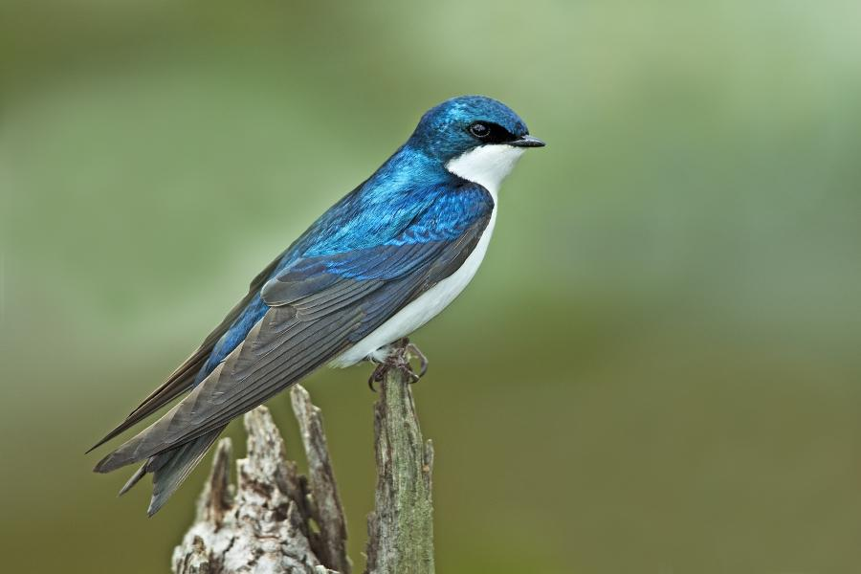
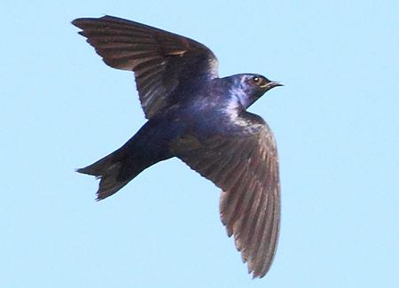
Why Study Bird Roosts?
Purple Martins and Swallows roost in large colonies visible on the radar
Important for ecological conservation (Shipley et al. 2017)
Reasons to study birds roosts and migration (Bauer et al. 2017)
Wind turbine collision
Habitat deterioration
Pest control
Crop damage
Dispersal of pathogens
Tree Swallow by Prem Balson
Purple Martin by Greg Homel, Natural Elements Productions
https://sheywicklundphotographs.com/2014/07/20/hundreds-of-purple-martins/

Slide 27
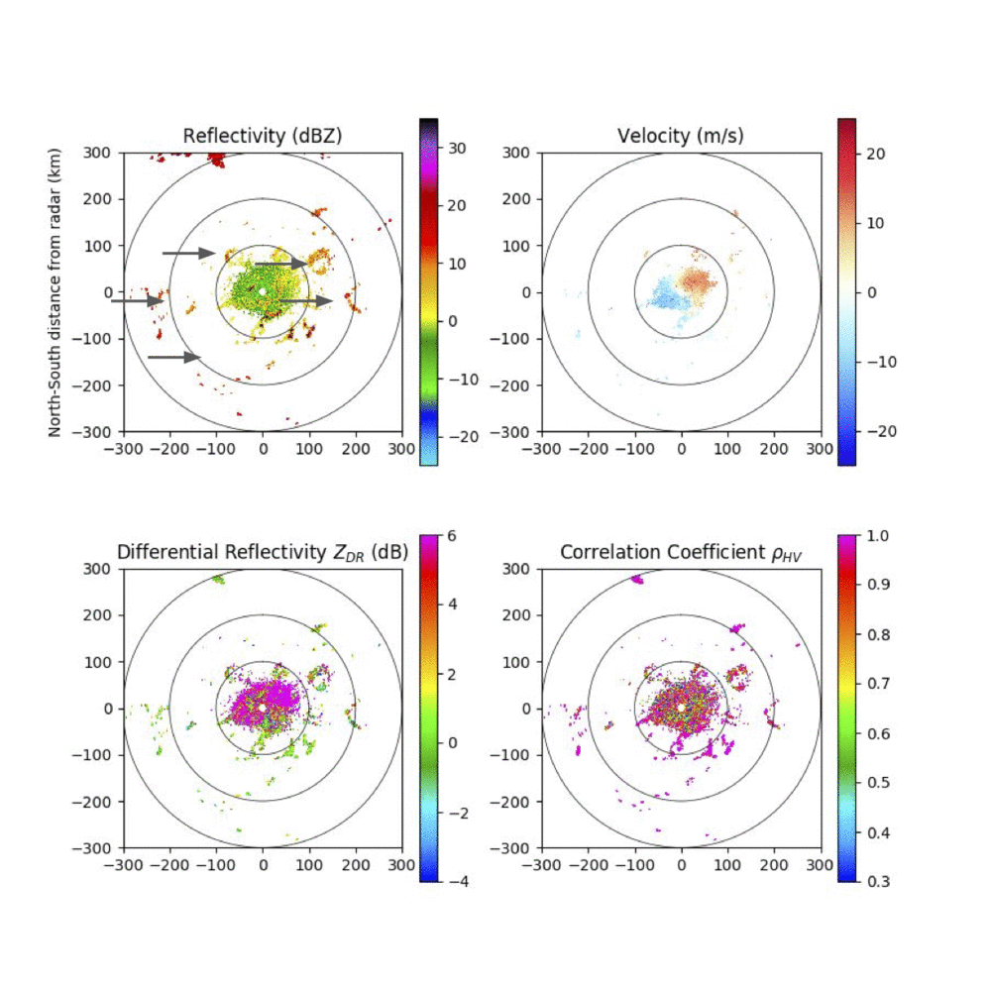
NEXRAD RADAR DATA
Roost at sunrise
Data:
Level 2 NEXRAD data
0.5° scan
Roosts most visible at sunrise
Products used (when available):
Reflectivity
Velocity
Correlation Coefficient (dual-pol)
Differential Reflectivity (dual-pol)

Slide 28
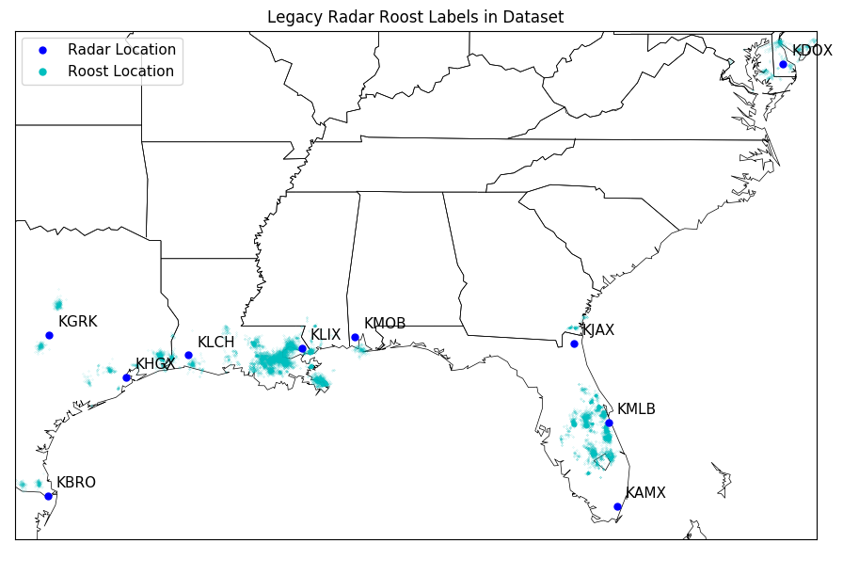
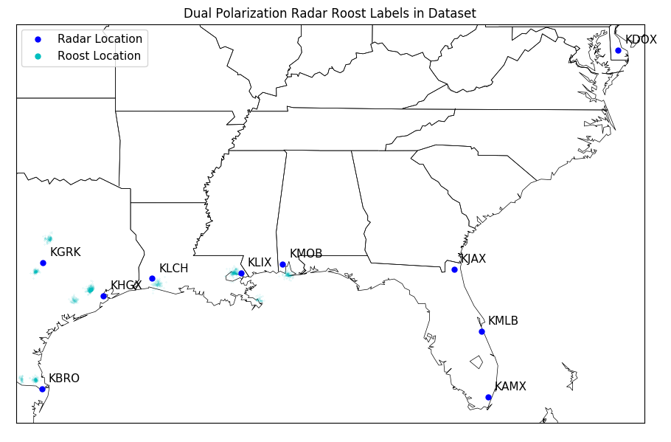
Dataset
Labels: Roost and No Roost
Two sets of radar data: legacy and dual-pol
10 different radars: KAMX, KBRO, KDOX, KGRK, KJAX, KHGX, KLCH, KLIX, KMLB, and KMOB
Hand-labeled data from OU and UMass Amherst
 | Roost | No Roost
Legacy | 11,112 | 19,939
Dual-pol | 1,346 | 10,806
Notes:
Someone is going to ask why there is so much more legacy data (at least if you explain it the same way). Tell us that there is more simply because there are more years of legacy data. Add legacy on top of the two columns of legacy data and dual-pol otherwise
Let’s talk about multiple runs for averaging - I thought you were already doing it so it's my fault I misunderstood

Slide 29
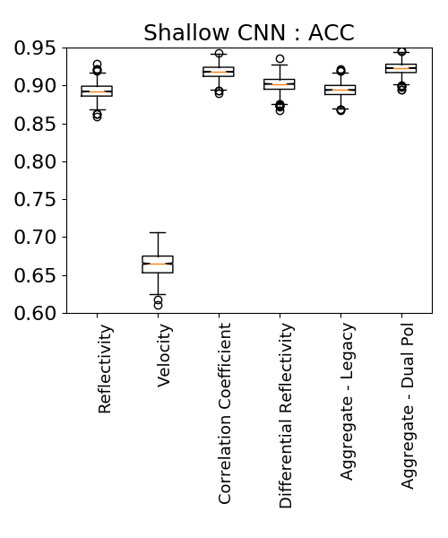
Results

Slide 30
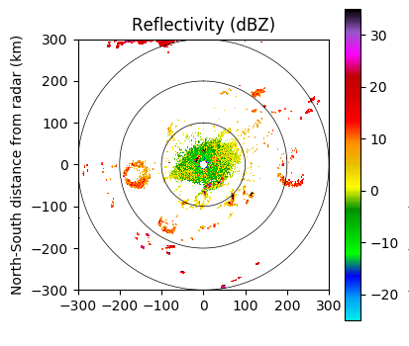
Current and Future work on Roosts
Identify locations of bird roosts
Track changes in behavior over time
Mitigate risk

Slide 31
Acknowledgments
Some of the computing for this project was performed at the OU Supercomputing Center for Education & Research (OSCER) at the University of Oklahoma (OU).
This material is based upon work supported by the National Science Foundation under Grant Numbers EF-1340921, DGE-1545261, AGS-1802627 and NOAA JTTI Grant No. NA16OAR4590239.
Funding was provided by NOAA/Office of Oceanic and Atmospheric Research under NOAA-University of Oklahoma Cooperative Agreement #NA16OAR4320115, U.S. Department of Commerce.
I’ve got an open PhD position right now!

Slide 32
Use AI/ML to Improve Societal Resilience to Climate Change and Extreme Weather
Proposal: create a joint university, industry, and government alpha-institute to bring together researchers in AI/ML and climate and weather
Contact me: Amy McGovern amcgovern@ou.edu

